Slide 1
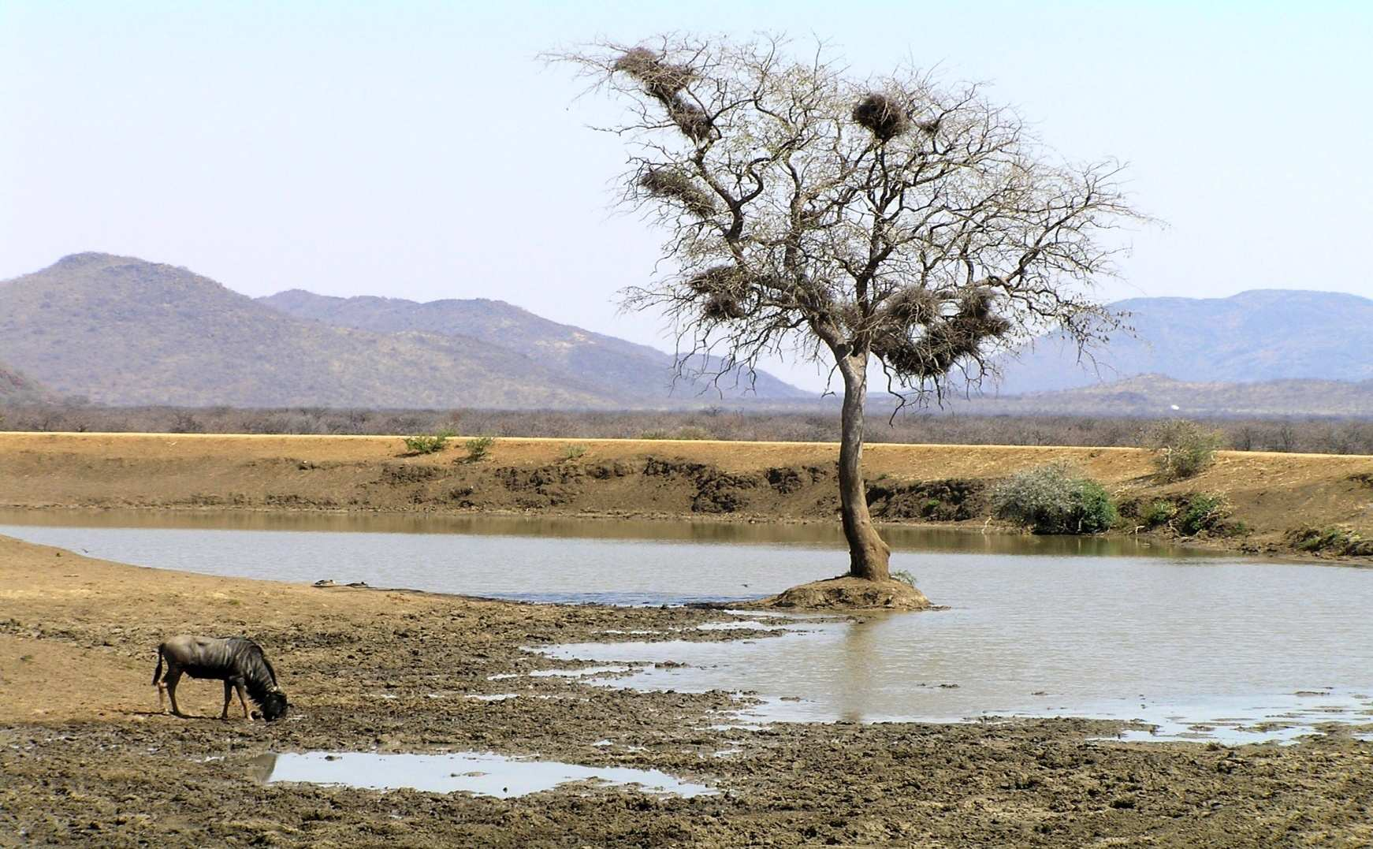

Ecology Abiotic Factors Unit
Part 1
Review Game

Slide 2
Ecology: Abiotic Factors Review Game
SUNNY SIDE UP | HOT SHOT | ALL WET | ON THE MOVE | (Bonus) NON-LIVING THINGS
1 | 6 | 11 | 16 | *21
2 | 7 | 12 | 17 | *22
3 | 8 | 13 | 18 | *23
4 | 9 | 14 | 19 | *24
5 | 10 | 15 | 20 | *25
Final Question:________________
Copyright © 2024 SlideSpark LLC

Slide 3
How to play…
  Don’t play like Jeo_ _ _ _ y.
  Class should be divided into several small groups.
  Groups should use science journal (red slide notes), homework, and other available materials to assist you.
  Groups can communicate quietly with each other but no sharing answers between groups.
    Practice quietly communicating right now?
    Practice Communication Question:
    Your group gets to order one pizza, and you can have two toppings, what does your group want?

Slide 4

Questions 1-20 = 5pts Each
Final Category (Bonus) = 1pt Each
Final Questions = 5 pt wager
If you wager 5 on the last question and get it wrong you lose 5 pts. Wager 5 and get right you get 5 pts.
Find the Owl =
Secretly write “Owl” in the correct box worth 1pt.
“I’ll be about this big.”

Slide 5
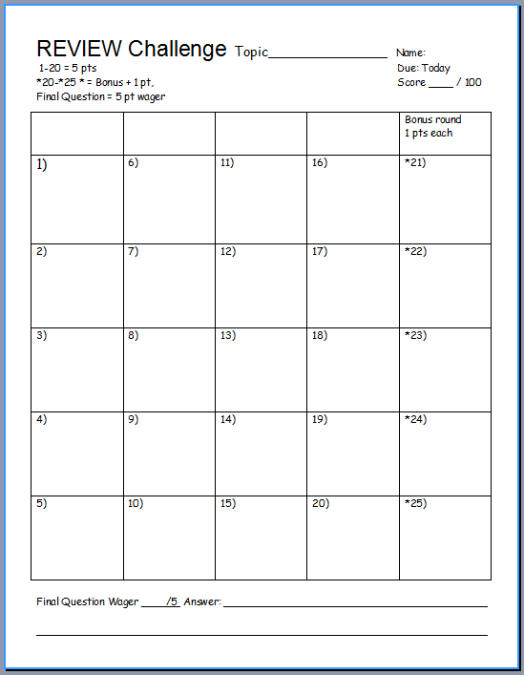
Is your name on the review sheet?
Name

Slide 6
Is your name on the review sheet?
Add the categories
along the top
on the next slide.

Slide 7
Ecology: Abiotic Factors Review Game
SUNNY SIDE UP | HOT SHOT | ALL WET | ON THE MOVE | (Bonus) NON-LIVING THINGS
1 | 6 | 11 | 16 | *21
2 | 7 | 12 | 17 | *22
3 | 8 | 13 | 18 | *23
4 | 9 | 14 | 19 | *24
5 | 10 | 15 | 20 | *25
Final Question:________________
Copyright © 2024 SlideSpark LLC

Slide 8
Ecology: Abiotic Factors Review Game
SUNNY SIDE UP | HOT SHOT | ALL WET | ON THE MOVE | (Bonus) NON-LIVING THINGS
1 | 6 | 11 | 16 | *21
2 | 7 | 12 | 17 | *22
3 | 8 | 13 | 18 | *23
4 | 9 | 14 | 19 | *24
5 | 10 | 15 | 20 | *25
Final Question:________________
Copyright © 2024 SlideSpark LLC

Slide 9
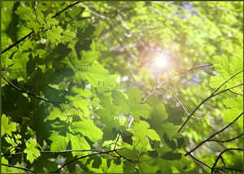
Light from the Sun provides producers the energy to make sugar (photosynthesis).
1
Copyright © 2024 SlideSpark LLC

Slide 10
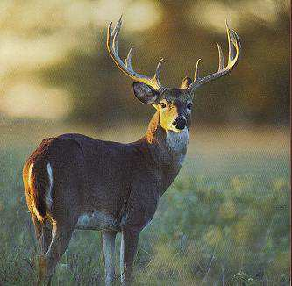
This is a term associated for when animals are active at dawn and at dusk.
2
Copyright © 2024 SlideSpark LLC

Slide 11
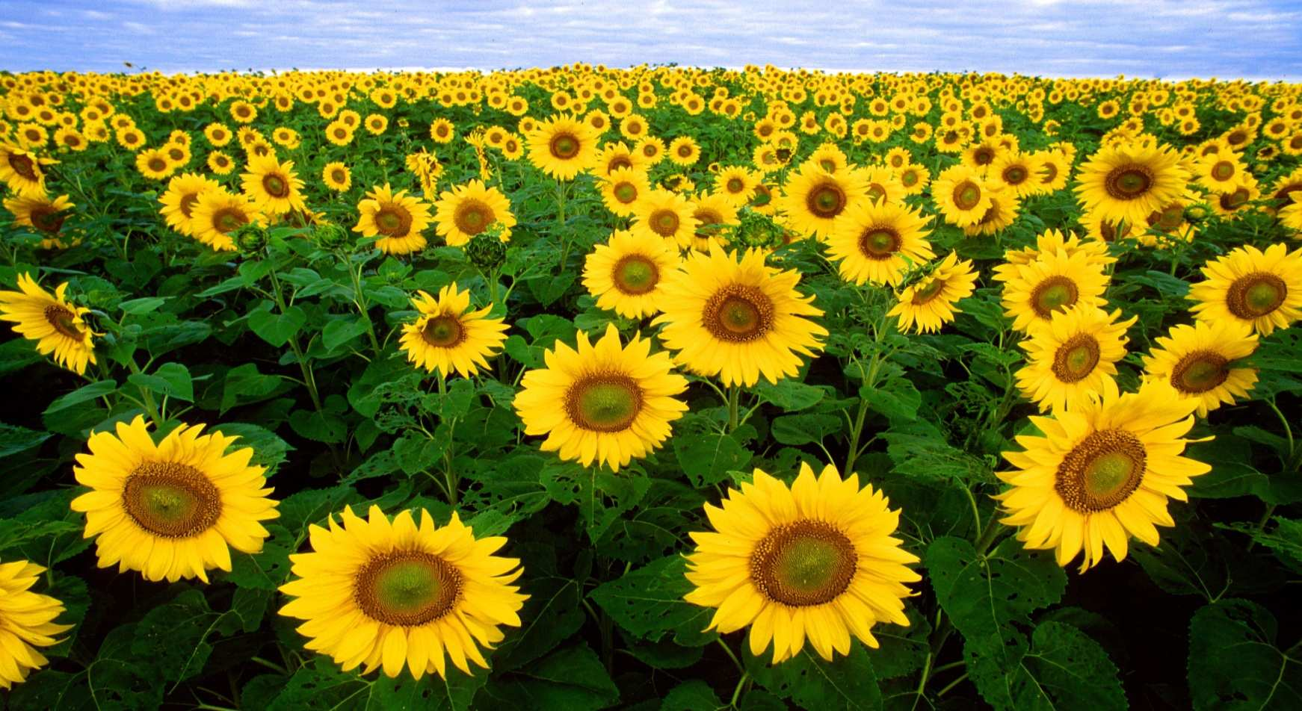
This is the name for the directional growth of plants in response to light?
3
Copyright © 2024 SlideSpark LLC

Slide 12
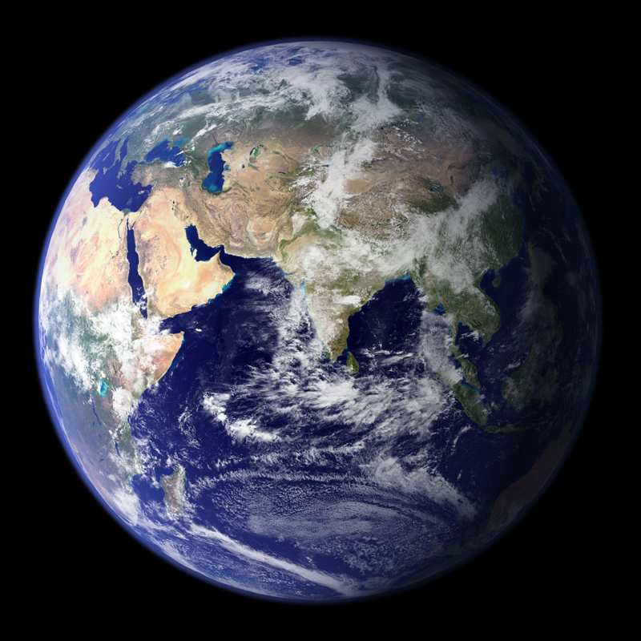
Which letter generally gets the most amount of light throughout the year?
4
A
B
C
Copyright © 2024 SlideSpark LLC

Slide 13
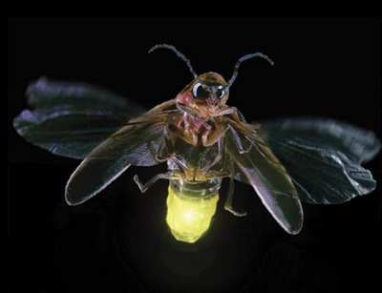
This is the name for the biological creation of light by a living creature?
5
Copyright © 2024 SlideSpark LLC

Slide 14
Ecology: Abiotic Factors Review Game
SUNNY SIDE UP | HOT SHOT | ALL WET | ON THE MOVE | (Bonus) NON-LIVING THINGS
1 | 6 | 11 | 16 | *21
2 | 7 | 12 | 17 | *22
3 | 8 | 13 | 18 | *23
4 | 9 | 14 | 19 | *24
5 | 10 | 15 | 20 | *25
Final Question:________________
Copyright © 2024 SlideSpark LLC

Slide 15
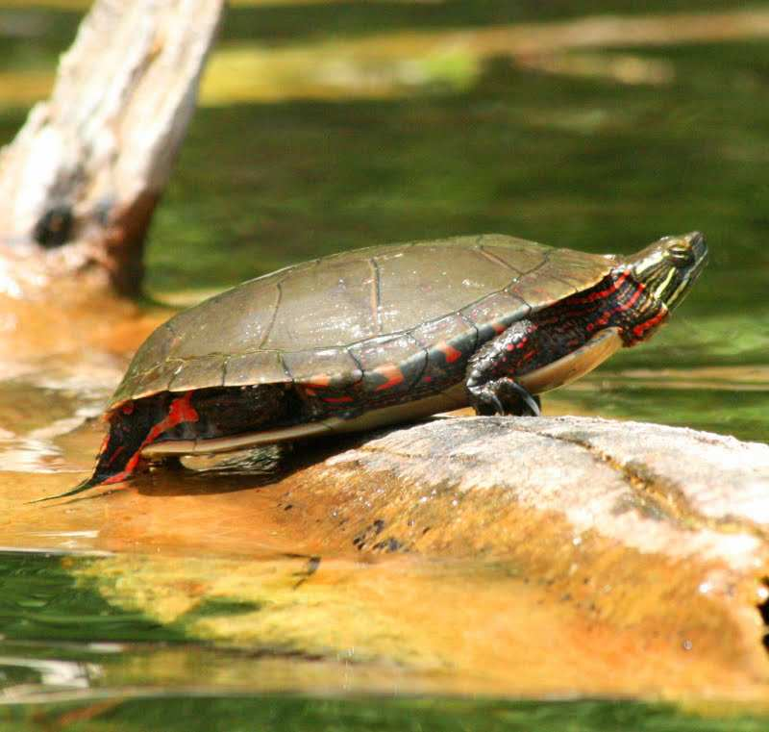
Thermoregulation is the ability of an organism to keep its body temperature within certain boundaries.
6
Copyright © 2024 SlideSpark LLC

Slide 16
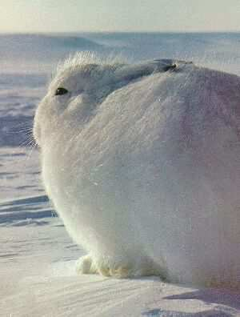
This is a process whereby an organism becomes better suited to its habitat. A characteristic which aids survival.
7
Copyright © 2024 SlideSpark LLC

Slide 17
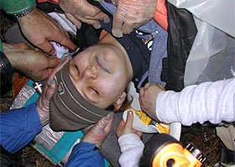
This condition is a decrease in the core body temperature to a level at which normal muscular and brain functions are impaired.
8
Copyright © 2024 SlideSpark LLC

Slide 18
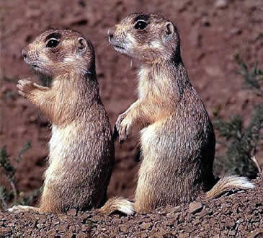
These type of animals are capable of maintaining a warm body temperature independent of environmental conditions.
9
Copyright © 2024 SlideSpark LLC

Slide 19
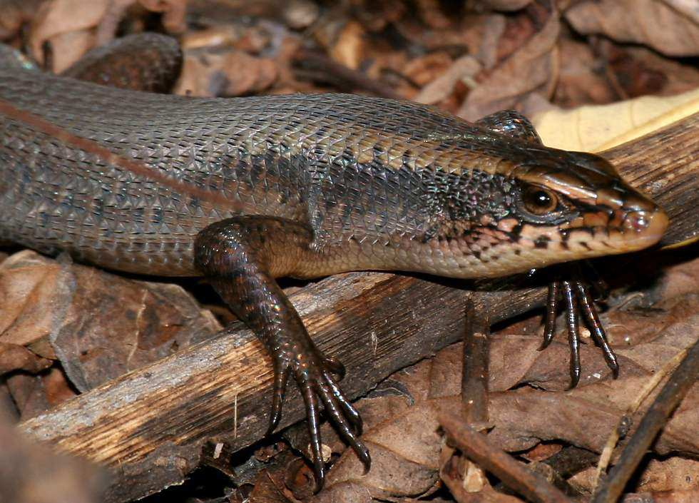
These type of organisms can’t regulate their internal temperature.
When it’s cold they can’t move, when it’s warm their more active.
10
Copyright © 2024 SlideSpark LLC

Slide 20
Ecology: Abiotic Factors Review Game
SUNNY SIDE UP | HOT SHOT | ALL WET | ON THE MOVE | (Bonus) NON-LIVING THINGS
1 | 6 | 11 | 16 | *21
2 | 7 | 12 | 17 | *22
3 | 8 | 13 | 18 | *23
4 | 9 | 14 | 19 | *24
5 | 10 | 15 | 20 | *25
Final Question:________________
Copyright © 2024 SlideSpark LLC

Slide 21
This is essential for life, and all organisms depend on it.
11
Copyright © 2024 SlideSpark LLC

Slide 22
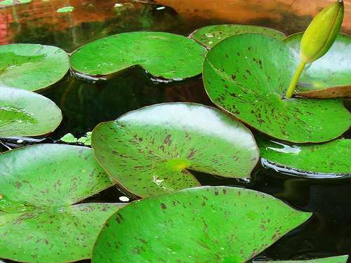
This picture best represents these type of plants?
  A.) Neophytes
  B.) Hydrophytes
  C.) Mesophytes
  D.) Xerophytes
  E.) Nobody
  Knows
12

Slide 23
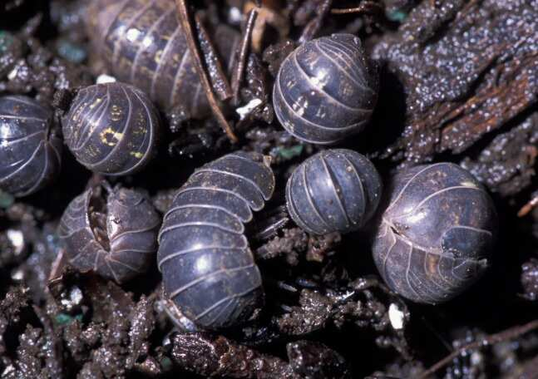
These organisms (science name please) require water because they breathe water vapor through external gills?
13
Copyright © 2024 SlideSpark LLC

Slide 24
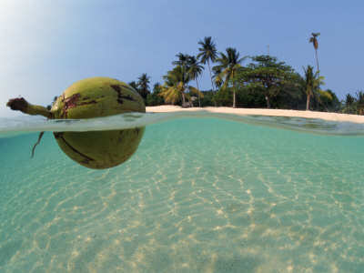
What type of seed dispersal is represented by the picture below?
14
Copyright © 2024 SlideSpark LLC

Slide 25
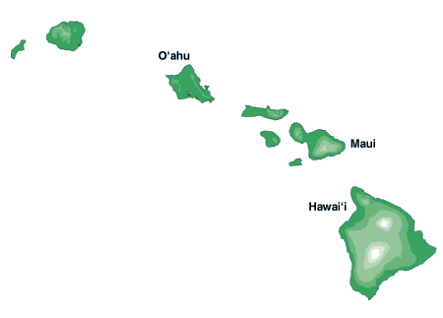
This is the term for how species spread through an island chain?
15
Copyright © 2024 SlideSpark LLC

Slide 26
Ecology: Abiotic Factors Review Game
SUNNY SIDE UP | HOT SHOT | ALL WET | ON THE MOVE | (Bonus) NON-LIVING THINGS
1 | 6 | 11 | 16 | *21
2 | 7 | 12 | 17 | *22
3 | 8 | 13 | 18 | *23
4 | 9 | 14 | 19 | *24
5 | 10 | 15 | 20 | *25
Final Question:________________
Copyright © 2024 SlideSpark LLC

Slide 27
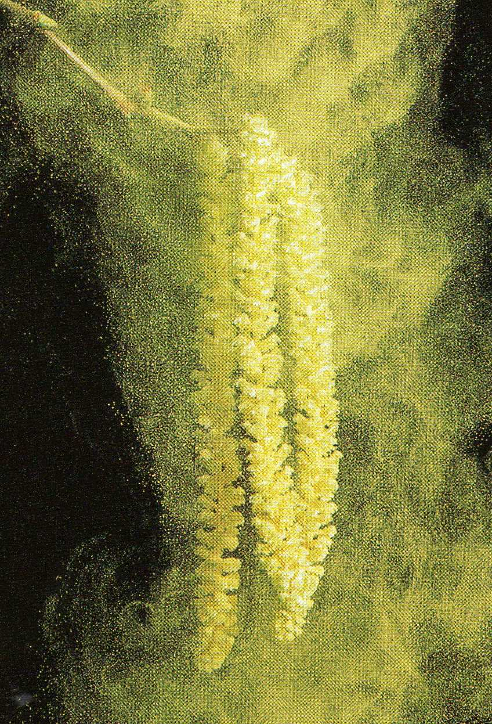
What type of dispersal is shown below?
16
Copyright © 2024 SlideSpark LLC

Slide 28
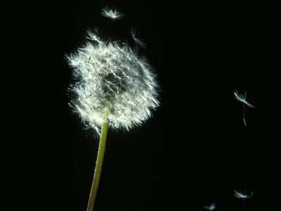
What type of seed dispersal can be seen below?
17
Copyright © 2024 SlideSpark LLC

Slide 29
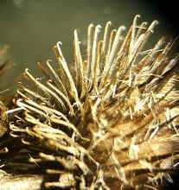
What type of seed dispersal mechanism is represented by the seed below?
18
Copyright © 2024 SlideSpark LLC

Slide 30
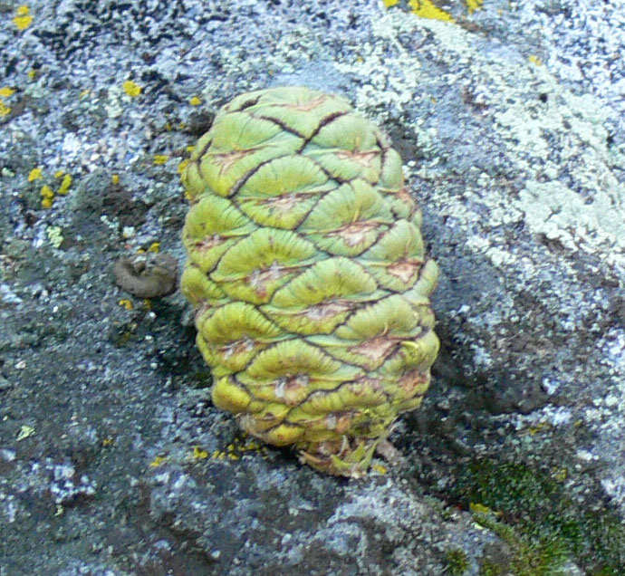
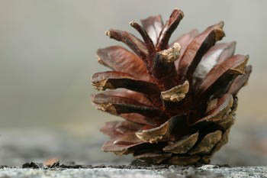
What is required to open this serotinous cone?
19
Copyright © 2024 SlideSpark LLC

Slide 31
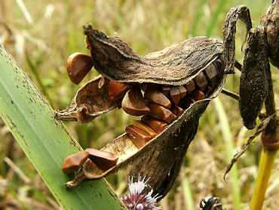
What type of seed dispersal mechanism is represented below?
20
Copyright © 2024 SlideSpark LLC

Slide 32
Ecology: Abiotic Factors Review Game
SUNNY SIDE UP | HOT SHOT | ALL WET | ON THE MOVE | (Bonus) NON-LIVING THINGS
1 | 6 | 11 | 16 | *21
2 | 7 | 12 | 17 | *22
3 | 8 | 13 | 18 | *23
4 | 9 | 14 | 19 | *24
5 | 10 | 15 | 20 | *25
Final Question:________________
Copyright © 2024 SlideSpark LLC

Slide 33
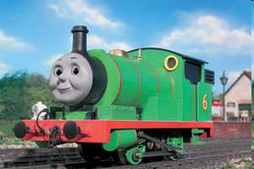
Who am I?
*21
Copyright © 2024 SlideSpark LLC

Slide 34
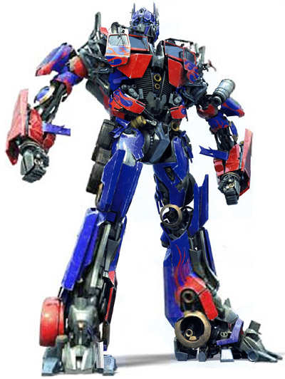
What is my name?
*22
Copyright © 2024 SlideSpark LLC

Slide 35
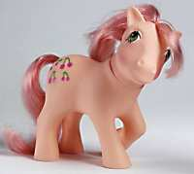
What is the name of this popular toy?
*23
Copyright © 2024 SlideSpark LLC

Slide 36
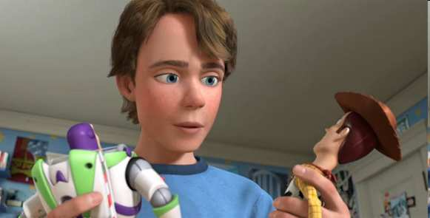
*24
“What’s my name?

Slide 37
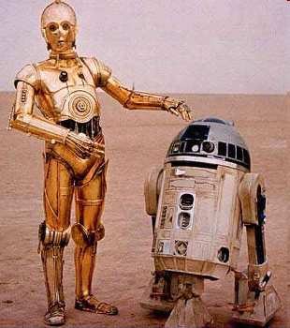
“What are our names?”
*25

Slide 38
Ecology: Abiotic Factors Review Game
SUNNY SIDE UP | HOT SHOT | ALL WET | ON THE MOVE | (Bonus) NON-LIVING THINGS
1 | 6 | 11 | 16 | *21
2 | 7 | 12 | 17 | *22
3 | 8 | 13 | 18 | *23
4 | 9 | 14 | 19 | *24
5 | 10 | 15 | 20 | *25
Final Question:________________
Copyright © 2024 SlideSpark LLC

Slide 39
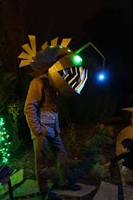
Final Question
5 Point wager
Copyright © 2024 SlideSpark LLC

Slide 40
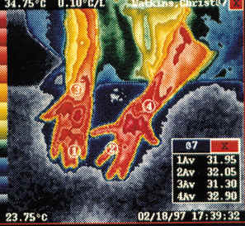
Final Question
  This condition occurs when your body temperature is too high, causes heart failure, among other problems and death.
FINAL QUESTION
Copyright © 2024 SlideSpark LLC

Slide 41
Ecology Abiotic Factors Unit
Part 1
Review Game

Slide 42

Ecology Abiotic Factors Unit
Part 1
Review Game

Slide 43
Ecology: Abiotic Factors Review Game
SUNNY SIDE UP | HOT SHOT | ALL WET | ON THE MOVE | (Bonus) NON-LIVING THINGS
1 | 6 | 11 | 16 | *21
2 | 7 | 12 | 17 | *22
3 | 8 | 13 | 18 | *23
4 | 9 | 14 | 19 | *24
5 | 10 | 15 | 20 | *25
Final Question:________________
Copyright © 2024 SlideSpark LLC

Slide 44
Light from the Sun provides producers the energy to make sugar (photosynthesis).
1
Copyright © 2024 SlideSpark LLC

Slide 45
Light from the Sun provides producers the energy to make sugar (photosynthesis).
1
Copyright © 2024 SlideSpark LLC

Slide 46
Light from the Sun provides producers the energy to make sugar (photosynthesis).
1
SUN
Copyright © 2024 SlideSpark LLC

Slide 47
This is a term associated for when animals are active at dawn and at dusk.
2
Copyright © 2024 SlideSpark LLC

Slide 48
This is a term associated for when animals are active at dawn and at dusk.
2
Crepuscular
Copyright © 2024 SlideSpark LLC

Slide 49
This is the name for the directional growth of plants in response to light?
3
Copyright © 2024 SlideSpark LLC

Slide 50
This is the name for the directional growth of plants in response to light?
3
Phototropism
Copyright © 2024 SlideSpark LLC

Slide 51
Which letter generally gets the most amount of light throughout the year?
4
A
B
C
Copyright © 2024 SlideSpark LLC

Slide 52
Which letter generally gets the most amount of light throughout the year? Answer: B
4
A
B
C
Copyright © 2024 SlideSpark LLC

Slide 53
This is the name for the biological creation of light by a living creature?
5
Copyright © 2024 SlideSpark LLC

Slide 54
This is the name for the biological creation of light by a living creature?
5
Bioluminesence
Copyright © 2024 SlideSpark LLC

Slide 55
Ecology: Abiotic Factors Review Game
SUNNY SIDE UP | HOT SHOT | ALL WET | ON THE MOVE | (Bonus) NON-LIVING THINGS
1 | 6 | 11 | 16 | *21
2 | 7 | 12 | 17 | *22
3 | 8 | 13 | 18 | *23
4 | 9 | 14 | 19 | *24
5 | 10 | 15 | 20 | *25
Final Question:________________
Copyright © 2024 SlideSpark LLC

Slide 56
Thermoregulation is the ability of an organism to keep its body temperature within certain boundaries.
6
Copyright © 2024 SlideSpark LLC

Slide 57
Thermoregulation is the ability of an organism to keep its body temperature within certain boundaries.
6
6
Copyright © 2024 SlideSpark LLC

Slide 58
This is a process whereby an organism becomes better suited to its habitat. A characteristic which aids survival.
7
Copyright © 2024 SlideSpark LLC

Slide 59
This is a process whereby an organism becomes better suited to its habitat. A characteristic which aids survival.
Adaptation
7
Copyright © 2024 SlideSpark LLC

Slide 60
This condition is a decrease in the core body temperature to a level at which normal muscular and brain functions are impaired.
8
Copyright © 2024 SlideSpark LLC

Slide 61
This condition is a decrease in the core body temperature to a level at which normal muscular and brain functions are impaired.
8
Hypothermia
Copyright © 2024 SlideSpark LLC

Slide 62
These type of animals are capable of maintaining a warm body temperature independent of environmental conditions.
9
Copyright © 2024 SlideSpark LLC

Slide 63
These type of animals are capable of maintaining a warm body temperature independent of environmental conditions. Warmblooded / Warmbloodedness.
9
Copyright © 2024 SlideSpark LLC

Slide 64
These type of organisms can’t regulate their internal temperature.
When it’s cold they can’t move, when it’s warm their more active.
10
Copyright © 2024 SlideSpark LLC

Slide 65
These type of organisms can’t regulate their internal temperature.
When it’s cold they can’t move, when it’s warm their more active.
Coldbloodedness
10
Copyright © 2024 SlideSpark LLC

Slide 66

These type of organisms can’t regulate their internal temperature.
When it’s cold they can’t move, when it’s warm their more active.
Coldbloodedness
10
Copyright © 2024 SlideSpark LLC

Slide 67
Ecology: Abiotic Factors Review Game
SUNNY SIDE UP | HOT SHOT | ALL WET | ON THE MOVE | (Bonus) NON-LIVING THINGS
1 | 6 | 11 | 16 | *21
2 | 7 | 12 | 17 | *22
3 | 8 | 13 | 18 | *23
4 | 9 | 14 | 19 | *24
5 | 10 | 15 | 20 | *25
Final Question:________________
Copyright © 2024 SlideSpark LLC

Slide 68
This is essential for life, and all organisms depend on it.
11
Copyright © 2024 SlideSpark LLC

Slide 69
This is essential for life, and all organisms depend on it. Water
11
Copyright © 2024 SlideSpark LLC

Slide 70
This picture best represents these type of plants?
  A.) Neophytes
  B.) Hydrophytes
  C.) Mesophytes
  D.) Xerophytes
  E.) Nobody
  Knows
12

Slide 71
This picture best represents these type of plants?
  A.) Neophytes
  B.) Hydrophytes
  C.) Mesophytes
  D.) Xerophytes
  E.) Nobody
  Knows
12

Slide 72
These organisms (science name please) require water because they breathe water vapor through external gills?
13
Copyright © 2024 SlideSpark LLC

Slide 73
These organisms (science name please) require water because they breathe water vapor through external gills?
13
Isopods
Copyright © 2024 SlideSpark LLC

Slide 74
What type of seed dispersal is represented by the picture below?
14
Copyright © 2024 SlideSpark LLC

Slide 75
What type of seed dispersal is represented by the picture below? Water Dispersal
14
WATER DISPERSAL
Copyright © 2024 SlideSpark LLC

Slide 76
This is the term for how species spread through an island chain?
15
Copyright © 2024 SlideSpark LLC

Slide 77
This is the term for how species spread through an island chain? Island Hopping
15
Copyright © 2024 SlideSpark LLC

Slide 78
This is the term for how species spread through an island chain? Island Hopping
15
Copyright © 2024 SlideSpark LLC

Slide 79
This is the term for how species spread through an island chain? Island Hopping
15
Copyright © 2024 SlideSpark LLC

Slide 80
This is the term for how species spread through an island chain? Island Hopping
15
Copyright © 2024 SlideSpark LLC

Slide 81
This is the term for how species spread through an island chain? Island Hopping
15
Copyright © 2024 SlideSpark LLC

Slide 82
This is the term for how species spread through an island chain? Island Hopping
A
Which Island will have the most species / colonization? And which Island will have the most extinctions?
15
B
Copyright © 2024 SlideSpark LLC

Slide 83
This is the term for how species spread through an island chain? Island Hopping
A
Which Island will have the most species / colonization? And which Island will have the most extinctions?
15
B
Copyright © 2024 SlideSpark LLC

Slide 84
This is the term for how species spread through an island chain? Island Hopping
A
Which Island will have the most species / colonization? And which Island will have the most extinctions? (and fewest migrations)
15
B
Copyright © 2024 SlideSpark LLC

Slide 85
This is the term for how species spread through an island chain? Island Hopping
A
Which Island will have the most species / colonization? And which Island will have the most extinctions? (and fewest migrations)
15
Larger Island
B
More Migrations and Fewer Extinctions
Copyright © 2024 SlideSpark LLC

Slide 86
Ecology: Abiotic Factors Review Game
SUNNY SIDE UP | HOT SHOT | ALL WET | ON THE MOVE | (Bonus) NON-LIVING THINGS
1 | 6 | 11 | 16 | *21
2 | 7 | 12 | 17 | *22
3 | 8 | 13 | 18 | *23
4 | 9 | 14 | 19 | *24
5 | 10 | 15 | 20 | *25
Final Question:________________
Copyright © 2024 SlideSpark LLC

Slide 87
What type of dispersal is shown below?
16
Copyright © 2024 SlideSpark LLC

Slide 88
What type of dispersal is shown below?
16
Wind
Copyright © 2024 SlideSpark LLC

Slide 89
What type of seed dispersal can be seen below?
17
Copyright © 2024 SlideSpark LLC

Slide 90
What type of seed dispersal can be seen below?
17
Wind
Copyright © 2024 SlideSpark LLC

Slide 91
What type of seed dispersal mechanism is represented by the seed below?
18
Copyright © 2024 SlideSpark LLC

Slide 92
What type of seed dispersal mechanism is represented by the seed below?
18
Animal
Copyright © 2024 SlideSpark LLC

Slide 93
What is required to open this serotinous cone?
19
Copyright © 2024 SlideSpark LLC

Slide 94
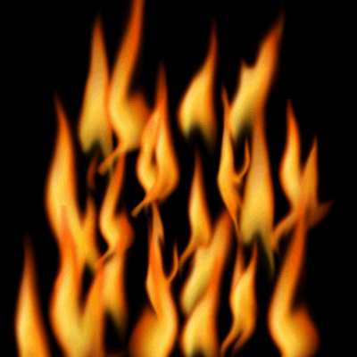
What is required to open this serotinous cone?
19
19
Copyright © 2024 SlideSpark LLC

Slide 95
What type of seed dispersal mechanism is represented below?
20
Copyright © 2024 SlideSpark LLC

Slide 96
What type of seed dispersal mechanism is represented below?
Tension /
Explosion
20
Copyright © 2024 SlideSpark LLC

Slide 97
Ecology: Abiotic Factors Review Game
SUNNY SIDE UP | HOT SHOT | ALL WET | ON THE MOVE | (Bonus) NON-LIVING THINGS
1 | 6 | 11 | 16 | *21
2 | 7 | 12 | 17 | *22
3 | 8 | 13 | 18 | *23
4 | 9 | 14 | 19 | *24
5 | 10 | 15 | 20 | *25
Final Question:________________
Copyright © 2024 SlideSpark LLC

Slide 98
Who am I?
*21
Copyright © 2024 SlideSpark LLC

Slide 99
Who am I? Percy from Thomas and Friends
*21
PERCY
Copyright © 2024 SlideSpark LLC

Slide 100
What is my name?
*22
Copyright © 2024 SlideSpark LLC

Slide 101
What is my name? Optimus Prime
*22
Copyright © 2024 SlideSpark LLC

Slide 102
What is the name of this popular toy?
*23
Copyright © 2024 SlideSpark LLC

Slide 103

What is the name of this popular toy?
My Little Pony
*23
Copyright © 2024 SlideSpark LLC

Slide 104
*24
“What’s my name?

Slide 105
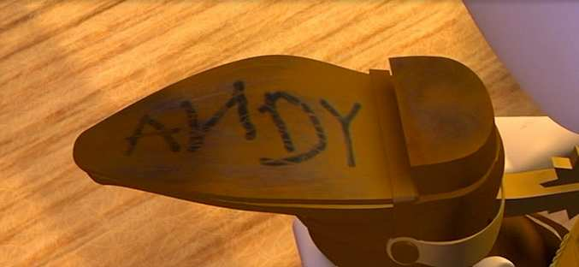
*24

Slide 106
“What are our names?”
*25

Slide 107
*25
C-3PO

Slide 108
*25
C-3PO
R2-D2

Slide 109
Ecology: Abiotic Factors Review Game
SUNNY SIDE UP | HOT SHOT | ALL WET | ON THE MOVE | (Bonus) NON-LIVING THINGS
1 | 6 | 11 | 16 | *21
2 | 7 | 12 | 17 | *22
3 | 8 | 13 | 18 | *23
4 | 9 | 14 | 19 | *24
5 | 10 | 15 | 20 | *25
Final Question:________________
Copyright © 2024 SlideSpark LLC

Slide 110
Final Question
5 Point wager
Copyright © 2024 SlideSpark LLC

Slide 111
Final Question
  This condition occurs when your body temperature is too high, causes heart failure, among other problems and death.
FINAL QUESTION
Copyright © 2024 SlideSpark LLC

Slide 112
Final Question
  This condition occurs when your body temperature is too high, causes heart failure, among other problems and death.
Hyperthermia
FINAL QUESTION
Copyright © 2024 SlideSpark LLC

Slide 113
Questions 1-20 = 5pts Each
Final Category (Bonus) = 1pt Each
Final Questions = 5 pt wager
Find the Owl =
Secretly write “Owl” in the correct box worth 1pt.

Slide 114
Ecology Abiotic Factors Unit
Part 1
Review Game

Slide 115



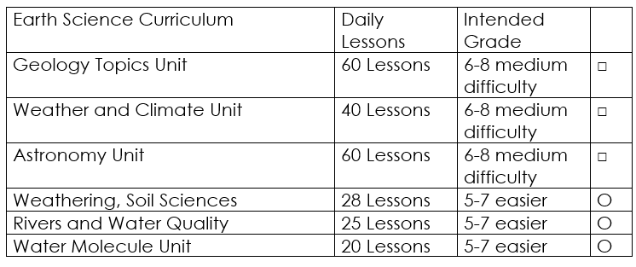

Curriculum Guide
Number of Lessons in each unit (50 min, daily lessons) and difficult rating scale / intended grade level.
=Easier, = More difficult, =Most difficult
Earth Science Units

Slide 116


Life Science Units

Slide 117

Physical Science

Slide 118
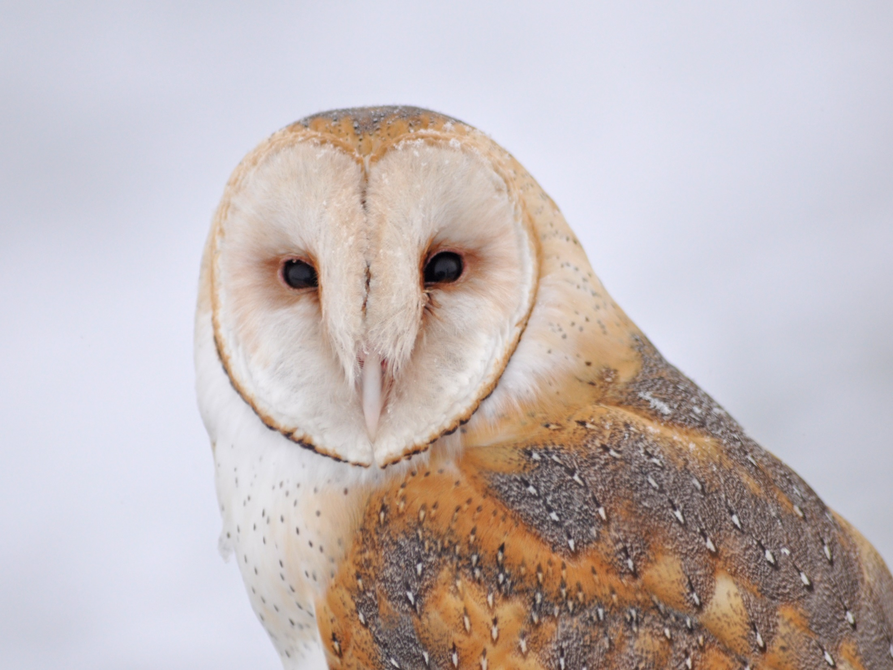
Dear Valued Educator,
Our fully editable .pptx and .doc resources are perfect for educators looking to bring enthusiasm and creativity to their lessons. We encourage you to make changes to fit your needs and style. As science educators, we’re committed to providing students with the tools they need to succeed in the classroom and beyond. Each unit in the curriculum includes a range of resources that have been developed through extensive research and use in a busy classroom. Our teaching approach is designed to make science education engaging and exciting for learners of all ages. We offer a one-of-a-kind science curriculum that will challenge, inspire, and educate students to become tomorrow's scientists and leaders. Join us today and learn more about how our program can help you achieve your classroom goals.
With appreciation,
Support@SlideSpark.net

Slide 119





Thank you for your time and interest in our Science curriculum. We strive to provide students with engaging and informative lessons that will spark their curiosity and encourage scientific exploration. Should you have any questions or concerns, please do not hesitate to contact us. Thank you again for considering our curriculum, and we wish you all the best in your educational journey.
Sincerely,
Support@slidespark.net
SlideSpark Science on TpT

