Slide 1
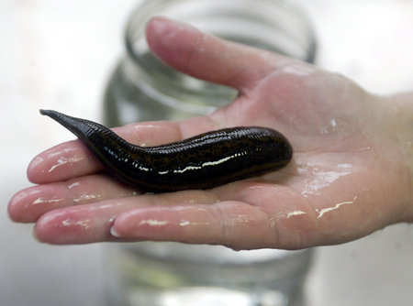
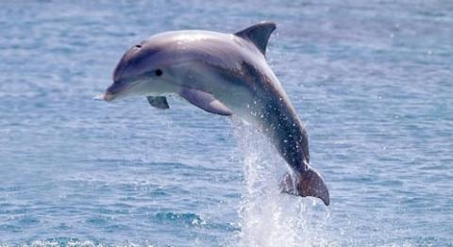

Animalia and Mammalia
Review Game
Part 4
Lesson 16

Slide 2
Kingdom Animals, Phylums, Class Mammalia
GOING WILD | SIMM CITY | FILE THEM | FURBIE | -BONUS- FAMOUS ANIMALS
1 | 6 | 11 | 16 | *21
2 | 7 | 12 | 17 | *22
3 | 8 | 13 | 18 | *23
4 | 9 | 14 | 19 | *24
5 | 10 | 15 | 20 | *25
Final Question:________________
Copyright © 2024 SlideSpark .LLC

Slide 3
How to play…
  Don’t play like Jeo_ _ _ _ y.
  Class should be divided into several small groups.
  Groups should use science journal (red slide notes), homework, and other available materials to assist you.
  Groups can communicate quietly with each other but no sharing answers between groups.
    Practice quietly communicating right now?
    Practice Communication Question:
    Your group gets to order one pizza, and you can have two toppings. What does your group want?

Slide 4

Questions 1-20 = 5pts Each
Final Category (Bonus) = 1pt Each
Final Questions = 5 pt wager
If you wager 5 on the last question and get it wrong you lose 5 pts. Wager 5 and get it right you get 5 pts.
Find the Owl =
Secretly write “Owl” in the correct box worth 1pt.
“I’ll be about this big.”

Slide 5
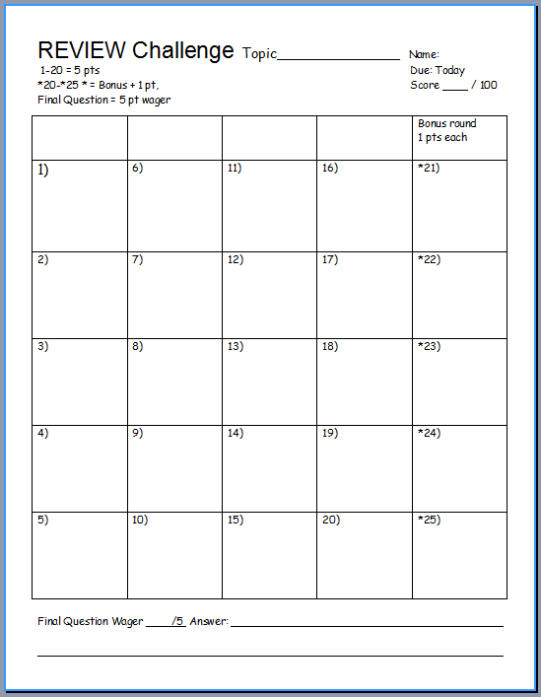
Is your name on the review sheet?
Name

Slide 6
Is your name on the review sheet?
Add the categories
along the top
on the next slide.

Slide 7
Kingdom Animals, Phylums, Class Mammalia
GOING WILD | SIMM CITY | FILE THEM | FURBIE | -BONUS- FAMOUS ANIMALS
1 | 6 | 11 | 16 | *21
2 | 7 | 12 | 17 | *22
3 | 8 | 13 | 18 | *23
4 | 9 | 14 | 19 | *24
5 | 10 | 15 | 20 | *25
Final Question:________________
Copyright © 2024 SlideSpark .LLC

Slide 8
Kingdom Animals, Phylums, Class Mammalia
GOING WILD | SIMM CITY | FILE THEM | FURBIE | -BONUS- FAMOUS ANIMALS
1 | 6 | 11 | 16 | *21
2 | 7 | 12 | 17 | *22
3 | 8 | 13 | 18 | *23
4 | 9 | 14 | 19 | *24
5 | 10 | 15 | 20 | *25
Final Question:________________
Copyright © 2024 SlideSpark .LLC

Slide 9
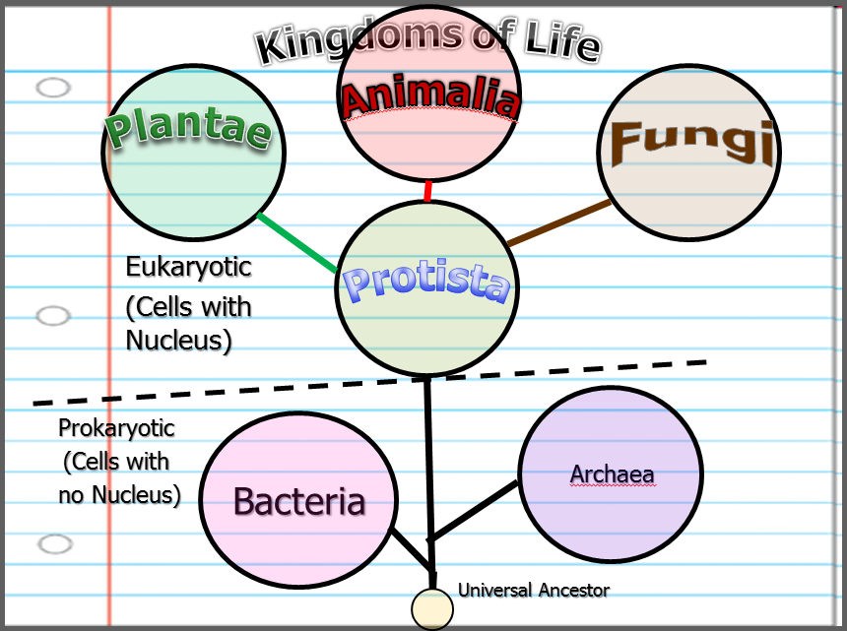
Which one below best describes the Kingdom Animalia?
  A.) An autotrophic single celled organism that’s eukaryotic.
  B.) A heterotrophic multi-cellular organism with cell walls made of chitin.
  C.) A prokaryotic heterotroph.
  D.) A eukaryotic multi-cellular heterotrophic organisms that consumes food.
  E.) A eukaryotic multi-cellular autroph.
1
Copyright © 2024 SlideSpark .LLC

Slide 10
Which one below best describes the Kingdom Animalia?
  A.) An autotrophic single celled organism that’s eukaryotic.
  B.) A heterotrophic multi-cellular organism with cell walls made of chitin.
  C.) A prokaryotic heterotroph.
  D.) A eukaryotic multi-cellular heterotrophic organisms that consumes food.
  E.) A eukaryotic multi-cellular autroph.
1
Copyright © 2024 SlideSpark .LLC

Slide 11
Which one below best describes the Kingdom Animalia?
  A.) An autotrophic single celled organism that’s eukaryotic.
  B.) A heterotrophic multi-cellular organism with cell walls made of chitin.
  C.) A prokaryotic heterotroph.
  D.) A eukaryotic multi-cellular heterotrophic organisms that consumes food.
  E.) A eukaryotic multi-cellular autroph.
1
Copyright © 2024 SlideSpark .LLC

Slide 12
Which one below best describes the Kingdom Animalia?
  A.) An autotrophic single celled organism that’s eukaryotic.
  B.) A heterotrophic multi-cellular organism with cell walls made of chitin.
  C.) A prokaryotic heterotroph.
  D.) A eukaryotic multi-cellular heterotrophic organisms that consumes food.
  E.) A eukaryotic multi-cellular autroph.
1
Copyright © 2024 SlideSpark .LLC

Slide 13
Which one below best describes the Kingdom Animalia?
  A.) An autotrophic single celled organism that’s eukaryotic.
  B.) A heterotrophic multi-cellular organism with cell walls made of chitin.
  C.) A prokaryotic heterotroph.
  D.) A eukaryotic multi-cellular heterotrophic organisms that consumes food.
  E.) A eukaryotic multi-cellular autroph.
1
Copyright © 2024 SlideSpark .LLC

Slide 14
Which one below best describes the Kingdom Animalia?
  A.) An autotrophic single celled organism that’s eukaryotic.
  B.) A heterotrophic multi-cellular organism with cell walls made of chitin.
  C.) A prokaryotic heterotroph.
  D.) A eukaryotic multi-cellular heterotrophic organisms that consumes food.
  E.) A eukaryotic multi-cellular autoroph.
1
Copyright © 2024 SlideSpark .LLC

Slide 15
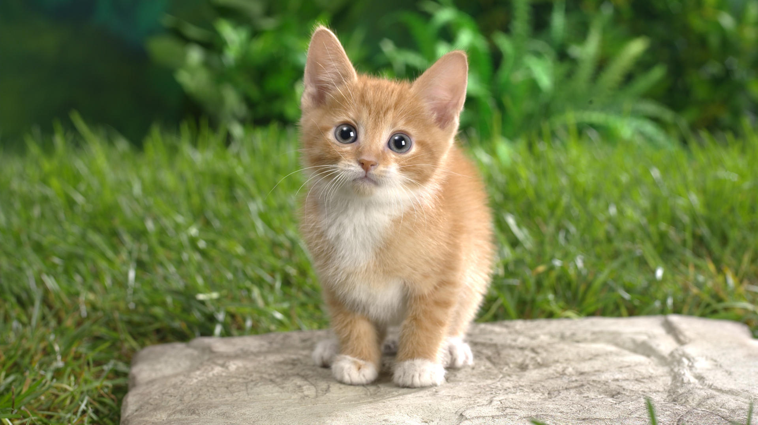
Which one of the following does not describe the Kingdom Animalia?
  A.) Has a nucleus in it’s cells.
  B.) Has a period of embryonic development.
  C.) Eats food.
  D.) Moves.
  E.) Has Cells Walls
  F.) Has nervous and muscle tissue.
  G.) Usually has a diplontic life cycle.
2
Copyright © 2024 SlideSpark .LLC

Slide 16
Which one of the following does not describe the Kingdom Animalia?
  A.) Has a nucleus in it’s cells.
  B.) Has a period of embryonic development.
  C.) Eats food.
  D.) Moves.
  E.) Has Cells Walls
  F.) Has nervous and muscle tissue.
  G.) Usually has a diplontic life cycle.
2
Copyright © 2024 SlideSpark .LLC

Slide 17
Which one of the following does not describe the Kingdom Animalia?
  A.) Has a nucleus in its cells.
  B.) Has a period of embryonic development.
  C.) Eats food.
  D.) Moves.
  E.) Has Cells Walls
  F.) Has nervous and muscle tissue.
  G.) Usually has a diplontic life cycle.
2
Copyright © 2024 SlideSpark .LLC

Slide 18
Which one of the following does not describe the Kingdom Animalia?
  A.) Has a nucleus in its cells.
  B.) Has a period of embryonic development.
  C.) Eats food.
  D.) Moves.
  E.) Has Cells Walls
  F.) Has nervous and muscle tissue.
  G.) Usually has a diplontic life cycle.
2
Copyright © 2024 SlideSpark .LLC

Slide 19
Which one of the following does not describe the Kingdom Animalia?
  A.) Has a nucleus in its cells.
  B.) Has a period of embryonic development.
  C.) Eats food.
  D.) Moves.
  E.) Has Cells Walls
  F.) Has nervous and muscle tissue.
  G.) Usually has a diplontic life cycle.
2
Copyright © 2024 SlideSpark .LLC

Slide 20
Which one of the following does not describe the Kingdom Animalia?
  A.) Has a nucleus in its cells.
  B.) Has a period of embryonic development.
  C.) Eats food.
  D.) Moves.
  E.) Has Cells Walls
  F.) Has nervous and muscle tissue.
  G.) Usually has a diplontic life cycle.
2
Copyright © 2024 SlideSpark .LLC

Slide 21
Which one of the following does not describe the Kingdom Animalia?
  A.) Has a nucleus in its cells.
  B.) Has a period of embryonic development.
  C.) Eats food.
  D.) Moves.
  E.) Has Cell Walls.
  F.) Has nervous and muscle tissue.
  G.) Usually has a diplontic life cycle.
2
Copyright © 2024 SlideSpark .LLC

Slide 22
Which one of the following does not describe the Kingdom Animalia?
  A.) Has a nucleus in its cells.
  B.) Has a period of embryonic development.
  C.) Eats food.
  D.) Moves.
  E.) Has Cell Walls.
  F.) Has nervous and muscle tissue.
  G.) Usually has a diplontic life cycle.
2
Copyright © 2024 SlideSpark .LLC

Slide 23
Which one of the following does not describe the Kingdom Animalia?
  A.) Has a nucleus in its cells.
  B.) Has a period of embryonic development.
  C.) Eats food.
  D.) Moves.
  E.) Has Cell Walls.
  F.) Has nervous and muscle tissue.
  G.) Usually has a diplontic life cycle.
2
Copyright © 2024 SlideSpark .LLC

Slide 24
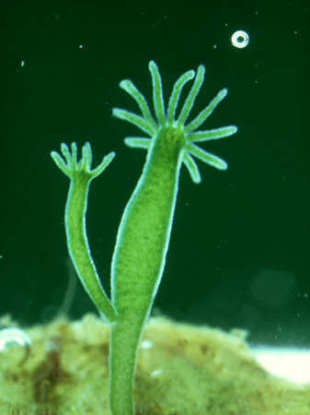
Budding: Is one form of asexual reproduction.
The offspring develop as a growth on the body of the parent.
3

Slide 25
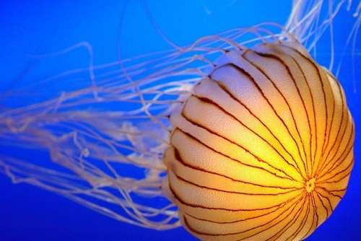
Name this type of animal symmetry
4

Slide 26
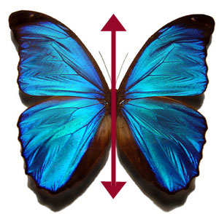
Many animal Phylums tend to have this type of symmetry.
5
Copyright © 2024 SlideSpark .LLC

Slide 27
Kingdom Animals, Phylums, Class Mammalia
GOING WILD | SIMM CITY | FILE THEM | FURBIE | -BONUS- FAMOUS ANIMALS
1 | 6 | 11 | 16 | *21
2 | 7 | 12 | 17 | *22
3 | 8 | 13 | 18 | *23
4 | 9 | 14 | 19 | *24
5 | 10 | 15 | 20 | *25
Final Question:________________
Copyright © 2024 SlideSpark .LLC

Slide 28
Kingdom Animals, Phylums, Class Mammalia
GOING WILD | SIMM CITY | FILE THEM | FURBIE | -BONUS- FAMOUS ANIMALS
1 | 6 | 11 | 16 | *21
2 | 7 | 12 | 17 | *22
3 | 8 | 13 | 18 | *23
4 | 9 | 14 | 19 | *24
5 | 10 | 15 | 20 | *25
Final Question:________________
Copyright © 2024 SlideSpark .LLC

Slide 29
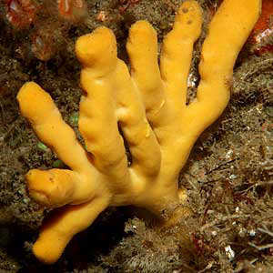
Name this type of animal symmetry? no symmetry.
6
Copyright © 2024 SlideSpark .LLC

Slide 30
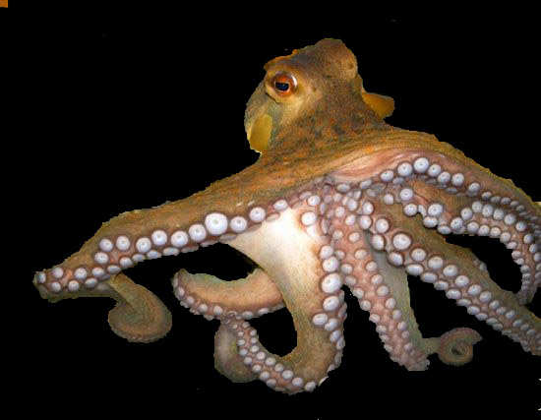
What is the name of this soft bodied and often shelled Phylum of animal?
7
Copyright © 2024 SlideSpark .LLC

Slide 31
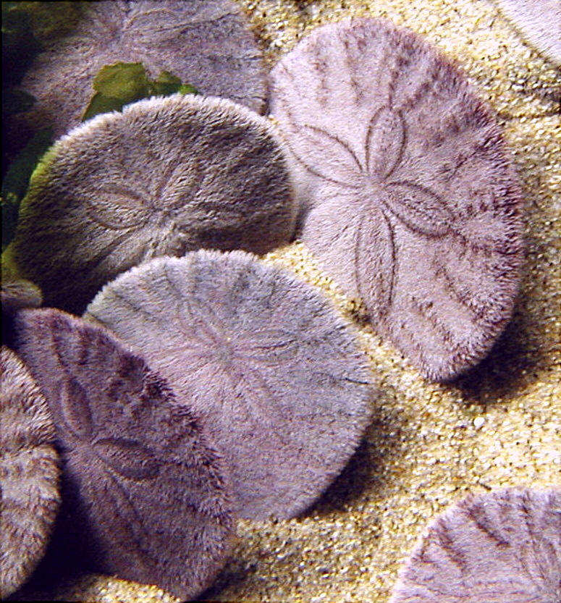
This Phylum of Animalia has spiny skin and many have radial symmetry.
8
Copyright © 2024 SlideSpark .LLC

Slide 32
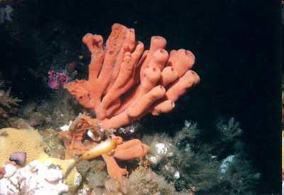
This Phylum of Animalia is asymmetrical?
9
Copyright © 2024 SlideSpark .LLC

Slide 33

Name the Classes of the Phylum Arthropoda.
A
B
C
D
E
C
E
Copyright © 2024 SlideSpark .LLC

Slide 34
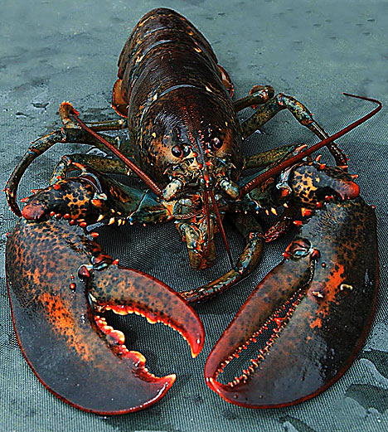
Name the Classes of the Phylum Arthropoda.
A
B
C
D
E
C
E
Copyright © 2024 SlideSpark .LLC

Slide 35
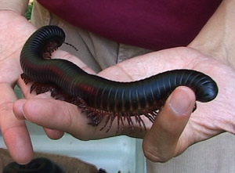
Name the Classes of the Phylum Arthropoda.
A
B
B
C
D
E
C
E
Copyright © 2024 SlideSpark .LLC

Slide 36
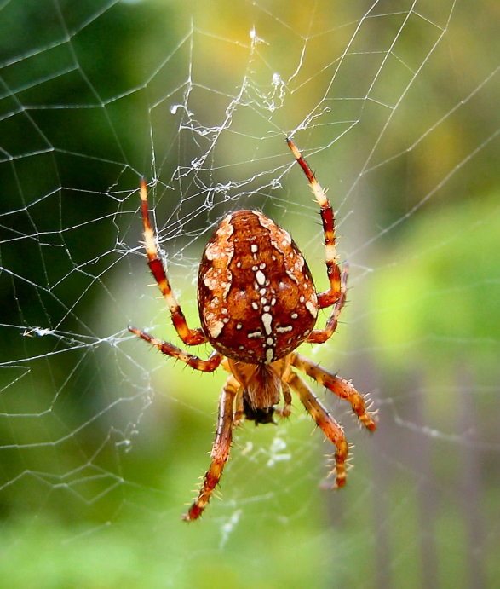
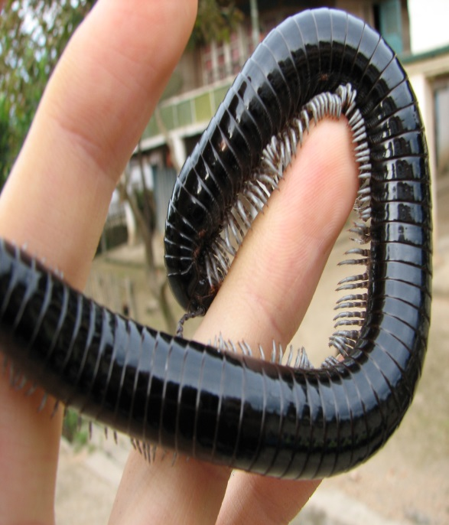
Name the Classes of the Phylum Arthropoda.
A
B
B
C
E
C
D
E
Copyright © 2024 SlideSpark .LLC

Slide 37
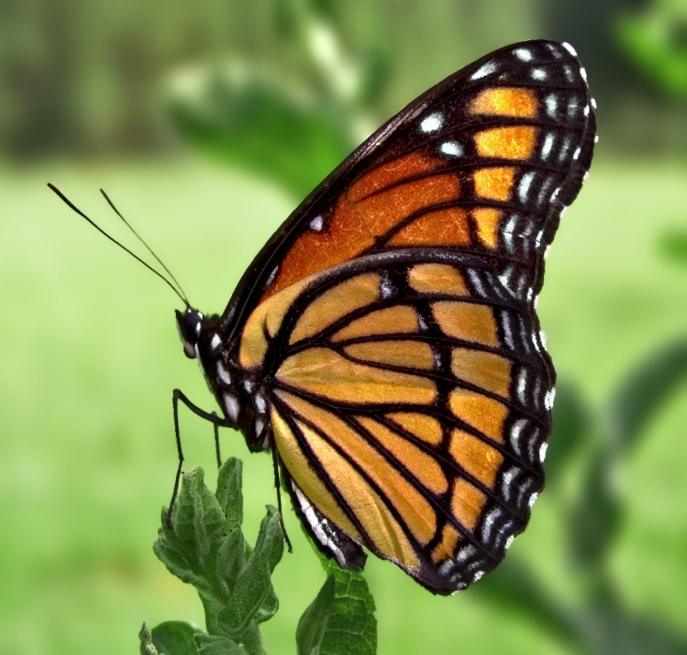
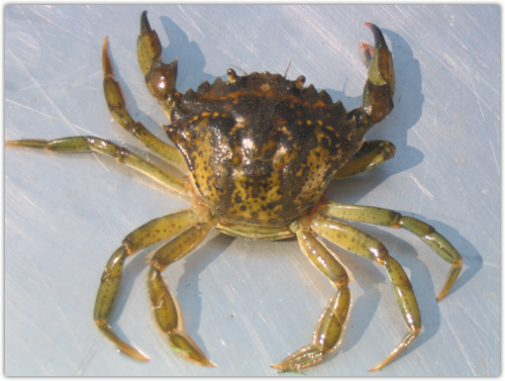

Name the Classes of the Phylum Arthropoda.
A
B
B
C
D
E
C
D
E
Copyright © 2024 SlideSpark .LLC

Slide 38
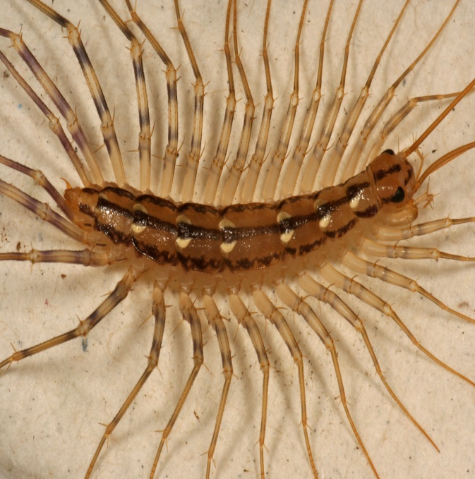
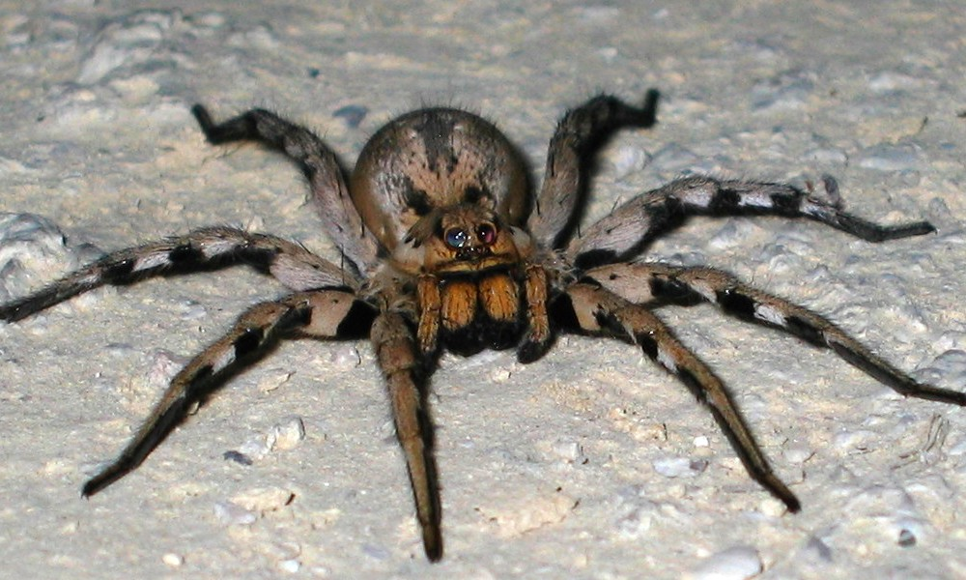
Name the Classes of the Phylum Arthropoda.
A
B
B
C
D
E
C
D
E
Copyright © 2024 SlideSpark .LLC

Slide 39
Kingdom Animals, Phylums, Class Mammalia
GOING WILD | SIMM CITY | FILE THEM | FURBIE | -BONUS- FAMOUS ANIMALS
1 | 6 | 11 | 16 | *21
2 | 7 | 12 | 17 | *22
3 | 8 | 13 | 18 | *23
4 | 9 | 14 | 19 | *24
5 | 10 | 15 | 20 | *25
Final Question:________________
Copyright © 2024 SlideSpark .LLC

Slide 40
Kingdom Animals, Phylums, Class Mammalia
GOING WILD | SIMM CITY | FILE THEM | FURBIE | -BONUS- FAMOUS ANIMALS
1 | 6 | 11 | 16 | *21
2 | 7 | 12 | 17 | *22
3 | 8 | 13 | 18 | *23
4 | 9 | 14 | 19 | *24
5 | 10 | 15 | 20 | *25
Final Question:________________
Copyright © 2024 SlideSpark .LLC

Slide 41
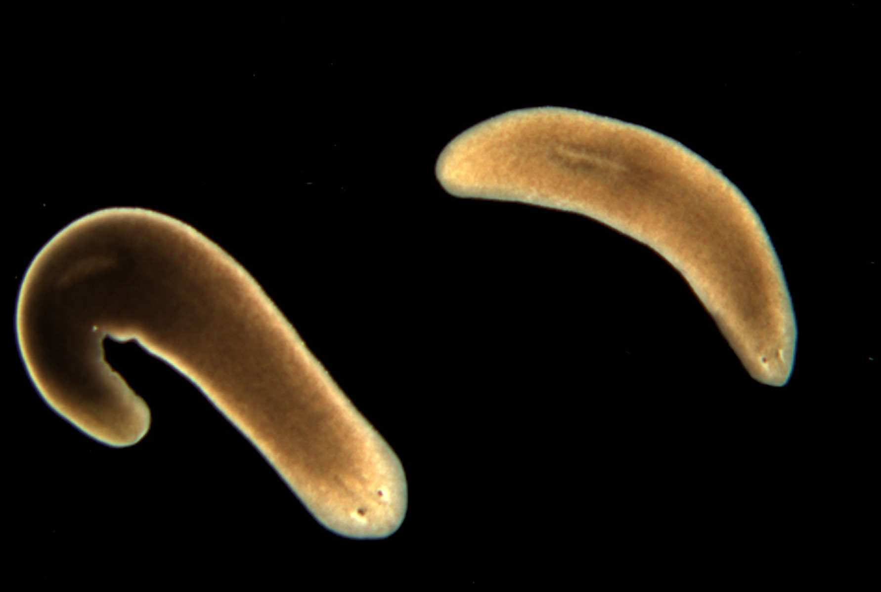
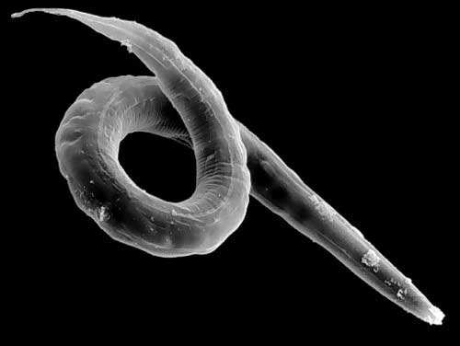
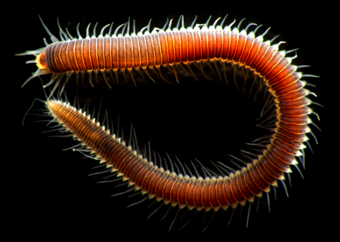
11
Name each phylum below?
B
A
B
C
Copyright © 2024 SlideSpark .LLC

Slide 42





Which is a…
  Coral (Anthozoa)
  Box Jelly (Cuboza)
  Hydra (Hydrozoa)
  True Jelly (Scyphozoa)

Slide 43
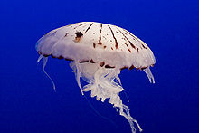
Which is a…
  Coral (Anthozoa)
  Box Jelly (Cuboza)
  Hydra (Hydrozoa)
  True Jelly (Scyphozoa)

Slide 44
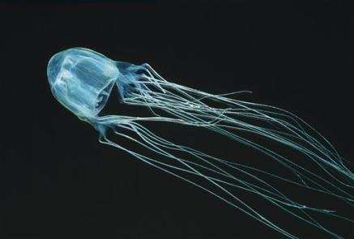
Which is a…
  Coral (Anthozoa)
  Box Jelly (Cuboza)
  Hydra (Hydrozoa)
  True Jelly (Scyphozoa)

Slide 45
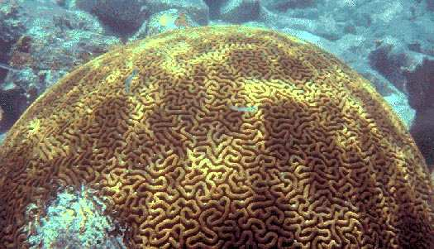
Which is a…
  Coral (Anthozoa)
  Box Jelly (Cuboza)
  Hydra (Hydrozoa)
  True Jelly (Scyphozoa)

Slide 46
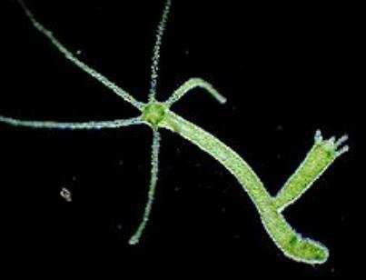
Which is a…
  Coral (Anthozoa)
  Box Jelly (Cuboza)
  Hydra (Hydrozoa)
  True Jelly (Scyphozoa)

Slide 47

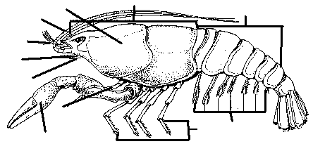
Name at least 5 parts of the crayfish below.

Slide 48
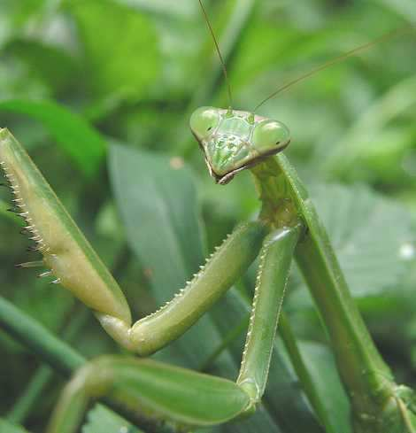

The Praying Mantis belongs to this Phylum and this class of Animalia?
Copyright © 2024 SlideSpark .LLC

Slide 49
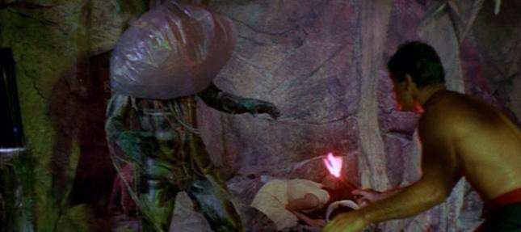

Slide 50
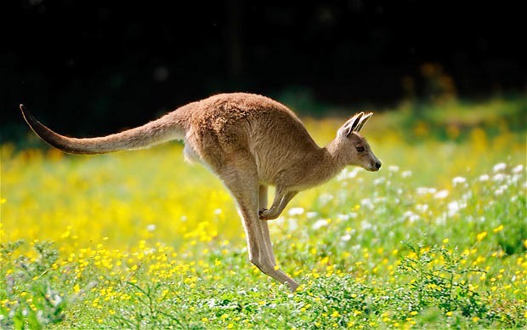
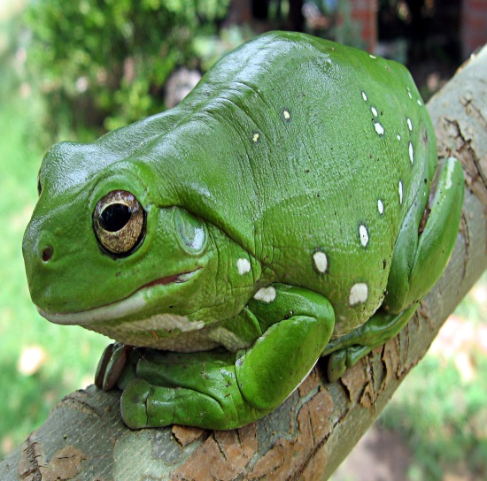
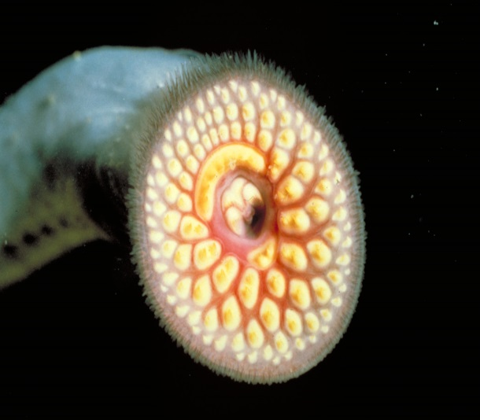
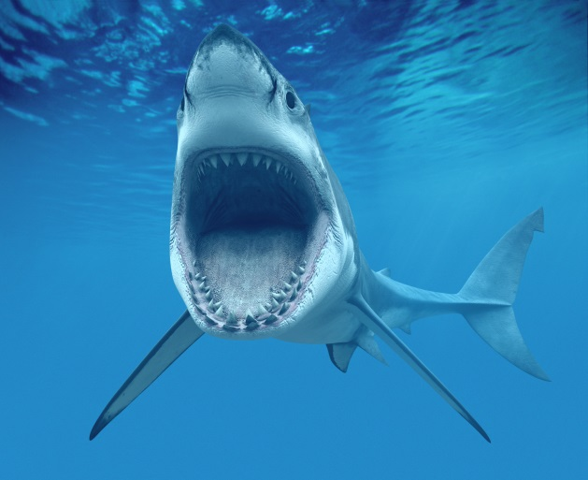
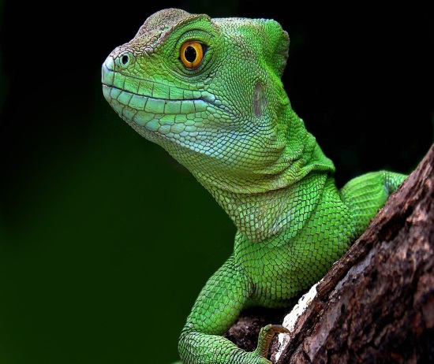
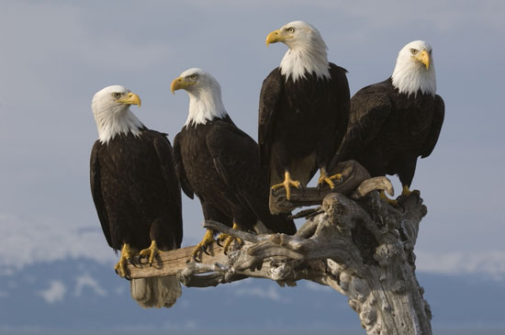
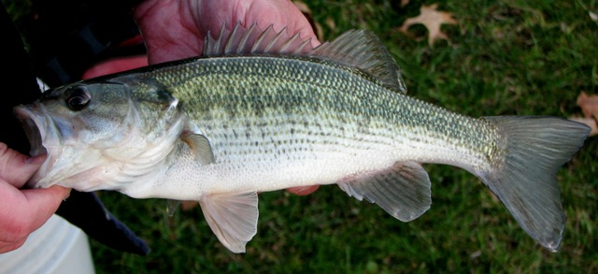
Which two Classes of Chordata are switched?.
Mammalia
Reptilia
Agnatha
Jawless
15
Chondrichthyes
Cartilaginous
Osteichthyes
Aves
Amphibia
Bony
Copyright © 2024 SlideSpark .LLC

Slide 51
Kingdom Animals, Phylums, Class Mammalia
GOING WILD | SIMM CITY | FILE THEM | FURBIE | -BONUS- FAMOUS ANIMALS
1 | 6 | 11 | 16 | *21
2 | 7 | 12 | 17 | *22
3 | 8 | 13 | 18 | *23
4 | 9 | 14 | 19 | *24
5 | 10 | 15 | 20 | *25
Final Question:________________
Copyright © 2024 SlideSpark .LLC

Slide 52
Kingdom Animals, Phylums, Class Mammalia
GOING WILD | SIMM CITY | FILE THEM | FURBIE | -BONUS- FAMOUS ANIMALS
1 | 6 | 11 | 16 | *21
2 | 7 | 12 | 17 | *22
3 | 8 | 13 | 18 | *23
4 | 9 | 14 | 19 | *24
5 | 10 | 15 | 20 | *25
Final Question:________________
Copyright © 2024 SlideSpark .LLC

Slide 53
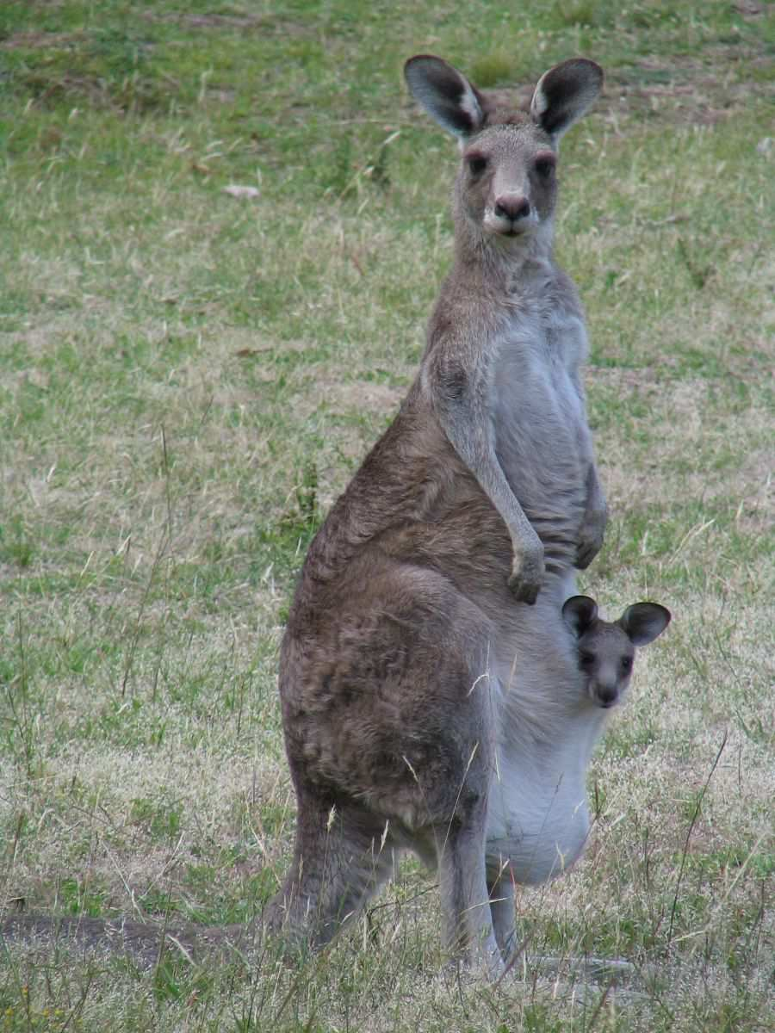
What subclass of mammals do Kangaroo’s belong?
16
Copyright © 2024 SlideSpark .LLC

Slide 54
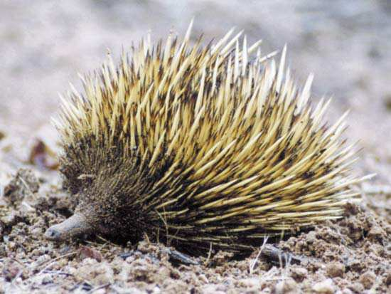
Prototheria / Monotremes are a unique subclass of mammals that reproduce by…
17
Copyright © 2024 SlideSpark .LLC

Slide 55
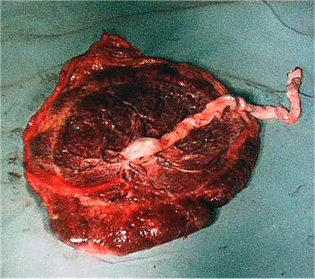
This is an organ that connects the developing fetus to the uterine wall to allow nutrient uptake, waste elimination, and gas exchange via the mother's blood supply in Eutherian mammals
  It’s released from the mothers uterine wall shortly after birth.
18
Copyright © 2024 SlideSpark .LLC

Slide 56
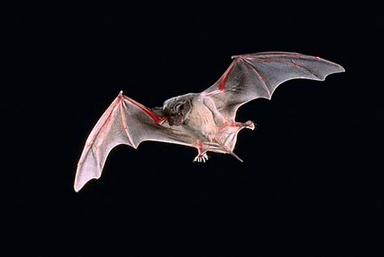
What’s the order of mammal capable of sustained flight?
19
Copyright © 2024 SlideSpark .LLC

Slide 57
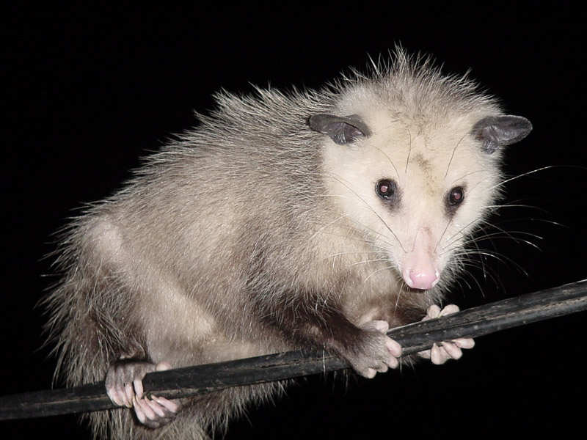
What is the common name for Didelphis virginiana , North America’s only marsupial.
20
Copyright © 2024 SlideSpark .LLC

Slide 58
Kingdom Animals, Phylums, Class Mammalia
GOING WILD | SIMM CITY | FILE THEM | FURBIE | -BONUS- FAMOUS ANIMALS
1 | 6 | 11 | 16 | *21
2 | 7 | 12 | 17 | *22
3 | 8 | 13 | 18 | *23
4 | 9 | 14 | 19 | *24
5 | 10 | 15 | 20 | *25
Final Question:________________
Copyright © 2024 SlideSpark .LLC

Slide 59
Kingdom Animals, Phylums, Class Mammalia
GOING WILD | SIMM CITY | FILE THEM | FURBIE | -BONUS- FAMOUS ANIMALS
1 | 6 | 11 | 16 | *21
2 | 7 | 12 | 17 | *22
3 | 8 | 13 | 18 | *23
4 | 9 | 14 | 19 | *24
5 | 10 | 15 | 20 | *25
Final Question:________________
Copyright © 2024 SlideSpark .LLC

Slide 60
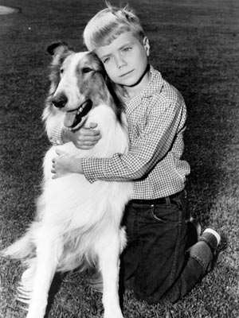
What is the name of this famous Rough Collie, that belongs to the order carnivora, family canidae, genus canis ?
*21
Copyright © 2024 SlideSpark .LLC

Slide 61

What is the name of this famous bear, Phylum Chordata, Subphylum Vertebrata, Class Mammalia, Order Carnivora ?
*22
*22
Copyright © 2024 SlideSpark .LLC

Slide 62
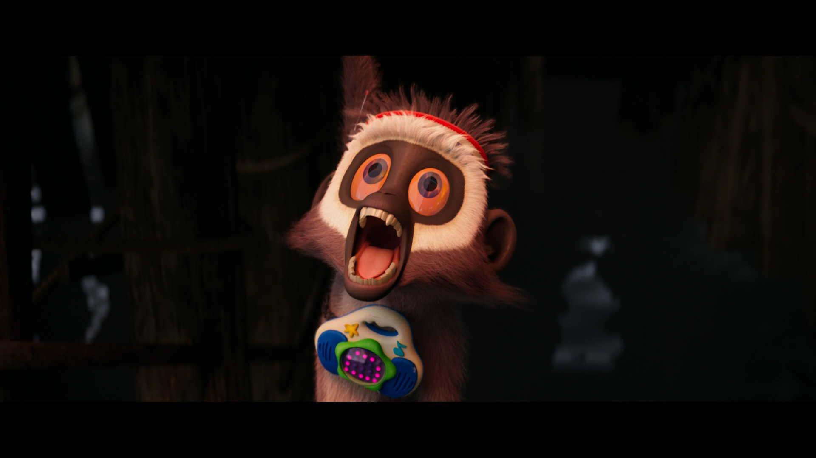
Name this Mammalia?
*23

Slide 63
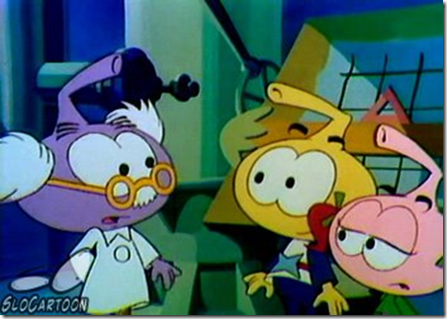
These cartoon sea squirts have a primitive notochord. Can you name these cartoon creatures?
*24
Copyright © 2024 SlideSpark .LLC

Slide 64
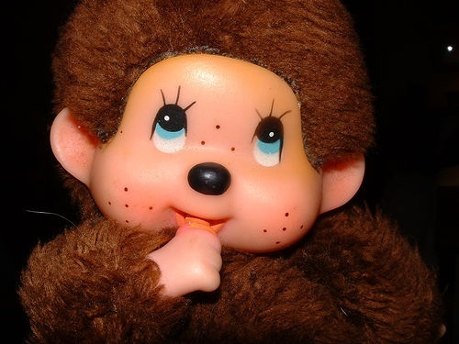
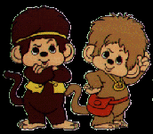
Name these dolls / cartoon show from the Primate Order of Mammals?
*25
Copyright © 2024 SlideSpark .LLC

Slide 65
Kingdom Animals, Phylums, Class Mammalia
GOING WILD | SIMM CITY | FILE THEM | FURBIE | -BONUS- FAMOUS ANIMALS
1 | 6 | 11 | 16 | *21
2 | 7 | 12 | 17 | *22
3 | 8 | 13 | 18 | *23
4 | 9 | 14 | 19 | *24
5 | 10 | 15 | 20 | *25
Final Question:________________
Copyright © 2024 SlideSpark .LLC

Slide 66
Kingdom Animals, Phylums, Class Mammalia
GOING WILD | SIMM CITY | FILE THEM | FURBIE | -BONUS- FAMOUS ANIMALS
1 | 6 | 11 | 16 | *21
2 | 7 | 12 | 17 | *22
3 | 8 | 13 | 18 | *23
4 | 9 | 14 | 19 | *24
5 | 10 | 15 | 20 | *25
Final Question:________________
Copyright © 2024 SlideSpark .LLC

Slide 67
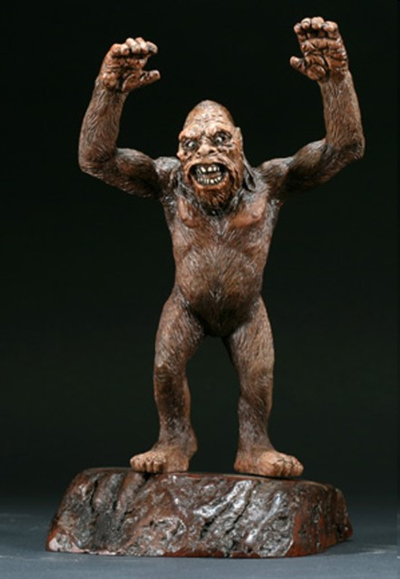

Slide 68
“This is 5 point
Wager question.”

Slide 69

Final Question! This Class of Arthropoda has…
Copyright © 2024 SlideSpark .LLC

Slide 70
Final Question! This Class of Arthropoda has…
  8 legs.
Copyright © 2024 SlideSpark .LLC

Slide 71
Final Question! This Class of Arthropoda has…
  8 legs.
  No antennae or wings.
Copyright © 2024 SlideSpark .LLC

Slide 72
Final Question! This Class of Arthropoda has…
  8 legs.
  No antennae or wings.
  Two body parts.
    Head and sensory.
    Abdomen.
Copyright © 2024 SlideSpark .LLC

Slide 73
Final Question! This Class of Arthropoda has…
  8 legs.
  No antennae or wings.
  Two body parts.
    Head and sensory.
    Abdomen.
  Most live on land.
Copyright © 2024 SlideSpark .LLC

Slide 74
Final Question! This Class of Arthropoda has…
  8 legs.
  No antennae or wings.
  Two body parts.
    Head and sensory.
    Abdomen.
  Most live on land.
Copyright © 2024 SlideSpark .LLC

Slide 75
Animalia and Mammalia
Review Game
Part 4
Lesson 16

Slide 76

Animalia and Mammalia
Review Game
Part 4
Lesson 17

Slide 77
Kingdom Animals, Phylums, Class Mammalia
GOING WILD | SIMM CITY | FILE THEM | FURBIE | -BONUS- FAMOUS ANIMALS
1 | 6 | 11 | 16 | *21
2 | 7 | 12 | 17 | *22
3 | 8 | 13 | 18 | *23
4 | 9 | 14 | 19 | *24
5 | 10 | 15 | 20 | *25
Final Question:________________
Copyright © 2024 SlideSpark .LLC

Slide 78
How to play…
  Don’t play like Jeo_ _ _ _ y.
  Class should be divided into several small groups.
  Groups should use science journal (red slide notes), homework, and other available materials to assist you.
  Groups can communicate quietly with each other but no sharing answers between groups.
    Practice quietly communicating right now?
    Practice Communication Question:
    Your group gets to order one pizza, and you can have two toppings. What does your group want?

Slide 79
Questions 1-20 = 5pts Each
Final Category (Bonus) = 1pt Each
Final Questions = 5 pt wager
If you wager 5 on the last question and get it wrong you lose 5 pts. Wager 5 and get it right you get 5 pts.
Find the Owl =
Secretly write “Owl” in the correct box worth 1pt.
“I’ll be about this big.”

Slide 80


Slide 81

Animalia and Mammalia
Review Game Scoring
1-20 = 5 points each
20-25 = Bonus (1 point each)
Final Question = 5 point wager
Find the Owl = 1 point

Slide 82
Kingdom Animals, Phylums, Class Mammalia
GOING WILD | SIMM CITY | FILE THEM | FURBIE | -BONUS- FAMOUS ANIMALS
1 | 6 | 11 | 16 | *21
2 | 7 | 12 | 17 | *22
3 | 8 | 13 | 18 | *23
4 | 9 | 14 | 19 | *24
5 | 10 | 15 | 20 | *25
Final Question:________________
Copyright © 2024 SlideSpark .LLC

Slide 83
Kingdom Animals, Phylums, Class Mammalia
GOING WILD | SIMM CITY | FILE THEM | FURBIE | -BONUS- FAMOUS ANIMALS
1 | 6 | 11 | 16 | *21
2 | 7 | 12 | 17 | *22
3 | 8 | 13 | 18 | *23
4 | 9 | 14 | 19 | *24
5 | 10 | 15 | 20 | *25
Final Question:________________
Copyright © 2024 SlideSpark .LLC

Slide 84
Which one below best describes the Kingdom Animalia?
  A.) An autotrophic single celled organism that’s eukaryotic.
  B.) A heterotrophic multi-cellular organism with cell walls made of chitin.
  C.) A prokaryotic heterotroph.
  D.) A eukaryotic multi-cellular heterotrophic organisms that consumes food.
  E.) A eukaryotic multi-cellular autroph.
1
Copyright © 2024 SlideSpark .LLC

Slide 85
Which one below best describes the Kingdom Animalia?
  A.) An autotrophic single celled organism that’s eukaryotic.
  B.) A heterotrophic multi-cellular organism with cell walls made of chitin.
  C.) A prokaryotic heterotroph.
  D.) A eukaryotic multi-cellular heterotrophic organisms that consumes food.
  E.) A eukaryotic multi-cellular autroph.
1
Copyright © 2024 SlideSpark .LLC

Slide 86
Which one below best describes the Kingdom Animalia?
  A.) An autotrophic single celled organism that’s eukaryotic.
  B.) A heterotrophic multi-cellular organism with cell walls made of chitin.
  C.) A prokaryotic heterotroph.
  D.) A eukaryotic multi-cellular heterotrophic organisms that consumes food.
  E.) A eukaryotic multi-cellular autroph.
1
Copyright © 2024 SlideSpark .LLC

Slide 87
Which one below best describes the Kingdom Animalia?
  A.) An autotrophic single celled organism that’s eukaryotic.
  B.) A heterotrophic multi-cellular organism with cell walls made of chitin.
  C.) A prokaryotic heterotroph.
  D.) A eukaryotic multi-cellular heterotrophic organisms that consumes food.
  E.) A eukaryotic multi-cellular autroph.
1
Copyright © 2024 SlideSpark .LLC

Slide 88
Which one below best describes the Kingdom Animalia?
  A.) An autotrophic single celled organism that’s eukaryotic.
  B.) A heterotrophic multi-cellular organism with cell walls made of chitin.
  C.) A prokaryotic heterotroph.
  D.) A eukaryotic multi-cellular heterotrophic organisms that consumes food.
  E.) A eukaryotic multi-cellular autroph.
1
Copyright © 2024 SlideSpark .LLC

Slide 89
Which one below best describes the Kingdom Animalia?
  A.) An autotrophic single celled organism that’s eukaryotic.
  B.) A heterotrophic multi-cellular organism with cell walls made of chitin.
  C.) A prokaryotic heterotroph.
  D.) A eukaryotic multi-cellular heterotrophic organisms that consumes food.
  E.) A eukaryotic multi-cellular autoroph.
1
Copyright © 2024 SlideSpark .LLC

Slide 90
Which one below best describes the Kingdom Animalia?
  A.) An autotrophic single celled organism that’s eukaryotic.
  B.) A heterotrophic multi-cellular organism with cell walls made of chitin.
  C.) A prokaryotic heterotroph.
  D.) A eukaryotic multi-cellular heterotrophic organisms that consumes food.
  E.) A eukaryotic multi-cellular autoroph.
1
answer is…
Copyright © 2024 SlideSpark .LLC

Slide 91
Which one below best describes the Kingdom Animalia?
  A.) An autotrophic single celled organism that’s eukaryotic.
  B.) A heterotrophic multi-cellular organism with cell walls made of chitin.
  C.) A prokaryotic heterotroph.
  D.) A eukaryotic multi-cellular heterotrophic organisms that consumes food.
  E.) A eukaryotic multi-cellular autoroph.
1
answer is…
Copyright © 2024 SlideSpark .LLC

Slide 92
Which one below best describes the Kingdom Animalia?
  A.) An autotrophic single celled organism that’s eukaryotic.
  B.) A heterotrophic multi-cellular organism with cell walls made of chitin.
  C.) A prokaryotic heterotroph.
  D.) A eukaryotic multi-cellular heterotrophic organisms that consumes food. No Cell Walls
  E.) A eukaryotic multi-cellular autoroph.
1
answer is…
Copyright © 2024 SlideSpark .LLC

Slide 93
Which one of the following does not describe the Kingdom Animalia?
  A.) Has a nucleus in it’s cells.
  B.) Has a period of embryonic development.
  C.) Eats food.
  D.) Moves.
  E.) Has Cells Walls
  F.) Has nervous and muscle tissue.
  G.) Usually has a diplontic life cycle.
2
Copyright © 2024 SlideSpark .LLC

Slide 94
Which one of the following does not describe the Kingdom Animalia?
  A.) Has a nucleus in it’s cells.
  B.) Has a period of embryonic development.
  C.) Eats food.
  D.) Moves.
  E.) Has Cells Walls
  F.) Has nervous and muscle tissue.
  G.) Usually has a diplontic life cycle.
2
Copyright © 2024 SlideSpark .LLC

Slide 95
Which one of the following does not describe the Kingdom Animalia?
  A.) Has a nucleus in its cells.
  B.) Has a period of embryonic development.
  C.) Eats food.
  D.) Moves.
  E.) Has Cells Walls
  F.) Has nervous and muscle tissue.
  G.) Usually has a diplontic life cycle.
2
Copyright © 2024 SlideSpark .LLC

Slide 96
Which one of the following does not describe the Kingdom Animalia?
  A.) Has a nucleus in its cells.
  B.) Has a period of embryonic development.
  C.) Eats food.
  D.) Moves.
  E.) Has Cells Walls
  F.) Has nervous and muscle tissue.
  G.) Usually has a diplontic life cycle.
2
Copyright © 2024 SlideSpark .LLC

Slide 97
Which one of the following does not describe the Kingdom Animalia?
  A.) Has a nucleus in its cells.
  B.) Has a period of embryonic development.
  C.) Eats food.
  D.) Moves.
  E.) Has Cells Walls
  F.) Has nervous and muscle tissue.
  G.) Usually has a diplontic life cycle.
2
Copyright © 2024 SlideSpark .LLC

Slide 98
Which one of the following does not describe the Kingdom Animalia?
  A.) Has a nucleus in its cells.
  B.) Has a period of embryonic development.
  C.) Eats food.
  D.) Moves.
  E.) Has Cells Walls
  F.) Has nervous and muscle tissue.
  G.) Usually has a diplontic life cycle.
2
Copyright © 2024 SlideSpark .LLC

Slide 99
Which one of the following does not describe the Kingdom Animalia?
  A.) Has a nucleus in its cells.
  B.) Has a period of embryonic development.
  C.) Eats food.
  D.) Moves.
  E.) Has Cell Walls.
  F.) Has nervous and muscle tissue.
  G.) Usually has a diplontic life cycle.
2
Copyright © 2024 SlideSpark .LLC

Slide 100
Which one of the following does not describe the Kingdom Animalia?
  A.) Has a nucleus in its cells.
  B.) Has a period of embryonic development.
  C.) Eats food.
  D.) Moves.
  E.) Has Cell Walls.
  F.) Has nervous and muscle tissue.
  G.) Usually has a diplontic life cycle.
2
Copyright © 2024 SlideSpark .LLC

Slide 101
Which one of the following does not describe the Kingdom Animalia?
  A.) Has a nucleus in its cells.
  B.) Has a period of embryonic development.
  C.) Eats food.
  D.) Moves.
  E.) Has Cell Walls.
  F.) Has nervous and muscle tissue.
  G.) Usually has a diplontic life cycle.
2
Copyright © 2024 SlideSpark .LLC

Slide 102
Which one of the following does not describe the Kingdom Animalia?
  A.) Has a nucleus in its cells.
  B.) Has a period of embryonic development.
  C.) Eats food.
  D.) Moves.
  E.) Has Cell Walls.
  F.) Has nervous and muscle tissue.
  G.) Usually has a diplontic life cycle.
2
answer…
Copyright © 2024 SlideSpark .LLC

Slide 103
Which one of the following does not describe the Kingdom Animalia?
  A.) Has a nucleus in its cells.
  B.) Has a period of embryonic development.
  C.) Eats food.
  D.) Moves.
  E.) Has Cell Walls.
  F.) Has nervous and muscle tissue.
  G.) Usually has a diplontic life cycle.
2
answer…
Copyright © 2024 SlideSpark .LLC

Slide 104
Which one of the following does not describe the Kingdom Animalia?
  A.) Has a nucleus in its cells.
  B.) Has a period of embryonic development.
  C.) Eats food.
  D.) Moves.
  E.) No Cell Walls.
  F.) Has nervous and muscle tissue.
  G.) Usually has a diplontic life cycle.
2
answer…
Copyright © 2024 SlideSpark .LLC

Slide 105
Budding: Is one form of asexual reproduction.
The offspring develop as a growth on the body of the parent.
3

Slide 106
Budding: Is one form of asexual reproduction.
The offspring develop as a growth on the body of the parent.
3

Slide 107
Budding: Is one form of asexual reproduction.
The offspring develop as a growth on the body of the parent.
3

Slide 108
Budding: Is one form of asexual reproduction.
The offspring develop as a growth on the body of the parent.
3

Slide 109
Budding: Is one form of asexual reproduction.
The offspring develop as a growth on the body of the parent.
3

Slide 110
Name this type of animal symmetry
4

Slide 111
Name this type of animal symmetry
4
Radial Symmetry

Slide 112
Many animal Phylums tend to have this type of symmetry.
5
Copyright © 2024 SlideSpark .LLC

Slide 113

Many animal Phylums tend to have this type of symmetry.
5
Bilateral
Symmetry
Copyright © 2024 SlideSpark .LLC

Slide 114
Kingdom Animals, Phylums, Class Mammalia
GOING WILD | SIMM CITY | FILE THEM | FURBIE | -BONUS- FAMOUS ANIMALS
1 | 6 | 11 | 16 | *21
2 | 7 | 12 | 17 | *22
3 | 8 | 13 | 18 | *23
4 | 9 | 14 | 19 | *24
5 | 10 | 15 | 20 | *25
Final Question:________________
Copyright © 2024 SlideSpark .LLC

Slide 115
Kingdom Animals, Phylums, Class Mammalia
GOING WILD | SIMM CITY | FILE THEM | FURBIE | -BONUS- FAMOUS ANIMALS
1 | 6 | 11 | 16 | *21
2 | 7 | 12 | 17 | *22
3 | 8 | 13 | 18 | *23
4 | 9 | 14 | 19 | *24
5 | 10 | 15 | 20 | *25
Final Question:________________
Copyright © 2024 SlideSpark .LLC

Slide 116
Name this type of animal symmetry? no symmetry.
6
Copyright © 2024 SlideSpark .LLC

Slide 117
Name this type of animal symmetry? no symmetry.
6
answer…
Copyright © 2024 SlideSpark .LLC

Slide 118
Name this type of animal symmetry? no symmetry.
6
Asymmetrical
answer…
Copyright © 2024 SlideSpark .LLC

Slide 119
What is the name of this soft bodied and often shelled Phylum of animal?
7
Copyright © 2024 SlideSpark .LLC

Slide 120
What is the name of this soft bodied and often shelled Phylum of animal?
7
Mollusca
Copyright © 2024 SlideSpark .LLC

Slide 121
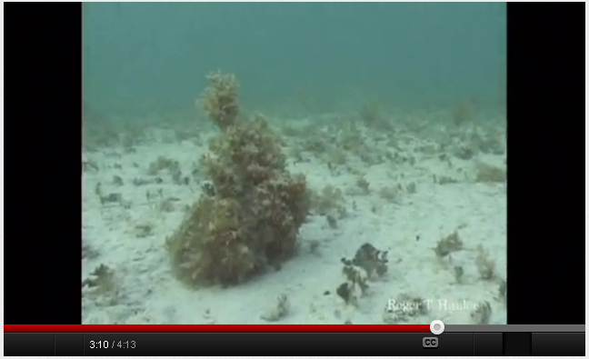
Video Link: Camouflage and cephalopods
  http://www.youtube.com/watch?v=k8RlGbpuhgc
Copyright © 2024 SlideSpark .LLC

Slide 122
This Phylum of Animalia has spiny skin and many have radial symmetry.
8
Copyright © 2024 SlideSpark .LLC

Slide 123
This Phylum of Animalia has spiny skin and many have radial symmetry.
Echinodermata
8
Copyright © 2024 SlideSpark .LLC

Slide 124
This Phylum of Animalia is asymmetrical?
9
Copyright © 2024 SlideSpark .LLC

Slide 125
This Phylum of Animalia is asymmetrical?
Porifera
9
Copyright © 2024 SlideSpark .LLC

Slide 126
Taxonomy and Classification Review Game II
GOING WILD | FUN WITH PHYLUMS | ITS GOT HAIR | A WHOLE LOT OF FUNGI | -BONUS- FAMOUS ANIMALS
1 | 6 | 11 | 16 | *21
2 | 7 | 12 | 17 | *22
3 | 8 | 13 | 18 | *23
4 | 9 | 14 | 19 | *24
5 | 10 | 15 | 20 | *25
Final Question:________________
Copyright © 2024 SlideSpark .LLC

Slide 127
Name the Classes of the Phylum Arthropoda.
A
B
B
C
D
E
C
D
E
Copyright © 2024 SlideSpark .LLC

Slide 128
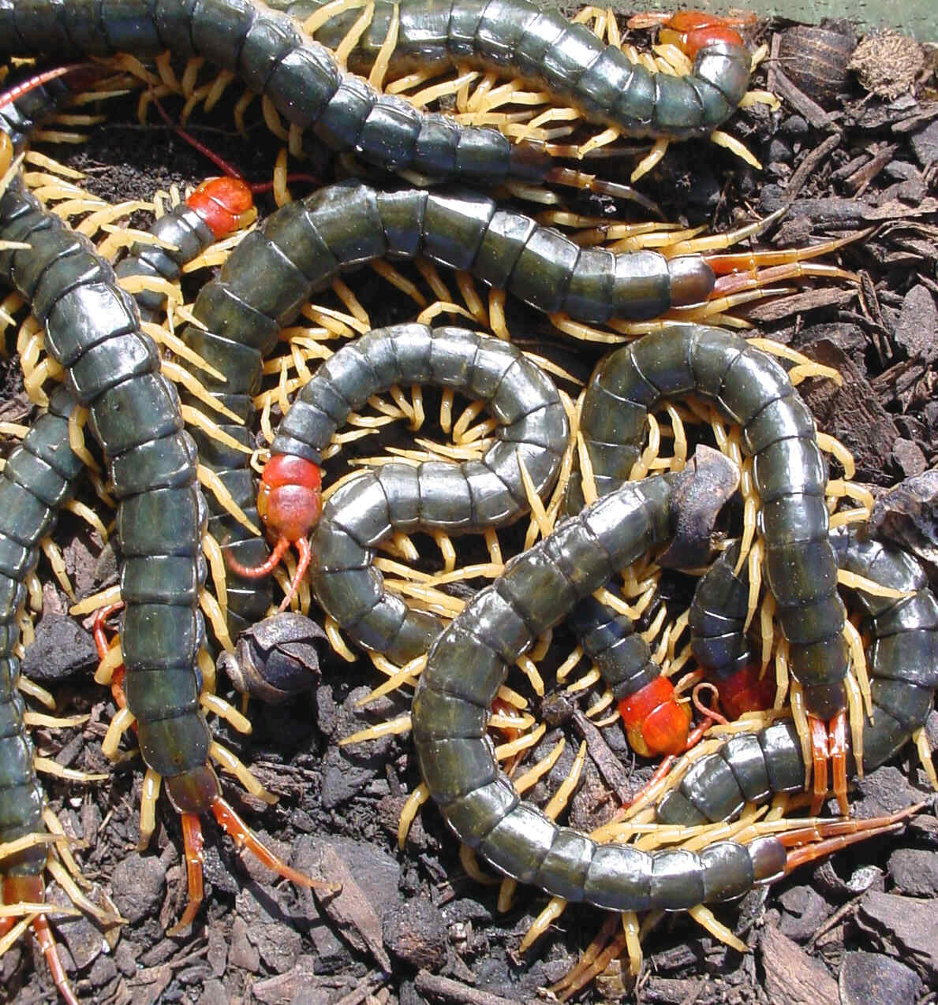

Name the Classes of the Phylum Arthropoda.
  Insecta
  Crustacea
  Arachnida
  Chilopoda
  Diplopoda
A
B
A
B
C
D
E
C
D
E
Copyright © 2024 SlideSpark .LLC

Slide 129
Name the Classes of the Phylum Arthropoda.
  Insecta
  Crustacea
  Arachnida
  Chilopoda
  Diplopoda
A
B
A
B
C
D
E
C
D
E
Copyright © 2024 SlideSpark .LLC

Slide 130
Name the Classes of the Phylum Arthropoda.
  Insecta
  Crustacea
  Arachnida
  Chilopoda
  Diplopoda
A
B
A
B
Crustacea
C
D
E
C
D
E
Copyright © 2024 SlideSpark .LLC

Slide 131
Name the Classes of the Phylum Arthropoda.
  Insecta
  Crustacea
  Arachnida
  Chilopoda
  Diplopoda
A
B
A
B
Crustacea
C
D
E
C
D
E
Copyright © 2024 SlideSpark .LLC

Slide 132
Name the Classes of the Phylum Arthropoda.
  Insecta
  Crustacea
  Arachnida
  Chilopoda
  Diplopoda
A
B
A
B
Millipedes
Crustacea
Diplopoda
C
D
E
C
D
E
Copyright © 2024 SlideSpark .LLC

Slide 133
Name the Classes of the Phylum Arthropoda.
  Insecta
  Crustacea
  Arachnida
  Chilopoda
  Diplopoda
A
B
A
B
Millipedes
Crustacea
Diplopoda
C
D
E
C
D
E
Copyright © 2024 SlideSpark .LLC

Slide 134
Name the Classes of the Phylum Arthropoda.
  Insecta
  Crustacea
  Arachnida
  Chilopoda
  Diplopoda
A
B
A
B
Millipedes
Crustacea
Diplopoda
C
D
E
C
D
E
Arachnida
Copyright © 2024 SlideSpark .LLC

Slide 135
Name the Classes of the Phylum Arthropoda.
  Insecta
  Crustacea
  Arachnida
  Chilopoda
  Diplopoda
A
B
A
B
Millipedes
Crustacea
Diplopoda
C
D
E
C
D
E
Arachnida
Copyright © 2024 SlideSpark .LLC

Slide 136
Name the Classes of the Phylum Arthropoda.
  Insecta
  Crustacea
  Arachnida
  Chilopoda
  Diplopoda
A
B
A
B
Millipedes
Crustacea
Diplopoda
C
D
E
C
D
E
Arachnida
Insecta
Copyright © 2024 SlideSpark .LLC

Slide 137
Name the Classes of the Phylum Arthropoda.
  Insecta
  Crustacea
  Arachnida
  Chilopoda
  Diplopoda
A
B
A
B
Millipedes
Crustacea
Diplopoda
C
D
E
C
D
E
Arachnida
Insecta
Copyright © 2024 SlideSpark .LLC

Slide 138
Name the Classes of the Phylum Arthropoda.
  Insecta
  Crustacea
  Arachnida
  Chilopoda
  Diplopoda
A
B
A
B
Millipedes
Crustacea
Diplopoda
C
D
E
Centipedes
C
D
E
Arachnida
Insecta
Chilopoda
Copyright © 2024 SlideSpark .LLC

Slide 139

Name the Classes of the Phylum Arthropoda.
  Insecta
  Crustacea
  Arachnida
  Chilopoda
  Diplopoda
A
B
A
B
Millipedes
Crustacea
Diplopoda
C
D
E
Centipedes
C
D
E
Arachnida
Insecta
Chilopoda
Copyright © 2024 SlideSpark .LLC

Slide 140
Kingdom Animals, Phylums, Class Mammalia
GOING WILD | SIMM CITY | FILE THEM | FURBIE | -BONUS- FAMOUS ANIMALS
1 | 6 | 11 | 16 | *21
2 | 7 | 12 | 17 | *22
3 | 8 | 13 | 18 | *23
4 | 9 | 14 | 19 | *24
5 | 10 | 15 | 20 | *25
Final Question:________________
Copyright © 2024 SlideSpark .LLC

Slide 141
Kingdom Animals, Phylums, Class Mammalia
GOING WILD | SIMM CITY | FILE THEM | FURBIE | -BONUS- FAMOUS ANIMALS
1 | 6 | 11 | 16 | *21
2 | 7 | 12 | 17 | *22
3 | 8 | 13 | 18 | *23
4 | 9 | 14 | 19 | *24
5 | 10 | 15 | 20 | *25
Final Question:________________
Copyright © 2024 SlideSpark .LLC

Slide 142
11
Name each phylum below?
B
A
B
C
Copyright © 2024 SlideSpark .LLC

Slide 143
11
Name each phylum below?
B
A
B
C
Copyright © 2024 SlideSpark .LLC

Slide 144
11
Name each phylum below?
Nematoda
B
A
B
C
Copyright © 2024 SlideSpark .LLC

Slide 145
11
Name each phylum below?
Nematoda
B
A
B
C
Copyright © 2024 SlideSpark .LLC

Slide 146
11
Name each phylum below?
Nematoda
Platyhelminthes
B
A
B
C
Copyright © 2024 SlideSpark .LLC

Slide 147
11
Name each phylum below?
Nematoda
Platyhelminthes
B
A
B
C
Copyright © 2024 SlideSpark .LLC

Slide 148
11
Name each phylum below?
Nematoda
Platyhelminthes
B
A
B
C
Annelida
Copyright © 2024 SlideSpark .LLC

Slide 149
Which is a…
  Coral (Anthozoa)
  Box Jelly (Cuboza)
  Hydra (Hydrozoa)
  True Jelly (Scyphozoa)

Slide 150

Which is a…
  Coral (Anthozoa)
  Box Jelly (Cuboza)
  Hydra (Hydrozoa)
  True Jelly (Scyphozoa)

Slide 151

Which is a…
  Coral (Anthozoa)
  Box Jelly (Cuboza)
  Hydra (Hydrozoa)
  True Jelly (Scyphozoa)
True

Slide 152

Which is a…
  Coral (Anthozoa)
  Box Jelly (Cuboza)
  Hydra (Hydrozoa)
  True Jelly (Scyphozoa)
True

Slide 153

Which is a…
  Coral (Anthozoa)
  Box Jelly (Cuboza)
  Hydra (Hydrozoa)
  True Jelly (Scyphozoa)
True
Box

Slide 154

Which is a…
  Coral (Anthozoa)
  Box Jelly (Cuboza)
  Hydra (Hydrozoa)
  True Jelly (Scyphozoa)
True
Box

Slide 155

Which is a…
  Coral (Anthozoa)
  Box Jelly (Cuboza)
  Hydra (Hydrozoa)
  True Jelly (Scyphozoa)
True
Box
Coral

Slide 156

Which is a…
  Coral (Anthozoa)
  Box Jelly (Cuboza)
  Hydra (Hydrozoa)
  True Jelly (Scyphozoa)
True
Box
Coral

Slide 157

Which is a…
  Coral (Anthozoa)
  Box Jelly (Cuboza)
  Hydra (Hydrozoa)
  True Jelly (Scyphozoa)
Hydra
Hydrazoa
True
Box
Coral

Slide 158
Name at least 5 parts of the crayfish below.

Slide 159
Name at least 5 parts of the crayfish below.
Cephalothorax
Head
Abdomen
Antennae
Antennules
Maxilliped
Swimmeretes
Walking Legs
Cheliped

Slide 160
The Praying Mantis belongs to this Phylum and this class of Animalia?
Copyright © 2024 SlideSpark .LLC

Slide 161
The Praying Mantis belongs to this Phylum and this class of Animalia?
Arthropoda,
Copyright © 2024 SlideSpark .LLC

Slide 162
The Praying Mantis belongs to this Phylum and this class of Animalia?
Arthropoda, Insecta
Copyright © 2024 SlideSpark .LLC

Slide 164
Which two Classes of Chordata are switched?.
Mammalia
Reptilia
Agnatha
Jawless
15
Chondrichthyes
Cartilaginous
Osteichthyes
Aves
Amphibia
Bony
Copyright © 2024 SlideSpark .LLC

Slide 165
Which two Classes of Chordata are switched?.
Mammalia
Reptilia
Agnatha
Jawless
15
Chondrichthyes
Cartilaginous
Osteichthyes
Aves
Amphibia
Bony
Copyright © 2024 SlideSpark .LLC

Slide 166
Which two Classes of Chordata are switched?.
Mammalia
Amphibia
Agnatha
Jawless
15
Chondrichthyes
Cartilaginous
Osteichthyes
Aves
Reptilia
Bony
Copyright © 2024 SlideSpark .LLC

Slide 167
Kingdom Animals, Phylums, Class Mammalia
GOING WILD | SIMM CITY | FILE THEM | FURBIE | -BONUS- FAMOUS ANIMALS
1 | 6 | 11 | 16 | *21
2 | 7 | 12 | 17 | *22
3 | 8 | 13 | 18 | *23
4 | 9 | 14 | 19 | *24
5 | 10 | 15 | 20 | *25
Final Question:________________
Copyright © 2024 SlideSpark .LLC

Slide 168
Kingdom Animals, Phylums, Class Mammalia
GOING WILD | SIMM CITY | FILE THEM | FURBIE | -BONUS- FAMOUS ANIMALS
1 | 6 | 11 | 16 | *21
2 | 7 | 12 | 17 | *22
3 | 8 | 13 | 18 | *23
4 | 9 | 14 | 19 | *24
5 | 10 | 15 | 20 | *25
Final Question:________________
Copyright © 2024 SlideSpark .LLC

Slide 169
What subclass of mammals do Kangaroo’s belong?
16
Copyright © 2024 SlideSpark .LLC

Slide 170
What subclass of mammals do Kangaroo’s belong?
16
Subclass Metatheria
Copyright © 2024 SlideSpark .LLC

Slide 171
Prototheria / Monotremes are a unique class of mammals that reproduce by…
17
Copyright © 2024 SlideSpark .LLC

Slide 172
Prototheria / Monotremes are a unique class of mammals that reproduce by…
Egg Laying Mammals
17
Copyright © 2024 SlideSpark .LLC

Slide 173
This is an organ that connects the developing fetus to the uterine wall to allow nutrient uptake, waste elimination, and gas exchange via the mother's blood supply in Eutherian mammals
  It’s released from the mothers uterine wall shortly after birth.
18
Copyright © 2024 SlideSpark .LLC

Slide 174
This is an organ that connects the developing fetus to the uterine wall to allow nutrient uptake, waste elimination, and gas exchange via the mother's blood supply in Eutherian mammals
  It’s released from the mothers uterine wall shortly after birth.
18
Placenta
Copyright © 2024 SlideSpark .LLC

Slide 175
What’s the order of mammal capable of sustained flight?
19
Copyright © 2024 SlideSpark .LLC

Slide 176
What’s the order of mammal capable of sustained flight?
19
Bat = Order Chiroptera
Copyright © 2024 SlideSpark .LLC

Slide 177
What is the common name for Didelphis virginiana , North America’s only marsupial.
20
Copyright © 2024 SlideSpark .LLC

Slide 178
What is the common name for Didelphis virginiana , North America’s only marsupial.
Opossum
20
Copyright © 2024 SlideSpark .LLC

Slide 179
Kingdom Animals, Phylums, Class Mammalia
GOING WILD | SIMM CITY | FILE THEM | FURBIE | -BONUS- FAMOUS ANIMALS
1 | 6 | 11 | 16 | *21
2 | 7 | 12 | 17 | *22
3 | 8 | 13 | 18 | *23
4 | 9 | 14 | 19 | *24
5 | 10 | 15 | 20 | *25
Final Question:________________
Copyright © 2024 SlideSpark .LLC

Slide 180
Kingdom Animals, Phylums, Class Mammalia
GOING WILD | SIMM CITY | FILE THEM | FURBIE | -BONUS- FAMOUS ANIMALS
1 | 6 | 11 | 16 | *21
2 | 7 | 12 | 17 | *22
3 | 8 | 13 | 18 | *23
4 | 9 | 14 | 19 | *24
5 | 10 | 15 | 20 | *25
Final Question:________________
Copyright © 2024 SlideSpark .LLC

Slide 181
What is the name of this famous Rough Collie, that belongs to the order carnivora, family canidae, genus canis ?
*21
Copyright © 2024 SlideSpark .LLC

Slide 182
What is the name of this famous Rough Collie, that belongs to the order carnivora, family canidae, genus canis ?
*21
Lassie
Copyright © 2024 SlideSpark .LLC

Slide 183
What is the name of this famous bear, Phylum Chordata, Subphylum Vertebrata, Class Mammalia, Order Carnivora ?
*22
*22
Copyright © 2024 SlideSpark .LLC

Slide 184

What is the name of this famous bear, Phylum Chordata, Subphylum Vertebrata, Class Mammalia, Order Carnivora ?
*22
*22
Copyright © 2024 SlideSpark .LLC

Slide 185
What is the name of this famous bear, Phylum Chordata, Subphylum Vertebrata, Class Mammalia, Order Carnivora ?
*22
*22
Boo Boo
Copyright © 2024 SlideSpark .LLC

Slide 186
Name this Mammalia?
*23

Slide 187
Name this Mammalia?
*23
STEVE

Slide 188
These cartoon sea squirts have a primitive notochord. Can you name these cartoon creatures?
*24
Copyright © 2024 SlideSpark .LLC

Slide 189
These cartoon sea squirts have a primitive notochord. Can you name these cartoon creatures?
SNORKS
*24
Copyright © 2024 SlideSpark .LLC

Slide 190
Name these dolls / cartoon show from the Primate Order of Mammals?
*25
Copyright © 2024 SlideSpark .LLC

Slide 191

Name these dolls / cartoon show from the Primate Order of Mammals? Monchhichis
*25
Copyright © 2024 SlideSpark .LLC

Slide 192
Name these dolls / cartoon show from the Primate Order of Mammals? Monchhichis
*25
Monchhichis Intro: The most bizarre 32 seconds in the history of television. https://www.youtube.com/watch?v=S9C6YyRT5AY
Copyright © 2024 SlideSpark .LLC

Slide 193
Kingdom Animals, Phylums, Class Mammalia
GOING WILD | SIMM CITY | FILE THEM | FURBIE | -BONUS- FAMOUS ANIMALS
1 | 6 | 11 | 16 | *21
2 | 7 | 12 | 17 | *22
3 | 8 | 13 | 18 | *23
4 | 9 | 14 | 19 | *24
5 | 10 | 15 | 20 | *25
Final Question:________________
Copyright © 2024 SlideSpark .LLC

Slide 194
Kingdom Animals, Phylums, Class Mammalia
GOING WILD | SIMM CITY | FILE THEM | FURBIE | -BONUS- FAMOUS ANIMALS
1 | 6 | 11 | 16 | *21
2 | 7 | 12 | 17 | *22
3 | 8 | 13 | 18 | *23
4 | 9 | 14 | 19 | *24
5 | 10 | 15 | 20 | *25
Final Question:________________
Copyright © 2024 SlideSpark .LLC

Slide 196
“5 Point Wager, I hope you knew your Arthropods.”

Slide 197
Final Question! This Class of Arthropoda has…
Copyright © 2024 SlideSpark .LLC

Slide 198
Final Question! This Class of Arthropoda has…
  8 legs.
Copyright © 2024 SlideSpark .LLC

Slide 199
Final Question! This Class of Arthropoda has…
  8 legs.
  No antennae or wings.
Copyright © 2024 SlideSpark .LLC

Slide 200
Final Question! This Class of Arthropoda has…
  8 legs.
  No antennae or wings.
  Two body parts.
    Head and sensory.
    Abdomen.
Copyright © 2024 SlideSpark .LLC

Slide 201
Final Question! This Class of Arthropoda has…
  8 legs.
  No antennae or wings.
  Two body parts.
    Head and sensory.
    Abdomen.
  Most live on land.
Copyright © 2024 SlideSpark .LLC

Slide 202
Final Question! This Class of Arthropoda has…
  8 legs.
  No antennae or wings.
  Two body parts.
    Head and sensory.
    Abdomen.
  Most live on land.
Copyright © 2024 SlideSpark .LLC

Slide 203

Final Question! This Class of Arthropoda has…
  8 legs.
  No antennae or wings.
  Two body parts.
    Head and sensory.
    Abdomen.
  Most live on land.
Arachnida
Copyright © 2024 SlideSpark .LLC

Slide 204
Animalia and Mammalia
Review Game Scoring
1-20 = 5 points each
20-25 = Bonus (1 point each)
Final Question = 5 point wager
Find the Owl = 1 point

Slide 205
Animalia and Mammalia
Review Game
Part 4
Lesson 17

Slide 206





Curriculum Guide
Number of Lessons in each unit (50 min, daily lessons) and difficult rating scale / intended grade level.
=Easier, = More difficult, =Most difficult
Earth Science Units

Slide 207


Life Science Units

Slide 208

Physical Science

Slide 209

Dear Valued Educator,
Our fully editable .pptx and .doc resources are perfect for educators looking to bring enthusiasm and creativity to their lessons. We encourage you to make changes to fit your needs and style. As science educators, we’re committed to providing students with the tools they need to succeed in the classroom and beyond. Each unit in the curriculum includes a range of resources that have been developed through extensive research and use in a busy classroom. Our teaching approach is designed to make science education engaging and exciting for learners of all ages. We offer a one-of-a-kind science curriculum that will challenge, inspire, and educate students to become tomorrow's scientists and leaders. Join us today and learn more about how our program can help you achieve your classroom goals.
With appreciation,
Support@SlideSpark.net

Slide 210





Thank you for your time and interest in our Science curriculum. We strive to provide students with engaging and informative lessons that will spark their curiosity and encourage scientific exploration. Should you have any questions or concerns, please do not hesitate to contact us. Thank you again for considering our curriculum, and we wish you all the best in your educational journey.
Sincerely,
Support@slidespark.net
SlideSpark Science on TpT

