Slide 1
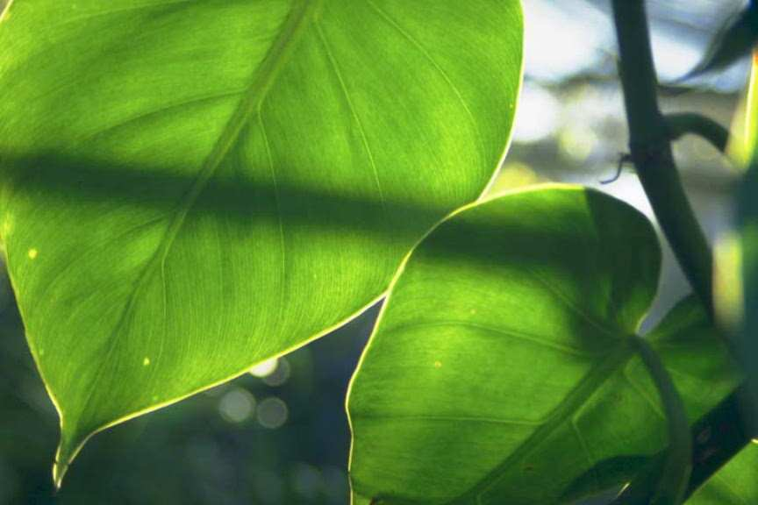


Review Game
Part 4
Lessons 10

Slide 2
Part 4 REVIEW GAME
ROUTE 66 | GROWING UP | IF I COULD I WOOD | LEAVE ME BE | -Bonus- SEE THE LIGHT
1 | 6 | 11 | 16 | *21
2 | 7 | 12 | 17 | *22
3 | 8 | 13 | 18 | *23
4 | 9 | 14 | 19 | *24
5 | 10 | 15 | 20 | *25

Slide 3
How to play…
  Don’t play like Jeo_ _ _ _ y.
  Class should be divided into several small groups.
  Groups should use science journal (red slide notes), homework, and other available materials to assist you.
  Groups can communicate quietly with each other but no sharing answers between groups.
    Practice quietly communicating right now?
    Practice Communication Question:
    Your group gets to order one pizza and you can have two toppings. What does your group want?

Slide 4

Questions 1-20 = 5pts Each
Final Category (Bonus) = 1pt Each
Final Questions = 5 pt wager
If you wager 5 on the last question and get it wrong you lose 5 pts. Wager 5 and get it right you get 5 pts.
Find the Owl =
Secretly write “Owl” in the correct box worth 1pt.
“I’ll be about this big.”

Slide 5
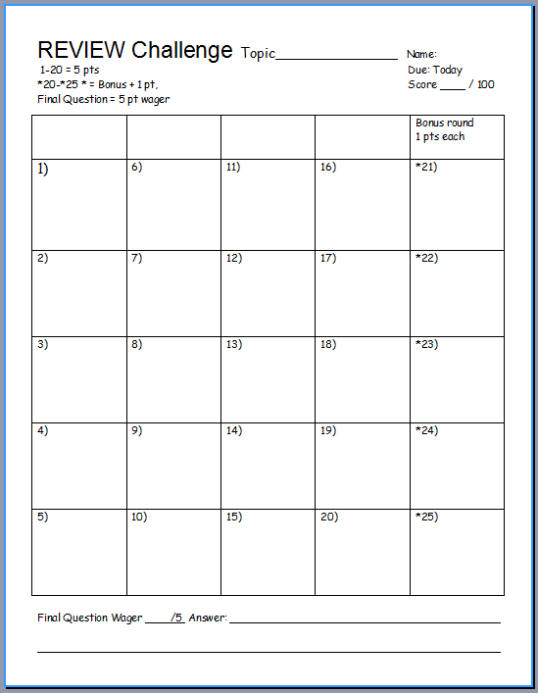
Is your name on the review sheet?
Name

Slide 6
Is your name on the review sheet?
Add the categories
along the top
on the next slide.

Slide 7
Part 4 REVIEW GAME
ROUTE 66 | GROWING UP | IF I COULD I WOOD | LEAVE ME BE | -Bonus- SEE THE LIGHT
1 | 6 | 11 | 16 | *21
2 | 7 | 12 | 17 | *22
3 | 8 | 13 | 18 | *23
4 | 9 | 14 | 19 | *24
5 | 10 | 15 | 20 | *25

Slide 8
Part 4 REVIEW GAME
ROUTE 66 | GROWING UP | IF I COULD I WOOD | LEAVE ME BE | -Bonus- SEE THE LIGHT
1 | 6 | 11 | 16 | *21
2 | 7 | 12 | 17 | *22
3 | 8 | 13 | 18 | *23
4 | 9 | 14 | 19 | *24
5 | 10 | 15 | 20 | *25

Slide 9
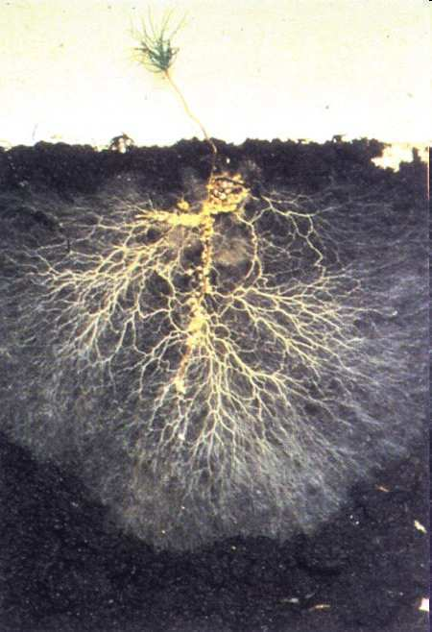
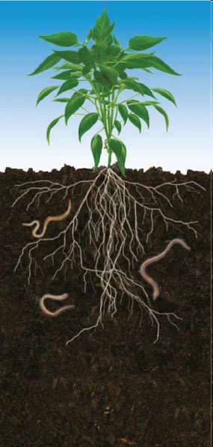
1
Which is incorrect of roots?
  A.) usually underground portion of a plant.
  B.) Contains buds and nodes.
  C.) Serves as support.
  D.) Draws minerals and water from the surrounding soil.
  E.) Sometimes stores food.
Copyright © 2024 SlideSpark .LLC

Slide 10
1
Which is incorrect of roots?
  A.) Usually underground portion of a plant.
  B.) Contains buds and nodes.
  C.) Serves as support.
  D.) Draws minerals and water from the surrounding soil.
  E.) Sometimes stores food.
Copyright © 2024 SlideSpark .LLC

Slide 11
1
Which is incorrect of roots?
  A.) Usually underground portion of a plant.
  B.) Contains buds and nodes.
  C.) Serves as support.
  D.) Draws minerals and water from the surrounding soil.
  E.) Sometimes stores food.
Copyright © 2024 SlideSpark .LLC

Slide 12
1
Which is incorrect of roots?
  A.) Usually underground portion of a plant.
  B.) Contains buds and nodes.
  C.) Serves as support.
  D.) Draws minerals and water from the surrounding soil.
  E.) Sometimes stores food.
Copyright © 2024 SlideSpark .LLC

Slide 13
1
Which is incorrect of roots?
  A.) Usually underground portion of a plant.
  B.) Contains buds and nodes.
  C.) Serves as support.
  D.) Draws minerals and water from the surrounding soil.
  E.) Sometimes stores food.
Copyright © 2024 SlideSpark .LLC

Slide 14
1
Which is incorrect of roots?
  A.) Usually underground portion of a plant.
  B.) Contains buds and nodes.
  C.) Serves as support.
  D.) Draws minerals and water from the surrounding soil.
  E.) Sometimes stores food.
Copyright © 2024 SlideSpark .LLC

Slide 15
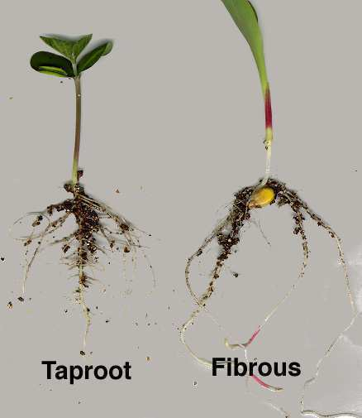
Which is a taproot and which is a fibrous root?
2
A
B
Copyright © 2024 SlideSpark .LLC

Slide 16
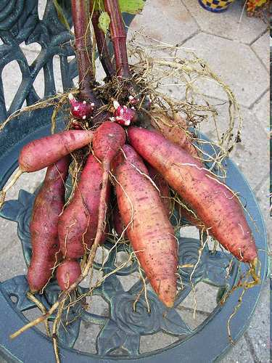
What’s the name for this type of root?
3

Slide 17
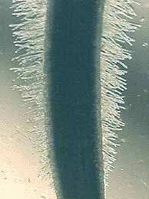
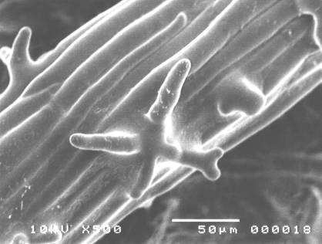
What’s the role of these?
  A.) Create sugar in photosynthesis
  B.) Disperse pollen.
  C.) Disperse waste from the plant.
  D.) Uptake water and nutrients.
  E.) Resist plant hormones.
4

Slide 18
What’s the role of these?
  A.) Create sugar in photosynthesis
  B.) Disperse pollen.
  C.) Disperse waste from the plant.
  D.) Uptake water and nutrients.
  E.) Resist plant hormones.
4

Slide 19
What’s the role of these?
  A.) Create sugar in photosynthesis
  B.) Disperse pollen.
  C.) Disperse waste from the plant.
  D.) Uptake water and nutrients.
  E.) Resist plant hormones.
4

Slide 20
What’s the role of these?
  A.) Create sugar in photosynthesis
  B.) Disperse pollen.
  C.) Disperse waste from the plant.
  D.) Uptake water and nutrients.
  E.) Resist plant hormones.
4

Slide 21
What’s the role of these?
  A.) Create sugar in photosynthesis
  B.) Disperse pollen.
  C.) Disperse waste from the plant.
  D.) Uptake water and nutrients.
  E.) Resist plant hormones.
4

Slide 22
What’s the role of these?
  A.) Create sugar in photosynthesis
  B.) Disperse pollen.
  C.) Disperse waste from the plant.
  D.) Uptake water and nutrients.
  E.) Resist plant hormones.
4

Slide 23
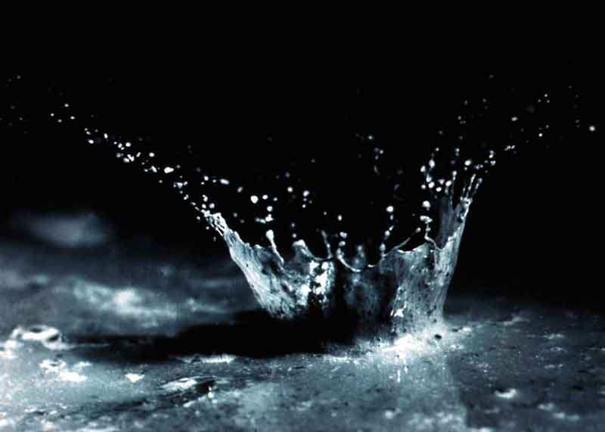
Water uptake in the roots is necessary for plants for all of the following reasons except…
  A.) Water is needed for photosynthesis.
  B.) Helps to keep plants rigid (turgor pressure).
  C.) Water can heat the plant to keep it warm.
  D.) Water carries dissolved nutrients and minerals throughout plant.
5

Slide 24
Water uptake in the roots is necessary for plants for all of the following reasons except…
  A.) Water is needed for photosynthesis.
  B.) Helps to keep plants rigid (turgor pressure).
  C.) Water can heat the plant to keep it warm.
  D.) Water carries dissolved nutrients and minerals throughout plant.
5

Slide 25
Water uptake in the roots is necessary for plants for all of the following reasons except…
  A.) Water is needed for photosynthesis.
  B.) Helps to keep plants rigid (turgor pressure).
  C.) Water can heat the plant to keep it warm.
  D.) Water carries dissolved nutrients and minerals throughout plant.
5

Slide 26
Water uptake in the roots is necessary for plants for all of the following reasons except…
  A.) Water is needed for photosynthesis.
  B.) Helps to keep plants rigid (turgor pressure).
  C.) Water can heat the plant to keep it warm.
  D.) Water carries dissolved nutrients and minerals throughout plant.
5

Slide 27
Water uptake in the roots is necessary for plants for all of the following reasons except…
  A.) Water is needed for photosynthesis.
  B.) Helps to keep plants rigid (turgor pressure).
  C.) Water can heat the plant to keep it warm.
  D.) Water carries dissolved nutrients and minerals throughout plant.
5

Slide 28
Part IV REVIEW GAME
ROUTE 66 | GROWING UP | IF I COULD I WOOD | LEAVE ME BE | -Bonus- SEE THE LIGHT
1 | 6 | 11 | 16 | *21
2 | 7 | 12 | 17 | *22
3 | 8 | 13 | 18 | *23
4 | 9 | 14 | 19 | *24
5 | 10 | 15 | 20 | *25

Slide 29
Part IV REVIEW GAME
ROUTE 66 | GROWING UP | IF I COULD I WOOD | LEAVE ME BE | -Bonus- SEE THE LIGHT
1 | 6 | 11 | 16 | *21
2 | 7 | 12 | 17 | *22
3 | 8 | 13 | 18 | *23
4 | 9 | 14 | 19 | *24
5 | 10 | 15 | 20 | *25

Slide 30
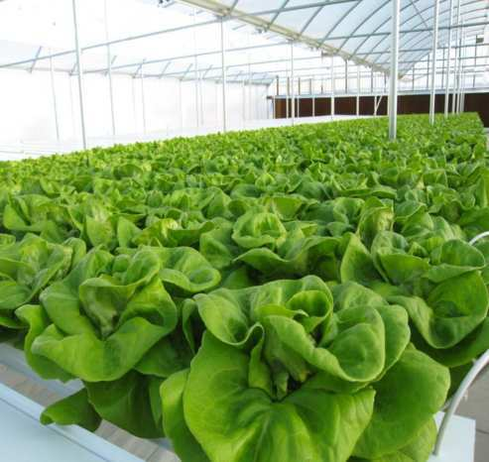
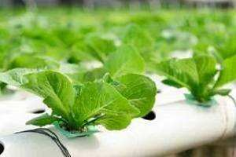
Plants get the nutrients they need primarily from the….
  A.) Air and Water.
  B.) Sun, Leaves, and Stems.
  C.) Soil and Air.
  D.) Soil only.
  E.) Plants can only get nutrients from man made fertilizers.
6

Slide 31
Plants get the nutrients they need primarily from the….
  A.) Air and Water.
  B.) Sun, Leaves, and Stems.
  C.) Soil and Air.
  D.) Soil only.
  E.) Plants can only get nutrients from man made fertilizers.
6

Slide 32
Plants get the nutrients they need primarily from the….
  A.) Air and Water.
  B.) Sun, Leaves, and Stems.
  C.)
  D.) Soil only.
  E.) Plants can only get nutrients from man made fertilizers.
6

Slide 33
Plants get the nutrients they need primarily from the….
  A.) Air and Water.
  B.) Sun, Leaves, and Stems.
  C.) Soil and Air.
  D.)
  E.) Plants can only get nutrients from man made fertilizers.
6

Slide 34
Plants get the nutrients they need primarily from the….
  A.) Air and Water.
  B.) Sun, Leaves, and Stems.
  C.) Soil and Air.
  D.) Soil only.
  E.) Plants can only get nutrients from man made fertilizers.
6

Slide 35
Plants get the nutrients they need primarily from the….
  A.) Air and Water.
  B.) Sun, Leaves, and Stems.
  C.) Soil and Air.
  D.) Soil only.
  E.) Plants can only get nutrients from man made fertilizers.
6

Slide 36
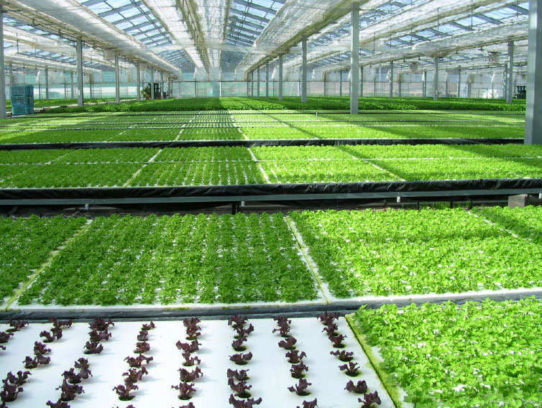
This is the name for the cultivation of plants in a nutrient solution rather than in soil.
7

Slide 37
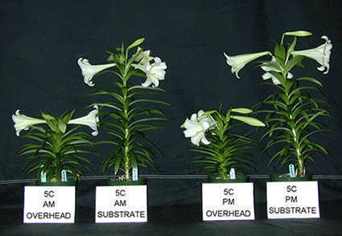
This is the name for the chemicals that affect flowering; aging; root growth; distortion, killing of leaves, stems, and other parts; prevention or promotion of stem elongation; color enhancement of fruit; prevention of leafing and/or leaf fall; and many other conditions.
8
Copyright © 2024 SlideSpark .LLC

Slide 38
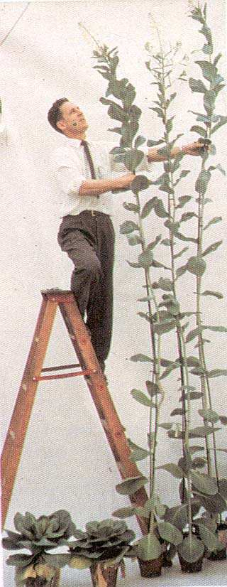
Plant B shows extra stem elongation over plant A.
9
B
A
Copyright © 2024 SlideSpark .LLC

Slide 39
Plant B shows extra stem elongation over plant A. Plant A is the normal plant / control while plant B is the variable.
9
B
A
Copyright © 2024 SlideSpark .LLC

Slide 40
Plant B shows extra stem elongation over plant A. Plant A is the normal plant / control while plant B is the variable.
What plant hormone was the independent variable given to B?
9
B
A
Copyright © 2024 SlideSpark .LLC

Slide 41
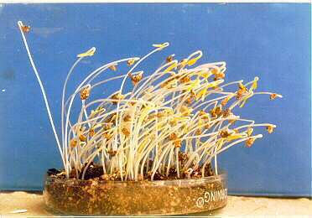
Auxin : Promotes stem elongation and bud dormancy.
  Phototropism: When plants grow toward a light source.
10
Copyright © 2024 SlideSpark .LLC

Slide 42
Part IV REVIEW GAME
ROUTE 66 | GROWING UP | IF I COULD I WOOD | LEAVE ME BE | -Bonus- SEE THE LIGHT
1 | 6 | 11 | 16 | *21
2 | 7 | 12 | 17 | *22
3 | 8 | 13 | 18 | *23
4 | 9 | 14 | 19 | *24
5 | 10 | 15 | 20 | *25

Slide 43
Part IV REVIEW GAME
ROUTE 66 | GROWING UP | IF I COULD I WOOD | LEAVE ME BE | -Bonus- SEE THE LIGHT
1 | 6 | 11 | 16 | *21
2 | 7 | 12 | 17 | *22
3 | 8 | 13 | 18 | *23
4 | 9 | 14 | 19 | *24
5 | 10 | 15 | 20 | *25

Slide 44
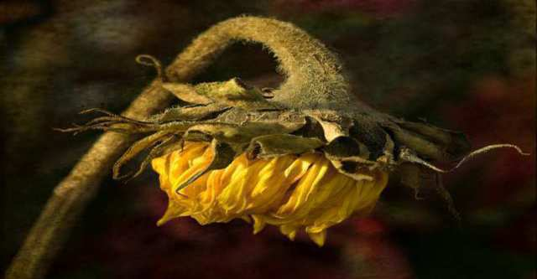
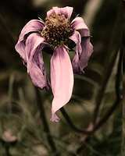
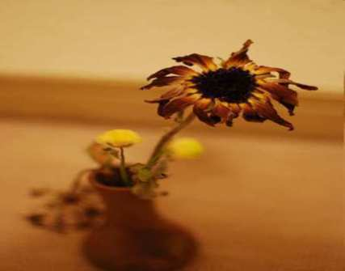
Ethylene does all of the following except…
  A.) Stimulates the release of seed dormancy.
  B.) Stimulates shoot and root growth.
  C.) Promotes cell division. They are produced in growing areas like the tips.
  D.) Stimulates leaf and fruit abscission.
  E.) Creates femaleness in flowers.
  F.) Stimulates flower opening.
  G.) Stimulates flower and leaf dying.
11
Copyright © 2024 SlideSpark .LLC

Slide 45
Ethylene does all of the following except…
  A.) Stimulates the release of seed dormancy.
  B.) Stimulates shoot and root growth.
  C.) Promotes cell division. They are produced in growing areas like the tips.
  D.) Stimulates leaf and fruit abscission.
  E.) Creates femaleness in flowers.
  F.) Stimulates flower opening.
  G.) Stimulates flower and leaf dying.
11
Copyright © 2024 SlideSpark .LLC

Slide 46
Ethylene does all of the following except…
  A.) Stimulates the release of seed dormancy.
  B.) Stimulates shoot and root growth.
  C.) Promotes cell division. They are produced in growing areas like the tips.
  D.) Stimulates leaf and fruit abscission.
  E.) Creates femaleness in flowers.
  F.) Stimulates flower opening.
  G.) Stimulates flower and leaf dying.
11
Copyright © 2024 SlideSpark .LLC

Slide 47
Ethylene does all of the following except…
  A.) Stimulates the release of seed dormancy.
  B.) Stimulates shoot and root growth.
  C.) Promotes cell division. They are produced in growing areas like the tips.
  D.) Stimulates leaf and fruit abscission.
  E.) Creates femaleness in flowers.
  F.) Stimulates flower opening.
  G.) Stimulates flower and leaf dying.
11
Copyright © 2024 SlideSpark .LLC

Slide 48
Ethylene does all of the following except…
  A.) Stimulates the release of seed dormancy.
  B.) Stimulates shoot and root growth.
  C.) Promotes cell division. They are produced in growing areas like the tips.
  D.) Stimulates leaf and fruit abscission.
  E.) Creates femaleness in flowers.
  F.) Stimulates flower opening.
  G.) Stimulates flower and leaf dying.
11
Copyright © 2024 SlideSpark .LLC

Slide 49
Ethylene does all of the following except…
  A.) Stimulates the release of seed dormancy.
  B.) Stimulates shoot and root growth.
  C.) Promotes cell division. They are produced in growing areas like the tips.
  D.) Stimulates leaf and fruit abscission.
  E.) Creates femaleness in flowers.
  F.) Stimulates flower opening.
  G.) Stimulates flower and leaf dying.
11
Copyright © 2024 SlideSpark .LLC

Slide 50
Ethylene does all of the following except…
  A.) Stimulates the release of seed dormancy.
  B.) Stimulates shoot and root growth.
  C.) Promotes cell division. They are produced in growing areas like the tips.
  D.) Stimulates leaf and fruit abscission.
  E.) Creates femaleness in flowers.
  F.) Stimulates flower opening.
  G.) Stimulates flower and leaf dying.
11
Copyright © 2024 SlideSpark .LLC

Slide 51
Ethylene does all of the following except…
  A.) Stimulates the release of seed dormancy.
  B.) Stimulates shoot and root growth.
  C.) Promotes cell division. They are produced in growing areas like the tips.
  D.) Stimulates leaf and fruit abscission.
  E.) Creates femaleness in flowers.
  F.) Stimulates flower opening.
  G.) Stimulates flower and leaf dying.
11
Copyright © 2024 SlideSpark .LLC

Slide 52
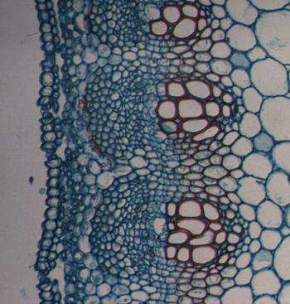

Which letter is dermal tissue, ground tissue, and which is vascular tissue?
A
C
B
Copyright © 2024 SlideSpark .LLC

Slide 53
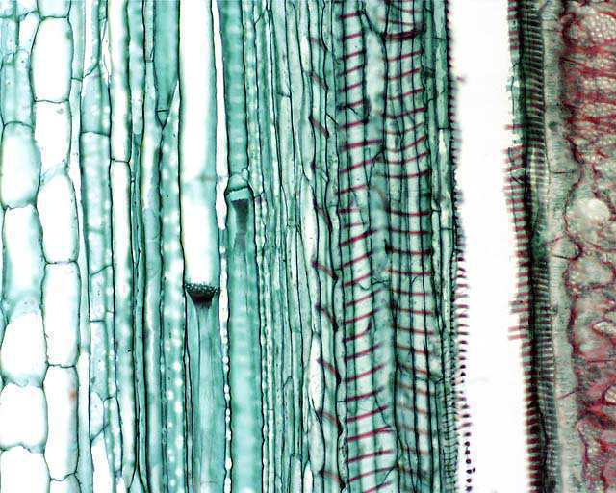
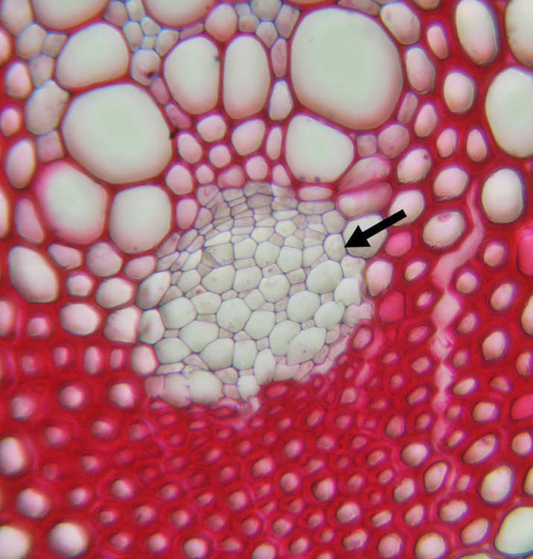
Tubes in the plant that food (sugar) moves through.
13
Copyright © 2024 SlideSpark .LLC

Slide 54
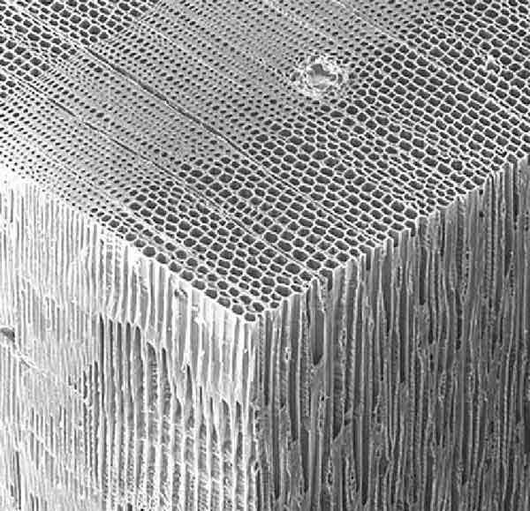
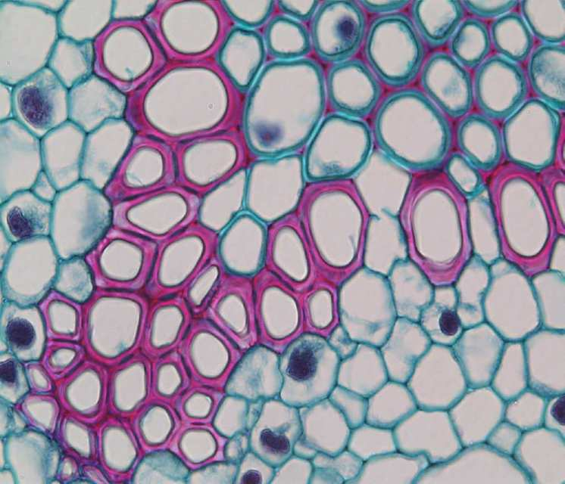
14
Name the very important tissue below…
  Part of a plants vascular system.
  Tubes that water and minerals move through.
  Water travels up the tree from roots to leaves.
  Old types of these cells help to support the plant (Wood).

Slide 55
14
Name the very important tissue below…
  Part of a plants vascular system.
  Tubes that water and minerals move through.
  Water travels up the tree from roots to leaves.
  Old types of these cells help to support the plant (Wood).

Slide 56
14
Name the very important tissue below…
  Part of a plants vascular system.
  Tubes that water and minerals move through.
  Water travels up the tree from roots to leaves.
  Old types of these cells help to support the plant (Wood).

Slide 57
14
Name the very important tissue below…
  Part of a plants vascular system.
  Tubes that water and minerals move through.
  Water travels up the tree from roots to leaves.
  Old types of these cells help to support the plant (Wood).

Slide 58
14
Name the very important tissue below…
  Part of a plants vascular system.
  Tubes that water and minerals move through.
  Water travels up the tree from roots to leaves.
  Old types of these cells help to support the plant (Wood).

Slide 59
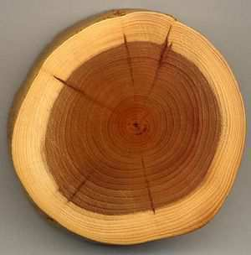
Which letter represents the living layer of cells in this hardwood?
15
Copyright © 2024 SlideSpark .LLC

Slide 60
Which letter represents the living layer of cells in this hardwood?
15
A
Copyright © 2024 SlideSpark .LLC

Slide 61
Which letter represents the living layer of cells in this hardwood?
15
A
B
Copyright © 2024 SlideSpark .LLC

Slide 62
Which letter represents the living layer of cells in this hardwood?
15
A
B
C
Copyright © 2024 SlideSpark .LLC

Slide 63
Which letter represents the living layer of cells in this hardwood?
15
A
B
D
C
Copyright © 2024 SlideSpark .LLC

Slide 64
Which letter represents the living layer of cells in this hardwood?
15
A
B
D
E
C
Copyright © 2024 SlideSpark .LLC

Slide 65
Part IV REVIEW GAME
ROUTE 66 | GROWING UP | IF I COULD I WOOD | LEAVE ME BE | -Bonus- SEE THE LIGHT
1 | 6 | 11 | 16 | *21
2 | 7 | 12 | 17 | *22
3 | 8 | 13 | 18 | *23
4 | 9 | 14 | 19 | *24
5 | 10 | 15 | 20 | *25

Slide 66
Part IV REVIEW GAME
ROUTE 66 | GROWING UP | IF I COULD I WOOD | LEAVE ME BE | -Bonus- SEE THE LIGHT
1 | 6 | 11 | 16 | *21
2 | 7 | 12 | 17 | *22
3 | 8 | 13 | 18 | *23
4 | 9 | 14 | 19 | *24
5 | 10 | 15 | 20 | *25

Slide 67
Which is the heartwood, sapwood, cambium, and pith?
A
16
Cambium
C
heartwood
B
D
Sapwood
Pith
Copyright © 2024 SlideSpark .LLC

Slide 68
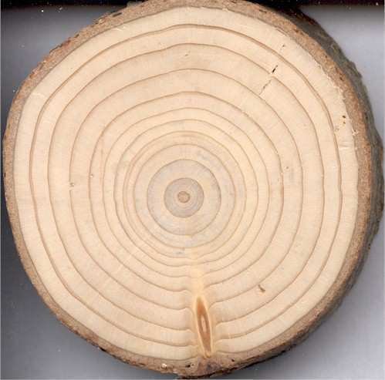
This the term for the dating of past events through study of tree ring growth.
  How old is this tree (+1point)
17

Slide 69
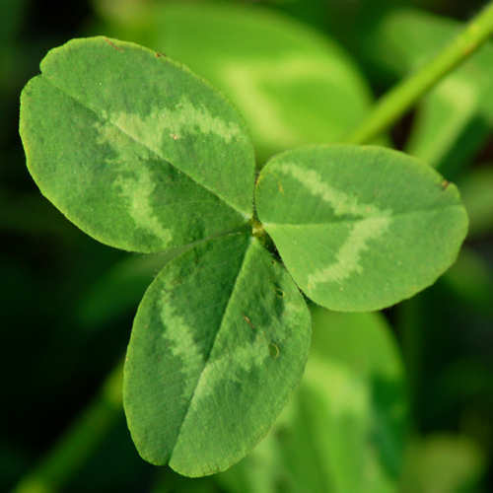
A leaf is a plant organ, that is photosynthetic, contains chloroplasts, and is usually thin so light can penetrate.
18
Copyright © 2024 SlideSpark .LLC

Slide 70
Which of the following equations is the correct equation for photosynthesis?
A.) 6O2 + 6H2O + light energy = C12H6O6 + 6O2
B.) 6CO2 + 6H2O + sugar = C6H12O6 + 6O2
C.) 6CO2 + 6CO2 + light energy = C6H12O6 + 6H2O
D.) 6CO2 + 6H2 + light energy = C6H12O6 + 6H2O
E.) 6CO2 + 6H2O + light energy = C6H12O6 + 6O2
F.) 6CO2 + 6H2O + light energy = C6H2O6 + 6O2
G.) 6CO2 + 6H2O + sugar = C6H12O6 + 6O2
H.) 6CO2 + 6H2O + light energy = C6H12O6 + 6CO2
I.) 6CO2 + H2O + light energy = C6H12O6 + 6O2
J.) C6H12O6 = 6CO2 + 6H2O + light energy + 6O2
K.) None of the above.
19
Copyright © 2024 SlideSpark .LLC

Slide 71
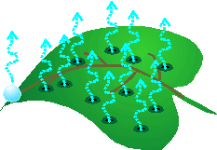
This is the name for the evaporation of water from plants.
  It occurs during photosynthesis.
  Helps pull water up the xylem from roots.
  Cools the leaf.
20
Copyright © 2024 SlideSpark .LLC

Slide 72
Part IV REVIEW GAME
ROUTE 66 | GROWING UP | IF I COULD I WOOD | LEAVE ME BE | -Bonus- SEE THE LIGHT
1 | 6 | 11 | 16 | *21
2 | 7 | 12 | 17 | *22
3 | 8 | 13 | 18 | *23
4 | 9 | 14 | 19 | *24
5 | 10 | 15 | 20 | *25

Slide 73
Part IV REVIEW GAME
ROUTE 66 | GROWING UP | IF I COULD I WOOD | LEAVE ME BE | -Bonus- SEE THE LIGHT
1 | 6 | 11 | 16 | *21
2 | 7 | 12 | 17 | *22
3 | 8 | 13 | 18 | *23
4 | 9 | 14 | 19 | *24
5 | 10 | 15 | 20 | *25

Slide 74
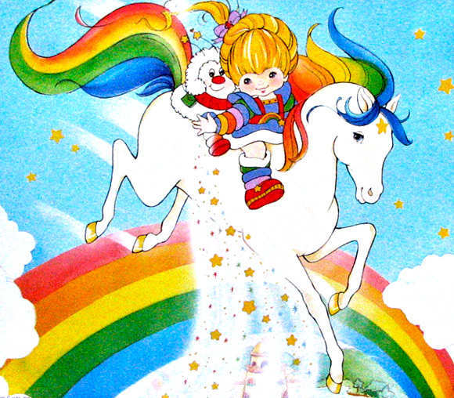
Who is this?
*21

Slide 75
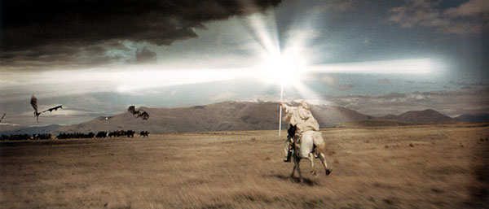
Who is this?
*22

Slide 76

*23
Who am
I?

Slide 77

*24
Name the movie?

Slide 78

*25
Name the Movie?

Slide 79
Part IV REVIEW GAME
ROUTE 66 | GROWING UP | IF I COULD I WOOD | LEAVE ME BE | -Bonus- SEE THE LIGHT
1 | 6 | 11 | 16 | *21
2 | 7 | 12 | 17 | *22
3 | 8 | 13 | 18 | *23
4 | 9 | 14 | 19 | *24
5 | 10 | 15 | 20 | *25
Final Question

Slide 80
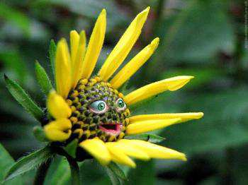
5 Point wager Question

Slide 81
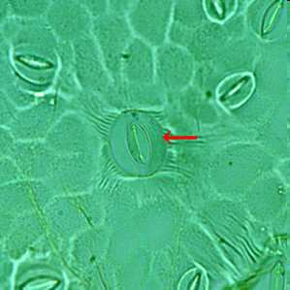
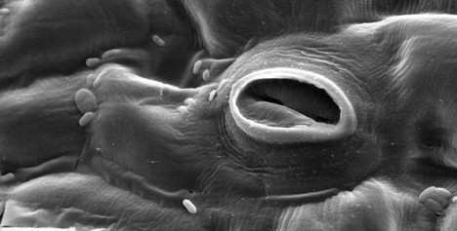
These are openings in the leaf controlled by guard cells that allow gases in and out.
Copyright © 2024 SlideSpark .LLC

Slide 82

Part 4 Unit Review Game
1-20 = 5 points each
20-25 = Bonus (1 point each)
Final Question = 5 point wager
Find the Owl = 1 point

Slide 83
Review Game
Part 4
Lessons 10

Slide 84

Part 4 Review Game
ANSWER VERSION
Part 4
Lesson 11

Slide 85
Part IV REVIEW GAME
ROUTE 66 | GROWING UP | IF I COULD I WOOD | LEAVE ME BE | -Bonus- SEE THE LIGHT
1 | 6 | 11 | 16 | *21
2 | 7 | 12 | 17 | *22
3 | 8 | 13 | 18 | *23
4 | 9 | 14 | 19 | *24
5 | 10 | 15 | 20 | *25

Slide 86
Part IV REVIEW GAME
ROUTE 66 | GROWING UP | IF I COULD I WOOD | LEAVE ME BE | -Bonus- SEE THE LIGHT
1 | 6 | 11 | 16 | *21
2 | 7 | 12 | 17 | *22
3 | 8 | 13 | 18 | *23
4 | 9 | 14 | 19 | *24
5 | 10 | 15 | 20 | *25

Slide 87
1
Which is incorrect of roots?
  A.) usually underground portion of a plant.
  B.) Contains buds and nodes.
  C.) Serves as support.
  D.) Draws minerals and water from the surrounding soil.
  E.) Sometimes stores food.
Copyright © 2024 SlideSpark .LLC

Slide 88
1
Which is incorrect of roots?
  A.) Usually underground portion of a plant.
  B.) Contains buds and nodes.
  C.) Serves as support.
  D.) Draws minerals and water from the surrounding soil.
  E.) Sometimes stores food.
Copyright © 2024 SlideSpark .LLC

Slide 89
1
Which is incorrect of roots?
  A.) Usually underground portion of a plant.
  B.) Contains buds and nodes.
  C.) Serves as support.
  D.) Draws minerals and water from the surrounding soil.
  E.) Sometimes stores food.
Copyright © 2024 SlideSpark .LLC

Slide 90
1
Which is incorrect of roots?
  A.) Usually underground portion of a plant.
  B.) Contains buds and nodes.
  C.) Serves as support.
  D.) Draws minerals and water from the surrounding soil.
  E.) Sometimes stores food.
Copyright © 2024 SlideSpark .LLC

Slide 91
1
Which is incorrect of roots?
  A.) Usually underground portion of a plant.
  B.) Contains buds and nodes.
  C.) Serves as support.
  D.) Draws minerals and water from the surrounding soil.
  E.) Sometimes stores food.
Copyright © 2024 SlideSpark .LLC

Slide 92
1
Which is incorrect of roots?
  A.) Usually underground portion of a plant.
  B.) Contains buds and nodes.
  C.) Serves as support.
  D.) Draws minerals and water from the surrounding soil.
  E.) Sometimes stores food.
Copyright © 2024 SlideSpark .LLC

Slide 93
1
Which is incorrect of roots?
  A.) Usually underground portion of a plant.
  B.) Contains buds and nodes.
  C.) Serves as support.
  D.) Draws minerals and water from the surrounding soil.
  E.) Sometimes stores food.
answer is…
Copyright © 2024 SlideSpark .LLC

Slide 94
1
Which is incorrect of roots?
  A.) Usually underground portion of a plant.
  B.) Contains buds and nodes.
  C.) Serves as support.
  D.) Draws minerals and water from the surrounding soil.
  E.) Sometimes stores food.
answer is…
Copyright © 2024 SlideSpark .LLC

Slide 95
Which is a taproot and which is a fibrous root?
2
A
B
Copyright © 2024 SlideSpark .LLC

Slide 96
Which is a taproot and which is a fibrous root?
2
A
B
Copyright © 2024 SlideSpark .LLC

Slide 97
Which is a taproot and which is a fibrous root?
2
A
B
Copyright © 2024 SlideSpark .LLC

Slide 98
Which is a taproot and which is a fibrous root?
2
A
B
Copyright © 2024 SlideSpark .LLC

Slide 99
Which is a taproot and which is a fibrous root?
2
A
B
Copyright © 2024 SlideSpark .LLC

Slide 100
What’s the name for this type of root?
3

Slide 101
What’s the name for this type of root?
3
and the answer is….

Slide 102

What’s the name for this type of root?
3
Tubercular
(Tubers)
and the answer is….

Slide 103
What’s the role of these?
  A.) Create sugar in photosynthesis
  B.) Disperse pollen.
  C.) Disperse waste from the plant.
  D.) Uptake water and nutrients.
  E.) Resist plant hormones.
4

Slide 104
What’s the role of these?
  A.) Create sugar in photosynthesis
  B.) Disperse pollen.
  C.) Disperse waste from the plant.
  D.) Uptake water and nutrients.
  E.) Resist plant hormones.
4

Slide 105
What’s the role of these?
  A.) Create sugar in photosynthesis
  B.) Disperse pollen.
  C.) Disperse waste from the plant.
  D.) Uptake water and nutrients.
  E.) Resist plant hormones.
4

Slide 106
What’s the role of these?
  A.) Create sugar in photosynthesis
  B.) Disperse pollen.
  C.) Disperse waste from the plant.
  D.) Uptake water and nutrients.
  E.) Resist plant hormones.
4

Slide 107
What’s the role of these?
  A.) Create sugar in photosynthesis
  B.) Disperse pollen.
  C.) Disperse waste from the plant.
  D.) Uptake water and nutrients.
  E.) Resist plant hormones.
4

Slide 108
What’s the role of these?
  A.) Create sugar in photosynthesis
  B.) Disperse pollen.
  C.) Disperse waste from the plant.
  D.) Uptake water and nutrients.
  E.) Resist plant hormones.
4

Slide 109
What’s the role of these?
  A.) Create sugar in photosynthesis
  B.) Disperse pollen.
  C.) Disperse waste from the plant.
  D.) Uptake water and nutrients.
  E.) Resist plant hormones.
4
answer is…

Slide 110
What’s the role of these?
  A.) Create sugar in photosynthesis
  B.) Disperse pollen.
  C.) Disperse waste from the plant.
  D.) Uptake water and nutrients.
  E.) Resist plant hormones.
4
answer is…

Slide 111
Water uptake in the roots is necessary for plants for all of the following reasons except…
  A.) Water is needed for photosynthesis.
  B.) Helps to keep plants rigid (turgor pressure).
  C.) Water can heat the plant to keep it warm.
  D.) Water carries dissolved nutrients and minerals throughout plant.
5

Slide 112
Water uptake in the roots is necessary for plants for all of the following reasons except…
  A.) Water is needed for photosynthesis.
  B.) Helps to keep plants rigid (turgor pressure).
  C.) Water can heat the plant to keep it warm.
  D.) Water carries dissolved nutrients and minerals throughout plant.
5

Slide 113
Water uptake in the roots is necessary for plants for all of the following reasons except…
  A.) Water is needed for photosynthesis.
  B.) Helps to keep plants rigid (turgor pressure).
  C.) Water can heat the plant to keep it warm.
  D.) Water carries dissolved nutrients and minerals throughout plant.
5

Slide 114
Water uptake in the roots is necessary for plants for all of the following reasons except…
  A.) Water is needed for photosynthesis.
  B.) Helps to keep plants rigid (turgor pressure).
  C.) Water can heat the plant to keep it warm.
  D.) Water carries dissolved nutrients and minerals throughout plant.
5

Slide 115
Water uptake in the roots is necessary for plants for all of the following reasons except…
  A.) Water is needed for photosynthesis.
  B.) Helps to keep plants rigid (turgor pressure).
  C.) Water can heat the plant to keep it warm.
  D.) Water carries dissolved nutrients and minerals throughout plant.
5

Slide 116
Water uptake in the roots is necessary for plants for all of the following reasons except…
  A.) Water is needed for photosynthesis.
  B.) Helps to keep plants rigid (turgor pressure).
  C.) Water can heat the plant to keep it warm.
  D.) Water carries dissolved nutrients and minerals throughout plant.
5
answer is…

Slide 117
Water uptake in the roots is necessary for plants for all of the following reasons except…
  A.) Water is needed for photosynthesis.
  B.) Helps to keep plants rigid (turgor pressure).
  C.) Water can heat the plant to keep it warm.
  D.) Water carries dissolved nutrients and minerals throughout plant.
5
answer is…

Slide 118
Water uptake in the roots is necessary for plants for all of the following reasons except…
  A.) Water is needed for photosynthesis.
  B.) Helps to keep plants rigid (turgor pressure).
  C.) Water can cool the plant.
  D.) Water carries dissolved nutrients and minerals throughout plant.
5
answer is…

Slide 119
Part IV REVIEW GAME
ROUTE 66 | GROWING UP | IF I COULD I WOOD | LEAVE ME BE | -Bonus- SEE THE LIGHT
1 | 6 | 11 | 16 | *21
2 | 7 | 12 | 17 | *22
3 | 8 | 13 | 18 | *23
4 | 9 | 14 | 19 | *24
5 | 10 | 15 | 20 | *25

Slide 120
Part IV REVIEW GAME
ROUTE 66 | GROWING UP | IF I COULD I WOOD | LEAVE ME BE | -Bonus- SEE THE LIGHT
1 | 6 | 11 | 16 | *21
2 | 7 | 12 | 17 | *22
3 | 8 | 13 | 18 | *23
4 | 9 | 14 | 19 | *24
5 | 10 | 15 | 20 | *25

Slide 121
Plants get the nutrients they need primarily from the….
  A.) Air and Water.
  B.) Sun, Leaves, and Stems.
  C.) Soil and Air.
  D.) Soil only.
  E.) Plants can only get nutrients from man made fertilizers.
6

Slide 122
Plants get the nutrients they need primarily from the….
  A.) Air and Water.
  B.) Sun, Leaves, and Stems.
  C.) Soil and Air.
  D.) Soil only.
  E.) Plants can only get nutrients from man made fertilizers.
6

Slide 123
Plants get the nutrients they need primarily from the….
  A.) Air and Water.
  B.) Sun, Leaves, and Stems.
  C.)
  D.) Soil only.
  E.) Plants can only get nutrients from man made fertilizers.
6

Slide 124
Plants get the nutrients they need primarily from the….
  A.) Air and Water.
  B.) Sun, Leaves, and Stems.
  C.) Soil and Air.
  D.)
  E.) Plants can only get nutrients from man made fertilizers.
6

Slide 125
Plants get the nutrients they need primarily from the….
  A.) Air and Water.
  B.) Sun, Leaves, and Stems.
  C.) Soil and Air.
  D.) Soil only.
  E.) Plants can only get nutrients from man made fertilizers.
6

Slide 126
Plants get the nutrients they need primarily from the….
  A.) Air and Water.
  B.) Sun, Leaves, and Stems.
  C.) Soil and Air.
  D.) Soil only.
  E.) Plants can only get nutrients from man made fertilizers.
6

Slide 127
Plants get the nutrients they need primarily from the….
  A.) Air and Water.
  B.) Sun, Leaves, and Stems.
  C.) Soil and Air.
  D.) Soil only.
  E.) Plants can only get nutrients from man made fertilizers.
6
answer is…

Slide 128
Plants get the nutrients they need primarily from the….
  A.) Air and Water.
  B.) Sun, Leaves, and Stems.
  C.) Soil and Air.
  D.) Soil only.
  E.) Plants can only get nutrients from man made fertilizers.
6
answer is…

Slide 129
This is the name for the cultivation of plants in a nutrient solution rather than in soil.
7

Slide 130
This is the name for the cultivation of plants in a nutrient solution rather than in soil.
7
and the answer is…

Slide 131
This is the name for the cultivation of plants in a nutrient solution rather than in soil.
7
Hydroponics
and the answer is…

Slide 132
This is the name for the chemicals that affect flowering; aging; root growth; distortion, killing of leaves, stems, and other parts; prevention or promotion of stem elongation; color enhancement of fruit; prevention of leafing and/or leaf fall; and many other conditions.
8
Copyright © 2024 SlideSpark .LLC

Slide 133
This is the name for the chemicals that affect flowering; aging; root growth; distortion, killing of leaves, stems, and other parts; prevention or promotion of stem elongation; color enhancement of fruit; prevention of leafing and/or leaf fall; and many other conditions.
8
and the answer is…
Copyright © 2024 SlideSpark .LLC

Slide 134
This is the name for the chemicals that affect flowering; aging; root growth; distortion, killing of leaves, stems, and other parts; prevention or promotion of stem elongation; color enhancement of fruit; prevention of leafing and/or leaf fall; and many other conditions.
Plant Hormones
8
and the answer is…
Copyright © 2024 SlideSpark .LLC

Slide 135
Plant B shows extra stem elongation over plant A.
9
B
A
Copyright © 2024 SlideSpark .LLC

Slide 136
Plant B shows extra stem elongation over plant A. Plant A is the normal plant / control while plant B is the variable.
9
B
A
Copyright © 2024 SlideSpark .LLC

Slide 137
Plant B shows extra stem elongation over plant A. Plant A is the normal plant / control while plant B is the variable.
What plant hormone was the independent variable given to B?
9
B
A
Copyright © 2024 SlideSpark .LLC

Slide 138
Plant B shows extra stem elongation over plant A. Plant A is the normal plant / control while plant B is the variable.
What plant hormone was the independent variable given to B?
9
B
A
answer is…
Copyright © 2024 SlideSpark .LLC

Slide 139
Plant B shows extra stem elongation over plant A. Plant A is the normal plant / control while plant B is the variable.
What plant hormone was the independent variable given to B?
9
Gibberellins
B
A
answer is…
Copyright © 2024 SlideSpark .LLC

Slide 140
Auxin : Promotes stem elongation and bud dormancy.
  Phototropism: When plants grow toward a light source.
10
Copyright © 2024 SlideSpark .LLC

Slide 141
Auxin : Promotes stem elongation and bud dormancy.
  Phototropism: When plants grow toward a light source.
10
Copyright © 2024 SlideSpark .LLC

Slide 142
Auxin : Promotes stem elongation and bud dormancy.
  Phototropism: When plants grow toward a light source.
10
Copyright © 2024 SlideSpark .LLC

Slide 143
Auxin : Promotes stem elongation and bud dormancy.
  Phototropism: When plants grow toward a light source.
10
Copyright © 2024 SlideSpark .LLC

Slide 144
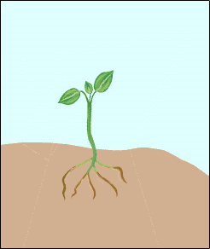
Auxin : Promotes stem elongation and bud dormancy.
  Phototropism: When plants grow toward a light source.
10
Copyright © 2024 SlideSpark .LLC

Slide 145
Part IV REVIEW GAME
ROUTE 66 | GROWING UP | IF I COULD I WOOD | LEAVE ME BE | -Bonus- SEE THE LIGHT
1 | 6 | 11 | 16 | *21
2 | 7 | 12 | 17 | *22
3 | 8 | 13 | 18 | *23
4 | 9 | 14 | 19 | *24
5 | 10 | 15 | 20 | *25

Slide 146
Part IV REVIEW GAME
ROUTE 66 | GROWING UP | IF I COULD I WOOD | LEAVE ME BE | -Bonus- SEE THE LIGHT
1 | 6 | 11 | 16 | *21
2 | 7 | 12 | 17 | *22
3 | 8 | 13 | 18 | *23
4 | 9 | 14 | 19 | *24
5 | 10 | 15 | 20 | *25

Slide 147
Ethylene does all of the following except…
  A.) Stimulates the release of seed dormancy.
  B.) Stimulates shoot and root growth.
  C.) Promotes cell division. They are produced in growing areas like the tips.
  D.) Stimulates leaf and fruit abscission.
  E.) Creates femaleness in flowers.
  F.) Stimulates flower opening.
  G.) Stimulates flower and leaf dying.
11
Copyright © 2024 SlideSpark .LLC

Slide 148
Ethylene does all of the following except…
  A.) Stimulates the release of seed dormancy.
  B.) Stimulates shoot and root growth.
  C.) Promotes cell division. They are produced in growing areas like the tips.
  D.) Stimulates leaf and fruit abscission.
  E.) Creates femaleness in flowers.
  F.) Stimulates flower opening.
  G.) Stimulates flower and leaf dying.
11
Copyright © 2024 SlideSpark .LLC

Slide 149
Ethylene does all of the following except…
  A.) Stimulates the release of seed dormancy.
  B.) Stimulates shoot and root growth.
  C.) Promotes cell division. They are produced in growing areas like the tips.
  D.) Stimulates leaf and fruit abscission.
  E.) Creates femaleness in flowers.
  F.) Stimulates flower opening.
  G.) Stimulates flower and leaf dying.
11
Copyright © 2024 SlideSpark .LLC

Slide 150
Ethylene does all of the following except…
  A.) Stimulates the release of seed dormancy.
  B.) Stimulates shoot and root growth.
  C.) Promotes cell division. They are produced in growing areas like the tips.
  D.) Stimulates leaf and fruit abscission.
  E.) Creates femaleness in flowers.
  F.) Stimulates flower opening.
  G.) Stimulates flower and leaf dying.
11
Copyright © 2024 SlideSpark .LLC

Slide 151
Ethylene does all of the following except…
  A.) Stimulates the release of seed dormancy.
  B.) Stimulates shoot and root growth.
  C.) Promotes cell division. They are produced in growing areas like the tips.
  D.) Stimulates leaf and fruit abscission.
  E.) Creates femaleness in flowers.
  F.) Stimulates flower opening.
  G.) Stimulates flower and leaf dying.
11
Copyright © 2024 SlideSpark .LLC

Slide 152
Ethylene does all of the following except…
  A.) Stimulates the release of seed dormancy.
  B.) Stimulates shoot and root growth.
  C.) Promotes cell division. They are produced in growing areas like the tips.
  D.) Stimulates leaf and fruit abscission.
  E.) Creates femaleness in flowers.
  F.) Stimulates flower opening.
  G.) Stimulates flower and leaf dying.
11
Copyright © 2024 SlideSpark .LLC

Slide 153
Ethylene does all of the following except…
  A.) Stimulates the release of seed dormancy.
  B.) Stimulates shoot and root growth.
  C.) Promotes cell division. They are produced in growing areas like the tips.
  D.) Stimulates leaf and fruit abscission.
  E.) Creates femaleness in flowers.
  F.) Stimulates flower opening.
  G.) Stimulates flower and leaf dying.
11
Copyright © 2024 SlideSpark .LLC

Slide 154
Ethylene does all of the following except…
  A.) Stimulates the release of seed dormancy.
  B.) Stimulates shoot and root growth.
  C.) Promotes cell division. They are produced in growing areas like the tips.
  D.) Stimulates leaf and fruit abscission.
  E.) Creates femaleness in flowers.
  F.) Stimulates flower opening.
  G.) Stimulates flower and leaf dying.
11
Copyright © 2024 SlideSpark .LLC

Slide 155
Ethylene does all of the following except…
  A.) Stimulates the release of seed dormancy.
  B.) Stimulates shoot and root growth.
  C.) Promotes cell division. They are produced in growing areas like the tips.
  D.) Stimulates leaf and fruit abscission.
  E.) Creates femaleness in flowers.
  F.) Stimulates flower opening.
  G.) Stimulates flower and leaf dying.
11
answer is…
Copyright © 2024 SlideSpark .LLC

Slide 156
Ethylene does all of the following except…
  A.) Stimulates the release of seed dormancy.
  B.) Stimulates shoot and root growth.
  C.) Promotes cell division. They are produced in growing areas like the tips.
  D.) Stimulates leaf and fruit abscission.
  E.) Creates femaleness in flowers.
  F.) Stimulates flower opening.
  G.) Stimulates flower and leaf dying.
11
answer is…
Copyright © 2024 SlideSpark .LLC

Slide 157
Ethylene does all of the following except…
  A.) Stimulates the release of seed dormancy.
  B.) Stimulates shoot and root growth.
  C.) Promotes cell division. They are produced in growing areas like the tips. Cytokinins
  D.) Stimulates leaf and fruit abscission.
  E.) Creates femaleness in flowers.
  F.) Stimulates flower opening.
  G.) Stimulates flower and leaf dying.
11
answer is…
Copyright © 2024 SlideSpark .LLC

Slide 158
Which letter is dermal tissue, ground tissue, and which is vascular tissue?
A
C
B
Copyright © 2024 SlideSpark .LLC

Slide 159
A =Ground Tissue, B = Dermal Tissue
C= Vascular Tissue
A
C
B
Copyright © 2024 SlideSpark .LLC

Slide 160
A =Ground Tissue, B = Dermal Tissue
C= Vascular Tissue
A
C
B
Copyright © 2024 SlideSpark .LLC

Slide 161
A =Ground Tissue, B = Dermal Tissue
C= Vascular Tissue
A
C
B
Copyright © 2024 SlideSpark .LLC

Slide 162
A =Ground Tissue, B = Dermal Tissue
C= Vascular Tissue
A
C
B
Copyright © 2024 SlideSpark .LLC

Slide 163
A =Ground Tissue, B = Dermal Tissue
C= Vascular Tissue
A
C
B
Copyright © 2024 SlideSpark .LLC

Slide 164
A =Ground Tissue, B = Dermal Tissue
C= Vascular Tissue
A
C
B
Copyright © 2024 SlideSpark .LLC

Slide 165
A =Ground Tissue, B = Dermal Tissue
C= Vascular Tissue
A
C
B
Copyright © 2024 SlideSpark .LLC

Slide 166
Tubes in the plant that food (sugar) moves through.
13
Copyright © 2024 SlideSpark .LLC

Slide 167
Tubes in the plant that food (sugar) moves through.
13
and the answer is…
Copyright © 2024 SlideSpark .LLC

Slide 168
Tubes in the plant that food (sugar) moves through.
13
Phloem
and the answer is…
Copyright © 2024 SlideSpark .LLC

Slide 169
14
Name the very important tissue below…
  Part of a plants vascular system.
  Tubes that water and minerals move through.
  Water travels up the tree from roots to leaves.
  Old types of these cells help to support the plant (Wood).

Slide 170
14
Name the very important tissue below…
  Part of a plants vascular system.
  Tubes that water and minerals move through.
  Water travels up the tree from roots to leaves.
  Old types of these cells help to support the plant (Wood).

Slide 171
14
Name the very important tissue below…
  Part of a plants vascular system.
  Tubes that water and minerals move through.
  Water travels up the tree from roots to leaves.
  Old types of these cells help to support the plant (Wood).

Slide 172
14
Name the very important tissue below…
  Part of a plants vascular system.
  Tubes that water and minerals move through.
  Water travels up the tree from roots to leaves.
  Old types of these cells help to support the plant (Wood).

Slide 173
14
Name the very important tissue below…
  Part of a plants vascular system.
  Tubes that water and minerals move through.
  Water travels up the tree from roots to leaves.
  Old types of these cells help to support the plant (Wood).

Slide 174
14
Name the very important tissue below…
  Part of a plants vascular system.
  Tubes that water and minerals move through.
  Water travels up the tree from roots to leaves.
  Old types of these cells help to support the plant (Wood).
and the answer is…

Slide 175
14
Name the very important tissue below…
  Part of a plants vascular system.
  Tubes that water and minerals move through.
  Water travels up the tree from roots to leaves.
  Old types of these cells help to support the plant (Wood).
Xylem
and the answer is…

Slide 176
Which letter represents the living layer of cells in this hardwood?
15
Copyright © 2024 SlideSpark .LLC

Slide 177
Which letter represents the living layer of cells in this hardwood?
15
A
Copyright © 2024 SlideSpark .LLC

Slide 178
Which letter represents the living layer of cells in this hardwood?
15
A
B
Copyright © 2024 SlideSpark .LLC

Slide 179
Which letter represents the living layer of cells in this hardwood?
15
A
B
C
Copyright © 2024 SlideSpark .LLC

Slide 180
Which letter represents the living layer of cells in this hardwood?
15
A
B
D
C
Copyright © 2024 SlideSpark .LLC

Slide 181
Which letter represents the living layer of cells in this hardwood?
15
A
B
D
E
C
Copyright © 2024 SlideSpark .LLC

Slide 182
Which letter represents the living layer of cells in this hardwood?
15
A
B
D
E
C
answer is…
Copyright © 2024 SlideSpark .LLC

Slide 183
Which letter represents the living layer of cells in this hardwood?
15
A
answer is…
Copyright © 2024 SlideSpark .LLC

Slide 184
Which letter represents the living layer of cells in this hardwood?
15
Cambium
A
answer is…
Copyright © 2024 SlideSpark .LLC

Slide 185
Which letter represents the living layer of cells in this hardwood?
15
Cambium
A
All Dead Cells
answer is…
Copyright © 2024 SlideSpark .LLC

Slide 186
Part IV REVIEW GAME
ROUTE 66 | GROWING UP | IF I COULD I WOOD | LEAVE ME BE | -Bonus- SEE THE LIGHT
1 | 6 | 11 | 16 | *21
2 | 7 | 12 | 17 | *22
3 | 8 | 13 | 18 | *23
4 | 9 | 14 | 19 | *24
5 | 10 | 15 | 20 | *25

Slide 187
Part IV REVIEW GAME
ROUTE 66 | GROWING UP | IF I COULD I WOOD | LEAVE ME BE | -Bonus- SEE THE LIGHT
1 | 6 | 11 | 16 | *21
2 | 7 | 12 | 17 | *22
3 | 8 | 13 | 18 | *23
4 | 9 | 14 | 19 | *24
5 | 10 | 15 | 20 | *25

Slide 188
Which is the heartwood, sapwood, cambium, and pith?
A
16
Cambium
C
heartwood
B
D
Sapwood
Pith
Copyright © 2024 SlideSpark .LLC

Slide 189
Which is the heartwood, sapwood, cambium, and pith?
A
16
Cambium
C
heartwood
B
D
Sapwood
Pith
Copyright © 2024 SlideSpark .LLC

Slide 190
Which is the heartwood, sapwood, cambium, and pith?
A
16
Cambium
C
heartwood
B
D
Sapwood
Pith
Copyright © 2024 SlideSpark .LLC

Slide 191
Which is the heartwood, sapwood, cambium, and pith?
A
16
Cambium
C
heartwood
B
D
Sapwood
Pith
Copyright © 2024 SlideSpark .LLC

Slide 192
Which is the heartwood, sapwood, cambium, and pith?
A
16
Cambium
C
heartwood
B
D
Sapwood
Pith
Copyright © 2024 SlideSpark .LLC

Slide 193
Which is the heartwood, sapwood, cambium, and pith?
A
16
Cambium
C
heartwood
B
D
Sapwood
Pith
Copyright © 2024 SlideSpark .LLC

Slide 194
Which is the heartwood, sapwood, cambium, and pith?
A
16
Cambium
C
heartwood
B
D
Sapwood
Pith
Copyright © 2024 SlideSpark .LLC

Slide 195
Which is the heartwood, sapwood, cambium, and pith?
A
16
Cambium
C
heartwood
B
D
Sapwood
Pith
Copyright © 2024 SlideSpark .LLC

Slide 196
Which is the heartwood, sapwood, cambium, and pith?
A
16
Cambium
C
heartwood
B
D
Sapwood
Pith
Copyright © 2024 SlideSpark .LLC

Slide 197
This the term for the dating of past events through study of tree ring growth.
  How old is this tree (+1point)
17

Slide 198
This the term for the dating of past events through study of tree ring growth.
  How old is this tree (+1point)
17
answer is…

Slide 199
This the term for the dating of past events through study of tree ring growth.
  How old is this tree (+1point)
17
Dendrochronology
answer is…

Slide 200
This the term for the dating of past events through study of tree ring growth.
  How old is this tree (+1point)
17
Dendrochronology
answer is…

Slide 201
This the term for the dating of past events through study of tree ring growth.
  How old is this tree (+1point)
17
Dendrochronology
12-13 years old
answer is…

Slide 202
A leaf is a plant organ, that is photosynthetic, contains chloroplasts, and is usually thin so light can penetrate.
18
Copyright © 2024 SlideSpark .LLC

Slide 203
A leaf is a plant organ, that is photosynthetic, contains chloroplasts, and is usually thin so light can penetrate.
18
Copyright © 2024 SlideSpark .LLC

Slide 204
A leaf is a plant organ, that is photosynthetic, contains chloroplasts, and is usually thin so light can penetrate.
18
Copyright © 2024 SlideSpark .LLC

Slide 205
A leaf is a plant organ, that is photosynthetic, contains chloroplasts, and is usually thin so light can penetrate.
18
Copyright © 2024 SlideSpark .LLC

Slide 206
A leaf is a plant organ, that is photosynthetic, contains chloroplasts, and is usually thin so light can penetrate.
18
Copyright © 2024 SlideSpark .LLC

Slide 207
A leaf is a plant organ, that is photosynthetic, contains chloroplasts, and is usually thin so light can penetrate.
18
Copyright © 2024 SlideSpark .LLC

Slide 208
A leaf is a plant organ, that is photosynthetic, contains chloroplasts, and is usually thin so light can penetrate.
18
Copyright © 2024 SlideSpark .LLC

Slide 209
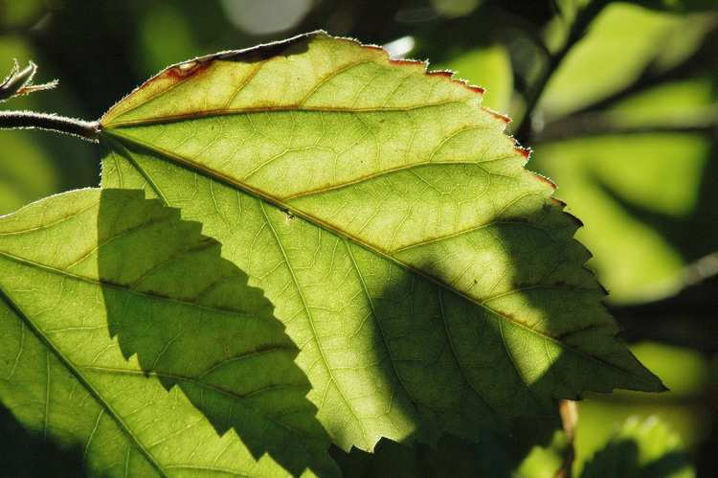
A leaf is a plant organ, that is photosynthetic, contains chloroplasts, and is usually thin so light can penetrate.
18
Copyright © 2024 SlideSpark .LLC

Slide 210
A leaf is a plant organ, that is photosynthetic, contains chloroplasts, and is usually thin so light can penetrate.
18
Copyright © 2024 SlideSpark .LLC

Slide 211
A leaf is a plant organ, that is photosynthetic, contains chloroplasts, and is usually thin so light can penetrate.
18
Copyright © 2024 SlideSpark .LLC

Slide 212
Which of the following equations is the correct equation for photosynthesis?
A.) 6O2 + 6H2O + light energy = C12H6O6 + 6O2
B.) 6CO2 + 6H2O + sugar = C6H12O6 + 6O2
C.) 6CO2 + 6CO2 + light energy = C6H12O6 + 6H2O
D.) 6CO2 + 6H2 + light energy = C6H12O6 + 6H2O
E.) 6CO2 + 6H2O + light energy = C6H12O6 + 6O2
F.) 6CO2 + 6H2O + light energy = C6H2O6 + 6O2
G.) 6CO2 + 6H2O + sugar = C6H12O6 + 6O2
H.) 6CO2 + 6H2O + light energy = C6H12O6 + 6CO2
I.) 6CO2 + H2O + light energy = C6H12O6 + 6O2
J.) C6H12O6 = 6CO2 + 6H2O + light energy + 6O2
K.) None of the above.
19
Copyright © 2024 SlideSpark .LLC

Slide 213
Which of the following equations is the correct equation for photosynthesis?
A.) 6O2 + 6H2O + light energy = C12H6O6 + 6O2
B.) 6CO2 + 6H2O + sugar = C6H12O6 + 6O2
C.) 6CO2 + 6CO2 + light energy = C6H12O6 + 6H2O
D.) 6CO2 + 6H2 + light energy = C6H12O6 + 6H2O
E.) 6CO2 + 6H2O + light energy = C6H12O6 + 6O2
F.) 6CO2 + 6H2O + light energy = C6H2O6 + 6O2
G.) 6CO2 + 6H2O + sugar = C6H12O6 + 6O2
H.) 6CO2 + 6H2O + light energy = C6H12O6 + 6CO2
I.) 6CO2 + H2O + light energy = C6H12O6 + 6O2
J.) C6H12O6 = 6CO2 + 6H2O + light energy + 6O2
K.) None of the above.
19
answer is…
Copyright © 2024 SlideSpark .LLC

Slide 214
Which of the following equations is the correct equation for photosynthesis?
A.) 6O2 + 6H2O + light energy = C12H6O6 + 6O2
B.) 6CO2 + 6H2O + sugar = C6H12O6 + 6O2
C.) 6CO2 + 6CO2 + light energy = C6H12O6 + 6H2O
D.) 6CO2 + 6H2 + light energy = C6H12O6 + 6H2O
E.) 6CO2 + 6H2O + light energy = C6H12O6 + 6O2
F.) 6CO2 + 6H2O + light energy = C6H2O6 + 6O2
G.) 6CO2 + 6H2O + sugar = C6H12O6 + 6O2
H.) 6CO2 + 6H2O + light energy = C6H12O6 + 6CO2
I.) 6CO2 + H2O + light energy = C6H12O6 + 6O2
J.) C6H12O6 = 6CO2 + 6H2O + light energy + 6O2
K.) None of the above.
19
answer is…
Copyright © 2024 SlideSpark .LLC

Slide 215
This is the name for the evaporation of water from plants.
  It occurs during photosynthesis.
  Helps pull water up the xylem from roots.
  Cools the leaf.
20
Copyright © 2024 SlideSpark .LLC

Slide 216
This is the name for the evaporation of water from plants.
  It occurs during photosynthesis.
  Helps pull water up the xylem from roots.
  Cools the leaf.
20
answer is…
Copyright © 2024 SlideSpark .LLC

Slide 217
This is the name for the evaporation of water from plants.
  It occurs during photosynthesis.
  Helps pull water up the xylem from roots.
  Cools the leaf.
20
Transpiration
answer is…
Copyright © 2024 SlideSpark .LLC

Slide 218
Part IV REVIEW GAME
ROUTE 66 | GROWING UP | IF I COULD I WOOD | LEAVE ME BE | -Bonus- SEE THE LIGHT
1 | 6 | 11 | 16 | *21
2 | 7 | 12 | 17 | *22
3 | 8 | 13 | 18 | *23
4 | 9 | 14 | 19 | *24
5 | 10 | 15 | 20 | *25

Slide 219
Part IV REVIEW GAME
ROUTE 66 | GROWING UP | IF I COULD I WOOD | LEAVE ME BE | -Bonus- SEE THE LIGHT
1 | 6 | 11 | 16 | *21
2 | 7 | 12 | 17 | *22
3 | 8 | 13 | 18 | *23
4 | 9 | 14 | 19 | *24
5 | 10 | 15 | 20 | *25

Slide 220
Who is this?
*21

Slide 221
Who is this?
*21
answer is…

Slide 222

Who is this?
*21
answer is…

Slide 223
Who is this?
*22

Slide 224
Who is this?
*22
answer is…

Slide 225
Who is this?
*22
Gandalf
answer is…

Slide 226
*23
Who am
I?

Slide 227
*23
Team Umizoomi
Bot
Who am
I?

Slide 228
*24
Name the movie?

Slide 229

*24
Name the movie?

Slide 230
*25
Name the Movie?

Slide 231
*25
Name the Movie?

Slide 232
*25
Name the Movie?

Slide 233
Part IV REVIEW GAME
ROUTE 66 | GROWING UP | IF I COULD I WOOD | LEAVE ME BE | -Bonus- SEE THE LIGHT
1 | 6 | 11 | 16 | *21
2 | 7 | 12 | 17 | *22
3 | 8 | 13 | 18 | *23
4 | 9 | 14 | 19 | *24
5 | 10 | 15 | 20 | *25
Final Question

Slide 234
5 Point wager Question

Slide 235
These are openings in the leaf controlled by guard cells that allow gases in and out.
Copyright © 2024 SlideSpark .LLC

Slide 236
These are openings in the leaf controlled by guard cells that allow gases in and out.
answer is…
Copyright © 2024 SlideSpark .LLC

Slide 237
These are openings in the leaf controlled by guard cells that allow gases in and out.
Stoma
answer is…
Copyright © 2024 SlideSpark .LLC

Slide 238
Part 4 Unit Review Game
1-20 = 5 points each
20-25 = Bonus (1 point each)
Final Question = 5 point wager
Find the Owl = 1 point

Slide 239
Part 4 Review Game
ANSWER VERSION
Part 4
Lesson 11

Slide 240



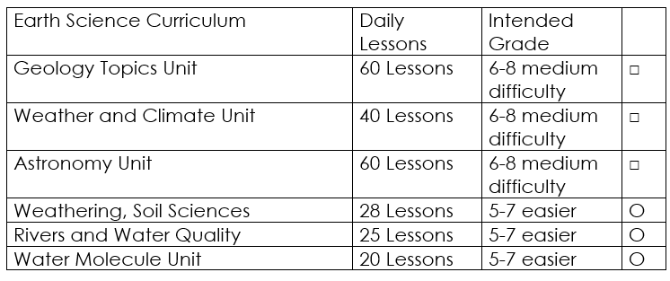

Curriculum Guide
Number of Lessons in each unit (50 min, daily lessons) and difficult rating scale / intended grade level.
=Easier, = More difficult, =Most difficult
Earth Science Units

Slide 241


Life Science Units

Slide 242

Physical Science

Slide 243
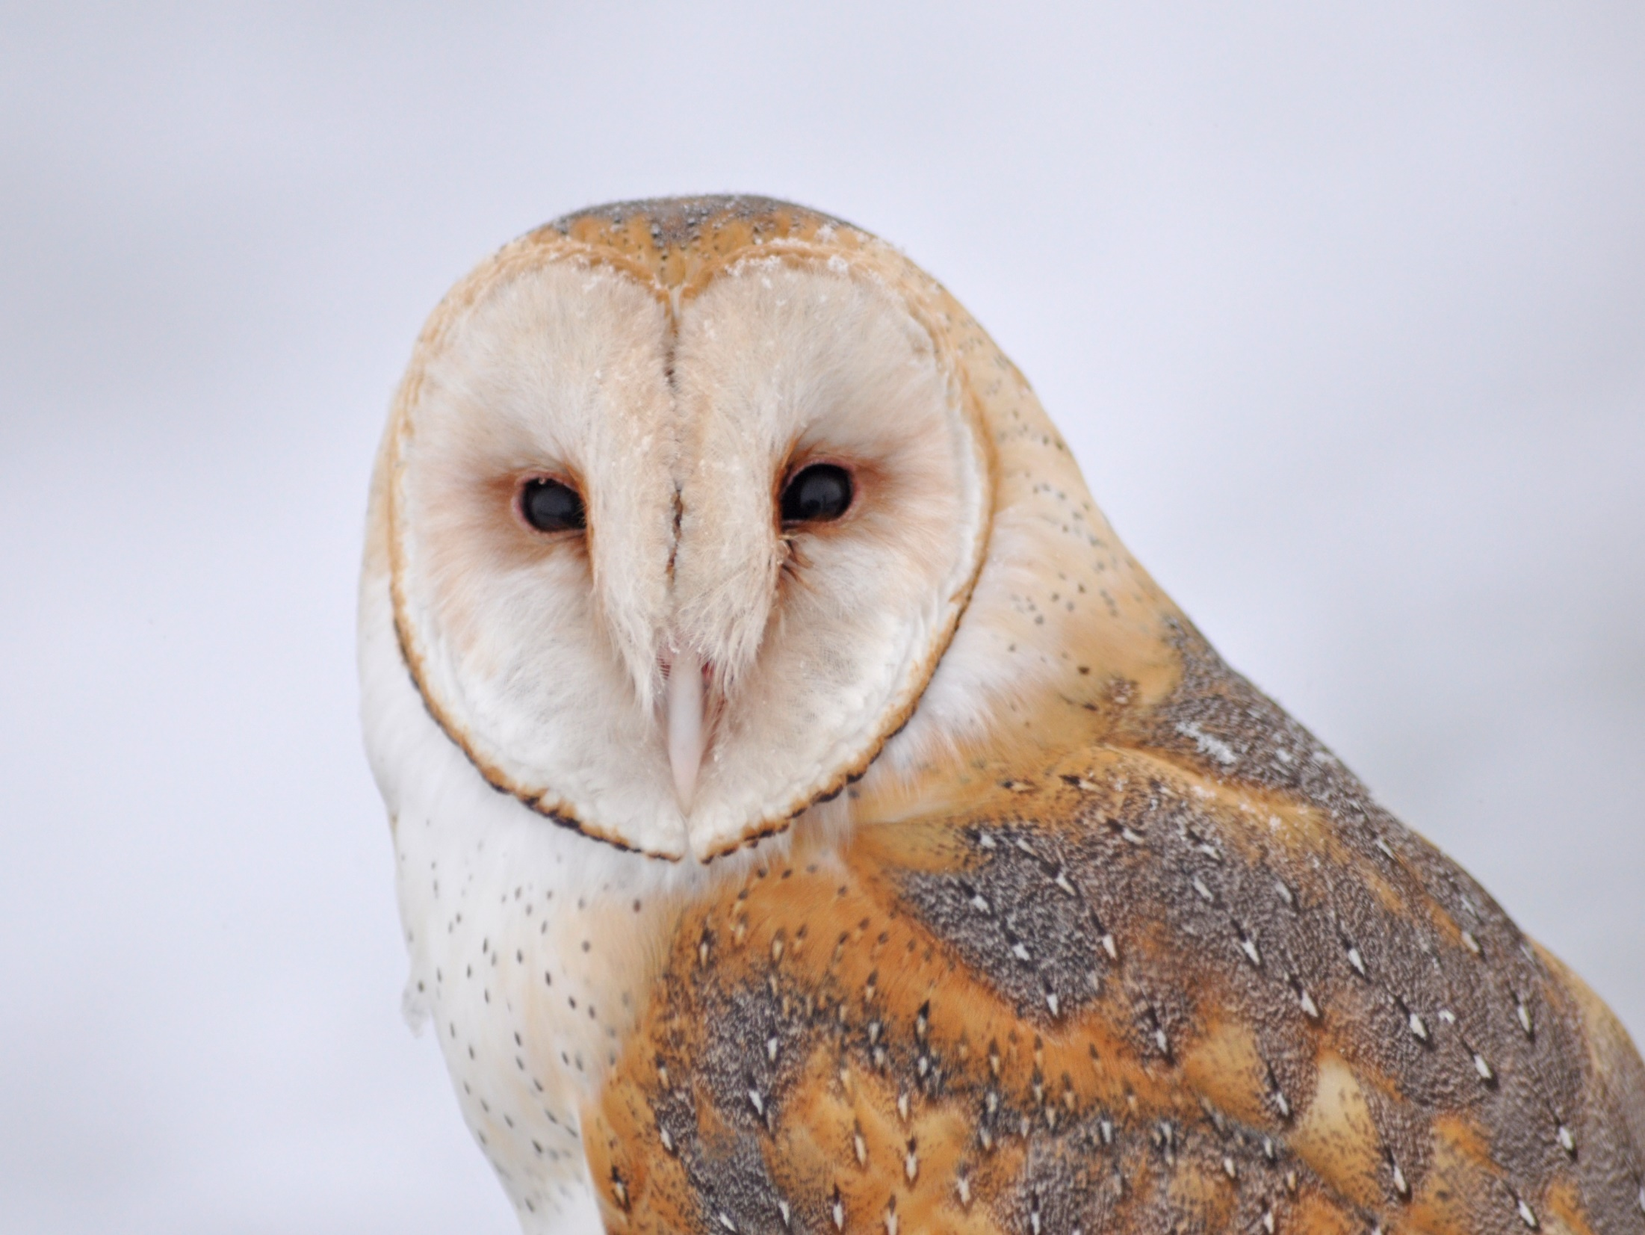
Dear Valued Educator,
Our fully editable .pptx and .doc resources are perfect for educators looking to bring enthusiasm and creativity to their lessons. We encourage you to make changes to fit your needs and style. As science educators, we’re committed to providing students with the tools they need to succeed in the classroom and beyond. Each unit in the curriculum includes a range of resources that have been developed through extensive research and use in a busy classroom. Our teaching approach is designed to make science education engaging and exciting for learners of all ages. We offer a one-of-a-kind science curriculum that will challenge, inspire, and educate students to become tomorrow's scientists and leaders. Join us today and learn more about how our program can help you achieve your classroom goals.
With appreciation,
Support@SlideSpark.net

Slide 244





Thank you for your time and interest in our Science curriculum. We strive to provide students with engaging and informative lessons that will spark their curiosity and encourage scientific exploration. Should you have any questions or concerns, please do not hesitate to contact us. Thank you again for considering our curriculum, and we wish you all the best in your educational journey.
Sincerely,
Support@slidespark.net
SlideSpark Science on TpT

