Slide 1
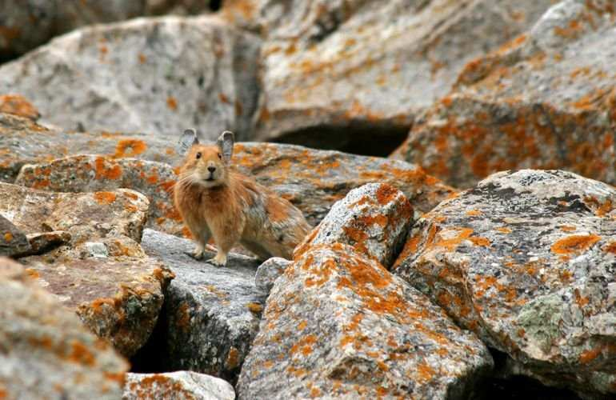
Ecology Interactions Unit
Part 2
Review Game

Slide 2
Part 2 Ecology Interactions
HOUSE OF CARDS | SNEAK PEEK | SIMON SAYS | HELPING HAND? | -Bonus- MIX UP
1 | 6 | 11 | 16 | *21
2 | 7 | 12 | 17 | *22
3 | 8 | 13 | 18 | *23
4 | 9 | 14 | 19 | *24
5 | 10 | 15 | 20 | *25

Slide 3
How to play…
Don’t play like Jeo_ _ _ _ y.
Class should be divided into several small groups.
Groups should use science journal (red slide notes), homework, and other available materials to assist you.
Groups can communicate quietly with each other but no sharing answers between groups.
Practice quietly communicating right now?
Practice Communication Question:
Your group gets to order one pizza and you can have two toppings. What does your group want?

Slide 4
Questions 1-20 = 5pts Each
Final Category (Bonus) = 1pt Each
Final Questions = 5 pt wager
If you wager 5 on the last question and get it wrong you lose 5 pts. Wager 5 and get it right you get 5 pts.
Find the Owl =
Secretly write “Owl” in the correct box worth 1pt.
“I’ll be about this big.”

Slide 5
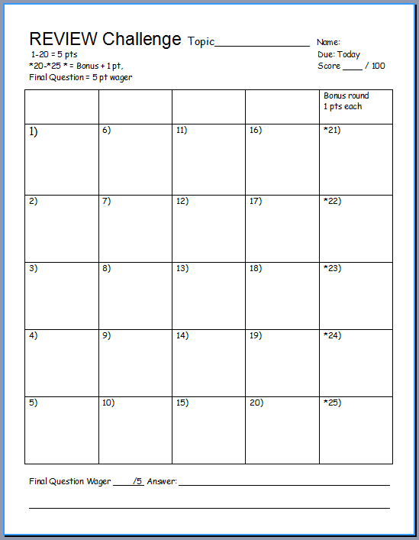
Is your name on the review sheet?
Name

Slide 6
Is your name on the review sheet?
Add the categories
along the top
on the next slide.

Slide 7
Part II Ecology Interactions
HOUSE OF CARDS | SNEAK PEEK | SIMON SAYS | HELPING HAND? | -Bonus- MIX UP
1 | 6 | 11 | 16 | *21
2 | 7 | 12 | 17 | *22
3 | 8 | 13 | 18 | *23
4 | 9 | 14 | 19 | *24
5 | 10 | 15 | 20 | *25

Slide 8
Part II Ecology Interactions
HOUSE OF CARDS | SNEAK PEEK | SIMON SAYS | HELPING HAND? | -Bonus- MIX UP
1 | 6 | 11 | 16 | *21
2 | 7 | 12 | 17 | *22
3 | 8 | 13 | 18 | *23
4 | 9 | 14 | 19 | *24
5 | 10 | 15 | 20 | *25

Slide 9
Find the relative abundance of stars____?
1

Slide 10
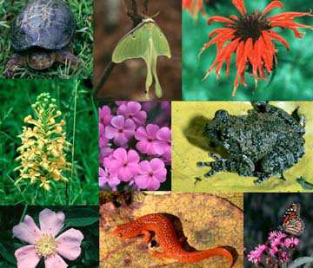
This is the term for the variety, or number of kinds of species living in an area.
2
Copyright © 2024 SlideSpark LLC

Slide 11
Which is not an importance of biodiversity
A.) Generation of soils and maintenance of soil quality.
B.) Maintenance of air quality.
C.) Maintenance of water quality.
D.) Pest Control
E.) Detoxification and decomposition of wastes.
F.) Pollination and crop production.
G.) Decrease in food security.
H.) Provision of health care (Medicines).
I.) Income generation.
J.) Spiritual / cultural value.
3
Copyright © 2024 SlideSpark LLC

Slide 12
Which is not an importance of biodiversity
A.) Generation of soils and maintenance of soil quality.
B.) Maintenance of air quality.
C.) Maintenance of water quality.
D.) Pest Control
E.) Detoxification and decomposition of wastes.
F.) Pollination and crop production.
G.) Decrease in food security.
H.) Provision of health care (Medicines).
I.) Income generation.
J.) Spiritual / cultural value.
3
Copyright © 2024 SlideSpark LLC

Slide 13
Which is not an importance of biodiversity
A.) Generation of soils and maintenance of soil quality.
B.) Maintenance of air quality.
C.) Maintenance of water quality.
D.) Pest Control
E.) Detoxification and decomposition of wastes.
F.) Pollination and crop production.
G.) Decrease in food security.
H.) Provision of health care (Medicines).
I.) Income generation.
J.) Spiritual / cultural value.
3
Copyright © 2024 SlideSpark LLC

Slide 14
Which is not an importance of biodiversity
A.) Generation of soils and maintenance of soil quality.
B.) Maintenance of air quality.
C.) Maintenance of water quality.
D.) Pest Control
E.) Detoxification and decomposition of wastes.
F.) Pollination and crop production.
G.) Decrease in food security.
H.) Provision of health care (Medicines).
I.) Income generation.
J.) Spiritual / cultural value.
3
Copyright © 2024 SlideSpark LLC

Slide 15
Which is not an importance of biodiversity
A.) Generation of soils and maintenance of soil quality.
B.) Maintenance of air quality.
C.) Maintenance of water quality.
D.) Pest Control
E.) Detoxification and decomposition of wastes.
F.) Pollination and crop production.
G.) Decrease in food security.
H.) Provision of health care (Medicines).
I.) Income generation.
J.) Spiritual / cultural value.
3
Copyright © 2024 SlideSpark LLC

Slide 16
Which is not an importance of biodiversity
A.) Generation of soils and maintenance of soil quality.
B.) Maintenance of air quality.
C.) Maintenance of water quality.
D.) Pest Control
E.) Detoxification and decomposition of wastes.
F.) Pollination and crop production.
G.) Decrease in food security.
H.) Provision of health care (Medicines).
I.) Income generation.
J.) Spiritual / cultural value.
3
Copyright © 2024 SlideSpark LLC

Slide 17
Which is not an importance of biodiversity
A.) Generation of soils and maintenance of soil quality.
B.) Maintenance of air quality.
C.) Maintenance of water quality.
D.) Pest Control
E.) Detoxification and decomposition of wastes.
F.) Pollination and crop production.
G.) Decrease in food security.
H.) Provision of health care (Medicines).
I.) Income generation.
J.) Spiritual / cultural value.
3
Copyright © 2024 SlideSpark LLC

Slide 18
Which is not an importance of biodiversity
A.) Generation of soils and maintenance of soil quality.
B.) Maintenance of air quality.
C.) Maintenance of water quality.
D.) Pest Control
E.) Detoxification and decomposition of wastes.
F.) Pollination and crop production.
G.) Decrease in food security.
H.) Provision of health care (Medicines).
I.) Income generation.
J.) Spiritual / cultural value.
3
Copyright © 2024 SlideSpark LLC

Slide 19
Which is not an importance of biodiversity
A.) Generation of soils and maintenance of soil quality.
B.) Maintenance of air quality.
C.) Maintenance of water quality.
D.) Pest Control
E.) Detoxification and decomposition of wastes.
F.) Pollination and crop production.
G.) Decrease in food security.
H.) Provision of health care (Medicines).
I.) Income generation.
J.) Spiritual / cultural value.
3
Copyright © 2024 SlideSpark LLC

Slide 20
Which is not an importance of biodiversity
A.) Generation of soils and maintenance of soil quality.
B.) Maintenance of air quality.
C.) Maintenance of water quality.
D.) Pest Control
E.) Detoxification and decomposition of wastes.
F.) Pollination and crop production.
G.) Decrease in food security.
H.) Provision of health care (Medicines).
I.) Income generation.
J.) Spiritual / cultural value.
3
Copyright © 2024 SlideSpark LLC

Slide 21
Which is not an importance of biodiversity
A.) Generation of soils and maintenance of soil quality.
B.) Maintenance of air quality.
C.) Maintenance of water quality.
D.) Pest Control
E.) Detoxification and decomposition of wastes.
F.) Pollination and crop production.
G.) Decrease in food security.
H.) Provision of health care (Medicines).
I.) Income generation.
J.) Spiritual / cultural value.
3
Copyright © 2024 SlideSpark LLC

Slide 22
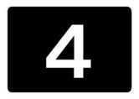
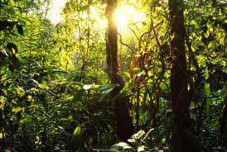
How can we maintain biodiversity?
Please provide at least one way that humans can maintain biodiversity.

Slide 23
How many, on average, species go extinct on planet earth every year from human impacts?
A.) 7-10 species
B.) 70-100 species
C.) 7,000 species
D.) 70,000 species
E.) 700 million
5

Slide 24
How many, on average, species go extinct on planet earth every year from human impacts?
A.) 7-10 species
B.) 70-100 species
C.) 7,000 species
D.) 70,000 species
E.) 700 million
5

Slide 25
How many, on average, species go extinct on planet earth every year from human impacts?
A.) 7-10 species
B.) 70-100 species
C.) 7,000 species
D.) 70,000 species
E.) 700 million
5

Slide 26
How many, on average, species go extinct on planet earth every year from human impacts?
A.) 7-10 species
B.) 70-100 species
C.) 7,000 species
D.) 70,000 species
E.) 700 million
5

Slide 27
How many, on average, species go extinct on planet earth every year from human impacts?
A.) 7-10 species
B.) 70-100 species
C.) 7,000 species
D.) 70,000 species
E.) 700 million
5

Slide 28
How many, on average, species go extinct on planet earth every year from human impacts?
A.) 7-10 species
B.) 70-100 species
C.) 7,000 species
D.) 70,000 species
E.) 700 million
5

Slide 29
Part II Ecology Interactions
HOUSE OF CARDS | SNEAK PEEK | SIMON SAYS | HELPING HAND? | -Bonus- MIX UP
1 | 6 | 11 | 16 | *21
2 | 7 | 12 | 17 | *22
3 | 8 | 13 | 18 | *23
4 | 9 | 14 | 19 | *24
5 | 10 | 15 | 20 | *25

Slide 30
Part II Ecology Interactions
HOUSE OF CARDS | SNEAK PEEK | SIMON SAYS | HELPING HAND? | -Bonus- MIX UP
1 | 6 | 11 | 16 | *21
2 | 7 | 12 | 17 | *22
3 | 8 | 13 | 18 | *23
4 | 9 | 14 | 19 | *24
5 | 10 | 15 | 20 | *25

Slide 31
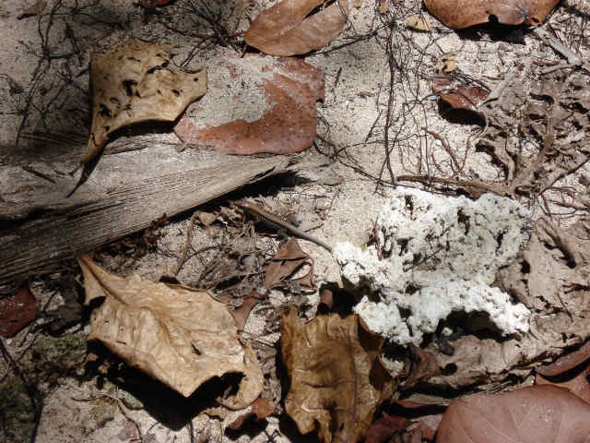
This is the name for an adaptation that allows the animal to blend in with its environment to avoid being detected.
6
Copyright © 2024 SlideSpark LLC

Slide 32
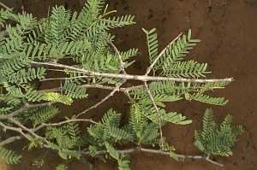
Name the correct type of camouflage for the picture? (Can only use each once 7-10)
Concealing Coloration, Disruptive Coloration, Disguise, or Mimicry
7

Slide 33
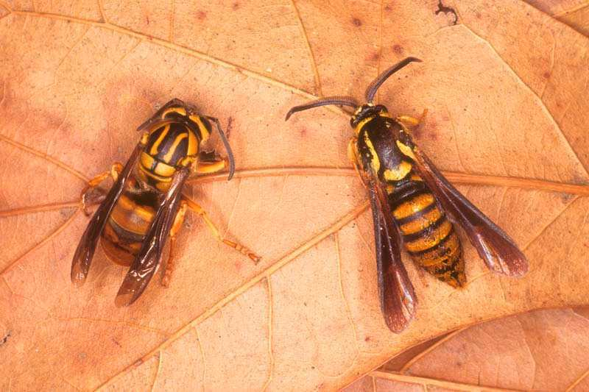
Name the correct type of camouflage for the picture? (Can only use each once 7-10)
Concealing Coloration, Disruptive Coloration, Disguise, or Mimicry
8
Yellow Jacket
Clearwing
Moth
Stinger
No Stinger

Slide 34
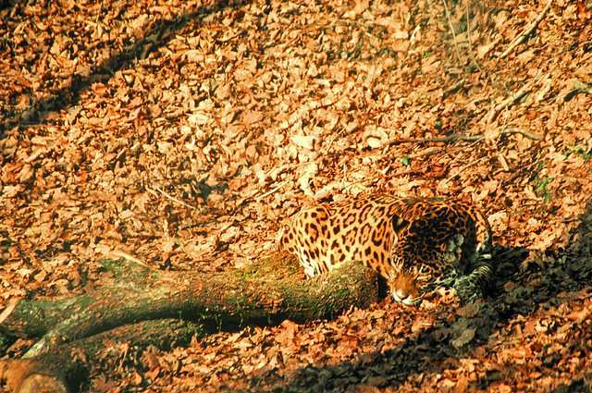
Name the correct type of camouflage for the picture? (Can only use each once 7-10)
Concealing Coloration, Disruptive Coloration, Disguise, or Mimicry
9

Slide 35
Name the correct type of camouflage for the picture? (Can only use each once 7-10)
Concealing Coloration, Disruptive Coloration, Disguise, or Mimicry
10

Slide 36
Part II Ecology Interactions
HOUSE OF CARDS | SNEAK PEEK | SIMON SAYS | HELPING HAND? | -Bonus- MIX UP
1 | 6 | 11 | 16 | *21
2 | 7 | 12 | 17 | *22
3 | 8 | 13 | 18 | *23
4 | 9 | 14 | 19 | *24
5 | 10 | 15 | 20 | *25

Slide 37
Part II Ecology Interactions
HOUSE OF CARDS | SNEAK PEEK | SIMON SAYS | HELPING HAND? | -Bonus- MIX UP
1 | 6 | 11 | 16 | *21
2 | 7 | 12 | 17 | *22
3 | 8 | 13 | 18 | *23
4 | 9 | 14 | 19 | *24
5 | 10 | 15 | 20 | *25

Slide 38
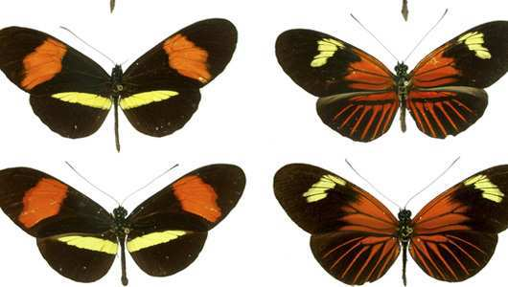
Where there’s a mimic, there must also be a… Model.
Sometimes they can be very unappetizing animals.
11
Poisonous/ unpalatable
Poisonous/ unpalatable
Model
Model
Palatable / non-poisonous
Palatable / non-poisonous
Mimic
Mimic

Slide 39
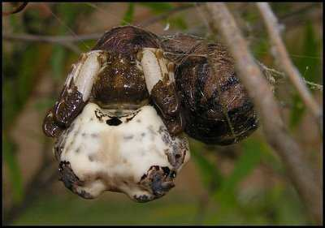
How does this spider “Not die” in less than seven words?
12

Slide 40
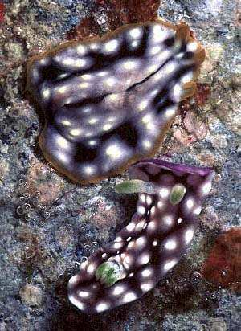
This is the type of mimicry where an organism resembles another species that is dangerous or may taste bad.
13
Flatworm
(No chemical defenses)
Sea Slug (Toxic)

Slide 41
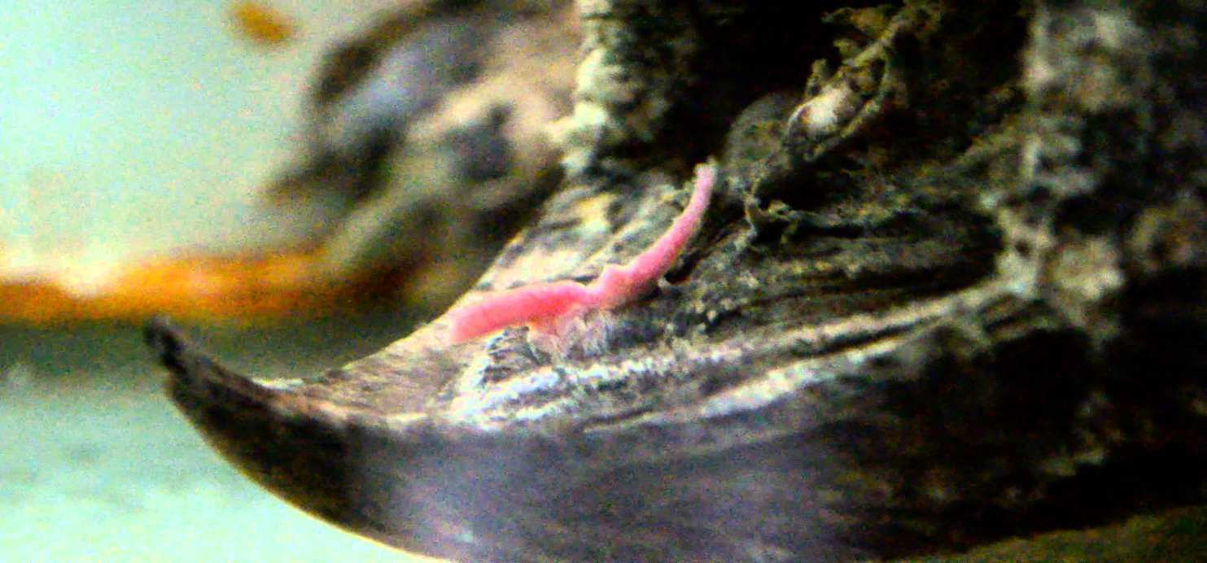
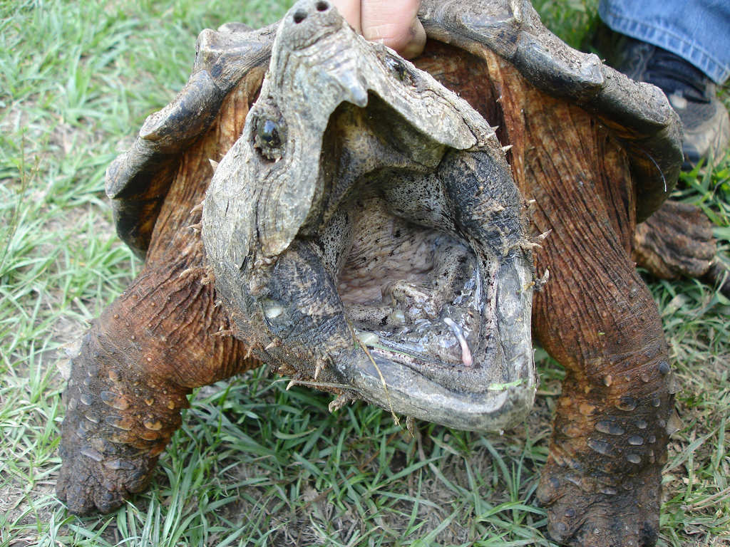
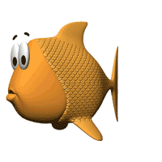
This is a form of mimicry in which a predator (the mimic) closely resembles another organism (the model) that is attractive to a third organism (the dupe) on which the mimic preys. student gets one old compact disc.
Guess correctly and you keep you disc.
Guess incorrectly and lose it.
You must try and beat.
Mimic = Alligator Snapper
Mimic = Alligator Snapper
Dupe
14
Model = worm / tongue
Model = Worm / Tongue

Slide 42
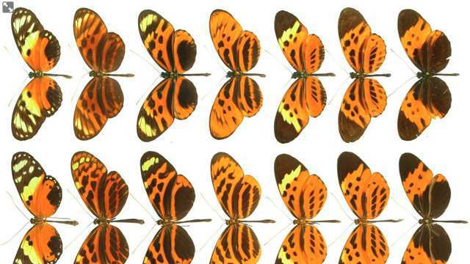
This is the type of mimicry where several unrelated species share warning colors that warn predators that these colors are dangerous or toxic.
15

Slide 43
Part II Ecology Interactions
HOUSE OF CARDS | SNEAK PEEK | SIMON SAYS | HELPING HAND? | -Bonus- MIX UP
1 | 6 | 11 | 16 | *21
2 | 7 | 12 | 17 | *22
3 | 8 | 13 | 18 | *23
4 | 9 | 14 | 19 | *24
5 | 10 | 15 | 20 | *25

Slide 44
Part II Ecology Interactions
HOUSE OF CARDS | SNEAK PEEK | SIMON SAYS | HELPING HAND? | -Bonus- MIX UP
1 | 6 | 11 | 16 | *21
2 | 7 | 12 | 17 | *22
3 | 8 | 13 | 18 | *23
4 | 9 | 14 | 19 | *24
5 | 10 | 15 | 20 | *25

Slide 45
Which species below has warning coloration?
A
B
C
D
16

Slide 46
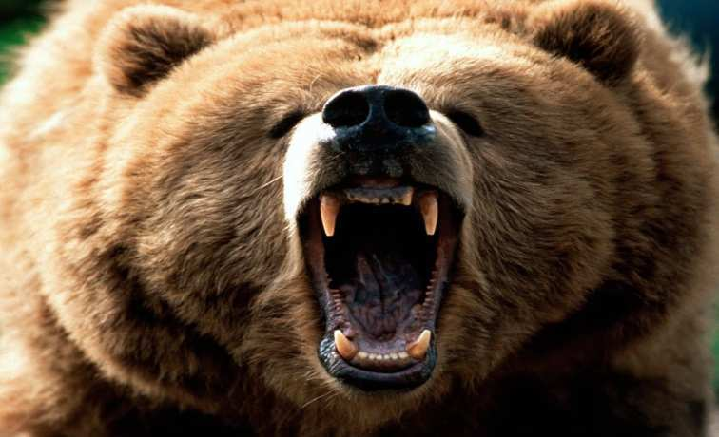
Which species below has warning coloration?
A
B
C
D
16

Slide 47
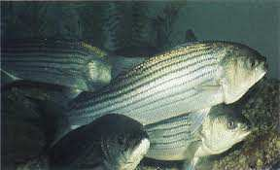
Which species below has warning coloration?
A
B
C
D
16

Slide 48
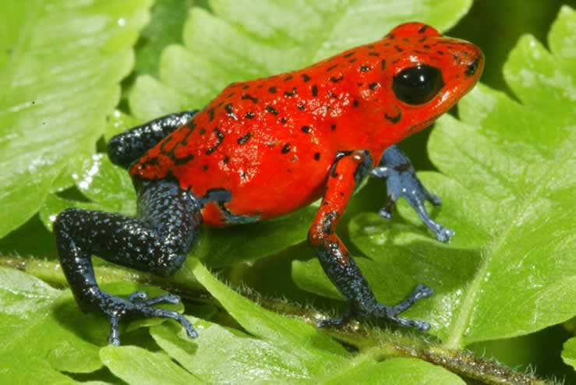
Which species below has warning coloration?
A
B
C
D
16

Slide 49
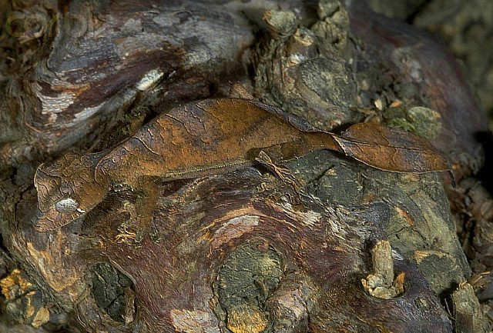
Which species below has warning coloration?
A
B
C
D
16

Slide 50
17
Please fill in the missing words...
The predator-prey relationship is important in maintaining balance among different animal species. Adaptations that are beneficial to prey, such as camouflage, mimicry, and chemical and physical defenses, ensure that the species will survive.
At the same time, predators must undergo certain adaptive changes to make finding and capturing prey less difficult.
Copyright © 2024 SlideSpark LLC

Slide 51
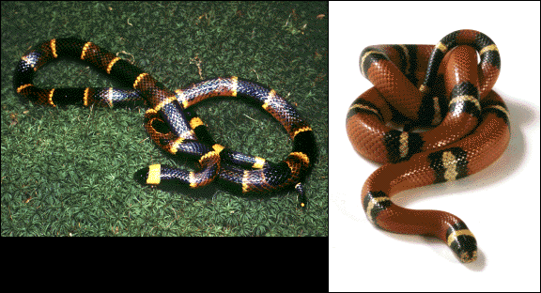
Which species is the venomous coral snake and which species is the nonvenomous king snake?
A
B
18
16

Slide 52
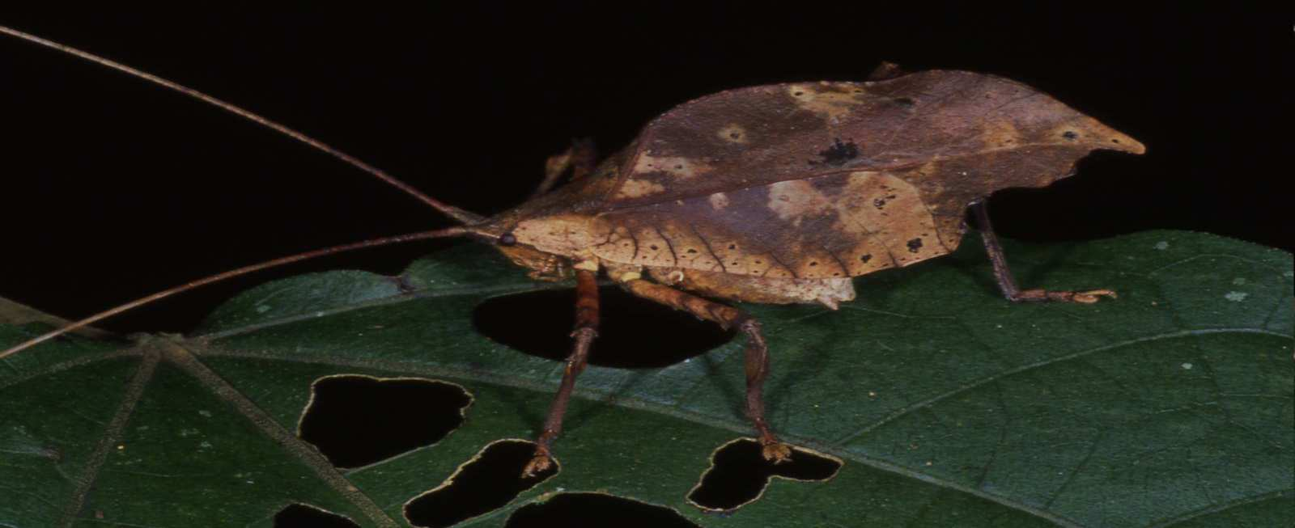
19
Name the Big Concept.
All organisms are in a constant state of change over time with the environment.
This can occur with another species and they will develop special interactions. Others with the nonliving world.

Slide 53
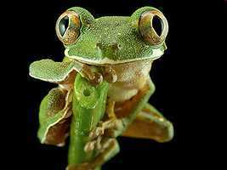
20
Name the Big Concept.
Ecosystems have a way to balance changes so that up and down fluctuations are part of the natural balance of the whole.

Slide 54
Part II Ecology Interactions
HOUSE OF CARDS | SNEAK PEEK | SIMON SAYS | HELPING HAND? | -Bonus- MIX UP
1 | 6 | 11 | 16 | *21
2 | 7 | 12 | 17 | *22
3 | 8 | 13 | 18 | *23
4 | 9 | 14 | 19 | *24
5 | 10 | 15 | 20 | *25

Slide 55
Part II Ecology Interactions
HOUSE OF CARDS | SNEAK PEEK | SIMON SAYS | HELPING HAND? | -Bonus- MIX UP
1 | 6 | 11 | 16 | *21
2 | 7 | 12 | 17 | *22
3 | 8 | 13 | 18 | *23
4 | 9 | 14 | 19 | *24
5 | 10 | 15 | 20 | *25

Slide 56
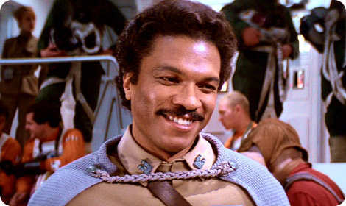
This person betrayed Han Solo to the Empire? (It wasn’t his fault)
*21

Slide 57
Who is this comedian / musician?
*22

Slide 58
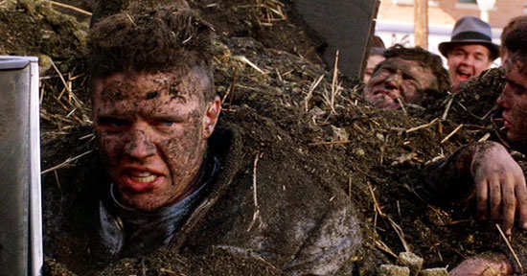
Name this Tannen from Back to the Future?
*23

Slide 59
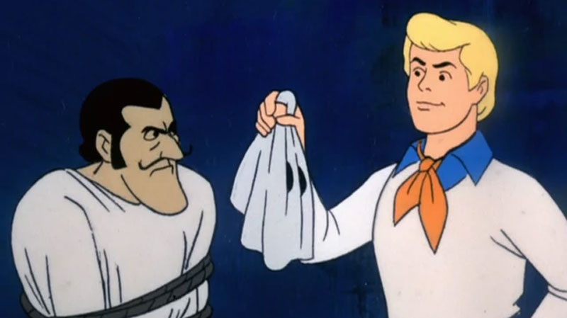
*24
Name this show?

Slide 60
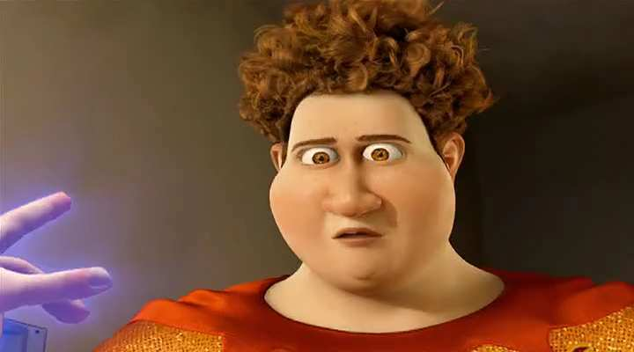
Name this hero created by Megamind?
*25

Slide 61
Part II Ecology Interactions
HOUSE OF CARDS | SNEAK PEEK | SIMON SAYS | HELPING HAND? | -Bonus- MIX UP
1 | 6 | 11 | 16 | *21
2 | 7 | 12 | 17 | *22
3 | 8 | 13 | 18 | *23
4 | 9 | 14 | 19 | *24
5 | 10 | 15 | 20 | *25

Slide 62
Part II Ecology Interactions
HOUSE OF CARDS | SNEAK PEEK | SIMON SAYS | HELPING HAND? | -Bonus- MIX UP
1 | 6 | 11 | 16 | *21
2 | 7 | 12 | 17 | *22
3 | 8 | 13 | 18 | *23
4 | 9 | 14 | 19 | *24
5 | 10 | 15 | 20 | *25
Final Question______

Slide 63
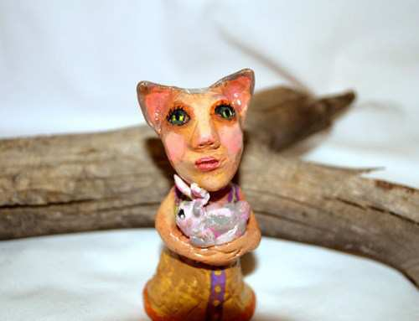
This is a 5 point
Wager question

Slide 64
Which is not an importance of biodiversity
A.) Generation of soils and maintenance of soil quality.
B.) Maintenance of air quality.
C.) Maintenance of water quality.
D.) Pest Control.
E.) Creation of waste.
F.) Pollination and crop production.
G.) Increase in food security.
H.) Provision of health care (Medicines).
I.) Income generation
J.) Spiritual / cultural value.
Copyright © 2024 SlideSpark LLC

Slide 65
Ecology Interactions Unit
Part 2
Review Game

Slide 66
Ecology Interactions Unit
Answer Key
Part 2
Review Game

Slide 67
Part II Ecology Interactions
HOUSE OF CARDS | SNEAK PEEK | SIMON SAYS | HELPING HAND? | -Bonus- MIX UP
1 | 6 | 11 | 16 | *21
2 | 7 | 12 | 17 | *22
3 | 8 | 13 | 18 | *23
4 | 9 | 14 | 19 | *24
5 | 10 | 15 | 20 | *25

Slide 68
Part II Ecology Interactions
HOUSE OF CARDS | SNEAK PEEK | SIMON SAYS | HELPING HAND? | -Bonus- MIX UP
1 | 6 | 11 | 16 | *21
2 | 7 | 12 | 17 | *22
3 | 8 | 13 | 18 | *23
4 | 9 | 14 | 19 | *24
5 | 10 | 15 | 20 | *25

Slide 69
Find the relative abundance of stars____?
1

Slide 70
Find the relative abundance of stars____?
1

Slide 71
Find the relative abundance of stars____?
1
2/10 x 100 = 20%

Slide 72
Find the relative abundance of stars____?
1
2/10 x 100 = 20%
1/10 x 100 = 10%

Slide 73
Find the relative abundance of stars____?
1
2/10 x 100 = 20%
1/10 x 100 = 10%
2/10 x 100 = 20%

Slide 74
50%
Find the relative abundance of stars____?
1
2/10 x 100 = 20%
1/10 x 100 = 10%
2/10 x 100 = 20%
5/10 x 100 = 50%

Slide 75
This is the term for the variety, or number of kinds of species living in an area.
2
Copyright © 2024 SlideSpark LLC

Slide 76
This is the term for the variety, or number of kinds of species living in an area.
2
Diversity or
Biodiversity
Copyright © 2024 SlideSpark LLC

Slide 77
Which is not an importance of biodiversity
A.) Generation of soils and maintenance of soil quality.
B.) Maintenance of air quality.
C.) Maintenance of water quality.
D.) Pest Control
E.) Detoxification and decomposition of wastes.
F.) Pollination and crop production.
G.) Decrease in food security.
H.) Provision of health care (Medicines).
I.) Income generation.
J.) Spiritual / cultural value.
3
Copyright © 2024 SlideSpark LLC

Slide 78
Which is not an importance of biodiversity
A.) Generation of soils and maintenance of soil quality.
B.) Maintenance of air quality.
C.) Maintenance of water quality.
D.) Pest Control
E.) Detoxification and decomposition of wastes.
F.) Pollination and crop production.
G.) Decrease in food security.
H.) Provision of health care (Medicines).
I.) Income generation.
J.) Spiritual / cultural value.
3
Copyright © 2024 SlideSpark LLC

Slide 79
Which is not an importance of biodiversity
A.) Generation of soils and maintenance of soil quality.
B.) Maintenance of air quality.
C.) Maintenance of water quality.
D.) Pest Control
E.) Detoxification and decomposition of wastes.
F.) Pollination and crop production.
G.) Decrease in food security.
H.) Provision of health care (Medicines).
I.) Income generation.
J.) Spiritual / cultural value.
3
Copyright © 2024 SlideSpark LLC

Slide 80
Which is not an importance of biodiversity
A.) Generation of soils and maintenance of soil quality.
B.) Maintenance of air quality.
C.) Maintenance of water quality.
D.) Pest Control
E.) Detoxification and decomposition of wastes.
F.) Pollination and crop production.
G.) Decrease in food security.
H.) Provision of health care (Medicines).
I.) Income generation.
J.) Spiritual / cultural value.
3
Copyright © 2024 SlideSpark LLC

Slide 81
Which is not an importance of biodiversity
A.) Generation of soils and maintenance of soil quality.
B.) Maintenance of air quality.
C.) Maintenance of water quality.
D.) Pest Control
E.) Detoxification and decomposition of wastes.
F.) Pollination and crop production.
G.) Decrease in food security.
H.) Provision of health care (Medicines).
I.) Income generation.
J.) Spiritual / cultural value.
3
Copyright © 2024 SlideSpark LLC

Slide 82
Which is not an importance of biodiversity
A.) Generation of soils and maintenance of soil quality.
B.) Maintenance of air quality.
C.) Maintenance of water quality.
D.) Pest Control
E.) Detoxification and decomposition of wastes.
F.) Pollination and crop production.
G.) Decrease in food security.
H.) Provision of health care (Medicines).
I.) Income generation.
J.) Spiritual / cultural value.
3
Copyright © 2024 SlideSpark LLC

Slide 83
Which is not an importance of biodiversity
A.) Generation of soils and maintenance of soil quality.
B.) Maintenance of air quality.
C.) Maintenance of water quality.
D.) Pest Control
E.) Detoxification and decomposition of wastes.
F.) Pollination and crop production.
G.) Decrease in food security.
H.) Provision of health care (Medicines).
I.) Income generation.
J.) Spiritual / cultural value.
3
Copyright © 2024 SlideSpark LLC

Slide 84
Which is not an importance of biodiversity
A.) Generation of soils and maintenance of soil quality.
B.) Maintenance of air quality.
C.) Maintenance of water quality.
D.) Pest Control
E.) Detoxification and decomposition of wastes.
F.) Pollination and crop production.
G.) Decrease in food security.
H.) Provision of health care (Medicines).
I.) Income generation.
J.) Spiritual / cultural value.
3
Copyright © 2024 SlideSpark LLC

Slide 85
Which is not an importance of biodiversity
A.) Generation of soils and maintenance of soil quality.
B.) Maintenance of air quality.
C.) Maintenance of water quality.
D.) Pest Control
E.) Detoxification and decomposition of wastes.
F.) Pollination and crop production.
G.) Decrease in food security.
H.) Provision of health care (Medicines).
I.) Income generation.
J.) Spiritual / cultural value.
3
Copyright © 2024 SlideSpark LLC

Slide 86
Which is not an importance of biodiversity
A.) Generation of soils and maintenance of soil quality.
B.) Maintenance of air quality.
C.) Maintenance of water quality.
D.) Pest Control
E.) Detoxification and decomposition of wastes.
F.) Pollination and crop production.
G.) Decrease in food security.
H.) Provision of health care (Medicines).
I.) Income generation.
J.) Spiritual / cultural value.
3
Copyright © 2024 SlideSpark LLC

Slide 87
Which is not an importance of biodiversity
A.) Generation of soils and maintenance of soil quality.
B.) Maintenance of air quality.
C.) Maintenance of water quality.
D.) Pest Control
E.) Detoxification and decomposition of wastes.
F.) Pollination and crop production.
G.) Decrease in food security.
H.) Provision of health care (Medicines).
I.) Income generation.
J.) Spiritual / cultural value.
3
Copyright © 2024 SlideSpark LLC

Slide 88
Which is not an importance of biodiversity
A.) Generation of soils and maintenance of soil quality.
B.) Maintenance of air quality.
C.) Maintenance of water quality.
D.) Pest Control
E.) Detoxification and decomposition of wastes.
F.) Pollination and crop production.
G.) Decrease in food security.
H.) Provision of health care (Medicines).
I.) Income generation.
J.) Spiritual / cultural value.
3
Answer is…
Copyright © 2024 SlideSpark LLC

Slide 89
Which is not an importance of biodiversity
A.) Generation of soils and maintenance of soil quality.
B.) Maintenance of air quality.
C.) Maintenance of water quality.
D.) Pest Control
E.) Detoxification and decomposition of wastes.
F.) Pollination and crop production.
G.) Decrease in food security.
H.) Provision of health care (Medicines).
I.) Income generation.
J.) Spiritual / cultural value.
3
Answer is…
Copyright © 2024 SlideSpark LLC

Slide 90
Which is not an importance of biodiversity
A.) Generation of soils and maintenance of soil quality.
B.) Maintenance of air quality.
C.) Maintenance of water quality.
D.) Pest Control
E.) Detoxification and decomposition of wastes.
F.) Pollination and crop production.
G.) Biodiversity increases food security.
H.) Provision of health care (Medicines).
I.) Income generation.
J.) Spiritual / cultural value.
3
Answer is…
Copyright © 2024 SlideSpark LLC

Slide 91
How can we maintain biodiversity?
Please provide at least one way that humans can maintain biodiversity.

Slide 92
How can we maintain biodiversity?
First see the value

Slide 93
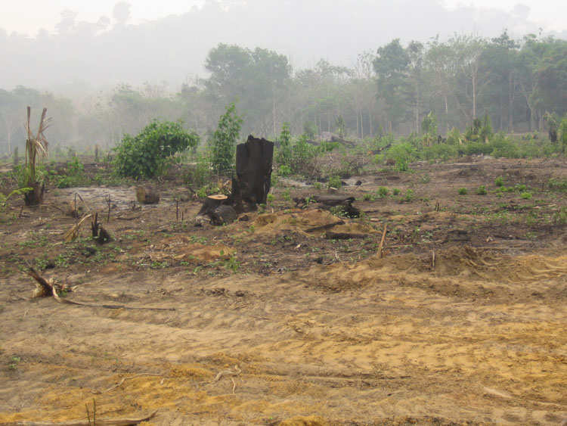
How can we maintain biodiversity?
First see the value
Don’t mess with this…

Slide 94
How can we maintain biodiversity?
First see the value
Don’t mess with this…
Prevent habitat destruction

Slide 95
How can we maintain biodiversity?
First see the value
Don’t mess with this…
Prevent habitat destruction
Laws and regulations, conservation measures, Parks, etc.

Slide 96
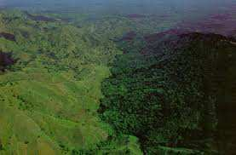
How can we maintain biodiversity?
First see the value
Don’t mess with this…
Prevent habitat destruction
Laws and regulations, conservation measures, Parks, etc.

Slide 97
How can we maintain biodiversity?
First see the value
Don’t mess with this…
Prevent habitat destruction
Laws and regulations, conservation measures, Parks, etc.
Haiti,
No Regulations

Slide 98
How can we maintain biodiversity?
First see the value
Don’t mess with this…
Prevent habitat destruction
Laws and regulations, conservation measures, Parks, etc.
Border
Haiti,
No Regulations

Slide 99
How can we maintain biodiversity?
First see the value
Don’t mess with this…
Prevent habitat destruction
Laws and regulations, conservation measures, Parks, etc.
Border
Haiti,
No Regulations
Dominican Republic
Regulations

Slide 100
How can we maintain biodiversity?
First see the value
Don’t mess with this…
Prevent habitat destruction
Laws and regulations, conservation measures, Parks, etc.
Conservation of key species

Slide 101
Hundred of species are lost everyday on this planet forever.
Estimates put it as high as 70,000 species per year.
How can we maintain biodiversity?
First see the value
Don’t mess with this…
Prevent habitat destruction
Laws and regulations, conservation measures, Parks, etc.
Conservation of key species
Minimize Human
Interference!

Slide 102
How many, on average, species go extinct on planet earth every year from human impacts?
A.) 7-10 species
B.) 70-100 species
C.) 7,000 species
D.) 70,000 species
E.) 700 million
5

Slide 103
How many, on average, species go extinct on planet earth every year from human impacts?
A.) 7-10 species
B.) 70-100 species
C.) 7,000 species
D.) 70,000 species
E.) 700 million
5

Slide 104
How many, on average, species go extinct on planet earth every year from human impacts?
A.) 7-10 species
B.) 70-100 species
C.) 7,000 species
D.) 70,000 species
E.) 700 million
5

Slide 105
How many, on average, species go extinct on planet earth every year from human impacts?
A.) 7-10 species
B.) 70-100 species
C.) 7,000 species
D.) 70,000 species
E.) 700 million
5

Slide 106
How many, on average, species go extinct on planet earth every year from human impacts?
A.) 7-10 species
B.) 70-100 species
C.) 7,000 species
D.) 70,000 species
E.) 700 million
5

Slide 107
How many, on average, species go extinct on planet earth every year from human impacts?
A.) 7-10 species
B.) 70-100 species
C.) 7,000 species
D.) 70,000 species
E.) 700 million
5

Slide 108
How many, on average, species go extinct on planet earth every year from human impacts?
A.) 7-10 species
B.) 70-100 species
C.) 7,000 species
D.) 70,000 species
E.) 700 million
5
answer is…

Slide 109
How many, on average, species go extinct on planet earth every year from human impacts?
A.) 7-10 species
B.) 70-100 species
C.) 7,000 species
D.) 70,000 species
E.) 700 million
5
answer is…

Slide 110
Part II Ecology Interactions
HOUSE OF CARDS | SNEAK PEEK | SIMON SAYS | HELPING HAND? | -Bonus- MIX UP
1 | 6 | 11 | 16 | *21
2 | 7 | 12 | 17 | *22
3 | 8 | 13 | 18 | *23
4 | 9 | 14 | 19 | *24
5 | 10 | 15 | 20 | *25

Slide 111
Part II Ecology Interactions
HOUSE OF CARDS | SNEAK PEEK | SIMON SAYS | HELPING HAND? | -Bonus- MIX UP
1 | 6 | 11 | 16 | *21
2 | 7 | 12 | 17 | *22
3 | 8 | 13 | 18 | *23
4 | 9 | 14 | 19 | *24
5 | 10 | 15 | 20 | *25

Slide 112
This is the name for an adaptation that allows the animal to blend in with its environment to avoid being detected.
6
Copyright © 2024 SlideSpark LLC

Slide 113
This is the name for an adaptation that allows the animal to blend in with its environment to avoid being detected.
6
Camouflage
Copyright © 2024 SlideSpark LLC

Slide 114
Name the correct type of camouflage for the picture? (Can only use each once 7-10)
Concealing Coloration, Disruptive Coloration, Disguise, or Mimicry
7

Slide 115
Name the correct type of camouflage for the picture? (Can only use each once 7-10)
Concealing Coloration, Disruptive Coloration, Disguise, or Mimicry
7
Disguise

Slide 116
Name the correct type of camouflage for the picture? (Can only use each once 7-10)
Concealing Coloration, Disruptive Coloration, Disguise, or Mimicry
8
Yellow Jacket
Clearwing
Moth
Stinger
No Stinger

Slide 117
Name the correct type of camouflage for the picture? (Can only use each once 7-10)
Concealing Coloration, Disruptive Coloration, Disguise, or Mimicry
8
Mimicry
Yellow Jacket
Clearwing
Moth
Stinger
No Stinger

Slide 118
Name the correct type of camouflage for the picture? (Can only use each once 7-10)
Concealing Coloration, Disruptive Coloration, Disguise, or Mimicry
9

Slide 119
Name the correct type of camouflage for the picture? (Can only use each once 7-10)
Concealing Coloration, Disruptive Coloration, Disguise, or Mimicry
9
Disruptive
Coloration

Slide 120
Name the correct type of camouflage for the picture? (Can only use each once 7-10)
Concealing Coloration, Disruptive Coloration, Disguise, or Mimicry
10

Slide 121
Name the correct type of camouflage for the picture? (Can only use each once 7-10)
Concealing Coloration, Disruptive Coloration, Disguise, or Mimicry
10
Concealing
Coloration

Slide 122
Part II Ecology Interactions
HOUSE OF CARDS | SNEAK PEEK | SIMON SAYS | HELPING HAND? | -Bonus- MIX UP
1 | 6 | 11 | 16 | *21
2 | 7 | 12 | 17 | *22
3 | 8 | 13 | 18 | *23
4 | 9 | 14 | 19 | *24
5 | 10 | 15 | 20 | *25

Slide 123
Part II Ecology Interactions
HOUSE OF CARDS | SNEAK PEEK | SIMON SAYS | HELPING HAND? | -Bonus- MIX UP
1 | 6 | 11 | 16 | *21
2 | 7 | 12 | 17 | *22
3 | 8 | 13 | 18 | *23
4 | 9 | 14 | 19 | *24
5 | 10 | 15 | 20 | *25

Slide 124
Where there’s a mimic, there must also be a… Model.
Sometimes they can be very unappetizing animals.
11
Poisonous/ unpalatable
Poisonous/ unpalatable
Model
Model
Palatable / non-poisonous
Palatable / non-poisonous
Mimic
Mimic

Slide 125
Where there’s a mimic, there must also be a… Model.
Sometimes they can be very unappetizing animals.
11
Poisonous/ unpalatable
Poisonous/ unpalatable
Model
Model
Palatable / non-poisonous
Palatable / non-poisonous
Mimic
Mimic

Slide 126
Where there’s a mimic, there must also be a… Model.
Sometimes they can be very unappetizing animals.
11
Poisonous/ unpalatable
Poisonous/ unpalatable
Model
Model
Palatable / non-poisonous
Palatable / non-poisonous
Mimic
Mimic

Slide 127
How does this spider “Not die” in less than seven words?
12

Slide 128
How does this spider “Not die” in less than seven words?
12
Look like poop /
scat, bird droppings

Slide 129
This is the type of mimicry where an organism resembles another species that is dangerous or may taste bad.
13
Flatworm
(No chemical defenses)
Sea Slug (Toxic)

Slide 130
This is the type of mimicry where an organism resembles another species that is dangerous or may taste bad.
13
Flatworm
(No chemical defenses)
Batesian Mimicry
Sea Slug (Toxic)

Slide 131
This is the type of mimicry where an organism resembles another species that is dangerous or may taste bad.
13
Flatworm
(No chemical defenses)
Batesian Mimicry
Sea Slug (Toxic)

Slide 132
This is the type of mimicry where an organism resembles another species that is dangerous or may taste bad.
13
Flatworm
(No chemical defenses)
Batesian Mimicry
Sea Slug (Toxic)

Slide 133
This is a form of mimicry in which a predator (the mimic) closely resembles another organism (the model) that is attractive to a third organism (the dupe) on which the mimic preys. student gets one old compact disc.
Guess correctly and you keep you disc.
Guess incorrectly and lose it.
You must try and beat.
Mimic = Alligator Snapper
Mimic = Alligator Snapper
Dupe
14
Model = worm / tongue
Model = Worm / Tongue

Slide 134
This is a form of mimicry in which a predator (the mimic) closely resembles another organism (the model) that is attractive to a third organism (the dupe) on which the mimic preys. student gets one old compact disc.
Guess correctly and you keep you disc.
Guess incorrectly and lose it.
You must try and beat.
Mimic = Alligator Snapper
Mimic = Alligator Snapper
Dupe
Aggressive Mimicry
14
Model = worm / tongue
Model = Worm / Tongue

Slide 135
This is the type of mimicry where several unrelated species share warning colors that warn predators that these colors are dangerous or toxic.
15

Slide 136
This is the type of mimicry where several unrelated species share warning colors that warn predators that these colors are dangerous or toxic.
15
Mullerian
Mimicry

Slide 137
Part II Ecology Interactions
HOUSE OF CARDS | SNEAK PEEK | SIMON SAYS | HELPING HAND? | -Bonus- MIX UP
1 | 6 | 11 | 16 | *21
2 | 7 | 12 | 17 | *22
3 | 8 | 13 | 18 | *23
4 | 9 | 14 | 19 | *24
5 | 10 | 15 | 20 | *25

Slide 138
Part II Ecology Interactions
HOUSE OF CARDS | SNEAK PEEK | SIMON SAYS | HELPING HAND? | -Bonus- MIX UP
1 | 6 | 11 | 16 | *21
2 | 7 | 12 | 17 | *22
3 | 8 | 13 | 18 | *23
4 | 9 | 14 | 19 | *24
5 | 10 | 15 | 20 | *25

Slide 139
Which species below has warning coloration?
A
B
C
D
16

Slide 140
Which species below has warning coloration?
A
B
C
D
16

Slide 141
Which species below has warning coloration?
A
B
C
D
16

Slide 142
Which species below has warning coloration?
A
B
C
D
16

Slide 143
Which species below has warning coloration?
A
B
C
D
16

Slide 144
Which species below has warning coloration?
A
B
Answer is…
C
D
16

Slide 145
Which species below has warning coloration?
A
B
Answer is…
C
D
16

Slide 146
Which species below has warning coloration?
A
B
Answer is…
C
D
Also called
Aposematic
Coloration
16

Slide 147
Which species below has warning coloration?
A
B
Answer is…
C
D
Also called
Aposematic
Coloration
16

Slide 148
Which species below has warning coloration?
A
B
Answer is…
C
D
Also called
Aposematic
Coloration
16

Slide 149
17
Please fill in the missing words...
The predator-prey relationship is important in maintaining balance among different animal species. Adaptations that are beneficial to prey, such as camouflage, mimicry, and chemical and physical defenses, ensure that the species will survive.
At the same time, predators must undergo certain adaptive changes to make finding and capturing prey less difficult.
Copyright © 2024 SlideSpark LLC

Slide 150
17
Please fill in the missing words...
The predator-prey relationship is important in maintaining balance among different animal species. Adaptations that are beneficial to prey, such as camouflage, mimicry, and chemical and physical defenses, ensure that the species will survive.
At the same time, predators must undergo certain adaptive changes to make finding and capturing prey less difficult.
Copyright © 2024 SlideSpark LLC

Slide 151
17
Please fill in the missing words...
The predator-prey relationship is important in maintaining balance among different animal species. Adaptations that are beneficial to prey, such as camouflage, mimicry, and chemical and physical defenses, ensure that the species will survive.
At the same time, predators must undergo certain adaptive changes to make finding and capturing prey less difficult.
Copyright © 2024 SlideSpark LLC

Slide 152
17
Please fill in the missing words...
The predator-prey relationship is important in maintaining balance among different animal species. Adaptations that are beneficial to prey, such as camouflage, mimicry, and chemical and physical defenses, ensure that the species will survive.
At the same time, predators must undergo certain adaptive changes to make finding and capturing prey less difficult.
Copyright © 2024 SlideSpark LLC

Slide 153
17
Please fill in the missing words...
The predator-prey relationship is important in maintaining balance among different animal species. Adaptations that are beneficial to prey, such as camouflage, mimicry, and chemical and physical defenses, ensure that the species will survive.
At the same time, predators must undergo certain adaptive changes to make finding and capturing prey less difficult.
Copyright © 2024 SlideSpark LLC

Slide 154
17
Please fill in the missing words...
The predator-prey relationship is important in maintaining balance among different animal species. Adaptations that are beneficial to prey, such as camouflage, mimicry, and chemical and physical defenses, ensure that the species will survive.
At the same time, predators must undergo certain adaptive changes to make finding and capturing prey less difficult.
Copyright © 2024 SlideSpark LLC

Slide 155
17
Please fill in the missing words...
The predator-prey relationship is important in maintaining balance among different animal species. Adaptations that are beneficial to prey, such as camouflage, mimicry, and chemical and physical defenses, ensure that the species will survive.
At the same time, predators must undergo certain adaptive changes to make finding and capturing prey less difficult.
Copyright © 2024 SlideSpark LLC

Slide 156
17
Please fill in the missing words...
The predator-prey relationship is important in maintaining balance among different animal species. Adaptations that are beneficial to prey, such as camouflage, mimicry, and chemical and physical defenses, ensure that the species will survive.
At the same time, predators must undergo certain adaptive changes to make finding and capturing prey less difficult.
Copyright © 2024 SlideSpark LLC

Slide 157
17
Please fill in the missing words...
The predator-prey relationship is important in maintaining balance among different animal species. Adaptations that are beneficial to prey, such as camouflage, mimicry, and chemical and physical defenses, ensure that the species will survive.
At the same time, predators must undergo certain adaptive changes to make finding and capturing prey less difficult.
Copyright © 2024 SlideSpark LLC

Slide 158
17
Please fill in the missing words...
The predator-prey relationship is important in maintaining balance among different animal species. Adaptations that are beneficial to prey, such as camouflage, mimicry, and chemical and physical defenses, ensure that the species will survive.
At the same time, predators must undergo certain adaptive changes to make finding and capturing prey less difficult.
Copyright © 2024 SlideSpark LLC

Slide 159
17
Please fill in the missing words...
The predator-prey relationship is important in maintaining balance among different animal species. Adaptations that are beneficial to prey, such as camouflage, mimicry, and chemical and physical defenses, ensure that the species will survive.
At the same time, predators must undergo certain adaptive changes to make finding and capturing prey less difficult.
Copyright © 2024 SlideSpark LLC

Slide 160
Which species is the venomous coral snake and which species is the nonvenomous king snake?
A
B
18
16

Slide 161
Which species is the venomous coral snake and which species is the nonvenomous king snake?
A
B
18
16

Slide 162
Which species is the venomous coral snake and which species is the nonvenomous king snake?
A
B
Red Touch Yellow Kill a Fellow
18
16

Slide 163
Which species is the venomous coral snake and which species is the nonvenomous king snake?
Venomous
Coral Snake
B
A
Red Touch Yellow Kill a Fellow
18
16

Slide 164
Which species is the venomous coral snake and which species is the nonvenomous king snake?
Venomous
Coral Snake
B
A
Red Touch Yellow Kill a Fellow
18
16

Slide 165
Which species is the venomous coral snake and which species is the nonvenomous king snake?
Venomous
Coral Snake
B
A
Red touch black, friend of Jack
Red Touch Yellow Kill a Fellow
18
16

Slide 166
Which species is the venomous coral snake and which species is the nonvenomous king snake?
Venomous
Coral Snake
B
A
Red touch black, friend of Jack
Red Touch Yellow Kill a Fellow
18
Nonvenomous
King Snake
16

Slide 167
19
Name the Big Concept.
All organisms are in a constant state of change over time with the environment.
This can occur with another species and they will develop special interactions. Others with the nonliving world.

Slide 168
19
Name the Big Concept.
All organisms are in a constant state of change over time with the environment.
This can occur with another species and they will develop special interactions. Others with the nonliving world.

Slide 169
19
Name the Big Concept.
All organisms are in a constant state of change over time with the environment.
This can occur with another species and they will develop special interactions. Others with the nonliving world.

Slide 170
20
Name the Big Concept.
Ecosystems have a way to balance changes so that up and down fluctuations are part of the natural balance of the whole.

Slide 171
20
Name the Big Concept.
Ecosystems have a way to balance changes so that up and down fluctuations are part of the natural balance of the whole.

Slide 172
20
Name the Big Concept.
Ecosystems have a way to balance changes so that up and down fluctuations are part of the natural balance of the whole.

Slide 173
Part II Ecology Interactions
HOUSE OF CARDS | SNEAK PEEK | SIMON SAYS | HELPING HAND? | -Bonus- MIX UP
1 | 6 | 11 | 16 | *21
2 | 7 | 12 | 17 | *22
3 | 8 | 13 | 18 | *23
4 | 9 | 14 | 19 | *24
5 | 10 | 15 | 20 | *25

Slide 174
Part II Ecology Interactions
HOUSE OF CARDS | SNEAK PEEK | SIMON SAYS | HELPING HAND? | -Bonus- MIX UP
1 | 6 | 11 | 16 | *21
2 | 7 | 12 | 17 | *22
3 | 8 | 13 | 18 | *23
4 | 9 | 14 | 19 | *24
5 | 10 | 15 | 20 | *25

Slide 175
This person betrayed Han Solo to the Empire? (It wasn’t his fault)
*21

Slide 176
This person betrayed Han Solo to the Empire? (It wasn’t his fault)
*21
Lando Calrissian

Slide 177
Who is this comedian / musician?
*22

Slide 178
Who is this comedian / musician?
*22
Weird Al Yankovic

Slide 179
Name this Tannen from Back to the Future?
*23

Slide 180
Name this Tannen from Back to the Future?
*23
Biff Tannen

Slide 181
*24
Name this show?

Slide 182
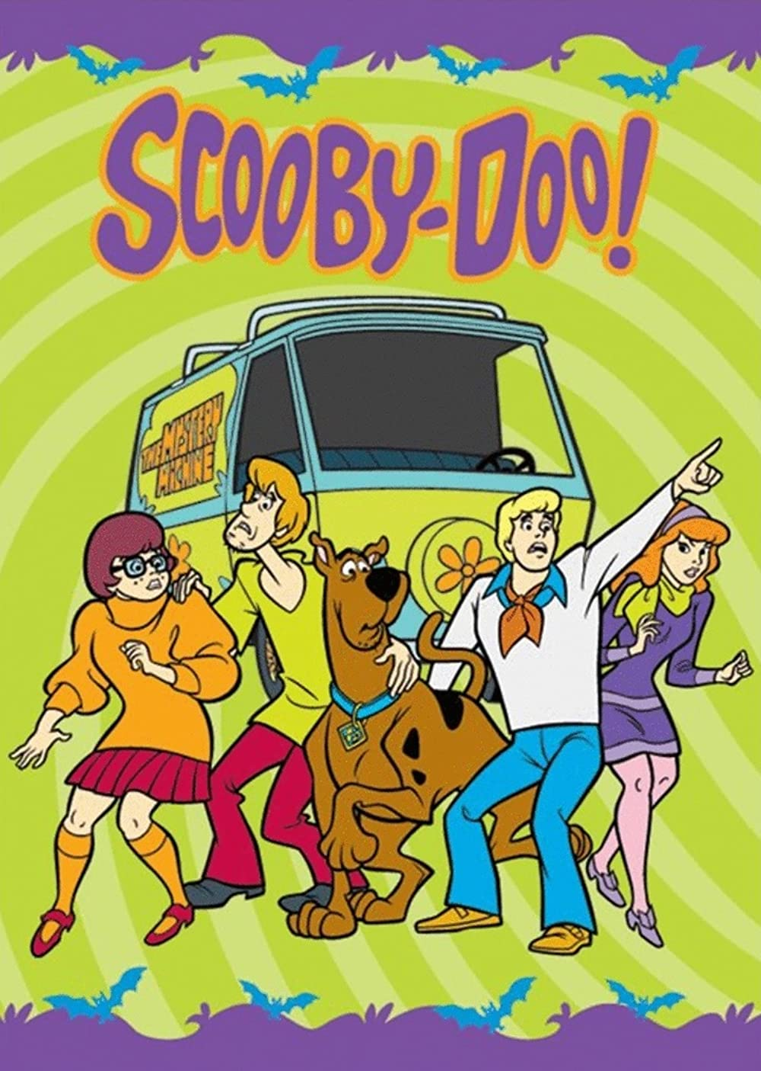
*24
Name this show?

Slide 183
Name this hero created by Megamind?
*25

Slide 184
Name this hero created by Megamind?
*25
Titan

Slide 185
Part II Ecology Interactions
HOUSE OF CARDS | SNEAK PEEK | SIMON SAYS | HELPING HAND? | -Bonus- MIX UP
1 | 6 | 11 | 16 | *21
2 | 7 | 12 | 17 | *22
3 | 8 | 13 | 18 | *23
4 | 9 | 14 | 19 | *24
5 | 10 | 15 | 20 | *25

Slide 186
Part II Ecology Interactions
HOUSE OF CARDS | SNEAK PEEK | SIMON SAYS | HELPING HAND? | -Bonus- MIX UP
1 | 6 | 11 | 16 | *21
2 | 7 | 12 | 17 | *22
3 | 8 | 13 | 18 | *23
4 | 9 | 14 | 19 | *24
5 | 10 | 15 | 20 | *25
Final Question______

Slide 187
This is a 5 point
Wager question

Slide 188
Which is not an importance of biodiversity
A.) Generation of soils and maintenance of soil quality.
B.) Maintenance of air quality.
C.) Maintenance of water quality.
D.) Pest Control.
E.) Creation of waste.
F.) Pollination and crop production.
G.) Increase in food security.
H.) Provision of health care (Medicines).
I.) Income generation
J.) Spiritual / cultural value.
Copyright © 2024 SlideSpark LLC

Slide 189
Which is not an importance of biodiversity
A.) Generation of soils and maintenance of soil quality.
B.) Maintenance of air quality.
C.) Maintenance of water quality.
D.) Pest Control.
E.) Creation of waste.
F.) Pollination and crop production.
G.) Increase in food security.
H.) Provision of health care (Medicines).
I.) Income generation
J.) Spiritual / cultural value.
Answer is…
Copyright © 2024 SlideSpark LLC

Slide 190
Which is not an importance of biodiversity
A.) Generation of soils and maintenance of soil quality.
B.) Maintenance of air quality.
C.) Maintenance of water quality.
D.) Pest Control.
E.) Creation of waste.
F.) Pollination and crop production.
G.) Increase in food security.
H.) Provision of health care (Medicines).
I.) Income generation
J.) Spiritual / cultural value.
Answer is…
Copyright © 2024 SlideSpark LLC

Slide 191
Which is not an importance of biodiversity
A.) Generation of soils and maintenance of soil quality.
B.) Maintenance of air quality.
C.) Maintenance of water quality.
D.) Pest Control.
E.) Detoxification and decomposition of wastes.
F.) Pollination and crop production.
G.) Increase in food security.
H.) Provision of health care (Medicines).
I.) Income generation
J.) Spiritual / cultural value.
Copyright © 2024 SlideSpark LLC

Slide 192
Interactions Part 2 Unit Review Game
1-20 = 5 points each
20-25 = Bonus (1 point each)
Final Question = 5 point wager
Find the Owl = 1 point

Slide 193
Ecology Interactions Unit
Answer Key
Part 2
Review Game

