Slide 1
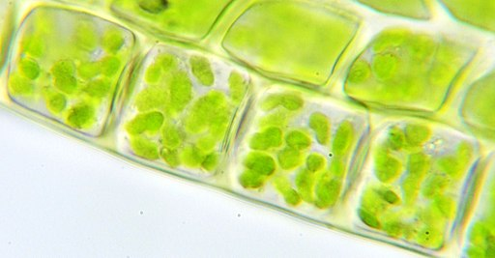

Part 4 Review Game
Part 4
Lesson 10

Slide 2
Part 4 Review Game
IT BURNS | PHOTOSHOP | BREATH IN | BIG GULP | -BONUS- GREEN SUPER HEROES
1 | 6 | 11 | 16 | *21
2 | 7 | 12 | 17 | *22
3 | 8 | 13 | 18 | *23
4 | 9 | 14 | 19 | *24
5 | 10 | 15 | 20 | *25
Copyright © 2024 SlideSpark .LLC

Slide 3
How to play…
  Don’t play like Jeo_ _ _ _ y.
  Class should be divided into several small groups.
  Groups should use science journal (red slide notes), homework, and other available materials to assist you.
  Groups can communicate quietly with each other but no sharing answers between groups.
    Practice quietly communicating right now?
    Practice Communication Question:
    Your group gets to order one pizza and you can have two toppings. What does your group want?

Slide 4

Questions 1-20 = 5pts Each
Final Category (Bonus) = 1pt Each
Final Questions = 5 pt wager
If you wager 5 on the last question and get it wrong you lose 5 pts. Wager 5 and get it right you get 5 pts.
Find the Owl =
Secretly write “Owl” in the correct box worth 1pt.
“I’ll be about this big.”

Slide 5
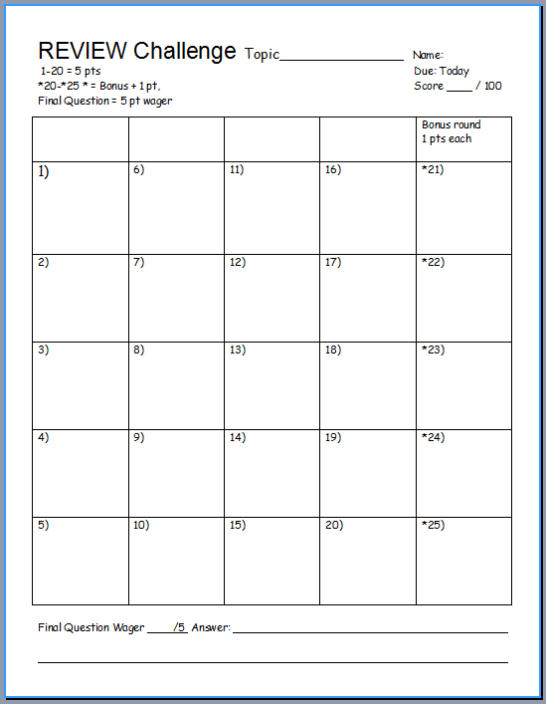
Is your name on the review sheet?
Name

Slide 6
Is your name on the review sheet?
Add the categories
along the top
on the next slide.

Slide 7
Part 4 Review Game
IT BURNS | PHOTOSHOP | BREATH IN | BIG GULP | -BONUS- GREEN SUPER HEROES
1 | 6 | 11 | 16 | *21
2 | 7 | 12 | 17 | *22
3 | 8 | 13 | 18 | *23
4 | 9 | 14 | 19 | *24
5 | 10 | 15 | 20 | *25
Copyright © 2024 SlideSpark .LLC

Slide 8

Part 4 Review Game
IT BURNS | PHOTOSHOP | BREATH IN | BIG GULP | -BONUS- GREEN SUPER HEROES
1 | 6 | 11 | 16 | *21
2 | 7 | 12 | 17 | *22
3 | 8 | 13 | 18 | *23
4 | 9 | 14 | 19 | *24
5 | 10 | 15 | 20 | *25
Copyright © 2024 SlideSpark .LLC

Slide 9
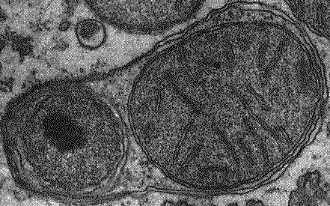
These have digestive enzymes to recycle cell parts and break down molecules?
1

Slide 10
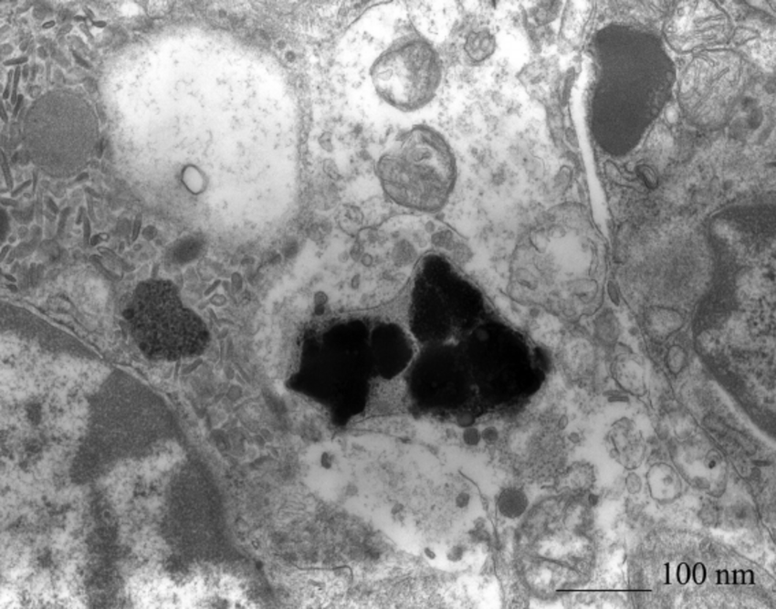
2
Which is not true of the Lysosome?
  A.) has digestive acids / enzymes
  B.) digestive organelle, recycles old cell parts
  C.) creates proteins, lipids, and carbohydrates
  D.) transports undigested material for removal
  E.) can cause a cell to self destruct

Slide 11
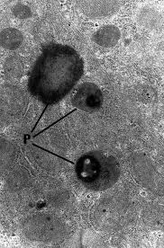
These are small organelles present in the cytoplasm of many cells, which contains the reducing enzyme catalase and usually some oxidases.
3

Slide 12
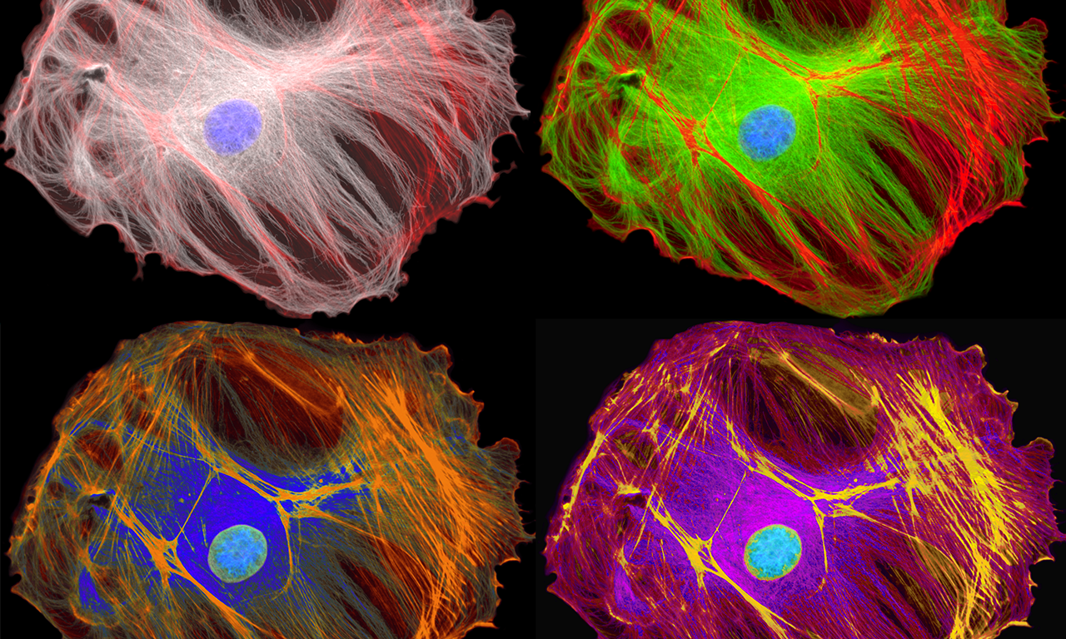
This is a microscopic network of protein filaments and tubules in the cytoplasm of many living cells, giving them shape and coherence.)
4

Slide 13

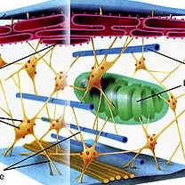
Which letter is which fiber?
  Microfilaments (thin fibers)
  Intermediate filaments (medium sized)
  Microtubules (Large hollow cylinders)
B
C
A

Slide 14
Part 4 Review Game
IT BURNS | PHOTOSHOP | BREATH IN | BIG GULP | -BONUS- GREEN SUPER HEROES
1 | 6 | 11 | 16 | *21
2 | 7 | 12 | 17 | *22
3 | 8 | 13 | 18 | *23
4 | 9 | 14 | 19 | *24
5 | 10 | 15 | 20 | *25
Copyright © 2024 SlideSpark .LLC

Slide 15

Part 4 Review Game
IT BURNS | PHOTOSHOP | BREATH IN | BIG GULP | -BONUS- GREEN SUPER HEROES
1 | 6 | 11 | 16 | *21
2 | 7 | 12 | 17 | *22
3 | 8 | 13 | 18 | *23
4 | 9 | 14 | 19 | *24
5 | 10 | 15 | 20 | *25
Copyright © 2024 SlideSpark .LLC

Slide 16
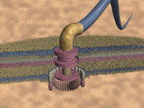
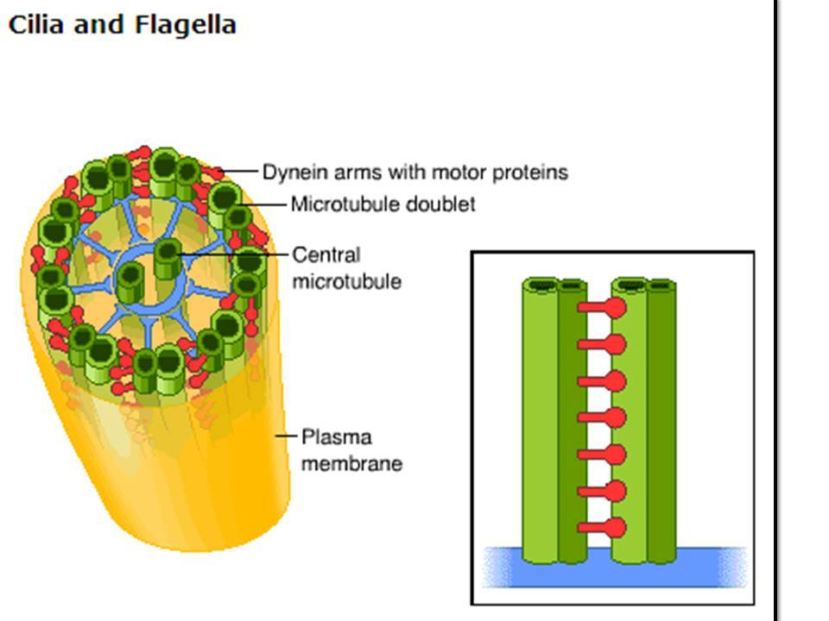
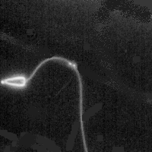
This is a hairlike structure that acts primarily as an organelle of locomotion.
  Made of a bundle of nine pairs of microtubules surrounding two central pairs of microtubules
6

Slide 17

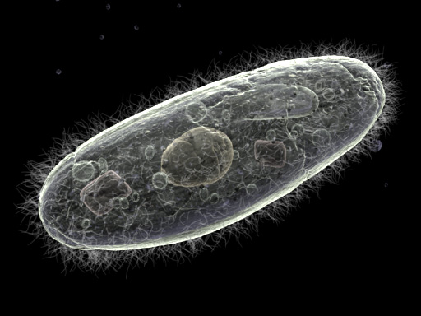
This is a small structure that extends out from the surface of cell and is used for movement.
7

Slide 18
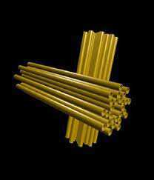
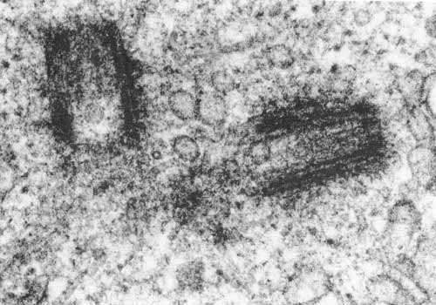
Centrioles
  Look like golden nuggets (Paired)
  Made of nine tubes
  Aid in cell division (Mitosis)
8

Slide 19
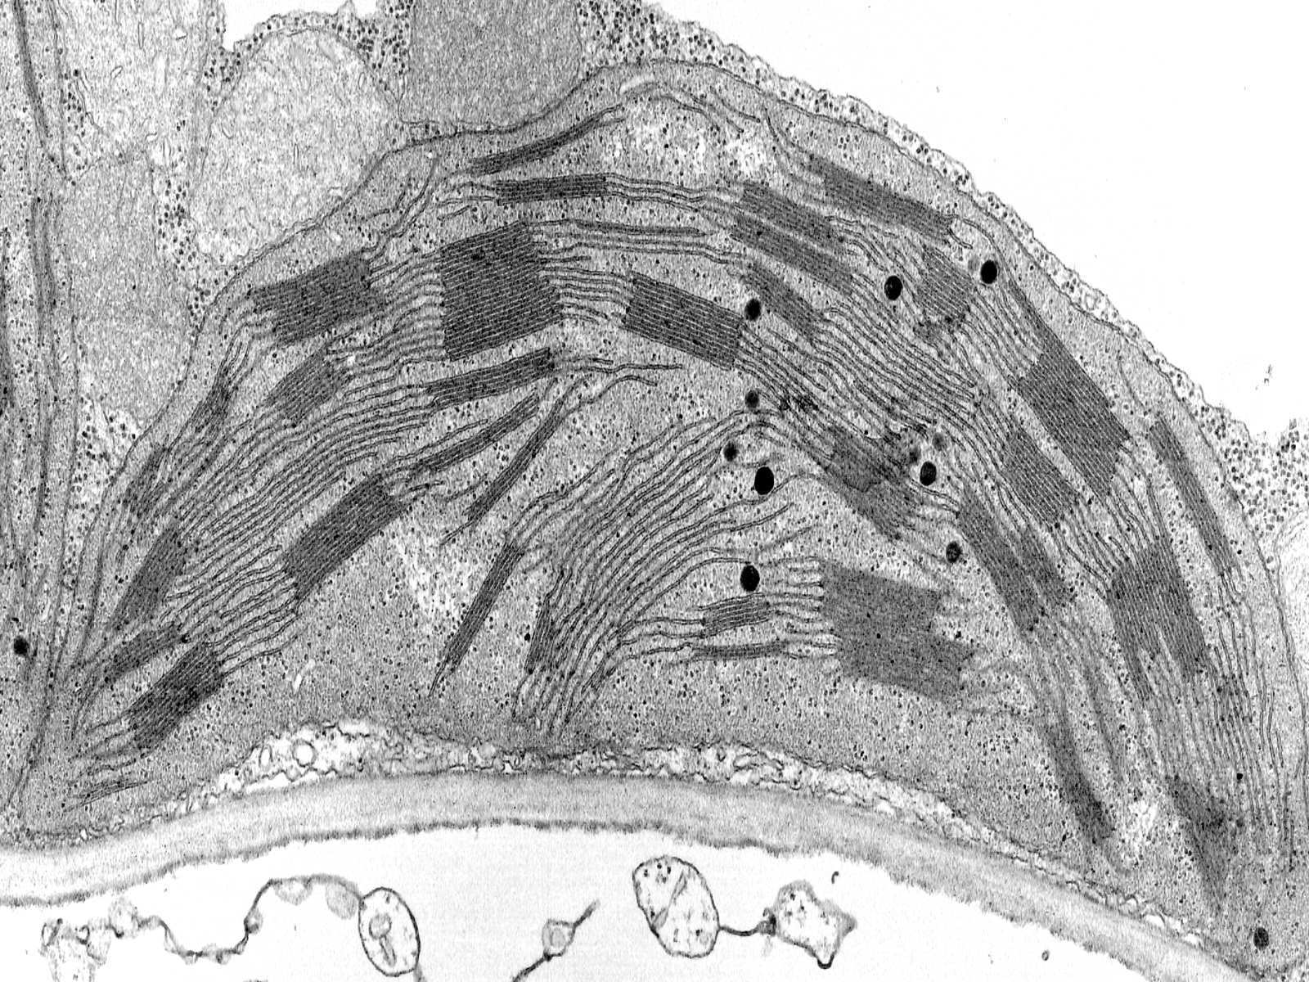
Organelle that conducts photosynthesis,
  Where the photosynthetic pigment chlorophyll captures the energy from sunlight, converts it, and stores it in the energy-storage molecules
9

Slide 20
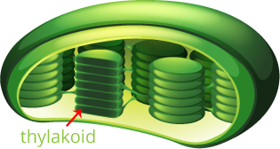
10
These are the membrane-bound compartments inside chloroplasts and cyanobacteria.
  They are the site of the light-dependent reactions of photosynthesis

Slide 21
Part 4 Review Game
IT BURNS | PHOTOSHOP | BREATH IN | BIG GULP | -BONUS- GREEN SUPER HEROES
1 | 6 | 11 | 16 | *21
2 | 7 | 12 | 17 | *22
3 | 8 | 13 | 18 | *23
4 | 9 | 14 | 19 | *24
5 | 10 | 15 | 20 | *25
Copyright © 2024 SlideSpark .LLC

Slide 22

Part 4 Review Game
IT BURNS | PHOTOSHOP | BREATH IN | BIG GULP | -BONUS- GREEN SUPER HEROES
1 | 6 | 11 | 16 | *21
2 | 7 | 12 | 17 | *22
3 | 8 | 13 | 18 | *23
4 | 9 | 14 | 19 | *24
5 | 10 | 15 | 20 | *25
Copyright © 2024 SlideSpark .LLC

Slide 23
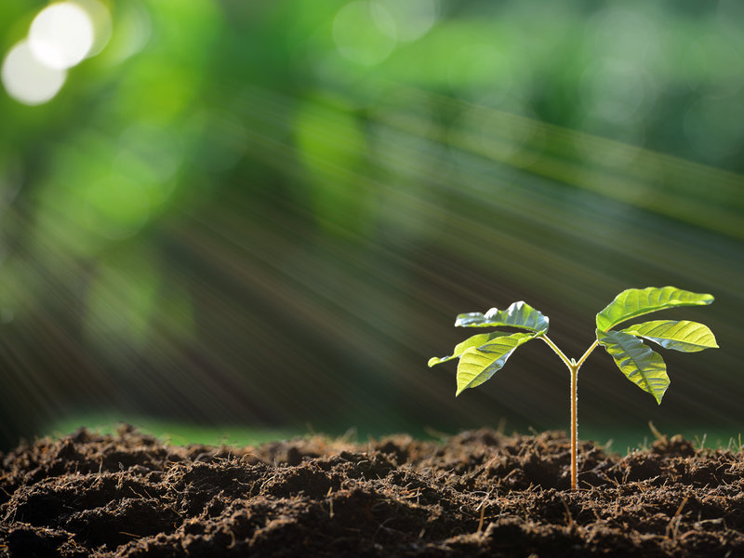
This is the process by which green plants and some other organisms use sunlight to synthesize foods from carbon dioxide and water.
11

Slide 24
Which of the following equations is the correct equation for photosynthesis?
A) 6O2 + 6H2O + light energy = C12H6O6 + 6O2
B) 6CO2 + 6H2O + sugar = C6H12O6 + 6O2
C) 6CO2 + 6O2 + light energy = C6H12O6 + 6H2O
D) 6CO2 + 6H2O + light energy = C6H12O6 + 6O2
E) 6CO2 + H2O + light energy = C6H12O6 + 6O2
F) 6CO2 + 6H2O + light energy = C6H2O6 + 6O2
G) 6CO2 + 6H2O + sugar = C6H12O6 + 6O2
H) 6CO2 + 6H2O + light energy = C6H12O3 + 6O2
I) 6CO2 + 6H2O + light energy = C6H12O6 + 6CO2
J) C6H12O6 = 6CO2 + 6H2O + light energy + 6O2
12
Copyright © 2024 SlideSpark .LLC

Slide 25

Which of the following statements is false of photosynthesis?
  A.) Photosynthesis requires sunlight, carbon dioxide, and water.
  B.) Oxygen and glucose are produced in photosynthesis.
  C.) Carbon Dioxide and water are produced.
  D.) In photosynthesis, plants use radiant energy from the sun to create chemical energy in the form of sugars.
  E.) None of the above.
Copyright © 2024 SlideSpark .LLC

Slide 26
Which of the following statements is false of photosynthesis?
  A.) Photosynthesis requires sunlight, carbon dioxide, and water.
  B.) Oxygen and glucose are produced in photosynthesis.
  C.) Carbon Dioxide and water are produced.
  D.) In photosynthesis, plants use radiant energy from the sun to create chemical energy in the form of sugars.
  E.) None of the above.
Copyright © 2024 SlideSpark .LLC

Slide 27
Which of the following statements is false of photosynthesis?
  A.) Photosynthesis requires sunlight, carbon dioxide, and water.
  B.) Oxygen and glucose are produced in photosynthesis.
  C.) Carbon Dioxide and water are produced.
  D.) In photosynthesis, plants use radiant energy from the sun to create chemical energy in the form of sugars.
  E.) None of the above.
Copyright © 2024 SlideSpark .LLC

Slide 28
Which of the following statements is false of photosynthesis?
  A.) Photosynthesis requires sunlight, carbon dioxide, and water.
  B.) Oxygen and glucose are produced in photosynthesis.
  C.) Carbon Dioxide and water are produced.
  D.) In photosynthesis, plants use radiant energy from the sun to create chemical energy in the form of sugars.
  E.) None of the above.
Copyright © 2024 SlideSpark .LLC

Slide 29
Which of the following statements is false of photosynthesis?
  A.) Photosynthesis requires sunlight, carbon dioxide, and water.
  B.) Oxygen and glucose are produced in photosynthesis.
  C.) Carbon Dioxide and water are produced.
  D.) In photosynthesis, plants use radiant energy from the sun to create chemical energy in the form of sugars.
  E.) None of the above.
Copyright © 2024 SlideSpark .LLC

Slide 30
Which of the following statements is false of photosynthesis?
  A.) Photosynthesis requires sunlight, carbon dioxide, and water.
  B.) Oxygen and glucose are produced in photosynthesis.
  C.) Carbon Dioxide and water are produced.
  D.) In photosynthesis, plants use radiant energy from the sun to create chemical energy in the form of sugars.
  E.) None of the above.
Copyright © 2024 SlideSpark .LLC

Slide 31
Which of the following statements is false of photosynthesis? and the answer is…
  A.) Photosynthesis requires sunlight, carbon dioxide, and water.
  B.) Oxygen and glucose are produced in photosynthesis.
  C.) Carbon Dioxide and water are produced.
  D.) In photosynthesis, plants use radiant energy from the sun to create chemical energy in the form of sugars.
  E.) None of the above.
Copyright © 2024 SlideSpark .LLC

Slide 32
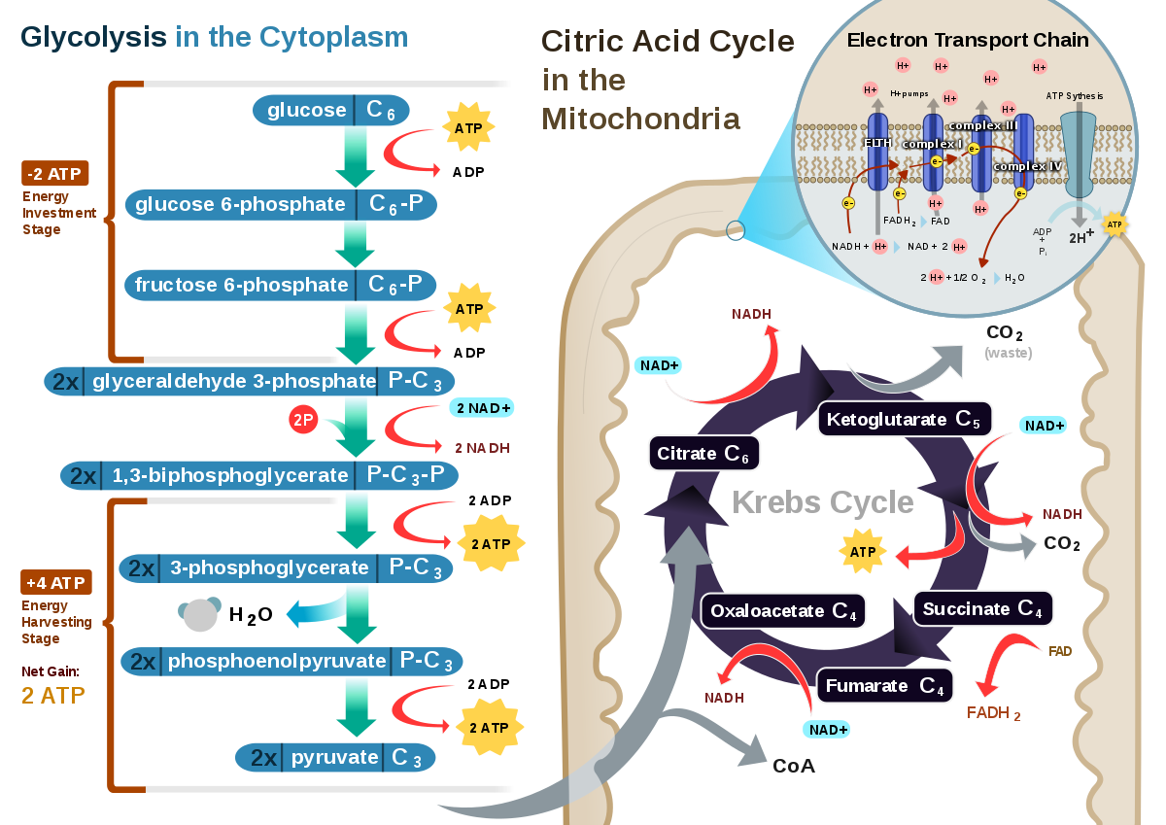

This is the processes whereby certain organisms obtain energy from organic molecules.
14

Slide 33
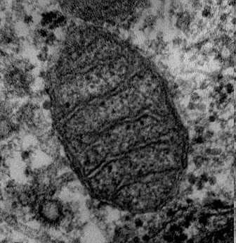
This cellular organelle uses sugar and oxygen to make energy?
15
15

Slide 34
Part 4 Review Game
IT BURNS | PHOTOSHOP | BREATH IN | BIG GULP | -BONUS- GREEN SUPER HEROES
1 | 6 | 11 | 16 | *21
2 | 7 | 12 | 17 | *22
3 | 8 | 13 | 18 | *23
4 | 9 | 14 | 19 | *24
5 | 10 | 15 | 20 | *25
Copyright © 2024 SlideSpark .LLC

Slide 35

Part 4 Review Game
IT BURNS | PHOTOSHOP | BREATH IN | BIG GULP | -BONUS- GREEN SUPER HEROES
1 | 6 | 11 | 16 | *21
2 | 7 | 12 | 17 | *22
3 | 8 | 13 | 18 | *23
4 | 9 | 14 | 19 | *24
5 | 10 | 15 | 20 | *25
Copyright © 2024 SlideSpark .LLC

Slide 36
Which of the following equations is the correct one for the respiration equation?
A) C6H12O6 + 6H2O = Released energy + 6CO2 + 6H2O.
B) C6H12O6 + 6O2 = Released energy + 6CO2 + 6H2O.
C) C6H12O6 + 6O2 = Released energy + 6O2 + 6H2O.
D) C12H6O6 + 6O2 = Released energy + 6CO2 + 6H2O.
E) C6H12O6 + 6CO2 = Released energy + 6O2 + 6H2O.
F) C6H12O6 + 6CO2 = Released energy + 6CO2 + 6H2O.
G) C6H12O6 + 6O2 = Released energy + 6CO2 + 62O.
H) C6H12O6 + 6O2 = Light Energy + 6CO2 + 6H2O.
I) C6H12O6 + 6O2 = Released energy + 6O2 + 6H2O.
J) C6H12O8 + 6O2 = Released energy + 6CO2 + 6H2O.
K) C6H12O6 + 16O2 = Released energy + 6O2 + 6H2O.
L) Released energy + 6CO2 + 6H2O C6H12O6 + 6O2 = ☺
16
Copyright © 2024 SlideSpark .LLC

Slide 37
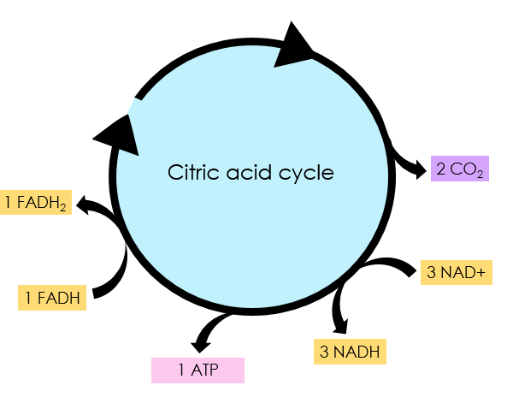
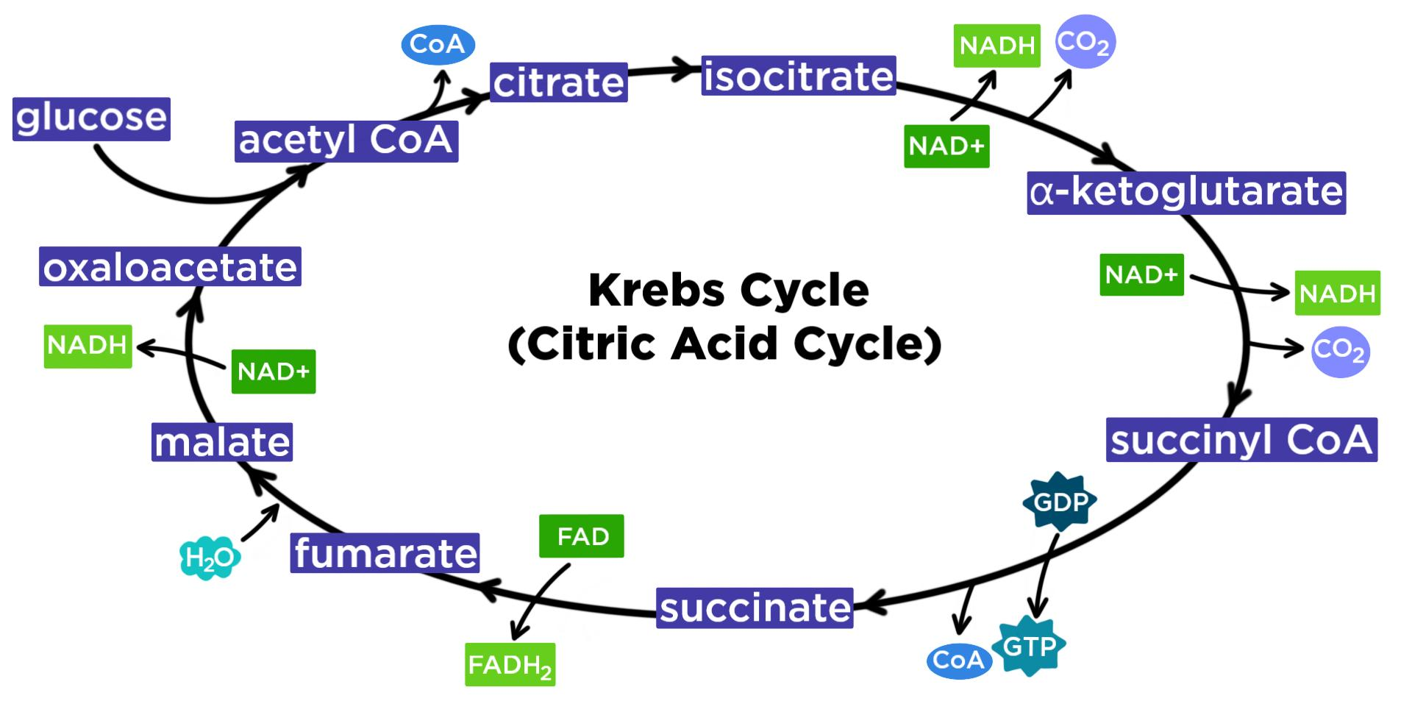
This cycle is a series of chemical reactions used by all aerobic organisms to generate energy.
  Requires the oxidation of acetate—derived from carbohydrates, fats, and proteins—into carbon dioxide.
Simplified a bit
17

Slide 38
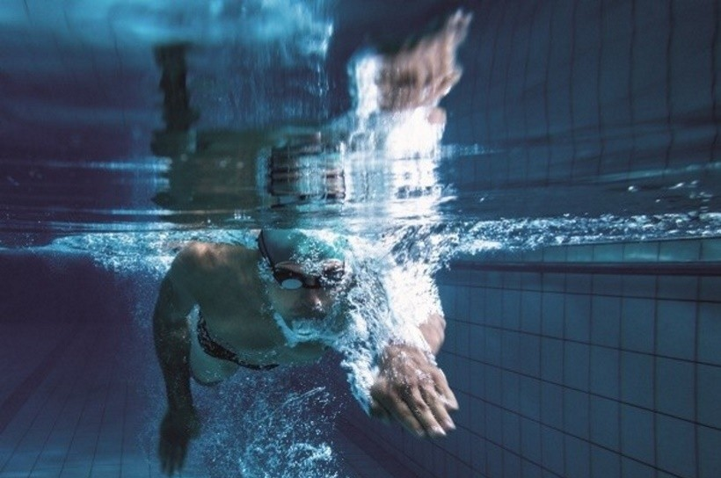
Which is not true of cellular respiration.
  A.) Burns sugars for energy.
  B.) Energy is released.
  C.) Occurs in most cells.
  D.) Oxygen is used.
  E.) Water is produced.
  F.) Oxygen is produced.
  G.) Occurs in dark and light.
18

Slide 39
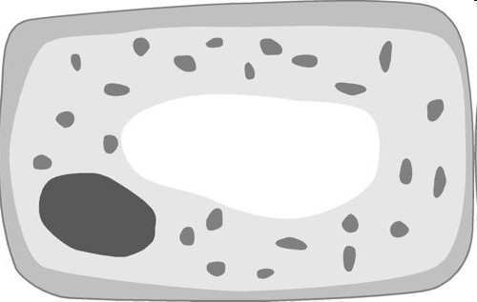
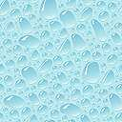
This is a membrane-bound sac for storage, digestion, and waste removal.
19

Slide 40
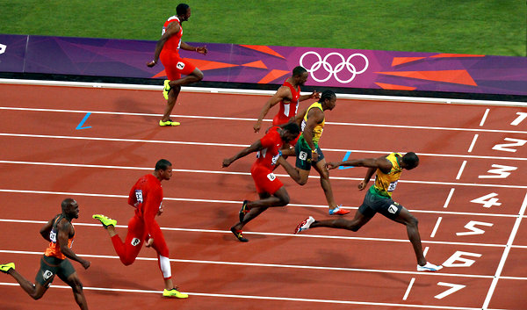
This is a form of cellular respiration that occurs when oxygen is absent or scarce.
20

Slide 41
Part 4 Review Game
IT BURNS | PHOTOSHOP | BREATH IN | BIG GULP | -BONUS- GREEN SUPER HEROES
1 | 6 | 11 | 16 | *21
2 | 7 | 12 | 17 | *22
3 | 8 | 13 | 18 | *23
4 | 9 | 14 | 19 | *24
5 | 10 | 15 | 20 | *25
Copyright © 2024 SlideSpark .LLC

Slide 42
Part 4 Review Game
IT BURNS | PHOTOSHOP | BREATH IN | BIG GULP | -BONUS- GREEN SUPER HEROES
1 | 6 | 11 | 16 | *21
2 | 7 | 12 | 17 | *22
3 | 8 | 13 | 18 | *23
4 | 9 | 14 | 19 | *24
5 | 10 | 15 | 20 | *25
Copyright © 2024 SlideSpark .LLC

Slide 43

*21
Name the Green
Superhero?

Slide 44
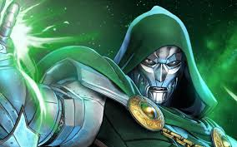
*22

Slide 45
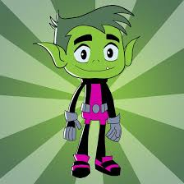
*23

Slide 46
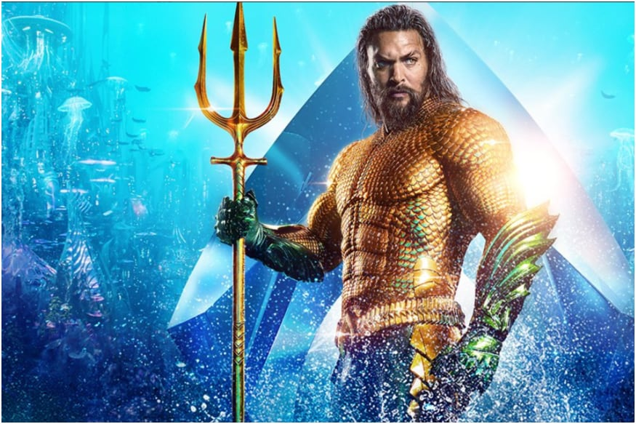
*24

Slide 47
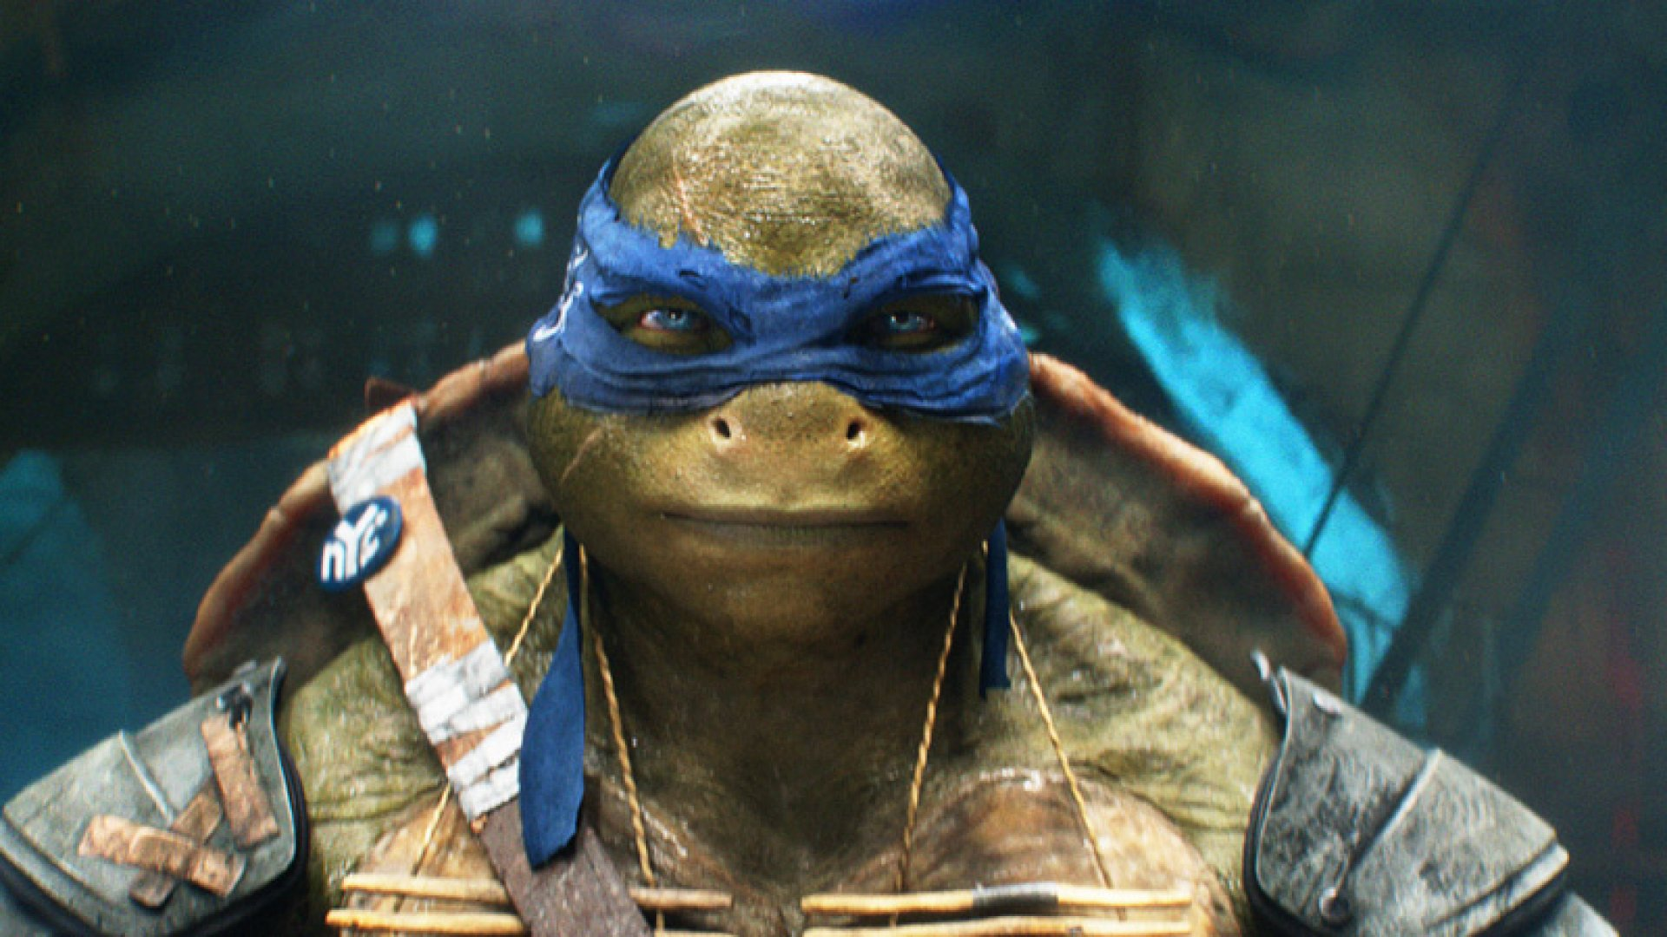
*25

Slide 48
Part 4 Review Game
IT BURNS | PHOTOSHOP | BREATH IN | BIG GULP | -BONUS- GREEN SUPER HEROES
1 | 6 | 11 | 16 | *21
2 | 7 | 12 | 17 | *22
3 | 8 | 13 | 18 | *23
4 | 9 | 14 | 19 | *24
5 | 10 | 15 | 20 | *25
Final Question
Copyright © 2024 SlideSpark .LLC

Slide 49
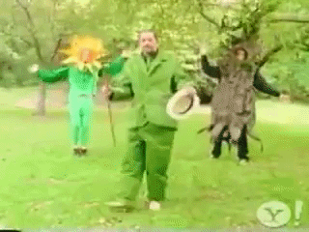
5 Point Wager Question

Slide 50
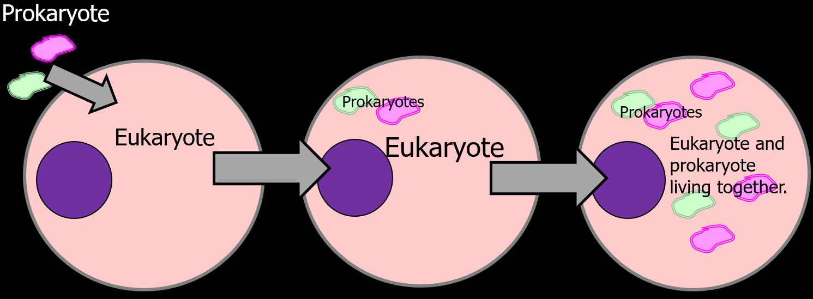
This theory states that some of the organelles in today's eukaryotic cells were once primitive prokaryotic microbes.

Slide 51
Part 4 Review Game
Part 4
Lesson 10

Slide 52

Part 4 Review Game
Part 4
Lesson 11

Slide 53
Part 4 Review Game
IT BURNS | PHOTOSHOP | BREATH IN | BIG GULP | -BONUS- GREEN SUPER HEROES
1 | 6 | 11 | 16 | *21
2 | 7 | 12 | 17 | *22
3 | 8 | 13 | 18 | *23
4 | 9 | 14 | 19 | *24
5 | 10 | 15 | 20 | *25
Copyright © 2024 SlideSpark .LLC

Slide 54
Part 4 Review Game
IT BURNS | PHOTOSHOP | BREATH IN | BIG GULP | -BONUS- GREEN SUPER HEROES
1 | 6 | 11 | 16 | *21
2 | 7 | 12 | 17 | *22
3 | 8 | 13 | 18 | *23
4 | 9 | 14 | 19 | *24
5 | 10 | 15 | 20 | *25
Copyright © 2024 SlideSpark .LLC

Slide 55
These have digestive enzymes to recycle cell parts and break down molecules?
1

Slide 56
These have digestive enzymes to recycle cell parts and break down molecules?
1
Lysosomes
Mitochondria
being recycled
Lysosome

Slide 57
2
Which is not true of the Lysosome?
  A.) has digestive acids / enzymes
  B.) digestive organelle, recycles old cell parts
  C.) creates proteins, lipids, and carbohydrates
  D.) transports undigested material for removal
  E.) can cause a cell to self destruct

Slide 58
2
Which is not true of the Lysosome?
  A.) has digestive acids / enzymes
  B.) digestive organelle, recycles old cell parts
  C.) creates proteins, lipids, and carbohydrates
  D.) transports undigested material for removal
  E.) can cause a cell to self destruct

Slide 59
2
Which is not true of the Lysosome?
  A.) has digestive acids / enzymes
  B.) digestive organelle, recycles old cell parts
  C.) breaks down proteins, lipids, and carbohydrates
  D.) transports undigested material for removal
  E.) can cause a cell to self destruct

Slide 60
These are small organelles present in the cytoplasm of many cells, which contains the reducing enzyme catalase and usually some oxidases.
3

Slide 61
These are small organelles present in the cytoplasm of many cells, which contains the reducing enzyme catalase and usually some oxidases.
3
Peroxisome

Slide 62
This is a microscopic network of protein filaments and tubules in the cytoplasm of many living cells, giving them shape and coherence.)
4

Slide 63
This is a microscopic network of protein filaments and tubules in the cytoplasm of many living cells, giving them shape and coherence.)
Cytoskeleton
4

Slide 64
Which letter is which fiber?
  Microfilaments (thin fibers)
  Intermediate filaments (medium sized)
  Microtubules (Large hollow cylinders)
B
C
A

Slide 65
Which letter is which fiber?
  Microfilaments (thin fibers)
  Intermediate filaments (medium sized)
  Microtubules (Large hollow cylinders)
B
C
A

Slide 66
Which letter is which fiber?
  Microfilaments (thin fibers)
  A.) Intermediate filaments (medium sized)
  Microtubules (Large hollow cylinders)
B
C
A

Slide 67
Which letter is which fiber?
  Microfilaments (thin fibers)
  A.) Intermediate filaments (medium sized)
  Microtubules (Large hollow cylinders)
B
C
A

Slide 68
Which letter is which fiber?
  Microfilaments (thin fibers)
  A.) Intermediate filaments (medium sized)
  B.) Microtubules (Large hollow cylinders)
B
C
A

Slide 69
Which letter is which fiber?
  Microfilaments (thin fibers)
  A.) Intermediate filaments (medium sized)
  B.) Microtubules (Large hollow cylinders)
B
C
A

Slide 70
Which letter is which fiber?
  C.) Microfilaments (thin fibers)
  A.) Intermediate filaments (medium sized)
  B.) Microtubules (Large hollow cylinders)
B
C
A

Slide 71
Part 4 Review Game
IT BURNS | PHOTOSHOP | BREATH IN | BIG GULP | -BONUS- GREEN SUPER HEROES
1 | 6 | 11 | 16 | *21
2 | 7 | 12 | 17 | *22
3 | 8 | 13 | 18 | *23
4 | 9 | 14 | 19 | *24
5 | 10 | 15 | 20 | *25
Copyright © 2024 SlideSpark .LLC

Slide 72
Part 4 Review Game
IT BURNS | PHOTOSHOP | BREATH IN | BIG GULP | -BONUS- GREEN SUPER HEROES
1 | 6 | 11 | 16 | *21
2 | 7 | 12 | 17 | *22
3 | 8 | 13 | 18 | *23
4 | 9 | 14 | 19 | *24
5 | 10 | 15 | 20 | *25
Copyright © 2024 SlideSpark .LLC

Slide 73
This is a hairlike structure that acts primarily as an organelle of locomotion.
  Made of a bundle of nine pairs of microtubules surrounding two central pairs of microtubules
6

Slide 74
This is a hairlike structure that acts primarily as an organelle of locomotion.
  Made of a bundle of nine pairs of microtubules surrounding two central pairs of microtubules
6
Flagellum

Slide 75
This is a small structure that extends out from the surface of cell and is used for movement.
7

Slide 76
This is a small structure that extends out from the surface of cell and is used for movement.
7
Cilia

Slide 77
Centrioles
  Look like golden nuggets (Paired)
  Made of nine tubes
  Aid in cell division (Mitosis)
8

Slide 78
Centrioles
  Look like golden nuggets (Paired)
  Made of nine tubes
  Aid in cell division (Mitosis)
8
Centrioles /
Centrosomes

Slide 79
Organelle that conducts photosynthesis,
  Where the photosynthetic pigment chlorophyll captures the energy from sunlight, converts it, and stores it in the energy-storage molecules
9

Slide 80
Organelle that conducts photosynthesis,
  Where the photosynthetic pigment chlorophyll captures the energy from sunlight, converts it, and stores it in the energy-storage molecules
9
Chloroplast

Slide 81
10
These are the membrane-bound compartments inside chloroplasts and cyanobacteria.
  They are the site of the light-dependent reactions of photosynthesis

Slide 82
10
These are the membrane-bound compartments inside chloroplasts and cyanobacteria.
  They are the site of the light-dependent reactions of photosynthesis
Thylakoids

Slide 83
Part 4 Review Game
IT BURNS | PHOTOSHOP | BREATH IN | BIG GULP | -BONUS- GREEN SUPER HEROES
1 | 6 | 11 | 16 | *21
2 | 7 | 12 | 17 | *22
3 | 8 | 13 | 18 | *23
4 | 9 | 14 | 19 | *24
5 | 10 | 15 | 20 | *25
Copyright © 2024 SlideSpark .LLC

Slide 84
Part 4 Review Game
IT BURNS | PHOTOSHOP | BREATH IN | BIG GULP | -BONUS- GREEN SUPER HEROES
1 | 6 | 11 | 16 | *21
2 | 7 | 12 | 17 | *22
3 | 8 | 13 | 18 | *23
4 | 9 | 14 | 19 | *24
5 | 10 | 15 | 20 | *25
Copyright © 2024 SlideSpark .LLC

Slide 85
This is the process by which green plants and some other organisms use sunlight to synthesize foods from carbon dioxide and water.
11

Slide 86
This is the process by which green plants and some other organisms use sunlight to synthesize foods from carbon dioxide and water.
11
Photosynthesis

Slide 87
Which of the following equations is the correct equation for photosynthesis?
A) 6O2 + 6H2O + light energy = C12H6O6 + 6O2
B) 6CO2 + 6H2O + sugar = C6H12O6 + 6O2
C) 6CO2 + 6O2 + light energy = C6H12O6 + 6H2O
D) 6CO2 + 6H2O + light energy = C6H12O6 + 6O2
E) 6CO2 + H2O + light energy = C6H12O6 + 6O2
F) 6CO2 + 6H2O + light energy = C6H2O6 + 6O2
G) 6CO2 + 6H2O + sugar = C6H12O6 + 6O2
H) 6CO2 + 6H2O + light energy = C6H12O3 + 6O2
I) 6CO2 + 6H2O + light energy = C6H12O6 + 6CO2
J) C6H12O6 = 6CO2 + 6H2O + light energy + 6O2
12
Copyright © 2024 SlideSpark .LLC

Slide 88
Which of the following equations is the correct equation for photosynthesis?
A) 6O2 + 6H2O + light energy = C12H6O6 + 6O2
B) 6CO2 + 6H2O + sugar = C6H12O6 + 6O2
C) 6CO2 + 6O2 + light energy = C6H12O6 + 6H2O
D) 6CO2 + 6H2O + light energy = C6H12O6 + 6O2
E) 6CO2 + H2O + light energy = C6H12O6 + 6O2
F) 6CO2 + 6H2O + light energy = C6H2O6 + 6O2
G) 6CO2 + 6H2O + sugar = C6H12O6 + 6O2
H) 6CO2 + 6H2O + light energy = C6H12O3 + 6O2
I) 6CO2 + 6H2O + light energy = C6H12O6 + 6CO2
J) C6H12O6 = 6CO2 + 6H2O + light energy + 6O2
12
Copyright © 2024 SlideSpark .LLC

Slide 89
Which of the following statements is false of photosynthesis?
  A.) Photosynthesis requires sunlight, carbon dioxide, and water.
  B.) Oxygen and glucose are produced in photosynthesis.
  C.) Carbon Dioxide and water are produced.
  D.) In photosynthesis, plants use radiant energy from the sun to create chemical energy in the form of sugars.
  E.) None of the above.
Copyright © 2024 SlideSpark .LLC

Slide 90
Which of the following statements is false of photosynthesis?
  A.) Photosynthesis requires sunlight, carbon dioxide, and water.
  B.) Oxygen and glucose are produced in photosynthesis.
  C.) Carbon Dioxide and water are produced.
  D.) In photosynthesis, plants use radiant energy from the sun to create chemical energy in the form of sugars.
  E.) None of the above.
Copyright © 2024 SlideSpark .LLC

Slide 91
Which of the following statements is false of photosynthesis?
  A.) Photosynthesis requires sunlight, carbon dioxide, and water.
  B.) Oxygen and glucose are produced in photosynthesis.
  C.) Carbon Dioxide and water are produced.
  D.) In photosynthesis, plants use radiant energy from the sun to create chemical energy in the form of sugars.
  E.) None of the above.
Copyright © 2024 SlideSpark .LLC

Slide 92
Which of the following statements is false of photosynthesis?
  A.) Photosynthesis requires sunlight, carbon dioxide, and water.
  B.) Oxygen and glucose are produced in photosynthesis.
  C.) Carbon Dioxide and water are produced.
  D.) In photosynthesis, plants use radiant energy from the sun to create chemical energy in the form of sugars.
  E.) None of the above.
Copyright © 2024 SlideSpark .LLC

Slide 93
Which of the following statements is false of photosynthesis?
  A.) Photosynthesis requires sunlight, carbon dioxide, and water.
  B.) Oxygen and glucose are produced in photosynthesis.
  C.) Carbon Dioxide and water are produced.
  D.) In photosynthesis, plants use radiant energy from the sun to create chemical energy in the form of sugars.
  E.) None of the above.
Copyright © 2024 SlideSpark .LLC

Slide 94
Which of the following statements is false of photosynthesis?
  A.) Photosynthesis requires sunlight, carbon dioxide, and water.
  B.) Oxygen and glucose are produced in photosynthesis.
  C.) Carbon Dioxide and water are produced.
  D.) In photosynthesis, plants use radiant energy from the sun to create chemical energy in the form of sugars.
  E.) None of the above.
Copyright © 2024 SlideSpark .LLC

Slide 95
Which of the following statements is false of photosynthesis? and the answer is…
  A.) Photosynthesis requires sunlight, carbon dioxide, and water.
  B.) Oxygen and glucose are produced in photosynthesis.
  C.) Carbon Dioxide and water are produced.
  D.) In photosynthesis, plants use radiant energy from the sun to create chemical energy in the form of sugars.
  E.) None of the above.
Copyright © 2024 SlideSpark .LLC

Slide 96
Which of the following statements is false of photosynthesis? and the answer is…
  A.) Photosynthesis requires sunlight, carbon dioxide, and water.
  B.) Oxygen and glucose are produced in photosynthesis.
  C.) Carbon Dioxide and water are produced.
  D.) In photosynthesis, plants use radiant energy from the sun to create chemical energy in the form of sugars.
  E.) None of the above.
Copyright © 2024 SlideSpark .LLC

Slide 97
Which of the following statements is false of photosynthesis? And the answer is…
  A.) Photosynthesis requires sunlight, carbon dioxide, and water.
  B.) Oxygen and glucose are produced in photosynthesis.
  C.) Oxygen and glucose are produced.
  D.) In photosynthesis, plants use radiant energy from the sun to create chemical energy in the form of sugars.
  E.) None of the above.
Copyright © 2024 SlideSpark .LLC

Slide 98
This is the processes whereby certain organisms obtain energy from organic molecules.
14

Slide 99

This is the processes whereby certain organisms obtain energy from organic molecules.
14
Cellular
Respiration

Slide 100
This cellular organelle uses sugar and oxygen to make energy?
15
15

Slide 101
This cellular organelle uses sugar and oxygen to make energy?
15
15
Mitochondria

Slide 102
Part 4 Review Game
IT BURNS | PHOTOSHOP | BREATH IN | BIG GULP | -BONUS- GREEN SUPER HEROES
1 | 6 | 11 | 16 | *21
2 | 7 | 12 | 17 | *22
3 | 8 | 13 | 18 | *23
4 | 9 | 14 | 19 | *24
5 | 10 | 15 | 20 | *25
Copyright © 2024 SlideSpark .LLC

Slide 103
Part 4 Review Game
IT BURNS | PHOTOSHOP | BREATH IN | BIG GULP | -BONUS- GREEN SUPER HEROES
1 | 6 | 11 | 16 | *21
2 | 7 | 12 | 17 | *22
3 | 8 | 13 | 18 | *23
4 | 9 | 14 | 19 | *24
5 | 10 | 15 | 20 | *25
Copyright © 2024 SlideSpark .LLC

Slide 104
Which of the following equations is the correct one for the respiration equation?
A) C6H12O6 + 6H2O = Released energy + 6CO2 + 6H2O.
B) C6H12O6 + 6O2 = Released energy + 6CO2 + 6H2O.
C) C6H12O6 + 6O2 = Released energy + 6O2 + 6H2O.
D) C12H6O6 + 6O2 = Released energy + 6CO2 + 6H2O.
E) C6H12O6 + 6CO2 = Released energy + 6O2 + 6H2O.
F) C6H12O6 + 6CO2 = Released energy + 6CO2 + 6H2O.
G) C6H12O6 + 6O2 = Released energy + 6CO2 + 62O.
H) C6H12O6 + 6O2 = Light Energy + 6CO2 + 6H2O.
I) C6H12O6 + 6O2 = Released energy + 6O2 + 6H2O.
J) C6H12O8 + 6O2 = Released energy + 6CO2 + 6H2O.
K) C6H12O6 + 16O2 = Released energy + 6O2 + 6H2O.
L) Released energy + 6CO2 + 6H2O C6H12O6 + 6O2 = ☺
16
Copyright © 2024 SlideSpark .LLC

Slide 105
Which of the following equations is the correct one for the respiration equation?
A) C6H12O6 + 6H2O = Released energy + 6CO2 + 6H2O.
B) C6H12O6 + 6O2 = Released energy + 6CO2 + 6H2O.
C) C6H12O6 + 6O2 = Released energy + 6O2 + 6H2O.
D) C12H6O6 + 6O2 = Released energy + 6CO2 + 6H2O.
E) C6H12O6 + 6CO2 = Released energy + 6O2 + 6H2O.
F) C6H12O6 + 6CO2 = Released energy + 6CO2 + 6H2O.
G) C6H12O6 + 6O2 = Released energy + 6CO2 + 62O.
H) C6H12O6 + 6O2 = Light Energy + 6CO2 + 6H2O.
I) C6H12O6 + 6O2 = Released energy + 6O2 + 6H2O.
J) C6H12O8 + 6O2 = Released energy + 6CO2 + 6H2O.
K) C6H12O6 + 16O2 = Released energy + 6O2 + 6H2O.
L) Released energy + 6CO2 + 6H2O C6H12O6 + 6O2 = ☺
ATP
16
Copyright © 2024 SlideSpark .LLC

Slide 106
This cycle is a series of chemical reactions used by all aerobic organisms to generate energy.
  Requires the oxidation of acetate—derived from carbohydrates, fats, and proteins—into carbon dioxide.
Simplified a bit
17

Slide 107
This cycle is a series of chemical reactions used by all aerobic organisms to generate energy.
  Requires the oxidation of acetate—derived from carbohydrates, fats, and proteins—into carbon dioxide.
Simplified a bit
17

Slide 108
Which is not true of cellular respiration.
  A.) Burns sugars for energy.
  B.) Energy is released.
  C.) Occurs in most cells.
  D.) Oxygen is used.
  E.) Water is produced.
  F.) Oxygen is produced.
  G.) Occurs in dark and light.
18

Slide 109
Which is not true of cellular respiration.
  A.) Burns sugars for energy.
  B.) Energy is released.
  C.) Occurs in most cells.
  D.) Oxygen is used.
  E.) Water is produced.
  F.) Oxygen is produced.
  G.) Occurs in dark and light.
18

Slide 110
Which is not true of cellular respiration.
  A.) Burns sugars for energy.
  B.) Energy is released.
  C.) Occurs in most cells.
  D.) Oxygen is used.
  E.) Water is produced.
  F.) Carbon dioxide is produced.
  G.) Occurs in dark and light.
18

Slide 111
This is a membrane-bound sac for storage, digestion, and waste removal.
19

Slide 112
This is a membrane-bound sac for storage, digestion, and waste removal.
19
Vacuole

Slide 113
This is a form of cellular respiration that occurs when oxygen is absent or scarce.
20

Slide 114
This is a form of cellular respiration that occurs when oxygen is absent or scarce.
20
answer is…

Slide 115
This is a form of cellular respiration that occurs when oxygen is absent or scarce.
20
Anaerobic
Respiration
answer is…

Slide 116
Part 4 Review Game
IT BURNS | PHOTOSHOP | BREATH IN | BIG GULP | -BONUS- GREEN SUPER HEROES
1 | 6 | 11 | 16 | *21
2 | 7 | 12 | 17 | *22
3 | 8 | 13 | 18 | *23
4 | 9 | 14 | 19 | *24
5 | 10 | 15 | 20 | *25
Copyright © 2024 SlideSpark .LLC

Slide 117
Part 4 Review Game
IT BURNS | PHOTOSHOP | BREATH IN | BIG GULP | -BONUS- GREEN SUPER HEROES
1 | 6 | 11 | 16 | *21
2 | 7 | 12 | 17 | *22
3 | 8 | 13 | 18 | *23
4 | 9 | 14 | 19 | *24
5 | 10 | 15 | 20 | *25
Copyright © 2024 SlideSpark .LLC

Slide 118
*21
Name the Green
Superhero?

Slide 119

*21
Name the Green
Superhero?

Slide 120
*22

Slide 121

*22

Slide 122
*23

Slide 123
*23
BEAST BOY

Slide 124
*24

Slide 125

*24

Slide 126
*25

Slide 127

*25

Slide 128
5 Point Wager Question

Slide 129
Part 4 Review Game
IT BURNS | PHOTOSHOP | BREATH IN | BIG GULP | -BONUS- GREEN SUPER HEROES
1 | 6 | 11 | 16 | *21
2 | 7 | 12 | 17 | *22
3 | 8 | 13 | 18 | *23
4 | 9 | 14 | 19 | *24
5 | 10 | 15 | 20 | *25
Final Question
Copyright © 2024 SlideSpark .LLC

Slide 130
This theory states that some of the organelles in today's eukaryotic cells were once primitive prokaryotic microbes.

Slide 131

This theory states that some of the organelles in today's eukaryotic cells were once primitive prokaryotic microbes.

Slide 132
Questions 1-20 = 5pts Each
Final Category (Bonus) = 1pt Each
Final Questions = 5 pt wager
Find the Owl =
Secretly write “Owl” in the correct box worth 1pt.

Slide 133
Part 4 Review Game
Part 4
Lesson 11

Slide 134



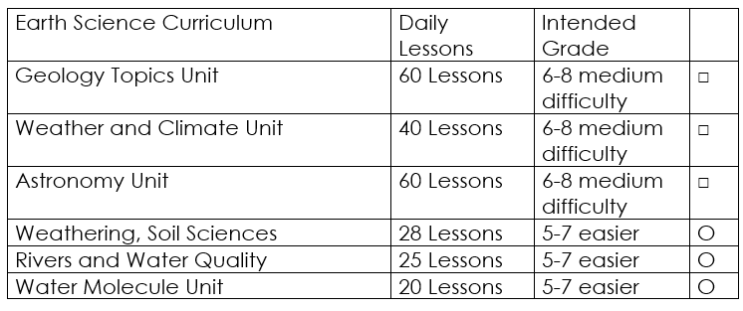

Curriculum Guide
Number of Lessons in each unit (50 min, daily lessons) and difficult rating scale / intended grade level.
=Easier, = More difficult, =Most difficult
Earth Science Units

Slide 135


Life Science Units

Slide 136

Physical Science

Slide 137
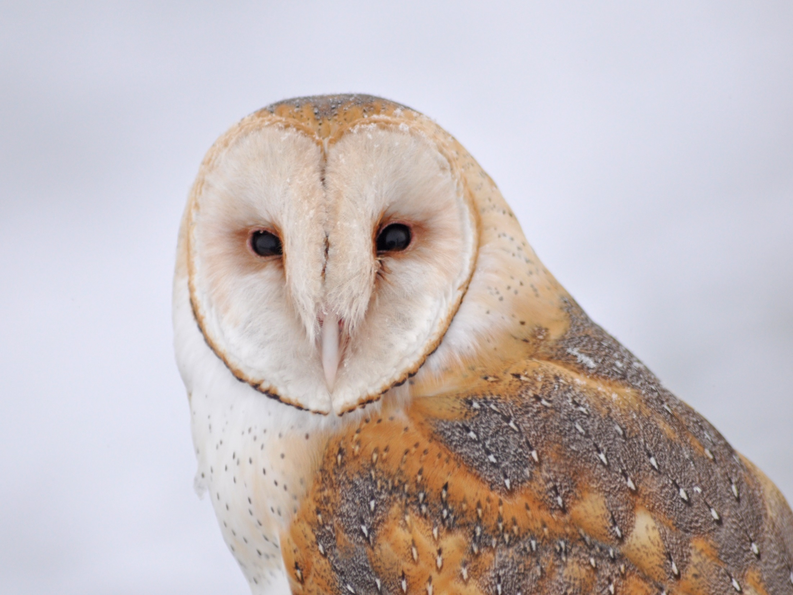
Dear Valued Educator,
Our fully editable .pptx and .doc resources are perfect for educators looking to bring enthusiasm and creativity to their lessons. We encourage you to make changes to fit your needs and style. As science educators, we’re committed to providing students with the tools they need to succeed in the classroom and beyond. Each unit in the curriculum includes a range of resources that have been developed through extensive research and use in a busy classroom. Our teaching approach is designed to make science education engaging and exciting for learners of all ages. We offer a one-of-a-kind science curriculum that will challenge, inspire, and educate students to become tomorrow's scientists and leaders. Join us today and learn more about how our program can help you achieve your classroom goals.
With appreciation,
Support@SlideSpark.net

Slide 138





Thank you for your time and interest in our Science curriculum. We strive to provide students with engaging and informative lessons that will spark their curiosity and encourage scientific exploration. Should you have any questions or concerns, please do not hesitate to contact us. Thank you again for considering our curriculum, and we wish you all the best in your educational journey.
Sincerely,
Support@slidespark.net
SlideSpark Science on TpT

