Slide 1
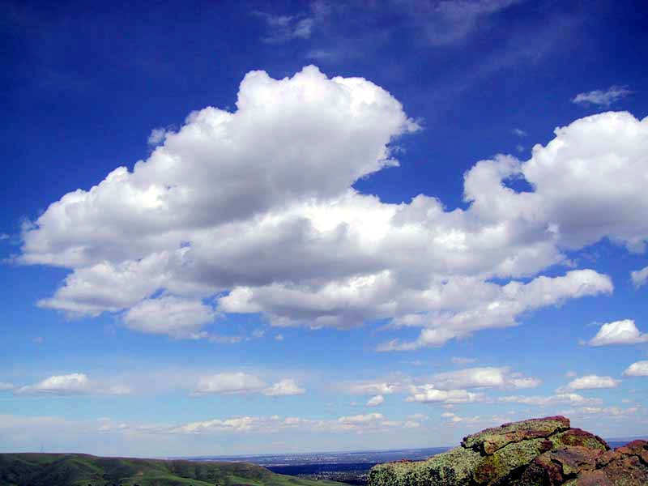

Biogeochemical Cycles
Review Game
Part 2
Lesson 16

Slide 2
Ecology: Abiotic (Biogeochemical Cycles)
WATER CYCLE | CARBON CYCLE | NITROGEN CYCLE | PHOSPHORUS CYCLE | (Bonus) CYCLES
1 | 6 | 11 | 16 | *21
2 | 7 | 12 | 17 | *22
3 | 8 | 13 | 18 | *23
4 | 9 | 14 | 19 | *24
5 | 10 | 15 | 20 | *25
Final Question:________________
Copyright © 2024 SlideSpark LLC

Slide 3
How to play…
  Don’t play like Jeo_ _ _ _ y.
  Class should be divided into several small groups.
  Groups should use science journal (red slide notes), homework, and other available materials to assist you.
  Groups can communicate quietly with each other but no sharing answers between groups.
    Practice quietly communicating right now?
    Practice Communication Question:
    Your group gets to order one pizza, and you can have two toppings, what does your group want?

Slide 4

Questions 1-20 = 5pts Each
Final Category (Bonus) = 1pt Each
Final Questions = 5 pt wager
If you wager 5 on the last question and get it wrong you lose 5 pts. Wager 5 and get right you get 5 pts.
Find the Owl =
Secretly write “Owl” in the correct box worth 1pt.
“I’ll be about this big.”

Slide 5
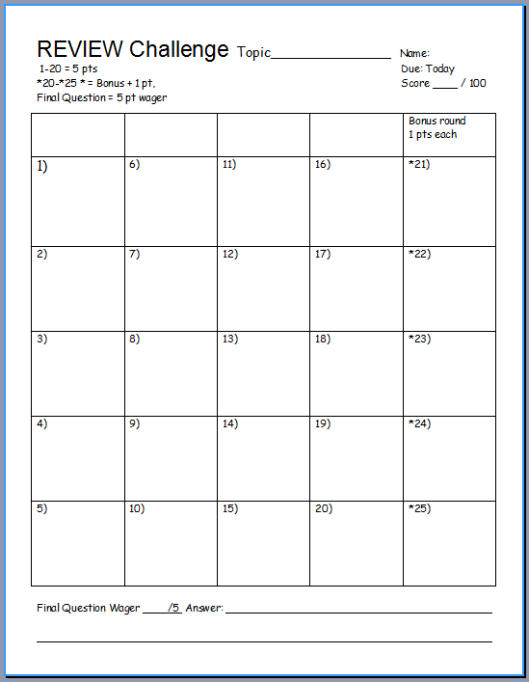
Is your name on the review sheet?
Name

Slide 6
Is your name on the review sheet?
Add the categories
along the top
on the next slide.

Slide 7
Ecology: Abiotic (Biogeochem Cycles)
WATER CYCLE | CARBON CYCLE | NITROGEN CYCLE | PHOSPHORUS CYCLE | (Bonus) CYCLES
1 | 6 | 11 | 16 | *21
2 | 7 | 12 | 17 | *22
3 | 8 | 13 | 18 | *23
4 | 9 | 14 | 19 | *24
5 | 10 | 15 | 20 | *25
Final Question:________________
Copyright © 2024 SlideSpark LLC

Slide 8
Ecology: Abiotic (Biogeochem Cycles)
WATER CYCLE | CARBON CYCLE | NITROGEN CYCLE | PHOSPHORUS CYCLE | (Bonus) CYCLES
1 | 6 | 11 | 16 | *21
2 | 7 | 12 | 17 | *22
3 | 8 | 13 | 18 | *23
4 | 9 | 14 | 19 | *24
5 | 10 | 15 | 20 | *25
A Nice Review
Opportunity
Final Question:________________
Copyright © 2024 SlideSpark LLC

Slide 9
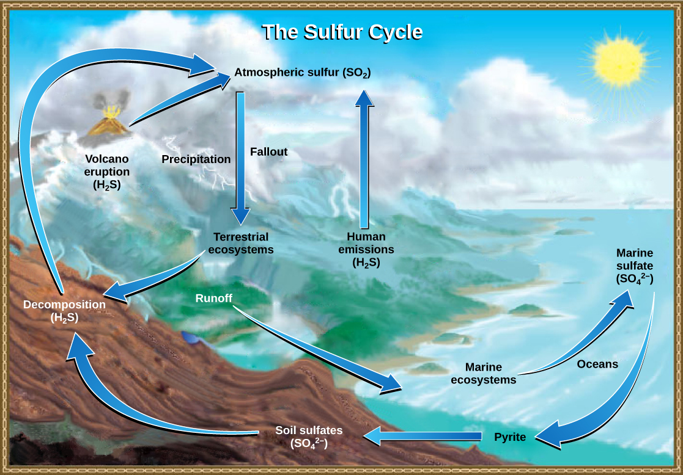
What does bio and geo mean in biogeochemical cycles?
Bio = Life
Geo = Earth
Chemical = To arrange atoms
1

Slide 10
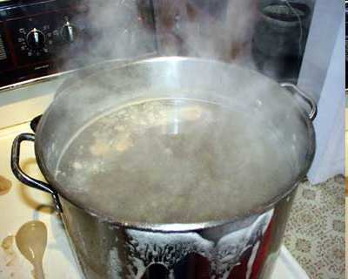
What part of the water cycle is represented best by the picture below?
2
2

Slide 11
Clouds form from this part of the water cycle?
3
Copyright © 2024 SlideSpark LLC

Slide 12
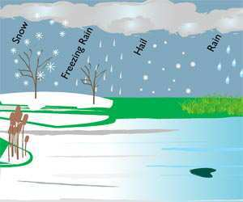
The following are all forms of what?
4
Copyright © 2024 SlideSpark LLC

Slide 13
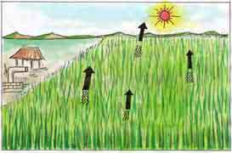
This is the name for when plants release water vapor into the air in the water cycle?
5
Copyright © 2024 SlideSpark LLC

Slide 14
Ecology: Abiotic (Biogeochem Cycles)
WATER CYCLE | CARBON CYCLE | NITROGEN CYCLE | PHOSPHORUS CYCLE | (Bonus) CYCLES
1 | 6 | 11 | 16 | *21
2 | 7 | 12 | 17 | *22
3 | 8 | 13 | 18 | *23
4 | 9 | 14 | 19 | *24
5 | 10 | 15 | 20 | *25
Final Question:________________
Copyright © 2024 SlideSpark LLC

Slide 15
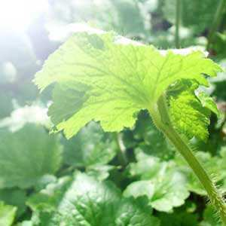
This is the name for when plants make sugar from sunlight.
6
Copyright © 2024 SlideSpark LLC

Slide 16
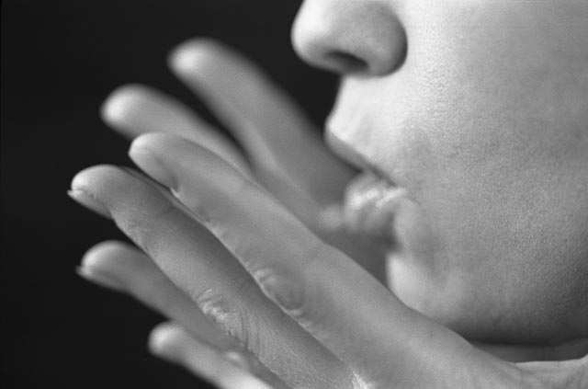
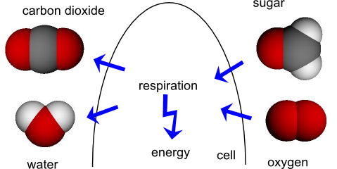
This is the processes whereby certain organisms obtain energy from organic molecules.
7
Copyright © 2024 SlideSpark LLC

Slide 17
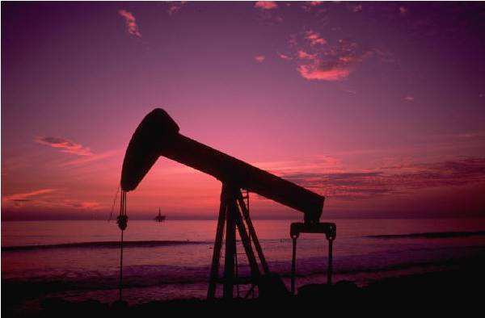
These reservoirs of carbon that use to be locked away are being introduced rapidly into the environment?
8
Copyright © 2024 SlideSpark LLC

Slide 18
Is this photosynthesis or cellular respiration?
  -Burns sugars for energy.
  -Energy is released.
  -Occurs in most cells.
  -Oxygen is used.
  -Water is produced.
  -Carbon dioxide produced.
  -Occurs in dark and light.
9
Copyright © 2024 SlideSpark LLC

Slide 19

NEW
QUESTION

Slide 20
Is this photosynthesis or cellular respiration?
  -Produces sugars from energy.
  -Occurs only in cells with Chloroplasts.
  -Oxygen is produced.
  -Water is used.
  -Carbon dioxide is used.
  -Occurs in light.
10
Copyright © 2024 SlideSpark LLC

Slide 21
Ecology: Abiotic (Biogeochem Cycles)
WATER CYCLE | CARBON CYCLE | NITROGEN CYCLE | PHOSPHORUS CYCLE | (Bonus) CYCLES
1 | 6 | 11 | 16 | *21
2 | 7 | 12 | 17 | *22
3 | 8 | 13 | 18 | *23
4 | 9 | 14 | 19 | *24
5 | 10 | 15 | 20 | *25
Final Question:________________
Copyright © 2024 SlideSpark LLC

Slide 22

True or False? Animals can uptake nitrogen directly from the air?
11
Copyright © 2024 SlideSpark LLC

Slide 23
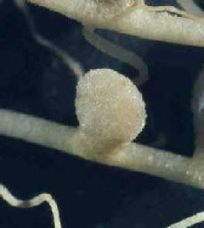
These take N2 gas from the atmosphere and fix it into a form that plants can use?
12
Copyright © 2024 SlideSpark LLC

Slide 24

Animals get their nitrogen by eating what?
13
Copyright © 2024 SlideSpark LLC

Slide 25
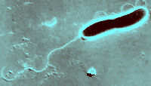
This type of bacteria release nitrogen from waste or dead cells back into the air?
14
Copyright © 2024 SlideSpark LLC

Slide 26
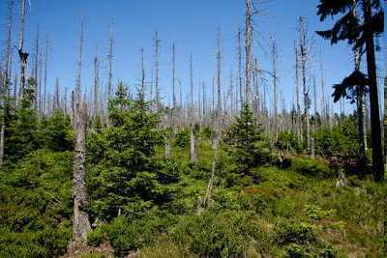
What environmental problem is shown below and one that we have learned?
15

Slide 27
Ecology: Abiotic (Biogeochem Cycles)
WATER CYCLE | CARBON CYCLE | NITROGEN CYCLE | PHOSPHORUS CYCLE | (Bonus) CYCLES
1 | 6 | 11 | 16 | *21
2 | 7 | 12 | 17 | *22
3 | 8 | 13 | 18 | *23
4 | 9 | 14 | 19 | *24
5 | 10 | 15 | 20 | *25
Final Question:________________
Copyright © 2024 SlideSpark LLC

Slide 28
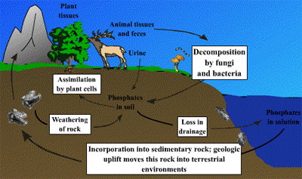
16
Phosphorus moves through…
Lithosphere
Hydrosphere
Ecosphere
Atmosphere
A,B,C only
All of the above.
Copyright © 2024 SlideSpark LLC

Slide 29
16
Phosphorus moves through…
Lithosphere
Hydrosphere
Ecosphere
Atmosphere
A,B,C only
All of the above.
Copyright © 2024 SlideSpark LLC

Slide 30
16
Phosphorus moves through…
Lithosphere
Hydrosphere
Ecosphere
Atmosphere
A,B,C only
All of the above.
Copyright © 2024 SlideSpark LLC

Slide 31
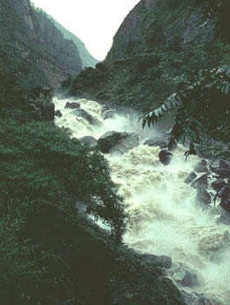
Through what processes does phosphorus enter the oceans from soil and rocks?
17
Copyright © 2024 SlideSpark LLC

Slide 32
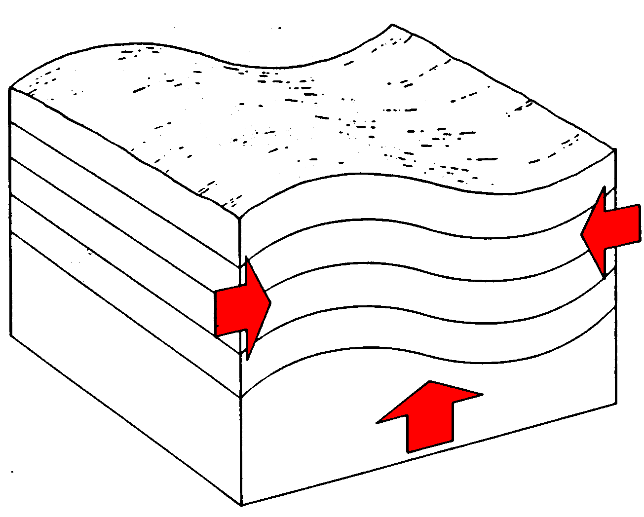
How does phosphorus from the bottom of the ocean make it back to the land?
18
Copyright © 2024 SlideSpark LLC

Slide 33

How do animals get phosphorus?
19
Copyright © 2024 SlideSpark LLC

Slide 34
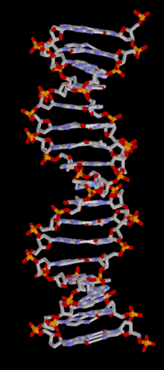
Phosphorus is an important part of this molecule of life?
20
Copyright © 2024 SlideSpark LLC

Slide 35
Ecology: Abiotic (Biogeochem Cycles)
WATER CYCLE | CARBON CYCLE | NITROGEN CYCLE | PHOSPHORUS CYCLE | (Bonus) CYCLES
1 | 6 | 11 | 16 | *21
2 | 7 | 12 | 17 | *22
3 | 8 | 13 | 18 | *23
4 | 9 | 14 | 19 | *24
5 | 10 | 15 | 20 | *25
Final Question:________________
Copyright © 2024 SlideSpark LLC

Slide 36
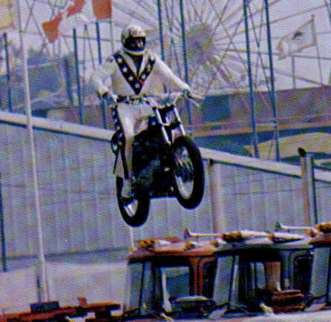
Who is this famous daredevil?
*21
Copyright © 2024 SlideSpark LLC

Slide 37
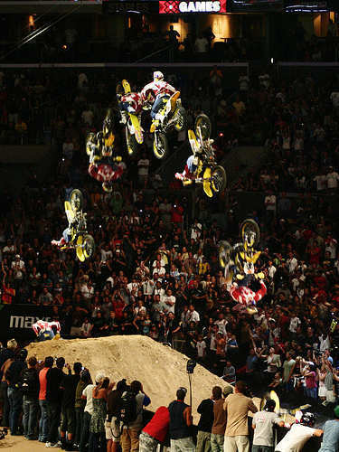
Travis Pastrana is seen front flipping below? Do not try at home!
*22
Copyright © 2024 SlideSpark LLC

Slide 38
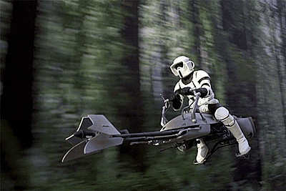
What is the name of this vehicle?
*23
Copyright © 2024 SlideSpark LLC

Slide 39

These three originally worked at...?
*24
Copyright © 2024 SlideSpark LLC

Slide 40
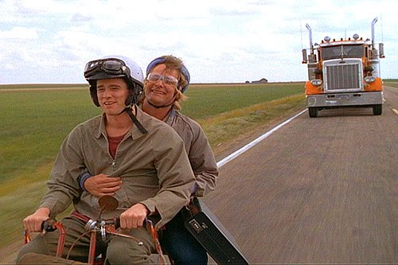
Can you name this movie?
*25
Copyright © 2024 SlideSpark LLC

Slide 41
Ecology: Abiotic (Biogeochemical Cycles)
WATER CYCLE | CARBON CYCLE | NITROGEN CYCLE | PHOSPHORUS CYCLE | (Bonus) CYCLES
1 | 6 | 11 | 16 | *21
2 | 7 | 12 | 17 | *22
3 | 8 | 13 | 18 | *23
4 | 9 | 14 | 19 | *24
5 | 10 | 15 | 20 | *25
Final Question:________________
Copyright © 2024 SlideSpark LLC

Slide 42
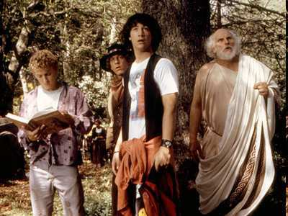
Final Question?
Copyright © 2024 SlideSpark LLC

Slide 43
Final Question?
“You may wager up to 5pts for this final and most excellent question.”
Copyright © 2024 SlideSpark LLC

Slide 44
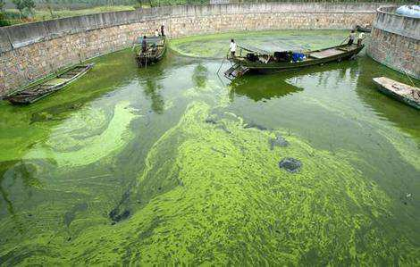
Final Question? What is the name of a process that effects water bodies and exhibits the following.
    Aquatic plants use Phosphorus and Nitrogen and grow out of control.
    Aquatic plants overpopulate and die.
    Bacteria break down dead plants and use oxygen in water (respiration).
    No oxygen left for fish / other aquatic life and they die.
Final Question
Copyright © 2024 SlideSpark LLC

Slide 45
Biogeochemical Cycles
Review Game
Part 2
Lesson 16

Slide 46

Biogeochemical Cycles
Review Game
Part 2
Lesson 16

Slide 47
Ecology: Abiotic (Biogeochem Cycles) Answers
WATER CYCLE | CARBON CYCLE | NITROGEN CYCLE | PHOSPHORUS CYCLE | (Bonus) CYCLES
1 | 6 | 11 | 16 | *21
2 | 7 | 12 | 17 | *22
3 | 8 | 13 | 18 | *23
4 | 9 | 14 | 19 | *24
5 | 10 | 15 | 20 | *25
Final Question:________________
Copyright © 2024 SlideSpark LLC

Slide 48
What does bio and geo mean in biogeochemical cycles?
Bio = Life
Geo = Earth
Chemical = To arrange atoms
1

Slide 49
What does bio and geo mean in biogeochemical cycles?
Bio = Life
Geo = Earth
Chemical = To arrange atoms
1

Slide 50
What does bio and geo mean in biogeochemical cycles?
Bio = Life
Geo = Earth
Chemical = To arrange atoms
1

Slide 51
What does bio and geo mean in biogeochemical cycles?
Bio = Life
Geo = Earth
Chemical = To arrange atoms
1

Slide 52
What does bio and geo mean in biogeochemical cycles?
Bio = Life
Geo = Earth
Chemical = To arrange atoms
1

Slide 53
What part of the water cycle is represented best by the picture below?
2
2

Slide 54
What part of the water cycle is represented best by the picture below?
2
Evaporation
2

Slide 55
What part of the water cycle is represented best by the picture below?
2
Evaporation
Liquid to a gas
2

Slide 56
Clouds form from this part of the water cycle?
3
Copyright © 2024 SlideSpark LLC

Slide 57
Clouds form from this part of the water cycle?
3
Condensation
Copyright © 2024 SlideSpark LLC

Slide 58
Clouds form from this part of the water cycle?
3
Condensation
Gas to a liquid
Copyright © 2024 SlideSpark LLC

Slide 59
The following are all forms of what?
4
Copyright © 2024 SlideSpark LLC

Slide 60
The following are all forms of what?
Precipitation
4
Copyright © 2024 SlideSpark LLC

Slide 61
This is the name for when plants release water vapor into the air in the water cycle?
5
Copyright © 2024 SlideSpark LLC

Slide 62
This is the name for when plants release water vapor into the air in the water cycle?
5
Transpiration
Copyright © 2024 SlideSpark LLC

Slide 63
This is the name for when plants release water vapor into the air in the water cycle?
5
Transpiration
Evapotranspiration
All water from transpiration
and evaporation
Copyright © 2024 SlideSpark LLC

Slide 64
Ecology: Abiotic (Biogeochem Cycles) Answers
WATER CYCLE | CARBON CYCLE | NITROGEN CYCLE | PHOSPHORUS CYCLE | (Bonus) CYCLES
1 | 6 | 11 | 16 | *21
2 | 7 | 12 | 17 | *22
3 | 8 | 13 | 18 | *23
4 | 9 | 14 | 19 | *24
5 | 10 | 15 | 20 | *25
Final Question:________________
Copyright © 2024 SlideSpark LLC

Slide 65
This is the name for when plants make sugar from sunlight.
6
Copyright © 2024 SlideSpark LLC

Slide 66
This is the name for when plants make sugar from sunlight.
6
Photosynthesis
Copyright © 2024 SlideSpark LLC

Slide 67
This is the processes whereby certain organisms obtain energy from organic molecules.
7
Copyright © 2024 SlideSpark LLC

Slide 68
This is the processes whereby certain organisms obtain energy from organic molecules.
Cellular
Respiration
7
Copyright © 2024 SlideSpark LLC

Slide 69
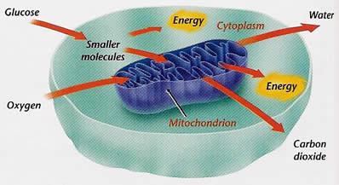
This is the processes whereby certain organisms obtain energy from organic molecules.
Cellular
Respiration
7
IN
Copyright © 2024 SlideSpark LLC

Slide 70
This is the processes whereby certain organisms obtain energy from organic molecules.
Cellular
Respiration
7
OUT
IN
Copyright © 2024 SlideSpark LLC

Slide 71
These reservoirs of carbon that use to be locked away are being introduced rapidly into the environment?
8
Copyright © 2024 SlideSpark LLC

Slide 72
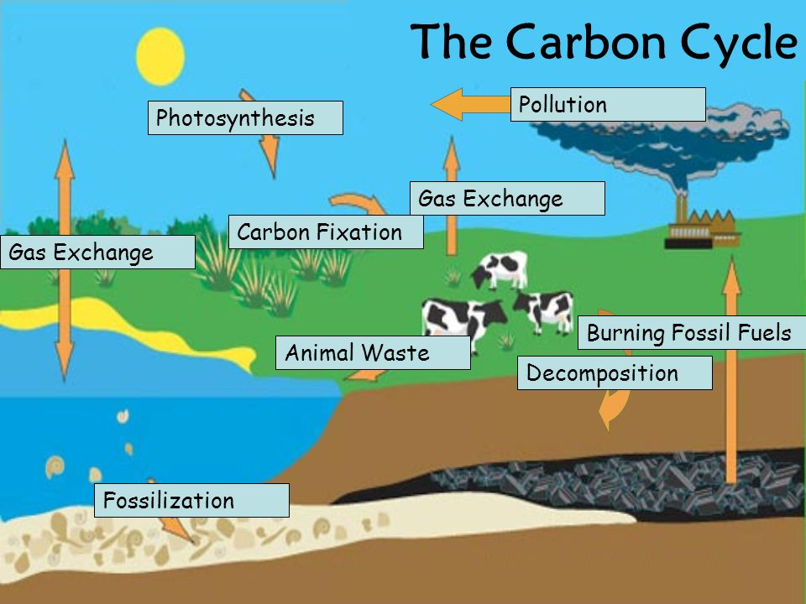
These reservoirs of carbon that use to be locked away are being introduced rapidly into the environment?
8
Copyright © 2024 SlideSpark LLC

Slide 73
These reservoirs of carbon that use to be locked away are being introduced rapidly into the environment?
8
Copyright © 2024 SlideSpark LLC

Slide 74
These reservoirs of carbon that use to be locked away are being introduced rapidly into the environment?
Fossil Fuels
8
Copyright © 2024 SlideSpark LLC

Slide 75
Is this photosynthesis or cellular respiration?
  -Burns sugars for energy.
  -Energy is released.
  -Occurs in most cells.
  -Oxygen is used.
  -Water is produced.
  -Carbon dioxide produced.
  -Occurs in dark and light.
9
Copyright © 2024 SlideSpark LLC

Slide 76
Is this photosynthesis or cellular respiration?
  -Burns sugars for energy.
  -Energy is released.
  -Occurs in most cells.
  -Oxygen is used.
  -Water is produced.
  -Carbon dioxide produced.
  -Occurs in dark and light.
9
Copyright © 2024 SlideSpark LLC

Slide 77
NEW
QUESTION

Slide 78
Is this photosynthesis or cellular respiration?
  -Produces sugars from energy.
  -Occurs only in cells with Chloroplasts.
  -Oxygen is produced.
  -Water is used.
  -Carbon dioxide is used.
  -Occurs in light.
10
Copyright © 2024 SlideSpark LLC

Slide 79
Is this photosynthesis or cellular respiration?
  -Produces sugars from energy.
  -Occurs only in cells with Chloroplasts.
  -Oxygen is produced.
  -Water is used.
  -Carbon dioxide is used.
  -Occurs in light.
10
Copyright © 2024 SlideSpark LLC

Slide 80
Ecology: Abiotic (Biogeochem Cycles) Answers
WATER CYCLE | CARBON CYCLE | NITROGEN CYCLE | PHOSPHORUS CYCLE | (Bonus) CYCLES
1 | 6 | 11 | 16 | *21
2 | 7 | 12 | 17 | *22
3 | 8 | 13 | 18 | *23
4 | 9 | 14 | 19 | *24
5 | 10 | 15 | 20 | *25
Final Question:________________
Copyright © 2024 SlideSpark LLC

Slide 81
True or False? Animals can uptake nitrogen directly from the air?
11
Copyright © 2024 SlideSpark LLC

Slide 82
True or False? Animals can uptake nitrogen directly from the air?
“FALSE!!”
“IT NEEDS TO BE FIXED FIRST!”
Copyright © 2024 SlideSpark LLC

Slide 83
True or False? Animals can uptake nitrogen directly from the air?
“FALSE!!”
“IT NEEDS TO BE FIXED FIRST!”
Copyright © 2024 SlideSpark LLC

Slide 84
True or False? Animals can uptake nitrogen directly from the air?
“FALSE!!”
“IT NEEDS TO BE FIXED FIRST!”
Copyright © 2024 SlideSpark LLC

Slide 85
These take N2 gas from the atmosphere and fix it into a form that plants can use?
12
Copyright © 2024 SlideSpark LLC

Slide 86
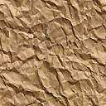
These take N2 gas from the atmosphere and fix it into a form that plants can use?
Nitrogen
Fixing
Bacteria
12
Copyright © 2024 SlideSpark LLC

Slide 87
Animals get their nitrogen by eating what?
13
Copyright © 2024 SlideSpark LLC

Slide 88
Animals get their nitrogen by eating what?
13
Plants
or
Animals
Copyright © 2024 SlideSpark LLC

Slide 89
This type of bacteria release nitrogen from waste or dead cells back into the air?
14
Copyright © 2024 SlideSpark LLC

Slide 90
This type of bacteria release nitrogen from waste or dead cells back into the air?
14
Denitrifying Bacteria
Copyright © 2024 SlideSpark LLC

Slide 91
What environmental problem is shown below and one that we have learned?
15

Slide 92
What environmental problem is shown below and one that we have learned?
Acid Rain
15

Slide 93
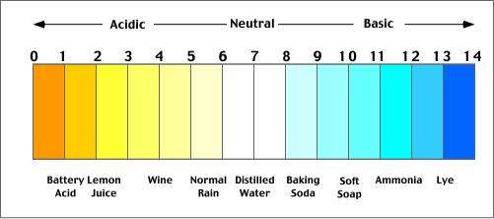
What environmental problem is shown below and one that we have learned?
Acid Rain
15

Slide 94
Ecology: Abiotic (Biogeochem Cycles) Answers
WATER CYCLE | CARBON CYCLE | NITROGEN CYCLE | PHOSPHORUS CYCLE | (Bonus) CYCLES
1 | 6 | 11 | 16 | *21
2 | 7 | 12 | 17 | *22
3 | 8 | 13 | 18 | *23
4 | 9 | 14 | 19 | *24
5 | 10 | 15 | 20 | *25
Final Question:________________
Copyright © 2024 SlideSpark LLC

Slide 95
16
Phosphorus moves through…
Lithosphere
Hydrosphere
Ecosphere
Atmosphere
A,B,C only
All of the above.
Copyright © 2024 SlideSpark LLC

Slide 96
16
Phosphorus moves through…
Lithosphere
Hydrosphere
Ecosphere
Atmosphere
A,B,C only
All of the above.
Answer…
Copyright © 2024 SlideSpark LLC

Slide 97
16
Phosphorus moves through…
Lithosphere
Hydrosphere
Ecosphere
Atmosphere
A,B,C only
All of the above.
Answer…
Copyright © 2024 SlideSpark LLC

Slide 98
16
Phosphorus moves through…
Lithosphere
Hydrosphere
Ecosphere
Atmosphere
A,B,C only
All of the above.
Phosphorus does not move
through the atmosphere
Answer…
Copyright © 2024 SlideSpark LLC

Slide 99
Through what processes does phosphorus enter the oceans from soil and rocks?
17
Copyright © 2024 SlideSpark LLC

Slide 100
Through what processes does phosphorus enter the oceans from soil and rocks?
17
Surface
Run-off
Copyright © 2024 SlideSpark LLC

Slide 101
How does phosphorus from the bottom of the ocean make it back to the land?
18
Copyright © 2024 SlideSpark LLC

Slide 102
How does phosphorus from the bottom of the ocean make it back to the land?
18
Geologic Uplift
Copyright © 2024 SlideSpark LLC

Slide 103
How do animals get phosphorus?
19
Copyright © 2024 SlideSpark LLC

Slide 104
How do animals get phosphorus?
19
Eating Plants
or
Animals
Copyright © 2024 SlideSpark LLC

Slide 105
Phosphorus is an important part of this molecule of life?
20
Copyright © 2024 SlideSpark LLC

Slide 106
Phosphorus is an important part of this molecule of life?
20
DNA
Copyright © 2024 SlideSpark LLC

Slide 107
Ecology: Abiotic (Biogeochem Cycles) Answers
WATER CYCLE | CARBON CYCLE | NITROGEN CYCLE | PHOSPHORUS CYCLE | (Bonus) CYCLES
1 | 6 | 11 | 16 | *21
2 | 7 | 12 | 17 | *22
3 | 8 | 13 | 18 | *23
4 | 9 | 14 | 19 | *24
5 | 10 | 15 | 20 | *25
Final Question:________________
Copyright © 2024 SlideSpark LLC

Slide 108
Who is this famous daredevil?
*21
Copyright © 2024 SlideSpark LLC

Slide 109
Who is this famous daredevil?
*21
Evil Kenevil
Copyright © 2024 SlideSpark LLC

Slide 110
Travis Pastrana is seen front flipping below? Do not try at home!
*22
Copyright © 2024 SlideSpark LLC

Slide 111
Travis Pastrana is seen front flipping below? Do not try at home!
*22
Copyright © 2024 SlideSpark LLC

Slide 112
Travis Pastrana is seen front flipping below? Do not try at home!
*22
Copyright © 2024 SlideSpark LLC

Slide 113
What is the name of this vehicle?
*23
Copyright © 2024 SlideSpark LLC

Slide 114
What is the name of this vehicle?
Speeder Bike
*23
Copyright © 2024 SlideSpark LLC

Slide 115
These three originally worked at...?
*24
Copyright © 2024 SlideSpark LLC

Slide 116

These three originally worked at...?
Orange County Choppers
*24
Copyright © 2024 SlideSpark LLC

Slide 117
Can you name this movie?
*25
Copyright © 2024 SlideSpark LLC

Slide 118

Can you name this movie?
*25
Copyright © 2024 SlideSpark LLC

Slide 119
Ecology: Abiotic (Biogeochemical Cycles)
WATER CYCLE | CARBON CYCLE | NITROGEN CYCLE | PHOSPHORUS CYCLE | (Bonus) CYCLES
1 | 6 | 11 | 16 | *21
2 | 7 | 12 | 17 | *22
3 | 8 | 13 | 18 | *23
4 | 9 | 14 | 19 | *24
5 | 10 | 15 | 20 | *25
Final Question:________________
Copyright © 2024 SlideSpark LLC

Slide 120
Final Question?
Copyright © 2024 SlideSpark LLC

Slide 121
Final Question?
“You may wager up to 5pts for this final and most excellent question.”
Copyright © 2024 SlideSpark LLC

Slide 122
Final Question? What is the name of a process that effects water bodies and exhibits the following.
    Aquatic plants use Phosphorus and Nitrogen and grow out of control.
    Aquatic plants overpopulate and die.
    Bacteria break down dead plants and use oxygen in water (respiration).
    No oxygen left for fish / other aquatic life and they die.
Final Question
Copyright © 2024 SlideSpark LLC

Slide 123

Final Question? What is the name of a process that effects water bodies and exhibits the following.
    Aquatic plants use Phosphorus and Nitrogen and grow out of control.
    Aquatic plants overpopulate and die.
    Bacteria break down dead plants and use oxygen in water (respiration).
    No oxygen left for fish / other aquatic life and they die.
Final Question
Copyright © 2024 SlideSpark LLC

Slide 124
Questions 1-20 = 5pts Each
Final Category (Bonus) = 1pt Each
Final Questions = 5 pt wager
Find the Owl =
Secretly write “Owl” in the correct box worth 1pt.

Slide 125
Biogeochemical Cycles
Review Game
Part 2
Lesson 16

Slide 126



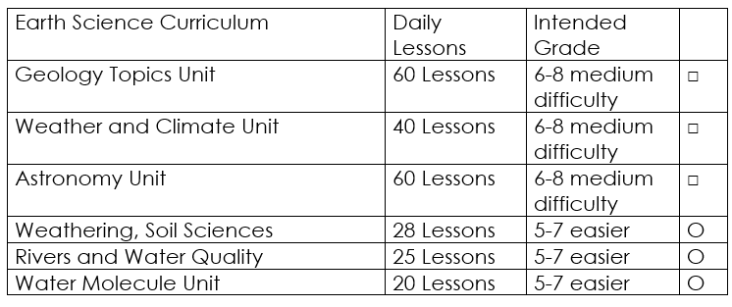

Curriculum Guide
Number of Lessons in each unit (50 min, daily lessons) and difficult rating scale / intended grade level.
=Easier, = More difficult, =Most difficult
Earth Science Units

Slide 127


Life Science Units

Slide 128

Physical Science

Slide 129
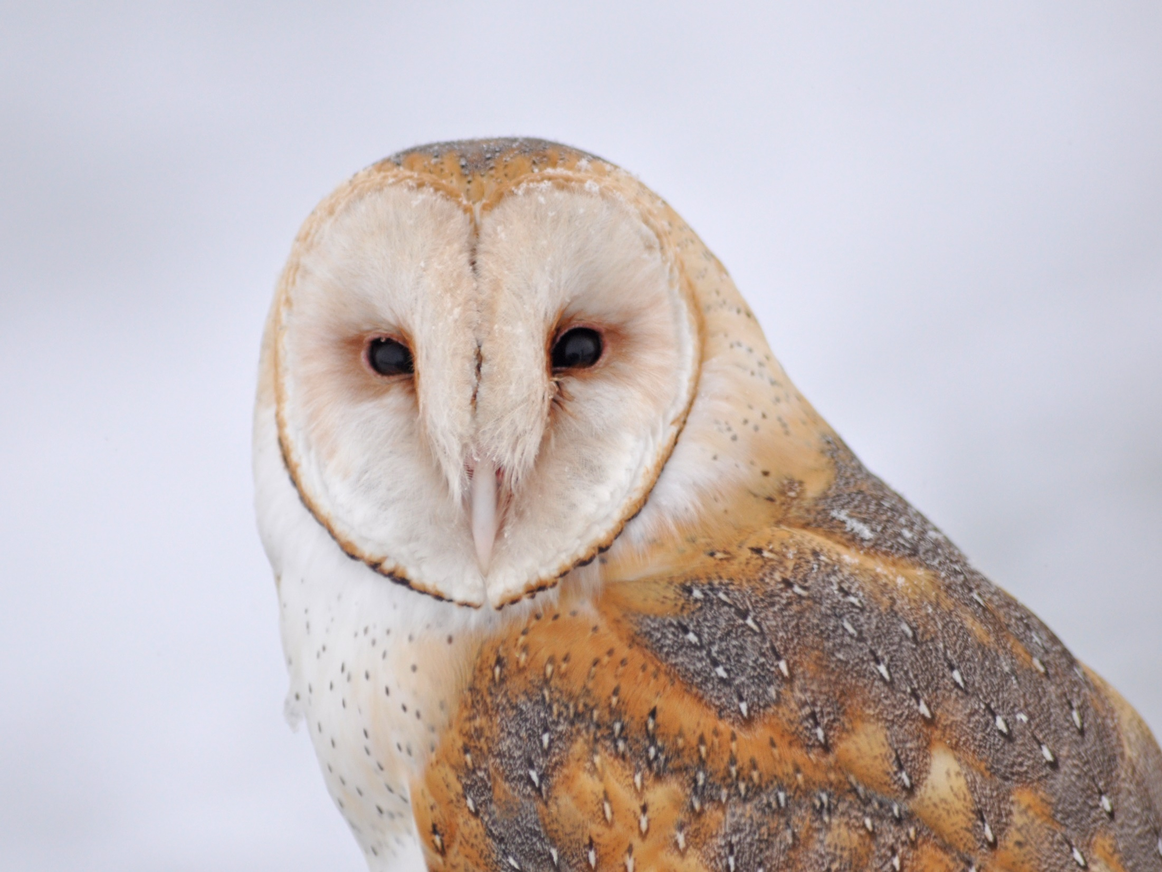
Dear Valued Educator,
Our fully editable .pptx and .doc resources are perfect for educators looking to bring enthusiasm and creativity to their lessons. We encourage you to make changes to fit your needs and style. As science educators, we’re committed to providing students with the tools they need to succeed in the classroom and beyond. Each unit in the curriculum includes a range of resources that have been developed through extensive research and use in a busy classroom. Our teaching approach is designed to make science education engaging and exciting for learners of all ages. We offer a one-of-a-kind science curriculum that will challenge, inspire, and educate students to become tomorrow's scientists and leaders. Join us today and learn more about how our program can help you achieve your classroom goals.
With appreciation,
Support@SlideSpark.net

Slide 130





Thank you for your time and interest in our Science curriculum. We strive to provide students with engaging and informative lessons that will spark their curiosity and encourage scientific exploration. Should you have any questions or concerns, please do not hesitate to contact us. Thank you again for considering our curriculum, and we wish you all the best in your educational journey.
Sincerely,
Support@slidespark.net
SlideSpark Science on TpT

