Slide 1
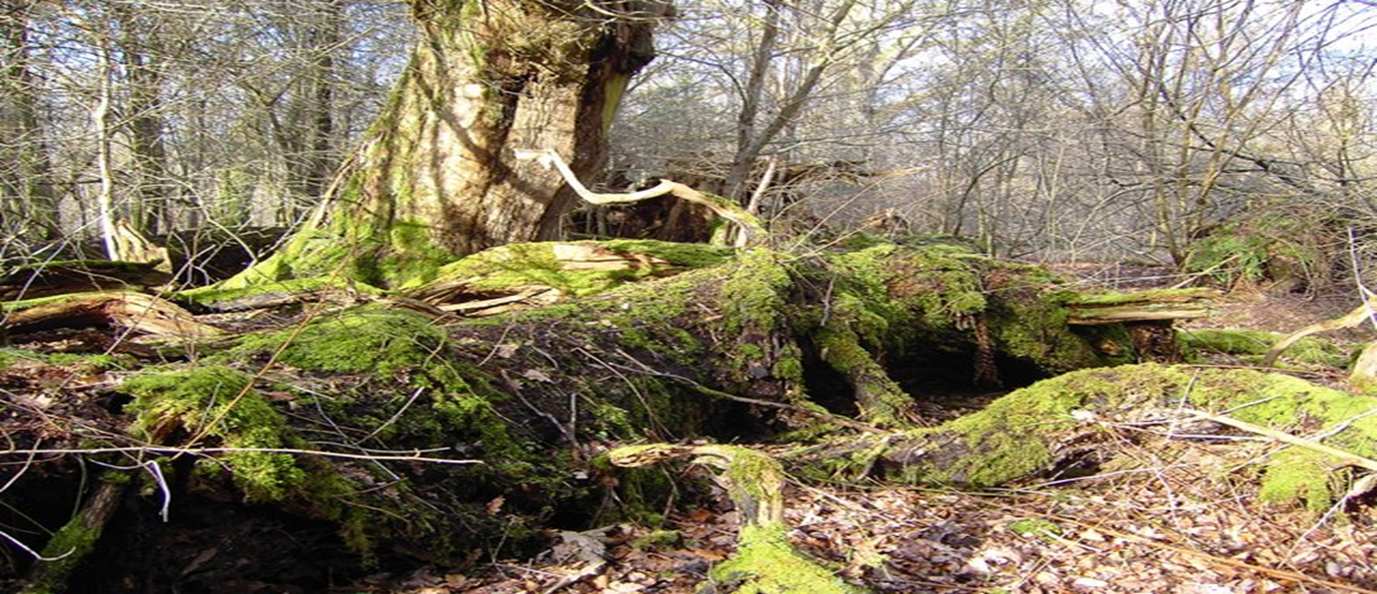


Habitat Lesson
Part 1
Lesson 5

Slide 2
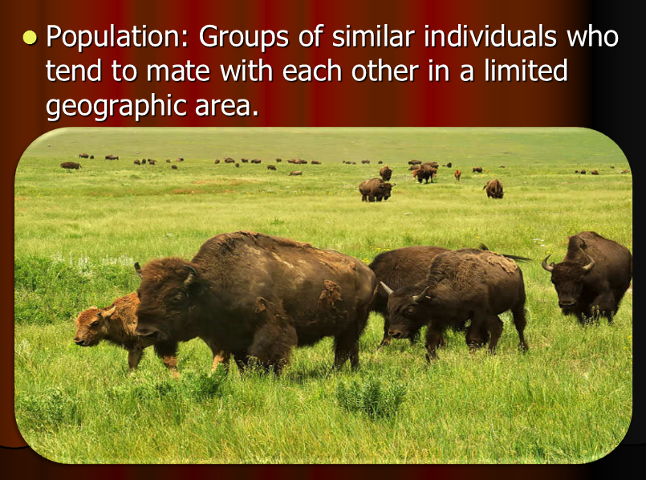
RED SLIDE: These slides contain critical notes and important fill-in the blanks. Please record the important terms in your work bundle.
First and last Name
Science, Grade, Class

Slide 3
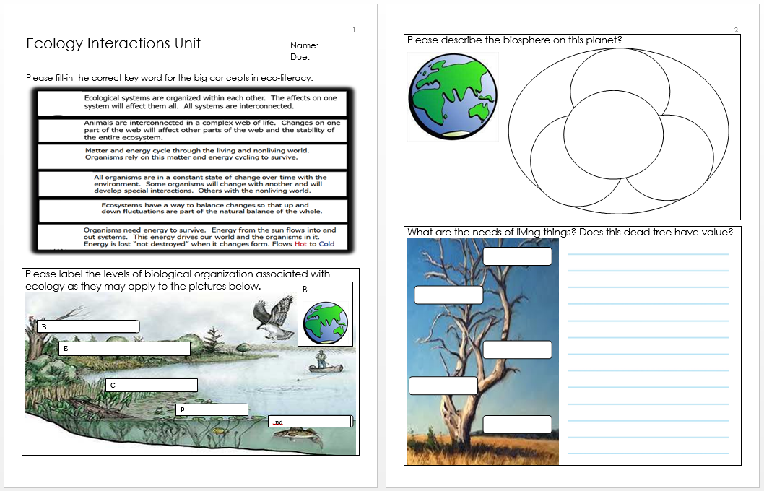
RED SLIDE: These slides contain critical notes and important fill-in the blanks. Please record the important terms in your work bundle.
  You’ll need these notes to complete the work bundle
First and last Name
Science, Grade, Class

Slide 4
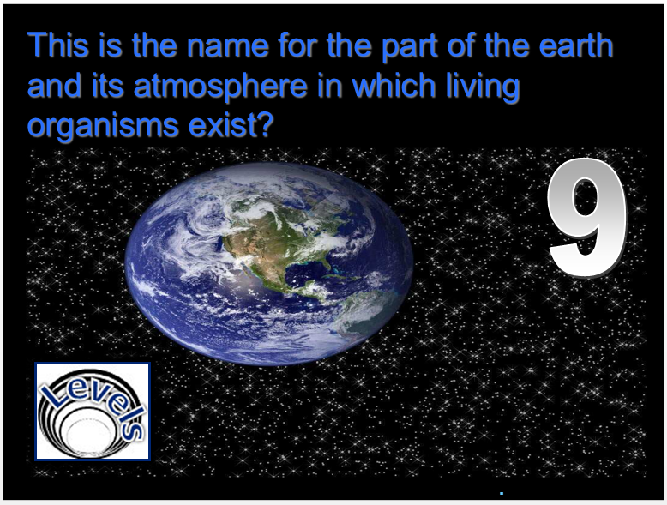
RED SLIDE: These slides contain critical notes and important fill-in the blanks. Please record the important terms in your work bundle.
  You’ll need these notes to complete the work bundle and to be successful on the review game.
First and last Name
Science, Grade, Class

Slide 5

Listen to the teacher and others.
Please no
shout outs.
One speaker at a
time. Please
raise your
hand.
Respect
First,
Last,
and Always.
Safety
Make
Good
Choices
Be Present
Never
Give
Up!
Responsibility
Stay
Organized
Help
Others
Focus on
Task completion
Avoid
Distractions
Science from Murf LLC

Slide 6
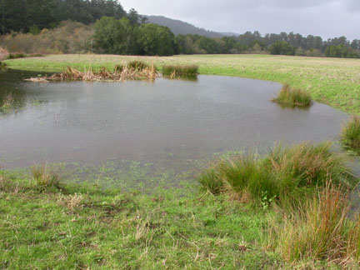
Habitat: The type of environment in which an organism lives.

Slide 7
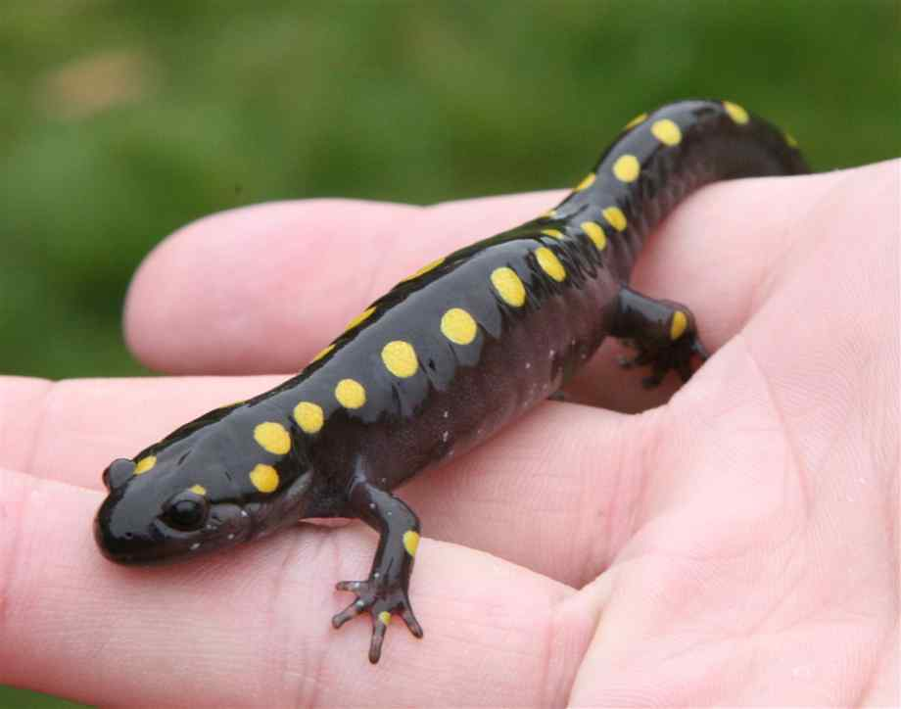
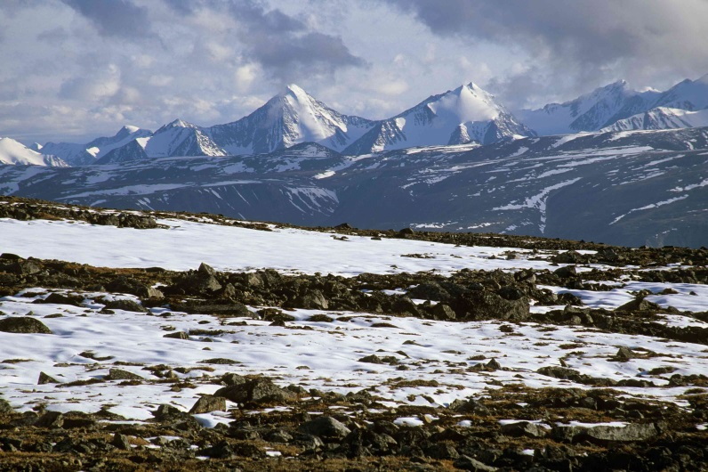
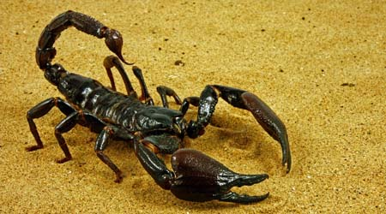
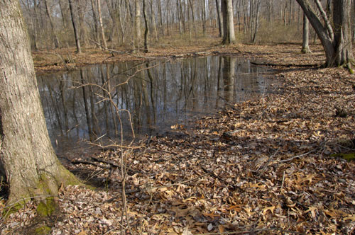
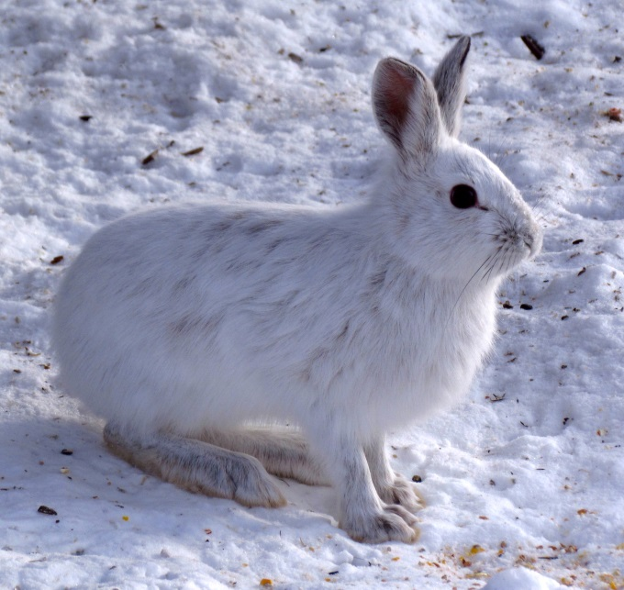
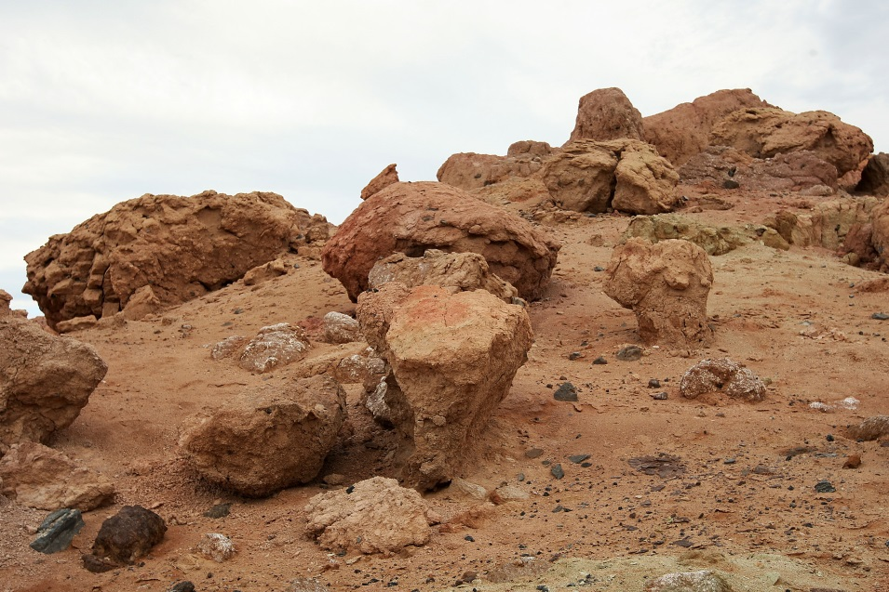
Match the animal to its habitat.
Tundra
Forest / Pool
Desert

Slide 8
Match the animal to its habitat.
Tundra
Forest / Pool
Desert

Slide 9
Match the animal to its habitat.
Tundra
Forest / Pool
Desert

Slide 10
Match the animal to its habitat.
Tundra
Forest / Pool
Desert

Slide 11
Match the animal to its habitat.
Tundra
Forest / Pool
Desert

Slide 12
Match the animal to its habitat.
Tundra
Forest / Pool
Desert

Slide 13
Match the animal to its habitat.
Tundra
Forest / Pool
Desert

Slide 14
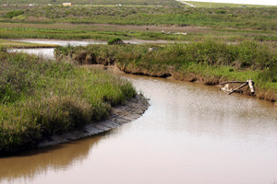
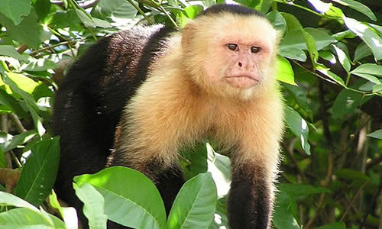
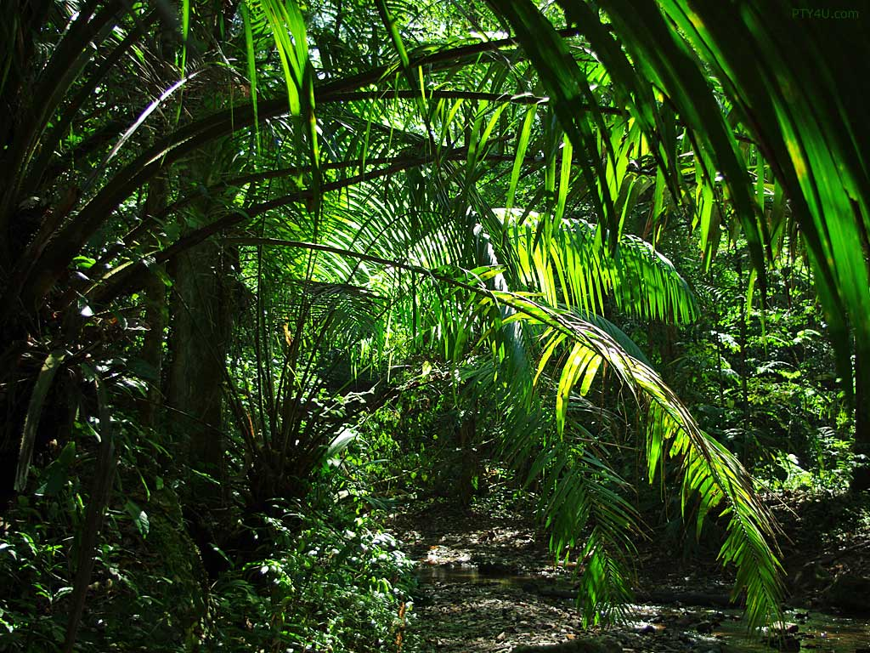
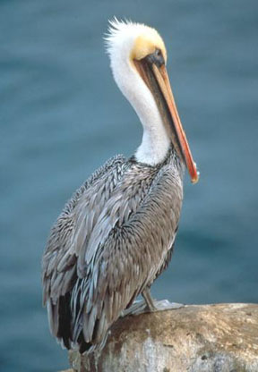
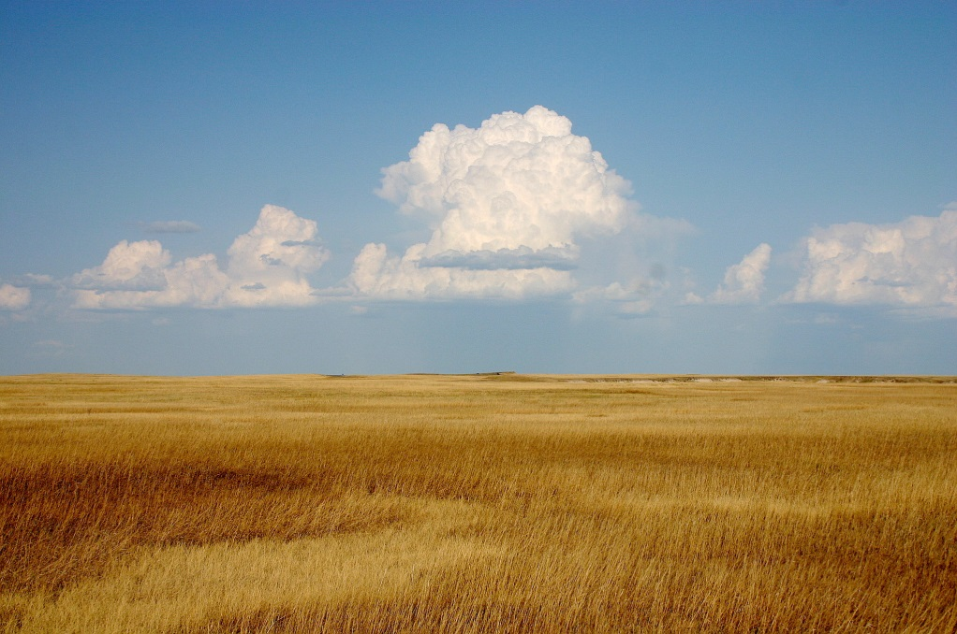
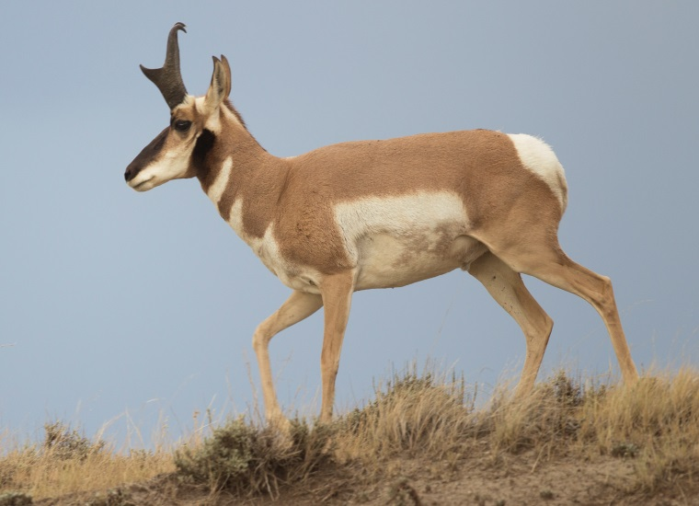
Match the animal to its habitat.
Marine /
Estuary
Tropical
Forest
Prairie

Slide 15
Match the animal to its habitat.
Marine /
Estuary
Tropical
Forest
Prairie

Slide 16
Match the animal to its habitat.
Marine /
Estuary
Tropical
Forest
Prairie

Slide 17
Match the animal to its habitat.
Marine /
Estuary
Tropical
Forest
Prairie

Slide 18
Match the animal to its habitat.
Marine /
Estuary
Tropical
Forest
Prairie

Slide 19
Match the animal to its habitat.
Marine /
Estuary
Tropical
Forest
Prairie

Slide 20
Match the animal to its habitat.
Marine /
Estuary
Tropical
Forest
Prairie

Slide 21

Match the animal to its habitat.
We will see some not so pretty parasites

Slide 22
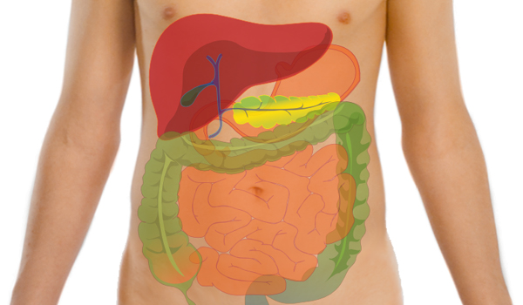
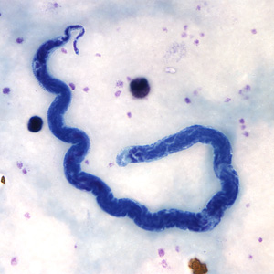
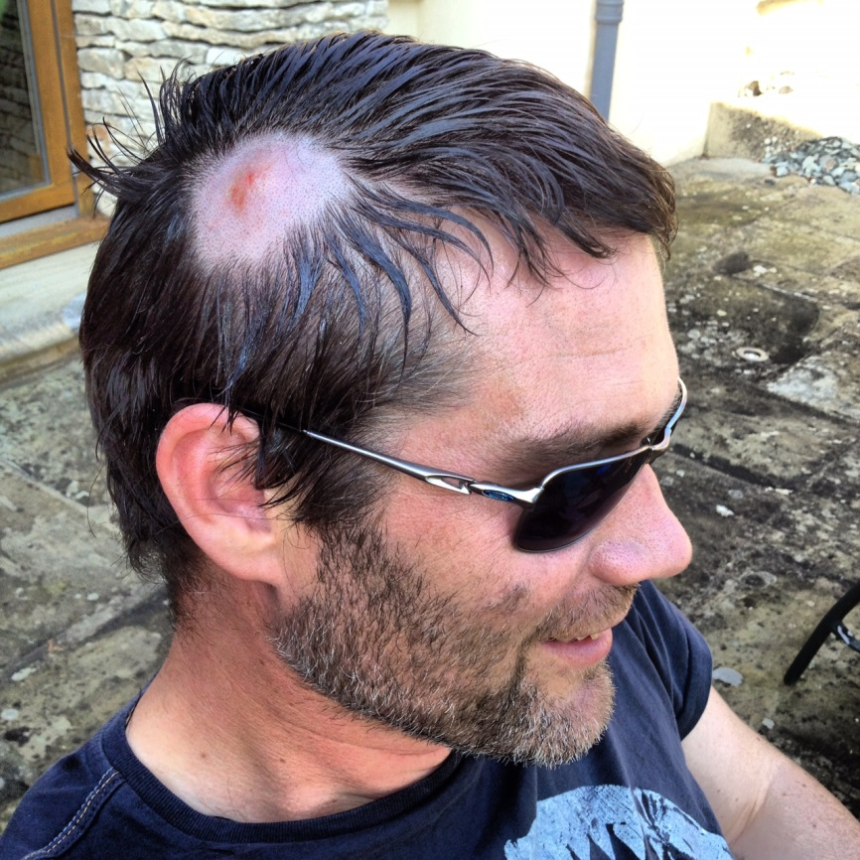
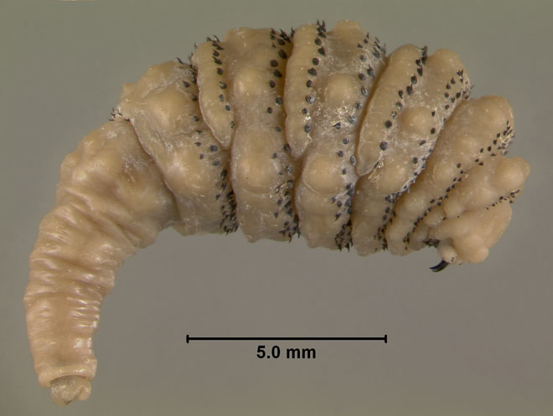
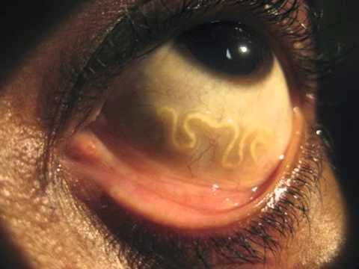
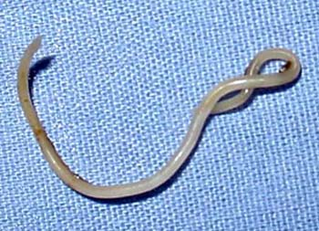
Match the animal to its habitat.

Slide 23
Match the animal to its habitat.

Slide 24
Match the animal to its habitat.
Loa loa
filarial nematode (roundworm)

Slide 25
Match the animal to its habitat.
Loa loa
filarial nematode (roundworm)

Slide 26
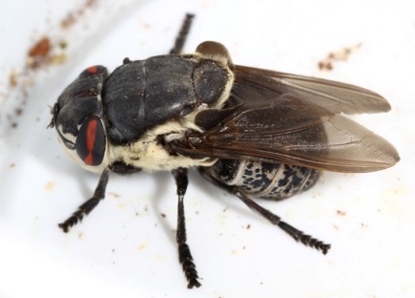
Match the animal to its habitat.
Bot fly larvae
Loa loa
filarial nematode (roundworm)

Slide 27
Match the animal to its habitat.
Bot fly larvae
Loa loa
filarial nematode (roundworm)

Slide 28
Match the animal to its habitat.
Intestinal worm
Bot fly larvae
Loa loa
filarial nematode (roundworm)

Slide 29
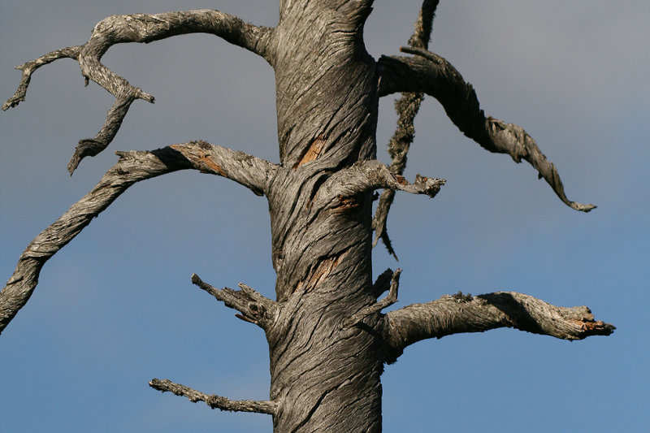
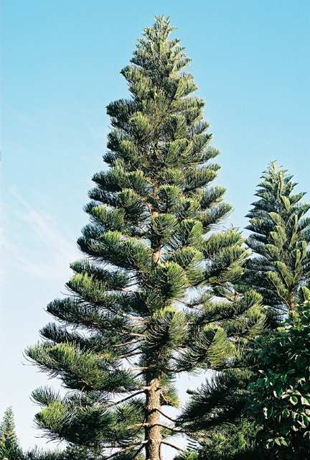
Which tree has more value in a forest ecosystem?
A
B

Slide 30
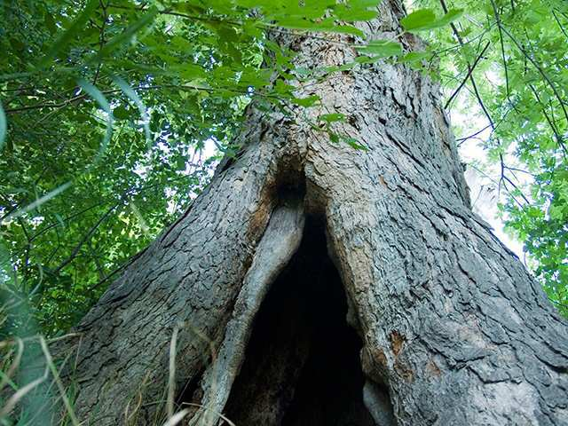
Answer!

Slide 31
Answer! Both have value,

Slide 32
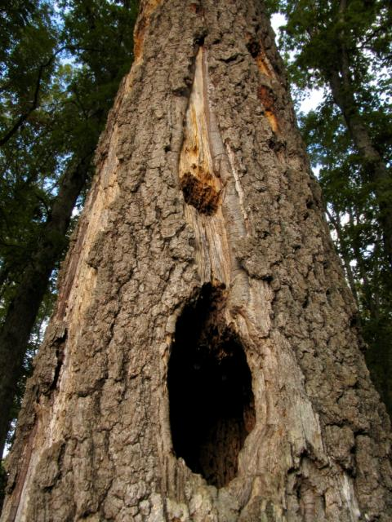
Answer! Both have value, but dead trees are extremely valuable to a forest ecosystem because they provide habitat such as den sites, a steady food source of insects, and ultimately fertilize the soil after decay.

Slide 33
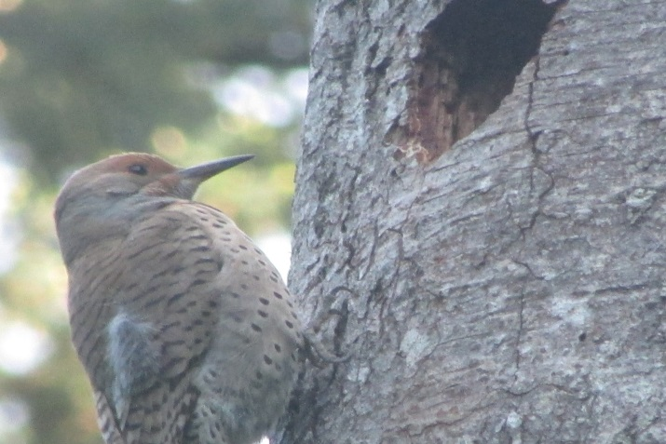
Answer! Both have value, but dead trees are extremely valuable to a forest ecosystem because they provide habitat such as den sites, a steady food source of insects, and ultimately fertilize the soil after decay.

Slide 34

Answer! Both have value, but dead trees are extremely valuable to a forest ecosystem because they provide habitat such as den sites, a steady food source of insects, and ultimately fertilize the soil after decay.

Slide 35
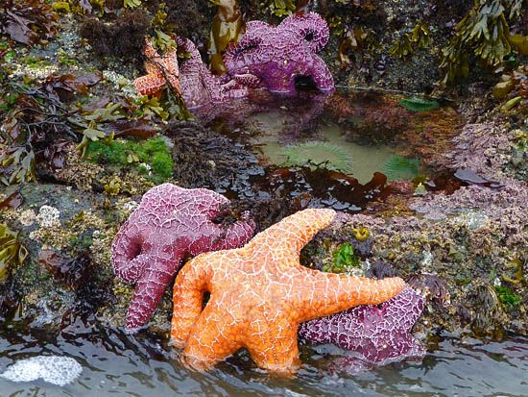
Note: Habitats can be both large and small.

Slide 36
Note: Habitats can be both large and small.
  Picture of a tide pool. A nice little habitat for many sea creatures.

Slide 37
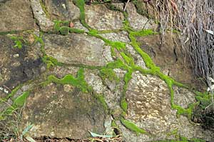
Microhabitat: The very small, specialized habitat that an organism lives.

Slide 38
Microhabitat: The very small, specialized habitat that an organism lives.
  Ex. a clump of grass or a space between rocks.

Slide 39
Microhabitat: The very small, specialized habitat that an organism lives.
  Ex. a clump of grass or a space between rocks.

Slide 40
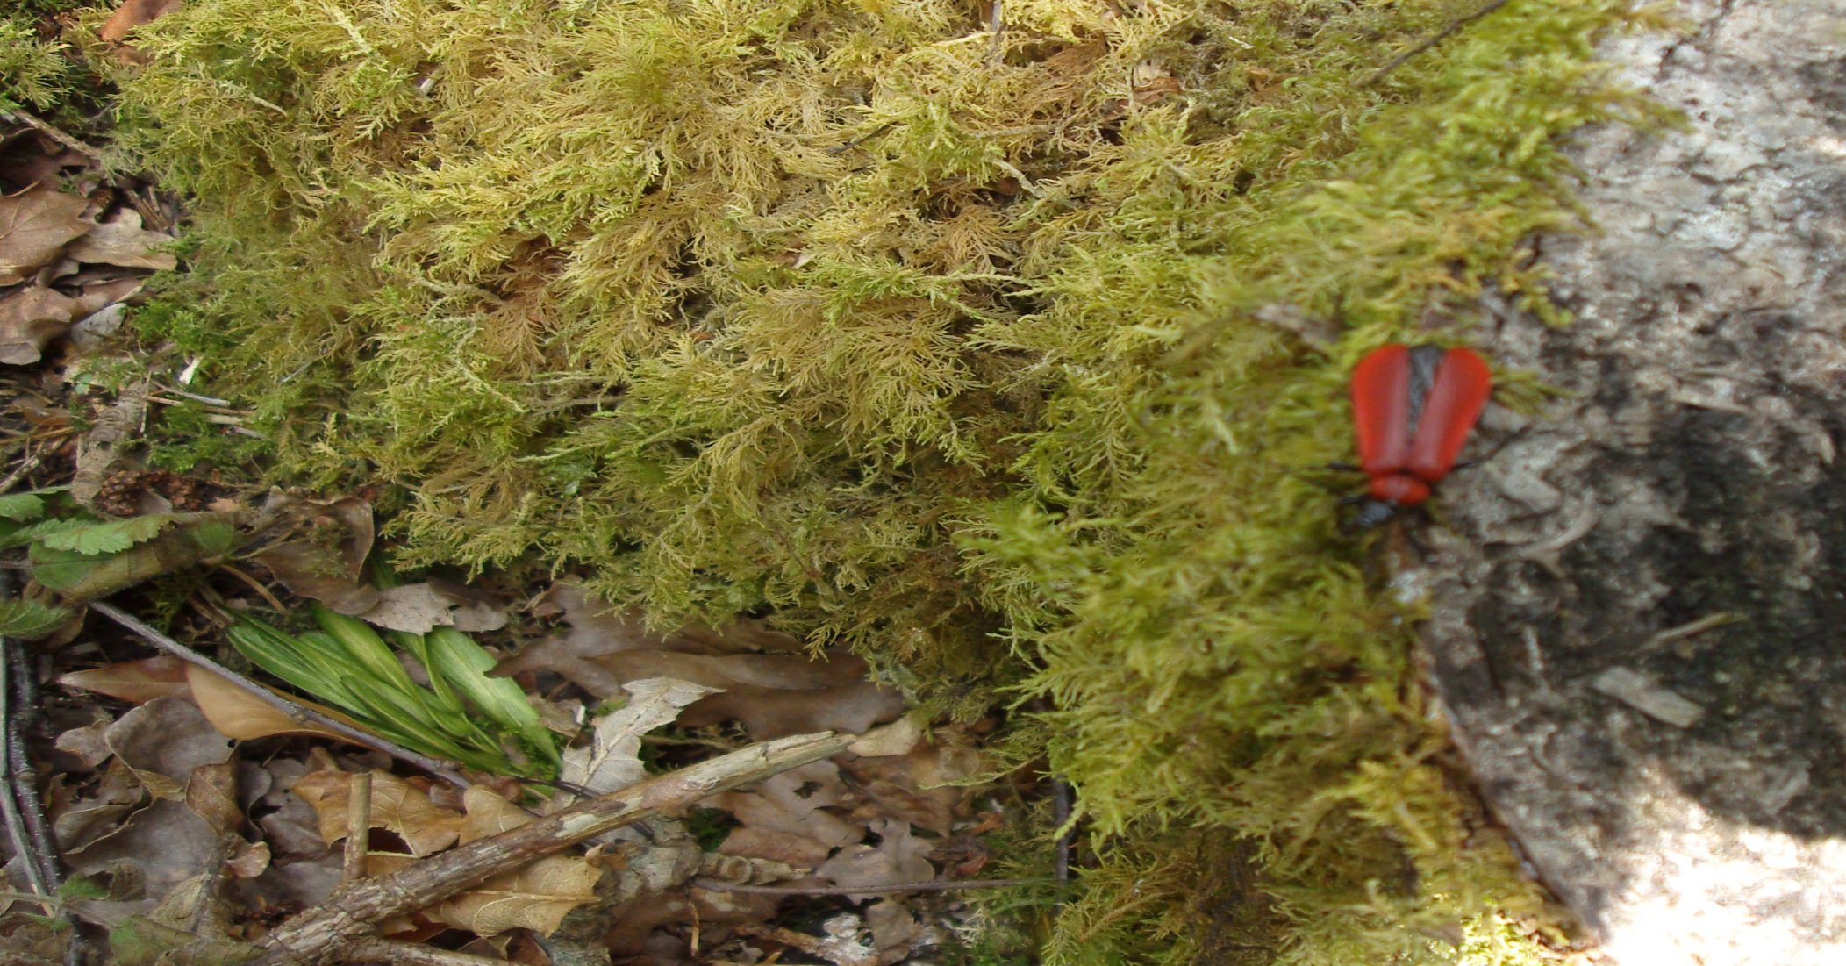
Microhabitat: The very small, specialized habitat that an organism lives.
  Ex. a clump of grass or a space between rocks.

Slide 41
Microhabitat: The very small, specialized habitat that an organism lives.
  Ex. a clump of grass or a space between rocks.

Slide 42
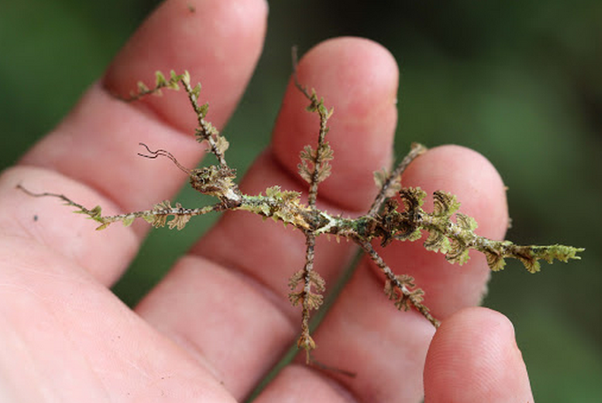
Microhabitat: The very small, specialized habitat that an organism lives.
  Ex. a clump of grass or a space between rocks.

Slide 43
Microhabitat: The very small, specialized habitat that an organism lives.
  Ex. a clump of grass or a space between rocks.

Slide 44
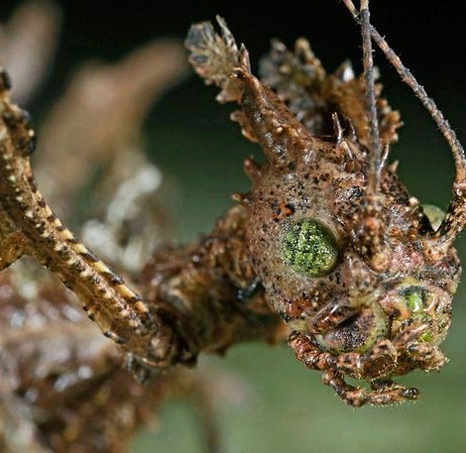
Microhabitat: The very small, specialized habitat that an organism lives.
  Ex. a clump of grass or a space between rocks.

Slide 45
Microhabitat: The very small, specialized habitat that an organism lives.
  Ex. a clump of grass or a space between rocks.
Learn more about microhabitats and lichen at… http://www.anbg.gov.au/lichen/ecology-habitats-micro.html

Slide 46
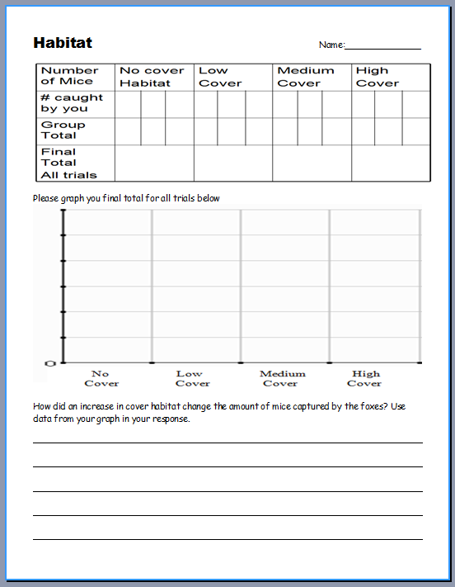
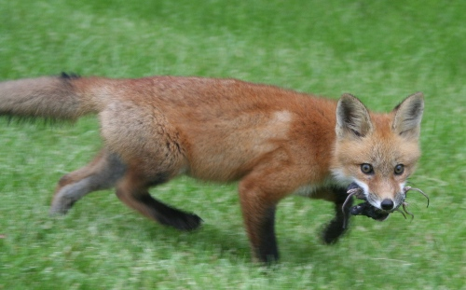
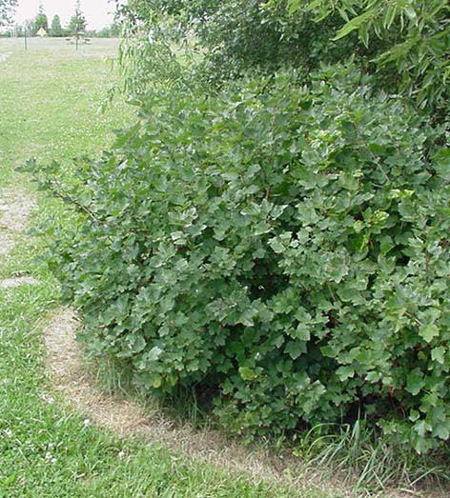
Habitat Activity Available Sheet

Slide 47
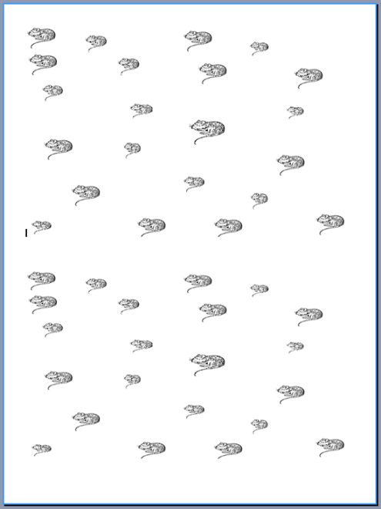
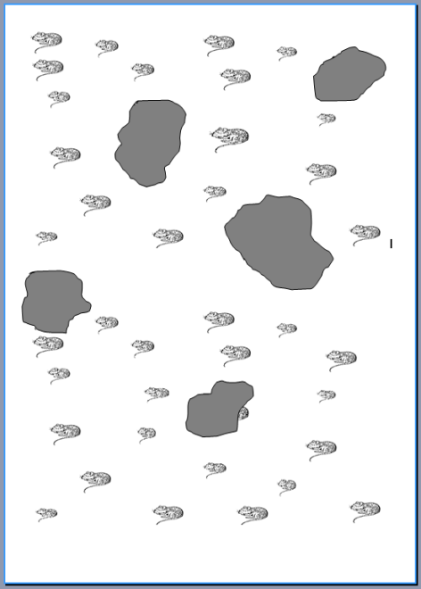
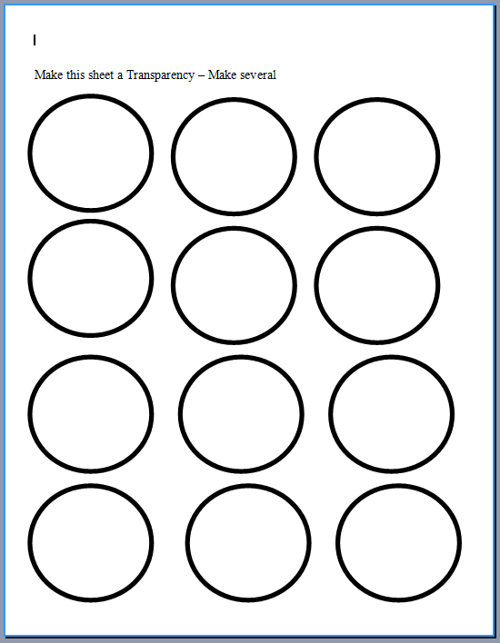
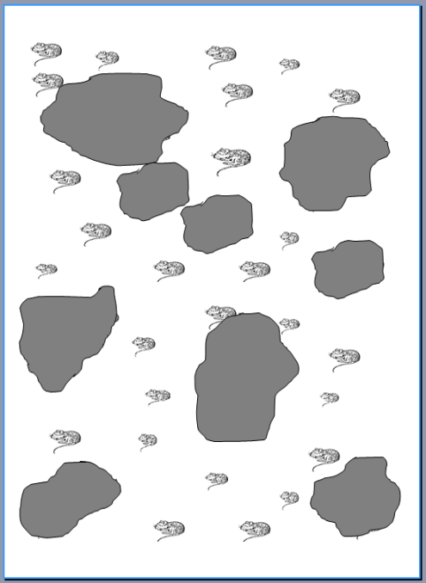
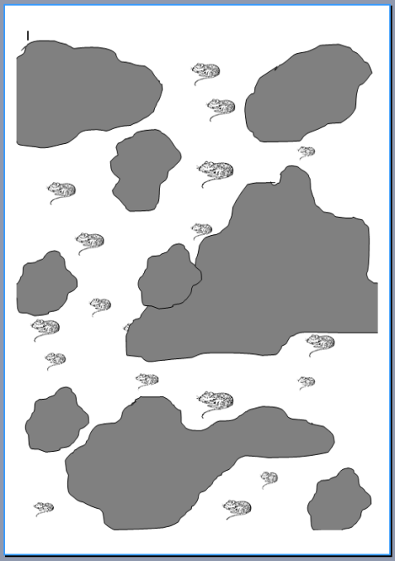
Habitat Activity Available Sheet

Slide 48
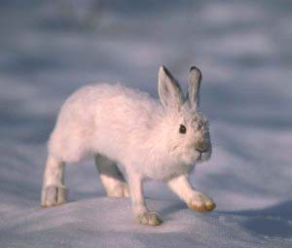
Law of Nature

Slide 49
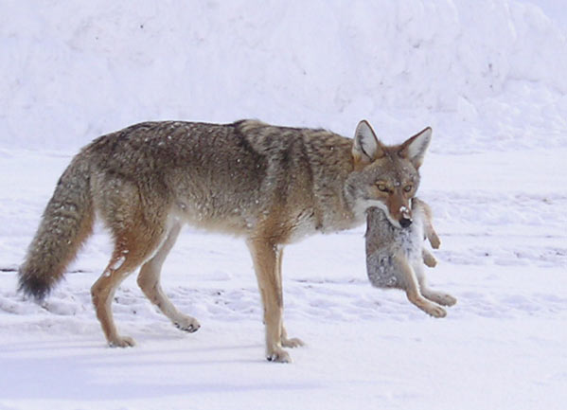
Law of Nature
Don’t Die!

Slide 50
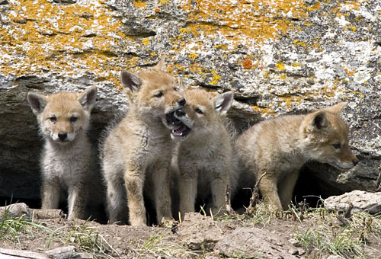
Law of Nature
Don’t Die!
Make lots of babies

Slide 51
Law of Nature
Don’t Die!
Make lots of babies
Important Note: We are talking about dragonflies and mites and things. Obviously don’t die, and you should hold off on the baby making thing for a considerable amount of time. Thank you.

Slide 52
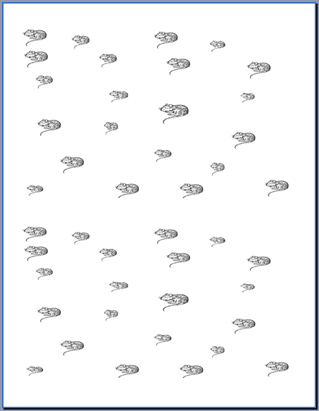
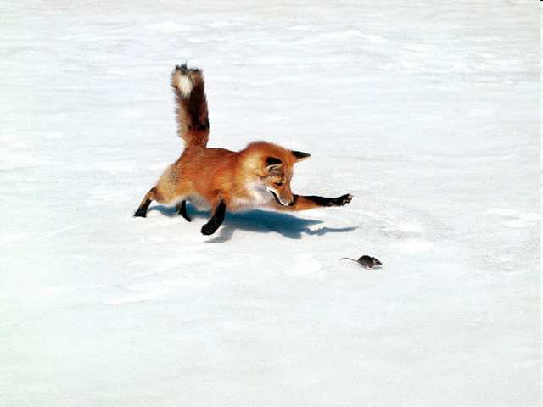
Habitat Activity. Mice and Foxes
  Sheets provided in activities folder.

Slide 53

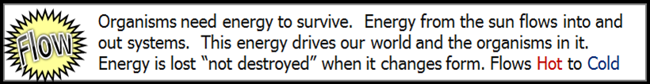
Habitat Activity. Mice and Foxes
  Sheets provided in activities folder.

Slide 54


Habitat Activity. Mice and Foxes

Slide 55
Students (FOXES) toss in small circle.

Slide 56
Students (FOXES) toss in small circle.

Slide 57
Students (FOXES) toss in small circle.

Slide 58
Habitat Activity. Mice and Foxes
This would count as 3 mice caught

Slide 59
Habitat Activity. Mice and Foxes
This would count as 2 mice caught

Slide 60
Habitat Activity. Mice and Foxes
This would count as 2 mice caught

Slide 61
No habitat

Slide 62
How many total mice were caught?

Slide 63
How many total mice were caught?
?
Your group must decide close calls

Slide 64
How many total mice were caught?
?
Your group must decide close calls
Not the teacher.

Slide 65
How many total mice were caught?
3
5
4
3
4

Slide 66
How many total mice were caught? 19
3
5
4
3
4

Slide 67
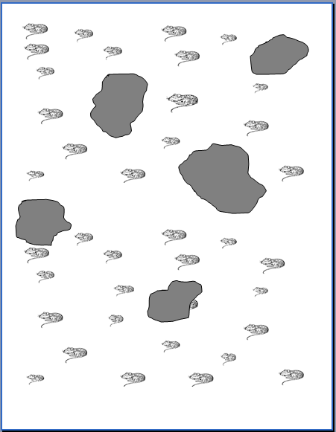
This is low cover habitat.

Slide 68
This is low cover habitat.

Slide 69
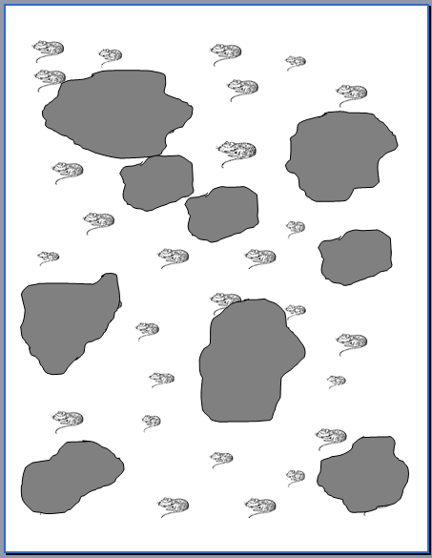
This is medium cover habitat.

Slide 70
This is medium cover habitat.

Slide 71

This is high cover habitat.

Slide 72
This is high cover habitat.

Slide 73
Habitat Activity Available Sheet

Slide 74
Please record the following spreadsheet into your science journal. (3 trials each round)
Number of Mice | No cover Habitat | Low Cover | Medium Cover | High Cover
# caught by you
Group Total
Final Total All trials

Slide 75

Procedure: Work in table groups 3-5.
  Each student must toss a transparency circle into the feeding zone with no cover habitat and record the number of mice you caught on your spreadsheet.
  Find the sum of everyone in your group to get group total.
2
11

Slide 76
Procedure: Work in table groups 3-5.
  Each student must toss a transparency circle into the feeding zone with no cover habitat and record the number of mice you caught on your spreadsheet.
  Find the sum of everyone in your group to get group total.
2
11
Need to communicate
with group.

Slide 77
Procedure: Work in table groups 3-5.
  Each student must toss a transparency circle into the feeding zone with no cover habitat and record the number of mice you caught on your spreadsheet.
  Find the sum of everyone in your group to get group total.
2
4
3
11
14
15
?

Slide 78
Procedure: Work in table groups 3-5.
  Each student must toss a transparency circle into the feeding zone with no cover habitat and record the number of mice you caught on your spreadsheet.
  Find the sum of everyone in your group to get group total.
2
4
3
11
14
15
40

Slide 79
Procedure: Work in table groups 3-5.
  Each student must toss a transparency circle into the feeding zone with low cover habitat and record the number of mice you caught on your spreadsheet.
  Find the sum of everyone in your group to get group total.
2
4
3
11
14
15
40

Slide 80
Procedure: Work in table groups 3-5.
  Each student must toss a transparency circle into the feeding zone with medium cover habitat and record the number of mice you caught on your spreadsheet.
  Find the sum of everyone in your group to get group total.
2
4
3
11
14
15
40

Slide 81
Procedure: Work in table groups 3-5.
  Each student must toss a transparency circle into the feeding zone with high cover habitat and record the number of mice you caught on your spreadsheet.
  Find the sum of everyone in your group to get group total.
2
4
3
11
14
15
40

Slide 82
Simulated data if not completing.
Number of Mice | No cover Habitat | Low Cover | Medium Cover | High Cover
# caught by you
Group Total
Final Total All trials
3 4 3 3 2 2 1 0 3 1 1 0
10 12 12 9 8 8 7 6 6 4 5 4
34
25
19
13

Slide 83
Habitat Activity Available Sheet

Slide 84
Habitat Activity Available Sheet
Most Caught

Slide 85
Habitat Activity Available Sheet
30
Example
30 25 20 15 10 5

Slide 86
Habitat Activity Available Sheet
30
25
15
5
Example
30 25 20 15 10 5

Slide 87
Habitat Activity Available Sheet
30
25
15
5
Example
30 25 20 15 10 5

Slide 88

Questions to answer in journal.
  Please make a column graph showing the totals of mice caught in no cover habitat, low cover habitat, medium cover habitat, and high cover habitat.

Slide 89
How did an increase in cover habitat change the amount of mice captured by the foxes?
Use data from graph!

Slide 90
How did an increase in cover habitat change the amount of mice captured by the foxes?
The data suggests that the high cover habitat was the most difficult to catch mice. Only 13 mice were captured in the high covered compared to 34 in no cover.

Slide 91


Slide 92
“What are the five things in a habitat that I need to survive?”

Slide 93

Habitat, Food Chain, Webs Video.
  Reviews Food Chains, Ecosystems
  https://www.youtube.com/watch?v=p15IrEuhYmo
Easy

Slide 94
Habitat Lesson
Part 1
Lesson 5

Slide 95





Curriculum Guide
Number of Lessons in each unit (50 min, daily lessons) and difficult rating scale / intended grade level.
=Easier, = More difficult, =Most difficult
Earth Science Units

Slide 96


Life Science Units

Slide 97

Physical Science

Slide 98

Dear Valued Educator,
Our fully editable .pptx and .doc resources are perfect for educators looking to bring enthusiasm and creativity to their lessons. We encourage you to make changes to fit your needs and style. As science educators, we’re committed to providing students with the tools they need to succeed in the classroom and beyond. Each unit in the curriculum includes a range of resources that have been developed through extensive research and use in a busy classroom. Our teaching approach is designed to make science education engaging and exciting for learners of all ages. We offer a one-of-a-kind science curriculum that will challenge, inspire, and educate students to become tomorrow's scientists and leaders. Join us today and learn more about how our program can help you achieve your classroom goals.
With appreciation,
Support@SlideSpark.net

Slide 99





Thank you for your time and interest in our Science curriculum. We strive to provide students with engaging and informative lessons that will spark their curiosity and encourage scientific exploration. Should you have any questions or concerns, please do not hesitate to contact us. Thank you again for considering our curriculum, and we wish you all the best in your educational journey.
Sincerely,
Support@slidespark.net
SlideSpark Science on TpT

