Slide 1
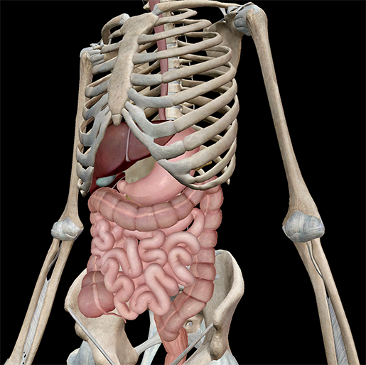

Digestive System
Review Game
Part 5
Lesson 6

Slide 2
The Digestive System PowerPoint Review Game
NUTRARIFIC | SUGAR AND SPICE | IT’S JUICY | WAVY GRAVY | -BONUS- UPSET AND BLOATED
1 | 6 | 11 | 16 | *21
2 | 7 | 12 | 17 | *22
3 | 8 | 13 | 18 | *23
4 | 9 | 14 | 19 | *24
5 | 10 | 15 | 20 | *25
Final Question:________________
Copyright © 2024 SlideSpark .LLC

Slide 3
How to play…
  Don’t play like Jeo_ _ _ _ y.
  Class should be divided into several small groups.
  Groups should use science journal (red slide notes), homework, and other available materials to assist you.
  Groups can communicate quietly with each other but no sharing answers between groups.
    Practice quietly communicating right now?
    Practice Communication Question:
    Your group gets to order one pizza, and you can have two toppings. What does your group want?

Slide 4

Questions 1-20 = 5pts Each
Final Category (Bonus) = 1pt Each
Final Questions = 5 pt wager
If you wager 5 on the last question and get it wrong you lose 5 pts. Wager 5 and get it right you get 5 pts.
Find the Owl =
Secretly write “Owl” in the correct box worth 1pt.
“I’ll be about this big.”

Slide 5
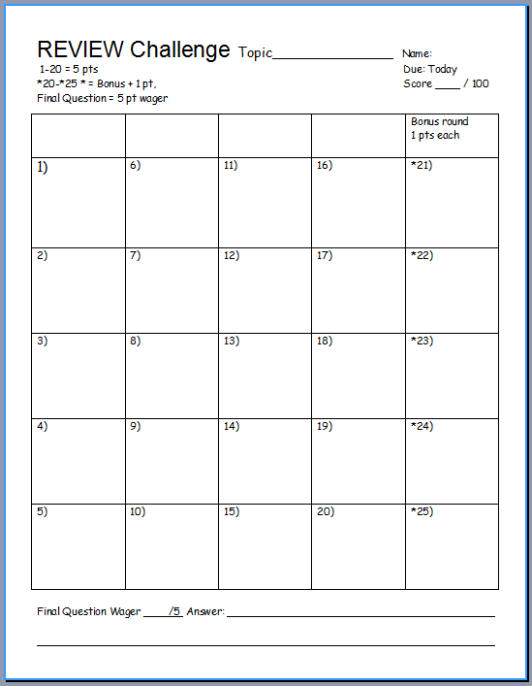
Is your name on the review sheet?
Name

Slide 6
Is your name on the review sheet?
Add the categories
along the top
on the next slide.

Slide 7
The Digestive System PowerPoint Review Game
NUTRARIFIC | SUGAR AND SPICE | ITS JUICY | WAVY GRAVY | -BONUS- UPSET AND BLOATED
1 | 6 | 11 | 16 | *21
2 | 7 | 12 | 17 | *22
3 | 8 | 13 | 18 | *23
4 | 9 | 14 | 19 | *24
5 | 10 | 15 | 20 | *25
Final Question:________________
Copyright © 2024 SlideSpark .LLC

Slide 8
The Digestive System PowerPoint Review Game
NUTRARIFIC | SUGAR AND SPICE | ITS JUICY | WAVY GRAVY | -BONUS- UPSET AND BLOATED
1 | 6 | 11 | 16 | *21
2 | 7 | 12 | 17 | *22
3 | 8 | 13 | 18 | *23
4 | 9 | 14 | 19 | *24
5 | 10 | 15 | 20 | *25
Final Question:________________
Copyright © 2024 SlideSpark .LLC

Slide 9
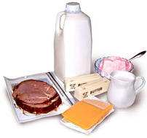
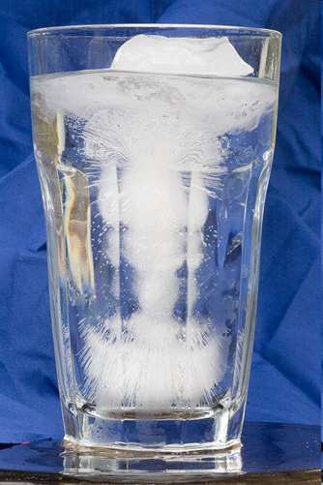
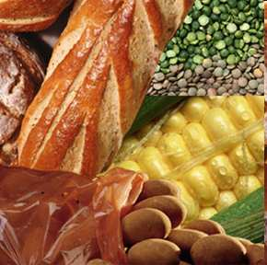
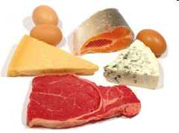
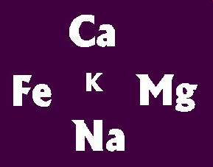
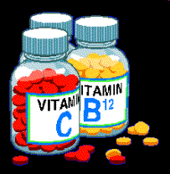
Nutrients include these 6 things. (1 point each)
1
Copyright © 2024 SlideSpark .LLC

Slide 10
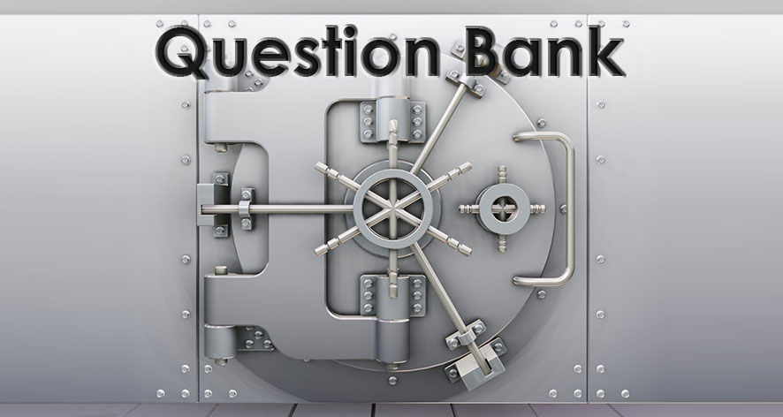

New Question

Slide 11
Which of these two are energy molecules?
2
Copyright © 2024 SlideSpark .LLC

Slide 12
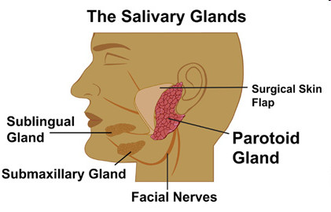
This is the chemical enzyme in salvia that breaks starches into simple sugars?
3
Copyright © 2024 SlideSpark .LLC

Slide 13
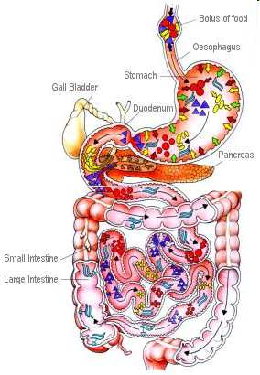

This type of digestion is the process of converting food into chemical substances that can be absorbed and used.
4
Copyright © 2024 SlideSpark .LLC

Slide 14
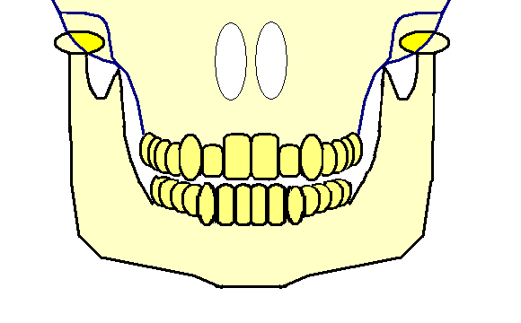
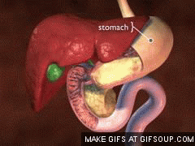
5
This is the type of digestion where you physically break up the food?
5
Copyright © 2024 SlideSpark .LLC

Slide 15
The Digestive System PowerPoint Review Game
NUTRARIFIC | SUGAR AND SPICE | ITS JUICY | WAVY GRAVY | -BONUS- UPSET AND BLOATED
1 | 6 | 11 | 16 | *21
2 | 7 | 12 | 17 | *22
3 | 8 | 13 | 18 | *23
4 | 9 | 14 | 19 | *24
5 | 10 | 15 | 20 | *25
Final Question:________________
Copyright © 2024 SlideSpark .LLC
Copyright © 2024 SlideSpark .LLC

Slide 16
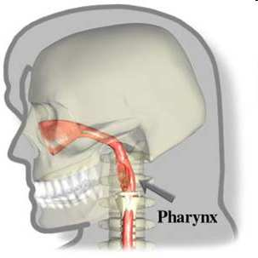
This is the part of the throat situated immediately behind the mouth and nasal cavity?
6
Copyright © 2024 SlideSpark .LLC

Slide 17
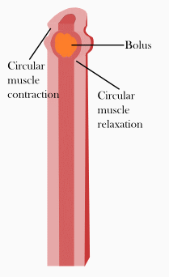
This is the name for the wave-like motion that helps to move food down the esophagus?
7
Copyright © 2024 SlideSpark .LLC

Slide 18
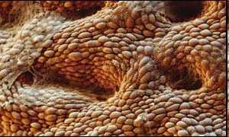
This is the chemical enzyme that is produced in the stomach that contains HCL Hydrochloric Acid?
8
Copyright © 2024 SlideSpark .LLC

Slide 19
This is the chemical enzyme that is produced in the stomach that contains HCL Hydrochloric Acid?
A.) Lactase
8
Copyright © 2024 SlideSpark .LLC

Slide 20
This is the chemical enzyme that is produced in the stomach that contains HCL Hydrochloric Acid?
A.) Lactase
B.) Ptyalin
8
Copyright © 2024 SlideSpark .LLC

Slide 21
This is the chemical enzyme that is produced in the stomach that contains HCL Hydrochloric Acid?
A.) Lactase
B.) Ptyalin
C.) Pepsin
8
Copyright © 2024 SlideSpark .LLC

Slide 22
This is the chemical enzyme that is produced in the stomach that contains HCL Hydrochloric Acid?
A.) Lactase
B.) Ptyalin
C.) Pepsin
D.) Bile
8
Copyright © 2024 SlideSpark .LLC

Slide 23
This is the chemical enzyme that is produced in the stomach that contains HCL Hydrochloric Acid?
A.) Lactase
B.) Ptyalin
C.) Pepsin
D.) Bile
E.) Sucrose
8
Copyright © 2024 SlideSpark .LLC

Slide 24
This is the chemical enzyme that is produced in the stomach that contains HCL Hydrochloric Acid?
A.) Lactase
B.) Ptyalin
C.) Pepsin
D.) Bile
E.) Sucrose
8
Copyright © 2024 SlideSpark .LLC

Slide 25
This is the chemical enzyme that is produced in the stomach that contains HCL Hydrochloric Acid?
A.) Lactase
B.) Ptyalin
C.) Pepsin
D.) Bile
E.) Sucrose
F.) Nobody Knows
8
Copyright © 2024 SlideSpark .LLC

Slide 26
This is the chemical enzyme that is produced in the stomach that contains HCL Hydrochloric Acid?
A.) Lactase
B.) Ptyalin
C.) Pepsin
D.) Bile
E.) Sucrose
F.) Nobody Knows
G.) None of the above
8
Copyright © 2024 SlideSpark .LLC

Slide 27
This is the chemical enzyme that is produced in the stomach that contains HCL Hydrochloric Acid?
A.) Lactase
B.) Ptyalin
C.) Pepsin
D.) Bile
E.) Sucrose
F.) Nobody Knows
G.) None of the above
H.) All of the above
8
Copyright © 2024 SlideSpark .LLC

Slide 28
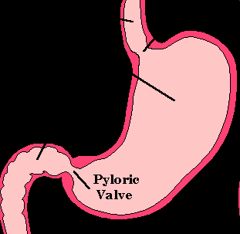
This is a strong ring of smooth muscle that lets food pass from the stomach to the duodenum?
9
Copyright © 2024 SlideSpark .LLC

Slide 29
This is a strong ring of smooth muscle that lets food pass from the stomach to the duodenum?
A.) Pharynx
9
Copyright © 2024 SlideSpark .LLC

Slide 30
This is a strong ring of smooth muscle that lets food pass from the stomach to the duodenum?
A.) Pharynx
B.) Larnyx
9
Copyright © 2024 SlideSpark .LLC

Slide 31
This is a strong ring of smooth muscle that lets food pass from the stomach to the duodenum?
A.) Pharynx
B.) Larnyx
C.) Anal Sphincter
9
Copyright © 2024 SlideSpark .LLC

Slide 32
This is a strong ring of smooth muscle that lets food pass from the stomach to the duodenum?
A.) Pharynx
B.) Larnyx
C.) Anal Sphincter
D.) Pyloric Valve
9
Copyright © 2024 SlideSpark .LLC

Slide 33
This is a strong ring of smooth muscle that lets food pass from the stomach to the duodenum?
A.) Pharynx
B.) Larnyx
C.) Anal Sphincter
D.) Pyloric Valve
E.) Appendix
9
Copyright © 2024 SlideSpark .LLC

Slide 34
This is a strong ring of smooth muscle that lets food pass from the stomach to the duodenum?
A.) Pharynx
B.) Larnyx
C.) Anal Sphincter
D.) Pyloric Valve
E.) Appendix
F.) Nobody Knows
9
Copyright © 2024 SlideSpark .LLC

Slide 35
This is a strong ring of smooth muscle that lets food pass from the stomach to the duodenum?
A.) Pharynx
B.) Larnyx
C.) Anal Sphincter
D.) Pyloric Valve
E.) Appendix
F.) Nobody Knows
G.) None of the above
9
Copyright © 2024 SlideSpark .LLC

Slide 36
This is a strong ring of smooth muscle that lets food pass from the stomach to the duodenum?
A.) Pharynx
B.) Larnyx
C.) Anal Sphincter
D.) Pyloric Valve
E.) Appendix
F.) Nobody Knows
G.) None of the above
H.) All of the above
9
Copyright © 2024 SlideSpark .LLC

Slide 37
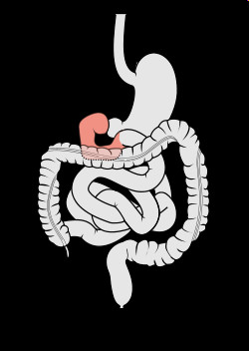
This is the beginning of the small intestine.
10
Copyright © 2024 SlideSpark .LLC

Slide 38
This is the beginning of the small intestine. It Distributes bile (produced by the liver and stored in the gall bladder),
10
Copyright © 2024 SlideSpark .LLC

Slide 39
This is the beginning of the small intestine. It Distributes bile (produced by the liver and stored in the gall bladder), pancreatic acids (pancreas), and other secretions to chemically breakdown food.
10
Copyright © 2024 SlideSpark .LLC

Slide 40
This is the beginning of the small intestine. It Distributes bile (produced by the liver and stored in the gall bladder), pancreatic acids (pancreas), and other secretions to chemically breakdown food.
10
Copyright © 2024 SlideSpark .LLC

Slide 41
The Digestive System PowerPoint Review Game
NUTRARIFIC | SUGAR AND SPICE | ITS JUICY | WAVY GRAVY | -BONUS- UPSET AND BLOATED
1 | 6 | 11 | 16 | *21
2 | 7 | 12 | 17 | *22
3 | 8 | 13 | 18 | *23
4 | 9 | 14 | 19 | *24
5 | 10 | 15 | 20 | *25
Final Question:________________
Copyright © 2024 SlideSpark .LLC

Slide 42
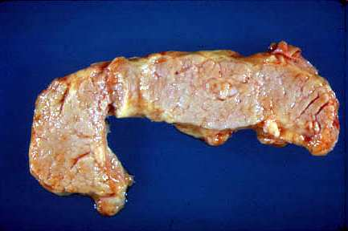
Name this organ that releases digestive juices into the small intestine?
11
Copyright © 2024 SlideSpark .LLC

Slide 43
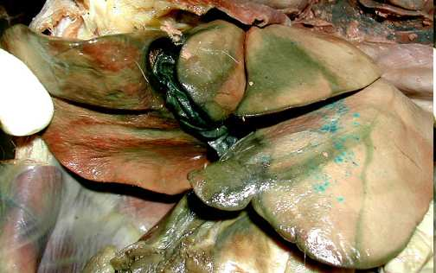
These two organs aid in the production and distribution of bile?
12
Copyright © 2024 SlideSpark .LLC

Slide 44

Please record the substance that each becomes in the box.
A
A
Proteins
B
B
Starches
C
C
Fats
Copyright © 2024 SlideSpark .LLC

Slide 45
Please record the substance that each becomes in the box.
A
A
Proteins
B
B
Starches
C
C
Fats
Copyright © 2024 SlideSpark .LLC

Slide 46
Please record the substance that each becomes in the box.
A
A
Proteins
B
B
Starches
C
C
Fats
Copyright © 2024 SlideSpark .LLC

Slide 47
Please record the substance that each becomes in the box.
A
A
Proteins
B
B
Starches
C
C
Fats
Copyright © 2024 SlideSpark .LLC

Slide 48
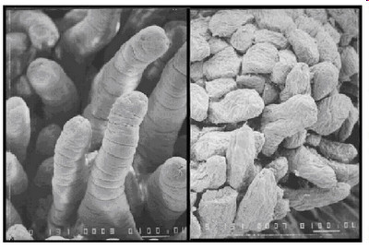
The small intestine is covered with millions of small fingerlike structures called villi.
14
They create more
surface area for
the absorption of
nutrients
Copyright © 2024 SlideSpark .LLC

Slide 49
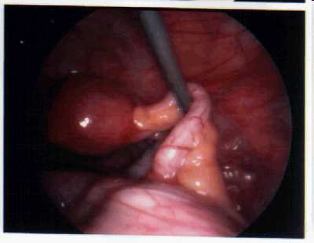
This is a small pouch that extends off of the large intestine.
  Plays a role in preventing infection.
  Can rupture causing serious injury if not fixed.
15
Copyright © 2024 SlideSpark .LLC

Slide 50
The Digestive System PowerPoint Review Game
NUTRARIFIC | SUGAR AND SPICE | ITS JUICY | WAVY GRAVY | -BONUS- UPSET AND BLOATED
1 | 6 | 11 | 16 | *21
2 | 7 | 12 | 17 | *22
3 | 8 | 13 | 18 | *23
4 | 9 | 14 | 19 | *24
5 | 10 | 15 | 20 | *25
Final Question:________________
Copyright © 2024 SlideSpark .LLC

Slide 51
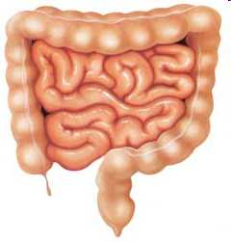
Water is absorbed, and bacteria make vitamins in this organ?
16
Copyright © 2024 SlideSpark .LLC

Slide 52
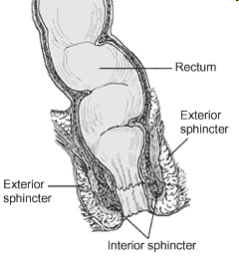

Name this important organ pictured below?
Copyright © 2024 SlideSpark .LLC

Slide 53
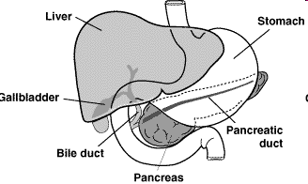
Name A, B, and C below?
A
B
C
18
Copyright © 2024 SlideSpark .LLC

Slide 54
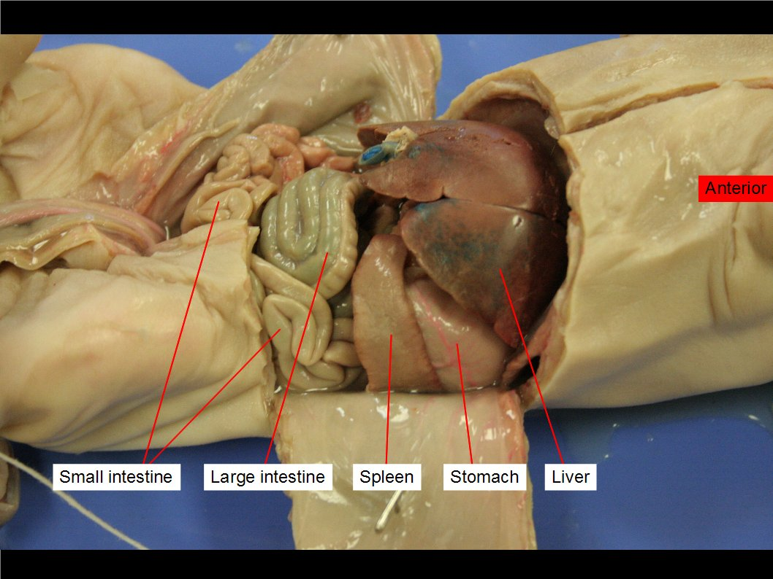
Please name A, B, C, D?
19
A
B
C
D

Slide 55
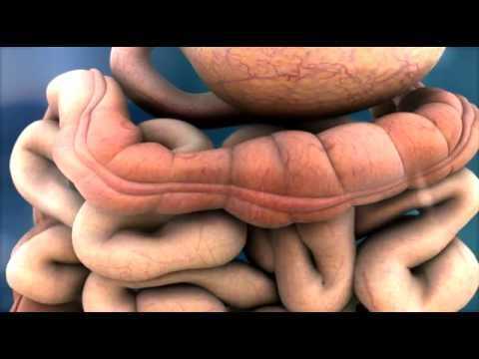
Bacteria in the intestine do all of the following except?
  A.) Break down undigested food.
  B.) Neutralize some of the harmful by-products of food breakdown.
  C.) Aid the absorption of nutrients.
  D.) Produce certain vitamins.
  E.) A major part of the immune system is located in your gut, beneficial bacteria also help support the body’s natural defenses.
  F.) Make conditions more favorable for the harmful gut bacteria that make you sick.
20

Slide 56
The Digestive System PowerPoint Review Game
NUTRARIFIC | SUGAR AND SPICE | ITS JUICY | WAVY GRAVY | -BONUS- UPSET AND BLOATED
1 | 6 | 11 | 16 | *21
2 | 7 | 12 | 17 | *22
3 | 8 | 13 | 18 | *23
4 | 9 | 14 | 19 | *24
5 | 10 | 15 | 20 | *25
Final Question:________________
Copyright © 2024 SlideSpark .LLC

Slide 57
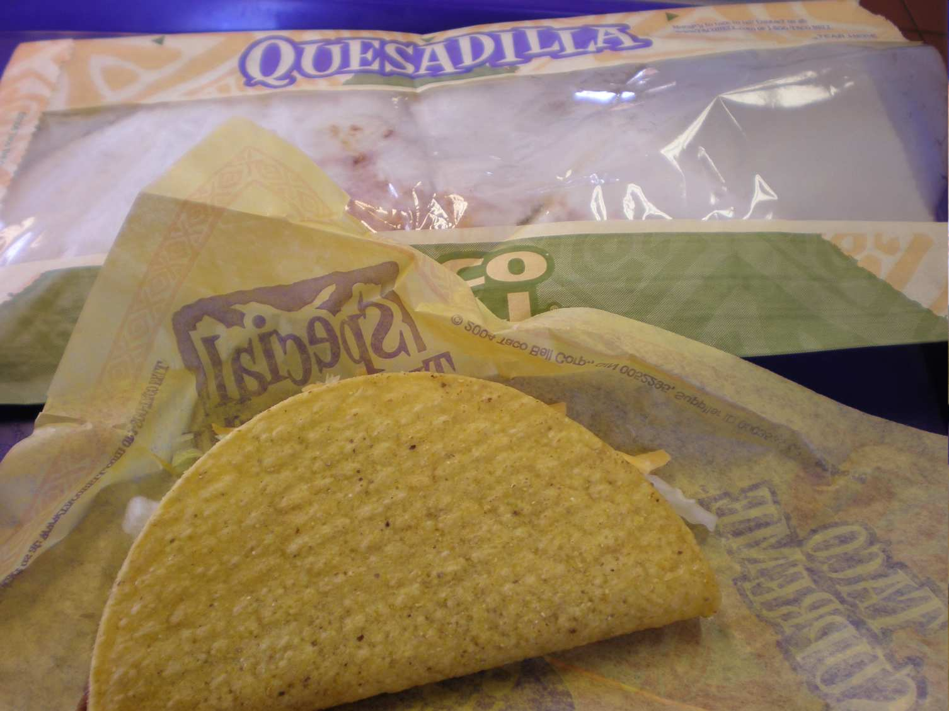
Name the Fast food Chain?
*21
Copyright © 2024 SlideSpark .LLC

Slide 58
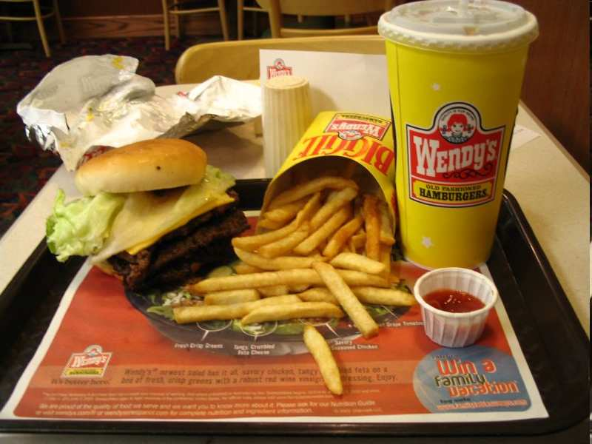
Name the Fast food Chain?
*22
Copyright © 2024 SlideSpark .LLC

Slide 59
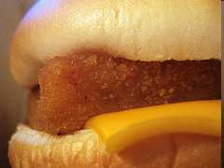
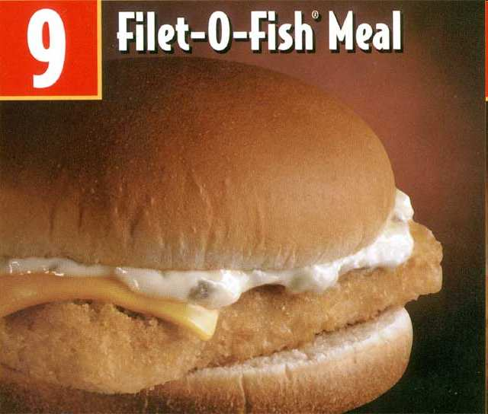
Name the Sandwich?
*23
*23
Copyright © 2024 SlideSpark .LLC

Slide 60
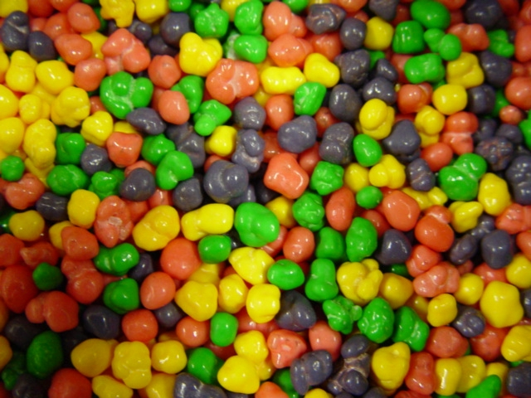
Name this candy?
24

Slide 61
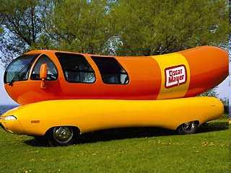
Name this Weinermobile?
*25
Copyright © 2024 SlideSpark .LLC

Slide 62
The Digestive System PowerPoint Review Game
NUTRARIFIC | SUGAR AND SPICE | ITS JUICY | WAVY GRAVY | -BONUS- UPSET AND BLOATED
1 | 6 | 11 | 16 | *21
2 | 7 | 12 | 17 | *22
3 | 8 | 13 | 18 | *23
4 | 9 | 14 | 19 | *24
5 | 10 | 15 | 20 | *25
Final Question:________________
Copyright © 2024 SlideSpark .LLC

Slide 63
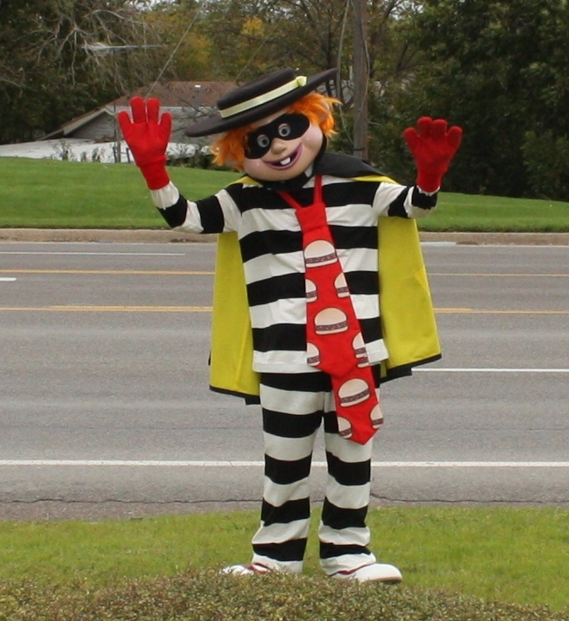
“You may wager up to 5pts for this final question.”
“Please make your wager now.”

Slide 64

Please put the following into the correct order as food passes through the digestive system.?
Large Intestine
Pharynx
Cecum
Stomach
Mouth
Anus
Esophagus
Duodenum
Small Intestine
Rectum
Copyright © 2024 SlideSpark .LLC

Slide 65
Please put the following into the correct order as food passes through the digestive system.?
Large Intestine
Pharynx
Cecum
Stomach
Mouth
Anus
Esophagus
Duodenum
Small Intestine
Rectum
Remember, food doesn’t travel through the liver, gall bladder, or pancreas. They make digestive juices and release them into the small intestine.
Copyright © 2024 SlideSpark .LLC

Slide 66
Digestive System
Review Game
Part 5
Lesson 6

Slide 67

Digestive System
Review Game
Part 5
Lesson 7

Slide 68
The Digestive System PowerPoint Review Game
NUTRARIFIC | SUGAR AND SPICE | IT’S JUICY | WAVY GRAVY | -BONUS- UPSET AND BLOATED
1 | 6 | 11 | 16 | *21
2 | 7 | 12 | 17 | *22
3 | 8 | 13 | 18 | *23
4 | 9 | 14 | 19 | *24
5 | 10 | 15 | 20 | *25
Final Question:________________
Copyright © 2024 SlideSpark .LLC

Slide 69
Nutrients include these 6 things. (1 point each)
1
Copyright © 2024 SlideSpark .LLC

Slide 70
Nutrients include these 6 things. (1 point each)
1
Copyright © 2024 SlideSpark .LLC

Slide 71
Nutrients include these 6 things. (1 point each)
Fats
1
Copyright © 2024 SlideSpark .LLC

Slide 72
Nutrients include these 6 things. (1 point each)
Fats
1
Copyright © 2024 SlideSpark .LLC

Slide 73
Nutrients include these 6 things. (1 point each)
Fats
Carbohydrates
1
Copyright © 2024 SlideSpark .LLC

Slide 74
Nutrients include these 6 things. (1 point each)
Fats
Carbohydrates
1
Copyright © 2024 SlideSpark .LLC

Slide 75
Nutrients include these 6 things. (1 point each)
Fats
Carbohydrates
Proteins
1
Copyright © 2024 SlideSpark .LLC

Slide 76
Nutrients include these 6 things. (1 point each)
Fats
Carbohydrates
Proteins
1
Copyright © 2024 SlideSpark .LLC
Copyright © 2024 SlideSpark .LLC

Slide 77
Nutrients include these 6 things. (1 point each)
Fats
Carbohydrates
Proteins
Vitamins
1

Slide 78
Nutrients include these 6 things. (1 point each)
Fats
Carbohydrates
Proteins
Vitamins
1
Copyright © 2024 SlideSpark .LLC

Slide 79
Nutrients include these 6 things. (1 point each)
Fats
Carbohydrates
Proteins
Minerals
Vitamins
1
Copyright © 2024 SlideSpark .LLC

Slide 80
Nutrients include these 6 things. (1 point each)
Fats
Carbohydrates
Proteins
Minerals
Vitamins
1
Copyright © 2024 SlideSpark .LLC

Slide 81
Nutrients include these 6 things. (1 point each)
Fats
Water
Carbohydrates
Proteins
Minerals
Vitamins
1
Copyright © 2024 SlideSpark .LLC

Slide 82
New Question

Slide 83
Which of these two are energy molecules?
Fats
Water
Carbohydrates
Proteins
Minerals
Vitamins
2
Copyright © 2024 SlideSpark .LLC

Slide 84
Which of these two are energy molecules?
Fats
Water
Carbohydrates
Proteins
Minerals
Vitamins
2
Copyright © 2024 SlideSpark .LLC

Slide 85
Which of these two are energy molecules?
Fats
Water
Carbohydrates
Proteins
Minerals
Vitamins
2
Copyright © 2024 SlideSpark .LLC

Slide 86
This is the chemical enzyme in salvia that breaks starches into sugars?
3
Copyright © 2024 SlideSpark .LLC

Slide 87
This is the chemical enzyme in salvia that breaks starches into sugars? Answer: Ptyalin
3
Copyright © 2024 SlideSpark .LLC

Slide 88
This is the chemical enzyme in salvia that breaks starches into sugars? Answer: Ptyalin
3
A type of Amylase
Copyright © 2024 SlideSpark .LLC

Slide 89
This type digestion is the process of converting food into chemical substances that can be absorbed and used.
4
Copyright © 2024 SlideSpark .LLC

Slide 90
This type digestion is the process of converting food into chemical substances that can be absorbed and used. Chemical Digestion
4
CHEMICAL
DIGESTION
Copyright © 2024 SlideSpark .LLC

Slide 91

This type digestion is the process of converting food into chemical substances that can be absorbed and used. Chemical Digestion
4
Owl +1pt
CHEMICAL
DIGESTION
Copyright © 2024 SlideSpark .LLC

Slide 92
This type digestion is the process of converting food into chemical substances that can be absorbed and used. Chemical Digestion
4
Owl +1pt
CHEMICAL
DIGESTION
Copyright © 2024 SlideSpark .LLC

Slide 93
5
This is the type of digestion where you physically break up the food?
5
Copyright © 2024 SlideSpark .LLC

Slide 94
5
This is the type of digestion where you physically break up the food?
Mechanical
Digestion
5
Copyright © 2024 SlideSpark .LLC

Slide 95
The Digestive System PowerPoint Review Game
NUTRARIFIC | SUGAR AND SPICE | ITS JUICY | WAVY GRAVY | -BONUS- UPSET AND BLOATED
1 | 6 | 11 | 16 | *21
2 | 7 | 12 | 17 | *22
3 | 8 | 13 | 18 | *23
4 | 9 | 14 | 19 | *24
5 | 10 | 15 | 20 | *25
Final Question:________________
Copyright © 2024 SlideSpark .LLC

Slide 96
This is the part of the throat situated immediately behind the mouth and nasal cavity?
6
Copyright © 2024 SlideSpark .LLC

Slide 97
This is the part of the throat situated immediately behind the mouth and nasal cavity?
6
Copyright © 2024 SlideSpark .LLC

Slide 98
This is the part of the throat situated immediately behind the mouth and nasal cavity?
6
Pharynx
Copyright © 2024 SlideSpark .LLC

Slide 99
This is the name for the wave-like motion that helps to move food down the esophagus?
7
Copyright © 2024 SlideSpark .LLC

Slide 100
This is the name for the wave-like motion that helps to move food down the esophagus?
Answer: Peristalsis
Peristalsis
7
Copyright © 2024 SlideSpark .LLC

Slide 101
This is the chemical enzyme that is produced in the stomach that contains HCL Hydrochloric Acid?
8
Copyright © 2024 SlideSpark .LLC

Slide 102
This is the chemical enzyme that is produced in the stomach that contains HCL Hydrochloric Acid?
A.) Lactase
8
Copyright © 2024 SlideSpark .LLC

Slide 103
This is the chemical enzyme that is produced in the stomach that contains HCL Hydrochloric Acid?
A.) Lactase
B.) Ptyalin
8
Copyright © 2024 SlideSpark .LLC

Slide 104
This is the chemical enzyme that is produced in the stomach that contains HCL Hydrochloric Acid?
A.) Lactase
B.) Ptyalin
C.) Pepsin
8
Copyright © 2024 SlideSpark .LLC

Slide 105
This is the chemical enzyme that is produced in the stomach that contains HCL Hydrochloric Acid?
A.) Lactase
B.) Ptyalin
C.) Pepsin
D.) Bile
8
Copyright © 2024 SlideSpark .LLC

Slide 106
This is the chemical enzyme that is produced in the stomach that contains HCL Hydrochloric Acid?
A.) Lactase
B.) Ptyalin
C.) Pepsin
D.) Bile
E.) Sucrose
8
Copyright © 2024 SlideSpark .LLC

Slide 107
This is the chemical enzyme that is produced in the stomach that contains HCL Hydrochloric Acid?
A.) Lactase
B.) Ptyalin
C.) Pepsin
D.) Bile
E.) Sucrose
8
Copyright © 2024 SlideSpark .LLC

Slide 108
This is the chemical enzyme that is produced in the stomach that contains HCL Hydrochloric Acid?
A.) Lactase
B.) Ptyalin
C.) Pepsin
D.) Bile
E.) Sucrose
F.) Nobody Knows
8
Copyright © 2024 SlideSpark .LLC

Slide 109
This is the chemical enzyme that is produced in the stomach that contains HCL Hydrochloric Acid?
A.) Lactase
B.) Ptyalin
C.) Pepsin
D.) Bile
E.) Sucrose
F.) Nobody Knows
G.) None of the above
8
Copyright © 2024 SlideSpark .LLC

Slide 110
This is the chemical enzyme that is produced in the stomach that contains HCL Hydrochloric Acid?
A.) Lactase
B.) Ptyalin
C.) Pepsin
D.) Bile
E.) Sucrose
F.) Nobody Knows
G.) None of the above
H.) All of the above
8
Copyright © 2024 SlideSpark .LLC

Slide 111
This is the chemical enzyme that is produced in the stomach that contains HCL Hydrochloric Acid?
A.) Lactase
B.) Ptyalin
C.) Pepsin
D.) Bile
E.) Sucrose
F.) Nobody Knows
G.) None of the above
H.) All of the above
Answer is…
8
Copyright © 2024 SlideSpark .LLC

Slide 112
This is the chemical enzyme that is produced in the stomach that contains HCL Hydrochloric Acid?
A.) Lactase
B.) Ptyalin
C.) Pepsin
D.) Bile
E.) Sucrose
F.) Nobody Knows
G.) None of the above
H.) All of the above
Answer is…
8
Copyright © 2024 SlideSpark .LLC

Slide 113
This is a strong ring of smooth muscle that lets food pass from the stomach to the duodenum?
9
Copyright © 2024 SlideSpark .LLC

Slide 114
This is a strong ring of smooth muscle that lets food pass from the stomach to the duodenum?
A.) Pharynx
9
Copyright © 2024 SlideSpark .LLC

Slide 115
This is a strong ring of smooth muscle that lets food pass from the stomach to the duodenum?
A.) Pharynx
B.) Larnyx
9
Copyright © 2024 SlideSpark .LLC

Slide 116
This is a strong ring of smooth muscle that lets food pass from the stomach to the duodenum?
A.) Pharynx
B.) Larnyx
C.) Anal Sphincter
9
Copyright © 2024 SlideSpark .LLC

Slide 117
This is a strong ring of smooth muscle that lets food pass from the stomach to the duodenum?
A.) Pharynx
B.) Larnyx
C.) Anal Sphincter
D.) Pyloric Valve
9
Copyright © 2024 SlideSpark .LLC

Slide 118
This is a strong ring of smooth muscle that lets food pass from the stomach to the duodenum?
A.) Pharynx
B.) Larnyx
C.) Anal Sphincter
D.) Pyloric Valve
E.) Appendix
9
Copyright © 2024 SlideSpark .LLC

Slide 119
This is a strong ring of smooth muscle that lets food pass from the stomach to the duodenum?
A.) Pharynx
B.) Larnyx
C.) Anal Sphincter
D.) Pyloric Valve
E.) Appendix
F.) Nobody Knows
9
Copyright © 2024 SlideSpark .LLC

Slide 120
This is a strong ring of smooth muscle that lets food pass from the stomach to the duodenum?
A.) Pharynx
B.) Larnyx
C.) Anal Sphincter
D.) Pyloric Valve
E.) Appendix
F.) Nobody Knows
G.) None of the above
9
Copyright © 2024 SlideSpark .LLC

Slide 121
This is a strong ring of smooth muscle that lets food pass from the stomach to the duodenum?
A.) Pharynx
B.) Larnyx
C.) Anal Sphincter
D.) Pyloric Valve
E.) Appendix
F.) Nobody Knows
G.) None of the above
H.) All of the above
9
Copyright © 2024 SlideSpark .LLC

Slide 122
This is a strong ring of smooth muscle that lets food pass from the stomach to the duodenum?
A.) Pharynx
B.) Larnyx
C.) Anal Sphincter
D.) Pyloric Valve
E.) Appendix
F.) Nobody Knows
G.) None of the above
H.) All of the above
answer is…
9
Copyright © 2024 SlideSpark .LLC

Slide 123
This is a strong ring of smooth muscle that lets food pass from the stomach to the duodenum?
A.) Pharynx
B.) Larnyx
C.) Anal Sphincter
D.) Pyloric Valve
E.) Appendix
F.) Nobody Knows
G.) None of the above
H.) All of the above
answer is…
9
Copyright © 2024 SlideSpark .LLC

Slide 124
This is the beginning of the small intestine.
10
Copyright © 2024 SlideSpark .LLC

Slide 125
This is the beginning of the small intestine. It Distributes bile (produced by the liver and stored in the gall bladder),
10
Copyright © 2024 SlideSpark .LLC

Slide 126
This is the beginning of the small intestine. It Distributes bile (produced by the liver and stored in the gall bladder), pancreatic acids (pancreas), and other secretions to chemically breakdown food.
10
Copyright © 2024 SlideSpark .LLC

Slide 127
This is the beginning of the small intestine. It Distributes bile (produced by the liver and stored in the gall bladder), pancreatic acids (pancreas), and other secretions to chemically breakdown food.
10
Copyright © 2024 SlideSpark .LLC

Slide 128
This is the beginning of the small intestine. It Distributes bile (produced by the liver and stored in the gall bladder), pancreatic acids (pancreas), and other secretions to chemically breakdown food.
Duodenum
10
Copyright © 2024 SlideSpark .LLC

Slide 129
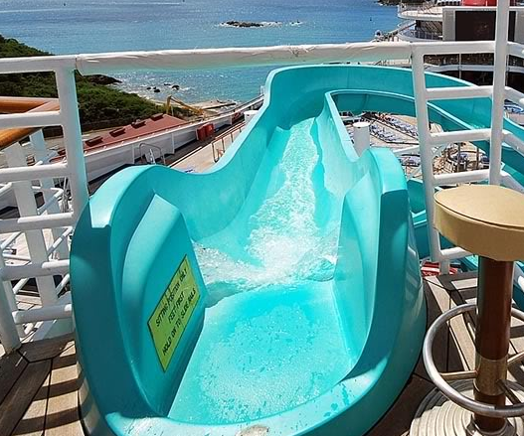
This is the beginning of the small intestine. It Distributes bile (produced by the liver and stored in the gall bladder), pancreatic acids (pancreas), and other secretions to chemically breakdown food.
Duodenum
10
Copyright © 2024 SlideSpark .LLC

Slide 130
The Digestive System PowerPoint Review Game
NUTRARIFIC | SUGAR AND SPICE | ITS JUICY | WAVY GRAVY | -BONUS- UPSET AND BLOATED
1 | 6 | 11 | 16 | *21
2 | 7 | 12 | 17 | *22
3 | 8 | 13 | 18 | *23
4 | 9 | 14 | 19 | *24
5 | 10 | 15 | 20 | *25
Final Question:________________
Copyright © 2024 SlideSpark .LLC

Slide 131
Name this organ that releases digestive juices into the small intestine?
11
Copyright © 2024 SlideSpark .LLC

Slide 132
Name this organ that releases digestive juices into the small intestine?
11
Copyright © 2024 SlideSpark .LLC

Slide 133
Name this organ that releases digestive juices into the small intestine?
Pancreas
11
Copyright © 2024 SlideSpark .LLC

Slide 134
These two organs aid in the production and distribution of bile?
12
Copyright © 2024 SlideSpark .LLC

Slide 135
These two organs aid in the production and distribution of bile?
12
Copyright © 2024 SlideSpark .LLC

Slide 136
These two organs aid in the production and distribution of bile? Liver,
12
Copyright © 2024 SlideSpark .LLC

Slide 137
These two organs aid in the production and distribution of bile? Liver,
12
Copyright © 2024 SlideSpark .LLC

Slide 138
These two organs aid in the production and distribution of bile? Liver, Gall Bladder
12
Copyright © 2024 SlideSpark .LLC

Slide 139
These two organs aid in the production and distribution of bile? Liver, Gall Bladder
Liver
Liver
Liver
12
Copyright © 2024 SlideSpark .LLC

Slide 140
These two organs aid in the production and distribution of bile? Liver, Gall Bladder
Liver
Liver
Gall Bladder
Liver
12
Copyright © 2024 SlideSpark .LLC

Slide 141
Please record the substance that each becomes in the box.
A
A
Proteins
B
B
Starches
C
C
Fats
Copyright © 2024 SlideSpark .LLC

Slide 142
Please record the substance that each becomes in the box.
A
A
Proteins
B
B
Starches
C
C
Fats
Copyright © 2024 SlideSpark .LLC

Slide 143
Please record the substance that each becomes in the box.
A
A
Proteins
Peptides / Amino Acids
B
B
Starches
C
C
Fats
Copyright © 2024 SlideSpark .LLC

Slide 144
Please record the substance that each becomes in the box.
A
A
Proteins
Peptides / Amino Acids
B
B
Starches
Simple Sugars
C
C
Fats
Copyright © 2024 SlideSpark .LLC

Slide 145
Please record the substance that each becomes in the box.
A
A
Proteins
Peptides / Amino Acids
B
B
Starches
Simple Sugars
C
C
Glycerol Fatty Acids
Fats
Copyright © 2024 SlideSpark .LLC

Slide 146
The small intestine is covered with millions of small fingerlike structures called villi.
14
Copyright © 2024 SlideSpark .LLC

Slide 147
The small intestine is covered with millions of small fingerlike structures called villi.
14
Copyright © 2024 SlideSpark .LLC

Slide 148
The small intestine is covered with millions of small fingerlike structures called villi.
14
Villi
Copyright © 2024 SlideSpark .LLC

Slide 149
This is a small pouch that extends off of the large intestine.
  Plays a role in preventing infection
  Can rupture causing serious injury if not fixed.
15
Copyright © 2024 SlideSpark .LLC

Slide 150
This is a small pouch that extends off of the large intestine.
  Plays a role in preventing infection
  Can rupture causing serious injury if not fixed.
Appendix
15
Copyright © 2024 SlideSpark .LLC

Slide 151
The Digestive System PowerPoint Review Game
NUTRARIFIC | SUGAR AND SPICE | IT’S JUICY | WAVY GRAVY | -BONUS- UPSET AND BLOATED
1 | 6 | 11 | 16 | *21
2 | 7 | 12 | 17 | *22
3 | 8 | 13 | 18 | *23
4 | 9 | 14 | 19 | *24
5 | 10 | 15 | 20 | *25
Final Question:________________
Copyright © 2024 SlideSpark .LLC

Slide 152
Water is absorbed, and bacteria make vitamins in this organ?
16
Copyright © 2024 SlideSpark .LLC

Slide 153
Water is absorbed, and bacteria make vitamins in this organ?
16
Copyright © 2024 SlideSpark .LLC

Slide 154
Water is absorbed, and bacteria make vitamins in this organ?
Large Intestine
(Colon)
16
Copyright © 2024 SlideSpark .LLC

Slide 155
Name this important organ pictured below?
Copyright © 2024 SlideSpark .LLC

Slide 156
Name this important organ pictured below?
Copyright © 2024 SlideSpark .LLC

Slide 157
Name this important organ pictured below?
Rectum
Copyright © 2024 SlideSpark .LLC

Slide 158
Name A, B, and C below?
A
B
C
18
Copyright © 2024 SlideSpark .LLC

Slide 159
Name A, B, and C below?
A
B
C
18
Copyright © 2024 SlideSpark .LLC

Slide 160
Name A, B, and C below?
B
C
18
Copyright © 2024 SlideSpark .LLC

Slide 161
Name A, B, and C below?
B
C
18
Copyright © 2024 SlideSpark .LLC

Slide 162
Name A, B, and C below?
C
18
Copyright © 2024 SlideSpark .LLC

Slide 163
Name A, B, and C below?
C
18
Copyright © 2024 SlideSpark .LLC

Slide 164
Name A, B, and C below?
18
Copyright © 2024 SlideSpark .LLC

Slide 165
Please name A, B, C, D?
19
A
B
C
D

Slide 166
Please name A, B, C, D?
19
A
B
C
D

Slide 167
Please name A, B, C, D?
19
A
B
C
D

Slide 168
Please name A, B, C, D?
19
A
B
C
D

Slide 169
Please name A, B, C, D?
19
A
B
C
D

Slide 170
Please name A, B, C, D?
19
A
B
C
D

Slide 171
Please name A, B, C, D?
19
A
B
C
D

Slide 172
Please name A, B, C, D?
19
A
B
C
D

Slide 173
Please name A, B, C, D?
19
A
B
C
D

Slide 174
Bacteria in the intestine do all of the following except?
  A.) Break down undigested food.
  B.) Neutralize some of the harmful by-products of food breakdown.
  C.) Aid the absorption of nutrients.
  D.) Produce certain vitamins.
  E.) A major part of the immune system is located in your gut, beneficial bacteria also help support the body’s natural defenses.
  F.) Make conditions more favorable for the harmful gut bacteria that make you sick.
20

Slide 175
Bacteria in the intestine do all of the following except?
  A.) Break down undigested food.
  B.) Neutralize some of the harmful by-products of food breakdown.
  C.) Aid the absorption of nutrients.
  D.) Produce certain vitamins.
  E.) A major part of the immune system is located in your gut, beneficial bacteria also help support the body’s natural defenses.
  F.) Make conditions more favorable for the harmful gut bacteria that make you sick.
20
answer is…

Slide 176
Bacteria in the intestine do all of the following except?
  A.) Break down undigested food.
  B.) Neutralize some of the harmful by-products of food breakdown.
  C.) Aid the absorption of nutrients.
  D.) Produce certain vitamins.
  E.) A major part of the immune system is located in your gut, beneficial bacteria also help support the body’s natural defenses.
  F.) Make conditions more favorable for the harmful gut bacteria that make you sick.
20
answer is…

Slide 177
The Digestive System PowerPoint Review Game
NUTRARIFIC | SUGAR AND SPICE | ITS JUICY | WAVY GRAVY | -BONUS- UPSET AND BLOATED
1 | 6 | 11 | 16 | *21
2 | 7 | 12 | 17 | *22
3 | 8 | 13 | 18 | *23
4 | 9 | 14 | 19 | *24
5 | 10 | 15 | 20 | *25
Final Question:________________
Copyright © 2024 SlideSpark .LLC

Slide 178
Name the Chain?
*21
Copyright © 2024 SlideSpark .LLC

Slide 179
Name the Chain?
*21
Copyright © 2024 SlideSpark .LLC

Slide 180
Name the Chain?
*21
Copyright © 2024 SlideSpark .LLC

Slide 181
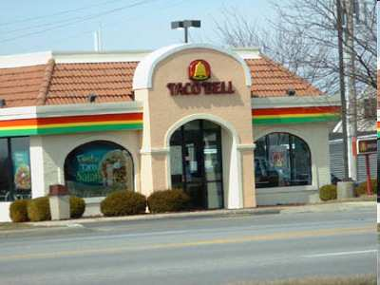
Name the Chain? Taco Bell
*21
Copyright © 2024 SlideSpark .LLC

Slide 182
Name the Chain?
*22
Copyright © 2024 SlideSpark .LLC

Slide 183
Name the Chain?
*22
Copyright © 2024 SlideSpark .LLC

Slide 184
Name the Chain?
*22
Copyright © 2024 SlideSpark .LLC

Slide 185
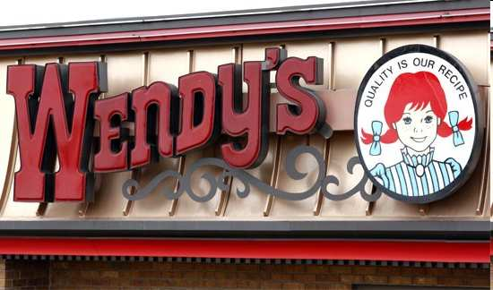
Name the Chain? Wendy’s
*22
Copyright © 2024 SlideSpark .LLC

Slide 186
Name the Sandwich?
*23
*23
Copyright © 2024 SlideSpark .LLC

Slide 187
Name the Sandwich? Filet-O-Fish
*23
*23
Copyright © 2024 SlideSpark .LLC

Slide 188
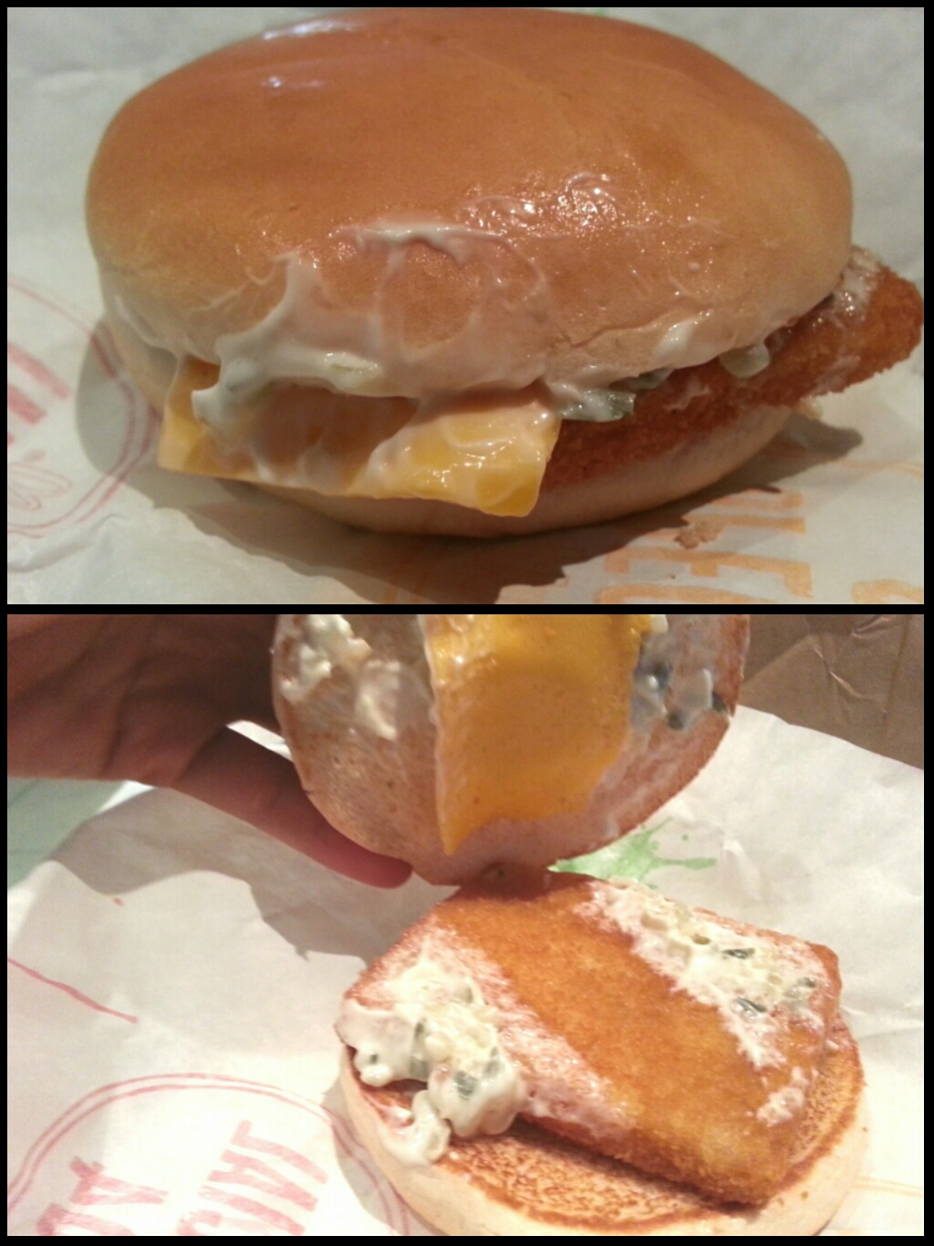
Name the Sandwich? Filet-O-Fish
*23
Reality
*23
Copyright © 2024 SlideSpark .LLC

Slide 189
Name this candy?
24

Slide 190
Name this candy?
24
answer is…

Slide 191
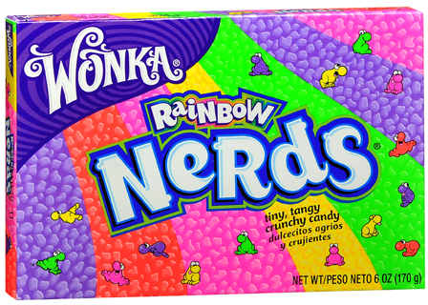
Name this candy?
24
answer is…

Slide 192
Name this Weinermobile?
*25
Copyright © 2024 SlideSpark .LLC

Slide 193

Oscar Mayer
Name this Weinermobile?
*25
Copyright © 2024 SlideSpark .LLC

Slide 194
The Digestive System PowerPoint Review Game
NUTRARIFIC | SUGAR AND SPICE | ITS JUICY | WAVY GRAVY | -BONUS- UPSET AND BLOATED
1 | 6 | 11 | 16 | *21
2 | 7 | 12 | 17 | *22
3 | 8 | 13 | 18 | *23
4 | 9 | 14 | 19 | *24
5 | 10 | 15 | 20 | *25
Final Question:________________
Copyright © 2024 SlideSpark .LLC

Slide 195
“This was a 5pt wager question.”

Slide 196
Please put the following into the correct order as food passes through the digestive system.?
Large Intestine
Pharynx
Cecum
Stomach
Mouth
Anus
Esophagus
Duodenum
Small Intestine
Rectum
Copyright © 2024 SlideSpark .LLC

Slide 197
Please put the following into the correct order as food passes through the digestive system.?
Mouth
Pharynx
Esophagus
Stomach
Duodenum
Small Intestine
Cecum
Large Intestine
Rectum
Anus
Copyright © 2024 SlideSpark .LLC

Slide 198
Please put the following into the correct order as food passes through the digestive system.?
Mouth
Pharynx
Esophagus
Stomach
Duodenum
Small Intestine
Cecum
Large Intestine
Rectum
Anus
Copyright © 2024 SlideSpark .LLC

Slide 199
Please put the following into the correct order as food passes through the digestive system.?
Mouth
Pharynx
Esophagus
Stomach
Duodenum
Small Intestine
Cecum
Large Intestine
Rectum
Anus
Copyright © 2024 SlideSpark .LLC

Slide 200
Please put the following into the correct order as food passes through the digestive system.?
Mouth
Pharynx
Esophagus
Stomach
Duodenum
Small Intestine
Cecum
Large Intestine
Rectum
Anus
Copyright © 2024 SlideSpark .LLC

Slide 201
Please put the following into the correct order as food passes through the digestive system.?
Mouth
Pharynx
Esophagus
Stomach
Duodenum
Small Intestine
Cecum
Large Intestine
Rectum
Anus
Copyright © 2024 SlideSpark .LLC

Slide 202
Please put the following into the correct order as food passes through the digestive system.?
Mouth
Pharynx
Esophagus
Stomach
Duodenum
Small Intestine
Cecum
Large Intestine
Rectum
Anus
Copyright © 2024 SlideSpark .LLC

Slide 203
Please put the following into the correct order as food passes through the digestive system.?
Mouth
Pharynx
Esophagus
Stomach
Duodenum
Small Intestine
Cecum
Large Intestine
Rectum
Anus
Copyright © 2024 SlideSpark .LLC

Slide 204
Please put the following into the correct order as food passes through the digestive system.?
Mouth
Pharynx
Esophagus
Stomach
Duodenum
Small Intestine
Cecum
Large Intestine
Rectum
Anus
Copyright © 2024 SlideSpark .LLC

Slide 205
Please put the following into the correct order as food passes through the digestive system.?
Mouth
Pharynx
Esophagus
Stomach
Duodenum
Small Intestine
Cecum
Large Intestine
Rectum
Anus
Copyright © 2024 SlideSpark .LLC

Slide 206
Please put the following into the correct order as food passes through the digestive system.?
Mouth
Pharynx
Esophagus
Stomach
Duodenum
Small Intestine
Cecum
Large Intestine
Rectum
Anus
Copyright © 2024 SlideSpark .LLC

Slide 207
Please put the following into the correct order as food passes through the digestive system.?
Mouth
Pharynx
Esophagus
Stomach
Duodenum
Small Intestine
Cecum
Large Intestine
Rectum
Anus
Copyright © 2024 SlideSpark .LLC

Slide 208
Digestive System PowerPoint
Review Game
1-20 = 5 points each
20-25 = Bonus (1 point each)
Final Question = 5 point wager
Find the Owl = 1 point
Answer Key is provided in PowerPoint Form after Final Question
Copyright © 2024 SlideSpark .LLC

Slide 209
Digestive System
Review Game
Part 5
Lesson 7

Slide 210



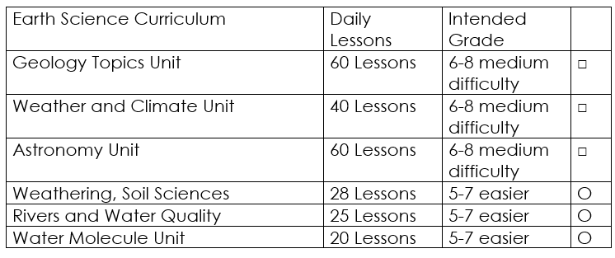

Curriculum Guide
Number of Lessons in each unit (50 min, daily lessons) and difficult rating scale / intended grade level.
=Easier, = More difficult, =Most difficult
Earth Science Units

Slide 211


Life Science Units

Slide 212

Physical Science

Slide 213
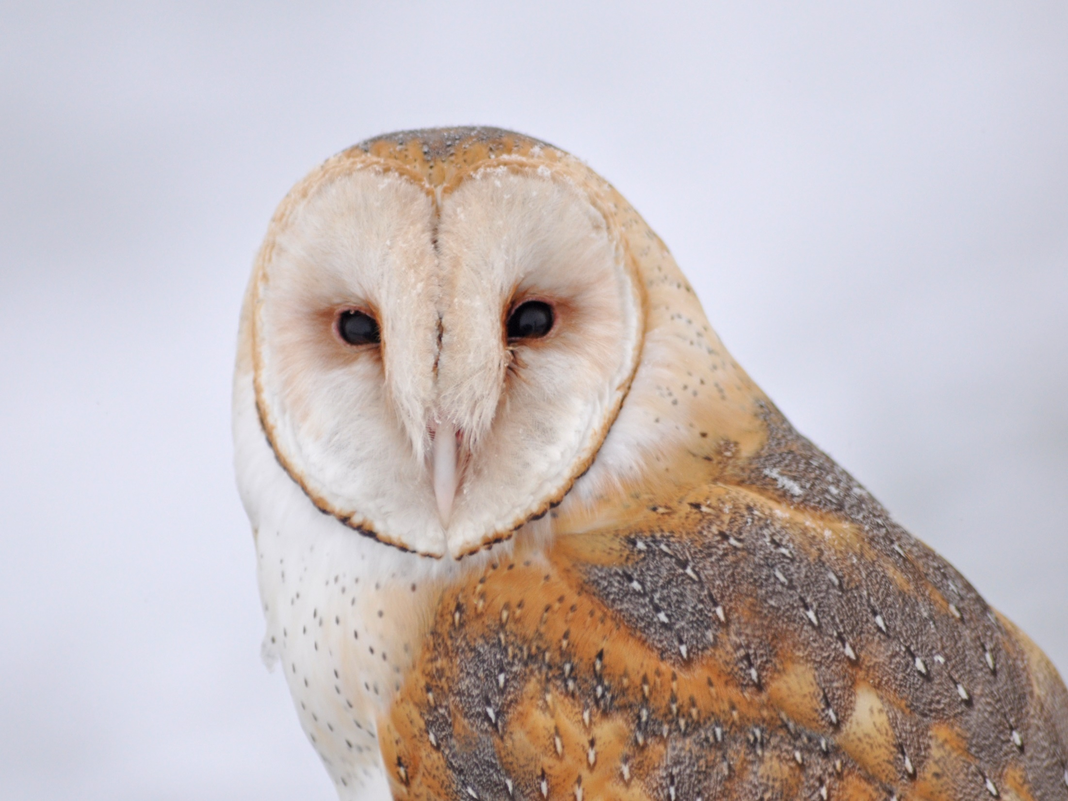
Dear Valued Educator,
Our fully editable .pptx and .doc resources are perfect for educators looking to bring enthusiasm and creativity to their lessons. We encourage you to make changes to fit your needs and style. As science educators, we’re committed to providing students with the tools they need to succeed in the classroom and beyond. Each unit in the curriculum includes a range of resources that have been developed through extensive research and use in a busy classroom. Our teaching approach is designed to make science education engaging and exciting for learners of all ages. We offer a one-of-a-kind science curriculum that will challenge, inspire, and educate students to become tomorrow's scientists and leaders. Join us today and learn more about how our program can help you achieve your classroom goals.
With appreciation,
Support@SlideSpark.net

Slide 214





Thank you for your time and interest in our Science curriculum. We strive to provide students with engaging and informative lessons that will spark their curiosity and encourage scientific exploration. Should you have any questions or concerns, please do not hesitate to contact us. Thank you again for considering our curriculum, and we wish you all the best in your educational journey.
Sincerely,
Support@slidespark.net
SlideSpark Science on TpT

