Slide 1
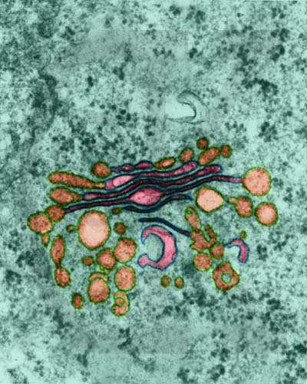

Cellular Organelles
Review Game
Part 3
Lesson 5

Slide 2
PART 3 Review Game
NUKEM | LOST IN TRANSLATION | IMPORTANT MESSAGE | FANNYPACKS | -BONUS- MAZES
1 | 6 | 11 | 16 | *21
2 | 7 | 12 | 17 | *22
3 | 8 | 13 | 18 | *23
4 | 9 | 14 | 19 | *24
5 | 10 | 15 | 20 | *25
Copyright © 2024 SlideSpark .LLC

Slide 3
How to play…
  Don’t play like Jeo_ _ _ _ y.
  Class should be divided into several small groups.
  Groups should use science journal (red slide notes), homework, and other available materials to assist you.
  Groups can communicate quietly with each other but no sharing answers between groups.
    Practice quietly communicating right now?
    Practice Communication Question:
    Your group gets to order one pizza and you can have two toppings. What does your group want?

Slide 4

Questions 1-20 = 5pts Each
Final Category (Bonus) = 1pt Each
Final Questions = 5 pt wager
If you wager 5 on the last question and get it wrong you lose 5 pts. Wager 5 and get it right you get 5 pts.
Find the Owl =
Secretly write “Owl” in the correct box worth 1pt.
“I’ll be about this big.”

Slide 5
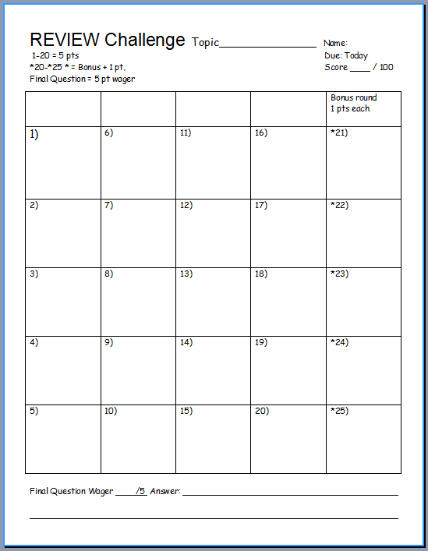
Is your name on the review sheet?
Name

Slide 6
Is your name on the review sheet?
Add the categories
along the top
on the next slide.

Slide 7
PART 3 Review Game
NUKEM | LOST IN TRANSLATION | IMPORTANT MESSAGE | FANNYPACKS | -BONUS- MAZES
1 | 6 | 11 | 16 | *21
2 | 7 | 12 | 17 | *22
3 | 8 | 13 | 18 | *23
4 | 9 | 14 | 19 | *24
5 | 10 | 15 | 20 | *25
Copyright © 2024 SlideSpark .LLC

Slide 8
PART 3 Review Game
NUKEM | LOST IN TRANSLATION | IMPORTANT MESSAGE | FANNYPACKS | -BONUS- MAZES
1 | 6 | 11 | 16 | *21
2 | 7 | 12 | 17 | *22
3 | 8 | 13 | 18 | *23
4 | 9 | 14 | 19 | *24
5 | 10 | 15 | 20 | *25
Copyright © 2024 SlideSpark .LLC

Slide 9
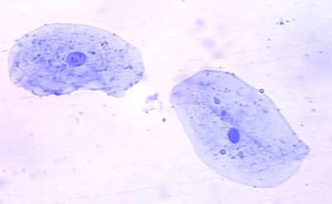
This is the largest organelle in the cell?
1

Slide 10
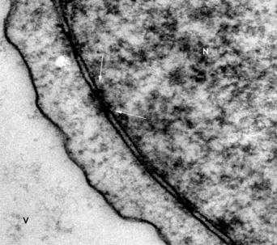
Name these openings.
2

Slide 11
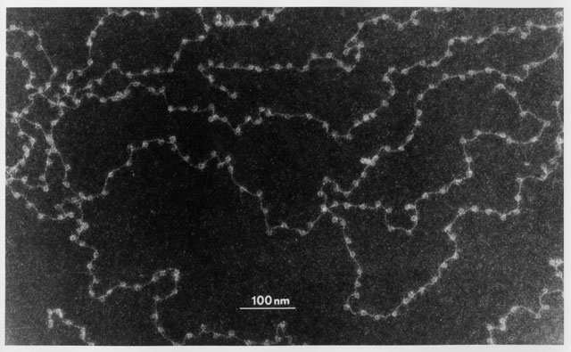
This genetic molecule is contained in the nucleus?
3

Slide 12
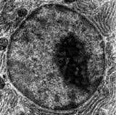
This important organelle is a…
  Round dark spot in center of nucleus
  Only visible when cell is not dividing
  Contains RNA for protein manufacturing
  Makes ribosomes that travel out of nucleus.
4

Slide 13


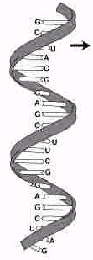

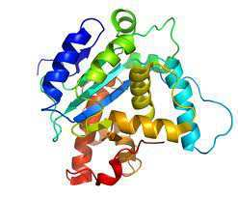
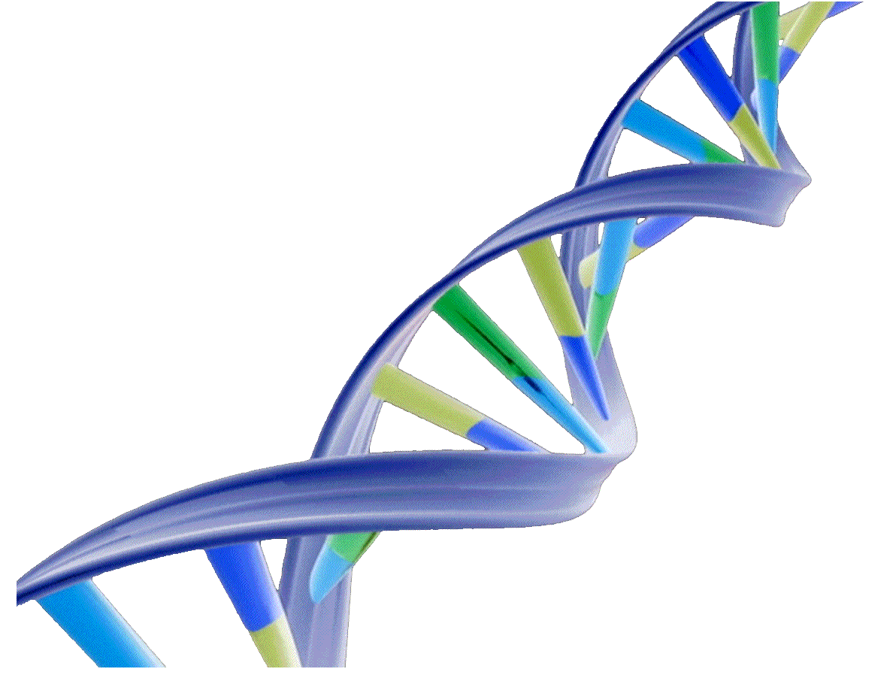
A
B
C
.
Ribosomes
Nuclear
Membrane
Name A, B, and C?
5
Copyright © 2024 SlideSpark .LLC

Slide 14
PART 3 Review Game
NUKEM | LOST IN TRANSLATION | IMPORTANT MESSAGE | FANNYPACKS | -BONUS- MAZES
1 | 6 | 11 | 16 | *21
2 | 7 | 12 | 17 | *22
3 | 8 | 13 | 18 | *23
4 | 9 | 14 | 19 | *24
5 | 10 | 15 | 20 | *25
Copyright © 2024 SlideSpark .LLC

Slide 15

PART 3 Review Game
NUKEM | LOST IN TRANSLATION | IMPORTANT MESSAGE | FANNYPACKS | -BONUS- MAZES
1 | 6 | 11 | 16 | *21
2 | 7 | 12 | 17 | *22
3 | 8 | 13 | 18 | *23
4 | 9 | 14 | 19 | *24
5 | 10 | 15 | 20 | *25
Copyright © 2024 SlideSpark .LLC

Slide 16
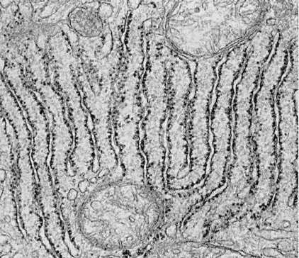
Name this organelle which is a series of folded membranes and site for protein synthesis?
6

Slide 17
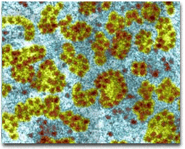
These very numerous and small organelles are mini protein synthesizing factories?
7

Slide 18

Name each of the boxes on the next slide when they light up.

Slide 19


Amino Acid
Protein
tRNA
codon
mRNA
A
U
C
G
Ribosome

Slide 20
Amino Acid
Protein
B
A
tRNA
codon
C
A
U
C
mRNA
G
D
Ribosome

Slide 21
This organelle packages and transports proteins and other macromolecules?
9

Slide 22
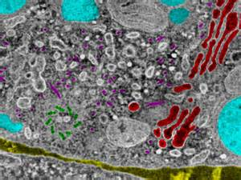
Cellular Organelles: A membrane-bound compartment or structure in a cell that performs a special function.
10
Copyright © 2024 SlideSpark .LLC

Slide 23
Cellular Organelles: A membrane-bound compartment or structure in a cell that performs a special function.
10
They…
one point
each…
within the cell.
Copyright © 2024 SlideSpark .LLC

Slide 24
PART 3 Review Game
NUKEM | LOST IN TRANSLATION | IMPORTANT MESSAGE | FANNYPACKS | -BONUS- MAZES
1 | 6 | 11 | 16 | *21
2 | 7 | 12 | 17 | *22
3 | 8 | 13 | 18 | *23
4 | 9 | 14 | 19 | *24
5 | 10 | 15 | 20 | *25
Copyright © 2024 SlideSpark .LLC

Slide 25
PART 3 Review Game
NUKEM | LOST IN TRANSLATION | IMPORTANT MESSAGE | FANNYPACKS | -BONUS- MAZES
1 | 6 | 11 | 16 | *21
2 | 7 | 12 | 17 | *22
3 | 8 | 13 | 18 | *23
4 | 9 | 14 | 19 | *24
5 | 10 | 15 | 20 | *25
Copyright © 2024 SlideSpark .LLC

Slide 26
This cellular organelle synthesizes sugars, stores enzymes, regulates calcium, makes lipids and steroids.
11

Slide 27
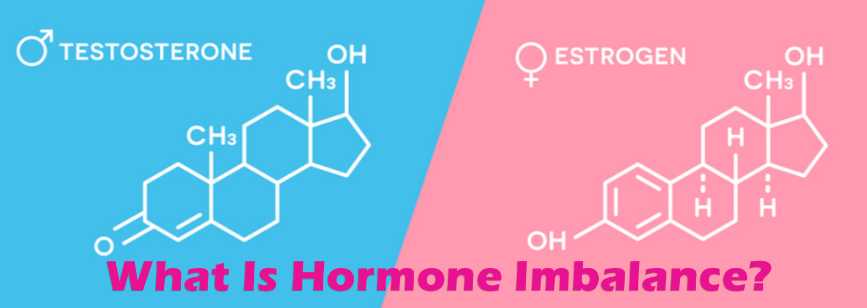
These are protein messengers which help to coordinate certain bodily activities.
12

Slide 28
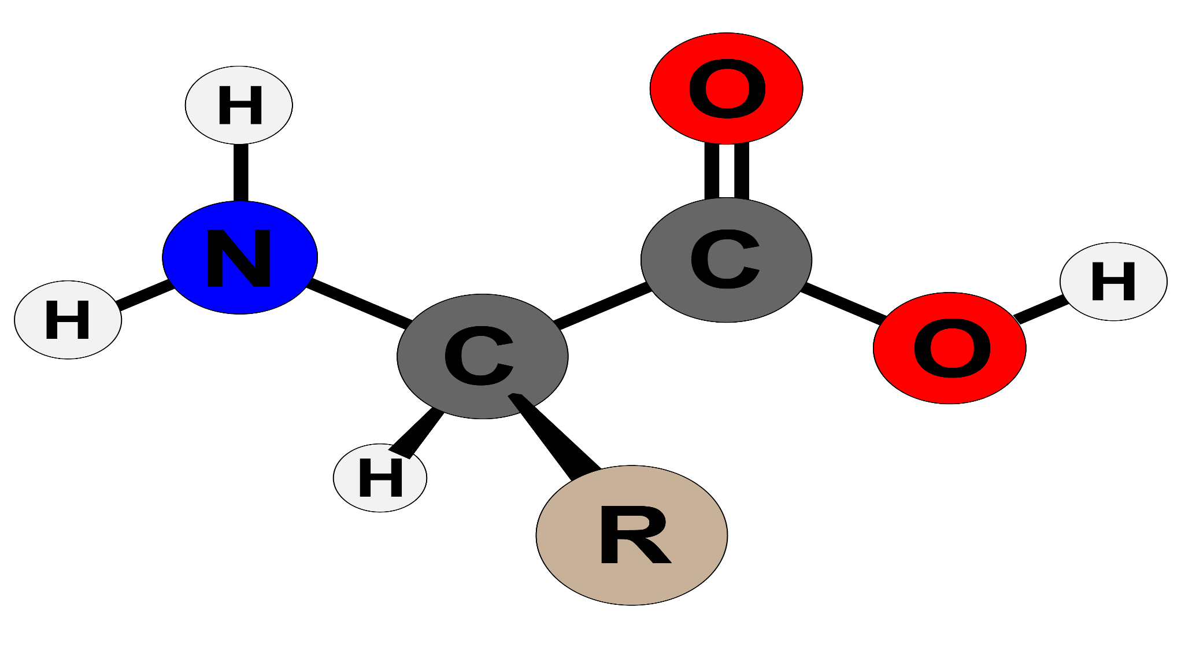
Name this a simple organic compound containing both a carboxyl (—COOH) and an amino (—NH₂) group.
13

Slide 29

Every cell in the human body contains these. The basic structure of these is a chain of amino acids. You need these in your diet to help your body repair cells and make new ones. It is important for growth and development in children, teens, and pregnant women.
14

Slide 30
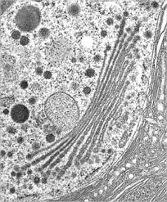
The Golgi Apparatus sends vesicles of macromolecules to destination in cell.
15
Copyright © 2024 SlideSpark .LLC

Slide 31
PART 3 Review Game
NUKEM | LOST IN TRANSLATION | IMPORTANT MESSAGE | FANNYPACKS | -BONUS- MAZES
1 | 6 | 11 | 16 | *21
2 | 7 | 12 | 17 | *22
3 | 8 | 13 | 18 | *23
4 | 9 | 14 | 19 | *24
5 | 10 | 15 | 20 | *25
Copyright © 2024 SlideSpark .LLC

Slide 32
PART 3 Review Game
NUKEM | LOST IN TRANSLATION | IMPORTANT MESSAGE | FANNYPACKS | -BONUS- MAZES
1 | 6 | 11 | 16 | *21
2 | 7 | 12 | 17 | *22
3 | 8 | 13 | 18 | *23
4 | 9 | 14 | 19 | *24
5 | 10 | 15 | 20 | *25
Copyright © 2024 SlideSpark .LLC

Slide 33
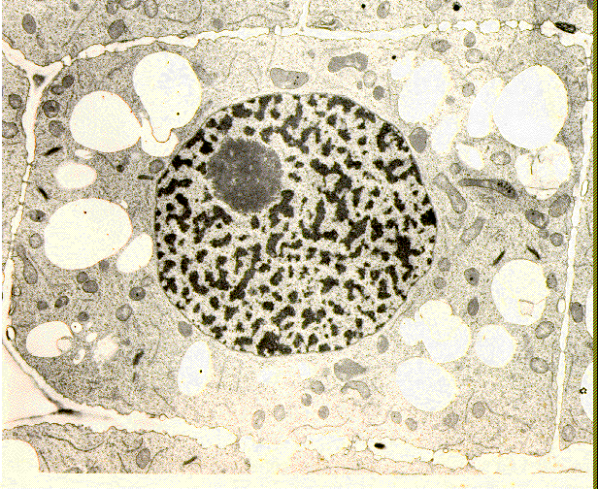
True or False? The nucleolus is only visible when cell is not dividing.
16
Copyright © 2024 SlideSpark .LLC

Slide 34
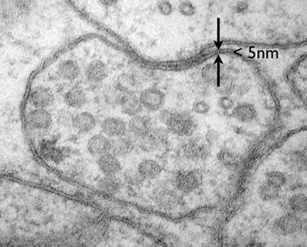
This serves to separate the chromosomes from the rest of the cell and includes an array of small holes or pores that permit the passage of certain materials, such as nucleic acids and proteins, between the nucleus and cytoplasm.
17

Slide 35
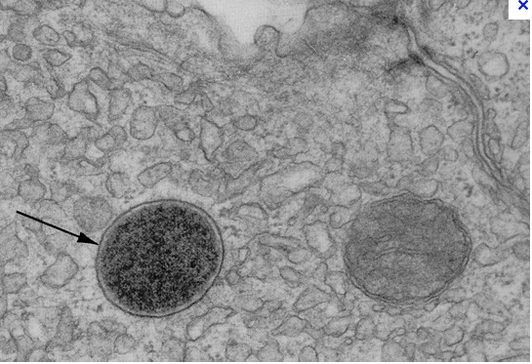
Enzymes of the lysosomes are synthesized in the rough endoplasmic reticulum and exported to the Golgi apparatus
18

Slide 36
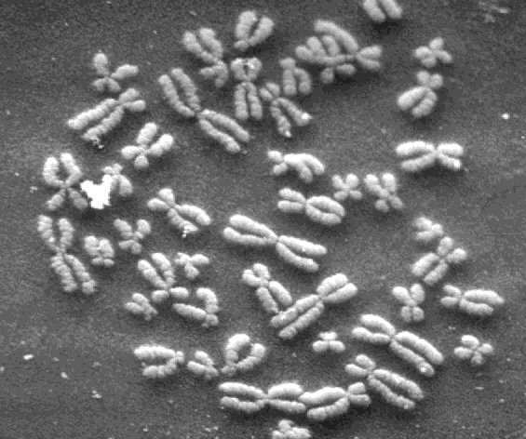
These form when the nucleus disappears and the cell is going to divide?
19
19

Slide 37

Name the four important roles of proteins.
Grrr…
G- Growth
r- Repair
r- Reproduction
r- Regulate
20
Copyright © 2024 SlideSpark .LLC

Slide 38
PART 3 Review Game
NUKEM | LOST IN TRANSLATION | IMPORTANT MESSAGE | FANNYPACKS | -BONUS- MAZES
1 | 6 | 11 | 16 | *21
2 | 7 | 12 | 17 | *22
3 | 8 | 13 | 18 | *23
4 | 9 | 14 | 19 | *24
5 | 10 | 15 | 20 | *25
Copyright © 2024 SlideSpark .LLC

Slide 39

PART 3 Review Game
NUKEM | LOST IN TRANSLATION | IMPORTANT MESSAGE | FANNYPACKS | -BONUS- MAZES
1 | 6 | 11 | 16 | *21
2 | 7 | 12 | 17 | *22
3 | 8 | 13 | 18 | *23
4 | 9 | 14 | 19 | *24
5 | 10 | 15 | 20 | *25
Copyright © 2024 SlideSpark .LLC

Slide 40
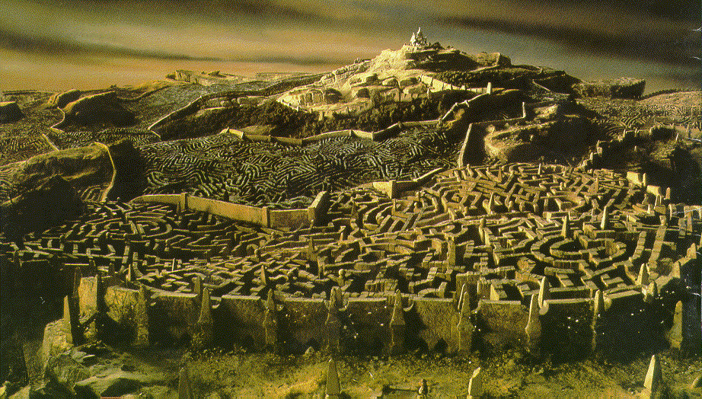

Name this maze movie like the Endoplasmic reticulum?
*21

Slide 41

*22
What movie / book has this maze?

Slide 42
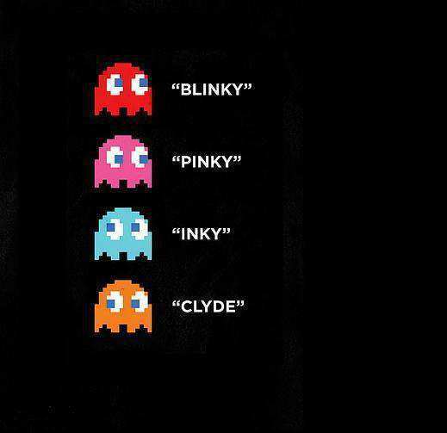

*23
Name the ghosts below?

Slide 43


*24

Slide 44
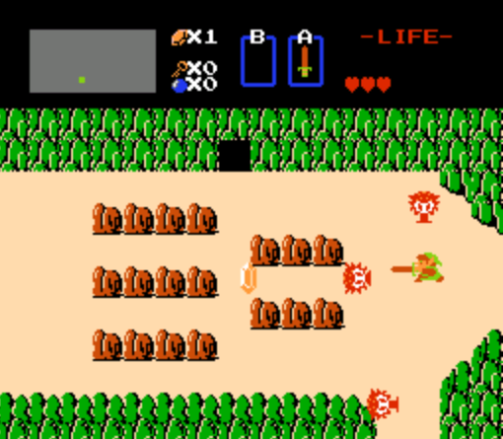
*25

Slide 45
PART 3 Review Game
NUKEM | LOST IN TRANSLATION | IMPORTANT MESSAGE | FANNYPACKS | -BONUS- MAZES
1 | 6 | 11 | 16 | *21
2 | 7 | 12 | 17 | *22
3 | 8 | 13 | 18 | *23
4 | 9 | 14 | 19 | *24
5 | 10 | 15 | 20 | *25
Final Question
Copyright © 2024 SlideSpark .LLC

Slide 46

5 point wager question

Slide 47
5 point wager question

Slide 48
5 point wager question

Slide 49
5 point wager question
Name all 5

Slide 50
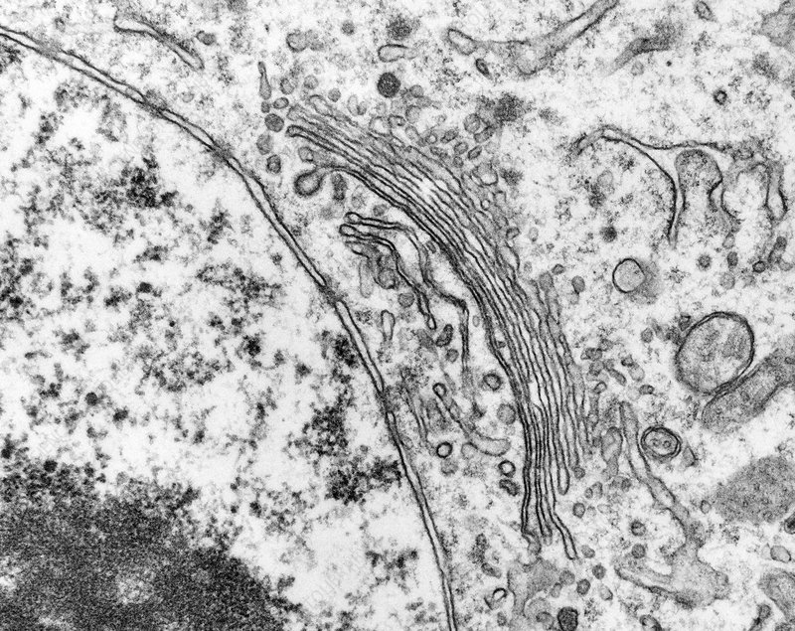
Name A,B,C,D,E
C
B
E
D
A

Slide 51
Questions 1-20 = 5pts Each
Final Category (Bonus) = 1pt Each
Final Questions = 5 pt wager
Find the Owl =
Secretly write “Owl” in the correct box worth 1pt.

Slide 52
Cellular Organelles
Review Game
Part 3
Lesson 5

Slide 53

Cellular Organelles
Review Game
Part 3
Lesson 6

Slide 54
PART 3 Review Game
NUKEM | LOST IN TRANSLATION | IMPORTANT MESSAGE | FANNYPACKS | -BONUS- MAZES
1 | 6 | 11 | 16 | *21
2 | 7 | 12 | 17 | *22
3 | 8 | 13 | 18 | *23
4 | 9 | 14 | 19 | *24
5 | 10 | 15 | 20 | *25
Copyright © 2024 SlideSpark .LLC

Slide 55
PART 3 Review Game
NUKEM | LOST IN TRANSLATION | IMPORTANT MESSAGE | FANNYPACKS | -BONUS- MAZES
1 | 6 | 11 | 16 | *21
2 | 7 | 12 | 17 | *22
3 | 8 | 13 | 18 | *23
4 | 9 | 14 | 19 | *24
5 | 10 | 15 | 20 | *25
Copyright © 2024 SlideSpark .LLC

Slide 56
PART 3 Review Game
NUKEM | LOST IN TRANSLATION | IMPORTANT MESSAGE | FANNYPACKS | -BONUS- MAZES
1 | 6 | 11 | 16 | *21
2 | 7 | 12 | 17 | *22
3 | 8 | 13 | 18 | *23
4 | 9 | 14 | 19 | *24
5 | 10 | 15 | 20 | *25
Copyright © 2024 SlideSpark .LLC

Slide 57
This is the largest organelle in the cell?
1

Slide 58
This is the largest organelle in the cell?
1
and the answer is…

Slide 59
This is the largest organelle in the cell?
1
The Nucleus
and the answer is…

Slide 60
Name these openings.
2

Slide 61
Name these openings.
and the answer is…
2

Slide 62
Name these openings.
and the answer is…
2
Nuclear Pores /
Openings

Slide 63
This genetic molecule is contained in the nucleus?
3

Slide 64
This genetic molecule is contained in the nucleus?
3
and the answer is…

Slide 65
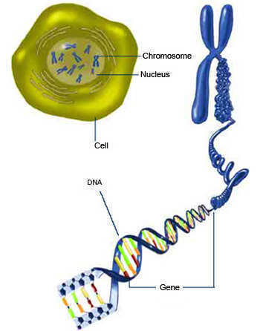
This genetic molecule is contained in the nucleus?
3
DNA / Chromatin
and the answer is…

Slide 66
This important organelle is a…
  Round dark spot in center of nucleus
  Only visible when cell is not dividing
  Contains RNA for protein manufacturing
  Makes ribosomes that travel out of nucleus.
4

Slide 67
This important organelle is a…
  Round dark spot in center of nucleus
  Only visible when cell is not dividing
  Contains RNA for protein manufacturing
  Makes ribosomes that travel out of nucleus.
4
and the answer is..

Slide 68
This important organelle is a…
  Round dark spot in center of nucleus
  Only visible when cell is not dividing
  Contains RNA for protein manufacturing
  Makes ribosomes that travel out of nucleus.
4
The Nucleolus
and the answer is..

Slide 69
A
B
C
.
Ribosomes
Nuclear
Membrane
Name A, B, and C?
5
Copyright © 2024 SlideSpark .LLC

Slide 70
A
B
C
.
Ribosomes
Nuclear
Membrane
Name A, B, and C?
5
Copyright © 2024 SlideSpark .LLC

Slide 71
A
B
C
.
Ribosomes
Nuclear
Membrane
Name A, B, and C?
5
Copyright © 2024 SlideSpark .LLC

Slide 72
A
B
C
.
Ribosomes
Nuclear
Membrane
Name A, B, and C?
5
Copyright © 2024 SlideSpark .LLC

Slide 73
A
B
C
.
Ribosomes
Nuclear
Membrane
Name A, B, and C?
5
Copyright © 2024 SlideSpark .LLC

Slide 74
A
B
C
.
Ribosomes
Nuclear
Membrane
Name A, B, and C?
5
Copyright © 2024 SlideSpark .LLC

Slide 75
A
B
C
.
Ribosomes
Nuclear
Membrane
Name A, B, and C?
5
Copyright © 2024 SlideSpark .LLC

Slide 76

A
B
C
.
Ribosomes
Nuclear
Membrane
Name A, B, and C?
5
Copyright © 2024 SlideSpark .LLC

Slide 77
A
B
C
.
Ribosomes
Nuclear
Membrane
Name A, B, and C?
5
Copyright © 2024 SlideSpark .LLC

Slide 78
PART 3 Review Game
NUKEM | LOST IN TRANSLATION | IMPORTANT MESSAGE | FANNYPACKS | -BONUS- MAZES
1 | 6 | 11 | 16 | *21
2 | 7 | 12 | 17 | *22
3 | 8 | 13 | 18 | *23
4 | 9 | 14 | 19 | *24
5 | 10 | 15 | 20 | *25
Copyright © 2024 SlideSpark .LLC

Slide 79
PART 3 Review Game
NUKEM | LOST IN TRANSLATION | IMPORTANT MESSAGE | FANNYPACKS | -BONUS- MAZES
1 | 6 | 11 | 16 | *21
2 | 7 | 12 | 17 | *22
3 | 8 | 13 | 18 | *23
4 | 9 | 14 | 19 | *24
5 | 10 | 15 | 20 | *25
Copyright © 2024 SlideSpark .LLC

Slide 80
Name this organelle which is a series of folded membranes and site for protein synthesis?
6

Slide 81
Name this organelle which is a series of folded membranes and site for protein synthesis?
6
and the answer is…

Slide 82
Name this organelle which is a series of folded membranes and site for protein synthesis?
6
Rough Endoplasmic Reticulum
and the answer is…

Slide 83
Name this organelle which is a series of folded membranes and site for protein synthesis?
6
Rough Endoplasmic Reticulum
F
F
F
and the answer is…

Slide 84
Name this organelle which is a series of folded membranes and site for protein synthesis?
6
Rough Endoplasmic Reticulum
Form
F
F
and the answer is…

Slide 85
Name this organelle which is a series of folded membranes and site for protein synthesis?
6
Rough Endoplasmic Reticulum
Form
Follows
F
and the answer is…

Slide 86
Name this organelle which is a series of folded membranes and site for protein synthesis?
6
Rough Endoplasmic Reticulum
Form
Follows
Function
and the answer is…

Slide 87
These very numerous and small organelles are mini protein synthesizing factories?
7

Slide 88
These very numerous and small organelles are mini protein synthesizing factories?
7
and the answer is…

Slide 89
These very numerous and small organelles are mini protein synthesizing factories?
7
Ribosomes
and the answer is…

Slide 90
Name each of the boxes on the next slide when they light up.

Slide 91
Amino Acid
Protein
B
A
tRNA
codon
C
A
U
C
mRNA
G
D
Ribosome

Slide 92
Amino Acid
Protein
B
A
tRNA
This is what is produced?
codon
C
A
U
C
mRNA
G
D
Ribosome

Slide 93
Amino Acid
Protein
B
A
tRNA
codon
C
A
U
C
mRNA
G
D
Ribosome

Slide 94
Amino Acid
Protein
B
A
tRNA
Small molecule in cells that carries amino acids?
codon
C
A
U
C
mRNA
G
D
Ribosome

Slide 95
Amino Acid
Protein
B
A
tRNA
Small molecule in cells that carries amino acids?
codon
C
A
U
C
mRNA
G
D
Ribosome

Slide 96
Amino Acid
Protein
B
A
tRNA
Molecule that conveys genetic information from DNA?
codon
C
A
U
C
mRNA
G
D
Ribosome

Slide 97
Amino Acid
Protein
B
A
tRNA
Molecule that conveys genetic information from DNA?
codon
C
A
U
C
mRNA
G
D
Ribosome

Slide 98
Amino Acid
Protein
B
A
tRNA
Protein synthesizers of the cell?
codon
C
A
U
C
mRNA
G
D
Ribosome

Slide 99
Amino Acid
Protein
B
A
tRNA
Protein synthesizers of the cell?
codon
C
A
U
C
mRNA
G
D
Ribosome

Slide 100
Amino Acid
Protein
B
A
tRNA
codon
C
A
U
C
mRNA
G
D
Ribosome

Slide 101
This organelle packages and transports proteins and other macromolecules?
9

Slide 102
This organelle packages and transports proteins and other macromolecules?
Golgi Apparatus
9

Slide 103
Cellular Organelles: A membrane-bound compartment or structure in a cell that performs a special function.
10
Copyright © 2024 SlideSpark .LLC

Slide 104
Cellular Organelles: A membrane-bound compartment or structure in a cell that performs a special function.
10
They…
one point
each…
within the cell.
Copyright © 2024 SlideSpark .LLC

Slide 105
Cellular Organelles: A membrane-bound compartment or structure in a cell that performs a special function.
10
They…
Support
within the cell.
Copyright © 2024 SlideSpark .LLC

Slide 106
Cellular Organelles: A membrane-bound compartment or structure in a cell that performs a special function.
10
They…
Support
Manufacture “Make”
within the cell.
Copyright © 2024 SlideSpark .LLC

Slide 107
Cellular Organelles: A membrane-bound compartment or structure in a cell that performs a special function.
10
They…
Support
Manufacture “Make”
Breakdown
Materials
within the cell.
Copyright © 2024 SlideSpark .LLC

Slide 108
Cellular Organelles: A membrane-bound compartment or structure in a cell that performs a special function.
10
They…
Support
Manufacture “Make”
Breakdown
Materials
Communicate
within the cell.
Copyright © 2024 SlideSpark .LLC

Slide 109
Cellular Organelles: A membrane-bound compartment or structure in a cell that performs a special function.
10
They…
Support
Manufacture “Make”
Breakdown
Transport
Materials
and
Materials
Communicate
within the cell.
Copyright © 2024 SlideSpark .LLC

Slide 110
PART 3 Review Game
NUKEM | LOST IN TRANSLATION | IMPORTANT MESSAGE | FANNYPACKS | -BONUS- MAZES
1 | 6 | 11 | 16 | *21
2 | 7 | 12 | 17 | *22
3 | 8 | 13 | 18 | *23
4 | 9 | 14 | 19 | *24
5 | 10 | 15 | 20 | *25
Copyright © 2024 SlideSpark .LLC

Slide 111
PART 3 Review Game
NUKEM | LOST IN TRANSLATION | IMPORTANT MESSAGE | FANNYPACKS | -BONUS- MAZES
1 | 6 | 11 | 16 | *21
2 | 7 | 12 | 17 | *22
3 | 8 | 13 | 18 | *23
4 | 9 | 14 | 19 | *24
5 | 10 | 15 | 20 | *25
Copyright © 2024 SlideSpark .LLC

Slide 112
This cellular organelle synthesizes sugars, stores enzymes, regulates calcium, makes lipids and steroids.
11

Slide 113
This cellular organelle synthesizes sugars, stores enzymes, regulates calcium, makes lipids and steroids.
11
Smooth
Endoplasmic
Reticulum

Slide 114
These are protein messengers which help to coordinate certain bodily activities.
12

Slide 115
These are protein messengers which help to coordinate certain bodily activities.
12
HORMONES

Slide 116
Name this a simple organic compound containing both a carboxyl (—COOH) and an amino (—NH₂) group.
13

Slide 117
Name this a simple organic compound containing both a carboxyl (—COOH) and an amino (—NH₂) group.
13
Amino Acid

Slide 118
Every cell in the human body contains these. The basic structure of these is a chain of amino acids. You need these in your diet to help your body repair cells and make new ones. It is important for growth and development in children, teens, and pregnant women.
14

Slide 119
Every cell in the human body contains these. The basic structure of these is a chain of amino acids. You need these in your diet to help your body repair cells and make new ones. It is important for growth and development in children, teens, and pregnant women.
14

Slide 120
The Golgi Apparatus sends vesicles of macromolecules to destination in cell.
15
Copyright © 2024 SlideSpark .LLC

Slide 121
The Golgi Apparatus sends vesicles of macromolecules to destination in cell.
15
Copyright © 2024 SlideSpark .LLC

Slide 122
The Golgi Apparatus sends vesicles of macromolecules to destination in cell.
15
Copyright © 2024 SlideSpark .LLC

Slide 123
PART 3 Review Game
NUKEM | LOST IN TRANSLATION | IMPORTANT MESSAGE | FANNYPACKS | -BONUS- MAZES
1 | 6 | 11 | 16 | *21
2 | 7 | 12 | 17 | *22
3 | 8 | 13 | 18 | *23
4 | 9 | 14 | 19 | *24
5 | 10 | 15 | 20 | *25
Copyright © 2024 SlideSpark .LLC

Slide 124
PART 3 Review Game
NUKEM | LOST IN TRANSLATION | IMPORTANT MESSAGE | FANNYPACKS | -BONUS- MAZES
1 | 6 | 11 | 16 | *21
2 | 7 | 12 | 17 | *22
3 | 8 | 13 | 18 | *23
4 | 9 | 14 | 19 | *24
5 | 10 | 15 | 20 | *25
Copyright © 2024 SlideSpark .LLC

Slide 125
True or False? The nucleolus is only visible when cell is not dividing.
16
Copyright © 2024 SlideSpark .LLC

Slide 126
True or False? The nucleolus is only visible when cell is not dividing.
16
TRUE
Copyright © 2024 SlideSpark .LLC

Slide 127
This serves to separate the chromosomes from the rest of the cell and includes an array of small holes or pores that permit the passage of certain materials, such as nucleic acids and proteins, between the nucleus and cytoplasm.
17

Slide 128
This serves to separate the chromosomes from the rest of the cell and includes an array of small holes or pores that permit the passage of certain materials, such as nucleic acids and proteins, between the nucleus and cytoplasm.
17
Nuclear Membrane

Slide 129
Enzymes of the lysosomes are synthesized in the rough endoplasmic reticulum and exported to the Golgi apparatus
18

Slide 130
Enzymes of the lysosomes are synthesized in the rough endoplasmic reticulum and exported to the Golgi apparatus
18

Slide 131
Enzymes of the lysosomes are synthesized in the rough endoplasmic reticulum and exported to the Golgi apparatus
18
LYSOSOMES

Slide 132
These form when the nucleus disappears and the cell is going to divide?
19
19
Chromosomes

Slide 133
Name the four important roles of proteins.
Grrr…
G- Growth
r- Repair
r- Reproduction
r- Regulate
20
Copyright © 2024 SlideSpark .LLC

Slide 134
Name the four important roles of proteins.
Grrr…
G-Growth
r-Repair
r-Reproduction
r-Regulate
20
Copyright © 2024 SlideSpark .LLC

Slide 135
PART 3 Review Game
NUKEM | LOST IN TRANSLATION | IMPORTANT MESSAGE | FANNYPACKS | -BONUS- MAZES
1 | 6 | 11 | 16 | *21
2 | 7 | 12 | 17 | *22
3 | 8 | 13 | 18 | *23
4 | 9 | 14 | 19 | *24
5 | 10 | 15 | 20 | *25
Copyright © 2024 SlideSpark .LLC

Slide 136
PART 3 Review Game
NUKEM | LOST IN TRANSLATION | IMPORTANT MESSAGE | FANNYPACKS | -BONUS- MAZES
1 | 6 | 11 | 16 | *21
2 | 7 | 12 | 17 | *22
3 | 8 | 13 | 18 | *23
4 | 9 | 14 | 19 | *24
5 | 10 | 15 | 20 | *25
Copyright © 2024 SlideSpark .LLC

Slide 137
Name this maze movie like the Endoplasmic reticulum?
*21

Slide 138

Name this maze movie like the Endoplasmic reticulum?
*21

Slide 139
*22
What movie / book has this maze?

Slide 140

*22
What movie / book has this maze?

Slide 141
*23
Name the ghosts below?

Slide 142
*23
Name the ghosts below?

Slide 143
*23
Name the ghosts below?

Slide 144
*23
Name the ghosts below?

Slide 145
*23
Name the ghosts below?

Slide 146
*23
Name the ghosts below?

Slide 147
*23
Name the ghosts below?

Slide 148
*23
Name the ghosts below?

Slide 149
*23
Name the ghosts below?

Slide 150
*24

Slide 151

*24

Slide 152
*25

Slide 153

*25

Slide 154
PART 3 Review Game
NUKEM | LOST IN TRANSLATION | IMPORTANT MESSAGE | FANNYPACKS | -BONUS- MAZES
1 | 6 | 11 | 16 | *21
2 | 7 | 12 | 17 | *22
3 | 8 | 13 | 18 | *23
4 | 9 | 14 | 19 | *24
5 | 10 | 15 | 20 | *25
Final Question
Copyright © 2024 SlideSpark .LLC

Slide 155
5 point wager question

Slide 156
5 point wager question

Slide 157
5 point wager question

Slide 158
5 point wager question
Name all 5

Slide 159
Name A,B,C,D,E
C
B
E
D
A

Slide 160
Name A,B,C,D,E
C
B
E
D
A

Slide 161
Name A,B,C,D,E
C
B
E
D
NUCLEOLUS
A

Slide 162
Name A,B,C,D,E
C
B
E
NUCLEUS
D
NUCLEOLUS
A

Slide 163
Name A,B,C,D,E
Nuclear
Membrane
C
B
E
NUCLEUS
D
NUCLEOLUS
A

Slide 164
Name A,B,C,D,E
Nuclear
Membrane
C
B
E
NUCLEUS
D
NUCLEOLUS
A

Slide 165
Name A,B,C,D,E
Nuclear
Membrane
C
B
E
NUCLEUS
NUCLEAR PORE
D
NUCLEOLUS
A

Slide 166
Name A,B,C,D,E
Nuclear
Membrane
C
B
E
NUCLEUS
NUCLEAR PORE
D
NUCLEOLUS
A

Slide 167
Name A,B,C,D,E
Nuclear
Membrane
C
B
GOLGI
BODY
E
NUCLEUS
NUCLEAR PORE
D
NUCLEOLUS
A

Slide 168
Questions 1-20 = 5pts Each
Final Category (Bonus) = 1pt Each
Final Questions = 5 pt wager
Find the Owl =
Secretly write “Owl” in the correct box worth 1pt.

Slide 169
Cellular Organelles
Review Game
Part 3
Lesson 6

Slide 170



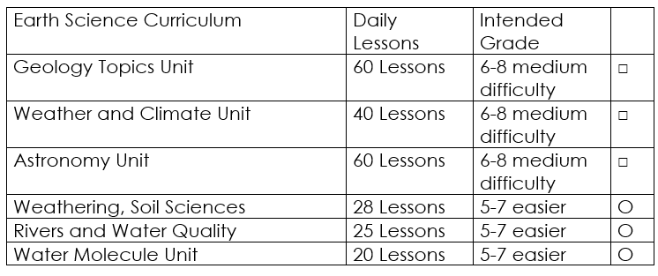

Curriculum Guide
Number of Lessons in each unit (50 min, daily lessons) and difficult rating scale / intended grade level.
=Easier, = More difficult, =Most difficult
Earth Science Units

Slide 171


Life Science Units

Slide 172

Physical Science

Slide 173

Dear Valued Educator,
Our fully editable .pptx and .doc resources are perfect for educators looking to bring enthusiasm and creativity to their lessons. We encourage you to make changes to fit your needs and style. As science educators, we’re committed to providing students with the tools they need to succeed in the classroom and beyond. Each unit in the curriculum includes a range of resources that have been developed through extensive research and use in a busy classroom. Our teaching approach is designed to make science education engaging and exciting for learners of all ages. We offer a one-of-a-kind science curriculum that will challenge, inspire, and educate students to become tomorrow's scientists and leaders. Join us today and learn more about how our program can help you achieve your classroom goals.
With appreciation,
Support@SlideSpark.net

Slide 174





Thank you for your time and interest in our Science curriculum. We strive to provide students with engaging and informative lessons that will spark their curiosity and encourage scientific exploration. Should you have any questions or concerns, please do not hesitate to contact us. Thank you again for considering our curriculum, and we wish you all the best in your educational journey.
Sincerely,
Support@slidespark.net
SlideSpark Science on TpT

