Slide 1
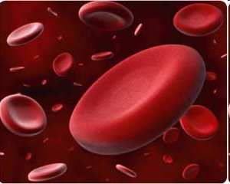
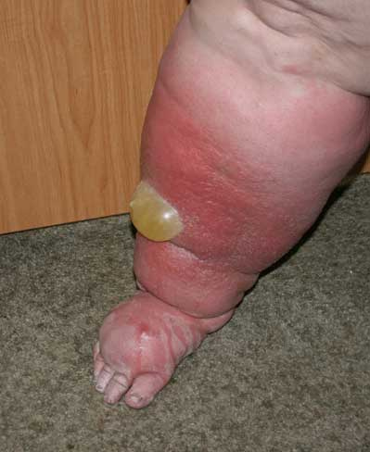

Circulatory System
Review Game
and Lymphatic
Part 6
Lesson 8

Slide 2
Circulatory System Review Game
and Lymphatic
THERE AND BACK AGAIN | LUB-DUB | HEART FELT | RED HOT | -BONUS- VALENTINES
1 | 6 | 11 | 16 | *21
2 | 7 | 12 | 17 | *22
3 | 8 | 13 | 18 | *23
4 | 9 | 14 | 19 | *24
5 | 10 | 15 | 20 | *25
Final Question:________________
Copyright © 2024 SlideSpark .LLC

Slide 3
How to play…
  Don’t play like Jeo_ _ _ _ y.
  Class should be divided into several small groups.
  Groups should use science journal (red slide notes), homework, and other available materials to assist you.
  Groups can communicate quietly with each other but no sharing answers between groups.
    Practice quietly communicating right now?
    Practice Communication Question:
    Your group gets to order one pizza, and you can have two toppings. What does your group want?

Slide 4

Questions 1-20 = 5pts Each
Final Category (Bonus) = 1pt Each
Final Questions = 5 pt wager
If you wager 5 on the last question and get it wrong you lose 5 pts. Wager 5 and get it right you get 5 pts.
Find the Owl =
Secretly write “Owl” in the correct box worth 1pt.
“I’ll be about this big.”

Slide 5
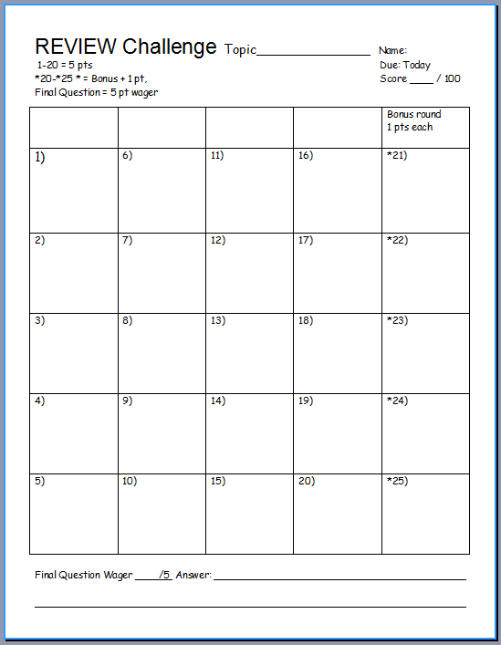
Is your name on the review sheet?
Name

Slide 6
Is your name on the review sheet?
Add the categories
along the top
on the next slide.

Slide 7
Circulatory System Review Game
THERE AND BACK AGAIN | LUB-DUB | HEART FELT | RED HOT | -BONUS- VALENTINES
1 | 6 | 11 | 16 | *21
2 | 7 | 12 | 17 | *22
3 | 8 | 13 | 18 | *23
4 | 9 | 14 | 19 | *24
5 | 10 | 15 | 20 | *25
Final Question:________________
Copyright © 2024 SlideSpark .LLC

Slide 8
Circulatory System Review Game
THERE AND BACK AGAIN | LUB-DUB | HEART FELT | RED HOT | -BONUS- VALENTINES
1 | 6 | 11 | 16 | *21
2 | 7 | 12 | 17 | *22
3 | 8 | 13 | 18 | *23
4 | 9 | 14 | 19 | *24
5 | 10 | 15 | 20 | *25
Final Question:________________
Copyright © 2024 SlideSpark .LLC

Slide 9
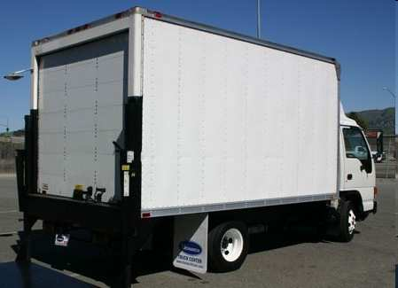
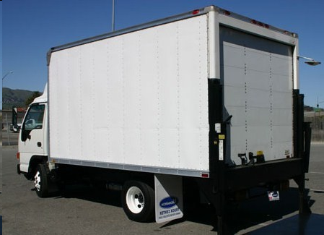
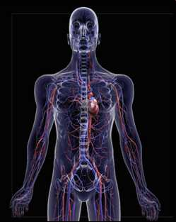
Which of the following two letters are incorrect?
A
B
Carbon Dioxide
Food
Food
CO
2
D
C
Oxygen
Waste
Oxygen
Waste
1

Slide 10
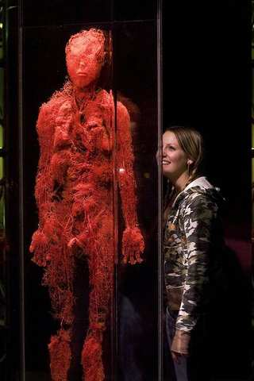
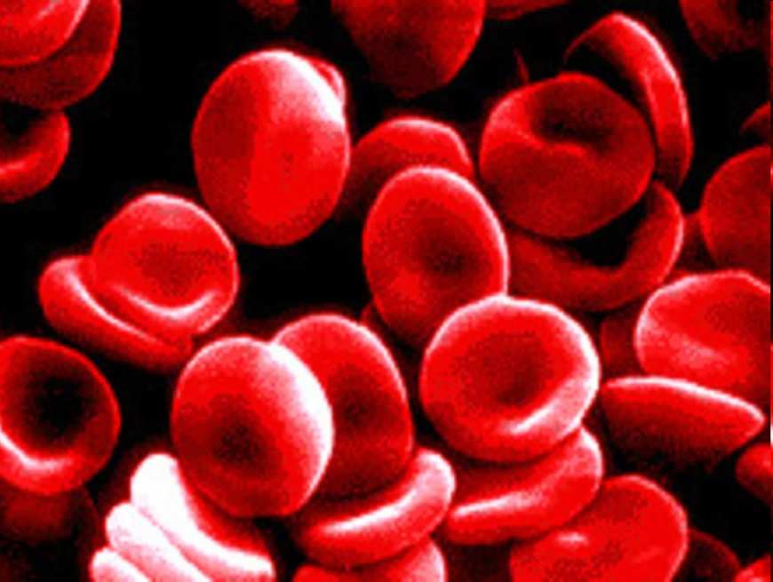
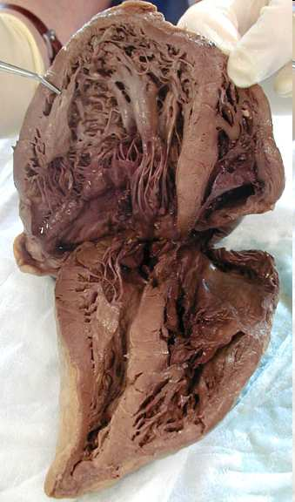

The circulatory systems consists of the following…
  Heart
  Blood Vessels
  Blood
A
B
C
and
Lungs
2
Copyright © 2024 SlideSpark .LLC

Slide 11


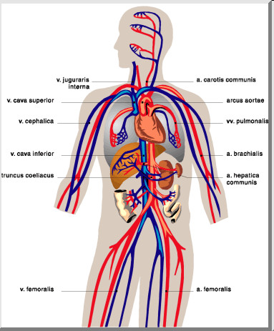
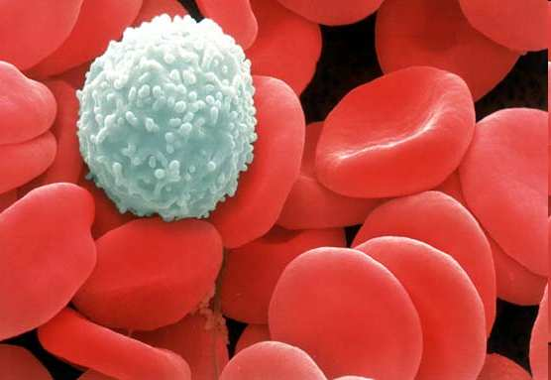
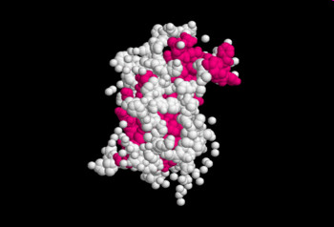
Please fill in the term beneath the squares below?
The function of the circulatory system is to…
  To deliver food and oxygen to cells.
  To carry away waste.
  To aid in disease prevention.
  To deliver chemical messages called hormones.
Copyright © 2024 SlideSpark .LLC

Slide 12
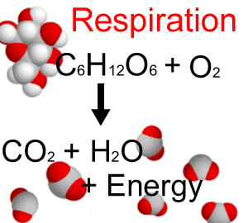
Cellular Respiration is the processes whereby certain organisms obtain energy from organic molecules.
  Fill in the correct part of the equation blocked out below.
A
B
4
Copyright © 2024 SlideSpark .LLC

Slide 13
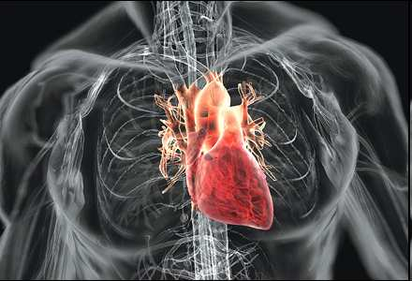
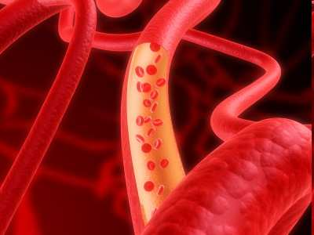
Which of the following is incorrect of the circulatory system?
  A.) The heart is the pump that moves blood through the body.
  B.) Food and oxygen is delivered to cells primarily in the heart.
  C.) Blood vessels provide the paths of travel and have unique structures.
  D.) The circulatory system is designed so it allows the continual circulation of blood.
5
Copyright © 2024 SlideSpark .LLC

Slide 14
Circulatory System Review Game
THERE AND BACK AGAIN | LUB-DUB | HEART FELT | RED HOT | -BONUS- VALENTINES
1 | 6 | 11 | 16 | *21
2 | 7 | 12 | 17 | *22
3 | 8 | 13 | 18 | *23
4 | 9 | 14 | 19 | *24
5 | 10 | 15 | 20 | *25
Final Question:________________
Copyright © 2024 SlideSpark .LLC

Slide 15
Circulatory System Review Game
THERE AND BACK AGAIN | LUB-DUB | HEART FELT | RED HOT | -BONUS- VALENTINES
1 | 6 | 11 | 16 | *21
2 | 7 | 12 | 17 | *22
3 | 8 | 13 | 18 | *23
4 | 9 | 14 | 19 | *24
5 | 10 | 15 | 20 | *25
Final Question:________________
Copyright © 2024 SlideSpark .LLC

Slide 16
6
What is the correct order that blood travels from the list below?
A.) Oxygen rich blood travels from the body to the lungs, to the heart.
B.) Oxygen poor blood travels to the body, then the heart, and then to the lungs.
C.) Blood rarely travels to all regions of the body.
D.) Oxygen rich blood travels from the lungs to the heart, to the body, back to the heart, and then to the lungs.
Copyright © 2024 SlideSpark .LLC

Slide 17
6
What is the correct order that blood travels from the list below?
A.) Oxygen rich blood travels from the body to the lungs, to the heart.
B.) Oxygen poor blood travels to the body, then the heart, and then to the lungs.
C.) Blood rarely travels to all regions of the body.
D.) Oxygen rich blood travels from the lungs to the heart, to the body, back to the heart, and then to the lungs.
Copyright © 2024 SlideSpark .LLC

Slide 18
6
What is the correct order that blood travels from the list below?
A.) Oxygen rich blood travels from the body to the lungs, to the heart.
B.) Oxygen poor blood travels to the body, then the heart, and then to the lungs.
C.) Blood rarely travels to all regions of the body.
D.) Oxygen rich blood travels from the lungs to the heart, to the body, back to the heart, and then to the lungs.
Copyright © 2024 SlideSpark .LLC

Slide 19
6
What is the correct order that blood travels from the list below?
A.) Oxygen rich blood travels from the body to the lungs, to the heart.
B.) Oxygen poor blood travels to the body, then the heart, and then to the lungs.
C.) Blood rarely travels to all regions of the body.
D.) Oxygen rich blood travels from the lungs to the heart, to the body, back to the heart, and then to the lungs.
Copyright © 2024 SlideSpark .LLC

Slide 20
6
What is the correct order that blood travels from the list below?
A.) Oxygen rich blood travels from the body to the lungs, to the heart.
B.) Oxygen poor blood travels to the body, then the heart, and then to the lungs.
C.) Blood rarely travels to all regions of the body.
D.) Oxygen rich blood travels from the lungs to the heart, to the body, back to the heart, and then to the lungs.
Copyright © 2024 SlideSpark .LLC

Slide 21
6
What is the correct order that blood travels from the list below?
A.) Oxygen rich blood travels from the body to the lungs, to the heart.
B.) Oxygen poor blood travels to the body, then the heart, and then to the lungs.
C.) Blood rarely travels to all regions of the body.
D.) Oxygen rich blood travels from the lungs to the heart, to the body, back to the heart, and then to the lungs.
E.) All of the above.
Copyright © 2024 SlideSpark .LLC

Slide 22
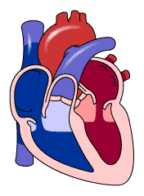

Which side is oxygenated, and which side is deoxygenated?
A
B

Slide 23
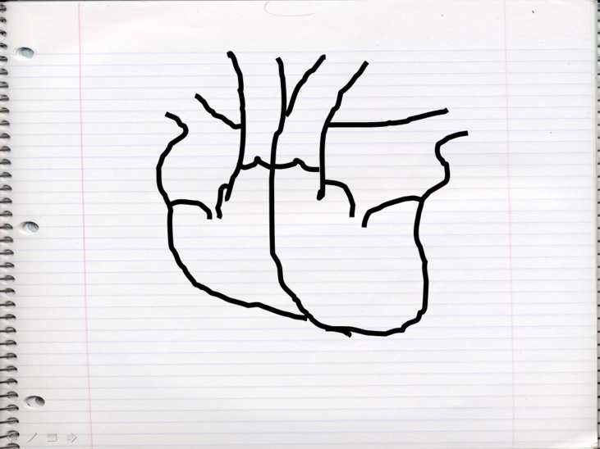
Which of the following diagrams is correct for blood flow through the heart?
8
A
Lungs
Body
B
Lungs
Body
Body
Body
Lungs
Lungs
C
Lungs
Lungs
D
Lungs
Body
Lungs
Body
Body
Lungs
Copyright © 2024 SlideSpark .LLC

Slide 24
Which of the following diagrams is correct for blood flow through the heart?
8
A
Lungs
Body
B
Lungs
Body
Body
Body
Lungs
Lungs
C
Lungs
Lungs
D
Lungs
Body
Lungs
Body
Body
Lungs
Copyright © 2024 SlideSpark .LLC

Slide 25
Which of the following diagrams is correct for blood flow through the heart?
8
A
Lungs
Body
B
Lungs
Body
Body
Body
Lungs
Lungs
C
Lungs
Lungs
D
Lungs
Body
Lungs
Body
Body
Lungs
Copyright © 2024 SlideSpark .LLC

Slide 26
Which of the following diagrams is correct for blood flow through the heart?
8
A
Lungs
Body
B
Lungs
Body
Body
Body
Lungs
Lungs
C
Lungs
Lungs
D
Lungs
Body
Lungs
Body
Body
Lungs
Copyright © 2024 SlideSpark .LLC

Slide 27
Which of the following diagrams is correct for blood flow through the heart?
8
A
Lungs
Body
B
Lungs
Body
Body
Body
Lungs
Lungs
C
Lungs
Lungs
D
Lungs
Body
Lungs
Body
Body
Lungs
Copyright © 2024 SlideSpark .LLC

Slide 28
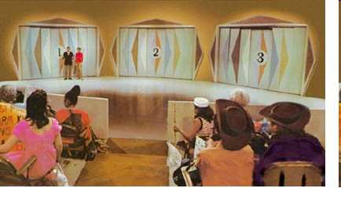
One the next slide. Please name A, B, C, D behind door number #3.
Copyright © 2024 SlideSpark .LLC

Slide 29
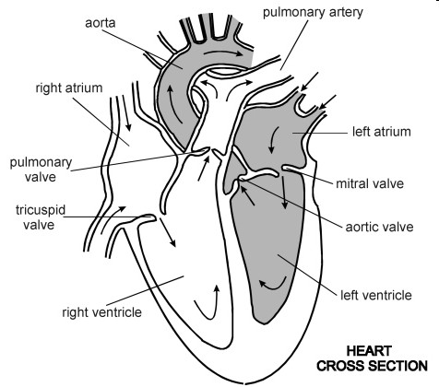
A
9
B
C
D

Slide 30
A
9
B
C
D

Slide 31
One the next slide. Please name A, B, C, D behind door number #2.
10
Copyright © 2024 SlideSpark .LLC

Slide 32
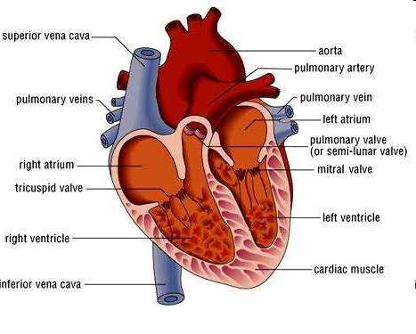
A
B
C
D
10

Slide 33
Circulatory System Review Game
THERE AND BACK AGAIN | LUB-DUB | HEART FELT | RED HOT | -BONUS- VALENTINES
1 | 6 | 11 | 16 | *21
2 | 7 | 12 | 17 | *22
3 | 8 | 13 | 18 | *23
4 | 9 | 14 | 19 | *24
5 | 10 | 15 | 20 | *25
Final Question:________________
Copyright © 2024 SlideSpark .LLC

Slide 34
Circulatory System Review Game
THERE AND BACK AGAIN | LUB-DUB | HEART FELT | RED HOT | -BONUS- VALENTINES
1 | 6 | 11 | 16 | *21
2 | 7 | 12 | 17 | *22
3 | 8 | 13 | 18 | *23
4 | 9 | 14 | 19 | *24
5 | 10 | 15 | 20 | *25
Final Question:________________
Copyright © 2024 SlideSpark .LLC

Slide 35

Hint

Slide 36
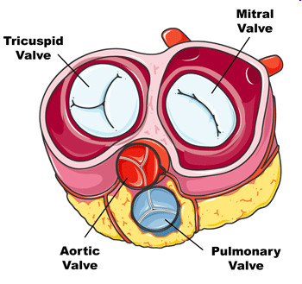
11
Please name A, B, C, D
B
A
1
1
2
3
2
C
D

Slide 37
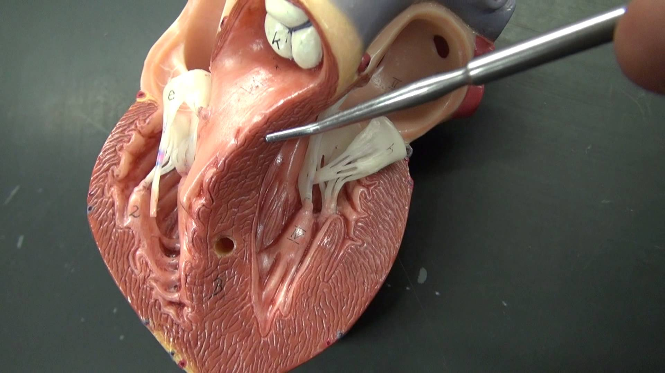
12

Slide 38
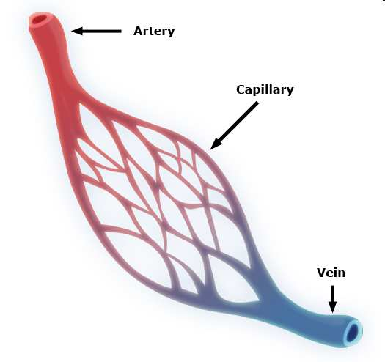
Please name A, B, and C. Which one carries blood with depleted oxygen levels?
13
C
A
B
Copyright © 2024 SlideSpark .LLC

Slide 39
14
Please name the four components of blood based on the pictures below?
Copyright © 2024 SlideSpark .LLC

Slide 40
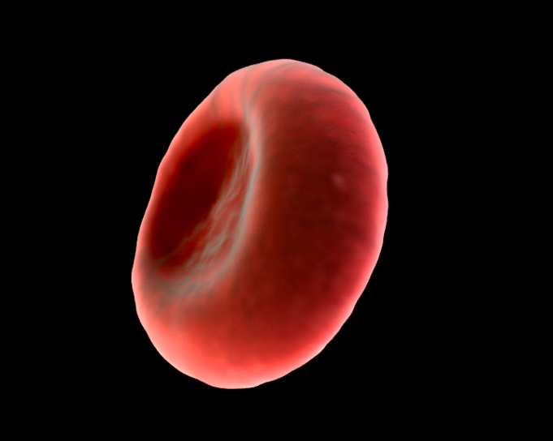
14
Please name the four components of blood based on the pictures below?
A
Copyright © 2024 SlideSpark .LLC

Slide 41
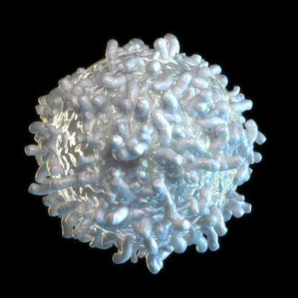
14
Please name the four components of blood based on the pictures below?
A
B
Copyright © 2024 SlideSpark .LLC

Slide 42
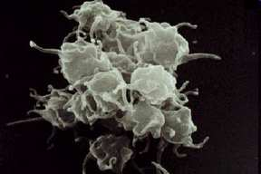
14
Please name the four components of blood based on the pictures below?
A
C
B
Copyright © 2024 SlideSpark .LLC

Slide 43
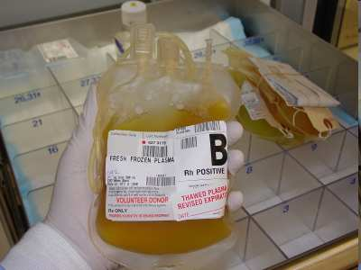
14
Please name the four components of blood based on the pictures below?
A
D
C
B
Copyright © 2024 SlideSpark .LLC

Slide 44
Antigen: A substance that when introduced into the body stimulates the production of an antibody.
Antibody: A blood protein produced in response to and counteracting a specific antigen.
Causes clotting in incorrect blood transfusions
15
Y
Y
Y
Y
Invading Blood
Y
Y
Y
Y
Y
Copyright © 2024 SlideSpark .LLC
Y

Slide 45
Circulatory System Review Game
THERE AND BACK AGAIN | LUB-DUB | HEART FELT | RED HOT | -BONUS- VALENTINES
1 | 6 | 11 | 16 | *21
2 | 7 | 12 | 17 | *22
3 | 8 | 13 | 18 | *23
4 | 9 | 14 | 19 | *24
5 | 10 | 15 | 20 | *25
Final Question:________________
Copyright © 2024 SlideSpark .LLC

Slide 46
Circulatory System Review Game
THERE AND BACK AGAIN | LUB-DUB | HEART FELT | RED HOT | -BONUS- VALENTINES
1 | 6 | 11 | 16 | *21
2 | 7 | 12 | 17 | *22
3 | 8 | 13 | 18 | *23
4 | 9 | 14 | 19 | *24
5 | 10 | 15 | 20 | *25
Final Question:________________
Copyright © 2024 SlideSpark .LLC

Slide 47
Name the mystery blood type?
16
O-, O+
A+/A-
AB+/AB-
?
O-
B+/ B-
Copyright © 2024 SlideSpark .LLC

Slide 48

Will the two blood types below = safe transfusion
1
2
B+
AB-
Copyright © 2024 SlideSpark .LLC

Slide 49
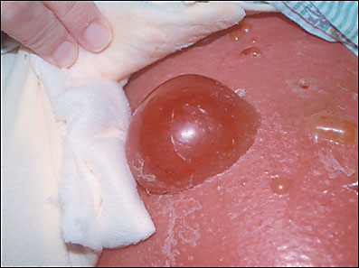
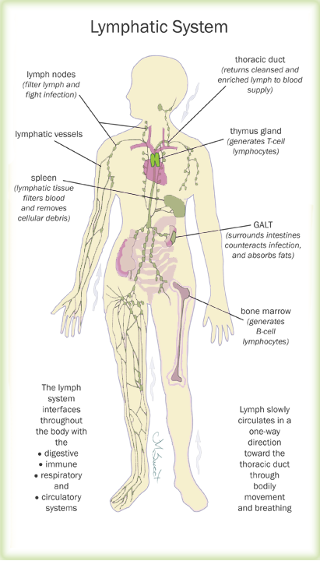
This system is a part of the circulatory system, comprising a network of vessels that carry a clear fluid called lymph.
18

Slide 50
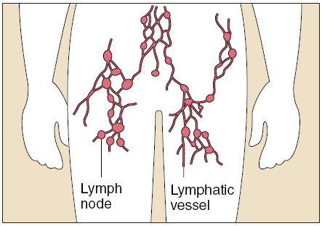
Which is a vessel, and
which is a node?
A
B
19

Slide 51
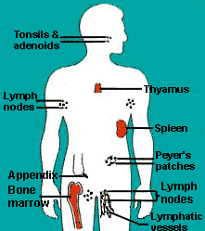


Slide 52
“Each part of the Lymphatic System is worth one point.”

Slide 53
Circulatory System Review Game
THERE AND BACK AGAIN | LUB-DUB | HEART FELT | RED HOT | -BONUS- VALENTINES
1 | 6 | 11 | 16 | *21
2 | 7 | 12 | 17 | *22
3 | 8 | 13 | 18 | *23
4 | 9 | 14 | 19 | *24
5 | 10 | 15 | 20 | *25
Final Question:________________
Copyright © 2024 SlideSpark .LLC

Slide 54
Circulatory System Review Game
THERE AND BACK AGAIN | LUB-DUB | HEART FELT | RED HOT | -BONUS- VALENTINES
1 | 6 | 11 | 16 | *21
2 | 7 | 12 | 17 | *22
3 | 8 | 13 | 18 | *23
4 | 9 | 14 | 19 | *24
5 | 10 | 15 | 20 | *25
Final Question:________________
Copyright © 2024 SlideSpark .LLC

Slide 55

*21
How many first dates?

Slide 56
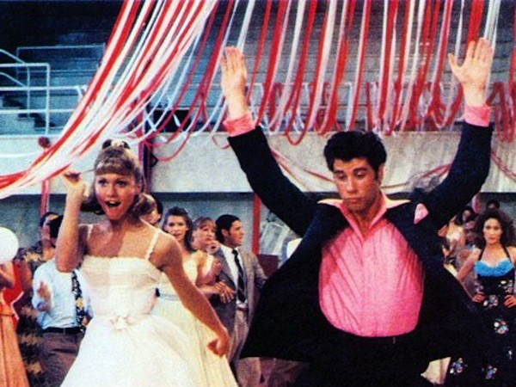
Name this movie with so much heart?
*22

Slide 57
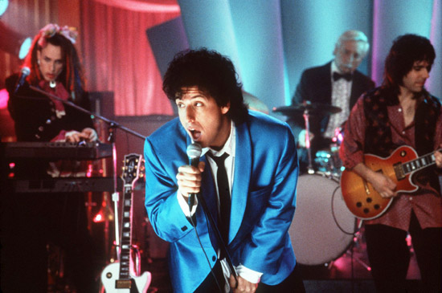
*23
Name this movie?

Slide 58
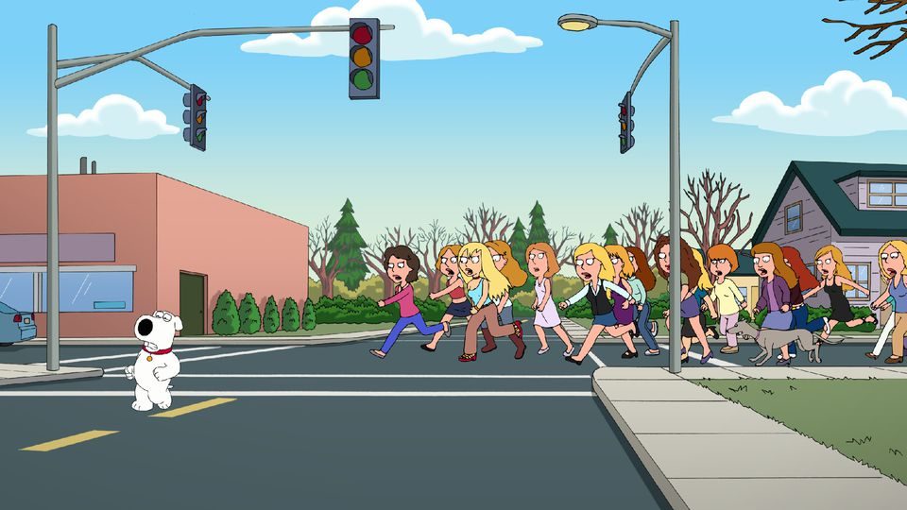
Name this town?
*24

Slide 59

Name this movie?
*25

Slide 60
Circulatory System Review Game
THERE AND BACK AGAIN | LUB-DUB | HEART FELT | RED HOT | -BONUS- VALENTINES
1 | 6 | 11 | 16 | *21
2 | 7 | 12 | 17 | *22
3 | 8 | 13 | 18 | *23
4 | 9 | 14 | 19 | *24
5 | 10 | 15 | 20 | *25
Final Question:________________
Copyright © 2024 SlideSpark .LLC

Slide 61
Circulatory System Review Game
THERE AND BACK AGAIN | LUB-DUB | HEART FELT | RED HOT | -BONUS- VALENTINES
1 | 6 | 11 | 16 | *21
2 | 7 | 12 | 17 | *22
3 | 8 | 13 | 18 | *23
4 | 9 | 14 | 19 | *24
5 | 10 | 15 | 20 | *25
Final Question:________________
Copyright © 2024 SlideSpark .LLC

Slide 62
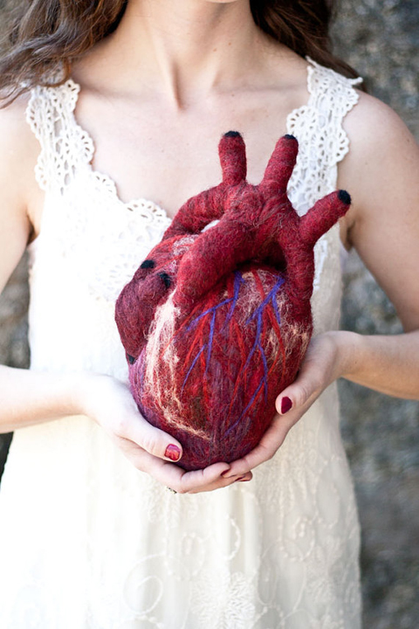
This is a 5 point wager
question

Slide 63
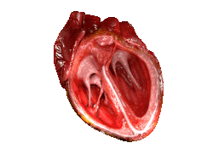
This is a 5 point wager
question

Slide 64
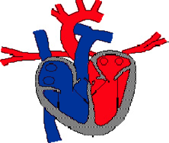
Please name A and B?
A
B

Slide 65
Circulatory System
Review Game
and Lymphatic
Part 6
Lesson 8

Slide 66

Circulatory System
Review Game
and Lymphatic
Part 6
Lesson 9

Slide 67
Circulatory System Review Game
THERE AND BACK AGAIN | LUB-DUB | HEART FELT | RED HOT | -BONUS- VALENTINES
1 | 6 | 11 | 16 | *21
2 | 7 | 12 | 17 | *22
3 | 8 | 13 | 18 | *23
4 | 9 | 14 | 19 | *24
5 | 10 | 15 | 20 | *25
Final Question:________________
Copyright © 2024 SlideSpark .LLC

Slide 68
Circulatory System Review Game
THERE AND BACK AGAIN | LUB-DUB | HEART FELT | RED HOT | -BONUS- VALENTINES
1 | 6 | 11 | 16 | *21
2 | 7 | 12 | 17 | *22
3 | 8 | 13 | 18 | *23
4 | 9 | 14 | 19 | *24
5 | 10 | 15 | 20 | *25
Final Question:________________
Copyright © 2024 SlideSpark .LLC

Slide 69
Which of the following two letters are incorrect?
A
B
Carbon Dioxide
Food
Food
CO
2
D
C
Oxygen
Waste
Oxygen
Waste
1

Slide 70
Which of the following two letters are incorrect?
A
B
Carbon Dioxide
Food
Food
CO
2
D
C
Oxygen
Waste
Oxygen
Waste
1

Slide 71
Which of the following two letters are incorrect?
A
B
Carbon Dioxide
Food
Food
CO
2
D
C
Oxygen
Waste
Oxygen
Waste
1
Copyright © 2024 SlideSpark .LLC

Slide 72
Which of the following two letters are incorrect?
A
B
Carbon Dioxide
Food
Food
CO
2
D
C
Oxygen
Waste
Oxygen
Waste
1
Copyright © 2024 SlideSpark .LLC

Slide 73
Which of the following two letters are incorrect?
A
B
Carbon Dioxide
Food
Food
CO
2
D
C
Oxygen
Waste
Oxygen
Waste
1
Copyright © 2024 SlideSpark .LLC

Slide 74
Correct
A
B
Oxygen
Food
Food
Oxygen
D
C
Carbon Dioxide
Waste
CO
Waste
2
1
Copyright © 2024 SlideSpark .LLC

Slide 75
The circulatory systems consists of the following…
  Heart
  Blood Vessels
  Blood
A
B
C
and
Lungs
2
Copyright © 2024 SlideSpark .LLC

Slide 76
The circulatory systems consists of the following…
  Heart
  Blood Vessels
  Blood
A
B
C
and
Lungs
2
Copyright © 2024 SlideSpark .LLC

Slide 77
The circulatory systems consists of the following…
  Heart
  Blood Vessels
  Blood
A
B
C
Blood
Vessels
and
Lungs
2
Copyright © 2024 SlideSpark .LLC

Slide 78
The circulatory systems consists of the following…
  Heart
  Blood Vessels
  Blood
A
B
C
Blood
Vessels
and
Lungs
2
Copyright © 2024 SlideSpark .LLC

Slide 79
The circulatory systems consists of the following…
  Heart
  Blood Vessels
  Blood
A
B
Blood Cells
C
Blood
Vessels
and
Lungs
2
Copyright © 2024 SlideSpark .LLC

Slide 80
The circulatory systems consists of the following…
  Heart
  Blood Vessels
  Blood
A
B
Blood Cells
C
Blood
Vessels
and
Lungs
2
Copyright © 2024 SlideSpark .LLC

Slide 81
The circulatory systems consists of the following…
  Heart
  Blood Vessels
  Blood
A
B
Blood Cells
C
Heart
Blood
Vessels
and
Lungs
2
Copyright © 2024 SlideSpark .LLC

Slide 82

The circulatory systems consists of the following…
  Heart
  Blood Vessels
  Blood
A
B
Blood Cells
C
Heart
Blood
Vessels
and
Lungs
2
Copyright © 2024 SlideSpark .LLC

Slide 83
Please fill in the term beneath the squares below?
The function of the circulatory system is to…
  To deliver food and oxygen to cells.
  To carry away waste.
  To aid in disease prevention.
  To deliver chemical messages called hormones.
Copyright © 2024 SlideSpark .LLC

Slide 84
Please fill in the term beneath the squares below?
The function of the circulatory system is to…
  To deliver food and oxygen to cells.
  To carry away waste.
  To aid in disease prevention.
  To deliver chemical messages called hormones.
Copyright © 2024 SlideSpark .LLC

Slide 85
Please fill in the term beneath the squares below?
The function of the circulatory system is to…
  To deliver food and oxygen to cells.
  To carry away waste.
  To aid in disease prevention.
  To deliver chemical messages called hormones.
Copyright © 2024 SlideSpark .LLC

Slide 86
Please fill in the term beneath the squares below?
The function of the circulatory system is to…
  To deliver food and oxygen to cells.
  To carry away waste.
  To aid in disease prevention.
  To deliver chemical messages called hormones.
Copyright © 2024 SlideSpark .LLC

Slide 87
Please fill in the term beneath the squares below?
The function of the circulatory system is to…
  To deliver food and oxygen to cells.
  To carry away waste.
  To aid in disease prevention.
  To deliver chemical messages called hormones.
Copyright © 2024 SlideSpark .LLC

Slide 88
Please fill in the term beneath the squares below?
The function of the circulatory system is to…
  To deliver food and oxygen to cells.
  To carry away waste.
  To aid in disease prevention.
  To deliver chemical messages called hormones.
Copyright © 2024 SlideSpark .LLC

Slide 89
Please fill in the term beneath the squares below?
The function of the circulatory system is to…
  To deliver food and oxygen to cells.
  To carry away waste.
  To aid in disease prevention.
  To deliver chemical messages called hormones.
Copyright © 2024 SlideSpark .LLC

Slide 90
Please fill in the term beneath the squares below?
The function of the circulatory system is to…
  To deliver food and oxygen to cells.
  To carry away waste.
  To aid in disease prevention.
  To deliver chemical messages called hormones.
Copyright © 2024 SlideSpark .LLC

Slide 91
Please fill in the term beneath the squares below?
The function of the circulatory system is to…
  To deliver food and oxygen to cells.
  To carry away waste.
  To aid in disease prevention.
  To deliver chemical messages called hormones.
Copyright © 2024 SlideSpark .LLC

Slide 92
Please fill in the term beneath the squares below?
The function of the circulatory system is to…
  To deliver food and oxygen to cells.
  To carry away waste.
  To aid in disease prevention.
  To deliver chemical messages called hormones.
Copyright © 2024 SlideSpark .LLC

Slide 93
Please fill in the term beneath the squares below?
The function of the circulatory system is to…
  To deliver food and oxygen to cells.
  To carry away waste.
  To aid in disease prevention.
  To deliver chemical messages called hormones.
Copyright © 2024 SlideSpark .LLC

Slide 94
Cellular Respiration is the processes whereby certain organisms obtain energy from organic molecules.
  Fill in the correct part of the equation blocked out below.
A
B
4
Copyright © 2024 SlideSpark .LLC

Slide 95
Cellular Respiration is the processes whereby certain organisms obtain energy from organic molecules.
  Fill in the correct part of the equation blocked out below.
A
B
4
Copyright © 2024 SlideSpark .LLC

Slide 96
Cellular Respiration is the processes whereby certain organisms obtain energy from organic molecules.
  Fill in the correct part of the equation blocked out below.
A
oxygen
B
4
Copyright © 2024 SlideSpark .LLC

Slide 97
Cellular Respiration is the processes whereby certain organisms obtain energy from organic molecules.
  Fill in the correct part of the equation blocked out below.
A
oxygen
B
4
Copyright © 2024 SlideSpark .LLC

Slide 98
Cellular Respiration is the processes whereby certain organisms obtain energy from organic molecules.
  Fill in the correct part of the equation blocked out below.
A
oxygen
B
4
Carbon Dioxide
Copyright © 2024 SlideSpark .LLC

Slide 99
Which of the following is incorrect of the circulatory system?
  A.) The heart is the pump that moves blood through the body.
  B.) Food and oxygen is delivered to cells primarily in the heart.
  C.) Blood vessels provide the paths of travel and have unique structures.
  D.) The circulatory system is designed so it allows the continual circulation of blood.
5
Copyright © 2024 SlideSpark .LLC

Slide 100
Which of the following is incorrect of the circulatory system?
  A.) The heart is the pump that moves blood through the body.
  B.) Food and oxygen is delivered to cells primarily in the heart.
  C.) Blood vessels provide the paths of travel and have unique structures.
  D.) The circulatory system is designed so it allows the continual circulation of blood.
5
Copyright © 2024 SlideSpark .LLC

Slide 101
Which of the following is incorrect of the circulatory system?
  A.) The heart is the pump that moves blood through the body.
  B.) Food and oxygen is delivered to cells primarily in the blood
  C.) Blood vessels provide the paths of travel and have unique structures.
  D.) The circulatory system is designed so it allows the continual circulation of blood.
5
Copyright © 2024 SlideSpark .LLC

Slide 102
Which of the following is incorrect of the circulatory system?
  A.) The heart is the pump that moves blood through the body.
  B.) Food and oxygen is delivered to cells primarily in the blood
  C.) Blood vessels provide the paths of travel and have unique structures.
  D.) The circulatory system is designed so it allows the continual circulation of blood.
5
Copyright © 2024 SlideSpark .LLC

Slide 103
Circulatory System Review Game
THERE AND BACK AGAIN | LUB-DUB | HEART FELT | RED HOT | -BONUS- VALENTINES
1 | 6 | 11 | 16 | *21
2 | 7 | 12 | 17 | *22
3 | 8 | 13 | 18 | *23
4 | 9 | 14 | 19 | *24
5 | 10 | 15 | 20 | *25
Final Question:________________
Copyright © 2024 SlideSpark .LLC

Slide 104
Circulatory System Review Game
THERE AND BACK AGAIN | LUB-DUB | HEART FELT | RED HOT | -BONUS- VALENTINES
1 | 6 | 11 | 16 | *21
2 | 7 | 12 | 17 | *22
3 | 8 | 13 | 18 | *23
4 | 9 | 14 | 19 | *24
5 | 10 | 15 | 20 | *25
Final Question:________________
Copyright © 2024 SlideSpark .LLC

Slide 105
6
What is the correct order that blood travels from the list below?
A.) Oxygen rich blood travels from the body to the lungs, to the heart.
B.) Oxygen poor blood travels to the body, then the heart, and then to the lungs.
C.) Blood rarely travels to all regions of the body.
D.) Oxygen rich blood travels from the lungs to the heart, to the body, back to the heart, and then to the lungs.
Copyright © 2024 SlideSpark .LLC

Slide 106
6
What is the correct order that blood travels from the list below?
A.) Oxygen rich blood travels from the body to the lungs, to the heart.
B.) Oxygen poor blood travels to the body, then the heart, and then to the lungs.
C.) Blood rarely travels to all regions of the body.
D.) Oxygen rich blood travels from the lungs to the heart, to the body, back to the heart, and then to the lungs.
Copyright © 2024 SlideSpark .LLC

Slide 107
6
What is the correct order that blood travels from the list below?
A.) Oxygen rich blood travels from the body to the lungs, to the heart.
B.) Oxygen poor blood travels to the body, then the heart, and then to the lungs.
C.) Blood rarely travels to all regions of the body.
D.) Oxygen rich blood travels from the lungs to the heart, to the body, back to the heart, and then to the lungs.
Copyright © 2024 SlideSpark .LLC

Slide 108
6
What is the correct order that blood travels from the list below?
A.) Oxygen rich blood travels from the body to the lungs, to the heart.
B.) Oxygen poor blood travels to the body, then the heart, and then to the lungs.
C.) Blood rarely travels to all regions of the body.
D.) Oxygen rich blood travels from the lungs to the heart, to the body, back to the heart, and then to the lungs.
Copyright © 2024 SlideSpark .LLC

Slide 109
6
What is the correct order that blood travels from the list below?
A.) Oxygen rich blood travels from the body to the lungs, to the heart.
B.) Oxygen poor blood travels to the body, then the heart, and then to the lungs.
C.) Blood rarely travels to all regions of the body.
D.) Oxygen rich blood travels from the lungs to the heart, to the body, back to the heart, and then to the lungs.
E.) All of the above.
Copyright © 2024 SlideSpark .LLC

Slide 110
6
What is the correct order that blood travels from the list below? Answer…
A.) Oxygen rich blood travels from the body to the lungs, to the heart.
B.) Oxygen poor blood travels to the body, then the heart, and then to the lungs.
C.) Blood rarely travels to all regions of the body.
D.) Oxygen rich blood travels from the lungs to the heart, to the body, back to the heart, and then to the lungs.
E.) All of the above.
Copyright © 2024 SlideSpark .LLC

Slide 111
6
What is the correct order that blood travels from the list below? Answer…
A.) Oxygen rich blood travels from the body to the lungs, to the heart.
B.) Oxygen poor blood travels to the body, then the heart, and then to the lungs.
C.) Blood rarely travels to all regions of the body.
D.) Oxygen rich blood travels from the lungs to the heart, to the body, back to the heart, and then to the lungs.
E.) All of the above.
Copyright © 2024 SlideSpark .LLC

Slide 112
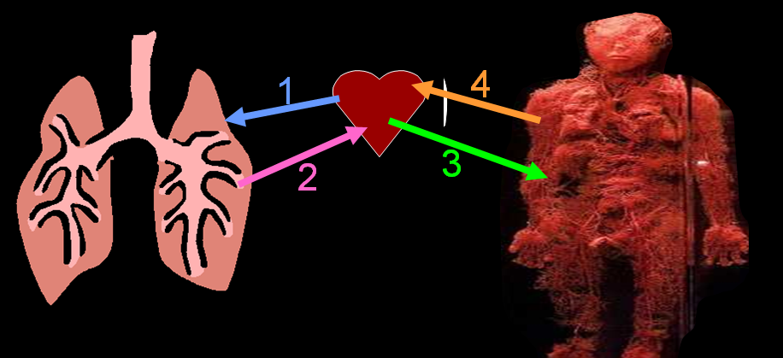
6
What is the correct order that blood travels from the list below? Answer…
A.) Oxygen rich blood travels from the body to the lungs, to the heart.
B.) Oxygen poor blood travels to the body, then the heart, and then to the lungs.
C.) Blood rarely travels to all regions of the body.
D.) Oxygen rich blood travels from the lungs to the heart, to the body, back to the heart, and then to the lungs.
Copyright © 2024 SlideSpark .LLC

Slide 113
Which side is oxygenated, and which side is deoxygenated?
A
B

Slide 114
Which side is oxygenated, and which side is deoxygenated?
A
B

Slide 115
Which side is oxygenated, and which side is deoxygenated?
A
B
Deoxygenated

Slide 116
Which side is oxygenated, and which side is deoxygenated?
A
B
Deoxygenated

Slide 117
Which side is oxygenated, and which side is deoxygenated?
A
Oxygenated
B
Deoxygenated

Slide 118
Which of the following diagrams is correct for blood flow through the heart?
8
A
Lungs
Body
B
Lungs
Body
Body
Body
Lungs
Lungs
C
Lungs
Lungs
D
Lungs
Body
Lungs
Body
Body
Lungs
Copyright © 2024 SlideSpark .LLC

Slide 119
Which of the following diagrams is correct for blood flow through the heart?
8
A
Lungs
Body
B
Lungs
Body
Body
Body
Lungs
Lungs
C
Lungs
Lungs
D
Lungs
Body
Lungs
Body
Body
Lungs
Copyright © 2024 SlideSpark .LLC

Slide 120
Which of the following diagrams is correct for blood flow through the heart?
8
A
Lungs
Body
B
Lungs
Body
Body
Body
Lungs
Lungs
C
Lungs
Lungs
D
Lungs
Body
Lungs
Body
Body
Lungs
Copyright © 2024 SlideSpark .LLC

Slide 121
Which of the following diagrams is correct for blood flow through the heart?
8
A
Lungs
Body
B
Lungs
Body
Body
Body
Lungs
Lungs
C
Lungs
Lungs
D
Lungs
Body
Lungs
Body
Body
Lungs
Copyright © 2024 SlideSpark .LLC

Slide 122
Which of the following diagrams is correct for blood flow through the heart?
8
A
Lungs
Body
B
Lungs
Body
Body
Body
Lungs
Lungs
C
Lungs
Lungs
D
Lungs
Body
Lungs
Body
Body
Lungs
Copyright © 2024 SlideSpark .LLC

Slide 123
Which of the following diagrams is correct for blood flow through the heart? Answer is…
8
A
Lungs
Body
B
Lungs
Body
Body
Body
Lungs
Lungs
C
Lungs
Lungs
D
Lungs
Body
Lungs
Body
Body
Lungs
Copyright © 2024 SlideSpark .LLC

Slide 124
Which of the following diagrams is correct for blood flow through the heart? Answer is…
8
A
Lungs
Body
B
Lungs
Body
Body
Body
Lungs
Lungs
C
Lungs
Lungs
D
Lungs
Body
Lungs
Body
Body
Lungs
Copyright © 2024 SlideSpark .LLC

Slide 125
One the next slide. Please name A, B, C, D behind door number #3.
Copyright © 2024 SlideSpark .LLC

Slide 126
A
9
B
C
D

Slide 127
A
9
B
C
D

Slide 128
A
9
B
C
D

Slide 129
A
9
B
C
D

Slide 130
A
9
B
C
D

Slide 131
A
9
B
C
D

Slide 132
A
9
B
C
D

Slide 133
A
9
B
C
D

Slide 134
A
9
B
C
D

Slide 135
One the next slide. Please name A, B, C, D behind door number #2.
10
Copyright © 2024 SlideSpark .LLC

Slide 136
A
B
C
D
10

Slide 137
A
B
C
D
10

Slide 138
A
B
C
D
10

Slide 139
A
B
C
D
10

Slide 140
A
B
C
D
10

Slide 141
A
B
C
D
10

Slide 142
A
B
C
D
10

Slide 143
A
B
C
D
10

Slide 144
A
B
C
D
10

Slide 145
Circulatory System Review Game
THERE AND BACK AGAIN | LUB-DUB | HEART FELT | RED HOT | -BONUS- VALENTINES
1 | 6 | 11 | 16 | *21
2 | 7 | 12 | 17 | *22
3 | 8 | 13 | 18 | *23
4 | 9 | 14 | 19 | *24
5 | 10 | 15 | 20 | *25
Final Question:________________
Copyright © 2024 SlideSpark .LLC

Slide 146
Circulatory System Review Game
THERE AND BACK AGAIN | LUB-DUB | HEART FELT | RED HOT | -BONUS- VALENTINES
1 | 6 | 11 | 16 | *21
2 | 7 | 12 | 17 | *22
3 | 8 | 13 | 18 | *23
4 | 9 | 14 | 19 | *24
5 | 10 | 15 | 20 | *25
Final Question:________________
Copyright © 2024 SlideSpark .LLC

Slide 147
Hint

Slide 148
11
Please name A, B, C, D
B
A
1
1
2
3
2
C
D

Slide 149
11
Please name A, B, C, D
B
A
C
D

Slide 150
11
Please name A, B, C, D
B
A
C
D

Slide 151
11
Please name A, B, C, D
B
A
C
D

Slide 152
11
Please name A, B, C, D
B
A
C
D

Slide 153
11
Please name A, B, C, D
B
A
C
D

Slide 154

11
Please name A, B, C, D
B
A
C
D

Slide 155
11
Please name A, B, C, D
B
A
C
D

Slide 156
11
Please name A, B, C, D
B
A
C
D

Slide 157
11
Please name A, B, C, D
B
A
C
D

Slide 158
12

Slide 159
12

Slide 160
12
Septum

Slide 161
Please name A, B, and C. Which one carries blood with depleted oxygen levels?
13
C
A
B
Copyright © 2024 SlideSpark .LLC

Slide 162
Please name A, B, and C. Which one carries blood with depleted oxygen levels?
Answers are…
13
C
A
B
Copyright © 2024 SlideSpark .LLC

Slide 163
Please name A, B, and C. Which one carries blood with depleted oxygen levels?
13
C
A
B
Copyright © 2024 SlideSpark .LLC

Slide 164
Please name A, B, and C. Which one carries blood with depleted oxygen levels?
13
C
A
Vein
B
Copyright © 2024 SlideSpark .LLC

Slide 165
Please name A, B, and C. Which one carries blood with depleted oxygen levels?
13
C
A
Vein
B
To heart

Slide 166
Please name A, B, and C. Which one carries blood with depleted oxygen levels?
13
C
A
Vein
B
To heart
Copyright © 2024 SlideSpark .LLC

Slide 167
Please name A, B, and C. Which one carries blood with depleted oxygen levels?
13
C
A
Vein
Artery
B
To heart
Copyright © 2024 SlideSpark .LLC

Slide 168
Please name A, B, and C. Which one carries blood with depleted oxygen levels?
13
C
A
Vein
Artery
B
To heart
From Heart
Copyright © 2024 SlideSpark .LLC

Slide 169
Please name A, B, and C. Which one carries blood with depleted oxygen levels?
13
C
A
Vein
Artery
B
To heart
From Heart
Copyright © 2024 SlideSpark .LLC

Slide 170
Please name A, B, and C. Which one carries blood with depleted oxygen levels?
13
Capillary
C
A
Vein
Artery
B
To heart
From Heart
Copyright © 2024 SlideSpark .LLC

Slide 171
Please name A, B, and C. Which one carries blood with depleted oxygen levels?
13
Capillary
Gas Exchange
C
A
Vein
Artery
B
To heart
From Heart
Copyright © 2024 SlideSpark .LLC

Slide 172
Please name A, B, and C. Which one carries blood with depleted oxygen levels?
13
Capillary
Gas Exchange
C
A
Vein
Artery
B
To heart
From Heart
Copyright © 2024 SlideSpark .LLC
Copyright © 2024 SlideSpark .LLC

Slide 173
Please name A, B, and C. Which one carries blood with depleted oxygen levels?
13
Capillary
Gas Exchange
C
A
Vein
Artery
B
To heart
From Heart
Copyright © 2024 SlideSpark .LLC

Slide 174
Please name A, B, and C. Which one carries blood with depleted oxygen levels?
13
Capillary
Gas Exchange
Low
Pressure
C
High
Pressure
A
Vein
Artery
B
To heart
From Heart
Copyright © 2024 SlideSpark .LLC

Slide 175
Please name A, B, and C. Which one carries blood with depleted oxygen levels?
13
Capillary
Gas Exchange
Low
Pressure
C
High
Pressure
A
Vein
Artery
B
To heart
From Heart
Copyright © 2024 SlideSpark .LLC

Slide 176
14
Please name the four components of blood based on the pictures below?
Copyright © 2024 SlideSpark .LLC

Slide 177
14
Please name the four components of blood based on the pictures below?
A
Copyright © 2024 SlideSpark .LLC

Slide 178
14
Please name the four components of blood based on the pictures below?
A
B
Copyright © 2024 SlideSpark .LLC

Slide 179
14
Please name the four components of blood based on the pictures below?
A
C
B
Copyright © 2024 SlideSpark .LLC

Slide 180
14
Please name the four components of blood based on the pictures below?
A
D
C
B
Copyright © 2024 SlideSpark .LLC

Slide 181
14
Please name the four components of blood based on the pictures below? Answers…
A
D
C
B
Copyright © 2024 SlideSpark .LLC

Slide 182
14
Please name the four components of blood based on the pictures below? Answers…
A
D
C
B
Copyright © 2024 SlideSpark .LLC

Slide 183
14
Please name the four components of blood based on the pictures below? Answers…
A
Red Blood Cells
D
C
B
Copyright © 2024 SlideSpark .LLC

Slide 184
14
Please name the four components of blood based on the pictures below? Answers…
A
Red Blood Cells
D
C
B
Copyright © 2024 SlideSpark .LLC

Slide 185
14
Please name the four components of blood based on the pictures below? Answers…
A
Red Blood Cells
D
C
B
White Blood Cells
Copyright © 2024 SlideSpark .LLC

Slide 186
14
Please name the four components of blood based on the pictures below? Answers…
A
Red Blood Cells
D
C
B
White Blood Cells
Copyright © 2024 SlideSpark .LLC

Slide 187
14
Please name the four components of blood based on the pictures below? Answers…
A
Red Blood Cells
D
C
B
Platelets
White Blood Cells
Copyright © 2024 SlideSpark .LLC

Slide 188
14
Please name the four components of blood based on the pictures below? Answers…
A
Red Blood Cells
D
C
B
Platelets
White Blood Cells
Copyright © 2024 SlideSpark .LLC

Slide 189
14
Please name the four components of blood based on the pictures below? Answers…
A
Red Blood Cells
D
C
B
Plasma
Platelets
White Blood Cells
Copyright © 2024 SlideSpark .LLC

Slide 190
Antigen: A substance that when introduced into the body stimulates the production of an antibody.
Antibody: A blood protein produced in response to and counteracting a specific antigen.
Causes clotting in incorrect blood transfusions
15
Y
Y
Y
Y
Invading Blood
Y
Y
Y
Y
Y
Copyright © 2024 SlideSpark .LLC
Y

Slide 191
Antigen: A substance that when introduced into the body stimulates the production of an antibody.
Antibody: A blood protein produced in response to and counteracting a specific antigen.
Causes clotting in incorrect blood transfusions
15
Y
Y
Y
Y
Invading Blood
Y
Y
Y
Y
Y
Copyright © 2024 SlideSpark .LLC
Y

Slide 192
Antigen: A substance that when introduced into the body stimulates the production of an antibody.
Antibody: A blood protein produced in response to and counteracting a specific antigen.
Causes clotting in incorrect blood transfusions
15
Y
Y
Y
Y
Invading Blood
Y
Y
Y
Y
Y
Copyright © 2024 SlideSpark .LLC
Y

Slide 193
Antigen: A substance that when introduced into the body stimulates the production of an antibody.
Antibody: A blood protein produced in response to and counteracting a specific antigen.
Causes clotting in incorrect blood transfusions
15
Y
Y
Y
Y
Invading Blood
Y
Y
Y
Y
Y
Copyright © 2024 SlideSpark .LLC
Y

Slide 194
Antigen: A substance that when introduced into the body stimulates the production of an antibody.
Antibody: A blood protein produced in response to and counteracting a specific antigen.
Causes clotting in incorrect blood transfusions
15
Y
Y
Y
Y
Invading Blood
Y
Y
Y
Y
Y
Copyright © 2024 SlideSpark .LLC
Y

Slide 195
Circulatory System Review Game
THERE AND BACK AGAIN | LUB-DUB | HEART FELT | RED HOT | -BONUS- VALENTINES
1 | 6 | 11 | 16 | *21
2 | 7 | 12 | 17 | *22
3 | 8 | 13 | 18 | *23
4 | 9 | 14 | 19 | *24
5 | 10 | 15 | 20 | *25
Final Question:________________
Copyright © 2024 SlideSpark .LLC

Slide 196
Circulatory System Review Game
THERE AND BACK AGAIN | LUB-DUB | HEART FELT | RED HOT | -BONUS- VALENTINES
1 | 6 | 11 | 16 | *21
2 | 7 | 12 | 17 | *22
3 | 8 | 13 | 18 | *23
4 | 9 | 14 | 19 | *24
5 | 10 | 15 | 20 | *25
Final Question:________________
Copyright © 2024 SlideSpark .LLC

Slide 197
Name the mystery blood type?
16
O-, O+
A+/-
AB+/AB-
?
O-
B+/ B-
Copyright © 2024 SlideSpark .LLC

Slide 198
Name the mystery blood type?
16
O-, O+
A+/-
AB+/AB-
?
O-
B+/ B-
Copyright © 2024 SlideSpark .LLC

Slide 199
Name the mystery blood type?
16
O-, O+
A+/-
AB+/AB-
O-
B+/ B-
O- Negative is the universal donor.
Copyright © 2024 SlideSpark .LLC

Slide 200
Will the two blood types below = safe transfusion
1
2
B+
AB-
Copyright © 2024 SlideSpark .LLC

Slide 201
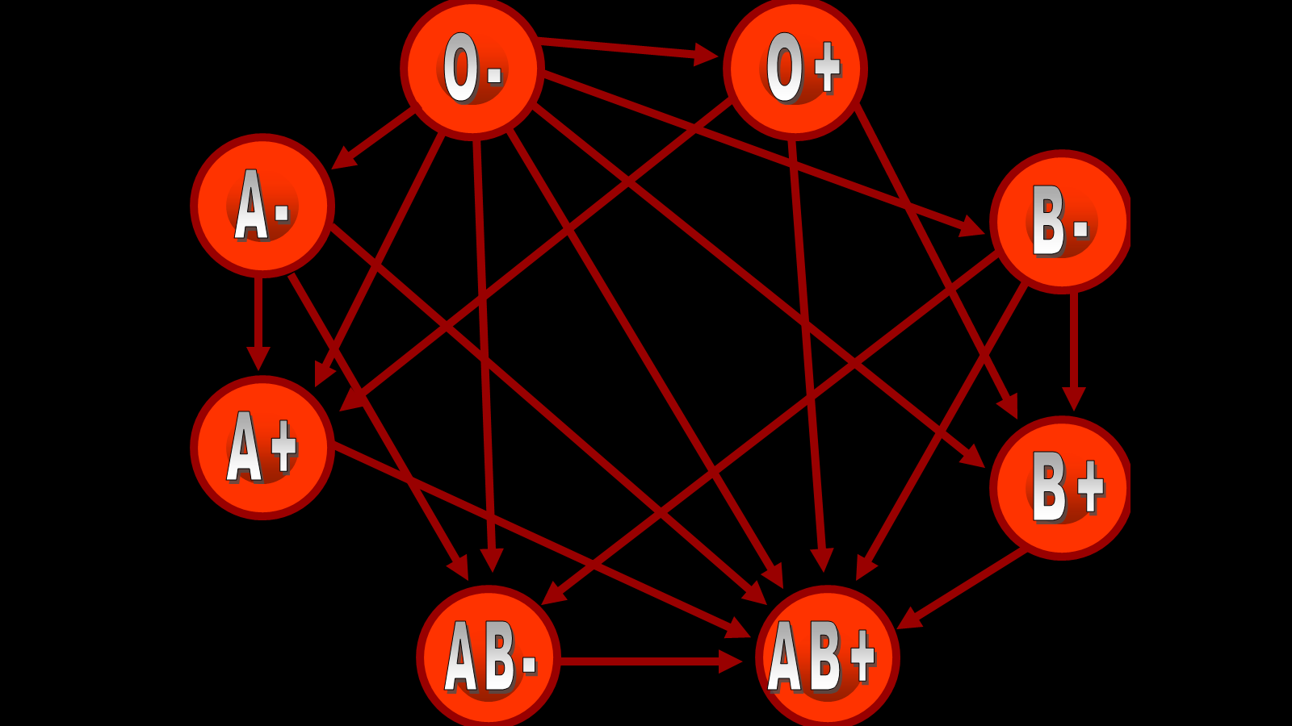
Will the two blood types below = safe transfusion
10
1
2
B+
AB-
Copyright © 2024 SlideSpark .LLC

Slide 202
Will the two blood types below = safe transfusion
10
1
2
B+
AB-
Copyright © 2024 SlideSpark .LLC

Slide 203
Will the two blood types below = safe transfusion
10
1
2
B+
AB-
Copyright © 2024 SlideSpark .LLC

Slide 204
This system is a part of the circulatory system, comprising a network of vessels that carry a clear fluid called lymph.
18

Slide 205
This system is a part of the circulatory system, comprising a network of vessels that carry a clear fluid called lymph.
18

Slide 206
This system is a part of the circulatory system, comprising a network of vessels that carry a clear fluid called lymph.
Lymph
18

Slide 207
Which is a vessel, and
which is a node?
A
B
19

Slide 208
Which is a vessel, and
which is a node?
A
B
19

Slide 209
Which is a vessel, and
which is a node?
A
B
19

Slide 210
Which is a vessel, and
which is a node?
A
B
19

Slide 211
Which is a vessel, and
which is a node?
A
B
19

Slide 212
Which is a vessel, and
which is a node?
A
B
19

Slide 214
“Each part of the Lymphatic System is worth one point.”

Slide 215
“Get Ready.”

Slide 216
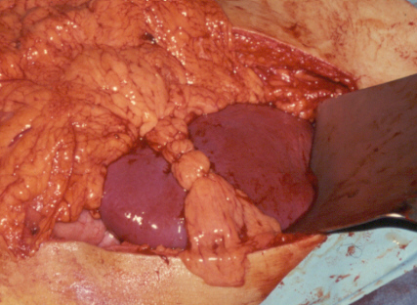
?

Slide 217
?
Spleen

Slide 219
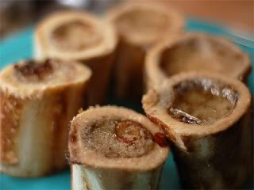

Slide 220
Bone Marrow

Slide 221
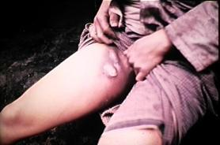
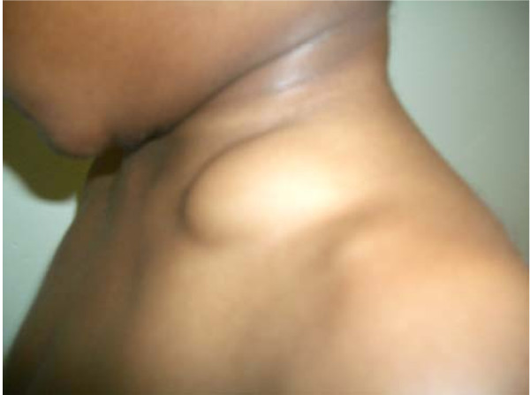
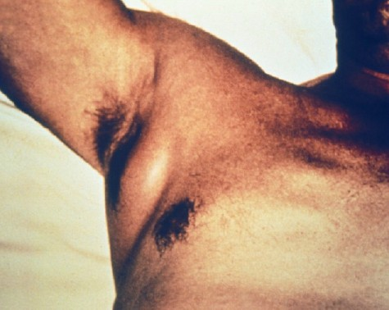

Slide 222
Lymph Nodes (Swollen)

Slide 224
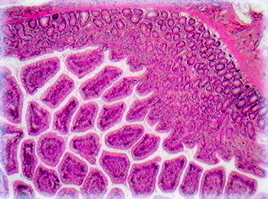

Slide 225
Peyer's Patches

Slide 227
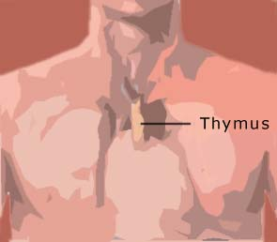

Slide 230
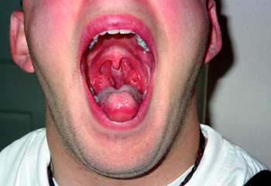

Slide 231
Tonsils

Slide 233
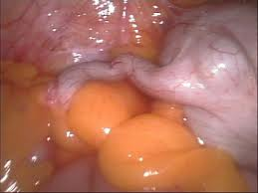

Slide 234
Appendix

Slide 235
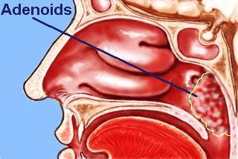

Slide 238
Circulatory System Review Game
THERE AND BACK AGAIN | LUB-DUB | HEART FELT | RED HOT | -BONUS- VALENTINES
1 | 6 | 11 | 16 | *21
2 | 7 | 12 | 17 | *22
3 | 8 | 13 | 18 | *23
4 | 9 | 14 | 19 | *24
5 | 10 | 15 | 20 | *25
Final Question:________________
Copyright © 2024 SlideSpark .LLC

Slide 239
Circulatory System Review Game
THERE AND BACK AGAIN | LUB-DUB | HEART FELT | RED HOT | -BONUS- VALENTINES
1 | 6 | 11 | 16 | *21
2 | 7 | 12 | 17 | *22
3 | 8 | 13 | 18 | *23
4 | 9 | 14 | 19 | *24
5 | 10 | 15 | 20 | *25
Final Question:________________
Copyright © 2024 SlideSpark .LLC

Slide 240
*21
How many first dates?

Slide 241
*21
How many first dates?

Slide 242
*21
How many first dates? 50

Slide 243
Name this movie with so much heart?
*22

Slide 244
Name this movie with so much heart?
*22
answer is…

Slide 245

Name this movie with so much heart?
*22
answer is…

Slide 246
*23
Name this movie?

Slide 247
*23
Name this movie?
answer…

Slide 248

*23
Name this movie?
answer…

Slide 249
Name this town?
*24

Slide 250
Name this town?
*24
answer is…

Slide 251
Name this town?
*24
Quahog
answer is…

Slide 252
Name this movie?
*25

Slide 253
Name this movie?
*25
answer is…

Slide 254

Name this movie?
*25
answer is…

Slide 255
Circulatory System Review Game
THERE AND BACK AGAIN | LUB-DUB | HEART FELT | RED HOT | -BONUS- VALENTINES
1 | 6 | 11 | 16 | *21
2 | 7 | 12 | 17 | *22
3 | 8 | 13 | 18 | *23
4 | 9 | 14 | 19 | *24
5 | 10 | 15 | 20 | *25
Final Question:________________
Copyright © 2024 SlideSpark .LLC

Slide 256
Circulatory System Review Game
THERE AND BACK AGAIN | LUB-DUB | HEART FELT | RED HOT | -BONUS- VALENTINES
1 | 6 | 11 | 16 | *21
2 | 7 | 12 | 17 | *22
3 | 8 | 13 | 18 | *23
4 | 9 | 14 | 19 | *24
5 | 10 | 15 | 20 | *25
Final Question:________________
Copyright © 2024 SlideSpark .LLC

Slide 257
This is a 5 point wager
question

Slide 258
This is a 5 point wager
question

Slide 259
Please name A and B?
A
B

Slide 260
Please name A and B?
A
B
answer is…

Slide 261
Please name A and B?
A
Vena Cava
B
answer is…

Slide 262
Please name A and B?
A
Superior
Vena Cava
B
answer is…

Slide 263
Please name A and B?
A
Superior
Vena Cava
Inferior
B
answer is…

Slide 264
Please name A and B?
Upper Body
A
Superior
Vena Cava
Inferior
B
Lower Body
answer is…

Slide 265

PowerPoint Review Game
1-20 = 5 points each
20-25 = Bonus (1 point each)
Final Question = 5 point wager
Find the Owl = 1 point
Copyright © 2024 SlideSpark .LLC

Slide 266
Circulatory System
Review Game
and Lymphatic
Part 6
Lesson 9

Slide 267



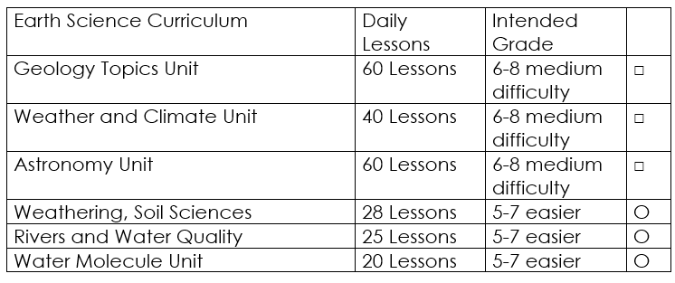

Curriculum Guide
Number of Lessons in each unit (50 min, daily lessons) and difficult rating scale / intended grade level.
=Easier, = More difficult, =Most difficult
Earth Science Units

Slide 268


Life Science Units

Slide 269

Physical Science

Slide 270

Dear Valued Educator,
Our fully editable .pptx and .doc resources are perfect for educators looking to bring enthusiasm and creativity to their lessons. We encourage you to make changes to fit your needs and style. As science educators, we’re committed to providing students with the tools they need to succeed in the classroom and beyond. Each unit in the curriculum includes a range of resources that have been developed through extensive research and use in a busy classroom. Our teaching approach is designed to make science education engaging and exciting for learners of all ages. We offer a one-of-a-kind science curriculum that will challenge, inspire, and educate students to become tomorrow's scientists and leaders. Join us today and learn more about how our program can help you achieve your classroom goals.
With appreciation,
Support@SlideSpark.net

Slide 271





Thank you for your time and interest in our Science curriculum. We strive to provide students with engaging and informative lessons that will spark their curiosity and encourage scientific exploration. Should you have any questions or concerns, please do not hesitate to contact us. Thank you again for considering our curriculum, and we wish you all the best in your educational journey.
Sincerely,
Support@slidespark.net
SlideSpark Science on TpT

