Slide 1
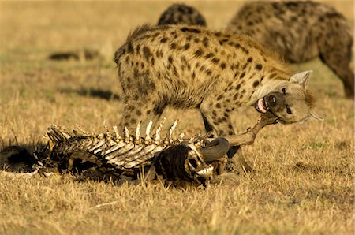


Feeding Levels
Part 1 Lesson 3

Slide 2
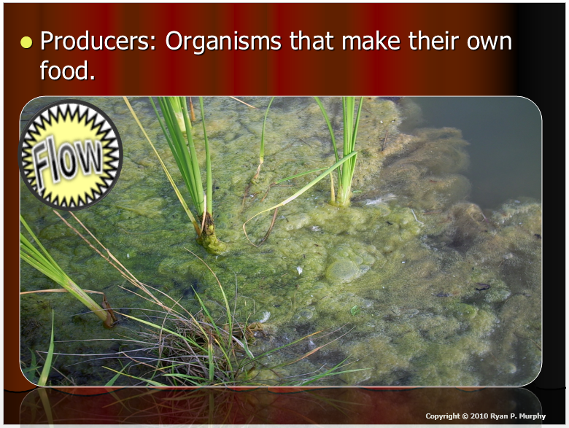
RED SLIDE: These slides contain critical notes and important fill-in the blanks. Please record the important terms in your work bundle.
First and last Name
Science, Grade, Class

Slide 3
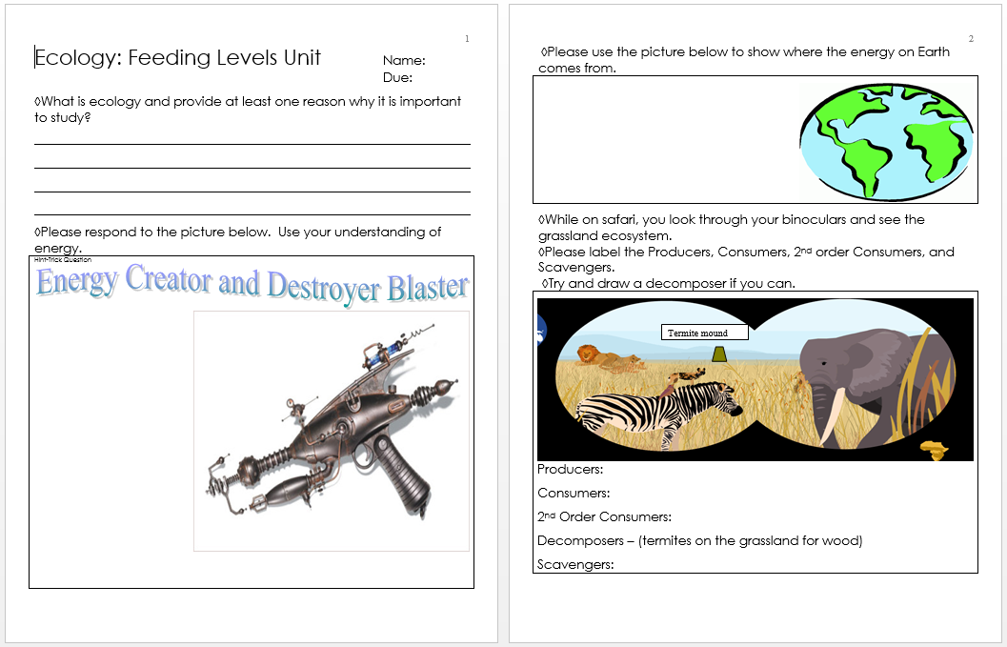
RED SLIDE: These slides contain critical notes and important fill-in the blanks. Please record the important terms in your work bundle.
  You’ll need these notes to complete the work bundle
First and last Name
Science, Grade, Class

Slide 4
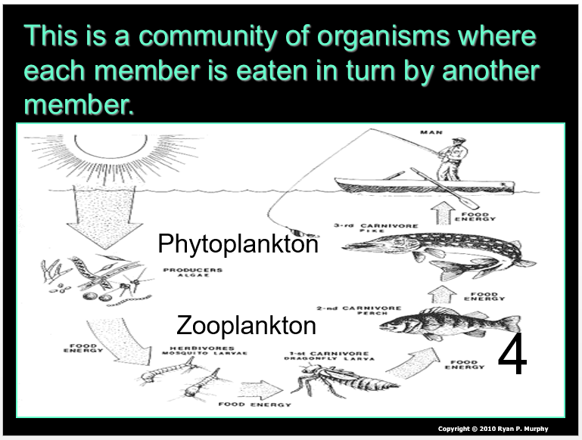
RED SLIDE: These slides contain critical notes and important fill-in the blanks. Please record the important terms in your work bundle.
  You’ll need these notes to complete the work bundle and to be successful on the review game.
First and last Name
Science, Grade, Class

Slide 5

Listen to the teacher and others.
Please no
shout outs.
One speaker at a
time. Please
raise your
hand.
Respect
First,
Last,
and Always.
Safety
Make
Good
Choices
Be Present
Never
Give
Up!
Responsibility
Stay
Organized
Help
Others
Focus on
Task completion
Avoid
Distractions
Science from Murf LLC

Slide 6


Huge
ENERGY!

Slide 7
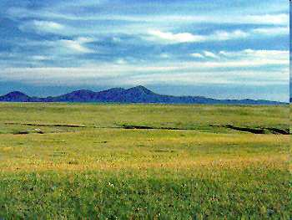
Producers (Plants)
Energy comes from sun.
Huge
ENERGY!

Slide 8
Producers (Plants)
What if we gathered
all of the plants
and burned them?

Slide 9
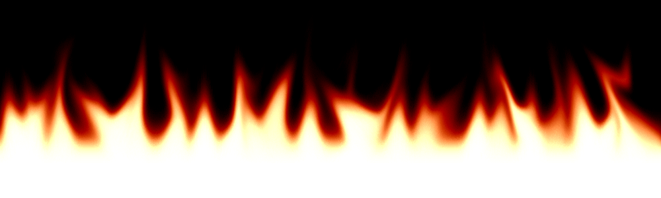
Producers (Plants)
What if we gathered
all of the plants
and burned them?
Big Fire!
Copyright © 2010 Ryan P. Murphy

Slide 10


Consumers
Producers (Plants)

Slide 11
Consumers
Producers (Plants)
What we collected all
of the bunnies and
burned them?

Slide 12
Consumers
Producers (Plants)
That’s sick. I’m not doing that…
What we collected all
of the bunnies and
burned them?

Slide 13
Consumers
Producers (Plants)
That’s sick. I’m not doing that…
A Much Smaller
Fire.
What we collected all
of the bunnies and
burned them?
Copyright © 2010 Ryan P. Murphy

Slide 14

2nd Order Consumers have even less.
Consumers
Producers (Plants)
Energy comes from sun.

Slide 15
Consumers
Producers (Plants)
Energy comes from sun.
2nd Order Consumers

Slide 16
Consumers
Producers (Plants)
Energy comes from sun.
2nd Order Consumers
What if we burned
all of the snakes?
Copyright © 2010 Ryan P. Murphy

Slide 17
Consumers
Producers (Plants)
Energy comes from sun.
2nd Order Consumers
Very small fire
What if we burned
all of the snakes?
Copyright © 2010 Ryan P. Murphy

Slide 18

3rd Order Consumers are even less.
Consumers
Producers (Plants)
Energy comes from sun.
2nd Order Consumers

Slide 19
Consumers
Producers (Plants)
Energy comes from sun.
2nd Order Consumers
3rd Order Consumers

Slide 20
Consumers
Producers (Plants)
Energy comes from sun.
2nd Order Consumers
3rd Order Consumers
What if we burned all
of the coyotes?
Copyright © 2010 Ryan P. Murphy

Slide 21
Consumers
Producers (Plants)
Energy comes from sun.
2nd Order Consumers
3rd Order Consumers
What if we burned all
of the coyotes?
Very small Fire

Slide 22
4th Even Less.
Consumers
Producers (Plants)
Energy comes from sun.
2nd Order Consumers
3rd Order Consumers

Slide 23
Consumers
Producers (Plants)
Energy comes from sun.
2nd Order Consumers
3rd Order Consumers
4th Order Consumers
Copyright © 2010 Ryan P. Murphy

Slide 24
Very Little available Energy
Consumers
Producers (Plants)
Energy comes from sun.
2nd Order Consumers
3rd Order Consumers
4th Order Consumers
5th Order Consumers

Slide 25
Very Little available Energy
Consumers
Producers (Plants)
Energy comes from sun.
2nd Order Consumers
3rd Order Consumers
4th Order Consumers
5th Order Consumers
Fire
.

Slide 26
Very Little available Energy
ENERGY
Consumers
Producers (Plants)
Energy comes from sun.
2nd Order Consumers
3rd Order Consumers
4th Order Consumers
5th Order Consumers
Fire
.

Slide 27
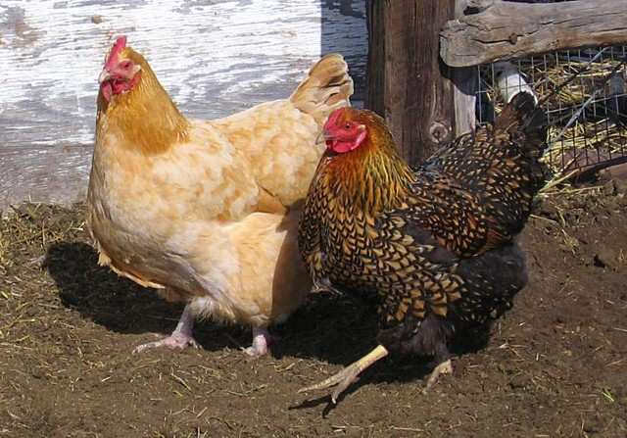
Omnivore: An organism that eats both plants and animals.
Omnivores. Learn more at…
http://www.nhptv.org/natureworks/nwep10b.htm

Slide 28
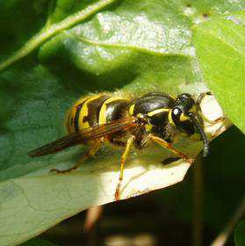
Wasps are omnivores.

Slide 29
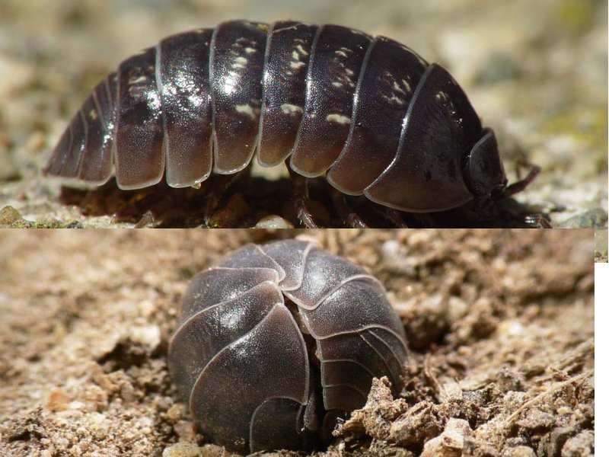
Pillbugs are omnivores.

Slide 30
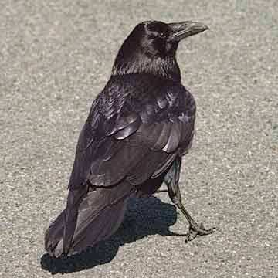
Ravens and crows are omnivores.

Slide 31
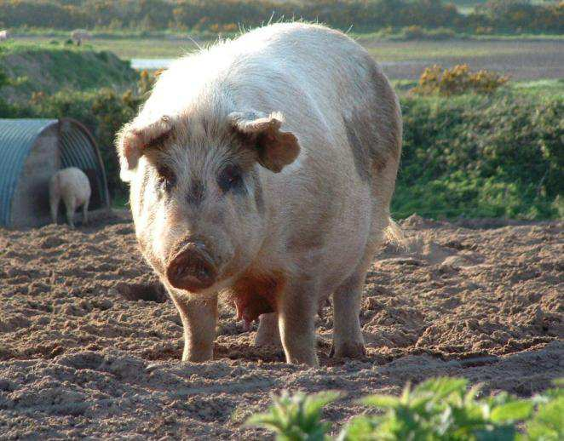
Pigs are omnivores.

Slide 32
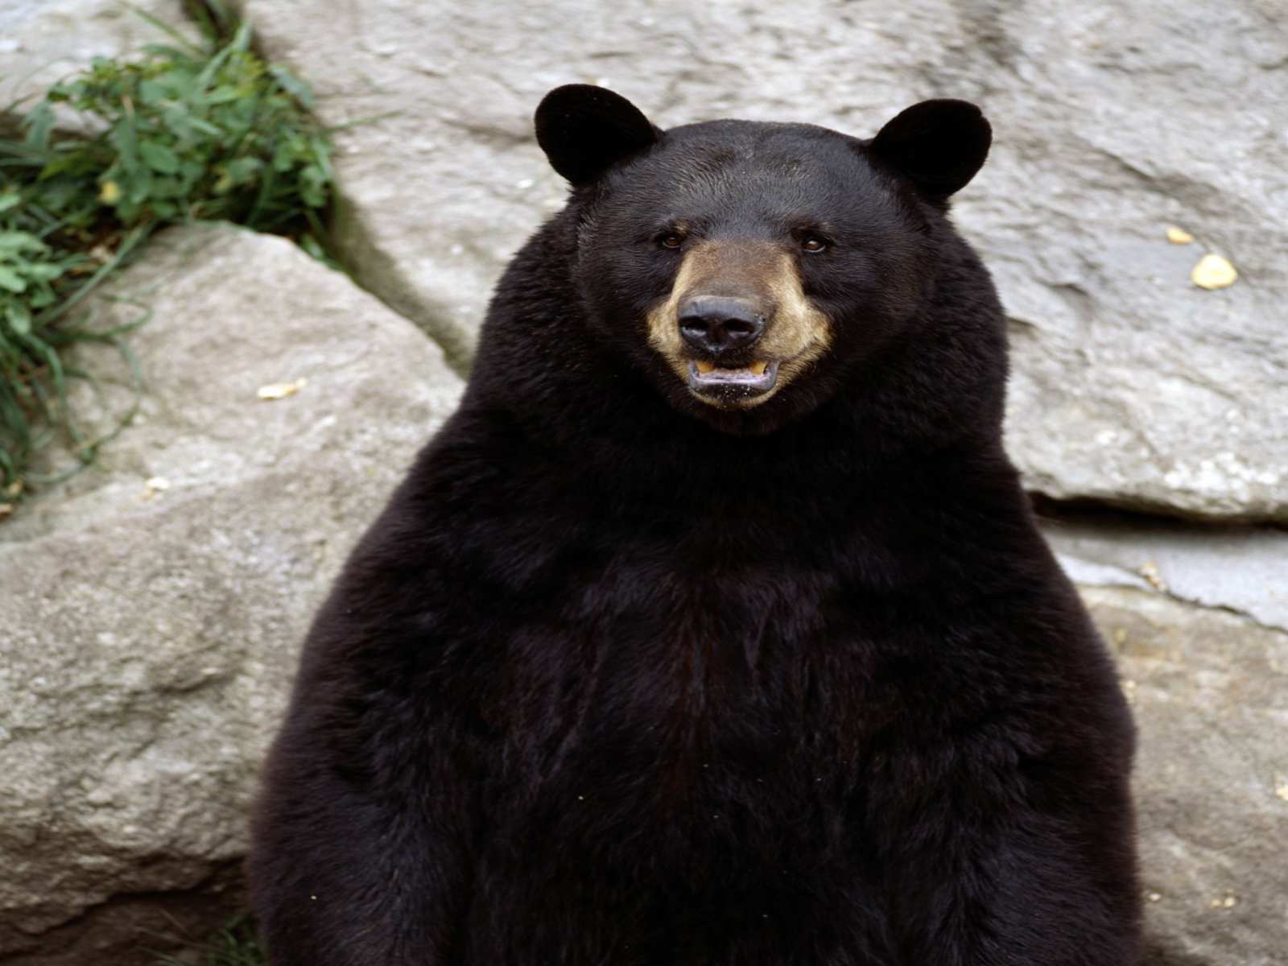
Bears are omnivores.

Slide 33
Activity! Stand up and make the correct letter if the animal is a…

Slide 34
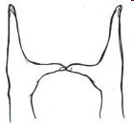
Activity! Stand up and make the correct letter if the animal is a… Herbivore (eats plants),
Herbivore

Slide 35

Activity! Stand up and make the correct letter if the animal is a… Herbivore (eats plants), Carnivore (eats other animals),
Carnivore
Herbivore

Slide 36

Activity! Stand up and make the correct letter if the animal is a… Herbivore (eats plants), Carnivore (eats other animals), or Omnivore (eats both plants and animals)
Carnivore
Herbivore
Omnivore

Slide 37
Activity! Stand up and make the correct letter if the animal is a… Herbivore (eats plants), Carnivore (eats other animals), or Omnivore (eats both plants and animals)
  Take your best guess.
Carnivore
Herbivore
Omnivore

Slide 38
Activity! Stand up and make the correct letter if the animal is a… Herbivore (eats plants), Carnivore (eats other animals), or Omnivore (eats both plants and animals)
  Take your best guess. (No worries if wrong)
Carnivore
Herbivore
Omnivore

Slide 39
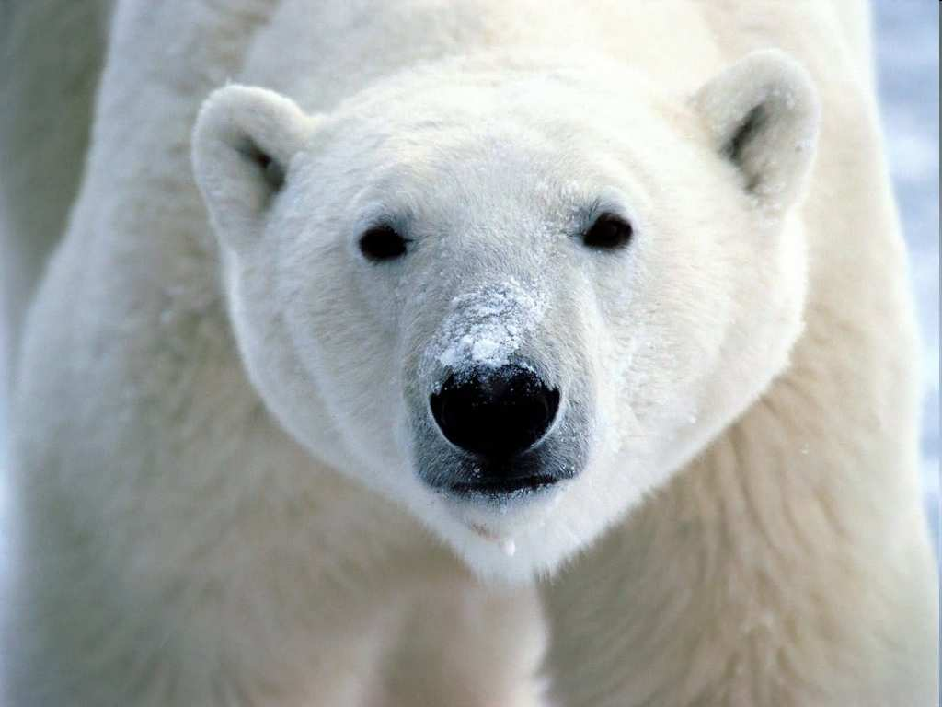
1

Slide 40
Carnivore
1

Slide 41
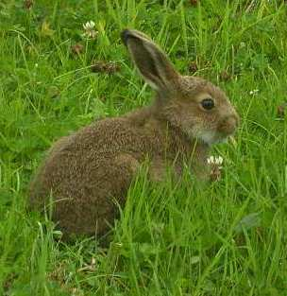
2

Slide 42
Herbivore
2

Slide 43
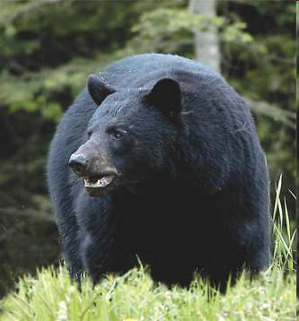
3

Slide 44
Omnivore
3

Slide 45
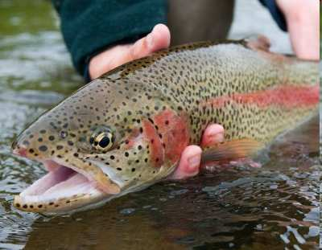
4

Slide 46
Carnivore
4

Slide 47
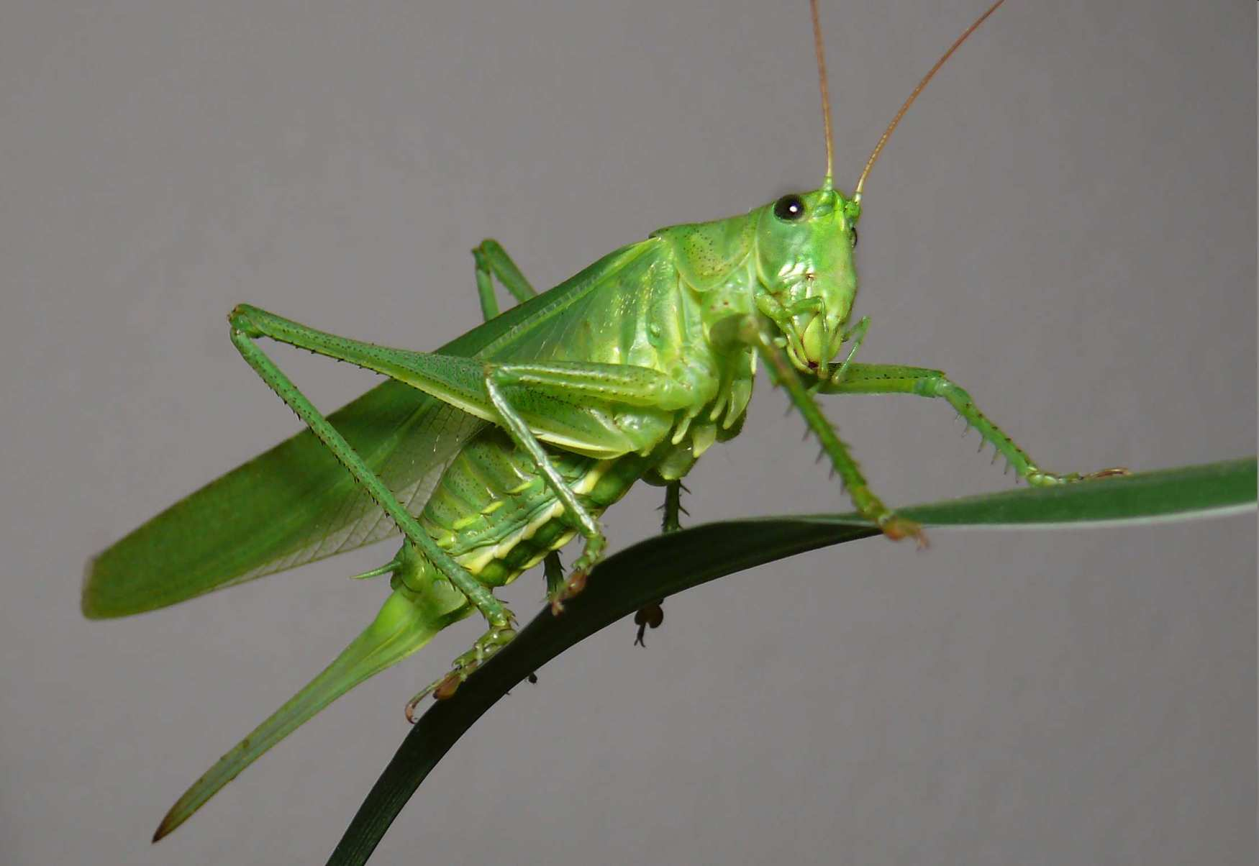
5

Slide 48
Herbivore
5

Slide 49
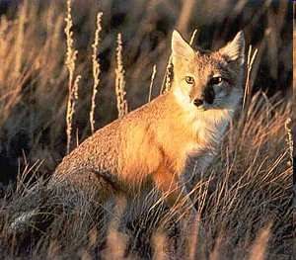
6

Slide 50
Carnivore
6

Slide 51
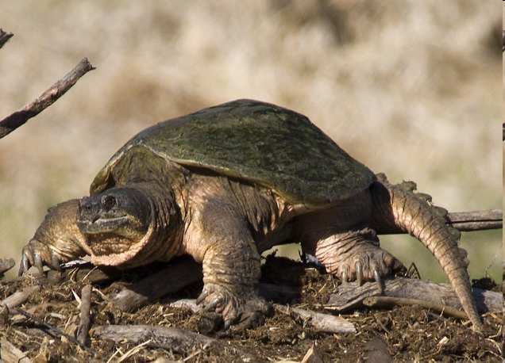
7

Slide 52
Omnivore
7

Slide 53
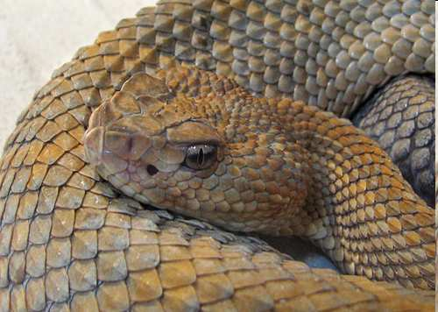
8

Slide 54
Carnivore
8

Slide 55
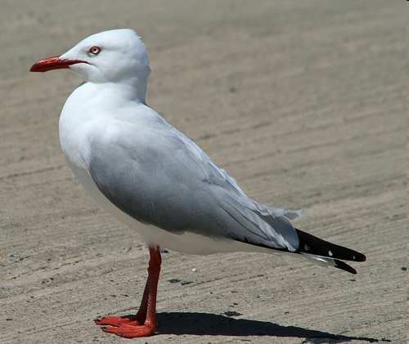
9

Slide 56
Omnivore
9

Slide 57
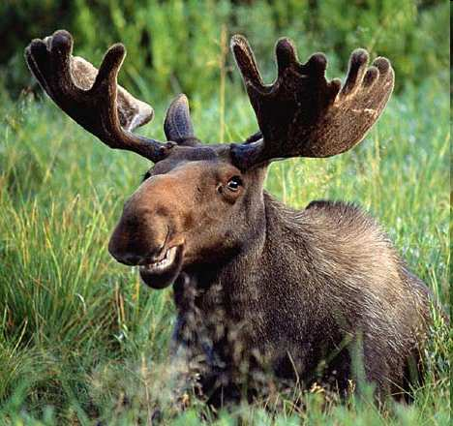
10

Slide 58
Herbivore
10

Slide 59

Bonus Question: Who is this Omnivore?

Slide 60
Bonus Question: Who is this Omnivore?
Jim Carrey

Slide 61
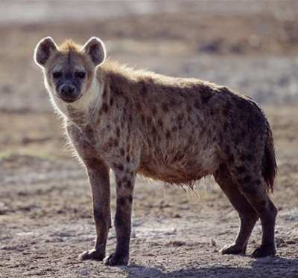
Opportunistic: Eat everything + scavenge.

Slide 62
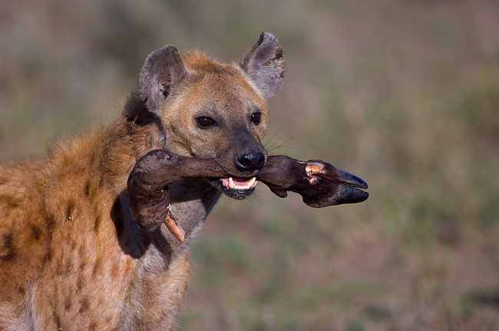
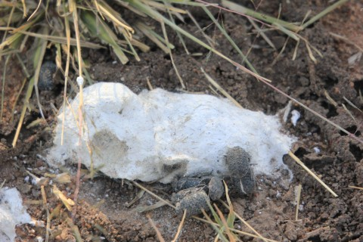
Opportunistic: Eat everything + scavenge.
White Scat
b/c they
will eat bones.

Slide 63
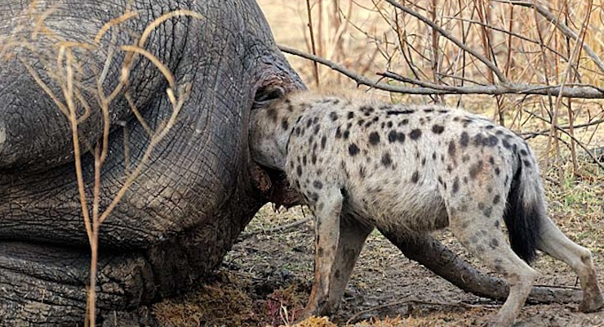
Hyena are opportunistic and will eat most everything.

Slide 64
Hyena are opportunistic and will eat most everything.
?

Slide 65
Hyena are opportunistic and will eat most everything.

Slide 66
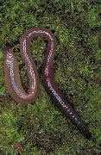
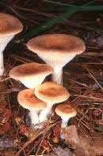
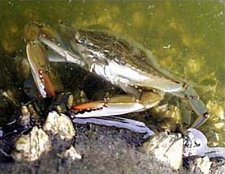
Decomposer: Organisms that feed on organic matter.
  -
  -

Slide 67
Decomposer: Organisms that feed on organic matter.
  Called Detritivores
  -

Slide 68



Decomposer: Organisms that feed on organic matter.
  Called Detritivores
  Return nutrients to soil. (Nutrient Pool)
?
?

Slide 69

Decomposer: Organisms that feed on organic matter.
  Called Detritivores
  Return nutrients to soil. (Nutrient Pool)
?

Slide 70
Decomposer: Organisms that feed on organic matter.
  Called Detritivores
  Return nutrients to soil. (Nutrient Pool)
?

Slide 71
Decomposer: Organisms that feed on organic matter.
  Called Detritivores
  Return nutrients to soil. (Nutrient Pool)

Slide 72
Decomposer: Organisms that feed on organic matter.
  Called Detritivores
  Return nutrients to soil. (Nutrient Pool)
Decomposers. Learn more at.. http://www.nhptv.org/natureworks/nwep11b.htm

Slide 73
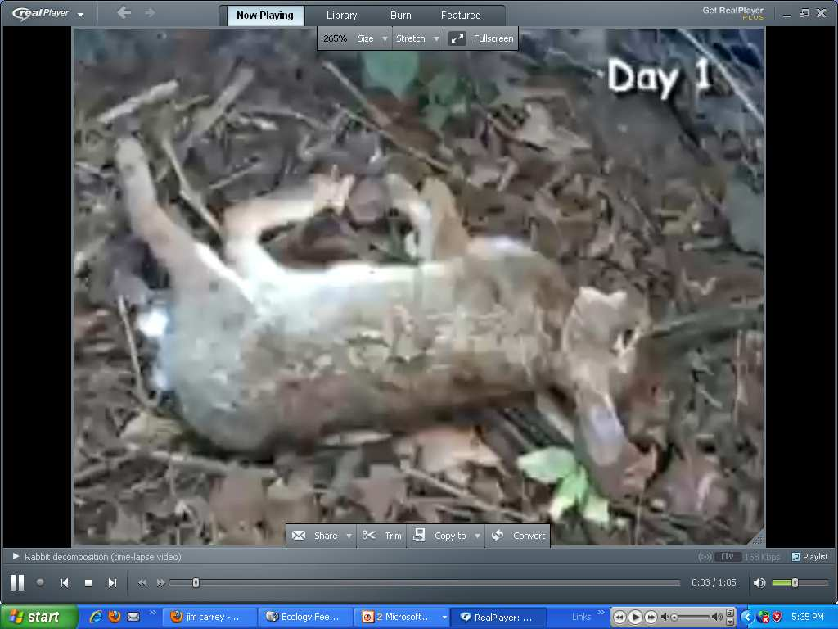

Video! Time lapse decomposition of a rabbit.
  http://www.youtube.com/watch?v=C6sFP_7Vezg

Slide 74
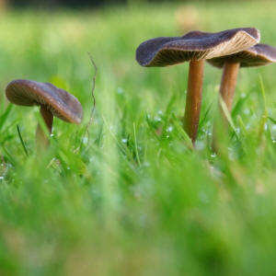

Slide 75
What is below ground?

Slide 79
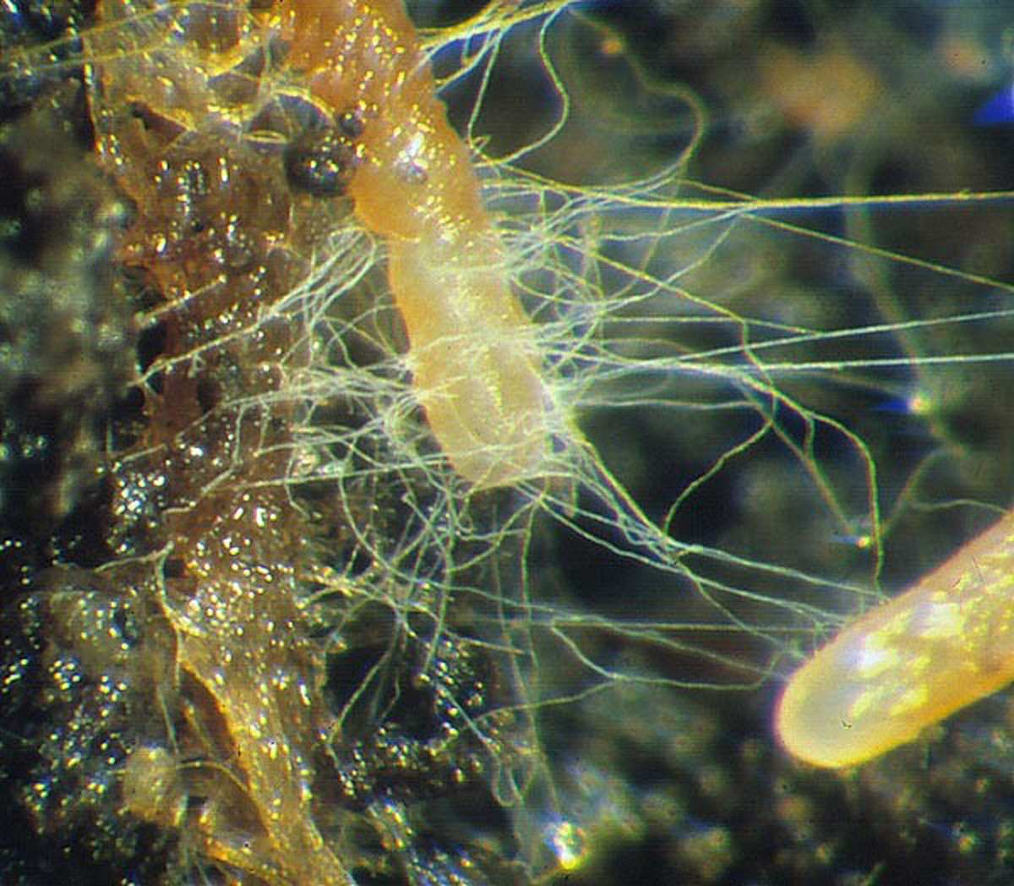
Fungus breaks down organic molecules and helps return those nutrients to plants.

Slide 80
Root

Slide 81
Root
Fungal Thread

Slide 82
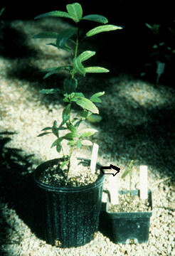
Which plant has helpful Mycorrhizae fungi in the soil providing nutrients to the plant?

Slide 83
The fungi will help the plant absorb valuable nutrients so the plant can grow?

Slide 84
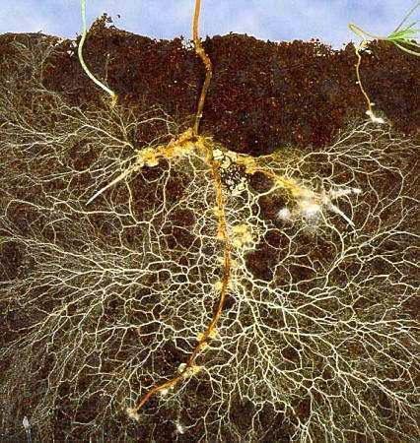
Look how the majority of the this plants roots are connected to the symbiotic fungi.

Slide 85
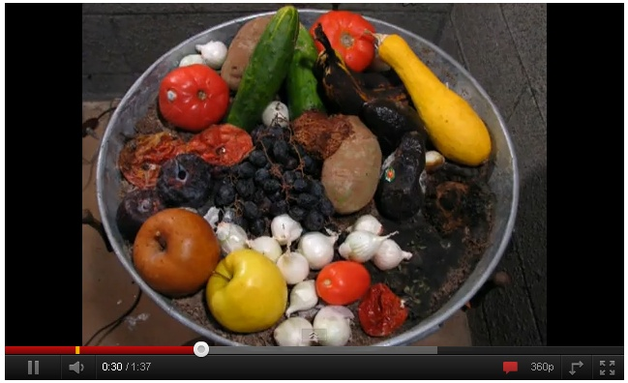
Video Link (Optional) Decomposition of Fruit.
  http://www.youtube.com/watch?v=c0En-_BVbGc

Slide 86
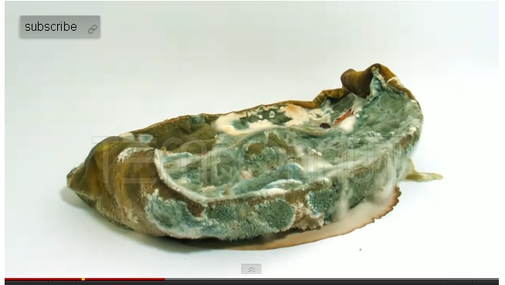
Video Link! (Optional) Reverse Decomposition of a Watermelon
  http://www.youtube.com/watch?v=S12zZhdOckc

Slide 87
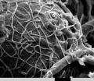
Hyphae / Part of the Mycelium- The part of the fungus that feeds, grows, and ultimately may produce a mushroom.

Slide 88
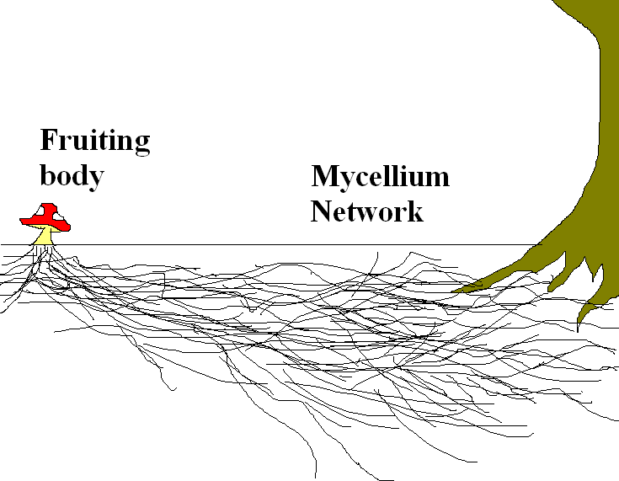

Slide 92
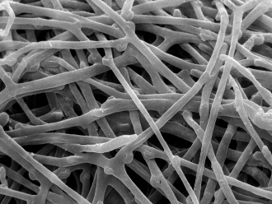

Slide 93
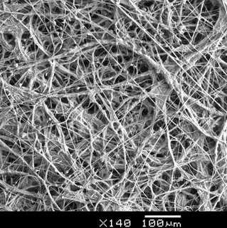
They look for molecules to break down.
Copyright © 2010 Ryan P. Murphy

Slide 94
They look for molecules to break down.

Slide 95
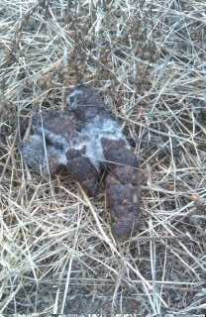
They look for molecules to break down.

Slide 96
They look for molecules to break down.

Slide 97
They look for molecules to break down.
Copyright © 2010 Ryan P. Murphy

Slide 98
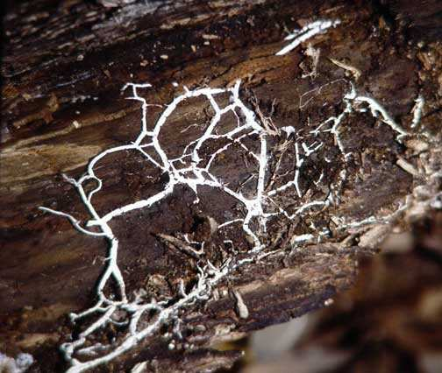
They look for molecules to break down.

Slide 99
They look for molecules to break down.

Slide 100
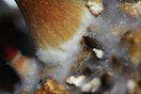
Mushrooms are just the fruiting body (reproductive structure) of the expansive fungi made of mycelium threads.
Mushroom
Mycelium threads

Slide 101
Mushrooms are just the fruiting body (reproductive structure) of the expansive fungi made of mycelium threads.
Mushroom
Mycelium threads
Copyright © 2010 Ryan P. Murphy

Slide 102
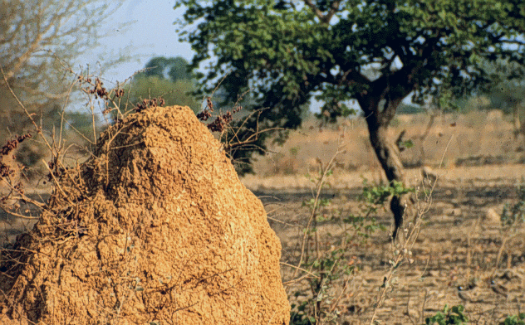
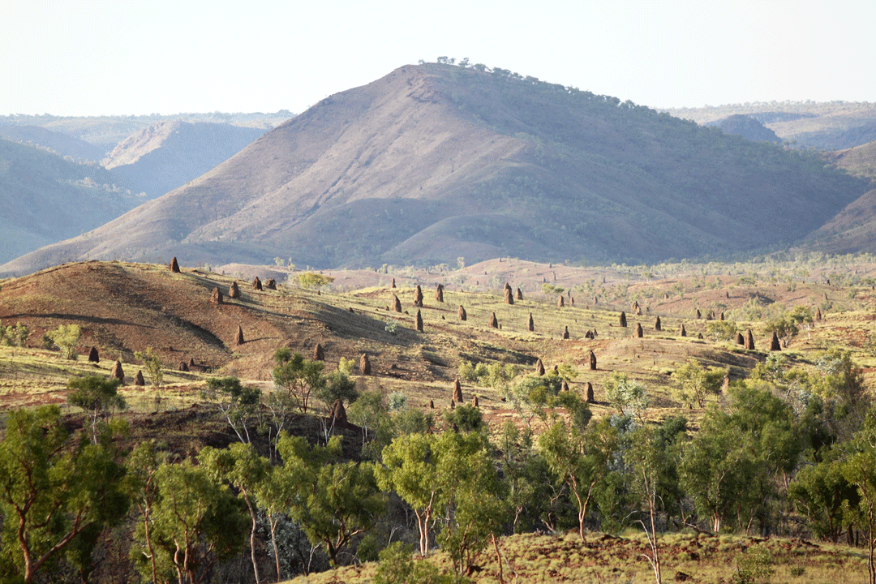
How many mushrooms do we see in this very dry area?

Slide 103
How many mushrooms do we see in this very dry area?
None

Slide 104
How many mushrooms do we see in this very dry area?
None

Slide 105
How many mushrooms do we see in this very dry area?
None
What’s this mound?
Copyright © 2010 Ryan P. Murphy

Slide 106
How many mushrooms do we see in this very dry area?
None
What’s this mound?
Termites
are the primary
decomposer of plants
in dry / arid areas

Slide 107
How many mushrooms do we see in this very dry area?
None
What’s this mound?
Termites
are the primary
decomposer of plants
in dry / arid areas

Slide 108
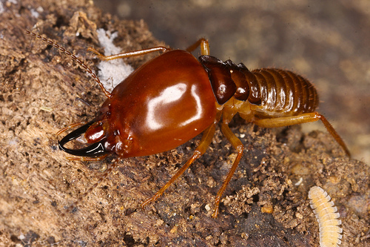
How many mushrooms do we see in this very dry area?
None
What’s this mound?
Termites
are the primary
decomposer of plants
in dry / arid areas

Slide 109
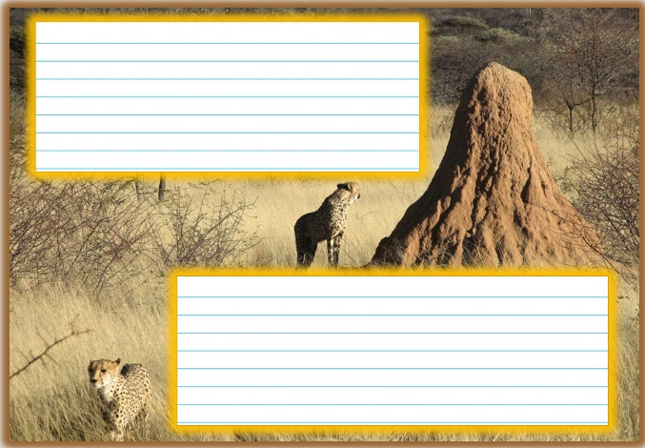
Termite Mounds
  https://www.youtube.com/watch?v=PHNrRtlBu6M

Slide 110
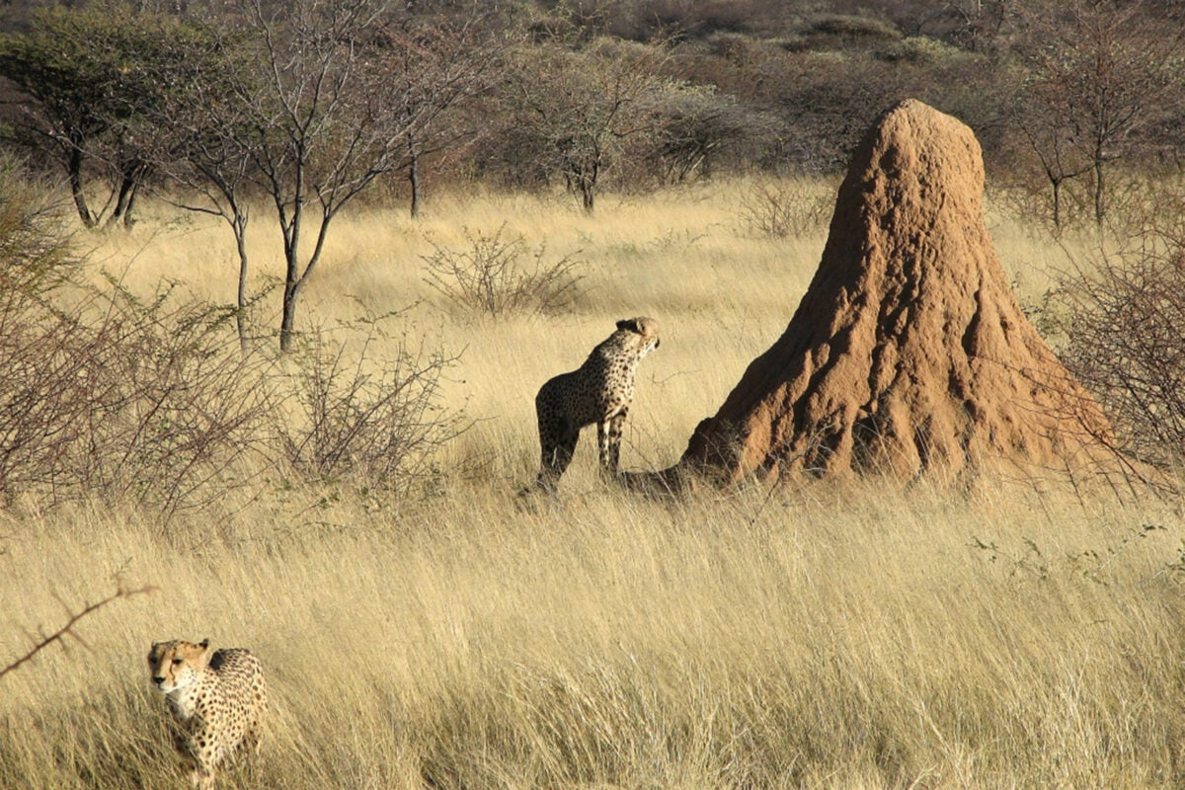


Slide 111
Termites are decomposers; they break down plant fibers. Their role is important in forests, where they break down fallen trees that are decaying.

Slide 112
Termites are decomposers; they break down plant fibers. Their role is important in forests, where they break down fallen trees that are decaying.
This allows new trees to grow and is an important part of the circle of life for a forest. Termites also tunnel in the soil and a food source to other animals

Slide 113
While looking through your binoculars you see this.
◊Please label the Producers, Consumers, 2nd Order Consumers, Scavenger, Decomposer
Producer= | Consumer= | Second order Consumer=
Scavenger= | Decomposer= | Bird?=

Slide 114
Feeding Levels
Part 1 Lesson 3

Slide 115



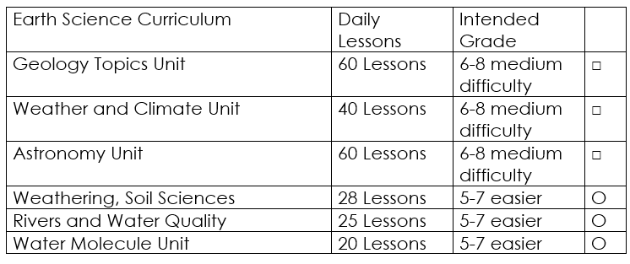

Curriculum Guide
Number of Lessons in each unit (50 min, daily lessons) and difficult rating scale / intended grade level.
=Easier, = More difficult, =Most difficult
Earth Science Units

Slide 116


Life Science Units

Slide 117

Physical Science

Slide 118

Dear Valued Educator,
Our fully editable .pptx and .doc resources are perfect for educators looking to bring enthusiasm and creativity to their lessons. We encourage you to make changes to fit your needs and style. As science educators, we’re committed to providing students with the tools they need to succeed in the classroom and beyond. Each unit in the curriculum includes a range of resources that have been developed through extensive research and use in a busy classroom. Our teaching approach is designed to make science education engaging and exciting for learners of all ages. We offer a one-of-a-kind science curriculum that will challenge, inspire, and educate students to become tomorrow's scientists and leaders. Join us today and learn more about how our program can help you achieve your classroom goals.
With appreciation,
Support@SlideSpark.net

Slide 119





Thank you for your time and interest in our Science curriculum. We strive to provide students with engaging and informative lessons that will spark their curiosity and encourage scientific exploration. Should you have any questions or concerns, please do not hesitate to contact us. Thank you again for considering our curriculum, and we wish you all the best in your educational journey.
Sincerely,
Support@slidespark.net
SlideSpark Science on TpT

