Slide 1
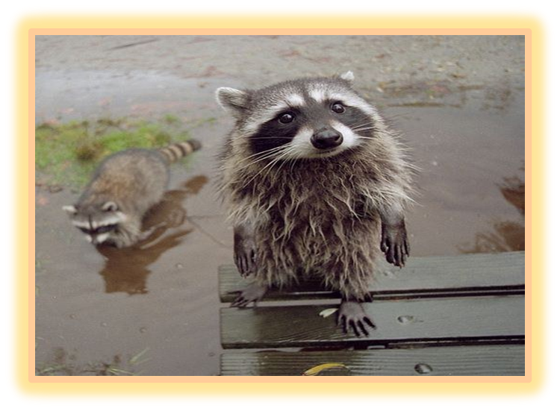

DNA
Inherited vs.
Acquired Traits
Part 1
Lesson 7

Slide 2
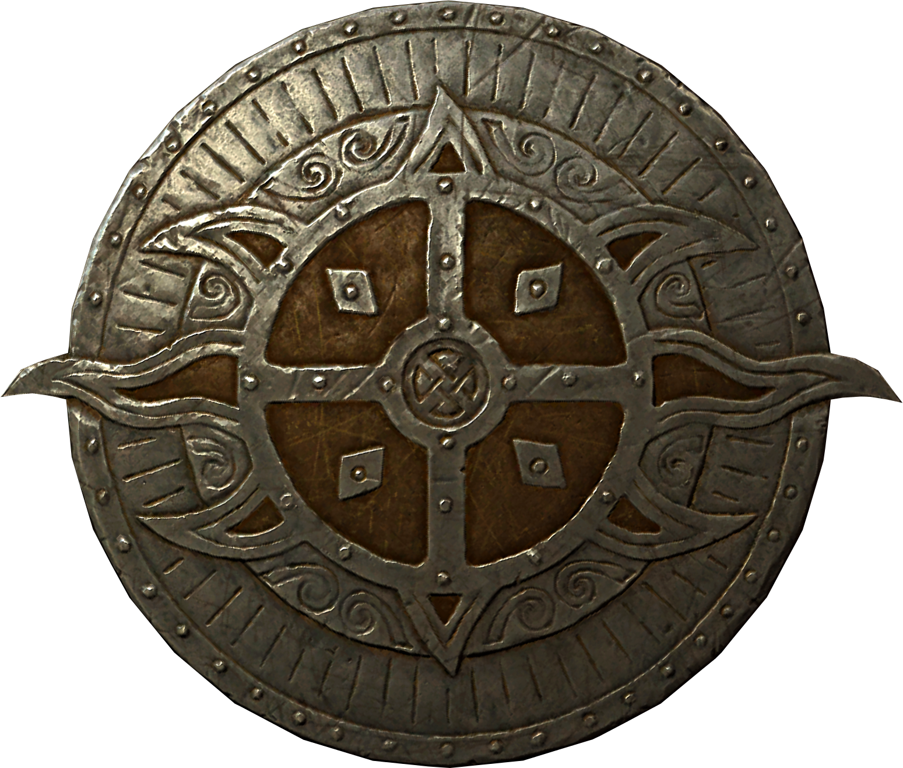
Listen to the teacher and others.
Please no
shout outs.
One speaker at a
time. Please
raise your
hand.
Respect
First,
Last,
and Always.
Safety
Make
Good
Choices
Be Present
Never
Give
Up!
Responsibility
Stay
Organized
Help
Others
Focus on
Task completion
Avoid
Distractions
Science from Murf LLC
Copyright © 2024 SlideSpark .LLC

Slide 3
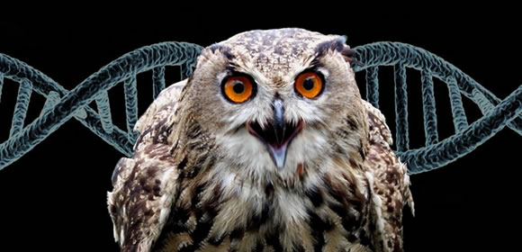


Keep an eye out for “The-Owl” and raise your hand as soon as you see her.
  She’ll be hiding somewhere in the slideshow
Copyright © 2024 SlideSpark .LLC

Slide 4
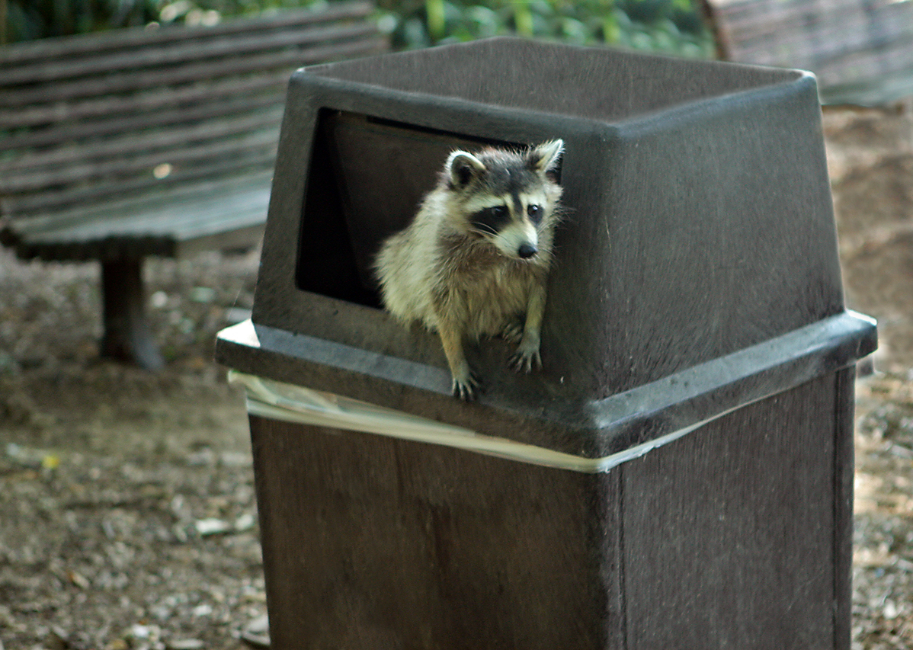
New Mini Area of Focus: Inherited Traits vs. Acquired Traits / Learned Behavior

Slide 5
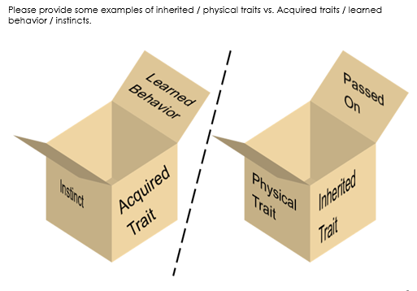

Slide 6
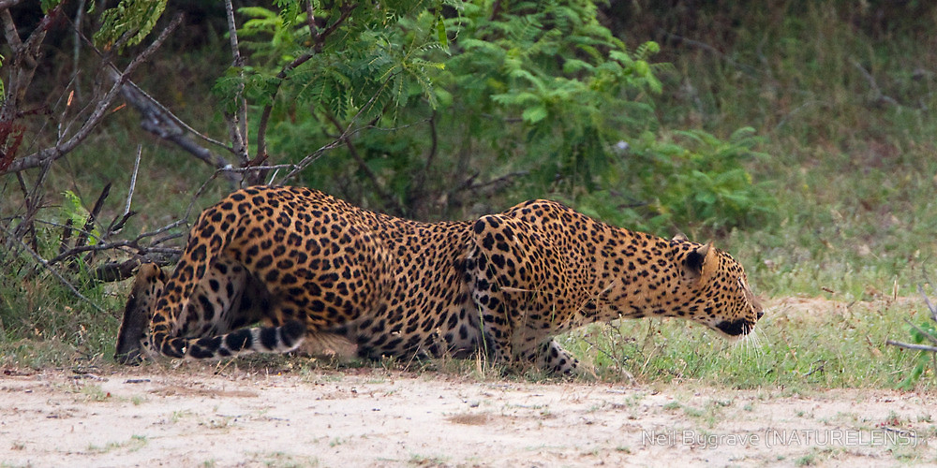
Instinct / learned Behavior. A behavior is a way of acting. Inherited behaviors are called instincts. Learned behaviors are not inherited traits but learned from others.
Copyright © 2024 SlideSpark .LLC

Slide 7
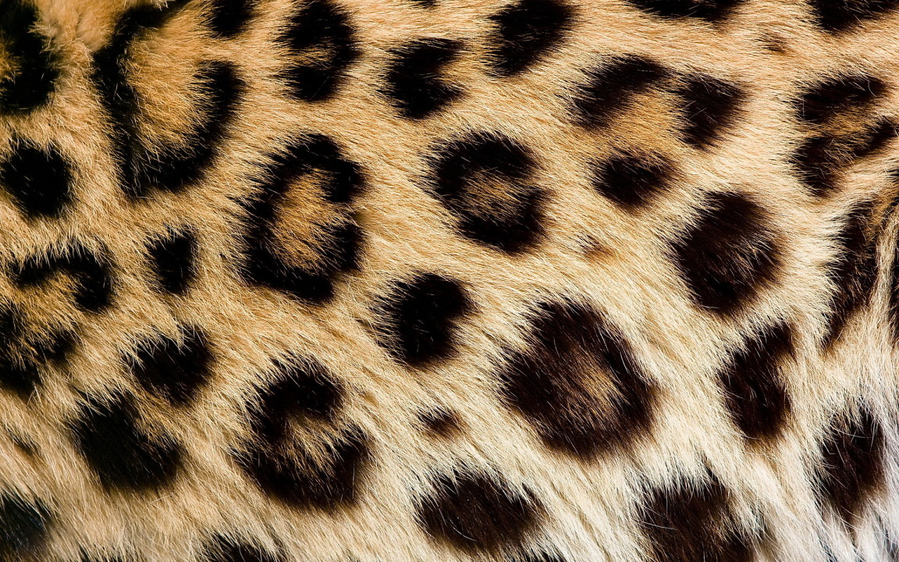
Instinct / learned Behavior. A behavior is a way of acting. Inherited behaviors are called instincts. Learned behaviors are not inherited traits but learned from others.
Inherited Trait: A physical characteristic that is passed from parents to their babies (offspring).
Copyright © 2024 SlideSpark .LLC

Slide 8
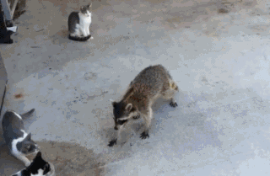
Decide if the picture / information is a learned behavior or inherited trait. 1-10
Copyright © 2024 SlideSpark .LLC

Slide 9
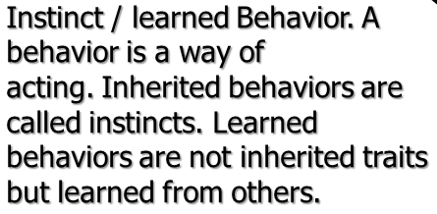
Decide if the picture / information is a learned behavior or inherited trait. 1-10
Learned Behavior
Copyright © 2024 SlideSpark .LLC

Slide 10
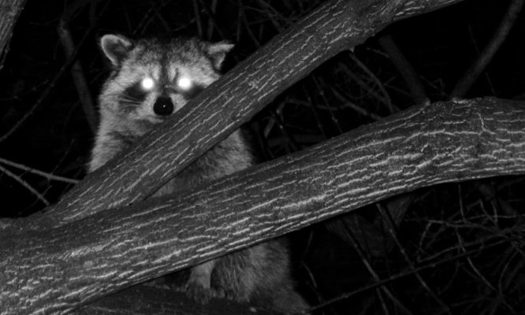
Decide if the picture / information is a learned behavior or inherited trait. 1-10
Good Night Vision
Copyright © 2024 SlideSpark .LLC

Slide 11
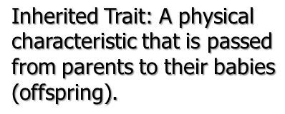
Decide if the picture / information is a learned behavior or inherited trait. 1-10
Good Night Vision
Inherited Trait
Copyright © 2024 SlideSpark .LLC

Slide 12
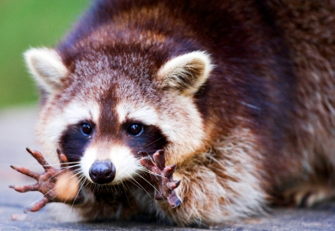
Decide if the picture / information is a learned behavior or inherited trait. 1-10
Paws for gripping
Copyright © 2024 SlideSpark .LLC

Slide 13
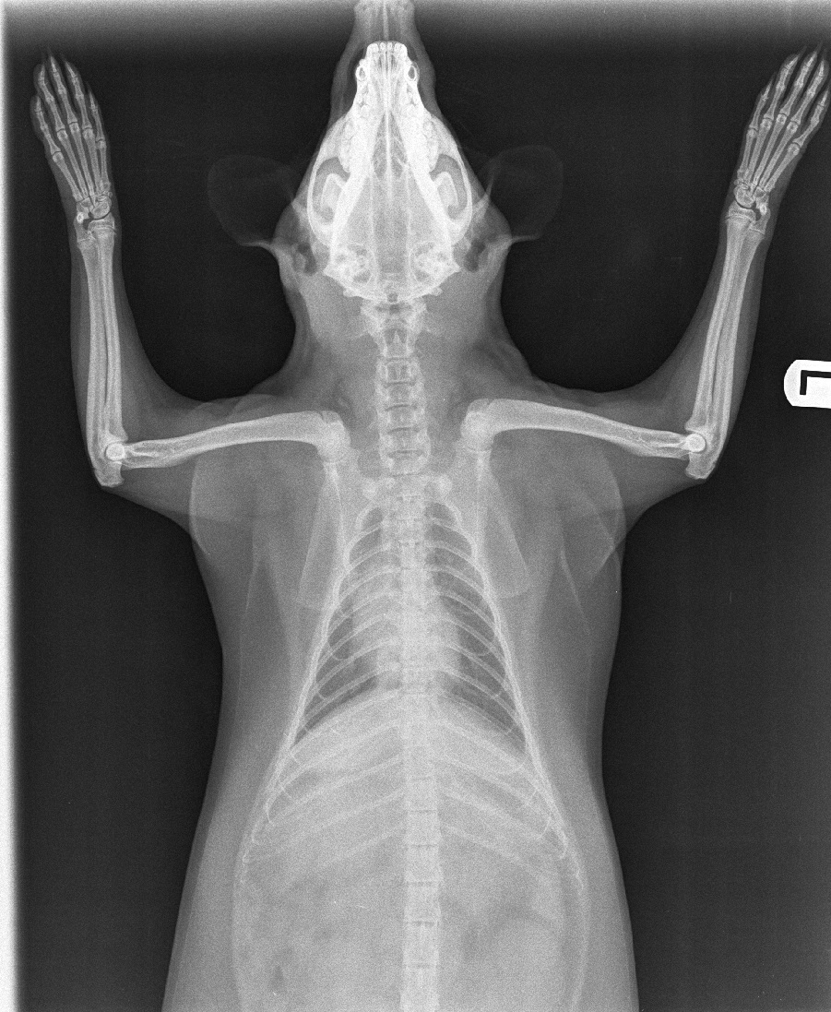
Decide if the picture / information is a learned behavior or inherited trait. 1-10
Paws for gripping
Inherited Trait
Copyright © 2024 SlideSpark .LLC

Slide 14
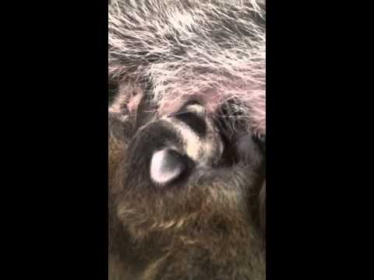
Decide if the picture / information is a learned behavior or inherited trait. 1-10
Raccoon Producing Milk
Copyright © 2024 SlideSpark .LLC

Slide 15
Decide if the picture / information is a learned behavior or inherited trait. 1-10
Raccoon Producing Milk
Inherited Trait
Copyright © 2024 SlideSpark .LLC

Slide 16
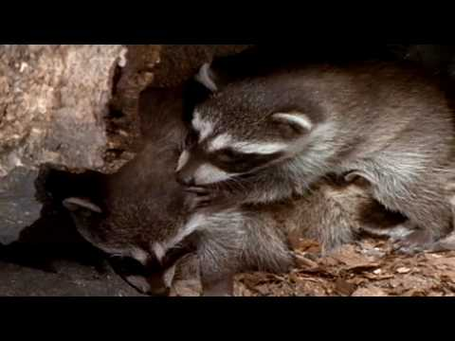
Decide if the picture / information is a learned behavior or inherited trait. 1-10
Raccoon being a good mom
Copyright © 2024 SlideSpark .LLC

Slide 17
Decide if the picture / information is a learned behavior or inherited trait. 1-10
Raccoon being a good mom
Learned Behavior
Copyright © 2024 SlideSpark .LLC

Slide 18
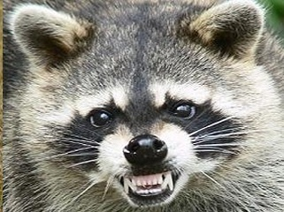

Decide if the picture / information is a learned behavior or inherited trait. 1-10
Raccoon Growling
Copyright © 2024 SlideSpark .LLC

Slide 19
Decide if the picture / information is a learned behavior or inherited trait. 1-10
Raccoon Growling
Copyright © 2024 SlideSpark .LLC

Slide 20
Decide if the picture / information is a learned behavior or inherited trait. 1-10
Raccoon Growling
Learned Behavior
Copyright © 2024 SlideSpark .LLC

Slide 21
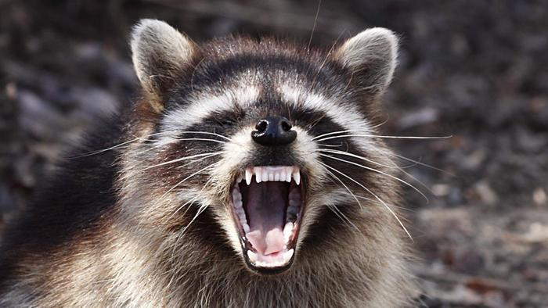
Decide if the picture / information is a learned behavior or inherited trait. 1-10
Sharp Teeth
Copyright © 2024 SlideSpark .LLC

Slide 22
Decide if the picture / information is a learned behavior or inherited trait. 1-10
Sharp Teeth
Inherited Trait
Copyright © 2024 SlideSpark .LLC

Slide 23
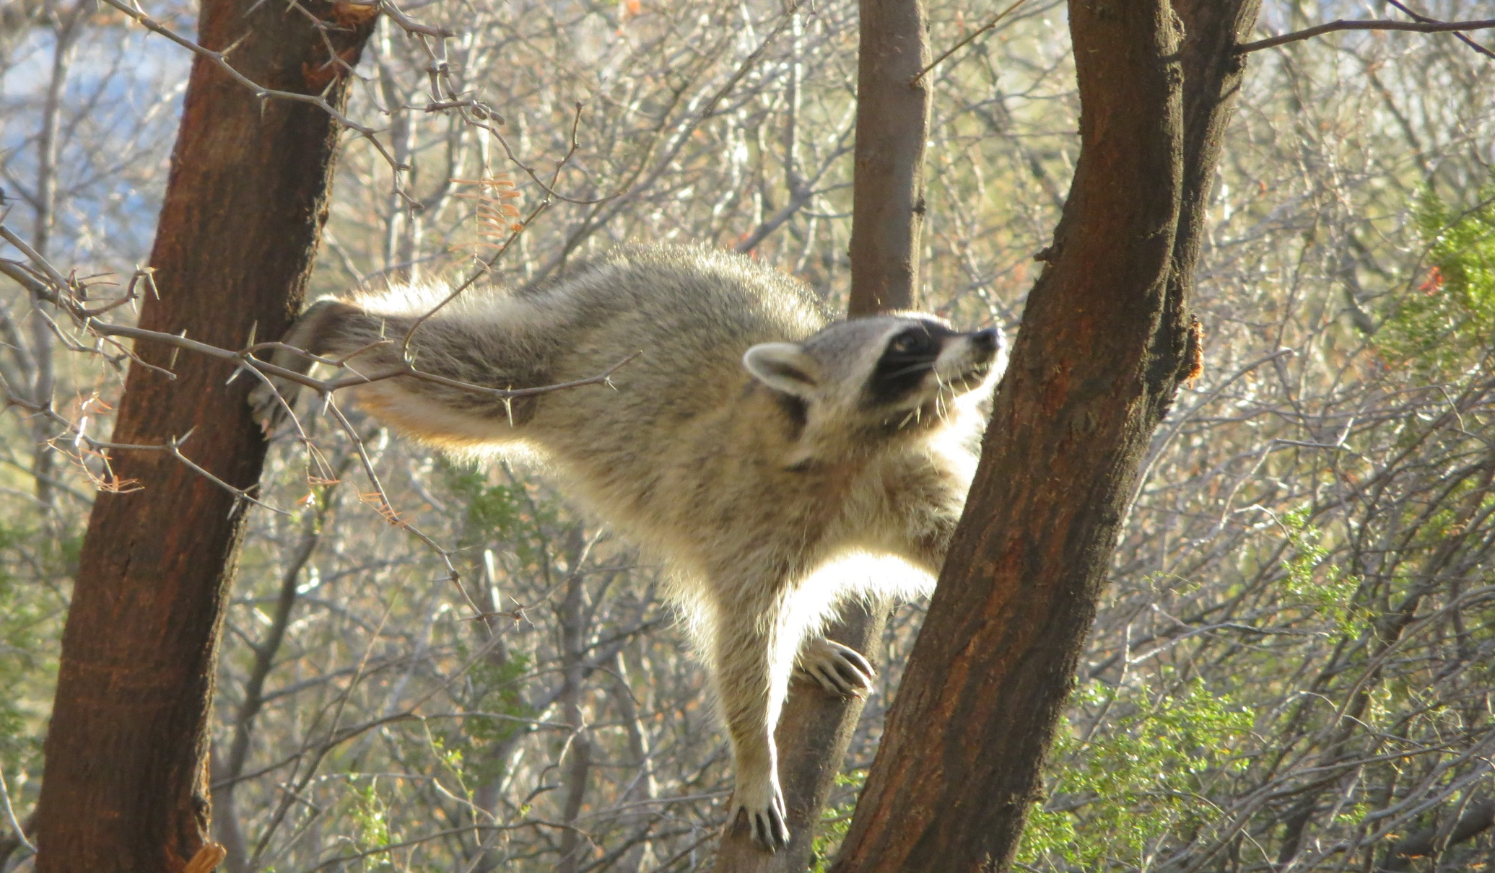
Decide if the picture / information is a learned behavior or inherited trait. 1-10
Good at climbing
Copyright © 2024 SlideSpark .LLC

Slide 24
Decide if the picture / information is a learned behavior or inherited trait. 1-10
Good at climbing
Learned Behavior
Copyright © 2024 SlideSpark .LLC

Slide 25
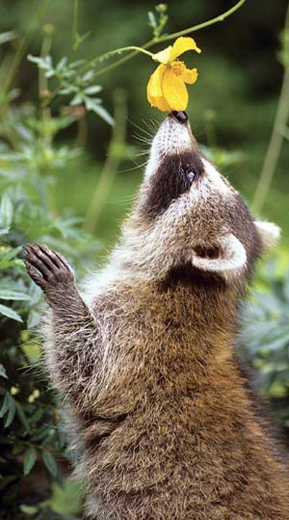
Decide if the picture / information is a learned behavior or inherited trait. 1-10
Good sense
of smell
Copyright © 2024 SlideSpark .LLC

Slide 26
Decide if the picture / information is a learned behavior or inherited trait. 1-10
Good sense
of smell
Inherited Trait
Ability to smell is a trait. But smells will become learned
Copyright © 2024 SlideSpark .LLC

Slide 27
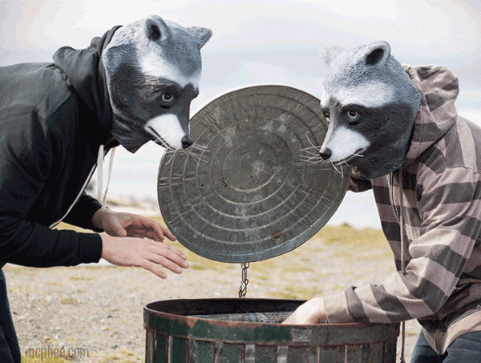
Decide if the picture / information is a learned behavior or inherited trait. 1-10
Good at getting garbage
Copyright © 2024 SlideSpark .LLC

Slide 28
Decide if the picture / information is a learned behavior or inherited trait. 1-10
Good at getting garbage
Learned Behavior
Copyright © 2024 SlideSpark .LLC

Slide 29
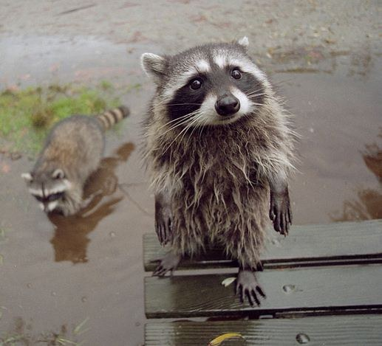
Decide if the picture / information is a learned behavior or inherited trait. 1-10
Hair Color
Copyright © 2024 SlideSpark .LLC

Slide 30
Decide if the picture / information is a learned behavior or inherited trait. 1-10
Hair Color
Inherited Trait
Copyright © 2024 SlideSpark .LLC

Slide 31
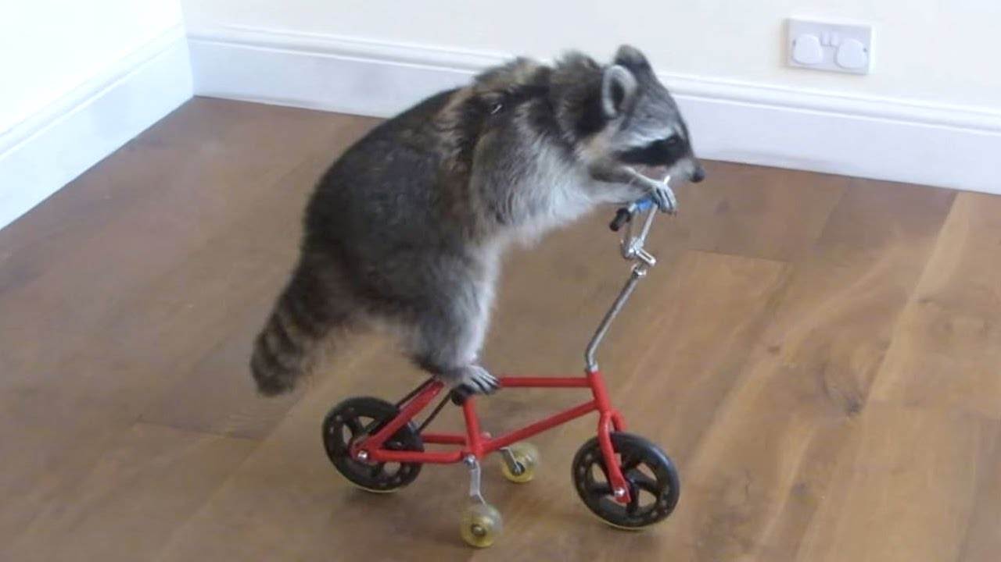
Decide if the picture / information is a learned behavior or inherited trait. 1-10
Ability to ride a bicycle
Copyright © 2024 SlideSpark .LLC

Slide 32
Decide if the picture / information is a learned behavior or inherited trait. 1-10
Ability to ride a bicycle
Learned Behavior
Copyright © 2024 SlideSpark .LLC

Slide 33
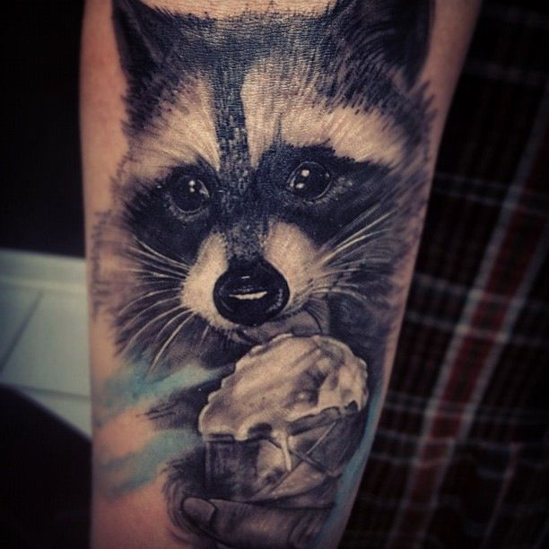
Decide if the picture / information is a learned behavior or inherited trait. 1-10
Raccoon licking an ice cream
cone tattoo on a human
Copyright © 2024 SlideSpark .LLC

Slide 34
Decide if the picture / information is a learned behavior or inherited trait. 1-10
Raccoon licking an ice cream
cone tattoo on a human
Acquired / Learned Behavior
The bigger Question: WHY?
Copyright © 2024 SlideSpark .LLC

Slide 35
An inherited trait is encoded in the DNA. It will be passed down from the parents to the young. Determined before birth.
A learned behavior / acquired trait is developed. It won’t be passed down from parents to offspring in the DNA. It will have to be learned. Determined after birth.
Copyright © 2024 SlideSpark .LLC

Slide 36
An inherited trait is encoded in the DNA. It will be passed down from the parents to the young. Determined before birth.
A learned behavior / acquired trait is developed. It won’t be passed down from parents to offspring in the DNA. It will have to be learned. Determined after birth.
Copyright © 2024 SlideSpark .LLC

Slide 37
An inherited trait is encoded in the DNA. It will be passed down from the parents to the young. Determined before birth.
A learned behavior / acquired trait is developed. It won’t be passed down from parents to offspring in the DNA. It will have to be learned. Determined after birth.
Copyright © 2024 SlideSpark .LLC

Slide 38
An inherited trait is encoded in the DNA. It will be passed down from the parents to the young. Determined before birth.
A learned behavior / acquired trait is developed. It won’t be passed down from parents to offspring in the DNA. It will have to be learned. Determined after birth.
Copyright © 2024 SlideSpark .LLC

Slide 39
An inherited trait is encoded in the DNA. It will be passed down from the parents to the young. Determined before birth.
A learned behavior / acquired trait is developed. It won’t be passed down from parents to offspring in the DNA. It will have to be learned. Determined after birth.
Copyright © 2024 SlideSpark .LLC

Slide 40
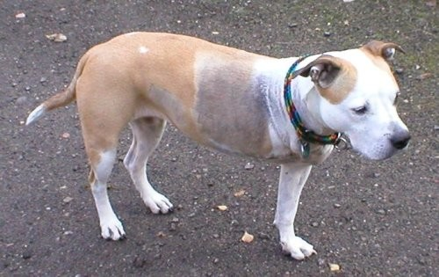
Question. If this dog mates and has puppies will the puppies have a missing leg? Why?
The puppies will not be born with a missing leg as the dog lost its leg in an accident. The DNA will not change as a result of the accident and the puppies will be normal.
Copyright © 2024 SlideSpark .LLC

Slide 41
Question. If this dog mates and has puppies will the puppies have a missing leg? Why?
The puppies will not be born with a missing leg as the dog lost its leg in an accident. The DNA will not change as a result of the accident and the puppies will be normal.
Copyright © 2024 SlideSpark .LLC

Slide 42
Question. If this dog mates and has puppies will the puppies have a missing leg? Why?
The puppies will not be born with a missing leg as the dog lost its leg in an accident. The DNA will not change as a result of the accident and the puppies will be normal.
If this dog were born with three legs as a result of a mutation it more than likely would die (if in the wild) and never pass on this mutation (evolution / survival of the fittest)
Copyright © 2024 SlideSpark .LLC

Slide 44
Being a good
mom
Ability to ride
a bicycle
Good at climbing
Growling
Good at getting
into
garbage

Slide 45
Hair
Color
Paws and
Claws for
Gripping
Being a good
mom
Ability to ride
a bicycle
Sharp Teeth
Good at climbing
Producing Milk
Growling
Night Vision
Good at getting
into
garbage
Sense of
smell
Puppies will not be born with a missing leg

Slide 46
QUICK BIOLOGY
ESSENTIAL

Slide 47
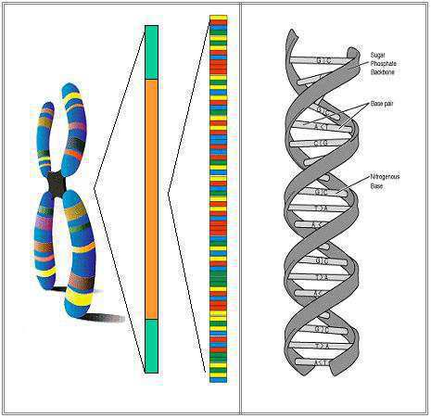
Scientist look at the genes in a DNA molecule (It is in all of our cells).
Copyright © 2024 SlideSpark .LLC

Slide 48
Scientist look at the genes in a DNA molecule (It is in all of our cells).
  DNA provides a unique marker.
Copyright © 2024 SlideSpark .LLC

Slide 49
Scientist look at the genes in a DNA molecule (It is in all of our cells).
  DNA provides a unique marker.
  It shows how similar and how different species are.
Copyright © 2024 SlideSpark .LLC

Slide 50
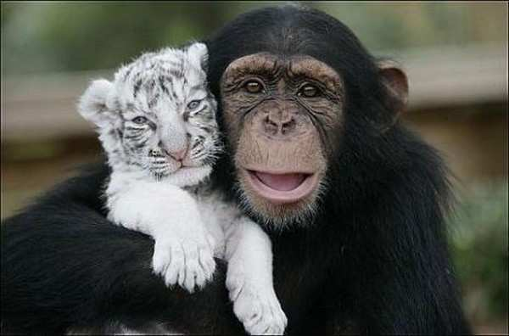
Scientist look at the genes in a DNA molecule (It is in all of our cells).
  DNA provides a unique marker.
  It shows how similar and how different species are.
Copyright © 2024 SlideSpark .LLC

Slide 51
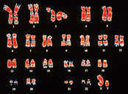
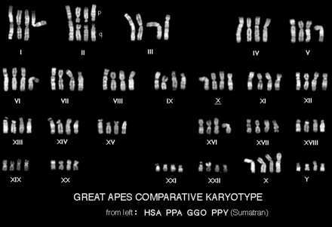
Scientist look at the genes in a DNA molecule (It is in all of our cells).
  DNA provides a unique marker.
  It shows how similar and how different species are.
Copyright © 2024 SlideSpark .LLC

Slide 52
How does society use the information learned from studying DNA.
  DNA is used to convict criminal in a court of law.
  DNA is used to determine genetic diseases and disorders.
  DNA is used to determine paternity – Whose the father or mother of a child?
  DNA is also used as a tool to see how species are connected, and how they have changed.
Copyright © 2024 SlideSpark .LLC

Slide 53
How does society use the information learned from studying DNA.
  DNA is used to convict criminal in a court of law.
  DNA is used to determine genetic diseases and disorders.
  DNA is used to determine paternity – Whose the father or mother of a child?
  DNA is also used as a tool to see how species are connected, and how they have changed.
Copyright © 2024 SlideSpark .LLC

Slide 54
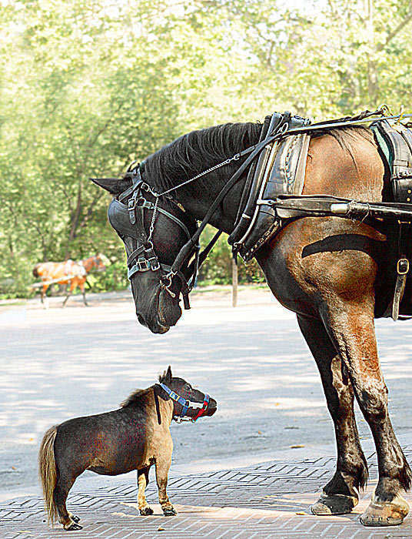
DNA provides insight into how similar and how different organisms are.
  This allows taxonomist to classify organisms more accurately.
Copyright © 2024 SlideSpark .LLC

Slide 55
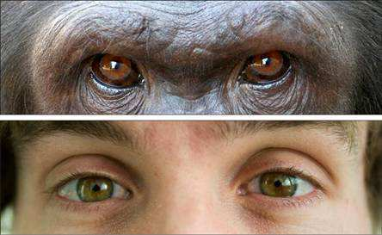
Humans and Chimpanzee share 94% of the same genes.
Copyright © 2024 SlideSpark .LLC

Slide 56
Humans and Chimpanzee share 94% of the same genes.
Copyright © 2024 SlideSpark .LLC

Slide 57
Humans and Chimpanzee share 94% of the same genes.
Copyright © 2024 SlideSpark .LLC

Slide 58
Humans and Chimpanzee share 94% of the same genes.
  We can get a blood transfusion from a chimp.
Copyright © 2024 SlideSpark .LLC

Slide 59
QUICK BIOLOGY
ESSENTIAL

Slide 60
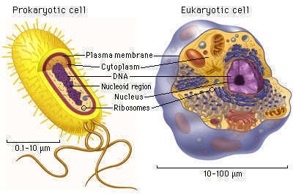
There are two main groups of cells.
  Prokaryotic
  Eukaryotic
Copyright © 2024 SlideSpark .LLC

Slide 61
There are two main groups of cells.
  Prokaryotic
  Eukaryotic
Copyright © 2024 SlideSpark .LLC

Slide 62
There are two main groups of cells.
  Prokaryotic
  Eukaryotic
Copyright © 2024 SlideSpark .LLC

Slide 63
What are some of the similarities between Prokaryotic and Eukaryotic Cells?
Copyright © 2024 SlideSpark .LLC

Slide 64
Answer: They both have all of these.
Copyright © 2024 SlideSpark .LLC

Slide 65
Answer: They both have all of these.
Copyright © 2024 SlideSpark .LLC

Slide 66
What are some of the differences between Prokaryotic and Eukaryotic Cells?
Copyright © 2024 SlideSpark .LLC

Slide 67
Answer: Eukaryotic cells have a nucleus, and are much larger and have more organelles. (More complex)
Copyright © 2024 SlideSpark .LLC

Slide 68
Answer: Eukaryotic cells have a nucleus, and are much larger and have more organelles. (More complex)
Much Larger
Copyright © 2024 SlideSpark .LLC

Slide 69

Answer: Eukaryotic cells have a nucleus, and are much larger and have more organelles. (More complex)
F
F
F
Copyright © 2024 SlideSpark .LLC

Slide 70
Answer: Eukaryotic cells have a nucleus, and are much larger and have more organelles. (More complex)
F
F
F
Copyright © 2024 SlideSpark .LLC

Slide 71
Answer: Eukaryotic cells have a nucleus, and are much larger and have more organelles. (More complex)
F
orm
F
F
Copyright © 2024 SlideSpark .LLC

Slide 72
Answer: Eukaryotic cells have a nucleus, and are much larger and have more organelles. (More complex)
F
orm
F
ollows
F
Copyright © 2024 SlideSpark .LLC

Slide 73
Answer: Eukaryotic cells have a nucleus, and are much larger and have more organelles. (More complex)
F
orm
F
ollows
F
unction
Copyright © 2024 SlideSpark .LLC

Slide 74
Prokaryotic cells
  -
  -
  -
  -
Copyright © 2024 SlideSpark .LLC
Copyright © 2024 SlideSpark .LLC

Slide 75
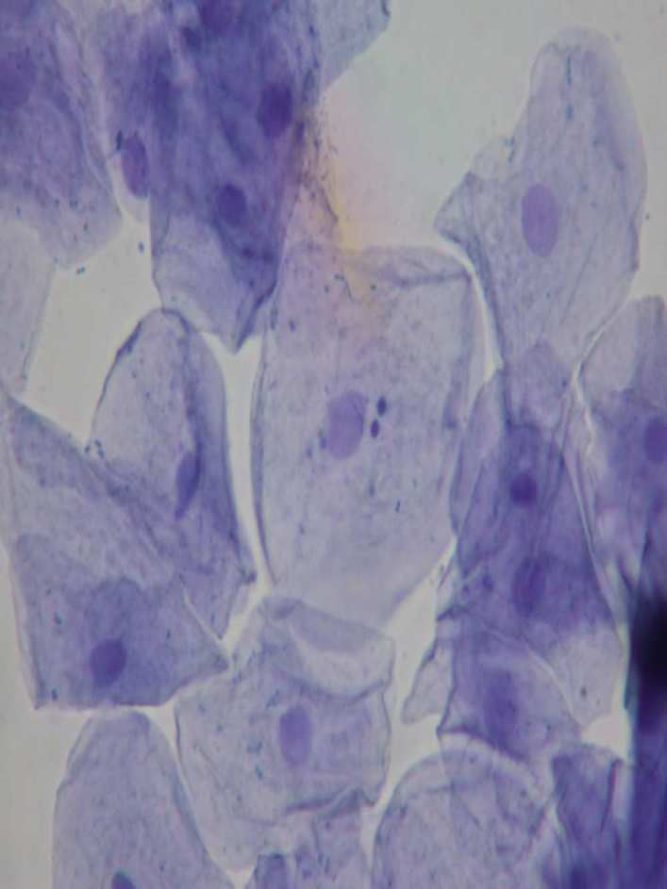
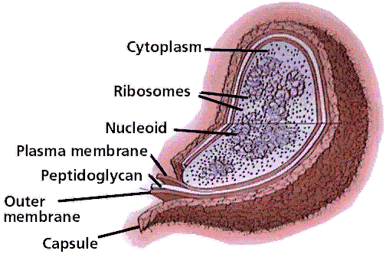
No nuclear membrane

Slide 76
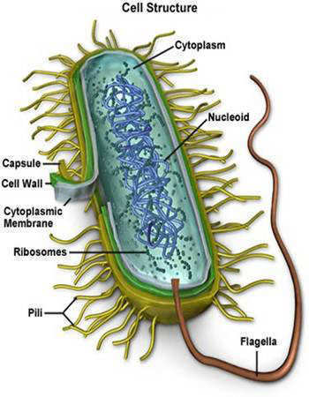
Genetic material is free in cytoplasm.
Copyright © 2024 SlideSpark .LLC

Slide 77
No membrane-bound organelles
Copyright © 2024 SlideSpark .LLC

Slide 78
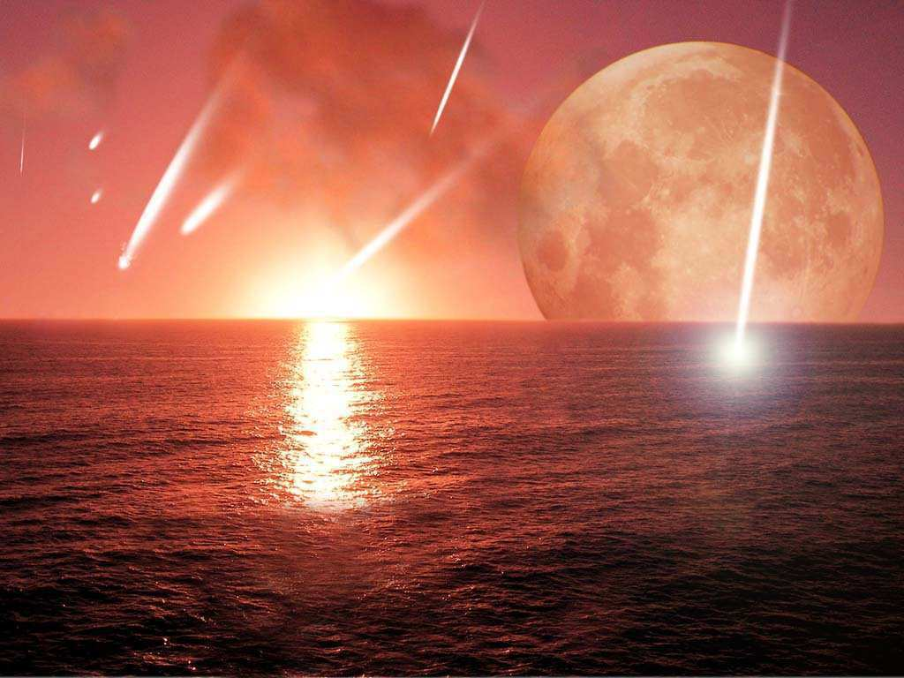
Most primitive type of cell
  appeared about 3.8 billion years ago.
Copyright © 2024 SlideSpark .LLC

Slide 79
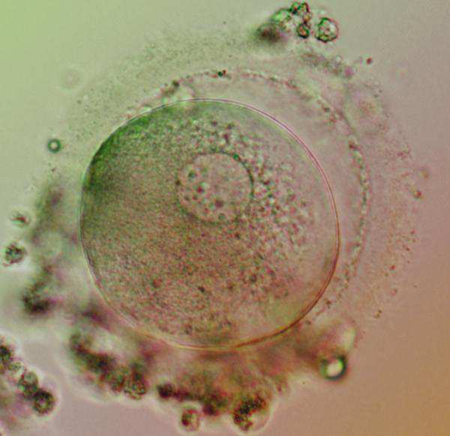
Eukaryotic Cells. We have eukaryotic cells.
Copyright © 2024 SlideSpark .LLC

Slide 80
Eukaryotic Cells
  -
  -
  -
  -
Copyright © 2024 SlideSpark .LLC

Slide 81
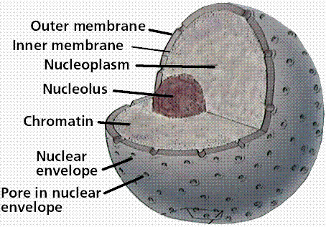
Nuclear membrane surrounding genetic material
Copyright © 2024 SlideSpark .LLC

Slide 82
Nuclear membrane surrounding genetic material
F
F
F
Copyright © 2024 SlideSpark .LLC

Slide 83
Nuclear membrane surrounding genetic material
F
orm
F
F
Copyright © 2024 SlideSpark .LLC

Slide 84
Nuclear membrane surrounding genetic material
F
orm
F
ollows
F
Copyright © 2024 SlideSpark .LLC

Slide 85
Nuclear membrane surrounding genetic material
F
orm
F
ollows
F
unction
Copyright © 2024 SlideSpark .LLC

Slide 86
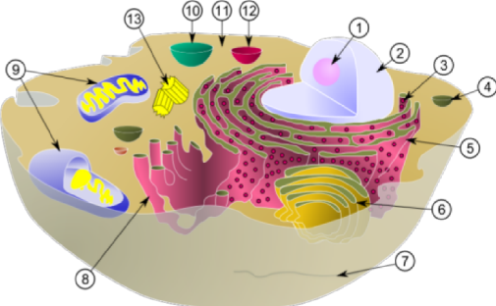
Numerous membrane-bound organelles
Copyright © 2024 SlideSpark .LLC

Slide 87
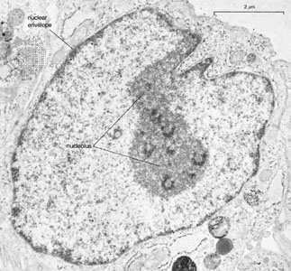
Complex internal structure.
Copyright © 2024 SlideSpark .LLC

Slide 88
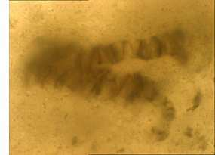
Appeared approximately 2.2 billion years ago.
Copyright © 2024 SlideSpark .LLC

Slide 89

Figure out the picture under the boxes.
  Raise your hand when you think you know.
  You only get one guess.
Copyright © 2024 SlideSpark .LLC

Slide 90
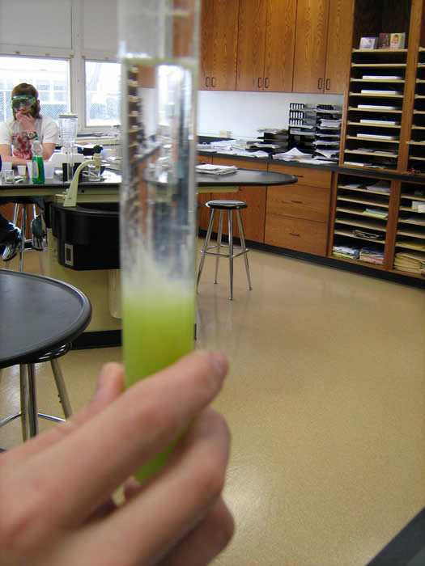

Slide 100
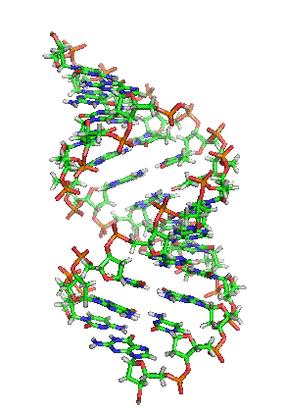
DNA EXTRACTION

Slide 101
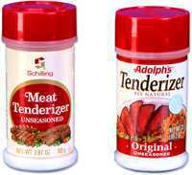
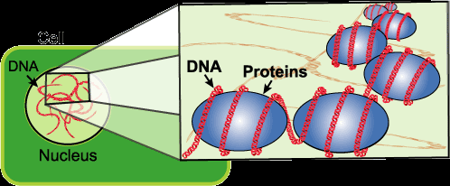
The meat tenderizer was added to break down the protein that the DNA is wrapped around.
This allows the DNA to be extracted.
Copyright © 2024 SlideSpark .LLC

Slide 102
Figure out the picture under the boxes.
  Raise your hand when you think you know.
  You only get one guess.
Copyright © 2024 SlideSpark .LLC

Slide 103
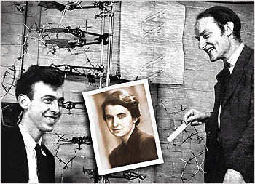
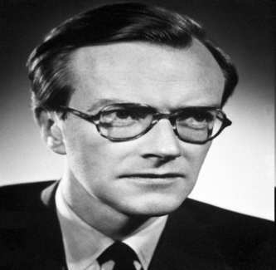

Slide 113
Watson

Slide 114
Watson

Slide 115
Crick
Watson

Slide 116
Crick
Watson

Slide 117
Wilkins
Crick
Watson

Slide 118
Wilkins
Crick
Watson

Slide 119
Wilkins
Crick
Watson
Franklin

Slide 120
Figure out the picture under the boxes.
  Raise your hand when you think you know.
  You only get one guess.
Copyright © 2024 SlideSpark .LLC

Slide 121
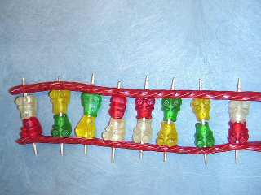

Slide 132
Phosphate Backbone

Slide 133
Phosphate Backbone
Nitrogen Base

Slide 134
Phosphate Backbone
Nitrogen Base

Slide 135
Phosphate Backbone
Nitrogen Base

Slide 136
Phosphate Backbone
Nucleotide
Nitrogen Base

Slide 137
Phosphate Backbone
Nucleotide
Nitrogen Base

Slide 138
Phosphate Backbone
Nucleotide
Nitrogen Base

Slide 139
Phosphate Backbone
Nucleotide
A
C
T
G
Nitrogen Base

Slide 140
Phosphate Backbone
Nucleotide
A
C
T
G
Nitrogen Base

Slide 141
Adenine
Phosphate Backbone
Nucleotide
A
C
T
G
Nitrogen Base

Slide 142
Adenine
Phosphate Backbone
Nucleotide
A
C
T
G
Nitrogen Base

Slide 143
Adenine
Thymine
Phosphate Backbone
Nucleotide
A
C
T
G
Nitrogen Base

Slide 144
Adenine
Thymine
Phosphate Backbone
Nucleotide
A
C
T
G
Nitrogen Base

Slide 145
Adenine
Thymine
Cytosine
Phosphate Backbone
Nucleotide
A
C
T
G
Nitrogen Base

Slide 146
Adenine
Thymine
Cytosine
Phosphate Backbone
Nucleotide
A
C
T
G
Nitrogen Base

Slide 147
Adenine
Thymine
Cytosine
Guanine
Phosphate Backbone
Nucleotide
A
C
T
G
Nitrogen Base

Slide 148
Adenine
Thymine
Cytosine
Guanine
Phosphate Backbone
Nucleotide
A
C
DNA
T
G
Nitrogen Base

Slide 149
Adenine
Thymine
Cytosine
Guanine
Phosphate Backbone
Nucleotide
A
C
DNA
T
G
Which stands for?
Nitrogen Base

Slide 150
Adenine
Thymine
Cytosine
Guanine
Deoxyribose Nucleic Acid
Phosphate Backbone
Nucleotide
A
C
DNA
T
G
Which stands for?
Nitrogen Base

Slide 151
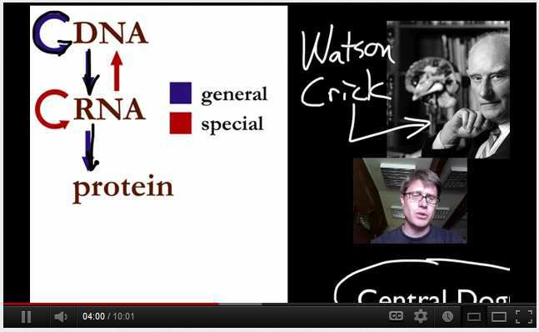
Video Link! Essential Characteristics of Life are Conserved, First Half of Video.
(Optional / Advanced)
  http://www.youtube.com/watch?v=bILvTe2_FEE

Slide 152
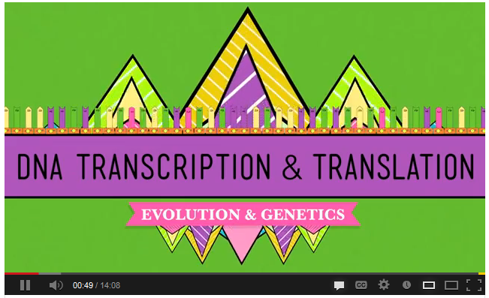
Video Link! (Optional) Transcription, Translation Crash Course.+ Review DNA
  http://www.youtube.com/watch?v=itsb2SqR-R0

Slide 153
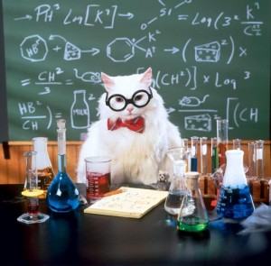

Slide 154
“Did you know that you share half of your DNA with a…

Slide 155

“Did you know that you share half of your DNA with a… baNANA.”

Slide 156


Slide 157

DNA Review Game
Study!

Slide 158

“AYE” Advance Your Exploration ELA and Literacy Opportunity Worksheet
  Visit some of the many provided links or..
  Articles can be found at (w/ membership to NABT and NSTA)
    http://www.nabt.org/websites/institution/index.php?p=1
    http://learningcenter.nsta.org/browse_journals.aspx?journal=tst
Please visit at least one of the “learn more” educational links provided in this unit and complete this worksheet.

Slide 159
“AYE” Advance Your Exploration ELA and Literacy Opportunity Worksheet
  Visit some of the many provided links or..
  Articles can be found at (w/ membership to NABT and NSTA)
    http://www.nabt.org/websites/institution/index.php?p=1
    http://learningcenter.nsta.org/browse_journals.aspx?journal=tst

Slide 160
DNA
Inherited vs.
Acquired Traits
Part 1
Lesson 7

Slide 161





Curriculum Guide
Number of Lessons in each unit (50 min, daily lessons) and difficult rating scale / intended grade level.
=Easier, = More difficult, =Most difficult
Earth Science Units

Slide 162


Life Science Units

Slide 163

Physical Science

Slide 164

Dear Valued Educator,
Our fully editable .pptx and .doc resources are perfect for educators looking to bring enthusiasm and creativity to their lessons. We encourage you to make changes to fit your needs and style. As science educators, we’re committed to providing students with the tools they need to succeed in the classroom and beyond. Each unit in the curriculum includes a range of resources that have been developed through extensive research and use in a busy classroom. Our teaching approach is designed to make science education engaging and exciting for learners of all ages. We offer a one-of-a-kind science curriculum that will challenge, inspire, and educate students to become tomorrow's scientists and leaders. Join us today and learn more about how our program can help you achieve your classroom goals.
With appreciation,
Support@SlideSpark.net

Slide 165





Thank you for your time and interest in our Science curriculum. We strive to provide students with engaging and informative lessons that will spark their curiosity and encourage scientific exploration. Should you have any questions or concerns, please do not hesitate to contact us. Thank you again for considering our curriculum, and we wish you all the best in your educational journey.
Sincerely,
Support@slidespark.net
SlideSpark Science on TpT

