Slide 1
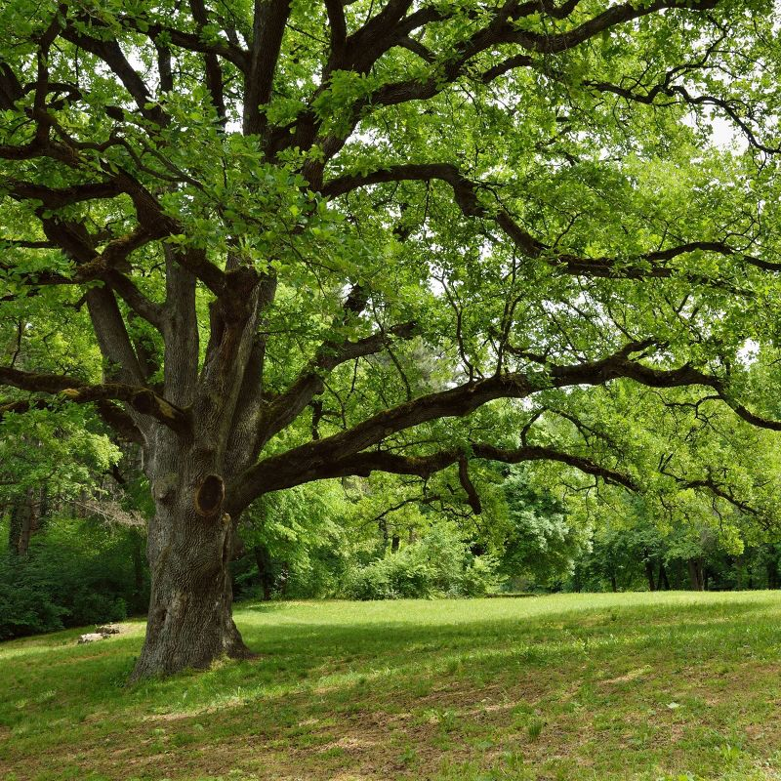

Taxonomy Review Game
Part 1
Lesson 7

Slide 2
Taxonomy and Classification Review Game
NAME GAME | STEP-UP | NEW DEAL | BOX SET | -BONUS- FAMOUS KINGS
1 | 6 | 11 | 16 | *21
2 | 7 | 12 | 17 | *22
3 | 8 | 13 | 18 | *23
4 | 9 | 14 | 19 | *24
5 | 10 | 15 | 20 | *25
Final Question:________________
Copyright © 2024 SlideSpark .LLC

Slide 3
How to play…
  Don’t play like Jeo_ _ _ _ y.
  Class should be divided into several small groups.
  Groups should use science journal (red slide notes), homework, and other available materials to assist you.
  Groups can communicate quietly with each other but no sharing answers between groups.
    Practice quietly communicating right now?
    Practice Communication Question:
    Your group gets to order one pizza, and you can have two toppings. What does your group want?

Slide 4

Questions 1-20 = 5pts Each
Final Category (Bonus) = 1pt Each
Final Questions = 5 pt wager
If you wager 5 on the last question and get it wrong you lose 5 pts. Wager 5 and get it right you get 5 pts.
Find the Owl =
Secretly write “Owl” in the correct box worth 1pt.
“I’ll be about this big.”

Slide 5
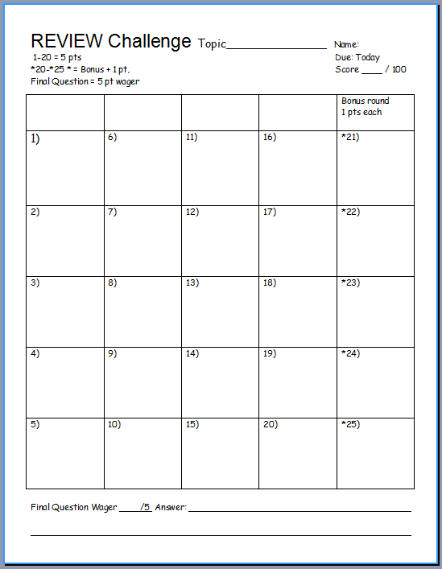
Is your name on the review sheet?
Name

Slide 6
Is your name on the review sheet?
Add the categories
along the top
on the next slide.

Slide 7
Taxonomy and Classification Review Game
NAME GAME | STEP-UP | NEW DEAL | BOX SET | -BONUS- FAMOUS KINGS
1 | 6 | 11 | 16 | *21
2 | 7 | 12 | 17 | *22
3 | 8 | 13 | 18 | *23
4 | 9 | 14 | 19 | *24
5 | 10 | 15 | 20 | *25
Final Question:________________
Copyright © 2024 SlideSpark .LLC

Slide 8
Taxonomy and Classification Review Game
NAME GAME | STEP-UP | NEW DEAL | BOX SET | -BONUS- FAMOUS KINGS
1 | 6 | 11 | 16 | *21
2 | 7 | 12 | 17 | *22
3 | 8 | 13 | 18 | *23
4 | 9 | 14 | 19 | *24
5 | 10 | 15 | 20 | *25
Final Question:________________
Copyright © 2024 SlideSpark .LLC

Slide 9
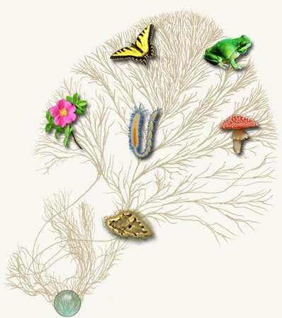
Is it Taxonomy, or Classification, when you give names to things?
1
Copyright © 2024 SlideSpark .LLC

Slide 10

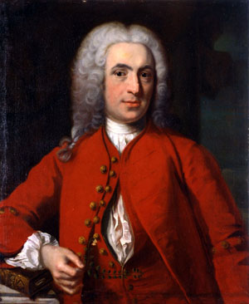
The modern taxonomic classification system is based on the natural concepts of the Swedish botanist named?
2
Copyright © 2024 SlideSpark .LLC

Slide 11

3
More recent technologies use DNA to help provide insight into how similar and how different organisms are.
  This allows taxonomist to classify organisms more accurately.
Copyright © 2024 SlideSpark .LLC

Slide 12
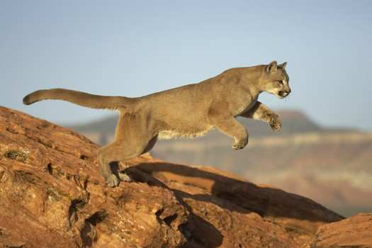
What’s the name of this animal?
4
Genus and species name please
Copyright © 2024 SlideSpark .LLC

Slide 13
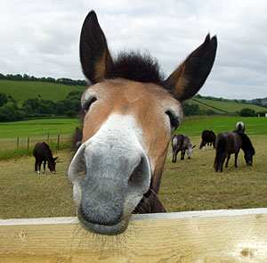
A mule is considered a hybrid animal.
  Is it sterile or fertile?
5
Mule
  Donkey Equus assinus X Horse Equus caballus
Copyright © 2024 SlideSpark .LLC

Slide 14
Taxonomy and Classification Review Game
NAME GAME | STEP-UP | NEW DEAL | BOX SET | -BONUS- FAMOUS KINGS
1 | 6 | 11 | 16 | *21
2 | 7 | 12 | 17 | *22
3 | 8 | 13 | 18 | *23
4 | 9 | 14 | 19 | *24
5 | 10 | 15 | 20 | *25
Final Question:________________
Copyright © 2024 SlideSpark .LLC

Slide 15
Taxonomy and Classification Review Game
NAME GAME | STEP-UP | NEW DEAL | BOX SET | -BONUS- FAMOUS KINGS
1 | 6 | 11 | 16 | *21
2 | 7 | 12 | 17 | *22
3 | 8 | 13 | 18 | *23
4 | 9 | 14 | 19 | *24
5 | 10 | 15 | 20 | *25
Final Question:________________
Copyright © 2024 SlideSpark .LLC

Slide 16
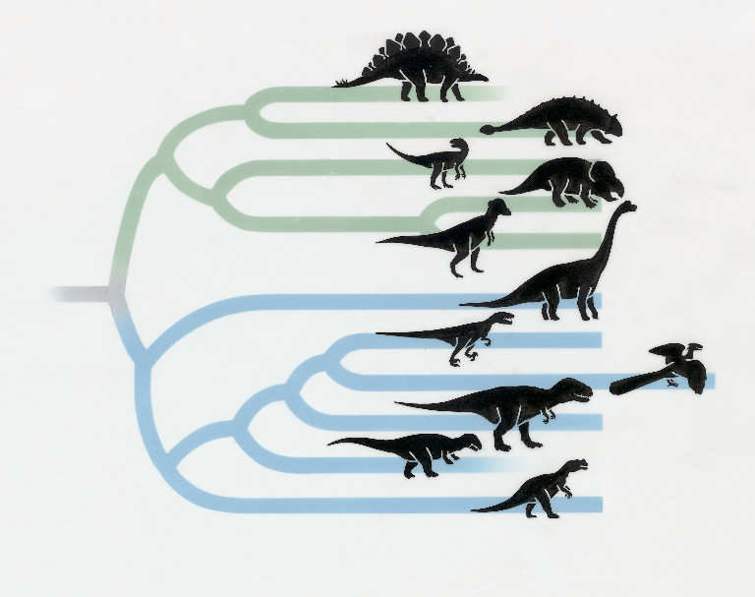
This is the name for the history of a species as it changes through time. Trying to figure who came from whom?
6
Copyright © 2024 SlideSpark .LLC

Slide 17
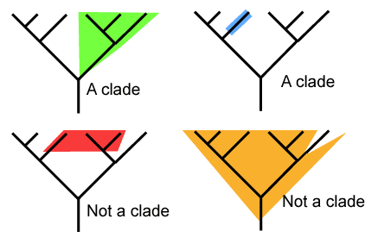
What ones are correct clades?
7
B
A
C
D
Copyright © 2024 SlideSpark .LLC

Slide 18
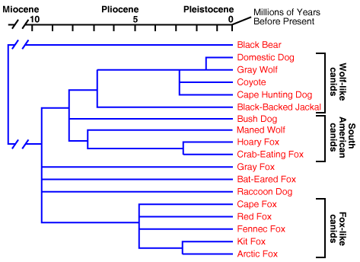
Who is more closely related to the Cape Hunting Dog?
  The Bush Dog, Domestic Dog, or Raccoon Dog?
8

Slide 19
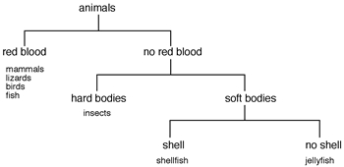
What is this a picture of below?
9
Copyright © 2024 SlideSpark .LLC

Slide 20
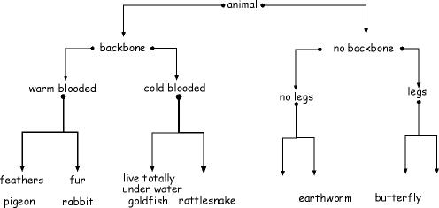
I’m a backboned cold blooded animal that does not live in water?
10

Slide 21
Taxonomy and Classification Review Game
NAME GAME | STEP-UP | NEW DEAL | BOX SET | -BONUS- FAMOUS KINGS
1 | 6 | 11 | 16 | *21
2 | 7 | 12 | 17 | *22
3 | 8 | 13 | 18 | *23
4 | 9 | 14 | 19 | *24
5 | 10 | 15 | 20 | *25
Final Question:________________
Copyright © 2024 SlideSpark .LLC

Slide 22
Taxonomy and Classification Review Game
NAME GAME | STEP-UP | NEW DEAL | BOX SET | -BONUS- FAMOUS KINGS
1 | 6 | 11 | 16 | *21
2 | 7 | 12 | 17 | *22
3 | 8 | 13 | 18 | *23
4 | 9 | 14 | 19 | *24
5 | 10 | 15 | 20 | *25
Final Question:________________
Copyright © 2024 SlideSpark .LLC

Slide 23
11
Which is not advised when following a dichotomous key?
  A.) Understand the meaning of the terms involved in the key.
  B.) When measurements are given, use a scale to measure the specimen. Do not guess at a measurement.
  C.) It is okay to skip ahead and read the choice that seems the most logical.
  D.) Living things are always variable, so do not base your organism identification in the field on a single observation.
Copyright © 2024 SlideSpark .LLC

Slide 24
11
Which is not advised when following a dichotomous key?
  A.) Understand the meaning of the terms involved in the key.
  B.) When measurements are given, use a scale to measure the specimen. Do not guess at a measurement.
  C.) It is okay to skip ahead and read the choice that seems the most logical.
  D.) Living things are always variable, so do not base your organism identification in the field on a single observation.
Copyright © 2024 SlideSpark .LLC

Slide 25
11
Which is not advised when following a dichotomous key?
  A.) Understand the meaning of the terms involved in the key.
  B.) When measurements are given, use a scale to measure the specimen. Do not guess at a measurement.
  C.) It is okay to skip ahead and read the choice that seems the most logical.
  D.) Living things are always variable, so do not base your organism identification in the field on a single observation.
Copyright © 2024 SlideSpark .LLC

Slide 26
11
Which is not advised when following a dichotomous key?
  A.) Understand the meaning of the terms involved in the key.
  B.) When measurements are given, use a scale to measure the specimen. Do not guess at a measurement.
  C.) It is okay to skip ahead and read the choice that seems the most logical.
  D.) Living things are always variable, so do not base your organism identification in the field on a single observation.
Copyright © 2024 SlideSpark .LLC

Slide 27
11
Which is not advised when following a dichotomous key?
  A.) Understand the meaning of the terms involved in the key.
  B.) When measurements are given, use a scale to measure the specimen. Do not guess at a measurement.
  C.) It is okay to skip ahead and read the choice that seems the most logical.
  D.) Living things are always variable, so do not base your organism identification in the field on a single observation.
Copyright © 2024 SlideSpark .LLC

Slide 28
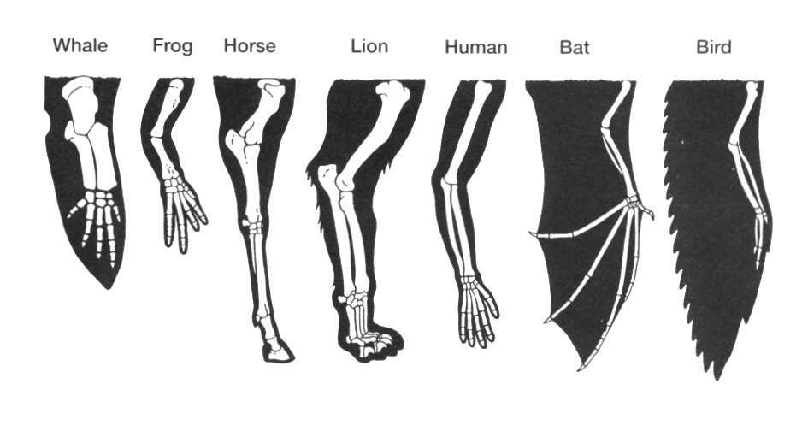
This is the name for describing the similarities between organisms.
12
Copyright © 2024 SlideSpark .LLC

Slide 29
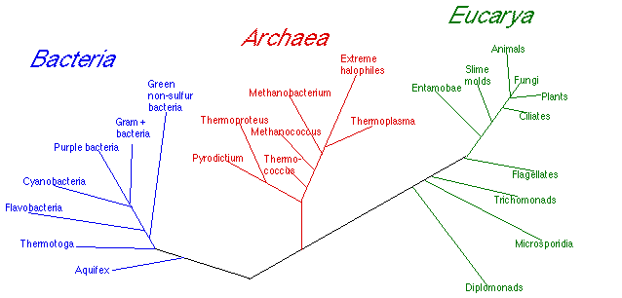
13
These are the 3 Domains of Life.
  A.) Monera, Protista, Fungi
  B.) Archaea, Bacteria, Eukarya
  C.) Thermoplasms, Cyanobacteria, Flagellates
  D.) Ribosomes, Cytoplasm, Nucleus
Copyright © 2024 SlideSpark .LLC

Slide 30
13
These are the 3 Domains of Life.
  A.) Monera, Protista, Fungi
  B.) Archaea, Bacteria, Eukarya
  C.) Thermoplasms, Cyanobacteria, Flagellates
  D.) Ribosomes, Cytoplasm, Nucleus
Copyright © 2024 SlideSpark .LLC

Slide 31
13
These are the 3 Domains of Life.
  A.) Monera, Protista, Fungi
  B.) Archaea, Bacteria, Eukarya
  C.) Thermoplasms, Cyanobacteria, Flagellates
  D.) Ribosomes, Cytoplasm, Nucleus
Copyright © 2024 SlideSpark .LLC

Slide 32
13
These are the 3 Domains of Life.
  A.) Monera, Protista, Fungi
  B.) Archaea, Bacteria, Eukarya
  C.) Thermoplasms, Cyanobacteria, Flagellates
  D.) Ribosomes, Cytoplasm, Nucleus
Copyright © 2024 SlideSpark .LLC

Slide 33
13
These are the 3 Domains of Life.
  A.) Monera, Protista, Fungi
  B.) Archaea, Bacteria, Eukarya
  C.) Thermoplasms, Cyanobacteria, Flagellates
  D.) Ribosomes, Cytoplasm, Nucleus
Copyright © 2024 SlideSpark .LLC

Slide 34
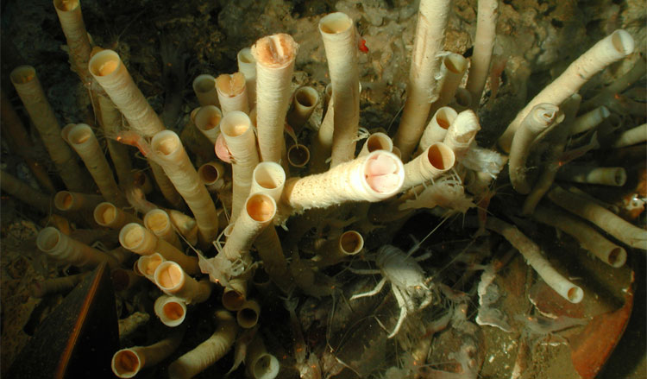
A whole new type of ecosystem was discovered on the ocean floor that doesn’t use light. This ecosystem is based on bacteria that perform this chemical process.
12H₂S + 6CO₂ → C₆H₁₂O₆ ( =carbohydrate ) + 6H₂O + 12S
14
Copyright © 2024 SlideSpark .LLC

Slide 35
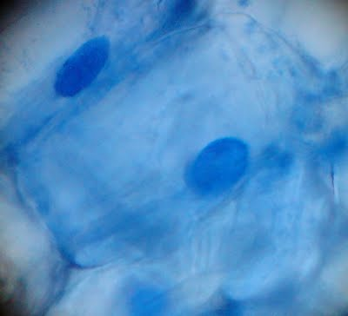
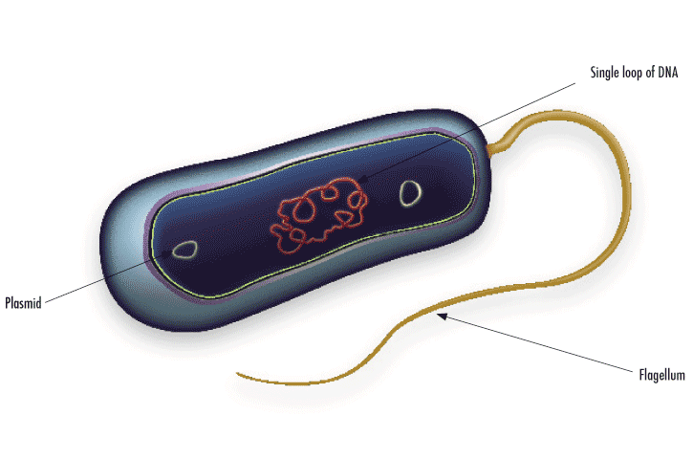
Which is Prokaryotic and which is Eukaryotic?
15
A
B
Not to scale
(extremely small)
Copyright © 2024 SlideSpark .LLC

Slide 36
Taxonomy and Classification Review Game
NAME GAME | STEP-UP | NEW DEAL | BOX SET | -BONUS- FAMOUS KINGS
1 | 6 | 11 | 16 | *21
2 | 7 | 12 | 17 | *22
3 | 8 | 13 | 18 | *23
4 | 9 | 14 | 19 | *24
5 | 10 | 15 | 20 | *25
Final Question:________________
Copyright © 2024 SlideSpark .LLC

Slide 37
Taxonomy and Classification Review Game
NAME GAME | STEP-UP | NEW DEAL | BOX SET | -BONUS- FAMOUS KINGS
1 | 6 | 11 | 16 | *21
2 | 7 | 12 | 17 | *22
3 | 8 | 13 | 18 | *23
4 | 9 | 14 | 19 | *24
5 | 10 | 15 | 20 | *25
Final Question:________________
Copyright © 2024 SlideSpark .LLC

Slide 38
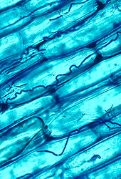
Name this Kingdom of Life?
  I’m a heterotrophic multicellular organism with a cell wall made of chitin and I absorb my food?
16
Copyright © 2024 SlideSpark .LLC

Slide 39
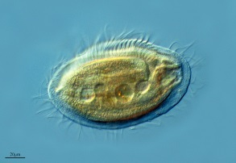
polyphyletic group
Name this Kingdom of Life?
  I’m hetero or autotrophic, generally single celled and I have a nucleus in my cells?
I’m hetero or autotrophic, generally single celled and I have a nucleus in my cells?
I’m hetero or autotrophic, generally single celled and I have a nucleus in my cells?
  I’m hetero or autotrophic, generally single celled and I have a nucleus in my cells?
17
Copyright © 2024 SlideSpark .LLC

Slide 40
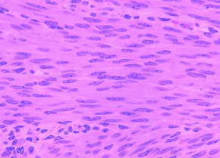
Name this Kingdom of Life?
  I don’t have a cell wall and consume my food?
18
Copyright © 2024 SlideSpark .LLC

Slide 41
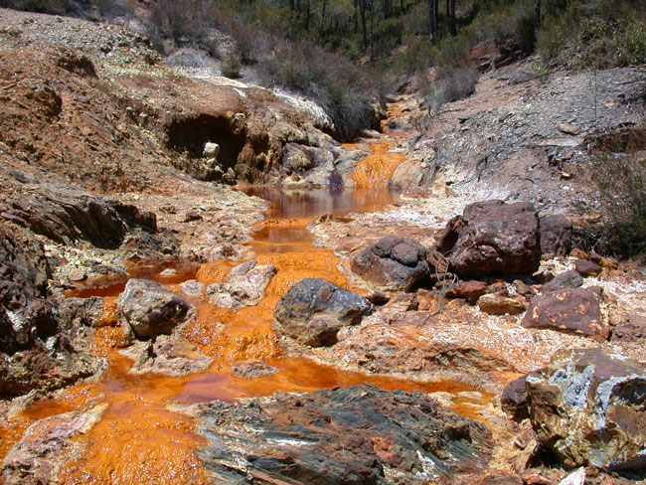
Name this Kingdom of Life?
  I’m hetero or autotrophic, my name means old / before the nucleus, I can live in extreme environments and don’t have peptidoglycan in my cell wall?
19
Copyright © 2024 SlideSpark .LLC

Slide 42
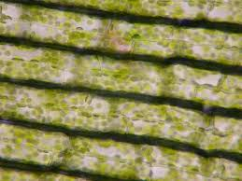
Name this Kingdom of Life?
  I’m completely autotrophic?
20
Copyright © 2024 SlideSpark .LLC

Slide 43
Taxonomy and Classification Review Game
NAME GAME | STEP-UP | NEW DEAL | BOX SET | -BONUS- FAMOUS KINGS
1 | 6 | 11 | 16 | *21
2 | 7 | 12 | 17 | *22
3 | 8 | 13 | 18 | *23
4 | 9 | 14 | 19 | *24
5 | 10 | 15 | 20 | *25
Final Question:________________
Copyright © 2024 SlideSpark .LLC

Slide 44
Taxonomy and Classification Review Game
NAME GAME | STEP-UP | NEW DEAL | BOX SET | -BONUS- FAMOUS KINGS
1 | 6 | 11 | 16 | *21
2 | 7 | 12 | 17 | *22
3 | 8 | 13 | 18 | *23
4 | 9 | 14 | 19 | *24
5 | 10 | 15 | 20 | *25
Final Question:________________
Copyright © 2024 SlideSpark .LLC

Slide 45
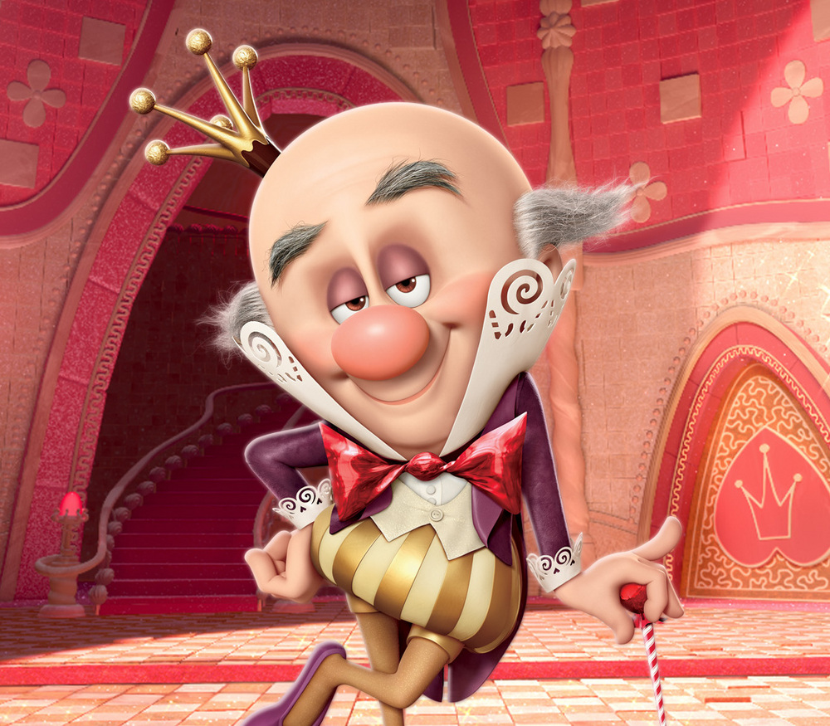
Who is this?
*21
Copyright © 2024 SlideSpark .LLC

Slide 46

What author of horror is this?
*22
Copyright © 2024 SlideSpark .LLC

Slide 47
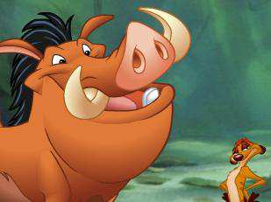
Name one of these two characters from the movie The Lion King?
*23
Copyright © 2024 SlideSpark .LLC

Slide 48
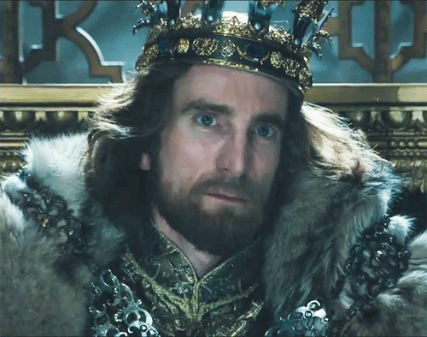
Name the movie with this villain king?
*24
Copyright © 2024 SlideSpark .LLC

Slide 49
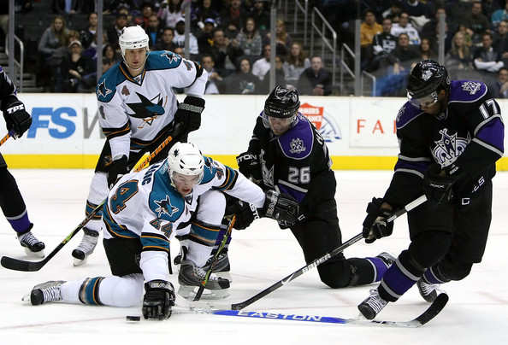
What city do “The Kings” play for?
*25
Copyright © 2024 SlideSpark .LLC

Slide 50
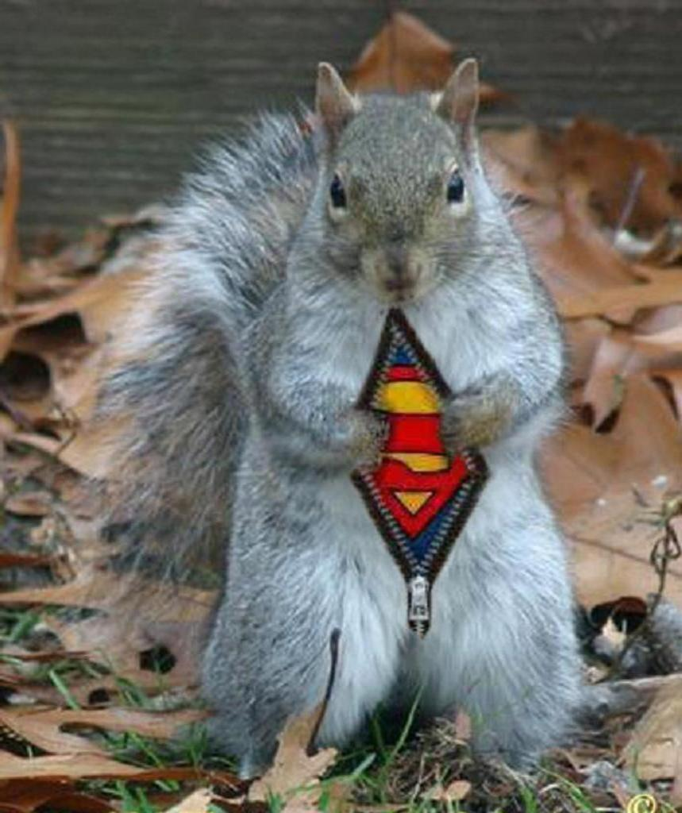
5 point Wager Question

Slide 51
Taxonomy and Classification Review Game
NAME GAME | STEP-UP | NEW DEAL | BOX SET | -BONUS- FAMOUS KINGS
1 | 6 | 11 | 16 | *21
2 | 7 | 12 | 17 | *22
3 | 8 | 13 | 18 | *23
4 | 9 | 14 | 19 | *24
5 | 10 | 15 | 20 | *25
Final Question:________________
Copyright © 2024 SlideSpark .LLC

Slide 52
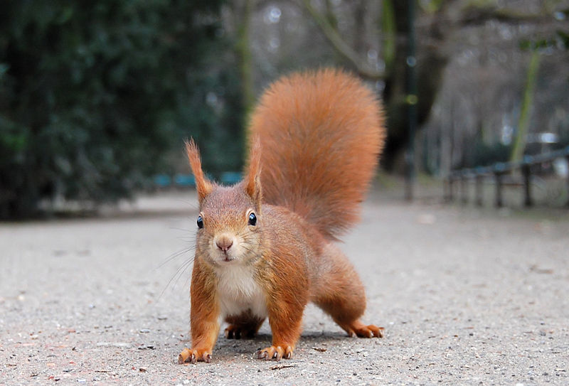
Which two are switched for the 8 Taxonomic Ranks below?
Domain -Eukarya
Kingdom -Animalia
Phylum –Chordata
Family -Mammalia
Order –Rodentia
Class –Sciuridae
Genus –Sciurus
Species -vulgaris

Slide 53
Taxonomy Review Game
Part 1
Lesson 7

Slide 54

Taxonomy Review Game
Part 1
Lesson 8

Slide 55
Taxonomy and Classification Review Game
NAME GAME | STEP-UP | NEW DEAL | BOX SET | -BONUS- FAMOUS KINGS
1 | 6 | 11 | 16 | *21
2 | 7 | 12 | 17 | *22
3 | 8 | 13 | 18 | *23
4 | 9 | 14 | 19 | *24
5 | 10 | 15 | 20 | *25
Final Question:________________
Copyright © 2024 SlideSpark .LLC

Slide 56
Taxonomy and Classification Review Game
NAME GAME | STEP-UP | NEW DEAL | BOX SET | -BONUS- FAMOUS KINGS
1 | 6 | 11 | 16 | *21
2 | 7 | 12 | 17 | *22
3 | 8 | 13 | 18 | *23
4 | 9 | 14 | 19 | *24
5 | 10 | 15 | 20 | *25
Final Question:________________
Copyright © 2024 SlideSpark .LLC

Slide 57
Is it Taxonomy, or Classification, when you give names to things?
1
Copyright © 2024 SlideSpark .LLC

Slide 58
Is it Taxonomy, or Classification, when you give names to things?
1
Taxonomy
Copyright © 2024 SlideSpark .LLC

Slide 59
The modern taxonomic classification system is based on the natural concepts of the Swedish botanist named?
2
Copyright © 2024 SlideSpark .LLC

Slide 60
The modern taxonomic classification system is based on the natural concepts of the Swedish botanist named?
2
Carolus Linnaeus
Copyright © 2024 SlideSpark .LLC

Slide 61
3
More recent technologies use DNA to help provide insight into how similar and how different organisms are.
  This allows taxonomist to classify organisms more accurately.
Copyright © 2024 SlideSpark .LLC

Slide 62
3
More recent technologies use DNA to help provide insight into how similar and how different organisms are.
  This allows taxonomist to classify organisms more accurately.
Copyright © 2024 SlideSpark .LLC

Slide 63
3
More recent technologies use DNA to help provide insight into how similar and how different organisms are.
  This allows taxonomist to classify organisms more accurately.
DNA
Deoxyribose
Nucleic Acid
Copyright © 2024 SlideSpark .LLC

Slide 64
What’s the name of this animal?
4
Copyright © 2024 SlideSpark .LLC

Slide 65
What’s the name of this animal?
4
Puma concolor
Copyright © 2024 SlideSpark .LLC

Slide 66
A mule is considered a hybrid animal.
  Is it sterile or fertile?
5
Mule
  Donkey Equus assinus X Horse Equus caballus
Copyright © 2024 SlideSpark .LLC

Slide 67
A mule is considered a hybrid animal.
  Is it sterile or fertile?
5
Mule
  Donkey Equus assinus X Horse Equus caballus
Copyright © 2024 SlideSpark .LLC

Slide 68
A mule is considered a hybrid animal.
  Is it sterile or fertile?
5
Mule
  Donkey Equus assinus X Horse Equus caballus
Copyright © 2024 SlideSpark .LLC

Slide 69
A mule is considered a hybrid animal.
  Is it sterile or fertile?
5
Mule
Sterile
  Donkey Equus assinus X Horse Equus caballus
Copyright © 2024 SlideSpark .LLC

Slide 70
Taxonomy and Classification Review Game
NAME GAME | STEP-UP | NEW DEAL | BOX SET | -BONUS- FAMOUS KINGS
1 | 6 | 11 | 16 | *21
2 | 7 | 12 | 17 | *22
3 | 8 | 13 | 18 | *23
4 | 9 | 14 | 19 | *24
5 | 10 | 15 | 20 | *25
Final Question:________________
Copyright © 2024 SlideSpark .LLC

Slide 71
Taxonomy and Classification Review Game
NAME GAME | STEP-UP | NEW DEAL | BOX SET | -BONUS- FAMOUS KINGS
1 | 6 | 11 | 16 | *21
2 | 7 | 12 | 17 | *22
3 | 8 | 13 | 18 | *23
4 | 9 | 14 | 19 | *24
5 | 10 | 15 | 20 | *25
Final Question:________________
Copyright © 2024 SlideSpark .LLC

Slide 72
This is the name for the history of a species as it changes through time. Trying to figure who came from whom?
6
Copyright © 2024 SlideSpark .LLC

Slide 73
This is the name for the history of a species as it changes through time. Trying to figure who came from whom?
6
Phylogeny
Or Phylogenetic Tree
Copyright © 2024 SlideSpark .LLC

Slide 74
What ones are correct clades?
7
B
A
C
D
Copyright © 2024 SlideSpark .LLC

Slide 75
What ones are correct clades?
7
B
A
C
D
Copyright © 2024 SlideSpark .LLC

Slide 76
What ones are correct clades? A and __
7
B
A
C
D
Copyright © 2024 SlideSpark .LLC

Slide 77
What ones are correct clades? A and __
7
B
A
C
D
Copyright © 2024 SlideSpark .LLC

Slide 78
What ones are correct clades? A and __
7
B
A
C
D
Copyright © 2024 SlideSpark .LLC

Slide 79
What ones are correct clades? A and __
7
B
A
C
D
Copyright © 2024 SlideSpark .LLC

Slide 80
What ones are correct clades? A and B
7
B
A
C
D
Copyright © 2024 SlideSpark .LLC

Slide 81
What ones are correct clades? A and B
7
B
A
C
D
Copyright © 2024 SlideSpark .LLC

Slide 82
Who is more closely related to the Cape Hunting Dog?
  The Bush Dog, Domestic Dog, or Raccoon Dog?
8

Slide 83
Who is more closely related to the Cape Hunting Dog?
  The Bush Dog, Domestic Dog, or Raccoon Dog?
8

Slide 84
What is this a picture of below?
9
Copyright © 2024 SlideSpark .LLC

Slide 85
What is this a picture of below?
Dichotomous Key
9
Copyright © 2024 SlideSpark .LLC

Slide 86
I’m a backboned cold blooded animal that does not live in water?
10

Slide 87
I’m a backboned cold blooded animal that does not live in water?
10

Slide 88
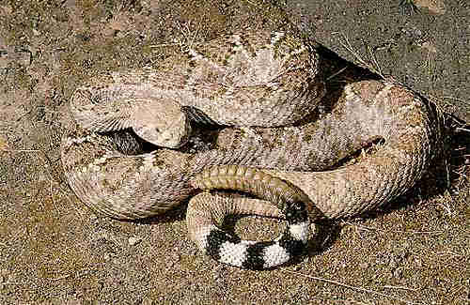
I’m a backboned cold blooded animal that does not live in water?
10
Rattlesnake

Slide 89
Taxonomy and Classification Review Game
NAME GAME | STEP-UP | NEW DEAL | BOX SET | -BONUS- FAMOUS KINGS
1 | 6 | 11 | 16 | *21
2 | 7 | 12 | 17 | *22
3 | 8 | 13 | 18 | *23
4 | 9 | 14 | 19 | *24
5 | 10 | 15 | 20 | *25
Final Question:________________
Copyright © 2024 SlideSpark .LLC

Slide 90
Taxonomy and Classification Review Game
NAME GAME | STEP-UP | NEW DEAL | BOX SET | -BONUS- FAMOUS KINGS
1 | 6 | 11 | 16 | *21
2 | 7 | 12 | 17 | *22
3 | 8 | 13 | 18 | *23
4 | 9 | 14 | 19 | *24
5 | 10 | 15 | 20 | *25
Final Question:________________
Copyright © 2024 SlideSpark .LLC

Slide 91
11
Which not advised when following a dichotomous key?
  A.) Understand the meaning of the terms involved in the key.
  B.) When measurements are given, use a scale to measure the specimen. Do not guess at a measurement.
  C.) It is okay to skip ahead and read the choice that seems the most logical.
  D.) Living things are always variable, so do not base your organism identification in the field on a single observation.
Copyright © 2024 SlideSpark .LLC

Slide 92
11
Which not advised when following a dichotomous key?
  A.) Understand the meaning of the terms involved in the key.
  B.) When measurements are given, use a scale to measure the specimen. Do not guess at a measurement.
  C.) It is okay to skip ahead and read the choice that seems the most logical.
  D.) Living things are always variable, so do not base your organism identification in the field on a single observation.
Copyright © 2024 SlideSpark .LLC

Slide 93
This is the name for describing the similarities between organisms.
12
Copyright © 2024 SlideSpark .LLC

Slide 94
This is the name for describing the similarities between organisms.
12
Homology
Homologous Structures
Copyright © 2024 SlideSpark .LLC

Slide 95
13
These are the 3 Domains of Life.
  A.) Monera, Protista, Fungi
  B.) Archaea, Bacteria, Eukarya
  C.) Thermoplasms, Cyanobacteria, Flagellates
  D.) Ribosomes, Cytoplasm, Nucleus
Copyright © 2024 SlideSpark .LLC

Slide 96
13
These are the 3 Domains of Life.
  A.) Monera, Protista, Fungi
  B.) Archaea, Bacteria, Eukarya
  C.) Thermoplasms, Cyanobacteria, Flagellates
  D.) Ribosomes, Cytoplasm, Nucleus
Copyright © 2024 SlideSpark .LLC

Slide 97
13
These are the 3 Domains of Life.
  A.) Monera, Protista, Fungi
  B.) Archaea, Bacteria, Eukarya
  C.) Thermoplasms, Cyanobacteria, Flagellates
  D.) Ribosomes, Cytoplasm, Nucleus
Copyright © 2024 SlideSpark .LLC

Slide 98
13
These are the 3 Domains of Life.
  A.) Monera, Protista, Fungi
  B.) Archaea, Bacteria, Eukarya
  C.) Thermoplasms, Cyanobacteria, Flagellates
  D.) Ribosomes, Cytoplasm, Nucleus
Copyright © 2024 SlideSpark .LLC

Slide 99
13
These are the 3 Domains of Life.
  A.) Monera, Protista, Fungi
  B.) Archaea, Bacteria, Eukarya
  C.) Thermoplasms, Cyanobacteria, Flagellates
  D.) Ribosomes, Cytoplasm, Nucleus
Copyright © 2024 SlideSpark .LLC

Slide 100
13
These are the 3 Domains of Life.
  A.) Monera, Protista, Fungi
  B.) Archaea, Bacteria, Eukarya
  C.) Thermoplasms, Cyanobacteria, Flagellates
  D.) Ribosomes, Cytoplasm, Nucleus
answer…
Copyright © 2024 SlideSpark .LLC

Slide 101
13
These are the 3 Domains of Life.
  A.) Monera, Protista, Fungi
  B.) Archaea, Bacteria, Eukarya
  C.) Thermoplasms, Cyanobacteria, Flagellates
  D.) Ribosomes, Cytoplasm, Nucleus
answer…
Copyright © 2024 SlideSpark .LLC

Slide 102
13
These are the 3 Domains of Life.
  A.) Monera, Protista, Fungi
  B.) Archaea, Bacteria, Eukarya
  C.) Thermoplasms, Cyanobacteria, Flagellates
  D.) Ribosomes, Cytoplasm, Nucleus
answer…
Copyright © 2024 SlideSpark .LLC

Slide 103
A whole new type of ecosystem was discovered on the ocean floor that doesn’t use light. This ecosystem is based on bacteria that perform this chemical process.
12H₂S + 6CO₂ → C₆H₁₂O₆ ( =carbohydrate ) + 6H₂O + 12S
14
Copyright © 2024 SlideSpark .LLC

Slide 104
A whole new type of ecosystem was discovered on the ocean floor that doesn’t use light. This ecosystem is based on bacteria that perform this chemical process.
12H₂S + 6CO₂ → C₆H₁₂O₆ ( =carbohydrate ) + 6H₂O + 12S
Chemosynthesis
14
Copyright © 2024 SlideSpark .LLC

Slide 105
Which is Prokaryotic and which is Eukaryotic?
15
A
B
Copyright © 2024 SlideSpark .LLC

Slide 106
Which is Prokaryotic and which is Eukaryotic?
15
A
B
Copyright © 2024 SlideSpark .LLC

Slide 107
Which is Prokaryotic and which is Eukaryotic?
15
A
B
Eukaryotic
Nucleus
Copyright © 2024 SlideSpark .LLC

Slide 108
Which is Prokaryotic and which is Eukaryotic?
15
A
B
Eukaryotic
Nucleus
Copyright © 2024 SlideSpark .LLC

Slide 109
Which is Prokaryotic and which is Eukaryotic?
15
A
B
Prokaryotic
Eukaryotic
Domain
Bacteria
Nucleus
No Nucleus
Copyright © 2024 SlideSpark .LLC

Slide 110
Which is Prokaryotic and which is Eukaryotic?
15
A
B
Prokaryotic
Eukaryotic
Plasmid
Nucleus
No Nucleus
Copyright © 2024 SlideSpark .LLC

Slide 111
Which is Prokaryotic and which is Eukaryotic?
15
A
B
Prokaryotic
Eukaryotic
Plasmid
Nucleus
No Nucleus
Copyright © 2024 SlideSpark .LLC

Slide 112
Which is Prokaryotic and which is Eukaryotic?
15
A
B
Prokaryotic
Eukaryotic
Plasmid
Nucleus
No Nucleus
Copyright © 2024 SlideSpark .LLC

Slide 113
Taxonomy and Classification Review Game
NAME GAME | STEP-UP | NEW DEAL | BOX SET | -BONUS- FAMOUS KINGS
1 | 6 | 11 | 16 | *21
2 | 7 | 12 | 17 | *22
3 | 8 | 13 | 18 | *23
4 | 9 | 14 | 19 | *24
5 | 10 | 15 | 20 | *25
Final Question:________________
Copyright © 2024 SlideSpark .LLC

Slide 114
Taxonomy and Classification Review Game
NAME GAME | STEP-UP | NEW DEAL | BOX SET | -BONUS- FAMOUS KINGS
1 | 6 | 11 | 16 | *21
2 | 7 | 12 | 17 | *22
3 | 8 | 13 | 18 | *23
4 | 9 | 14 | 19 | *24
5 | 10 | 15 | 20 | *25
Final Question:________________
Copyright © 2024 SlideSpark .LLC

Slide 115
Name this Kingdom of Life?
  I’m a heterotrophic multicellular organism with a cell wall made of chitin and I absorb my food?
16
Copyright © 2024 SlideSpark .LLC

Slide 116
Name this Kingdom of Life?
  I’m a heterotrophic multicellular organism with a cell wall made of chitin and I absorb my food?
16
Copyright © 2024 SlideSpark .LLC

Slide 117
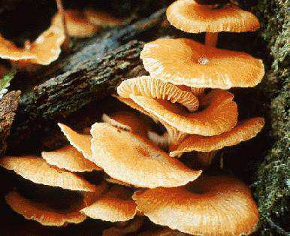
Name this Kingdom of Life?
  I’m a heterotrophic multicellular organism with a cell wall made of chitin and I absorb my food?
16
Copyright © 2024 SlideSpark .LLC

Slide 118
Name this Kingdom of Life?
  I’m a heterotrophic multicellular organism with a cell wall made of chitin and I absorb my food?
16
Fungi
Copyright © 2024 SlideSpark .LLC

Slide 119
polyphyletic group
Name this Kingdom of Life?
  I’m hetero or autotrophic, generally single celled and I have a nucleus in my cells?
17
Copyright © 2024 SlideSpark .LLC

Slide 120
polyphyletic group
Name this Kingdom of Life?
I’m hetero or autotrophic, generally single celled and I have a nucleus in my cells?
  I’m hetero or autotrophic, generally single celled and I have a nucleus in my cells?
17
Copyright © 2024 SlideSpark .LLC

Slide 121
polyphyletic group
Name this Kingdom of Life?
I’m hetero or autotrophic, generally single celled and I have a nucleus in my cells?
  I’m hetero or autotrophic, generally single celled and I have a nucleus in my cells?
17
PROTISTA
Copyright © 2024 SlideSpark .LLC

Slide 122
Name this Kingdom of Life?
  I don’t have a cell wall and consume my food?
18
Copyright © 2024 SlideSpark .LLC

Slide 123
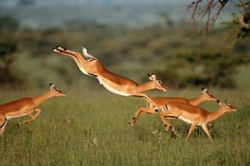
Name this Kingdom of Life?
  I don’t have a cell wall and consume my food?
18
Copyright © 2024 SlideSpark .LLC

Slide 124
Name this Kingdom of Life?
  I don’t have a cell wall and consume my food?
18
Animalia
Copyright © 2024 SlideSpark .LLC

Slide 125
Name this Kingdom of Life?
  I’m hetero or autotrophic, my name means old / before the nucleus, I can live in extreme environments and don’t have peptidoglycan in my cell wall?
19
Copyright © 2024 SlideSpark .LLC

Slide 126

Name this Kingdom of Life?
  I’m hetero or autotrophic, my name means old / before the nucleus, I can live in extreme environments and don’t have peptidoglycan in my cell wall?
19
Archaea
Copyright © 2024 SlideSpark .LLC

Slide 127
Name this Kingdom of Life?
  I’m completely autotrophic?
20
Copyright © 2024 SlideSpark .LLC

Slide 128
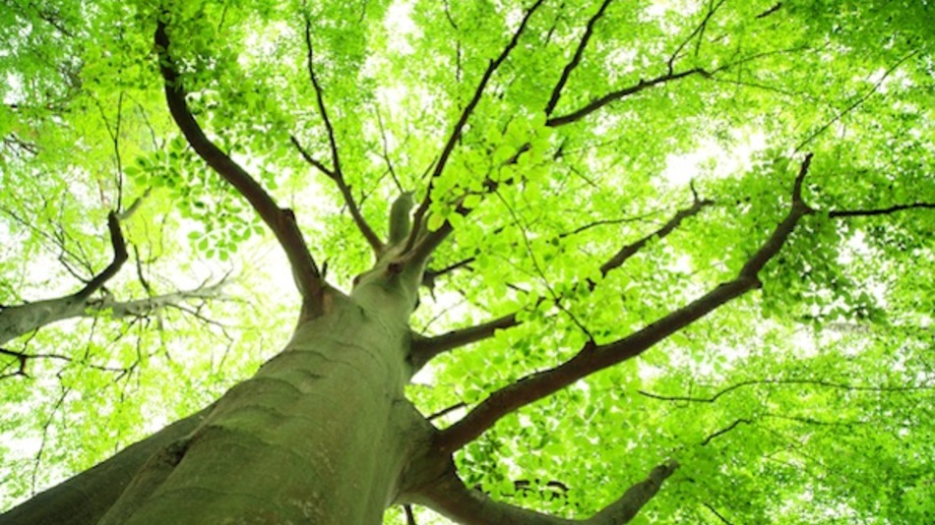
Name this Kingdom of Life?
  I’m completely autotrophic?
20
Plantae
Copyright © 2024 SlideSpark .LLC

Slide 129
Taxonomy and Classification Review Game
NAME GAME | STEP-UP | NEW DEAL | BOX SET | -BONUS- FAMOUS KINGS
1 | 6 | 11 | 16 | *21
2 | 7 | 12 | 17 | *22
3 | 8 | 13 | 18 | *23
4 | 9 | 14 | 19 | *24
5 | 10 | 15 | 20 | *25
Final Question:________________
Copyright © 2024 SlideSpark .LLC

Slide 130
Taxonomy and Classification Review Game
NAME GAME | STEP-UP | NEW DEAL | BOX SET | -BONUS- FAMOUS KINGS
1 | 6 | 11 | 16 | *21
2 | 7 | 12 | 17 | *22
3 | 8 | 13 | 18 | *23
4 | 9 | 14 | 19 | *24
5 | 10 | 15 | 20 | *25
Final Question:________________
Copyright © 2024 SlideSpark .LLC

Slide 131
Who is this?
*21
Copyright © 2024 SlideSpark .LLC

Slide 132
Who is this?
*21
King Candy
Copyright © 2024 SlideSpark .LLC

Slide 133
What author of horror is this?
*22
Copyright © 2024 SlideSpark .LLC

Slide 134

What author of horror is this? Stephen King
*22
Copyright © 2024 SlideSpark .LLC

Slide 135
Name one of these two characters from the move The Lion King?
*23
Copyright © 2024 SlideSpark .LLC

Slide 136
Name one of these two characters from the move The Lion King? Pumbaa
*23
Copyright © 2024 SlideSpark .LLC

Slide 137
Name one of these two characters from the move The Lion King? Pumbaa and Timon
*23
Copyright © 2024 SlideSpark .LLC

Slide 138
Name the movie with this villain king?
*24
Copyright © 2024 SlideSpark .LLC

Slide 139

Name the movie with this villain king?
*24
Copyright © 2024 SlideSpark .LLC

Slide 140
What city do “The Kings” play for?
*25
Copyright © 2024 SlideSpark .LLC

Slide 141
What city do “The Kings” play for?
Los Angeles
*25
Copyright © 2024 SlideSpark .LLC

Slide 142
5 point Wager Question

Slide 143
Taxonomy and Classification Review Game
NAME GAME | STEP-UP | NEW DEAL | BOX SET | -BONUS- FAMOUS KINGS
1 | 6 | 11 | 16 | *21
2 | 7 | 12 | 17 | *22
3 | 8 | 13 | 18 | *23
4 | 9 | 14 | 19 | *24
5 | 10 | 15 | 20 | *25
Final Question:________________
Copyright © 2024 SlideSpark .LLC

Slide 144
Which two are switched for the 8 Taxonomic Ranks below?
Domain -Eukarya
Kingdom -Animalia
Phylum –Chordata
Family -Mammalia
Order –Rodentia
Class –Sciuridae
Genus –Sciurus
Species -vulgaris

Slide 145
Which two are switched for the 8 Taxonomic Ranks below?
Domain -Eukarya
Kingdom -Animalia
Phylum –Chordata
Family -Mammalia
Order –Rodentia
Class –Sciuridae
Genus –Sciurus
Species -vulgaris

Slide 146
Which two are switched for the 8 Taxonomic Ranks below?
Domain -Eukarya
Kingdom -Animalia
Phylum –Chordata
Class -Mammalia
Order –Rodentia
Family –Sciuridae
Genus –Sciurus
Species -vulgaris

Slide 147
Which two are switched for the 8 Taxonomic Ranks below?
Domain -Eukarya
Kingdom -Animalia
Phylum –Chordata
Class -Mammalia
Order –Rodentia
Family –Sciuridae
Genus –Sciurus
Species -vulgaris

Slide 148

Taxonomy and Classification
Review Game
1-20 = 5 points each
20-25 = Bonus (1 point each)
Final Question = 5 point wager
Find the Owl = 1 point

Slide 149
Taxonomy Review Game
Part 1
Lesson 8

Slide 150



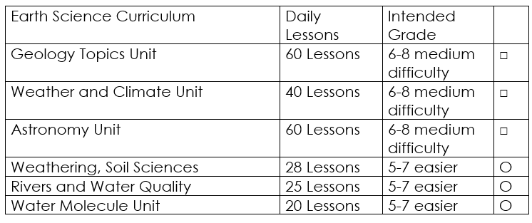

Curriculum Guide
Number of Lessons in each unit (50 min, daily lessons) and difficult rating scale / intended grade level.
=Easier, = More difficult, =Most difficult
Earth Science Units

Slide 151


Life Science Units

Slide 152

Physical Science

Slide 153
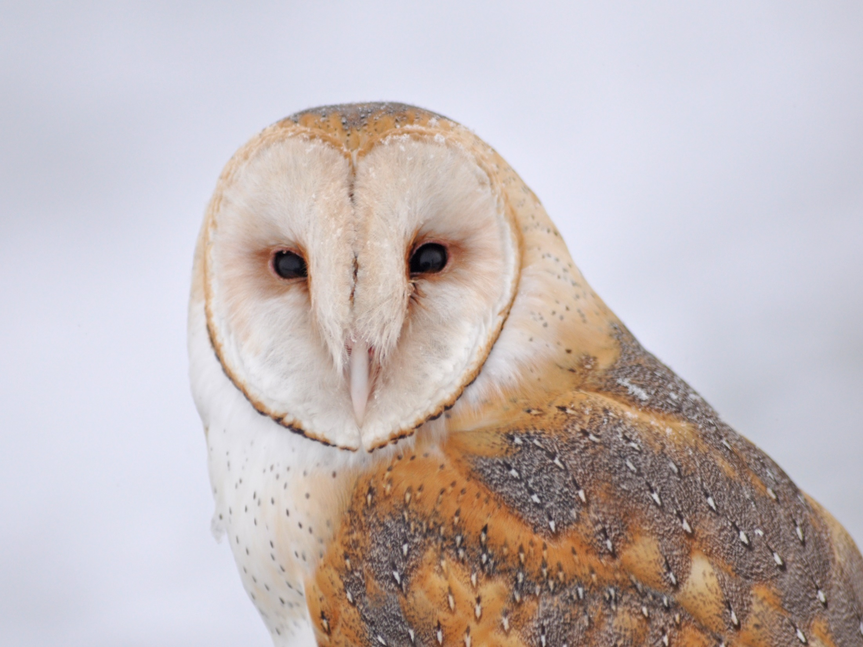
Dear Valued Educator,
Our fully editable .pptx and .doc resources are perfect for educators looking to bring enthusiasm and creativity to their lessons. We encourage you to make changes to fit your needs and style. As science educators, we’re committed to providing students with the tools they need to succeed in the classroom and beyond. Each unit in the curriculum includes a range of resources that have been developed through extensive research and use in a busy classroom. Our teaching approach is designed to make science education engaging and exciting for learners of all ages. We offer a one-of-a-kind science curriculum that will challenge, inspire, and educate students to become tomorrow's scientists and leaders. Join us today and learn more about how our program can help you achieve your classroom goals.
With appreciation,
Support@SlideSpark.net

Slide 154





Thank you for your time and interest in our Science curriculum. We strive to provide students with engaging and informative lessons that will spark their curiosity and encourage scientific exploration. Should you have any questions or concerns, please do not hesitate to contact us. Thank you again for considering our curriculum, and we wish you all the best in your educational journey.
Sincerely,
Support@slidespark.net
SlideSpark Science on TpT

