Slide 1
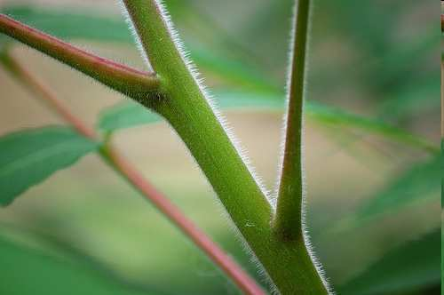

Part 3 Review Game
Part 3
Lesson 8

Slide 2
Part 3 REVIEW GAME
NEED FOR SEED | UP, UP, AND AWAY | YOUNG ONE | ONE FOR ME, TWO FOR YOU | -Bonus- GREEN MACHINE
1 | 6 | 11 | 16 | *21
2 | 7 | 12 | 17 | *22
3 | 8 | 13 | 18 | *23
4 | 9 | 14 | 19 | *24
5 | 10 | 15 | 20 | *25

Slide 3
How to play…
  Don’t play like Jeo_ _ _ _ y.
  Class should be divided into several small groups.
  Groups should use science journal (red slide notes), homework, and other available materials to assist you.
  Groups can communicate quietly with each other but no sharing answers between groups.
    Practice quietly communicating right now?
    Practice Communication Question:
    Your group gets to order one pizza and you can have two toppings. What does your group want?

Slide 4

Questions 1-20 = 5pts Each
Final Category (Bonus) = 1pt Each
Final Questions = 5 pt wager
If you wager 5 on the last question and get it wrong you lose 5 pts. Wager 5 and get it right you get 5 pts.
Find the Owl =
Secretly write “Owl” in the correct box worth 1pt.
“I’ll be about this big.”

Slide 5
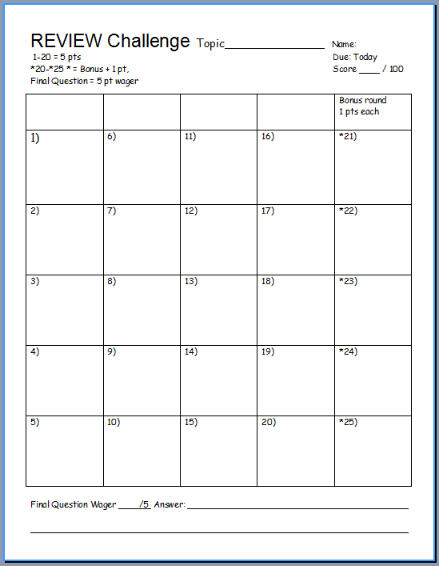
Is your name on the review sheet?
Name

Slide 6
Is your name on the review sheet?
Add the categories
along the top
on the next slide.

Slide 7
Part III REVIEW GAME
NEED FOR SEED | UP, UP, AND AWAY | YOUNG ONE | ONE FOR ME, TWO FOR YOU | -Bonus- GREEN MACHINE
1 | 6 | 11 | 16 | *21
2 | 7 | 12 | 17 | *22
3 | 8 | 13 | 18 | *23
4 | 9 | 14 | 19 | *24
5 | 10 | 15 | 20 | *25

Slide 8
Part III REVIEW GAME
NEED FOR SEED | UP, UP, AND AWAY | YOUNG ONE | ONE FOR ME, TWO FOR YOU | -Bonus- GREEN MACHINE
1 | 6 | 11 | 16 | *21
2 | 7 | 12 | 17 | *22
3 | 8 | 13 | 18 | *23
4 | 9 | 14 | 19 | *24
5 | 10 | 15 | 20 | *25

Slide 9
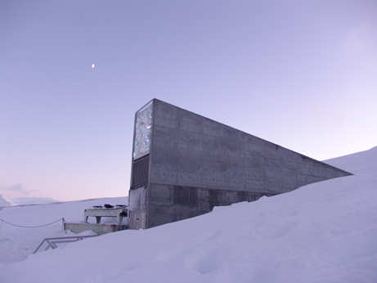
What is this and what’s stored here?
1
Copyright © 2024 SlideSpark .LLC

Slide 10

One word is bogus on the next slide. Please record the bogus word as your answer.
  Can you make the definition correct?

Slide 11
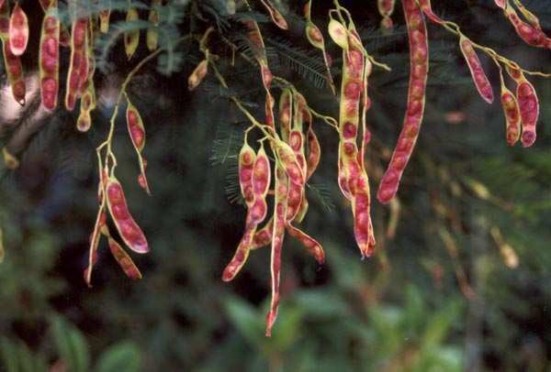
Seed: A mature unfertilized plant ovule consisting of an embryo and its food source and having a protective coat.
2
Copyright © 2024 SlideSpark .LLC

Slide 12
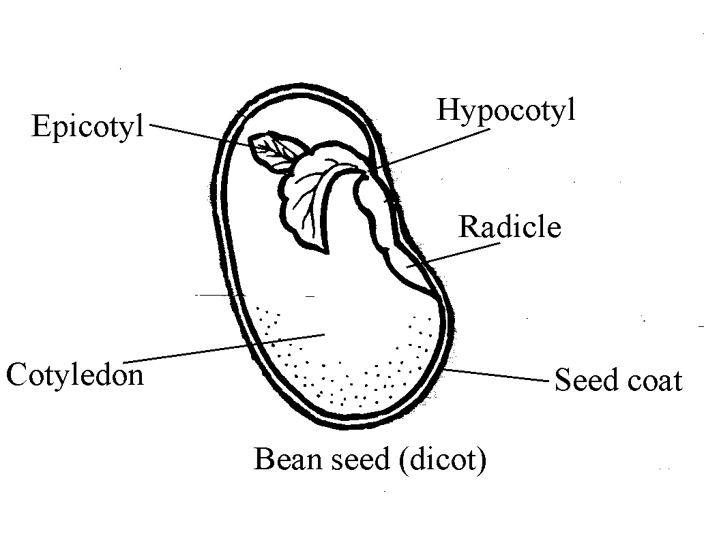
Name all 5. One point each
3
C
A
D
B
E
Copyright © 2024 SlideSpark .LLC

Slide 13
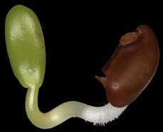
All of the following are factors that break seed dormancy except…
  A.) Gravitropism
  B.) Mechanical Abrasion.
  C.) Digestion processes of animals.
  D.) Temperatures – Warm and Cold + Fire.
  E.) Water
4

Slide 14
All of the following are factors that break seed dormancy except…
  A.) Gravitropism
  B.) Mechanical Abrasion.
  C.) Digestion processes of animals.
  D.) Temperatures – Warm and Cold + Fire.
  E.) Water
4

Slide 15
All of the following are factors that break seed dormancy except…
  A.) Gravitropism
  B.) Mechanical Abrasion
  C.) Digestion processes of animals.
  D.) Temperatures – Warm and Cold + Fire.
  E.) Water
4

Slide 16
All of the following are factors that break seed dormancy except…
  A.) Gravitropism
  B.) Mechanical Abrasion
  C.) Digestion processes of animals
  D.) Temperatures – Warm and Cold + Fire.
  E.) Water
4

Slide 17
All of the following are factors that break seed dormancy except…
  A.) Gravitropism
  B.) Mechanical Abrasion
  C.) Digestion processes of animals
  D.) Temperatures – Warm and Cold + Fire
  E.) Water
4

Slide 18
All of the following are factors that break seed dormancy except…
  A.) Gravitropism
  B.) Mechanical Abrasion
  C.) Digestion processes of animals
  D.) Temperatures – Warm and Cold + Fire
  E.) Water
4

Slide 19
5
Which is pollinated by wind?
A
B
C
D

Slide 20
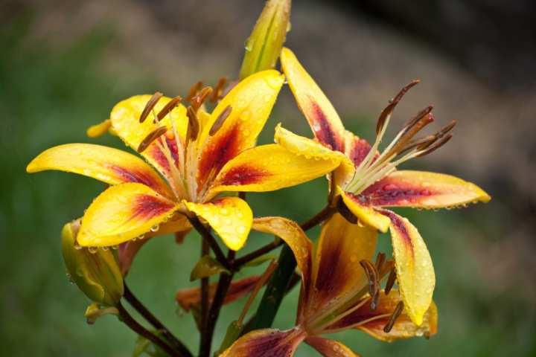
5
Which is pollinated by wind?
A
B
C
D

Slide 21
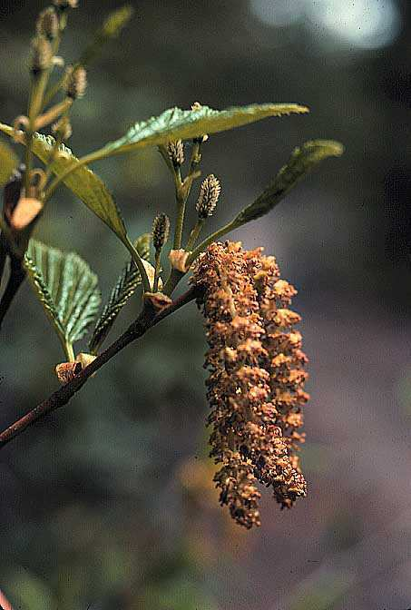
5
Which is pollinated by wind?
A
B
C
D

Slide 22
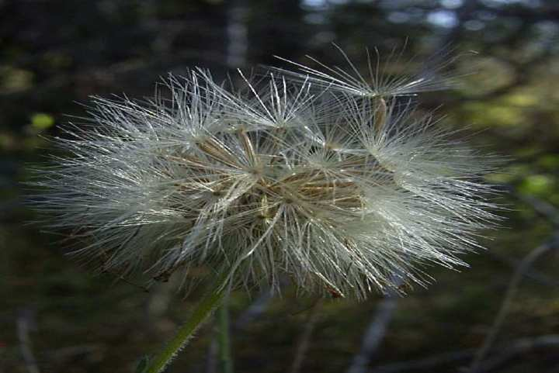
5
Which is pollinated by wind?
A
B
C
D

Slide 23
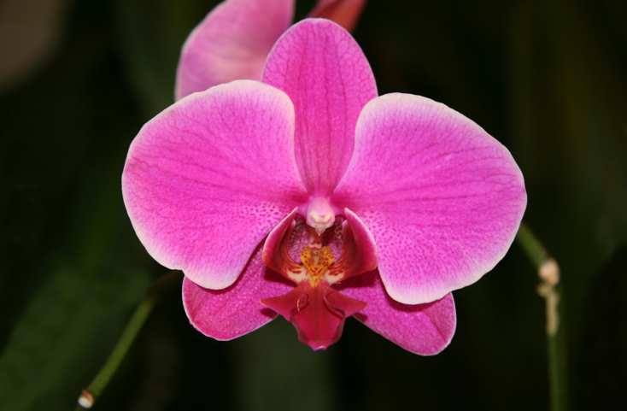
5
Which is pollinated by wind?
A
B
C
D

Slide 24
Part III REVIEW GAME
NEED FOR SEED | UP, UP, AND AWAY | YOUNG ONE | ONE FOR ME, TWO FOR YOU | -Bonus- GREEN MACHINE
1 | 6 | 11 | 16 | *21
2 | 7 | 12 | 17 | *22
3 | 8 | 13 | 18 | *23
4 | 9 | 14 | 19 | *24
5 | 10 | 15 | 20 | *25

Slide 25
Part III REVIEW GAME
NEED FOR SEED | UP, UP, AND AWAY | YOUNG ONE | ONE FOR ME, TWO FOR YOU | -Bonus- GREEN MACHINE
1 | 6 | 11 | 16 | *21
2 | 7 | 12 | 17 | *22
3 | 8 | 13 | 18 | *23
4 | 9 | 14 | 19 | *24
5 | 10 | 15 | 20 | *25

Slide 26
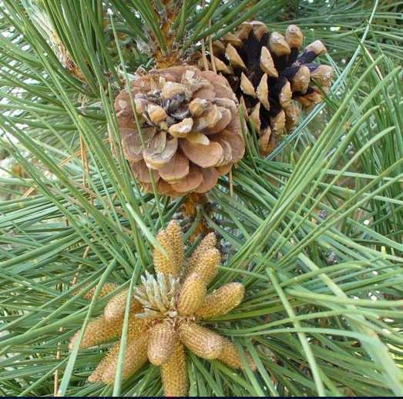
Which cone is the male cone, and which cone is the female cone?
6
A
B
Copyright © 2024 SlideSpark .LLC

Slide 27
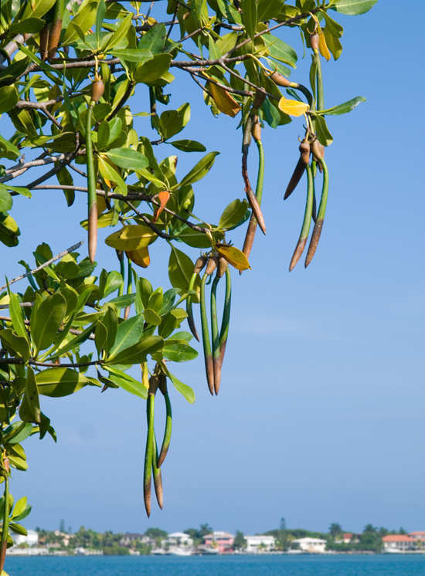
What mechanism disperses these seeds?
7
Copyright © 2024 SlideSpark .LLC

Slide 28
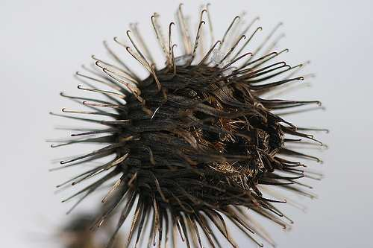
What mechanism disperses these seeds?
8
Copyright © 2024 SlideSpark .LLC

Slide 29
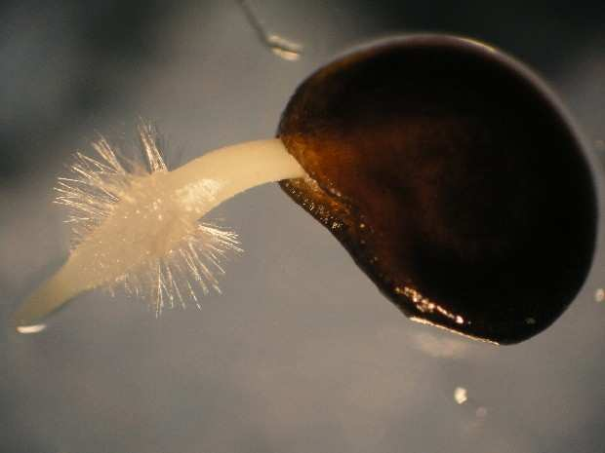

This is the process whereby growth emerges from a period of dormancy.
9
Copyright © 2024 SlideSpark .LLC

Slide 30
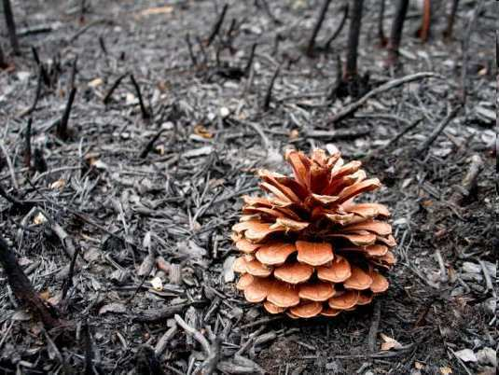
Seed dormancy was broken by…
10
Copyright © 2024 SlideSpark .LLC

Slide 31
Part III REVIEW GAME
NEED FOR SEED | UP, UP, AND AWAY | YOUNG ONE | ONE FOR ME, TWO FOR YOU | -Bonus- GREEN MACHINE
1 | 6 | 11 | 16 | *21
2 | 7 | 12 | 17 | *22
3 | 8 | 13 | 18 | *23
4 | 9 | 14 | 19 | *24
5 | 10 | 15 | 20 | *25

Slide 32
Part III REVIEW GAME
NEED FOR SEED | UP, UP, AND AWAY | YOUNG ONE | ONE FOR ME, TWO FOR YOU | -Bonus- GREEN MACHINE
1 | 6 | 11 | 16 | *21
2 | 7 | 12 | 17 | *22
3 | 8 | 13 | 18 | *23
4 | 9 | 14 | 19 | *24
5 | 10 | 15 | 20 | *25

Slide 33
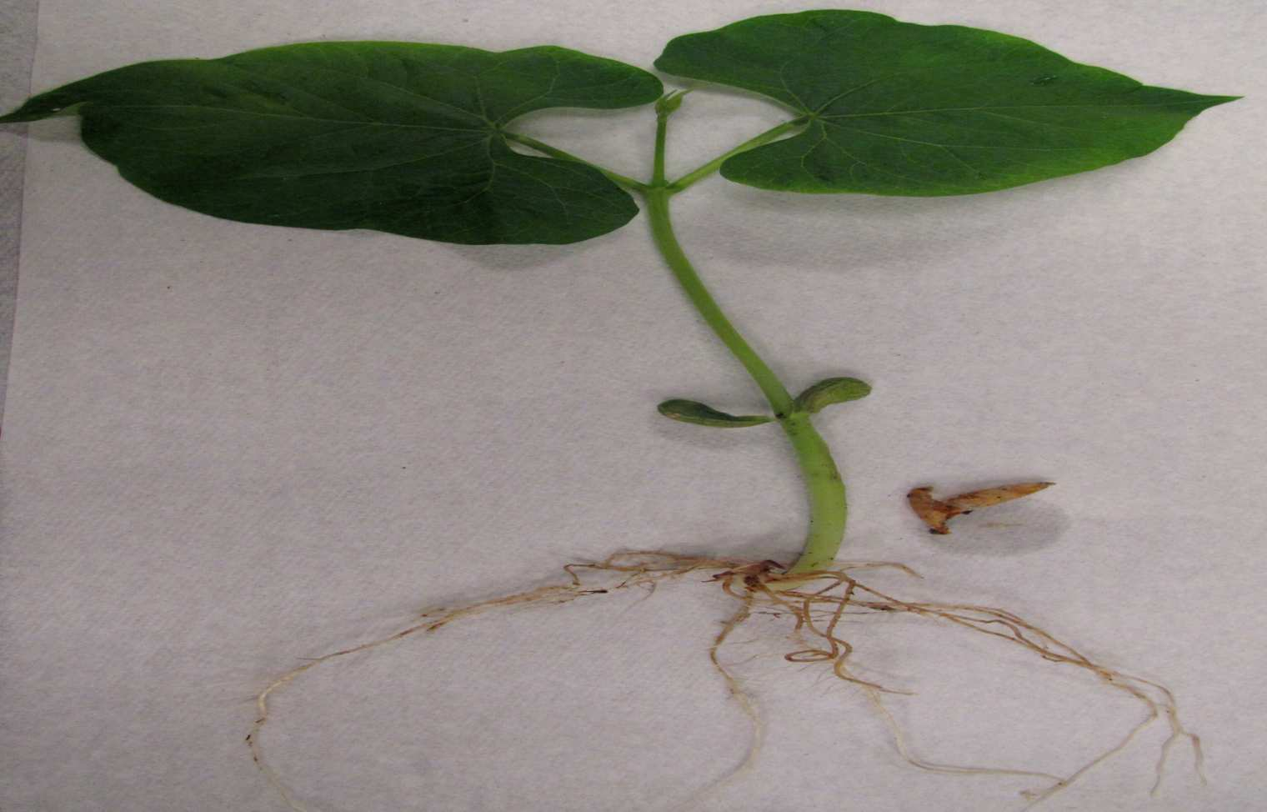
Which is a cotyledon?
11
A
B
C
E
D
Copyright © 2024 SlideSpark .LLC

Slide 34
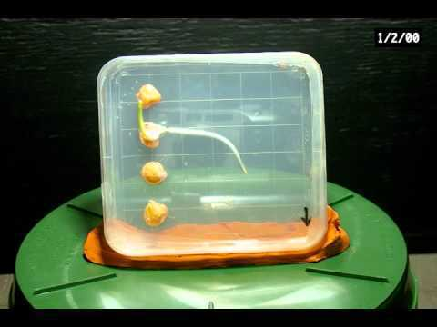
Name this process?
12
Copyright © 2024 SlideSpark .LLC

Slide 35
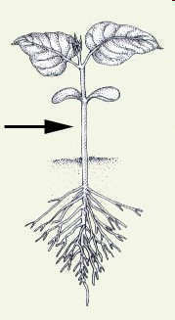
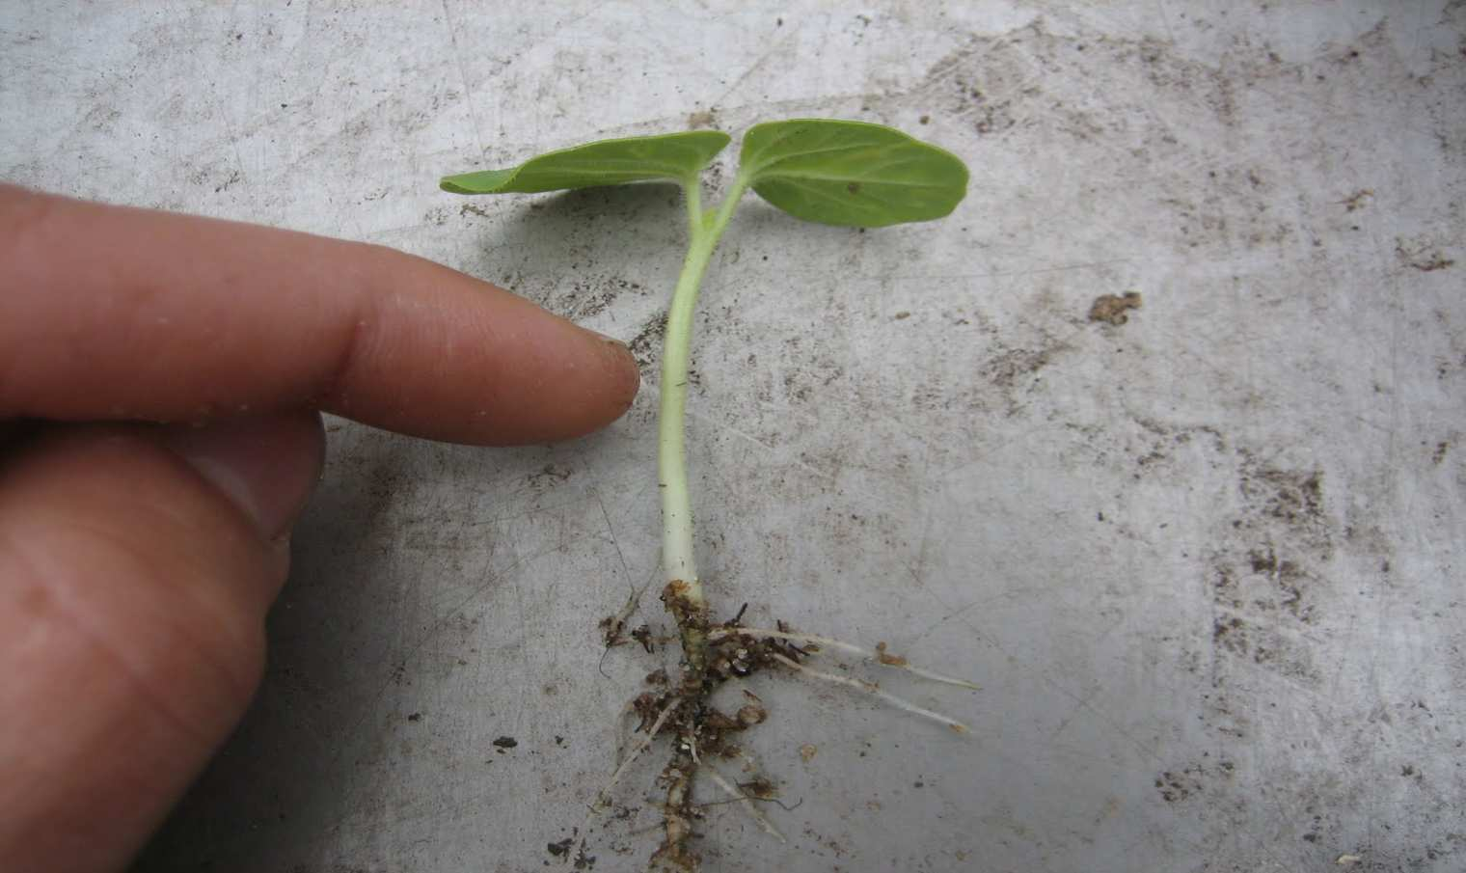
This is the part of the plant between the radicle and cotyledons.
13
13
Copyright © 2024 SlideSpark .LLC

Slide 36
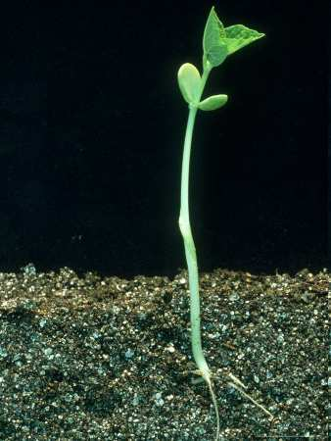
This is the stem of a seedling or embryo located between the cotyledons and the first true leaves.
14
Copyright © 2024 SlideSpark .LLC

Slide 37
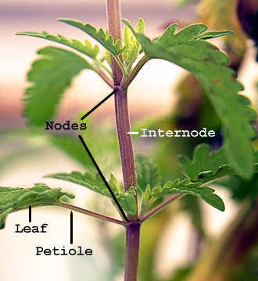
Name this part of a plant between the nodes.
15
Copyright © 2024 SlideSpark .LLC

Slide 38
Part III REVIEW GAME
NEED FOR SEED | UP, UP, AND AWAY | YOUNG ONE | ONE FOR ME, TWO FOR YOU | -Bonus- GREEN MACHINE
1 | 6 | 11 | 16 | *21
2 | 7 | 12 | 17 | *22
3 | 8 | 13 | 18 | *23
4 | 9 | 14 | 19 | *24
5 | 10 | 15 | 20 | *25

Slide 39
Part III REVIEW GAME
NEED FOR SEED | UP, UP, AND AWAY | YOUNG ONE | ONE FOR ME, TWO FOR YOU | -Bonus- GREEN MACHINE
1 | 6 | 11 | 16 | *21
2 | 7 | 12 | 17 | *22
3 | 8 | 13 | 18 | *23
4 | 9 | 14 | 19 | *24
5 | 10 | 15 | 20 | *25

Slide 40
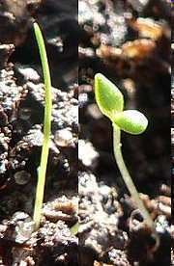
Which is a moncotyledon and which is a dicotyledon?
A
B
16
Copyright © 2024 SlideSpark .LLC

Slide 41
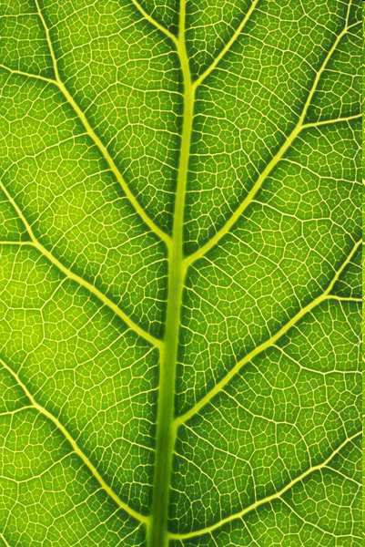
Why isn’t this a monocotyledon?
17
Copyright © 2024 SlideSpark .LLC

Slide 42
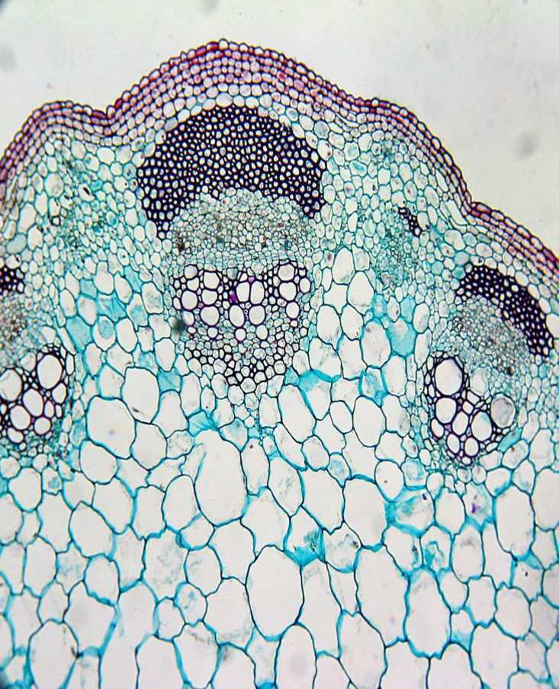
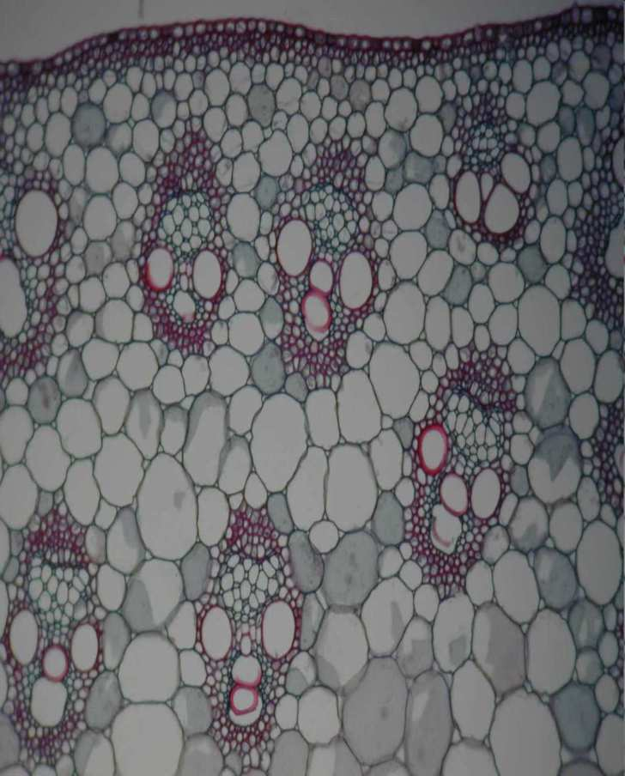
Which is a monocotyledon and which is a dicotyledon?
A
B
18
Copyright © 2024 SlideSpark .LLC

Slide 43
19
Which is a monocotyledon?
A
B
C
D

Slide 44
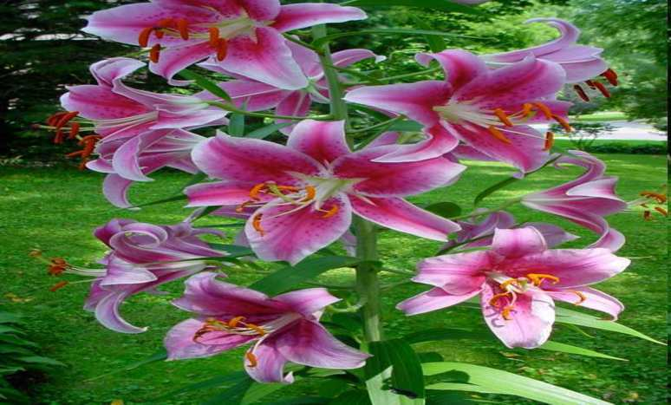
19
Which is a monocotyledon?
A
B
C
D

Slide 45
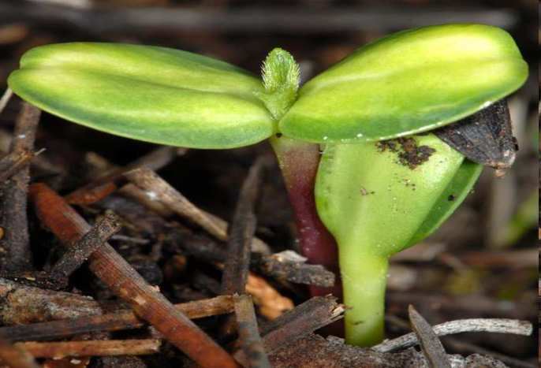
19
Which is a monocotyledon?
A
B
C
D

Slide 46
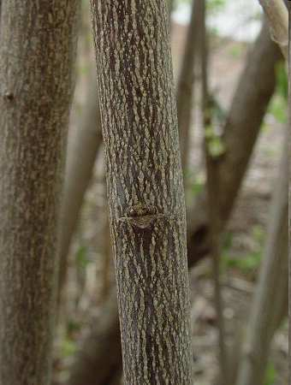
19
Which is a monocotyledon?
A
B
C
D

Slide 47
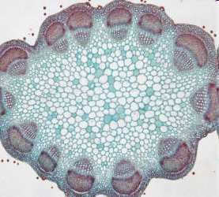
19
Which is a monocotyledon?
A
B
C
D

Slide 48
20
Who…
  Was born into slavery during the Civil War.
  Was Orphaned as an infant.
  Survived a life threatening childhood sickness.
  Survived bloody guerilla warfare in Missouri.
  Survived extreme poverty.
  Endured racism for his entire life.
  Earned B.S., M.S., D.Sc., Ph.D., Fellow of the Royal Society of Arts, London, and Director of Research and Experiment at Tuskegee Institute, Alabama.
  Became the worlds greatest agricultural chemist and spent his life improving the lives of others.
Copyright © 2024 SlideSpark .LLC

Slide 49
Part III REVIEW GAME
NEED FOR SEED | UP, UP, AND AWAY | YOUNG ONE | ONE FOR ME, TWO FOR YOU | -Bonus- GREEN MACHINE
1 | 6 | 11 | 16 | *21
2 | 7 | 12 | 17 | *22
3 | 8 | 13 | 18 | *23
4 | 9 | 14 | 19 | *24
5 | 10 | 15 | 20 | *25

Slide 50
Part III REVIEW GAME
NEED FOR SEED | UP, UP, AND AWAY | YOUNG ONE | ONE FOR ME, TWO FOR YOU | -Bonus- GREEN MACHINE
1 | 6 | 11 | 16 | *21
2 | 7 | 12 | 17 | *22
3 | 8 | 13 | 18 | *23
4 | 9 | 14 | 19 | *24
5 | 10 | 15 | 20 | *25

Slide 51
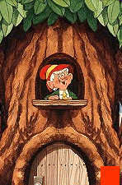
What are the names for the elves that live in this tree?
*21

Slide 52

*22
Who is wearing a dicotyledon?
Blacked
Out
Blacked
Out
Copyright © 2024 SlideSpark .LLC

Slide 53
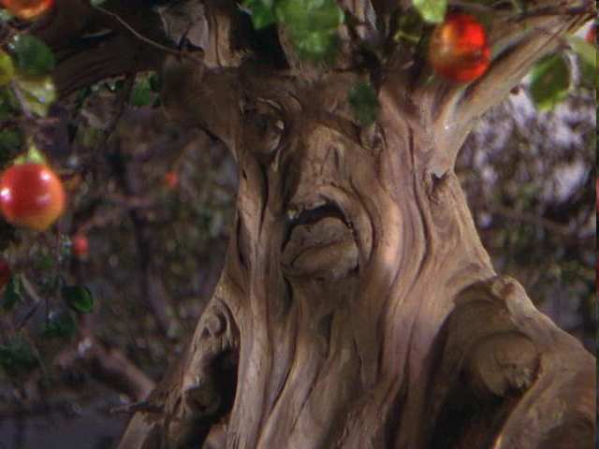
These evil trees can be found in this movie?
*23
Copyright © 2024 SlideSpark .LLC

Slide 54
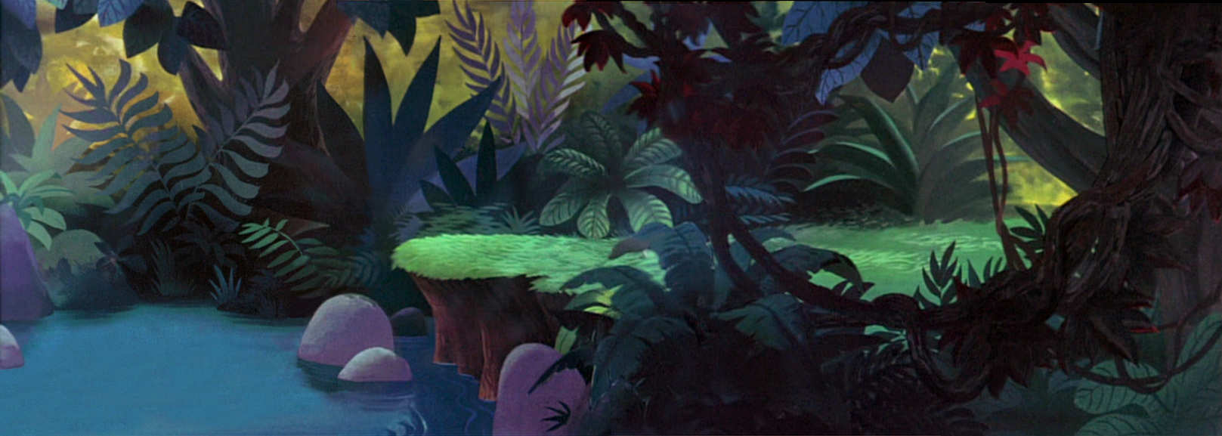
Name this place? Do you need a hint?
*24
Copyright © 2024 SlideSpark .LLC

Slide 55
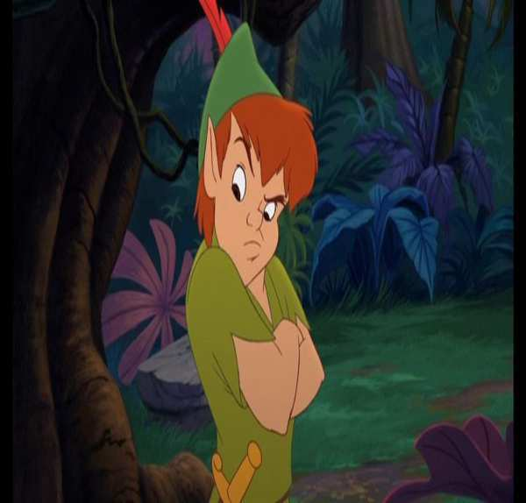
Name this place? Do you need a hint?
*24
Hint
Copyright © 2024 SlideSpark .LLC

Slide 56
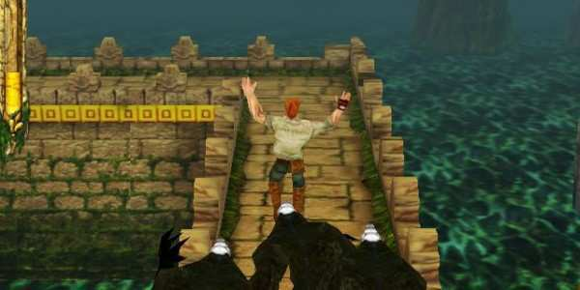
Name this game?
*25
Copyright © 2024 SlideSpark .LLC

Slide 57
Part III REVIEW GAME
NEED FOR SEED | UP, UP, AND AWAY | YOUNG ONE | ONE FOR ME, TWO FOR YOU | -Bonus- GREEN MACHINE
1 | 6 | 11 | 16 | *21
2 | 7 | 12 | 17 | *22
3 | 8 | 13 | 18 | *23
4 | 9 | 14 | 19 | *24
5 | 10 | 15 | 20 | *25
Final Question

Slide 58
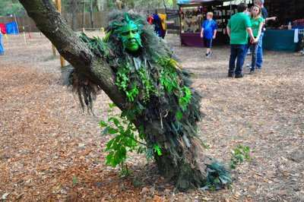
5 Point Wager
Question

Slide 59
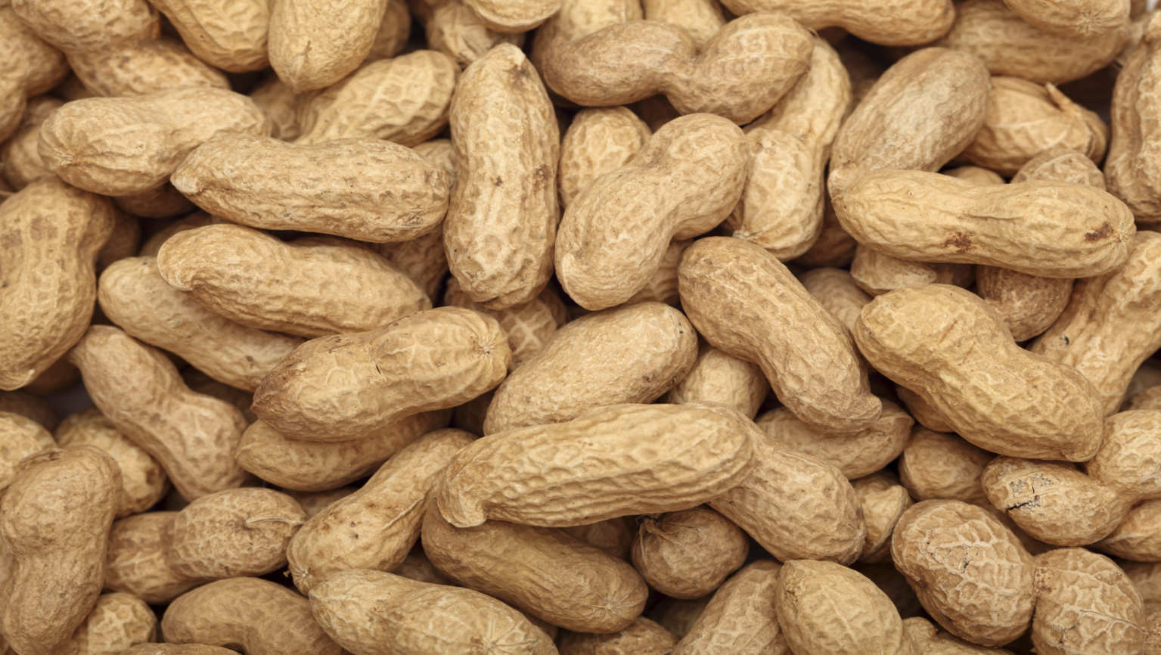
Name all four parts of the peanut on the next slide?
Copyright © 2024 SlideSpark .LLC

Slide 60
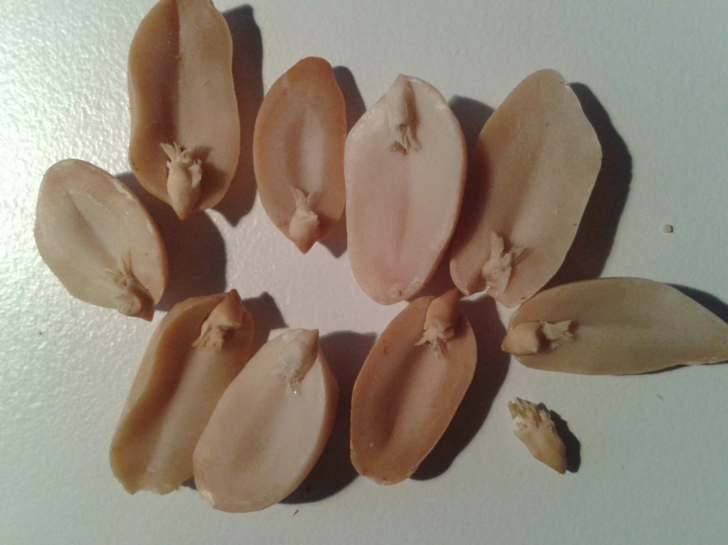
A
B
Hypocotyl
Epicotyl
C
D
Cotyledon
Radicle

Slide 61

Part 3 Unit Review Game
1-20 = 5 points each
20-25 = Bonus (1 point each)
Final Question = 5 point wager
Find the Owl = 1 point

Slide 62
Part 3 Review Game
Part 3
Lesson 8

Slide 63

Part 3 Review Game
Part 3
Lesson 8

Slide 64
Part III REVIEW GAME
NEED FOR SEED | UP, UP, AND AWAY | YOUNG ONE | ONE FOR ME, TWO FOR YOU | -Bonus- GREEN MACHINE
1 | 6 | 11 | 16 | *21
2 | 7 | 12 | 17 | *22
3 | 8 | 13 | 18 | *23
4 | 9 | 14 | 19 | *24
5 | 10 | 15 | 20 | *25

Slide 65
Part III REVIEW GAME
NEED FOR SEED | UP, UP, AND AWAY | YOUNG ONE | ONE FOR ME, TWO FOR YOU | -Bonus- GREEN MACHINE
1 | 6 | 11 | 16 | *21
2 | 7 | 12 | 17 | *22
3 | 8 | 13 | 18 | *23
4 | 9 | 14 | 19 | *24
5 | 10 | 15 | 20 | *25

Slide 66
What is this and what’s stored here?
1
Copyright © 2024 SlideSpark .LLC

Slide 67
What is this and what’s stored here?
1
The Svalbard Global
Seed Vault
Copyright © 2024 SlideSpark .LLC

Slide 68
What is this and what’s stored here?
1
The Svalbard Global
Seed Vault
Aka “Doomsday Vault”
Copyright © 2024 SlideSpark .LLC

Slide 69
What is this and what’s stored here?
1
The Svalbard Global
Seed Vault
Aka “Doomsday Vault”
Copyright © 2024 SlideSpark .LLC

Slide 70
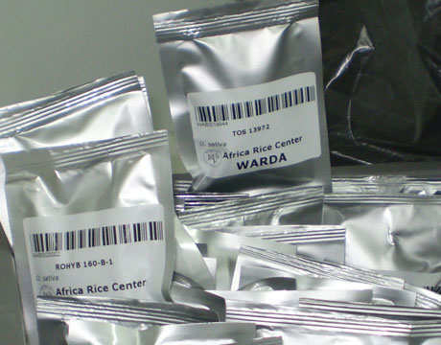
What is this and what’s stored here?
1
The Svalbard Global
Seeds Vault
Aka “Doomsday Vault”
Copyright © 2024 SlideSpark .LLC

Slide 71
One word is bogus on the next slide. Please record the bogus word as your answer.
  Can you make the definition correct?

Slide 72
Seed: A mature unfertilized plant ovule consisting of an embryo and its food source and having a protective coat.
2
Copyright © 2024 SlideSpark .LLC

Slide 73
Seed: A mature unfertilized plant ovule consisting of an embryo and its food source and having a protective coat.
2
Bogus word is…
Copyright © 2024 SlideSpark .LLC

Slide 74
Seed: A mature unfertilized plant ovule consisting of an embryo and its food source and having a protective coat.
2
Bogus word is…
Copyright © 2024 SlideSpark .LLC

Slide 75
Seed: A mature fertilized plant ovule consisting of an embryo and its food source and having a protective coat.
2
Bogus word is…
Copyright © 2024 SlideSpark .LLC

Slide 76
Name all 5. One point each
3
C
A
D
B
E
Copyright © 2024 SlideSpark .LLC

Slide 77
Name all 5. One point each
3
C
A
D
B
E
Copyright © 2024 SlideSpark .LLC

Slide 78
Name all 5. One point each
3
C
A
D
B
E
Copyright © 2024 SlideSpark .LLC

Slide 79
Name all 5. One point each
3
C
A
D
B
E
Copyright © 2024 SlideSpark .LLC

Slide 80
Name all 5. One point each
3
C
A
D
B
E
Copyright © 2024 SlideSpark .LLC

Slide 81
Name all 5. One point each
3
C
A
D
B
E
Copyright © 2024 SlideSpark .LLC

Slide 82
Name all 5. One point each
3
C
A
D
B
E
Copyright © 2024 SlideSpark .LLC

Slide 83
Name all 5. One point each
3
C
A
D
B
E
Copyright © 2024 SlideSpark .LLC

Slide 84
Name all 5. One point each
3
C
A
D
B
E
Copyright © 2024 SlideSpark .LLC

Slide 85
Name all 5. One point each
3
C
A
D
B
E
Copyright © 2024 SlideSpark .LLC

Slide 86
Name all 5. One point each
3
C
A
D
B
E
Copyright © 2024 SlideSpark .LLC

Slide 87
All of the following are factors that break seed dormancy except…
  A.) Gravitropism
  B.) Mechanical Abrasion.
  C.) Digestion processes of animals.
  D.) Temperatures – Warm and Cold + Fire.
  E.) Water
4

Slide 88
All of the following are factors that break seed dormancy except…
  A.) Gravitropism
  B.) Mechanical Abrasion.
  C.) Digestion processes of animals.
  D.) Temperatures – Warm and Cold + Fire.
  E.) Water
4

Slide 89
All of the following are factors that break seed dormancy except…
  A.) Gravitropism
  B.) Mechanical Abrasion
  C.) Digestion processes of animals.
  D.) Temperatures – Warm and Cold + Fire.
  E.) Water
4

Slide 90
All of the following are factors that break seed dormancy except…
  A.) Gravitropism
  B.) Mechanical Abrasion
  C.) Digestion processes of animals
  D.) Temperatures – Warm and Cold + Fire.
  E.) Water
4

Slide 91
All of the following are factors that break seed dormancy except…
  A.) Gravitropism
  B.) Mechanical Abrasion
  C.) Digestion processes of animals
  D.) Temperatures – Warm and Cold + Fire
  E.) Water
4

Slide 92
All of the following are factors that break seed dormancy except…
  A.) Gravitropism
  B.) Mechanical Abrasion
  C.) Digestion processes of animals
  D.) Temperatures – Warm and Cold + Fire
  E.) Water
4

Slide 93
All of the following are factors that break seed dormancy except…
  A.) Gravitropism
  B.) Mechanical Abrasion
  C.) Digestion processes of animals
  D.) Temperatures – Warm and Cold + Fire
  E.) Water
4
answer is…

Slide 94
All of the following are factors that break seed dormancy except…
  A.) Gravitropism
  B.) Mechanical Abrasion
  C.) Digestion processes of animals
  D.) Temperatures – Warm and Cold + Fire
  E.) Water
4
answer is…

Slide 95
5
Which is pollinated by wind?
A
B
C
D

Slide 96
5
Which is pollinated by wind?
A
B
C
D

Slide 97
5
Which is pollinated by wind?
A
B
Insects
C
D
Insects

Slide 98
5
Which is pollinated by wind?
A
B
Insects
C
D
Insects

Slide 99
5
Which is pollinated by wind?
A
B
Insects
C
D
Insects

Slide 100
5
Which is pollinated by wind?
A
B
Insects
C
D
Seeds
dispersed by wind
Insects

Slide 101
5
Which is pollinated by wind?
A
B
Insects
C
D
Seeds
dispersed by wind
Insects

Slide 102
Part III REVIEW GAME
NEED FOR SEED | UP, UP, AND AWAY | YOUNG ONE | ONE FOR ME, TWO FOR YOU | -Bonus- GREEN MACHINE
1 | 6 | 11 | 16 | *21
2 | 7 | 12 | 17 | *22
3 | 8 | 13 | 18 | *23
4 | 9 | 14 | 19 | *24
5 | 10 | 15 | 20 | *25

Slide 103
Part III REVIEW GAME
NEED FOR SEED | UP, UP, AND AWAY | YOUNG ONE | ONE FOR ME, TWO FOR YOU | -Bonus- GREEN MACHINE
1 | 6 | 11 | 16 | *21
2 | 7 | 12 | 17 | *22
3 | 8 | 13 | 18 | *23
4 | 9 | 14 | 19 | *24
5 | 10 | 15 | 20 | *25

Slide 104
Which cone is the male cone, and which cone is the female cone?
6
A
B
Copyright © 2024 SlideSpark .LLC

Slide 105
Which cone is the male cone, and which cone is the female cone?
6
A
B
Copyright © 2024 SlideSpark .LLC

Slide 106
Which cone is the male cone, and which cone is the female cone?
6
Female
A
B
Copyright © 2024 SlideSpark .LLC

Slide 107
Which cone is the male cone, and which cone is the female cone?
6
Female
A
B
Copyright © 2024 SlideSpark .LLC

Slide 108
Which cone is the male cone, and which cone is the female cone?
6
Female
A
Male
B
Copyright © 2024 SlideSpark .LLC

Slide 109
What mechanism disperses these seeds?
7
Copyright © 2024 SlideSpark .LLC

Slide 110
What mechanism disperses these seeds?
7
answer is…
Copyright © 2024 SlideSpark .LLC

Slide 111
What mechanism disperses these seeds?
7
WATER
answer is…
Copyright © 2024 SlideSpark .LLC

Slide 112
What mechanism disperses these seeds?
8
Copyright © 2024 SlideSpark .LLC

Slide 113
What mechanism disperses these seeds?
8
answer is…
Copyright © 2024 SlideSpark .LLC

Slide 114
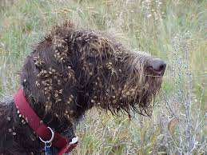
What mechanism disperses these seeds?
8
answer is…
Copyright © 2024 SlideSpark .LLC

Slide 115
What mechanism disperses these seeds?
8
Animals
answer is…
Copyright © 2024 SlideSpark .LLC

Slide 116
This is the process whereby growth emerges from a period of dormancy.
9
Copyright © 2024 SlideSpark .LLC

Slide 117
This is the process whereby growth emerges from a period of dormancy.
9
answer is…
Copyright © 2024 SlideSpark .LLC

Slide 118
This is the process whereby growth emerges from a period of dormancy.
9
Germination
answer is…
Copyright © 2024 SlideSpark .LLC

Slide 119

This is the process whereby growth emerges from a period of dormancy.
9
Germination
answer is…
Copyright © 2024 SlideSpark .LLC

Slide 120
Seed dormancy was broken by…
10
Copyright © 2024 SlideSpark .LLC

Slide 121
Seed dormancy was broken by…
10
answer is…
Copyright © 2024 SlideSpark .LLC

Slide 122
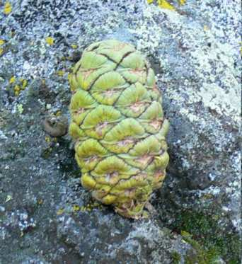
Seed dormancy was broken by…
10
answer is…
Copyright © 2024 SlideSpark .LLC

Slide 123

Seed dormancy was broken by…
10
FIRE
answer is…
Copyright © 2024 SlideSpark .LLC

Slide 124
Seed dormancy was broken by…
10
FIRE
Seeds
answer is…
Copyright © 2024 SlideSpark .LLC

Slide 125
Part III REVIEW GAME
NEED FOR SEED | UP, UP, AND AWAY | YOUNG ONE | ONE FOR ME, TWO FOR YOU | -Bonus- GREEN MACHINE
1 | 6 | 11 | 16 | *21
2 | 7 | 12 | 17 | *22
3 | 8 | 13 | 18 | *23
4 | 9 | 14 | 19 | *24
5 | 10 | 15 | 20 | *25

Slide 126
Part III REVIEW GAME
NEED FOR SEED | UP, UP, AND AWAY | YOUNG ONE | ONE FOR ME, TWO FOR YOU | -Bonus- GREEN MACHINE
1 | 6 | 11 | 16 | *21
2 | 7 | 12 | 17 | *22
3 | 8 | 13 | 18 | *23
4 | 9 | 14 | 19 | *24
5 | 10 | 15 | 20 | *25

Slide 127
Which is a cotyledon?
11
A
B
C
E
D
Copyright © 2024 SlideSpark .LLC

Slide 128
Which is a cotyledon?
11
A
B
C
E
D
answer is…
Copyright © 2024 SlideSpark .LLC

Slide 129
Which is a cotyledon?
11
Cotyledons
answer is…
Copyright © 2024 SlideSpark .LLC

Slide 130
Name this process?
12
Copyright © 2024 SlideSpark .LLC

Slide 131
Name this process?
12
and the answer is…
Copyright © 2024 SlideSpark .LLC

Slide 132
Name this process?
12
Gravitropism
Radicle goes downward
and the answer is…
Copyright © 2024 SlideSpark .LLC

Slide 133
This is the part of the plant between the radicle and cotyledons.
13
13
Copyright © 2024 SlideSpark .LLC

Slide 134
This is the part of the plant between the radicle and cotyledons.
13
13
answer is…
Copyright © 2024 SlideSpark .LLC

Slide 135
This is the part of the plant between the radicle and cotyledons.
13
13
Hypocotyl
answer is…
Copyright © 2024 SlideSpark .LLC

Slide 136
This is the stem of a seedling or embryo located between the cotyledons and the first true leaves.
14
Copyright © 2024 SlideSpark .LLC

Slide 137
This is the stem of a seedling or embryo located between the cotyledons and the first true leaves.
14
answer is…
Copyright © 2024 SlideSpark .LLC

Slide 138
This is the stem of a seedling or embryo located between the cotyledons and the first true leaves.
14
Epicotyl
answer is…
Copyright © 2024 SlideSpark .LLC

Slide 139
Name this part of a plant between the nodes.
15
Copyright © 2024 SlideSpark .LLC

Slide 140
Name this part of a plant between the nodes.
15
Copyright © 2024 SlideSpark .LLC

Slide 141
Name this part of a plant between the nodes.
15
Copyright © 2024 SlideSpark .LLC

Slide 142
Part III REVIEW GAME
NEED FOR SEED | UP, UP, AND AWAY | YOUNG ONE | ONE FOR ME, TWO FOR YOU | -Bonus- GREEN MACHINE
1 | 6 | 11 | 16 | *21
2 | 7 | 12 | 17 | *22
3 | 8 | 13 | 18 | *23
4 | 9 | 14 | 19 | *24
5 | 10 | 15 | 20 | *25

Slide 143
Part III REVIEW GAME
NEED FOR SEED | UP, UP, AND AWAY | YOUNG ONE | ONE FOR ME, TWO FOR YOU | -Bonus- GREEN MACHINE
1 | 6 | 11 | 16 | *21
2 | 7 | 12 | 17 | *22
3 | 8 | 13 | 18 | *23
4 | 9 | 14 | 19 | *24
5 | 10 | 15 | 20 | *25

Slide 144
Which is a moncotyledon and which is a dicotyledon?
A
B
16
Copyright © 2024 SlideSpark .LLC

Slide 145
Which is a moncotyledon and which is a dicotyledon?
A
B
16
Copyright © 2024 SlideSpark .LLC

Slide 146
Which is a moncotyledon and which is a dicotyledon?
A
B
Monocotyledon
16
Copyright © 2024 SlideSpark .LLC

Slide 147
Which is a moncotyledon and which is a dicotyledon?
A
B
Monocotyledon
16
Copyright © 2024 SlideSpark .LLC

Slide 148
Which is a moncotyledon and which is a dicotyledon?
A
B
Monocotyledon
16
Copyright © 2024 SlideSpark .LLC

Slide 149
Which is a moncotyledon and which is a dicotyledon?
A
B
Monocotyledon
Dicotyledon
16
Copyright © 2024 SlideSpark .LLC

Slide 150
Why is this not a monocotyledon?
17
Copyright © 2024 SlideSpark .LLC

Slide 151
Why is this not a monocotyledon?
17
answer is…
Copyright © 2024 SlideSpark .LLC

Slide 152
Why is this not a monocotyledon?
17
Veins are
branched
Dicotyledon
answer is…
Copyright © 2024 SlideSpark .LLC

Slide 153
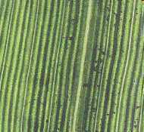
Why is this not a monocotyledon?
Parallel
17
Monocot
Veins are
branched
Dicotyledon
answer is…
Copyright © 2024 SlideSpark .LLC

Slide 154
Which is a monocotyledon and which is a dicotyledon?
A
B
18
Copyright © 2024 SlideSpark .LLC

Slide 155
Which is a monocotyledon and which is a dicotyledon?
A
B
18
Copyright © 2024 SlideSpark .LLC

Slide 156
Which is a monocotyledon and which is a dicotyledon?
A
B
Dicotyledon
18
Copyright © 2024 SlideSpark .LLC

Slide 157
Which is a monocotyledon and which is a dicotyledon?
A
B
Dicotyledon
18
Copyright © 2024 SlideSpark .LLC

Slide 158
Which is a monocotyledon and which is a dicotyledon?
A
B
Monocotyledon
Dicotyledon
18
Copyright © 2024 SlideSpark .LLC

Slide 159
Which is a monocotyledon and which is a dicotyledon?
A
B
Monocotyledon
Dicotyledon
18
Copyright © 2024 SlideSpark .LLC

Slide 160
19
Which is a monocotyledon?
A
B
C
D

Slide 161
19
Which is a monocotyledon?
A
B
C
D

Slide 162

19
Which is a monocotyledon?
A
B
C
D
Woody

Slide 163
19
Which is a monocotyledon?
A
B
C
D
Woody

Slide 164
19
Which is a monocotyledon?
A
B
C
D
Woody

Slide 165
19
Which is a monocotyledon?
A
B
Two Cotyledons
C
D
Woody

Slide 166
19
Which is a monocotyledon?
A
B
Two Cotyledons
C
D
Woody

Slide 167
19
Which is a monocotyledon?
A
B
Two Cotyledons
C
D
Woody

Slide 168
19
Which is a monocotyledon?
A
B
Two Cotyledons
C
D
Woody
Vascular Bundles
Arranged on Edge

Slide 169
19
Which is a monocotyledon?
A
B
Two Cotyledons
C
D
Woody
Vascular Bundles
Arranged on Edge

Slide 170
19
Which is a monocotyledon?
A
B
Petals in 3’s
Two Cotyledons
C
D
Woody
Vascular Bundles
Arranged on Edge

Slide 171
20
Who…
  Was born into slavery during the Civil War.
  Was Orphaned as an infant.
  Survived a life threatening childhood sickness.
  Survived bloody guerilla warfare in Missouri.
  Survived extreme poverty.
  Endured racism for his entire life.
  Earned B.S., M.S., D.Sc., Ph.D., Fellow of the Royal Society of Arts, London, and Director of Research and Experiment at Tuskegee Institute, Alabama.
  Became the worlds greatest agricultural chemist and spent his life improving the lives of others.
Copyright © 2024 SlideSpark .LLC

Slide 172
20
Who…
  Was born into slavery during the Civil War.
  Was Orphaned as an infant.
  Survived a life threatening childhood sickness.
  Survived bloody guerilla warfare in Missouri.
  Survived extreme poverty.
  Endured racism for his entire life.
  Earned B.S., M.S., D.Sc., Ph.D., Fellow of the Royal Society of Arts, London, and Director of Research and Experiment at Tuskegee Institute, Alabama.
  Became the worlds greatest agricultural chemist and spent his life improving the lives of others.
answer is…
Copyright © 2024 SlideSpark .LLC

Slide 173
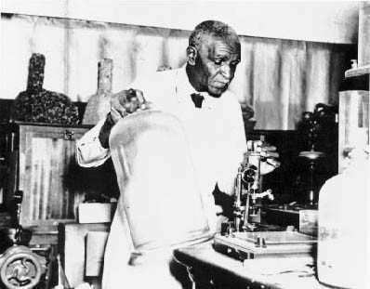
20
Who…
  Was born into slavery during the Civil War.
  Was Orphaned as an infant.
  Survived a life threatening childhood sickness.
  Survived bloody guerilla warfare in Missouri.
  Survived extreme poverty.
  Endured racism for his entire life.
  Earned B.S., M.S., D.Sc., Ph.D., Fellow of the Royal Society of Arts, London, and Director of Research and Experiment at Tuskegee Institute, Alabama.
  Became the worlds greatest agricultural chemist and spent his life improving the lives of others.
answer is…
Copyright © 2024 SlideSpark .LLC

Slide 174
20
Who…
  Was born into slavery during the Civil War.
  Was Orphaned as an infant.
  Survived a life threatening childhood sickness.
  Survived bloody guerilla warfare in Missouri.
  Survived extreme poverty.
  Endured racism for his entire life.
  Earned B.S., M.S., D.Sc., Ph.D., Fellow of the Royal Society of Arts, London, and Director of Research and Experiment at Tuskegee Institute, Alabama.
  Became the worlds greatest agricultural chemist and spent his life improving the lives of others.
George Washington
Carver
answer is…
Copyright © 2024 SlideSpark .LLC

Slide 175
Part III REVIEW GAME
NEED FOR SEED | UP, UP, AND AWAY | YOUNG ONE | ONE FOR ME, TWO FOR YOU | -Bonus- GREEN MACHINE
1 | 6 | 11 | 16 | *21
2 | 7 | 12 | 17 | *22
3 | 8 | 13 | 18 | *23
4 | 9 | 14 | 19 | *24
5 | 10 | 15 | 20 | *25

Slide 176
Part III REVIEW GAME
NEED FOR SEED | UP, UP, AND AWAY | YOUNG ONE | ONE FOR ME, TWO FOR YOU | -Bonus- GREEN MACHINE
1 | 6 | 11 | 16 | *21
2 | 7 | 12 | 17 | *22
3 | 8 | 13 | 18 | *23
4 | 9 | 14 | 19 | *24
5 | 10 | 15 | 20 | *25

Slide 177
What are the names for the elves that live in this tree?
*21

Slide 178
What are the names for the elves that live in this tree?
*21
and the answer is…

Slide 179
What are the names for the elves that live in this tree?
*21
Keebler Elves
and the answer is…

Slide 180
*22
Who is wearing a dicotyledon?
Blacked
Out
Blacked
Out
Copyright © 2024 SlideSpark .LLC

Slide 181
*22
Who is wearing a dicotyledon?
Blacked
Out
Blacked
Out
Copyright © 2024 SlideSpark .LLC

Slide 182
*22
Who is wearing a dicotyledon?
Copyright © 2024 SlideSpark .LLC

Slide 183
*22
Who is wearing a dicotyledon?
Lucky
Copyright © 2024 SlideSpark .LLC

Slide 184
These evil trees can be found in this movie?
*23
Copyright © 2024 SlideSpark .LLC

Slide 185
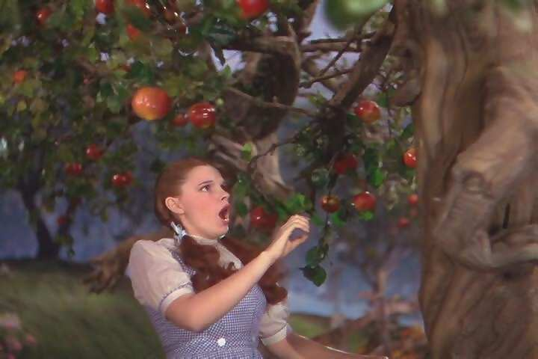
These evil trees can be found in this movie?
*23
*23
Copyright © 2024 SlideSpark .LLC

Slide 186

These evil trees can be found in this movie?
*23
*23
*23
Copyright © 2024 SlideSpark .LLC

Slide 187
Name this place? Do you need a hint?
*24
Copyright © 2024 SlideSpark .LLC

Slide 188
Name this place? Do you need a hint?
*24
Hint
Copyright © 2024 SlideSpark .LLC

Slide 189
Name this place? Do you need a hint?
*24
Hint
answer is…
Copyright © 2024 SlideSpark .LLC

Slide 190
Name this place? Do you need a hint?
*24
Neverland
Hint
answer is…
Copyright © 2024 SlideSpark .LLC

Slide 191
Name this game?
*25
Copyright © 2024 SlideSpark .LLC

Slide 192
Name this game?
*25
Answer is…
Copyright © 2024 SlideSpark .LLC

Slide 193
Name this game?
Temple Run
*25
Answer is…
Copyright © 2024 SlideSpark .LLC

Slide 194
Part III REVIEW GAME
NEED FOR SEED | UP, UP, AND AWAY | YOUNG ONE | ONE FOR ME, TWO FOR YOU | -Bonus- GREEN MACHINE
1 | 6 | 11 | 16 | *21
2 | 7 | 12 | 17 | *22
3 | 8 | 13 | 18 | *23
4 | 9 | 14 | 19 | *24
5 | 10 | 15 | 20 | *25
Final Question

Slide 195
5 Point Wager
Question

Slide 196
Name all four parts of the peanut on the next slide?
Copyright © 2024 SlideSpark .LLC

Slide 197
A
B
Hypocotyl
Epicotyl
C
D
Cotyledon
Radicle

Slide 198
A
B
Hypocotyl
Epicotyl
C
D
Cotyledon
Radicle

Slide 199
A
B
Hypocotyl
Epicotyl
C
D
Cotyledon
Radicle

Slide 200
A
B
Hypocotyl
Epicotyl
C
D
Cotyledon
Radicle

Slide 201
A
B
Hypocotyl
Epicotyl
C
D
Cotyledon
Radicle

Slide 202
A
B
Hypocotyl
Epicotyl
C
D
Cotyledon
Radicle

Slide 203
A
B
Hypocotyl
Epicotyl
C
D
Cotyledon
Radicle

Slide 204
A
B
Hypocotyl
Epicotyl
C
D
Cotyledon
Radicle

Slide 205
A
B
Hypocotyl
Epicotyl
C
D
Cotyledon
Radicle

Slide 206
Part 3 Unit Review Game
1-20 = 5 points each
20-25 = Bonus (1 point each)
Final Question = 5 point wager
Find the Owl = 1 point

Slide 207
Part 3 Review Game
Part 3
Lesson 8

Slide 208



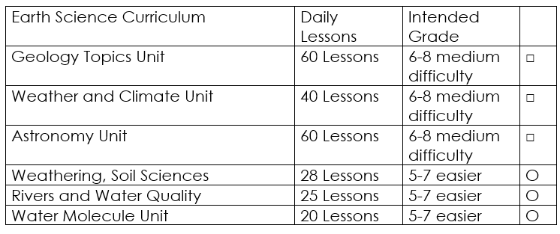

Curriculum Guide
Number of Lessons in each unit (50 min, daily lessons) and difficult rating scale / intended grade level.
=Easier, = More difficult, =Most difficult
Earth Science Units

Slide 209


Life Science Units

Slide 210

Physical Science

Slide 211
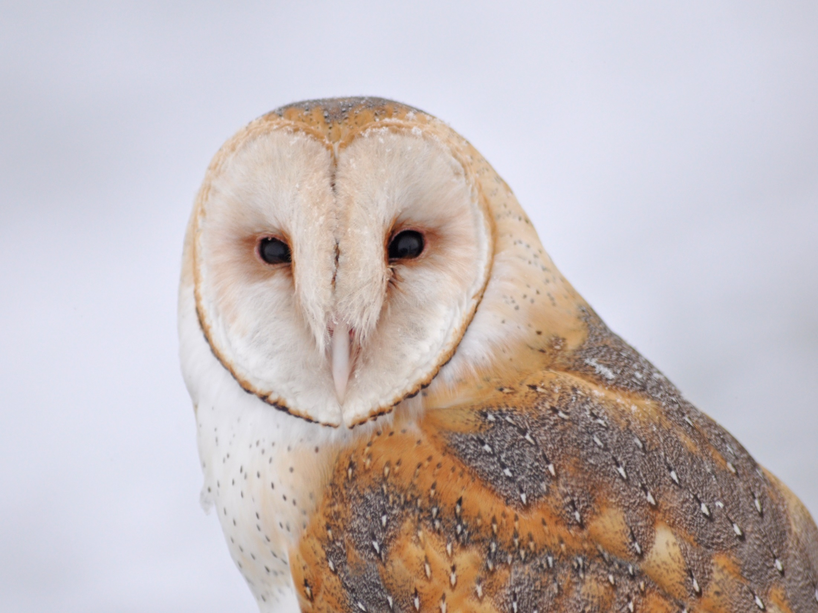
Dear Valued Educator,
Our fully editable .pptx and .doc resources are perfect for educators looking to bring enthusiasm and creativity to their lessons. We encourage you to make changes to fit your needs and style. As science educators, we’re committed to providing students with the tools they need to succeed in the classroom and beyond. Each unit in the curriculum includes a range of resources that have been developed through extensive research and use in a busy classroom. Our teaching approach is designed to make science education engaging and exciting for learners of all ages. We offer a one-of-a-kind science curriculum that will challenge, inspire, and educate students to become tomorrow's scientists and leaders. Join us today and learn more about how our program can help you achieve your classroom goals.
With appreciation,
Support@SlideSpark.net

Slide 212





Thank you for your time and interest in our Science curriculum. We strive to provide students with engaging and informative lessons that will spark their curiosity and encourage scientific exploration. Should you have any questions or concerns, please do not hesitate to contact us. Thank you again for considering our curriculum, and we wish you all the best in your educational journey.
Sincerely,
Support@slidespark.net
SlideSpark Science on TpT

