Slide 1

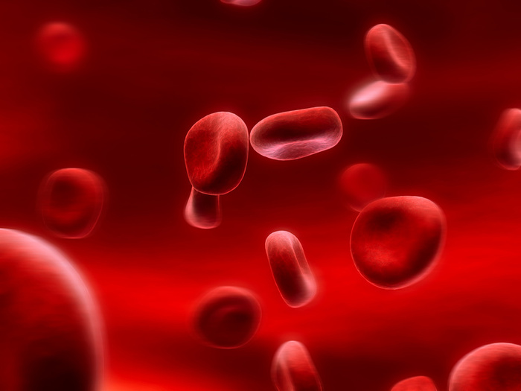

Blood Cells
Part 6
Lesson 5
Copyright © 2024 SlideSpark .LLC

Slide 2
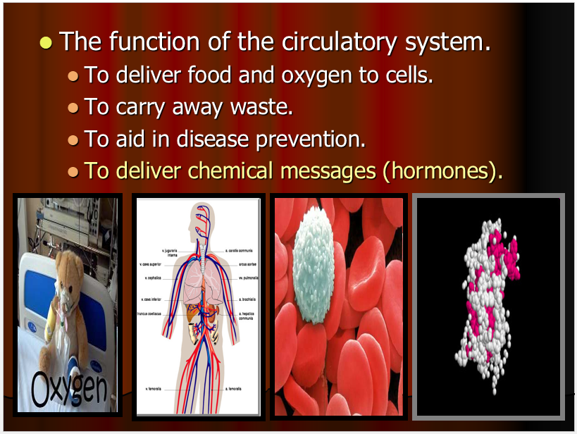
RED SLIDE: These slides contain critical notes and important fill-in the blanks. Please record the important terms in your work bundle.
First and last Name
Science, Grade, Class
Copyright © 2024 SlideSpark .LLC

Slide 3
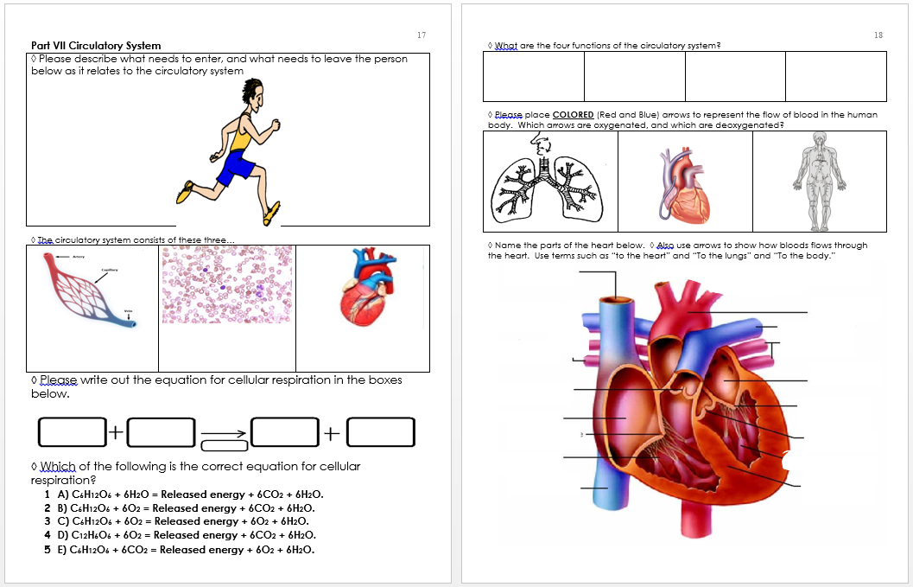
RED SLIDE: These slides contain critical notes and important fill-in the blanks. Please record the important terms in your work bundle.
  You’ll need these notes to complete the work bundle
First and last Name
Science, Grade, Class
Copyright © 2024 SlideSpark .LLC

Slide 4
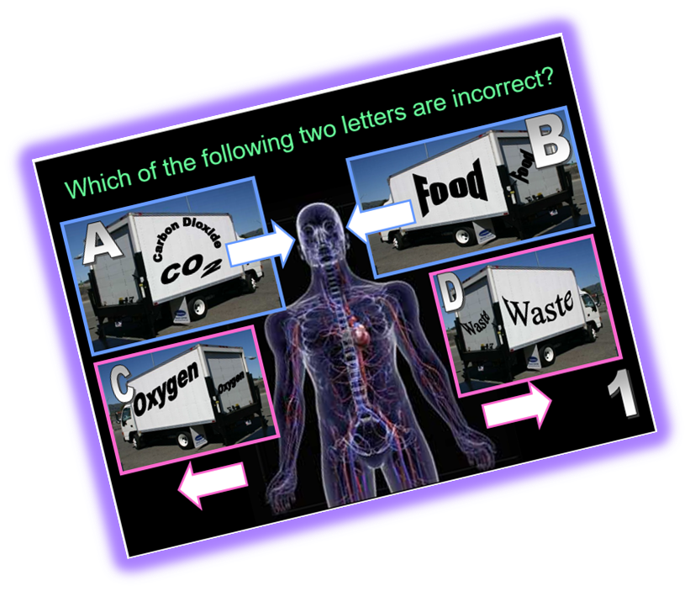
RED SLIDE: These slides contain critical notes and important fill-in the blanks. Please record the important terms in your work bundle.
  You’ll need these notes to complete the work bundle and to be successful on the review game.
First and last Name
Science, Grade, Class
Copyright © 2024 SlideSpark .LLC

Slide 5



Keep an eye out for “The-Owl” and raise your hand as soon as you see her.
  She’ll be hiding somewhere in the slideshow
Copyright © 2024 SlideSpark .LLC

Slide 6
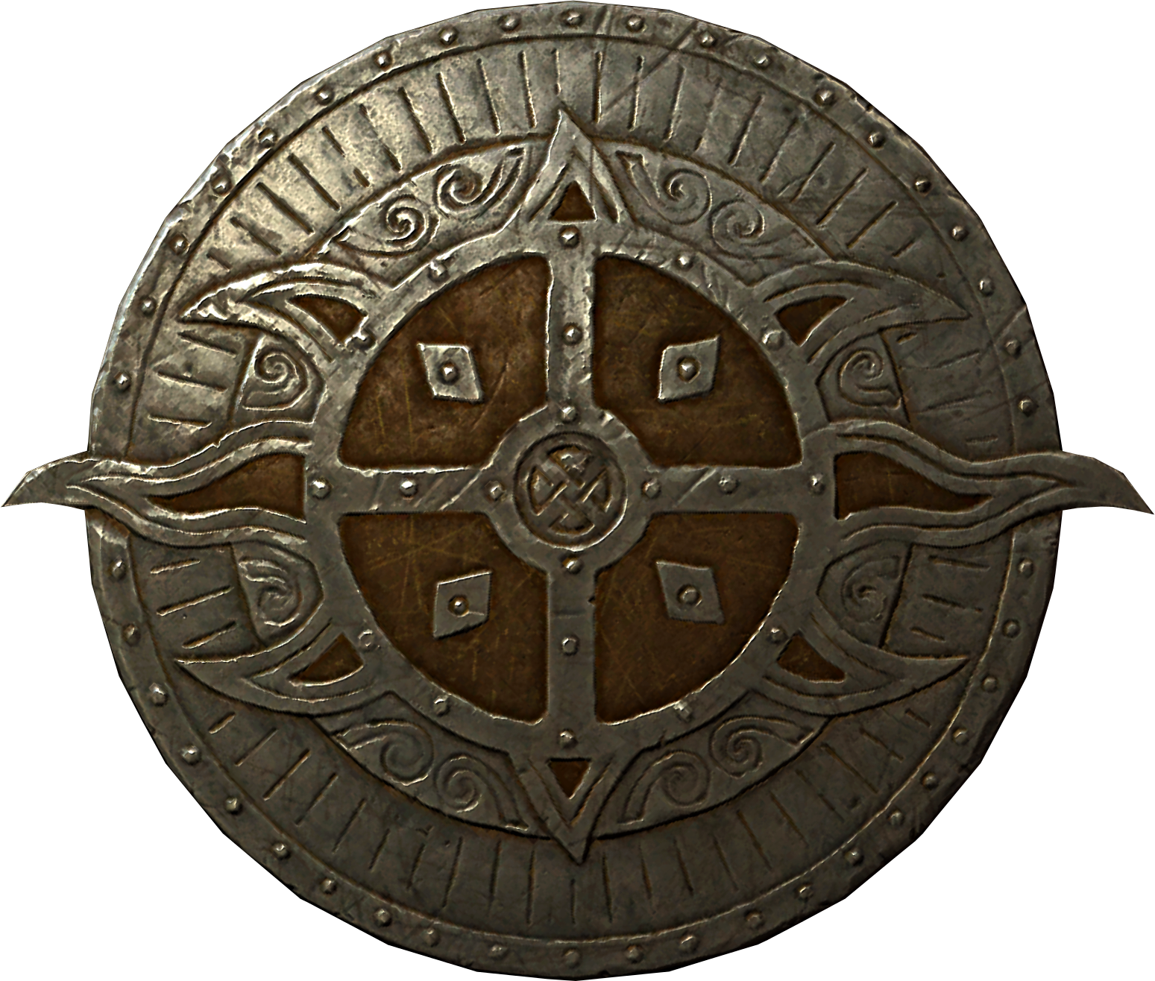
Listen to the teacher and others.
Please no
shout outs.
One speaker at a
time. Please
raise your
hand.
Respect
First,
Last,
and Always.
Safety
Make
Good
Choices
Be Present
Never
Give
Up!
Responsibility
Stay
Organized
Help
Others
Focus on
Task completion
Avoid
Distractions
Science from Murf LLC
Copyright © 2024 SlideSpark .LLC

Slide 7
Blood: A specialized bodily fluid that delivers necessary substances to the body's cells.
Copyright © 2024 SlideSpark .LLC

Slide 8
Blood: A specialized bodily fluid that delivers necessary substances to the body's cells.
  Such as nutrients and oxygen – and transports waste products away from those same cells.
Copyright © 2024 SlideSpark .LLC

Slide 9

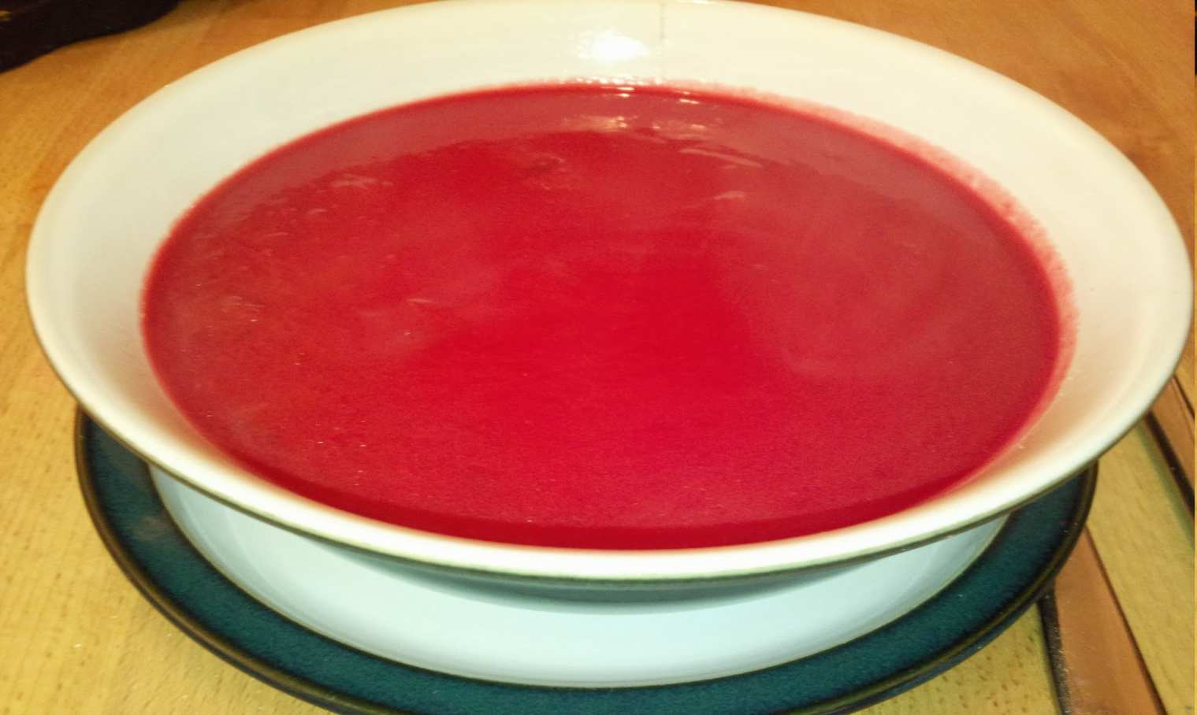
Activity! Making Blood Soup
  What is blood made of?
Copyright © 2024 SlideSpark .LLC

Slide 10
Blood is made up of…
  -
  -
  -
  -
Copyright © 2024 SlideSpark .LLC

Slide 11
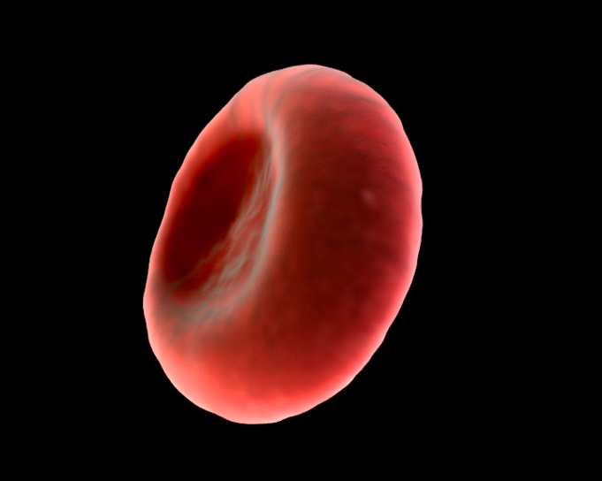
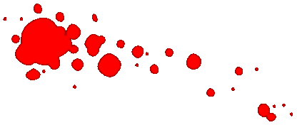
Blood is made up of…
  -
  -
  -
  -
Copyright © 2024 SlideSpark .LLC

Slide 12
Blood is made up of…
  Red Blood Cells
  -
  -
  -
Copyright © 2024 SlideSpark .LLC

Slide 13
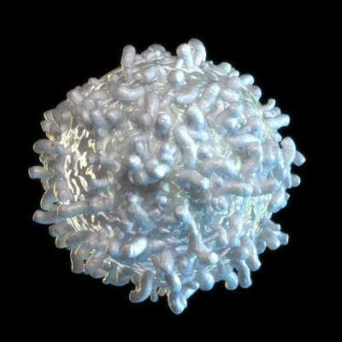
Blood is made up of…
  Red Blood Cells
  -
  -
  -
Copyright © 2024 SlideSpark .LLC

Slide 14
Blood is made up of…
  Red Blood Cells
  White Blood Cells
  -
  -
Copyright © 2024 SlideSpark .LLC

Slide 15
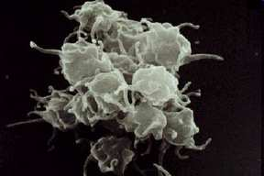
Blood is made up of…
  Red Blood Cells
  White Blood Cells
  -
  -
Copyright © 2024 SlideSpark .LLC

Slide 16
Blood is made up of…
  Red Blood Cells
  White Blood Cells
  Platelets
  -
Copyright © 2024 SlideSpark .LLC

Slide 17
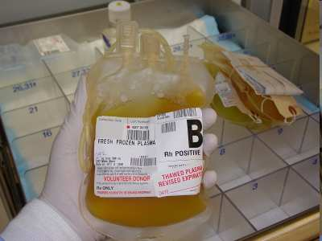
Blood is made up of…
  Red Blood Cells
  White Blood Cells
  Platelets
  Plasma
Copyright © 2024 SlideSpark .LLC

Slide 18
Blood is made up of…
  -Red Blood Cells
  -White Blood Cells
  -Platelets
  -Plasma
Copyright © 2024 SlideSpark .LLC
Copyright © 2024 SlideSpark .LLC

Slide 19
Blood is made up of…
  -Red Blood Cells
  -White Blood Cells
  -Platelets
  -Plasma

Slide 20
Blood is made up of…
  -Red Blood Cells
  -White Blood Cells
  -Platelets
  -Plasma
Copyright © 2024 SlideSpark .LLC
Copyright © 2024 SlideSpark .LLC

Slide 21
Blood is made up of…
  -Red Blood Cells
  -White Blood Cells
  -Platelets
  -Plasma

Slide 22
Blood is made up of…
  -Red Blood Cells
  -White Blood Cells
  -Platelets
  -Plasma
Copyright © 2024 SlideSpark .LLC

Slide 23
Blood is made up of…
  -Red Blood Cells
  -White Blood Cells
  -Platelets
  -Plasma
Copyright © 2024 SlideSpark .LLC

Slide 24
Blood is made up of…
  -Red Blood Cells
  -White Blood Cells
  -Platelets
  -Plasma
Copyright © 2024 SlideSpark .LLC

Slide 25

Blood is made up of…
  -Red Blood Cells
  -White Blood Cells
  -Platelets
  -Plasma
Copyright © 2024 SlideSpark .LLC

Slide 26

“I see four white blood cells.” “Count them with me.”

Slide 27
“1”

Slide 28
“2”

Slide 29
“3”

Slide 30
“4”

Slide 31
Blood is made up of…
  -Red Blood Cells
  -White Blood Cells
  -Platelets
  -Plasma

Slide 32
Blood is made up of…
  -Red Blood Cells
  -White Blood Cells
  -Platelets
  -Plasma

Slide 33
Blood is made up of…
  -Red Blood Cells
  -White Blood Cells
  -Platelets
  -Plasma
Copyright © 2024 SlideSpark .LLC

Slide 34
Blood is made up of…
  -Red Blood Cells
  -White Blood Cells
  -Platelets
  -Plasma
Copyright © 2024 SlideSpark .LLC

Slide 35
Blood is made up of…
  -Red Blood Cells
  -White Blood Cells
  -Platelets
  -Plasma
Copyright © 2024 SlideSpark .LLC

Slide 36
Blood is made up of…
  -Red Blood Cells
  -White Blood Cells
  -Platelets
  -Plasma
Copyright © 2024 SlideSpark .LLC

Slide 37
Blood is made up of…
  -Red Blood Cells
  -White Blood Cells
  -Platelets
  -Plasma
Copyright © 2024 SlideSpark .LLC

Slide 38
Blood is made up of…
  -Red Blood Cells
  -White Blood Cells
  -Platelets
  -Plasma
Copyright © 2024 SlideSpark .LLC

Slide 39
Blood is made up of…
  -Red Blood Cells
  -White Blood Cells
  -Platelets
  -Plasma
Copyright © 2024 SlideSpark .LLC

Slide 41
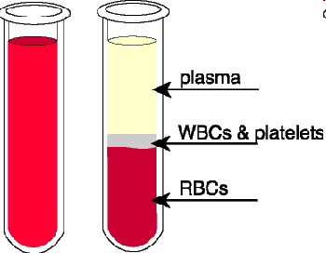

Slide 48
55%

Slide 49
55%
<1%

Slide 50
55%
<1%
45%

Slide 51
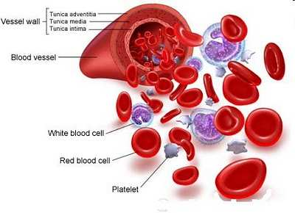

Review:
Copyright © 2024 SlideSpark .LLC

Slide 52
Review: Blood is a fluid tissue.
Copyright © 2024 SlideSpark .LLC

Slide 53
Review: Blood is a fluid tissue.
Copyright © 2024 SlideSpark .LLC

Slide 54
Review: Blood is a fluid tissue. It delivers food and oxygen to cells,
Copyright © 2024 SlideSpark .LLC

Slide 55
Review: Blood is a fluid tissue. It delivers food and oxygen to cells, carries away waste products,
Copyright © 2024 SlideSpark .LLC

Slide 56
Review: Blood is a fluid tissue. It delivers food and oxygen to cells, carries away waste products, aids in the prevention of diseases,
Copyright © 2024 SlideSpark .LLC

Slide 57
Review: Blood is a fluid tissue. It delivers food and oxygen to cells, carries away waste products, aids in the prevention of diseases, and delivers chemical messages.
Copyright © 2024 SlideSpark .LLC

Slide 58
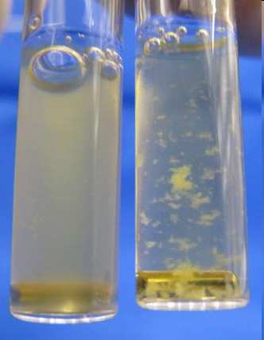
Plasma: Fluid of blood, 90% water, 10% sugars, fats, salts, gases, and proteins.
  Controls amount of water in blood
  Has antibody proteins that fight off disease
  Blood clotting agents
  Carries chemical messages (hormones)
  Carries waste products
Copyright © 2024 SlideSpark .LLC

Slide 59
Plasma: Fluid of blood, 90% water, 10% sugars, fats, salts, gases, and proteins.
  Controls amount of water in blood.
  Has antibody proteins that fight off disease
  Blood clotting agents
  Carries chemical messages (hormones)
  Carries waste products
Copyright © 2024 SlideSpark .LLC

Slide 60
Plasma: Fluid of blood, 90% water, 10% sugars, fats, salts, gases, and proteins.
  Controls amount of water in blood.
  Has antibody proteins that fight off disease.
  Blood clotting agents
  Carries chemical messages (hormones)
  Carries waste products

Slide 61
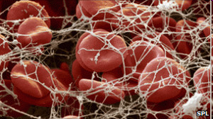
Plasma: Fluid of blood, 90% water, 10% sugars, fats, salts, gases, and proteins.
  Controls amount of water in blood.
  Has antibody proteins that fight off disease.
  Blood clotting agents.
  Carries chemical messages (hormones)
  Carries waste products
Copyright © 2024 SlideSpark .LLC

Slide 62
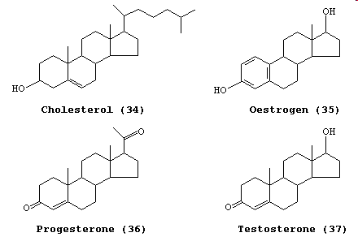
Plasma: Fluid of blood, 90% water, 10% sugars, fats, salts, gases, and proteins.
  Controls amount of water in blood.
  Has antibody proteins that fight off disease.
  Blood clotting agents.
  Carries chemical messages (hormones).
  Carries waste products
Copyright © 2024 SlideSpark .LLC

Slide 63
Plasma: Fluid of blood, 90% water, 10% sugars, fats, salts, gases, and proteins.
  Controls amount of water in blood.
  Has antibody proteins that fight off disease.
  Blood clotting agents.
  Carries chemical messages (hormones).
  Carries waste products.
Copyright © 2024 SlideSpark .LLC

Slide 64
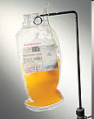
Activity! Blood Soup.
  Add 150 ml of water and 50 ml of sugar or corn syrup to a clear plastic Zip-Lock Bag and seal it.
  Record 55% plasma in Sharpie Marker on the outside of the bag.
55% Plasma
Copyright © 2024 SlideSpark .LLC

Slide 66
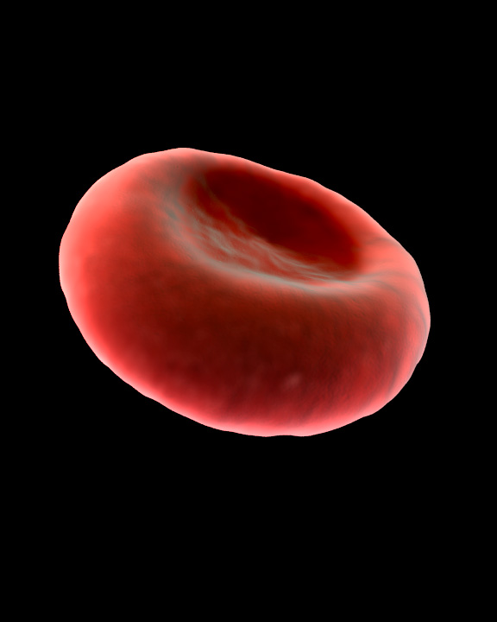
Red Blood Cells: Produced in bone marrow, no nucleus in cell (mature cell), delivers oxygen to cells, carries away CO2.
Copyright © 2024 SlideSpark .LLC

Slide 67
Red Blood Cells: Produced in bone marrow, no nucleus in cell (mature cell), delivers oxygen to cells, carries away CO2.
  Hemoglobin: Protein in blood that helps blood bind with oxygen and carbon dioxide.
Copyright © 2024 SlideSpark .LLC

Slide 68
Please sketch the unique shape of the red blood cell in your journal.
Copyright © 2024 SlideSpark .LLC

Slide 69
Please sketch the unique shape of the red blood cell in your journal.
120 day life span and then destroyed in spleen and liver
Shape allows the cell to bend and squeeze through tight places.
Shape allows the maximum amount of surface area for gas exchange.
Mature RBC has no nucleus which allows more room for important gases and hemoglobin.
Most numerous cell in body. 5 million RBC in one drop of blood.
Copyright © 2024 SlideSpark .LLC

Slide 70
Please sketch the unique shape of the red blood cell in your journal.
120 day life span and then destroyed in spleen
Shape allows the cell to bend and squeeze through tight places.
Shape allows the maximum amount of surface area for gas exchange.
Mature RBC has no nucleus which allows more room for important gases and hemoglobin.
Most numerous cell in body. 5 million RBC in one drop of blood.
Copyright © 2024 SlideSpark .LLC

Slide 71
Please sketch the unique shape of the red blood cell in your journal.
120 day life span and then destroyed in spleen
Shape allows the cell to bend and squeeze through tight places.
Shape allows the maximum amount of surface area for gas exchange.
Mature RBC has no nucleus which allows more room for important gases and hemoglobin.
Most numerous cell in body. 5 million RBC in one drop of blood.
Copyright © 2024 SlideSpark .LLC

Slide 72
Please sketch the unique shape of the red blood cell in your journal.
120 day life span and then destroyed in spleen
Shape allows the cell to bend and squeeze through tight places.
Shape allows the maximum amount of surface area for gas exchange.
Mature RBC has no nucleus which allows more room for important gases and hemoglobin.
Most numerous cell in body. 5 million RBC in one drop of blood.
Copyright © 2024 SlideSpark .LLC

Slide 73
Please sketch the unique shape of the red blood cell in your journal.
120 day life span and then destroyed in spleen
Shape allows the cell to bend and squeeze through tight places.
Shape allows the maximum amount of surface area for gas exchange.
Mature RBC has no nucleus which allows more room for important gases and hemoglobin.
Most numerous cell in body. 5 million RBC in one drop of blood.
Copyright © 2024 SlideSpark .LLC

Slide 74
Please sketch the unique shape of the red blood cell in your journal.
120 day life span and then destroyed in spleen
Shape allows the cell to bend and squeeze through tight places.
Shape allows the maximum amount of surface area for gas exchange.
Mature RBC has no nucleus which allows more room for important gases and hemoglobin.
Most numerous cell in body. 5 million RBC in one drop of blood.
Copyright © 2024 SlideSpark .LLC

Slide 75
Please sketch the unique shape of the red blood cell in your journal.
120 day life span and then destroyed in spleen
Shape allows the cell to bend and squeeze through tight places.
Shape allows the maximum amount of surface area for gas exchange.
Mature RBC has no nucleus which allows more room for important gases and hemoglobin.
Most numerous cell in body. 5 million RBC in one drop of blood.
Copyright © 2024 SlideSpark .LLC

Slide 76
F
Please sketch the unique shape of the red blood cell in your journal.
120 day life span and then destroyed in spleen
Shape allows the cell to bend and squeeze through tight places.
F
Shape allows the maximum amount of surface area for gas exchange.
F
Mature RBC has no nucleus which allows more room for important gases and hemoglobin.
Most numerous cell in body. 5 million RBC in one drop of blood.
Copyright © 2024 SlideSpark .LLC

Slide 77
F
Please sketch the unique shape of the red blood cell in your journal.
orm
120 day life span and then destroyed in spleen
Shape allows the cell to bend and squeeze through tight places.
F
Shape allows the maximum amount of surface area for gas exchange.
F
Mature RBC has no nucleus which allows more room for important gases and hemoglobin.
Most numerous cell in body. 5 million RBC in one drop of blood.
Copyright © 2024 SlideSpark .LLC

Slide 78
F
Please sketch the unique shape of the red blood cell in your journal.
orm
120 day life span and then destroyed in spleen
Shape allows the cell to bend and squeeze through tight places.
F
Shape allows the maximum amount of surface area for gas exchange.
ollows
F
Mature RBC has no nucleus which allows more room for important gases and hemoglobin.
Most numerous cell in body. 5 million RBC in one drop of blood.
Copyright © 2024 SlideSpark .LLC

Slide 79
F
Please sketch the unique shape of the red blood cell in your journal.
orm
120 day life span and then destroyed in spleen
Shape allows the cell to bend and squeeze through tight places.
F
Shape allows the maximum amount of surface area for gas exchange.
ollows
F
Mature RBC has no nucleus which allows more room for important gases and hemoglobin.
unction
Most numerous cell in body. 5 million RBC in one drop of blood.
Copyright © 2024 SlideSpark .LLC

Slide 80
F
Please sketch the unique shape of the red blood cell in your journal.
orm
120 day life span and then destroyed in spleen
Shape allows the cell to bend and squeeze through tight places.
F
Shape allows the maximum amount of surface area for gas exchange.
ollows
F
Mature RBC has no nucleus which allows more room for important gases and hemoglobin.
unction
Most numerous cell in body. 5 million RBC in one drop of blood.
Copyright © 2024 SlideSpark .LLC

Slide 81
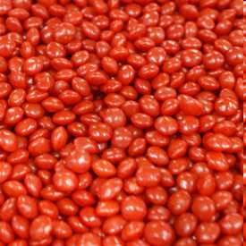
Activity! Making Blood Soup
  Add several (Red Hot candies or Red Tic-Tac’s or other small Red candy in the relative shape of a disc, that won’t dissolve quickly) into the Zip-Lock bag and seal it.
  Record 45% RBC’s on the bag in black sharpie.
55% plasma 45% RBC’s
Copyright © 2024 SlideSpark .LLC

Slide 82
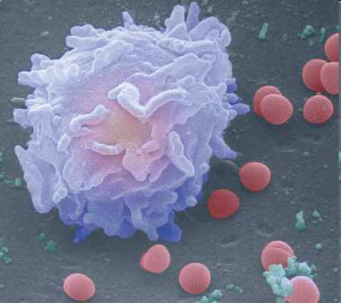
White Blood Cells: Circulate throughout the body providing protection against foreign organisms and matter.
Copyright © 2024 SlideSpark .LLC

Slide 83
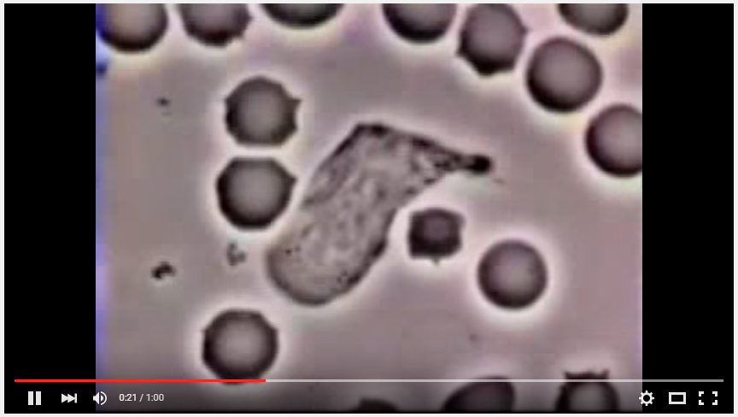
Video. WBC Neutrophil chasing down a bad bacteria in your blood.
  https://www.youtube.com/watch?v=Z_mXDvZQ6dU

Slide 85
Please sketch out a white blood cell in your journal. Make twice as large as RBC.
Can surround and digest foreign organisms such as viruses and bacteria.
Outnumbered by RBC’s 500 to 1
Has a nucleus and can live considerably longer than a RBC. They can self replicate / divide.
Twice as large as a RBC.
Other WBC’s can make antibodies.
Copyright © 2024 SlideSpark .LLC

Slide 86
Please sketch out a white blood cell in your journal. Make twice as large as RBC.
Can surround and digest foreign organisms such as viruses and bacteria.
Outnumbered by RBC’s 500 to 1
Has a nucleus and can live considerably longer than a RBC. They can self replicate / divide.
Twice as large as a RBC.
Other WBC’s can make antibodies.
Copyright © 2024 SlideSpark .LLC

Slide 87
Please sketch out a white blood cell in your journal. Make twice as large as RBC.
Can surround and digest foreign organisms such as viruses and bacteria.
Outnumbered by RBC’s 500 to 1
Has a nucleus and can live considerably longer than a RBC. They can self replicate / divide.
Twice as large as a RBC.
Other WBC’s can make antibodies.
Copyright © 2024 SlideSpark .LLC

Slide 88
Please sketch out a white blood cell in your journal. Make twice as large as RBC.
Can surround and digest foreign organisms such as viruses and bacteria.
Outnumbered by RBC’s 500 to 1
Has a nucleus and can live considerably longer than a RBC. They can self replicate / divide.
Twice as large as a RBC.
Other WBC’s can make antibodies.
Copyright © 2024 SlideSpark .LLC

Slide 89
Please sketch out a white blood cell in your journal. Make twice as large as RBC.
Can surround and digest foreign organisms such as viruses and bacteria.
Outnumbered by RBC’s 500 to 1
Has a nucleus and can live considerably longer than a RBC. They can self replicate / divide.
Twice as large as a RBC.
Other WBC’s can make antibodies.
Copyright © 2024 SlideSpark .LLC

Slide 90
F
Please sketch out a white blood cell in your journal. Make twice as large as RBC.
Can surround and digest foreign organisms such as viruses and bacteria.
Outnumbered by RBC’s 500 to 1
F
Has a nucleus and can live considerably longer than a RBC. They can self replicate / divide.
F
Twice as large as a RBC.
Other WBC’s can make antibodies.
Copyright © 2024 SlideSpark .LLC

Slide 91
F
Please sketch out a white blood cell in your journal. Make twice as large as RBC.
orm
Can surround and digest foreign organisms such as viruses and bacteria.
Outnumbered by RBC’s 500 to 1
F
Has a nucleus and can live considerably longer than a RBC. They can self replicate / divide.
F
Twice as large as a RBC.
Other WBC’s can make antibodies.
Copyright © 2024 SlideSpark .LLC

Slide 92
F
Please sketch out a white blood cell in your journal. Make twice as large as RBC.
orm
Can surround and digest foreign organisms such as viruses and bacteria.
Outnumbered by RBC’s 500 to 1
F
ollows
Has a nucleus and can live considerably longer than a RBC. They can self replicate / divide.
F
Twice as large as a RBC.
Other WBC’s can make antibodies.
Copyright © 2024 SlideSpark .LLC

Slide 93
F
Please sketch out a white blood cell in your journal. Make twice as large as RBC.
orm
Can surround and digest foreign organisms such as viruses and bacteria.
Outnumbered by RBC’s 500 to 1
F
ollows
Has a nucleus and can live considerably longer than a RBC. They can self replicate / divide.
F
Twice as large as a RBC.
unction
Other WBC’s can make antibodies.
Copyright © 2024 SlideSpark .LLC

Slide 94

F
Please sketch out a white blood cell in your journal. Make twice as large as RBC.
orm
Can surround and digest foreign organisms such as viruses and bacteria.
Outnumbered by RBC’s 500 to 1
F
ollows
Has a nucleus and can live considerably longer than a RBC. They can self replicate / divide.
F
Twice as large as a RBC.
unction
Other WBC’s can make antibodies.
Copyright © 2024 SlideSpark .LLC

Slide 95
F
Please sketch out a white blood cell in your journal. Make twice as large as RBC.
orm
Can surround and digest foreign organisms such as viruses and bacteria.
Outnumbered by RBC’s 500 to 1
F
ollows
Has a nucleus and can live considerably longer than a RBC. They can self replicate / divide.
F
Twice as large as a RBC.
unction
Other WBC’s can make antibodies.
Copyright © 2024 SlideSpark .LLC

Slide 96
F
Please sketch out a white blood cell in your journal. Make twice as large as RBC.
orm
Can surround and digest foreign organisms such as viruses and bacteria.
Outnumbered by RBC’s 500 to 1
F
ollows
Has a nucleus and can live considerably longer than a RBC. They can self replicate / divide.
Circulatory System and
Immune System
F
Twice as large as a RBC.
unction
Other WBC’s can make antibodies.
Copyright © 2024 SlideSpark .LLC

Slide 97
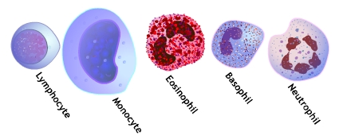
Types of White Blood Cells
  They have different functions.
Learn more about the 5 types of white blood cells and their functions at… https://www.boundless.com/physiology/textbooks/boundless-anatomy-and-physiology-textbook/blood-17/leukocytes-white-blood-cells-166/types-of-wbcs-831-7902/

Slide 98
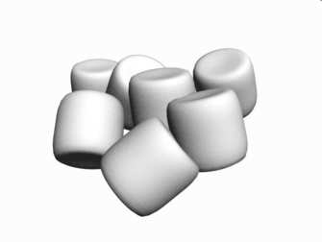
Activity! Blood Soup.
  Add a few mini- marshmallows to the clear plastic Zip-Lock Bag and seal it.
  Record <1% WBC’s on the bag in black Sharpie Marker.
100 ml Plasma
55% Plasma 45% RBC’s <1% WBC’s
Copyright © 2024 SlideSpark .LLC

Slide 99
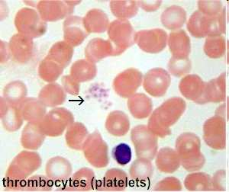
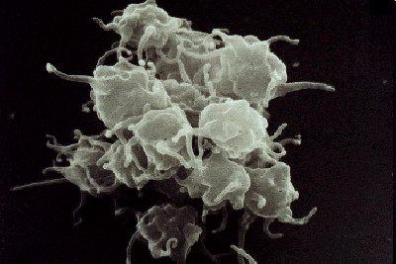
Platelets: Irregularly shaped bodies with sticky surfaces that form clots to stop bleeding.
Copyright © 2024 SlideSpark .LLC

Slide 101
Please sketch a platelet below.
.
Copyright © 2024 SlideSpark .LLC

Slide 102
Please sketch a platelet below.
Only lives for 5-9 days.
Copyright © 2024 SlideSpark .LLC

Slide 103
Please sketch a platelet below.
Only lives for 5-9 days.
Prevents blood loss and allows homeostasis.
Copyright © 2024 SlideSpark .LLC

Slide 104
Please sketch a platelet below.
Only lives for 5-9 days.
Prevents blood loss and allows homeostasis.
Platelets can sense air and begin clotting a cut very quickly.
Copyright © 2024 SlideSpark .LLC

Slide 105
Please sketch a platelet below.
Only lives for 5-9 days.
Prevents blood loss and allows homeostasis.
Clots can be very dangerous if they block a blood vessel such as those in your brain (stroke).
Platelets can sense air and begin clotting a cut very quickly.
Copyright © 2024 SlideSpark .LLC

Slide 106
Please sketch a platelet below.
Only lives for 5-9 days.
Not cells but tiny fragments of other cells.
Prevents blood loss and allows homeostasis.
Clots can be very dangerous if they block a blood vessel such as those in your brain (stroke).
Platelets can sense air and begin clotting a cut very quickly.
Copyright © 2024 SlideSpark .LLC

Slide 107
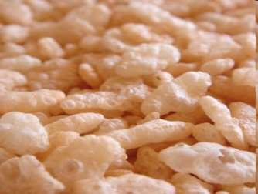
Activity! Blood Soup.
  Add a few Rice Krispies to the soup.
  Record <1% Platelets on the bag in black Sharpie Marker.
100 ml Plasma
55% Plasma 45% RBC’s <1% WBC’s <1% Platelets
Copyright © 2024 SlideSpark .LLC

Slide 108
Activity! Blood Soup.
  Add one of the following blood types in huge visible Sharpie Marker to the bag.
  A+, A-, B+, B-, AB+, AB-, O+, O-
AB+
100 ml Plasma
55% Plasma 45% RBC’s <1% WBC’s <1% Platelets
Copyright © 2024 SlideSpark .LLC

Slide 109
Blood Soup!
  Record a quick picture of your blood soup with the stat sheet on the front.
  Teacher can add a few drops of red food coloring to taste.
  Students can divide equally into small cups and enjoy (Optional).
55% Plasma 45% RBC’s <1% WBC’s <1% Platelets
AB+
Copyright © 2024 SlideSpark .LLC

Slide 110
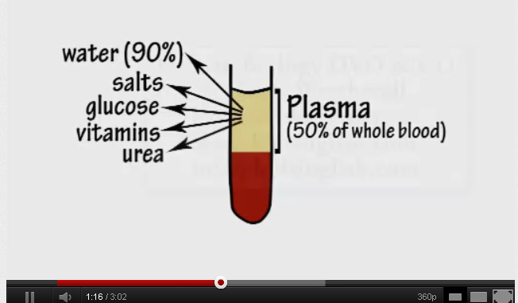
Video Song Link! Blood
http://www.youtube.com/watch?v=j3HDrifRENE

Slide 111
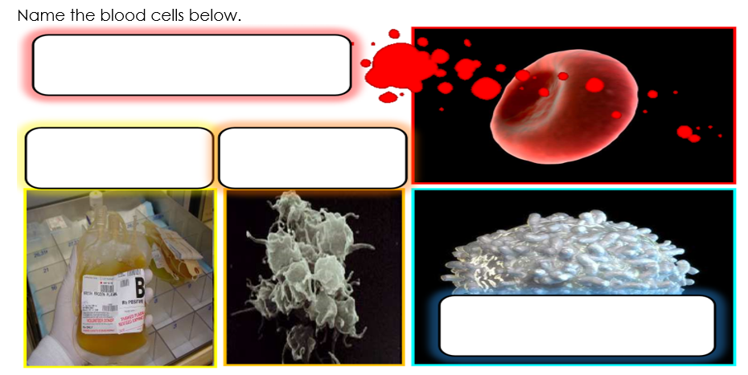

Slide 112

Try and guess the mystery picture beneath the boxes.
  Raise your hand when you think you know. You only get one guess.
Copyright © 2024 SlideSpark .LLC

Slide 113
Copyright © 2024 SlideSpark .LLC

Slide 122
WBC
White Blood Cell

Slide 123
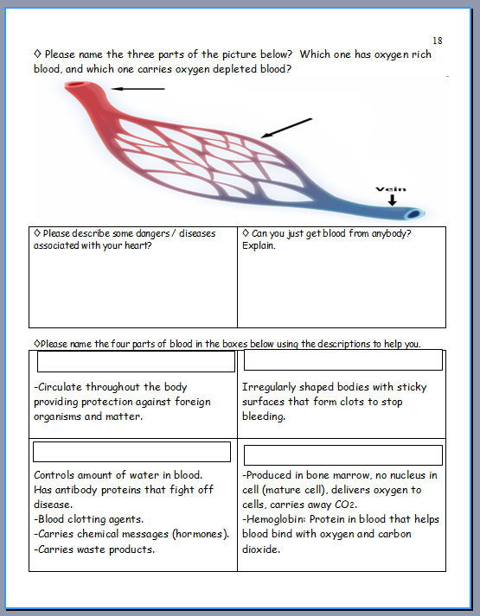
You can now complete parts to this page in your bundled homework.

Slide 124
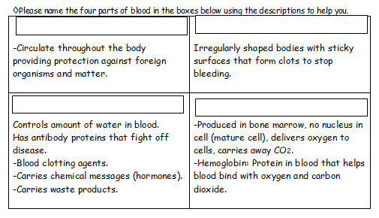

Slide 129
Blood Cells
Part 6
Lesson 5
Copyright © 2010 Ryan P. Murphy

Slide 130



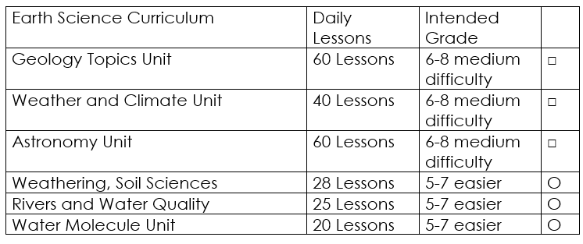

Curriculum Guide
Number of Lessons in each unit (50 min, daily lessons) and difficult rating scale / intended grade level.
=Easier, = More difficult, =Most difficult
Earth Science Units

Slide 131


Life Science Units

Slide 132

Physical Science

Slide 133
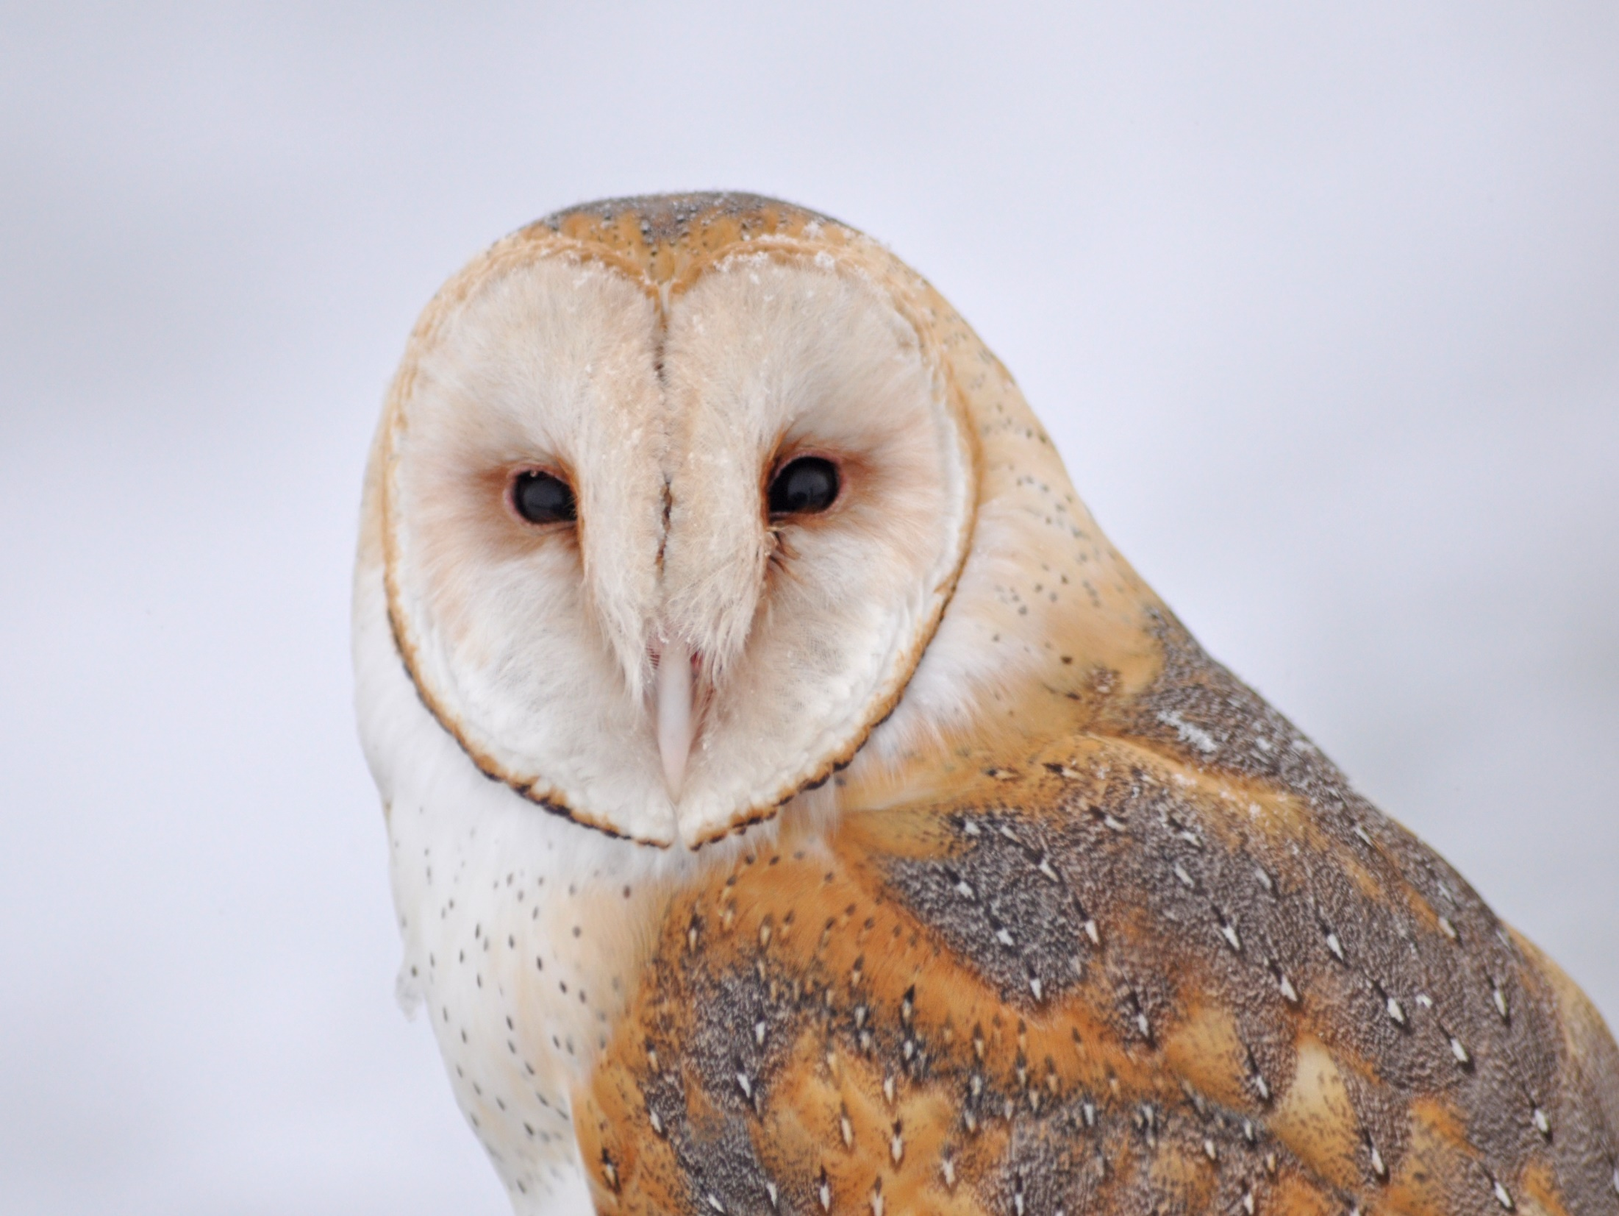
Dear Valued Educator,
Our fully editable .pptx and .doc resources are perfect for educators looking to bring enthusiasm and creativity to their lessons. We encourage you to make changes to fit your needs and style. As science educators, we’re committed to providing students with the tools they need to succeed in the classroom and beyond. Each unit in the curriculum includes a range of resources that have been developed through extensive research and use in a busy classroom. Our teaching approach is designed to make science education engaging and exciting for learners of all ages. We offer a one-of-a-kind science curriculum that will challenge, inspire, and educate students to become tomorrow's scientists and leaders. Join us today and learn more about how our program can help you achieve your classroom goals.
With appreciation,
Support@SlideSpark.net

Slide 134





Thank you for your time and interest in our Science curriculum. We strive to provide students with engaging and informative lessons that will spark their curiosity and encourage scientific exploration. Should you have any questions or concerns, please do not hesitate to contact us. Thank you again for considering our curriculum, and we wish you all the best in your educational journey.
Sincerely,
Support@slidespark.net
SlideSpark Science on TpT

