Slide 1
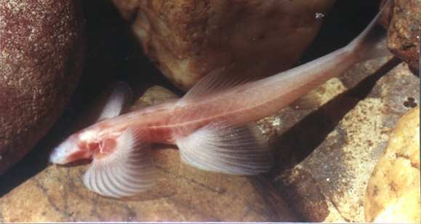

Evolution and Natural
Selection Review Game
Part 1
Lesson 10

Slide 2
Evolution and Natural Selection Review Game
THINGS PAST | DARWIN AND EVOLUTION | WHICH MECHANISM NATURAL SELECTION | STILL CHANGING | SECRET IDENTITIES -BONUS-
1 | 6 | 11 | 16 | *21
2 | 7 | 12 | 17 | *22
3 | 8 | 13 | 18 | *23
4 | 9 | 14 | 19 | *24
5 | 10 | 15 | 20 | *25
Copyright © 2024 SlideSpark .LLC

Slide 3
How to play…
  Don’t play like Jeo_ _ _ _ y.
  Class should be divided into several small groups.
  Groups should use science journal (red slide notes), homework, and other available materials to assist you.
  Groups can communicate quietly with each other but no sharing answers between groups.
    Practice quietly communicating right now?
    Practice Communication Question:
    Your group gets to order one pizza and you can have two toppings. What does your group want?

Slide 4

Questions 1-20 = 5pts Each
Final Category (Bonus) = 1pt Each
Final Questions = 5 pt wager
If you wager 5 on the last question and get it wrong you lose 5 pts. Wager 5 and get it right you get 5 pts.
Find the Owl =
Secretly write “Owl” in the correct box worth 1pt.
“I’ll be about this big.”

Slide 5
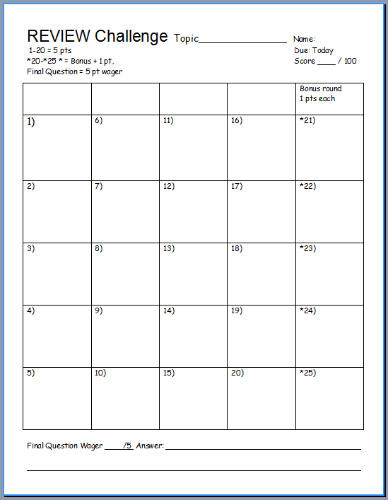
Is your name on the review sheet?
Name

Slide 6
Is your name on the review sheet?
Add the categories
along the top
on the next slide.

Slide 7
Evolution and Natural Selection Review Game
THINGS PAST | DARWIN AND EVOLUTION | WHICH MECHANISM NATURAL SELECTION | STILL CHANGING | SECRET IDENTITIES -BONUS-
1 | 6 | 11 | 16 | *21
2 | 7 | 12 | 17 | *22
3 | 8 | 13 | 18 | *23
4 | 9 | 14 | 19 | *24
5 | 10 | 15 | 20 | *25
Copyright © 2024 SlideSpark .LLC

Slide 8
Evolution and Natural Selection Review Game
THINGS PAST | DARWIN AND EVOLUTION | WHICH MECHANISM NATURAL SELECTION | STILL CHANGING | SECRET IDENTITIES -BONUS-
1 | 6 | 11 | 16 | *21
2 | 7 | 12 | 17 | *22
3 | 8 | 13 | 18 | *23
4 | 9 | 14 | 19 | *24
5 | 10 | 15 | 20 | *25
Copyright © 2024 SlideSpark .LLC

Slide 9

Within a billion years,
How old is the earth?
When did life begin?
1
Copyright © 2024 SlideSpark .LLC

Slide 10
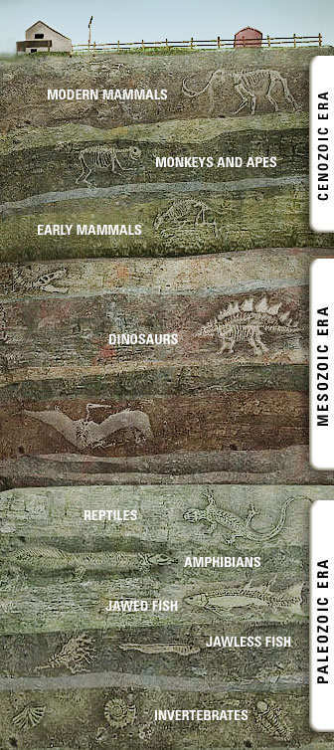
What principle can be seen in this picture?
2
Copyright © 2024 SlideSpark .LLC

Slide 11
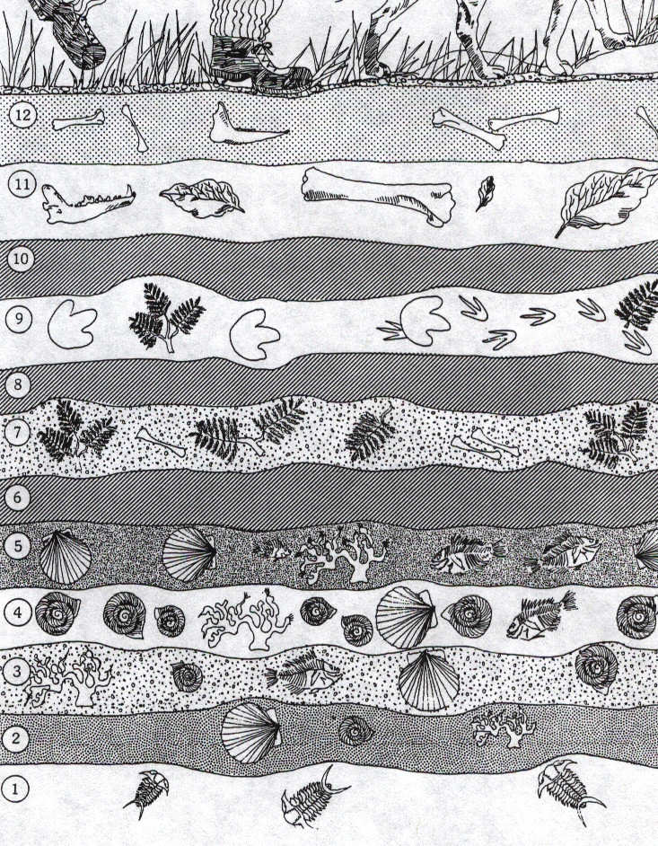
Which letter represents the oldest and most primitive fossil layer, and which letter represents the youngest and most complicated fossil layer?
A
3
B
C
D
Copyright © 2024 SlideSpark .LLC

Slide 12

Write down three things about this person?
4
4
Copyright © 2024 SlideSpark .LLC

Slide 13
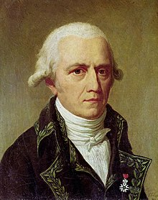
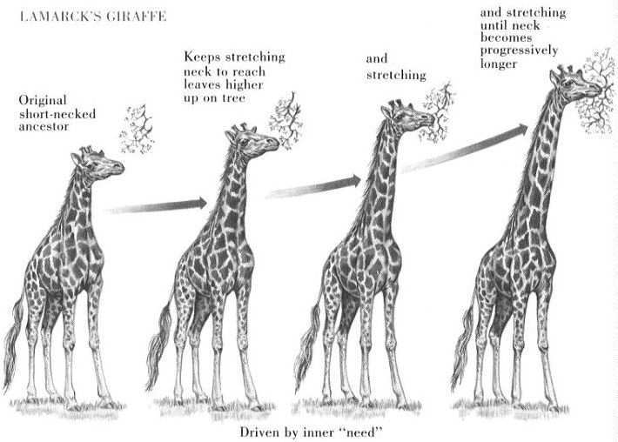
This person was incorrect before Darwin when he proposed the theory of transmutation of species.
5
Animals were
driven by a need to change.
Copyright © 2024 SlideSpark .LLC

Slide 14
Evolution and Natural Selection Review Game
THINGS PAST | DARWIN AND EVOLUTION | WHICH MECHANISM NATURAL SELECTION | STILL CHANGING | SECRET IDENTITIES -BONUS-
1 | 6 | 11 | 16 | *21
2 | 7 | 12 | 17 | *22
3 | 8 | 13 | 18 | *23
4 | 9 | 14 | 19 | *24
5 | 10 | 15 | 20 | *25
Copyright © 2024 SlideSpark .LLC

Slide 15
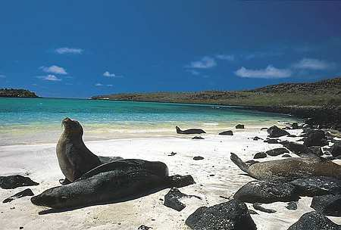
What was the name of the Island Chain that Darwin visited that gave him many clues to create his theories?
6
Copyright © 2024 SlideSpark .LLC

Slide 16
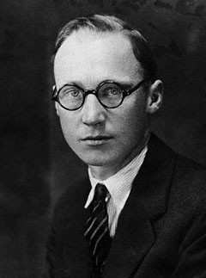

What was the name of the science teacher in Tennessee who was arrested for teaching the theory of evolution in science class?
77
Copyright © 2024 SlideSpark .LLC

Slide 17
This Angel Fish has no eyes because it lives in caves and has evolved better use of its other sensory organs.
8
Copyright © 2024 SlideSpark .LLC

Slide 18
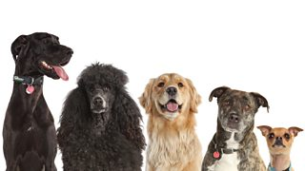
This is the term for the intentional breeding of organisms with desirable traits in an attempt to produce offspring with similar desirable characteristics or with improved traits.
A.) Adaptive Radiation
B.) Speciation
C.) Selective Breeding
D.) Natural Selection
E.) None of the Above
9
Copyright © 2024 SlideSpark .LLC

Slide 19
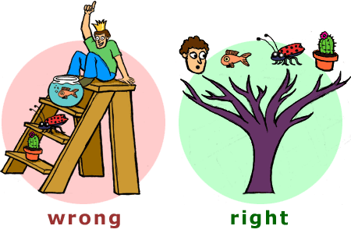

Which picture demonstrates how change in species occurs over time?
10
A
B
Copyright © 2024 SlideSpark .LLC

Slide 20
Evolution and Natural Selection Review Game
THINGS PAST | DARWIN AND EVOLUTION | WHICH MECHANISM NATURAL SELECTION | STILL CHANGING | SECRET IDENTITIES -BONUS-
1 | 6 | 11 | 16 | *21
2 | 7 | 12 | 17 | *22
3 | 8 | 13 | 18 | *23
4 | 9 | 14 | 19 | *24
5 | 10 | 15 | 20 | *25
Copyright © 2024 SlideSpark .LLC

Slide 21
Your response must be one of the five mechanisms for natural selection discussed
in class that best represents the picture.
There are no repeats.

Slide 22
Review
The mechanism for evolution is natural selection.
  #1.) Without checks like predators, populations would increase exponentially. Survival of the fittest!
  #2.) Most populations are stable in size except for seasonal changes.
  #3.) Natural Resources are limited. – A struggle for existence.
  #4.) No two individuals are alike.
  #5.) Variation is inheritable. (Animals pass their traits to their young).

Slide 23
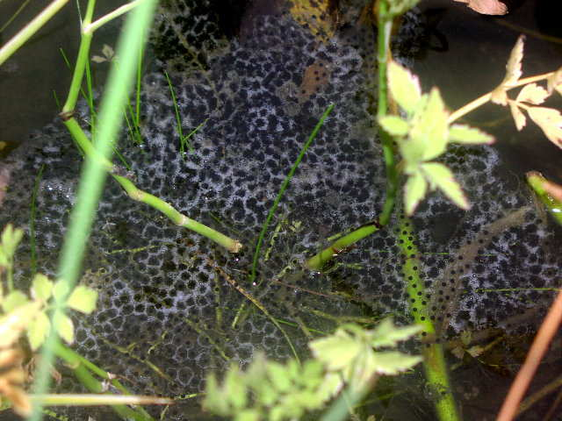
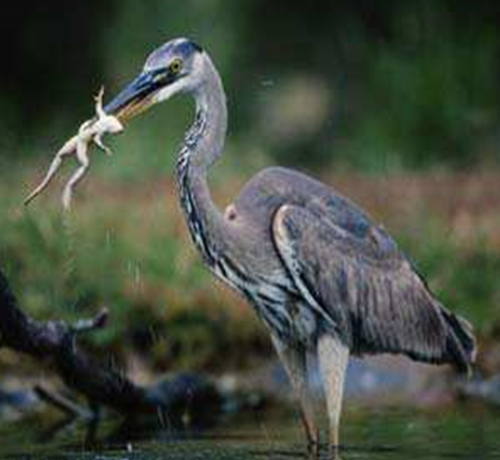
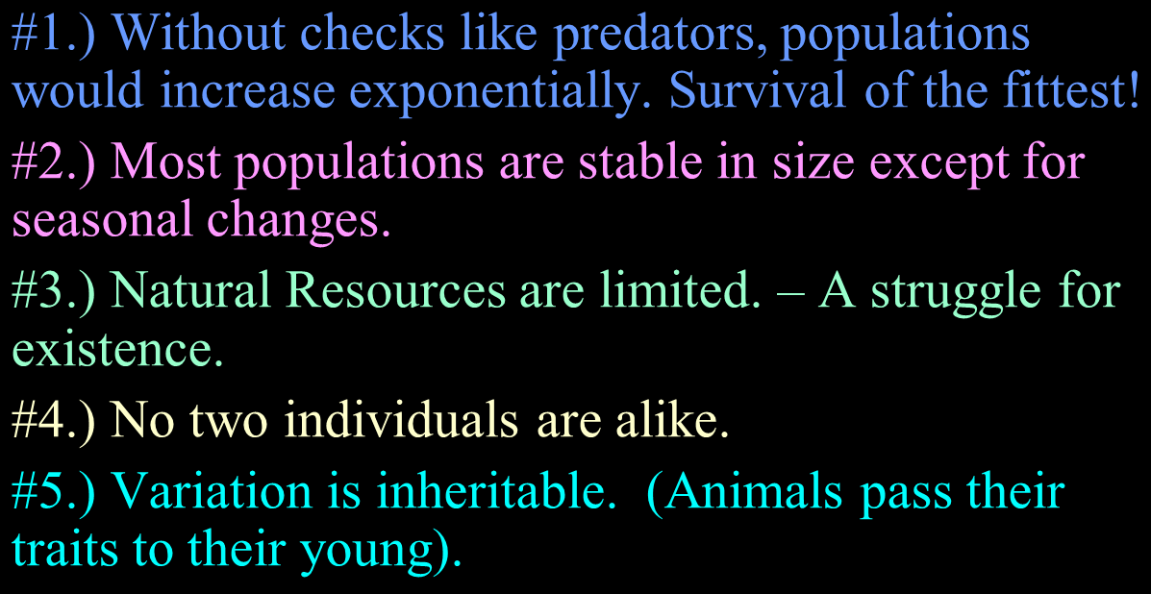
What is going to happen to these tadpoles? Respond using one mechanism of Natural Selection. Survival of the fittest!
11
Copyright © 2024 SlideSpark .LLC

Slide 24
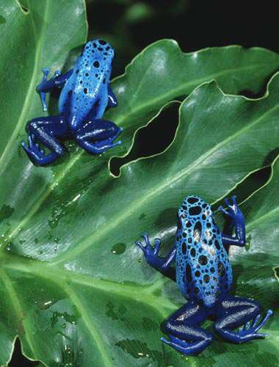
Which mechanism for natural selection best represents the picture below?
12
Copyright © 2024 SlideSpark .LLC

Slide 25
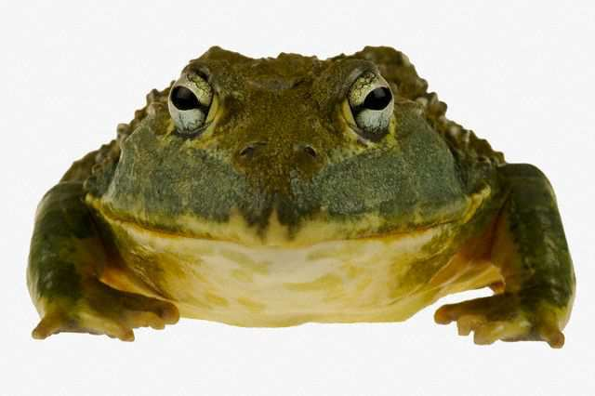
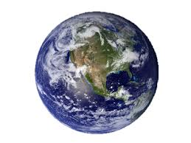
Earth isn’t covered
in frogs.
13
Copyright © 2024 SlideSpark .LLC

Slide 26
Which mechanism of natural selection tells us that the world will not be covered in frogs?
13
Copyright © 2024 SlideSpark .LLC

Slide 27
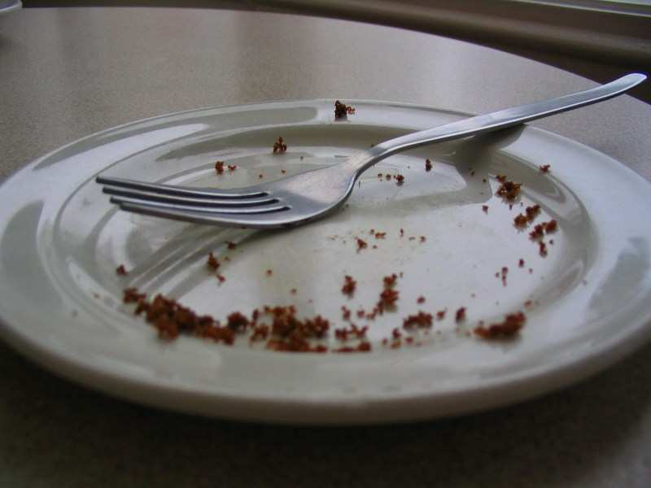
What mechanism for natural selection can be seen below?
14
Copyright © 2024 SlideSpark .LLC

Slide 28
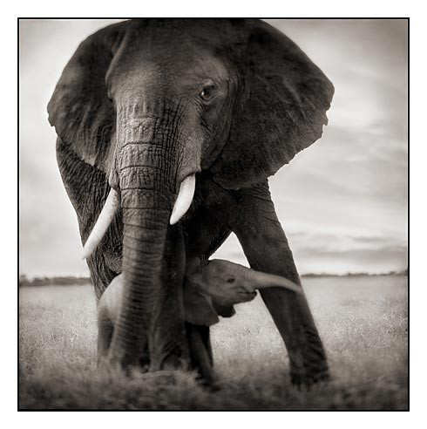
What mechanism for natural selection can be seen below?
15
Copyright © 2024 SlideSpark .LLC

Slide 29
What mechanism for natural selection can be seen below?
15
Copyright © 2024 SlideSpark .LLC

Slide 30
Evolution and Natural Selection Review Game
THINGS PAST | DARWIN AND EVOLUTION | WHICH MECHANISM NATURAL SELECTION | STILL CHANGING | SECRET IDENTITIES -BONUS-
1 | 6 | 11 | 16 | *21
2 | 7 | 12 | 17 | *22
3 | 8 | 13 | 18 | *23
4 | 9 | 14 | 19 | *24
5 | 10 | 15 | 20 | *25
Copyright © 2024 SlideSpark .LLC

Slide 31
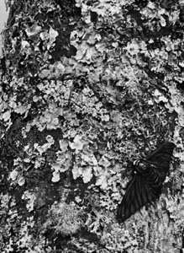
What was the name for this moth which is a good example for how the environment selects favorable traits?
16
Copyright © 2024 SlideSpark .LLC

Slide 32
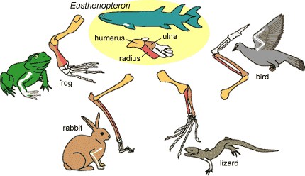
Modern day animals share similar characteristics.
  What is the name for four-footed animals, especially members which includes all vertebrates higher than fishes.
    -An object or structure with four feet, legs, or supports.
17
Copyright © 2024 SlideSpark .LLC

Slide 33
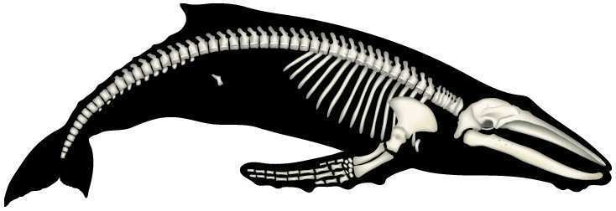
What is the name for a structure in an organism that has lost all or most of its original function over the course of its evolution.
18
Copyright © 2024 SlideSpark .LLC

Slide 34
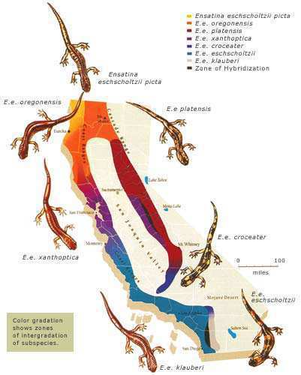
The diagram below represents the…
  A.) Evolution of tetrapods
  B.) The geographic distribution of related species.
  C.) Principle of Superposition
  D.) The Wallace Line
19
Copyright © 2024 SlideSpark .LLC

Slide 35
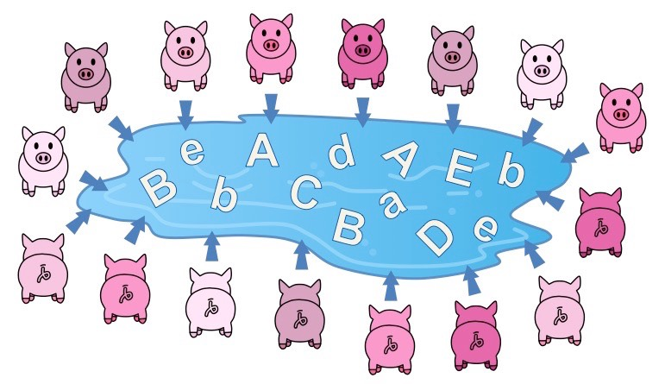
Evolution is the change in the gene pool over time.
  Usually an advancement.
20
Copyright © 2024 SlideSpark .LLC

Slide 36
Evolution and Natural Selection Review Game
THINGS PAST | DARWIN AND EVOLUTION | WHICH MECHANISM NATURAL SELECTION | STILL CHANGING | SECRET IDENTITIES -BONUS-
1 | 6 | 11 | 16 | *21
2 | 7 | 12 | 17 | *22
3 | 8 | 13 | 18 | *23
4 | 9 | 14 | 19 | *24
5 | 10 | 15 | 20 | *25
Copyright © 2024 SlideSpark .LLC

Slide 37
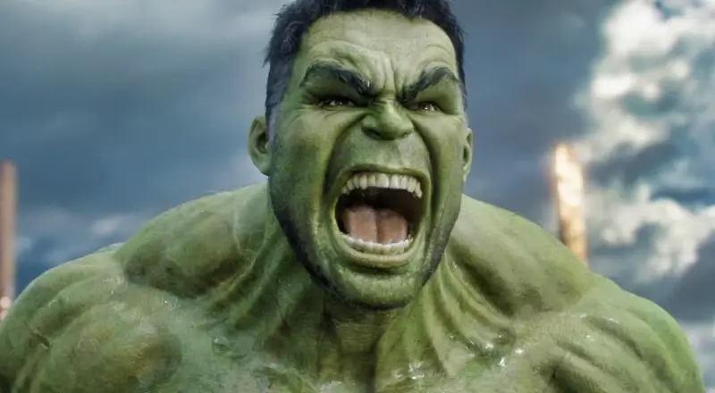
*21
Who becomes the hulk?

Slide 38
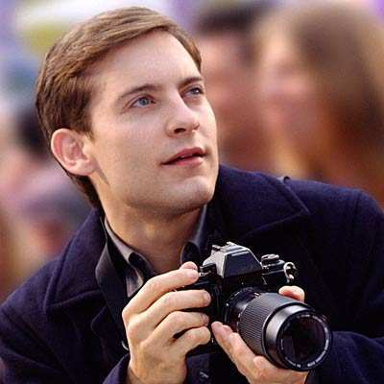
What is the name of this person before he changes into Spiderman?
*22
Copyright © 2024 SlideSpark .LLC

Slide 39
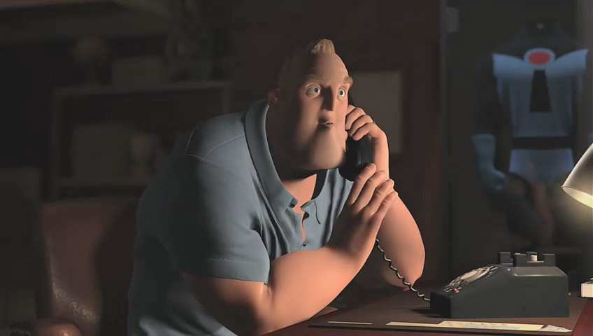
What superhero is this?
*23
Copyright © 2024 SlideSpark .LLC

Slide 40
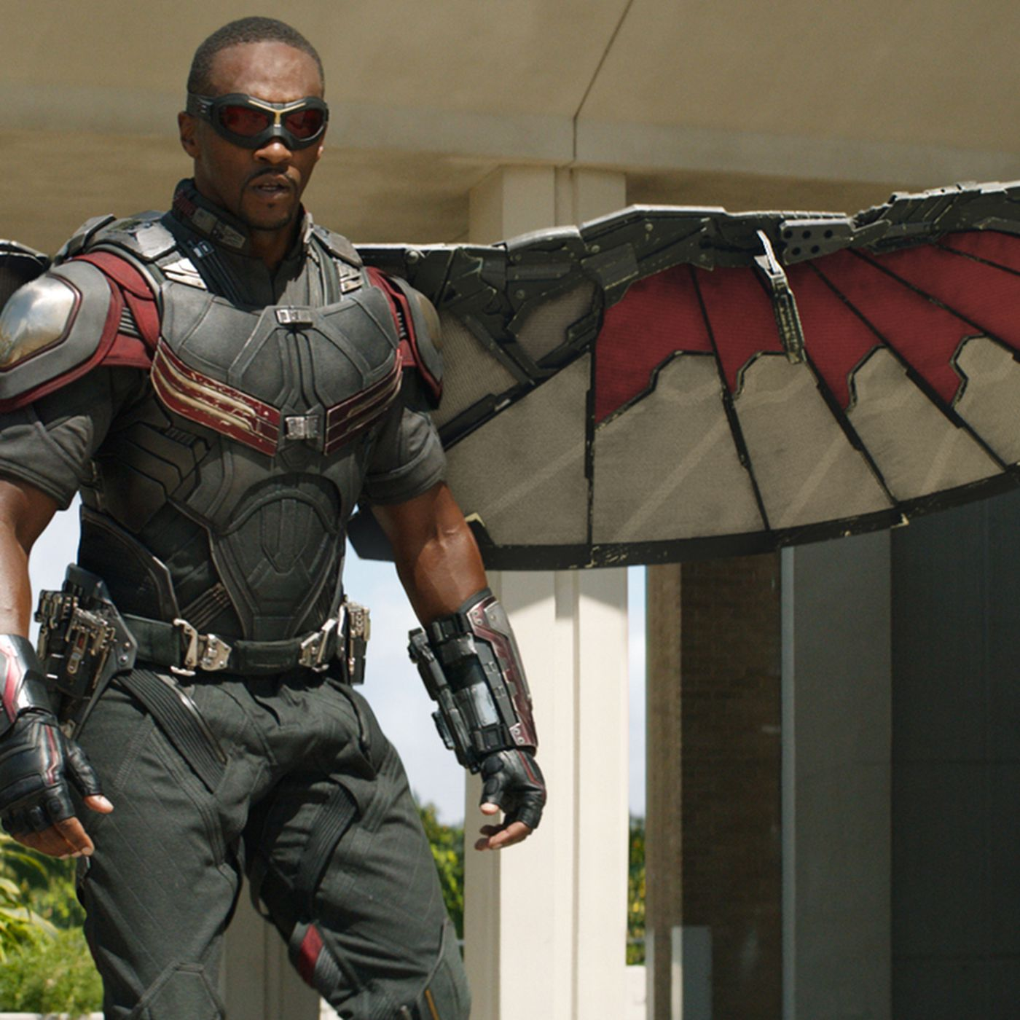
What is the name of the person who becomes the Falcon?
*24
*24

Slide 41
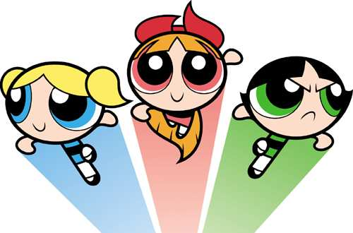
Who are these superheroes?
*25
Copyright © 2024 SlideSpark .LLC

Slide 42
Evolution and Natural Selection Review Game
THINGS PAST | DARWIN AND EVOLUTION | WHICH MECHANISM NATURAL SELECTION | STILL CHANGING | SECRET IDENTITIES -BONUS-
1 | 6 | 11 | 16 | *21
2 | 7 | 12 | 17 | *22
3 | 8 | 13 | 18 | *23
4 | 9 | 14 | 19 | *24
5 | 10 | 15 | 20 | *25
FINAL QUESTION_____________
Copyright © 2024 SlideSpark .LLC

Slide 43
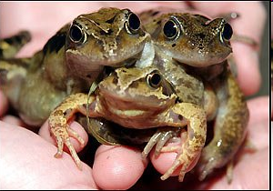

Slide 44
Picture of three headed frog.
You may wager up to 5pts for this final question.

Slide 45
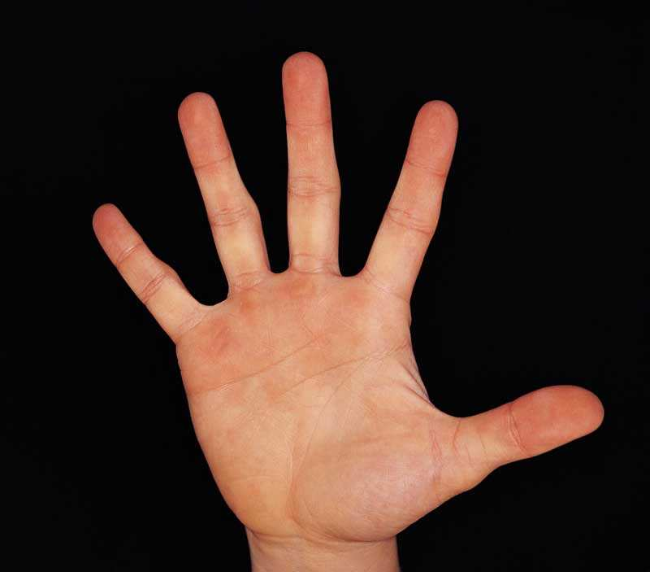

Slide 46
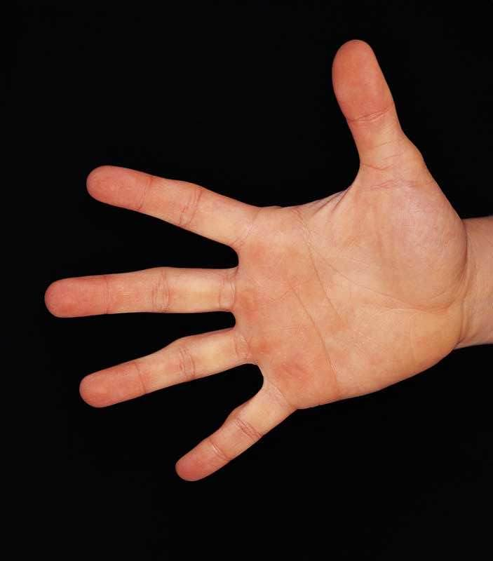
Fill in the missing words. (One point each)
Evolution is the change in the gene pool overtime.
  Gene Pools can change when…
  Populations can shrink
    Diseases, extinctions, introduction of new better adapted species, predators.
  Non-random mating
    Organisms choose strongest mate, ones in similar boundaries,
  Mutations in the genes
    Genes can change. Some are good, some are bad.
    The environment will decide.
  Movement in and out of the population
    Immigration, gene flow.
  Natural selection
    Adaptations to the environment that do well replace poor ones. Usually an advancement.

Slide 47
Fill in the missing words. (One point each)
Evolution is the change in the gene pool overtime.
  Gene Pools can change when…
  Populations can shrink
    Diseases, extinctions, introduction of new better adapted species, predators.
  Non-random mating
    Organisms choose strongest mate, ones in similar boundaries,
  Mutations in the genes
    Genes can change. Some are good, some are bad.
    The environment will decide.
  Movement in and out of the population
    Immigration, gene flow.
  Natural selection
    Adaptations to the environment that do well replace poor ones. Usually an advancement.

Slide 48
Fill in the missing words. (One point each)
Evolution is the change in the gene pool overtime.
  Gene Pools can change when…
  Populations can shrink
    Diseases, extinctions, introduction of new better adapted species, predators.
  Non-random mating
    Organisms choose strongest mate, ones in similar boundaries,
  Mutations in the genes
    Genes can change. Some are good, some are bad.
    The environment will decide.
  Movement in and out of the population
    Immigration, gene flow.
  Natural selection
    Adaptations to the environment that do well replace poor ones. Usually an advancement.

Slide 49
Fill in the missing words. (One point each)
Evolution is the change in the gene pool overtime.
  Gene Pools can change when…
  Populations can shrink
    Diseases, extinctions, introduction of new better adapted species, predators.
  Non-random mating
    Organisms choose strongest mate, ones in similar boundaries,
  Mutations in the genes
    Genes can change. Some are good, some are bad.
    The environment will decide.
  Movement in and out of the population
    Immigration, gene flow.
  Natural selection
    Adaptations to the environment that do well replace poor ones. Usually an advancement.

Slide 50
Evolution and Natural
Selection Review Game
Part 1
Lesson 10

Slide 51

Evolution and Natural
Selection Review Game
Part 1
Lesson 11

Slide 52
Evolution and Natural Selection Review Game
THINGS PAST | DARWIN AND EVOLUTION | WHICH MECHANISM NATURAL SELECTION | STILL CHANGING | SECRET IDENTITIES -BONUS-
1 | 6 | 11 | 16 | *21
2 | 7 | 12 | 17 | *22
3 | 8 | 13 | 18 | *23
4 | 9 | 14 | 19 | *24
5 | 10 | 15 | 20 | *25
Copyright © 2024 SlideSpark .LLC

Slide 53
Within a billion years,
How old is the earth?
When did life begin?
1
Copyright © 2024 SlideSpark .LLC

Slide 54
Within a billion years,
How old is the earth?
When did life begin?
1
Copyright © 2024 SlideSpark .LLC

Slide 55
Within a billion years,
How old is the earth? 4.6 Billion years
When did life begin?
1
Copyright © 2024 SlideSpark .LLC

Slide 56
Within a billion years,
How old is the earth? 4.543 Billion years
When did life begin?
1
Copyright © 2024 SlideSpark .LLC

Slide 57
Within a billion years,
How old is the earth? 4.543 Billion years
When did life begin? 3.85 billion years
1
Copyright © 2024 SlideSpark .LLC

Slide 58
What principle can be seen in this picture?
2
Copyright © 2024 SlideSpark .LLC

Slide 59
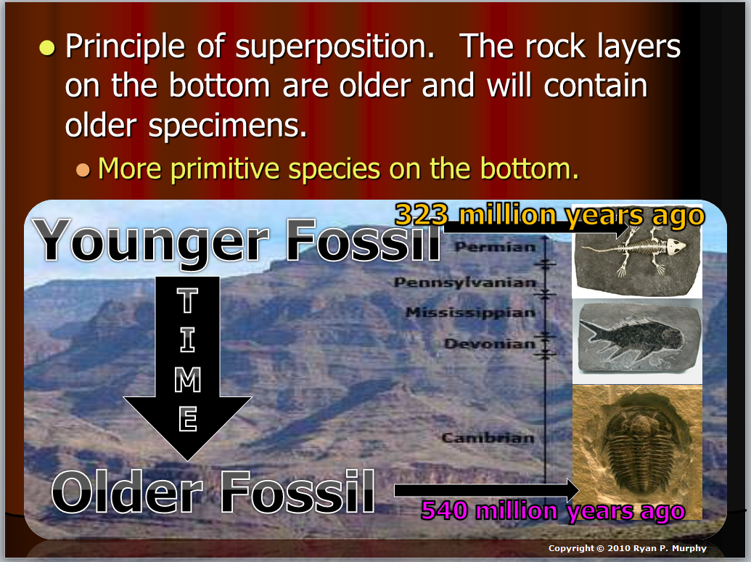
What principle can be seen in this picture?
Principle of Superposition
2
Copyright © 2024 SlideSpark .LLC

Slide 60
Which letter represents the oldest and most primitive fossil layer, and which letter represents the youngest and most complicated fossil layer?
3
A
B
C
D
Copyright © 2024 SlideSpark .LLC

Slide 61
Which letter represents the oldest and most primitive fossil layer, and which letter represents the youngest and most complicated fossil layer?
D is the oldest,
3
A
B
C
D
Copyright © 2024 SlideSpark .LLC

Slide 62
Which letter represents the oldest and most primitive fossil layer, and which letter represents the youngest and most complicated fossil layer?
D is the oldest, and A is the youngest
3
A
B
C
D
Copyright © 2024 SlideSpark .LLC

Slide 63
Write down three things about this person?
4
4
Copyright © 2024 SlideSpark .LLC

Slide 64
Write down three things about this person?
-British Naturalist famous for his theories of evolution by natural selection.
-Didn’t enjoy being a doctor
-Didn’t like being in the clergy
-Went on sea voyage, collected specimens
-Married
-Had many children
-Kept a science journal
-Much More
4
4
Copyright © 2024 SlideSpark .LLC

Slide 65
This person was incorrect before Darwin when he proposed the theory of transmutation of species.
5
Animals were
driven by a need to change.
Copyright © 2024 SlideSpark .LLC

Slide 66
This person was incorrect before Darwin when he proposed the theory of transmutation of species. Jean Baptiste Lamarck
5
Animals were
driven by a need to change.
Copyright © 2024 SlideSpark .LLC

Slide 67
Evolution and Natural Selection Review Game
THINGS PAST | DARWIN AND EVOLUTION | WHICH MECHANISM NATURAL SELECTION | STILL CHANGING | SECRET IDENTITIES -BONUS-
1 | 6 | 11 | 16 | *21
2 | 7 | 12 | 17 | *22
3 | 8 | 13 | 18 | *23
4 | 9 | 14 | 19 | *24
5 | 10 | 15 | 20 | *25
Copyright © 2024 SlideSpark .LLC

Slide 68
What was the name of the Island Chain that Darwin visited that gave him many clues to create his theories?
6
Copyright © 2024 SlideSpark .LLC

Slide 69
What was the name of the Island Chain that Darwin visited that gave him many clues to create his theories?
Galapagos Islands
6
Copyright © 2024 SlideSpark .LLC

Slide 70
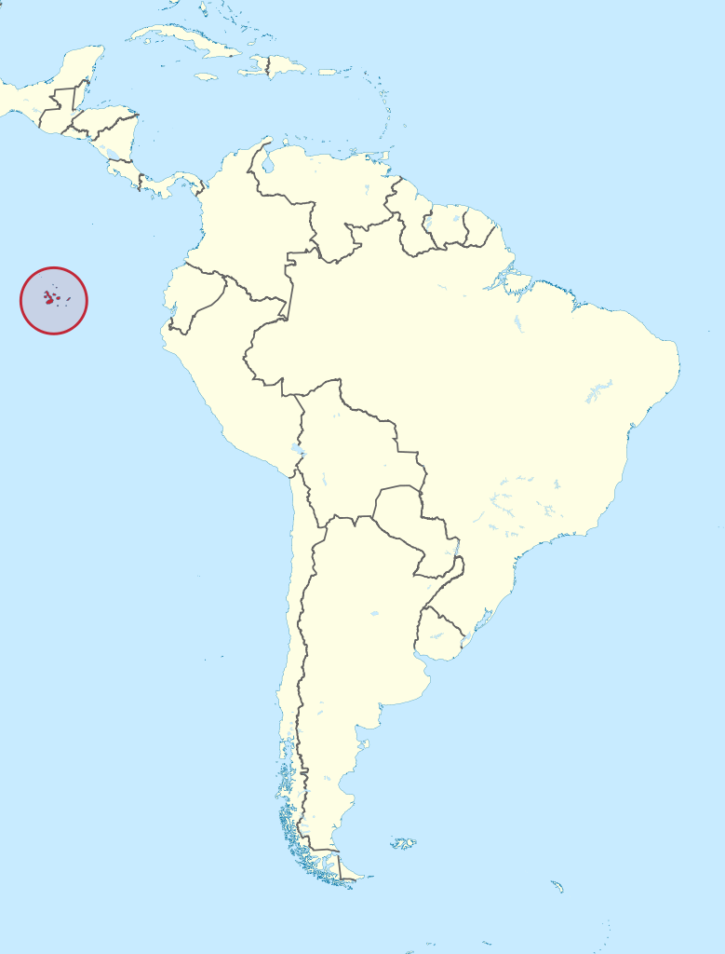
What was the name of the Island Chain that Darwin visited that gave him many clues to create his theories?
Galapagos Islands
6
Copyright © 2024 SlideSpark .LLC

Slide 71
What was the name of the science teacher in Tennessee who was arrested for teaching the theory of evolution in science class?
77
Copyright © 2024 SlideSpark .LLC

Slide 72
What was the name of the science teacher in Tennessee who was arrested for teaching the theory of evolution in science class?
77
John Scopes
Copyright © 2024 SlideSpark .LLC

Slide 73
This Angel Fish has no eyes because it lives in caves and has evolved better use of its other sensory organs.
8
Copyright © 2024 SlideSpark .LLC

Slide 74
This Angel Fish has no eyes because it lives in caves and has evolved better use of its other sensory organs.
8
Copyright © 2024 SlideSpark .LLC

Slide 75
This Angel Fish has no eyes because it lives in caves and has evolved better use of its other sensory organs.
8
Copyright © 2024 SlideSpark .LLC

Slide 76
This is the term for the intentional breeding of organisms with desirable traits in an attempt to produce offspring with similar desirable characteristics or with improved traits.
A.) Adaptive Radiation
B.) Speciation
C.) Selective Breeding
D.) Natural Selection
E.) None of the Above
9
Copyright © 2024 SlideSpark .LLC

Slide 77
This is the term for the intentional breeding of organisms with desirable traits in an attempt to produce offspring with similar desirable characteristics or with improved traits.
A.) Adaptive Radiation
B.) Speciation
C.) Selective Breeding
D.) Natural Selection
E.) None of the Above
9
Copyright © 2024 SlideSpark .LLC

Slide 78
Which picture demonstrates how change in species occurs over time?
10
A
B
Copyright © 2024 SlideSpark .LLC

Slide 79
Which picture demonstrates how change in species occurs over time?
10
A
B
Copyright © 2024 SlideSpark .LLC

Slide 80

Which picture demonstrates how change in species occurs over time?
Owl + 1pt
10
A
B
Copyright © 2024 SlideSpark .LLC

Slide 81
Evolution and Natural Selection Review Game
THINGS PAST | DARWIN AND EVOLUTION | WHICH MECHANISM NATURAL SELECTION | STILL CHANGING | SECRET IDENTITIES -BONUS-
1 | 6 | 11 | 16 | *21
2 | 7 | 12 | 17 | *22
3 | 8 | 13 | 18 | *23
4 | 9 | 14 | 19 | *24
5 | 10 | 15 | 20 | *25
Copyright © 2024 SlideSpark .LLC

Slide 82
Your response must be one of the five mechanisms for natural selection discussed
in class that best represents the picture.
There are no repeats.

Slide 83
Review
The mechanism for evolution is natural selection.
  #1.) Without checks like predators, populations would increase exponentially. Survival of the fittest!
  #2.) Most populations are stable in size except for seasonal changes.
  #3.) Natural Resources are limited. – A struggle for existence.
  #4.) No two individuals are alike.
  #5.) Variation is inheritable. (Animals pass their traits to their young).

Slide 84
What is going to happen to these tadpoles? Respond using one mechanism of Natural Selection. Survival of the fittest!
11
Copyright © 2024 SlideSpark .LLC

Slide 85
What is going to happen to these tadpoles? Respond using one mechanism of Natural Selection.
#1.) Without checks like predators, populations would increase exponentially. Survival of the fittest!
11
Copyright © 2024 SlideSpark .LLC

Slide 86
What is going to happen to these tadpoles? Respond using one mechanism of Natural Selection.
#1.) Without checks like predators, populations would increase exponentially. Survival of the fittest!
11
Copyright © 2024 SlideSpark .LLC

Slide 87
Which mechanism for natural selection best represents the picture below?
12
Copyright © 2024 SlideSpark .LLC

Slide 88
Which mechanism for natural selection best represents the picture below?
#4.) No two individuals are alike.
12
Copyright © 2024 SlideSpark .LLC

Slide 89
Which mechanism of natural selection tells us that the world will not be covered in frogs?
13
Copyright © 2024 SlideSpark .LLC

Slide 90
Which mechanism of natural selection tells us that the world will not be covered in frogs?
#2.) Most populations are stable in size except for seasonal changes.
13
Copyright © 2024 SlideSpark .LLC

Slide 91
What mechanism for natural selection can be seen below?
14
Copyright © 2024 SlideSpark .LLC

Slide 92
What mechanism for natural selection can be seen below? #3.) Natural Resources are limited. – A struggle for existence.
14
Copyright © 2024 SlideSpark .LLC

Slide 93
What mechanism for natural selection can be seen below?
15
Copyright © 2024 SlideSpark .LLC

Slide 94
What mechanism for natural selection can be seen below? #5.) Variation is inheritable. (Animals pass their traits to their young).
15
Copyright © 2024 SlideSpark .LLC

Slide 95
Evolution and Natural Selection Review Game
THINGS PAST | DARWIN AND EVOLUTION | WHICH MECHANISM NATURAL SELECTION | STILL CHANGING | SECRET IDENTITIES -BONUS-
1 | 6 | 11 | 16 | *21
2 | 7 | 12 | 17 | *22
3 | 8 | 13 | 18 | *23
4 | 9 | 14 | 19 | *24
5 | 10 | 15 | 20 | *25
Copyright © 2024 SlideSpark .LLC

Slide 96
What was the name for this moth which is a good example for how the environment selects favorable traits?
16
Copyright © 2024 SlideSpark .LLC

Slide 97
What was the name for this moth which is a good example for how the environment selects favorable traits?
16
Peppered
Moth
Copyright © 2024 SlideSpark .LLC

Slide 98
What was the name for this moth which is a good example for how the environment selects favorable traits?
16
Peppered
Moth
Industrial Period
Copyright © 2024 SlideSpark .LLC

Slide 99

What was the name for this moth which is a good example for how the environment selects favorable traits?
16
Peppered
Moth
Post Industrial
Copyright © 2024 SlideSpark .LLC

Slide 100
Modern day animals share similar characteristics.
  What is the name for four-footed animals, especially members which includes all vertebrates higher than fishes.
    -An object or structure with four feet, legs, or supports.
17
Copyright © 2024 SlideSpark .LLC

Slide 101
Modern day animals share similar characteristics.
  What is the name for four-footed animals, especially members which includes all vertebrates higher than fishes.
    -An object or structure with four feet, legs, or supports.
Tetrapods
17
Copyright © 2024 SlideSpark .LLC

Slide 102
What is the name for a structure in an organism that has lost all or most of its original function over the course of its evolution.
18
Copyright © 2024 SlideSpark .LLC

Slide 103
What is the name for a structure in an organism that has lost all or most of its original function over the course of its evolution.
18
Vestigial Structure
Copyright © 2024 SlideSpark .LLC

Slide 104
The diagram below represents the…
  A.) Evolution of tetrapods
  B.) The geographic distribution of related species.
  C.) Principle of Superposition
  D.) The Wallace Line
19
Copyright © 2024 SlideSpark .LLC

Slide 105
The diagram below represents the…
  A.) Evolution of tetrapods
  B.) The geographic distribution of related species.
  C.) Principle of Superposition
  D.) The Wallace Line
19
Copyright © 2024 SlideSpark .LLC

Slide 106
Evolution is the change in the gene pool over time.
  Usually an advancement.
20
Copyright © 2024 SlideSpark .LLC

Slide 107
Evolution is the change in the gene pool over time.
  Usually an advancement.
20
Copyright © 2024 SlideSpark .LLC

Slide 108
Evolution is the change in the gene pool over time.
  Usually an advancement.
20
Copyright © 2024 SlideSpark .LLC

Slide 109
Evolution and Natural Selection Review Game
THINGS PAST | DARWIN AND EVOLUTION | WHICH MECHANISM NATURAL SELECTION | STILL CHANGING | SECRET IDENTITIES -BONUS-
1 | 6 | 11 | 16 | *21
2 | 7 | 12 | 17 | *22
3 | 8 | 13 | 18 | *23
4 | 9 | 14 | 19 | *24
5 | 10 | 15 | 20 | *25
Copyright © 2024 SlideSpark .LLC

Slide 110
*21
Who becomes the hulk?

Slide 111
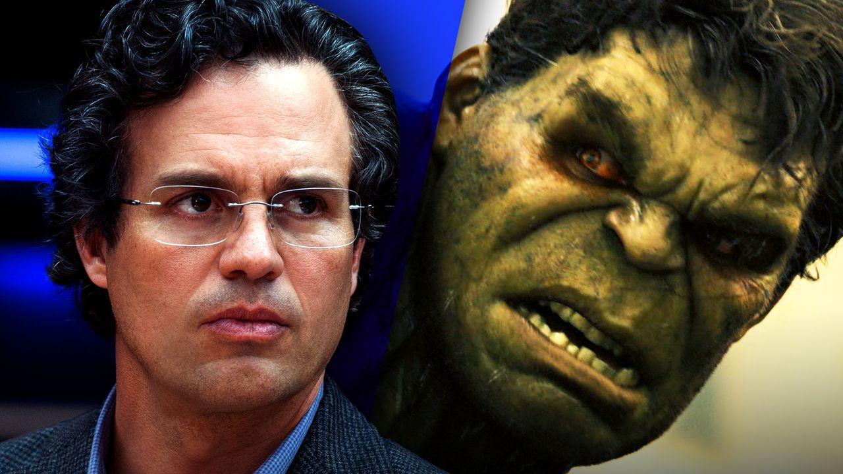
*21
Who becomes the hulk?
Bruce Banner

Slide 112
What is the name of this person before he changes into Spiderman?
*22
Copyright © 2024 SlideSpark .LLC

Slide 113
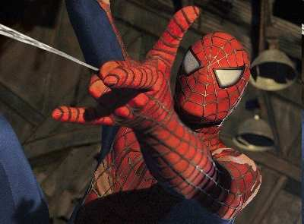
What is the name of this person before he changes into Spiderman? Peter Parker
Copyright © 2024 SlideSpark .LLC

Slide 114
What superhero is this?
*23
Copyright © 2024 SlideSpark .LLC

Slide 115
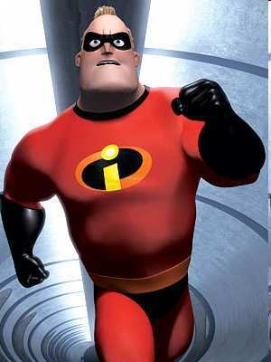
What superhero is this?
Mr. Incredible
Copyright © 2024 SlideSpark .LLC

Slide 116
What is the name of the person who becomes the Falcon?
*24
*24

Slide 117
What is the name of the person who becomes the Falcon?
*24
*24
“Sam” Wilson

Slide 118
Who are these superheroes?
*25
Copyright © 2024 SlideSpark .LLC

Slide 119
Who are these superheroes?
The Powerpuff Girls
*25
Copyright © 2024 SlideSpark .LLC

Slide 120
Evolution and Natural Selection Review Game
THINGS PAST | DARWIN AND EVOLUTION | WHICH MECHANISM NATURAL SELECTION | STILL CHANGING | SECRET IDENTITIES -BONUS-
1 | 6 | 11 | 16 | *21
2 | 7 | 12 | 17 | *22
3 | 8 | 13 | 18 | *23
4 | 9 | 14 | 19 | *24
5 | 10 | 15 | 20 | *25
FINAL QUESTION
Copyright © 2024 SlideSpark .LLC

Slide 121
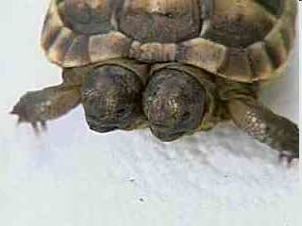

Slide 122
“Answer to the 5pt wager question.”

Slide 124
Fill in the missing words. (One point each)
Evolution is the change in the gene pool overtime.
  Gene Pools can change when…
  Populations can shrink
    Diseases, extinctions, introduction of new better adapted species, predators.
  Non-random mating
    Organisms choose strongest mate, ones in similar boundaries,
  Mutations in the genes
    Genes can change. Some are good, some are bad.
    The environment will decide.
  Movement in and out of the population
    Immigration, gene flow.
  Natural selection
    Adaptations to the environment that do well replace poor ones. Usually an advancement.

Slide 125
Fill in the missing words. (One point each)
Evolution is the change in the gene pool overtime.
  Gene Pools can change when…
  Populations can shrink
    Diseases, extinctions, introduction of new better adapted species, predators.
  Non-random mating
    Organisms choose strongest mate, ones in similar boundaries,
  Mutations in the genes
    Genes can change. Some are good, some are bad.
    The environment will decide.
  Movement in and out of the population
    Immigration, gene flow.
  Natural selection
    Adaptations to the environment that do well replace poor ones. Usually an advancement.

Slide 126
Fill in the missing words. (One point each)
Evolution is the change in the gene pool overtime.
  Gene Pools can change when…
  Populations can shrink
    Diseases, extinctions, introduction of new better adapted species, predators.
  Non-random mating
    Organisms choose strongest mate, ones in similar boundaries,
  Mutations in the genes
    Genes can change. Some are good, some are bad.
    The environment will decide.
  Movement in and out of the population
    Immigration, gene flow.
  Natural selection
    Adaptations to the environment that do well replace poor ones. Usually an advancement.

Slide 127
Fill in the missing words.
Evolution is the change in the gene pool overtime.
  Gene Pools can change when…
  Populations can shrink
    Diseases, extinctions, introduction of new better adapted species, predators.
  Non-random mating
    Organisms choose strongest mate, ones in similar boundaries,
  Mutations in the genes
    Genes can change. Some are good, some are bad.
    The environment will decide.
  Movement in and out of the population
    Immigration, gene flow.
  Natural selection
    Adaptations to the environment that do well replace poor ones. Usually an advancement.

Slide 128
Fill in the missing words.
Evolution is the change in the gene pool overtime.
  Gene Pools can change when…
  Populations can shrink
    Diseases, extinctions, introduction of new better adapted species, predators.
  Non-random mating
    Organisms choose strongest mate, ones in similar boundaries,
  Mutations in the genes
    Genes can change. Some are good, some are bad.
    The environment will decide.
  Movement in and out of the population
    Immigration, gene flow.
  Natural selection
    Adaptations to the environment that do well replace poor ones. Usually an advancement.

Slide 129
Fill in the missing words.
Evolution is the change in the gene pool overtime.
  Gene Pools can change when…
  Populations can shrink
    Diseases, extinctions, introduction of new better adapted species, predators.
  Non-random mating
    Organisms choose strongest mate, ones in similar boundaries,
  Mutations in the genes
    Genes can change. Some are good, some are bad.
    The environment will decide.
  Movement in and out of the population
    Immigration, gene flow.
  Natural selection
    Adaptations to the environment that do well replace poor ones. Usually an advancement.

Slide 130
Fill in the missing words.
Evolution is the change in the gene pool overtime.
  Gene Pools can change when…
  Populations can shrink
    Diseases, extinctions, introduction of new better adapted species, predators.
  Non-random mating
    Organisms choose strongest mate, ones in similar boundaries,
  Mutations in the genes
    Genes can change. Some are good, some are bad.
    The environment will decide.
  Movement in and out of the population
    Immigration, gene flow.
  Natural selection
    Adaptations to the environment that do well replace poor ones. Usually an advancement.

Slide 131
Fill in the missing words.
Evolution is the change in the gene pool overtime.
  Gene Pools can change when…
  Populations can shrink
    Diseases, extinctions, introduction of new better adapted species, predators.
  Non-random mating
    Organisms choose strongest mate, ones in similar boundaries,
  Mutations in the genes
    Genes can change. Some are good, some are bad.
    The environment will decide.
  Movement in and out of the population
    Immigration, gene flow.
  Natural selection
    Adaptations to the environment that do well replace poor ones. Usually an advancement.

Slide 132
Fill in the missing words.
Evolution is the change in the gene pool overtime.
  Gene Pools can change when…
  Populations can shrink
    Diseases, extinctions, introduction of new better adapted species, predators.
  Non-random mating
    Organisms choose strongest mate, ones in similar boundaries,
  Mutations in the genes
    Genes can change. Some are good, some are bad.
    The environment will decide.
  Movement in and out of the population
    Immigration, gene flow.
  Natural selection
    Adaptations to the environment that do well replace poor ones. Usually an advancement.

Slide 133
Fill in the missing words.
Evolution is the change in the gene pool overtime.
  Gene Pools can change when…
  Populations can shrink
    Diseases, extinctions, introduction of new better adapted species, predators.
  Non-random mating
    Organisms choose strongest mate, ones in similar boundaries,
  Mutations in the genes
    Genes can change. Some are good, some are bad.
    The environment will decide.
  Movement in and out of the population
    Immigration, gene flow.
  Natural selection
    Adaptations to the environment that do well replace poor ones. Usually an advancement.

Slide 134
Fill in the missing words.
Evolution is the change in the gene pool overtime.
  Gene Pools can change when…
  Populations can shrink
    Diseases, extinctions, introduction of new better adapted species, predators.
  Non-random mating
    Organisms choose strongest mate, ones in similar boundaries,
  Mutations in the genes
    Genes can change. Some are good, some are bad.
    The environment will decide.
  Movement in and out of the population
    Immigration, gene flow.
  Natural selection
    Adaptations to the environment that do well replace poor ones. Usually an advancement.

Slide 135
Fill in the missing words.
Evolution is the change in the gene pool overtime.
  Gene Pools can change when…
  Populations can shrink
    Diseases, extinctions, introduction of new better adapted species, predators.
  Non-random mating
    Organisms choose strongest mate, ones in similar boundaries,
  Mutations in the genes
    Genes can change. Some are good, some are bad.
    The environment will decide.
  Movement in and out of the population
    Immigration, gene flow.
  Natural selection
    Adaptations to the environment that do well replace poor ones. Usually an advancement.

Slide 136
Fill in the missing words.
Evolution is the change in the gene pool overtime.
  Gene Pools can change when…
  Populations can shrink
    Diseases, extinctions, introduction of new better adapted species, predators.
  Non-random mating
    Organisms choose strongest mate, ones in similar boundaries,
  Mutations in the genes
    Genes can change. Some are good, some are bad.
    The environment will decide.
  Movement in and out of the population
    Immigration, gene flow.
  Natural selection
    Adaptations to the environment that do well replace poor ones. Usually an advancement.

Slide 137
Questions 1-20 = 5pts Each
Final Category (Bonus) = 1pt Each
Final Questions = 5 pt wager
Find the Owl =
Secretly write “Owl” in the correct box worth 1pt.

Slide 138
Evolution and Natural
Selection Review Game
Part 1
Lesson 11

Slide 139



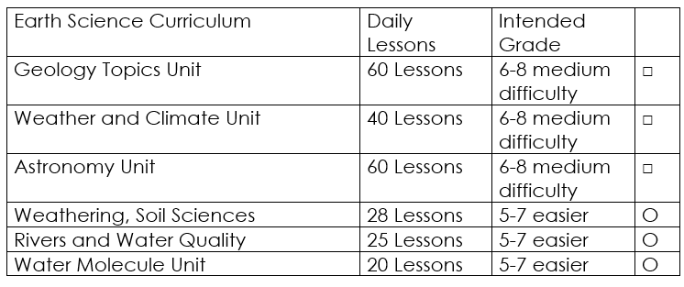

Curriculum Guide
Number of Lessons in each unit (50 min, daily lessons) and difficult rating scale / intended grade level.
=Easier, = More difficult, =Most difficult
Earth Science Units

Slide 140


Life Science Units

Slide 141

Physical Science

Slide 142
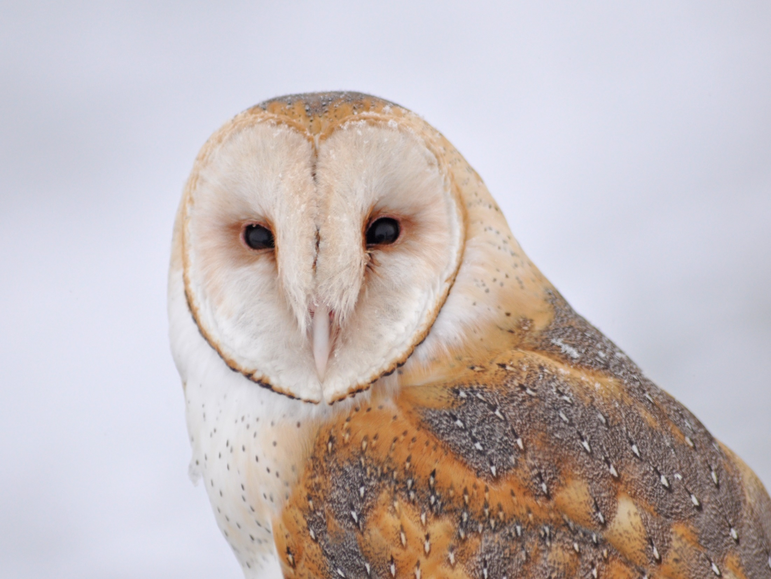
Dear Valued Educator,
Our fully editable .pptx and .doc resources are perfect for educators looking to bring enthusiasm and creativity to their lessons. We encourage you to make changes to fit your needs and style. As science educators, we’re committed to providing students with the tools they need to succeed in the classroom and beyond. Each unit in the curriculum includes a range of resources that have been developed through extensive research and use in a busy classroom. Our teaching approach is designed to make science education engaging and exciting for learners of all ages. We offer a one-of-a-kind science curriculum that will challenge, inspire, and educate students to become tomorrow's scientists and leaders. Join us today and learn more about how our program can help you achieve your classroom goals.
With appreciation,
Support@SlideSpark.net

Slide 143





Thank you for your time and interest in our Science curriculum. We strive to provide students with engaging and informative lessons that will spark their curiosity and encourage scientific exploration. Should you have any questions or concerns, please do not hesitate to contact us. Thank you again for considering our curriculum, and we wish you all the best in your educational journey.
Sincerely,
Support@slidespark.net
SlideSpark Science on TpT

