Slide 1
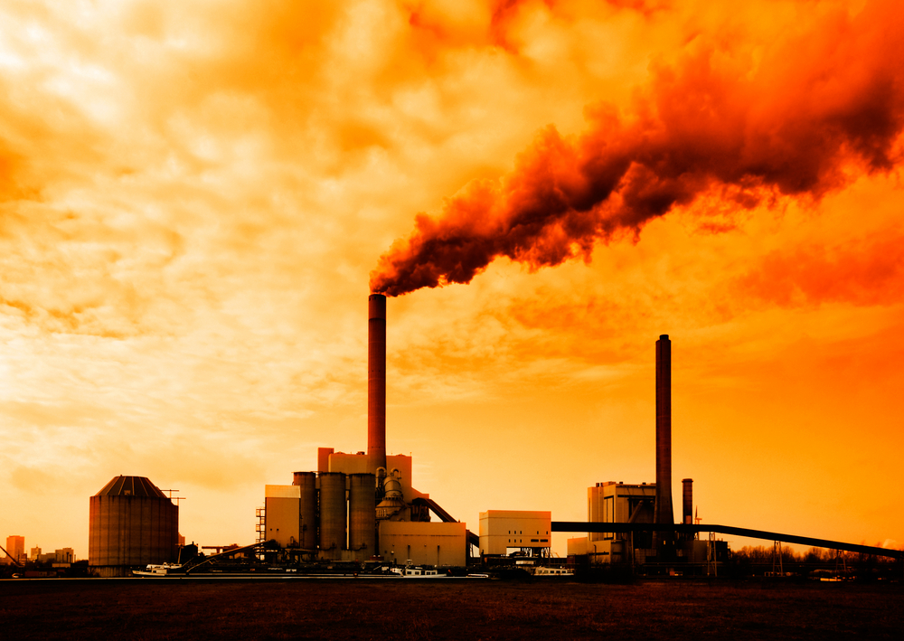

Review Game
Part 6
Lesson 6

Slide 2
AGW Review Game
ITS ALL ABOUT CARBON | HOT AND COLD | DEEP IMPACT | FUTURE PLANS | -Bonus- FIRED
1 | 6 | 11 | 16 | *21
2 | 7 | 12 | 17 | *22
3 | 8 | 13 | 18 | *23
4 | 9 | 14 | 19 | *24
5 | 10 | 15 | 20 | *25

Slide 3
How to play…
  Don’t play like Jeo_ _ _ _ y.
  Class should be divided into several small groups.
  Groups should use science journal (red slide notes), homework, and other available materials to assist you.
  Groups can communicate quietly with each other but no sharing answers between groups.
    Practice quietly communicating right now?
    Practice Communication Question:
    Your group gets to order one pizza and you can have two toppings. What does your group want?

Slide 4

Questions 1-20 = 5pts Each
Final Category (Bonus) = 1pt Each
Final Questions = 5 pt wager
If you wager 5 on the last question and get it wrong you lose 5 pts. Wager 5 and get it right you get 5 pts.
Find the Owl =
Secretly write “Owl” in the correct box worth 1pt.
“I’ll be about this big.”

Slide 5
AGW Review Game
ITS ALL ABOUT CARBON | HOT AND COLD | DEEP IMPACT | FUTURE PLANS | -Bonus- FIRED
1 | 6 | 11 | 16 | *21
2 | 7 | 12 | 17 | *22
3 | 8 | 13 | 18 | *23
4 | 9 | 14 | 19 | *24
5 | 10 | 15 | 20 | *25

Slide 6
AGW Review Game
ITS ALL ABOUT CARBON | HOT AND COLD | DEEP IMPACT | FUTURE PLANS | -Bonus- FIRED
1 | 6 | 11 | 16 | *21
2 | 7 | 12 | 17 | *22
3 | 8 | 13 | 18 | *23
4 | 9 | 14 | 19 | *24
5 | 10 | 15 | 20 | *25

Slide 7

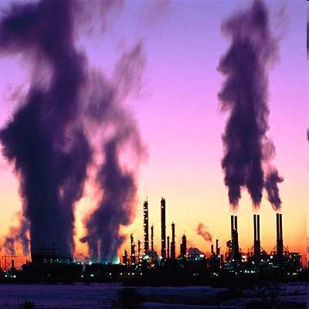
1
Anthropogenic Global Warming means…
  A.) The planet is getting warmer naturally
  B.) The planet is experiencing a cooling trend
  C.) This is human induced climate change
  D.) Alien Generated Warming
  E.) A Greenhouse Works
AGW
Copyright © 2024 SlideSpark .LLC

Slide 8
1
Anthropogenic Global Warming means…
  A.) The planet is getting warmer naturally
  B.) The planet is experiencing a cooling trend
  C.) This is human induced climate change
  D.) Alien Generated Warming
  E.) A Greenhouse Works
AGW
Copyright © 2024 SlideSpark .LLC

Slide 9
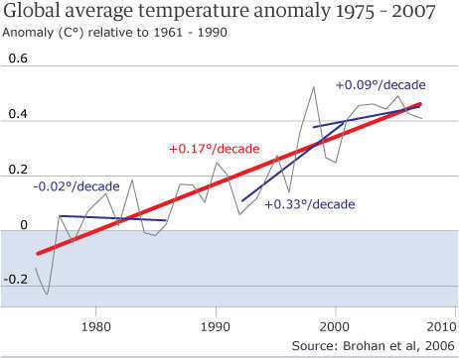
Which is weather, and which is climate?
  A.) Climate is the atmospheric conditions over a long period of time (years).
  B.) Weather is what is occurring right now.
2
“So much for
global warming.”
Copyright © 2024 SlideSpark .LLC

Slide 10
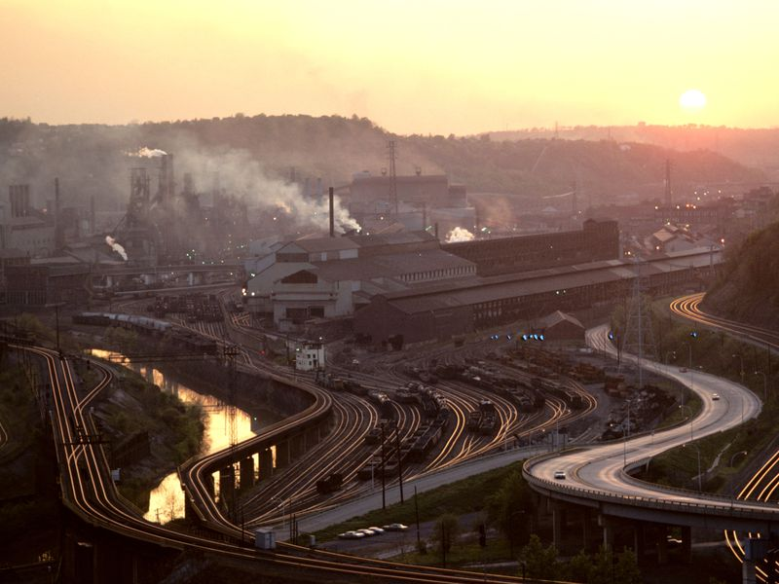
3
Name 5 greenhouse gases. 1 point each.

Slide 11
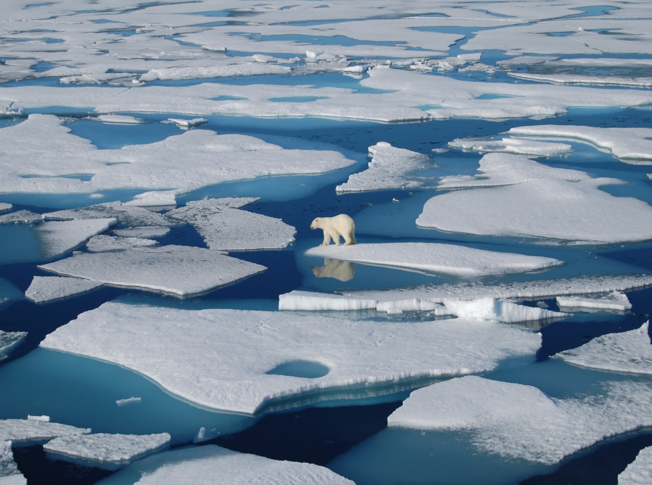
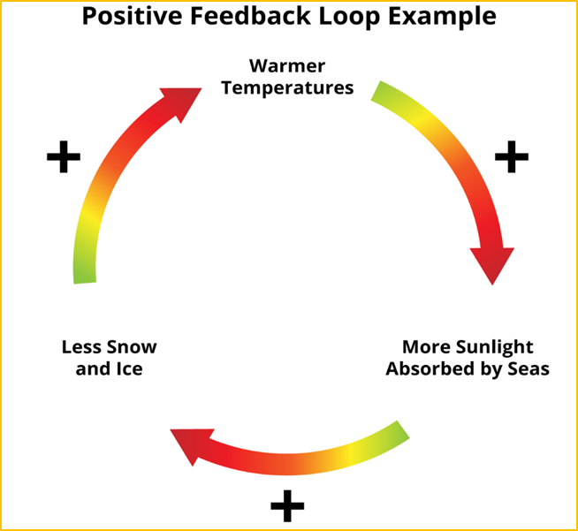
Is this a positive or negative feedback loop?
4

Slide 12
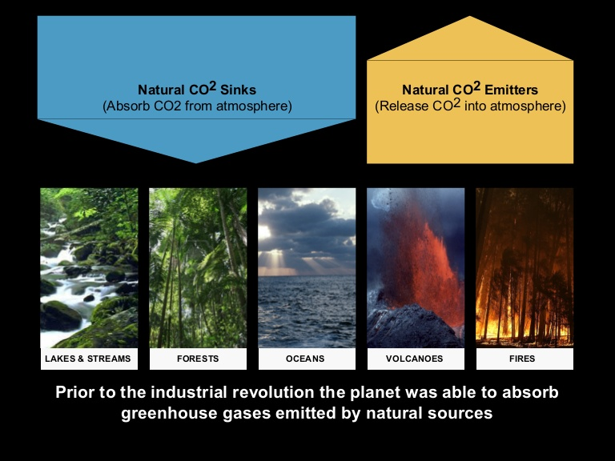

Name 3 natural CO2 Sinks, and 2 natural CO2 emitters?
5
1pt each?
This has been happening for millions of years
Copyright © 2024 SlideSpark .LLC

Slide 13
AGW Review Game
ITS ALL ABOUT CARBON | HOT AND COLD | DEEP IMPACT | FUTURE PLANS | -Bonus- FIRED
1 | 6 | 11 | 16 | *21
2 | 7 | 12 | 17 | *22
3 | 8 | 13 | 18 | *23
4 | 9 | 14 | 19 | *24
5 | 10 | 15 | 20 | *25

Slide 14
AGW Review Game
ITS ALL ABOUT CARBON | HOT AND COLD | DEEP IMPACT | FUTURE PLANS | -Bonus- FIRED
1 | 6 | 11 | 16 | *21
2 | 7 | 12 | 17 | *22
3 | 8 | 13 | 18 | *23
4 | 9 | 14 | 19 | *24
5 | 10 | 15 | 20 | *25

Slide 15
6
Peer reviewed articles are…
scholarly articles are written by experts and are reviewed by several other experts in the field before the article is published.
This ensure the article's quality and makes the article more likely to be scientifically valid / reach a conclusions.

Slide 16
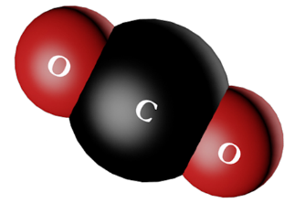
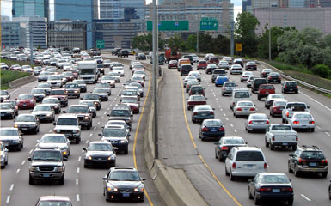
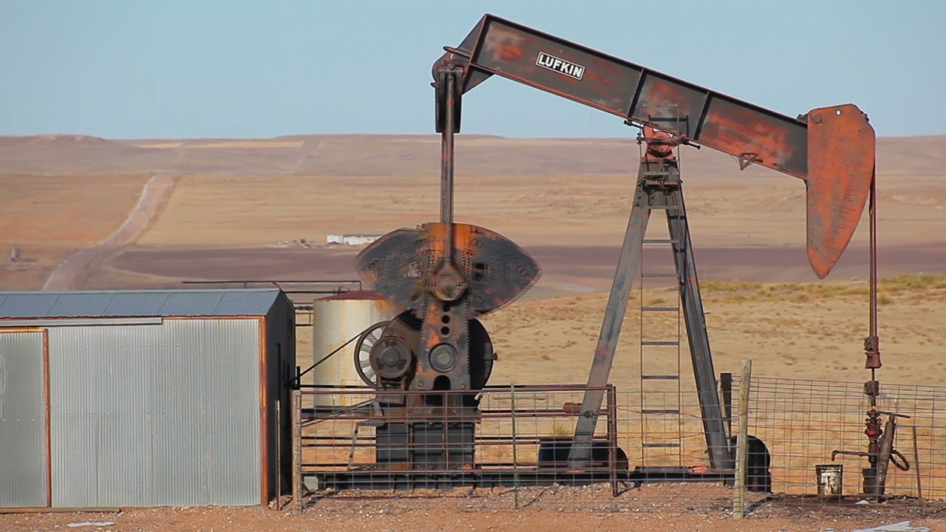
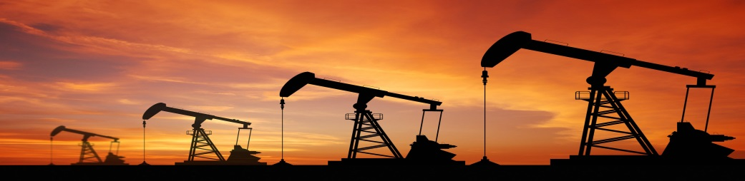
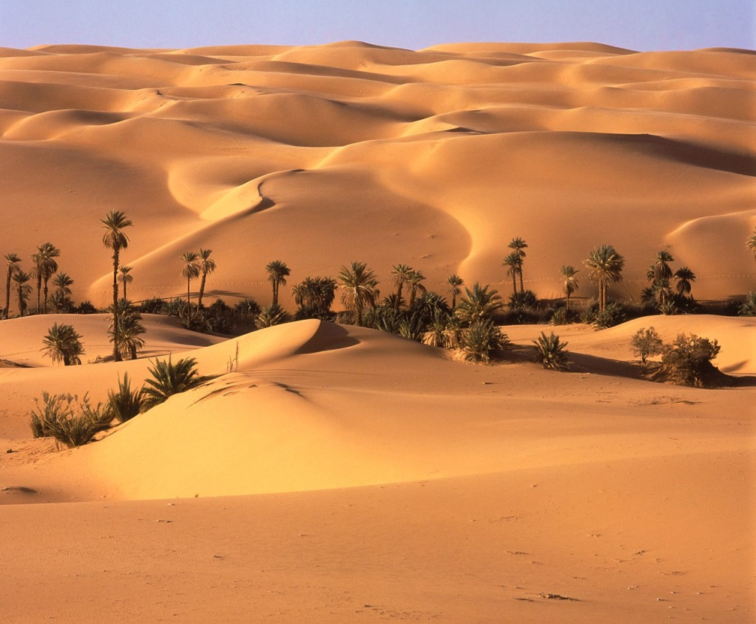
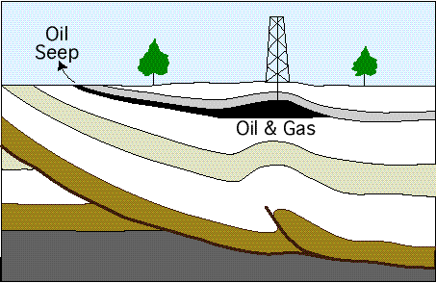
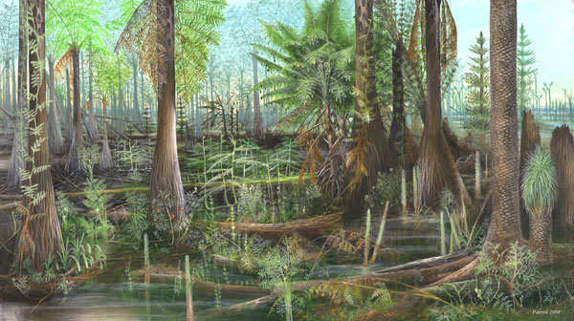
These are the remains of plants and animals from hundreds of millions of years ago.
  We found a way to use ancient sunlight from millions of years ago, thus borrowed light.
7
Copyright © 2024 SlideSpark .LLC

Slide 17
This is the name for the trapping of Earth’s heat at or near the surface.
8
Copyright © 2024 SlideSpark .LLC

Slide 18
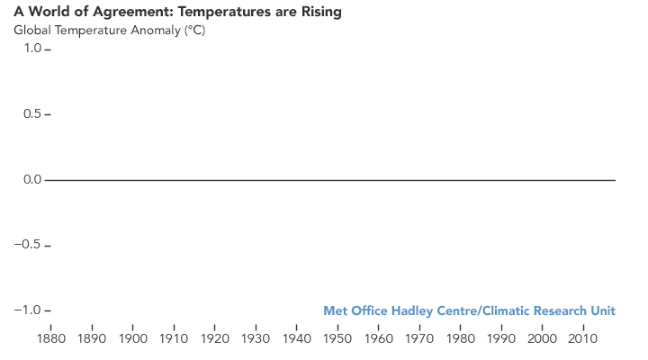
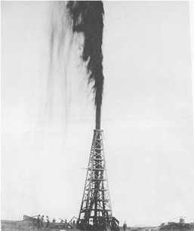
True or False! The major agencies that monitor global temperature agree that atmosphere is warming at an alarming pace.
9

Slide 19
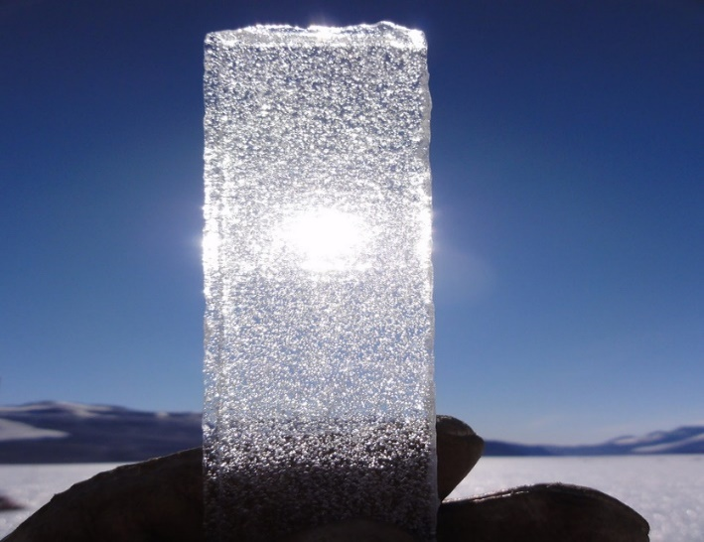
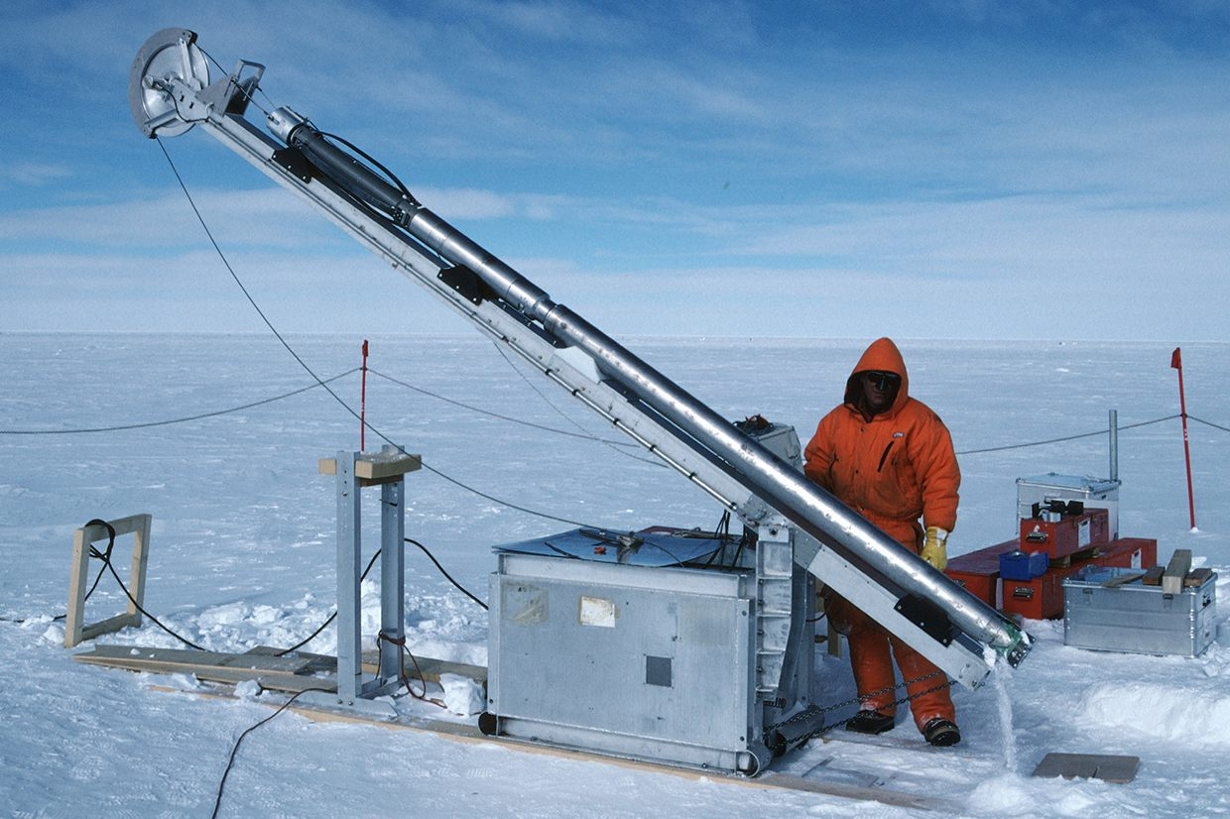
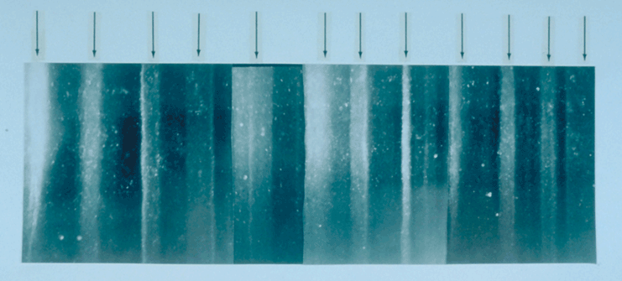
These are drilled from Ice in the worlds largest ice sheets and contain ancient bubbles of gas.
  These bubbles contain the ancient atmosphere including amounts of CO2 and help us look back at the ancient atmosphere.
10

Slide 20
AGW Review Game
ITS ALL ABOUT CARBON | HOT AND COLD | DEEP IMPACT | FUTURE PLANS | -Bonus- FIRED
1 | 6 | 11 | 16 | *21
2 | 7 | 12 | 17 | *22
3 | 8 | 13 | 18 | *23
4 | 9 | 14 | 19 | *24
5 | 10 | 15 | 20 | *25

Slide 21
AGW Review Game
ITS ALL ABOUT CARBON | HOT AND COLD | DEEP IMPACT | FUTURE PLANS | -Bonus- FIRED
1 | 6 | 11 | 16 | *21
2 | 7 | 12 | 17 | *22
3 | 8 | 13 | 18 | *23
4 | 9 | 14 | 19 | *24
5 | 10 | 15 | 20 | *25

Slide 22
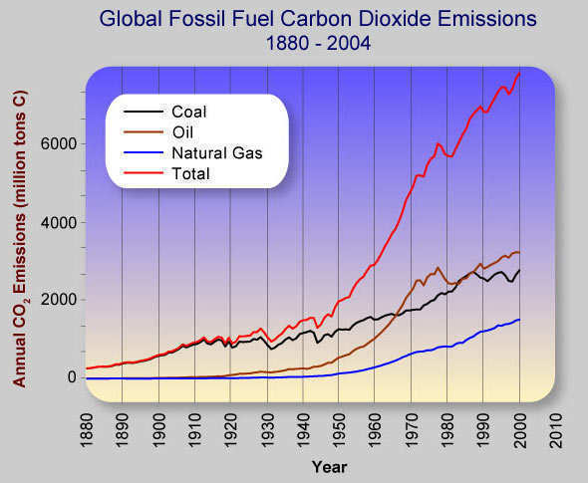
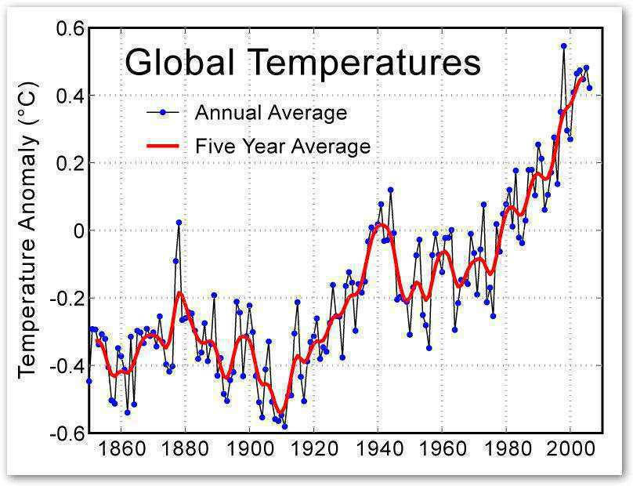
  What is the connection between these two graphs?
11
Copyright © 2024 SlideSpark .LLC

Slide 23
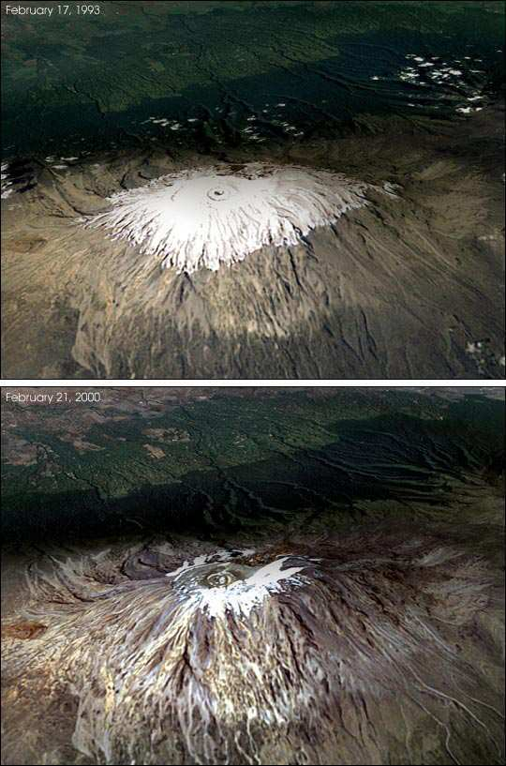
The loss of these over the last few decades is one piece of evidence that the planet is warming.
12
1993
2000

Slide 24
Which is not one of the big impacts of AGW?
  A.) Spread of Disease.
  B.) More hurricanes (warmer water).
  C.) Long droughts and intense heat waves.
  D.) Slow ecological changes.
  E.) Economic consequences.
  F.) Polar ice caps melt and sea level rise.
  G.) Arctic species will lose habitat / become extinct.
13
Copyright © 2024 SlideSpark .LLC

Slide 25
Which is not one of the big impacts of AGW?
  A.) Spread of Disease.
  B.) More hurricanes (warmer water).
  C.) Long droughts and intense heat waves.
  D.) Slow ecological changes.
  E.) Economic consequences.
  F.) Polar ice caps melt and sea level rise.
  G.) Arctic species will lose habitat / become extinct.
13
Copyright © 2024 SlideSpark .LLC

Slide 26
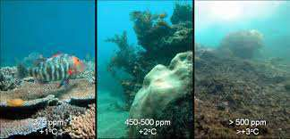
As the oceans absorb more and more carbon dioxide gas they become more acidic.
  This will impact many marine ecosystems and the services they provide.
14

Slide 27
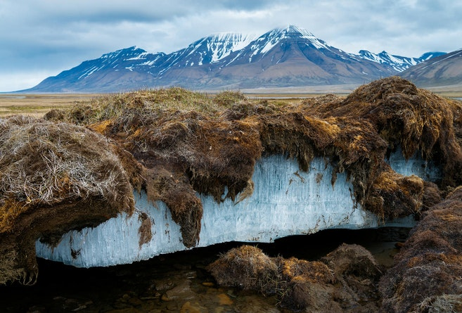
This is the name for the frozen ground that is most common at higher latitudes near the North and South Poles.
    Covers large regions of the Earth and melting rapidly causing the release of gas through decay.
15
ICE
Copyright © 2024 SlideSpark .LLC

Slide 28
AGW Review Game
ITS ALL ABOUT CARBON | HOT AND COLD | DEEP IMPACT | FUTURE PLANS | -Bonus- FIRED
1 | 6 | 11 | 16 | *21
2 | 7 | 12 | 17 | *22
3 | 8 | 13 | 18 | *23
4 | 9 | 14 | 19 | *24
5 | 10 | 15 | 20 | *25

Slide 29
AGW Review Game
ITS ALL ABOUT CARBON | HOT AND COLD | DEEP IMPACT | FUTURE PLANS | -Bonus- FIRED
1 | 6 | 11 | 16 | *21
2 | 7 | 12 | 17 | *22
3 | 8 | 13 | 18 | *23
4 | 9 | 14 | 19 | *24
5 | 10 | 15 | 20 | *25

Slide 30
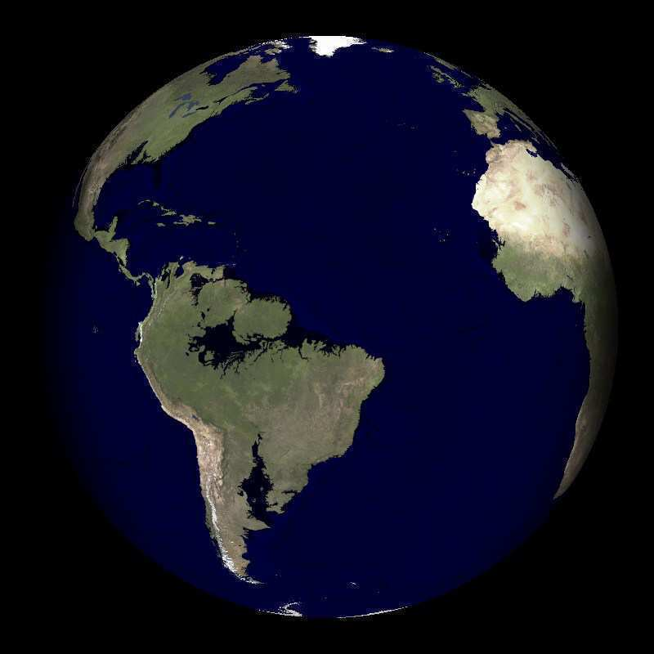
Which danger associated with climate change does this picture represent?
16

Slide 31

Who do we blame? Which four release the most carbon dioxide into the atmosphere?
17
Russia
Bolivia
Argentina
Kenya
Peru
Brazil
Bolivia
Europe
Libya
United States
China/India
Australia
South Africa
Mexico
Canada
New Zealand
Copyright © 2024 SlideSpark .LLC

Slide 32
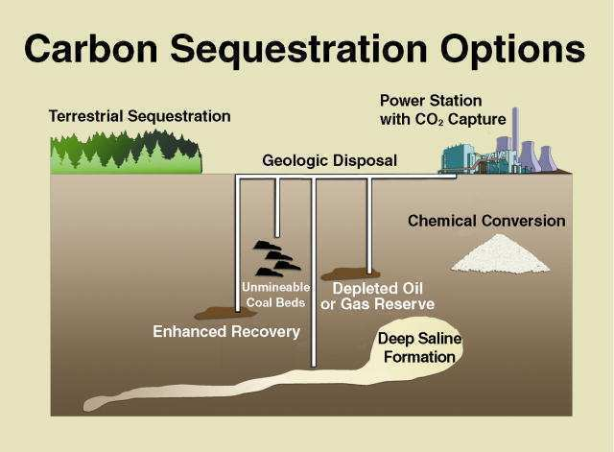
This is the name for the process that collects CO2 from the atmosphere and stores it back in the ground.
  Costs will be high and it’s a new technology.
18

Slide 33
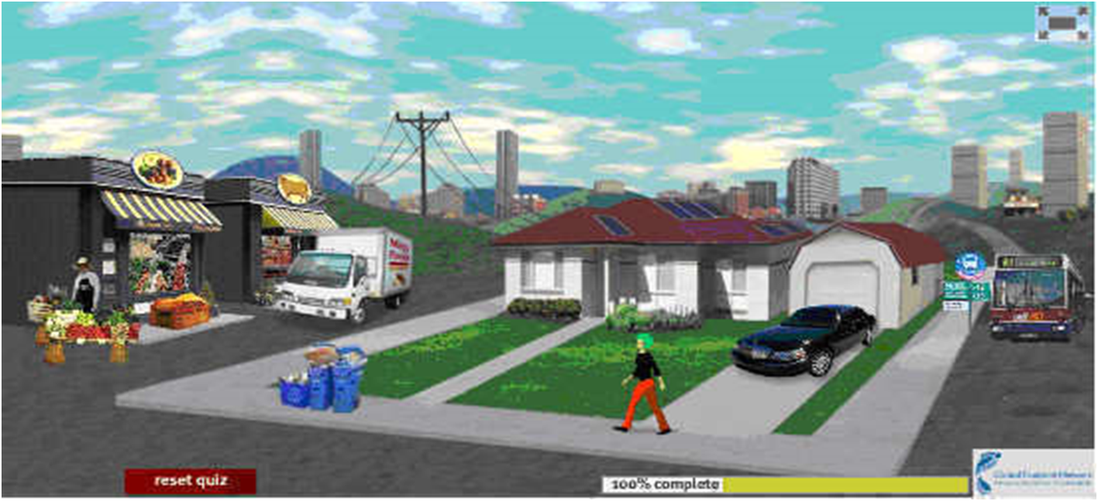

The world needs to also find ways to limit their carbon footprint.
  This is the amount of carbon dioxide and other carbon compounds emitted due to the consumption of fossil fuels by a particular person, group, etc.
19

Slide 34
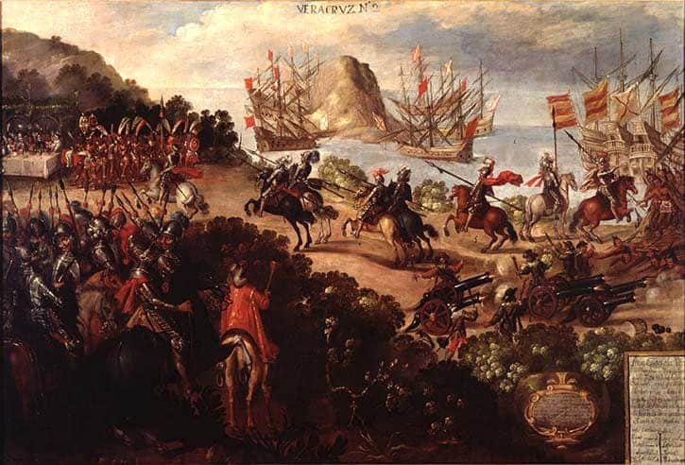
True or False! Today’s level of carbon dioxide gas in the atmosphere is the same level found roughly 500 years ago?
20

Slide 35
AGW Review Game
ITS ALL ABOUT CARBON | HOT AND COLD | DEEP IMPACT | FUTURE PLANS | -Bonus- FIRED
1 | 6 | 11 | 16 | *21
2 | 7 | 12 | 17 | *22
3 | 8 | 13 | 18 | *23
4 | 9 | 14 | 19 | *24
5 | 10 | 15 | 20 | *25

Slide 36
AGW Review Game
ITS ALL ABOUT CARBON | HOT AND COLD | DEEP IMPACT | FUTURE PLANS | -Bonus- FIRED
1 | 6 | 11 | 16 | *21
2 | 7 | 12 | 17 | *22
3 | 8 | 13 | 18 | *23
4 | 9 | 14 | 19 | *24
5 | 10 | 15 | 20 | *25

Slide 37

Who is this?
*21

Slide 38
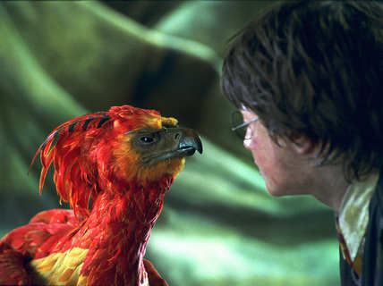
Name this bird?
*22

Slide 39

*23
Name this movie?

Slide 40
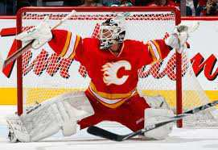
Name this NHL Team?
*24

Slide 41
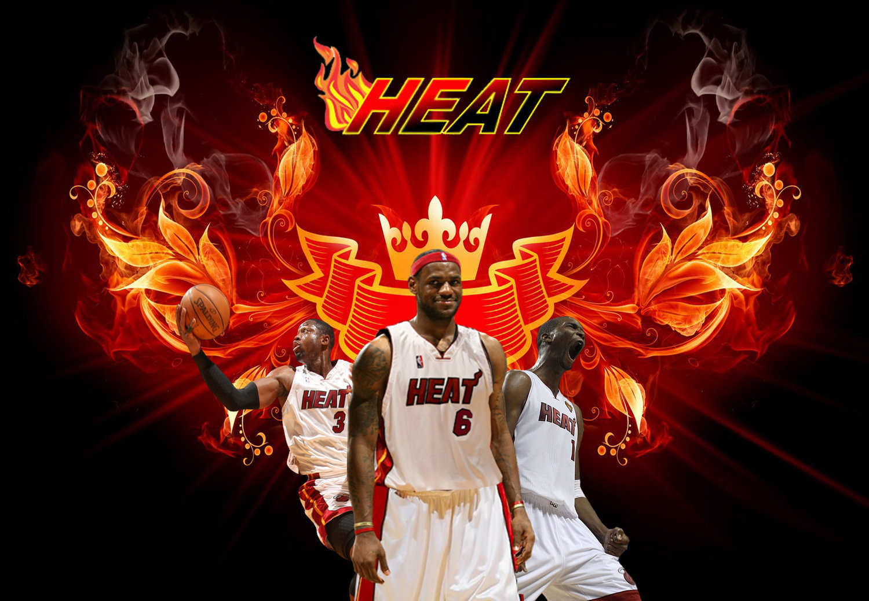
Name this prior NBA Team?
*25

Slide 42
AGW Review Game
ITS ALL ABOUT CARBON | HOT AND COLD | DEEP IMPACT | FUTURE PLANS | -Bonus- FIRED
1 | 6 | 11 | 16 | *21
2 | 7 | 12 | 17 | *22
3 | 8 | 13 | 18 | *23
4 | 9 | 14 | 19 | *24
5 | 10 | 15 | 20 | *25
Final Question

Slide 43
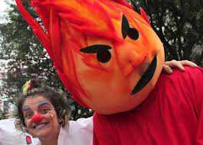

Slide 44
“This was a 5 pt wager question.”

Slide 45
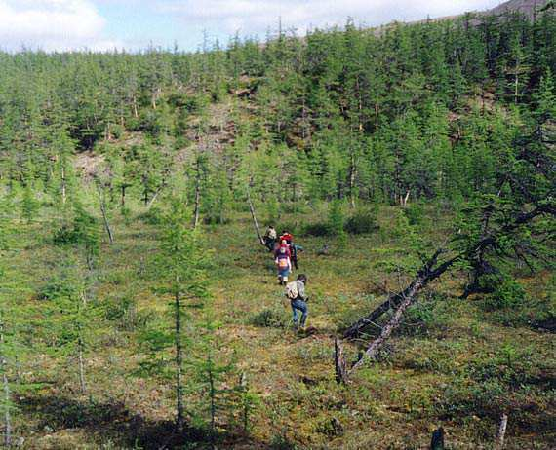
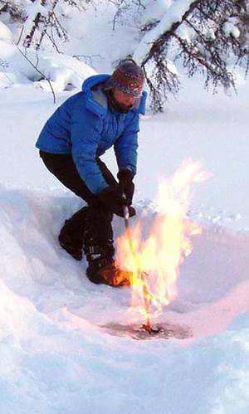
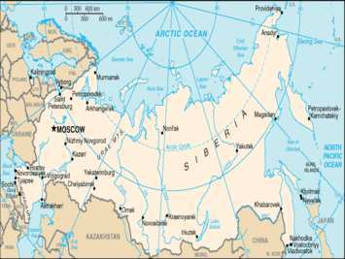
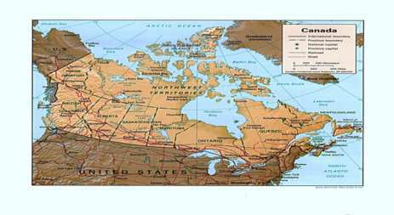
When the ice caps melt, less light is reflected back into space, the planet then warms faster. Arctic swamps then begin to decay releasing methane gas.
  25 times worse than a CO2 Molecule.
Copyright © 2024 SlideSpark .LLC

Slide 46
Review Game
Part 6
Lesson 6

Slide 47

Review Game
Part 6
Lesson 7

Slide 48
AGW Review Game
ITS ALL ABOUT CARBON | HOT AND COLD | DEEP IMPACT | FUTURE PLANS | -Bonus- FIRED
1 | 6 | 11 | 16 | *21
2 | 7 | 12 | 17 | *22
3 | 8 | 13 | 18 | *23
4 | 9 | 14 | 19 | *24
5 | 10 | 15 | 20 | *25

Slide 49
AGW Review Game
ITS ALL ABOUT CARBON | HOT AND COLD | DEEP IMPACT | FUTURE PLANS | -Bonus- FIRED
1 | 6 | 11 | 16 | *21
2 | 7 | 12 | 17 | *22
3 | 8 | 13 | 18 | *23
4 | 9 | 14 | 19 | *24
5 | 10 | 15 | 20 | *25

Slide 50
1
Anthropogenic Global Warming means…
  A.) The planet is getting warmer naturally
  B.) The planet is experiencing a cooling trend
  C.) This is human induced climate change
  D.) Alien Generated Warming
  E.) A Greenhouse Works
AGW
Copyright © 2024 SlideSpark .LLC

Slide 51
1
Anthropogenic Global Warming means…
  A.) The planet is getting warmer naturally
  B.) The planet is experiencing a cooling trend
  C.) This is human induced climate change
  D.) Alien Generated Warming
  E.) A Greenhouse Works
AGW
Copyright © 2024 SlideSpark .LLC

Slide 52
1
Anthropogenic Global Warming means…
  A.) The planet is getting warmer naturally
  B.) The planet is experiencing a cooling trend
  C.) This is human induced climate change
  D.) Alien Generated Warming
  E.) A Greenhouse Works
AGW
Copyright © 2024 SlideSpark .LLC

Slide 53
Which is weather, and which is climate?
  A.) Climate is the atmospheric conditions over a long period of time (years).
  B.) Weather is what is occurring right now.
2
“So much for
global warming.”
Copyright © 2024 SlideSpark .LLC

Slide 54
Which is weather, and which is climate?
  A.) Climate is the atmospheric conditions over a long period of time (years).
  B.) Weather is what is occurring right now.
2
“So much for
global warming.”
Copyright © 2024 SlideSpark .LLC

Slide 55
Which is weather, and which is climate?
  A.) Climate is the atmospheric conditions over a long period of time (years).
  B.) Weather is what is occurring right now.
2
“So much for
global warming.”
Climate
Copyright © 2024 SlideSpark .LLC

Slide 56
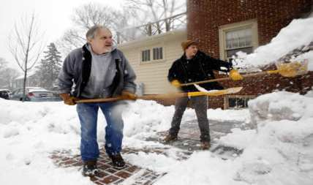
Which is weather, and which is climate?
  A.) Climate is the atmospheric conditions over a long period of time (years).
  B.) Weather is what is occurring right now.
2
“So much for
global warming.”
Climate
Copyright © 2024 SlideSpark .LLC

Slide 57
Which is weather, and which is climate?
  A.) Climate is the atmospheric conditions over a long period of time (years).
  B.) Weather is what is occurring right now.
2
“So much for
global warming.”
Weather
Climate
Copyright © 2024 SlideSpark .LLC

Slide 58
3
Name 5 greenhouse gases. 1 point each.

Slide 59
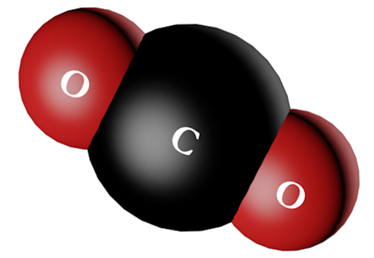
3
Name 5 greenhouse gases. 1 point each.
Carbon Dioxide

Slide 60
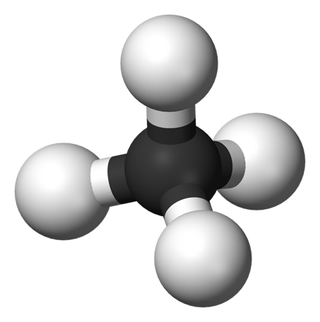

3
Name 5 greenhouse gases. 1 point each.
Carbon Dioxide
H
Methane
C

Slide 61
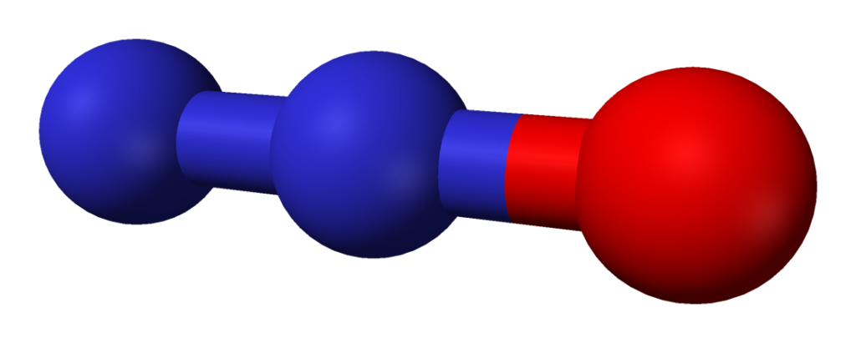
3
Name 5 greenhouse gases. 1 point each.
Carbon Dioxide
O
H
Methane
C
N
N
Nitrous
Oxides

Slide 62
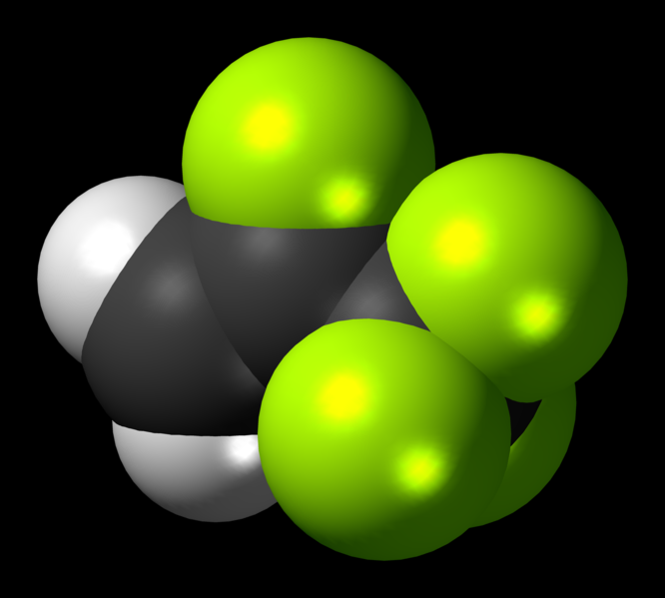
3
Name 5 greenhouse gases. 1 point each.
Carbon Dioxide
O
H
Methane
C
N
N
Fluorinated
Gases
Nitrous
Oxides
F
C
F
C
F

Slide 63
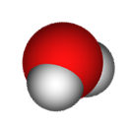
3
Name 5 greenhouse gases. 1 point each.
Carbon Dioxide
O
Water Vapor
H
O
H
Methane
C
N
N
Fluorinated
Gases
Nitrous
Oxides
F
C
F
C
F

Slide 64
Is this a positive or negative feedback loop?
4

Slide 65
Is this a positive or negative feedback loop?
4
Positive Feedback Loop

Slide 66
Name 3 natural CO2 Sinks, and 2 natural CO2 emitters?
5
1pt each?
This has been happening for millions of years
Copyright © 2024 SlideSpark .LLC

Slide 67
Name 3 natural CO2 Sinks, and 2 natural CO2 emitters?
5
1pt each?
This has been happening for millions of years
Copyright © 2024 SlideSpark .LLC

Slide 68
Name 3 natural CO2 Sinks, and 2 natural CO2 emitters?
5
1pt each?
This has been happening for millions of years
Copyright © 2024 SlideSpark .LLC

Slide 69
Name 3 natural CO2 Sinks, and 2 natural CO2 emitters?
5
1pt each?
This has been happening for millions of years
Copyright © 2024 SlideSpark .LLC

Slide 70
Name 3 natural CO2 Sinks, and 2 natural CO2 emitters?
5
1pt each?
This has been happening for millions of years
Copyright © 2024 SlideSpark .LLC

Slide 71
AGW Review Game
ITS ALL ABOUT CARBON | HOT AND COLD | DEEP IMPACT | FUTURE PLANS | -Bonus- FIRED
1 | 6 | 11 | 16 | *21
2 | 7 | 12 | 17 | *22
3 | 8 | 13 | 18 | *23
4 | 9 | 14 | 19 | *24
5 | 10 | 15 | 20 | *25

Slide 72
AGW Review Game
ITS ALL ABOUT CARBON | HOT AND COLD | DEEP IMPACT | FUTURE PLANS | -Bonus- FIRED
1 | 6 | 11 | 16 | *21
2 | 7 | 12 | 17 | *22
3 | 8 | 13 | 18 | *23
4 | 9 | 14 | 19 | *24
5 | 10 | 15 | 20 | *25

Slide 73
6
Peer reviewed articles are…
scholarly articles are written by experts and are reviewed by several other experts in the field before the article is published.
This ensure the article's quality and makes the article more likely to be scientifically valid / reach a conclusions.

Slide 74
6
Peer reviewed articles are…
scholarly articles are written by experts and are reviewed by several other experts in the field before the article is published.
This ensure the article's quality and makes the article more likely to be scientifically valid / reach a conclusions.

Slide 75
6
Peer reviewed articles are…
scholarly articles are written by experts and are reviewed by several other experts in the field before the article is published.
This ensure the article's quality and makes the article more likely to be scientifically valid / reach a conclusions.

Slide 76
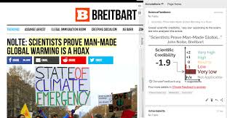
6
Peer reviewed articles are…
scholarly articles are written by experts and are reviewed by several other experts in the field before the article is published.
This ensure the article's quality and makes the article more likely to be scientifically valid / reach a conclusions.
Not peer
reviewed,
not accurate

Slide 77
These are the remains of plants and animals from hundreds of millions of years ago.
  We found a way to use ancient sunlight from millions of years ago, thus borrowed light.
7
Copyright © 2024 SlideSpark .LLC

Slide 78
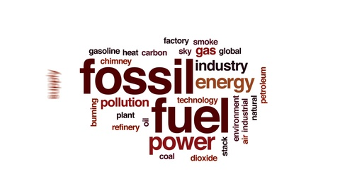
These are the remains of plants and animals from hundreds of millions of years ago.
  We found a way to use ancient sunlight from millions of years ago, thus borrowed light.
7
Copyright © 2024 SlideSpark .LLC

Slide 79
This is the name for the trapping of Earth’s heat at or near the surface.
8
Copyright © 2024 SlideSpark .LLC

Slide 80
This is the name for the trapping of Earth’s heat at or near the surface.
8
The Greenhouse Effect
Copyright © 2024 SlideSpark .LLC

Slide 81
True or False! The major agencies that monitor global temperature agree that atmosphere is warming at an alarming pace.
9

Slide 82
True or False! The major agencies that monitor global temperature agree that atmosphere is warming at an alarming pace.
9
TRUE!
Different agencies have found the same warming trends.

Slide 83
These are drilled from Ice in the worlds largest ice sheets and contain ancient bubbles of gas.
  These bubbles contain the ancient atmosphere including amounts of CO2 and help us look back at the ancient atmosphere.
10

Slide 84
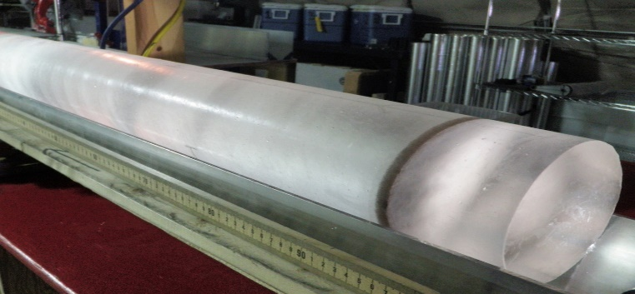
These are drilled from Ice in the worlds largest ice sheets and contain ancient bubbles of gas.
  These bubbles contain the ancient atmosphere including amounts of CO2 and help us look back at the ancient atmosphere.
10
ICE CORE
Can also measure thickness of ice layer
per year

Slide 85
AGW Review Game
ITS ALL ABOUT CARBON | HOT AND COLD | DEEP IMPACT | FUTURE PLANS | -Bonus- FIRED
1 | 6 | 11 | 16 | *21
2 | 7 | 12 | 17 | *22
3 | 8 | 13 | 18 | *23
4 | 9 | 14 | 19 | *24
5 | 10 | 15 | 20 | *25

Slide 86
AGW Review Game
ITS ALL ABOUT CARBON | HOT AND COLD | DEEP IMPACT | FUTURE PLANS | -Bonus- FIRED
1 | 6 | 11 | 16 | *21
2 | 7 | 12 | 17 | *22
3 | 8 | 13 | 18 | *23
4 | 9 | 14 | 19 | *24
5 | 10 | 15 | 20 | *25

Slide 87
  What is the connection between these two graphs?
11
Copyright © 2024 SlideSpark .LLC

Slide 88
  What is the connection between these two graphs?
11
Copyright © 2024 SlideSpark .LLC

Slide 89
  What is the connection between these two graphs?
11
Copyright © 2024 SlideSpark .LLC

Slide 90
The loss of these over the last few decades is one piece of evidence that the planet is warming.
12
1993
2000

Slide 91
The loss of these over the last few decades is one piece of evidence that the planet is warming.
12
1993
Glaciers
2000

Slide 92
Which is not one of the big impacts of AGW?
  A.) Spread of Disease.
  B.) More hurricanes (warmer water).
  C.) Long droughts and intense heat waves.
  D.) Slow ecological changes.
  E.) Economic consequences.
  F.) Polar ice caps melt and sea level rise.
  G.) Arctic species will lose habitat / become extinct.
13
Copyright © 2024 SlideSpark .LLC

Slide 93
Which is not one of the big impacts of AGW?
  A.) Spread of Disease.
  B.) More hurricanes (warmer water).
  C.) Long droughts and intense heat waves.
  D.) Slow ecological changes.
  E.) Economic consequences.
  F.) Polar ice caps melt and sea level rise.
  G.) Arctic species will lose habitat / become extinct.
13
Copyright © 2024 SlideSpark .LLC

Slide 94
Which is not one of the big impacts of AGW?
  A.) Spread of Disease.
  B.) More hurricanes (warmer water).
  C.) Long droughts and intense heat waves.
  D.) Slow ecological changes.
  E.) Economic consequences.
  F.) Polar ice caps melt and sea level rise.
  G.) Arctic species will lose habitat / become extinct.
13
Copyright © 2024 SlideSpark .LLC

Slide 95
Which is not one of the big impacts of AGW?
  A.) Spread of Disease.
  B.) More hurricanes (warmer water).
  C.) Long droughts and intense heat waves.
  D.) RAPID ecological changes.
  E.) Economic consequences.
  F.) Polar ice caps melt and sea level rise.
  G.) Arctic species will lose habitat / become extinct.
13
Copyright © 2024 SlideSpark .LLC

Slide 96
As the oceans absorb more and more carbon dioxide gas they become more acidic.
  This will impact many marine ecosystems and the services they provide.
14

Slide 97
As the oceans absorb more and more carbon dioxide gas they become more acidic.
  This will impact many marine ecosystems and the services they provide.
14

Slide 98
As the oceans absorb more and more carbon dioxide gas they become more acidic.
  This will impact many marine ecosystems and the services they provide.
14

Slide 99
This is the name for the frozen ground that is most common at higher latitudes near the North and South Poles.
    Covers large regions of the Earth and melting rapidly causing the release of gas through decay.
15
ICE
Copyright © 2024 SlideSpark .LLC

Slide 100
This is the name for the frozen ground that is most common at higher latitudes near the North and South Poles.
    Covers large regions of the Earth and melting rapidly causing the release of gas through decay.
15
Permafrost
ICE
Copyright © 2024 SlideSpark .LLC

Slide 101
AGW Review Game
ITS ALL ABOUT CARBON | HOT AND COLD | DEEP IMPACT | FUTURE PLANS | -Bonus- FIRED
1 | 6 | 11 | 16 | *21
2 | 7 | 12 | 17 | *22
3 | 8 | 13 | 18 | *23
4 | 9 | 14 | 19 | *24
5 | 10 | 15 | 20 | *25

Slide 102
AGW Review Game
ITS ALL ABOUT CARBON | HOT AND COLD | DEEP IMPACT | FUTURE PLANS | -Bonus- FIRED
1 | 6 | 11 | 16 | *21
2 | 7 | 12 | 17 | *22
3 | 8 | 13 | 18 | *23
4 | 9 | 14 | 19 | *24
5 | 10 | 15 | 20 | *25

Slide 103
Which danger associated with climate change does this picture represent?
16

Slide 104
Which danger associated with climate change does this picture represent?
16
and the answer is…

Slide 105
Which danger associated with climate change does this picture represent?
16
Sea Level Rise

Slide 106
Who do we blame? Which four release the most carbon dioxide into the atmosphere?
17
Russia
Bolivia
Argentina
Kenya
Peru
Brazil
Bolivia
Europe
Libya
United States
China/India
Australia
South Africa
Mexico
Canada
New Zealand
Copyright © 2024 SlideSpark .LLC

Slide 107
Who do we blame? Which four release the most carbon dioxide into the atmosphere?
17
Russia
Bolivia
Argentina
Kenya
Peru
Brazil
Bolivia
Europe
Libya
United States
China/India
Australia
South Africa
Mexico
Canada
New Zealand
Copyright © 2024 SlideSpark .LLC

Slide 108
Who do we blame? Which four release the most carbon dioxide into the atmosphere?
17
Russia
Europe
United States
China/India
Copyright © 2024 SlideSpark .LLC

Slide 109
Who do we blame? Which four release the most carbon dioxide into the atmosphere?
17
Russia
All nations are emitting carbon into the atmosphere. Blame isn’t what is needed. A serious and immediate reduction in carbon emissions across the planet is.
Europe
United States
China/India
Copyright © 2024 SlideSpark .LLC

Slide 110
Who do we blame? Which four release the most carbon dioxide into the atmosphere?
17
Russia
All nations are emitting carbon into the atmosphere. Blame isn’t what is needed. A serious and immediate reduction in carbon emissions across the planet is.
Europe
United States
China/India
These four should
take the lead in this process.
Copyright © 2024 SlideSpark .LLC

Slide 111
Who do we blame? Which four release the most carbon dioxide into the atmosphere?
17
Russia
All nations are emitting carbon into the atmosphere. Blame isn’t what is needed. A serious and immediate reduction in carbon emissions across the planet is.
Europe
United States
China/India
These four should
take the lead in this process.
and do it quickly!
Copyright © 2024 SlideSpark .LLC

Slide 112
This is the name for the process that collects CO2 from the atmosphere and stores it back in the ground.
  Costs will be high and it’s a new technology.
18

Slide 113
This is the name for the process that collects CO2 from the atmosphere and stores it back in the ground.
  Costs will be high and it’s a new technology.
18

Slide 114
This is the name for the process that collects CO2 from the atmosphere and stores it back in the ground.
  Costs will be high and it’s a new technology.
18

Slide 115
The world needs to also find ways to limit their carbon footprint.
  This is the amount of carbon dioxide and other carbon compounds emitted due to the consumption of fossil fuels by a particular person, group, etc.
19

Slide 116

The world needs to also find ways to limit their carbon footprint.
  This is the amount of carbon dioxide and other carbon compounds emitted due to the consumption of fossil fuels by a particular person, group, etc.
19

Slide 117
The world needs to also find ways to limit their carbon footprint.
  This is the amount of carbon dioxide and other carbon compounds emitted due to the consumption of fossil fuels by a particular person, group, etc.
19

Slide 118
True or False! Today’s level of carbon dioxide gas in the atmosphere is the same level found roughly 500 years ago?
20

Slide 119
True or False! Today’s level of carbon dioxide gas in the atmosphere is the same level found roughly 500 years ago?
20
FALSE!

Slide 120
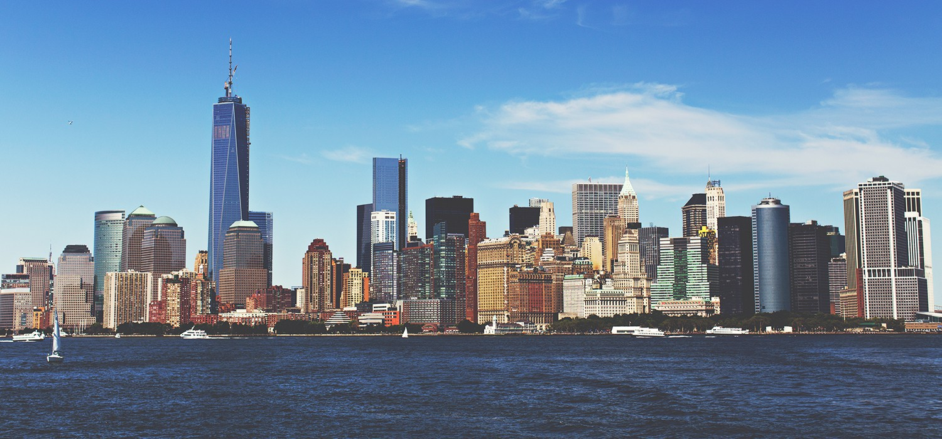
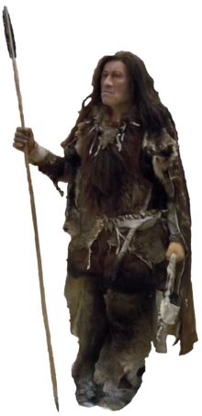
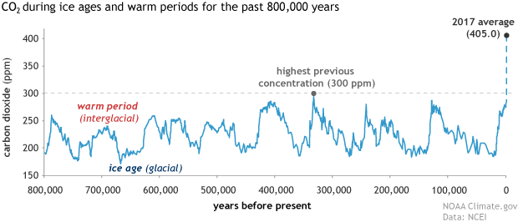
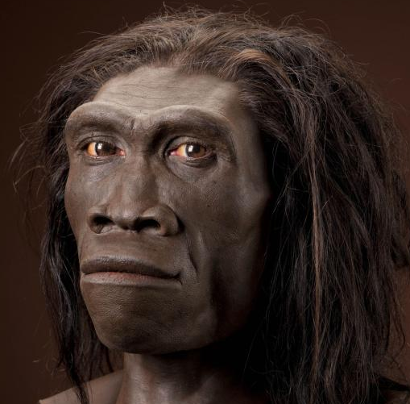
You have to go back about 3-5 million years to find a time where CO2 was at modern levels.
This graph shows CO2 and goes even further back in time
Modern human didn’t exist (Homo erectus)
Learn more about this graph at… https://www.climate.gov/news-features/understanding-climate/climate-change-atmospheric-carbon-dioxide
Copyright © 2024 SlideSpark .LLC

Slide 121
AGW Review Game
ITS ALL ABOUT CARBON | HOT AND COLD | DEEP IMPACT | FUTURE PLANS | -Bonus- FIRED
1 | 6 | 11 | 16 | *21
2 | 7 | 12 | 17 | *22
3 | 8 | 13 | 18 | *23
4 | 9 | 14 | 19 | *24
5 | 10 | 15 | 20 | *25

Slide 122
AGW Review Game
ITS ALL ABOUT CARBON | HOT AND COLD | DEEP IMPACT | FUTURE PLANS | -Bonus- FIRED
1 | 6 | 11 | 16 | *21
2 | 7 | 12 | 17 | *22
3 | 8 | 13 | 18 | *23
4 | 9 | 14 | 19 | *24
5 | 10 | 15 | 20 | *25

Slide 123
Who is this?
*21

Slide 124
Who is this?
*21
and the answer is…

Slide 125
Who is this?
*21
Bruce Lee
and the answer is…

Slide 126
Name this bird?
*22

Slide 127
Name this bird?
*22
Phoenix

Slide 128
*23
Name this movie?

Slide 129
*23
Name this movie?

Slide 130
*23
Name this movie?

Slide 131
*23
Name this movie?
The Hunger Games

Slide 132
Name this NHL Team?
*24

Slide 133
Name this NHL Team?
*24
Calgary
Flames

Slide 134
Name this prior NBA Team?
*25

Slide 135
Name this prior NBA Team?
*25

Slide 136
AGW Review Game
ITS ALL ABOUT CARBON | HOT AND COLD | DEEP IMPACT | FUTURE PLANS | -Bonus- FIRED
1 | 6 | 11 | 16 | *21
2 | 7 | 12 | 17 | *22
3 | 8 | 13 | 18 | *23
4 | 9 | 14 | 19 | *24
5 | 10 | 15 | 20 | *25
Final Question

Slide 138
“This was a 5 pt wager question.”

Slide 139
When the ice caps melt, less light is reflected back into space, the planet then warms faster. Arctic swamps then begin to decay releasing methane gas.
  25 times worse than a CO2 Molecule.
Copyright © 2024 SlideSpark .LLC

Slide 140
When the ice caps melt, less light is reflected back into space, the planet then warms faster. Arctic swamps then begin to decay releasing methane gas.
  25 times worse than a CO2 Molecule.
Copyright © 2024 SlideSpark .LLC

Slide 141
When the ice caps melt, less light is reflected back into space, the planet then warms faster. Arctic swamps then begin to decay releasing methane gas.
  25 times worse than a CO2 Molecule.
Methane
Copyright © 2024 SlideSpark .LLC

Slide 142
Questions 1-20 = 5pts Each
Final Category (Bonus) = 1pt Each
Final Questions = 5 pt wager
If you wager 5 on the last question and get it wrong you lose 5 pts. Wager 5 and get it right you get 5 pts.
Find the Owl =
Secretly write “Owl” in the correct box worth 1pt.
“I’ll be about this big.”

Slide 143
Review Game
Part 6
Lesson 7

Slide 144



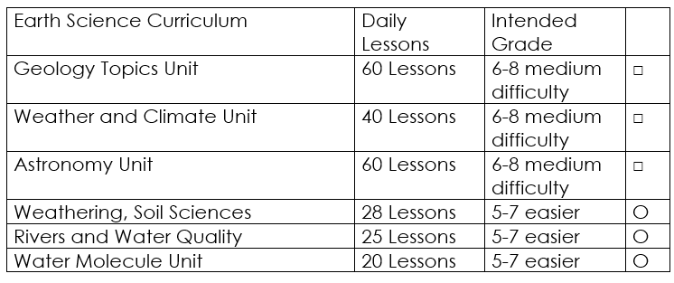

Curriculum Guide
Number of Lessons in each unit (50 min, daily lessons) and difficult rating scale / intended grade level.
=Easier, = More difficult, =Most difficult
Earth Science Units

Slide 145


Life Science Units

Slide 146

Physical Science

Slide 147

Dear Valued Educator,
Our fully editable .pptx and .doc resources are perfect for educators looking to bring enthusiasm and creativity to their lessons. We encourage you to make changes to fit your needs and style. As science educators, we’re committed to providing students with the tools they need to succeed in the classroom and beyond. Each unit in the curriculum includes a range of resources that have been developed through extensive research and use in a busy classroom. Our teaching approach is designed to make science education engaging and exciting for learners of all ages. We offer a one-of-a-kind science curriculum that will challenge, inspire, and educate students to become tomorrow's scientists and leaders. Join us today and learn more about how our program can help you achieve your classroom goals.
With appreciation,
Support@SlideSpark.net

Slide 148





Thank you for your time and interest in our Science curriculum. We strive to provide students with engaging and informative lessons that will spark their curiosity and encourage scientific exploration. Should you have any questions or concerns, please do not hesitate to contact us. Thank you again for considering our curriculum, and we wish you all the best in your educational journey.
Sincerely,
Support@slidespark.net
SlideSpark Science on TpT

