Slide 1
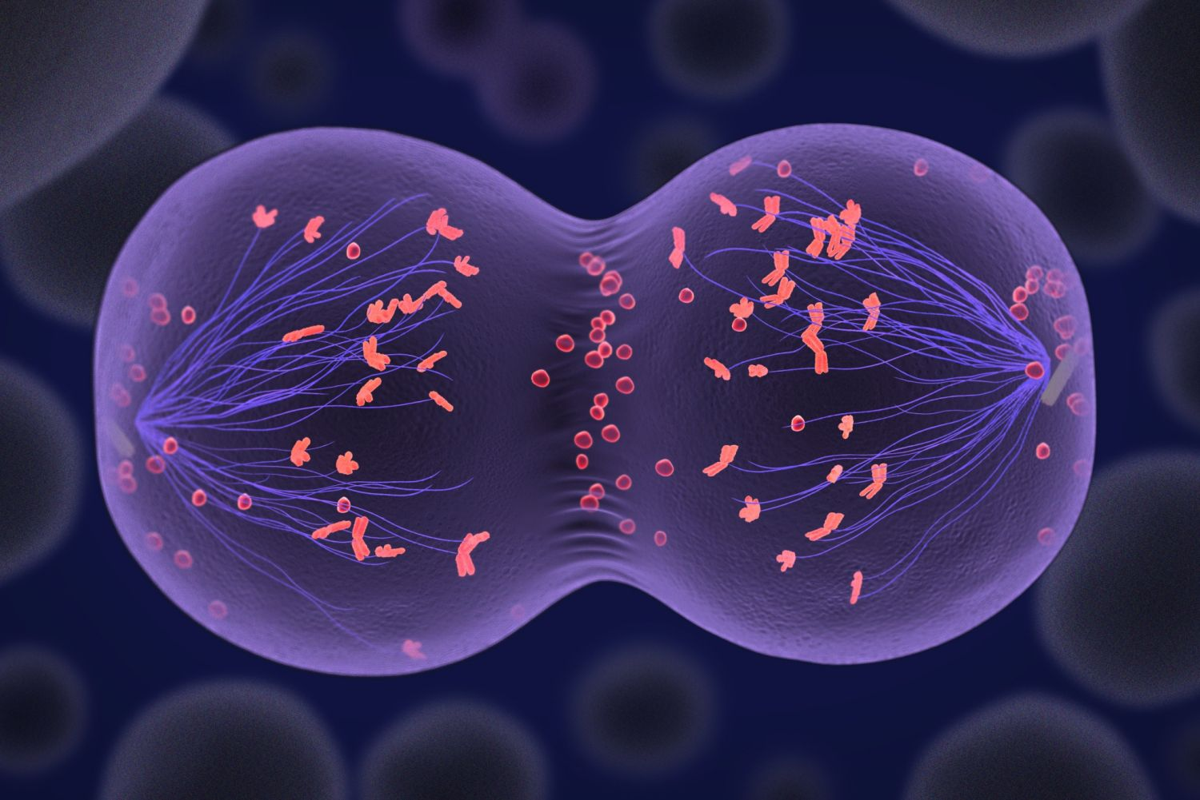

Meiosis Review Game
Part 4
Lesson 4

Slide 2
Part 4 Meiosis Review Game
MY OATH IS | CROSSY ROAD | TIME TO REDUCE | MEIOSIS HODGE PODGE | -Bonus- Famous Cartoon Dogs
1 | 6 | 11 | 16 | *21
2 | 7 | 12 | 17 | *22
3 | 8 | 13 | 18 | *23
4 | 9 | 14 | 19 | *24
5 | 10 | 15 | 20 | *25

Slide 3
How to play…
  Don’t play like Jeo_ _ _ _ y.
  Class should be divided into several small groups.
  Groups should use science journal (red slide notes), homework, and other available materials to assist you.
  Groups can communicate quietly with each other but no sharing answers between groups.
    Practice quietly communicating right now?
    Practice Communication Question:
    Your group gets to order one pizza and you can have two toppings. What does your group want?

Slide 4

Questions 1-20 = 5pts Each
Final Category (Bonus) = 1pt Each
Final Questions = 5 pt wager
If you wager 5 on the last question and get it wrong you lose 5 pts. Wager 5 and get it right you get 5 pts.
Find the Owl =
Secretly write “Owl” in the correct box worth 1pt.
“I’ll be about this big.”

Slide 5
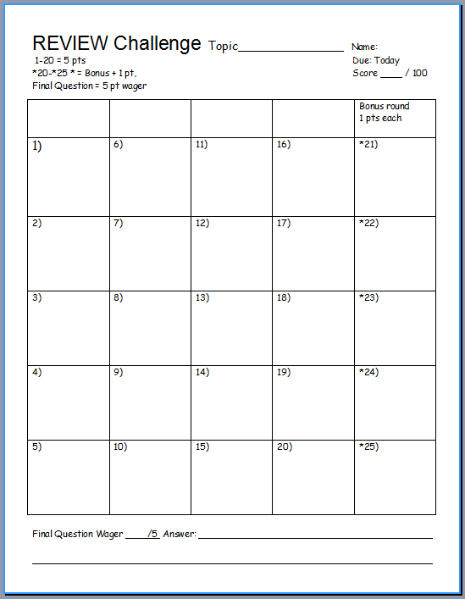
Is your name on the review sheet?
Name

Slide 6
Is your name on the review sheet?
Add the categories
along the top
on the next slide.

Slide 7
Part 4 Meiosis Review Game
MY OATH IS | CROSSY ROAD | TIME TO REDUCE | MEIOSIS HODGE PODGE | -Bonus- Famous Cartoon Dogs
1 | 6 | 11 | 16 | *21
2 | 7 | 12 | 17 | *22
3 | 8 | 13 | 18 | *23
4 | 9 | 14 | 19 | *24
5 | 10 | 15 | 20 | *25

Slide 8
Part 4 Meiosis Review Game
MY OATH IS | CROSSY ROAD | TIME TO REDUCE | MEIOSIS HODGE PODGE | -Bonus- Famous Cartoon Dogs
1 | 6 | 11 | 16 | *21
2 | 7 | 12 | 17 | *22
3 | 8 | 13 | 18 | *23
4 | 9 | 14 | 19 | *24
5 | 10 | 15 | 20 | *25

Slide 9
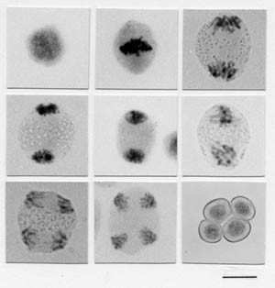
1
99.9% of your cells replicate by using mitosis or meiosis?
Copyright © 2024 SlideSpark .LLC

Slide 10
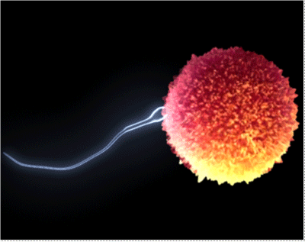
2
Your sex cells are called?
  A.) Love Cells
  B.) Diploid Cells
  C.) Nucleated Cells
  D.) Gametes
  E.) Socratic Cells
Copyright © 2024 SlideSpark .LLC

Slide 11
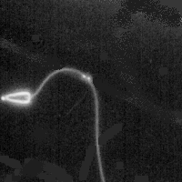
Name these two cells?
flagellating tail,
In a single male ejaculation
3

Slide 12
This is the name of the cell division that produces reproductive cells.
4
Copyright © 2024 SlideSpark .LLC

Slide 13
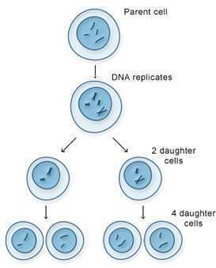
Meiosis has two cell divisions that results in a reduction in the amount of genetic material.
5
Copyright © 2024 SlideSpark .LLC

Slide 14
Part 4 Meiosis Review Game
MY OATH IS | CROSSY ROAD | TIME TO REDUCE | MEIOSIS HODGE PODGE | -Bonus- Famous Cartoon Dogs
1 | 6 | 11 | 16 | *21
2 | 7 | 12 | 17 | *22
3 | 8 | 13 | 18 | *23
4 | 9 | 14 | 19 | *24
5 | 10 | 15 | 20 | *25

Slide 15
Part 4 Meiosis Review Game
MY OATH IS | CROSSY ROAD | TIME TO REDUCE | MEIOSIS HODGE PODGE | -Bonus- Famous Cartoon Dogs
1 | 6 | 11 | 16 | *21
2 | 7 | 12 | 17 | *22
3 | 8 | 13 | 18 | *23
4 | 9 | 14 | 19 | *24
5 | 10 | 15 | 20 | *25

Slide 16
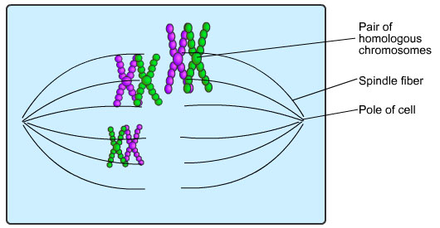
This is the name for a set of one maternal and one paternal chromosome that pair up with each other inside a cell during fertilization.
A.) Two Set Chromosome
B.) Nucleosome
C.) Homologous
  Chromosome
D.) Daughter Cells
E.) A DNA Diploid
6

Slide 17
This is the name for a set of one maternal and one paternal chromosome that pair up with each other inside a cell during fertilization.
A.) Two Set Chromosome
B.) Nucleosome
C.) Homologous
  Chromosome
D.) Daughter Cells
E.) A DNA Diploid
6

Slide 18
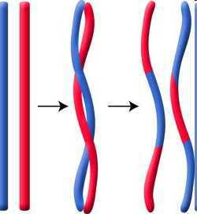
This is when genetic segments of information are swapped when the chromosomes are next to each other.
  Occurs at random and creates millions of possibilities.
7
Copyright © 2024 SlideSpark .LLC

Slide 19
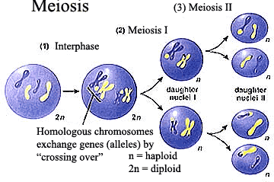
8
Which letter represents haploid, and which letter is diploid?
B
A
Copyright © 2024 SlideSpark .LLC

Slide 20
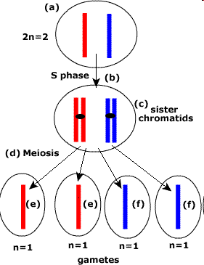
In Meiosis, there’s a Reduction of genetic information
  Produces four different germ (reproductive cells).
9
Copyright © 2024 SlideSpark .LLC

Slide 21
In Meiosis, there’s a Reduction of genetic information
  Produces four different germ (reproductive cells).
9
Which one will
fertilize the egg for a bonus point?
Copyright © 2024 SlideSpark .LLC

Slide 22
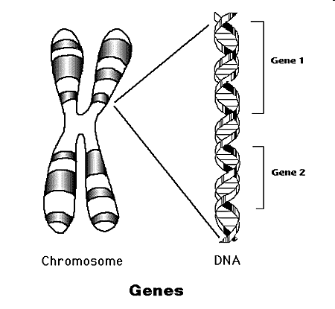
Scientists call the factors that control traits…
A.)DNA B.)Genes C.)Helicase D.)Meiosis II
10
Copyright© 2010 Ryan P. Murphy

Slide 23
Part 4 Meiosis Review Game
MY OATH IS | CROSSY ROAD | TIME TO REDUCE | MEIOSIS HODGE PODGE | -Bonus- Famous Cartoon Dogs
1 | 6 | 11 | 16 | *21
2 | 7 | 12 | 17 | *22
3 | 8 | 13 | 18 | *23
4 | 9 | 14 | 19 | *24
5 | 10 | 15 | 20 | *25

Slide 24
Part 4 Meiosis Review Game
MY OATH IS | CROSSY ROAD | TIME TO REDUCE | MEIOSIS HODGE PODGE | -Bonus- Famous Cartoon Dogs
1 | 6 | 11 | 16 | *21
2 | 7 | 12 | 17 | *22
3 | 8 | 13 | 18 | *23
4 | 9 | 14 | 19 | *24
5 | 10 | 15 | 20 | *25

Slide 25
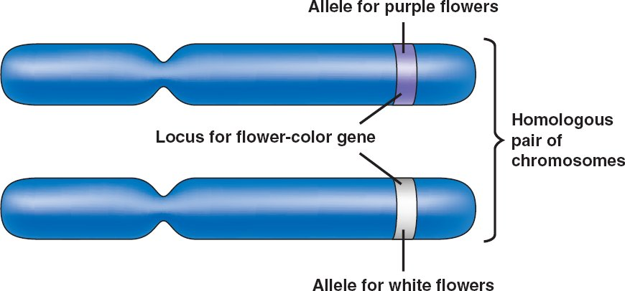
The different forms in genes are called…
A.) Genoids
B.) Chromatin
C.) RNA
D.) Alleles
E.) Ribosomes
11
Copyright© 2010 Ryan P. Murphy

Slide 26
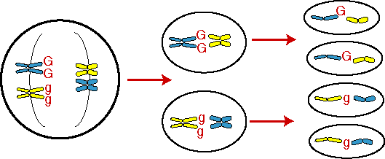
12
Mendel's law of segregation: Allele pairs separate during gamete formation, and randomly unite at fertilization.
  Organisms inherit two alleles for each trait when gametes are produced.
  Allele pairs separate leaving each cell with a single allele for each trait.
Copyright © 2024 SlideSpark .LLC

Slide 27
12
Mendel's law of segregation: Allele pairs separate during gamete formation, and randomly unite at fertilization.
  Organisms inherit two alleles for each trait when gametes are produced.
  Allele pairs separate leaving each cell with a single allele for each trait.
Which will fertilize
for a bonus point
Copyright © 2024 SlideSpark .LLC

Slide 28
Which is not an important event of Meiosis
  #1.) Two cell divisions that end without DNA replication. (leads to a reduction of genetic information).
  #2.) Pairing of homologous chromosomes that lead to crossing over creating genetic variation.
  #3.) Separation of homologous chromosomes (Anaphase I of Meiosis I)
  #4.) The DNA replicates and divides one last time during prophase II.
  #5.) Separation sister chromatids (Anaphase II of Meiosis II)
2.) Pairing of homologous chromosomes that lead to crossing over creating genetic variation.
3.) Separation of homologous chromosomes (Anaphase I of Meiosis I)
4.) Separation sister chromatids (Anaphase II of Meiosis II) Which will fertilize?
13

Slide 29
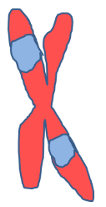
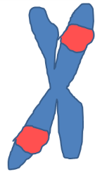
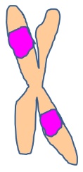
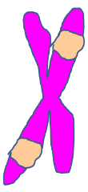
Independent orientation: Chromosomes align along the metaphase plate in metaphase I.
  One chromosome is inherited from your mother and the other from your father.
  Two possibilities; each pole has a 50% chance of inheriting one or the other.
?
?
14
Copyright © 2024 SlideSpark .LLC

Slide 30
Which is not one of Mendel's Laws of Heredity:
1) The Law of Segregation: Each inherited trait is defined by a gene pair. Parental genes are randomly separated to the sex cells so that sex cells contain only one gene of the pair. Offspring therefore inherit one genetic allele from each parent when sex cells unite in fertilization.
2) Sexual reproduction will always result in a new individual that is genetically identical to either the father or mother.
3) The Law of Independent Assortment: Genes for different traits are sorted separately from one another so that the inheritance of one trait is not dependent on the inheritance of another.
4) The Law of Dominance: An organism with alternate forms of a gene will express the form that is dominant.
15
Copyright © 2024 SlideSpark .LLC

Slide 31
Which is not one of Mendel's Laws of Heredity:
1) The Law of Segregation: Each inherited trait is defined by a gene pair. Parental genes are randomly separated to the sex cells so that sex cells contain only one gene of the pair. Offspring therefore inherit one genetic allele from each parent when sex cells unite in fertilization.
2) Sexual reproduction will always result in a new individual that is genetically identical to either the father or mother.
3) The Law of Independent Assortment: Genes for different traits are sorted separately from one another so that the inheritance of one trait is not dependent on the inheritance of another.
4) The Law of Dominance: An organism with alternate forms of a gene will express the form that is dominant.
15
Copyright © 2024 SlideSpark .LLC

Slide 32
Part 4 Meiosis Review Game
MY OATH IS | CROSSY ROAD | TIME TO REDUCE | MEIOSIS HODGE PODGE | -Bonus- Famous Cartoon Dogs
1 | 6 | 11 | 16 | *21
2 | 7 | 12 | 17 | *22
3 | 8 | 13 | 18 | *23
4 | 9 | 14 | 19 | *24
5 | 10 | 15 | 20 | *25

Slide 33
Part 4 Meiosis Review Game
MY OATH IS | CROSSY ROAD | TIME TO REDUCE | MEIOSIS HODGE PODGE | -Bonus- Famous Cartoon Dogs
1 | 6 | 11 | 16 | *21
2 | 7 | 12 | 17 | *22
3 | 8 | 13 | 18 | *23
4 | 9 | 14 | 19 | *24
5 | 10 | 15 | 20 | *25

Slide 34
How many chromosomes are in the sex cells of a human?
16

Slide 35
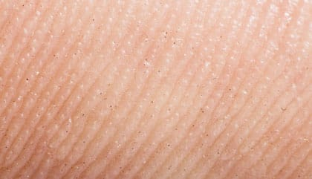
How many Chromosomes
are in our somatic cells?
Somatic Cell= Any cell other than a gamete, germ cell, gametocyte or undifferentiated stem cell.
17

Slide 36
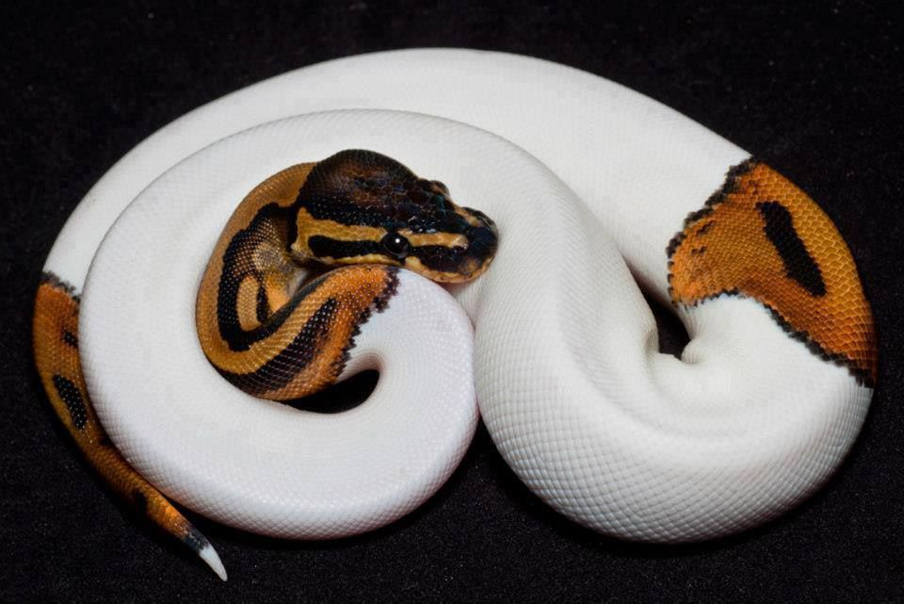
18
Evolution is the change in the gene pool overtime.
  Gene Pools can change when…
  Mutations in the genes
    Genes can change. Some are good, some are bad.
    The environment will decide.

Slide 37
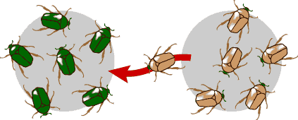

Evolution is the change in the gene pool overtime.
  Gene Pools can change when…
  Movement in and out of the population
    Immigration, gene flow.
19

Slide 38
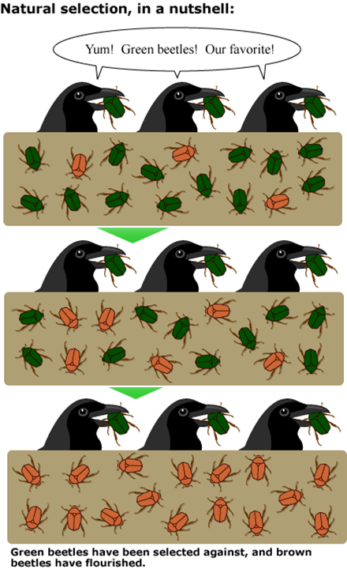
Evolution is the change in the gene pool overtime.
  Gene Pools can change when…
  Natural selection
    Adaptations to the environment that do well replace poor ones. Usually an advancement.
20

Slide 39
Part 4 Meiosis Review Game
MY OATH IS | CROSSY ROAD | TIME TO REDUCE | MEIOSIS HODGE PODGE | -Bonus- Famous Cartoon Dogs
1 | 6 | 11 | 16 | *21
2 | 7 | 12 | 17 | *22
3 | 8 | 13 | 18 | *23
4 | 9 | 14 | 19 | *24
5 | 10 | 15 | 20 | *25

Slide 40
Part 4 Meiosis Review Game
MY OATH IS | CROSSY ROAD | TIME TO REDUCE | MEIOSIS HODGE PODGE | -Bonus- Famous Cartoon Dogs
1 | 6 | 11 | 16 | *21
2 | 7 | 12 | 17 | *22
3 | 8 | 13 | 18 | *23
4 | 9 | 14 | 19 | *24
5 | 10 | 15 | 20 | *25

Slide 41
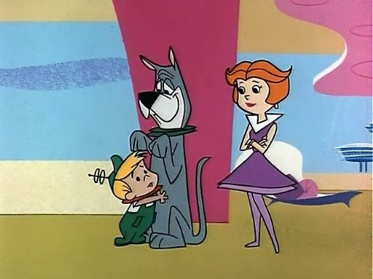
Name the famous dog?
*21

Slide 42
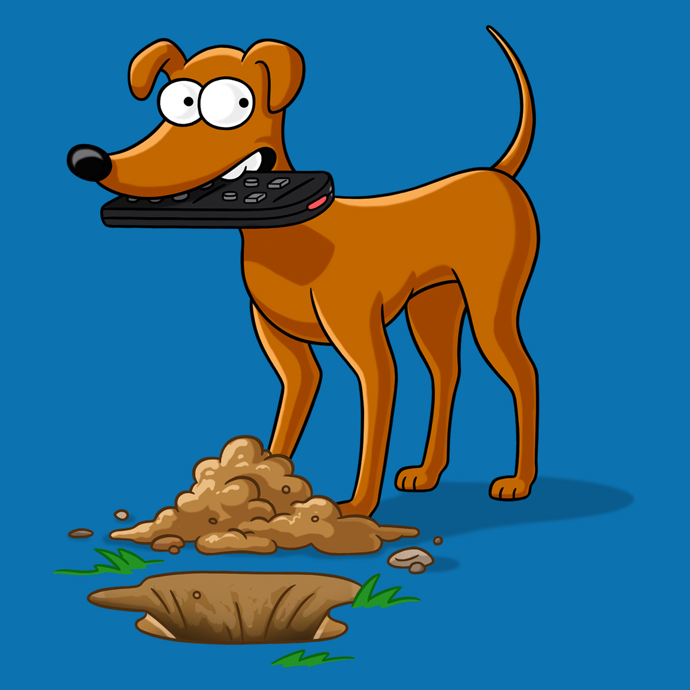
*22

Slide 43
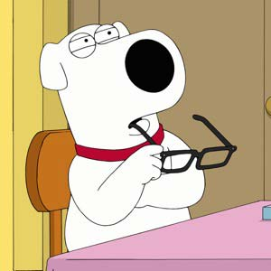
*23

Slide 44
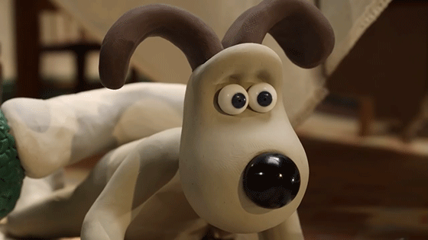
*24

Slide 45
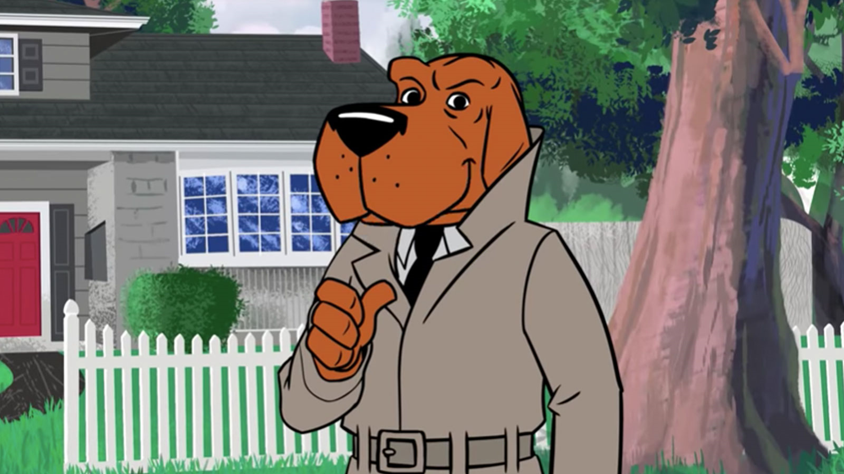
*25
Mc _ _ _ _ _
The Crime Dog

Slide 46
Part 4 Meiosis Review Game
MY OATH IS | CROSSY ROAD | TIME TO REDUCE | MEIOSIS HODGE PODGE | -Bonus- Famous Cartoon Dogs
1 | 6 | 11 | 16 | *21
2 | 7 | 12 | 17 | *22
3 | 8 | 13 | 18 | *23
4 | 9 | 14 | 19 | *24
5 | 10 | 15 | 20 | *25
Final Question

Slide 47
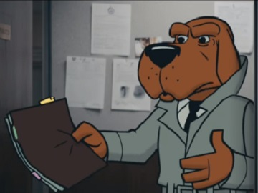
Final
Wager
Question
5pt max

Slide 48
Which is not an Important Event of Meiosis
1.) One cell division that ends with DNA replication. (leads to a copy of genetic information)
2.) Pairing of homologous chromosomes that lead to crossing over creating genetic variation.
3.) DNA replicates during Anaphase I of Meiosis I to create two identical cells.
4.) Separation of homologous chromosomes (Anaphase I of Meiosis I)
There is only one answer
on this question

Slide 49
Meiosis Review Game
Part 4
Lesson 4

Slide 50

Meiosis Review Game
Answer Version
Part 4
Lesson 5

Slide 51
Part 4 Meiosis Review Game
MY OATH IS | CROSSY ROAD | TIME TO REDUCE | MEIOSIS HODGE PODGE | -Bonus- Famous Cartoon Dogs
1 | 6 | 11 | 16 | *21
2 | 7 | 12 | 17 | *22
3 | 8 | 13 | 18 | *23
4 | 9 | 14 | 19 | *24
5 | 10 | 15 | 20 | *25

Slide 52
How to play…
  Don’t play like Jeo_ _ _ _ y.
  Class should be divided into several small groups.
  Groups should use science journal (red slide notes), homework, and other available materials to assist you.
  Groups can communicate quietly with each other but no sharing answers between groups.
    Practice quietly communicating right now?
    Practice Communication Question:
    Your group gets to order one pizza and you can have two toppings. What does your group want?

Slide 53
Questions 1-20 = 5pts Each
Final Category (Bonus) = 1pt Each
Final Questions = 5 pt wager
If you wager 5 on the last question and get it wrong you lose 5 pts. Wager 5 and get it right you get 5 pts.
Find the Owl =
Secretly write “Owl” in the correct box worth 1pt.
“I’ll be about this big.”

Slide 54
Is your name on the review sheet?
Name

Slide 55
Is your name on the review sheet?
Add the categories
along the top
on the next slide.

Slide 56
Part 4 Meiosis Review Game
MY OATH IS | CROSSY ROAD | TIME TO REDUCE | MEIOSIS HODGE PODGE | -Bonus- Famous Cartoon Dogs
1 | 6 | 11 | 16 | *21
2 | 7 | 12 | 17 | *22
3 | 8 | 13 | 18 | *23
4 | 9 | 14 | 19 | *24
5 | 10 | 15 | 20 | *25

Slide 57
Part 4 Meiosis Review Game
MY OATH IS | CROSSY ROAD | TIME TO REDUCE | MEIOSIS HODGE PODGE | -Bonus- Famous Cartoon Dogs
1 | 6 | 11 | 16 | *21
2 | 7 | 12 | 17 | *22
3 | 8 | 13 | 18 | *23
4 | 9 | 14 | 19 | *24
5 | 10 | 15 | 20 | *25

Slide 58
1
99.9% of your cells replicate by using mitosis or meiosis?
Copyright © 2024 SlideSpark .LLC

Slide 59
1
99.9% of your cells replicate by using mitosis or meiosis?
Mitosis
Copyright © 2024 SlideSpark .LLC

Slide 60
1
99.9% of your cells replicate by using mitosis or meiosis?
Mitosis
Meiosis occurs
only in your sex cells
Copyright © 2024 SlideSpark .LLC

Slide 61
2
Your sex cells are called?
  A.) Love Cells
  B.) Diploid Cells
  C.) Nucleated Cells
  D.) Gametes
  E.) Socratic Cells
Copyright © 2024 SlideSpark .LLC

Slide 62
2
Your sex cells are called?
  A.) Love Cells
  B.) Diploid Cells
  C.) Nucleated Cells
  D.) Gametes
  E.) Socratic Cells
Copyright © 2024 SlideSpark .LLC

Slide 63
Name these two cells?
flagellating tail,
In a single male ejaculation
3

Slide 64
Name these two cells?
flagellating tail,
In a single male ejaculation
3

Slide 65
Name these two cells?
flagellating tail,
In a single male ejaculation
3

Slide 66
Name these two cells?
flagellating tail,
Sperm
In a single male ejaculation
3

Slide 67
Name these two cells?
flagellating tail,
Sperm
In a single male ejaculation
3

Slide 68
Name these two cells?
Egg
flagellating tail,
Sperm
In a single male ejaculation
3

Slide 69
This is the name of the cell division that produces reproductive cells.
4
Copyright © 2024 SlideSpark .LLC

Slide 70
This is the name of the cell division that produces reproductive cells.
4
and the answer is…
Copyright © 2024 SlideSpark .LLC

Slide 71
This is the name of the cell division that produces reproductive cells.
4
Meiosis
and the answer is…
Copyright © 2024 SlideSpark .LLC

Slide 72
Meiosis has two cell divisions that results in a reduction in the amount of genetic material.
5
Copyright © 2024 SlideSpark .LLC

Slide 73
Meiosis has two cell divisions that results in a reduction in the amount of genetic material.
5
Copyright © 2024 SlideSpark .LLC

Slide 74
Meiosis has two cell divisions that results in a reduction in the amount of genetic material.
    -Results in half the number of chromosomes.
5
Copyright © 2024 SlideSpark .LLC

Slide 75
Part 4 Meiosis Review Game
MY OATH IS | CROSSY ROAD | TIME TO REDUCE | MEIOSIS HODGE PODGE | -Bonus- Famous Cartoon Dogs
1 | 6 | 11 | 16 | *21
2 | 7 | 12 | 17 | *22
3 | 8 | 13 | 18 | *23
4 | 9 | 14 | 19 | *24
5 | 10 | 15 | 20 | *25

Slide 76
Part 4 Meiosis Review Game
MY OATH IS | CROSSY ROAD | TIME TO REDUCE | MEIOSIS HODGE PODGE | -Bonus- Famous Cartoon Dogs
1 | 6 | 11 | 16 | *21
2 | 7 | 12 | 17 | *22
3 | 8 | 13 | 18 | *23
4 | 9 | 14 | 19 | *24
5 | 10 | 15 | 20 | *25

Slide 77
This is the name for a set of one maternal and one paternal chromosome that pair up with each other inside a cell during fertilization.
A.) Two Set Chromosome
B.) Nucleosome
C.) Homologous
  Chromosome
D.) Daughter Cells
E.) A DNA Diploid
6

Slide 78
This is the name for a set of one maternal and one paternal chromosome that pair up with each other inside a cell during fertilization.
A.) Two Set Chromosome
B.) Nucleosome
C.) Homologous
  Chromosome
D.) Daughter Cells
E.) A DNA Diploid
6

Slide 79
This is the name for a set of one maternal and one paternal chromosome that pair up with each other inside a cell during fertilization.
A.) Two Set Chromosome
B.) Nucleosome
C.) Homologous
  Chromosome
D.) Daughter Cells
E.) A DNA Diploid
6

Slide 80
This is when genetic segments of information are swapped when the chromosomes are next to each other.
  Occurs at random and creates millions of possibilities.
7
Copyright © 2024 SlideSpark .LLC

Slide 81
This is when genetic segments of information are swapped when the chromosomes are next to each other.
  Occurs at random and creates millions of possibilities.
7
answer is…
Copyright © 2024 SlideSpark .LLC

Slide 82
This is when genetic segments of information are swapped when the chromosomes are next to each other.
  Occurs at random and creates millions of possibilities.
Crossing Over
7
answer is…
Copyright © 2024 SlideSpark .LLC

Slide 83
This is when genetic segments of information are swapped when the chromosomes are next to each other.
  Occurs at random and creates millions of possibilities.
Crossing Over
Also called
Homologous Recombination
7
answer is…
Copyright © 2024 SlideSpark .LLC

Slide 84
8
Which letter represents haploid, and which letter is diploid?
B
A
Copyright © 2024 SlideSpark .LLC

Slide 85
8
Which letter represents haploid, and which letter is diploid?
B
A
Copyright © 2024 SlideSpark .LLC

Slide 86
8
Which letter represents haploid, and which letter is diploid?
B
A
Copyright © 2024 SlideSpark .LLC

Slide 87
8
Which letter represents haploid, and which letter is diploid?
B
A
Copyright © 2024 SlideSpark .LLC

Slide 88
8
Which letter represents haploid, and which letter is diploid?
B
A
Diploid
Copyright © 2024 SlideSpark .LLC

Slide 89
8
Which letter represents haploid, and which letter is diploid?
B
A
Diploid
Copyright © 2024 SlideSpark .LLC

Slide 90
8
Which letter represents haploid, and which letter is diploid?
B
A
Diploid
Copyright © 2024 SlideSpark .LLC

Slide 91
8
Which letter represents haploid, and which letter is diploid?
B
A
Haploid
Diploid
Copyright © 2024 SlideSpark .LLC

Slide 92
8
Which letter represents haploid, and which letter is diploid?
B
A
Haploid
46
46
46
Diploid
46
Copyright © 2024 SlideSpark .LLC

Slide 93
8
Which letter represents haploid, and which letter is diploid?
B
A
Haploid
46
46
46
DNA doesn’t
replicate
Diploid
46
Copyright © 2024 SlideSpark .LLC

Slide 94
8
Which letter represents haploid, and which letter is diploid?
B
23
A
Haploid
46
23
46
46
DNA doesn’t
replicate
Diploid
23
46
23
Copyright © 2024 SlideSpark .LLC

Slide 95
8
Which letter represents haploid, and which letter is diploid?
B
23
A
Haploid
46
23
46
46
DNA doesn’t
replicate
Diploid
23
46
23
Copyright © 2024 SlideSpark .LLC

Slide 96
8
Which letter represents haploid, and which letter is diploid? Reduction
B
23
Which one will fertilize?
A
Haploid
46
23
46
46
DNA doesn’t
replicate
Diploid
23
46
23
Copyright © 2024 SlideSpark .LLC

Slide 97
8
Which letter represents haploid, and which letter is diploid? Reduction
B
Which one will fertilize?
Haploid
A
46
46
46
DNA doesn’t
replicate
Diploid
23
46
23
Copyright © 2024 SlideSpark .LLC

Slide 98
In Meiosis, there’s a Reduction of genetic information
  Produces four different germ (reproductive cells).
9
Copyright © 2024 SlideSpark .LLC

Slide 99
In Meiosis, there’s a Reduction of genetic information
  Produces four different germ (reproductive cells).
9
Which one will
fertilize the egg for a bonus point?
Copyright © 2024 SlideSpark .LLC

Slide 100
In Meiosis, there’s a Reduction of genetic information
  Produces four different germ (reproductive cells).
9
Which one will
fertilize the egg for a bonus point?
Copyright © 2024 SlideSpark .LLC

Slide 101
In Meiosis, there’s a Reduction of genetic information
  Produces four different germ (reproductive cells).
9
Which one will
fertilize the egg for a bonus point?
Copyright © 2024 SlideSpark .LLC

Slide 102
In Meiosis, there’s a Reduction of genetic information
  Produces four different germ (reproductive cells).
9
Which one will
fertilize the egg for a bonus point?
Copyright © 2024 SlideSpark .LLC

Slide 103
In Meiosis, there’s a Reduction of genetic information
  Produces four different germ (reproductive cells).
9
Which one will
fertilize the egg for a bonus point?
+1pt
Copyright © 2024 SlideSpark .LLC

Slide 104
Scientists call the factors that control traits…
A.)DNA B.)Genes C.)Helicase D.)Meiosis II
10
Copyright© 2010 Ryan P. Murphy

Slide 105
Scientists call the factors that control traits…
A.)DNA B.)Genes C.)Helicase D.)Meiosis II
Genes
10
Copyright© 2010 Ryan P. Murphy

Slide 106
Part 4 Meiosis Review Game
MY OATH IS | CROSSY ROAD | TIME TO REDUCE | MEIOSIS HODGE PODGE | -Bonus- Famous Cartoon Dogs
1 | 6 | 11 | 16 | *21
2 | 7 | 12 | 17 | *22
3 | 8 | 13 | 18 | *23
4 | 9 | 14 | 19 | *24
5 | 10 | 15 | 20 | *25

Slide 107
Part 4 Meiosis Review Game
MY OATH IS | CROSSY ROAD | TIME TO REDUCE | MEIOSIS HODGE PODGE | -Bonus- Famous Cartoon Dogs
1 | 6 | 11 | 16 | *21
2 | 7 | 12 | 17 | *22
3 | 8 | 13 | 18 | *23
4 | 9 | 14 | 19 | *24
5 | 10 | 15 | 20 | *25

Slide 108
The different forms in genes are called…
A.) Genoids
B.) Chromatin
C.) RNA
D.) Alleles
E.) Ribosomes
11
Copyright© 2010 Ryan P. Murphy

Slide 109
The different forms in genes are called…
A.) Genoids
B.) Chromatin
C.) RNA
D.) Alleles
E.) Ribosomes
11
Copyright© 2010 Ryan P. Murphy

Slide 110
The different forms in genes are called…
A.) Genoids
B.) Chromatin
C.) RNA
D.) Alleles
E.) Ribosomes
11
Copyright© 2010 Ryan P. Murphy

Slide 111
12
Mendel's law of segregation: Allele pairs separate during gamete formation, and randomly unite at fertilization.
  Organisms inherit two alleles for each trait when gametes are produced.
  Allele pairs separate leaving each cell with a single allele for each trait.
Copyright © 2024 SlideSpark .LLC

Slide 112
12
Mendel's law of segregation: Allele pairs separate during gamete formation, and randomly unite at fertilization.
  Organisms inherit two alleles for each trait when gametes are produced.
  Allele pairs separate leaving each cell with a single allele for each trait.
Which will fertilize
for a bonus point
Copyright © 2024 SlideSpark .LLC

Slide 113
12
Mendel's law of segregation: Allele pairs separate during gamete formation, and randomly unite at fertilization.
  Organisms inherit two alleles for each trait when gametes are produced.
  Allele pairs separate leaving each cell with a single allele for each trait.
Which will fertilize
for a bonus point
Copyright © 2024 SlideSpark .LLC

Slide 114
12
Mendel's law of segregation: Allele pairs separate during gamete formation, and randomly unite at fertilization.
  Organisms inherit two alleles for each trait when gametes are produced.
  Allele pairs separate leaving each cell with a single allele for each trait.
Which will fertilize
for a bonus point
Copyright © 2024 SlideSpark .LLC

Slide 115
12
Mendel's law of segregation: Allele pairs separate during gamete formation, and randomly unite at fertilization.
  Organisms inherit two alleles for each trait when gametes are produced.
  Allele pairs separate leaving each cell with a single allele for each trait.
Which will fertilize
for a bonus point
Copyright © 2024 SlideSpark .LLC

Slide 116
12
Mendel's law of segregation: Allele pairs separate during gamete formation, and randomly unite at fertilization.
  Organisms inherit two alleles for each trait when gametes are produced.
  Allele pairs separate leaving each cell with a single allele for each trait.
Which will fertilize
for a bonus point
+1pt
Copyright © 2024 SlideSpark .LLC

Slide 117
Which is not an important event of Meiosis
  #1.) Two cell divisions that end without DNA replication. (leads to a reduction of genetic information).
  #2.) Pairing of homologous chromosomes that lead to crossing over creating genetic variation.
  #3.) Separation of homologous chromosomes (Anaphase I of Meiosis I)
  #4.) The DNA replicates and divides one last time during prophase II.
  #5.) Separation sister chromatids (Anaphase II of Meiosis II)
2.) Pairing of homologous chromosomes that lead to crossing over creating genetic variation.
3.) Separation of homologous chromosomes (Anaphase I of Meiosis I)
4.) Separation sister chromatids (Anaphase II of Meiosis II) Which will fertilize?
13

Slide 118
Which is not an important event of Meiosis
  #1.) Two cell divisions that end without DNA replication. (leads to a reduction of genetic information).
  #2.) Pairing of homologous chromosomes that lead to crossing over creating genetic variation.
  #3.) Separation of homologous chromosomes (Anaphase I of Meiosis I)
  #4.) The DNA replicates and divides one last time during prophase II.
  #5.) Separation sister chromatids (Anaphase II of Meiosis II)
2.) Pairing of homologous chromosomes that lead to crossing over creating genetic variation.
3.) Separation of homologous chromosomes (Anaphase I of Meiosis I)
4.) Separation sister chromatids (Anaphase II of Meiosis II) Which will fertilize?
Not a step!
13

Slide 119
Which is not an important event of Meiosis
  #1.) Two cell divisions that end without DNA replication. (leads to a reduction of genetic information).
  #2.) Pairing of homologous chromosomes that lead to crossing over creating genetic variation.
  #3.) Separation of homologous chromosomes (Anaphase I of Meiosis I)
  #4.) Separation sister chromatids (Anaphase II of Meiosis II)
2.) Pairing of homologous chromosomes that lead to crossing over creating genetic variation.
3.) Separation of homologous chromosomes (Anaphase I of Meiosis I)
4.) Separation sister chromatids (Anaphase II of Meiosis II) Which will fertilize?
13

Slide 120
Independent orientation: Chromosomes align along the metaphase plate in metaphase I.
  One chromosome is inherited from your mother and the other from your father.
  Two possibilities; each pole has a 50% chance of inheriting one or the other.
?
?
14
Copyright © 2024 SlideSpark .LLC

Slide 121
Independent orientation: Chromosomes align along the metaphase plate in metaphase I.
  One chromosome is inherited from your mother and the other from your father.
  Two possibilities; each pole has a 50% chance of inheriting one or the other.
?
?
14
Copyright © 2024 SlideSpark .LLC

Slide 122
Independent orientation: Chromosomes align along the metaphase plate in metaphase I.
  One chromosome is inherited from your mother and the other from your father.
  Two possibilities; each pole has a 50% chance of inheriting one or the other.
Orientation
or
?
?
Assortment
14
Copyright © 2024 SlideSpark .LLC

Slide 123
Independent orientation: Chromosomes align along the metaphase plate in metaphase I.
  One chromosome is inherited from your mother and the other from your father.
  Two possibilities; each pole has a 50% chance of inheriting one or the other.
Orientation
or
?
?
Assortment
Remember, humans have 23 chromosomes in their sex cells so there’s a lot of ways to line up. Over 8 million!
14
Copyright © 2024 SlideSpark .LLC

Slide 124
Which is not one of Mendel's Laws of Heredity:
1) The Law of Segregation: Each inherited trait is defined by a gene pair. Parental genes are randomly separated to the sex cells so that sex cells contain only one gene of the pair. Offspring therefore inherit one genetic allele from each parent when sex cells unite in fertilization.
2) Sexual reproduction will always result in a new individual that is genetically identical to either the father or mother.
3) The Law of Independent Assortment: Genes for different traits are sorted separately from one another so that the inheritance of one trait is not dependent on the inheritance of another.
4) The Law of Dominance: An organism with alternate forms of a gene will express the form that is dominant.
15
Copyright © 2024 SlideSpark .LLC

Slide 125
Which is not one of Mendel's Laws of Heredity:
1) The Law of Segregation: Each inherited trait is defined by a gene pair. Parental genes are randomly separated to the sex cells so that sex cells contain only one gene of the pair. Offspring therefore inherit one genetic allele from each parent when sex cells unite in fertilization.
2) Sexual reproduction will always result in a new individual that is genetically identical to either the father or mother.
3) The Law of Independent Assortment: Genes for different traits are sorted separately from one another so that the inheritance of one trait is not dependent on the inheritance of another.
4) The Law of Dominance: An organism with alternate forms of a gene will express the form that is dominant.
15
Copyright © 2024 SlideSpark .LLC

Slide 126
Which is not one of Mendel's Laws of Heredity:
1) The Law of Segregation: Each inherited trait is defined by a gene pair. Parental genes are randomly separated to the sex cells so that sex cells contain only one gene of the pair. Offspring therefore inherit one genetic allele from each parent when sex cells unite in fertilization.
2) Sexual reproduction will always result in a new individual that is genetically identical to either the father or mother.
3) The Law of Independent Assortment: Genes for different traits are sorted separately from one another so that the inheritance of one trait is not dependent on the inheritance of another.
4) The Law of Dominance: An organism with alternate forms of a gene will express the form that is dominant.
15
Copyright © 2024 SlideSpark .LLC

Slide 127
Which is not one of Mendel's Laws of Heredity:
1) The Law of Segregation: Each inherited trait is defined by a gene pair. Parental genes are randomly separated to the sex cells so that sex cells contain only one gene of the pair. Offspring therefore inherit one genetic allele from each parent when sex cells unite in fertilization.
2) The Law of Independent Assortment: Genes for different traits are sorted separately from one another so that the inheritance of one trait is not dependent on the inheritance of another.
3) The Law of Dominance: An organism with alternate forms of a gene will express the form that is dominant.
15
Copyright © 2024 SlideSpark .LLC

Slide 128
Part 4 Meiosis Review Game
MY OATH IS | CROSSY ROAD | TIME TO REDUCE | MEIOSIS HODGE PODGE | -Bonus- Famous Cartoon Dogs
1 | 6 | 11 | 16 | *21
2 | 7 | 12 | 17 | *22
3 | 8 | 13 | 18 | *23
4 | 9 | 14 | 19 | *24
5 | 10 | 15 | 20 | *25

Slide 129
Part 4 Meiosis Review Game
MY OATH IS | CROSSY ROAD | TIME TO REDUCE | MEIOSIS HODGE PODGE | -Bonus- Famous Cartoon Dogs
1 | 6 | 11 | 16 | *21
2 | 7 | 12 | 17 | *22
3 | 8 | 13 | 18 | *23
4 | 9 | 14 | 19 | *24
5 | 10 | 15 | 20 | *25

Slide 130
How many chromosomes are in the sex cells of a human?
16

Slide 131
How many chromosomes are in the sex cells of a human?
16
23 Chromosomes
23
(haploid)
23
(haploid)

Slide 132
How many Chromosomes
are in our somatic cells?
Somatic Cell= Any cell other than a gamete, germ cell, gametocyte or undifferentiated stem cell.
17

Slide 133
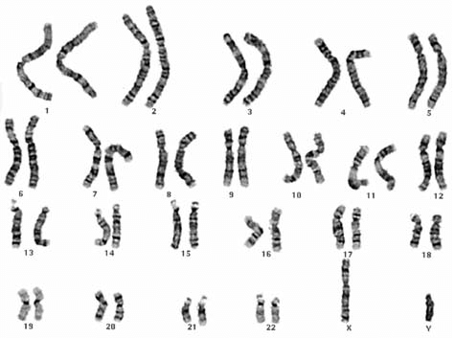
How many Chromosomes
are in our somatic cells?
Somatic Cell= Any cell other than a gamete, germ cell, gametocyte or undifferentiated stem cell.
17

Slide 134
How many Chromosomes
are in our somatic cells?
Somatic Cell= Any cell other than a gamete, germ cell, gametocyte or undifferentiated stem cell.
46
17

Slide 135
18
Evolution is the change in the gene pool overtime.
  Gene Pools can change when…
  Mutations in the genes
    Genes can change. Some are good, some are bad.
    The environment will decide.

Slide 136
18
Evolution is the change in the gene pool overtime.
  Gene Pools can change when…
  Mutations in the genes
    Genes can change. Some are good, some are bad.
    The environment will decide.
Mutation in the genes

Slide 137
Evolution is the change in the gene pool overtime.
  Gene Pools can change when…
  Movement in and out of the population
    Immigration, gene flow.
19

Slide 138

Evolution is the change in the gene pool overtime.
  Gene Pools can change when…
  Movement in and out of the population
    Immigration, gene flow.
19
Movement

Slide 139
Evolution is the change in the gene pool overtime.
  Gene Pools can change when…
  Natural selection
    Adaptations to the environment that do well replace poor ones. Usually an advancement.
20

Slide 140
Evolution is the change in the gene pool overtime.
  Gene Pools can change when…
  Natural selection
    Adaptations to the environment that do well replace poor ones. Usually an advancement.
20

Slide 141
Evolution is the change in the gene pool overtime.
  Gene Pools can change when…
  Natural selection
    Adaptations to the environment that do well replace poor ones. Usually an advancement.
20

Slide 142
Part 4 Meiosis Review Game
MY OATH IS | CROSSY ROAD | TIME TO REDUCE | MEIOSIS HODGE PODGE | -Bonus- Famous Cartoon Dogs
1 | 6 | 11 | 16 | *21
2 | 7 | 12 | 17 | *22
3 | 8 | 13 | 18 | *23
4 | 9 | 14 | 19 | *24
5 | 10 | 15 | 20 | *25

Slide 143
Part 4 Meiosis Review Game
MY OATH IS | CROSSY ROAD | TIME TO REDUCE | MEIOSIS HODGE PODGE | -Bonus- Famous Cartoon Dogs
1 | 6 | 11 | 16 | *21
2 | 7 | 12 | 17 | *22
3 | 8 | 13 | 18 | *23
4 | 9 | 14 | 19 | *24
5 | 10 | 15 | 20 | *25

Slide 144
Name the famous dog?
*21

Slide 145

Name the famous dog?
*21
from The Jetsons

Slide 146
*22

Slide 147
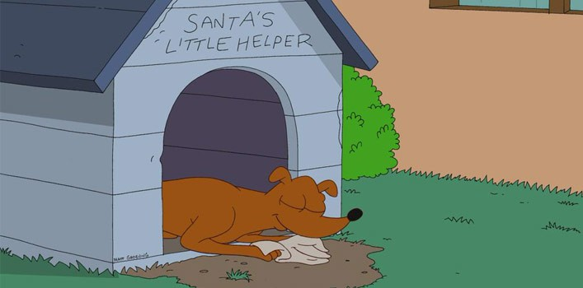
*22

Slide 148
*23

Slide 149

*23
Brian

Slide 150
*24

Slide 151
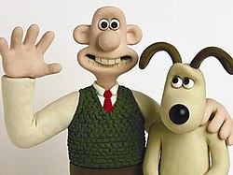
*24
Wallace
Gromit

Slide 152
*25
Mc _ _ _ _ _
The Crime Dog

Slide 153
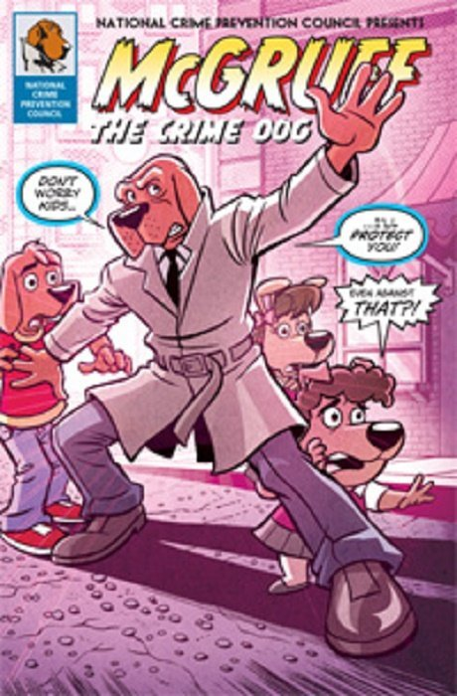
*25
Mc GRUFF
The Crime Dog

Slide 154
Part 4 Meiosis Review Game
MY OATH IS | CROSSY ROAD | TIME TO REDUCE | MEIOSIS HODGE PODGE | -Bonus- Famous Cartoon Dogs
1 | 6 | 11 | 16 | *21
2 | 7 | 12 | 17 | *22
3 | 8 | 13 | 18 | *23
4 | 9 | 14 | 19 | *24
5 | 10 | 15 | 20 | *25
Final Question

Slide 155
Final
Wager
Question
5pt max

Slide 156
Which is not an Important Event of Meiosis
1.) One cell division that ends with DNA replication. (leads to a copy of genetic information)
2.) Pairing of homologous chromosomes that lead to crossing over creating genetic variation.
3.) DNA replicates during Anaphase I of Meiosis I to create two identical cells.
4.) Separation of homologous chromosomes (Anaphase I of Meiosis I)

Slide 157
Which is not an Important Event of Meiosis
1.) One cell division that ends with DNA replication. (leads to a copy of genetic information)
2.) Pairing of homologous chromosomes that lead to crossing over creating genetic variation.
3.) DNA replicates during Anaphase I of Meiosis I to create two identical cells.
4.) Separation of homologous chromosomes (Anaphase I of Meiosis I)

Slide 158
Which is not an Important Event of Meiosis
1.) Two cell divisions that end without DNA replication. (leads to a reduction of genetic information)
2.) Pairing of homologous chromosomes that lead to crossing over creating genetic variation.
3.) DNA replicates during Anaphase I of Meiosis I to create two identical cells.
4.) Separation of homologous chromosomes (Anaphase I of Meiosis I)

Slide 159

Questions 1-20 = 5pts Each
Final Category (Bonus) = 1pt Each
Final Questions = 5 pt wager
Find the Owl = + 1pt
Secretly write “Owl” in the correct box worth 1pt.

Slide 160
Meiosis Review Game
Answer Version
Part 4
Lesson 5

Slide 161



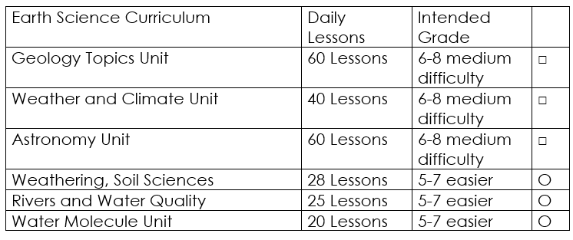

Curriculum Guide
Number of Lessons in each unit (50 min, daily lessons) and difficult rating scale / intended grade level.
=Easier, = More difficult, =Most difficult
Earth Science Units

Slide 162


Life Science Units

Slide 163

Physical Science

Slide 164
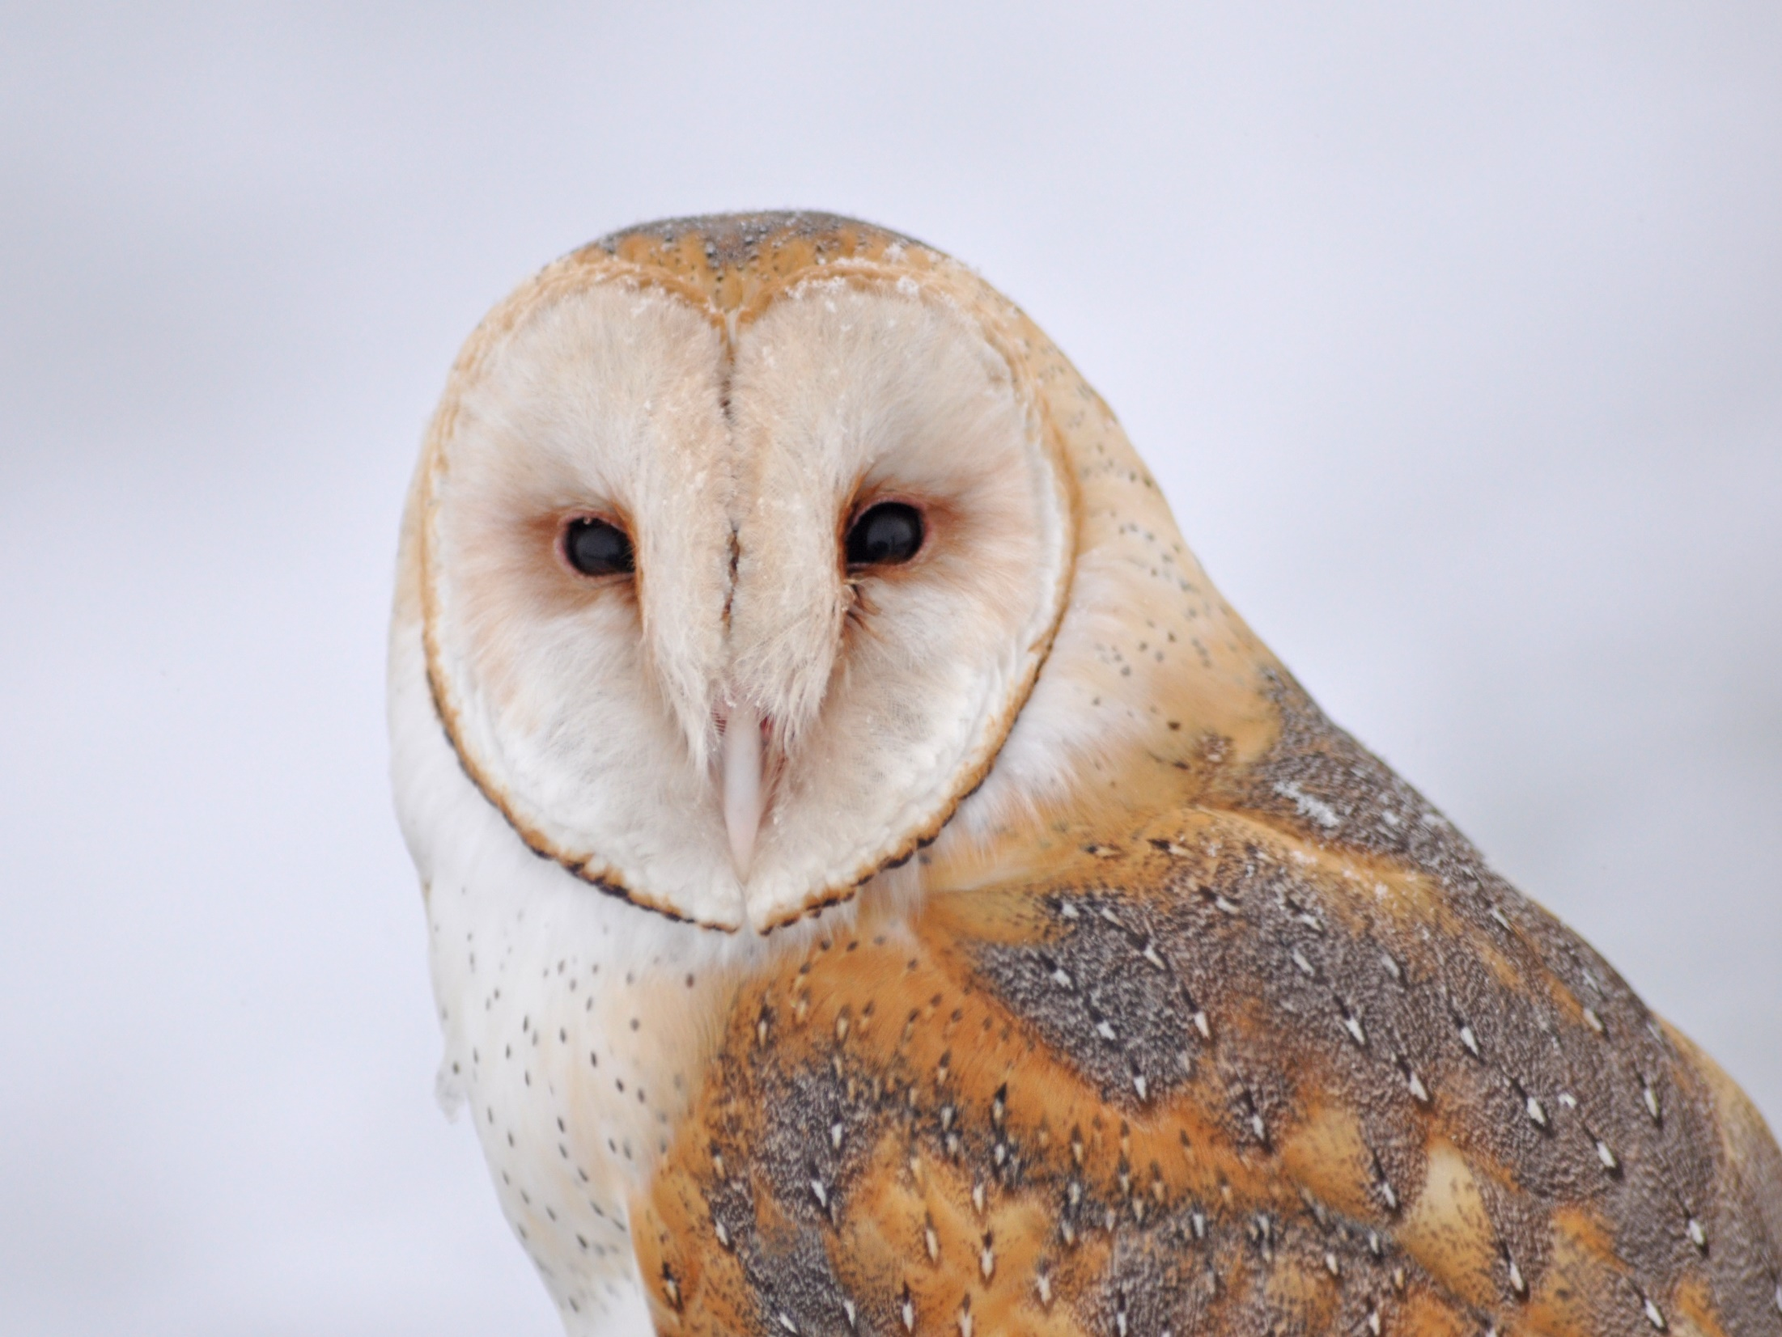
Dear Valued Educator,
Our fully editable .pptx and .doc resources are perfect for educators looking to bring enthusiasm and creativity to their lessons. We encourage you to make changes to fit your needs and style. As science educators, we’re committed to providing students with the tools they need to succeed in the classroom and beyond. Each unit in the curriculum includes a range of resources that have been developed through extensive research and use in a busy classroom. Our teaching approach is designed to make science education engaging and exciting for learners of all ages. We offer a one-of-a-kind science curriculum that will challenge, inspire, and educate students to become tomorrow's scientists and leaders. Join us today and learn more about how our program can help you achieve your classroom goals.
With appreciation,
Support@SlideSpark.net

Slide 165





Thank you for your time and interest in our Science curriculum. We strive to provide students with engaging and informative lessons that will spark their curiosity and encourage scientific exploration. Should you have any questions or concerns, please do not hesitate to contact us. Thank you again for considering our curriculum, and we wish you all the best in your educational journey.
Sincerely,
Support@slidespark.net
SlideSpark Science on TpT

