Slide 1
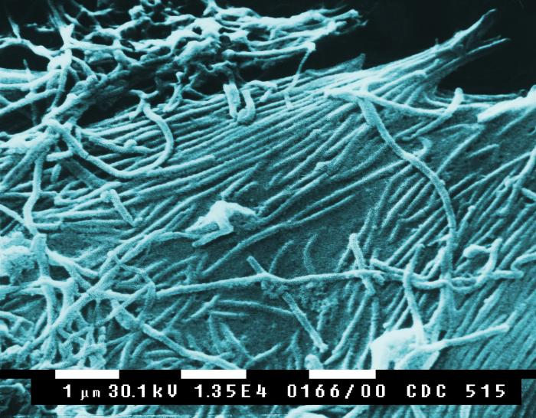

Viruses Review Game
Part 1
Lesson 7

Slide 2
Infectious Diseases Review Game
ITS GONE VIRAL | SHAPE-UP | ITS NOT ALIVE | OH-NO! | -BONUS- -COMPUTER VIRUS-
1 | 6 | 11 | 16 | *21
2 | 7 | 12 | 17 | *22
3 | 8 | 13 | 18 | *23
4 | 9 | 14 | 19 | *24
5 | 10 | 15 | 20 | *25
Copyright © 2024 SlideSpark .LLC

Slide 3
How to play…
  Don’t play like Jeo_ _ _ _ y.
  Class should be divided into several small groups.
  Groups should use science journal (red slide notes), homework, and other available materials to assist you.
  Groups can communicate quietly with each other but no sharing answers between groups.
    Practice quietly communicating right now?
    Practice Communication Question:
    Your group gets to order one pizza, and you can have two toppings. What does your group want?

Slide 4

Questions 1-20 = 5pts Each
Final Category (Bonus) = 1pt Each
Final Questions = 5 pt wager
If you wager 5 on the last question and get it wrong you lose 5 pts. Wager 5 and get it right you get 5 pts.
Find the Owl =
Secretly write “Owl” in the correct box worth 1pt.
“I’ll be about this big.”

Slide 5
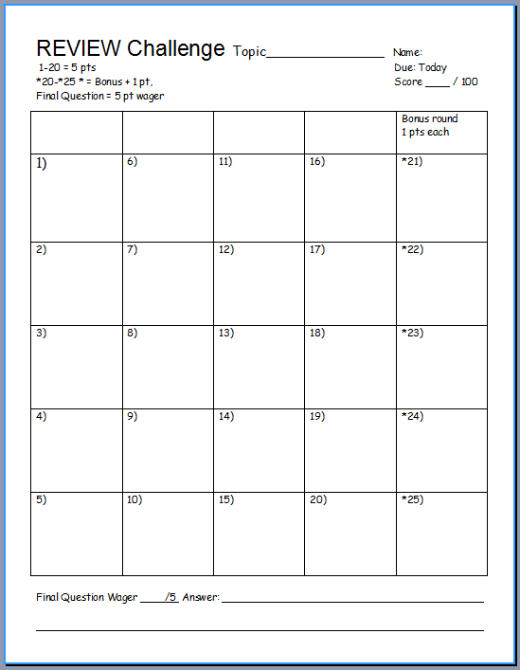
Is your name on the review sheet?
Name

Slide 6
Is your name on the review sheet?
Add the categories
along the top
on the next slide.

Slide 7
Infectious Diseases Review Game
ITS GONE VIRAL | SHAPE-UP | ITS NOT ALIVE | OH-NO! | -BONUS- -COMPUTER VIRUS-
1 | 6 | 11 | 16 | *21
2 | 7 | 12 | 17 | *22
3 | 8 | 13 | 18 | *23
4 | 9 | 14 | 19 | *24
5 | 10 | 15 | 20 | *25
Copyright © 2024 SlideSpark .LLC

Slide 8
Infectious Diseases Review Game
ITS GONE VIRAL | SHAPE-UP | ITS NOT ALIVE | OH-NO! | -BONUS- -COMPUTER VIRUS-
1 | 6 | 11 | 16 | *21
2 | 7 | 12 | 17 | *22
3 | 8 | 13 | 18 | *23
4 | 9 | 14 | 19 | *24
5 | 10 | 15 | 20 | *25
Copyright © 2024 SlideSpark .LLC

Slide 9
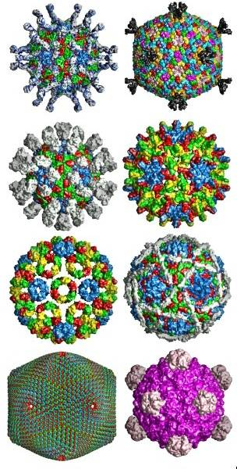
The pictures below all show different types of these structures on a virus?
A.) DNA
B.) Tails
C.) Capsid / Protein Coat
D.) Cell Walls
E.) Fatty Coats
1
1
Copyright © 2024 SlideSpark .LLC

Slide 10
The pictures below all show different types of these structures on a virus?
A.) DNA
B.) Tails
C.) Capsid / Protein Coat
D.) Cell Walls
E.) Fatty Coats
1
1
Copyright © 2024 SlideSpark .LLC

Slide 11
The pictures below all show different types of these structures on a virus?
A.) DNA
B.) Tails
C.) Capsid / Protein Coat
D.) Cell Walls
E.) Fatty Coats
1
1
Copyright © 2024 SlideSpark .LLC

Slide 12
The pictures below all show different types of these structures on a virus?
A.) DNA
B.) Tails
C.) Capsid / Protein Coat
D.) Cell Walls
E.) Fatty Coats
1
1
Copyright © 2024 SlideSpark .LLC

Slide 13
The pictures below all show different types of these structures on a virus?
A.) DNA
B.) Tails
C.) Capsid / Protein Coat
D.) Cell Walls
E.) Fatty Coats
1
1
Copyright © 2024 SlideSpark .LLC

Slide 14
The pictures below all show different types of these structures on a virus?
A.) DNA
B.) Tails
C.) Capsid / Protein Coat
D.) Cell Walls
E.) Fatty Coats
1
1
Copyright © 2024 SlideSpark .LLC

Slide 15
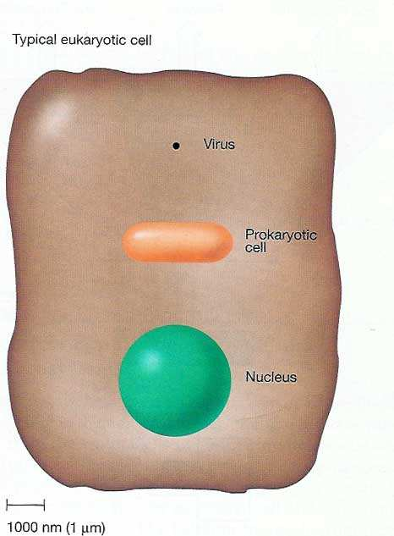
Which one below is the size of a virus?
2
3
A
B
C
Copyright © 2024 SlideSpark .LLC

Slide 16
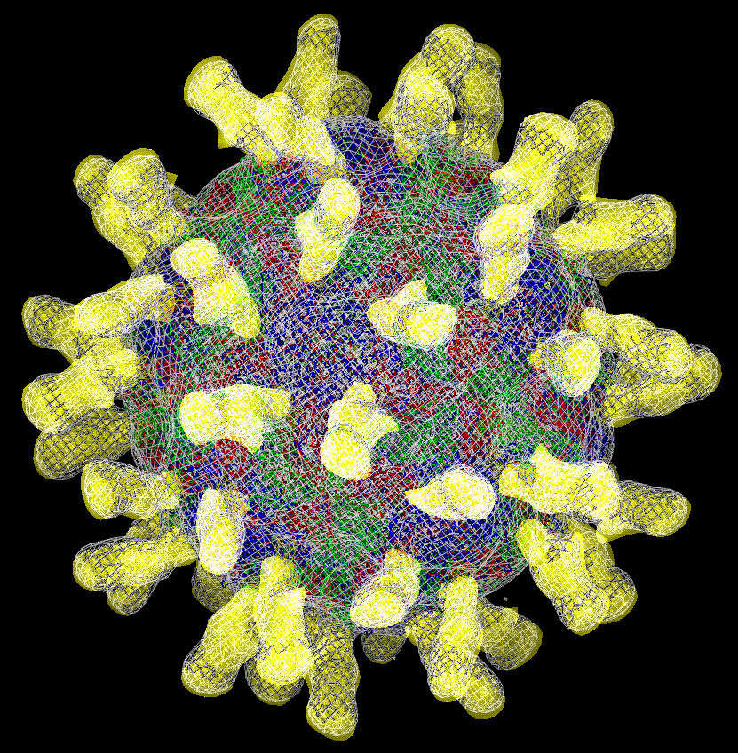
Viruses can only replicate by…
A.) Finding another similar virus.
B.) Binary Fission.
C.) Invading and taking over other cells.
D.) Conjugation.
E.) Sexual Reproduction .
3
Copyright © 2024 SlideSpark .LLC

Slide 17
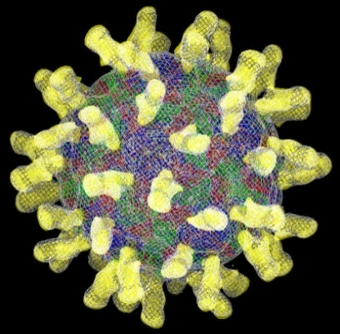
Viruses can only replicate by…
A.) Finding another similar virus.
B.) Binary Fission.
C.) Invading and taking over other cells.
D.) Conjugation.
E.) Sexual Reproduction .
3
Copyright © 2024 SlideSpark .LLC

Slide 18
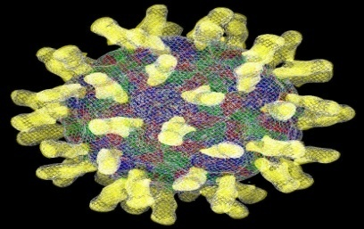
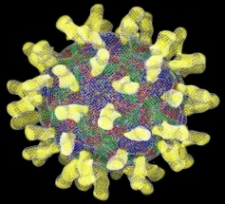
Viruses can only replicate by…
A.) Finding another similar virus.
B.) Binary Fission.
C.) Invading and taking over other cells.
D.) Conjugation.
E.) Sexual Reproduction .
3
Copyright © 2024 SlideSpark .LLC

Slide 19
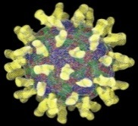
Viruses can only replicate by…
A.) Finding another similar virus.
B.) Binary Fission.
C.) Invading and taking over other cells.
3
Copyright © 2024 SlideSpark .LLC

Slide 20



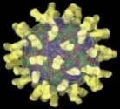
Viruses can only replicate by…
A.) Finding another similar virus.
B.) Binary Fission.
C.) Invading and taking over other cells.
D.) Conjugation.
E.) Sexual Reproduction .
3
Copyright © 2024 SlideSpark .LLC

Slide 21


Viruses can only replicate by…
A.) Finding another similar virus.
B.) Binary Fission.
C.) Invading and taking over other cells.
D.) Conjugation.
E.) Sexual Reproduction.
3
Copyright © 2024 SlideSpark .LLC

Slide 22
Which of the following is not a reason why viruses are generally considered non-living?
4
Copyright © 2024 SlideSpark .LLC

Slide 23


Which of the following is not a reason why viruses are generally considered non-living?
A.) Viruses are not made of cells.
B.) Viruses do not respond to a stimulus.
C.) Limited Movement.
D.) They do not grow and develop.
4
Copyright © 2024 SlideSpark .LLC

Slide 24
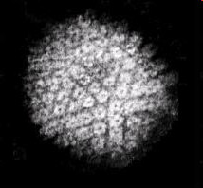
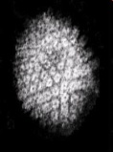
Which of the following is not a reason why viruses are generally considered non-living?
A.) Viruses are not made of cells.
B.) Viruses do not respond to a stimulus.
C.) Limited Movement.
D.) They do not grow and develop.
4
Copyright © 2024 SlideSpark .LLC

Slide 25
Which of the following is not a reason why viruses are generally considered non-living?
A.) Viruses are not made of cells.
B.) Viruses do not respond to a stimulus.
C.) Limited Movement.
D.) They do not grow and develop.
4
Copyright © 2024 SlideSpark .LLC

Slide 26
Which of the following is not a reason why viruses are generally considered non-living?
A.) Viruses are not made of cells.
B.) Viruses do not respond to a stimulus.
C.) Limited Movement.
D.) They do not grow and develop.
4
Copyright © 2024 SlideSpark .LLC

Slide 27

5
These type of viruses only invade…
3
Copyright © 2024 SlideSpark .LLC

Slide 28
Virus Review Game
ITS GONE VIRAL | SHAPE-UP | ITS NOT ALIVE | OH-NO! | -BONUS- -COMPUTER VIRUS-
1 | 6 | 11 | 16 | *21
2 | 7 | 12 | 17 | *22
3 | 8 | 13 | 18 | *23
4 | 9 | 14 | 19 | *24
5 | 10 | 15 | 20 | *25
Copyright © 2024 SlideSpark .LLC

Slide 29
For the next 5 questions…
Name the type of virus.
-Filamentous (Helical)
-Enveloped (Spherical)
-Isometric (Polyhedral)
-Head and Tail / (Complex)
7
Copyright © 2024 SlideSpark .LLC

Slide 30
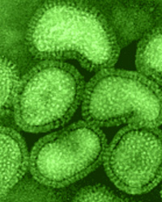
6

Slide 31
6
H1N1

Slide 32
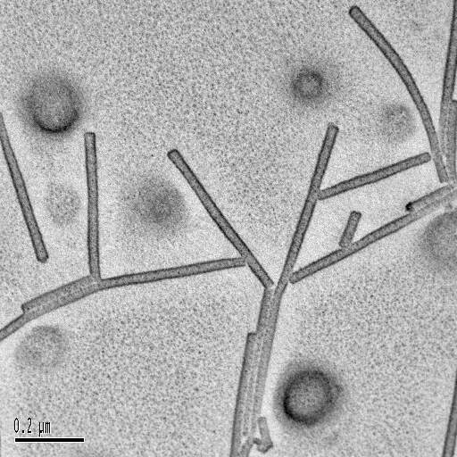
7

Slide 33

7
Tobacco Mosaic Virus

Slide 34
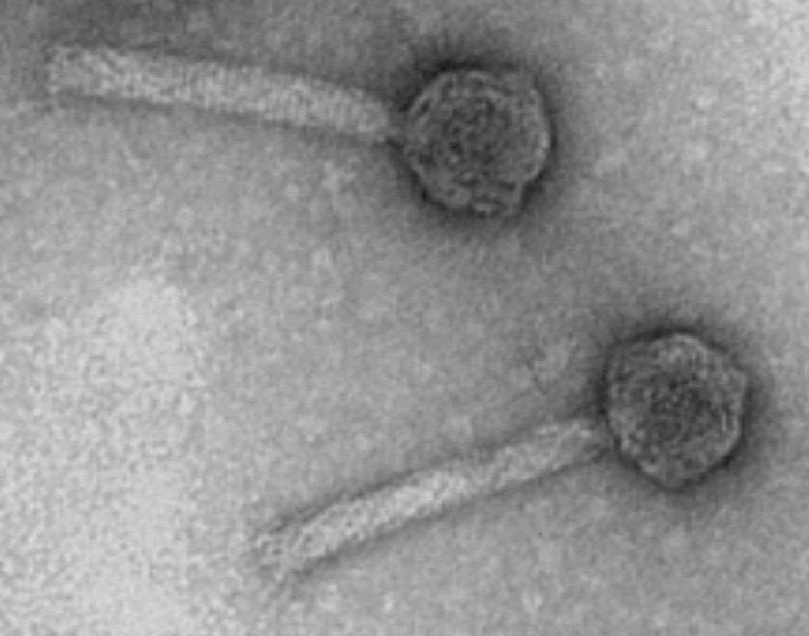
8

Slide 35
8

Slide 36
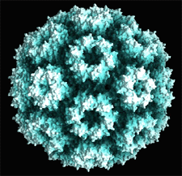
9

Slide 37
9

Slide 38
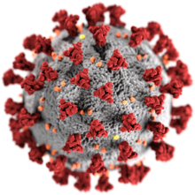
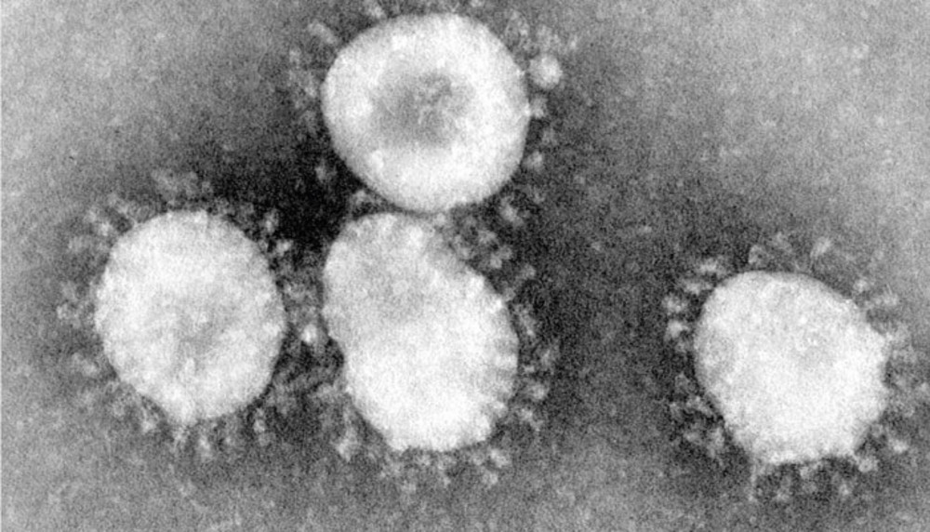
10

Slide 39
Virus Review Game
ITS GONE VIRAL | SHAPE-UP | ITS NOT ALIVE? | OH-NO! | -BONUS- -COMPUTER VIRUS-
1 | 6 | 11 | 16 | *21
2 | 7 | 12 | 17 | *22
3 | 8 | 13 | 18 | *23
4 | 9 | 14 | 19 | *24
5 | 10 | 15 | 20 | *25
Copyright © 2024 SlideSpark .LLC

Slide 40
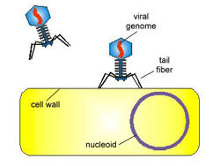
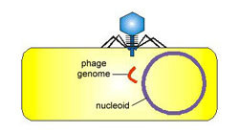
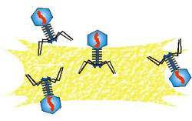
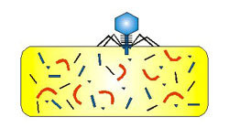
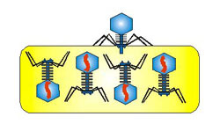
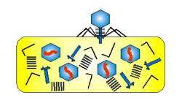
11
Which two letters should be switched?
A
B
C
F
E
D

Slide 41
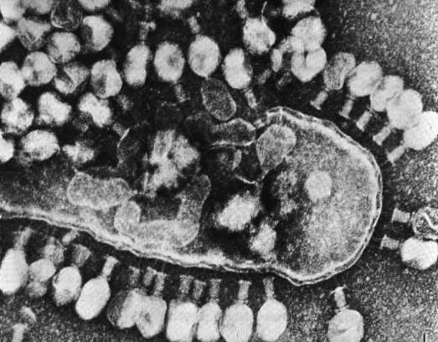
These types of viruses cause the cell to split and die?
A.) Lytic Viruses
B.) Mimivirus
C.) Phelps Virus
D.) Bacteria
E.) DNA / RNA
12
Copyright © 2024 SlideSpark .LLC

Slide 42
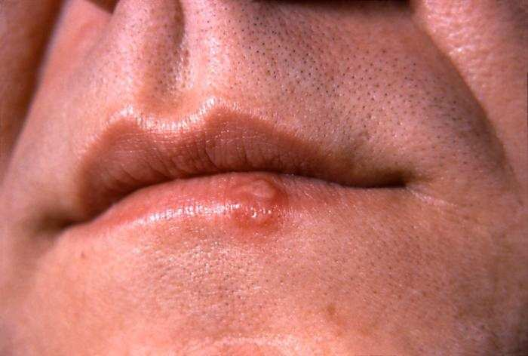
The picture below best respresents…
13

Slide 43
The picture below best respresents…
  A.) Bacteriophage – Lytic Virus
13

Slide 44
The picture below best respresents…
  A.) Bacteriophage – Lytic Virus
  B.) Polio Virus – Unnucleated
13

Slide 45
The picture below best respresents…
  A.) Bacteriophage – Lytic Virus
  B.) Polio Virus – Unnucleated
  C.) Herpes Virus – Lysogenic
13

Slide 46
The picture below best respresents…
  A.) Bacteriophage – Lytic Virus
  B.) Polio Virus – Unnucleated
  C.) Herpes Virus – Lysogenic
  D.) Influenza – Rod Shaped
13

Slide 47
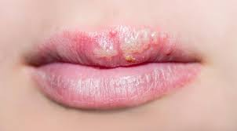

Slide 48
This virus will be completely removed from your body in…
14

Slide 49
This virus will be completely removed from your body in…
  A.) 3-7 days
14

Slide 50
This virus will be completely removed from your body in…
  A.) 3-7 days
  B.) 1 month
14

Slide 51
This virus will be completely removed from your body in…
  A.) 3-7 days
  B.) 1 month
  C.) After treatment
14

Slide 52
This virus will be completely removed from your body in…
  A.) 3-7 days
  B.) 1 month
  C.) After treatment
  D.) Never
14

Slide 53
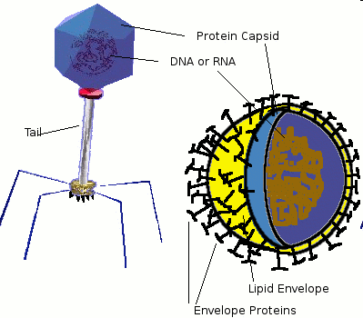
What can be found inside a virus?
15

Slide 54
Virus Review Game
ITS GONE VIRAL | SHAPE-UP | ITS NOT ALIVE | OH-NO! | -BONUS- -COMPUTER VIRUS-
1 | 6 | 11 | 16 | *21
2 | 7 | 12 | 17 | *22
3 | 8 | 13 | 18 | *23
4 | 9 | 14 | 19 | *24
5 | 10 | 15 | 20 | *25
Copyright © 2024 SlideSpark .LLC

Slide 55
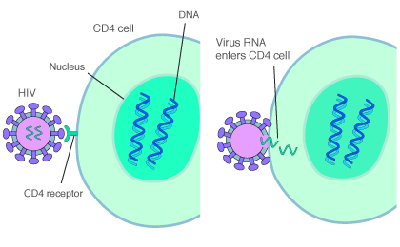
These are places on the outside of the cell where materials can enter / leave?
  A.) DNA or RNA
  B.) Cell Nucleus
  C.) Trans-membrane / protein receptor
  D.) T4 Bacteriophage
  E.) None of the Above
16

Slide 56
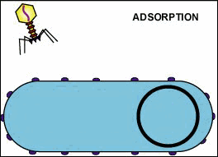
In order for a virus to multiply once inside a cell, its DNA / RNA must replicate.
17

Slide 57
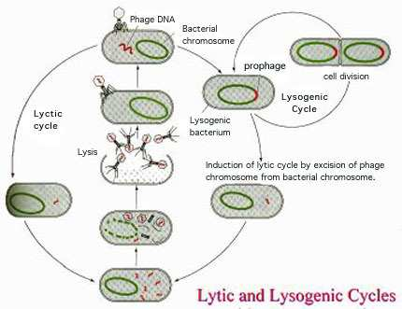
Which is lytic, and which is lysogenic?
18
B
A

Slide 58

Which is a bogus statement about Ebola?
  A.) Gloves, full protective facemask, gowns, and all precautions should be used to help in the treatment.
  B.) Clothing and bedding from an infected person is not contagious.
  C.) Diagnosis is difficult at first because the fever and fatigue are like a lot of other tropical diseases.
  D.) Humans are not infectious until they develop symptoms.
  E.) People can continue to spread the virus for up to 7 weeks in their body fluids if the virus is present.

Slide 59
Which is a bogus statement about Ebola?
  A.) Gloves, full protective facemask, gowns, and all precautions should be used to help in the treatment.
  B.) Clothing and bedding from an infected person is not contagious.
  C.) Diagnosis is difficult at first because the fever and fatigue are like a lot of other tropical diseases.
  D.) Humans are not infectious until they develop symptoms.
  E.) People can continue to spread the virus for up to 7 weeks in their body fluids if the virus is present.

Slide 60
Which is a bogus statement about Ebola?
  A.) Gloves, full protective facemask, gowns, and all precautions should be used to help in the treatment.
  B.) Clothing and bedding from an infected person is not contagious.
  C.) Diagnosis is difficult at first because the fever and fatigue are like a lot of other tropical diseases.
  D.) Humans are not infectious until they develop symptoms.
  E.) People can continue to spread the virus for up to 7 weeks in their body fluids if the virus is present.
The bogus one is…

Slide 61
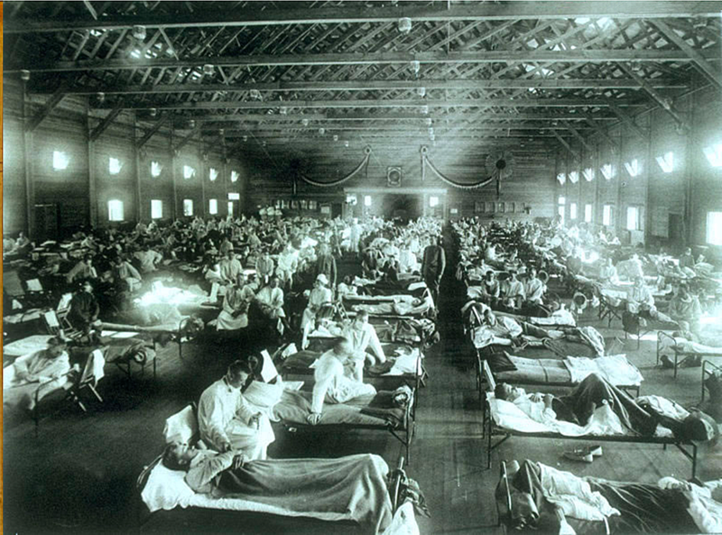
40 million people died in this pandemic that occurred (1918-1920)?
20

Slide 62
Virus Review Game
ITS GONE VIRAL | SHAPE-UP | ITS NOT ALIVE | OH-NO! | -BONUS- -COMPUTER VIRUS-
1 | 6 | 11 | 16 | *21
2 | 7 | 12 | 17 | *22
3 | 8 | 13 | 18 | *23
4 | 9 | 14 | 19 | *24
5 | 10 | 15 | 20 | *25
Copyright © 2024 SlideSpark .LLC

Slide 63

What movie is this?
*21

Slide 64

What movie is this?
*22

Slide 65
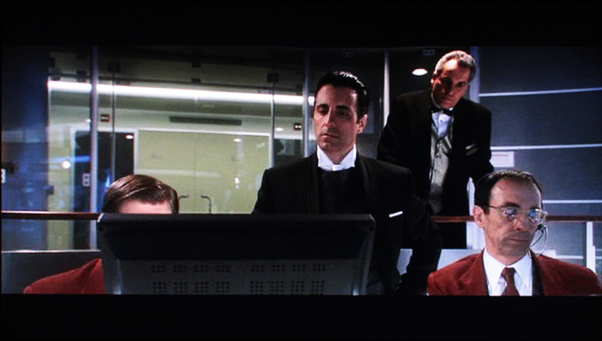
Name this movie?
*23

Slide 66

Name this movie?
*24

Slide 67
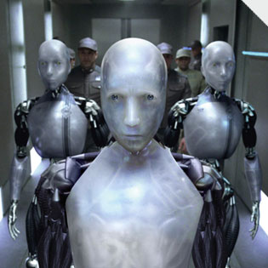
Name this movie?
*25

Slide 68
Virus Review Game
ITS GONE VIRAL | SHAPE-UP | ITS NOT ALIVE | OH-NO! | -BONUS- -COMPUTER VIRUS-
1 | 6 | 11 | 16 | *21
2 | 7 | 12 | 17 | *22
3 | 8 | 13 | 18 | *23
4 | 9 | 14 | 19 | *24
5 | 10 | 15 | 20 | *25
Final Question_____________
Copyright © 2024 SlideSpark .LLC

Slide 69
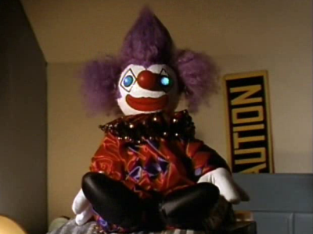
Be Aware Next 10 Slides

Slide 70
“This is a 5pt wager question.” “Please make your wager now.”

Slide 72
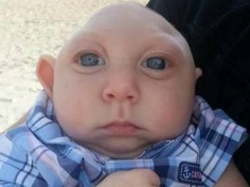
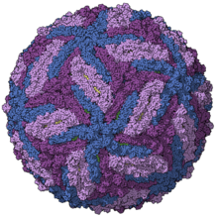
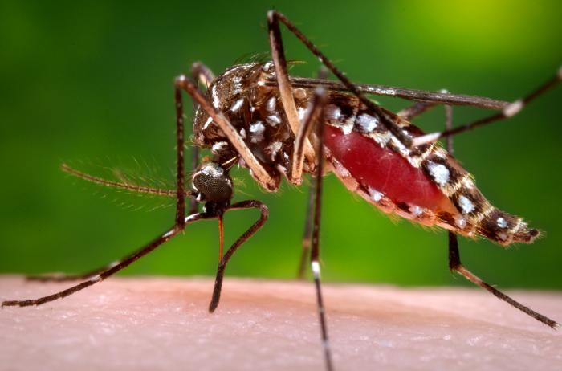
Name this virus that is spread mostly by the bite of an infected Aedes species mosquito.
  Can also be passed through sexual transmission.
  Infection during pregnancy can cause a birth defect of the brain called microcephaly in the fetus.

Slide 73
Viruses Review Game
Part 1
Lesson 7

Slide 74

Viruses Review Game
ANSWER KEY
Part 1
Lesson 8

Slide 75
Infectious Diseases Review Game
ITS GONE VIRAL | SHAPE-UP | ITS NOT ALIVE | OH-NO! | -BONUS- -COMPUTER VIRUS-
1 | 6 | 11 | 16 | *21
2 | 7 | 12 | 17 | *22
3 | 8 | 13 | 18 | *23
4 | 9 | 14 | 19 | *24
5 | 10 | 15 | 20 | *25
Copyright © 2024 SlideSpark .LLC

Slide 76
Infectious Diseases Review Game
ITS GONE VIRAL | SHAPE-UP | ITS NOT ALIVE | OH-NO! | -BONUS- -COMPUTER VIRUS-
1 | 6 | 11 | 16 | *21
2 | 7 | 12 | 17 | *22
3 | 8 | 13 | 18 | *23
4 | 9 | 14 | 19 | *24
5 | 10 | 15 | 20 | *25
Copyright © 2024 SlideSpark .LLC

Slide 77
The pictures below all show different types of these structures on a virus?
1
1
Copyright © 2024 SlideSpark .LLC

Slide 78
The pictures below all show different types of these structures on a virus?
A.) DNA
1
1
Copyright © 2024 SlideSpark .LLC

Slide 79
The pictures below all show different types of these structures on a virus?
A.) DNA
B.) Tails
1
1
Copyright © 2024 SlideSpark .LLC

Slide 80
The pictures below all show different types of these structures on a virus?
A.) DNA
B.) Tails
C.) Capsid
1
1
Copyright © 2024 SlideSpark .LLC

Slide 81
The pictures below all show different types of these structures on a virus?
A.) DNA
B.) Tails
C.) Capsid
D.) Cell Walls
1
1
Copyright © 2024 SlideSpark .LLC

Slide 82
The pictures below all show different types of these structures on a virus?
A.) DNA
B.) Tails
C.) Capsid
D.) Cell Walls
E.) Fatty Coats
1
1
Copyright © 2024 SlideSpark .LLC

Slide 83
The pictures below all show different types of these structures on a virus?
A.) DNA
B.) Tails
C.) Capsid
D.) Cell Walls
E.) Fatty Coats
1
1
Copyright © 2024 SlideSpark .LLC

Slide 84
The pictures below all show different types of these structures on a virus?
A.) DNA
B.) Tails
C.) Capsid
D.) Cell Walls
E.) Fatty Coats
1
1
Copyright © 2024 SlideSpark .LLC

Slide 85
Which one below is the size of a virus?
2
3
A
B
C
Copyright © 2024 SlideSpark .LLC

Slide 86
Which one below is the size of a virus?
2
3
A
B
C
Copyright © 2024 SlideSpark .LLC

Slide 87
Viruses can only replicate by…
A.) Finding another similar virus.
B.) Binary Fission.
C.) Invading and taking over other cells.
D.) Conjugation.
E.) Sexual Reproduction .
3
Copyright © 2024 SlideSpark .LLC

Slide 88
Viruses can only replicate by…
A.) Finding another similar virus.
B.) Binary Fission.
C.) Invading and taking over other cells.
D.) Conjugation.
E.) Sexual Reproduction .
3
Copyright © 2024 SlideSpark .LLC

Slide 89
Viruses can only replicate by…
A.) Finding another similar virus.
B.) Binary Fission.
C.) Invading and taking over other cells.
D.) Conjugation.
E.) Sexual Reproduction .
3
Copyright © 2024 SlideSpark .LLC

Slide 90
Viruses can only replicate by…
A.) Finding another similar virus.
B.) Binary Fission.
C.) Invading and taking over other cells.
3
Copyright © 2024 SlideSpark .LLC

Slide 91
Viruses can only replicate by…
A.) Finding another similar virus.
B.) Binary Fission.
C.) Invading and taking over other cells.
D.) Conjugation.
E.) Sexual Reproduction .
3
Copyright © 2024 SlideSpark .LLC

Slide 92
Viruses can only replicate by…
A.) Finding another similar virus.
B.) Binary Fission.
C.) Invading and taking over other cells.
D.) Conjugation.
E.) Sexual Reproduction.
3
Copyright © 2024 SlideSpark .LLC

Slide 93
Viruses can only replicate by…
A.) Finding another similar virus.
B.) Binary Fission.
C.) Invading and taking over other cells.
D.) Conjugation.
E.) Sexual Reproduction.
3
Copyright © 2024 SlideSpark .LLC

Slide 94

Viruses can only replicate by…
A.) Finding another similar virus.
B.) Binary Fission.
C.) Invading and taking over other cells.
D.) Conjugation.
E.) Sexual Reproduction.
3
Copyright © 2024 SlideSpark .LLC

Slide 95
Which of the following is not a reason why viruses are generally considered non-living?
4
Copyright © 2024 SlideSpark .LLC

Slide 96
Which of the following is not a reason why viruses are generally considered non-living?
A.) Viruses are not made of cells.
B.) Viruses do not respond to a stimulus.
C.) Limited Movement.
D.) They do not grow and develop.
4
Copyright © 2024 SlideSpark .LLC

Slide 97
Which of the following is not a reason why viruses are generally considered non-living?
A.) Viruses are not made of cells.
B.) Viruses do not respond to a stimulus.
C.) Limited Movement.
D.) They do not grow and develop.
4
Copyright © 2024 SlideSpark .LLC

Slide 98
Which of the following is not a reason why viruses are generally considered non-living?
A.) Viruses are not made of cells.
B.) Viruses do not respond to a stimulus.
C.) Limited Movement.
D.) They do not grow and develop.
4
4
Copyright © 2024 SlideSpark .LLC

Slide 99
Which of the following is not a reason why viruses are generally considered non-living?
A.) Viruses are not made of cells.
B.) Viruses do not respond to a stimulus.
C.) Limited Movement.
D.) They do not grow and develop.
4
Copyright © 2024 SlideSpark .LLC

Slide 100
Which of the following is not a reason why viruses are generally considered non-living?
A.) Viruses are not made of cells.
B.) Viruses do not respond to a stimulus.
C.) Limited Movement.
D.) They do not grow and develop.
4
Copyright © 2024 SlideSpark .LLC

Slide 101
5
These type of viruses only invade…
3
Copyright © 2024 SlideSpark .LLC

Slide 102
5
These type of viruses only invade…
Bacteria
3
Copyright © 2024 SlideSpark .LLC

Slide 103
Virus Review Game
ITS GONE VIRAL | SHAPE-UP | ITS NOT ALIVE | OH-NO! | -BONUS- -COMPUTER VIRUS-
1 | 6 | 11 | 16 | *21
2 | 7 | 12 | 17 | *22
3 | 8 | 13 | 18 | *23
4 | 9 | 14 | 19 | *24
5 | 10 | 15 | 20 | *25
Copyright © 2024 SlideSpark .LLC

Slide 104
For the next 5 questions…
Name the type of virus.
-Filamentous (Helical)
-Enveloped (Spherical)
-Isometric (Polyhedral)
-Head and Tail / (Complex)
7
Copyright © 2024 SlideSpark .LLC

Slide 105
6

Slide 106
6
H1N1
Enveloped

Slide 107
7

Slide 108
7
Tobacco Mosaic Virus
Filamentous

Slide 109
8

Slide 110
8
Bacteriophage
Head and Tail

Slide 111
9

Slide 112
9
Isometric
Icosahedral

Slide 113
10

Slide 114

Enveloped
10

Slide 115
Virus Review Game
ITS GONE VIRAL | SHAPE-UP | ITS NOT ALIVE? | OH-NO! | -BONUS- -COMPUTER VIRUS-
1 | 6 | 11 | 16 | *21
2 | 7 | 12 | 17 | *22
3 | 8 | 13 | 18 | *23
4 | 9 | 14 | 19 | *24
5 | 10 | 15 | 20 | *25
Copyright © 2024 SlideSpark .LLC

Slide 116
11
Which two letters should be switched?
A
B
C
F
E
D

Slide 117
11
Which two letters should be switched?
A
B
C
F
E
D

Slide 118
11
Which two letters should be switched?
A
B
C
F
E
D

Slide 119
11
Which two letters should be switched?
A
B
C
F
E
D

Slide 120
11
Which two letters should be switched?
A
B
C
F
E
D

Slide 121
11
Which two letters should be switched?
A
B
C
F
E
D

Slide 122
11
Which two letters should be switched?
A
B
C
F
E
D

Slide 123
11
Which two letters should be switched?
A
B
C
F
E
D

Slide 124
11
Which two letters should be switched?
A
B
C
F
E
D

Slide 125
11
Which two letters should be switched?
A
B
C
F
E
D

Slide 126
These types of viruses cause the cell to split and die?
A.) Lytic Viruses
B.) Mimivirus
C.) Phelps Virus
D.) Bacteria
E.) DNA / RNA
12
Copyright © 2024 SlideSpark .LLC

Slide 127
These types of viruses cause the cell to split and die?
A.) Lytic Viruses
B.) Mimivirus
C.) Phelps Virus
D.) Bacteria
E.) DNA / RNA
12
Copyright © 2024 SlideSpark .LLC

Slide 128
The picture below best respresents…
13

Slide 129
The picture below best respresents…
  A.) Bacteriophage – Lytic Virus
13

Slide 130
The picture below best respresents…
  A.) Bacteriophage – Lytic Virus
  B.) Polio Virus – Unnucleated
13

Slide 131
The picture below best respresents…
  A.) Bacteriophage – Lytic Virus
  B.) Polio Virus – Unnucleated
  C.) Herpes Virus – Lysogenic
13

Slide 132
The picture below best respresents…
  A.) Bacteriophage – Lytic Virus
  B.) Polio Virus – Unnucleated
  C.) Herpes Virus – Lysogenic
  D.) Influenza – Rod Shaped
13

Slide 133
The picture below best respresents…
  A.) Bacteriophage – Lytic Virus
  B.) Polio Virus – Unnucleated
  C.) Herpes Virus – Lysogenic
  D.) Influenza – Rod Shaped
13
and the answer is...

Slide 134
The picture below best respresents…
  A.) Bacteriophage – Lytic Virus
  B.) Polio Virus – Unnucleated
  C.) Herpes Virus – Lysogenic
  D.) Influenza – Rod Shaped
13

Slide 135
This virus will be completely removed from your body in…
14

Slide 136
This virus will be completely removed from your body in…
  A.) 3-7 days
14

Slide 137
This virus will be completely removed from your body in…
  A.) 3-7 days
  B.) 1 month
14

Slide 138
This virus will be completely removed from your body in…
  A.) 3-7 days
  B.) 1 month
  C.) After treatment
14

Slide 139
This virus will be completely removed from your body in…
  A.) 3-7 days
  B.) 1 month
  C.) After treatment
  D.) Never
14

Slide 140
This virus will be completely removed from your body in…
  A.) 3-7 days
  B.) 1 month
  C.) After treatment
  D.) Never
14
and the answer is...

Slide 141
This virus will be completely removed from your body in…
  A.) 3-7 days
  B.) 1 month
  C.) After treatment
  D.) Never
14

Slide 142
What can be found inside a virus?
15

Slide 143
What can be found inside a virus?
15

Slide 144
What can be found inside a virus?
15

Slide 145
Virus Review Game
ITS GONE VIRAL | SHAPE-UP | ITS NOT ALIVE | OH-NO! | -BONUS- -COMPUTER VIRUS-
1 | 6 | 11 | 16 | *21
2 | 7 | 12 | 17 | *22
3 | 8 | 13 | 18 | *23
4 | 9 | 14 | 19 | *24
5 | 10 | 15 | 20 | *25
Copyright © 2024 SlideSpark .LLC

Slide 146
These are places on the outside of the cell where materials enter / leave?
  A.) DNA or RNA
  B.) Cell Nucleus
  C.) Trans-membrane / protein receptor
  D.) T4 Bacteriophage
  E.) None of the Above
16

Slide 147
These are places on the outside of the cell where materials enter / leave?
  A.) DNA or RNA
  B.) Cell Nucleus
  C.) Trans-membrane / protein receptor
  D.) T4 Bacteriophage
  E.) None of the Above
16

Slide 148
In order for a virus to multiply once inside a cell, its DNA / RNA must replicate.
17

Slide 149
In order for a virus to multiply once inside a cell, its DNA / RNA must replicate.
17

Slide 150
In order for a virus to multiply once inside a cell, its DNA / RNA must replicate.
17

Slide 151
In order for a virus to multiply once inside a cell, its DNA / RNA must replicate.
17
or viral genone

Slide 152
Which is lytic, and which is lysogenic?
18
B
A

Slide 153
Which is lytic, and which is lysogenic?
18
B
A

Slide 154
Which is lytic, and which is lysogenic?
18
B
A

Slide 155
Which is lytic, and which is lysogenic?
18
B
A

Slide 156
Which is a bogus statement about Ebola?
  A.) Gloves, full protective facemask, gowns, and all precautions should be used to help in the treatment.
  B.) Clothing and bedding from an infected person is not contagious.
  C.) Diagnosis is difficult at first because the fever and fatigue are like a lot of other tropical diseases.
  D.) Humans are not infectious until they develop symptoms.
  E.) People can continue to spread the virus for up to 7 weeks in their body fluids if the virus is present.

Slide 157
Which is a bogus statement about Ebola?
  A.) Gloves, full protective facemask, gowns, and all precautions should be used to help in the treatment.
  B.) Clothing and bedding from an infected person is not contagious.
  C.) Diagnosis is difficult at first because the fever and fatigue are like a lot of other tropical diseases.
  D.) Humans are not infectious until they develop symptoms.
  E.) People can continue to spread the virus for up to 7 weeks in their body fluids if the virus is present.

Slide 158
Which is a bogus statement about Ebola?
  A.) Gloves, full protective facemask, gowns, and all precautions should be used to help in the treatment.
  B.) Clothing and bedding from an infected person is not contagious.
  C.) Diagnosis is difficult at first because the fever and fatigue are like a lot of other tropical diseases.
  D.) Humans are not infectious until they develop symptoms.
  E.) People can continue to spread the virus for up to 7 weeks in their body fluids if the virus is present.
The bogus one is…

Slide 159
Which is a bogus statement about Ebola?
  A.) Gloves, full protective facemask, gowns, and all precautions should be used to help in the treatment.
  B.) Clothing and bedding from an infected person is not contagious.
  C.) Diagnosis is difficult at first because the fever and fatigue are like a lot of other tropical diseases.
  D.) Humans are not infectious until they develop symptoms.
  E.) People can continue to spread the virus for up to 7 weeks in their body fluids if the virus is present.
The bogus one is…

Slide 160
Which is a bogus statement about Ebola?
  A.) Gloves, full protective facemask, gowns, and all precautions should be used to help in the treatment.
  B.) Clothing and bedding from an infected person is highly contagious.
  C.) Diagnosis is difficult at first because the fever and fatigue are like a lot of other tropical diseases.
  D.) Humans are not infectious until they develop symptoms.
  E.) People can continue to spread the virus for up to 7 weeks in their body fluids if the virus is present.
The bogus one is…

Slide 161
40 million people died in this pandemic that occurred (1918-1920)?
20

Slide 162
40 million people died in this pandemic that occurred (1918-1920)?
20
Spanish Flu

Slide 163
Virus Review Game
ITS GONE VIRAL | SHAPE-UP | ITS NOT ALIVE | OH-NO! | -BONUS- -COMPUTER VIRUS-
1 | 6 | 11 | 16 | *21
2 | 7 | 12 | 17 | *22
3 | 8 | 13 | 18 | *23
4 | 9 | 14 | 19 | *24
5 | 10 | 15 | 20 | *25
Copyright © 2024 SlideSpark .LLC

Slide 164
What movie is this?
*21

Slide 165
What movie is this?
*21
The
Matrix

Slide 166
What movie is this?
*22

Slide 167
What movie is this?
*22
Tron

Slide 168
Name this movie?
*23

Slide 169

Name this movie?
*23

Slide 170
Name this movie?
*24

Slide 171

Name this movie?
*24

Slide 172
Name this movie?
*25

Slide 173

Name this movie?
*25

Slide 174
Virus Review Game
ITS GONE VIRAL | SHAPE-UP | ITS NOT ALIVE | OH-NO! | -BONUS- -COMPUTER VIRUS-
1 | 6 | 11 | 16 | *21
2 | 7 | 12 | 17 | *22
3 | 8 | 13 | 18 | *23
4 | 9 | 14 | 19 | *24
5 | 10 | 15 | 20 | *25
Final Question_____________
Copyright © 2024 SlideSpark .LLC

Slide 176
“This was a 5pt wager question.”

Slide 177


Slide 179
Name this virus that is spread mostly by the bite of an infected Aedes species mosquito.
  Can also be passed through sexual transmission.
  Infection during pregnancy can cause a birth defect of the brain called microcephaly in the fetus.

Slide 180
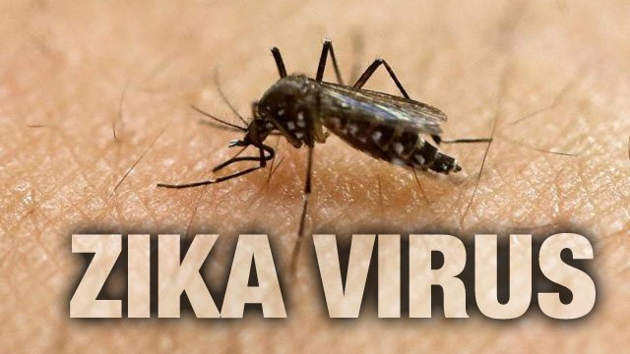
Name this virus that is spread mostly by the bite of an infected Aedes species mosquito.
  Can also be passed through sexual transmission.
  Infection during pregnancy can cause a birth defect of the brain called microcephaly in the fetus.

Slide 181
Questions 1-20 = 5pts Each
Final Category (Bonus) = 1pt Each
Final Questions = 5 pt wager
Find the Owl =
Secretly write “Owl” in the correct box worth 1pt.

Slide 182
Viruses Review Game
ANSWER KEY
Part 1
Lesson 8

Slide 183



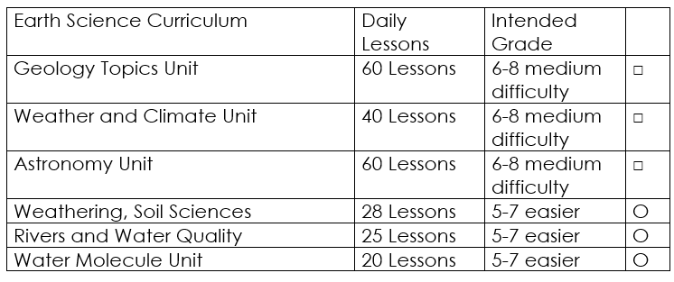

Curriculum Guide
Number of Lessons in each unit (50 min, daily lessons) and difficult rating scale / intended grade level.
=Easier, = More difficult, =Most difficult
Earth Science Units

Slide 184


Life Science Units

Slide 185

Physical Science

Slide 186
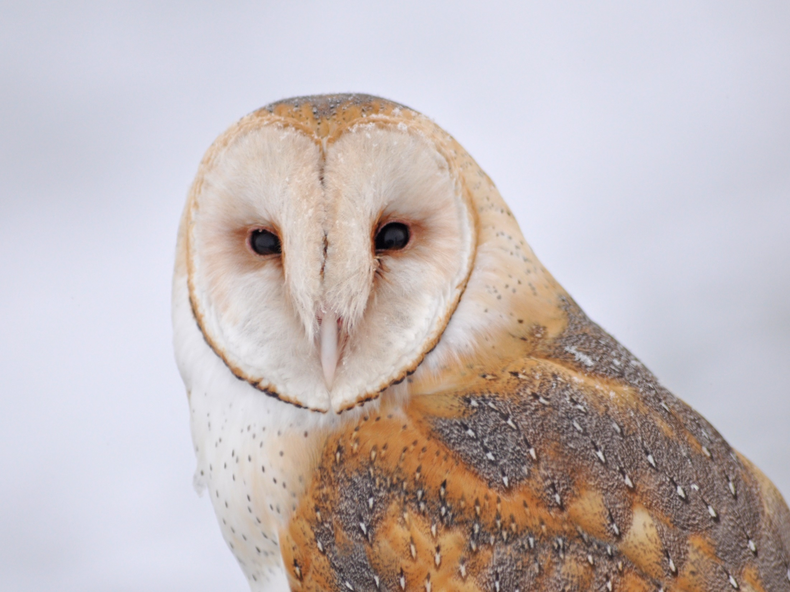
Dear Valued Educator,
Our fully editable .pptx and .doc resources are perfect for educators looking to bring enthusiasm and creativity to their lessons. We encourage you to make changes to fit your needs and style. As science educators, we’re committed to providing students with the tools they need to succeed in the classroom and beyond. Each unit in the curriculum includes a range of resources that have been developed through extensive research and use in a busy classroom. Our teaching approach is designed to make science education engaging and exciting for learners of all ages. We offer a one-of-a-kind science curriculum that will challenge, inspire, and educate students to become tomorrow's scientists and leaders. Join us today and learn more about how our program can help you achieve your classroom goals.
With appreciation,
Support@SlideSpark.net

Slide 187





Thank you for your time and interest in our Science curriculum. We strive to provide students with engaging and informative lessons that will spark their curiosity and encourage scientific exploration. Should you have any questions or concerns, please do not hesitate to contact us. Thank you again for considering our curriculum, and we wish you all the best in your educational journey.
Sincerely,
Support@slidespark.net
SlideSpark Science on TpT

