Slide 1
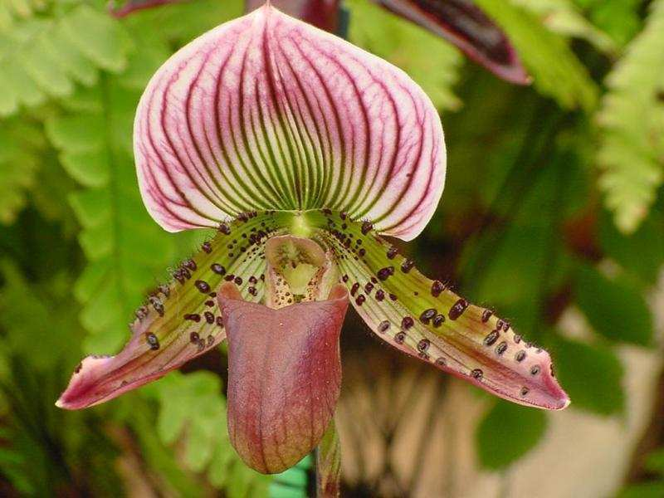

Review Game
Part 5
Lesson 9

Slide 2
Part V REVIEW GAME
IDENTITY CRISIS | THE WONDER YEARS | BOYS AND GIRLS | TOOTY FRUITY | -Bonus- BIG BERRY
1 | 6 | 11 | 16 | *21
2 | 7 | 12 | 17 | *22
3 | 8 | 13 | 18 | *23
4 | 9 | 14 | 19 | *24
5 | 10 | 15 | 20 | *25

Slide 3
How to play…
  Don’t play like Jeo_ _ _ _ y.
  Class should be divided into several small groups.
  Groups should use science journal (red slide notes), homework, and other available materials to assist you.
  Groups can communicate quietly with each other but no sharing answers between groups.
    Practice quietly communicating right now?
    Practice Communication Question:
    Your group gets to order one pizza and you can have two toppings. What does your group want?

Slide 4

Questions 1-20 = 5pts Each
Final Category (Bonus) = 1pt Each
Final Questions = 5 pt wager
If you wager 5 on the last question and get it wrong you lose 5 pts. Wager 5 and get it right you get 5 pts.
Find the Owl =
Secretly write “Owl” in the correct box worth 1pt.
“I’ll be about this big.”

Slide 5
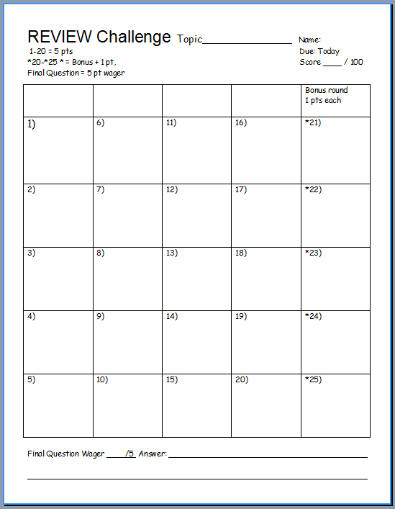
Is your name on the review sheet?
Name

Slide 6
Is your name on the review sheet?
Add the categories
along the top
on the next slide.

Slide 7
Part V REVIEW GAME
IDENTITY CRISIS | THE WONDER YEARS | BOYS AND GIRLS | TOOTY FRUITY | -Bonus- BIG BERRY
1 | 6 | 11 | 16 | *21
2 | 7 | 12 | 17 | *22
3 | 8 | 13 | 18 | *23
4 | 9 | 14 | 19 | *24
5 | 10 | 15 | 20 | *25

Slide 8
Part V REVIEW GAME
IDENTITY CRISIS | THE WONDER YEARS | BOYS AND GIRLS | TOOTY FRUITY | -Bonus- BIG BERRY
1 | 6 | 11 | 16 | *21
2 | 7 | 12 | 17 | *22
3 | 8 | 13 | 18 | *23
4 | 9 | 14 | 19 | *24
5 | 10 | 15 | 20 | *25

Slide 9
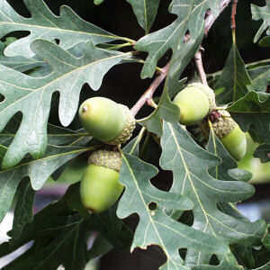
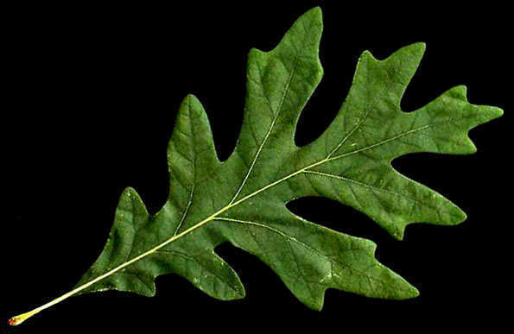
This is an alternating simple leaf, oblong to ovate, with lobate margins
1
Copyright © 2024 SlideSpark .LLC

Slide 10
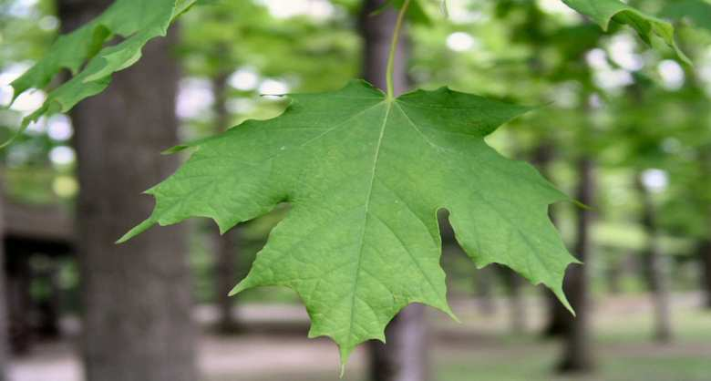


Identify this type of tree?
2

Slide 11
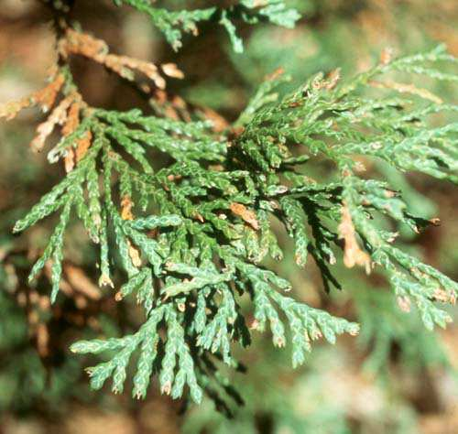
Name this type of tree?
3

Slide 12
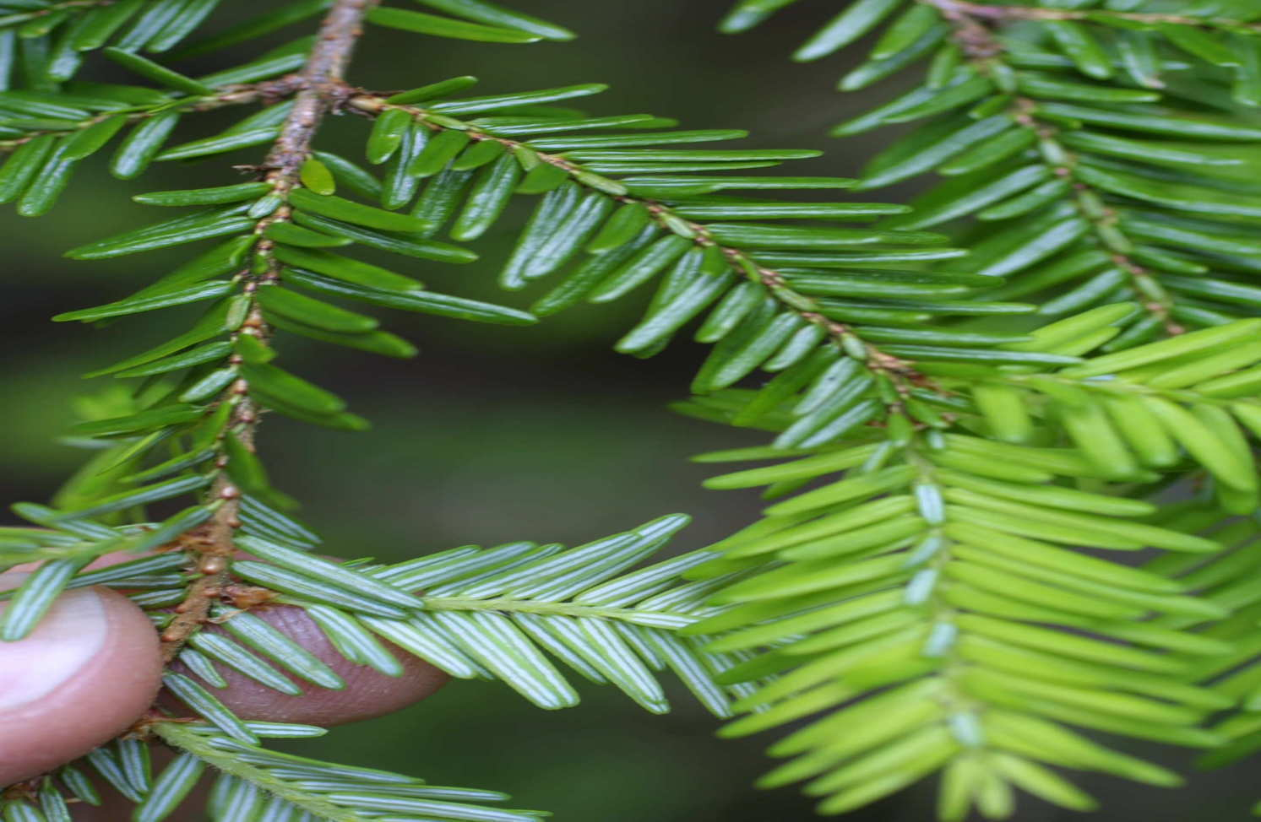
Identify this type of tree.
4

Slide 13
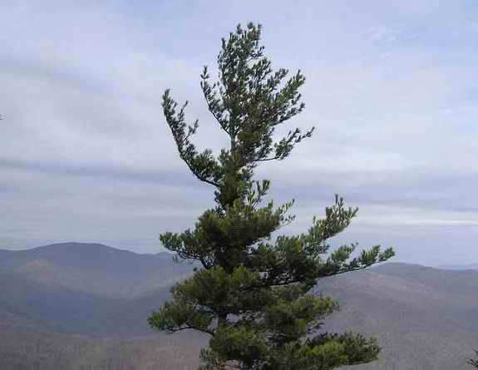
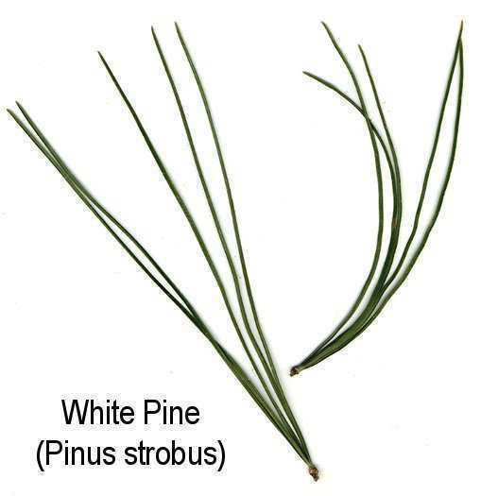
Identify this tree.
5

Slide 14
Part V REVIEW GAME
IDENTITY CRISIS | THE WONDER YEARS | BOYS AND GIRLS | TOOTY FRUITY | -Bonus- BIG BERRY
1 | 6 | 11 | 16 | *21
2 | 7 | 12 | 17 | *22
3 | 8 | 13 | 18 | *23
4 | 9 | 14 | 19 | *24
5 | 10 | 15 | 20 | *25

Slide 15
Part V REVIEW GAME
IDENTITY CRISIS | THE WONDER YEARS | BOYS AND GIRLS | TOOTY FRUITY | -Bonus- BIG BERRY
1 | 6 | 11 | 16 | *21
2 | 7 | 12 | 17 | *22
3 | 8 | 13 | 18 | *23
4 | 9 | 14 | 19 | *24
5 | 10 | 15 | 20 | *25

Slide 16
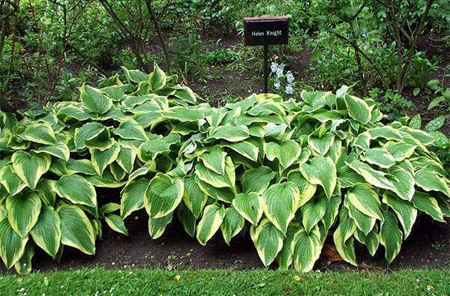
This the name for plants that live for many years producing seeds each year?
6
Copyright © 2024 SlideSpark .LLC

Slide 17
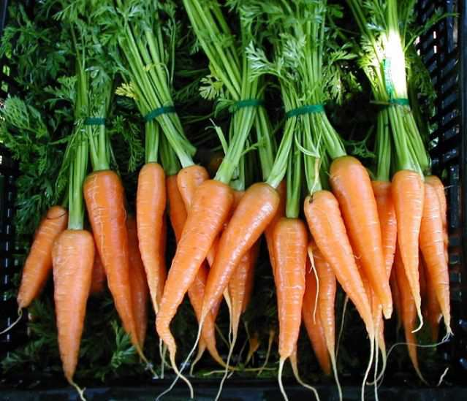
Carrots are examples of biennials. They live through their first winter and produce seeds before dying.
7

Slide 18
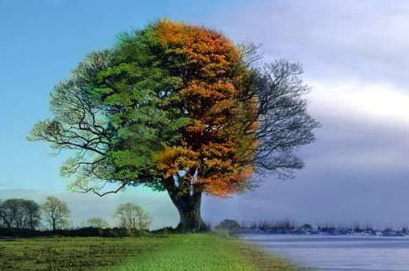
These are the types of plants and shrubs that lose leaves in fall and grow them back in spring.
8
Copyright © 2024 SlideSpark .LLC

Slide 19
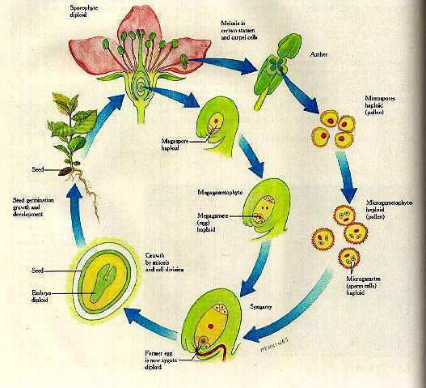
All plants undergo sexual reproduction (two partners). When the sperm and egg come together you get a zygote / baby plant.
9
Copyright © 2024 SlideSpark .LLC

Slide 20
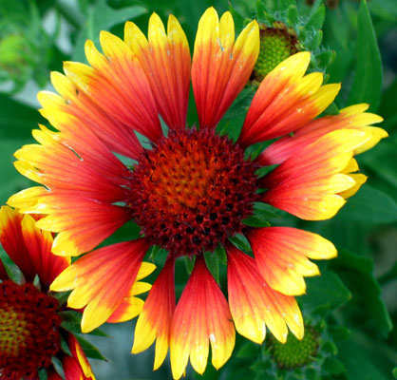
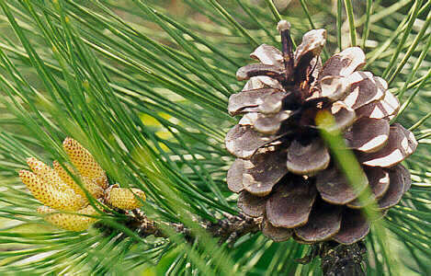
Please name A and B.
  Hint. You can try and unscramble the words.
onsameirgp
smopermnyg
10

Slide 21
Part V REVIEW GAME
IDENTITY CRISIS | THE WONDER YEARS | BOYS AND GIRLS | TOOTY FRUITY | -Bonus- BIG BERRY
1 | 6 | 11 | 16 | *21
2 | 7 | 12 | 17 | *22
3 | 8 | 13 | 18 | *23
4 | 9 | 14 | 19 | *24
5 | 10 | 15 | 20 | *25

Slide 22
Part V REVIEW GAME
IDENTITY CRISIS | THE WONDER YEARS | BOYS AND GIRLS | TOOTY FRUITY | -Bonus- BIG BERRY
1 | 6 | 11 | 16 | *21
2 | 7 | 12 | 17 | *22
3 | 8 | 13 | 18 | *23
4 | 9 | 14 | 19 | *24
5 | 10 | 15 | 20 | *25

Slide 23
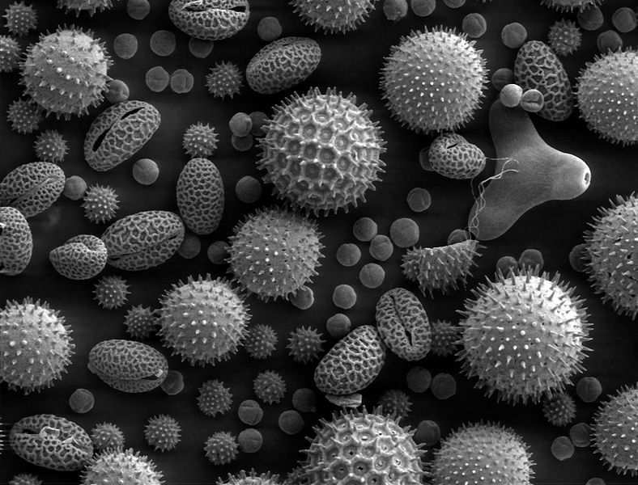
What is this….
  A fine powdery substance, typically yellow, consisting of microscopic grains discharged from the male part of a flower or from a male cone. Each grain contains a male gamete that can fertilize the female ovule, which is transported by the wind, insects, or other animals.
11

Slide 24
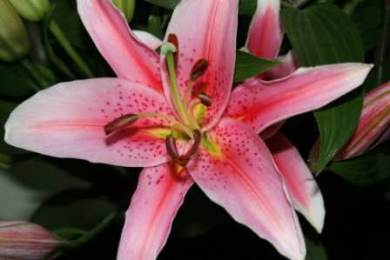
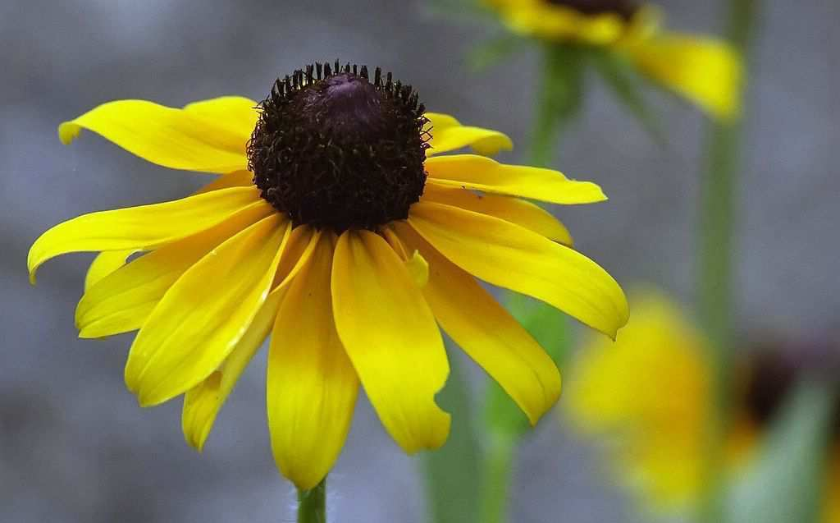
Which one below is the perfect flower?
A
Male
B
Female
12
Female

Slide 25
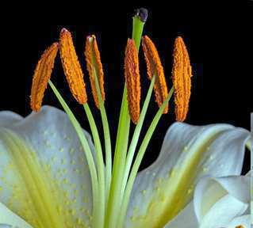
13
Name A, B, and C?
A
B
C =
A and B

Slide 26
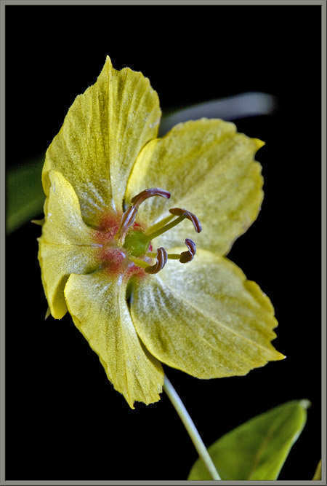
This is at the bottom of the flower. It has the seeds inside and turns into the fruit when fertilized. (contains ovules)
14
Copyright © 2024 SlideSpark .LLC

Slide 27
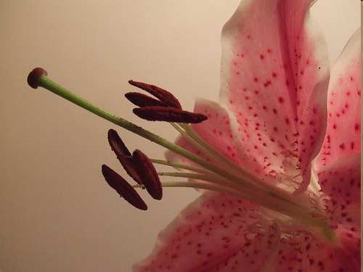
Name A and B and C?
15
A
C
B

Slide 28
Part V REVIEW GAME
IDENTITY CRISIS | THE WONDER YEARS | BOYS AND GIRLS | TOOTY FRUITY | -Bonus- BIG BERRY
1 | 6 | 11 | 16 | *21
2 | 7 | 12 | 17 | *22
3 | 8 | 13 | 18 | *23
4 | 9 | 14 | 19 | *24
5 | 10 | 15 | 20 | *25

Slide 29
Part V REVIEW GAME
IDENTITY CRISIS | THE WONDER YEARS | BOYS AND GIRLS | TOOTY FRUITY | -Bonus- BIG BERRY
1 | 6 | 11 | 16 | *21
2 | 7 | 12 | 17 | *22
3 | 8 | 13 | 18 | *23
4 | 9 | 14 | 19 | *24
5 | 10 | 15 | 20 | *25

Slide 30
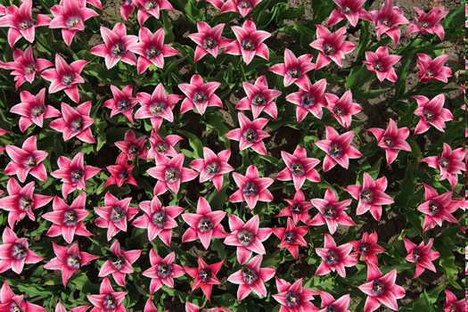
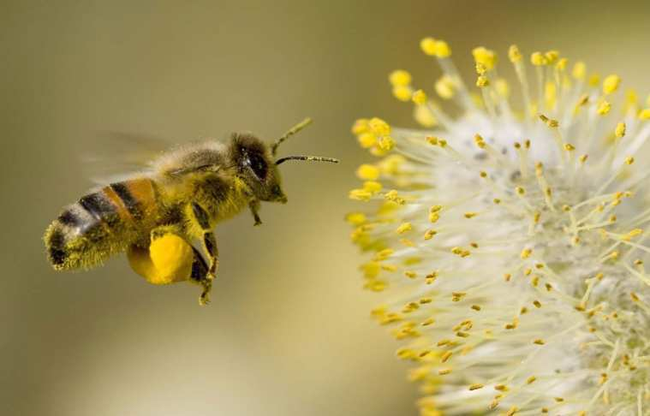
Flowers attract pollinators through all of the following except…
  A.) Fragrance (smell)
  B.) Nectar (food)
  C.) Storms (wind)
  D.) Colors (sight)
16
Copyright © 2024 SlideSpark .LLC

Slide 31
Flowers attract pollinators through all of the following except…
  A.) Fragrance (smell)
  B.) Nectar (food)
  C.) Storms (wind)
  D.) Colors (sight)
16
Copyright © 2024 SlideSpark .LLC

Slide 32
Flowers attract pollinators through all of the following except…
  A.) Fragrance (smell)
  B.) Nectar (food)
  C.) Storms (wind)
  D.) Colors (sight)
16
Copyright © 2024 SlideSpark .LLC

Slide 33
Flowers attract pollinators through all of the following except…
  A.) Fragrance (smell)
  B.) Nectar (food)
  C.) Storms (wind)
  D.) Colors (sight)
16
Copyright © 2024 SlideSpark .LLC

Slide 34
Flowers attract pollinators through all of the following except…
  A.) Fragrance (smell)
  B.) Nectar (food)
  C.) Storms (wind)
  D.) Colors (sight)
16
Copyright © 2024 SlideSpark .LLC

Slide 35
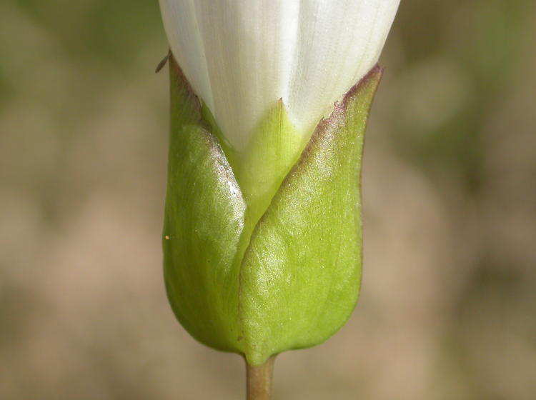
These are the names for the green leaves that cover the outside of a flower bud to protect it before opening.
17
Copyright © 2024 SlideSpark .LLC

Slide 36
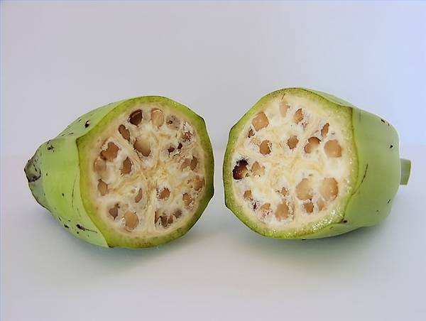
This is the name for a matured ovary in the pistil that contains the seeds.
18
Copyright © 2024 SlideSpark .LLC

Slide 37
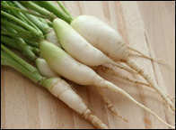
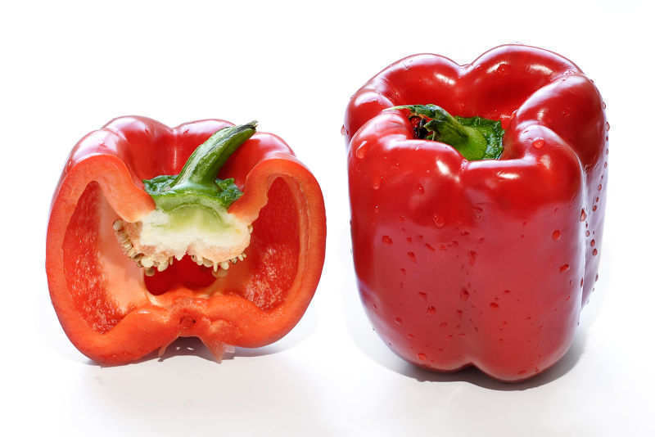

Which is a fruit and which is a vegetable?
A
B

Slide 38
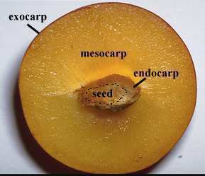
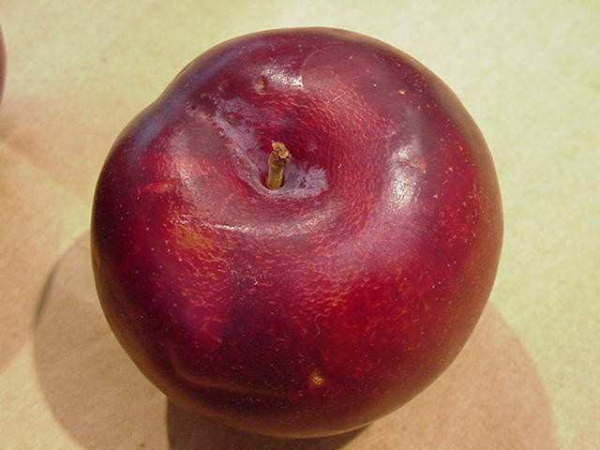
What type of fruit is this plume?
  It developed from one ovary and has one seed.
  Please label the endocarp, mesocarp, and epicarp.
A
20
B
C

Slide 39
Part V REVIEW GAME
IDENTITY CRISIS | THE WONDER YEARS | BOYS AND GIRLS | TOOTY FRUITY | -Bonus- BIG BERRY
1 | 6 | 11 | 16 | *21
2 | 7 | 12 | 17 | *22
3 | 8 | 13 | 18 | *23
4 | 9 | 14 | 19 | *24
5 | 10 | 15 | 20 | *25

Slide 40
Part V REVIEW GAME
IDENTITY CRISIS | THE WONDER YEARS | BOYS AND GIRLS | TOOTY FRUITY | -Bonus- BIG BERRY
1 | 6 | 11 | 16 | *21
2 | 7 | 12 | 17 | *22
3 | 8 | 13 | 18 | *23
4 | 9 | 14 | 19 | *24
5 | 10 | 15 | 20 | *25

Slide 41
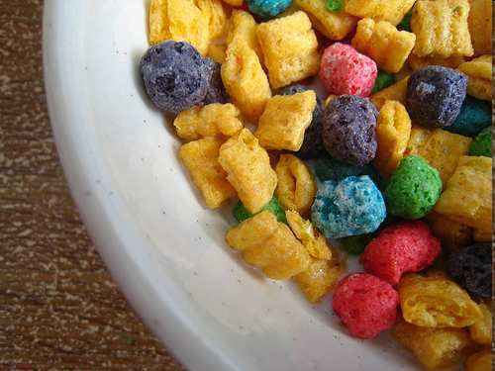
*21
Name this cereal?
Copyright © 2024 SlideSpark .LLC

Slide 42
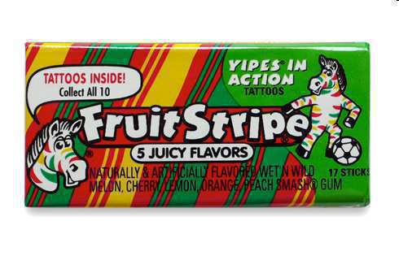
What is the name of this brand of gum?
*22
??????????????????
Copyright © 2024 SlideSpark .LLC

Slide 43
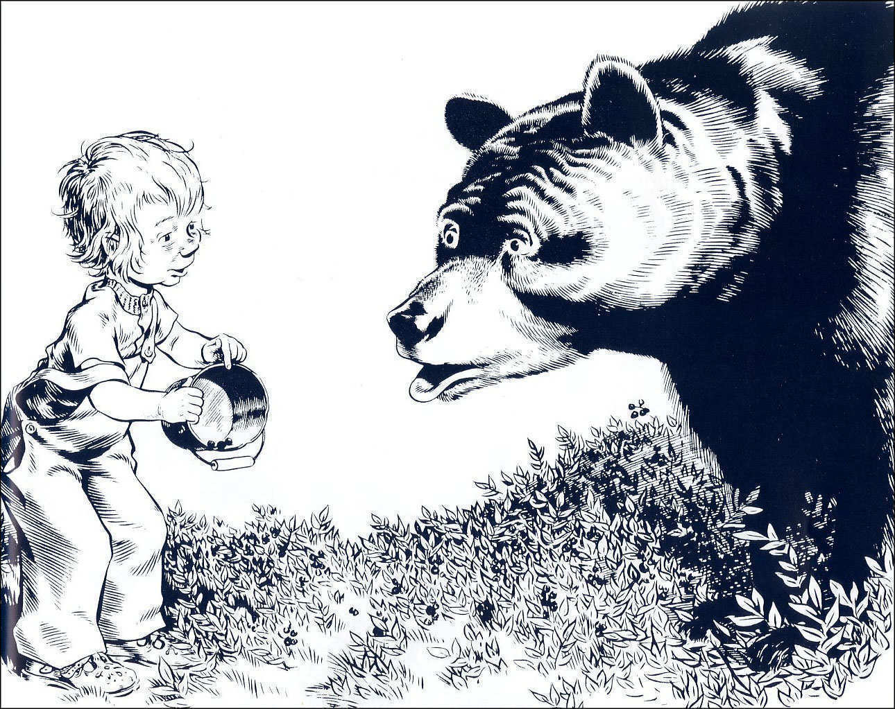
*23
Name this book?

Slide 44
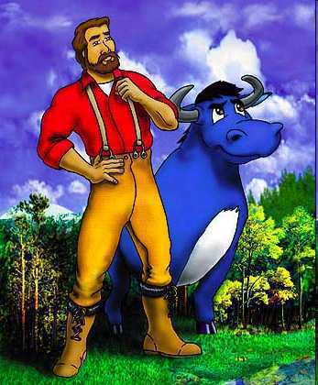
What is the name of this famous lore lumberjack and his ox?
*24
Copyright © 2024 SlideSpark .LLC

Slide 45
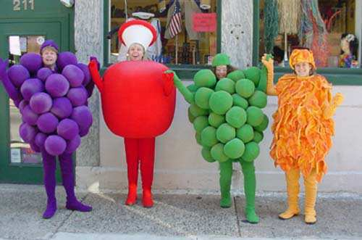
Name this brand of underwear?
*25

Slide 46
Part V REVIEW GAME
IDENTITY CRISIS | THE WONDER YEARS | BOYS AND GIRLS | TOOTY FRUITY | -Bonus- BIG BERRY
1 | 6 | 11 | 16 | *21
2 | 7 | 12 | 17 | *22
3 | 8 | 13 | 18 | *23
4 | 9 | 14 | 19 | *24
5 | 10 | 15 | 20 | *25
Final Question

Slide 47
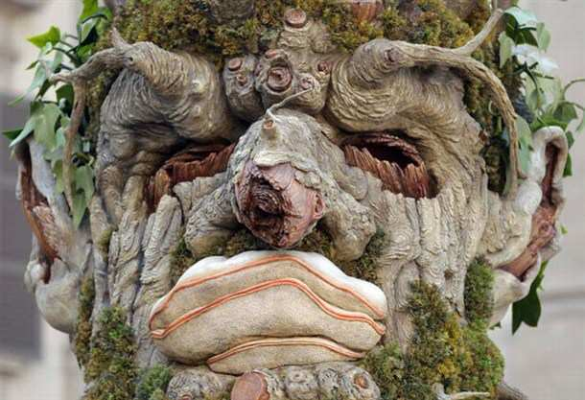
5 Point Wager Question

Slide 48
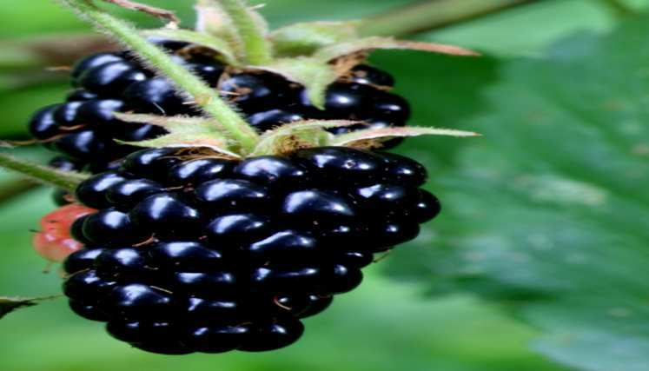
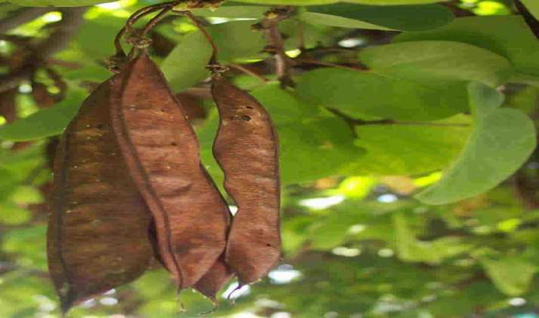
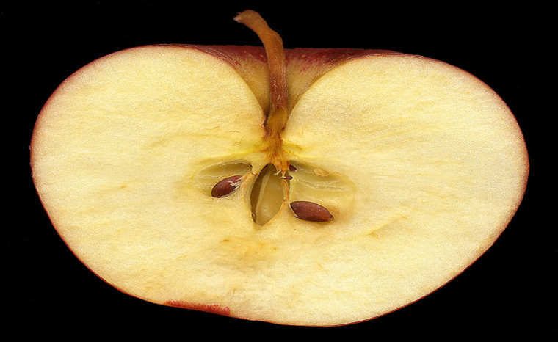
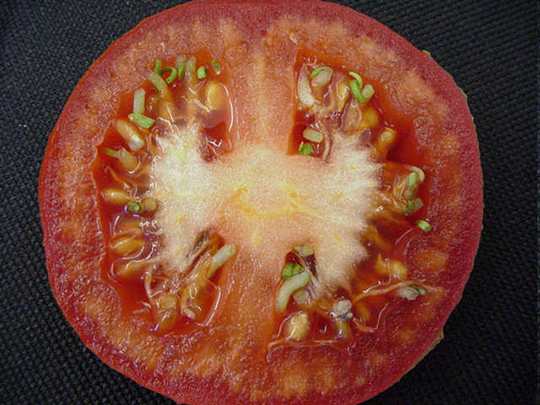
Which one is a Berry, Aggregate, and Pome Fleshy Fruit and which is a Dry Dehiscent Fruit?
A
B
C
D

Slide 49

Plants Part V Unit Review Game
1-20 = 5 points each
20-25 = Bonus (1 point each)
Final Question = 5 point wager
Find the Owl = 1 point

Slide 50
Review Game
Part 5
Lesson 9

Slide 51

Review Game
Part 5
Lesson 10

Slide 52
Part V REVIEW GAME
IDENTITY CRISIS | THE WONDER YEARS | BOYS AND GIRLS | TOOTY FRUITY | -Bonus- BIG BERRY
1 | 6 | 11 | 16 | *21
2 | 7 | 12 | 17 | *22
3 | 8 | 13 | 18 | *23
4 | 9 | 14 | 19 | *24
5 | 10 | 15 | 20 | *25

Slide 53
Part V REVIEW GAME
IDENTITY CRISIS | THE WONDER YEARS | BOYS AND GIRLS | TOOTY FRUITY | -Bonus- BIG BERRY
1 | 6 | 11 | 16 | *21
2 | 7 | 12 | 17 | *22
3 | 8 | 13 | 18 | *23
4 | 9 | 14 | 19 | *24
5 | 10 | 15 | 20 | *25

Slide 54
This is an alternating simple Leaf, Oblong to Ovate, with lobate margins
1
Copyright © 2010 Ryan P. Murphy

Slide 55
This is an alternating simple Leaf, Oblong to Ovate, with lobate margins
1
answer is…
Copyright © 2010 Ryan P. Murphy

Slide 56
This is an alternating simple Leaf, Oblong to Ovate, with lobate margins
  White Oak (Quercus alba)
1
answer is…
Copyright © 2010 Ryan P. Murphy

Slide 57
Identify this type of tree
2

Slide 58
Identify this type of tree
2
answer is…

Slide 59
Identify this type of tree
2
answer is…

Slide 60
Identify this type of tree
S
E
2
R
R
D
U
G
A
Maples
answer is…

Slide 61
Name this type of tree?
3

Slide 62
Name this type of tree?
3
answer is…

Slide 63
Name this type of tree?
3
Cedar
answer is…

Slide 64
Name this type of tree?
3
Cedar
North Atlantic White Cedar
Chamaecyparis thyoides
answer is…

Slide 65
Identify this type of tree.
4

Slide 66
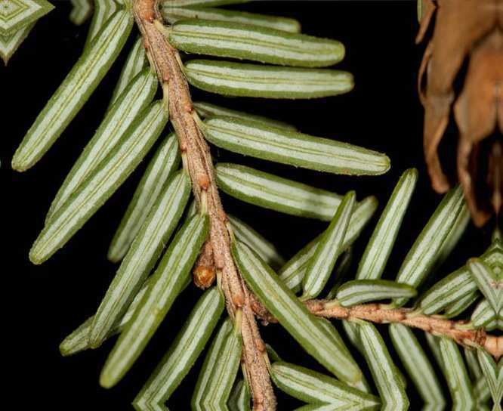
Identify this type of tree.
4

Slide 67
Identify this type of tree.
Hemlock
4
Apiaceae family

Slide 68
Identify this tree.
5

Slide 69
Identify this tree.
5
answer is…

Slide 70
Identify this tree.
5
White
White
5
5
PINE
answer is…

Slide 71
Part V REVIEW GAME
IDENTITY CRISIS | THE WONDER YEARS | BOYS AND GIRLS | TOOTY FRUITY | -Bonus- BIG BERRY
1 | 6 | 11 | 16 | *21
2 | 7 | 12 | 17 | *22
3 | 8 | 13 | 18 | *23
4 | 9 | 14 | 19 | *24
5 | 10 | 15 | 20 | *25

Slide 72
Part V REVIEW GAME
IDENTITY CRISIS | THE WONDER YEARS | BOYS AND GIRLS | TOOTY FRUITY | -Bonus- BIG BERRY
1 | 6 | 11 | 16 | *21
2 | 7 | 12 | 17 | *22
3 | 8 | 13 | 18 | *23
4 | 9 | 14 | 19 | *24
5 | 10 | 15 | 20 | *25

Slide 73
This the name for plants that live for many years producing seeds each year?
6
Copyright © 2010 Ryan P. Murphy

Slide 74
This the name for plants that live for many years producing seeds each year?
6
answer is…
Copyright © 2010 Ryan P. Murphy

Slide 75

This the name for plants that live for many years producing seeds each year?
6
Perennial
answer is…
Copyright © 2010 Ryan P. Murphy

Slide 76
Carrots are examples of biennials. They live through their first winter and produce seeds before dying.
7

Slide 77
Carrots are examples of biennials. They live through their first winter and produce seeds before dying.
7

Slide 78
Carrots are examples of biennials. They live through their first winter and produce seeds before dying.
7

Slide 79
These are the types of plants and shrubs that lose leaves in fall and grow them back in spring.
8
Copyright © 2010 Ryan P. Murphy

Slide 80
These are the types of plants and shrubs that lose leaves in fall and grow them back in spring.
8
answer is…
Copyright © 2010 Ryan P. Murphy

Slide 81
These are the types of plants and shrubs that lose leaves in fall and grow them back in spring.
8
Deciduous
answer is…
Copyright © 2010 Ryan P. Murphy

Slide 82
All plants undergo sexual reproduction (two partners). When the sperm and egg come together you get a zygote / baby plant.
9
Copyright © 2010 Ryan P. Murphy

Slide 83
All plants undergo sexual reproduction (two partners). When the sperm and egg come together you get a zygote / baby plant.
9
Copyright © 2010 Ryan P. Murphy

Slide 84
All plants undergo sexual reproduction (two partners). When the sperm and egg come together you get a zygote / baby plant.
9
Copyright © 2010 Ryan P. Murphy

Slide 85
All plants undergo sexual reproduction (two partners). When the sperm and egg come together you get a zygote / baby plant.
9
Copyright © 2010 Ryan P. Murphy

Slide 86
All plants undergo sexual reproduction (two partners). When the sperm and egg come together you get a zygote / baby plant.
9
Copyright © 2010 Ryan P. Murphy

Slide 87
All plants undergo sexual reproduction (two partners). When the sperm and egg come together you get a zygote / baby plant.
9
Copyright © 2010 Ryan P. Murphy

Slide 88
All plants undergo sexual reproduction (two partners). When the sperm and egg come together you get a zygote / baby plant.
9
Copyright © 2010 Ryan P. Murphy

Slide 89
Please name A and B.
  Hint. You can try and unscramble the words.
onsameirgp
spmoermnyg
10

Slide 90
Please name A and B.
  Hint. You can try and unscramble the words.
onsameirgp
spmoermnyg
10

Slide 91
Please name A and B.
  Hint. You can try and unscramble the words.
angiosperm
spmoermnyg
10

Slide 92
Please name A and B.
  Hint. You can try and unscramble the words.
angiosperm
spmoermnyg
10

Slide 93
Please name A and B.
  Hint. You can try and unscramble the words.
angiosperm
gymnosperm
10

Slide 94
Please name A and B.
  Hint. You can try and unscramble the words.
angiosperm
gymnosperm
Which one evolved first?
10

Slide 95
Please name A and B.
  Hint. You can try and unscramble the words.
gymnosperm
Which one evolved first?
10

Slide 96
Part V REVIEW GAME
IDENTITY CRISIS | THE WONDER YEARS | BOYS AND GIRLS | TOOTY FRUITY | -Bonus- BIG BERRY
1 | 6 | 11 | 16 | *21
2 | 7 | 12 | 17 | *22
3 | 8 | 13 | 18 | *23
4 | 9 | 14 | 19 | *24
5 | 10 | 15 | 20 | *25

Slide 97
Part V REVIEW GAME
IDENTITY CRISIS | THE WONDER YEARS | BOYS AND GIRLS | TOOTY FRUITY | -Bonus- BIG BERRY
1 | 6 | 11 | 16 | *21
2 | 7 | 12 | 17 | *22
3 | 8 | 13 | 18 | *23
4 | 9 | 14 | 19 | *24
5 | 10 | 15 | 20 | *25

Slide 98
What is this….
  A fine powdery substance, typically yellow, consisting of microscopic grains discharged from the male part of a flower or from a male cone. Each grain contains a male gamete that can fertilize the female ovule, which is transported by the wind, insects, or other animals
11

Slide 99
What is this….
  A fine powdery substance, typically yellow, consisting of microscopic grains discharged from the male part of a flower or from a male cone. Each grain contains a male gamete that can fertilize the female ovule, which is transported by the wind, insects, or other animals
11
answer is…

Slide 100
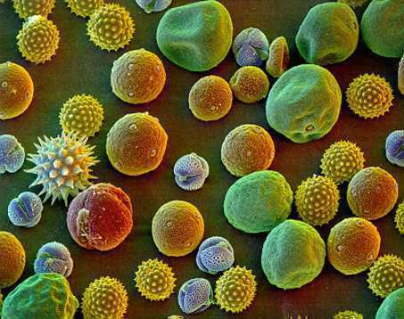
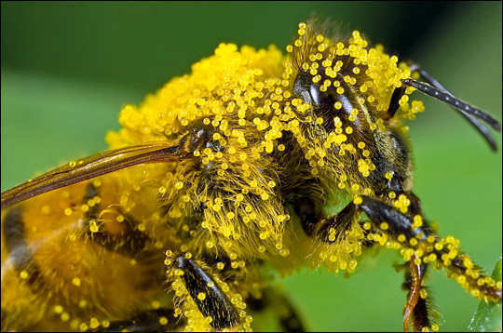
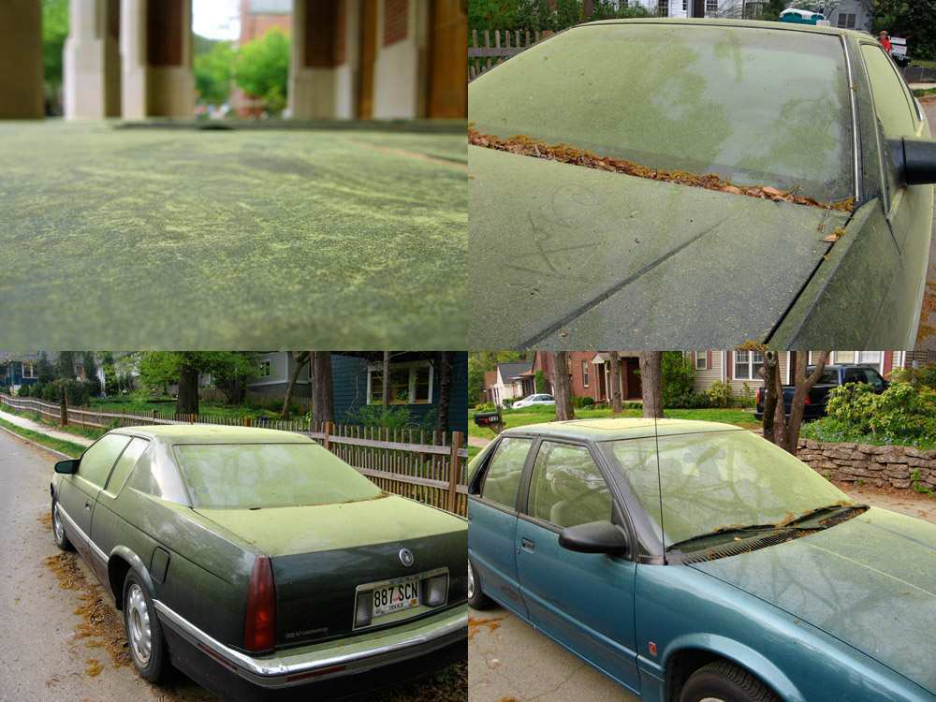
What is this….
  A fine powdery substance, typically yellow, consisting of microscopic grains discharged from the male part of a flower or from a male cone. Each grain contains a male gamete that can fertilize the female ovule, which is transported by the wind, insects, or other animals
11
answer is…

Slide 101
What is this….
  A fine powdery substance, typically yellow, consisting of microscopic grains discharged from the male part of a flower or from a male cone. Each grain contains a male gamete that can fertilize the female ovule, which is transported by the wind, insects, or other animals
11
answer is…

Slide 102
What is this….
  A fine powdery substance, typically yellow, consisting of microscopic grains discharged from the male part of a flower or from a male cone. Each grain contains a male gamete that can fertilize the female ovule, which is transported by the wind, insects, or other animals
11
answer is…

Slide 103
What is this….
  A fine powdery substance, typically yellow, consisting of microscopic grains discharged from the male part of a flower or from a male cone. Each grain contains a male gamete that can fertilize the female ovule, which is transported by the wind, insects, or other animals
POLLEN
11
11
answer is…

Slide 104
Which one below is the perfect flower?
A
Male
B
Female
12
Female

Slide 105
Which one below is the perfect flower?
A
Male
B
Female
12
Female
answer is…

Slide 106
Which one below is the perfect flower?
A
Male
A perfect flower has both the male parts and female parts on the same flower.
12
Female

Slide 107
13
Name A, B, and C?
A
B
C =
A and B

Slide 108
13
Name A, B, and C?
A
B
C =
A and B

Slide 109
13
Name A, B, and C?
Anther
A
B
C =
A and B

Slide 110
13
Name A, B, and C?
Anther
A
B
C =
A and B

Slide 111
13
Name A, B, and C?
Anther
A
B
Filament
C =
A and B

Slide 112
13
Name A, B, and C?
Anther
A
B
Filament
C =
A and B

Slide 113
13
Name A, B, and C?
Anther
A
Stamen
B
Filament
C =
A and B

Slide 114
13
Name A, B, and C?
Pollen
Anther
A
Stamen
B
Filament
C =
A and B

Slide 115
13
Name A, B, and C?
Pollen
Anther
A
Stamen
B
Filament
C =
A and B

Slide 116
13
Name A, B, and C?
Pollen
Anther
A
Stamen
B
Filament
C =
A and B

Slide 117
This is at the bottom of the flower. It has the seeds inside and turns into the fruit when fertilized. (contains ovules)
14
Copyright © 2010 Ryan P. Murphy

Slide 118
This is at the bottom of the flower. It has the seeds inside and turns into the fruit when fertilized. (contains ovules)
14
answer is…
Copyright © 2010 Ryan P. Murphy

Slide 119
This is at the bottom of the flower. It has the seeds inside and turns into the fruit when fertilized. (contains ovules)
14
Ovary
answer is…
Copyright © 2010 Ryan P. Murphy

Slide 120
Name A and B and C?
15
A
C
B

Slide 121
Name A and B and C?
15
A
C
B

Slide 122
Name A and B and C?
15
Stigma
A
C
B

Slide 123
Name A and B and C?
15
Stigma
A
C
B

Slide 124
Name A and B and C?
15
Stigma
A
C
B
Style

Slide 125
Name A and B and C?
15
Stigma
A
C
B
Style

Slide 126
Name A and B and C?
15
Stigma
A
C
Pistil
B
Style

Slide 127
Part V REVIEW GAME
IDENTITY CRISIS | THE WONDER YEARS | BOYS AND GIRLS | TOOTY FRUITY | -Bonus- BIG BERRY
1 | 6 | 11 | 16 | *21
2 | 7 | 12 | 17 | *22
3 | 8 | 13 | 18 | *23
4 | 9 | 14 | 19 | *24
5 | 10 | 15 | 20 | *25

Slide 128
Part V REVIEW GAME
IDENTITY CRISIS | THE WONDER YEARS | BOYS AND GIRLS | TOOTY FRUITY | -Bonus- BIG BERRY
1 | 6 | 11 | 16 | *21
2 | 7 | 12 | 17 | *22
3 | 8 | 13 | 18 | *23
4 | 9 | 14 | 19 | *24
5 | 10 | 15 | 20 | *25

Slide 129
Flowers attract pollinators through all of the following except…
  A.) Fragrance (smell)
  B.) Nectar (food)
  C.) Storms (wind)
  D.) Colors (sight)
16
Copyright © 2010 Ryan P. Murphy

Slide 130
Flowers attract pollinators through all of the following except…
  A.) Fragrance (smell)
  B.) Nectar (food)
  C.) Storms (wind)
  D.) Colors (sight)
16
Copyright © 2010 Ryan P. Murphy

Slide 131
Flowers attract pollinators through all of the following except…
  A.) Fragrance (smell)
  B.) Nectar (food)
  C.) Storms (wind)
  D.) Colors (sight)
16
Copyright © 2010 Ryan P. Murphy

Slide 132
Flowers attract pollinators through all of the following except…
  A.) Fragrance (smell)
  B.) Nectar (food)
  C.) Storms (wind)
  D.) Colors (sight)
16
Copyright © 2010 Ryan P. Murphy

Slide 133
Flowers attract pollinators through all of the following except…
  A.) Fragrance (smell)
  B.) Nectar (food)
  C.) Storms (wind)
  D.) Colors (sight)
16
Copyright © 2010 Ryan P. Murphy

Slide 134
Flowers attract pollinators through all of the following except…
  A.) Fragrance (smell)
  B.) Nectar (food)
  C.) Storms (wind)
  D.) Colors (sight)
16
answer…
Copyright © 2010 Ryan P. Murphy

Slide 135
Flowers attract pollinators through all of the following except…
  A.) Fragrance (smell)
  B.) Nectar (food)
  C.) Storms (wind)
  D.) Colors (sight)
16
answer…
Copyright © 2010 Ryan P. Murphy

Slide 136
These are the names for the green leaves that cover the outside of a flower bud to protect it before opening.
17
Copyright © 2010 Ryan P. Murphy

Slide 137
These are the names for the green leaves that cover the outside of a flower bud to protect it before opening.
17
answer is…
Copyright © 2010 Ryan P. Murphy

Slide 138
These are the names for the green leaves that cover the outside of a flower bud to protect it before opening.
17
Sepals
answer is…
Copyright © 2010 Ryan P. Murphy

Slide 139
This is the name for a matured ovary in the pistil that contains the seeds.
18
Copyright © 2010 Ryan P. Murphy

Slide 140
This is the name for a matured ovary in the pistil that contains the seeds.
18
“Hey Joey, Do you think they over thought this one.”
Copyright © 2010 Ryan P. Murphy

Slide 141
This is the name for a matured ovary in the pistil that contains the seeds.
18
“Hey Joey, Do you think they over thought this one.”
“All this ovary, pistil, pollen lingo can make a really easy question difficult….”
Copyright © 2010 Ryan P. Murphy

Slide 142
This is the name for a matured ovary in the pistil that contains the seeds.
18
“Hey Joey, Do you think they over thought this one.”
answer…
“All this ovary, pistil, pollen lingo can make a really easy question difficult….”
Copyright © 2010 Ryan P. Murphy

Slide 143
This is the name for a matured ovary in the pistil that contains the seeds.
18
“Hey Joey, Do you think they over thought this one.”
Fruit
answer…
“All this ovary, pistil, pollen lingo can make a really easy question difficult….”
Copyright © 2010 Ryan P. Murphy

Slide 144
Which is a fruit and which is a vegetable?
A
B

Slide 145
Which is a fruit and which is a vegetable?
A
B

Slide 146
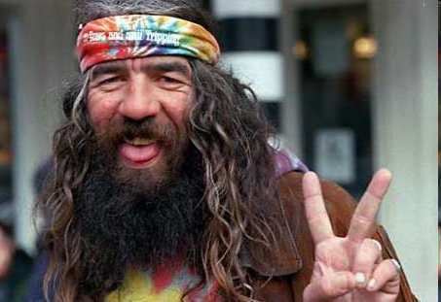
Which is a fruit and which is a vegetable?
A
B
Vegetable

Slide 147
Which is a fruit and which is a vegetable?
A
B
Vegetable

Slide 148

Which is a fruit and which is a vegetable?
A
B
Vegetable
Fruit

Slide 149
What type of fruit is this plume?
  It developed from one ovary and has one seed.
  Please label the endocarp, mesocarp, and exocarp.
A
20
B
C

Slide 150
What type of fruit is this plume?
  It developed from one ovary and has one seed.
  Please label the endocarp, mesocarp, and exocarp.
A
20
B
C

Slide 151
What type of fruit is this plume? Drupe
  It developed from one ovary and has one seed.
  Please label the endocarp, mesocarp, and exocarp.
A
20
B
C
Drupe

Slide 152
What type of fruit is this plume? Drupe
  It developed from one ovary and has one seed.
  Please label the endocarp, mesocarp, and exocarp.
A
20
B
C
Drupe

Slide 153
What type of fruit is this plume? Drupe
  It developed from one ovary and has one seed.
  Please label the endocarp, mesocarp, and exocarp.
A
20
B
C
Drupe

Slide 154
What type of fruit is this plume? Drupe
  It developed from one ovary and has one seed.
  Please label the endocarp, mesocarp, and exocarp.
A
20
B
C
Drupe

Slide 155
What type of fruit is this plume? Drupe
  It developed from one ovary and has one seed.
  Please label the endocarp, mesocarp, and exocarp.
A
20
B
C
Drupe

Slide 156
What type of fruit is this plume? Drupe
  It developed from one ovary and has one seed.
  Please label the endocarp, mesocarp, and exocarp.
A
20
B
C
Drupe

Slide 157
What type of fruit is this plume? Drupe
  It developed from one ovary and has one seed.
  Please label the endocarp, mesocarp, and exocarp.
A
20
B
C
Drupe

Slide 158
Part V REVIEW GAME
IDENTITY CRISIS | THE WONDER YEARS | BOYS AND GIRLS | TOOTY FRUITY | -Bonus- BIG BERRY
1 | 6 | 11 | 16 | *21
2 | 7 | 12 | 17 | *22
3 | 8 | 13 | 18 | *23
4 | 9 | 14 | 19 | *24
5 | 10 | 15 | 20 | *25

Slide 159
Part V REVIEW GAME
IDENTITY CRISIS | THE WONDER YEARS | BOYS AND GIRLS | TOOTY FRUITY | -Bonus- BIG BERRY
1 | 6 | 11 | 16 | *21
2 | 7 | 12 | 17 | *22
3 | 8 | 13 | 18 | *23
4 | 9 | 14 | 19 | *24
5 | 10 | 15 | 20 | *25

Slide 160
*21
Name this cereal?
Copyright © 2010 Ryan P. Murphy

Slide 161
*21
Name this cereal?
answer is…
Copyright © 2010 Ryan P. Murphy

Slide 162
*21
Name this cereal?
answer is…
Copyright © 2010 Ryan P. Murphy

Slide 163
*21
Name this cereal?
answer is…
Copyright © 2010 Ryan P. Murphy

Slide 164
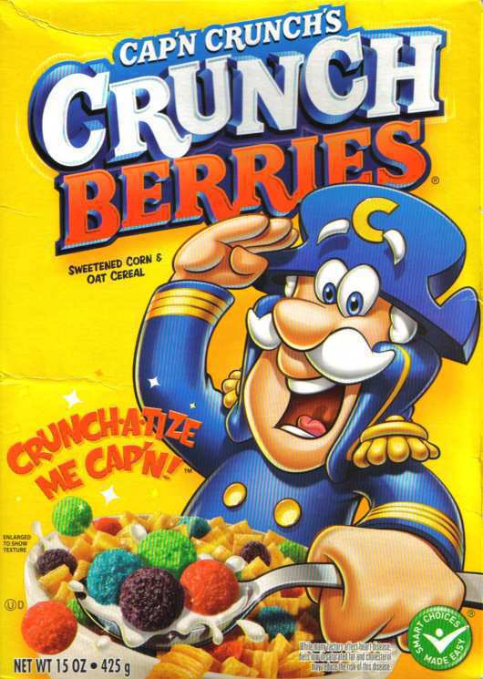
*21
Name this cereal?
answer is…
Copyright © 2010 Ryan P. Murphy

Slide 165
What is the name of this brand of gum?
*22
??????????????????
Copyright © 2010 Ryan P. Murphy

Slide 166
What is the name of this brand of gum?
*22
??????????????????
Copyright © 2010 Ryan P. Murphy

Slide 167
What is the name of this brand of gum?
*22
Copyright © 2010 Ryan P. Murphy

Slide 168
*23
Name this book?

Slide 169
*23
Name this book?
Answer is…

Slide 170

*23
Name this book?
Answer is…

Slide 171
What is the name of this famous lore lumberjack and his ox?
*24
Copyright © 2010 Ryan P. Murphy

Slide 172
What is the name of this famous lore lumberjack and his ox?
*24
answer is…
Copyright © 2010 Ryan P. Murphy

Slide 173
What is the name of this famous lore lumberjack and his ox?
Paul Bunyan and
*24
answer is…
Copyright © 2010 Ryan P. Murphy

Slide 174
What is the name of this famous lore lumberjack and his ox?
Paul Bunyan and Babe
*24
answer is…
Copyright © 2010 Ryan P. Murphy

Slide 175
Name this brand of underwear?
*25

Slide 176
Name this brand of underwear?
*25
answer is…

Slide 177

Name this brand of underwear?
*25
answer is…

Slide 178
Name this brand of underwear?
*25
Dried Grape
Berry
Pome
Berry
Berry
answer is…

Slide 179
Part V REVIEW GAME
IDENTITY CRISIS | THE WONDER YEARS | BOYS AND GIRLS | TOOTY FRUITY | -Bonus- BIG BERRY
1 | 6 | 11 | 16 | *21
2 | 7 | 12 | 17 | *22
3 | 8 | 13 | 18 | *23
4 | 9 | 14 | 19 | *24
5 | 10 | 15 | 20 | *25
Final Question

Slide 180
5 Point Wager Question

Slide 181
Which one is a Berry, Aggregate, Pome and Dehiscent Fruit?
A
B
C
D

Slide 182
Which one is a Berry, Aggregate, Pome and Dehiscent Fruit?
A
B
C
D

Slide 183
Which one is a Berry, Aggregate, Pome and Dehiscent Fruit?
A
B
Aggregate
C
D

Slide 184
Which one is a Berry, Aggregate, Pome and Dehiscent Fruit?
A
B
Aggregate
C
D

Slide 185
Which one is a Berry, Aggregate, Pome and Dehiscent Fruit?
A
B
Aggregate
Dehiscent
C
D

Slide 186
Which one is a Berry, Aggregate, Pome and Dehiscent Fruit?
A
B
Aggregate
Dehiscent
C
D

Slide 187
Which one is a Berry, Aggregate, Pome and Dehiscent Fruit?
A
B
Aggregate
Dehiscent
C
D
Pome

Slide 188
Which one is a Berry, Aggregate, Pome and Dehiscent Fruit?
A
B
Aggregate
Dehiscent
C
D
Pome

Slide 189
Which one is a Berry, Aggregate, Pome and Dehiscent Fruit?
A
B
Aggregate
Dehiscent
C
D
Pome
Berry

Slide 190
Plants Part V Unit Review Game
1-20 = 5 points each
20-25 = Bonus (1 point each)
Final Question = 5 point wager
Find the Owl = 1 point

Slide 191
Review Game
Part 5
Lesson 10

Slide 192



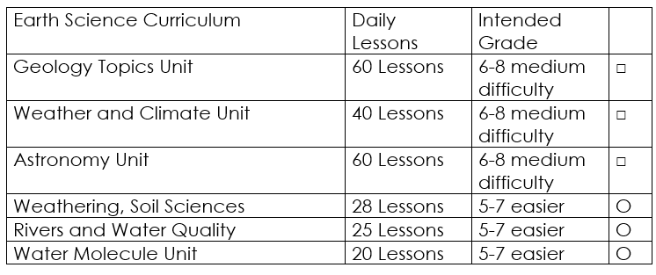

Curriculum Guide
Number of Lessons in each unit (50 min, daily lessons) and difficult rating scale / intended grade level.
=Easier, = More difficult, =Most difficult
Earth Science Units

Slide 193


Life Science Units

Slide 194

Physical Science

Slide 195
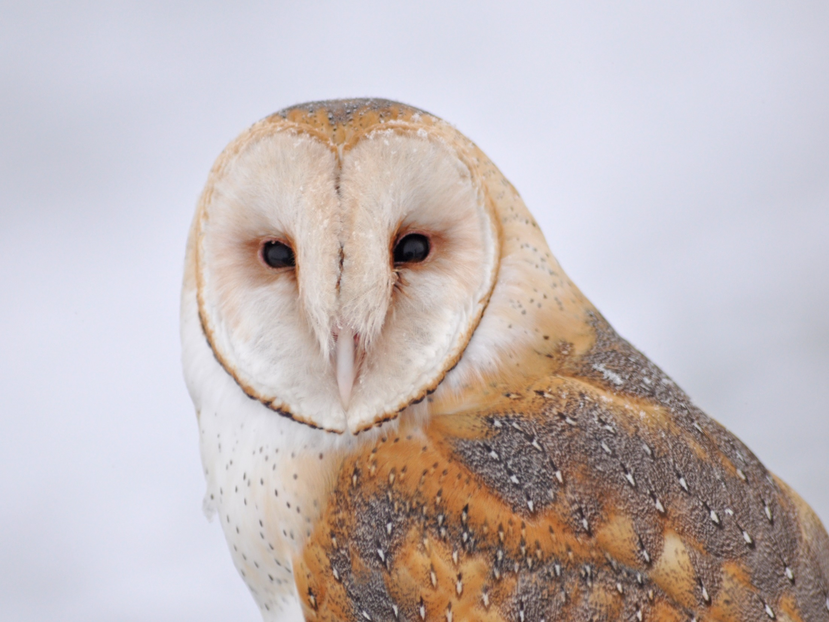
Dear Valued Educator,
Our fully editable .pptx and .doc resources are perfect for educators looking to bring enthusiasm and creativity to their lessons. We encourage you to make changes to fit your needs and style. As science educators, we’re committed to providing students with the tools they need to succeed in the classroom and beyond. Each unit in the curriculum includes a range of resources that have been developed through extensive research and use in a busy classroom. Our teaching approach is designed to make science education engaging and exciting for learners of all ages. We offer a one-of-a-kind science curriculum that will challenge, inspire, and educate students to become tomorrow's scientists and leaders. Join us today and learn more about how our program can help you achieve your classroom goals.
With appreciation,
Support@SlideSpark.net

Slide 196





Thank you for your time and interest in our Science curriculum. We strive to provide students with engaging and informative lessons that will spark their curiosity and encourage scientific exploration. Should you have any questions or concerns, please do not hesitate to contact us. Thank you again for considering our curriculum, and we wish you all the best in your educational journey.
Sincerely,
Support@slidespark.net
SlideSpark Science on TpT

