Slide 1
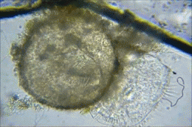

Protista
Review Game
Part 3
Lesson 6

Slide 2
Protista Review Game
THE VERY FIRST | GREEN HOUSE | ANIMAL HOUSE | FUN HOUSE | -BONUS- GREEN MACHINE
1 | 6 | 11 | 16 | *21
2 | 7 | 12 | 17 | *22
3 | 8 | 13 | 18 | *23
4 | 9 | 14 | 19 | *24
5 | 10 | 15 | 20 | *25
Copyright © 2024 SlideSpark .LLC

Slide 3
How to play…
  Don’t play like Jeo_ _ _ _ y.
  Class should be divided into several small groups.
  Groups should use science journal (red slide notes), homework, and other available materials to assist you.
  Groups can communicate quietly with each other but no sharing answers between groups.
    Practice quietly communicating right now?
    Practice Communication Question:
    Your group gets to order one pizza, and you can have two toppings. What does your group want?

Slide 4

Questions 1-20 = 5pts Each
Final Category (Bonus) = 1pt Each
Final Questions = 5 pt wager
If you wager 5 on the last question and get it wrong you lose 5 pts. Wager 5 and get it right you get 5 pts.
Find the Owl =
Secretly write “Owl” in the correct box worth 1pt.
“I’ll be about this big.”

Slide 5
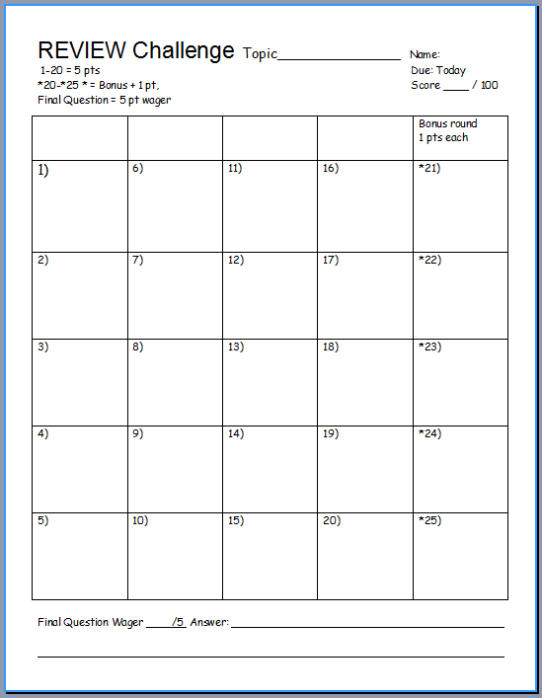
Is your name on the review sheet?
Name

Slide 6
Is your name on the review sheet?
Add the categories
along the top
on the next slide.

Slide 7
Protista Review Game
THE VERY FIRST | GREEN HOUSE | ANIMAL HOUSE | FUN HOUSE | -BONUS- GREEN MACHINE
1 | 6 | 11 | 16 | *21
2 | 7 | 12 | 17 | *22
3 | 8 | 13 | 18 | *23
4 | 9 | 14 | 19 | *24
5 | 10 | 15 | 20 | *25
Copyright © 2024 SlideSpark .LLC

Slide 8
Protista Review Game
THE VERY FIRST | GREEN HOUSE | ANIMAL HOUSE | FUN HOUSE | -BONUS- GREEN MACHINE
1 | 6 | 11 | 16 | *21
2 | 7 | 12 | 17 | *22
3 | 8 | 13 | 18 | *23
4 | 9 | 14 | 19 | *24
5 | 10 | 15 | 20 | *25
Copyright © 2024 SlideSpark .LLC

Slide 9
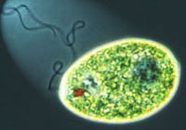
Protista belongs to this Domain because they have a membrane bound nucleus in their cells?
1
3
Copyright © 2024 SlideSpark .LLC

Slide 10

Which letter is Protista?
Domain | Bacteria | Archaea
Kingdom
Cell Type | Prokaryotic (No nucleus) | Prokaryotic (No nucleus) | Eukaryotic (Nucleus) | Eukaryotic (Nucleus) | Eukaryotic (Nucleus) | Eukaryotic (Nucleus)
Single or Multi-Cellular | Single (Unicellular) | Single (Unicellular) | Single (Unicellular) | Multicellular | Multicellular | Multicellular
Gets Energy from.. | Varies | Varies | Varies Auto / Hetero | Sunlight | Absorbs | Consumes Food
Eukarya
A
B
C
D
E
F

Slide 11
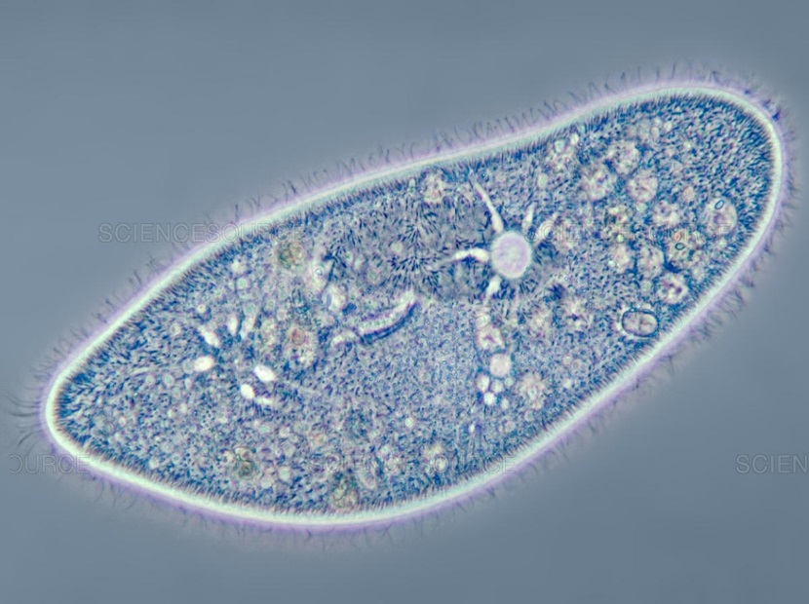
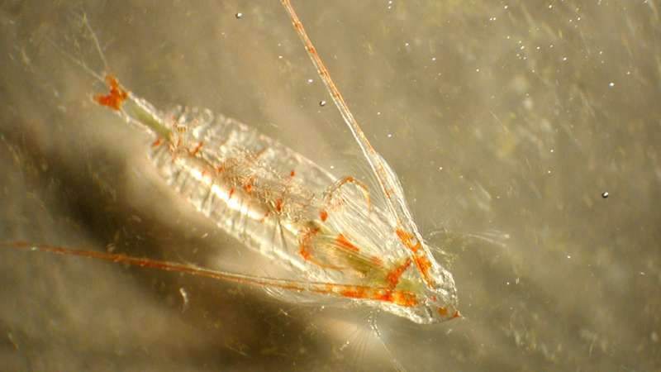
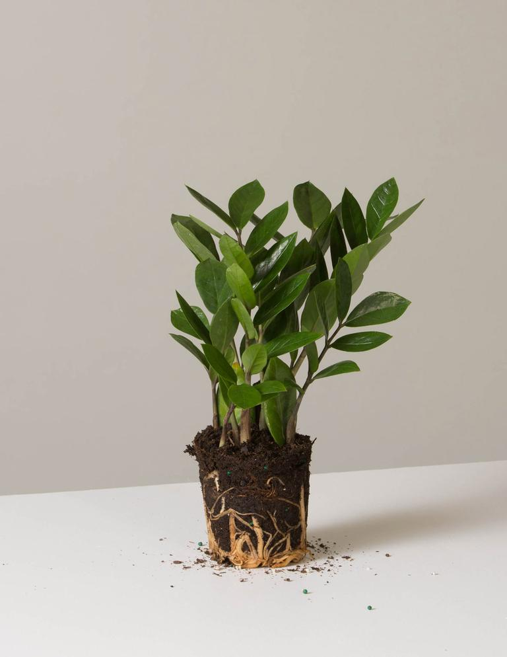
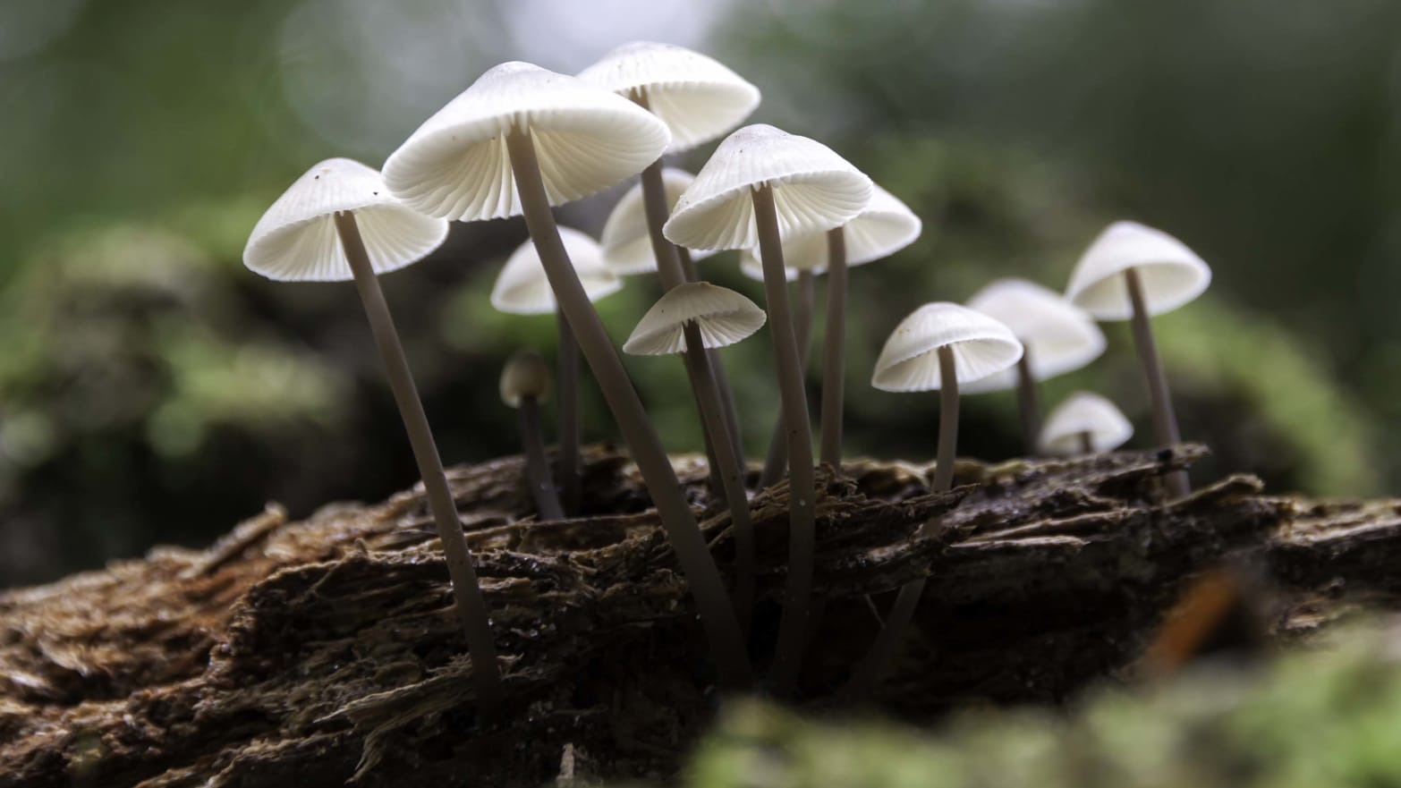
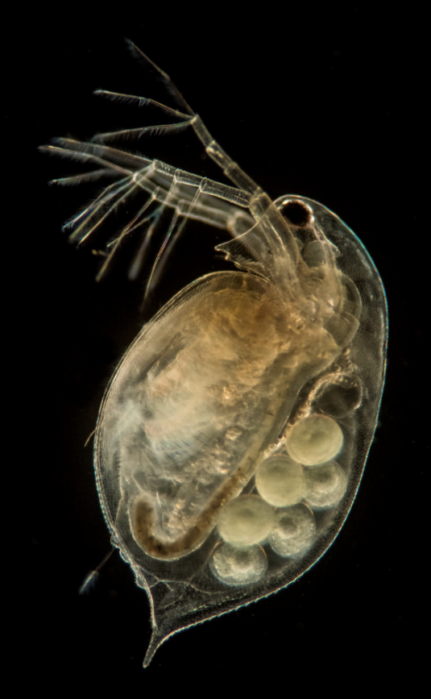
3
Which letter is a Protist?
B
A
C
E
C
D

Slide 12
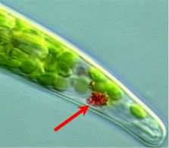
True or False? This is an organ made of tissues / true eye that allow this Euglena to see the world?
4

Slide 13
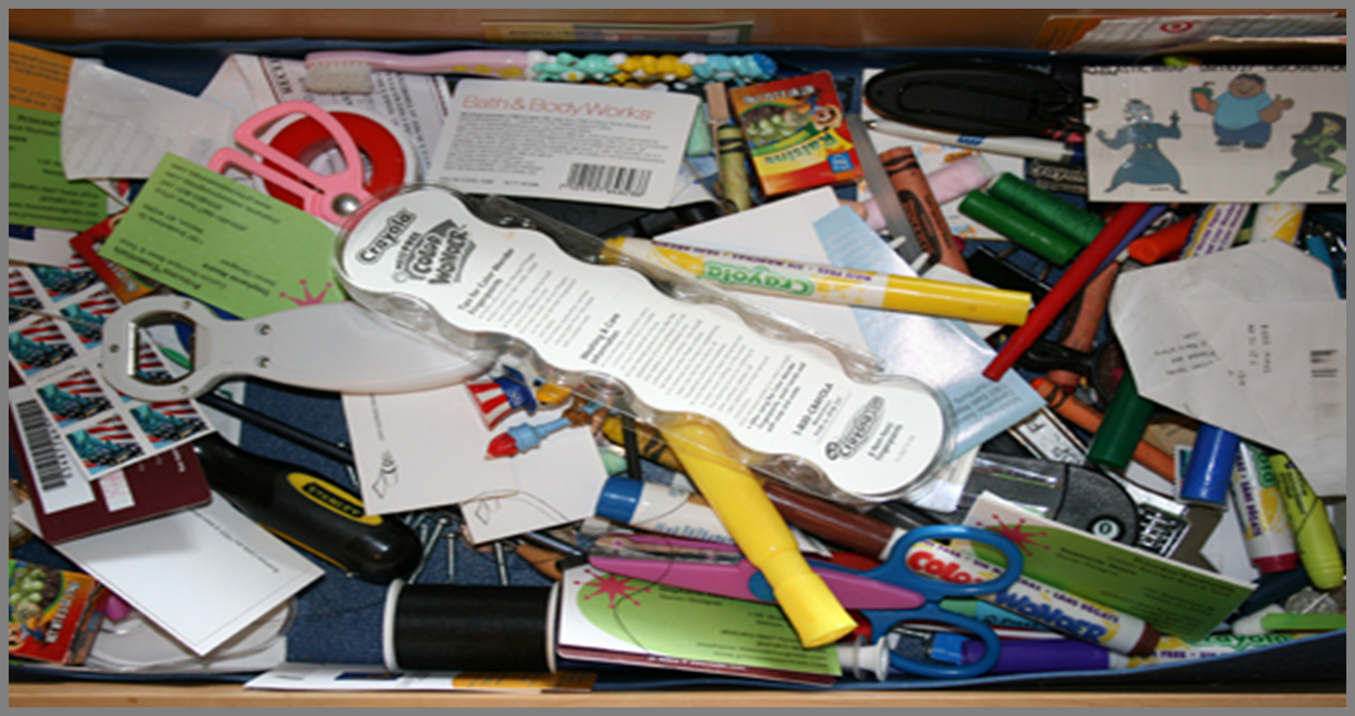
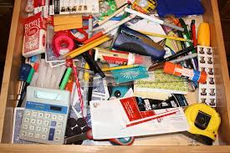
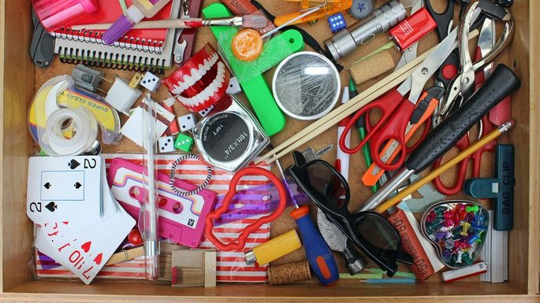


Biologist tend to organize protists into three general types?
  What are these three types?
5
The ones that make their own food.
The ones that eat food.
The ones that absorb / decompose food

Slide 14
Protista Review Game
THE VERY FIRST | GREEN HOUSE | ANIMAL HOUSE | FUN HOUSE | -BONUS- GREEN MACHINE
1 | 6 | 11 | 16 | *21
2 | 7 | 12 | 17 | *22
3 | 8 | 13 | 18 | *23
4 | 9 | 14 | 19 | *24
5 | 10 | 15 | 20 | *25
Copyright © 2024 SlideSpark .LLC

Slide 15
Protista Review Game
THE VERY FIRST | GREEN HOUSE | ANIMAL HOUSE | FUN HOUSE | -BONUS- GREEN MACHINE
1 | 6 | 11 | 16 | *21
2 | 7 | 12 | 17 | *22
3 | 8 | 13 | 18 | *23
4 | 9 | 14 | 19 | *24
5 | 10 | 15 | 20 | *25
Copyright © 2024 SlideSpark .LLC

Slide 16
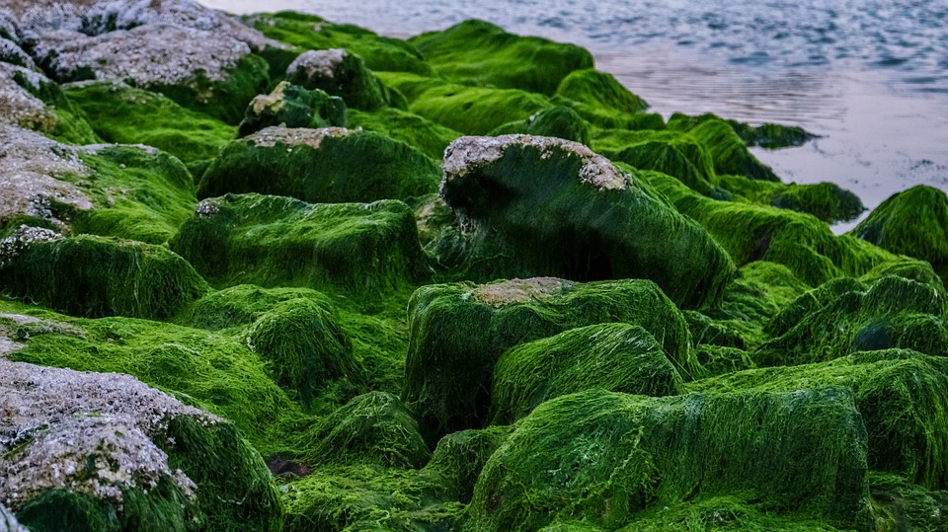
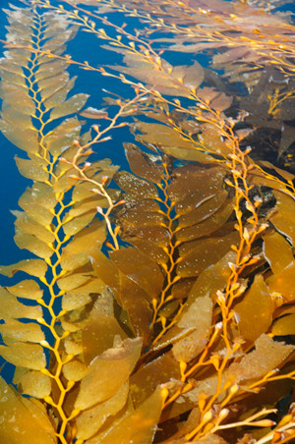
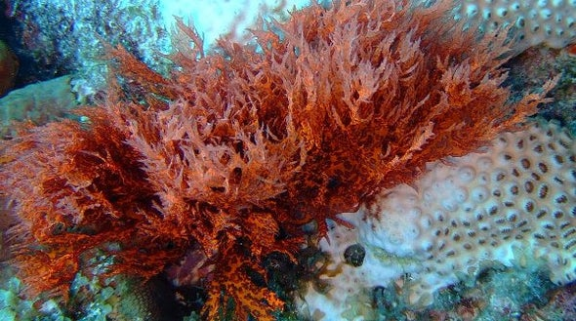
6
What are the common names to the three algae classes below?
Chlorophyta
A
B
Rhodophyta
Phaeo-
phyceae
C
Copyright © 2024 SlideSpark .LLC

Slide 17
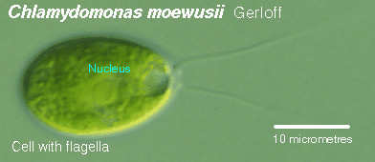
7
Is this Algae… (Chlorophyta)
Autotrophic or
Heterotrophic?
Copyright © 2024 SlideSpark .LLC

Slide 18
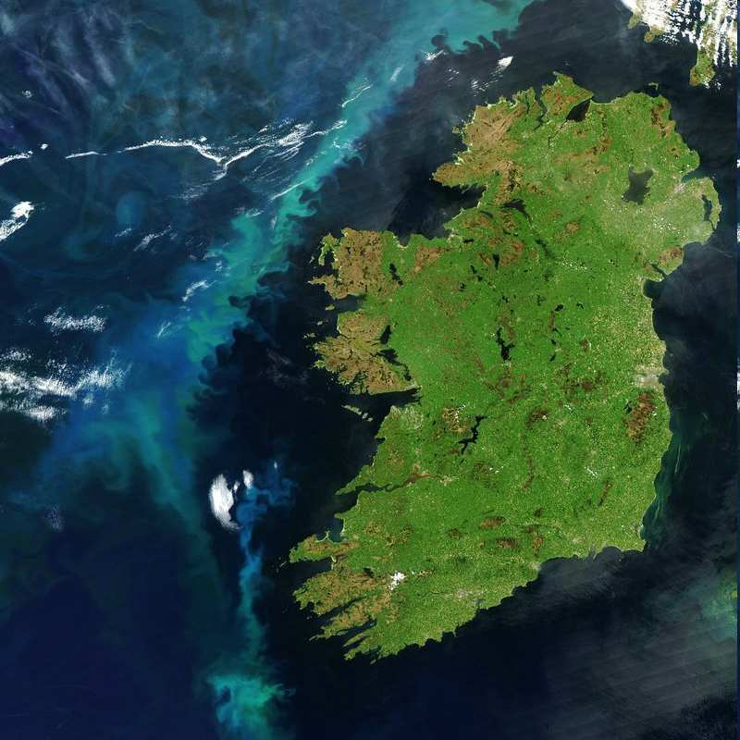
Algae remove huge amounts of this gas from the air?
  This gas causes global warming, so algae is one of our most important allies in the fight against climate change.
8
Copyright © 2024 SlideSpark .LLC

Slide 19
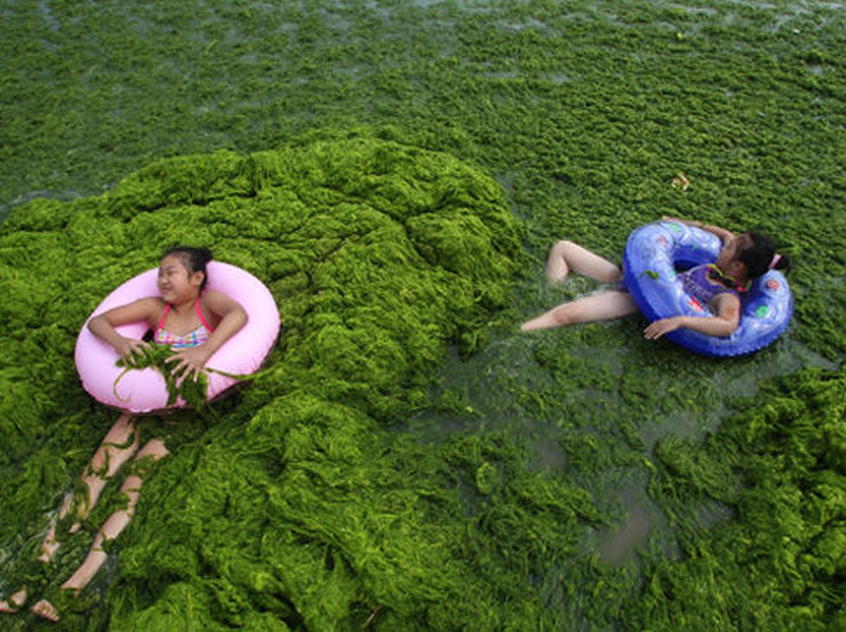
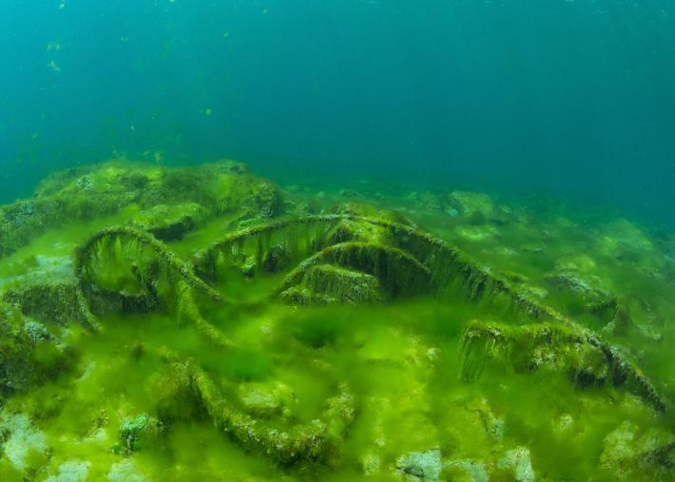
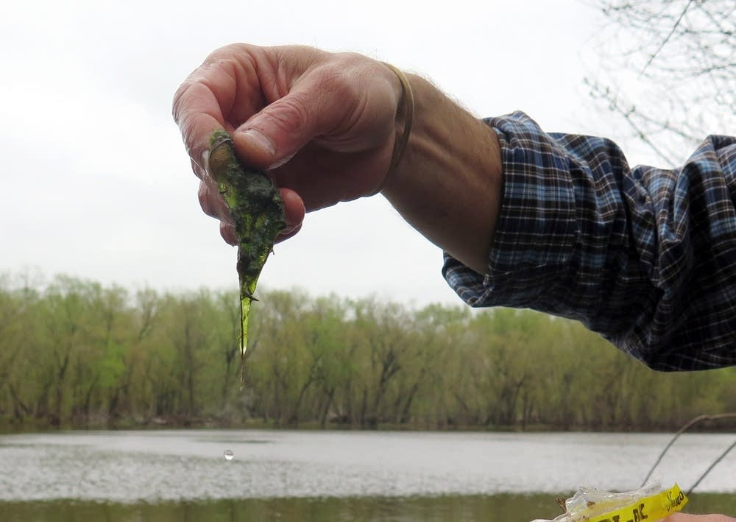
9
Algae can be used as a…
  A.) Food Source
  B.) Biofuel
  C.) Agricultural Feed
  D.) Food Supplement
  E.) All of the above

Slide 20
9
Algae can be used as a…
  A.) Food Source
  B.) Biofuel
  C.) Agricultural Feed
  D.) Food Supplement
  E.) All of the above

Slide 21
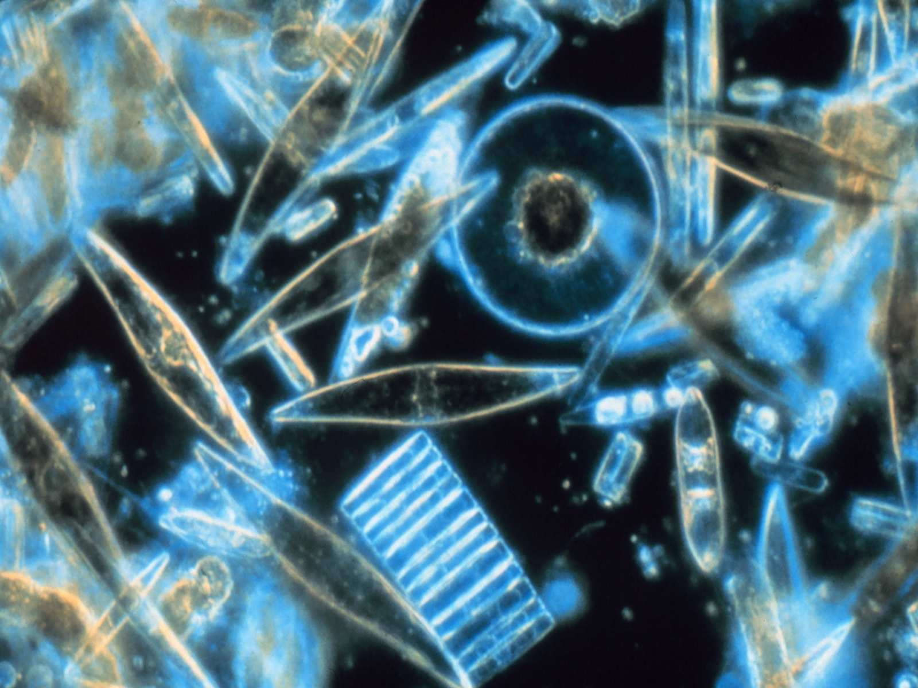
These types of protists use silicon to make their glass shells using a process called biomineralization.
10
Copyright © 2024 SlideSpark .LLC

Slide 22
Protista Review Game
THE VERY FIRST | GREEN HOUSE | ANIMAL HOUSE | FUN HOUSE | -BONUS- GREEN MACHINE
1 | 6 | 11 | 16 | *21
2 | 7 | 12 | 17 | *22
3 | 8 | 13 | 18 | *23
4 | 9 | 14 | 19 | *24
5 | 10 | 15 | 20 | *25
Copyright © 2024 SlideSpark .LLC

Slide 23
Protista Review Game
THE VERY FIRST | GREEN HOUSE | ANIMAL HOUSE | FUN HOUSE | -BONUS- GREEN MACHINE
1 | 6 | 11 | 16 | *21
2 | 7 | 12 | 17 | *22
3 | 8 | 13 | 18 | *23
4 | 9 | 14 | 19 | *24
5 | 10 | 15 | 20 | *25
Copyright © 2024 SlideSpark .LLC

Slide 24
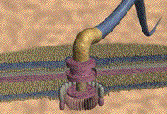
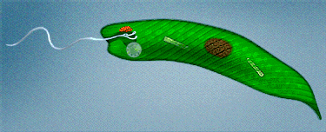
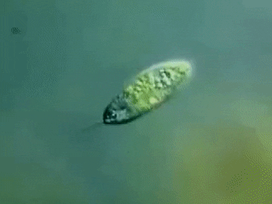
This is a hairlike structure that acts primarily as an organelle of locomotion on the cells of many protists.
11

Slide 25
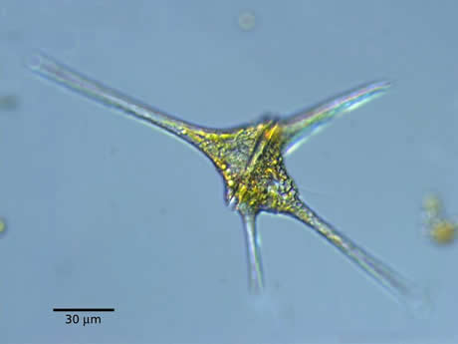
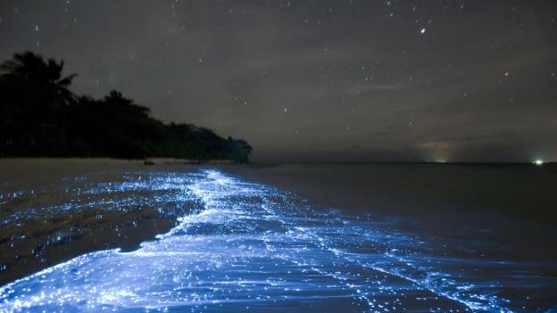
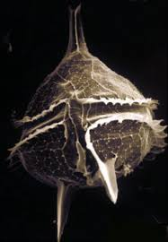
Name this Protist?
  It’s a motile unicellular algae characterized by a pair of flagellae.
12

Slide 26
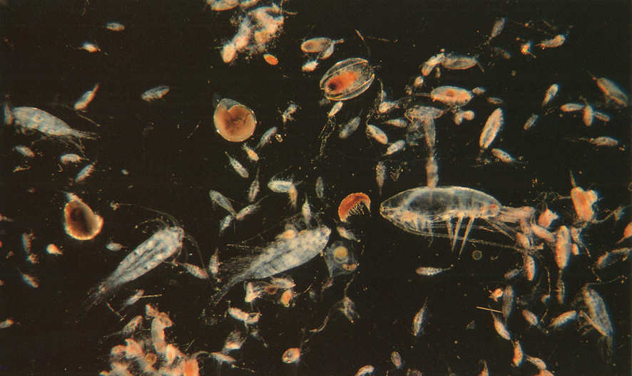
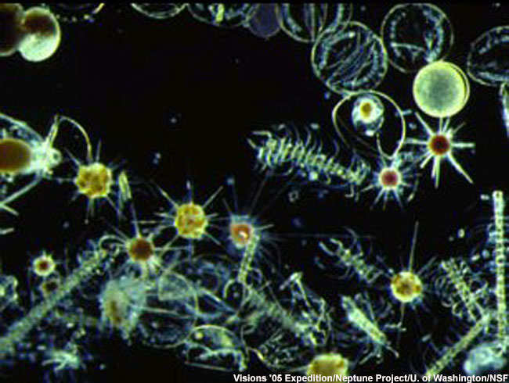
Which picture is the plant-like protists known as phytoplankton, they are eaten by zooplankton which are animals in this box.
A
B
13
Copyright © 2024 SlideSpark .LLC

Slide 27
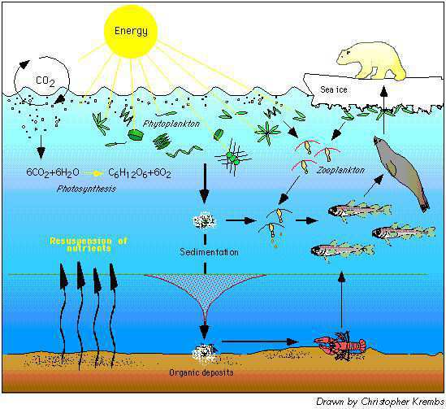
Phytoplankton are the base of the aquatic food chain. They’re autotrophic and get their energy from the ______?
14
Copyright © 2024 SlideSpark .LLC

Slide 28
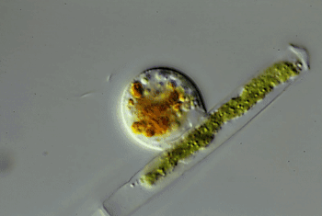
Which one is heterotrophic?
A
B
15
Copyright © 2024 SlideSpark .LLC

Slide 29
Protista Review Game
THE VERY FIRST | GREEN HOUSE | ANIMAL HOUSE | FUN HOUSE | -BONUS- GREEN MACHINE
1 | 6 | 11 | 16 | *21
2 | 7 | 12 | 17 | *22
3 | 8 | 13 | 18 | *23
4 | 9 | 14 | 19 | *24
5 | 10 | 15 | 20 | *25
Copyright © 2024 SlideSpark .LLC

Slide 30
Protista Review Game
THE VERY FIRST | GREEN HOUSE | ANIMAL HOUSE | FUN HOUSE | -BONUS- GREEN MACHINE
1 | 6 | 11 | 16 | *21
2 | 7 | 12 | 17 | *22
3 | 8 | 13 | 18 | *23
4 | 9 | 14 | 19 | *24
5 | 10 | 15 | 20 | *25
Copyright © 2024 SlideSpark .LLC

Slide 31
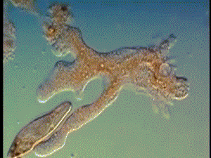

16
Name these two animal-like protists?
A
B
Copyright © 2024 SlideSpark .LLC

Slide 32
16
Name these two animal-like protists?
A
B
Name this arm for a bonus point
Copyright © 2024 SlideSpark .LLC

Slide 33
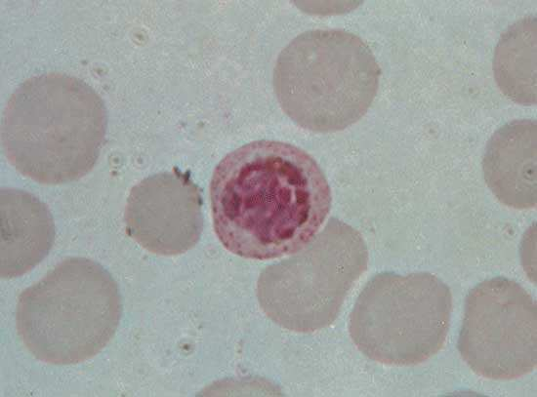
These parasitic protists are heterotrophic and have no means of locomotion.
17
Copyright © 2024 SlideSpark .LLC

Slide 34
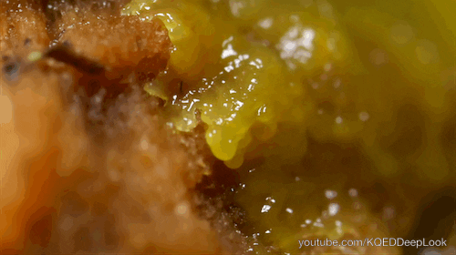
Once considered a member of the Kingdom Fungi…
  This protist is a mass of creeping gelatinous protoplasm containing nuclei, or a mass of amoeboid cells.
18

Slide 35
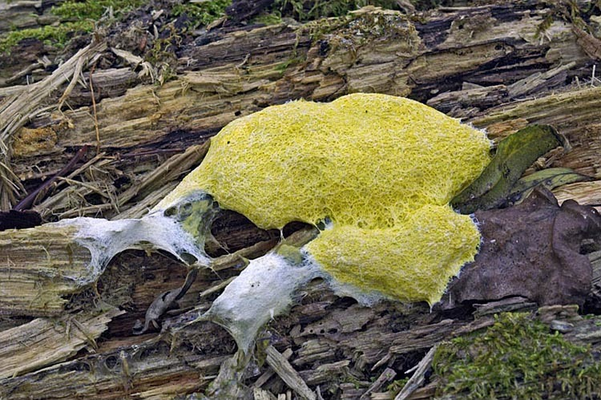
This is the name that describes when protists feed by extracellular (Outside of cell) digestion.
  The feed on decayed organic matter.
  A.) Autotrophic
  B.) Mixotrophic
  C.) Saprotrophic
  D.) Heterotrophic
  E.) Eutrophic
19

Slide 36
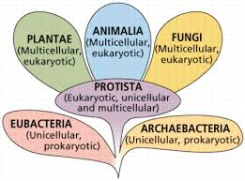
Single celled protists evolved into these other Kingdoms of Life?
20
Eukaryotic
(Cells with Nucleus)
Prokaryotic
(Cells with
no Nucleus)
Archaea
Bacteria
Universal Ancestor
Copyright © 2024 SlideSpark .LLC

Slide 37
Protista Review Game
THE VERY FIRST | GREEN HOUSE | ANIMAL HOUSE | FUN HOUSE | -BONUS- GREEN MACHINE
1 | 6 | 11 | 16 | *21
2 | 7 | 12 | 17 | *22
3 | 8 | 13 | 18 | *23
4 | 9 | 14 | 19 | *24
5 | 10 | 15 | 20 | *25
Copyright © 2024 SlideSpark .LLC

Slide 38
Protista Review Game
THE VERY FIRST | GREEN HOUSE | ANIMAL HOUSE | FUN HOUSE | -BONUS- GREEN MACHINE
1 | 6 | 11 | 16 | *21
2 | 7 | 12 | 17 | *22
3 | 8 | 13 | 18 | *23
4 | 9 | 14 | 19 | *24
5 | 10 | 15 | 20 | *25
Copyright © 2024 SlideSpark .LLC

Slide 39

Who is this Teen Titans Character?
*21

Slide 40
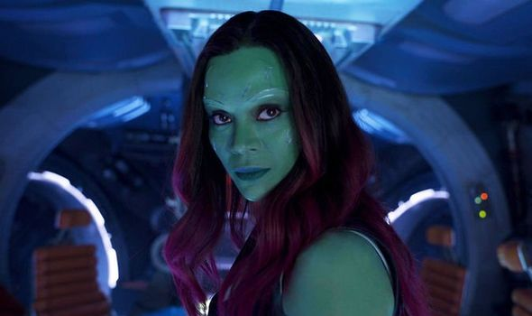
Who is this Guardian of the Galaxy?
*22

Slide 41
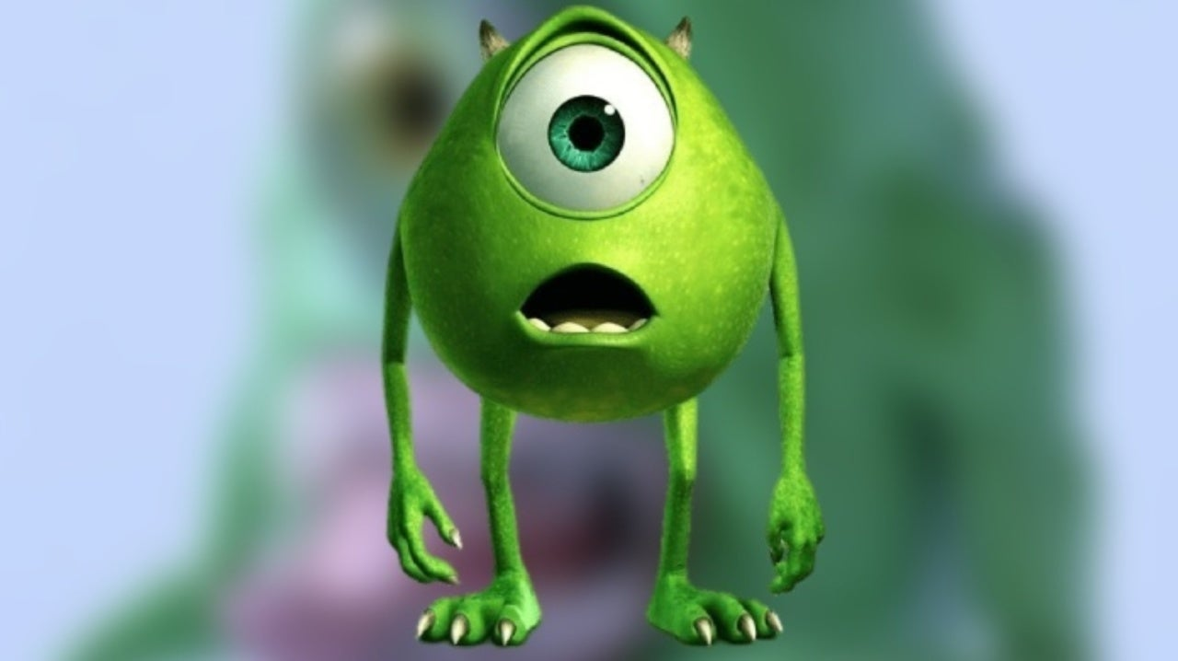
*23
This is Mike Wazowski from…

Slide 42
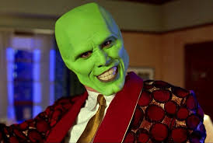
*24
Name this movie?

Slide 43
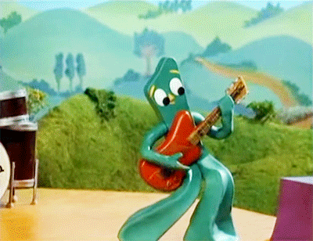
*25
Who is this?

Slide 44
Protista Review Game
THE VERY FIRST | GREEN HOUSE | ANIMAL HOUSE | FUN HOUSE | -BONUS- GREEN MACHINE
1 | 6 | 11 | 16 | *21
2 | 7 | 12 | 17 | *22
3 | 8 | 13 | 18 | *23
4 | 9 | 14 | 19 | *24
5 | 10 | 15 | 20 | *25
Final Question
Copyright © 2024 SlideSpark .LLC

Slide 45

This is a 5 point
wager question

Slide 46
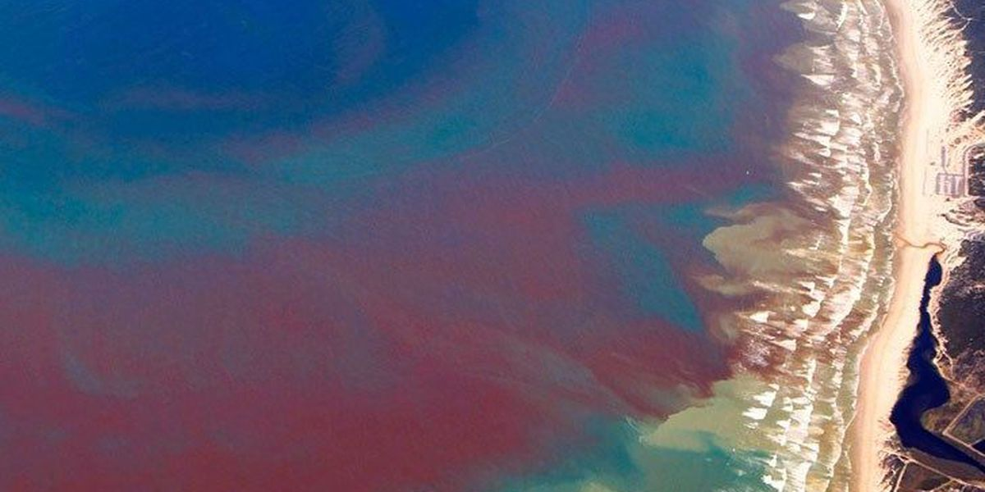
This is an algal bloom that discolors the water and may deplete oxygen and/or release toxins that may cause illness in humans and other animals.
  Don’t eat shellfish during one of these events.

Slide 47
Protista
Review Game
Part 3
Lesson 6

Slide 48

Protista
Review Game
Part 3
Lesson 7

Slide 49
Protista Review Game
THE VERY FIRST | GREEN HOUSE | ANIMAL HOUSE | FUN HOUSE | -BONUS- GREEN MACHINE
1 | 6 | 11 | 16 | *21
2 | 7 | 12 | 17 | *22
3 | 8 | 13 | 18 | *23
4 | 9 | 14 | 19 | *24
5 | 10 | 15 | 20 | *25
Copyright © 2024 SlideSpark .LLC

Slide 50
Protista Review Game
THE VERY FIRST | GREEN HOUSE | ANIMAL HOUSE | FUN HOUSE | -BONUS- GREEN MACHINE
1 | 6 | 11 | 16 | *21
2 | 7 | 12 | 17 | *22
3 | 8 | 13 | 18 | *23
4 | 9 | 14 | 19 | *24
5 | 10 | 15 | 20 | *25
Copyright © 2024 SlideSpark .LLC

Slide 51
Protista belongs to this Domain because they have a membrane bound nucleus in their cells?
1
3
Copyright © 2024 SlideSpark .LLC

Slide 52
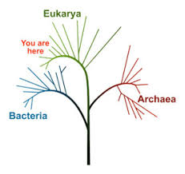
Protista belongs to this Domain because they have a membrane bound nucleus in their cells?
1
Domain
Eukarya
3
Protists
Copyright © 2024 SlideSpark .LLC

Slide 53
Which letter is Protista?
Domain | Bacteria | Archaea
Kingdom
Cell Type | Prokaryotic (No nucleus) | Prokaryotic (No nucleus) | Eukaryotic (Nucleus) | Eukaryotic (Nucleus) | Eukaryotic (Nucleus) | Eukaryotic (Nucleus)
Single or Multi-Cellular | Single (Unicellular) | Single (Unicellular) | Single (Unicellular) | Multicellular | Multicellular | Multicellular
Gets Energy from.. | Varies | Varies | Varies Auto / Hetero | Sunlight | Absorbs | Consumes Food
Eukarya
A
B
C
D
E
F

Slide 54
Which letter is Protista?
C
Domain | Bacteria | Archaea
Kingdom | Bacteria | Archaea | Protista | Plantae | Fungi | Animalia
Cell Type | Prokaryotic (No nucleus) | Prokaryotic (No nucleus) | Eukaryotic (Nucleus) | Eukaryotic (Nucleus) | Eukaryotic (Nucleus) | Eukaryotic (Nucleus)
Single or Multi-Cellular | Single (Unicellular) | Single (Unicellular) | Single (Unicellular) | Multicellular | Multicellular | Multicellular
Gets Energy from.. | Varies | Varies | Varies Auto / Hetero | Sunlight | Absorbs | Consumes Food
Eukarya

Slide 55
3
Which letter is a Protist?
B
A
C
E
C
D

Slide 56
3
Which letter is a Protist?
B
A
Animal
C
E
C
D
Animal

Slide 57
3
Which letter is a Protist?
B
A
Animal
C
E
C
D
Fungi
Animal

Slide 58
3
Which letter is a Protist?
B
A
Animal
C
E
C
D
Fungi
Animal
Plant

Slide 59
3
Which letter is a Protist?
B
A
Protist
C
D
E

Slide 60
True or False? This is an organ made of tissues / true eye that allow this Euglena to see the world?
4

Slide 61
True or False? This is an organ made of tissues / true eye that allow this Euglena to see the world?
4
False, Protists don’t have
Tissues / Organs.
It’s an organelle that
can sense light

Slide 62
Biologist tend to organize protists into three general types?
  What are these three types?
5
The ones that make their own food.
The ones that eat food.
The ones that absorb / decompose food

Slide 63
Biologist tend to organize protists into three general types?
  What are these three types?
5
The ones that make their own food.
The ones that eat food.
The ones that absorb / decompose food
Plant-like

Slide 64
Biologist tend to organize protists into three general types?
  What are these three types?
5
The ones that make their own food.
The ones that eat food.
The ones that absorb / decompose food
Plant-like
Animal-like

Slide 65
Biologist tend to organize protists into three general types?
  What are these three types?
5
The ones that make their own food.
The ones that eat food.
The ones that absorb / decompose food
Plant-like
Animal-like
Fungus
-like

Slide 66

Biologist tend to organize protists into three general types?
  What are these three types?
5
The ones that make their own food.
The ones that eat food.
The ones that absorb / decompose food
Plant-like
Animal-like
Fungus
-like

Slide 67
Protista Review Game
THE VERY FIRST | GREEN HOUSE | ANIMAL HOUSE | FUN HOUSE | -BONUS- GREEN MACHINE
1 | 6 | 11 | 16 | *21
2 | 7 | 12 | 17 | *22
3 | 8 | 13 | 18 | *23
4 | 9 | 14 | 19 | *24
5 | 10 | 15 | 20 | *25
Copyright © 2024 SlideSpark .LLC

Slide 68
Protista Review Game
THE VERY FIRST | GREEN HOUSE | ANIMAL HOUSE | FUN HOUSE | -BONUS- GREEN MACHINE
1 | 6 | 11 | 16 | *21
2 | 7 | 12 | 17 | *22
3 | 8 | 13 | 18 | *23
4 | 9 | 14 | 19 | *24
5 | 10 | 15 | 20 | *25
Copyright © 2024 SlideSpark .LLC

Slide 69
6
What are the common names to the three algae classes below?
Chlorophyta
A
B
Rhodophyta
Phaeo-
phyceae
C
Copyright © 2024 SlideSpark .LLC

Slide 70
6
What are the common names to the three algae classes below?
Chlorophyta
A
Brown
Algae
B
Rhodophyta
Phaeo-
phyceae
C
Copyright © 2024 SlideSpark .LLC

Slide 71
6
What are the common names to the three algae classes below?
Chlorophyta
A
Green Algae
Brown
Algae
B
Rhodophyta
Phaeo-
phyceae
C
Copyright © 2024 SlideSpark .LLC

Slide 72
6
What are the common names to the three algae classes below?
Chlorophyta
A
Green Algae
Brown
Algae
B
Rhodophyta
Red Algae
Phaeo-
phyceae
C
Copyright © 2024 SlideSpark .LLC

Slide 73
7
Is this Algae… (Chlorophyta)
Autotrophic or
Heterotrophic?
Copyright © 2024 SlideSpark .LLC

Slide 74
7
Is this Algae… (Chlorophyta)
Autotrophic
It makes its own
food / Photosynthetic
Copyright © 2024 SlideSpark .LLC

Slide 75
Algae remove huge amounts of this gas from the air?
  This gas causes global warming, so algae is one of our most important allies in the fight against climate change.
8
Copyright © 2024 SlideSpark .LLC

Slide 76

Algae remove huge amounts of this gas from the air?
  This gas causes global warming, so algae is one of our most important allies in the fight against climate change.
8
Carbon Dioxide
Copyright © 2024 SlideSpark .LLC

Slide 77
9
Algae can be used as a…
  A.) Food Source
  B.) Biofuel
  C.) Agricultural Feed
  D.) Food Supplement
  E.) All of the above

Slide 78
9
Algae can be used as a…
  A.) Food Source
  B.) Biofuel
  C.) Agricultural Feed
  D.) Food Supplement
  E.) All of the above

Slide 79
9
Algae can be used as a…
  A.) Food Source
  B.) Biofuel
  C.) Agricultural Feed
  D.) Food Supplement
  E.) All of the above

Slide 80
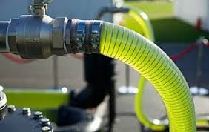
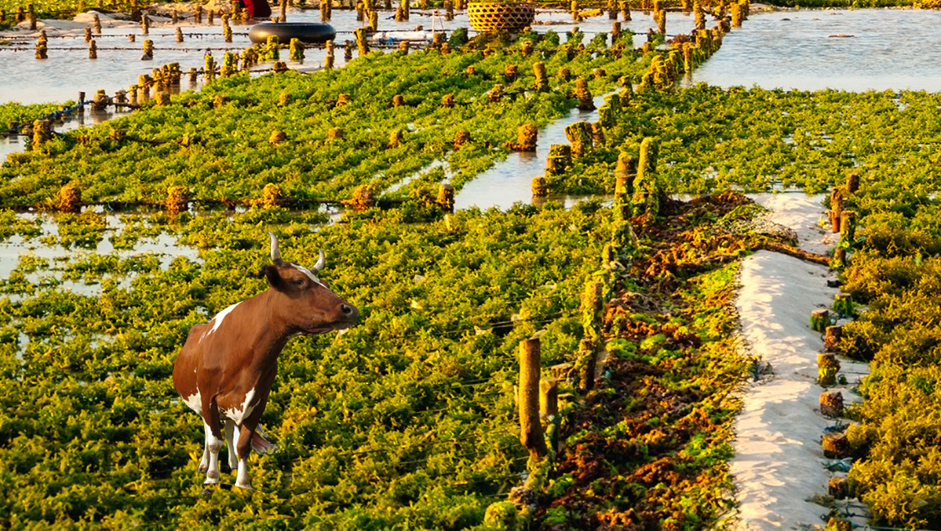
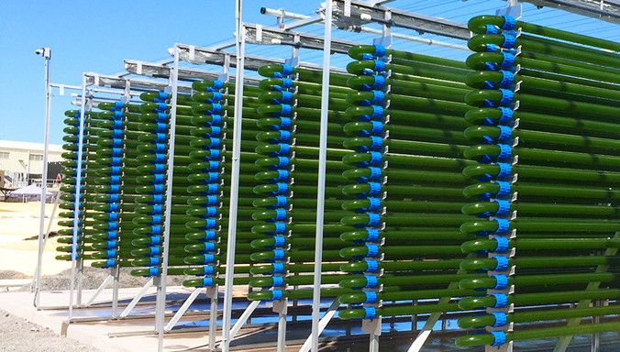
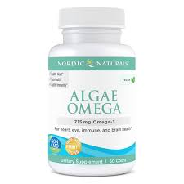
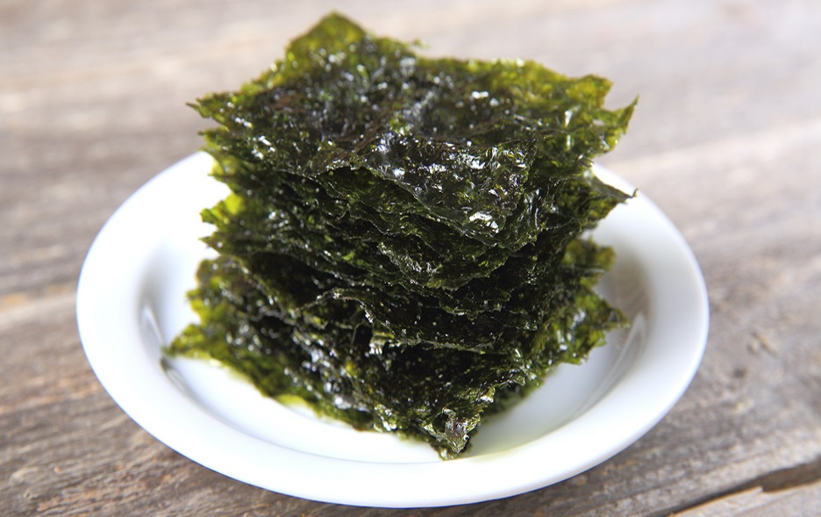
9
Algae can be used as a…
  A.) Food Source
  B.) Biofuel
  C.) Agricultural Feed
  D.) Food Supplement
  E.) All of the above

Slide 81
These types of protists use silicon to make their glass shells using a process called biomineralization.
10
Copyright © 2024 SlideSpark .LLC

Slide 82
These types of protists use silicon to make their glass shells using a process called biomineralization.
Diatoms
10
Phylum Ochrophyta
Copyright © 2024 SlideSpark .LLC

Slide 83
Protista Review Game
THE VERY FIRST | GREEN HOUSE | ANIMAL HOUSE | FUN HOUSE | -BONUS- GREEN MACHINE
1 | 6 | 11 | 16 | *21
2 | 7 | 12 | 17 | *22
3 | 8 | 13 | 18 | *23
4 | 9 | 14 | 19 | *24
5 | 10 | 15 | 20 | *25
Copyright © 2024 SlideSpark .LLC

Slide 84
Protista Review Game
THE VERY FIRST | GREEN HOUSE | ANIMAL HOUSE | FUN HOUSE | -BONUS- GREEN MACHINE
1 | 6 | 11 | 16 | *21
2 | 7 | 12 | 17 | *22
3 | 8 | 13 | 18 | *23
4 | 9 | 14 | 19 | *24
5 | 10 | 15 | 20 | *25
Copyright © 2024 SlideSpark .LLC

Slide 85
This is a hairlike structure that acts primarily as an organelle of locomotion on the cells of many protists.
11

Slide 86
This is a hairlike structure that acts primarily as an organelle of locomotion on the cells of many protists.
Flagella
11

Slide 87
Name this Protist?
  It’s a motile unicellular algae characterized by a pair of flagellae.
12

Slide 88
Name this Protist?
  It’s a motile unicellular algae characterized by a pair of flagellae.
Dinoflagellates
12
Phylum Dinoflagellata

Slide 89
Which picture is the plant-like protists known as phytoplankton, they are eaten by zooplankton which are animals in this box.
A
B
13
Copyright © 2024 SlideSpark .LLC

Slide 90
Which picture is the plant-like protists known as phytoplankton, they are eaten by zooplankton which are animals in this box.
A
B
13
Copyright © 2024 SlideSpark .LLC

Slide 91
Which picture is the plant-like protists known as phytoplankton, they are eaten by zooplankton which are animals in this box.
A
B
13
Zooplankton
Copyright © 2024 SlideSpark .LLC

Slide 92
Which picture is the plant-like protists known as phytoplankton, they are eaten by zooplankton which are animals in this box.
A
B
13
Zooplankton
Copyright © 2024 SlideSpark .LLC

Slide 93
Which picture is the plant-like protists known as phytoplankton, they are eaten by zooplankton which are animals in this box.
A
B
13
Zooplankton
Phytoplankton
Copyright © 2024 SlideSpark .LLC

Slide 94
Phytoplankton are the base of the aquatic food chain. They’re autotrophic and get their energy from the ______?
14
Copyright © 2024 SlideSpark .LLC

Slide 95
Phytoplankton are the base of the aquatic food chain. They’re autotrophic and get their energy from the ______?
Sun
14
Copyright © 2024 SlideSpark .LLC

Slide 96
Which one is heterotrophic?
A
B
15
Copyright © 2024 SlideSpark .LLC

Slide 97
Which one is heterotrophic?
A
B
Heterotrophic: Eats Food
15
Copyright © 2024 SlideSpark .LLC

Slide 98
Protista Review Game
THE VERY FIRST | GREEN HOUSE | ANIMAL HOUSE | FUN HOUSE | -BONUS- GREEN MACHINE
1 | 6 | 11 | 16 | *21
2 | 7 | 12 | 17 | *22
3 | 8 | 13 | 18 | *23
4 | 9 | 14 | 19 | *24
5 | 10 | 15 | 20 | *25
Copyright © 2024 SlideSpark .LLC

Slide 99
Protista Review Game
THE VERY FIRST | GREEN HOUSE | ANIMAL HOUSE | FUN HOUSE | -BONUS- GREEN MACHINE
1 | 6 | 11 | 16 | *21
2 | 7 | 12 | 17 | *22
3 | 8 | 13 | 18 | *23
4 | 9 | 14 | 19 | *24
5 | 10 | 15 | 20 | *25
Copyright © 2024 SlideSpark .LLC

Slide 100
16
Name these two animal-like protists?
A
B
Copyright © 2024 SlideSpark .LLC

Slide 101
16
Name these two animal-like protists?
A
meobas
B
Copyright © 2024 SlideSpark .LLC

Slide 102
16
Name these two animal-like protists?
A
meobas
B
Ciliate “Paramecium”
Copyright © 2024 SlideSpark .LLC

Slide 103
16
Name these two animal-like protists?
A
Phylum: Sarcodina
meobas
Pseudopod +1
B
Ciliate “Paramecium”
Phylum Ciliophora
Copyright © 2024 SlideSpark .LLC

Slide 104
These parasitic protists are heterotrophic and have no means of locomotion.
17
Copyright © 2024 SlideSpark .LLC

Slide 105
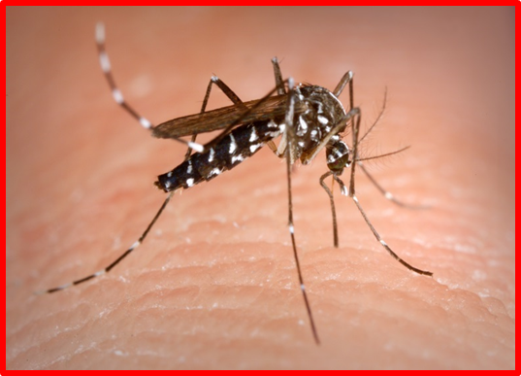
These parasitic protists are heterotrophic and have no means of locomotion.
Sporozoans
17
Malaria
Annually, 584,000 deaths from malaria worldwide
Phylum Sporozoa
Copyright © 2024 SlideSpark .LLC

Slide 106
Once considered a member of the Kingdom Fungi…
  This protist is a mass of creeping gelatinous protoplasm containing nuclei, or a mass of amoeboid cells.
18

Slide 107
Once considered a member of the Kingdom Fungi…
  This protist is a mass of creeping gelatinous protoplasm containing nuclei, or a mass of amoeboid cells.
18
Slime Molds
Phylum Myxomycota

Slide 108
This is the name that describes when protists feed by extracellular (Outside of cell) digestion.
  The feed on decayed organic matter.
  A.) Autotrophic
  B.) Mixotrophic
  C.) Saprotrophic
  D.) Heterotrophic
  E.) Eutrophic
19

Slide 109
This is the name that describes when protists feed by extracellular (Outside of cell) digestion.
  The feed on decayed organic matter.
  A.) Autotrophic
  B.) Mixotrophic
  C.) Saprotrophic
  D.) Heterotrophic
  E.) Eutrophic
19

Slide 110
Single celled protists evolved into these other Kingdoms of Life?
20
Eukaryotic
(Cells with Nucleus)
Prokaryotic
(Cells with
no Nucleus)
Archaea
Bacteria
Universal Ancestor
Copyright © 2024 SlideSpark .LLC

Slide 111
Single celled protists evolved into these other Kingdoms of Life?
20
Eukaryotic
(Cells with Nucleus)
Prokaryotic
(Cells with
no Nucleus)
Archaea
Bacteria
Universal Ancestor
Copyright © 2024 SlideSpark .LLC

Slide 112
Protista Review Game
THE VERY FIRST | GREEN HOUSE | ANIMAL HOUSE | FUN HOUSE | -BONUS- GREEN MACHINE
1 | 6 | 11 | 16 | *21
2 | 7 | 12 | 17 | *22
3 | 8 | 13 | 18 | *23
4 | 9 | 14 | 19 | *24
5 | 10 | 15 | 20 | *25
Copyright © 2024 SlideSpark .LLC

Slide 113
Protista Review Game
THE VERY FIRST | GREEN HOUSE | ANIMAL HOUSE | FUN HOUSE | -BONUS- GREEN MACHINE
1 | 6 | 11 | 16 | *21
2 | 7 | 12 | 17 | *22
3 | 8 | 13 | 18 | *23
4 | 9 | 14 | 19 | *24
5 | 10 | 15 | 20 | *25
Copyright © 2024 SlideSpark .LLC

Slide 114
Who is this Teen Titans Character?
*21

Slide 115
Who is this Teen Titans Character?
*21
BEAST BOY

Slide 116
Who is this Guardian of the Galaxy?
*22

Slide 117
Who is this Guardian of the Galaxy?
*22
Gamora

Slide 118
*23
This is Mike Wazowski from…

Slide 119

*23
This is Mike Wazowski from…

Slide 120
*24
Name this movie?

Slide 121

*24
Name this movie?

Slide 122
*25
Who is this?

Slide 123
*25
Who is this?
Gumby

Slide 124
Protista Review Game
THE VERY FIRST | GREEN HOUSE | ANIMAL HOUSE | FUN HOUSE | -BONUS- GREEN MACHINE
1 | 6 | 11 | 16 | *21
2 | 7 | 12 | 17 | *22
3 | 8 | 13 | 18 | *23
4 | 9 | 14 | 19 | *24
5 | 10 | 15 | 20 | *25
Final Question
Copyright © 2024 SlideSpark .LLC

Slide 125
This is a 5 point
wager question

Slide 126
This is an algal bloom that discolors the water and may deplete oxygen and/or release toxins that may cause illness in humans and other animals.
  Don’t eat shellfish during one of these events.

Slide 127
This is an algal bloom that discolors the water and may deplete oxygen and/or release toxins that may cause illness in humans and other animals.
  Don’t eat shellfish during one of these events.
Red Tide

Slide 128
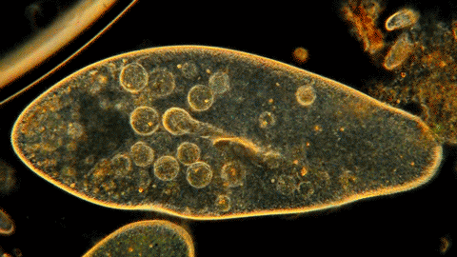
Questions 1-20 = 5pts Each
Final Category (Bonus) = 1pt Each
Final Questions = 5 pt wager
Find the Owl =
Secretly write “Owl” in the correct box worth 1pt.

Slide 129
Protista
Review Game
Part 3
Lesson 7

Slide 130



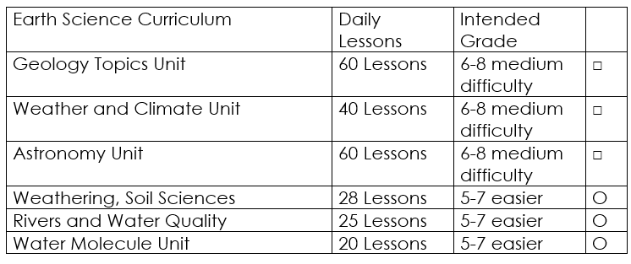

Curriculum Guide
Number of Lessons in each unit (50 min, daily lessons) and difficult rating scale / intended grade level.
=Easier, = More difficult, =Most difficult
Earth Science Units

Slide 131


Life Science Units

Slide 132

Physical Science

Slide 133

Dear Valued Educator,
Our fully editable .pptx and .doc resources are perfect for educators looking to bring enthusiasm and creativity to their lessons. We encourage you to make changes to fit your needs and style. As science educators, we’re committed to providing students with the tools they need to succeed in the classroom and beyond. Each unit in the curriculum includes a range of resources that have been developed through extensive research and use in a busy classroom. Our teaching approach is designed to make science education engaging and exciting for learners of all ages. We offer a one-of-a-kind science curriculum that will challenge, inspire, and educate students to become tomorrow's scientists and leaders. Join us today and learn more about how our program can help you achieve your classroom goals.
With appreciation,
Support@SlideSpark.net

Slide 134





Thank you for your time and interest in our Science curriculum. We strive to provide students with engaging and informative lessons that will spark their curiosity and encourage scientific exploration. Should you have any questions or concerns, please do not hesitate to contact us. Thank you again for considering our curriculum, and we wish you all the best in your educational journey.
Sincerely,
Support@slidespark.net
SlideSpark Science on TpT

