Slide 1
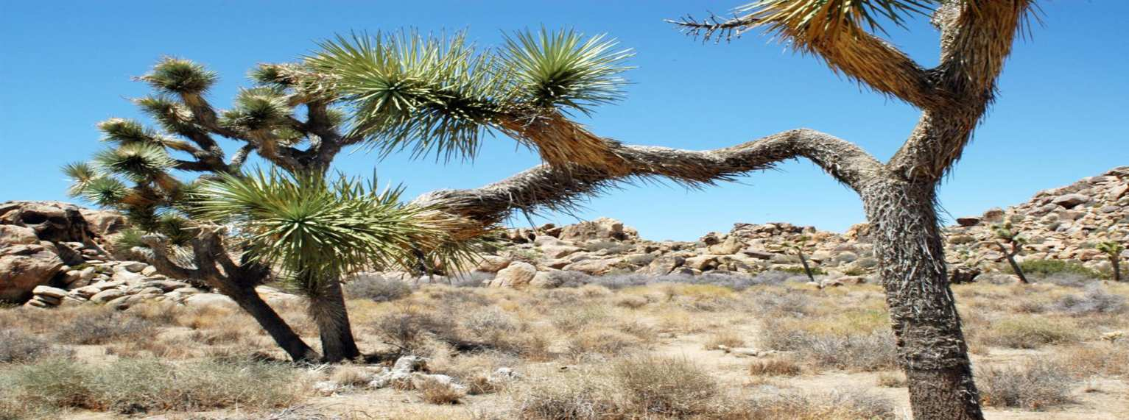

Ecology Interactions Unit
Part 1
Review Game

Slide 2
Part I Ecology Interactions
IT’s BIG | LEVEL -UP | MR. NEEDS | WATCH YOUR BACK JACK | -Bonus- CARTOON PREDATORS
1 | 6 | 11 | 16 | *21
2 | 7 | 12 | 17 | *22
3 | 8 | 13 | 18 | *23
4 | 9 | 14 | 19 | *24
5 | 10 | 15 | 20 | *25

Slide 3
How to play…
  Don’t play like Jeo_ _ _ _ y.
  Class should be divided into several small groups.
  Groups should use science journal (red slide notes), homework, and other available materials to assist you.
  Groups can communicate quietly with each other but no sharing answers between groups.
    Practice quietly communicating right now?
    Practice Communication Question:
    Your group gets to order one pizza and you can have two toppings. What does your group want?

Slide 4

Questions 1-20 = 5pts Each
Final Category (Bonus) = 1pt Each
Final Questions = 5 pt wager
If you wager 5 on the last question and get it wrong you lose 5 pts. Wager 5 and get it right you get 5 pts.
Find the Owl =
Secretly write “Owl” in the correct box worth 1pt.
“I’ll be about this big.”

Slide 5
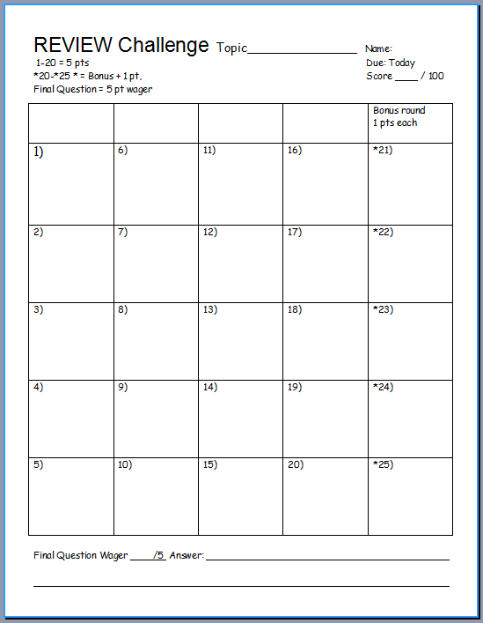
Is your name on the review sheet?
Name

Slide 6
Is your name on the review sheet?
Add the categories
along the top
on the next slide.

Slide 7
Part I Ecology Interactions
IT’s BIG | LEVEL -UP | MR. NEEDS | WATCH YOUR BACK JACK | -Bonus- CARTOON PREDATORS
1 | 6 | 11 | 16 | *21
2 | 7 | 12 | 17 | *22
3 | 8 | 13 | 18 | *23
4 | 9 | 14 | 19 | *24
5 | 10 | 15 | 20 | *25

Slide 8
Part I Ecology Interactions
IT’s BIG | LEVEL -UP | MR. NEEDS | WATCH YOUR BACK JACK | -Bonus- CARTOON PREDATORS
1 | 6 | 11 | 16 | *21
2 | 7 | 12 | 17 | *22
3 | 8 | 13 | 18 | *23
4 | 9 | 14 | 19 | *24
5 | 10 | 15 | 20 | *25

Slide 9
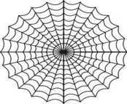


Organisms need energy to survive. Energy from the sun flows into and out systems. This energy drives our world and the organisms in it. Energy is lost “not destroyed” when it changes form. Flows Hot to Cold
Flow
Ecological systems are organized within each other. The effects on one system will effect them all. All systems are interconnected.
Levels
All organisms are in a constant state of change over time with the environment. Some organisms will change with another and will develop special interactions. Others with the nonliving world.
Change
You get one minute
to review this…
(Next Slide)
Matter and energy cycle through the living and nonliving world. Organisms rely on this matter and energy cycling to survive.
Cycles
Animals are interconnected in a complex web of life. Changes on one part of the web have will effect other parts of the web and the stability of the entire ecosystem.
WEB
Balance
Ecosystems have a way to balance changes so that up and down fluctuations are part of the natural balance of the whole.
Copyright © 2024 SlideSpark LLC

Slide 10
Organisms need energy to survive. Energy from the sun flows into and out systems. This energy drives our world and the organisms in it. Energy is lost “not destroyed” when it changes form. Flows Hot to Cold
Flow
Ecological systems are organized within each other. The effects on one system will effect them all. All systems are interconnected.
Levels
All organisms are in a constant state of change over time with the environment. Some organisms will change with another and will develop special interactions. Others with the nonliving world.
Change
Matter and energy cycle through the living and nonliving world. Organisms rely on this matter and energy cycling to survive.
Cycles
Animals are interconnected in a complex web of life. Changes on one part of the web have will effect other parts of the web and the stability of the entire ecosystem.
WEB
Balance
Ecosystems have a way to balance changes so that up and down fluctuations are part of the natural balance of the whole.
Copyright © 2024 SlideSpark LLC

Slide 11
Organisms need energy to survive. Energy from the sun flows into and out systems. This energy drives our world and the organisms in it. Energy is lost “not destroyed” when it changes form. Flows Hot to Cold
Flow
Ecological systems are organized within each other. The effects on one system will effect them all. All systems are interconnected.
Levels
Please answer
with one of
these for 1-5.
All organisms are in a constant state of change over time with the environment. Some organisms will change with another and will develop special interactions. Others with the nonliving world.
Change
Matter and energy cycle through the living and nonliving world. Organisms rely on this matter and energy cycling to survive.
Cycles
Note: They won’t be used twice, and one will not be used.
Animals are interconnected in a complex web of life. Changes on one part of the web have will effect other parts of the web and the stability of the entire ecosystem.
WEB
Balance
Ecosystems have a way to balance changes so that up and down fluctuations are part of the natural balance of the whole.
Copyright © 2024 SlideSpark LLC

Slide 12
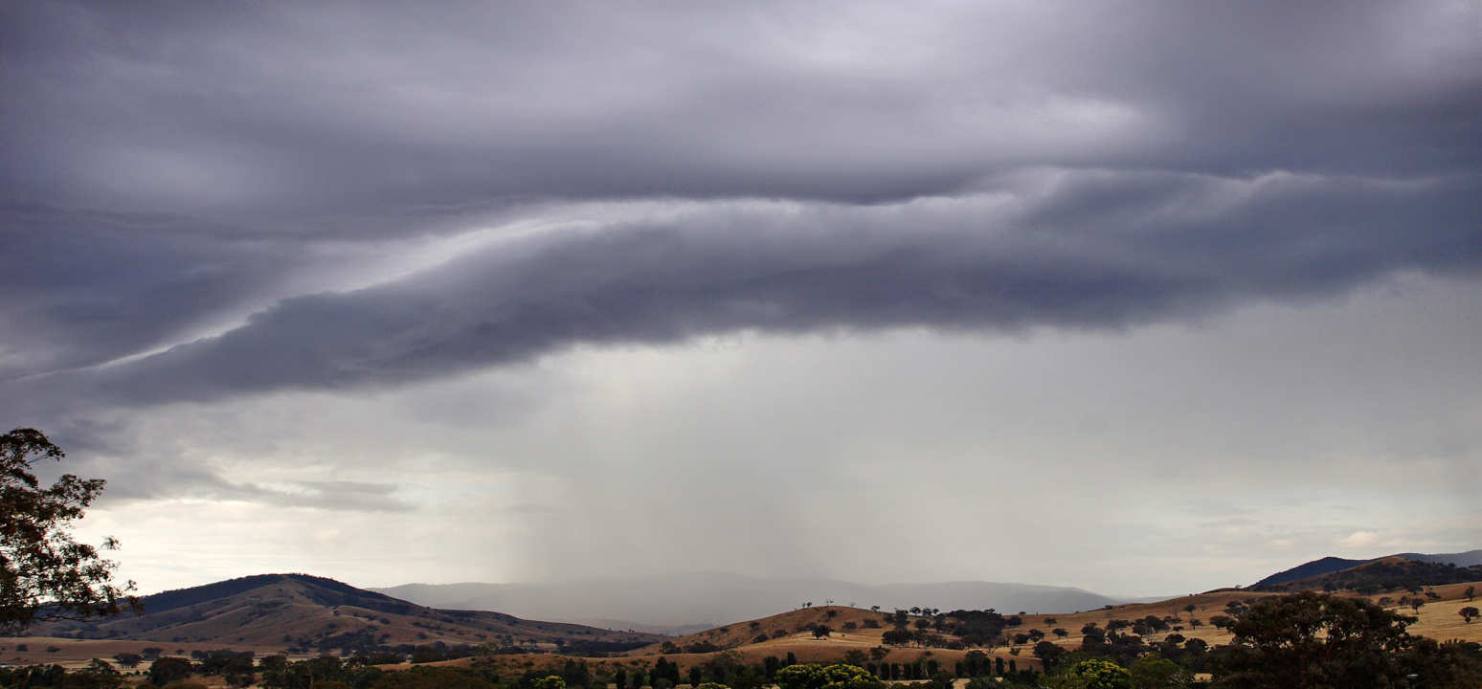
Matter and energy cycle through the living and nonliving world.
  Organisms rely on this matter and energy cycling to survive.
1
Copyright© 2010 Ryan P. Murphy

Slide 13
Matter and energy cycle through the living and nonliving world.
  Organisms rely on this matter and energy cycling to survive.
1
Copyright© 2010 Ryan P. Murphy

Slide 14
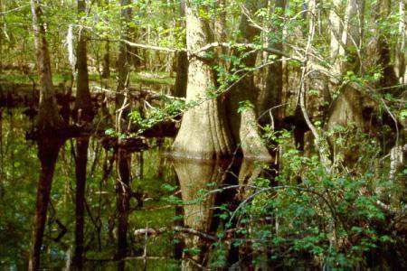
Ecological systems are organized within each other.
  The effects on one system will effect them all. All systems are interconnected.
2
Copyright© 2010 Ryan P. Murphy

Slide 15
Ecological systems are organized within each other.
  The effects on one system will effect them all. All systems are interconnected.
2
Copyright© 2010 Ryan P. Murphy

Slide 16
Organisms need energy to survive. Energy from the sun flows into and out systems.
  This energy drives our world and the organisms in it. Energy is lost “not destroyed” when it changes form. Flows Hot to Cold.
3
Copyright© 2010 Ryan P. Murphy

Slide 17
Organisms need energy to survive. Energy from the sun flows into and out systems.
  This energy drives our world and the organisms in it. Energy is lost “not destroyed” when it changes form. Flows Hot to Cold.
3
Copyright© 2010 Ryan P. Murphy

Slide 18
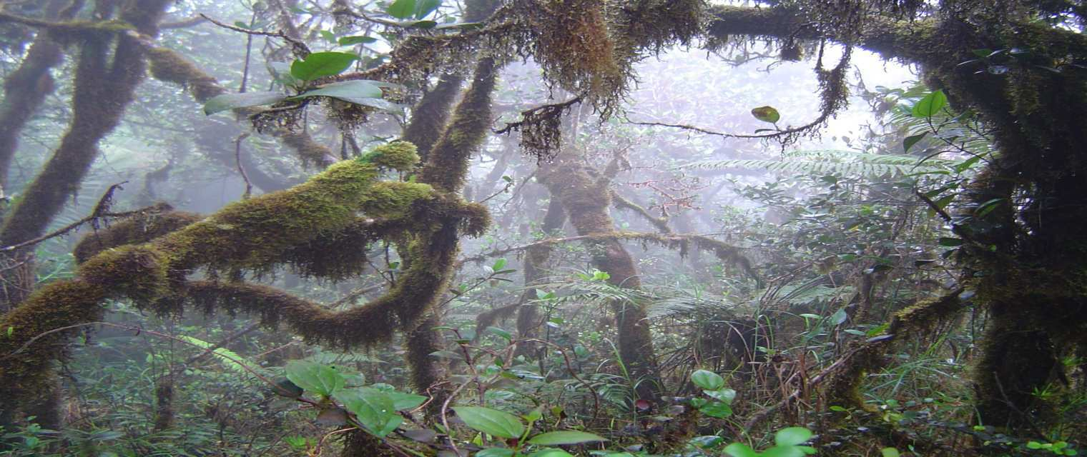
Animals are interconnected in a complex web of life.
  Changes on one part of the web effect other parts of the web and the stability of the entire ecosystem.
4
Copyright© 2010 Ryan P. Murphy

Slide 19
Animals are interconnected in a complex web of life.
  Changes on one part of the web effect other parts of the web and the stability of the entire ecosystem.
4
Copyright© 2010 Ryan P. Murphy

Slide 20
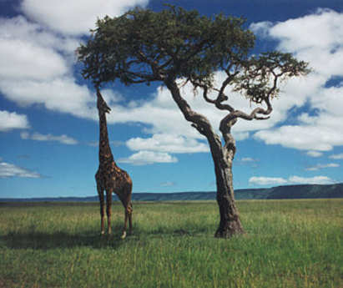
All organisms are in a constant state of change over time with the environment.
  Some organisms will change with another and will develop special interactions. Others with the nonliving world.
5
Copyright© 2010 Ryan P. Murphy

Slide 21
All organisms are in a constant state of change over time with the environment.
  Some organisms will change with another and will develop special interactions. Others with the nonliving world.
5
Copyright© 2010 Ryan P. Murphy

Slide 22
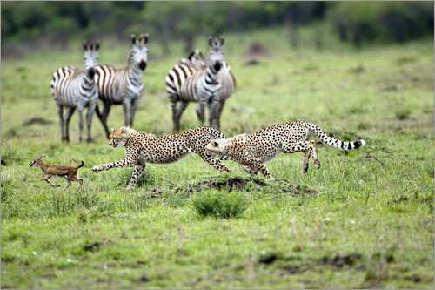
For 1 bonus point. Which big concept was missing from this round?
5*
Copyright© 2010 Ryan P. Murphy

Slide 23
Part I Ecology Interactions
IT’s BIG | LEVEL -UP | MR. NEEDS | WATCH YOUR BACK JACK | -Bonus- CARTOON PREDATORS
1 | 6 | 11 | 16 | *21
2 | 7 | 12 | 17 | *22
3 | 8 | 13 | 18 | *23
4 | 9 | 14 | 19 | *24
5 | 10 | 15 | 20 | *25

Slide 24
Part I Ecology Interactions
IT’s BIG | LEVEL -UP | MR. NEEDS | WATCH YOUR BACK JACK | -Bonus- CARTOON PREDATORS
1 | 6 | 11 | 16 | *21
2 | 7 | 12 | 17 | *22
3 | 8 | 13 | 18 | *23
4 | 9 | 14 | 19 | *24
5 | 10 | 15 | 20 | *25

Slide 25
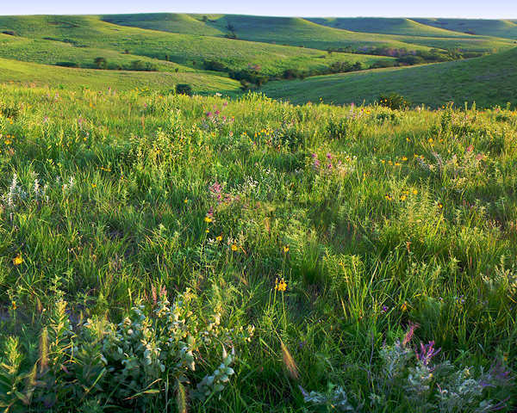

This is the name for all of the relationships of populations with each other and their environment?
6
Can be large and small
Copyright © 2024 SlideSpark LLC

Slide 26
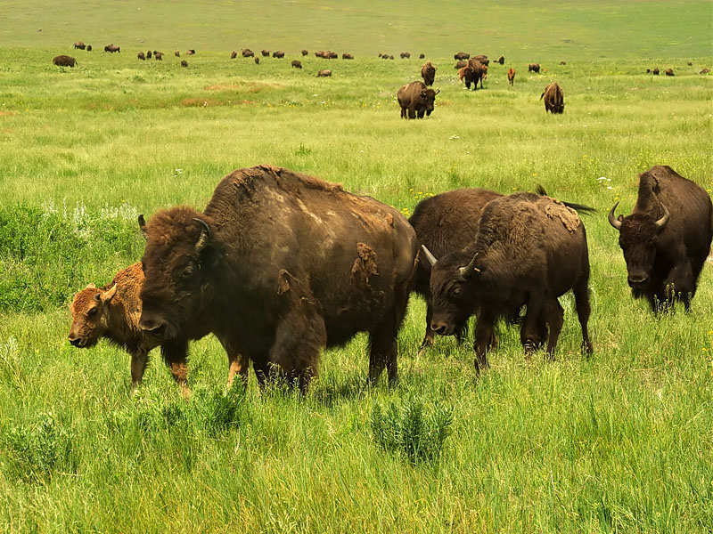
These are groups of similar individuals who tend to mate with each other in a limited geographic area?
7
Copyright © 2024 SlideSpark LLC

Slide 27
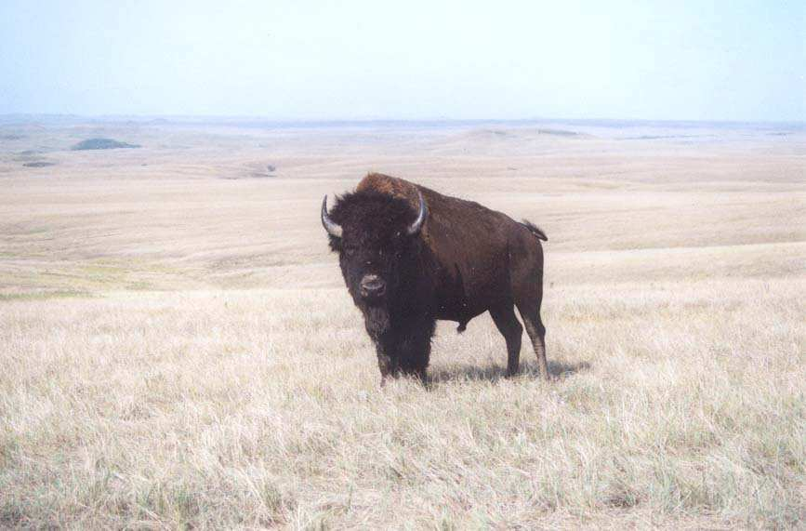

This is an organism with unique DNA and cells.
8
Copyright © 2024 SlideSpark LLC

Slide 28
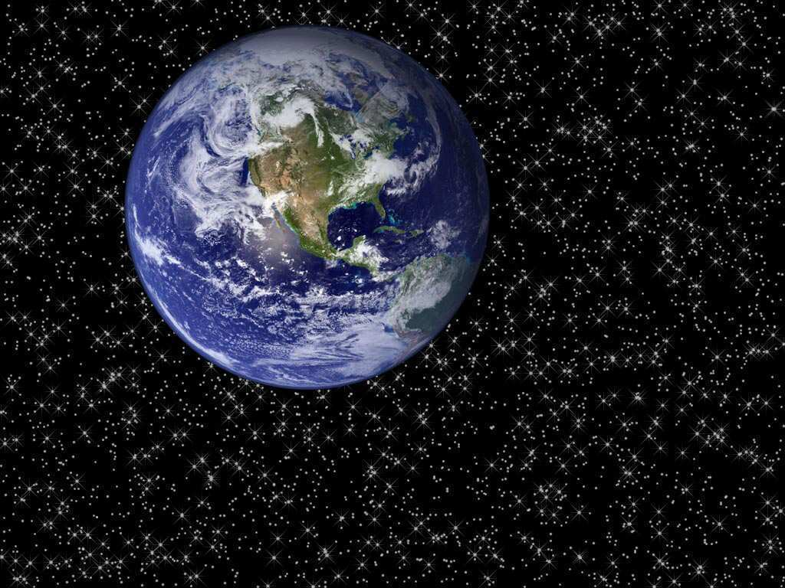
This is the name for the part of the earth and its atmosphere in which living organisms exist?
9
Copyright © 2024 SlideSpark LLC

Slide 29
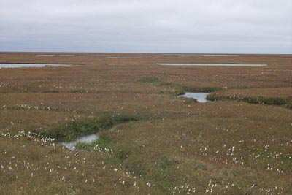
This is the name for a regional ecosystem characterized by distinct types of vegetation, animals.
Determined by temperature and rainfall.
10
Copyright © 2024 SlideSpark LLC

Slide 30
Part I Ecology Interactions
IT’s BIG | LEVEL -UP | MR. NEEDS | WATCH YOUR BACK JACK | -Bonus- CARTOON PREDATORS
1 | 6 | 11 | 16 | *21
2 | 7 | 12 | 17 | *22
3 | 8 | 13 | 18 | *23
4 | 9 | 14 | 19 | *24
5 | 10 | 15 | 20 | *25

Slide 31
Part I Ecology Interactions
IT’s BIG | LEVEL -UP | MR. NEEDS | WATCH YOUR BACK JACK | -Bonus- CARTOON PREDATORS
1 | 6 | 11 | 16 | *21
2 | 7 | 12 | 17 | *22
3 | 8 | 13 | 18 | *23
4 | 9 | 14 | 19 | *24
5 | 10 | 15 | 20 | *25

Slide 32
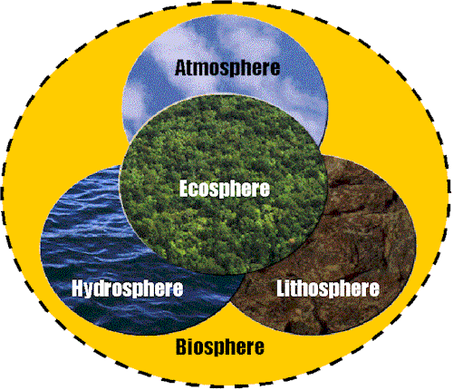
Which two parts of the biosphere are covered up?
11
Copyright © 2024 SlideSpark LLC

Slide 33
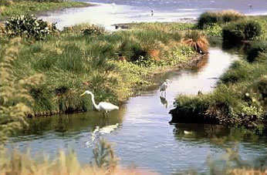
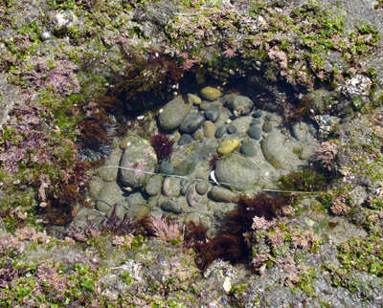
This is the type of environment that an organism lives in? (Can be large and small)
12
Copyright © 2024 SlideSpark LLC

Slide 34
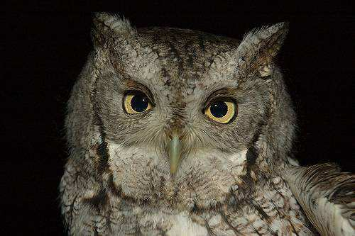


This is the place or function of a given organism within its ecosystem?
13

Slide 35
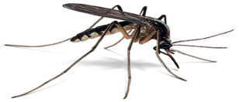
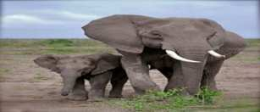
14
What letters are under which box?
A
B
K Selected
Species
R Selected
Species
R Species | K Species
Organism is very small size | Large Organism
Energy to make a new organism is low | Energy to make a new organism is high
Many babies made at once | Low number of babies made at a time
Early maturity | Long time for maturity
Short Life | Long Life
Each individual reproduces once and then dies | Individuals can reproduce many times throughout life

Slide 36
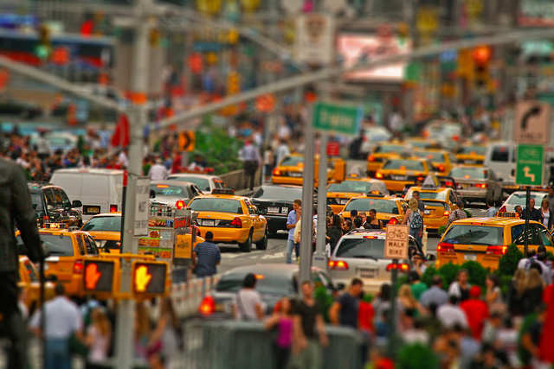
This is the amount of food that an area of land will yield.
(Controls the population that can be present)
15
Copyright © 2024 SlideSpark LLC

Slide 37
Part I Ecology Interactions
IT’s BIG | LEVEL -UP | MR. NEEDS | WATCH YOUR BACK JACK | -Bonus- CARTOON PREDATORS
1 | 6 | 11 | 16 | *21
2 | 7 | 12 | 17 | *22
3 | 8 | 13 | 18 | *23
4 | 9 | 14 | 19 | *24
5 | 10 | 15 | 20 | *25

Slide 38
Part I Ecology Interactions
IT’s BIG | LEVEL -UP | MR. NEEDS | WATCH YOUR BACK JACK | -Bonus- CARTOON PREDATORS
1 | 6 | 11 | 16 | *21
2 | 7 | 12 | 17 | *22
3 | 8 | 13 | 18 | *23
4 | 9 | 14 | 19 | *24
5 | 10 | 15 | 20 | *25

Slide 39

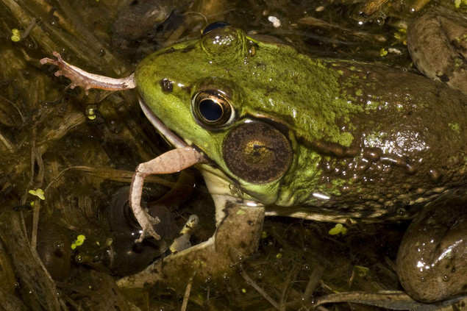
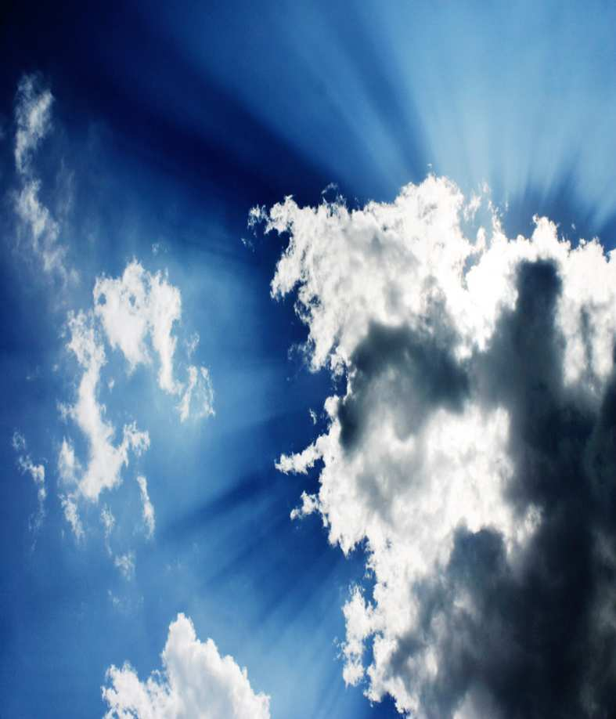
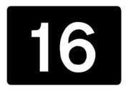
Which is a density independent and which is density dependent limiting factor?
A
B

Slide 40
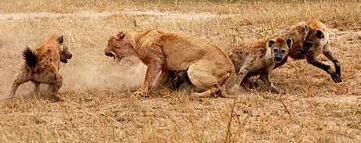
Which type of competition is seen below?
17
Hyena
Lion

Slide 41
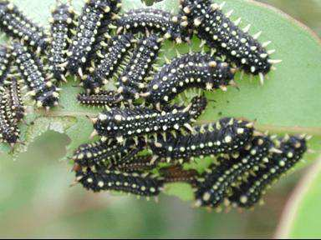
What is the type of competition seen below?
18
Copyright © 2024 SlideSpark LLC

Slide 42
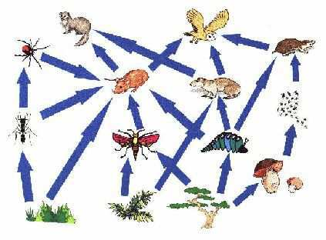
This is a complex network of many interconnected food chains and feeding relationships?
19
Copyright © 2024 SlideSpark LLC

Slide 43
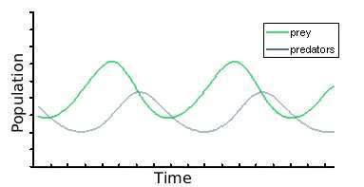
20
Draw a typical predator prey graph.
*
Copyright © 2024 SlideSpark LLC

Slide 44
Part I Ecology Interactions
IT’s BIG | LEVEL -UP | MR. NEEDS | WATCH YOUR BACK JACK | -Bonus- CARTOON PREDATORS
1 | 6 | 11 | 16 | *21
2 | 7 | 12 | 17 | *22
3 | 8 | 13 | 18 | *23
4 | 9 | 14 | 19 | *24
5 | 10 | 15 | 20 | *25

Slide 45
Part I Ecology Interactions
IT’s BIG | LEVEL -UP | MR. NEEDS | WATCH YOUR BACK JACK | -Bonus- CARTOON PREDATORS
1 | 6 | 11 | 16 | *21
2 | 7 | 12 | 17 | *22
3 | 8 | 13 | 18 | *23
4 | 9 | 14 | 19 | *24
5 | 10 | 15 | 20 | *25

Slide 46
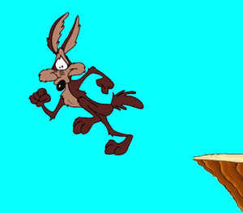
Name this famous predator?
*21
Copyright© 2010 Ryan P. Murphy

Slide 47
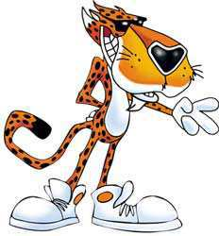
Name this famous predator?
*22
Copyright© 2010 Ryan P. Murphy

Slide 48
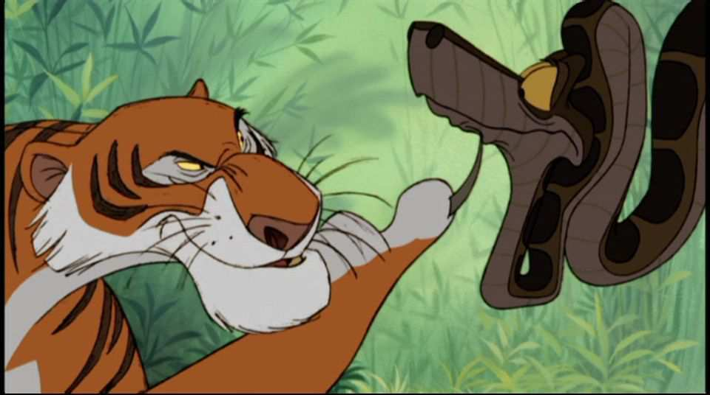
Name either of these two famous predators?
*23
Copyright© 2010 Ryan P. Murphy

Slide 49
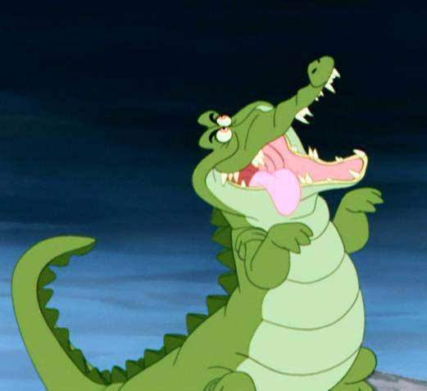
Name the movie / playwright with this alligator?
*24

Slide 50
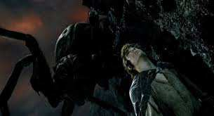
Can you name this spider?
*25

Slide 51
Part I Ecology Interactions
IT’s BIG | LEVEL -UP | MR. NEEDS | WATCH YOUR BACK JACK | -Bonus- CARTOON PREDATORS
1 | 6 | 11 | 16 | *21
2 | 7 | 12 | 17 | *22
3 | 8 | 13 | 18 | *23
4 | 9 | 14 | 19 | *24
5 | 10 | 15 | 20 | *25

Slide 52
Part I Ecology Interactions
IT’s BIG | LEVEL -UP | MR. NEEDS | WATCH YOUR BACK JACK | -Bonus- CARTOON PREDATORS
1 | 6 | 11 | 16 | *21
2 | 7 | 12 | 17 | *22
3 | 8 | 13 | 18 | *23
4 | 9 | 14 | 19 | *24
5 | 10 | 15 | 20 | *25
Final Question_______

Slide 53
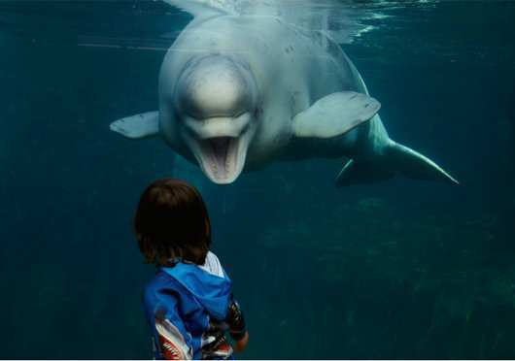
This is a 5pt
wager question

Slide 54
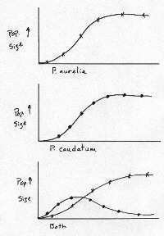
Final Question: Name this theory?
  Those that create a competitive advantage will flourish at the expense of the less competitive.
  No two organisms can have the same niche.
  One species thrives, the other goes extinct.

Slide 55
Ecology Interactions Unit
Part 1
Review Game

Slide 56


Ecology Interactions Unit
ANSWER KEY
Part 1
Review Game

Slide 57
Part I Ecology Interactions
IT’s BIG | LEVEL -UP | MR. NEEDS | WATCH YOUR BACK JACK | -Bonus- CARTOON PREDATORS
1 | 6 | 11 | 16 | *21
2 | 7 | 12 | 17 | *22
3 | 8 | 13 | 18 | *23
4 | 9 | 14 | 19 | *24
5 | 10 | 15 | 20 | *25

Slide 58
Part I Ecology Interactions
IT’s BIG | LEVEL -UP | MR. NEEDS | WATCH YOUR BACK JACK | -Bonus- CARTOON PREDATORS
1 | 6 | 11 | 16 | *21
2 | 7 | 12 | 17 | *22
3 | 8 | 13 | 18 | *23
4 | 9 | 14 | 19 | *24
5 | 10 | 15 | 20 | *25

Slide 59
Organisms need energy to survive. Energy from the sun flows into and out systems. This energy drives our world and the organisms in it. Energy is lost “not destroyed” when it changes form. Flows Hot to Cold
Flow
Ecological systems are organized within each other. The effects on one system will effect them all. All systems are interconnected.
Levels
All organisms are in a constant state of change over time with the environment. Some organisms will change with another and will develop special interactions. Others with the nonliving world.
Change
You get one minute
to review this…
(Next Slide)
Matter and energy cycle through the living and nonliving world. Organisms rely on this matter and energy cycling to survive.
Cycles
Animals are interconnected in a complex web of life. Changes on one part of the web have will effect other parts of the web and the stability of the entire ecosystem.
WEB
Balance
Ecosystems have a way to balance changes so that up and down fluctuations are part of the natural balance of the whole.
Copyright © 2024 SlideSpark LLC

Slide 60
Organisms need energy to survive. Energy from the sun flows into and out systems. This energy drives our world and the organisms in it. Energy is lost “not destroyed” when it changes form. Flows Hot to Cold
Flow
Ecological systems are organized within each other. The effects on one system will effect them all. All systems are interconnected.
Levels
All organisms are in a constant state of change over time with the environment. Some organisms will change with another and will develop special interactions. Others with the nonliving world.
Change
Matter and energy cycle through the living and nonliving world. Organisms rely on this matter and energy cycling to survive.
Cycles
Animals are interconnected in a complex web of life. Changes on one part of the web have will effect other parts of the web and the stability of the entire ecosystem.
WEB
Balance
Ecosystems have a way to balance changes so that up and down fluctuations are part of the natural balance of the whole.
Copyright © 2024 SlideSpark LLC

Slide 61
Organisms need energy to survive. Energy from the sun flows into and out systems. This energy drives our world and the organisms in it. Energy is lost “not destroyed” when it changes form. Flows Hot to Cold
Flow
Ecological systems are organized within each other. The effects on one system will effect them all. All systems are interconnected.
Levels
Please answer
with one of
these for 1-5.
All organisms are in a constant state of change over time with the environment. Some organisms will change with another and will develop special interactions. Others with the nonliving world.
Change
Matter and energy cycle through the living and nonliving world. Organisms rely on this matter and energy cycling to survive.
Cycles
Note: They won’t be used twice, and one will not be used.
Animals are interconnected in a complex web of life. Changes on one part of the web have will effect other parts of the web and the stability of the entire ecosystem.
WEB
Balance
Ecosystems have a way to balance changes so that up and down fluctuations are part of the natural balance of the whole.
Copyright © 2024 SlideSpark LLC

Slide 62
Matter and energy cycle through the living and nonliving world.
  Organisms rely on this matter and energy cycling to survive.
1
Copyright© 2010 Ryan P. Murphy

Slide 63
Matter and energy cycle through the living and nonliving world.
  Organisms rely on this matter and energy cycling to survive.
1
Copyright© 2010 Ryan P. Murphy

Slide 64

Matter and energy cycle through the living and nonliving world.
  Organisms rely on this matter and energy cycling to survive.
1
Copyright© 2010 Ryan P. Murphy

Slide 65

Matter and energy cycle through the living and nonliving world.
  Organisms rely on this matter and energy cycling to survive.
1
Copyright© 2010 Ryan P. Murphy

Slide 66
Ecological systems are organized within each other.
  The effects on one system will effect them all. All systems are interconnected.
2
Copyright© 2010 Ryan P. Murphy

Slide 67
Ecological systems are organized within each other.
  The effects on one system will effect them all. All systems are interconnected.
2
Copyright© 2010 Ryan P. Murphy

Slide 68

Ecological systems are organized within each other.
  The effects on one system will effect them all. All systems are interconnected.
2
Copyright© 2010 Ryan P. Murphy

Slide 69

Ecological systems are organized within each other.
  The effects on one system will effect them all. All systems are interconnected.
2
Copyright© 2010 Ryan P. Murphy

Slide 70
Organisms need energy to survive. Energy from the sun flows into and out systems.
  This energy drives our world and the organisms in it. Energy is lost “not destroyed” when it changes form. Flows Hot to Cold.
3
Copyright© 2010 Ryan P. Murphy

Slide 71
Organisms need energy to survive. Energy from the sun flows into and out systems.
  This energy drives our world and the organisms in it. Energy is lost “not destroyed” when it changes form. Flows Hot to Cold.
3
Copyright© 2010 Ryan P. Murphy

Slide 72

Organisms need energy to survive. Energy from the sun flows into and out systems.
  This energy drives our world and the organisms in it. Energy is lost “not destroyed” when it changes form. Flows Hot to Cold.
3
Copyright© 2010 Ryan P. Murphy

Slide 73

Organisms need energy to survive. Energy from the sun flows into and out systems.
  This energy drives our world and the organisms in it. Energy is lost “not destroyed” when it changes form. Flows Hot to Cold.
3
Copyright© 2010 Ryan P. Murphy

Slide 74
Animals are interconnected in a complex web of life.
  Changes on one part of the web effect other parts of the web and the stability of the entire ecosystem.
4
Copyright© 2010 Ryan P. Murphy

Slide 75
Animals are interconnected in a complex web of life.
  Changes on one part of the web effect other parts of the web and the stability of the entire ecosystem.
4
Copyright© 2010 Ryan P. Murphy

Slide 76

Animals are interconnected in a complex web of life.
  Changes on one part of the web effect other parts of the web and the stability of the entire ecosystem.
4
Copyright© 2010 Ryan P. Murphy

Slide 77

Animals are interconnected in a complex web of life.
  Changes on one part of the web effect other parts of the web and the stability of the entire ecosystem.
4
Copyright© 2010 Ryan P. Murphy

Slide 78
All organisms are in a constant state of change over time with the environment.
  Some organisms will change with another and will develop special interactions. Others with the nonliving world.
5
Copyright© 2010 Ryan P. Murphy

Slide 79
All organisms are in a constant state of change over time with the environment.
  Some organisms will change with another and will develop special interactions. Others with the nonliving world.
5
Copyright© 2010 Ryan P. Murphy

Slide 80

All organisms are in a constant state of change over time with the environment.
  Some organisms will change with another and will develop special interactions. Others with the nonliving world.
5
Copyright© 2010 Ryan P. Murphy

Slide 81

All organisms are in a constant state of change over time with the environment.
  Some organisms will change with another and will develop special interactions. Others with the nonliving world.
5
Copyright© 2010 Ryan P. Murphy

Slide 82
For 1 bonus point. Which big concept was missing from this round?
5*
Copyright© 2010 Ryan P. Murphy

Slide 83


For 1 bonus point. Which big concept was missing from this round?
5*
Copyright© 2010 Ryan P. Murphy

Slide 84
Part I Ecology Interactions
IT’s BIG | LEVEL -UP | MR. NEEDS | WATCH YOUR BACK JACK | -Bonus- CARTOON PREDATORS
1 | 6 | 11 | 16 | *21
2 | 7 | 12 | 17 | *22
3 | 8 | 13 | 18 | *23
4 | 9 | 14 | 19 | *24
5 | 10 | 15 | 20 | *25

Slide 85
Part I Ecology Interactions
IT’s BIG | LEVEL -UP | MR. NEEDS | WATCH YOUR BACK JACK | -Bonus- CARTOON PREDATORS
1 | 6 | 11 | 16 | *21
2 | 7 | 12 | 17 | *22
3 | 8 | 13 | 18 | *23
4 | 9 | 14 | 19 | *24
5 | 10 | 15 | 20 | *25

Slide 86
This is the name for all of the relationships of populations with each other and their environment?
6
Can be large and small
Copyright © 2024 SlideSpark LLC

Slide 87
This is the name for all of the relationships of populations with each other and their environment?
6
Can be large and small
Ecosystem
Copyright © 2024 SlideSpark LLC

Slide 88
These are groups of similar individuals who tend to mate with each other in a limited geographic area?
7
Copyright © 2024 SlideSpark LLC

Slide 89
These are groups of similar individuals who tend to mate with each other in a limited geographic area?
7
Population
Copyright © 2024 SlideSpark LLC

Slide 90
This is an organism with unique DNA and cells.
8
Copyright © 2024 SlideSpark LLC

Slide 91
This is an organism with unique DNA and cells.
8
Individual
Copyright © 2024 SlideSpark LLC

Slide 92
This is the name for the part of the earth and its atmosphere in which living organisms exist?
9
Copyright © 2024 SlideSpark LLC

Slide 93
This is the name for the part of the earth and its atmosphere in which living organisms exist?
9
Biosphere
Copyright © 2024 SlideSpark LLC

Slide 94
This is the name for a regional ecosystem characterized by distinct types of vegetation, animals.
Determined by temperature and rainfall.
10
Copyright © 2024 SlideSpark LLC

Slide 95
This is the name for a regional ecosystem characterized by distinct types of vegetation, animals.
Determined by temperature and rainfall.
10
Biome
Copyright © 2024 SlideSpark LLC

Slide 96
Part I Ecology Interactions
IT’s BIG | LEVEL -UP | MR. NEEDS | WATCH YOUR BACK JACK | -Bonus- CARTOON PREDATORS
1 | 6 | 11 | 16 | *21
2 | 7 | 12 | 17 | *22
3 | 8 | 13 | 18 | *23
4 | 9 | 14 | 19 | *24
5 | 10 | 15 | 20 | *25

Slide 97
Part I Ecology Interactions
IT’s BIG | LEVEL -UP | MR. NEEDS | WATCH YOUR BACK JACK | -Bonus- CARTOON PREDATORS
1 | 6 | 11 | 16 | *21
2 | 7 | 12 | 17 | *22
3 | 8 | 13 | 18 | *23
4 | 9 | 14 | 19 | *24
5 | 10 | 15 | 20 | *25

Slide 98
Which two parts of the biosphere are covered up?
11
Copyright © 2024 SlideSpark LLC

Slide 99
Which two parts of the biosphere are covered up?
11
Copyright © 2024 SlideSpark LLC

Slide 100
Which two parts of the biosphere are covered up?
11
Copyright © 2024 SlideSpark LLC

Slide 101
Which two parts of the biosphere are covered up?
11
Copyright © 2024 SlideSpark LLC

Slide 102
Which two parts of the biosphere are covered up?
11
Copyright © 2024 SlideSpark LLC

Slide 103
Which two parts of the biosphere are covered up?
11
Copyright © 2024 SlideSpark LLC

Slide 104
This is the type of environment that an organism lives in? (Can be large and small)
12
Copyright © 2024 SlideSpark LLC

Slide 105
This is the type of environment that an organism lives in? (Can be large and small)
12
Habitat
Copyright © 2024 SlideSpark LLC

Slide 106

This is the type of environment that an organism lives in? (Can be large and small)
12
Habitat
Copyright © 2024 SlideSpark LLC

Slide 107
This is the type of environment that an organism lives in? (Can be large and small)
12
Habitat
Copyright © 2024 SlideSpark LLC

Slide 108
This is the place or function of a given organism within its ecosystem?
13

Slide 109
This is the place or function of a given organism within its ecosystem?
13
Niche

Slide 110
14
What letters are under which box?
A
B
K Selected
Species
R Selected
Species
R Species | K Species
Organism is very small size | Large Organism
Energy to make a new organism is low | Energy to make a new organism is high
Many babies made at once | Low number of babies made at a time
Early maturity | Long time for maturity
Short Life | Long Life
Each individual reproduces once and then dies | Individuals can reproduce many times throughout life

Slide 111
14
What letters are under which box?
A
B
K Selected
Species
R Selected
Species
R Species | K Species
Organism is very small size | Large Organism
Energy to make a new organism is low | Energy to make a new organism is high
Many babies made at once | Low number of babies made at a time
Early maturity | Long time for maturity
Short Life | Long Life
Each individual reproduces once and then dies | Individuals can reproduce many times throughout life

Slide 112
14
What letters are under which box?
A
B
K Selected
Species
R Selected
Species
R Species | K Species
Organism is very small size | Large Organism
Energy to make a new organism is low | Energy to make a new organism is high
Many babies made at once | Low number of babies made at a time
Early maturity | Long time for maturity
Short Life | Long Life
Each individual reproduces once and then dies | Individuals can reproduce many times throughout life

Slide 113
14
What letters are under which box?
A
B
K Selected
Species
R Selected
Species
R Species | K Species
Organism is very small size | Large Organism
Energy to make a new organism is low | Energy to make a new organism is high
Many babies made at once | Low number of babies made at a time
Early maturity | Long time for maturity
Short Life | Long Life
Each individual reproduces once and then dies | Individuals can reproduce many times throughout life

Slide 114
14
What letters are under which box?
A
B
K Selected
Species
R Selected
Species
R Species | K Species
Organism is very small size | Large Organism
Energy to make a new organism is low | Energy to make a new organism is high
Many babies made at once | Low number of babies made at a time
Early maturity | Long time for maturity
Short Life | Long Life
Each individual reproduces once and then dies | Individuals can reproduce many times throughout life

Slide 115
14
What letters are under which box?
A
B
K Selected
Species
R Selected
Species
R Species | K Species
Organism is very small size | Large Organism
Energy to make a new organism is low | Energy to make a new organism is high
Many babies made at once | Low number of babies made at a time
Early maturity | Long time for maturity
Short Life | Long Life
Each individual reproduces once and then dies | Individuals can reproduce many times throughout life

Slide 116
This is the amount of food that an area of land will yield.
(Controls the population that can be present)
15
Copyright © 2024 SlideSpark LLC

Slide 117
This is the amount of food that an area of land will yield.
(Controls the population that can be present)
15
Carrying Capacity
Copyright © 2024 SlideSpark LLC

Slide 118
Part I Ecology Interactions
IT’s BIG | LEVEL -UP | MR. NEEDS | WATCH YOUR BACK JACK | -Bonus- CARTOON PREDATORS
1 | 6 | 11 | 16 | *21
2 | 7 | 12 | 17 | *22
3 | 8 | 13 | 18 | *23
4 | 9 | 14 | 19 | *24
5 | 10 | 15 | 20 | *25

Slide 119
Part I Ecology Interactions
IT’s BIG | LEVEL -UP | MR. NEEDS | WATCH YOUR BACK JACK | -Bonus- CARTOON PREDATORS
1 | 6 | 11 | 16 | *21
2 | 7 | 12 | 17 | *22
3 | 8 | 13 | 18 | *23
4 | 9 | 14 | 19 | *24
5 | 10 | 15 | 20 | *25

Slide 120
Which is a density independent and which is density dependent limiting factor?
A
B

Slide 121
Which is a density independent and which is density dependent limiting factor?
A
B

Slide 122
Which is a density independent and which is density dependent limiting factor?
A
B
Density
Dependent
(Living)

Slide 123
Which is a density independent and which is density dependent limiting factor?
A
B
Density
Dependent
(Living)

Slide 124
Which is a density independent and which is density dependent limiting factor?
A
B
Density
Dependent
(Living)
Density
Independent
(Non-living)

Slide 125
Which type of competition is seen below?
17

Slide 126
Which type of competition is seen below?
17
Hyena
Lion

Slide 127



Which type of competition is seen below?
17
Hyena
Lion

Slide 128
Which type of competition is seen below?
17
Hyena
Lion
Interspecific
Competition

Slide 129
What is the type of competition seen below?
18
Copyright © 2024 SlideSpark LLC

Slide 130
What is the type of competition seen below?
18
Copyright © 2024 SlideSpark LLC

Slide 131
What is the type of competition seen below?
18
Intraspecific
Competition
Copyright © 2024 SlideSpark LLC

Slide 132
This is a complex network of many interconnected food chains and feeding relationships?
19
Copyright © 2024 SlideSpark LLC

Slide 133


This is a complex network of many interconnected food chains and feeding relationships?
19
Food Web
Copyright © 2024 SlideSpark LLC

Slide 134
20
Draw a typical predator prey graph.
*
Copyright © 2024 SlideSpark LLC

Slide 135
20
Draw a typical predator prey graph.
*
Copyright © 2024 SlideSpark LLC

Slide 136
20
Draw a typical predator prey graph.
*
Copyright © 2024 SlideSpark LLC

Slide 137
20
Draw a typical predator prey graph.
*
Copyright © 2024 SlideSpark LLC

Slide 138
20
Draw a typical predator prey graph.
*
Copyright © 2024 SlideSpark LLC

Slide 139
20
Draw a typical predator prey graph.
*
Copyright © 2024 SlideSpark LLC

Slide 140
20
Draw a typical predator prey graph.
*
Copyright © 2024 SlideSpark LLC

Slide 141
Part I Ecology Interactions
IT’s BIG | LEVEL -UP | MR. NEEDS | WATCH YOUR BACK JACK | -Bonus- CARTOON PREDATORS
1 | 6 | 11 | 16 | *21
2 | 7 | 12 | 17 | *22
3 | 8 | 13 | 18 | *23
4 | 9 | 14 | 19 | *24
5 | 10 | 15 | 20 | *25

Slide 142
Part I Ecology Interactions
IT’s BIG | LEVEL -UP | MR. NEEDS | WATCH YOUR BACK JACK | -Bonus- CARTOON PREDATORS
1 | 6 | 11 | 16 | *21
2 | 7 | 12 | 17 | *22
3 | 8 | 13 | 18 | *23
4 | 9 | 14 | 19 | *24
5 | 10 | 15 | 20 | *25

Slide 143
Name this famous predator?
*21
Copyright© 2010 Ryan P. Murphy

Slide 144
Name this famous predator?
*21
Wile E. Coyote
Copyright© 2010 Ryan P. Murphy

Slide 145
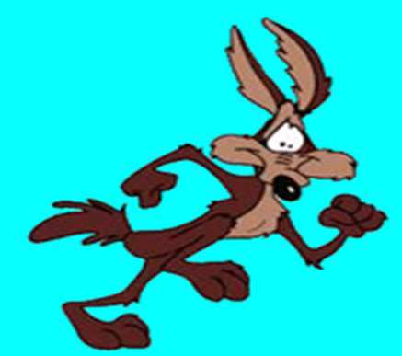
Name this famous predator?
*21
Copyright© 2010 Ryan P. Murphy

Slide 146
Name this famous predator?
*22
Copyright© 2010 Ryan P. Murphy

Slide 147
Name this famous predator?
*22
Chester
Cheetah
Copyright© 2010 Ryan P. Murphy

Slide 148
Name either of these two famous predators?
*23
Copyright© 2010 Ryan P. Murphy

Slide 149
Name either of these two famous predators?
*23
Copyright© 2010 Ryan P. Murphy

Slide 150
Name either of these two famous predators?
*23
Shere Khan
Copyright© 2010 Ryan P. Murphy

Slide 151
Name either of these two famous predators?
*23
Shere Khan
Kaa
Copyright© 2010 Ryan P. Murphy

Slide 152
Name the movie / playwright with this alligator?
*24

Slide 153
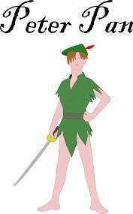
Name the movie / playwright with this alligator?
*24

Slide 154
Can you name this spider?
*25

Slide 155
Can you name this spider?
*25
Shelob

Slide 156
Part I Ecology Interactions
IT’s BIG | LEVEL -UP | MR. NEEDS | WATCH YOUR BACK JACK | -Bonus- CARTOON PREDATORS
1 | 6 | 11 | 16 | *21
2 | 7 | 12 | 17 | *22
3 | 8 | 13 | 18 | *23
4 | 9 | 14 | 19 | *24
5 | 10 | 15 | 20 | *25

Slide 157
Part I Ecology Interactions
IT’s BIG | LEVEL -UP | MR. NEEDS | WATCH YOUR BACK JACK | -Bonus- CARTOON PREDATORS
1 | 6 | 11 | 16 | *21
2 | 7 | 12 | 17 | *22
3 | 8 | 13 | 18 | *23
4 | 9 | 14 | 19 | *24
5 | 10 | 15 | 20 | *25
Final Question_______

Slide 158
This is a 5pt
wager question

Slide 159
Final Question: Name this theory?
  Those that create a competitive advantage will flourish at the expense of the less competitive.
  No two organisms can have the same niche.
  One species thrives, the other goes extinct.

Slide 160
Final Question: Name this theory?
  Those that create a competitive advantage will flourish at the expense of the less competitive.
  No two organisms can have the same niche.
  One species thrives, the other goes extinct.
Answer is…

Slide 161
Final Question: Name this theory?
  Those that create a competitive advantage will flourish at the expense of the less competitive.
  No two organisms can have the same niche.
  One species thrives, the other goes extinct.
Competitive
Exclusion Theory
Answer is…

Slide 162

Ecology Unit Review Game
1-20 = 5 points each
20-25 = Bonus (1 point each)
Final Question = 5 point wager
Find the Owl = 1 point

Slide 163
Ecology Interactions Unit
ANSWER KEY
Part 1
Review Game

