Slide 1
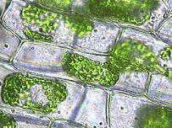

Cell Transport
Review Game
Part 2
Lesson 6

Slide 2
Cellular Biology Review Game
INSIDE AND OUT | INSANE IN THE MEMBRANE | UNCOMMON SOLUTIONS | BIG- GULP | -BONUS- SOLUTION FLICKS
1 | 6 | 11 | 16 | *21
2 | 7 | 12 | 17 | *22
3 | 8 | 13 | 18 | *23
4 | 9 | 14 | 19 | *24
5 | 10 | 15 | 20 | *25
Copyright © 2024 SlideSpark .LLC

Slide 3
How to play…
  Don’t play like Jeo_ _ _ _ y.
  Class should be divided into several small groups.
  Groups should use science journal (red slide notes), homework, and other available materials to assist you.
  Groups can communicate quietly with each other but no sharing answers between groups.
    Practice quietly communicating right now?
    Practice Communication Question:
    Your group gets to order one pizza and you can have two toppings. What does your group want?

Slide 4

Questions 1-20 = 5pts Each
Final Category (Bonus) = 1pt Each
Final Questions = 5 pt wager
If you wager 5 on the last question and get it wrong you lose 5 pts. Wager 5 and get it right you get 5 pts.
Find the Owl =
Secretly write “Owl” in the correct box worth 1pt.
“I’ll be about this big.”

Slide 5
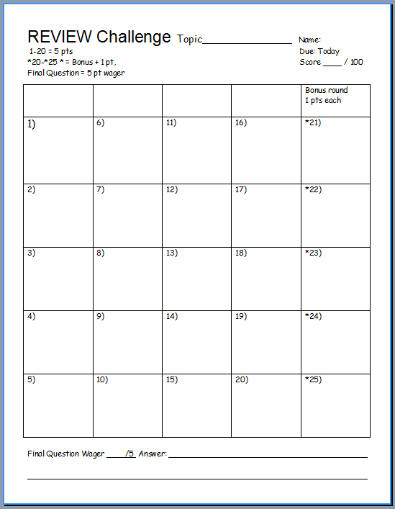
Is your name on the review sheet?
Name

Slide 6
Is your name on the review sheet?
Add the categories
along the top
on the next slide.

Slide 7
Cellular Biology Review Game
INSIDE AND OUT | INSANE IN THE MEMBRANE | UNCOMMON SOLUTIONS | BIG- GULP | -BONUS- SOLUTION FLICKS
1 | 6 | 11 | 16 | *21
2 | 7 | 12 | 17 | *22
3 | 8 | 13 | 18 | *23
4 | 9 | 14 | 19 | *24
5 | 10 | 15 | 20 | *25
Copyright © 2024 SlideSpark .LLC

Slide 8
Cellular Biology Review Game
INSIDE AND OUT | INSANE IN THE MEMBRANE | UNCOMMON SOLUTIONS | BIG- GULP | -BONUS- SOLUTION FLICKS
1 | 6 | 11 | 16 | *21
2 | 7 | 12 | 17 | *22
3 | 8 | 13 | 18 | *23
4 | 9 | 14 | 19 | *24
5 | 10 | 15 | 20 | *25
Copyright © 2024 SlideSpark .LLC

Slide 9
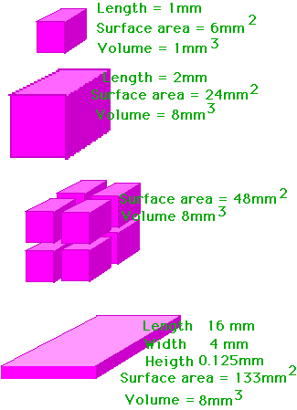
Which letter represents the shape of a typical cell? Why in two words?
A
1
B
C
D
Copyright © 2024 SlideSpark .LLC

Slide 10

2
This is the rich chemical fluid that helps breakdown molecules for use.
  Moves materials through cell (food and waste)

Slide 11
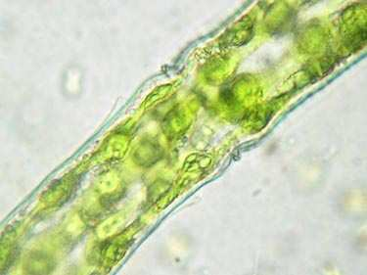
Name this cellular organelle?
3

Slide 12
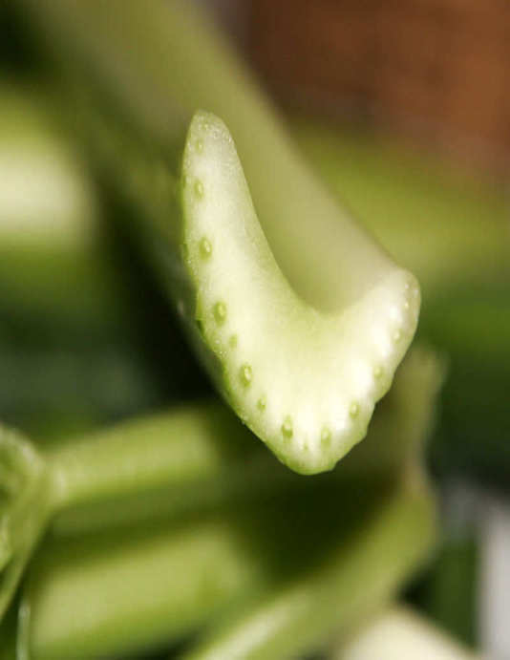
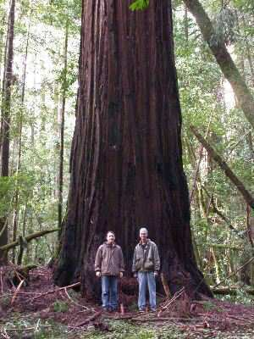
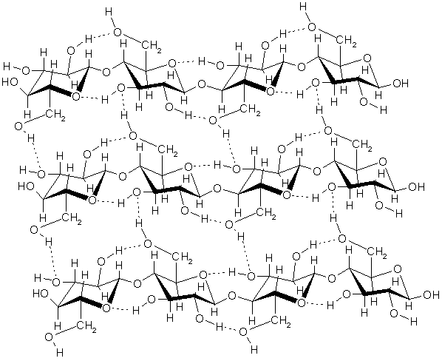
Cell Walls… (1 point each)
Found in plants, bacteria, and fungi
Made of cellulose sugar (permeable)
Supports and protects plants
4
Copyright © 2024 SlideSpark .LLC

Slide 13

5
Name A and B?
A
B
Copyright © 2024 SlideSpark .LLC

Slide 14
Cellular Biology Review Game
INSIDE AND OUT | INSANE IN THE MEMBRANE | UNCOMMON SOLUTIONS | BIG- GULP | -BONUS- SOLUTION FLICKS
1 | 6 | 11 | 16 | *21
2 | 7 | 12 | 17 | *22
3 | 8 | 13 | 18 | *23
4 | 9 | 14 | 19 | *24
5 | 10 | 15 | 20 | *25
Copyright © 2024 SlideSpark .LLC

Slide 15
Cellular Biology Review Game
INSIDE AND OUT | INSANE IN THE MEMBRANE | UNCOMMON SOLUTIONS | BIG- GULP | -BONUS- SOLUTION FLICKS
1 | 6 | 11 | 16 | *21
2 | 7 | 12 | 17 | *22
3 | 8 | 13 | 18 | *23
4 | 9 | 14 | 19 | *24
5 | 10 | 15 | 20 | *25
Copyright © 2024 SlideSpark .LLC

Slide 16
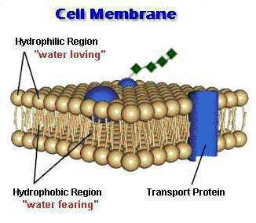
6
Outside Watery Environment
A
Hydrophilic
B
Hydrophobic
Hydrophobic
Hydrophilic
A
Inside Watery Environment

Slide 17

Name some things an animal cell would want to let in. (1 point each) The cell wants to let in...
  Oxygen.
  Water.
  Food.
    Molecules
  Protein.
  Minerals
  Vitamins
7
Copyright © 2024 SlideSpark .LLC

Slide 18

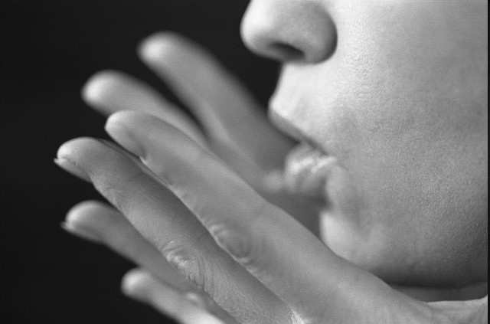
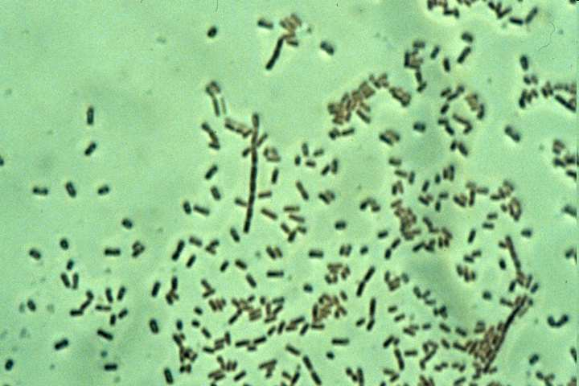
8
The cell doesn’t want to let in…
  Carbon Dioxide.
  Waste.
  Viruses.
  Bacteria.
Harmful bacteria
Copyright © 2024 SlideSpark .LLC

Slide 19
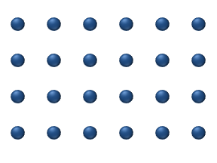
9
The animation below best represents…
  A.) Osmosis
  B.) Diffusion
  C.) Active Transport
  D.) An unbalanced gradient
  E.) A balanced gradient
Copyright © 2024 SlideSpark .LLC

Slide 20
9
The animation below best represents…
  A.) Osmosis
  B.) Diffusion
  C.) Active Transport
  D.) An unbalanced gradient
  E.) A balanced gradient
Copyright © 2024 SlideSpark .LLC

Slide 21
9
The animation below best represents…
  A.) Osmosis
  B.) Diffusion
  C.) Active Transport
  D.) An unbalanced gradient
  E.) A balanced gradient
Copyright © 2024 SlideSpark .LLC

Slide 22
9
The animation below best represents…
  A.) Osmosis
  B.) Diffusion
  C.) Active Transport
  D.) An unbalanced gradient
  E.) A balanced gradient
Copyright © 2024 SlideSpark .LLC

Slide 23
9
The animation below best represents…
  A.) Osmosis
  B.) Diffusion
  C.) Active Transport
  D.) An unbalanced gradient
  E.) A balanced gradient
Copyright © 2024 SlideSpark .LLC

Slide 24
9
The animation below best represents…
  A.) Osmosis
  B.) Diffusion
  C.) Active Transport
  D.) An unbalanced gradient
  E.) A balanced gradient
Copyright © 2024 SlideSpark .LLC

Slide 25
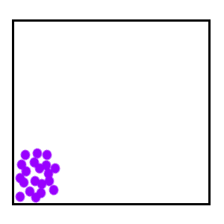
Molecules try to reach equilibrium.
  They go from areas of…(finish)
10
Copyright © 2024 SlideSpark .LLC

Slide 26
Cellular Biology Review Game
INSIDE AND OUT | INSANE IN THE MEMBRANE | UNCOMMON SOLUTIONS | BIG- GULP | -BONUS- SOLUTION FLICKS
1 | 6 | 11 | 16 | *21
2 | 7 | 12 | 17 | *22
3 | 8 | 13 | 18 | *23
4 | 9 | 14 | 19 | *24
5 | 10 | 15 | 20 | *25
Copyright © 2024 SlideSpark .LLC

Slide 27
Cellular Biology Review Game
INSIDE AND OUT | INSANE IN THE MEMBRANE | UNCOMMON SOLUTIONS | BIG- GULP | -BONUS- SOLUTION FLICKS
1 | 6 | 11 | 16 | *21
2 | 7 | 12 | 17 | *22
3 | 8 | 13 | 18 | *23
4 | 9 | 14 | 19 | *24
5 | 10 | 15 | 20 | *25
Copyright © 2024 SlideSpark .LLC

Slide 28
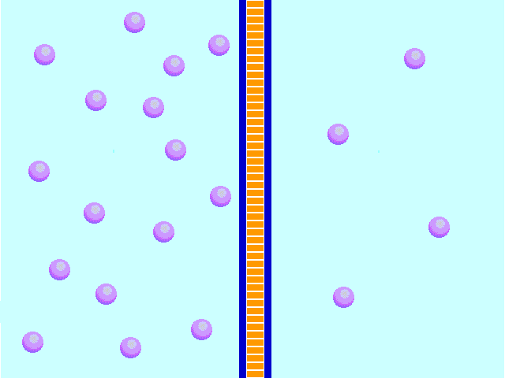
What process is this?
Semi permeable membrane
11
Copyright © 2024 SlideSpark .LLC

Slide 29
The Solution that these plants cells are in must be…
  A.) Hypotonic
  B.) Hypertonic
  C.) Isotonic
  D.) Facilitated
  E.) None of the
  above.
12

Slide 30
The Solution that these plants cells are in must be…
  A.) Hypotonic
  B.) Hypertonic
  C.) Isotonic
  D.) Facilitated
  E.) None of the
  above.
12

Slide 31
The Solution that these plants cells are in must be…
  A.) Hypotonic
  B.) Hypertonic
  C.) Isotonic
  D.) Facilitated
  E.) None of the
  above.
12

Slide 32
The Solution that these plants cells are in must be…
  A.) Hypotonic
  B.) Hypertonic
  C.) Isotonic
  D.) Facilitated
  E.) None of the
  above.
12

Slide 33
The Solution that these plants cells are in must be…
  A.) Hypotonic
  B.) Hypertonic
  C.) Isotonic
  D.) Facilitated
  E.) None of the
  above.
12

Slide 34
The Solution that these plants cells are in must be…
  A.) Hypotonic
  B.) Hypertonic
  C.) Isotonic
  D.) Facilitated
  E.) None of the
  above.
12

Slide 35
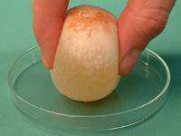

Slide 36
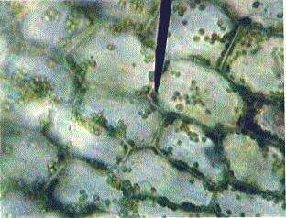
The Solution that these plants cells are in must be…
  A.) Hypotonic
  B.) Hypertonic
  C.) Isotonic
  D.) Facilitated
  E.) None of the
  above.
13

Slide 37
The Solution that these plants cells are in must be…
  A.) Hypotonic
  B.) Hypertonic
  C.) Isotonic
  D.) Facilitated
  E.) None of the
  above.
13

Slide 38
The Solution that these plants cells are in must be…
  A.) Hypotonic
  B.) Hypertonic
  C.) Isotonic
  D.) Facilitated
  E.) None of the
  above.
13

Slide 39
The Solution that these plants cells are in must be…
  A.) Hypotonic
  B.) Hypertonic
  C.) Isotonic
  D.) Facilitated
  E.) None of the
  above.
13

Slide 40
The Solution that these plants cells are in must be…
  A.) Hypotonic
  B.) Hypertonic
  C.) Isotonic
  D.) Facilitated
  E.) None of the
  above.
13

Slide 41
The Solution that these plants cells are in must be…
  A.) Hypotonic
  B.) Hypertonic
  C.) Isotonic
  D.) Facilitated
  E.) None of the
  above.
13

Slide 42

14
Isotonic Solution: The cell has an equal proportion of concentration with the area surrounding.
  Water continually flows in and out to keep concentration even.
Cell
Copyright © 2024 SlideSpark .LLC
Copyright © 2024 SlideSpark .LLC

Slide 43
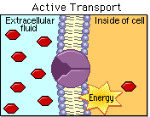
This uses energy to move molecules from areas of low concentration to areas of high concentration.
15
Copyright © 2024 SlideSpark .LLC

Slide 44
Cellular Biology Review Game
INSIDE AND OUT | INSANE IN THE MEMBRANE | UNCOMMON SOLUTIONS | BIG- GULP | -BONUS- SOLUTION FLICKS
1 | 6 | 11 | 16 | *21
2 | 7 | 12 | 17 | *22
3 | 8 | 13 | 18 | *23
4 | 9 | 14 | 19 | *24
5 | 10 | 15 | 20 | *25
Copyright © 2024 SlideSpark .LLC

Slide 45
Cellular Biology Review Game
INSIDE AND OUT | INSANE IN THE MEMBRANE | UNCOMMON SOLUTIONS | BIG- GULP | -BONUS- SOLUTION FLICKS
1 | 6 | 11 | 16 | *21
2 | 7 | 12 | 17 | *22
3 | 8 | 13 | 18 | *23
4 | 9 | 14 | 19 | *24
5 | 10 | 15 | 20 | *25
Copyright © 2024 SlideSpark .LLC

Slide 46
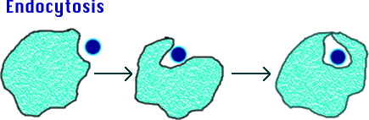
Name this process.
16
Copyright © 2024 SlideSpark .LLC

Slide 47
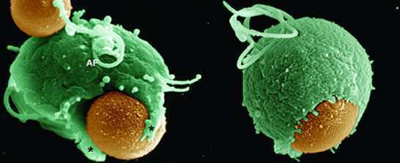
17
This is the process where the membrane surrounds large solid particles.
Copyright © 2024 SlideSpark .LLC

Slide 48
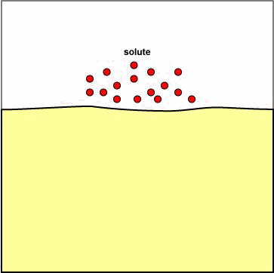
Process where the membrane surrounds a liquid.
18
Copyright © 2024 SlideSpark .LLC

Slide 49
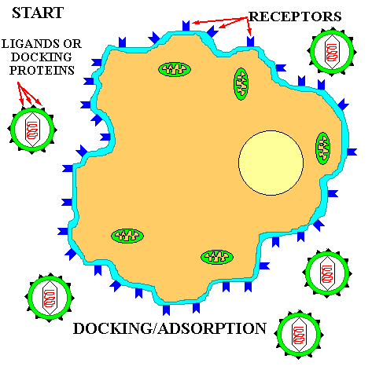
19
How did this virus enter the cell?
Copyright © 2024 SlideSpark .LLC

Slide 50

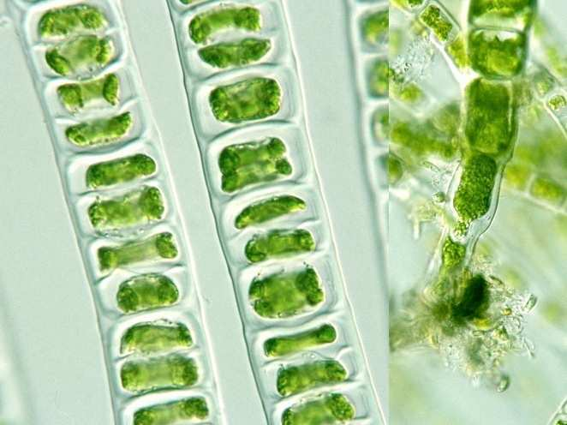
20
Why don’t
the plant
cells burst?

Slide 51
Cellular Biology Review Game
INSIDE AND OUT | INSANE IN THE MEMBRANE | UNCOMMON SOLUTIONS | BIG- GULP | -BONUS- SOLUTION FLICKS
1 | 6 | 11 | 16 | *21
2 | 7 | 12 | 17 | *22
3 | 8 | 13 | 18 | *23
4 | 9 | 14 | 19 | *24
5 | 10 | 15 | 20 | *25
Copyright © 2024 SlideSpark .LLC

Slide 52
Cellular Biology Review Game
INSIDE AND OUT | INSANE IN THE MEMBRANE | UNCOMMON SOLUTIONS | BIG- GULP | -BONUS- SOLUTION FLICKS
1 | 6 | 11 | 16 | *21
2 | 7 | 12 | 17 | *22
3 | 8 | 13 | 18 | *23
4 | 9 | 14 | 19 | *24
5 | 10 | 15 | 20 | *25
Copyright © 2024 SlideSpark .LLC

Slide 53

Name this movie with a hypertonic chocolate milk?
*21
Copyright © 2024 SlideSpark .LLC

Slide 54
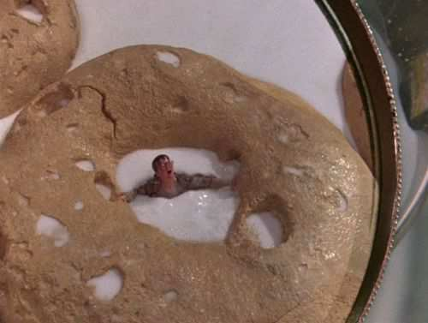
Name this movie with hypertonic milk?
*22
Copyright © 2024 SlideSpark .LLC

Slide 55

Name this movie with a hypotonic white blood cell?
*23
Copyright © 2024 SlideSpark .LLC

Slide 56

Name this movie with hypertonic slime?
*24
Copyright © 2024 SlideSpark .LLC

Slide 57

Name this movie with hypo and hypertonic solutions?
*25
Copyright © 2024 SlideSpark .LLC

Slide 58
Name this movie with hypo and hypertonic solutions?
*25
“You’re hypotonic, and you….”
Copyright © 2024 SlideSpark .LLC

Slide 59
Name this movie with hypo and hypertonic solutions?
*25
“You’re hypotonic, and you….”
Copyright © 2024 SlideSpark .LLC

Slide 60
Name this movie with hypo and hypertonic solutions?
*25
“You’re hypertonic…”
Copyright © 2024 SlideSpark .LLC

Slide 61
Cellular Biology Review Game
INSIDE AND OUT | INSANE IN THE MEMBRANE | UNCOMMON SOLUTIONS | BIG- GULP | -BONUS- SOLUTION FLICKS
1 | 6 | 11 | 16 | *21
2 | 7 | 12 | 17 | *22
3 | 8 | 13 | 18 | *23
4 | 9 | 14 | 19 | *24
5 | 10 | 15 | 20 | *25
Final Question
Copyright © 2024 SlideSpark .LLC

Slide 62

5 pt Wager Question
(You can wager up to 5 pts)

Slide 63
  Fill beak with distilled water.
  Add corn syrup to dialysis tubing
  Align the corn syrup and water levels in the beaker.
  Visit tomorrow.
  What happened?
Tie

Slide 64
Time passes
Tie

Slide 65
Time passes
Tie

Slide 66
  The corn syrup was hypertonic (more solute). Water was hypotonic. The water moved into the dialysis tubing to equal the concentrations (isotonic = equal).
  The fluid in the tubing rose.
Tie

Slide 67
Cell Transport
Review Game
Part 2
Lesson 6

Slide 68

Cell Transport
Review Game
Part 2
Lesson 7

Slide 69
Cellular Biology Review Game
INSIDE AND OUT | INSANE IN THE MEMBRANE | UNCOMMON SOLUTIONS | BIG- GULP | -BONUS- SOLUTION FLICKS
1 | 6 | 11 | 16 | *21
2 | 7 | 12 | 17 | *22
3 | 8 | 13 | 18 | *23
4 | 9 | 14 | 19 | *24
5 | 10 | 15 | 20 | *25
Copyright © 2024 SlideSpark .LLC

Slide 70
How to play…
  Don’t play like Jeo_ _ _ _ y.
  Class should be divided into several small groups.
  Groups should use science journal (red slide notes), homework, and other available materials to assist you.
  Groups can communicate quietly with each other but no sharing answers between groups.
    Practice quietly communicating right now?
    Practice Communication Question:
    Your group gets to order one pizza and you can have two toppings. What does your group want?

Slide 71
Questions 1-20 = 5pts Each
Final Category (Bonus) = 1pt Each
Final Questions = 5 pt wager
If you wager 5 on the last question and get it wrong you lose 5 pts. Wager 5 and get it right you get 5 pts.
Find the Owl =
Secretly write “Owl” in the correct box worth 1pt.
“I’ll be about this big.”

Slide 72
Is your name on the review sheet?
Name

Slide 73
Is your name on the review sheet?
Add the categories
along the top
on the next slide.

Slide 74
Answer Key

Slide 75
Cellular Biology Review Game
INSIDE AND OUT | INSANE IN THE MEMBRANE | UNCOMMON SOLUTIONS | BIG- GULP | -BONUS- SOLUTION FLICKS
1 | 6 | 11 | 16 | *21
2 | 7 | 12 | 17 | *22
3 | 8 | 13 | 18 | *23
4 | 9 | 14 | 19 | *24
5 | 10 | 15 | 20 | *25
Copyright © 2024 SlideSpark .LLC

Slide 76
Cellular Biology Review Game
INSIDE AND OUT | INSANE IN THE MEMBRANE | UNCOMMON SOLUTIONS | BIG- GULP | -BONUS- SOLUTION FLICKS
1 | 6 | 11 | 16 | *21
2 | 7 | 12 | 17 | *22
3 | 8 | 13 | 18 | *23
4 | 9 | 14 | 19 | *24
5 | 10 | 15 | 20 | *25
Copyright © 2024 SlideSpark .LLC

Slide 77
Which letter represents the shape of a typical cell? Why in two words?
A
1
B
C
D
Copyright © 2024 SlideSpark .LLC

Slide 78
Which letter represents the shape of a typical cell? Why in two words?
answer is…
A
1
B
C
D
Copyright © 2024 SlideSpark .LLC

Slide 79
Which letter represents the shape of a typical cell? Why in two words?
answer is…
A
1
B
C
D
Copyright © 2024 SlideSpark .LLC

Slide 80
Which letter represents the shape of a typical cell? Why in two words?
answer is…
A
1
B
C
Why?
D
Copyright © 2024 SlideSpark .LLC

Slide 81
Which letter represents the shape of a typical cell? Why in two words?
answer is…
A
1
B
C
Most Surface Area
Why?
D
Copyright © 2024 SlideSpark .LLC

Slide 82
2
This is the rich chemical fluid that helps breakdown molecules for use.
  Moves materials through cell (food and waste)

Slide 83
2
This is the rich chemical fluid that helps breakdown molecules for use.
  Moves materials through cell (food and waste)
and the answer is…

Slide 84
2
This is the rich chemical fluid that helps breakdown molecules for use.
  Moves materials through cell (food and waste)
Cytoplasm
and the answer is…

Slide 85
Name this cellular organelle?
3

Slide 86
Name this cellular organelle?
3
and the answer is…

Slide 87
Name this cellular organelle?
3
CELL WALL
and the answer is…

Slide 88
Cell Walls… (1 point each)
Found in plants, bacteria, and fungi
Made of cellulose sugar (permeable)
Supports and protects plants
4
Copyright © 2024 SlideSpark .LLC

Slide 89
Cell Walls… (1 point each)
Found in plants, bacteria, and fungi
Made of cellulose sugar (permeable)
Supports and protects plants
4
Copyright © 2024 SlideSpark .LLC

Slide 90
Cell Walls… (1 point each)
Found in plants, bacteria, and fungi
Made of cellulose sugar (permeable)
Supports and protects plants
4
Copyright © 2024 SlideSpark .LLC

Slide 91
Cell Walls… (1 point each)
Found in plants, bacteria, and fungi
Made of cellulose sugar (permeable)
Supports and protects plants
4
Copyright © 2024 SlideSpark .LLC

Slide 92
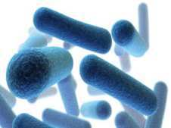
Cell Walls… (1 point each)
Found in plants, bacteria, and fungi
Made of cellulose sugar (permeable)
Supports and protects plants
4
Copyright © 2024 SlideSpark .LLC

Slide 93
Cell Walls… (1 point each)
Found in plants, bacteria, and fungi
Made of cellulose sugar (permeable)
Supports and protects plants
4
Copyright © 2024 SlideSpark .LLC

Slide 94
Cell Walls… (1 point each)
Found in plants, bacteria, and fungi
Made of cellulose sugar (permeable)
Supports and protects plants
4
Copyright © 2024 SlideSpark .LLC

Slide 95
Cell Walls… (1 point each)
Found in plants, bacteria, and fungi
Made of cellulose sugar (permeable)
Supports and protects plants
4
Copyright © 2024 SlideSpark .LLC

Slide 96
Cell Walls… (1 point each)
Found in plants, bacteria, and fungi
Made of cellulose sugar (permeable)
Supports and protects plants
4
Copyright © 2024 SlideSpark .LLC

Slide 97
Cell Walls… (1 point each)
Found in plants, bacteria, and fungi
Made of cellulose sugar (permeable)
Supports and protects plants
4
Copyright © 2024 SlideSpark .LLC

Slide 98
5
Name A and B?
A
B
Copyright © 2024 SlideSpark .LLC

Slide 99
5
Name A and B?
A
B
Copyright © 2024 SlideSpark .LLC

Slide 100
5
Name A and B?
A
B
Phospholipid
Bilayer
Copyright © 2024 SlideSpark .LLC

Slide 101
5
Name A and B?
A
B
Phospholipid
Bilayer
Copyright © 2024 SlideSpark .LLC

Slide 102
5
Name A and B?
A
B
Phospholipid
Bilayer
Membrane
Protein
Copyright © 2024 SlideSpark .LLC

Slide 103
Cellular Biology Review Game
INSIDE AND OUT | INSANE IN THE MEMBRANE | UNCOMMON SOLUTIONS | BIG- GULP | -BONUS- SOLUTION FLICKS
1 | 6 | 11 | 16 | *21
2 | 7 | 12 | 17 | *22
3 | 8 | 13 | 18 | *23
4 | 9 | 14 | 19 | *24
5 | 10 | 15 | 20 | *25
Copyright © 2024 SlideSpark .LLC

Slide 104
Cellular Biology Review Game
INSIDE AND OUT | INSANE IN THE MEMBRANE | UNCOMMON SOLUTIONS | BIG- GULP | -BONUS- SOLUTION FLICKS
1 | 6 | 11 | 16 | *21
2 | 7 | 12 | 17 | *22
3 | 8 | 13 | 18 | *23
4 | 9 | 14 | 19 | *24
5 | 10 | 15 | 20 | *25
Copyright © 2024 SlideSpark .LLC

Slide 105
6
Outside Watery Environment
A
Hydrophilic
B
Hydrophobic
Hydrophobic
Hydrophilic
A
Inside Watery Environment

Slide 106
6
Outside Watery Environment
A
Hydrophilic
B
Hydrophobic
Hydrophobic
Hydrophilic
A
Inside Watery Environment

Slide 107
6
Outside Watery Environment
philic = attraction to something
A
Hydrophilic
B
Hydrophobic
Hydrophobic
Hydrophilic
A
Inside Watery Environment

Slide 108
6
Outside Watery Environment
philic = attraction to something
A
Hydrophilic
B
Hydrophobic
Hydrophobic
Hydrophilic
A
Inside Watery Environment

Slide 109
6
Outside Watery Environment
philic = attraction to something
phobic = Afraid of / repelled
A
Hydrophilic
Hydrophobic
B
Hydrophobic
Hydrophilic
A
Inside Watery Environment

Slide 110
Name some things an animal cell would want to let in. (1 point each) The cell wants to let in...
  Oxygen.
  Water.
  Food.
    Molecules
  Protein.
  Minerals
  Vitamins
7
Copyright © 2024 SlideSpark .LLC

Slide 111
Name some things an animal cell would want to let in. (1 point each) The cell wants to let in...
  Oxygen.
  Water.
  Food.
    Molecules
  Protein.
  Minerals
  Vitamins
7
Copyright © 2024 SlideSpark .LLC

Slide 112
Name some things an animal cell would want to let in. (1 point each) The cell wants to let in...
  Oxygen.
  Water.
  Food.
    Molecules
  Protein.
  Minerals
  Vitamins
7
Copyright © 2024 SlideSpark .LLC

Slide 113
8
The cell doesn’t want to let in….
  Waste.
  Viruses.
  Bacteria.
Harmful bacteria
Copyright © 2024 SlideSpark .LLC

Slide 114
8
The cell doesn’t want to let in…
  Waste.
  Viruses.
  Bacteria.
  Large Particles
Harmful bacteria
Copyright © 2024 SlideSpark .LLC

Slide 115
9
The animation below best represents…
  A.) Osmosis
  B.) Diffusion
  C.) Active Transport
  D.) An unbalanced gradient
  E.) A balanced gradient
Copyright © 2024 SlideSpark .LLC

Slide 116
9
The animation below best represents…
  A.) Osmosis
  B.) Diffusion
  C.) Active Transport
  D.) An unbalanced gradient
  E.) A balanced gradient
Copyright © 2024 SlideSpark .LLC

Slide 117
9
The animation below best represents…
  A.) Osmosis
  B.) Diffusion
  C.) Active Transport
  D.) An unbalanced gradient
  E.) A balanced gradient
Copyright © 2024 SlideSpark .LLC

Slide 118
9
The animation below best represents…
  A.) Osmosis
  B.) Diffusion
  C.) Active Transport
  D.) An unbalanced gradient
  E.) A balanced gradient
Copyright © 2024 SlideSpark .LLC

Slide 119
9
The animation below best represents…
  A.) Osmosis
  B.) Diffusion
  C.) Active Transport
  D.) An unbalanced gradient
  E.) A balanced gradient
Copyright © 2024 SlideSpark .LLC

Slide 120
9
The animation below best represents…
  A.) Osmosis
  B.) Diffusion
  C.) Active Transport
  D.) An unbalanced gradient
  E.) A balanced gradient
Copyright © 2024 SlideSpark .LLC

Slide 121
9
The animation below best represents…
  A.) Osmosis
  B.) Diffusion
  C.) Active Transport
  D.) An unbalanced gradient
  E.) A balanced gradient
and the answer is…
Copyright © 2024 SlideSpark .LLC

Slide 122
9
The animation below best represents…
  A.) Osmosis
  B.) Diffusion
  C.) Active Transport
  D.) An unbalanced gradient
  E.) A balanced gradient
and the answer is…
Copyright © 2024 SlideSpark .LLC

Slide 123
9
The animation below best represents…
  A.) Osmosis
  B.) Diffusion
  C.) Active Transport
  D.) An unbalanced gradient
  E.) A balanced gradient
Also called passive transport
and the answer is…
Copyright © 2024 SlideSpark .LLC

Slide 124
Molecules try to reach equilibrium.
  They go from areas of…(finish)
10
Copyright © 2024 SlideSpark .LLC

Slide 125
Molecules try to reach equilibrium.
  They go from areas of…(finish)
10
and the answer is…
Copyright © 2024 SlideSpark .LLC

Slide 126
Molecules try to reach equilibrium.
  They go from areas of…(finish)
10
high concentration
to areas of low
concentration
and the answer is…
Copyright © 2024 SlideSpark .LLC

Slide 127
Cellular Biology Review Game
INSIDE AND OUT | INSANE IN THE MEMBRANE | UNCOMMON SOLUTIONS | BIG- GULP | -BONUS- SOLUTION FLICKS
1 | 6 | 11 | 16 | *21
2 | 7 | 12 | 17 | *22
3 | 8 | 13 | 18 | *23
4 | 9 | 14 | 19 | *24
5 | 10 | 15 | 20 | *25
Copyright © 2024 SlideSpark .LLC

Slide 128
Cellular Biology Review Game
INSIDE AND OUT | INSANE IN THE MEMBRANE | UNCOMMON SOLUTIONS | BIG- GULP | -BONUS- SOLUTION FLICKS
1 | 6 | 11 | 16 | *21
2 | 7 | 12 | 17 | *22
3 | 8 | 13 | 18 | *23
4 | 9 | 14 | 19 | *24
5 | 10 | 15 | 20 | *25
Copyright © 2024 SlideSpark .LLC

Slide 129
What process is this?
Semi permeable membrane
11
Copyright © 2024 SlideSpark .LLC

Slide 130
What process is this?
Semi permeable membrane
11
Osmosis
Copyright © 2024 SlideSpark .LLC

Slide 131
The Solution that these plants cells are in must be…
  A.) Hypotonic
  B.) Hypertonic
  C.) Isotonic
  D.) Facilitated
  E.) None of the
  above.
12

Slide 132
The Solution that these plants cells are in must be…
  A.) Hypotonic
  B.) Hypertonic
  C.) Isotonic
  D.) Facilitated
  E.) None of the
  above.
12

Slide 133
The Solution that these plants cells are in must be…
  A.) Hypotonic
  B.) Hypertonic
  C.) Isotonic
  D.) Facilitated
  E.) None of the
  above.
12

Slide 134
The Solution that these plants cells are in must be…
  A.) Hypotonic
  B.) Hypertonic
  C.) Isotonic
  D.) Facilitated
  E.) None of the
  above.
12

Slide 135
The Solution that these plants cells are in must be…
  A.) Hypotonic
  B.) Hypertonic
  C.) Isotonic
  D.) Facilitated
  E.) None of the
  above.
12

Slide 136
The Solution that these plants cells are in must be…
  A.) Hypotonic
  B.) Hypertonic
  C.) Isotonic
  D.) Facilitated
  E.) None of the
  above.
12

Slide 137
The Solution that these plants cells are in must be…
  A.) Hypotonic
  B.) Hypertonic
  C.) Isotonic
  D.) Facilitated
  E.) None of the
  above.
12
And the answer is…

Slide 138
The Solution that these plants cells are in must be…
  A.) Hypotonic
  B.) Hypertonic
  C.) Isotonic
  D.) Facilitated
  E.) None of the
  above.
12
And the answer is…

Slide 139
The Solution that these plants cells are in must be…
  A.) Hypotonic
  B.) Hypertonic
  C.) Isotonic
  D.) Facilitated
  E.) None of the
  above.
Water moves out
12
And the answer is…

Slide 140
The Solution that these plants cells are in must be…
  A.) Hypotonic
  B.) Hypertonic
  C.) Isotonic
  D.) Facilitated
  E.) None of the
  above.
Water moves out
Cell Shrinks
12
And the answer is…

Slide 141
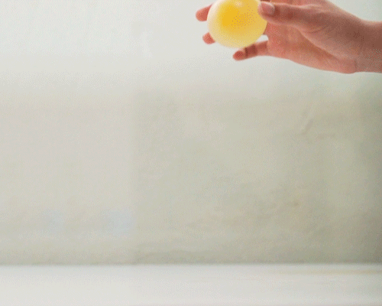

Slide 142
The Solution that these plants cells are in must be…
  A.) Hypotonic
  B.) Hypertonic
  C.) Isotonic
  D.) Facilitated
  E.) None of the
  above.
13

Slide 143
The Solution that these plants cells are in must be…
  A.) Hypotonic
  B.) Hypertonic
  C.) Isotonic
  D.) Facilitated
  E.) None of the
  above.
13

Slide 144
The Solution that these plants cells are in must be…
  A.) Hypotonic
  B.) Hypertonic
  C.) Isotonic
  D.) Facilitated
  E.) None of the
  above.
13

Slide 145
The Solution that these plants cells are in must be…
  A.) Hypotonic
  B.) Hypertonic
  C.) Isotonic
  D.) Facilitated
  E.) None of the
  above.
13

Slide 146
The Solution that these plants cells are in must be…
  A.) Hypotonic
  B.) Hypertonic
  C.) Isotonic
  D.) Facilitated
  E.) None of the
  above.
13

Slide 147
The Solution that these plants cells are in must be…
  A.) Hypotonic
  B.) Hypertonic
  C.) Isotonic
  D.) Facilitated
  E.) None of the
  above.
13

Slide 148
The Solution that these plants cells are in must be…
  A.) Hypotonic
  B.) Hypertonic
  C.) Isotonic
  D.) Facilitated
  E.) None of the
  above.
13
and the answer is…

Slide 149
The Solution that these plants cells are in must be…
  A.) Hypotonic
  B.) Hypertonic
  C.) Isotonic
  D.) Facilitated
  E.) None of the
  above.
13
and the answer is…

Slide 150
The Solution that these plants cells are in must be…
  A.) Hypotonic
  B.) Hypertonic
  C.) Isotonic
  D.) Facilitated
  E.) None of the
  above.
Water moves in
13
and the answer is…

Slide 151
The Solution that these plants cells are in must be…
  A.) Hypotonic
  B.) Hypertonic
  C.) Isotonic
  D.) Facilitated
  E.) None of the
  above.
Water moves in
Cell
Swells
13
and the answer is…

Slide 152
14
Isotonic Solution: The cell has an equal proportion of concentration with the area surrounding.
  Water continually flows in and out to keep concentration even.
Cell
Copyright © 2024 SlideSpark .LLC
Copyright © 2024 SlideSpark .LLC

Slide 153
14
Isotonic Solution: The cell has an equal proportion of concentration with the area surrounding.
  Water continually flows in and out to keep concentration even.
Cell
Copyright © 2024 SlideSpark .LLC
Copyright © 2024 SlideSpark .LLC

Slide 154
14
Isotonic Solution: The cell has an equal proportion of concentration with the area surrounding.
  Water continually flows in and out to keep concentration even.
Cell
Copyright © 2024 SlideSpark .LLC
Copyright © 2024 SlideSpark .LLC

Slide 155

14
Isotonic Solution: The cell has an equal proportion of concentration with the area surrounding.
  Water continually flows in and out to keep concentration even.
Cell
Copyright © 2024 SlideSpark .LLC
Copyright © 2024 SlideSpark .LLC

Slide 156
14
Isotonic Solution: The cell has an equal proportion of concentration with the area surrounding.
  Water continually flows in and out to keep concentration even.
Cell
Copyright © 2024 SlideSpark .LLC
Copyright © 2024 SlideSpark .LLC

Slide 157
This uses energy to move molecules from areas of low concentration to areas of high concentration.
15
Copyright © 2024 SlideSpark .LLC

Slide 158
This uses energy to move molecules from areas of low concentration to areas of high concentration.
15
and the answer is…
Copyright © 2024 SlideSpark .LLC

Slide 159
This uses energy to move molecules from areas of low concentration to areas of high concentration.
15
Active
Transport
Copyright © 2024 SlideSpark .LLC

Slide 160
Cellular Biology Review Game
INSIDE AND OUT | INSANE IN THE MEMBRANE | UNCOMMON SOLUTIONS | BIG- GULP | -BONUS- SOLUTION FLICKS
1 | 6 | 11 | 16 | *21
2 | 7 | 12 | 17 | *22
3 | 8 | 13 | 18 | *23
4 | 9 | 14 | 19 | *24
5 | 10 | 15 | 20 | *25
Copyright © 2024 SlideSpark .LLC

Slide 161
Cellular Biology Review Game
INSIDE AND OUT | INSANE IN THE MEMBRANE | UNCOMMON SOLUTIONS | BIG- GULP | -BONUS- SOLUTION FLICKS
1 | 6 | 11 | 16 | *21
2 | 7 | 12 | 17 | *22
3 | 8 | 13 | 18 | *23
4 | 9 | 14 | 19 | *24
5 | 10 | 15 | 20 | *25
Copyright © 2024 SlideSpark .LLC

Slide 162
Name this process.
16
Copyright © 2024 SlideSpark .LLC

Slide 163
Name this process.
and the answer is…
16
Copyright © 2024 SlideSpark .LLC

Slide 164
Name this process.
and the answer is…
16
Endocytosis
Copyright © 2024 SlideSpark .LLC

Slide 165
17
This is the process where the membrane surrounds large solid particles.
Copyright © 2024 SlideSpark .LLC

Slide 166
17
This is the process where the membrane surrounds large solid particles.
and the answer is…
Copyright © 2024 SlideSpark .LLC

Slide 167
17
This is the process where the membrane surrounds large solid particles.
and the answer is…
Phagocytosis
Copyright © 2024 SlideSpark .LLC

Slide 168

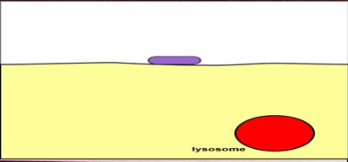


Slide 170
Just when you
thought it was safe..

Slide 171
To go swimming in the plasma…
Just when you
thought it was safe..

Slide 172
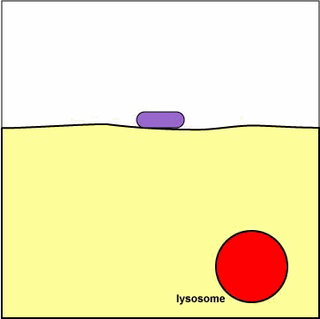
Phagocytosis 2
“AHHHHH!”

Slide 173
Phagocytosis 3

Slide 174
Phagocytosis 3
Revenge of the
Phagolysosome

Slide 175
Phagocytosis 3
Revenge of the
Phagolysosome
“Noooooooooooo!

Slide 176
Process where the membrane surrounds a liquid.
18
Copyright © 2024 SlideSpark .LLC

Slide 177
Process where the membrane surrounds a liquid.
18
and the answer is…
Copyright © 2024 SlideSpark .LLC

Slide 178
Process where the membrane surrounds a liquid.
18
Pinocytosis
and the answer is…
Copyright © 2024 SlideSpark .LLC

Slide 179
19
How did this virus enter the cell?
Copyright © 2024 SlideSpark .LLC

Slide 180
19
How did this virus enter the cell?
and the answer is…
Copyright © 2024 SlideSpark .LLC

Slide 181
19
How did this virus enter the cell?
Transmembrane
Protein receptor mediated
endocytosis
and the answer is…
Copyright © 2024 SlideSpark .LLC

Slide 182
20
Why don’t
the plant
cells burst?

Slide 183
20
Why don’t
the plant
cells burst?
and the answer is…

Slide 184
20
Why don’t
the plant
cells burst?
Cell Walls
and the answer is…

Slide 185
Cellular Biology Review Game
INSIDE AND OUT | INSANE IN THE MEMBRANE | UNCOMMON SOLUTIONS | BIG- GULP | -BONUS- SOLUTION FLICKS
1 | 6 | 11 | 16 | *21
2 | 7 | 12 | 17 | *22
3 | 8 | 13 | 18 | *23
4 | 9 | 14 | 19 | *24
5 | 10 | 15 | 20 | *25
Copyright © 2024 SlideSpark .LLC

Slide 186
Cellular Biology Review Game
INSIDE AND OUT | INSANE IN THE MEMBRANE | UNCOMMON SOLUTIONS | BIG- GULP | -BONUS- SOLUTION FLICKS
1 | 6 | 11 | 16 | *21
2 | 7 | 12 | 17 | *22
3 | 8 | 13 | 18 | *23
4 | 9 | 14 | 19 | *24
5 | 10 | 15 | 20 | *25
Copyright © 2024 SlideSpark .LLC

Slide 187
Name this movie with hypertonic chocolate milk?
*21
Copyright © 2024 SlideSpark .LLC

Slide 188

Name this movie with hypertonic chocolate milk?
*21
Copyright © 2024 SlideSpark .LLC

Slide 189
Name this movie with hypertonic milk?
*22
Copyright © 2024 SlideSpark .LLC

Slide 190

Name this movie with hypertonic milk?
*22
Copyright © 2024 SlideSpark .LLC

Slide 191
Name this movie with a hypotonic white blood cell?
*23
Copyright © 2024 SlideSpark .LLC

Slide 192

Name this movie with a hypotonic white blood cell?
*23
Osmosis
Jones
Copyright © 2024 SlideSpark .LLC

Slide 193
Name this movie with hypertonic slime?
*24
Copyright © 2024 SlideSpark .LLC

Slide 194

Name this movie with hypertonic slime?
*24
Ghostbusters
Copyright © 2024 SlideSpark .LLC

Slide 195
Name this movie with hypo and hypertonic solutions?
*25
Copyright © 2024 SlideSpark .LLC

Slide 196

Name this movie with hypo and hypertonic solutions?
*25
Copyright © 2024 SlideSpark .LLC

Slide 197
Name this movie with hypo and hypertonic solutions?
*25
“Ahhh, Why can’t you both be Isotonic solutions.”
Copyright © 2024 SlideSpark .LLC

Slide 198
Cellular Biology Review Game
INSIDE AND OUT | INSANE IN THE MEMBRANE | UNCOMMON SOLUTIONS | BIG- GULP | -BONUS- SOLUTION FLICKS
1 | 6 | 11 | 16 | *21
2 | 7 | 12 | 17 | *22
3 | 8 | 13 | 18 | *23
4 | 9 | 14 | 19 | *24
5 | 10 | 15 | 20 | *25
Final Question
Copyright © 2024 SlideSpark .LLC

Slide 199
5 pt Wager Question
(You can wager up to 5 pts)

Slide 200
  Fill beak with distilled water.
  Add corn syrup to dialysis tubing
  Align the corn syrup and water levels in the beaker.
  Visit tomorrow.
  What happened?
Tie

Slide 201
Time passes
Tie

Slide 202
Time passes
Tie

Slide 203
  The corn syrup was hypertonic (more solute). Water was hypotonic. The water moved into the dialysis tubing to equal the concentrations (isotonic ).
  The fluid in the tubing rose.
Tie

Slide 204
  The corn syrup was hypertonic (more solute). Water was hypotonic. The water moved into the dialysis tubing to equal the concentrations (isotonic ).
  The fluid in the tubing rose.
Tie

Slide 205
  The corn syrup was hypertonic (more solute). Water was hypotonic. The water moved into the dialysis tubing to equal the concentrations (isotonic ).
  The fluid in the tubing rose.
Tie

Slide 206
  The corn syrup was hypertonic (more solute). Water was hypotonic. The water moved into the dialysis tubing to equal the concentrations (isotonic ).
  The fluid in the tubing rose.
Tie

Slide 207
  The corn syrup was hypertonic (more solute). Water was hypotonic. The water moved into the dialysis tubing to equal the concentrations (isotonic ).
  The fluid in the tubing rose.
Tie

Slide 208
  The corn syrup was hypertonic (more solute). Water was hypotonic. The water moved into the dialysis tubing to equal the concentrations (isotonic ).
  The fluid in the tubing rose.
Tie

Slide 209
  The corn syrup was hypertonic (more solute). Water was hypotonic. The water moved into the dialysis tubing to equal the concentrations ( Isotonic ).
  The fluid in the tubing rose.
Tie

Slide 210
Questions 1-20 = 5pts Each
Final Category (Bonus) = 1pt Each
Final Questions = 5 pt wager
Find the Owl =
Secretly write “Owl” in the correct box worth 1pt.

Slide 211
Cell Transport
Review Game
Part 2
Lesson 7

Slide 212



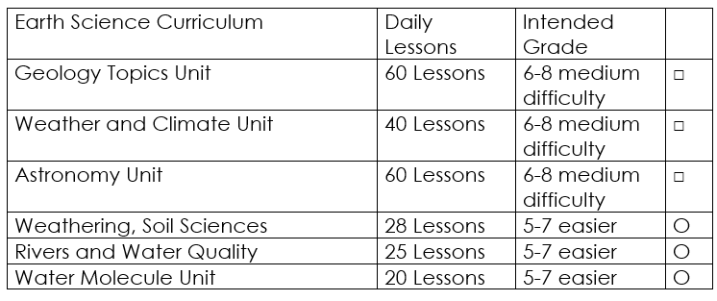

Curriculum Guide
Number of Lessons in each unit (50 min, daily lessons) and difficult rating scale / intended grade level.
=Easier, = More difficult, =Most difficult
Earth Science Units

Slide 213


Life Science Units

Slide 214

Physical Science

Slide 215
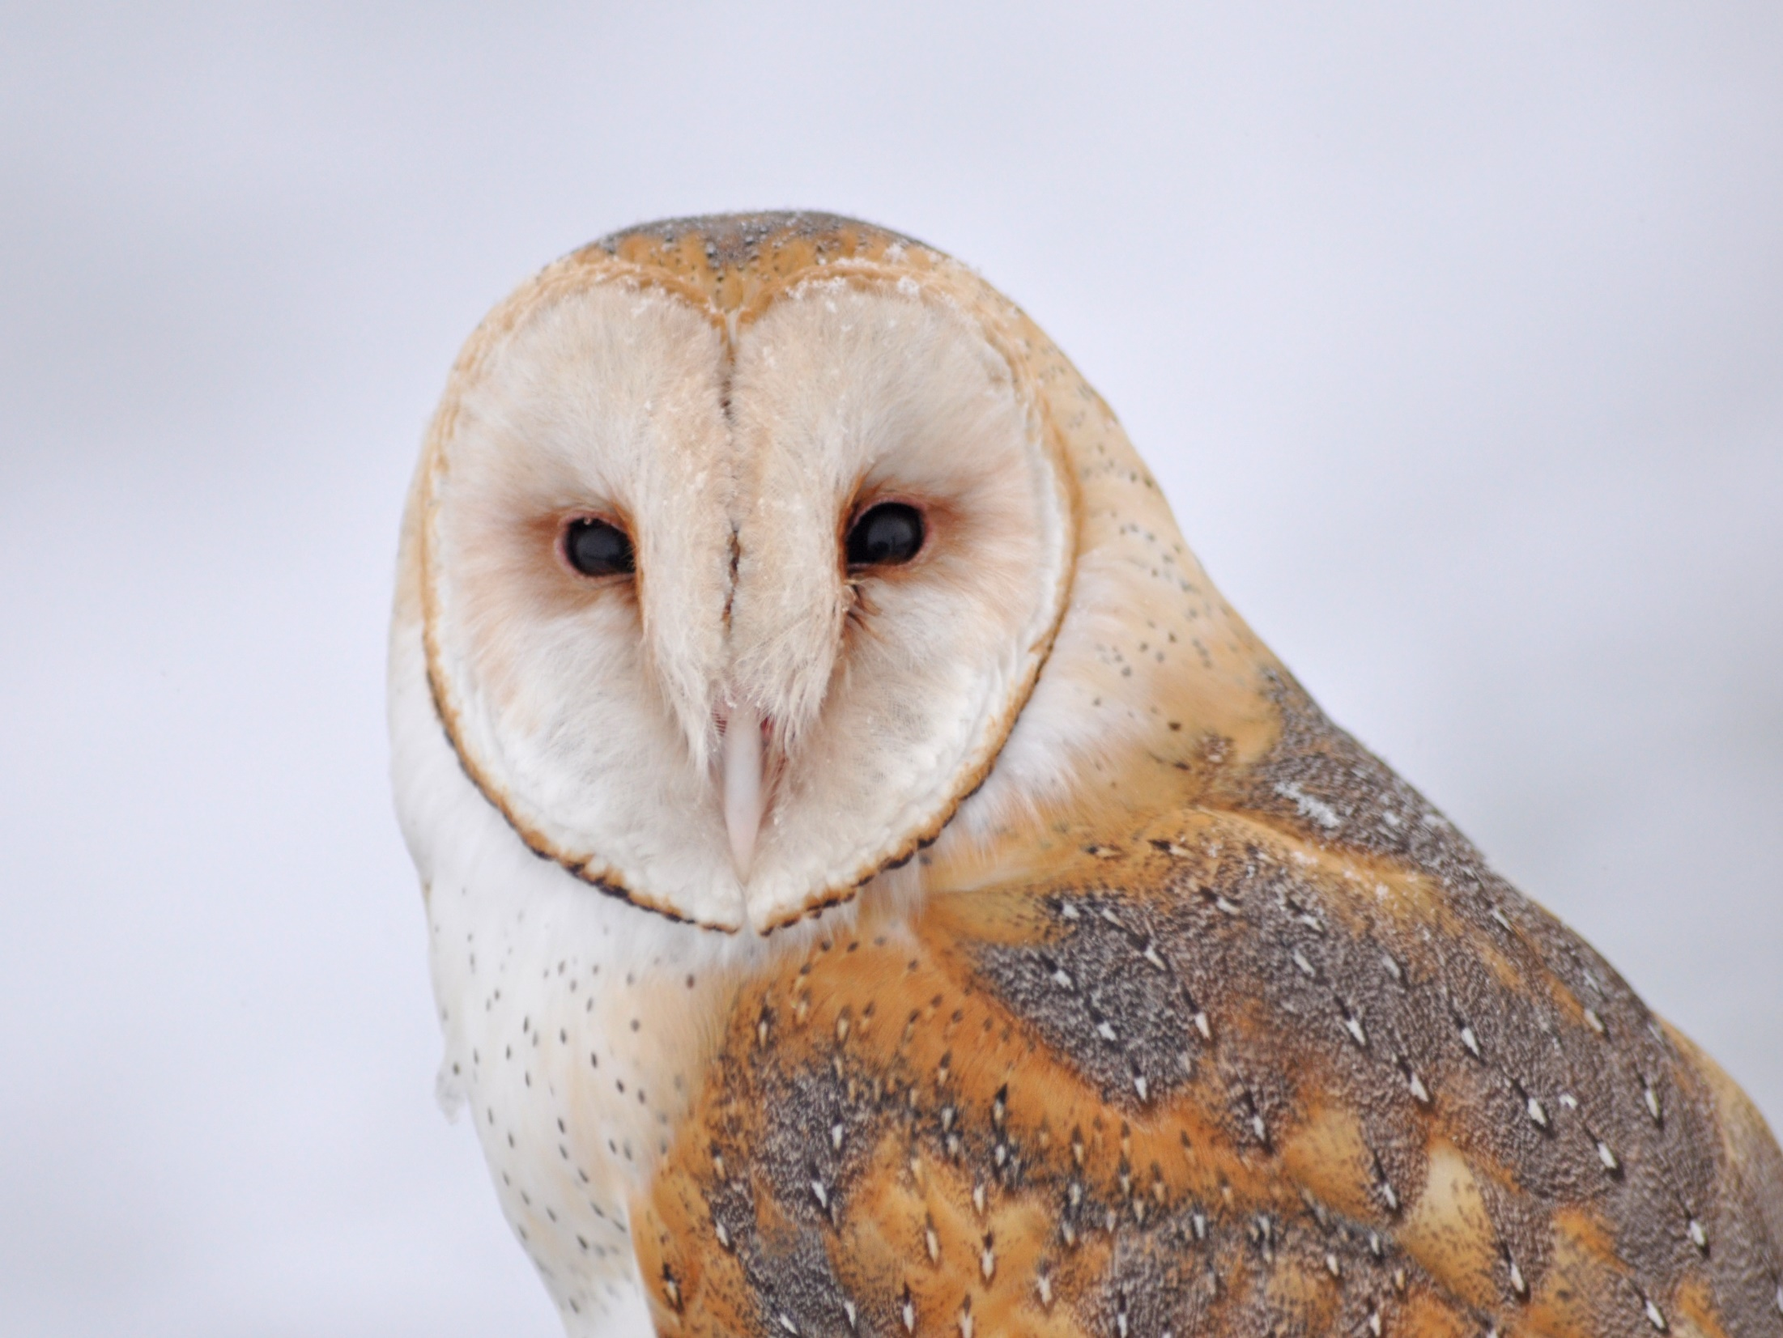
Dear Valued Educator,
Our fully editable .pptx and .doc resources are perfect for educators looking to bring enthusiasm and creativity to their lessons. We encourage you to make changes to fit your needs and style. As science educators, we’re committed to providing students with the tools they need to succeed in the classroom and beyond. Each unit in the curriculum includes a range of resources that have been developed through extensive research and use in a busy classroom. Our teaching approach is designed to make science education engaging and exciting for learners of all ages. We offer a one-of-a-kind science curriculum that will challenge, inspire, and educate students to become tomorrow's scientists and leaders. Join us today and learn more about how our program can help you achieve your classroom goals.
With appreciation,
Support@SlideSpark.net

Slide 216





Thank you for your time and interest in our Science curriculum. We strive to provide students with engaging and informative lessons that will spark their curiosity and encourage scientific exploration. Should you have any questions or concerns, please do not hesitate to contact us. Thank you again for considering our curriculum, and we wish you all the best in your educational journey.
Sincerely,
Support@slidespark.net
SlideSpark Science on TpT

