Slide 1
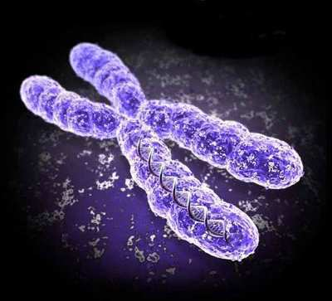

Mitosis Review Game
Part 2
Lesson 5

Slide 2
Parts 2 Cell Division (Mitosis) Review Game
THE GREAT DIVIDE | IT’S JUST A PHASE | CHROMA- Something | GEE WIZ | -Bonus- FAMILY QUEST
1 | 6 | 11 | 16 | *21
2 | 7 | 12 | 17 | *22
3 | 8 | 13 | 18 | *23
4 | 9 | 14 | 19 | *24
5 | 10 | 15 | 20 | *25

Slide 3
How to play…
  Don’t play like Jeo_ _ _ _ y.
  Class should be divided into several small groups.
  Groups should use science journal (red slide notes), homework, and other available materials to assist you.
  Groups can communicate quietly with each other but no sharing answers between groups.
    Practice quietly communicating right now?
    Practice Communication Question:
    Your group gets to order one pizza and you can have two toppings. What does your group want?

Slide 4

Questions 1-10 = 10pts Each
Final Category (Bonus) = 1pt Each
Final Questions = 5 pt wager
Find the Owl = + 1pt
Secretly write “Owl” in the correct box worth 1pt.

Slide 5
Parts 2 Cell Division (Mitosis) Review Game
THE GREAT DIVIDE | IT’S JUST A PHASE | CHROMA- Something | GEE WIZ | -Bonus- FAMILY QUEST
1 | 6 | 11 | 16 | *21
2 | 7 | 12 | 17 | *22
3 | 8 | 13 | 18 | *23
4 | 9 | 14 | 19 | *24
5 | 10 | 15 | 20 | *25

Slide 6
Parts 2 Cell Division (Mitosis) Review Game
THE GREAT DIVIDE | IT’S JUST A PHASE | CHROMA- Something | GEE WIZ | -Bonus- FAMILY QUEST
1 | 6 | 11 | 16 | *21
2 | 7 | 12 | 17 | *22
3 | 8 | 13 | 18 | *23
4 | 9 | 14 | 19 | *24
5 | 10 | 15 | 20 | *25

Slide 7
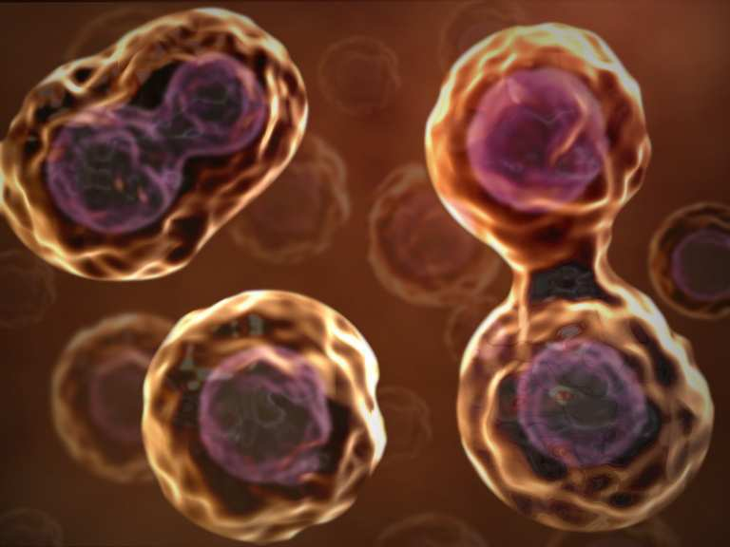
This is the name of the process where one cell divides into two?
  Exact copy is made.
1
Copyright © 2024 SlideSpark .LLC

Slide 8
This is an organized structure of DNA and protein that is found in cells.
2
6
Copyright © 2024 SlideSpark .LLC

Slide 9
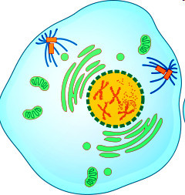
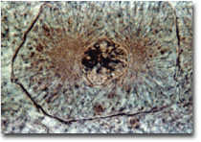
Name this phase of Mitosis.
  Chromatin draws together to create chromosomes.
  Spindle fibers form.
3
Copyright © 2024 SlideSpark .LLC

Slide 10
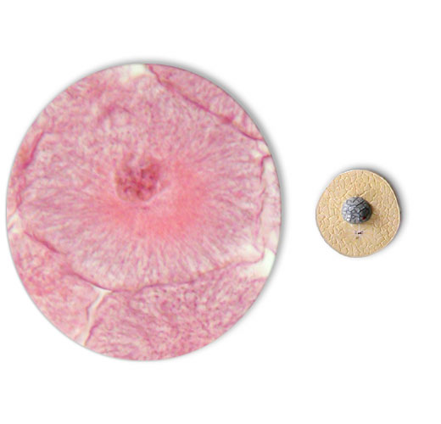
4
Name this phase of Mitosis.
  Most of cell cycle (90%)
  Cell grows and develops (gets bigger)
  Chromosomes not visible
  Nucleus intact
  DNA is copied
Copyright © 2024 SlideSpark .LLC

Slide 11
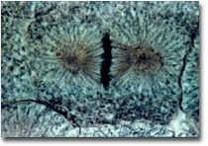
This phase of mitosis (cellular division) is best represented by the image below?
5
7
Copyright © 2024 SlideSpark .LLC

Slide 12
Parts 2 Cell Division (Mitosis) Review Game
THE GREAT DIVIDE | IT’S JUST A PHASE | CHROMA- Something | GEE WIZ | -Bonus- FAMILY QUEST
1 | 6 | 11 | 16 | *21
2 | 7 | 12 | 17 | *22
3 | 8 | 13 | 18 | *23
4 | 9 | 14 | 19 | *24
5 | 10 | 15 | 20 | *25

Slide 13
Parts 2 Cell Division (Mitosis) Review Game
THE GREAT DIVIDE | IT’S JUST A PHASE | CHROMA- Something | GEE WIZ | -Bonus- FAMILY QUEST
1 | 6 | 11 | 16 | *21
2 | 7 | 12 | 17 | *22
3 | 8 | 13 | 18 | *23
4 | 9 | 14 | 19 | *24
5 | 10 | 15 | 20 | *25

Slide 14
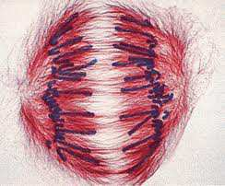
These structures help pull the chromosomes to opposite poles of the cell.
A.) DNA
B.) Cytoplasm
C.) Spindle Fibers /
Microtubules
D.) Membrane
E.) None of the
above.
6

Slide 15
These structures help pull the chromosomes to opposite poles of the cell.
A.) DNA
B.) Cytoplasm
C.) Spindle Fibers /
Microtubules
D.) Membrane
E.) None of the
above.
6

Slide 16
These structures help pull the chromosomes to opposite poles of the cell.
A.) DNA
B.) Cytoplasm
C.) Spindle Fibers /
Microtubules
D.) Membrane
E.) None of the
above.
6

Slide 17
These structures help pull the chromosomes to opposite poles of the cell.
A.) DNA
B.) Cytoplasm
C.) Spindle Fibers /
Microtubules
D.) Membrane
E.) None of the
above.
6

Slide 18
These structures help pull the chromosomes to opposite poles of the cell.
A.) DNA
B.) Cytoplasm
C.) Spindle Fibers /
Microtubules
D.) Membrane
E.) None of the
above.
6

Slide 19
These structures help pull the chromosomes to opposite poles of the cell.
A.) DNA
B.) Cytoplasm
C.) Spindle Fibers /
Microtubules
D.) Membrane
E.) None of the
above.
6

Slide 20
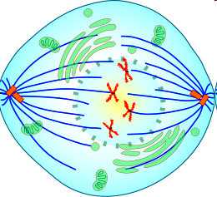
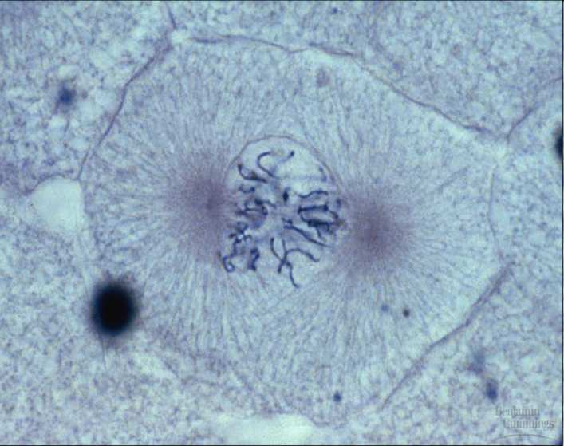
Name this phase just before metaphase?
  Nuclear envelope breaks down.
  Centrosomes are positioned at opposite poles of the cell.
  Spindle fibers attach to chromosome at the kinetochore.
7

Slide 21
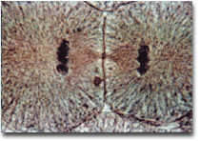
Name this phase of Mitosis?
  Chromosomes reaching poles.
  Nuclear membrane begins to form.
  Cleavage furrow forms pinching cell into two.
  Chromosomes begin to unwrap.
8

Slide 22
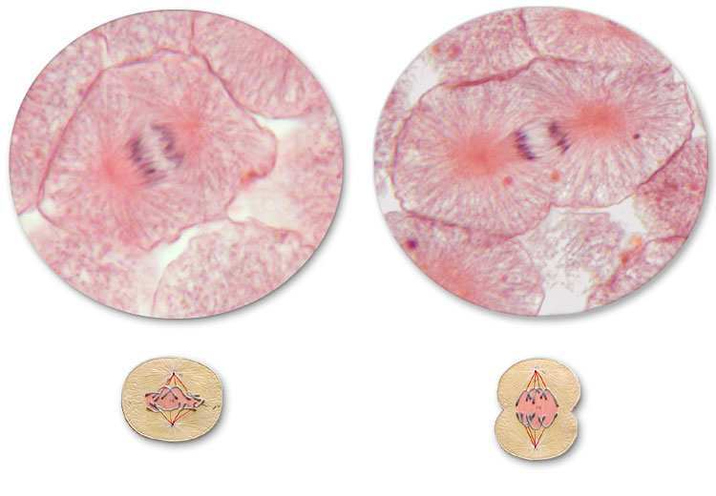
9
Early Anaphase
Late Anaphase

Slide 23
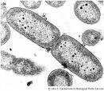
This is the term when the cell breaks into two identical cells?
10

Slide 24
Parts 2 Cell Division (Mitosis) Review Game
THE GREAT DIVIDE | IT’S JUST A PHASE | CHROMA- Something | GEE WIZ | -Bonus- FAMILY QUEST
1 | 6 | 11 | 16 | *21
2 | 7 | 12 | 17 | *22
3 | 8 | 13 | 18 | *23
4 | 9 | 14 | 19 | *24
5 | 10 | 15 | 20 | *25

Slide 25
Parts 2 Cell Division (Mitosis) Review Game
THE GREAT DIVIDE | IT’S JUST A PHASE | CHROMA- Something | GEE WIZ | -Bonus- FAMILY QUEST
1 | 6 | 11 | 16 | *21
2 | 7 | 12 | 17 | *22
3 | 8 | 13 | 18 | *23
4 | 9 | 14 | 19 | *24
5 | 10 | 15 | 20 | *25

Slide 26
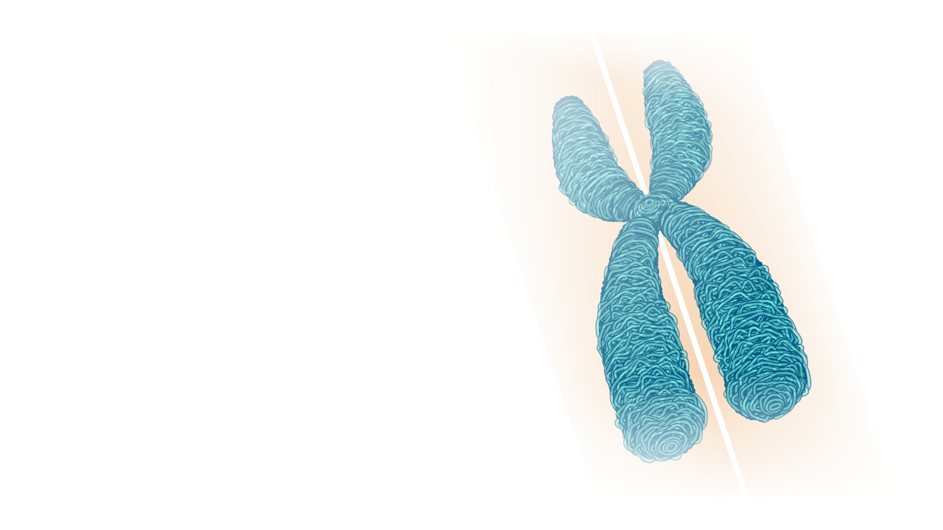
This is the name for one copy of a duplicated chromosome, which generally is joined to the other copy by a centromere, for the process of cellular division (mitosis).
11

Slide 27
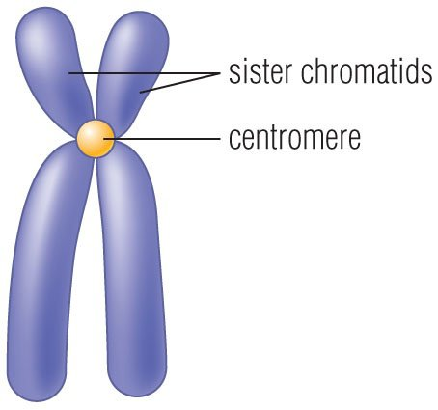
The region of a chromosome to which the microtubules of the spindle attach, via the kinetochore, during cell division.
12

Slide 28
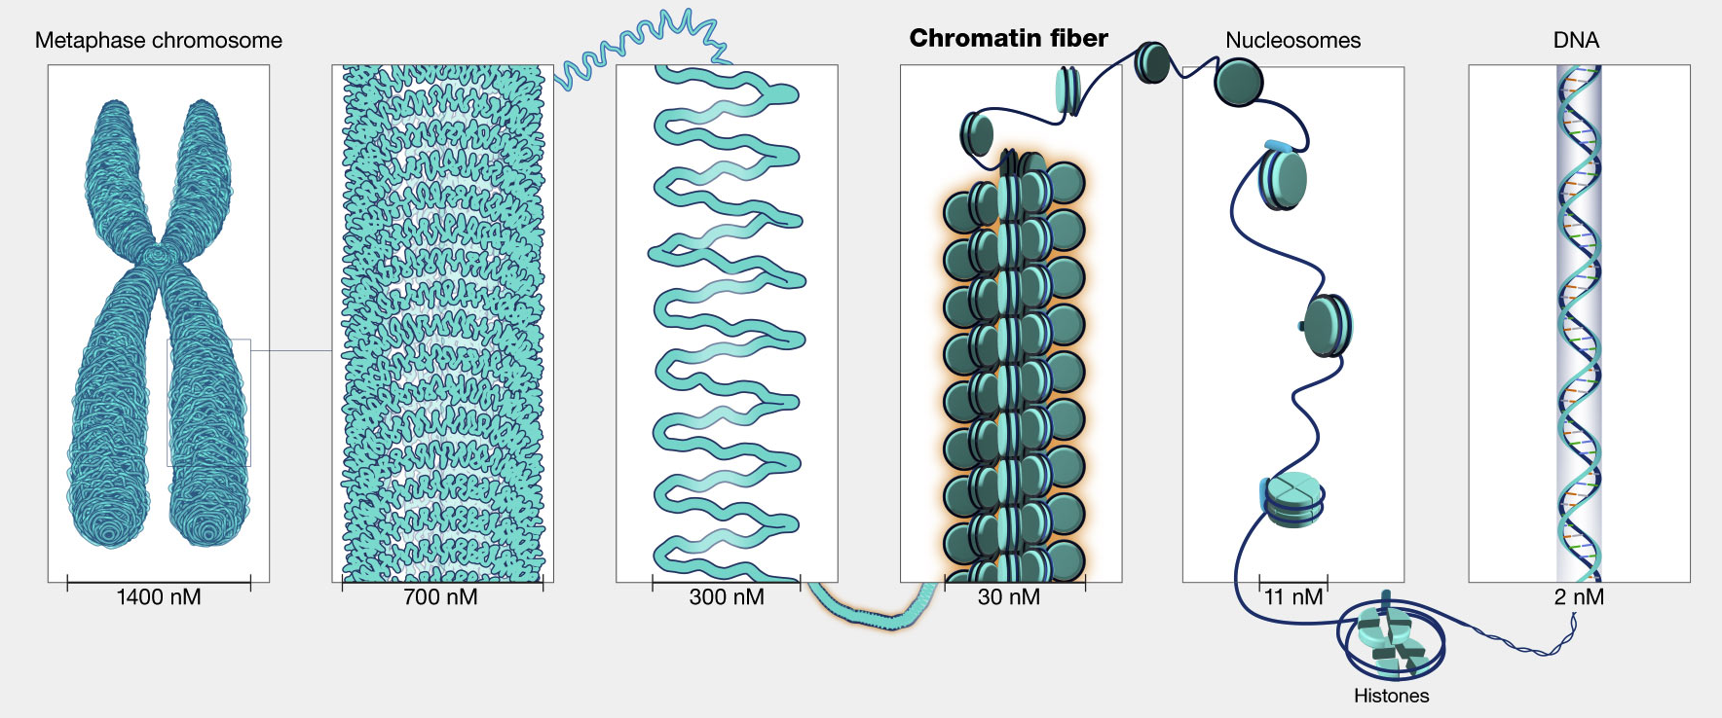
Which is DNA, which is Chromatin, and which is a Chromosome?
C
A
B
13

Slide 29
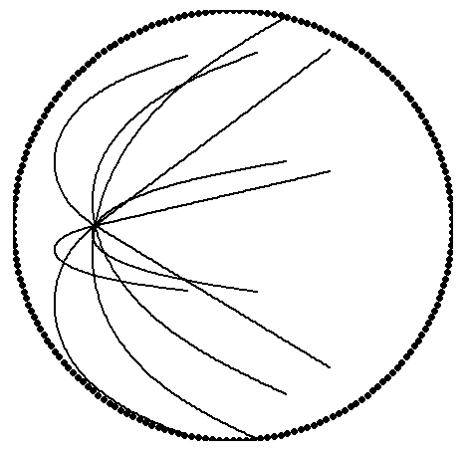
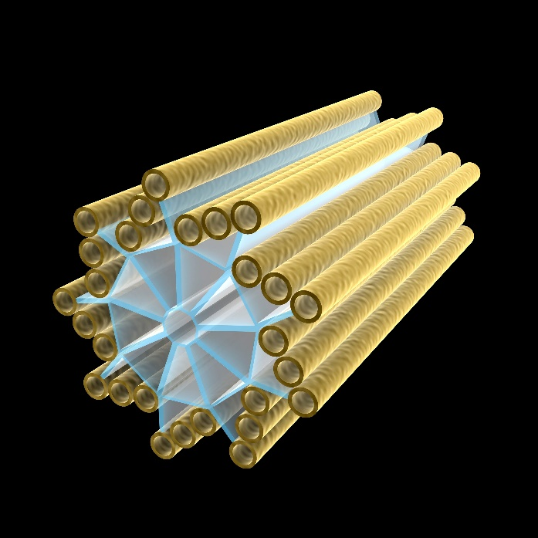

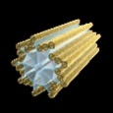
These are a minute cylindrical organelle near the nucleus in animal cells, occurring in pairs and involved in the development of spindle fibers in cell division
14

Slide 30
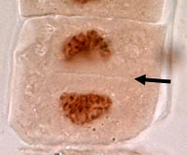
Cytokinesis in Plants
  This is the name for the partition formed during cell division in plants and some algae.
15
New Cell Wall

Slide 31
Parts 2 Cell Division (Mitosis) Review Game
THE GREAT DIVIDE | IT’S JUST A PHASE | CHROMA- Something | GEE WIZ | -Bonus- FAMILY QUEST
1 | 6 | 11 | 16 | *21
2 | 7 | 12 | 17 | *22
3 | 8 | 13 | 18 | *23
4 | 9 | 14 | 19 | *24
5 | 10 | 15 | 20 | *25

Slide 32
Parts 2 Cell Division (Mitosis) Review Game
THE GREAT DIVIDE | IT’S JUST A PHASE | CHROMA- Something | GEE WIZ | -Bonus- FAMILY QUEST
1 | 6 | 11 | 16 | *21
2 | 7 | 12 | 17 | *22
3 | 8 | 13 | 18 | *23
4 | 9 | 14 | 19 | *24
5 | 10 | 15 | 20 | *25

Slide 33
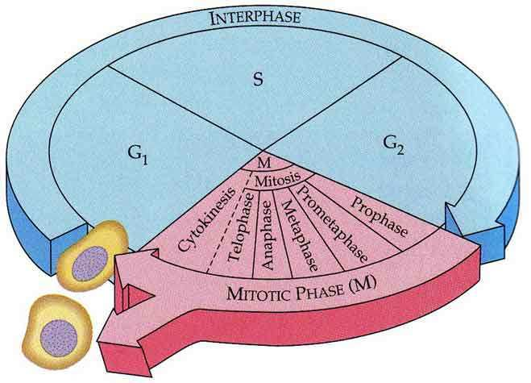
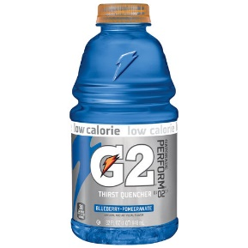

In which part of Interphase does the cell copy the DNA?
16

Slide 34
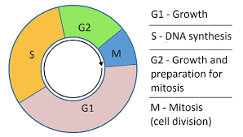
In which part of the Cell Cycle does growth, preparation, and check occur. This occurs just before cell division.
17

Slide 35
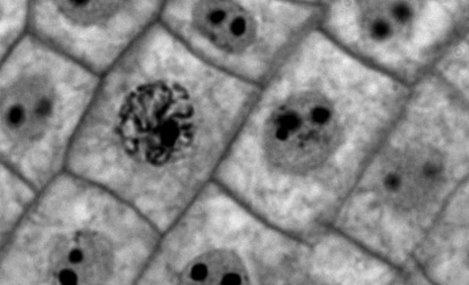
True or False? This cell are undergoing cell division.
18

Slide 36
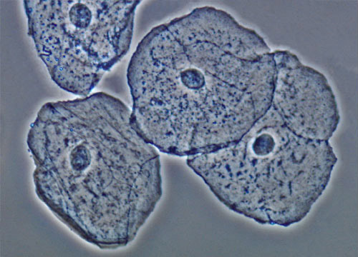
True or False? These cheek cell are undergoing cell division.
19

Slide 37
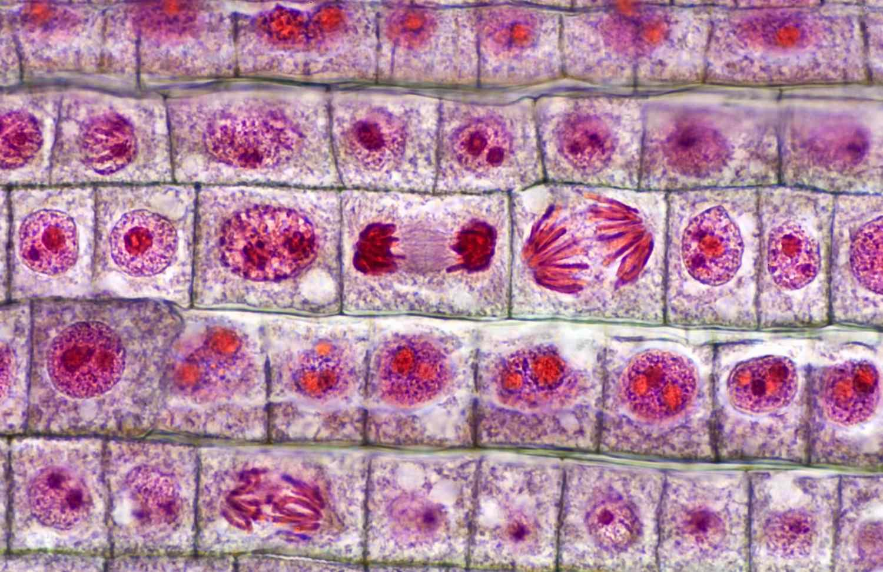
Name…
A
B
C
D
E
20

Slide 38
Parts 2 Cell Division (Mitosis) Review Game
THE GREAT DIVIDE | IT’S JUST A PHASE | CHROMA- Something | GEE WIZ | -Bonus- FAMILY QUEST
1 | 6 | 11 | 16 | *21
2 | 7 | 12 | 17 | *22
3 | 8 | 13 | 18 | *23
4 | 9 | 14 | 19 | *24
5 | 10 | 15 | 20 | *25

Slide 39
Parts 2 Cell Division (Mitosis) Review Game
THE GREAT DIVIDE | IT’S JUST A PHASE | CHROMA- Something | GEE WIZ | -Bonus- FAMILY QUEST
1 | 6 | 11 | 16 | *21
2 | 7 | 12 | 17 | *22
3 | 8 | 13 | 18 | *23
4 | 9 | 14 | 19 | *24
5 | 10 | 15 | 20 | *25

Slide 40

*21
Name this family?

Slide 41
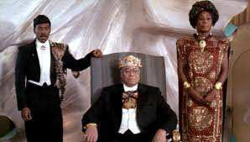
*22
Name this movie?

Slide 42

*23
Meet…

Slide 43

*24

Slide 44
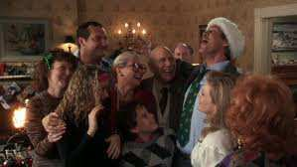

Name this family?
*25

Slide 45
Parts 2 Cell Division (Mitosis) Review Game
THE GREAT DIVIDE | IT’S JUST A PHASE | CHROMA- Something | GEE WIZ | -Bonus- FAMILY QUEST
1 | 6 | 11 | 16 | *21
2 | 7 | 12 | 17 | *22
3 | 8 | 13 | 18 | *23
4 | 9 | 14 | 19 | *24
5 | 10 | 15 | 20 | *25
Final Question

Slide 46
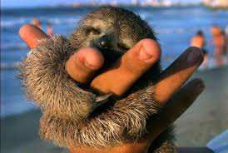
5 Point Wager Question

Slide 47
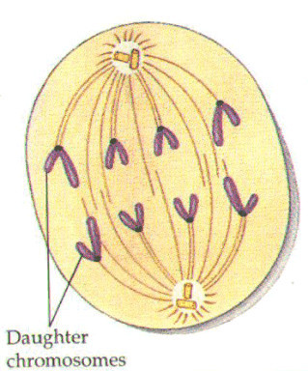
Name this phase of Mitosis?
  Chromosomes get split at centromere
  The two identical copies get pulled apart
Copyright © 2024 SlideSpark .LLC

Slide 48
Name this phase of Mitosis?
  Chromosomes get split at centromere
  The two identical copies get pulled apart
Anaphase
Copyright © 2024 SlideSpark .LLC

Slide 49
Questions 1-10 = 10pts Each
Final Category (Bonus) = 1pt Each
Final Questions = 5 pt wager
Find the Owl = + 1pt
Secretly write “Owl” in the correct box worth 1pt.

Slide 50
Mitosis Review Game
Part 2
Lesson 5

Slide 51

Mitosis Review Game
ANSWER VERSION
Part 2
Lesson 6

Slide 52
Parts 2 Cell Division (Mitosis) Review Game
THE GREAT DIVIDE | IT’S JUST A PHASE | CHROMA- Something | GEE WIZ | -Bonus- FAMILY QUEST
1 | 6 | 11 | 16 | *21
2 | 7 | 12 | 17 | *22
3 | 8 | 13 | 18 | *23
4 | 9 | 14 | 19 | *24
5 | 10 | 15 | 20 | *25

Slide 53
How to play…
  Don’t play like Jeo_ _ _ _ y.
  Class should be divided into several small groups.
  Groups should use science journal (red slide notes), homework, and other available materials to assist you.
  Groups can communicate quietly with each other but no sharing answers between groups.
    Practice quietly communicating right now?
    Practice Communication Question:
    Your group gets to order one pizza and you can have two toppings. What does your group want?

Slide 54
Questions 1-10 = 10pts Each
Final Category (Bonus) = 1pt Each
Final Questions = 5 pt wager
Find the Owl = + 1pt
Secretly write “Owl” in the correct box worth 1pt.

Slide 55
Parts 2 Cell Division (Mitosis) Review Game
THE GREAT DIVIDE | IT’S JUST A PHASE | CHROMA- Something | GEE WIZ | -Bonus- FAMILY QUEST
1 | 6 | 11 | 16 | *21
2 | 7 | 12 | 17 | *22
3 | 8 | 13 | 18 | *23
4 | 9 | 14 | 19 | *24
5 | 10 | 15 | 20 | *25

Slide 56
Parts 2 Cell Division (Mitosis) Review Game
THE GREAT DIVIDE | IT’S JUST A PHASE | CHROMA- Something | GEE WIZ | -Bonus- FAMILY QUEST
1 | 6 | 11 | 16 | *21
2 | 7 | 12 | 17 | *22
3 | 8 | 13 | 18 | *23
4 | 9 | 14 | 19 | *24
5 | 10 | 15 | 20 | *25

Slide 57
This is the name of the process where one cell divides into two?
  Exact copy is made.
1
Copyright © 2024 SlideSpark .LLC

Slide 58
This is the name of the process where one cell divides into two?
  An exact copy is made. (Hopefully)
1
and the answer is…
Copyright © 2024 SlideSpark .LLC

Slide 59
This is the name of the process where one cell divides into two?
  An exact copy is made. (Hopefully)
1
Mitosis
and the answer is…
Copyright © 2024 SlideSpark .LLC

Slide 60
This is an organized structure of DNA and protein that is found in cells.
2
6
Copyright © 2024 SlideSpark .LLC

Slide 61
This is an organized structure of DNA and protein that is found in cells.
2
6
and the answer is…
Copyright © 2024 SlideSpark .LLC

Slide 62
This is an organized structure of DNA and protein that is found in cells.
2
6
Chromosomes
and the answer is…
Copyright © 2024 SlideSpark .LLC

Slide 63
Name this phase of Mitosis.
  Chromatin draws together to create chromosomes.
  Spindle fibers form.
3
Copyright © 2024 SlideSpark .LLC

Slide 64
Name this phase of Mitosis.
  Chromatin draws together to create chromosomes.
  Spindle fibers form.
3
Prophase
Copyright © 2024 SlideSpark .LLC

Slide 65
4
Name this phase of Mitosis.
  Most of cell cycle (90%)
  Cell grows and develops (gets bigger)
  Chromosomes not visible
  Nucleus intact
  DNA is copied
Copyright © 2024 SlideSpark .LLC

Slide 66
4
Name this phase of Mitosis.
  Most of cell cycle (90%)
  Cell grows and develops (gets bigger)
  Chromosomes not visible
  Nucleus intact
  DNA is copied
Interphase
Copyright © 2024 SlideSpark .LLC

Slide 67
This phase of mitosis (cellular division) is best represented by the image below?
5
7
Copyright © 2024 SlideSpark .LLC

Slide 68
This phase of mitosis (cellular division) is best represented by the image below?
5
7
Metaphase
Copyright © 2024 SlideSpark .LLC

Slide 69
Parts 2 Cell Division (Mitosis) Review Game
THE GREAT DIVIDE | IT’S JUST A PHASE | CHROMA- Something | GEE WIZ | -Bonus- FAMILY QUEST
1 | 6 | 11 | 16 | *21
2 | 7 | 12 | 17 | *22
3 | 8 | 13 | 18 | *23
4 | 9 | 14 | 19 | *24
5 | 10 | 15 | 20 | *25

Slide 70
Parts 2 Cell Division (Mitosis) Review Game
THE GREAT DIVIDE | IT’S JUST A PHASE | CHROMA- Something | GEE WIZ | -Bonus- FAMILY QUEST
1 | 6 | 11 | 16 | *21
2 | 7 | 12 | 17 | *22
3 | 8 | 13 | 18 | *23
4 | 9 | 14 | 19 | *24
5 | 10 | 15 | 20 | *25

Slide 71
These structures help pull the chromosomes to opposite poles of the cell.
A.) DNA
B.) Cytoplasm
C.) Spindle Fibers /
Microtubules
D.) Membrane
E.) None of the
above.
6

Slide 72
These structures help pull the chromosomes to opposite poles of the cell.
A.) DNA
B.) Cytoplasm
C.) Spindle Fibers /
Microtubules
D.) Membrane
E.) None of the
above.
6

Slide 73
These structures help pull the chromosomes to opposite poles of the cell.
A.) DNA
B.) Cytoplasm
C.) Spindle Fibers /
Microtubules
D.) Membrane
E.) None of the
above.
6

Slide 74
These structures help pull the chromosomes to opposite poles of the cell.
A.) DNA
B.) Cytoplasm
C.) Spindle Fibers /
Microtubules
D.) Membrane
E.) None of the
above.
6

Slide 75
These structures help pull the chromosomes to opposite poles of the cell.
A.) DNA
B.) Cytoplasm
C.) Spindle Fibers /
Microtubules
D.) Membrane
E.) None of the
above.
6

Slide 76
These structures help pull the chromosomes to opposite poles of the cell.
A.) DNA
B.) Cytoplasm
C.) Spindle Fibers /
Microtubules
D.) Membrane
E.) None of the
above.
6

Slide 77
These structures help pull the chromosomes to opposite poles of the cell.
A.) DNA
B.) Cytoplasm
C.) Spindle Fibers /
Microtubules
D.) Membrane
E.) None of the
above.
6
and the answer is…

Slide 78
These structures help pull the chromosomes to opposite poles of the cell.
A.) DNA
B.) Cytoplasm
C.) Spindle Fibers /
Microtubules
D.) Membrane
E.) None of the
above.
6
and the answer is…

Slide 79
Name this phase just before metaphase?
  Nuclear envelope breaks down.
  Centrosomes are positioned at opposite poles of the cell.
  Spindle fibers attach to chromosome at the kinetochore.
7

Slide 80
Name this phase just before metaphase?
  Nuclear envelope breaks down.
  Centrosomes are positioned at opposite poles of the cell.
  Spindle fibers attach to chromosome at the kinetochore.
7
and the answer is…

Slide 81
Name this phase just before metaphase?
  Nuclear envelope breaks down.
  Centrosomes are positioned at opposite poles of the cell.
  Spindle fibers attach to chromosome at the kinetochore.
7
Prometaphase
and the answer is…

Slide 82
Name this phase of Mitosis?
  Chromosomes reaching poles.
  Nuclear membrane begins to form.
  Cleavage furrow forms pinching cell into two.
  Chromosomes begin to unwrap.
8

Slide 83
Name this phase of Mitosis?
  Chromosomes reaching poles.
  Nuclear membrane begins to form.
  Cleavage furrow forms pinching cell into two.
  Chromosomes begin to unwrap.
8
and the answer is…

Slide 84
Name this phase of Mitosis?
  Chromosomes reaching poles.
  Nuclear membrane begins to form.
  Cleavage furrow forms pinching cell into two.
  Chromosomes begin to unwrap.
8
Telophase
and the answer is…

Slide 85
9
Early Anaphase
Late Anaphase

Slide 86
9
Early Anaphase
Late Anaphase

Slide 87
9
Early Anaphase
Late Anaphase

Slide 88
This is the term when the cell breaks into two identical cells?
10

Slide 89
This is the term when the cell breaks into two identical cells?
10
And the answer is…

Slide 90
This is the term when the cell breaks into two identical cells?
10
Cytokinesis
And the answer is…

Slide 91
Parts 2 Cell Division (Mitosis) Review Game
THE GREAT DIVIDE | IT’S JUST A PHASE | CHROMA- Something | GEE WIZ | -Bonus- FAMILY QUEST
1 | 6 | 11 | 16 | *21
2 | 7 | 12 | 17 | *22
3 | 8 | 13 | 18 | *23
4 | 9 | 14 | 19 | *24
5 | 10 | 15 | 20 | *25

Slide 92
Parts 2 Cell Division (Mitosis) Review Game
THE GREAT DIVIDE | IT’S JUST A PHASE | CHROMA- Something | GEE WIZ | -Bonus- FAMILY QUEST
1 | 6 | 11 | 16 | *21
2 | 7 | 12 | 17 | *22
3 | 8 | 13 | 18 | *23
4 | 9 | 14 | 19 | *24
5 | 10 | 15 | 20 | *25

Slide 93
This is the name for one copy of a duplicated chromosome, which generally is joined to the other copy by a centromere, for the process of cellular division (mitosis).
11

Slide 94
This is the name for one copy of a duplicated chromosome, which generally is joined to the other copy by a centromere, for the process of cellular division (mitosis).
Chromatid
11

Slide 95
The region of a chromosome to which the microtubules of the spindle attach, via the kinetochore, during cell division.
12

Slide 96
The region of a chromosome to which the microtubules of the spindle attach, via the kinetochore, during cell division.
12

Slide 97
The region of a chromosome to which the microtubules of the spindle attach, via the kinetochore, during cell division.
Centromere
12

Slide 98
Which is DNA, which is Chromatin, and which is a Chromosome?
C
A
B
13

Slide 99
Which is DNA, which is Chromatin, and which is a Chromosome?
C
A
B
13

Slide 100
Which is DNA, which is Chromatin, and which is a Chromosome?
C
A
B
Chromosome
13

Slide 101
Which is DNA, which is Chromatin, and which is a Chromosome?
C
A
B
Chromosome
13

Slide 102
Which is DNA, which is Chromatin, and which is a Chromosome?
C
A
B
Chromosome
Chromatin
13

Slide 103
Which is DNA, which is Chromatin, and which is a Chromosome?
C
A
B
Chromosome
Chromatin
13

Slide 104
Which is DNA, which is Chromatin, and which is a Chromosome?
C
A
B
DNA
Chromosome
Chromatin
13

Slide 105
These are a minute cylindrical organelle near the nucleus in animal cells, occurring in pairs and involved in the development of spindle fibers in cell division
14

Slide 106
These are a minute cylindrical organelle near the nucleus in animal cells, occurring in pairs and involved in the development of spindle fibers in cell division
14
Centrosome /
Centrioles

Slide 107
Cytokinesis in Plants
  This is the name for the partition formed during cell division in plants and some algae.
15
New Cell Wall

Slide 108

Cytokinesis in Plants
  This is the name for the partition formed during cell division in plants and some algae.
15
Cell Plate
New Cell Wall

Slide 109
Parts 2 Cell Division (Mitosis) Review Game
THE GREAT DIVIDE | IT’S JUST A PHASE | CHROMA- Something | GEE WIZ | -Bonus- FAMILY QUEST
1 | 6 | 11 | 16 | *21
2 | 7 | 12 | 17 | *22
3 | 8 | 13 | 18 | *23
4 | 9 | 14 | 19 | *24
5 | 10 | 15 | 20 | *25

Slide 110
Parts 2 Cell Division (Mitosis) Review Game
THE GREAT DIVIDE | IT’S JUST A PHASE | CHROMA- Something | GEE WIZ | -Bonus- FAMILY QUEST
1 | 6 | 11 | 16 | *21
2 | 7 | 12 | 17 | *22
3 | 8 | 13 | 18 | *23
4 | 9 | 14 | 19 | *24
5 | 10 | 15 | 20 | *25

Slide 111
In which part of Interphase does the cell copy the DNA?
16

Slide 112
In which part of Interphase does the cell copy the DNA?
S Phase
16
The S phase of a cell cycle occurs during interphase, before mitosis or meiosis, and is responsible for the synthesis or replication of DNA

Slide 113
In which part of Interphase does the cell copy the DNA?
S Phase
16
The S phase of a cell cycle occurs during interphase, before mitosis or meiosis, and is responsible for the synthesis or replication of DNA

Slide 114
In which part of the Cell Cycle does growth, preparation, and check occur. This occurs just before cell division.
17

Slide 115
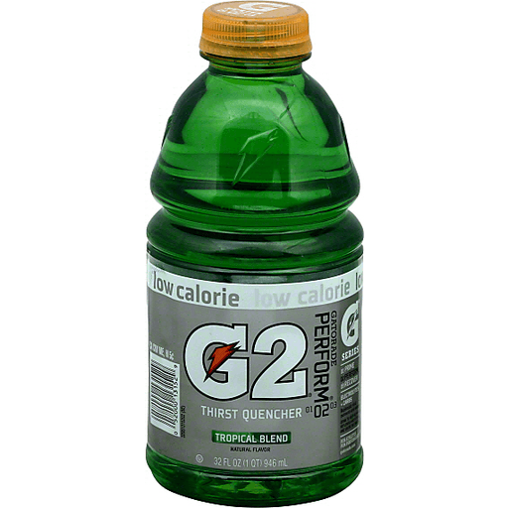
In which part of the Cell Cycle does growth, preparation, and check occur. This occurs just before cell division.
17

Slide 116
True or False? This cell are undergoing cell division.
18

Slide 117
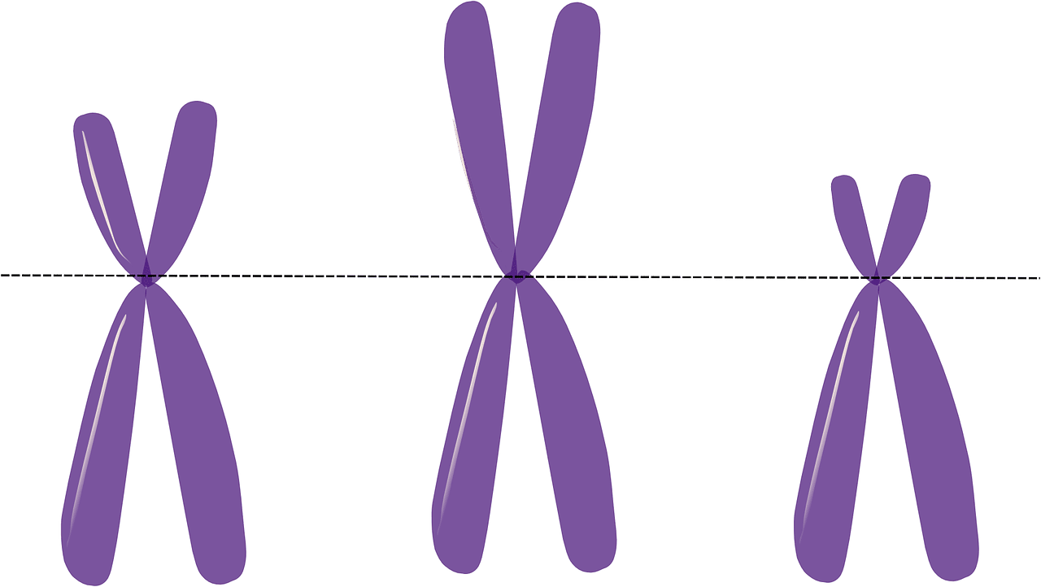
True or False? This cell are undergoing cell division.
True, Chromosomes
are starting to form
18

Slide 118
True or False? These cheek cell are undergoing cell division.
19

Slide 119
True or False? These cheek cell are undergoing cell division.
19
False! Chromosomes
are not visible

Slide 120

Name…
A
B
C
D
E
20

Slide 121
Name…
Anaphase
Cytokinesis
A
B
C
D
Telophase
Prophase
E
Interphase
20

Slide 122
Parts 2 Cell Division (Mitosis) Review Game
THE GREAT DIVIDE | IT’S JUST A PHASE | CHROMA- Something | GEE WIZ | -Bonus- FAMILY QUEST
1 | 6 | 11 | 16 | *21
2 | 7 | 12 | 17 | *22
3 | 8 | 13 | 18 | *23
4 | 9 | 14 | 19 | *24
5 | 10 | 15 | 20 | *25

Slide 123
Parts 2 Cell Division (Mitosis) Review Game
THE GREAT DIVIDE | IT’S JUST A PHASE | CHROMA- Something | GEE WIZ | -Bonus- FAMILY QUEST
1 | 6 | 11 | 16 | *21
2 | 7 | 12 | 17 | *22
3 | 8 | 13 | 18 | *23
4 | 9 | 14 | 19 | *24
5 | 10 | 15 | 20 | *25

Slide 124
*21
Name this family?

Slide 125
*21
Name this family?

Slide 126
*22
Name this movie?

Slide 127

*22
Name this movie?

Slide 128
*23
Meet…

Slide 129
*23

Slide 130
*24

Slide 131
*24

Slide 132
*24

Slide 133
*24

Slide 134
*24

Slide 135
To
S
*24

Slide 136
To
S
“No…”
“It’s Meowsis”
*24

Slide 137
Name this family?
*25

Slide 138
Name this family?
Griswolds
*25

Slide 139
Parts 2 Cell Division (Mitosis) Review Game
THE GREAT DIVIDE | IT’S JUST A PHASE | CHROMA- Something | GEE WIZ | -Bonus- FAMILY QUEST
1 | 6 | 11 | 16 | *21
2 | 7 | 12 | 17 | *22
3 | 8 | 13 | 18 | *23
4 | 9 | 14 | 19 | *24
5 | 10 | 15 | 20 | *25
Final Question

Slide 140
5 Point Wager Question

Slide 141
Name this phase of Mitosis?
  Chromosomes get split at centromere
  The two identical copies get pulled apart
Copyright © 2024 SlideSpark .LLC

Slide 142
Name this phase of Mitosis?
  Chromosomes get split at centromere
  The two identical copies get pulled apart
Anaphase
Copyright © 2024 SlideSpark .LLC

Slide 143
Questions 1-10 = 10pts Each
Final Category (Bonus) = 1pt Each
Final Questions = 5 pt wager
Find the Owl = + 1pt
Secretly write “Owl” in the correct box worth 1pt.

Slide 144
Mitosis Review Game
ANSWER VERSION
Part 2
Lesson 6

Slide 145



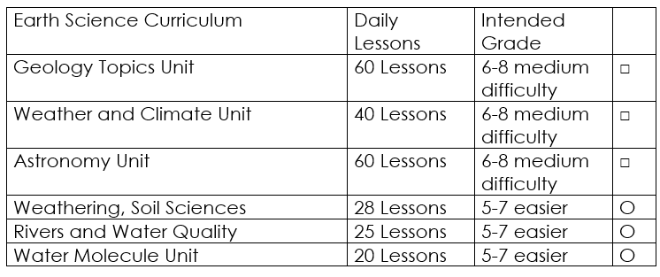

Curriculum Guide
Number of Lessons in each unit (50 min, daily lessons) and difficult rating scale / intended grade level.
=Easier, = More difficult, =Most difficult
Earth Science Units

Slide 146


Life Science Units

Slide 147

Physical Science

Slide 148
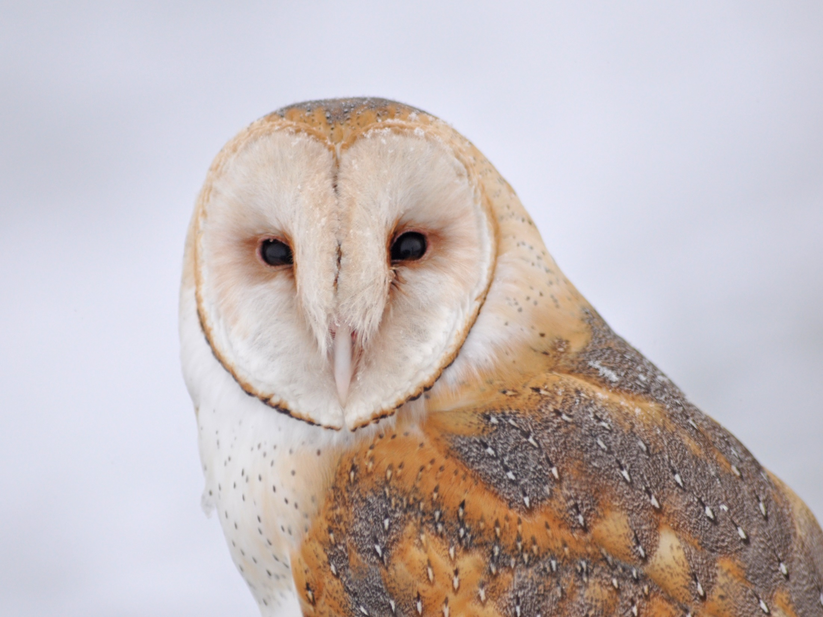
Dear Valued Educator,
Our fully editable .pptx and .doc resources are perfect for educators looking to bring enthusiasm and creativity to their lessons. We encourage you to make changes to fit your needs and style. As science educators, we’re committed to providing students with the tools they need to succeed in the classroom and beyond. Each unit in the curriculum includes a range of resources that have been developed through extensive research and use in a busy classroom. Our teaching approach is designed to make science education engaging and exciting for learners of all ages. We offer a one-of-a-kind science curriculum that will challenge, inspire, and educate students to become tomorrow's scientists and leaders. Join us today and learn more about how our program can help you achieve your classroom goals.
With appreciation,
Support@SlideSpark.net

Slide 149





Thank you for your time and interest in our Science curriculum. We strive to provide students with engaging and informative lessons that will spark their curiosity and encourage scientific exploration. Should you have any questions or concerns, please do not hesitate to contact us. Thank you again for considering our curriculum, and we wish you all the best in your educational journey.
Sincerely,
Support@slidespark.net
SlideSpark Science on TpT

