Slide 1
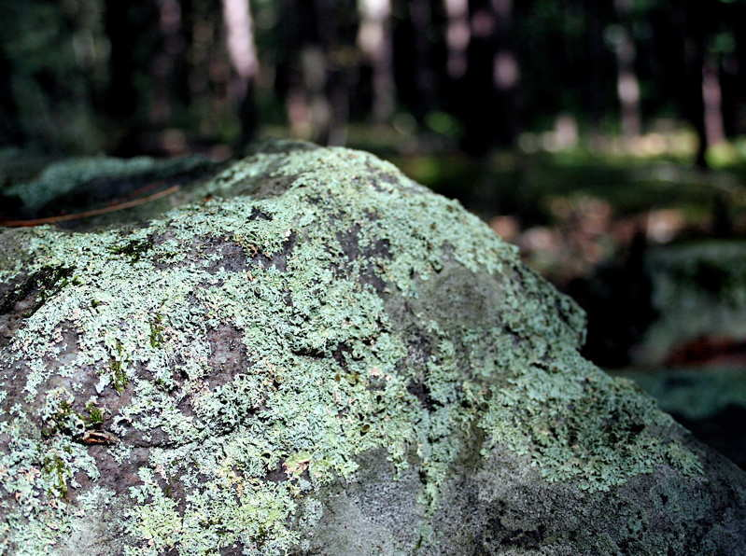

Ecological Succession
Review Game
Part 6
Lesson 7

Slide 2
Ecological Succession Review Game
TIMES HAVE CHANGED | PRIME TIME | ON STAGE | GET YOUR SUCCESS ON | THEN AND NOW -BONUS-
1 | 6 | 11 | 16 | *21
2 | 7 | 12 | 17 | *22
3 | 8 | 13 | 18 | *23
4 | 9 | 14 | 19 | *24
5 | 10 | 15 | 20 | *25
Copyright © 2024 SlideSpark .LLC

Slide 3
How to play…
  Don’t play like Jeo_ _ _ _ y.
  Class should be divided into several small groups.
  Groups should use science journal (red slide notes), homework, and other available materials to assist you.
  Groups can communicate quietly with each other but no sharing answers between groups.
    Practice quietly communicating right now?
    Practice Communication Question:
    Your group gets to order one pizza, and you can have two toppings. What does your group want?

Slide 4

Questions 1-20 = 5pts Each
Final Category (Bonus) = 1pt Each
Final Questions = 5 pt wager
If you wager 5 on the last question and get it wrong you lose 5 pts. Wager 5 and get it right you get 5 pts.
Find the Owl =
Secretly write “Owl” in the correct box worth 1pt.
“I’ll be about this big.”

Slide 5
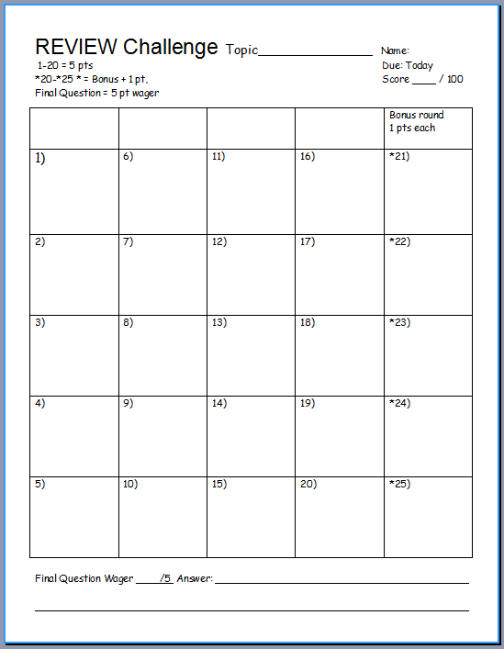
Is your name on the review sheet?
Name

Slide 6
Is your name on the review sheet?
Add the categories
along the top
on the next slide.

Slide 7
Ecological Succession Review Game
TIMES HAVE CHANGED | PRIME TIME | ON STAGE | GET YOUR SUCCESS ON | THEN AND NOW -BONUS-
1 | 6 | 11 | 16 | *21
2 | 7 | 12 | 17 | *22
3 | 8 | 13 | 18 | *23
4 | 9 | 14 | 19 | *24
5 | 10 | 15 | 20 | *25
Copyright © 2024 SlideSpark .LLC

Slide 8
Ecological Succession Review Game
TIMES HAVE CHANGED | PRIME TIME | ON STAGE | GET YOUR SUCCESS ON | THEN AND NOW -BONUS-
1 | 6 | 11 | 16 | *21
2 | 7 | 12 | 17 | *22
3 | 8 | 13 | 18 | *23
4 | 9 | 14 | 19 | *24
5 | 10 | 15 | 20 | *25
Copyright © 2024 SlideSpark .LLC

Slide 9
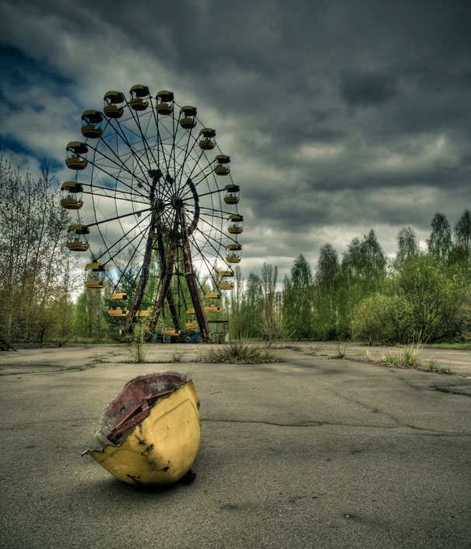
A nuclear accident at Chernobyl required everyone in Pripyat to evacuate. This is now an example of what happens to a city after humans.
1
3
Copyright © 2024 SlideSpark .LLC

Slide 10


Chemical weathering weakens rocks which facilitates entry of water and further mechanical weathering.
2
Copyright © 2024 SlideSpark .LLC

Slide 11
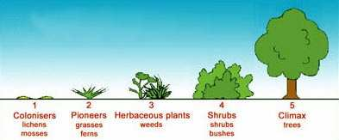
This is the gradual replacement of one community of living things by another community.
3
Copyright © 2024 SlideSpark .LLC

Slide 12
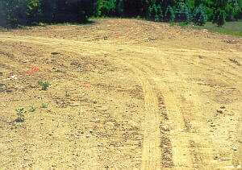
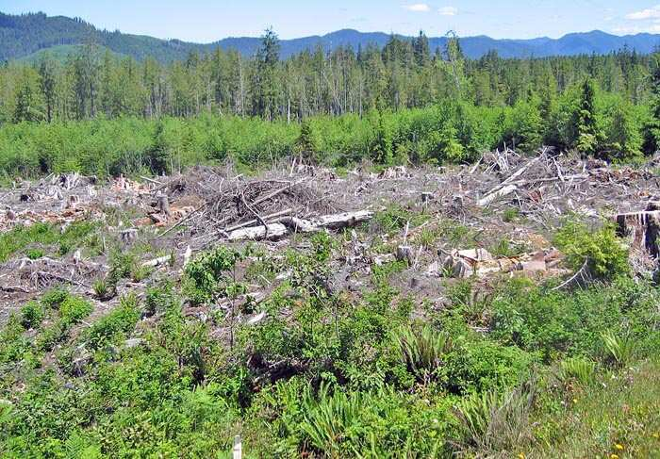
Type of succession that occurs in an area that previously colonized life but is now disturbed.
4
Copyright © 2024 SlideSpark .LLC

Slide 13

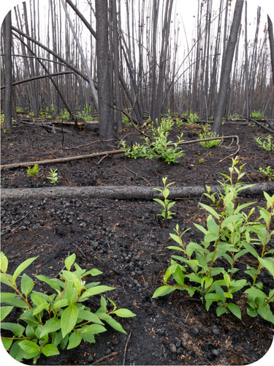
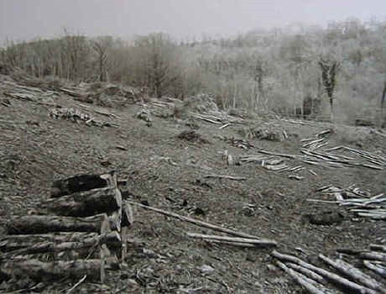
Which of the following is not a reason why regrowth is usually faster in secondary succession.
  A.) The area still has a soil base.
  B.) Seeds can be found in the soil
  C.) Secondary Shrubs create the soil making process.
  D.) Soil Microbes are still present
  E.) Stumps and roots and some plants can re-grow.
Copyright © 2024 SlideSpark .LLC

Slide 14
Which of the following is not a reason why regrowth is usually faster in secondary succession.
  A.) The area still has a soil base.
  B.) Seeds can be found in the soil
  C.) Secondary Shrubs create the soil making process.
  D.) Soil Microbes are still present
  E.) Stumps and roots and some plants can re-grow.
Copyright © 2024 SlideSpark .LLC

Slide 15
Ecological Succession Review Game
TIMES HAVE CHANGED | PRIME TIME | ON STAGE | GET YOUR SUCCESS ON | THEN AND NOW -BONUS-
1 | 6 | 11 | 16 | *21
2 | 7 | 12 | 17 | *22
3 | 8 | 13 | 18 | *23
4 | 9 | 14 | 19 | *24
5 | 10 | 15 | 20 | *25
Copyright © 2024 SlideSpark .LLC

Slide 16
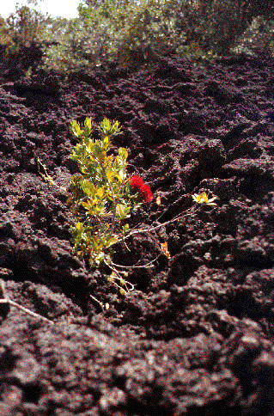
This is the general name for the first species to colonize after a disturbance.
6

Slide 17
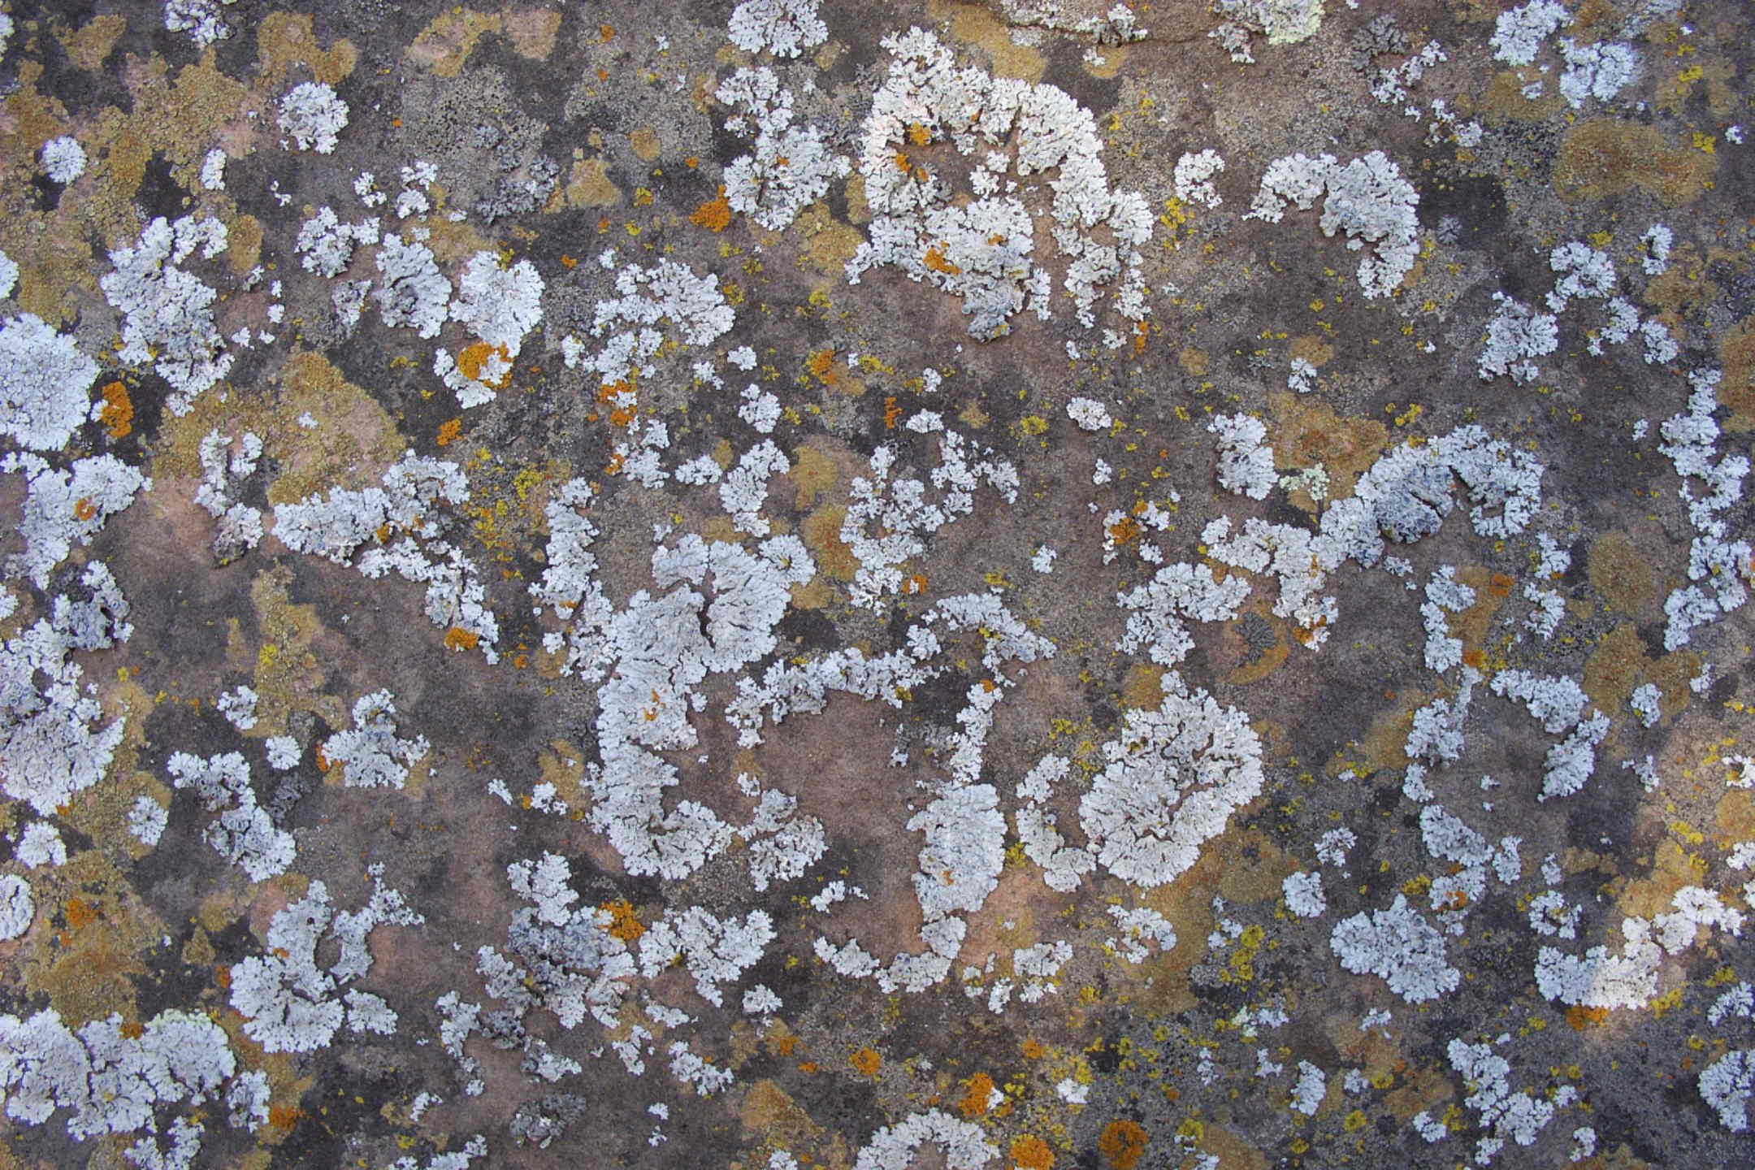
Acids secreted by these attack the rock (chemical weathering) and create soil fragments.
7
Copyright © 2024 SlideSpark .LLC

Slide 18




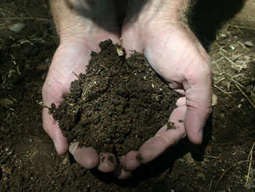

Name the material below.
A brown or black organic substance consisting of partially or wholly decayed vegetable or animal matter that provides nutrients for plants and increases the ability to retain water.
M
Copyright © 2024 SlideSpark .LLC

Slide 19
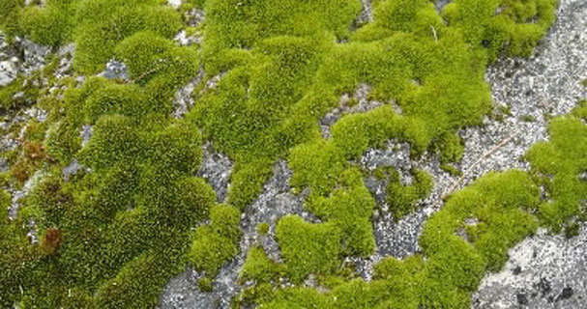
The growth, death, and decay of these help to produce organic matter / soil.
  They also help to retain soil moisture.
9
Copyright © 2024 SlideSpark .LLC

Slide 20

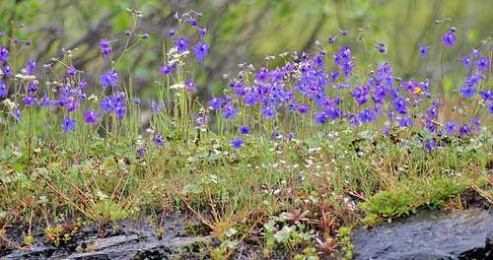
You may find grasses, yearly plants, weeds, and flowers in this stage of ecological succession.
Copyright © 2024 SlideSpark .LLC

Slide 21
Ecological Succession Review Game
TIMES HAVE CHANGED | PRIME TIME | ON STAGE | GET YOUR SUCCESS ON | THEN AND NOW -BONUS-
1 | 6 | 11 | 16 | *21
2 | 7 | 12 | 17 | *22
3 | 8 | 13 | 18 | *23
4 | 9 | 14 | 19 | *24
5 | 10 | 15 | 20 | *25
Copyright © 2024 SlideSpark .LLC

Slide 22
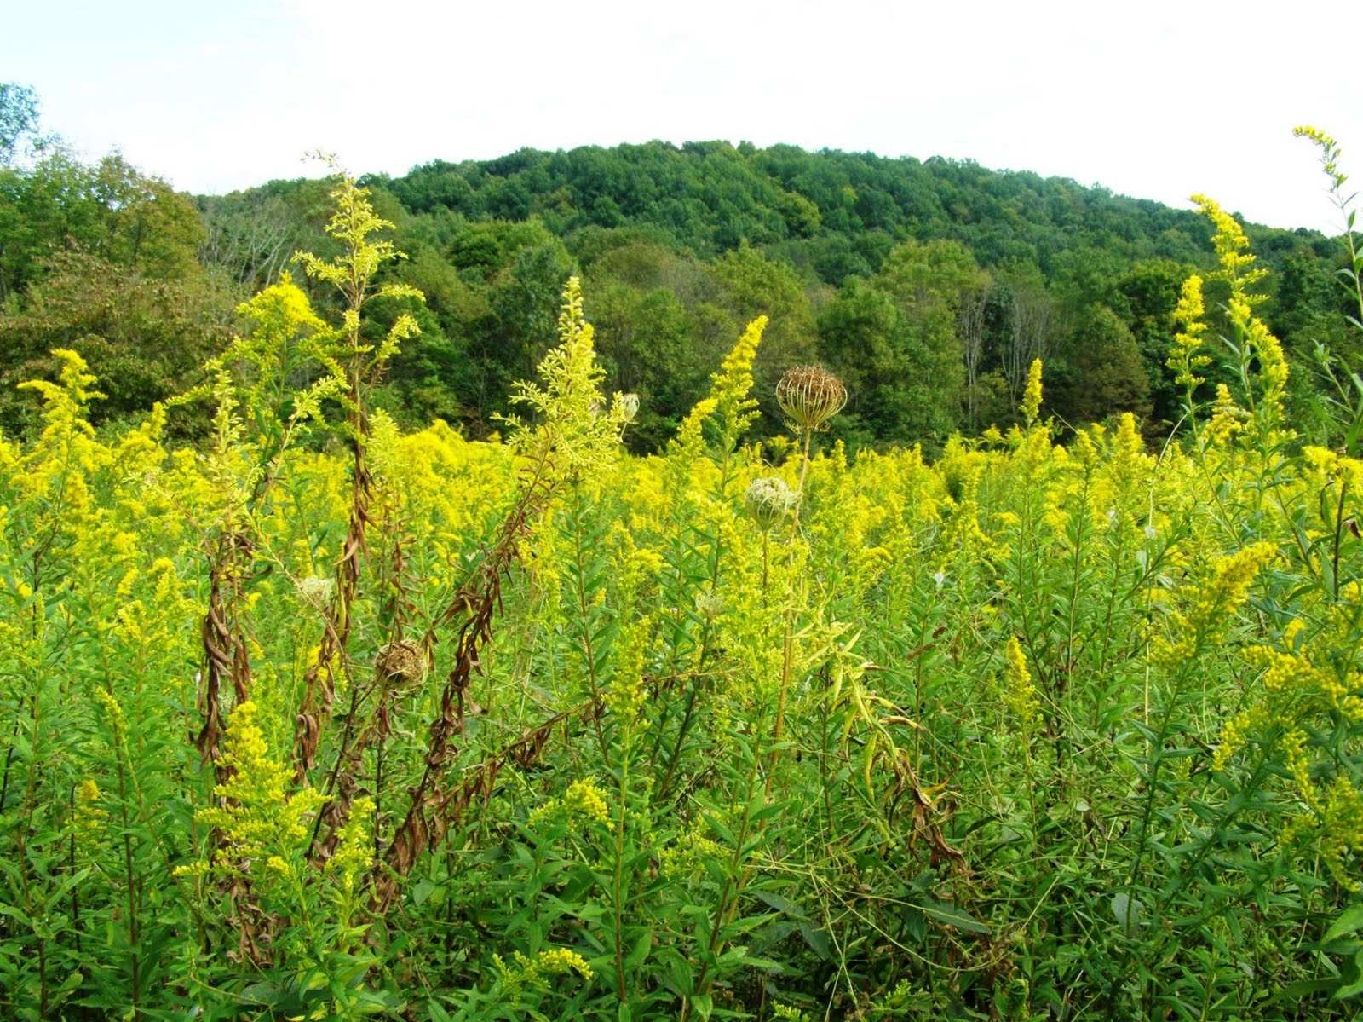
Name this stage of Ecological Succession.
11
Copyright © 2024 SlideSpark .LLC

Slide 23
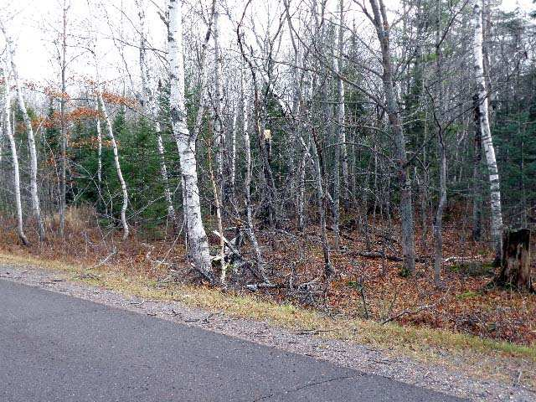
This area is transitioning from a __________ community to a ____________ community.
12
Copyright © 2024 SlideSpark .LLC

Slide 24
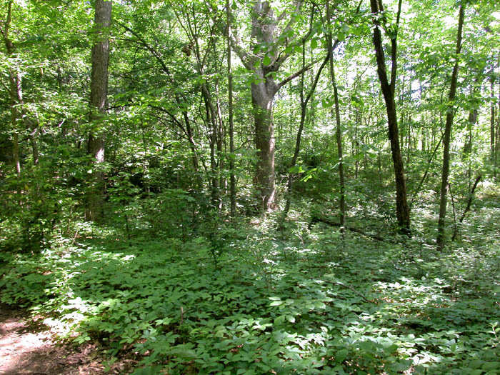
S hade T olerant H ardwoods
  Oak, Hickory, Ash.
13
Copyright © 2024 SlideSpark .LLC

Slide 25
S hade T olerant H ardwoods
  Oak, Hickory, Ash.
13
Copyright © 2024 SlideSpark .LLC

Slide 26
S hade T olerant H ardwoods
  Oak, Hickory, Ash.
13
Copyright © 2024 SlideSpark .LLC

Slide 27
S hade T olerant H ardwoods
  Oak, Hickory, Ash.
13
Copyright © 2024 SlideSpark .LLC

Slide 28
S hade T olerant H ardwoods
  Oak, Hickory, Ash.
13
Copyright © 2024 SlideSpark .LLC

Slide 29
S hade T olerant H ardwoods
  Oak, Hickory, Ash.
13
Copyright © 2024 SlideSpark .LLC

Slide 30
S hade T olerant H ardwoods
  Oak, Hickory, Ash.
13
Copyright © 2024 SlideSpark .LLC

Slide 31
S hade T olerant H ardwoods
  Oak, Hickory, Ash.
13
Copyright © 2024 SlideSpark .LLC

Slide 32
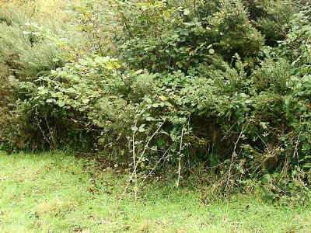
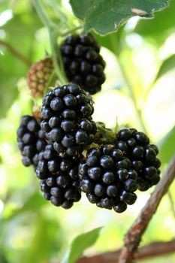
Name this stage of ecological succession.
  Soil base now forms.
  Sumac, Willow, Dogwood, Apple, Blackberries
14
Copyright © 2024 SlideSpark .LLC

Slide 33
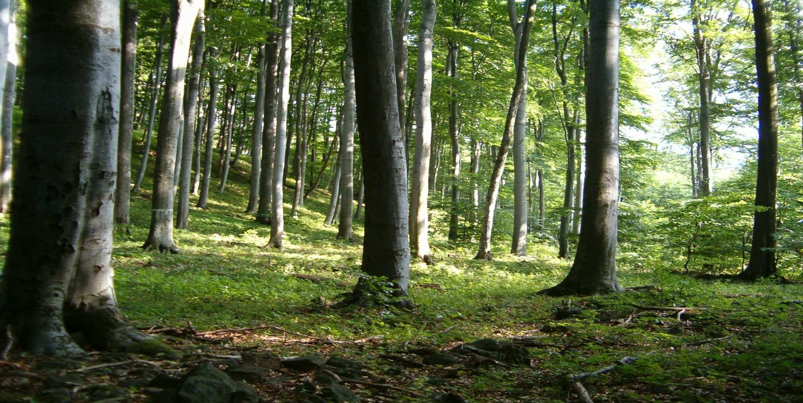
This is the final community that exists. These trees such as Beech and Maple can survive low light conditions.
15
Copyright © 2024 SlideSpark .LLC

Slide 34
Ecological Succession Review Game
TIMES HAVE CHANGED | PRIME TIME | ON STAGE | GET YOUR SUCCESS ON | THEN AND NOW -BONUS-
1 | 6 | 11 | 16 | *21
2 | 7 | 12 | 17 | *22
3 | 8 | 13 | 18 | *23
4 | 9 | 14 | 19 | *24
5 | 10 | 15 | 20 | *25
Copyright © 2024 SlideSpark .LLC

Slide 35


Which of the following is a way to restart succession.
A.) Volcanic Event
B.) Forest Fire
C.) Erosion
D.) Logging / Human Impact
E.) All of the above.
Copyright © 2024 SlideSpark .LLC

Slide 36
Which of the following is a way to restart succession.
A.) Volcanic Event
B.) Forest Fire
C.) Erosion
D.) Logging / Human Impact
E.) All of the above.
Copyright © 2024 SlideSpark .LLC

Slide 37
Which of the following is a way to restart succession.
A.) Volcanic Event
B.) Forest Fire
C.) Erosion
D.) Logging / Human Impact
E.) All of the above.
Copyright © 2024 SlideSpark .LLC

Slide 38
Which of the following is a way to restart succession.
A.) Volcanic Event
B.) Forest Fire
C.) Erosion
D.) Logging / Human Impact
E.) All of the above.
Copyright © 2024 SlideSpark .LLC

Slide 39
Which of the following is a way to restart succession.
A.) Volcanic Event
B.) Forest Fire
C.) Erosion
D.) Logging / Human Impact
E.) All of the above.
Copyright © 2024 SlideSpark .LLC

Slide 40
Which of the following is a way to restart succession.
A.) Volcanic Event
B.) Forest Fire
C.) Erosion
D.) Logging / Human Impact
E.) All of the above.
Copyright © 2024 SlideSpark .LLC

Slide 41

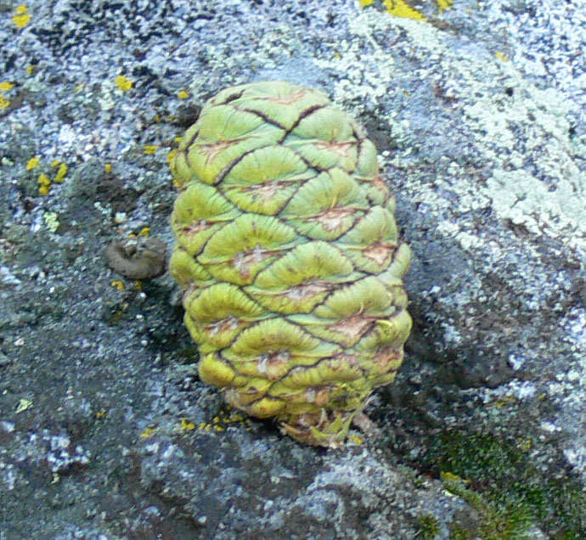
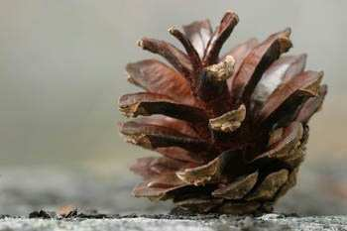
Some seeds require this type of event to germinate.
Copyright © 2024 SlideSpark .LLC

Slide 42

Which is not part of the “Let it Burn Philosophy.”
Copyright © 2024 SlideSpark .LLC

Slide 43
Which is not part of the “Let it Burn Philosophy.”
  A.) Large destructive fires result from fuel accumulations above historic levels.
Copyright © 2024 SlideSpark .LLC

Slide 44
Which is not part of the “Let it Burn Philosophy.”
  A.) Large destructive fires result from fuel accumulations above historic levels.
  B.) Both firefighters and the public risk loss of life or serious injury.
Copyright © 2024 SlideSpark .LLC

Slide 45
Which is not part of the “Let it Burn Philosophy.”
  A.) Large destructive fires result from fuel accumulations above historic levels.
  B.) Both firefighters and the public risk loss of life or serious injury.
  C.) Fire poses a serious risk to the ecology of a forest and should be put out immediately.
Copyright © 2024 SlideSpark .LLC

Slide 46
Which is not part of the “Let it Burn Philosophy.”
  A.) Large destructive fires result from fuel accumulations above historic levels.
  B.) Both firefighters and the public risk loss of life or serious injury.
  C.) Fire poses a serious risk to the ecology of a forest and should be put out immediately.
  D.) Intense or long-lasting smoke caused by large uncontrolled fire can impact air quality and seriously affect respiratory health.
Copyright © 2024 SlideSpark .LLC

Slide 47
Which is not part of the “Let it Burn Philosophy.”
  A.) Large destructive fires result from fuel accumulations above historic levels.
  B.) Both firefighters and the public risk loss of life or serious injury.
  C.) Fire poses a serious risk to the ecology of a forest and should be put out immediately.
  D.) Intense or long-lasting smoke caused by large uncontrolled fire can impact air quality and seriously affect respiratory health.
  E.)The costs of controlling larger and more damaging wildland fires have risen dramatically.
Copyright © 2024 SlideSpark .LLC

Slide 48

Which letter is the correct order for aquatic succession?
19
A
B
C
End
Copyright © 2024 SlideSpark .LLC

Slide 49
Which letter is the correct order for aquatic succession?
19
A
B
C
End
Copyright © 2024 SlideSpark .LLC

Slide 50
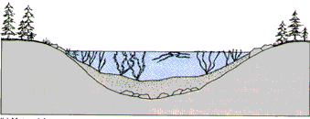
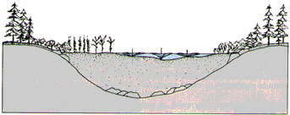
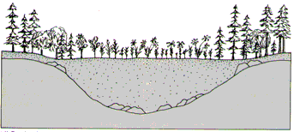

Which letter is the correct order for aquatic succession?
19
A
B
C
End
Copyright © 2024 SlideSpark .LLC

Slide 51
Which letter is the correct order for aquatic succession?
19
A
B
C
End
Copyright © 2024 SlideSpark .LLC

Slide 52
Which letter is the correct order for aquatic succession?
19
A
B
C
End
Copyright © 2024 SlideSpark .LLC

Slide 53
Which letter is the correct order for aquatic succession?
19
A
B
C
End
Copyright © 2024 SlideSpark .LLC

Slide 54
Which letter is the correct order for aquatic succession?
19
A
B
C
End
Copyright © 2024 SlideSpark .LLC

Slide 55
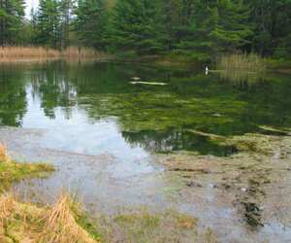
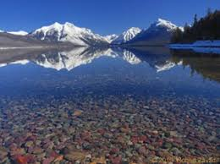
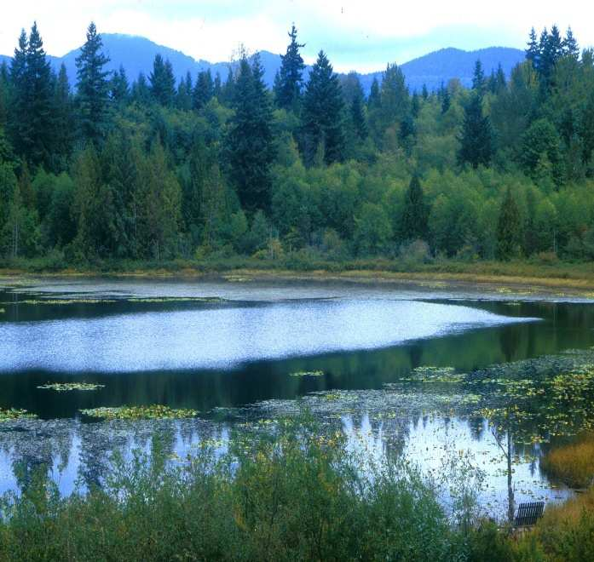
Which lake is Olgiotrophic, Mesotrophic, and Eutrophic?
B
C
A
20
Copyright © 2024 SlideSpark .LLC

Slide 56
Ecological Succession Review Game
TIMES HAVE CHANGED | PRIME TIME | ON STAGE | GET YOUR SUCCESS ON | THEN AND NOW -BONUS-
1 | 6 | 11 | 16 | *21
2 | 7 | 12 | 17 | *22
3 | 8 | 13 | 18 | *23
4 | 9 | 14 | 19 | *24
5 | 10 | 15 | 20 | *25
Copyright © 2024 SlideSpark .LLC

Slide 57

Name this person then?
*21

Slide 58
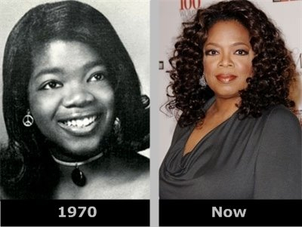
*22
?

Slide 59

*23

Slide 60

*24

Slide 61
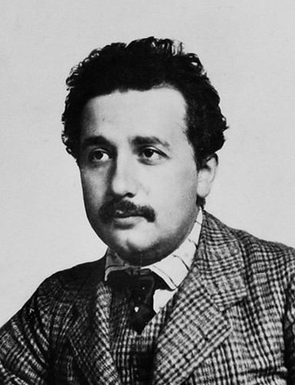
*25

Slide 62
Ecological Succession Review Game
TIMES HAVE CHANGED | PRIME TIME | ON STAGE | GET YOUR SUCCESS ON | THEN AND NOW -BONUS-
1 | 6 | 11 | 16 | *21
2 | 7 | 12 | 17 | *22
3 | 8 | 13 | 18 | *23
4 | 9 | 14 | 19 | *24
5 | 10 | 15 | 20 | *25
Final Question:________________
Copyright © 2024 SlideSpark .LLC

Slide 63

“This is a 5 pt wager question.”

Slide 64

“Please make your wager now.”

Slide 65
Please name this stage / community of ecological succession based on this description.
  A soil base has formed. No canopy of trees above, many animal and plant species on the ground such as goldenrod, milkweed, tall grasses, and insects.

Slide 66
Ecological Succession
Review Game
Part 6
Lesson 7

Slide 67

Ecological Succession
Review Game
Answer Key
Part 6
Lesson 8

Slide 68
Ecological Succession Review Game
TIMES HAVE CHANGED | PRIME TIME | ON STAGE | GET YOUR SUCCESS ON | THEN AND NOW -BONUS-
1 | 6 | 11 | 16 | *21
2 | 7 | 12 | 17 | *22
3 | 8 | 13 | 18 | *23
4 | 9 | 14 | 19 | *24
5 | 10 | 15 | 20 | *25
Copyright © 2024 SlideSpark .LLC

Slide 69
How to play…
  Don’t play like Jeo_ _ _ _ y.
  Class should be divided into several small groups.
  Groups should use science journal (red slide notes), homework, and other available materials to assist you.
  Groups can communicate quietly with each other but no sharing answers between groups.
    Practice quietly communicating right now?
    Practice Communication Question:
    Your group gets to order one pizza, and you can have two toppings. What does your group want?

Slide 70
Questions 1-20 = 5pts Each
Final Category (Bonus) = 1pt Each
Final Questions = 5 pt wager
If you wager 5 on the last question and get it wrong you lose 5 pts. Wager 5 and get it right you get 5 pts.
Find the Owl =
Secretly write “Owl” in the correct box worth 1pt.
“I’ll be about this big.”

Slide 71
Is your name on the review sheet?
Name

Slide 72
Is your name on the review sheet?
Add the categories
along the top
on the next slide.

Slide 73
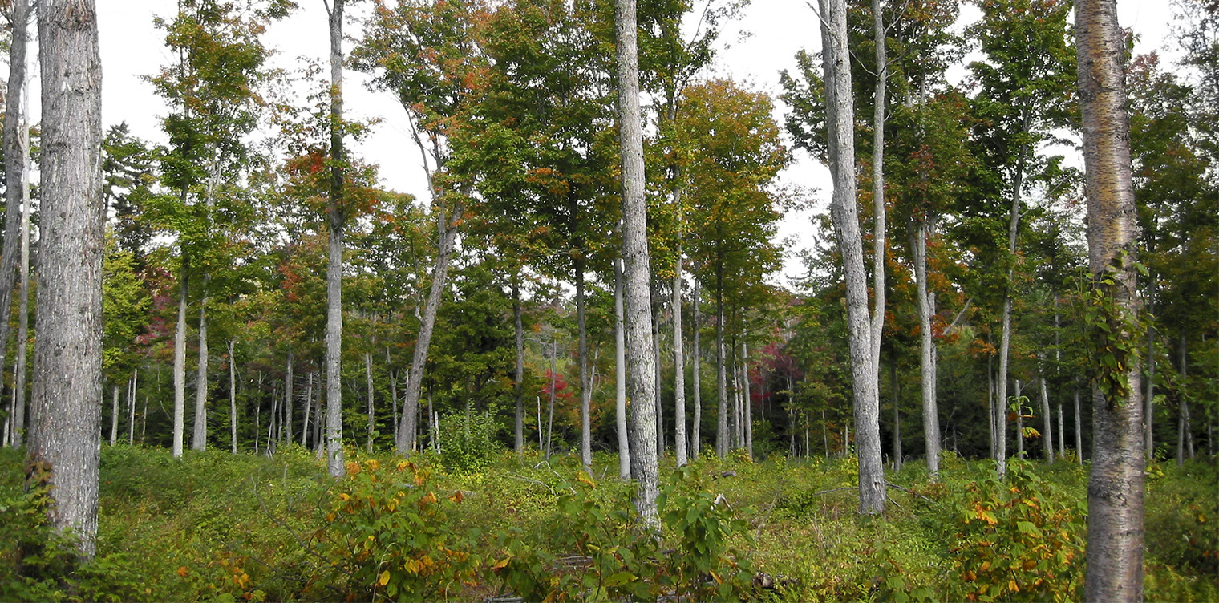
Answer Key

Slide 74
Ecological Succession Review Game
TIMES HAVE CHANGED | PRIME TIME | ON STAGE | GET YOUR SUCCESS ON | THEN AND NOW -BONUS-
1 | 6 | 11 | 16 | *21
2 | 7 | 12 | 17 | *22
3 | 8 | 13 | 18 | *23
4 | 9 | 14 | 19 | *24
5 | 10 | 15 | 20 | *25
Copyright © 2024 SlideSpark .LLC

Slide 75
Questions 1-20 = 5pts Each
Final Category (Bonus) = 1pt Each
Final Questions = 5 pt wager
Find the Owl =
Secretly write “Owl” in the correct box worth 1pt.

Slide 76
Ecological Succession Review Game
TIMES HAVE CHANGED | PRIME TIME | ON STAGE | GET YOUR SUCCESS ON | THEN AND NOW -BONUS-
1 | 6 | 11 | 16 | *21
2 | 7 | 12 | 17 | *22
3 | 8 | 13 | 18 | *23
4 | 9 | 14 | 19 | *24
5 | 10 | 15 | 20 | *25
Copyright © 2024 SlideSpark .LLC

Slide 77
Ecological Succession Review Game
TIMES HAVE CHANGED | PRIME TIME | ON STAGE | GET YOUR SUCCESS ON | THEN AND NOW -BONUS-
1 | 6 | 11 | 16 | *21
2 | 7 | 12 | 17 | *22
3 | 8 | 13 | 18 | *23
4 | 9 | 14 | 19 | *24
5 | 10 | 15 | 20 | *25
Copyright © 2024 SlideSpark .LLC

Slide 78
A nuclear accident at Chernobyl required everyone in Pripyat to evacuate. This is now an example of what happens to a city after humans.
1
3
Copyright © 2024 SlideSpark .LLC

Slide 79
A nuclear accident at Chernobyl required everyone in Pripyat to evacuate. This is now an example of what happens to a city after humans.
1
3
Copyright © 2024 SlideSpark .LLC

Slide 80
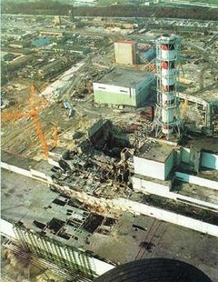

A nuclear accident at Chernobyl required everyone in Pripyat to evacuate. This is now an example of what happens to a city after humans.
1
3
Copyright © 2024 SlideSpark .LLC

Slide 81
Chemical weathering weakens rocks which facilitates entry of water and further mechanical weathering.
2
Copyright © 2024 SlideSpark .LLC

Slide 82

Chemical weathering weakens rocks which facilitates entry of water and further mechanical weathering.
2
Copyright © 2024 SlideSpark .LLC

Slide 83
Chemical weathering weakens rocks which facilitates entry of water and further mechanical weathering.
2
Copyright © 2024 SlideSpark .LLC

Slide 84
This is the gradual replacement of one community of living things by another community.
3
Copyright © 2024 SlideSpark .LLC

Slide 85

This is the gradual replacement of one community of living things by another community.
3
Copyright © 2024 SlideSpark .LLC

Slide 86
Type of succession that occurs in an area that previously colonized life but is now disturbed.
4
Copyright © 2024 SlideSpark .LLC

Slide 87

Type of succession that occurs in an area that previously colonized life but is now disturbed.
4
Copyright © 2024 SlideSpark .LLC

Slide 88
Which of the following is not a reason why regrowth is usually faster in secondary succession.
  A.) The area still has a soil base.
  B.) Seeds can be found in the soil
  C.) Secondary Shrubs create the soil making process.
  D.) Soil Microbes are still present
  E.) Stumps and roots and some plants can re-grow.
Copyright © 2024 SlideSpark .LLC

Slide 89
Which of the following is not a reason why regrowth is usually faster in secondary succession.
  A.) The area still has a soil base.
  B.) Seeds can be found in the soil
  C.) Secondary Shrubs create the soil making process.
  D.) Soil Microbes are still present
  E.) Stumps and roots and some plants can re-grow.
Copyright © 2024 SlideSpark .LLC

Slide 90
Which of the following is not a reason why regrowth is usually faster in secondary succession.
  A.) The area still has a soil base.
  B.) Seeds can be found in the soil
  C.) Secondary Shrubs create the soil making process.
  D.) Soil Microbes are still present
  E.) Stumps and roots and some plants can re-grow.
Copyright © 2024 SlideSpark .LLC

Slide 91
Ecological Succession Review Game
TIMES HAVE CHANGED | PRIME TIME | ON STAGE | GET YOUR SUCCESS ON | THEN AND NOW -BONUS-
1 | 6 | 11 | 16 | *21
2 | 7 | 12 | 17 | *22
3 | 8 | 13 | 18 | *23
4 | 9 | 14 | 19 | *24
5 | 10 | 15 | 20 | *25
Copyright © 2024 SlideSpark .LLC

Slide 92
This is the general name for the first species to colonize after a disturbance.
6

Slide 93

This is the general name for the first species to colonize after a disturbance.
6

Slide 94
Acids secreted by these attack the rock (chemical weathering) and create soil fragments.
7
Copyright © 2024 SlideSpark .LLC

Slide 95

Acids secreted by these attack the rock (chemical weathering) and create soil fragments.
7
Copyright © 2024 SlideSpark .LLC

Slide 96
Name the material below.
A brown or black organic substance consisting of partially or wholly decayed vegetable or animal matter that provides nutrients for plants and increases the ability to retain water.
M
Copyright © 2024 SlideSpark .LLC

Slide 97


Name the material below.
A brown or black organic substance consisting of partially or wholly decayed vegetable or animal matter that provides nutrients for plants and increases the ability to retain water.
Copyright © 2024 SlideSpark .LLC

Slide 98

Name the material below.
A brown or black organic substance consisting of partially or wholly decayed vegetable or animal matter that provides nutrients for plants and increases the ability to retain water.
M
Copyright © 2024 SlideSpark .LLC

Slide 99



Name the material below.
A brown or black organic substance consisting of partially or wholly decayed vegetable or animal matter that provides nutrients for plants and increases the ability to retain water.
Copyright © 2024 SlideSpark .LLC

Slide 100


Name the material below.
A brown or black organic substance consisting of partially or wholly decayed vegetable or animal matter that provides nutrients for plants and increases the ability to retain water.
Copyright © 2024 SlideSpark .LLC

Slide 101

Name the material below.
A brown or black organic substance consisting of partially or wholly decayed vegetable or animal matter that provides nutrients for plants and increases the ability to retain water.
Copyright © 2024 SlideSpark .LLC

Slide 102



Name the material below.
A brown or black organic substance consisting of partially or wholly decayed vegetable or animal matter that provides nutrients for plants and increases the ability to retain water.
Copyright © 2024 SlideSpark .LLC

Slide 103


Name the material below.
A brown or black organic substance consisting of partially or wholly decayed vegetable or animal matter that provides nutrients for plants and increases the ability to retain water.
Copyright © 2024 SlideSpark .LLC

Slide 104
Name the material below.
A brown or black organic substance consisting of partially or wholly decayed vegetable or animal matter that provides nutrients for plants and increases the ability to retain water.
Copyright © 2024 SlideSpark .LLC

Slide 105
The growth, death, and decay of these help to produce organic matter / soil.
  They also help to retain soil moisture.
9
Copyright © 2024 SlideSpark .LLC

Slide 106

The growth, death, and decay of these help to produce organic matter / soil.
  They also help to retain soil moisture.
9
Copyright © 2024 SlideSpark .LLC

Slide 107
You may find grasses, yearly plants, weeds, and flowers in this stage of ecological succession.
Copyright © 2024 SlideSpark .LLC

Slide 108

You may find grasses, yearly plants, weeds, and flowers in this stage of ecological succession.
Copyright © 2024 SlideSpark .LLC

Slide 109

You may find grasses, yearly plants, weeds, and flowers in this stage of ecological succession.
Copyright © 2024 SlideSpark .LLC

Slide 110
You may find grasses, yearly plants, weeds, and flowers in this stage of ecological succession.
Copyright © 2024 SlideSpark .LLC

Slide 111
Ecological Succession Review Game
TIMES HAVE CHANGED | PRIME TIME | ON STAGE | GET YOUR SUCCESS ON | THEN AND NOW -BONUS-
1 | 6 | 11 | 16 | *21
2 | 7 | 12 | 17 | *22
3 | 8 | 13 | 18 | *23
4 | 9 | 14 | 19 | *24
5 | 10 | 15 | 20 | *25
Copyright © 2024 SlideSpark .LLC

Slide 112
Name this stage of Ecological Succession.
11
Copyright © 2024 SlideSpark .LLC

Slide 113

Name this stage of Ecological Succession.
11
Copyright © 2024 SlideSpark .LLC

Slide 114
This area is transitioning from a __________ community to a ____________ community.
12
Copyright © 2024 SlideSpark .LLC

Slide 115

This area is transitioning from sun loving trees community to a ____________ community.
12
Copyright © 2024 SlideSpark .LLC

Slide 116

This area is transitioning from sun loving trees community to a conifer community.
12
Copyright © 2024 SlideSpark .LLC

Slide 117
S hade T olerant H ardwoods
  Oak, Hickory, Ash.
13
Copyright © 2024 SlideSpark .LLC

Slide 118
S hade T olerant H ardwoods
  Oak, Hickory, Ash.
13
Copyright © 2024 SlideSpark .LLC

Slide 119
S hade T olerant H ardwoods
  Oak, Hickory, Ash.
13
Copyright © 2024 SlideSpark .LLC

Slide 120
S hade T olerant H ardwoods
  Oak, Hickory, Ash.
13
Copyright © 2024 SlideSpark .LLC

Slide 121
S hade T olerant H ardwoods
  Oak, Hickory, Ash.
13
Copyright © 2024 SlideSpark .LLC

Slide 122
S hade T olerant H ardwoods
  Oak, Hickory, Ash.
13
Copyright © 2024 SlideSpark .LLC

Slide 123
S hade T olerant H ardwoods
  Oak, Hickory, Ash.
13
Copyright © 2024 SlideSpark .LLC

Slide 124
S hade T olerant H ardwoods
  Oak, Hickory, Ash.
13
Copyright © 2024 SlideSpark .LLC

Slide 125
S hade T olerant H ardwoods
  Oak, Hickory, Ash.
13
Copyright © 2024 SlideSpark .LLC

Slide 126
S hade T olerant H ardwoods
  Oak, Hickory, Ash.
13
Copyright © 2024 SlideSpark .LLC

Slide 127
Name this stage of ecological succession.
  Soil base now forms.
  Sumac, Willow, Dogwood, Apple, Blackberries
14
Copyright © 2024 SlideSpark .LLC

Slide 128
Name this stage of ecological succession.
  Soil base now forms.
  Sumac, Willow, Dogwood, Apple, Blackberries
14
Copyright © 2024 SlideSpark .LLC

Slide 129

Name this stage of ecological succession.
  Soil base now forms.
  Sumac, Willow, Dogwood, Apple, Blackberries
14
Copyright © 2024 SlideSpark .LLC

Slide 130
This is the final community that exists. These trees such as Beech and Maple can survive low light conditions.
15
Copyright © 2024 SlideSpark .LLC

Slide 131


This is the final community that exists. These trees such as Beech and Maple can survive low light conditions.
Copyright © 2024 SlideSpark .LLC

Slide 132
Ecological Succession Review Game
TIMES HAVE CHANGED | PRIME TIME | ON STAGE | GET YOUR SUCCESS ON | THEN AND NOW -BONUS-
1 | 6 | 11 | 16 | *21
2 | 7 | 12 | 17 | *22
3 | 8 | 13 | 18 | *23
4 | 9 | 14 | 19 | *24
5 | 10 | 15 | 20 | *25
Copyright © 2024 SlideSpark .LLC

Slide 133
Which of the following is a way to restart succession.
A.) Volcanic Event
B.) Forest Fire
C.) Erosion
D.) Logging / Human Impact
E.) All of the above.
Copyright © 2024 SlideSpark .LLC

Slide 134
Which of the following is a way to restart succession.
A.) Volcanic Event
B.) Forest Fire
C.) Erosion
D.) Logging / Human Impact
E.) All of the above.
Copyright © 2024 SlideSpark .LLC

Slide 135
Which of the following is a way to restart succession.
A.) Volcanic Event
B.) Forest Fire
C.) Erosion
D.) Logging / Human Impact
E.) All of the above.
Copyright © 2024 SlideSpark .LLC

Slide 136
Which of the following is a way to restart succession.
A.) Volcanic Event
B.) Forest Fire
C.) Erosion
D.) Logging / Human Impact
E.) All of the above.
Copyright © 2024 SlideSpark .LLC

Slide 137
Which of the following is a way to restart succession.
A.) Volcanic Event
B.) Forest Fire
C.) Erosion
D.) Logging / Human Impact
E.) All of the above.
Copyright © 2024 SlideSpark .LLC

Slide 138
Which of the following is a way to restart succession.
A.) Volcanic Event
B.) Forest Fire
C.) Erosion
D.) Logging / Human Impact
E.) All of the above.
Copyright © 2024 SlideSpark .LLC

Slide 139

Which of the following is a way to restart succession.
A.) Volcanic Event
B.) Forest Fire
C.) Erosion
D.) Logging / Human Impact
E.) All of the above.
Copyright © 2024 SlideSpark .LLC

Slide 140
Which of the following is a way to restart succession.
A.) Volcanic Event
B.) Forest Fire
C.) Erosion
D.) Logging / Human Impact
E.) All of the above.
Copyright © 2024 SlideSpark .LLC

Slide 141
Some seeds require this type of event to germinate.
Copyright © 2024 SlideSpark .LLC

Slide 142

Some seeds require this type of event to germinate.
Copyright © 2024 SlideSpark .LLC

Slide 143
Which is not part of the “Let it Burn Philosophy.”
Copyright © 2024 SlideSpark .LLC

Slide 144
Which is not part of the “Let it Burn Philosophy.”
  A.) Large destructive fires result from fuel accumulations above historic levels.
Copyright © 2024 SlideSpark .LLC

Slide 145
Which is not part of the “Let it Burn Philosophy.”
  A.) Large destructive fires result from fuel accumulations above historic levels.
  B.) Both firefighters and the public risk loss of life or serious injury.
Copyright © 2024 SlideSpark .LLC

Slide 146
Which is not part of the “Let it Burn Philosophy.”
  A.) Large destructive fires result from fuel accumulations above historic levels.
  B.) Both firefighters and the public risk loss of life or serious injury.
  C.) Fire poses a serious risk to the ecology of a forest and should be put out immediately.
Copyright © 2024 SlideSpark .LLC

Slide 147
Which is not part of the “Let it Burn Philosophy.”
  A.) Large destructive fires result from fuel accumulations above historic levels.
  B.) Both firefighters and the public risk loss of life or serious injury.
  C.) Fire poses a serious risk to the ecology of a forest and should be put out immediately.
  D.) Intense or long-lasting smoke caused by large uncontrolled fire can impact air quality and seriously affect respiratory health.
Copyright © 2024 SlideSpark .LLC

Slide 148
Which is not part of the “Let it Burn Philosophy.”
  A.) Large destructive fires result from fuel accumulations above historic levels.
  B.) Both firefighters and the public risk loss of life or serious injury.
  C.) Fire poses a serious risk to the ecology of a forest and should be put out immediately.
  D.) Intense or long-lasting smoke caused by large uncontrolled fire can impact air quality and seriously affect respiratory health.
  E.)The costs of controlling larger and more damaging wildland fires have risen dramatically.
Copyright © 2024 SlideSpark .LLC

Slide 149
Which is not part of the “Let it Burn Philosophy.”
  A.) Large destructive fires result from fuel accumulations above historic levels.
  B.) Both firefighters and the public risk loss of life or serious injury.
  C.) Fire poses a serious risk to the ecology of a forest and should be put out immediately.
  D.) Intense or long-lasting smoke caused by large uncontrolled fire can impact air quality and seriously affect respiratory health.
  E.)The costs of controlling larger and more damaging wildland fires have risen dramatically.
  And the answer is…
Copyright © 2024 SlideSpark .LLC

Slide 150
Which is not part of the “Let it Burn Philosophy.”
  A.) Large destructive fires result from fuel accumulations above historic levels.
  B.) Both firefighters and the public risk loss of life or serious injury.
  C.) Fire poses a serious risk to the ecology of a forest and should be put out immediately.
  D.) Intense or long-lasting smoke caused by large uncontrolled fire can impact air quality and seriously affect respiratory health.
  E.)The costs of controlling larger and more damaging wildland fires have risen dramatically.
  And the answer is…
Copyright © 2024 SlideSpark .LLC

Slide 151
Which is not part of the “Let it Burn Philosophy.”
  A.) Large destructive fires result from fuel accumulations above historic levels.
  B.) Both firefighters and the public risk loss of life or serious injury.
  C.) Fire is a natural part of the forest ecosystem and helps to remove dominating plants for others.
  D.) Intense or long-lasting smoke caused by large uncontrolled fire can impact air quality and seriously affect respiratory health.
  E.)The costs of controlling larger and more damaging wildland fires have risen dramatically.
  And the answer is…
Copyright © 2024 SlideSpark .LLC

Slide 152
Which letter is the correct order for aquatic succession?
19
A
B
C
End
Copyright © 2024 SlideSpark .LLC

Slide 153
Which letter is the correct order for aquatic succession?
19
A
B
C
End
Copyright © 2024 SlideSpark .LLC

Slide 154
Which letter is the correct order for aquatic succession?
19
A
B
C
End
Copyright © 2024 SlideSpark .LLC

Slide 155
Which letter is the correct order for aquatic succession?
19
A
B
C
End
Copyright © 2024 SlideSpark .LLC

Slide 156
Which letter is the correct order for aquatic succession?
19
A
B
C
End
Copyright © 2024 SlideSpark .LLC

Slide 157
Which letter is the correct order for aquatic succession?
19
A
B
C
End
Copyright © 2024 SlideSpark .LLC

Slide 158
Which letter is the correct order for aquatic succession?
19
A
B
C
End
Copyright © 2024 SlideSpark .LLC

Slide 159
Which letter is the correct order for aquatic succession?
19
answer is...
A
B
C
End
Copyright © 2024 SlideSpark .LLC

Slide 160
Which letter is the correct order for aquatic succession?
19
B
End
Copyright © 2024 SlideSpark .LLC

Slide 161
Which lake is Olgiotrophic, Mesotrophic, and Eutrophic?
B
C
A
20
Copyright © 2024 SlideSpark .LLC

Slide 162
Which lake is Olgiotrophic, Mesotrophic, and Eutrophic?
B
C
A
Eutrophic
Olgiotrophic
Mesotrophic
20
Copyright © 2024 SlideSpark .LLC

Slide 163
Which lake is Olgiotrophic, Mesotrophic, and Eutrophic?
B
C
A
Low Productivity
Low Nutrients
Eutrophic
Olgiotrophic
Mesotrophic
Medium Productivity
Medium Nutrients
High Productivity
High Nutrients
20
Copyright © 2024 SlideSpark .LLC

Slide 164
Ecological Succession Review Game
TIMES HAVE CHANGED | PRIME TIME | ON STAGE | GET YOUR SUCCESS ON | THEN AND NOW -BONUS-
1 | 6 | 11 | 16 | *21
2 | 7 | 12 | 17 | *22
3 | 8 | 13 | 18 | *23
4 | 9 | 14 | 19 | *24
5 | 10 | 15 | 20 | *25
Copyright © 2024 SlideSpark .LLC

Slide 165
Name this person then?
*21

Slide 166
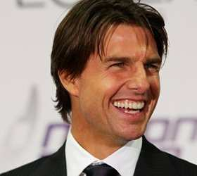
Name this person then?
*21

Slide 167
Name this person then?
*21
Tom Cruise

Slide 168
*22
?

Slide 169
*22

Slide 170
*22
Oprah Winfrey

Slide 171
*23

Slide 172

*23

Slide 173
*23
President Barack Obama

Slide 174
*24

Slide 175


*24

Slide 176
*24
Johnny Depp

Slide 177
*25

Slide 178
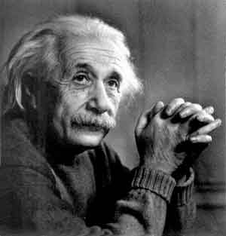
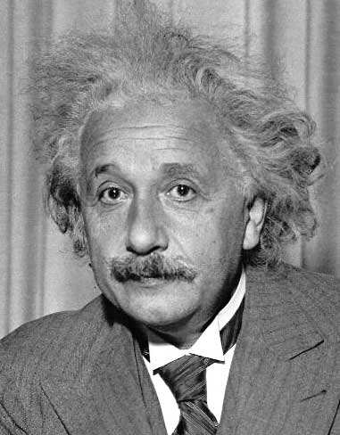
*25

Slide 179
*25
Albert Einstein

Slide 180
Ecological Succession Review Game
TIMES HAVE CHANGED | PRIME TIME | ON STAGE | GET YOUR SUCCESS ON | THEN AND NOW -BONUS-
1 | 6 | 11 | 16 | *21
2 | 7 | 12 | 17 | *22
3 | 8 | 13 | 18 | *23
4 | 9 | 14 | 19 | *24
5 | 10 | 15 | 20 | *25
Final Question:________________
Copyright © 2024 SlideSpark .LLC

Slide 181
“This was a 5 pt wager question.”

Slide 182
“Get Your Success ON”

Slide 183
Please name this stage / community of ecological succession based on this description.
  A soil base has formed. No canopy of trees above, many animal and plant species on the ground such as goldenrod and insects.

Slide 184
Please name this stage / community of ecological succession based on this description.
  A soil base has formed. No canopy of trees above, many animal and plant species on the ground such as goldenrod and insects.

Slide 185
Please name this stage / community of ecological succession based on this description.
  A soil base has formed. No canopy of trees above, many animal and plant species on the ground such as goldenrod and insects.

Slide 186
Please name this stage / community of ecological succession based on this description.
  A soil base has formed. No canopy of trees above, many animal and plant species on the ground such as goldenrod and insects.

Slide 187
Please name this stage / community of ecological succession based on this description.
  A soil base has formed. No canopy of trees above, many animal and plant species on the ground such as goldenrod and insects.

Slide 188
Please name this stage / community of ecological succession based on this description.
  A soil base has formed. No canopy of trees above, many animal and plant species on the ground such as goldenrod and insects.
Old-Field
Community

Slide 189
Questions 1-20 = 5pts Each
Final Category (Bonus) = 1pt Each
Final Questions = 5 pt wager
Find the Owl =
Secretly write “Owl” in the correct box worth 1pt.

Slide 190
Ecological Succession
Review Game
Answer Key
Part 6
Lesson 8

Slide 191



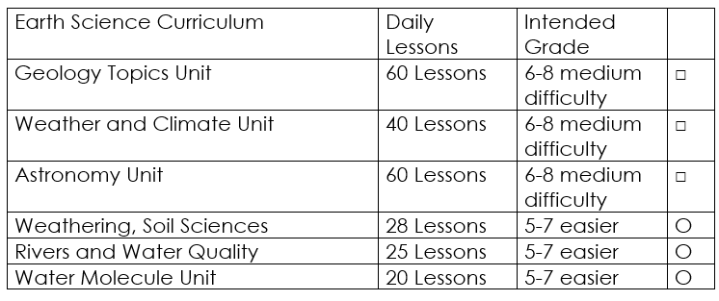

Curriculum Guide
Number of Lessons in each unit (50 min, daily lessons) and difficult rating scale / intended grade level.
=Easier, = More difficult, =Most difficult
Earth Science Units

Slide 192


Life Science Units

Slide 193

Physical Science

Slide 194
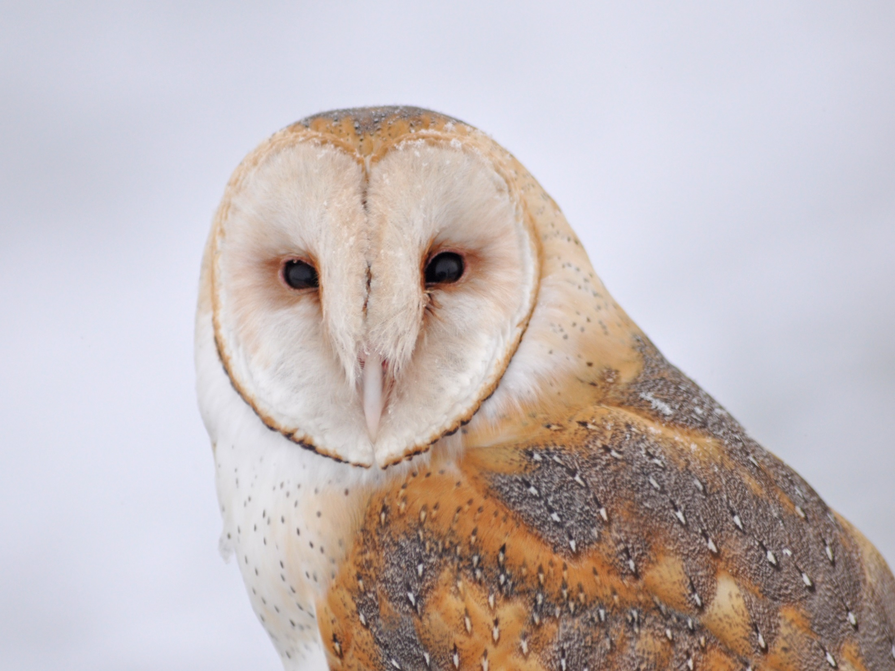
Dear Valued Educator,
Our fully editable .pptx and .doc resources are perfect for educators looking to bring enthusiasm and creativity to their lessons. We encourage you to make changes to fit your needs and style. As science educators, we’re committed to providing students with the tools they need to succeed in the classroom and beyond. Each unit in the curriculum includes a range of resources that have been developed through extensive research and use in a busy classroom. Our teaching approach is designed to make science education engaging and exciting for learners of all ages. We offer a one-of-a-kind science curriculum that will challenge, inspire, and educate students to become tomorrow's scientists and leaders. Join us today and learn more about how our program can help you achieve your classroom goals.
With appreciation,
Support@SlideSpark.net

Slide 195





Thank you for your time and interest in our Science curriculum. We strive to provide students with engaging and informative lessons that will spark their curiosity and encourage scientific exploration. Should you have any questions or concerns, please do not hesitate to contact us. Thank you again for considering our curriculum, and we wish you all the best in your educational journey.
Sincerely,
Support@slidespark.net
SlideSpark Science on TpT

