Slide 1
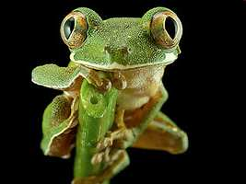

Biodiversity
Part 2
Lesson 2

Slide 2
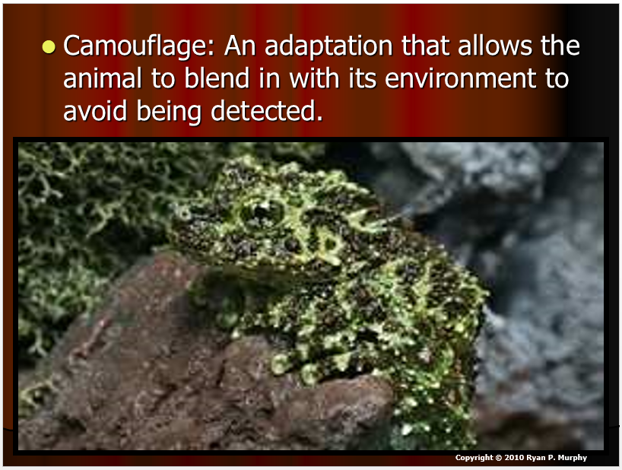
RED SLIDE: These slides contain critical notes and important fill-in the blanks. Please record the important terms in your work bundle.
First and last Name
Science, Grade, Class
Copyright © 2024 SlideSpark LLC

Slide 3
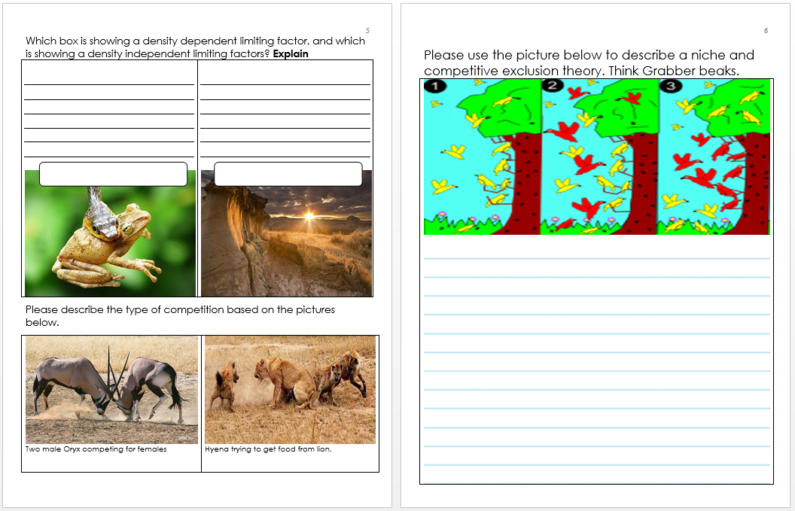
RED SLIDE: These slides contain critical notes and important fill-in the blanks. Please record the important terms in your work bundle.
  You’ll need these notes to complete the work bundle
First and last Name
Science, Grade, Class
Copyright © 2024 SlideSpark LLC

Slide 4
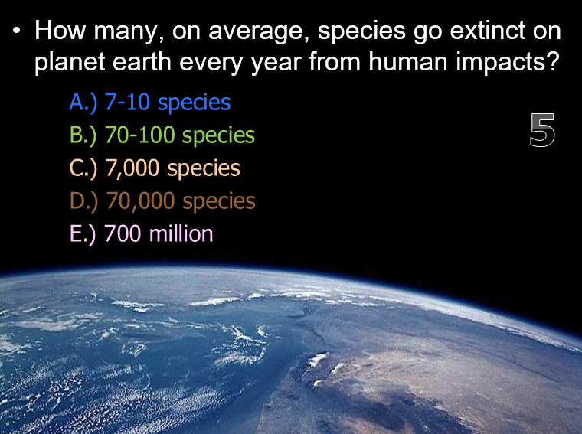
RED SLIDE: These slides contain critical notes and important fill-in the blanks. Please record the important terms in your work bundle.
  You’ll need these notes to complete the work bundle and to be successful on the review game.
First and last Name
Science, Grade, Class
Copyright © 2024 SlideSpark LLC

Slide 5
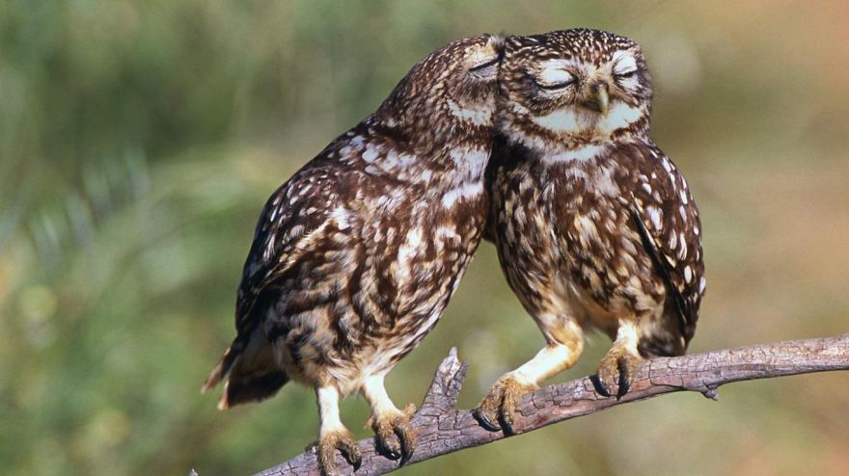



Keep an eye out for “The-Owl” and raise your hand as soon as you see him.
  He will be hiding somewhere in the slideshow today.
Copyright © 2024 SlideSpark LLC

Slide 6

Listen to the teacher and others.
Please no
shout outs.
One speaker at a
time. Please
raise your
hand.
Respect
First,
Last,
and Always.
Safety
Make
Good
Choices
Be Present
Never
Give
Up!
Responsibility
Stay
Organized
Help
Others
Focus on
Task completion
Avoid
Distractions
Science from Murf LLC
Copyright © 2024 SlideSpark LLC

Slide 7
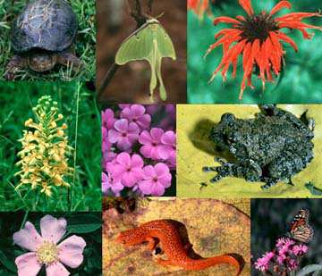
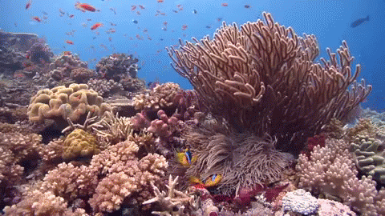
Diversity: The variety, or number of kinds of species.
  -
Copyright © 2024 SlideSpark LLC

Slide 8
Diversity: The variety, or number of kinds of species.
  Counting the number of different species.
Copyright © 2024 SlideSpark LLC

Slide 9
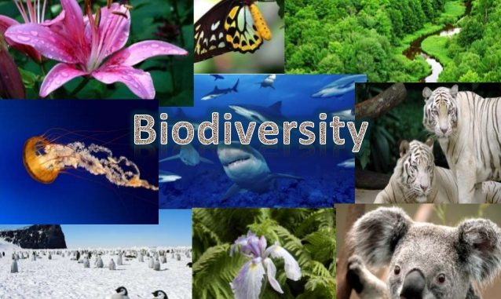
Biodiversity is the biological variety and variability of life on Earth.

Slide 10
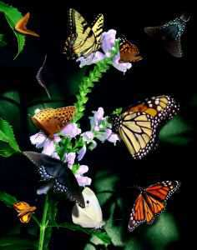
We know of about 1.75 of the estimated 6-14 million species on this planet.
Copyright © 2024 SlideSpark LLC

Slide 11
We know of about 1.75 of the estimated 6-14 million species on this planet.
  Most of these species are going extinct without ever knowing about them.
Copyright © 2024 SlideSpark LLC

Slide 12


Slide 13

Hundred of species are lost everyday on this planet forever.

Slide 14
Hundred of species are lost everyday on this planet forever.
  Estimates put it as high as 70,000 species per year.

Slide 15
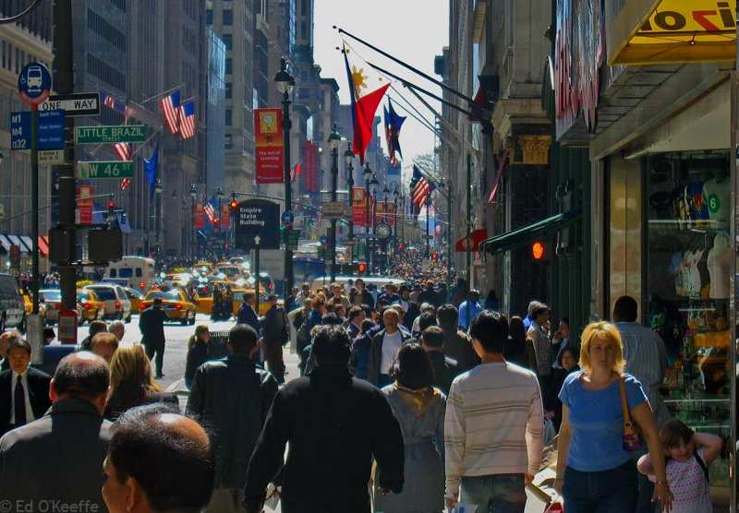
Hundred of species are lost everyday on this planet forever.
  Estimates put it as high as 70,000 species per year.
  Humanity is the 6th mass extinction event.

Slide 16
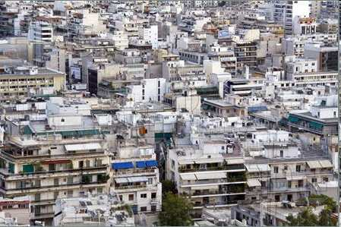
Hundred of species are lost everyday on this planet forever.
  Estimates put it as high as 70,000 species per year.
  Humanity is the 6th mass extinction event.

Slide 17
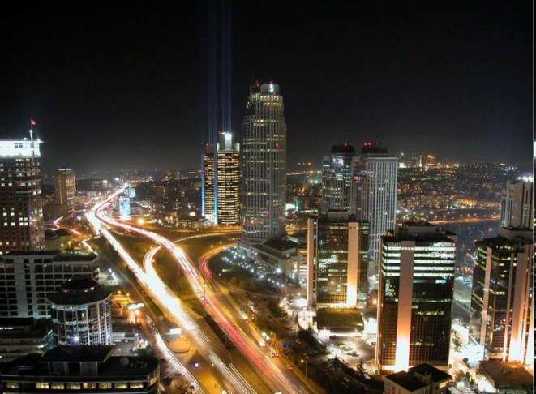
Hundred of species are lost everyday on this planet forever.
  Estimates put it as high as 70,000 species per year.
  Humanity is the 6th mass extinction event.

Slide 18
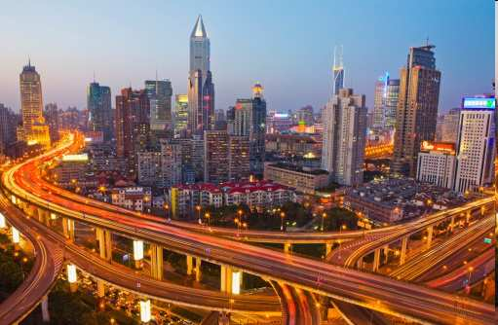

Hundred of species are lost everyday on this planet forever.
  Estimates put it as high as 70,000 species per year.
  Humanity is the 6th mass extinction event.

Slide 19
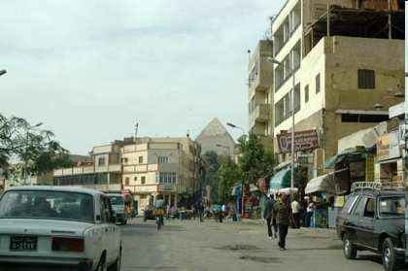
Hundred of species are lost everyday on this planet forever.
  Estimates put it as high as 70,000 species per year.
  Humanity is the 6th mass extinction event.

Slide 20
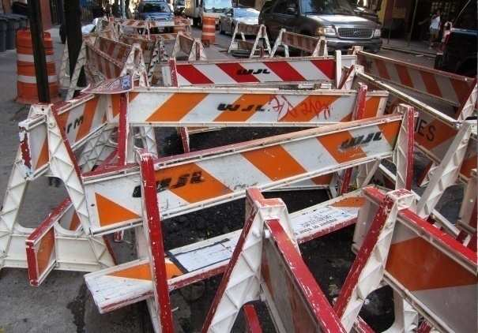
Hundred of species are lost everyday on this planet forever.
  Estimates put it as high as 70,000 species per year.
  Humanity is the 6th mass extinction event.

Slide 21
Hundred of species are lost everyday on this planet forever.
  Estimates put it as high as 70,000 species per year.
  Humanity is the 6th mass extinction event.

Slide 22
Hundred of species are lost everyday on this planet forever.
  Estimates put it as high as 70,000 species per year.
  Humanity is the 6th mass extinction event.

Slide 23
Hundred of species are lost everyday on this planet forever.
  Estimates put it as high as 70,000 species per year.
  Humanity is the 6th mass extinction event.

Slide 24
Hundred of species are lost everyday on this planet forever.
  Estimates put it as high as 70,000 species per year.
  Humanity is the 6th mass extinction event.

Slide 25
Hundred of species are lost everyday on this planet forever.
  Estimates put it as high as 70,000 species per year.
  Humanity is the 6th mass extinction event.

Slide 26
From the brink
of extinction

Slide 27


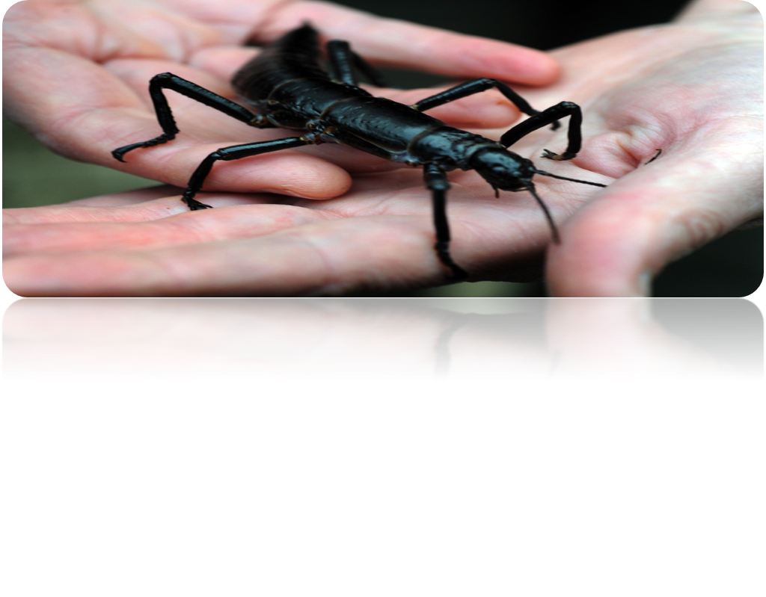

Slide 28
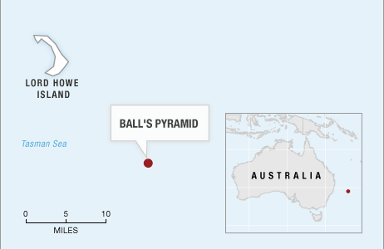
AMAZING STORY

Slide 30
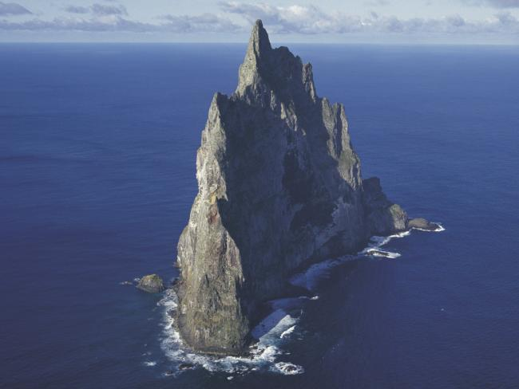

Slide 31
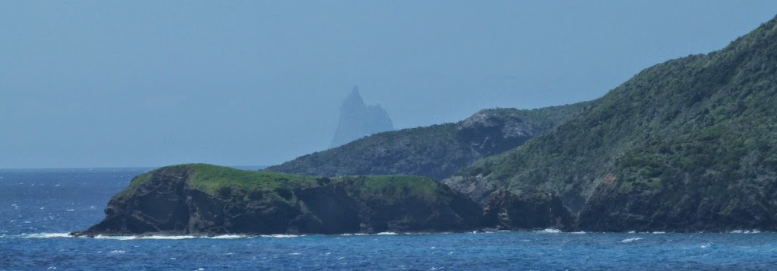

Slide 32
Ball’s Pyramid
Lord Howe Island

Slide 33
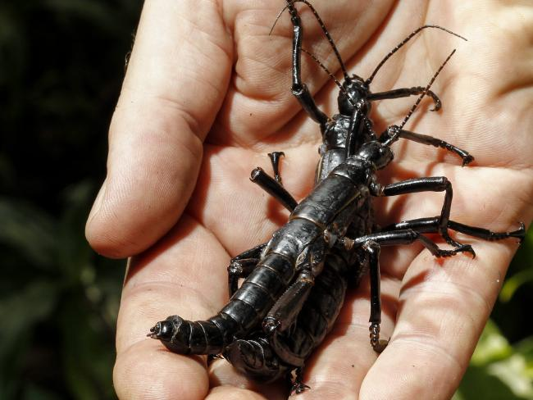
Lord Howe
Stick Insect
Ball’s Pyramid
Lord Howe Island

Slide 34
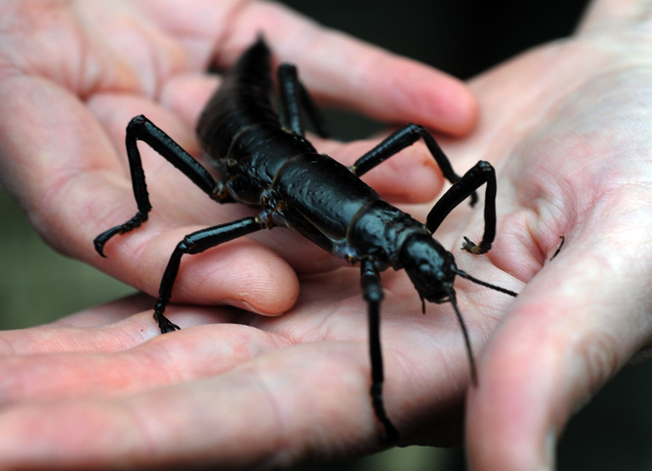
Neat reading article about the Lord Howe stick insect, Dryococelus australis.
  From the edge of extinction.
  http://www.npr.org/blogs/krulwich/2012/02/24/147367644/six-legged-giant-finds-secret-hideaway-hides-for-80-years

Slide 35
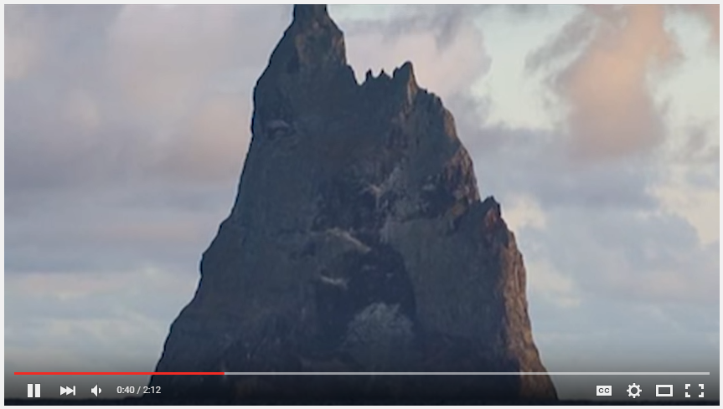
Review! Lord Howe Stick Insect
  https://www.youtube.com/watch?v=zRx-UtW1FLk
  Or
  https://www.youtube.com/watch?v=0XNyDfoFp-4&ab_channel=AtlasObscura

Slide 37
This is a Lord Howe stick insect (Dryococelus australis)

Slide 38
This is a Lord Howe stick insect (Dryococelus australis)
The Lord Howe Stick Insect was thought to be extinct for 80 years, after the population living on Lord Howe Island in Australia was wiped out by rats in 1920.

Slide 39
Ball’s Pyramid
This is a Lord Howe stick insect (Dryococelus australis)
The Lord Howe Stick Insect was thought to be extinct for 80 years, after the population living on Lord Howe Island in Australia was wiped out by rats in 1920.
However, on Ball’s Pyramid, a narrow rock formation 13 miles from Lord Howe Island, scientists found surviving stick insects. They don’t know how they got to Ball’s Pyramid or how they managed to survive.

Slide 40
Ball’s Pyramid
This is a Lord Howe stick insect (Dryococelus australis)
The Lord Howe Stick Insect was thought to be extinct for 80 years, after the population living on Lord Howe Island in Australia was wiped out by rats in 1920.
However, on Ball’s Pyramid, a narrow rock formation 13 miles from Lord Howe Island, scientists found surviving stick insects. They don’t know how they got to Ball’s Pyramid or how they managed to survive. To help maintain biodiversity, the scientists went through a lot of effort to keep the insects alive and to increase the population.

Slide 41
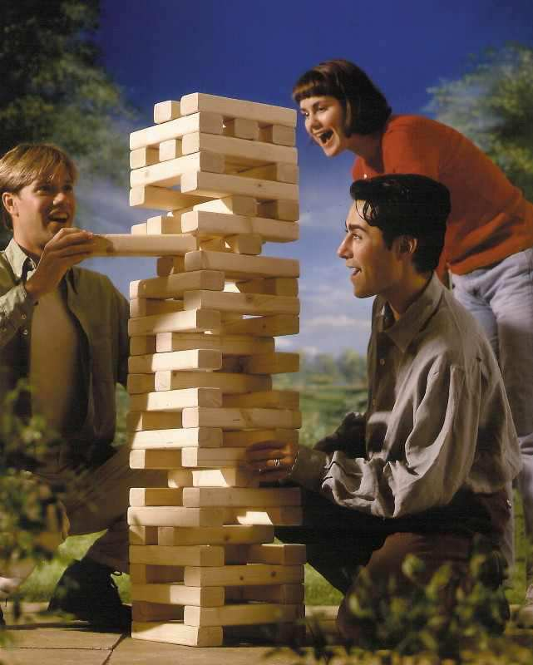
Activity! Biodiversity Jeng-ah
  Each student gets a piece of masking tape and Jeng-ah block.
  Write the name of a plant, animal, fungus, bacteria, or protist on it and tape it to the block.
  Teacher will collect blocks, set-up Jeng-ah and start removing species one at a time.
  Question: What happens to an ecosystem when you decrease biodiversity?
Copyright © 2024 SlideSpark LLC

Slide 42
Activity! Biodiversity Jeng-ah
  Each student gets a piece of masking tape and Jeng-ah block.
  Write the name of a plant, animal, fungus, bacteria, or protist on it and tape it to the block.
  Teacher will collect blocks, set-up Jeng-ah and start removing species one at a time.
  Question: What happens to an ecosystem when you decrease biodiversity?
Healthy
Ecosystem
Copyright © 2024 SlideSpark LLC

Slide 43
Activity! Biodiversity Jeng-ah
  Each student gets a piece of masking tape and Jeng-ah block.
  Write the name of a plant, animal, fungus, bacteria, or protist on it and tape it to the block.
  Teacher will collect blocks, set-up Jeng-ah and start removing species one at a time.
  Question: What happens to an ecosystem when you decrease biodiversity?
Healthy
Ecosystem
That contains life
sustaining systems for people.
Copyright © 2024 SlideSpark LLC

Slide 44
Activity! Biodiversity Jeng-ah
  Each student gets a piece of masking tape and Jeng-ah block.
  Write the name of a plant, animal, fungus, bacteria, or protist on it and tape it to the block.
  Teacher will collect blocks, set-up Jeng-ah and start removing species one at a time.
  Question: What happens to an ecosystem when you decrease biodiversity?
Clear Air
Soil Quality
Forests
Oceans
Healthy
Ecosystem
Rivers
That contains life
sustaining systems for people.
Clean Water
Wetlands
Biodiversity
Copyright © 2024 SlideSpark LLC

Slide 45
Activity! Biodiversity Jeng-ah
  Each student gets a piece of masking tape and Jeng-ah block.
  Write the name of a plant, animal, fungus, bacteria, or protist on it and tape it to the block. Just one.
  Teacher will collect blocks, set-up Jeng-ah and start removing species one at a time carefully.
  Question: What happens to an ecosystem when you decrease biodiversity?
Copyright © 2024 SlideSpark LLC

Slide 46
Activity! Biodiversity Jeng-ah
  Each student gets a piece of masking tape and Jeng-ah block.
  Write the name of a plant, animal, fungus, bacteria, or protist on it and tape it to the block. Just one.
  Teacher will collect blocks, set-up Jeng-ah and start removing species one at a time carefully.
  Question: What happens to an ecosystem when you decrease biodiversity?
Copyright © 2024 SlideSpark LLC

Slide 47
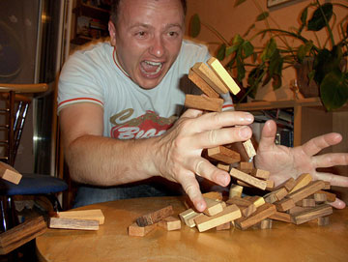


Slide 48
“The health of the ecosystems is collapsing.”

Slide 49
“Our very survival depends on life sustaining natural systems.”

Slide 50
“Maintaining biodiversity is critical to our survival.”

Slide 51
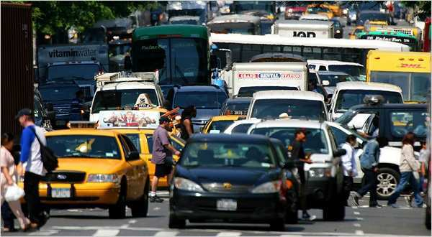

Video! Biodiversity and the Extinction Crisis.
  Question: Why is maintaining a high level of biodiversity important?
    https://www.youtube.com/watch?v=GK_vRtHJZu4
Copyright © 2024 SlideSpark LLC

Slide 52
Video! Biodiversity and the Extinction Crisis.
  Question: Why is maintaining a high level of biodiversity important?
    https://www.youtube.com/watch?v=GK_vRtHJZu4
Copyright © 2024 SlideSpark LLC

Slide 53
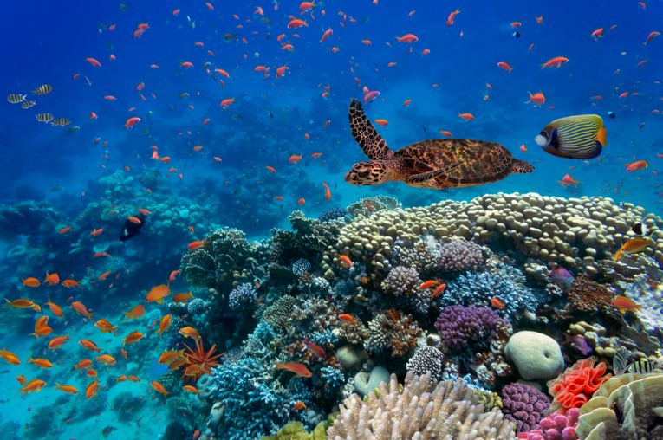
Importance of biodiversity
  Generation of soils and maintenance of soil quality.
  Maintenance of air quality.
  Maintenance of water quality.
  Pest Control.
  Detoxification and decomposition of wastes.
  Pollination and crop production.
  Provision of food security.
  Provision of health care (Medicines).
  Income generation.
  Spiritual / cultural value.
Copyright © 2024 SlideSpark LLC

Slide 54
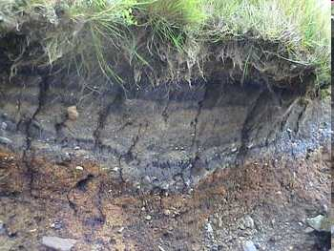
Importance of biodiversity
  Generation of soils and maintenance of soil quality.
  Maintenance of air quality.
  Maintenance of water quality.
  Pest Control.
  Detoxification and decomposition of wastes.
  Pollination and crop production.
  Provision of food security.
  Provision of health care (Medicines).
  Income generation.
  Spiritual / cultural value.
Copyright © 2024 SlideSpark LLC

Slide 55
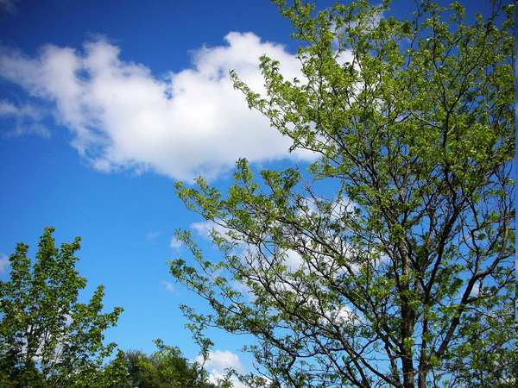
Importance of biodiversity
  Generation of soils and maintenance of soil quality.
  Maintenance of air quality.
  Maintenance of water quality.
  Pest Control.
  Detoxification and decomposition of wastes.
  Pollination and crop production.
  Provision of food security.
  Provision of health care (Medicines).
  Income generation.
  Spiritual / cultural value.
Copyright © 2024 SlideSpark LLC

Slide 56
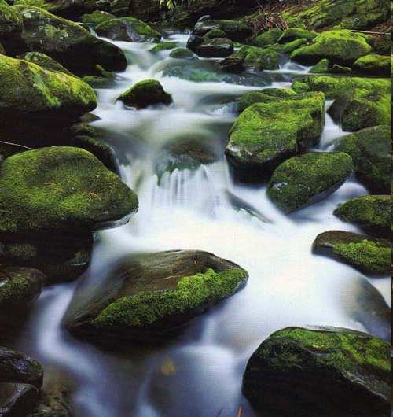
Importance of biodiversity
  Generation of soils and maintenance of soil quality.
  Maintenance of air quality.
  Maintenance of water quality.
  Pest Control.
  Detoxification and decomposition of wastes.
  Pollination and crop production.
  Provision of food security.
  Provision of health care (Medicines).
  Income generation.
  Spiritual / cultural value.
Copyright © 2024 SlideSpark LLC

Slide 57
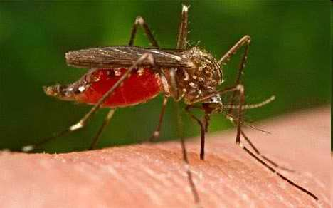
Importance of biodiversity
  Generation of soils and maintenance of soil quality.
  Maintenance of air quality.
  Maintenance of water quality.
  Pest Control.
  Detoxification and decomposition of wastes.
  Pollination and crop production.
  Provision of food security.
  Provision of health care (Medicines).
  Income generation.
  Spiritual / cultural value.
Copyright © 2024 SlideSpark LLC

Slide 58
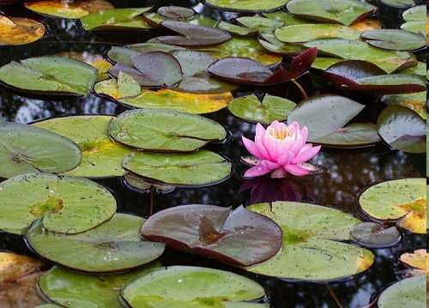
Importance of biodiversity
  Generation of soils and maintenance of soil quality.
  Maintenance of air quality.
  Maintenance of water quality.
  Pest Control.
  Detoxification and decomposition of wastes.
  Pollination and crop production.
  Provision of food security.
  Provision of health care (Medicines).
  Income generation.
  Spiritual / cultural value.
Copyright © 2024 SlideSpark LLC

Slide 59
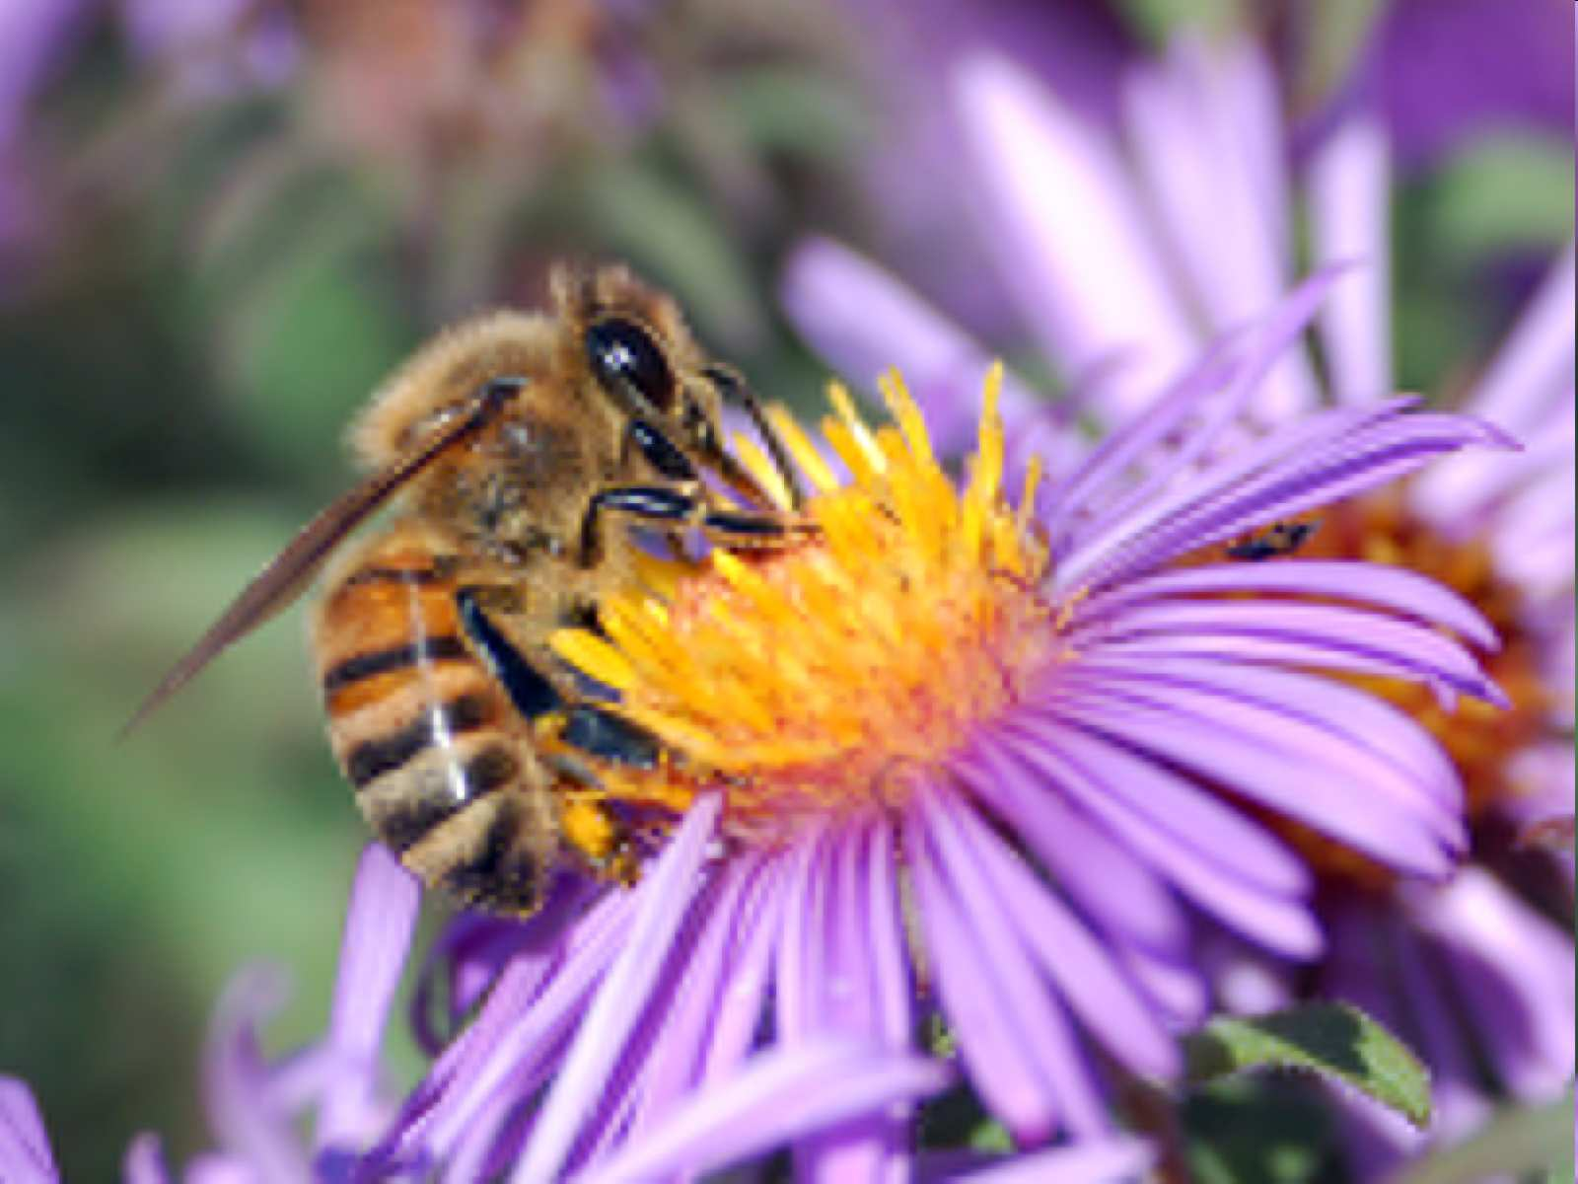
Importance of biodiversity
  Generation of soils and maintenance of soil quality.
  Maintenance of air quality.
  Maintenance of water quality.
  Pest Control.
  Detoxification and decomposition of wastes.
  Pollination and crop production.
  Provision of food security.
  Provision of health care (Medicines).
  Income generation.
  Spiritual / cultural value.
Copyright © 2024 SlideSpark LLC

Slide 60
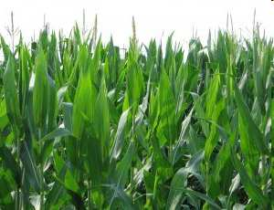
Importance of biodiversity
  Generation of soils and maintenance of soil quality.
  Maintenance of air quality.
  Maintenance of water quality.
  Pest Control.
  Detoxification and decomposition of wastes.
  Pollination and crop production.
  Provision of food security.
  Provision of health care (Medicines).
  Income generation.
  Spiritual / cultural value.
Copyright © 2024 SlideSpark LLC

Slide 61
Importance of biodiversity
  Generation of soils and maintenance of soil quality.
  Maintenance of air quality.
  Maintenance of water quality.
  Pest Control.
  Detoxification and decomposition of wastes.
  Pollination and crop production.
  Provision of food security.
  Provision of health care (Medicines).
  Income generation.
  Spiritual / cultural value.
Copyright © 2024 SlideSpark LLC

Slide 62
Importance of biodiversity
  Generation of soils and maintenance of soil quality.
  Maintenance of air quality.
  Maintenance of water quality.
  Pest Control.
  Detoxification and decomposition of wastes.
  Pollination and crop production.
  Provision of food security.
  Provision of health care (Medicines).
  Income generation.
  Spiritual / cultural value.
$
$
Copyright © 2024 SlideSpark LLC

Slide 63
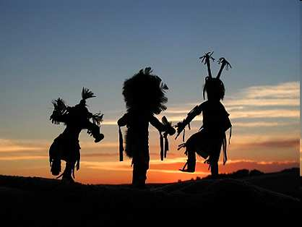
Importance of biodiversity
  Generation of soils and maintenance of soil quality.
  Maintenance of air quality.
  Maintenance of water quality.
  Pest Control.
  Detoxification and decomposition of wastes.
  Pollination and crop production.
  Provision of food security.
  Provision of health care (Medicines).
  Income generation.
  Spiritual / cultural value.
Copyright © 2024 SlideSpark LLC

Slide 64
Importance of biodiversity
  Generation of soils and maintenance of soil quality.
  Maintenance of air quality.
  Maintenance of water quality.
  Pest Control.
  Detoxification and decomposition of wastes.
  Pollination and crop production.
  Provision of food security.
  Provision of health care (Medicines).
  Income generation.
  Spiritual / cultural value.
Why is biodiversity important? Learn more at… http://www.globalissues.org/article/170/why-is-biodiversity-important-who-cares
Copyright © 2024 SlideSpark LLC

Slide 65
Which is not an importance of biodiversity
  A.) Generation of soils and maintenance of soil quality.
  B.) Maintenance of air quality.
  C.) Maintenance of water quality.
  D.) Increase pest species.
  E.) Detoxification and decomposition of wastes.
  F.) Pollination and crop production.
  G.) Provision of food security.
  H.) Provision of health care (Medicines).
  I.) Income generation.
  J.) Spiritual / cultural value.
Copyright © 2024 SlideSpark LLC

Slide 66
Which is not an importance of biodiversity
  A.) Generation of soils and maintenance of soil quality.
  B.) Maintenance of air quality.
  C.) Maintenance of water quality.
  D.) Increase pest species.
  E.) Detoxification and decomposition of wastes.
  F.) Pollination and crop production.
  G.) Provision of food security.
  H.) Provision of health care (Medicines).
  I.) Income generation.
  J.) Spiritual / cultural value.
Copyright © 2024 SlideSpark LLC

Slide 67
Which is not an importance of biodiversity
  A.) Generation of soils and maintenance of soil quality.
  B.) Maintenance of air quality.
  C.) Maintenance of water quality.
  D.) Pest Control
  E.) Detoxification and decomposition of wastes.
  F.) Pollination and crop production.
  G.) Provision of food security.
  H.) Provision of health care (Medicines).
  I.) Income generation.
  J.) Spiritual / cultural value.
Copyright © 2024 SlideSpark LLC

Slide 68
Which is not an importance of biodiversity
  A.) Generation of soils and maintenance of soil quality.
  B.) Maintenance of air quality.
  C.) Maintenance of water quality.
  D.) Pest Control.
  E.) The creation of waste
  F.) Pollination and crop production.
  G.) Provision of food security.
  H.) Provision of health care (Medicines).
  I.) Income generation.
  J.) Spiritual / cultural value.
Copyright © 2024 SlideSpark LLC

Slide 69
Which is not an importance of biodiversity
  A.) Generation of soils and maintenance of soil quality.
  B.) Maintenance of air quality.
  C.) Maintenance of water quality.
  D.) Pest Control.
  E.) The creation of waste
  F.) Pollination and crop production.
  G.) Provision of food security.
  H.) Provision of health care (Medicines).
  I.) Income generation.
  J.) Spiritual / cultural value.
Copyright © 2024 SlideSpark LLC

Slide 70
Which is not an importance of biodiversity
  A.) Generation of soils and maintenance of soil quality.
  B.) Maintenance of air quality.
  C.) Maintenance of water quality.
  D.) Pest Control.
  E.) Detoxification and decomposition of wastes.
  F.) Pollination and crop production.
  G.) Provision of food security.
  H.) Provision of health care (Medicines).
  I.) Income generation.
  J.) Spiritual / cultural value.
Copyright © 2024 SlideSpark LLC

Slide 71
Which is not an importance of biodiversity
  A.) Generation of soils and maintenance of soil quality.
  B.) Maintenance of air quality.
  C.) Maintenance of water quality.
  D.) Pest Control
  E.) Detoxification and decomposition of wastes.
  F.) Pollination and crop production.
  G.) Decrease in food security.
  H.) Provision of health care (Medicines).
  I.) Income generation.
  J.) Spiritual / cultural value.
Copyright © 2024 SlideSpark LLC

Slide 72
Which is not an importance of biodiversity
  A.) Generation of soils and maintenance of soil quality.
  B.) Maintenance of air quality.
  C.) Maintenance of water quality.
  D.) Pest Control
  E.) Detoxification and decomposition of wastes.
  F.) Pollination and crop production.
  G.) Decrease in food security.
  H.) Provision of health care (Medicines).
  I.) Income generation.
  J.) Spiritual / cultural value.
Copyright © 2024 SlideSpark LLC

Slide 73
Which is not an importance of biodiversity
  A.) Generation of soils and maintenance of soil quality.
  B.) Maintenance of air quality.
  C.) Maintenance of water quality.
  D.) Pest Control
  E.) Detoxification and decomposition of wastes.
  F.) Pollination and crop production.
  G.) Increase in food security.
  H.) Provision of health care (Medicines).
  I.) Income generation.
  J.) Spiritual / cultural value.
Copyright © 2024 SlideSpark LLC

Slide 74
Which is not an importance of biodiversity
  A.) Generation of soils and maintenance of soil quality.
  B.) Maintenance of air quality.
  C.) Maintenance of water quality.
  D.) Pest Control
  E.) Detoxification and decomposition of wastes.
  F.) Pollination and crop production.
  G.) Increase in food security.
  H.) Provision of health care (Medicines).
  I.) Loss of income.
  J.) Spiritual / cultural value.
Copyright © 2024 SlideSpark LLC

Slide 75
Which is not an importance of biodiversity
  A.) Generation of soils and maintenance of soil quality.
  B.) Maintenance of air quality.
  C.) Maintenance of water quality.
  D.) Pest Control
  E.) Detoxification and decomposition of wastes.
  F.) Pollination and crop production.
  G.) Increase in food security.
  H.) Provision of health care (Medicines).
  I.) Loss of income.
  J.) Spiritual / cultural value.
Copyright © 2024 SlideSpark LLC

Slide 76
Which is not an importance of biodiversity
  A.) Generation of soils and maintenance of soil quality.
  B.) Maintenance of air quality.
  C.) Maintenance of water quality.
  D.) Pest Control
  E.) Detoxification and decomposition of wastes.
  F.) Pollination and crop production.
  G.) Increase in food security.
  H.) Provision of health care (Medicines).
  I.) Income generation
  J.) Spiritual / cultural value.
Copyright © 2024 SlideSpark LLC

Slide 78
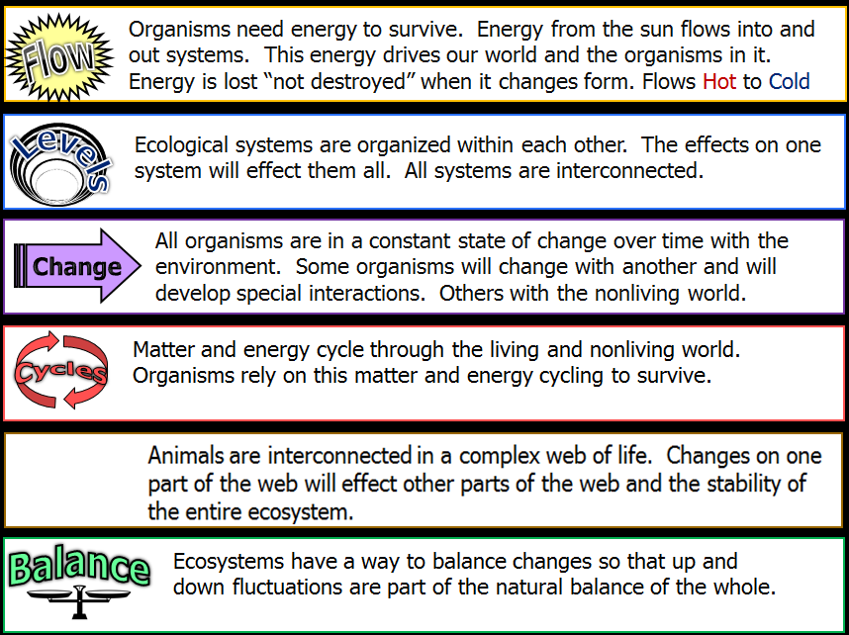

All of the concepts below connect to biodiversity.

Slide 79
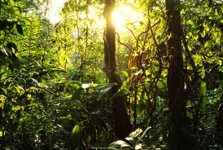
How can we maintain biodiversity?

Slide 80
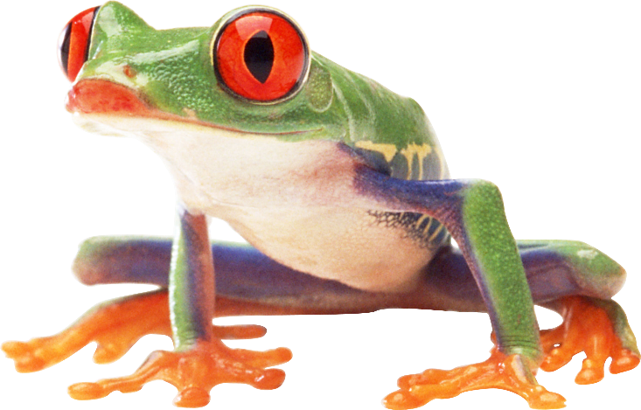
Why should we maintain biodiversity?

Slide 81
Why should we maintain biodiversity?
Main Idea and Topic Sentence: It should be strong and clear. How can we maintain biodiversity?
Supporting Details: Your paragraph should have three supporting details and relate to your main idea / topic sentence.
  A.) Generation of soils and maintenance of soil quality.
  B.) Maintenance of air quality.
  C.) Maintenance of water quality.
  D.) Pest Control
  E.) Detoxification and decomposition of wastes.
  F.) Pollination and crop production.
  G.) Increase in food security.
  H.) Provision of health care (Medicines).
  I.) Income generation
  J.) Spiritual / cultural value.
Concluding Sentence. Your concluding sentence is connected to the topic sentence and does not include new details.

Slide 82
Why should we maintain biodiversity?

Slide 83
Why should we maintain biodiversity?
Topic
Supporting Details
Concluding
Sentence

Slide 84
Why should we maintain biodiversity?
Maintaining biodiversity is important to our very survival. Biodiversity helps maintain the valuable and life sustaining systems on our planet. Clean air, clean water, food security, and pest control are all improved with increased biodiversity. When species are removed from an ecosystem, the stability of the entire ecosystem can be threatened. It is important to remember that we are a part of the ecosystem, and our actions, and how we maintain biodiversity matters.
Topic
Supporting Details
Concluding
Sentence

Slide 85
Why should we maintain biodiversity?
Maintaining biodiversity is important to our very survival. Biodiversity helps maintain the valuable and life sustaining systems on our planet. Clean air, clean water, food security, and pest control are all improved with increased biodiversity. When species are removed from an ecosystem, the stability of the entire ecosystem can be threatened. It is important to remember that we are a part of the ecosystem, and our actions, and how we maintain biodiversity matters.
Topic
Supporting
Details
Concluding
Sentence

Slide 86
Why should we maintain biodiversity?
Maintaining biodiversity is important to our very survival. Biodiversity helps maintain the valuable and life sustaining systems on our planet. Clean air, clean water, food security, and pest control are all improved with increased biodiversity. When species are removed from an ecosystem, the stability of the entire ecosystem can be threatened. It is important to remember that we are a part of the ecosystem, and our actions, and how we maintain biodiversity matters.
Topic
Supporting
Details
Concluding
Sentence

Slide 87
How can we maintain biodiversity?
First see the value

Slide 88
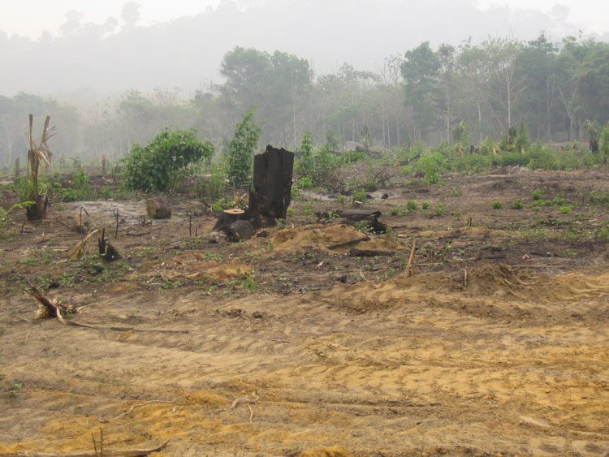
How can we maintain biodiversity?
First see the value
Don’t mess with this…

Slide 89
How can we maintain biodiversity?
First see the value
Don’t mess with this…
Prevent habitat destruction

Slide 90
How can we maintain biodiversity?
First see the value
Don’t mess with this…
Prevent habitat destruction
Laws and regulations, conservation measures, Parks, etc.

Slide 91
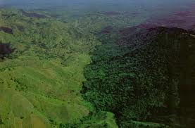
How can we maintain biodiversity?
First see the value
Don’t mess with this…
Prevent habitat destruction
Laws and regulations, conservation measures, Parks, etc.

Slide 92
How can we maintain biodiversity?
First see the value
Don’t mess with this…
Prevent habitat destruction
Laws and regulations, conservation measures, Parks, etc.
Haiti,
No Regulations

Slide 93
How can we maintain biodiversity?
First see the value
Don’t mess with this…
Prevent habitat destruction
Laws and regulations, conservation measures, Parks, etc.
Border
Haiti,
No Regulations

Slide 94
How can we maintain biodiversity?
First see the value
Don’t mess with this…
Prevent habitat destruction
Laws and regulations, conservation measures, Parks, etc.
Border
Haiti,
No Regulations
Dominican Republic
Regulations

Slide 95
How can we maintain biodiversity?
First see the value
Don’t mess with this…
Prevent habitat destruction
Laws and regulations, conservation measures, Parks, etc.
Conservation of key species

Slide 96
How can we maintain biodiversity?
First see the value
Don’t mess with this…
Prevent habitat destruction
Laws and regulations, conservation measures, Parks, etc.
Conservation of key species
Minimize Human
Interference!

Slide 97
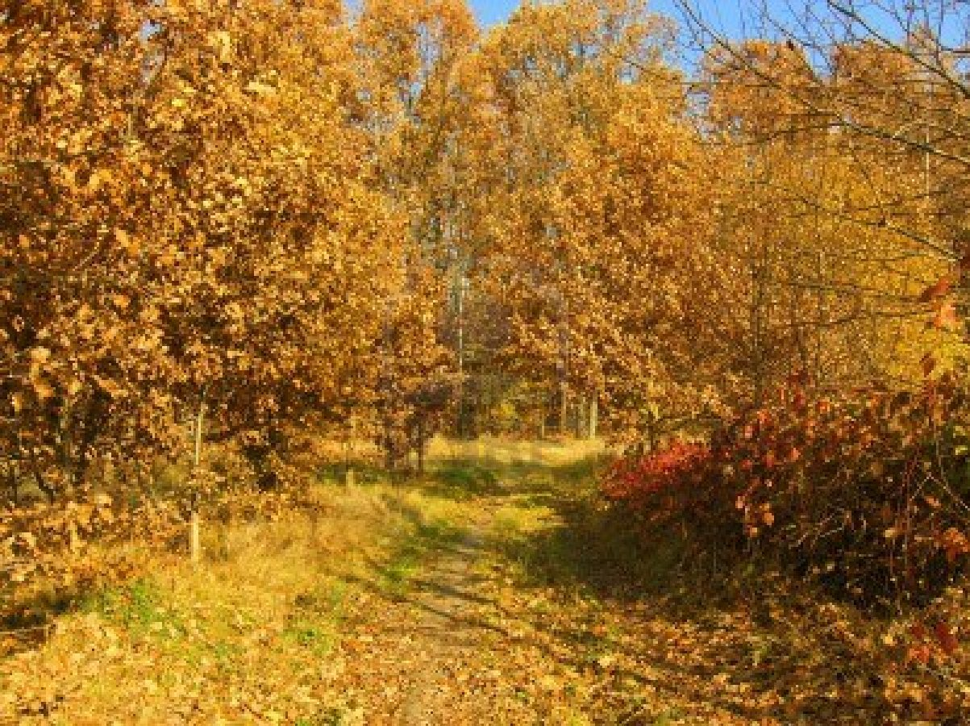
How can we maintain biodiversity?
First see the value
Don’t mess with this…
Prevent habitat destruction
Laws and regulations, conservation measures, Parks, etc.
Conservation of key species
Minimize Human
Interference!

Slide 98
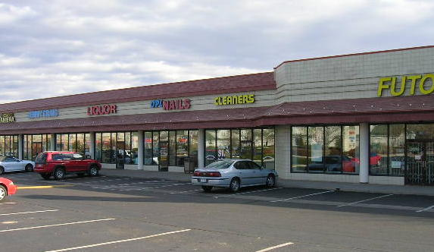
How can we maintain biodiversity?
First see the value
Don’t mess with this…
Prevent habitat destruction
Laws and regulations, conservation measures, Parks, etc.
Conservation of key species
Minimize Human
Interference!

Slide 99
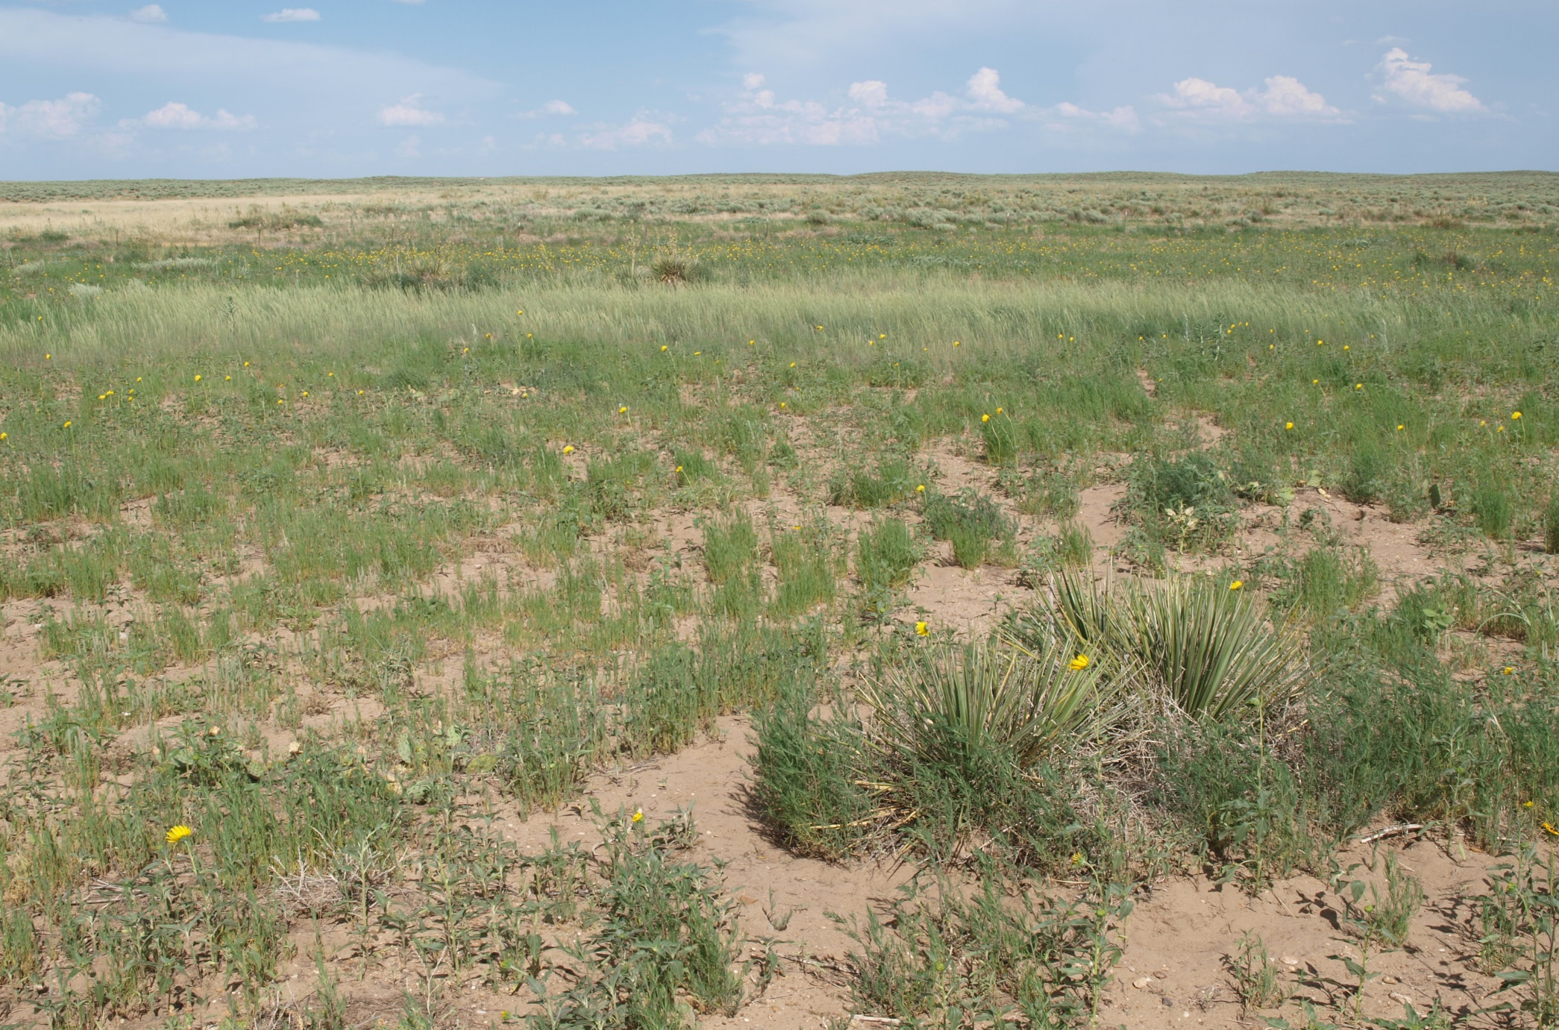
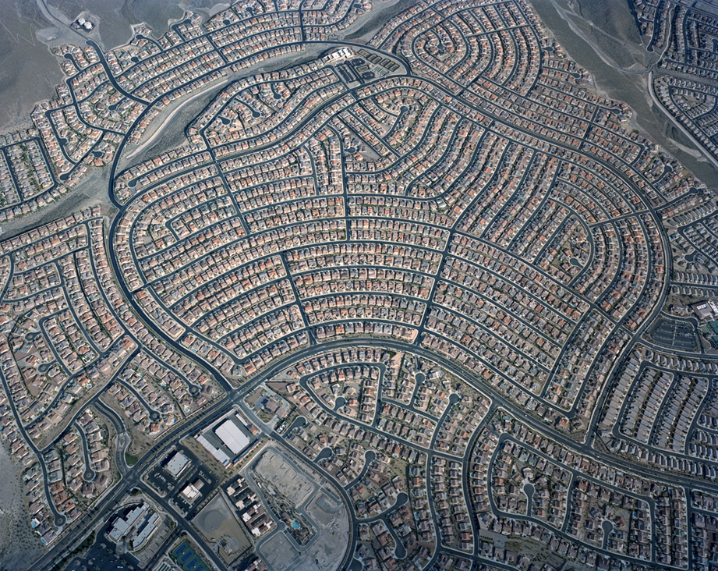
How can we maintain biodiversity?
First see the value
Don’t mess with this…
Prevent habitat destruction
Laws and regulations, conservation measures, Parks, etc.
Conservation of key species
Minimize Human
Interference!

Slide 100
How can we maintain biodiversity?
First see the value
Don’t mess with this…
Prevent habitat destruction
Laws and regulations, conservation measures, Parks, etc.
Conservation of key species
Minimize Human
Interference!

Slide 101
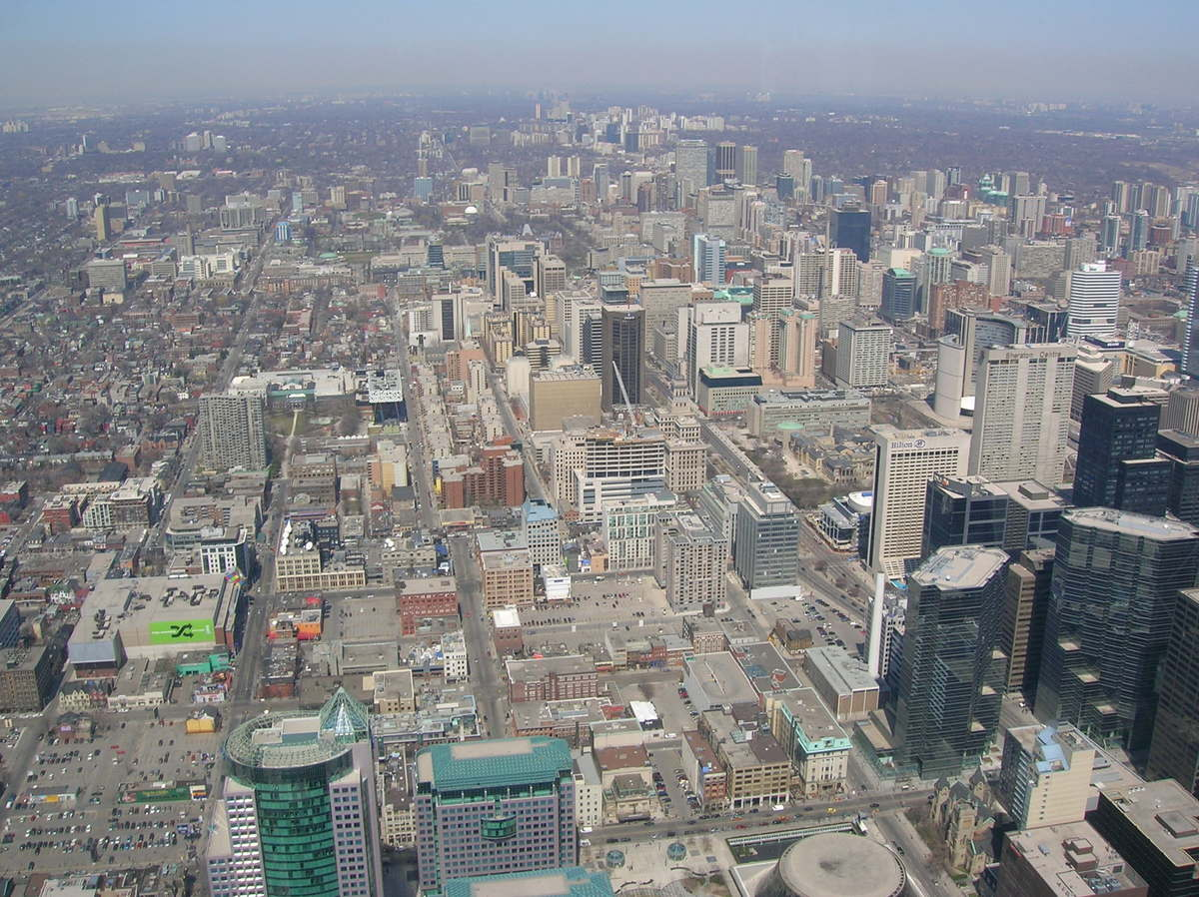
How can we maintain biodiversity?
First see the value
Don’t mess with this…
Prevent habitat destruction
Laws and regulations, conservation measures, Parks, etc.
Conservation of key species
Minimize Human
Interference!

Slide 102
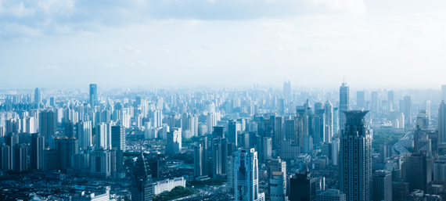
How can we maintain biodiversity?
First see the value
Don’t mess with this…
Prevent habitat destruction
Laws and regulations, conservation measures, Parks, etc.
Conservation of key species
Minimize Human
Interference!

Slide 103
How can we maintain biodiversity?
First see the value
Don’t mess with this…
Not like this….
Prevent habitat destruction
Laws and regulations, conservation measures, Parks, etc.
Conservation of key species
Minimize Human
Interference!

Slide 104
How can we maintain biodiversity?
First see the value
Don’t mess with this…
Not like this….
Prevent habitat destruction
Laws and regulations, conservation measures, Parks, etc.
Conservation of key species
A Species
Minimize Human
Interference!

Slide 105
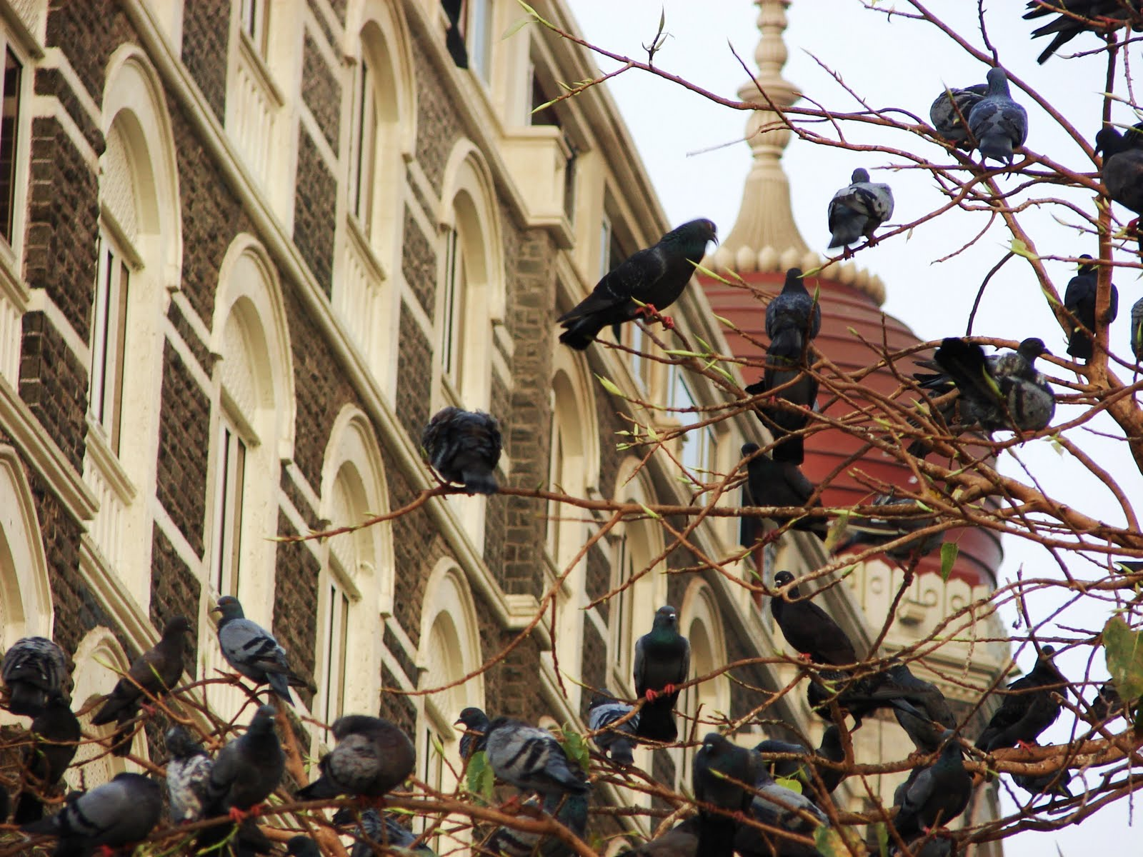
How can we maintain biodiversity?
First see the value
Don’t mess with this…
Not like this….
Prevent habitat destruction
Laws and regulations, conservation measures, Parks, etc.
Conservation of key species
Minimize Human
Interference!

Slide 106
How can we maintain biodiversity?
First see the value
Don’t mess with this…
Not like this….
Prevent habitat destruction
Laws and regulations, conservation measures, Parks, etc.
Another Species
Conservation of key species
Minimize Human
Interference!

Slide 107
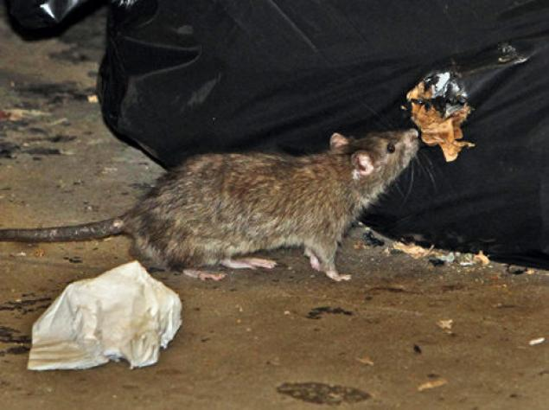
How can we maintain biodiversity?
First see the value
Don’t mess with this…
Not like this….
Prevent habitat destruction
Laws and regulations, conservation measures, Parks, etc.
Conservation of key species
Minimize Human
Interference!

Slide 108
How can we maintain biodiversity?
First see the value
Don’t mess with this…
Not like this….
Prevent habitat destruction
Some species thrive
in metropolitan areas
Laws and regulations, conservation measures, Parks, etc.
Conservation of key species
Minimize Human
Interference!

Slide 109
How can we maintain biodiversity?
First see the value
Don’t mess with this…
Not like this….
Prevent habitat destruction
Some species thrive
in metropolitan areas
Laws and regulations, conservation measures, Parks, etc.
Conservation of key species
Minimize Human
Interference!
Usually species we
don’t like that much

Slide 110
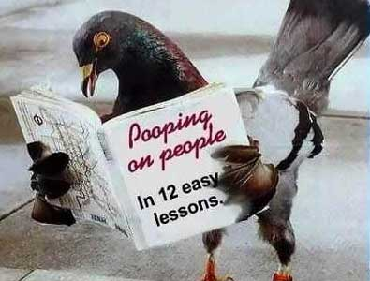
How can we maintain biodiversity?
First see the value
Don’t mess with this…
Not like this….
Prevent habitat destruction
Some species thrive
in metropolitan areas
Laws and regulations, conservation measures, Parks, etc.
Conservation of key species
Minimize Human
Interference!
Usually species we
don’t like that much

Slide 111
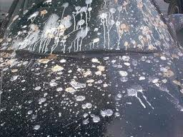
How can we maintain biodiversity?
First see the value
Don’t mess with this…
Not like this….
Prevent habitat destruction
Some species thrive
in metropolitan areas
Laws and regulations, conservation measures, Parks, etc.
Conservation of key species
Minimize Human
Interference!
Usually species we
don’t like that much

Slide 112

Plantation Forestry vs.
Regeneration Forestry
+
+
Positives
Positives
Write this down
-
-
Negatives
Negatives

Slide 113
Plantation Forestry vs.
Regeneration Forestry
+
+
Positives
Positives
-
-
Negatives
Negatives

Slide 114
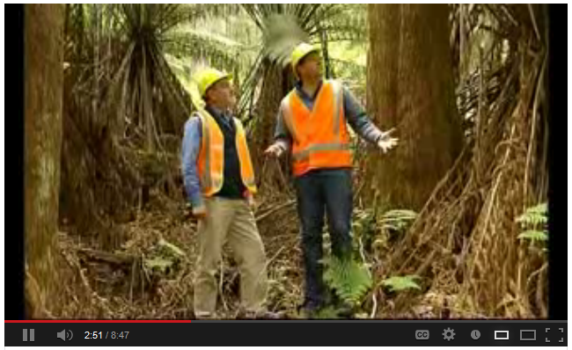
Video Link! (Optional) Plantation Forestry vs. Native Regeneration Forestry (Tasmania)
  Pay attention each side of the story.
  Which is better to maintain biodiversity?
  http://www.youtube.com/watch?v=vplUH8A_wE

Slide 115
Plantation Forestry vs.
Regeneration Forestry
+
+
Positives
Positives
-Grow 4 to 5 times faster than native regenerative forest. $
-More biodiversity than farmland.
-All the wood is useable.
-Species are not displaced
-More biodiversity
-Premium wood, better wood and larger in size.
-Stores more carbon, ecologically friendly
-
-
Negatives
Negatives

Slide 116
Plantation Forestry vs.
Regeneration Forestry
+
+
Positives
Positives
-Grow 4 to 5 times faster than native regenerative forest. $
-More biodiversity than farmland.
-All the wood is useable.
-Species are not displaced
-More biodiversity
-Premium wood, better wood and larger in size.
-Stores more carbon, ecologically friendly
-
-
Negatives
Negatives
-Not as biodiverse as a native regenerative forest.
-Use chemicals and fertilizers
-Not natural
-Grows much slower, and not all the wood produced is useable.

Slide 117
Biodiversity
Part 2
Lesson 2

Slide 118





Curriculum Guide
Number of Lessons in each unit (50 min, daily lessons) and difficult rating scale / intended grade level.
=Easier, = More difficult, =Most difficult
Earth Science Units

Slide 119


Life Science Units

Slide 120

Physical Science

Slide 121

Dear Valued Educator,
Our fully editable .pptx and .doc resources are perfect for educators looking to bring enthusiasm and creativity to their lessons. We encourage you to make changes to fit your needs and style. As science educators, we’re committed to providing students with the tools they need to succeed in the classroom and beyond. Each unit in the curriculum includes a range of resources that have been developed through extensive research and use in a busy classroom. Our teaching approach is designed to make science education engaging and exciting for learners of all ages. We offer a one-of-a-kind science curriculum that will challenge, inspire, and educate students to become tomorrow's scientists and leaders. Join us today and learn more about how our program can help you achieve your classroom goals.
With appreciation,
Support@SlideSpark.net

Slide 122





Thank you for your time and interest in our Science curriculum. We strive to provide students with engaging and informative lessons that will spark their curiosity and encourage scientific exploration. Should you have any questions or concerns, please do not hesitate to contact us. Thank you again for considering our curriculum, and we wish you all the best in your educational journey.
Sincerely,
Support@slidespark.net
SlideSpark Science on TpT

