Slide 1
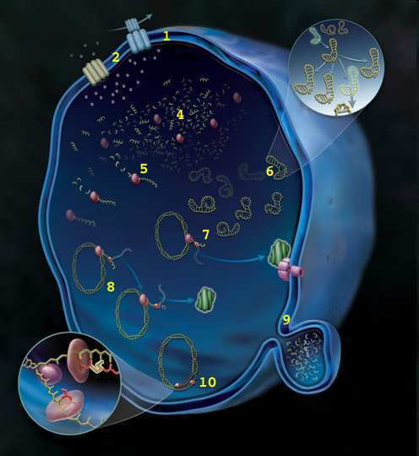


DNA Review Game
Part 1
Lesson 8

Slide 2
DNA Review Game
HIP HIP HOORAY | SPIRAL SPIRAL | SHAPE-UP | LIFE LINE | -Bonus- FAMILY JEANS
1 | 6 | 11 | 16 | *21
2 | 7 | 12 | 17 | *22
3 | 8 | 13 | 18 | *23
4 | 9 | 14 | 19 | *24
5 | 10 | 15 | 20 | *25

Slide 3
How to play…
  Don’t play like Jeo_ _ _ _ y.
  Class should be divided into several small groups.
  Groups should use science journal (red slide notes), homework, and other available materials to assist you.
  Groups can communicate quietly with each other but no sharing answers between groups.
    Practice quietly communicating right now?
    Practice Communication Question:
    Your group gets to order one pizza and you can have two toppings. What does your group want?

Slide 4

Questions 1-20 = 5pts Each
Final Category (Bonus) = 1pt Each
Final Questions = 5 pt wager
If you wager 5 on the last question and get it wrong you lose 5 pts. Wager 5 and get it right you get 5 pts.
Find the Owl =
Secretly write “Owl” in the correct box worth 1pt.
“I’ll be about this big.”

Slide 5
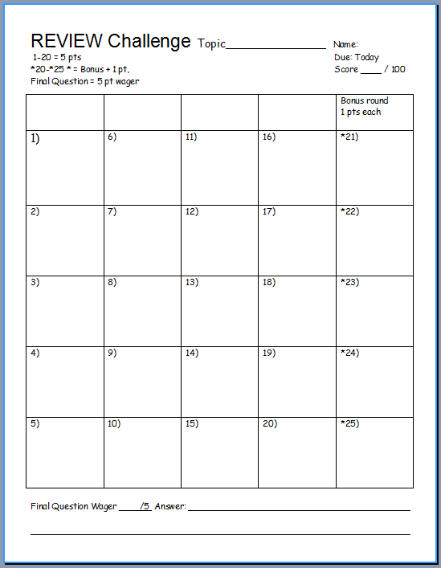
Is your name on the review sheet?
Name

Slide 6
Is your name on the review sheet?
Add the categories
along the top
on the next slide.

Slide 7
DNA Review Game
HIP HIP HOORAY | SPIRAL SPIRAL | SHAPE-UP | LIFE LINE | -Bonus- FAMILY JEANS
1 | 6 | 11 | 16 | *21
2 | 7 | 12 | 17 | *22
3 | 8 | 13 | 18 | *23
4 | 9 | 14 | 19 | *24
5 | 10 | 15 | 20 | *25

Slide 8
DNA Review Game
HIP HIP HOORAY | SPIRAL SPIRAL | SHAPE-UP | LIFE LINE | -Bonus- FAMILY JEANS
1 | 6 | 11 | 16 | *21
2 | 7 | 12 | 17 | *22
3 | 8 | 13 | 18 | *23
4 | 9 | 14 | 19 | *24
5 | 10 | 15 | 20 | *25

Slide 9
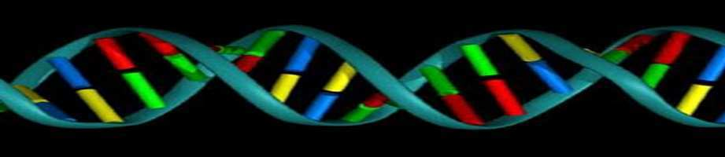
1
Which is not correct of DNA?
  A.) DNA is housed in the nucleus of Eukaryotic Cells.
  B.) DNA stands for Double Nucleus Amino acid.
  C.) The shape is called the double helix.
  D.) DNA has the information for our cells to make proteins.
  E.) DNA through transcription makes mRNA.

Slide 10
1
Which is not correct of DNA?
  A.) DNA is housed in the nucleus of Eukaryotic Cells.
  B.) DNA stands for Double Nucleus Amino acid.
  C.) The shape is called the double helix.
  D.) DNA has the information for our cells to make proteins.
  E.) DNA through transcription makes mRNA.

Slide 11
1
Which is not correct of DNA?
  A.) DNA is housed in the nucleus of Eukaryotic Cells.
  B.) DNA stands for Double Nucleus Amino acid.
  C.) The shape is called the double helix.
  D.) DNA has the information for our cells to make proteins.
  E.) DNA through transcription makes mRNA.

Slide 12
1
Which is not correct of DNA?
  A.) DNA is housed in the nucleus of Eukaryotic Cells.
  B.) DNA stands for Double Nucleus Amino acid.
  C.) The shape is called the double helix.
  D.) DNA has the information for our cells to make proteins.
  E.) DNA through transcription makes mRNA.

Slide 13
1
Which is not correct of DNA?
  A.) DNA is housed in the nucleus of Eukaryotic Cells.
  B.) DNA stands for Double Nucleus Amino acid.
  C.) The shape is called the double helix.
  D.) DNA has the information for our cells to make proteins.
  E.) DNA through transcription makes mRNA.

Slide 14
1
Which is not correct of DNA?
  A.) DNA is housed in the nucleus of Eukaryotic Cells.
  B.) DNA stands for Double Nucleus Amino acid.
  C.) The shape is called the double helix.
  D.) DNA has the information for our cells to make proteins.
  E.) DNA through transcription makes mRNA.

Slide 15
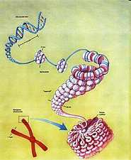
How many meters (roughly) of DNA stretched out can be found in a single cell?
  A.) .18 nanometers
  B.) 18 millimeters
  C.) 1.8 meters
  D.) 180 kilometers
  E.) It can wrap around the world over 180 million times.
2

Slide 16
How many meters (roughly) of DNA stretched out can be found in a single cell?
  A.) .18 nanometers
  B.) 18 millimeters
  C.) 1.8 meters
  D.) 180 kilometers
  E.) It can wrap around the world over 180 million times.
2

Slide 17
How many meters (roughly) of DNA stretched out can be found in a single cell?
  A.) .18 nanometers
  B.) 18 millimeters
  C.) 1.8 meters
  D.) 180 kilometers
  E.) It can wrap around the world over 180 million times.
2

Slide 18
How many meters (roughly) of DNA stretched out can be found in a single cell?
  A.) .18 nanometers
  B.) 18 millimeters
  C.) 1.8 meters
  D.) 180 kilometers
  E.) It can wrap around the world over 180 million times.
2

Slide 19
How many meters (roughly) of DNA stretched out can be found in a single cell?
  A.) .18 nanometers
  B.) 18 millimeters
  C.) 1.8 meters
  D.) 180 kilometers
  E.) It can wrap around the world over 180 million times.
2

Slide 20
How many meters (roughly) of DNA stretched out can be found in a single cell?
  A.) .18 nanometers
  B.) 18 millimeters
  C.) 1.8 meters
  D.) 180 kilometers
  E.) It can wrap around the world over 180 million times.
2

Slide 21
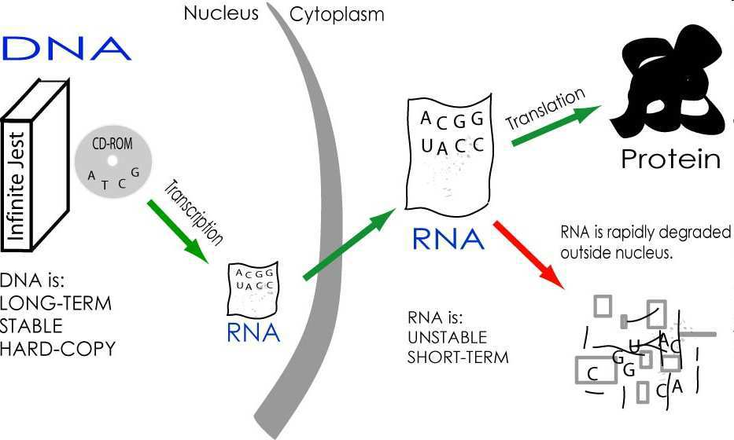





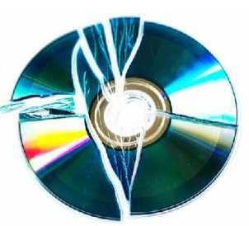
3
DNA has the information for our cells to make proteins. Name A and B?
Except
Proteins
Keep your
hard copy
safe in the nucleus
B
A
Copyright © 2024 SlideSpark .LLC

Slide 22
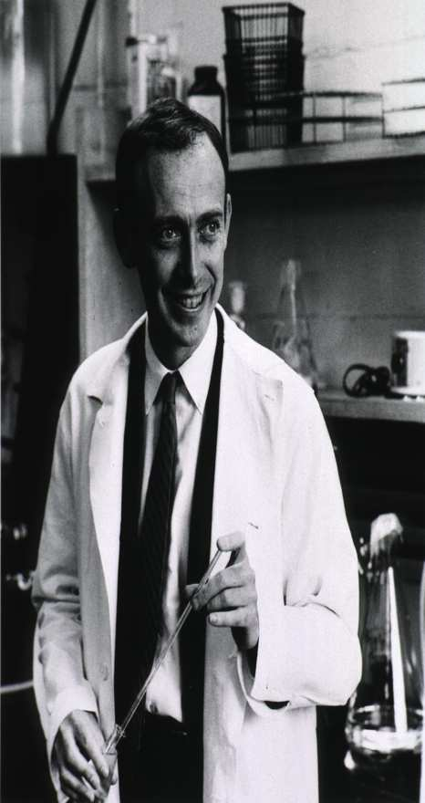
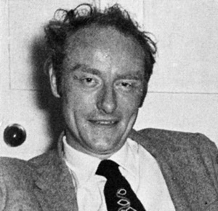
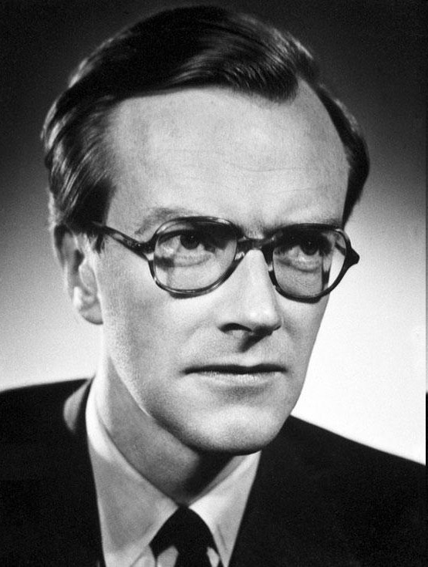
In 1962, Watson, Crick, and Wilkins won the Nobel Prize for discovering DNA’s structure.
4
A
B
C
Copyright © 2024 SlideSpark .LLC

Slide 23
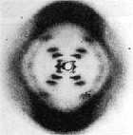

This scientist took X-Ray pictures of DNA’s structure and lectured about phosphate being a part of the outside of the molecule.
  Watson attended her lecture.
5
Copyright © 2024 SlideSpark .LLC

Slide 24
DNA Review Game
HIP HIP HOORAY | SPIRAL SPIRAL | SHAPE-UP | LIFE LINE | -Bonus- FAMILY JEANS
1 | 6 | 11 | 16 | *21
2 | 7 | 12 | 17 | *22
3 | 8 | 13 | 18 | *23
4 | 9 | 14 | 19 | *24
5 | 10 | 15 | 20 | *25

Slide 25
DNA Review Game
HIP HIP HOORAY | SPIRAL SPIRAL | SHAPE-UP | LIFE LINE | -Bonus- FAMILY JEANS
1 | 6 | 11 | 16 | *21
2 | 7 | 12 | 17 | *22
3 | 8 | 13 | 18 | *23
4 | 9 | 14 | 19 | *24
5 | 10 | 15 | 20 | *25

Slide 26
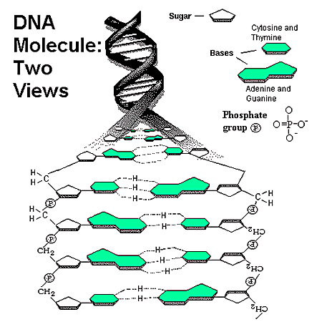
Which one is A, B, and C?
A.) mRNA, DNA, Sugar Complex
B.) Hydrogen Bond, mRNA, DNA wrap.
C.) Phosphate Group, 5 Carbon Sugar, Nitrogen Base
D.) Enzymes, Helix, Ribosomal Unit.
A
B
C
6
Copyright © 2024 SlideSpark .LLC

Slide 27
Which one is A, B, and C?
A.) mRNA, DNA, Sugar Complex
B.) Hydrogen Bond, mRNA, DNA wrap.
C.) Phosphate Group, 5 Carbon Sugar, Nitrogen Base
D.) Enzymes, Helix, Ribosomal Unit.
A
B
C
6
Copyright © 2024 SlideSpark .LLC

Slide 28
Which one is A, B, and C?
A.) mRNA, DNA, Sugar Complex
B.) Hydrogen Bond, mRNA, DNA wrap.
C.) Phosphate Group, 5 Carbon Sugar, Nitrogen Base
D.) Enzymes, Helix, Ribosomal Unit.
A
B
C
6
Copyright © 2024 SlideSpark .LLC

Slide 29
Which one is A, B, and C?
A.) mRNA, DNA, Sugar Complex
B.) Hydrogen Bond, mRNA, DNA wrap.
C.) Phosphate Group, 5 Carbon Sugar, Nitrogen Base
D.) Enzymes, Helix, Ribosomal Unit.
A
B
C
6
Copyright © 2024 SlideSpark .LLC

Slide 30
Which one is A, B, and C?
A.) mRNA, DNA, Sugar Complex
B.) Hydrogen Bond, mRNA, DNA wrap.
C.) Phosphate Group, 5 Carbon Sugar, Nitrogen Base
D.) Enzymes, Helix, Ribosomal Unit.
A
B
C
6
Copyright © 2024 SlideSpark .LLC

Slide 31
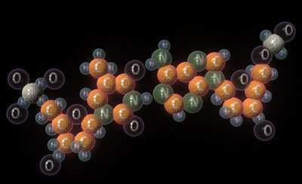

Nucleic Acids – P O N C H (Nucleotide)
Are made of these 5 biologically important elements?
Copyright © 2024 SlideSpark .LLC

Slide 32
There are four different types of nitrogen bases found in DNA. Name them?
A is for adenine
G is for guanine
C is for cytosine
T is for thymine
8
Copyright © 2024 SlideSpark .LLC

Slide 33
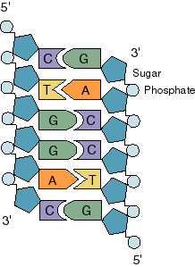
Name the corresponding base pair on the right. Each one is worth 1 point.
9
A
B
C
D
E
F
Copyright © 2024 SlideSpark .LLC

Slide 34
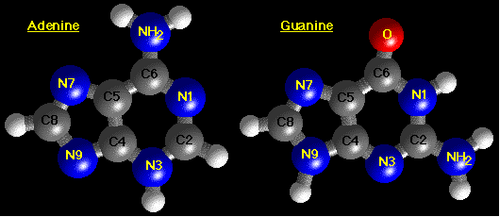
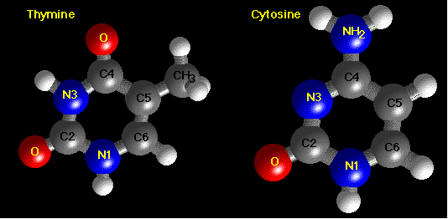
Which two are Purines? The larger of the two types of bases found in DNA.
10
Copyright © 2024 SlideSpark .LLC

Slide 35
DNA Review Game
HIP HIP HOORAY | SPIRAL SPIRAL | SHAPE-UP | LIFE LINE | -Bonus- FAMILY JEANS
1 | 6 | 11 | 16 | *21
2 | 7 | 12 | 17 | *22
3 | 8 | 13 | 18 | *23
4 | 9 | 14 | 19 | *24
5 | 10 | 15 | 20 | *25

Slide 36
DNA Review Game
HIP HIP HOORAY | SPIRAL SPIRAL | SHAPE-UP | LIFE LINE | -Bonus- FAMILY JEANS
1 | 6 | 11 | 16 | *21
2 | 7 | 12 | 17 | *22
3 | 8 | 13 | 18 | *23
4 | 9 | 14 | 19 | *24
5 | 10 | 15 | 20 | *25

Slide 37
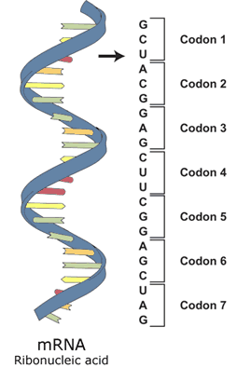
11
Name this molecule?

Slide 38
New Question

Slide 39
12
What nitrogen base is the U?

Slide 40
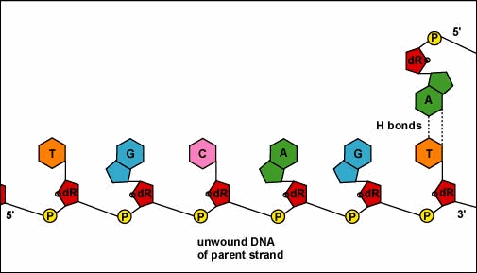
This animation best represents…
  A.) DNA extraction
  B.) Protein Synthesis
  C.) Random Griddle Formation
  D.) DNA Replication
  E.) None of the above.
13

Slide 41
This animation best represents…
  A.) DNA extraction
  B.) Protein Synthesis
  C.) Random Griddle Formation
  D.) DNA Replication
  E.) None of the above.
13

Slide 42
This animation best represents…
  A.) DNA extraction
  B.) Protein Synthesis
  C.) Random Griddle Formation
  D.) DNA Replication
  E.) None of the above.
13

Slide 43
This animation best represents…
  A.) DNA extraction
  B.) Protein Synthesis
  C.) Random Griddle Formation
  D.) DNA Replication
  E.) None of the above.
13

Slide 44
This animation best represents…
  A.) DNA extraction
  B.) Protein Synthesis
  C.) Random Griddle Formation
  D.) DNA Replication
  E.) None of the above.
13

Slide 45
This animation best represents…
  A.) DNA extraction
  B.) Protein Synthesis
  C.) Random Griddle Formation
  D.) DNA Replication
  E.) None of the above.
13

Slide 46

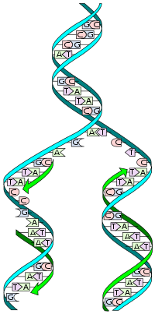
Which enzymes below are switched?
14
The primase generates short strands of RNA that bind to the single stranded-DNA to initiate DNA synthesis by the DNA polymerase. This enzyme can work only in the 5' to 3' direction, so it replicates the leading strand continuously.
DNA Enzymes: DNA Polymerase helps in the replication of double-stranded DNA into two identical DNA molecules. Ligase: It helps in the separation of double-stranded DNA into single strands allowing each strand to be copied. Helicase: It acts as glue by joining 2 DNA fragments to form a new DNA strand.
DNA polymerase moves along the old strand in the 3'–5' direction, creating a new strand having a 5'–3' direction.
Ligase
Primase
DNA
Polymerase
Helicase
3’
5’
5’
DNA
Polymerase
3’

Slide 47
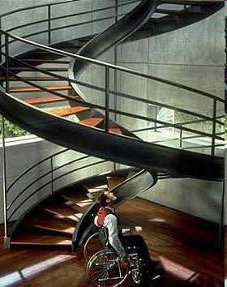
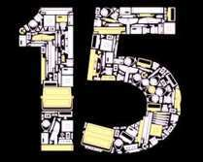
Name a movie starring Ethan Hawke, Uma Thurman, and Jude Law?
C - ____
T - ____
A - ____
A - ____
T - ____
G - ____
T - ____
Copyright © 2024 SlideSpark .LLC

Slide 48
DNA Review Game
HIP HIP HOORAY | SPIRAL SPIRAL | SHAPE-UP | LIFE LINE | -Bonus- FAMILY JEANS
1 | 6 | 11 | 16 | *21
2 | 7 | 12 | 17 | *22
3 | 8 | 13 | 18 | *23
4 | 9 | 14 | 19 | *24
5 | 10 | 15 | 20 | *25

Slide 49
DNA Review Game
HIP HIP HOORAY | SPIRAL SPIRAL | SHAPE-UP | LIFE LINE | -Bonus- FAMILY JEANS
1 | 6 | 11 | 16 | *21
2 | 7 | 12 | 17 | *22
3 | 8 | 13 | 18 | *23
4 | 9 | 14 | 19 | *24
5 | 10 | 15 | 20 | *25

Slide 50
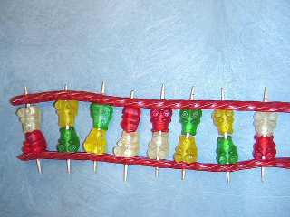
Name, A, B, C, and D?
A
DNA
Phosphate Backbone
C
A
C
T
G
D
16
B
Toothpick
Nitrogen Base

Slide 51
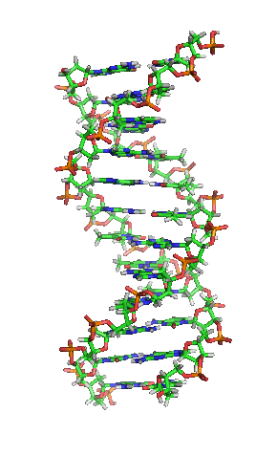
17
Spell what DNA stands for..

Slide 52

DNA has the information for our cells to make proteins?
Copyright © 2024 SlideSpark .LLC

Slide 53
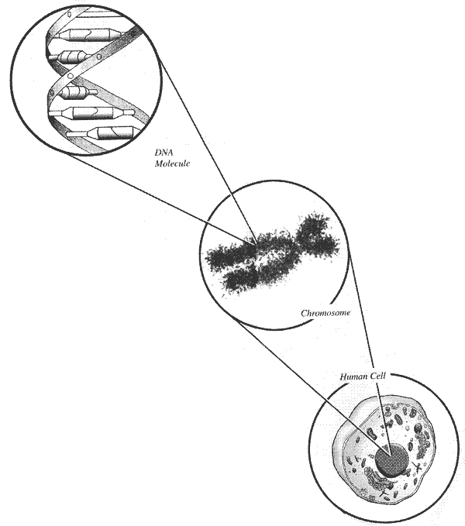
Name this tightly wound package of DNA?
  A structure within the cell that bears the genetic material as a threadlike linear strand of DNA.
19
Copyright © 2024 SlideSpark .LLC

Slide 54
Which is a hard copy (long term) and which is a short term copy?
20
DNA
RNA
Hard
Copy
Short
Term
Copy
Copyright © 2024 SlideSpark .LLC

Slide 55
DNA Review Game
HIP HIP HOORAY | SPIRAL SPIRAL | SHAPE-UP | LIFE LINE | -Bonus- FAMILY JEANS
1 | 6 | 11 | 16 | *21
2 | 7 | 12 | 17 | *22
3 | 8 | 13 | 18 | *23
4 | 9 | 14 | 19 | *24
5 | 10 | 15 | 20 | *25

Slide 56
DNA Review Game
HIP HIP HOORAY | SPIRAL SPIRAL | SHAPE-UP | LIFE LINE | -Bonus- FAMILY JEANS
1 | 6 | 11 | 16 | *21
2 | 7 | 12 | 17 | *22
3 | 8 | 13 | 18 | *23
4 | 9 | 14 | 19 | *24
5 | 10 | 15 | 20 | *25

Slide 57
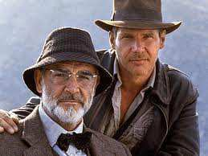
Name the famous movie son?
*21
Copyright © 2024 SlideSpark .LLC

Slide 58

Name this family?
#22

Slide 59
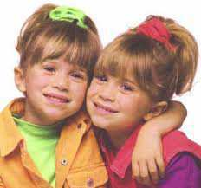
Name these twins?
*23

Slide 60
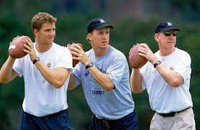
Name this family?
*24

Slide 61

Name this T.V. show?
#25

Slide 62
DNA Review Game
HIP HIP HOORAY | SPIRAL SPIRAL | SHAPE-UP | LIFE LINE | -Bonus- FAMILY JEANS
1 | 6 | 11 | 16 | *21
2 | 7 | 12 | 17 | *22
3 | 8 | 13 | 18 | *23
4 | 9 | 14 | 19 | *24
5 | 10 | 15 | 20 | *25
Final Question

Slide 63
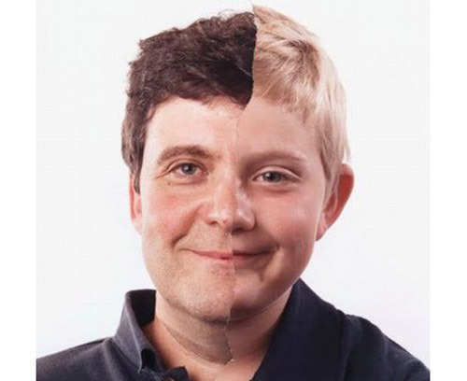
5 Point Wager Question

Slide 64
5 Point Wager Question

Slide 65

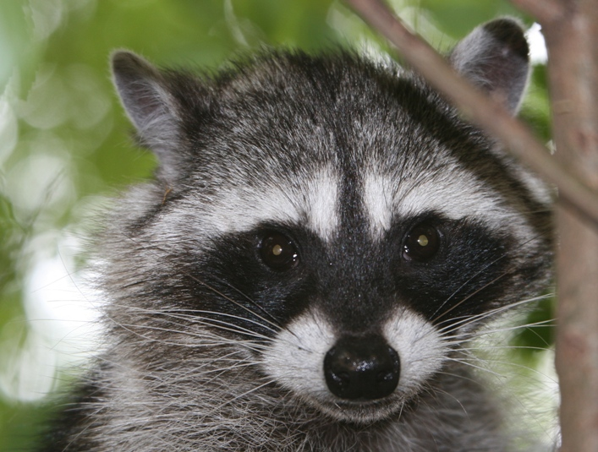
The bandit mask of a raccoon. Is it an acquired or inherited trait?
Copyright © 2024 SlideSpark .LLC

Slide 66
DNA Review Game
Part 1
Lesson 8

Slide 67

DNA Review Game
Answer Key
Part 1
Lesson 9

Slide 68
DNA Review Game
HIP HIP HOORAY | SPIRAL SPIRAL | SHAPE-UP | LIFE LINE | -Bonus- FAMILY JEANS
1 | 6 | 11 | 16 | *21
2 | 7 | 12 | 17 | *22
3 | 8 | 13 | 18 | *23
4 | 9 | 14 | 19 | *24
5 | 10 | 15 | 20 | *25

Slide 69
DNA Review Game
HIP HIP HOORAY | SPIRAL SPIRAL | SHAPE-UP | LIFE LINE | -Bonus- FAMILY JEANS
1 | 6 | 11 | 16 | *21
2 | 7 | 12 | 17 | *22
3 | 8 | 13 | 18 | *23
4 | 9 | 14 | 19 | *24
5 | 10 | 15 | 20 | *25

Slide 70
1
Which is not correct of DNA?
  A.) DNA is housed in the nucleus of Eukaryotic Cells.
  B.) DNA stands for Double Nucleus Amino acid.
  C.) The shape is called the double helix.
  D.) DNA has the information for our cells to make proteins.
  E.) DNA through transcription makes mRNA.

Slide 71
1
Which is not correct of DNA?
  A.) DNA is housed in the nucleus of Eukaryotic Cells.
  B.) DNA stands for Double Nucleus Amino acid.
  C.) The shape is called the double helix.
  D.) DNA has the information for our cells to make proteins.
  E.) DNA through transcription makes mRNA.

Slide 72
1
Which is not correct of DNA?
  A.) DNA is housed in the nucleus of Eukaryotic Cells.
  B.) DNA stands for Double Nucleus Amino acid.
  C.) The shape is called the double helix.
  D.) DNA has the information for our cells to make proteins.
  E.) DNA through transcription makes mRNA.

Slide 73
1
Which is not correct of DNA?
  A.) DNA is housed in the nucleus of Eukaryotic Cells.
  B.) DNA stands for Double Nucleus Amino acid.
  C.) The shape is called the double helix.
  D.) DNA has the information for our cells to make proteins.
  E.) DNA through transcription makes mRNA.

Slide 74
1
Which is not correct of DNA?
  A.) DNA is housed in the nucleus of Eukaryotic Cells.
  B.) DNA stands for Double Nucleus Amino acid.
  C.) The shape is called the double helix.
  D.) DNA has the information for our cells to make proteins.
  E.) DNA through transcription makes mRNA.

Slide 75
1
Which is not correct of DNA?
  A.) DNA is housed in the nucleus of Eukaryotic Cells.
  B.) DNA stands for Double Nucleus Amino acid.
  C.) The shape is called the double helix.
  D.) DNA has the information for our cells to make proteins.
  E.) DNA through transcription makes mRNA.

Slide 76
1
Which is not correct of DNA?
  A.) DNA is housed in the nucleus of Eukaryotic Cells.
  B.) DNA stands for Double Nucleus Amino acid.
  C.) The shape is called the double helix.
  D.) DNA has the information for our cells to make proteins.
  E.) DNA through transcription makes mRNA.
And the answer is…

Slide 77
1
Which is not correct of DNA?
  A.) DNA is housed in the nucleus of Eukaryotic Cells.
  B.) DNA stands for Double Nucleus Amino acid.
  C.) The shape is called the double helix.
  D.) DNA has the information for our cells to make proteins.
  E.) DNA through transcription makes mRNA.
And the answer is…

Slide 78
1
Which is not correct of DNA?
  A.) DNA is housed in the nucleus of Eukaryotic Cells.
  B.) DNA stands for Deoxyribose Nucleic Acid
  C.) The shape is called the double helix.
  D.) DNA has the information for our cells to make proteins.
  E.) DNA through transcription makes mRNA.
And the answer is…

Slide 79
How many meters (roughly) of DNA stretched out can be found in a single cell?
  A.) .18 nanometers
  B.) 18 millimeters
  C.) 1.8 meters
  D.) 180 kilometers
  E.) It can wrap around the world over 180 million times.
2

Slide 80
How many meters (roughly) of DNA stretched out can be found in a single cell?
  A.) .18 nanometers
  B.) 18 millimeters
  C.) 1.8 meters
  D.) 180 kilometers
  E.) It can wrap around the world over 180 million times.
2

Slide 81
How many meters (roughly) of DNA stretched out can be found in a single cell?
  A.) .18 nanometers
  B.) 18 millimeters
  C.) 1.8 meters
  D.) 180 kilometers
  E.) It can wrap around the world over 180 million times.
2

Slide 82
How many meters (roughly) of DNA stretched out can be found in a single cell?
  A.) .18 nanometers
  B.) 18 millimeters
  C.) 1.8 meters
  D.) 180 kilometers
  E.) It can wrap around the world over 180 million times.
2

Slide 83
How many meters (roughly) of DNA stretched out can be found in a single cell?
  A.) .18 nanometers
  B.) 18 millimeters
  C.) 1.8 meters
  D.) 180 kilometers
  E.) It can wrap around the world over 180 million times.
2

Slide 84
How many meters (roughly) of DNA stretched out can be found in a single cell?
  A.) .18 nanometers
  B.) 18 millimeters
  C.) 1.8 meters
  D.) 180 kilometers
  E.) It can wrap around the world over 180 million times.
2

Slide 85
How many meters (roughly) of DNA stretched out can be found in a single cell?
  A.) .18 nanometers
  B.) 18 millimeters
  C.) 1.8 meters
  D.) 180 kilometers
  E.) It can wrap around the world over 180 million times.
2
and the answer is…

Slide 86
How many meters (roughly) of DNA stretched out can be found in a single cell?
  A.) .18 nanometers
  B.) 18 millimeters
  C.) 1.8 meters
  D.) 180 kilometers
  E.) It can wrap around the world over 180 million times.
2
and the answer is…

Slide 87
3
DNA has the information for our cells to make proteins. Name A and B?
Except
Proteins
Keep your
hard copy
safe in the nucleus
B
A
Copyright © 2024 SlideSpark .LLC

Slide 88
3
DNA has the information for our cells to make proteins. Name A and B?
Except
Proteins
Keep your
hard copy
safe in the nucleus
B
A
Copyright © 2024 SlideSpark .LLC

Slide 89
3
DNA has the information for our cells to make proteins. Name A and B?
Except
Proteins
Keep your
hard copy
safe in the nucleus
B
A
Copyright © 2024 SlideSpark .LLC

Slide 90
3
DNA has the information for our cells to make proteins. Name A and B?
Except
Proteins
Keep your
hard copy
safe in the nucleus
B
A
Copyright © 2024 SlideSpark .LLC

Slide 91
3
DNA has the information for our cells to make proteins. Name A and B?
Except
Proteins
Keep your
hard copy
safe in the nucleus
B
A
Copyright © 2024 SlideSpark .LLC

Slide 92

3
DNA has the information for our cells to make proteins. Name A and B?
Except
Proteins
Keep your
hard copy
safe in the nucleus
B
A
Copyright © 2024 SlideSpark .LLC

Slide 93
In 1962, Watson, Crick, and Wilkins discovered DNA’s structure and won the Nobel Prize.
4
A
B
C
Copyright © 2024 SlideSpark .LLC

Slide 94
In 1962, Watson, Crick, and Wilkins discovered DNA’s structure and won the Nobel Prize.
4
A
B
C
Copyright © 2024 SlideSpark .LLC

Slide 95
In 1962, Watson, Crick, and Wilkins discovered DNA’s structure and won the Nobel Prize.
4
A
B
C
Copyright © 2024 SlideSpark .LLC

Slide 96
In 1962, Watson, Crick, and Wilkins discovered DNA’s structure and won the Nobel Prize.
4
A
B
C
Copyright © 2024 SlideSpark .LLC

Slide 97
In 1962, Watson, Crick, and Wilkins discovered DNA’s structure and won the Nobel Prize.
4
A
B
C
Copyright © 2024 SlideSpark .LLC

Slide 98
In 1962, Watson, Crick, and Wilkins discovered DNA’s structure and won the Nobel Prize.
4
A
B
C
Copyright © 2024 SlideSpark .LLC

Slide 99
This scientist took X-Ray pictures of DNA’s structure and lectured about phosphate being a part of the outside of the molecule.
  Watson attended her lecture.
5
Copyright © 2024 SlideSpark .LLC

Slide 100
This scientist took X-Ray pictures of DNA’s structure and lectured about phosphate being a part of the outside of the molecule.
  Watson attended her lecture.
5
Rosalind Franklin
Copyright © 2024 SlideSpark .LLC

Slide 101
This scientist took X-Ray pictures of DNA’s structure and lectured about phosphate being a part of the outside of the molecule.
  Watson attended her lecture.
5
Rosalind Franklin
Copyright © 2024 SlideSpark .LLC

Slide 102
This scientist took X-Ray pictures of DNA’s structure and lectured about phosphate being a part of the outside of the molecule.
  Watson attended her lecture.
5
Rosalind Franklin
Copyright © 2024 SlideSpark .LLC

Slide 103
DNA Review Game
HIP HIP HOORAY | SPIRAL SPIRAL | SHAPE-UP | LIFE LINE | -Bonus- FAMILY JEANS
1 | 6 | 11 | 16 | *21
2 | 7 | 12 | 17 | *22
3 | 8 | 13 | 18 | *23
4 | 9 | 14 | 19 | *24
5 | 10 | 15 | 20 | *25

Slide 104
DNA Review Game
HIP HIP HOORAY | SPIRAL SPIRAL | SHAPE-UP | LIFE LINE | -Bonus- FAMILY JEANS
1 | 6 | 11 | 16 | *21
2 | 7 | 12 | 17 | *22
3 | 8 | 13 | 18 | *23
4 | 9 | 14 | 19 | *24
5 | 10 | 15 | 20 | *25

Slide 105
Which one is A, B, and C?
A.) mRNA, DNA, Sugar Complex
B.) Hydrogen Bond, mRNA, DNA wrap.
C.) Phosphate Group, 5 Carbon Sugar, Nitrogen Base
D.) Enzymes, Helix, Ribosomal Unit.
A
B
C
6
Copyright © 2024 SlideSpark .LLC

Slide 106
Which one is A, B, and C?
A.) mRNA, DNA, Sugar Complex
B.) Hydrogen Bond, mRNA, DNA wrap.
C.) Phosphate Group, 5 Carbon Sugar, Nitrogen Base
D.) Enzymes, Helix, Ribosomal Unit.
A
B
C
6
Copyright © 2024 SlideSpark .LLC

Slide 107
Which one is A, B, and C?
A.) mRNA, DNA, Sugar Complex
B.) Hydrogen Bond, mRNA, DNA wrap.
C.) Phosphate Group, 5 Carbon Sugar, Nitrogen Base
D.) Enzymes, Helix, Ribosomal Unit.
A
B
C
6
Copyright © 2024 SlideSpark .LLC

Slide 108
Which one is A, B, and C?
A.) mRNA, DNA, Sugar Complex
B.) Hydrogen Bond, mRNA, DNA wrap.
C.) Phosphate Group, 5 Carbon Sugar, Nitrogen Base
D.) Enzymes, Helix, Ribosomal Unit.
A
B
C
6
Copyright © 2024 SlideSpark .LLC

Slide 109
Which one is A, B, and C?
A.) mRNA, DNA, Sugar Complex
B.) Hydrogen Bond, mRNA, DNA wrap.
C.) Phosphate Group, 5 Carbon Sugar, Nitrogen Base
D.) Enzymes, Helix, Ribosomal Unit.
A
B
C
6
Copyright © 2024 SlideSpark .LLC

Slide 110
Which one is A, B, and C?
A.) mRNA, DNA, Sugar Complex
B.) Hydrogen Bond, mRNA, DNA wrap.
C.) Phosphate Group, 5 Carbon Sugar, Nitrogen Base
D.) Enzymes, Helix, Ribosomal Unit.
A
B
C
6
And the answer is…
Copyright © 2024 SlideSpark .LLC

Slide 111
Which one is A, B, and C?
A.) mRNA, DNA, Sugar Complex
B.) Hydrogen Bond, mRNA, DNA wrap.
C.) Phosphate Group, 5 Carbon Sugar, Nitrogen Base
D.) Enzymes, Helix, Ribosomal Unit.
A
B
C
6
And the answer is…
Copyright © 2024 SlideSpark .LLC

Slide 112
Which one is A, B, and C?
A.) mRNA, DNA, Sugar Complex
B.) Hydrogen Bond, mRNA, DNA wrap.
C.) Phosphate Group, 5 Carbon Sugar, Nitrogen Base
D.) Enzymes, Helix, Ribosomal Unit.
A
B
C
6
And the answer is…
Copyright © 2024 SlideSpark .LLC

Slide 113
Nucleic Acids – P O N C H (Nucleotide)
Are made of these 5 biologically important elements?
Copyright © 2024 SlideSpark .LLC

Slide 114
Nucleic Acids – P O N C H (Nucleotide)
Phosphorus
Copyright © 2024 SlideSpark .LLC

Slide 115
Nucleic Acids – P O N C H (Nucleotide)
Phosphorus
Copyright © 2024 SlideSpark .LLC

Slide 116
Nucleic Acids – P O N C H (Nucleotide)
Phosphorus
Oxygen
Copyright © 2024 SlideSpark .LLC

Slide 117
Nucleic Acids – P O N C H (Nucleotide)
Phosphorus
Oxygen
Copyright © 2024 SlideSpark .LLC

Slide 118
Nucleic Acids – P O N C H (Nucleotide)
Phosphorus
Oxygen
Nitrogen
Copyright © 2024 SlideSpark .LLC

Slide 119
Nucleic Acids – P O N C H (Nucleotide)
Phosphorus
Oxygen
Nitrogen
Copyright © 2024 SlideSpark .LLC

Slide 120
Nucleic Acids – P O N C H (Nucleotide)
Phosphorus
Oxygen
Nitrogen
Copyright © 2024 SlideSpark .LLC

Slide 121
Nucleic Acids – P O N C H (Nucleotide)
Phosphorus
Oxygen
Nitrogen
Carbon
Copyright © 2024 SlideSpark .LLC

Slide 122
Nucleic Acids – P O N C H (Nucleotide)
Phosphorus
Oxygen
Nitrogen
Carbon
Hydrogen
Copyright © 2024 SlideSpark .LLC

Slide 123
Nucleic Acids – P O N C H (Nucleotide)
Phosphorus
Oxygen
Nitrogen
Carbon
Hydrogen
Copyright © 2024 SlideSpark .LLC

Slide 124
Nucleic Acids – P O N C H (Nucleotide)
Phosphorus
Oxygen
Nitrogen
Carbon
Hydrogen
Copyright © 2024 SlideSpark .LLC

Slide 125
Nucleic Acids – P O N C H (Nucleotide)
Phosphorus
Oxygen
Nitrogen
Carbon
Hydrogen
Copyright © 2024 SlideSpark .LLC

Slide 126
There are four different types of nitrogen bases found in DNA. Name them?
A is for adenine
G is for guanine
C is for cytosine
T is for thymine
8
Copyright © 2024 SlideSpark .LLC

Slide 127
There are four different types of nitrogen bases found in DNA. Name them?
A is for adenine
G is for guanine
C is for cytosine
T is for thymine
8
Copyright © 2024 SlideSpark .LLC

Slide 128
There are four different types of nitrogen bases found in DNA. Name them?
A is for adenine
G is for guanine
C is for cytosine
T is for thymine
8
Copyright © 2024 SlideSpark .LLC

Slide 129
There are four different types of nitrogen bases found in DNA. Name them?
A is for adenine
G is for guanine
C is for cytosine
T is for thymine
8
Copyright © 2024 SlideSpark .LLC

Slide 130
There are four different types of nitrogen bases found in DNA. Name them?
A is for adenine
G is for guanine
C is for cytosine
T is for thymine
8
Copyright © 2024 SlideSpark .LLC

Slide 131
There are four different types of nitrogen bases found in DNA. Name them?
A is for adenine
G is for guanine
C is for cytosine
T is for thymine
8
Copyright © 2024 SlideSpark .LLC

Slide 132
There are four different types of nitrogen bases found in DNA. Name them?
A is for adenine
G is for guanine
C is for cytosine
T is for thymine
8
Copyright © 2024 SlideSpark .LLC

Slide 133
There are four different types of nitrogen bases found in DNA. Name them?
A is for adenine
G is for guanine
C is for cytosine
T is for thymine
8
Copyright © 2024 SlideSpark .LLC

Slide 134
There are four different types of nitrogen bases found in DNA. Name them?
A is for adenine
G is for guanine
C is for cytosine
T is for thymine
8
Copyright © 2024 SlideSpark .LLC

Slide 135
Name the corresponding base pair on the right. Each one is worth 1 point.
9
A
B
C
D
E
F
Copyright © 2024 SlideSpark .LLC

Slide 136
Name the corresponding base pair on the right. Each one is worth 1 point.
9
A
B
C
D
E
F
Copyright © 2024 SlideSpark .LLC

Slide 137
Name the corresponding base pair on the right. Each one is worth 1 point.
9
A
B
C
D
E
F
Copyright © 2024 SlideSpark .LLC

Slide 138
Name the corresponding base pair on the right. Each one is worth 1 point.
9
A
B
C
D
E
F
Copyright © 2024 SlideSpark .LLC

Slide 139
Name the corresponding base pair on the right. Each one is worth 1 point.
9
A
B
C
D
E
F
Copyright © 2024 SlideSpark .LLC

Slide 140
Name the corresponding base pair on the right. Each one is worth 1 point.
9
A
B
C
D
E
F
Copyright © 2024 SlideSpark .LLC

Slide 141
Name the corresponding base pair on the right. Each one is worth 1 point.
9
A
B
C
D
E
F
Copyright © 2024 SlideSpark .LLC

Slide 142
Which two are Purines? The larger of the two types of bases found in DNA.
10
And the answer is…
Copyright © 2024 SlideSpark .LLC

Slide 143
Which two are Purines? The larger of the two types of bases found in DNA.
10
And the answer is…
Copyright © 2024 SlideSpark .LLC

Slide 144
Which two are Purines? The larger of the two types of bases found in DNA.
10
And the answer is…
Copyright © 2024 SlideSpark .LLC

Slide 145
DNA Review Game
HIP HIP HOORAY | SPIRAL SPIRAL | SHAPE-UP | LIFE LINE | -Bonus- FAMILY JEANS
1 | 6 | 11 | 16 | *21
2 | 7 | 12 | 17 | *22
3 | 8 | 13 | 18 | *23
4 | 9 | 14 | 19 | *24
5 | 10 | 15 | 20 | *25

Slide 146
DNA Review Game
HIP HIP HOORAY | SPIRAL SPIRAL | SHAPE-UP | LIFE LINE | -Bonus- FAMILY JEANS
1 | 6 | 11 | 16 | *21
2 | 7 | 12 | 17 | *22
3 | 8 | 13 | 18 | *23
4 | 9 | 14 | 19 | *24
5 | 10 | 15 | 20 | *25

Slide 147
11
Name this molecule?

Slide 148
11
Name this molecule? mRNA

Slide 149
New Question

Slide 150
12
What nitrogen base is the U?

Slide 151
12
What nitrogen base is the U?
Uracil

Slide 152
12
What nitrogen base is the U?
Uracil
Replaced
Thymine

Slide 153
12
What nitrogen base is the U?
Uracil
Replaced
Thymine

Slide 154
This animation best represents…
  A.) DNA extraction
  B.) Protein Synthesis
  C.) Random Griddle Formation
  D.) DNA Replication
  E.) None of the above.
13

Slide 155
This animation best represents…
  A.) DNA extraction
  B.) Protein Synthesis
  C.) Random Griddle Formation
  D.) DNA Replication
  E.) None of the above.
13

Slide 156
This animation best represents…
  A.) DNA extraction
  B.) Protein Synthesis
  C.) Random Griddle Formation
  D.) DNA Replication
  E.) None of the above.
13

Slide 157
This animation best represents…
  A.) DNA extraction
  B.) Protein Synthesis
  C.) Random Griddle Formation
  D.) DNA Replication
  E.) None of the above.
13

Slide 158
This animation best represents…
  A.) DNA extraction
  B.) Protein Synthesis
  C.) Random Griddle Formation
  D.) DNA Replication
  E.) None of the above.
13

Slide 159
This animation best represents…
  A.) DNA extraction
  B.) Protein Synthesis
  C.) Random Griddle Formation
  D.) DNA Replication
  E.) None of the above.
13

Slide 160
This animation best represents…
  A.) DNA extraction
  B.) Protein Synthesis
  C.) Random Griddle Formation
  D.) DNA Replication
  E.) None of the above.
13

Slide 161
Which enzymes below is not correct?
14
The primase generates short strands of RNA that bind to the single stranded-DNA to initiate DNA synthesis by the DNA polymerase. This enzyme can work only in the 5' to 3' direction, so it replicates the leading strand continuously.
DNA Enzymes: DNA Polymerase helps in the replication of double-stranded DNA into two identical DNA molecules. Ligase: It helps in the separation of double-stranded DNA into single strands allowing each strand to be copied. Helicase: It acts as glue by joining 2 DNA fragments to form a new DNA strand.
DNA polymerase moves along the old strand in the 3'–5' direction, creating a new strand having a 5'–3' direction.
Ligase
Primase
DNA
Polymerase
Helicase
3’
5’
5’
DNA
Polymerase
3’

Slide 162
Which enzymes below is not correct?
14
The primase generates short strands of RNA that bind to the single stranded-DNA to initiate DNA synthesis by the DNA polymerase. This enzyme can work only in the 5' to 3' direction, so it replicates the leading strand continuously.
DNA Enzymes: DNA Polymerase helps in the replication of double-stranded DNA into two identical DNA molecules. Ligase: It helps in the separation of double-stranded DNA into single strands allowing each strand to be copied. Helicase: It acts as glue by joining 2 DNA fragments to form a new DNA strand.
DNA polymerase moves along the old strand in the 3'–5' direction, creating a new strand having a 5'–3' direction.
Ligase
Primase
DNA
Polymerase
Helicase
3’
5’
5’
DNA
Polymerase
3’

Slide 163
Which enzymes below is not correct?
14
The primase generates short strands of RNA that bind to the single stranded-DNA to initiate DNA synthesis by the DNA polymerase. This enzyme can work only in the 5' to 3' direction, so it replicates the leading strand continuously.
DNA Enzymes: DNA Polymerase helps in the replication of double-stranded DNA into two identical DNA molecules. Ligase: It helps in the separation of double-stranded DNA into single strands allowing each strand to be copied. Helicase: It acts as glue by joining 2 DNA fragments to form a new DNA strand.
DNA polymerase moves along the old strand in the 3'–5' direction, creating a new strand having a 5'–3' direction.
Ligase
Primase
DNA
Polymerase
Helicase
3’
5’
5’
DNA
Polymerase
3’

Slide 164
Which enzymes below is not correct?
14
The primase generates short strands of RNA that bind to the single stranded-DNA to initiate DNA synthesis by the DNA polymerase. This enzyme can work only in the 5' to 3' direction, so it replicates the leading strand continuously.
DNA Enzymes: DNA Polymerase helps in the replication of double-stranded DNA into two identical DNA molecules. Helicase: It helps in the separation of double-stranded DNA into single strands allowing each strand to be copied. Helicase: It acts as glue by joining 2 DNA fragments to form a new DNA strand.
DNA polymerase moves along the old strand in the 3'–5' direction, creating a new strand having a 5'–3' direction.
Helicase
Primase
DNA
Polymerase
Ligase
3’
5’
5’
DNA
Polymerase
3’

Slide 165
Name a movie starring Ethan Hawke, Uma Thurman, and Jude Law?
C - ____
T - ____
A - ____
A - ____
T - ____
G - ____
T - ____
Copyright © 2024 SlideSpark .LLC

Slide 166
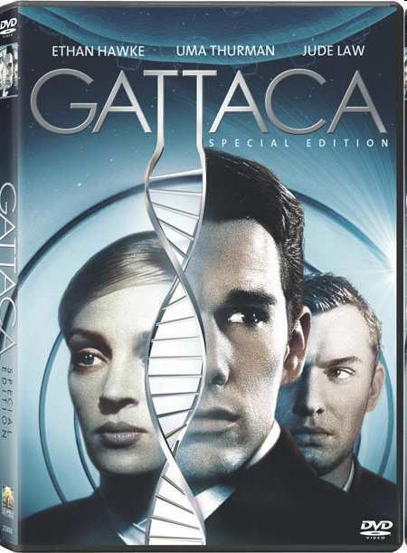
Name a movie starring Ethan Hawke, Uma Thurman, and Jude Law?
C - _G___
T - _A___
A - _T___
A - _T__
T - _A__
G - _C__
T - _A___
Copyright © 2024 SlideSpark .LLC

Slide 167
DNA Review Game
HIP HIP HOORAY | SPIRAL SPIRAL | SHAPE-UP | LIFE LINE | -Bonus- FAMILY JEANS
1 | 6 | 11 | 16 | *21
2 | 7 | 12 | 17 | *22
3 | 8 | 13 | 18 | *23
4 | 9 | 14 | 19 | *24
5 | 10 | 15 | 20 | *25

Slide 168
DNA Review Game
HIP HIP HOORAY | SPIRAL SPIRAL | SHAPE-UP | LIFE LINE | -Bonus- FAMILY JEANS
1 | 6 | 11 | 16 | *21
2 | 7 | 12 | 17 | *22
3 | 8 | 13 | 18 | *23
4 | 9 | 14 | 19 | *24
5 | 10 | 15 | 20 | *25

Slide 169
Name, A, B, C, and D?
A
DNA
Phosphate Backbone
C
A
C
T
G
D
16
B
Nitrogen Base
Toothpick

Slide 170
Name, A, B, C, and D?
A
DNA
Phosphate Backbone
C
A
C
T
G
D
16
B
Nitrogen Base
Toothpick

Slide 171
Name, A, B, C, and D?
A
DNA
Phosphate Backbone
C
A
C
T
G
D
16
B
Nitrogen Base
Toothpick

Slide 172
Name, A, B, C, and D?
A
DNA
Phosphate Backbone
C
A
C
T
G
D
16
B
Nitrogen Base
Toothpick

Slide 173
Name, A, B, C, and D?
A
DNA
Phosphate Backbone
C
A
C
T
G
D
16
B
Ribose Sugar

Slide 174
Name, A, B, C, and D?
A
DNA
Phosphate Backbone
C
A
C
T
G
D
16
B
Ribose Sugar

Slide 175
Name, A, B, C, and D?
A
DNA
Phosphate Backbone
C
A
C
T
G
D
16
B
Ribose Sugar

Slide 176
Name, A, B, C, and D?
A
DNA
Phosphate Backbone
C
A
C
T
G
D
16
B
Ribose Sugar

Slide 177
Name, A, B, C, and D?
A
DNA
Phosphate Backbone
C
A
C
T
G
D
16
B
Ribose Sugar

Slide 178
Name, A, B, C, and D?
A
DNA
Phosphate Backbone
C
A
C
T
G
D
16
B
Ribose Sugar

Slide 179
17
Spell what DNA stands for..

Slide 180
17
Spell what DNA stands for..
Deoxyribose Nucleic Acid

Slide 181
17
Spell what DNA stands for..
Deoxyribose Nucleic Acid

Slide 182
17
Spell what DNA stands for..
Deoxyribose Nucleic Acid

Slide 183
17
Spell what DNA stands for..
Deoxyribose Nucleic Acid

Slide 184
DNA has the information for our cells to make proteins?
Copyright © 2024 SlideSpark .LLC

Slide 185
DNA has the information for our cells to make proteins?
Copyright © 2024 SlideSpark .LLC

Slide 186
DNA has the information for our cells to make proteins?
Copyright © 2024 SlideSpark .LLC

Slide 187
Name this tightly wound package of DNA?
  A structure within the cell that bears the genetic material as a threadlike linear strand of DNA.
19
Copyright © 2024 SlideSpark .LLC

Slide 188
Name this tightly wound package of DNA?
  A structure within the cell that bears the genetic material as a threadlike linear strand of DNA.
19
Chromosome
Copyright © 2024 SlideSpark .LLC

Slide 189
Which is a hard copy (long term) and which is a short term copy?
20
DNA
RNA
Hard
Copy
Short
Term
Copy
Copyright © 2024 SlideSpark .LLC

Slide 190
Which is a hard copy (long term) and which is a short term copy?
20
DNA
RNA
Hard
Copy
Short
Term
Copy
Copyright © 2024 SlideSpark .LLC

Slide 191
Which is a hard copy (long term) and which is a short term copy?
20
DNA
RNA
Hard
Copy
Short
Term
Copy
Copyright © 2024 SlideSpark .LLC

Slide 192
Which is a hard copy (long term) and which is a short term copy?
20
DNA
RNA
Hard
Copy
Short
Term
Copy
Copyright © 2024 SlideSpark .LLC

Slide 193
Which is a hard copy (long term) and which is a short term copy?
20
DNA
RNA
Hard
Copy
Short
Term
Copy
Copyright © 2024 SlideSpark .LLC

Slide 194
Which is a hard copy (long term) and which is a short term copy?
20
DNA
RNA
Hard
Copy
Short
Term
Copy
Copyright © 2024 SlideSpark .LLC

Slide 195
DNA Review Game
HIP HIP HOORAY | SPIRAL SPIRAL | SHAPE-UP | LIFE LINE | -Bonus- FAMILY JEANS
1 | 6 | 11 | 16 | *21
2 | 7 | 12 | 17 | *22
3 | 8 | 13 | 18 | *23
4 | 9 | 14 | 19 | *24
5 | 10 | 15 | 20 | *25

Slide 196
DNA Review Game
HIP HIP HOORAY | SPIRAL SPIRAL | SHAPE-UP | LIFE LINE | -Bonus- FAMILY JEANS
1 | 6 | 11 | 16 | *21
2 | 7 | 12 | 17 | *22
3 | 8 | 13 | 18 | *23
4 | 9 | 14 | 19 | *24
5 | 10 | 15 | 20 | *25

Slide 197
Name the famous movie son?
*21
Copyright © 2024 SlideSpark .LLC

Slide 198
Name the famous movie son?
*21
Copyright © 2024 SlideSpark .LLC

Slide 199
Name the famous movie son?
*21
Copyright © 2024 SlideSpark .LLC

Slide 200
Name the famous movie son?
*21
Indiana Jones
Copyright © 2024 SlideSpark .LLC

Slide 201
Name this family?
#22

Slide 202
Name this family?
#22
The Addams Family

Slide 203
Name these twins?
*23

Slide 204

Name these twins?
*23
Olson Twins

Slide 205
Name this family?
*24

Slide 206
Name this family?
*24
The Manning Family

Slide 207
Name this T.V. show?
#25

Slide 208
Name this T.V. show?
#25

Slide 209
DNA Review Game
HIP HIP HOORAY | SPIRAL SPIRAL | SHAPE-UP | LIFE LINE | -Bonus- FAMILY JEANS
1 | 6 | 11 | 16 | *21
2 | 7 | 12 | 17 | *22
3 | 8 | 13 | 18 | *23
4 | 9 | 14 | 19 | *24
5 | 10 | 15 | 20 | *25
Final Question

Slide 210
5 Point Wager Question

Slide 211
5 Point Wager Question

Slide 212
The bandit mask of a raccoon. Is it an acquired or inherited trait?
Copyright © 2024 SlideSpark .LLC

Slide 213
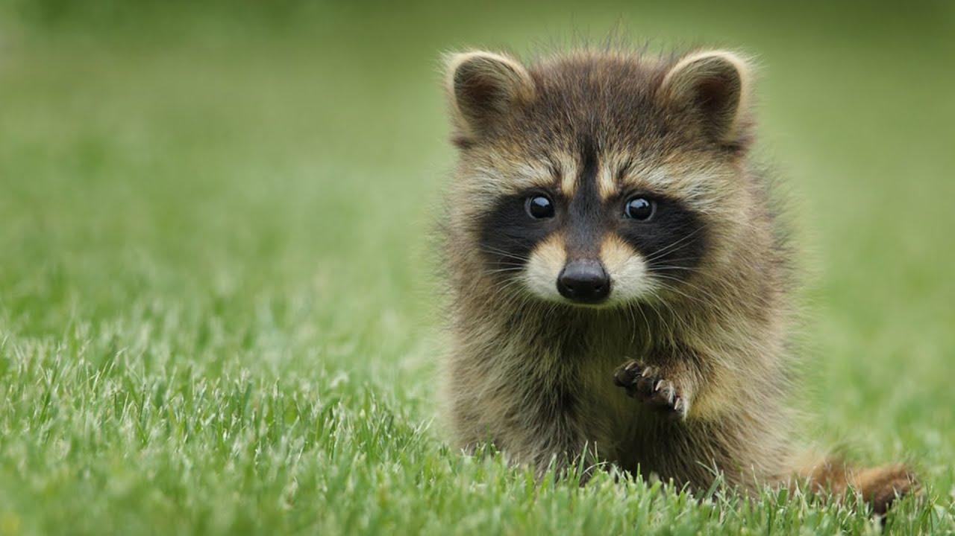
The bandit mask of a raccoon. Is it an acquired or inherited trait?
Copyright © 2024 SlideSpark .LLC

Slide 214
The bandit mask of a raccoon. Is it an acquired or inherited trait?
Inherited Trait.
Born with…
and passed on
The dark coloration may reduce glare so raccoons can see more clearly at night when they're most active.
Copyright © 2024 SlideSpark .LLC

Slide 215

Questions 1-20 = 5pts Each
Final Category (Bonus) = 1pt Each
Final Questions = 5 pt wager
Find the Owl = + 1pt
Secretly write “Owl” in the correct box worth 1pt.

Slide 216
DNA Review Game
Answer Key
Part 1
Lesson 9

Slide 217



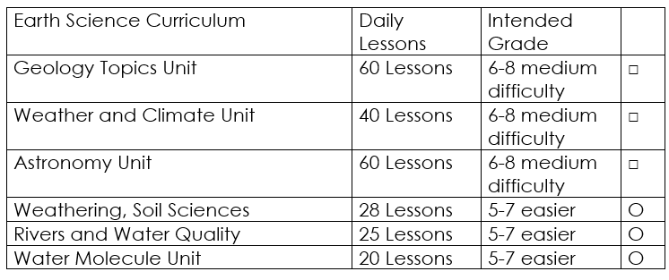

Curriculum Guide
Number of Lessons in each unit (50 min, daily lessons) and difficult rating scale / intended grade level.
=Easier, = More difficult, =Most difficult
Earth Science Units

Slide 218


Life Science Units

Slide 219

Physical Science

Slide 220
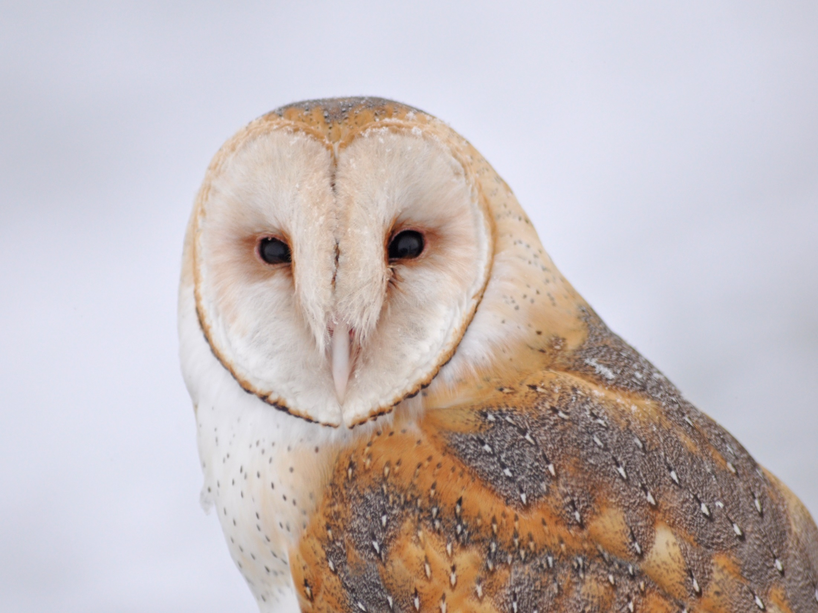
Dear Valued Educator,
Our fully editable .pptx and .doc resources are perfect for educators looking to bring enthusiasm and creativity to their lessons. We encourage you to make changes to fit your needs and style. As science educators, we’re committed to providing students with the tools they need to succeed in the classroom and beyond. Each unit in the curriculum includes a range of resources that have been developed through extensive research and use in a busy classroom. Our teaching approach is designed to make science education engaging and exciting for learners of all ages. We offer a one-of-a-kind science curriculum that will challenge, inspire, and educate students to become tomorrow's scientists and leaders. Join us today and learn more about how our program can help you achieve your classroom goals.
With appreciation,
Support@SlideSpark.net

Slide 221





Thank you for your time and interest in our Science curriculum. We strive to provide students with engaging and informative lessons that will spark their curiosity and encourage scientific exploration. Should you have any questions or concerns, please do not hesitate to contact us. Thank you again for considering our curriculum, and we wish you all the best in your educational journey.
Sincerely,
Support@slidespark.net
SlideSpark Science on TpT

