Slide 1
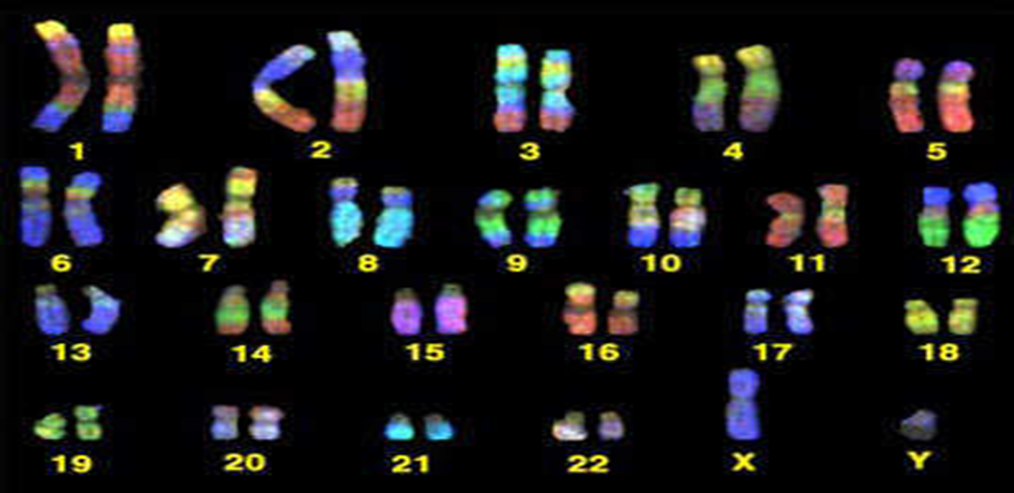

Genetics
Part 5
Lesson 3

Slide 2
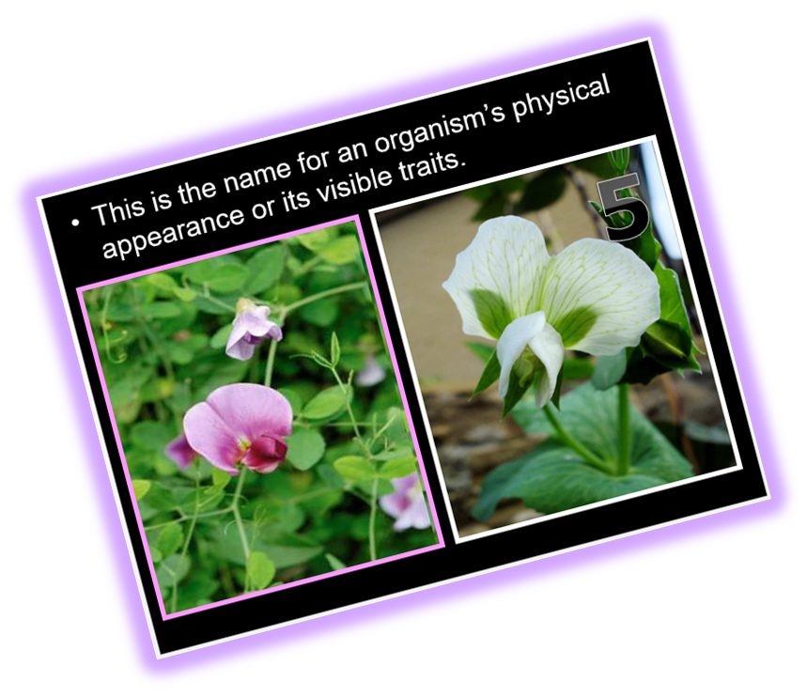
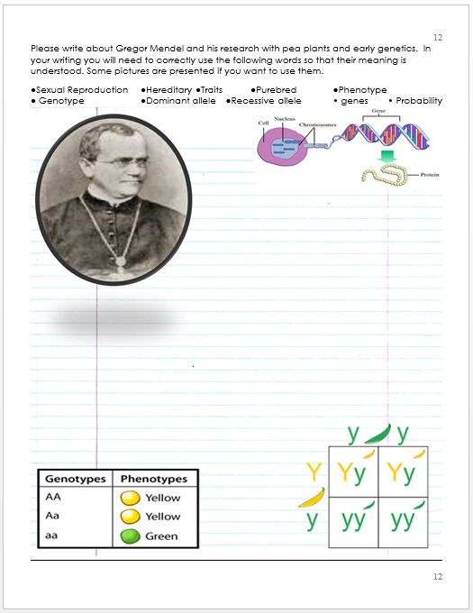
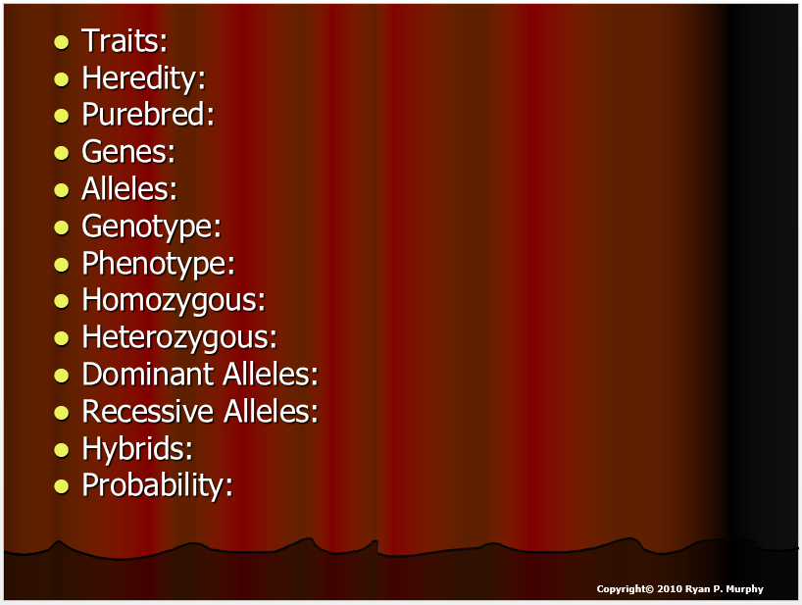

RED SLIDE: These slides contain critical notes and important fill-in the blanks. Please record the important terms in your work bundle.
  You’ll need these notes to complete the work bundle and to be successful on the review game.
blue
text
First and last Name
Science, Grade, Class
Copyright © 2010 Ryan P. Murphy

Slide 3

Listen to the teacher and others.
Please no
shout outs.
One speaker at a
time. Please
raise your
hand.
Respect
First,
Last,
and Always.
Safety
Make
Good
Choices
Be Present
Never
Give
Up!
Responsibility
Stay
Organized
Help
Others
Focus on
Task completion
Avoid
Distractions
Science from Murf LLC
Copyright © 2010 Ryan P. Murphy

Slide 4
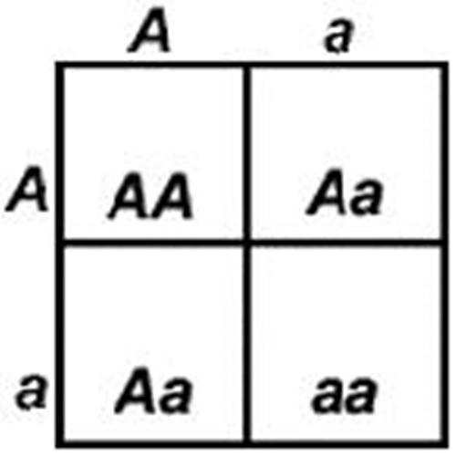
A dominant allele is one whose trait always shows up in the organism when the allele is present.
Meiosis
Meiosis
Copyright © 2024 SlideSpark .LLC

Slide 5
A dominant allele is one whose trait always shows up in the organism when the allele is present.
Meiosis
Meiosis
Fertilization
Copyright © 2024 SlideSpark .LLC

Slide 6
A dominant allele is one whose trait always shows up in the organism when the allele is present.
Copyright © 2024 SlideSpark .LLC

Slide 7
A dominant allele is one whose trait always shows up in the organism when the allele is present.
Copyright © 2024 SlideSpark .LLC

Slide 8
A recessive allele is covered up when the dominant allele is with it. A hybrid has two different alleles
Copyright © 2024 SlideSpark .LLC

Slide 9
A recessive allele is covered up when the dominant allele is with it. A hybrid has two different alleles
Copyright © 2024 SlideSpark .LLC

Slide 10
A recessive allele is covered up when the dominant allele is with it. A hybrid has two different alleles
Copyright © 2024 SlideSpark .LLC

Slide 11
A recessive allele is covered up when the dominant allele is with it. A hybrid has two different alleles
Copyright © 2024 SlideSpark .LLC

Slide 12

“That’s it.” “The small pea plants were recessive and didn’t appear because the tall were dominant”
Copyright © 2024 SlideSpark .LLC

Slide 13
“Glad I didn’t
Just get frustrated
and quit.”
Copyright © 2024 SlideSpark .LLC

Slide 14
T = Dominant
t = Recessive
TT = Two dominant
tt = Two recessive
Tt = One dominant, one recessive
Copyright © 2024 SlideSpark .LLC

Slide 15
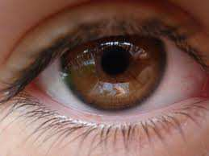
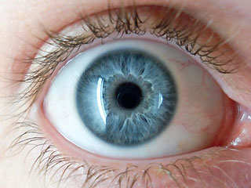
T = Dominant
t = Recessive
TT = Two dominant
tt = Two recessive
Tt = One dominant, one recessive
B Brown Dominant
b blue recessive
Copyright © 2024 SlideSpark .LLC

Slide 16
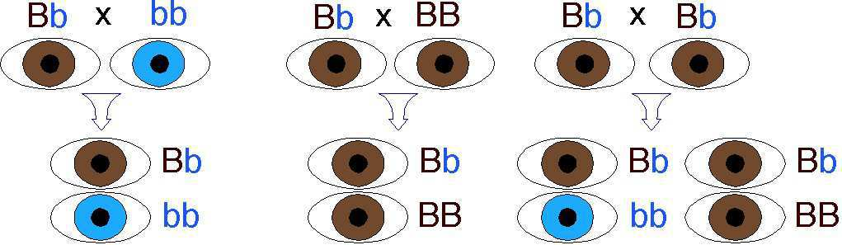

Slide 34
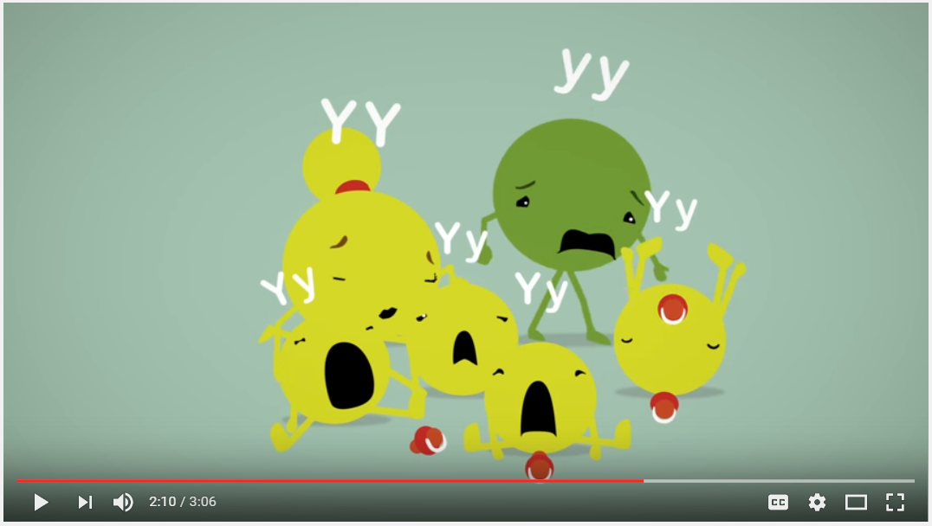
Video Review before questions.
  https://www.youtube.com/watch?v=Mehz7tCxjSEWhen the female contributes one factor, while the male contributes the other.
Copyright © 2010 Ryan P. Murphy

Slide 35
Vocabulary Review.
Which letter below best describes a gene?
  A.) Allele that is covered up when the dominant allele is with it.
  B.) An organisms physical appearance or visible traits.
  C.) Factors that control traits.
  D.) When the female contributes one factor, while the male contributes the other.
Copyright © 2010 Ryan P. Murphy

Slide 36
Vocabulary Review.
Which letter below best describes a gene?
  A.) Allele that is covered up when the dominant allele is with it.
  B.) An organisms physical appearance or visible traits.
  C.) Factors that control traits.
  D.) When the female contributes one factor, while the male contributes the other.
Copyright © 2010 Ryan P. Murphy

Slide 37
Vocabulary Review.
Which letter below best describes a gene?
  A.) Allele that is covered up when the dominant allele is with it.
  B.) An organisms physical appearance or visible traits.
  C.) Factors that control traits.
  D.) When the female contributes one factor, while the male contributes the other.
Copyright © 2010 Ryan P. Murphy

Slide 38
Vocabulary Review.
Which letter below best describes a gene?
  A.) Allele that is covered up when the dominant allele is with it.
  B.) An organisms physical appearance or visible traits.
  C.) Factors that control traits.
  D.) When the female contributes one factor, while the male contributes the other.
Copyright © 2010 Ryan P. Murphy

Slide 39
Vocabulary Review.
Which letter below best describes a gene?
  A.) Allele that is covered up when the dominant allele is with it.
  B.) An organisms physical appearance or visible traits.
  C.) Factors that control traits.
  D.) When the female contributes one factor, while the male contributes the other.
Copyright © 2010 Ryan P. Murphy

Slide 40
Vocabulary Review.
Which letter below best describes a gene?
  A.) Allele that is covered up when the dominant allele is with it.
  B.) An organisms physical appearance or visible traits.
  C.) Factors that control traits.
  D.) When the female contributes one factor, while the male contributes the other.
and the answer is…
Copyright © 2010 Ryan P. Murphy

Slide 41
Vocabulary Review.
Which letter below best describes a gene?
  A.) Allele that is covered up when the dominant allele is with it.
  B.) An organisms physical appearance or visible traits.
  C.) Factors that control traits.
  D.) When the female contributes one factor, while the male contributes the other.
and the answer is…
Copyright © 2010 Ryan P. Murphy

Slide 42
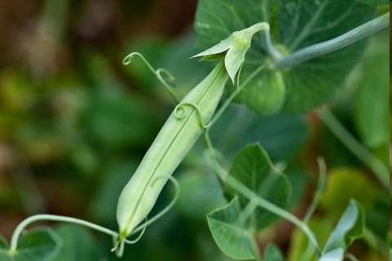

Slide 43
Vocabulary Review.
Which letter below best describes heredity?
  A.) When the female contributes one factor, while the male contributes the other.
  B.) An organisms physical appearance or visible traits.
  C.) When traits are passed from parents to offspring.
  D.) Factors that control traits.
  E.) Allele that is covered up when the dominant allele is with it.
Copyright © 2010 Ryan P. Murphy

Slide 44
Vocabulary Review.
Which letter below best describes heredity?
  A.) When the female contributes one factor, while the male contributes the other.
  B.) An organisms physical appearance or visible traits.
  C.) When traits are passed from parents to offspring.
  D.) Factors that control traits.
  E.) Allele that is covered up when the dominant allele is with it.
Copyright © 2010 Ryan P. Murphy

Slide 45
Vocabulary Review.
Which letter below best describes heredity?
  A.) When the female contributes one factor, while the male contributes the other.
  B.) An organisms physical appearance or visible traits.
  C.) When traits are passed from parents to offspring.
  D.) Factors that control traits.
  E.) Allele that is covered up when the dominant allele is with it.
Copyright © 2010 Ryan P. Murphy

Slide 46
Vocabulary Review.
Which letter below best describes heredity?
  A.) When the female contributes one factor, while the male contributes the other.
  B.) An organisms physical appearance or visible traits.
  C.) When traits are passed from parents to offspring.
  D.) Factors that control traits.
  E.) Allele that is covered up when the dominant allele is with it.
Copyright © 2010 Ryan P. Murphy

Slide 47
Vocabulary Review.
Which letter below best describes heredity?
  A.) When the female contributes one factor, while the male contributes the other.
  B.) An organisms physical appearance or visible traits.
  C.) When traits are passed from parents to offspring.
  D.) Factors that control traits.
  E.) Allele that is covered up when the dominant allele is with it.
Copyright © 2010 Ryan P. Murphy

Slide 48
Vocabulary Review.
Which letter below best describes heredity?
  A.) When the female contributes one factor, while the male contributes the other.
  B.) An organisms physical appearance or visible traits.
  C.) When traits are passed from parents to offspring.
  D.) Factors that control traits.
  E.) Allele that is covered up when the dominant allele is with it.
Copyright © 2010 Ryan P. Murphy

Slide 49
Vocabulary Review.
Which letter below best describes heredity?
  A.) When the female contributes one factor, while the male contributes the other.
  B.) An organisms physical appearance or visible traits.
  C.) When traits are passed from parents to offspring.
  D.) Factors that control traits.
  E.) Allele that is covered up when the dominant allele is with it.
and the answer is…
Copyright © 2010 Ryan P. Murphy

Slide 50
Vocabulary Review.
Which letter below best describes heredity?
  A.) When the female contributes one factor, while the male contributes the other.
  B.) An organisms physical appearance or visible traits.
  C.) When traits are passed from parents to offspring.
  D.) Factors that control traits.
  E.) Allele that is covered up when the dominant allele is with it.
and the answer is…
Copyright © 2010 Ryan P. Murphy

Slide 52
Vocabulary Review.
Which letter below best describes Mendel’s Law of Segregation?
  A.) An organisms physical appearance or visible traits.
  B.) When allele pairs separate during gamete formation, and randomly unite at fertilization.
  C.) When traits are passed from parents to offspring.
  D.) An organisms genetic makeup, or allele combinations
  E.) Allele that is covered up when the dominant allele is with it.
Copyright © 2010 Ryan P. Murphy

Slide 53
Vocabulary Review.
Which letter below best describes Mendel’s Law of Segregation?
  A.) An organisms physical appearance or visible traits.
  B.) When allele pairs separate during gamete formation, and randomly unite at fertilization.
  C.) When traits are passed from parents to offspring.
  D.) An organisms genetic makeup, or allele combinations
  E.) Allele that is covered up when the dominant allele is with it.
Copyright © 2010 Ryan P. Murphy

Slide 54
Vocabulary Review.
Which letter below best describes Mendel’s Law of Segregation?
  A.) An organisms physical appearance or visible traits.
  B.) When allele pairs separate during gamete formation, and randomly unite at fertilization.
  C.) When traits are passed from parents to offspring.
  D.) An organisms genetic makeup, or allele combinations
  E.) Allele that is covered up when the dominant allele is with it.
Copyright © 2010 Ryan P. Murphy

Slide 55
Vocabulary Review.
Which letter below best describes Mendel’s Law of Segregation?
  A.) An organisms physical appearance or visible traits.
  B.) When allele pairs separate during gamete formation, and randomly unite at fertilization.
  C.) When traits are passed from parents to offspring.
  D.) An organisms genetic makeup, or allele combinations
  E.) Allele that is covered up when the dominant allele is with it.
Copyright © 2010 Ryan P. Murphy

Slide 56
Vocabulary Review.
Which letter below best describes Mendel’s Law of Segregation?
  A.) An organisms physical appearance or visible traits.
  B.) When allele pairs separate during gamete formation, and randomly unite at fertilization.
  C.) When traits are passed from parents to offspring.
  D.) An organisms genetic makeup, or allele combinations.
  E.) Allele that is covered up when the dominant allele is with it.
Copyright © 2010 Ryan P. Murphy

Slide 57
Vocabulary Review.
Which letter below best describes Mendel’s Law of Segregation?
  A.) An organisms physical appearance or visible traits.
  B.) When allele pairs separate during gamete formation, and randomly unite at fertilization.
  C.) When traits are passed from parents to offspring.
  D.) An organisms genetic makeup, or allele combinations.
  E.) Allele that is covered up when the dominant allele is with it.
Copyright © 2010 Ryan P. Murphy

Slide 58
Vocabulary Review. Answer is…
Which letter below best describes Mendel’s Law of Segregation?
  A.) An organisms physical appearance or visible traits.
  B.) When allele pairs separate during gamete formation, and randomly unite at fertilization.
  C.) When traits are passed from parents to offspring.
  D.) An organisms genetic makeup, or allele combinations.
  E.) Allele that is covered up when the dominant allele is with it.
Copyright © 2010 Ryan P. Murphy

Slide 59
Vocabulary Review. Answer is…
Which letter below best describes Mendel’s Law of Segregation?
  A.) An organisms physical appearance or visible traits.
  B.) When allele pairs separate during gamete formation, and randomly unite at fertilization.
  C.) When traits are passed from parents to offspring.
  D.) An organisms genetic makeup, or allele combinations.
  E.) Allele that is covered up when the dominant allele is with it.
Copyright © 2010 Ryan P. Murphy

Slide 60
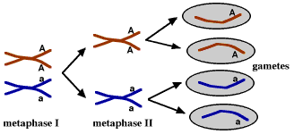
Vocabulary Review. Answer is…
Which letter below best describes Mendel’s Law of Segregation?
  A.) An organisms physical appearance or visible traits.
  B.) When allele pairs separate during gamete formation, and randomly unite at fertilization.
  C.) When traits are passed from parents to offspring.
  D.) An organisms genetic makeup, or allele combinations.
  E.) Allele that is covered up when the dominant allele is with it.
female
male
Copyright © 2010 Ryan P. Murphy

Slide 61
Vocabulary Review. Answer is…
Which letter below best describes Mendel’s Law of Segregation?
  A.) An organisms physical appearance or visible traits.
  B.) When allele pairs separate during gamete formation, and randomly unite at fertilization.
  C.) When traits are passed from parents to offspring.
  D.) An organisms genetic makeup, or allele combinations.
  E.) Allele that is covered up when the dominant allele is with it.
female
male
Copyright © 2010 Ryan P. Murphy

Slide 62
Vocabulary Review. Answer is…
Which letter below best describes Mendel’s Law of Segregation?
  A.) An organisms physical appearance or visible traits.
  B.) When allele pairs separate during gamete formation, and randomly unite at fertilization.
  C.) When traits are passed from parents to offspring.
  D.) An organisms genetic makeup, or allele combinations.
  E.) Allele that is covered up when the dominant allele is with it.
female
male
Copyright © 2010 Ryan P. Murphy

Slide 63
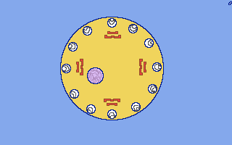
Vocabulary Review. Answer is…
Which letter below best describes Mendel’s Law of Segregation?
  A.) An organisms physical appearance or visible traits.
  B.) When allele pairs separate during gamete formation, and randomly unite at fertilization.
  C.) When traits are passed from parents to offspring.
  D.) An organisms genetic makeup, or allele combinations.
  E.) Allele that is covered up when the dominant allele is with it.
female
male
Copyright © 2010 Ryan P. Murphy

Slide 65
Vocabulary Review.
Which letter below best describes an allele?
  A.) An organisms genetic make up.
  B.) An organisms physical appearance or visible traits.
  C.) When traits are passed from parents to offspring.
  D.) The different forms of a gene.
  E.) Alleles do not exist in nature.
Copyright © 2010 Ryan P. Murphy

Slide 66
Vocabulary Review.
Which letter below best describes an allele?
  A.) An organisms genetic make up.
  B.) An organisms physical appearance or visible traits.
  C.) When traits are passed from parents to offspring.
  D.) The different forms of a gene.
  E.) Alleles do not exist in nature.
Copyright © 2010 Ryan P. Murphy

Slide 67
Vocabulary Review.
Which letter below best describes an allele?
  A.) An organisms genetic make up.
  B.) An organisms physical appearance or visible traits.
  C.) When traits are passed from parents to offspring.
  D.) The different forms of a gene.
  E.) Alleles do not exist in nature.
Copyright © 2010 Ryan P. Murphy

Slide 68
Vocabulary Review.
Which letter below best describes an allele?
  A.) An organisms genetic make up.
  B.) An organisms physical appearance or visible traits.
  C.) When traits are passed from parents to offspring.
  D.) The different forms of a gene.
  E.) Alleles do not exist in nature.
Copyright © 2010 Ryan P. Murphy

Slide 69
Vocabulary Review.
Which letter below best describes an allele?
  A.) An organisms genetic make up.
  B.) An organisms physical appearance or visible traits.
  C.) When traits are passed from parents to offspring.
  D.) The different forms of a gene.
  E.) Alleles do not exist in nature.
Copyright © 2010 Ryan P. Murphy

Slide 70
Vocabulary Review.
Which letter below best describes an allele?
  A.) An organisms genetic make up.
  B.) An organisms physical appearance or visible traits.
  C.) When traits are passed from parents to offspring.
  D.) The different forms of a gene.
  E.) Alleles do not exist in nature.
Copyright © 2010 Ryan P. Murphy

Slide 71
Vocabulary Review.
Which letter below best describes an allele?
  A.) An organisms genetic make up.
  B.) An organisms physical appearance or visible traits.
  C.) When traits are passed from parents to offspring.
  D.) The different forms of a gene.
  E.) Alleles do not exist in nature.
and the answer is…
Copyright © 2010 Ryan P. Murphy

Slide 72
Vocabulary Review.
Which letter below best describes an allele?
  A.) An organisms genetic make up.
  B.) An organisms physical appearance or visible traits.
  C.) When traits are passed from parents to offspring.
  D.) The different forms of a gene.
  E.) Alleles do not exist in nature.
and the answer is…
Copyright © 2010 Ryan P. Murphy

Slide 74
Vocabulary Review.
Which two letters below best describes an organisms phenotype and genotype?
  A.) When traits are passed from parents to offspring.
  B.) An organisms genetic make up.
  C.) An organisms physical appearance or visible traits.
  D.) The different forms of a gene.
  E.) When an organism cannot pass on genetic information.
Copyright © 2010 Ryan P. Murphy

Slide 75
Vocabulary Review.
Which two letters below best describes an organisms phenotype and genotype?
  A.) When traits are passed from parents to offspring.
  B.) An organisms genetic make up.
  C.) An organisms physical appearance or visible traits.
  D.) The different forms of a gene.
  E.) When an organism cannot pass on genetic information.
Copyright © 2010 Ryan P. Murphy

Slide 76
Vocabulary Review.
Which two letters below best describes an organisms phenotype and genotype?
  A.) When traits are passed from parents to offspring.
  B.) An organisms genetic make up.
  C.) An organisms physical appearance or visible traits.
  D.) The different forms of a gene.
  E.) When an organism cannot pass on genetic information.
Copyright © 2010 Ryan P. Murphy

Slide 77
Vocabulary Review.
Which two letters below best describes an organisms phenotype and genotype?
  A.) When traits are passed from parents to offspring.
  B.) An organisms genetic make up.
  C.) An organisms physical appearance or visible traits.
  D.) The different forms of a gene.
  E.) When an organism cannot pass on genetic information.
Copyright © 2010 Ryan P. Murphy

Slide 78
Vocabulary Review.
Which two letters below best describes an organisms phenotype and genotype?
  A.) When traits are passed from parents to offspring.
  B.) An organisms genetic make up.
  C.) An organisms physical appearance or visible traits.
  D.) The different forms of a gene.
  E.) When an organism cannot pass on genetic information.
Copyright © 2010 Ryan P. Murphy

Slide 79
Vocabulary Review.
Which two letters below best describes an organisms phenotype and genotype?
  A.) When traits are passed from parents to offspring.
  B.) An organisms genetic make up.
  C.) An organisms physical appearance or visible traits.
  D.) The different forms of a gene.
  E.) When an organism cannot pass on genetic information.
Copyright © 2010 Ryan P. Murphy

Slide 80
Vocabulary Review.
Which two letters below best describes an organisms phenotype and genotype?
  A.) When traits are passed from parents to offspring.
  B.) An organisms genetic make up.
  C.) An organisms physical appearance or visible traits.
  D.) The different forms of a gene.
  E.) When an organism cannot pass on genetic information.
and the answer is…
Copyright © 2010 Ryan P. Murphy

Slide 81
Vocabulary Review.
Which two letters below best describes an organisms phenotype and genotype?
  A.) When traits are passed from parents to offspring.
  B.) An organisms genetic make up.
  C.) An organisms physical appearance or visible traits.
  D.) The different forms of a gene.
  E.) When an organism cannot pass on genetic information.
and the answer is…
Copyright © 2010 Ryan P. Murphy

Slide 82
Vocabulary Review.
Which two letters below best describes an organisms phenotype and genotype?
  A.) When traits are passed from parents to offspring.
  B.) An organisms genetic make up.
  C.) An organisms physical appearance or visible traits.
  D.) The different forms of a gene.
  E.) When an organism cannot pass on genetic information.
and the answer is…
Copyright © 2010 Ryan P. Murphy

Slide 83
Vocabulary Review.
Which two letters below best describes an organisms phenotype and genotype?
  A.) When traits are passed from parents to offspring.
  B.) An organisms genetic make up.
  C.) An organisms physical appearance or visible traits.
  D.) The different forms of a gene.
  E.) When an organism cannot pass on genetic information.
and the answer is…
Copyright © 2010 Ryan P. Murphy

Slide 84
Mendel's Laws of Heredity:
1) The Law of Segregation: Each inherited trait is defined by a gene pair. Parental genes are randomly separated to the sex cells so that sex cells contain only one gene of the pair. Offspring therefore inherit one genetic allele from each parent when sex cells unite in fertilization.
2) The Law of Independent Assortment: Genes for different traits are sorted separately from one another so that the inheritance of one trait is not dependent on the inheritance of another.
3) The Law of Dominance: An organism with alternate forms of a gene will express the form that is dominant.
Study for
1 minute
Copyright © 2010 Ryan P. Murphy

Slide 85
Mendel's Laws of Heredity:
1) The Law of Segregation: Each inherited trait is defined by a gene pair. Parental genes are randomly separated to the sex cells so that sex cells contain only one gene of the pair. Offspring therefore inherit one genetic allele from each parent when sex cells unite in fertilization.
2) The Law of Independent Assortment: Genes for different traits are sorted separately from one another so that the inheritance of one trait is not dependent on the inheritance of another.
3) The Law of Dominance: An organism with alternate forms of a gene will express the form that is dominant.
Copyright © 2010 Ryan P. Murphy

Slide 86
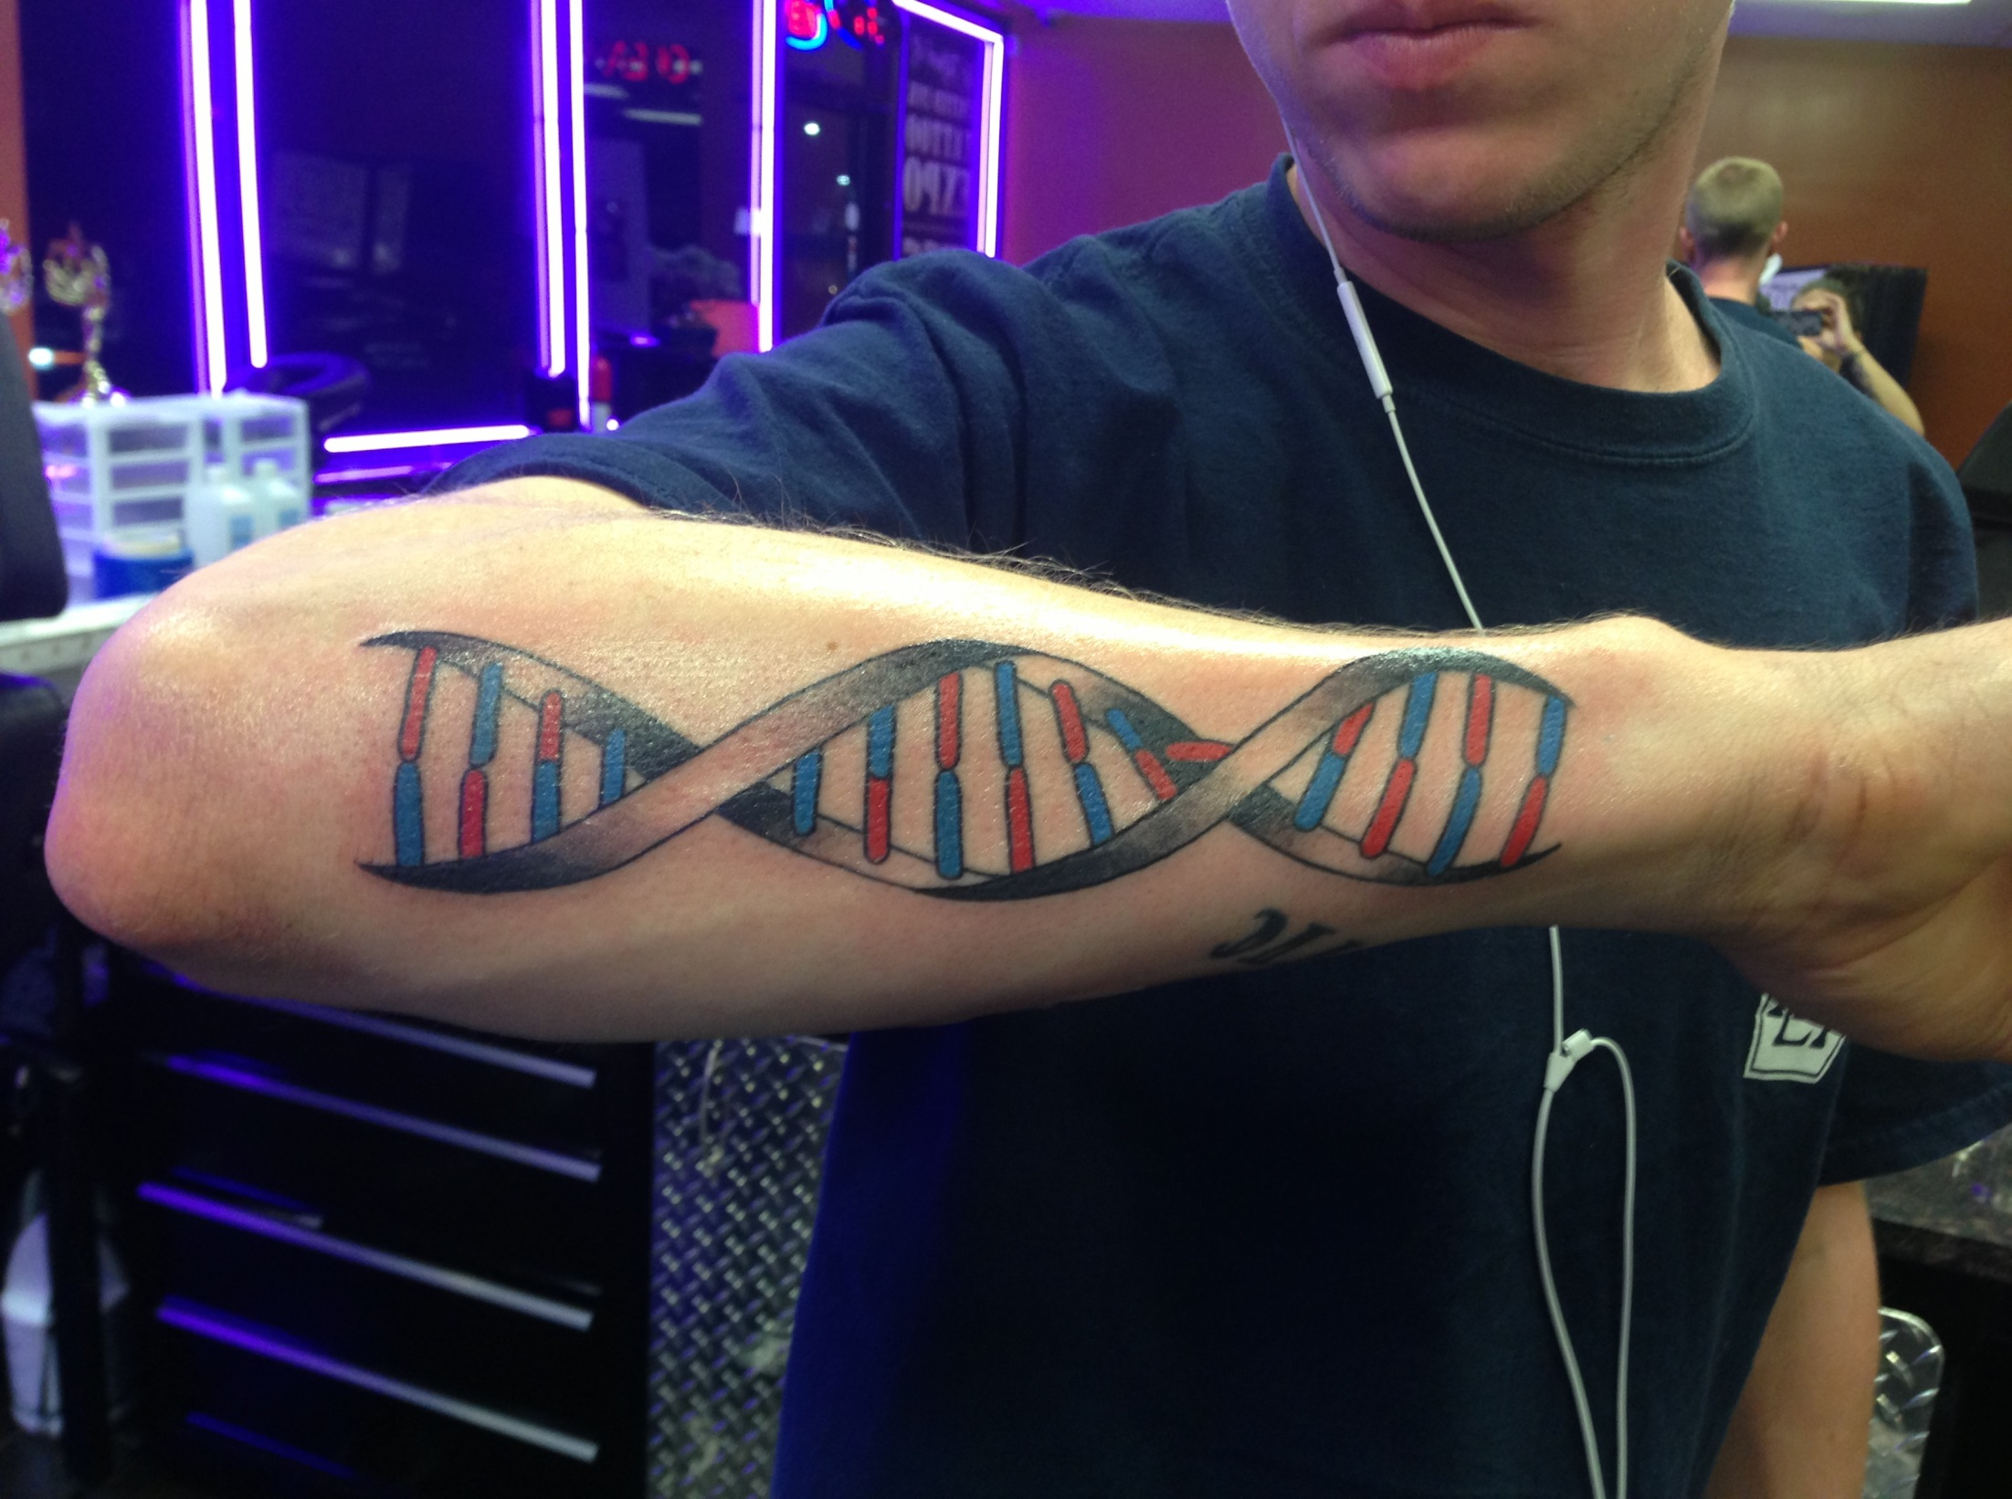

Slide 87
Mendel's Laws of Heredity:
1) The Law of Segregation: Each inherited trait is defined by a gene pair. Parental genes are randomly separated to the sex cells so that sex cells contain only one gene of the pair. Offspring therefore inherit one genetic allele from each parent when sex cells unite in fertilization.
2) The Law of Independent Assortment: Genes for different traits are sorted separately from one another so that the inheritance of one trait is not dependent on the inheritance of another.
3) The Law of Dominance: An organism with alternate forms of a gene will express the form that is dominant.
Copyright © 2010 Ryan P. Murphy

Slide 88
Mendel's Laws of Heredity:
1) The Law of Segregation: Each inherited trait is defined by a gene pair. Parental genes are randomly separated to the sex cells so that sex cells contain only one gene of the pair. Offspring therefore inherit one genetic allele from each parent when sex cells unite in fertilization.
2) The Law of Independent Assortment: Genes for different traits are sorted separately from one another so that the inheritance of one trait is not dependent on the inheritance of another.
3) The Law of Dominance: An organism with alternate forms of a gene will express the form that is dominant.
Copyright © 2010 Ryan P. Murphy

Slide 89
Mendel's Laws of Heredity:
1) The Law of Segregation: Each inherited trait is defined by a gene pair. Parental genes are randomly separated to the sex cells so that sex cells contain only one gene of the pair. Offspring therefore inherit one genetic allele from each parent when sex cells unite in fertilization.
2) The Law of Independent Assortment: Genes for different traits are sorted separately from one another so that the inheritance of one trait is not dependent on the inheritance of another.
3) The Law of Dominance: An organism with alternate forms of a gene will express the form that is dominant.
Copyright © 2010 Ryan P. Murphy

Slide 90
Mendel's Laws of Heredity:
1) The Law of Segregation: Each inherited trait is defined by a gene pair. Parental genes are randomly separated to the sex cells so that sex cells contain only one gene of the pair. Offspring therefore inherit one genetic allele from each parent when sex cells unite in fertilization.
2) The Law of Independent Assortment: Genes for different traits are sorted separately from one another so that the inheritance of one trait is not dependent on the inheritance of another.
3) The Law of Dominance: An organism with alternate forms of a gene will express the form that is dominant.
Copyright © 2010 Ryan P. Murphy

Slide 91
Mendel's Laws of Heredity:
1) The Law of Segregation: Each inherited trait is defined by a gene pair. Parental genes are randomly separated to the sex cells so that sex cells contain only one gene of the pair. Offspring therefore inherit one genetic allele from each parent when sex cells unite in fertilization.
2) The Law of Independent Assortment: Genes for different traits are sorted separately from one another so that the inheritance of one trait is not dependent on the inheritance of another.
3) The Law of Dominance: An organism with alternate forms of a gene will express the form that is dominant.
Copyright © 2010 Ryan P. Murphy

Slide 92
Mendel's Laws of Heredity:
1) The Law of Segregation: Each inherited trait is defined by a gene pair. Parental genes are randomly separated to the sex cells so that sex cells contain only one gene of the pair. Offspring therefore inherit one genetic allele from each parent when sex cells unite in fertilization.
2) The Law of Independent Assortment: Genes for different traits are sorted separately from one another so that the inheritance of one trait is not dependent on the inheritance of another.
3) The Law of Dominance: An organism with alternate forms of a gene will express the form that is dominant.
Copyright © 2010 Ryan P. Murphy

Slide 93
Mendel's Laws of Heredity:
1) The Law of Segregation: Each inherited trait is defined by a gene pair. Parental genes are randomly separated to the sex cells so that sex cells contain only one gene of the pair. Offspring therefore inherit one genetic allele from each parent when sex cells unite in fertilization.
2) The Law of Independent Assortment: Genes for different traits are sorted separately from one another so that the inheritance of one trait is not dependent on the inheritance of another.
3) The Law of Dominance: An organism with alternate forms of a gene will express the form that is dominant.
Copyright © 2010 Ryan P. Murphy

Slide 94
Mendel's Laws of Heredity:
1) The Law of Segregation: Each inherited trait is defined by a gene pair. Parental genes are randomly separated to the sex cells so that sex cells contain only one gene of the pair. Offspring therefore inherit one genetic allele from each parent when sex cells unite in fertilization.
2) The Law of Independent Assortment: Genes for different traits are sorted separately from one another so that the inheritance of one trait is not dependent on the inheritance of another.
3) The Law of Dominance: An organism with alternate forms of a gene will express the form that is dominant.
Copyright © 2010 Ryan P. Murphy

Slide 95
Mendel's Laws of Heredity:
1) The Law of Segregation: Each inherited trait is defined by a gene pair. Parental genes are randomly separated to the sex cells so that sex cells contain only one gene of the pair. Offspring therefore inherit one genetic allele from each parent when sex cells unite in fertilization.
2) The Law of Independent Assortment: Genes for different traits are sorted separately from one another so that the inheritance of one trait is not dependent on the inheritance of another.
3) The Law of Dominance: An organism with alternate forms of a gene will express the form that is dominant.
Copyright © 2010 Ryan P. Murphy

Slide 96
Mendel's Laws of Heredity:
1) The Law of Segregation: Each inherited trait is defined by a gene pair. Parental genes are randomly separated to the sex cells so that sex cells contain only one gene of the pair. Offspring therefore inherit one genetic allele from each parent when sex cells unite in fertilization.
2) The Law of Independent Assortment: Genes for different traits are sorted separately from one another so that the inheritance of one trait is not dependent on the inheritance of another.
3) The Law of Dominance: An organism with alternate forms of a gene will express the form that is dominant.
Copyright © 2010 Ryan P. Murphy

Slide 97
Mendel's Laws of Heredity:
1) The Law of Segregation: Each inherited trait is defined by a gene pair. Parental genes are randomly separated to the sex cells so that sex cells contain only one gene of the pair. Offspring therefore inherit one genetic allele from each parent when sex cells unite in fertilization.
2) The Law of Independent Assortment: Genes for different traits are sorted separately from one another so that the inheritance of one trait is not dependent on the inheritance of another.
3) The Law of Dominance: An organism with alternate forms of a gene will express the form that is dominant.
Copyright © 2010 Ryan P. Murphy

Slide 98
Mendel's Laws of Heredity:
1) The Law of Segregation: Each inherited trait is defined by a gene pair. Parental genes are randomly separated to the sex cells so that sex cells contain only one gene of the pair. Offspring therefore inherit one genetic allele from each parent when sex cells unite in fertilization.
2) The Law of Independent Assortment: Genes for different traits are sorted separately from one another so that the inheritance of one trait is not dependent on the inheritance of another.
3) The Law of Dominance: An organism with alternate forms of a gene will express the form that is dominant.
Copyright © 2010 Ryan P. Murphy

Slide 99
Mendel's Laws of Heredity:
1) The Law of Segregation: Each inherited trait is defined by a gene pair. Parental genes are randomly separated to the sex cells so that sex cells contain only one gene of the pair. Offspring therefore inherit one genetic allele from each parent when sex cells unite in fertilization.
2) The Law of Independent Assortment: Genes for different traits are sorted separately from one another so that the inheritance of one trait is not dependent on the inheritance of another.
3) The Law of Dominance: An organism with alternate forms of a gene will express the form that is dominant.
Copyright © 2010 Ryan P. Murphy

Slide 100
Mendel's Laws of Heredity:
1) The Law of Segregation: Each inherited trait is defined by a gene pair. Parental genes are randomly separated to the sex cells so that sex cells contain only one gene of the pair. Offspring therefore inherit one genetic allele from each parent when sex cells unite in fertilization.
2) The Law of Independent Assortment: Genes for different traits are sorted separately from one another so that the inheritance of one trait is not dependent on the inheritance of another.
3) The Law of Dominance: An organism with alternate forms of a gene will express the form that is dominant.
Copyright © 2010 Ryan P. Murphy

Slide 101
Mendel's Laws of Heredity:
1) The Law of Segregation: Each inherited trait is defined by a gene pair. Parental genes are randomly separated to the sex cells so that sex cells contain only one gene of the pair. Offspring therefore inherit one genetic allele from each parent when sex cells unite in fertilization.
2) The Law of Independent Assortment: Genes for different traits are sorted separately from one another so that the inheritance of one trait is not dependent on the inheritance of another.
3) The Law of Dominance: An organism with alternate forms of a gene will express the form that is dominant.
Copyright © 2010 Ryan P. Murphy

Slide 102
Mendel's Laws of Heredity:
1) The Law of Segregation: Each inherited trait is defined by a gene pair. Parental genes are randomly separated to the sex cells so that sex cells contain only one gene of the pair. Offspring therefore inherit one genetic allele from each parent when sex cells unite in fertilization.
2) The Law of Independent Assortment: Genes for different traits are sorted separately from one another so that the inheritance of one trait is not dependent on the inheritance of another.
3) The Law of Dominance: An organism with alternate forms of a gene will express the form that is dominant.
Copyright © 2010 Ryan P. Murphy

Slide 103
Mendel's Laws of Heredity:
1) The Law of Segregation: Each inherited trait is defined by a gene pair. Parental genes are randomly separated to the sex cells so that sex cells contain only one gene of the pair. Offspring therefore inherit one genetic allele from each parent when sex cells unite in fertilization.
2) The Law of Independent Assortment: Genes for different traits are sorted separately from one another so that the inheritance of one trait is not dependent on the inheritance of another.
3) The Law of Dominance: An organism with alternate forms of a gene will express the form that is dominant.
Copyright © 2010 Ryan P. Murphy

Slide 104
Mendel's Laws of Heredity:
1) The Law of Segregation: Each inherited trait is defined by a gene pair. Parental genes are randomly separated to the sex cells so that sex cells contain only one gene of the pair. Offspring therefore inherit one genetic allele from each parent when sex cells unite in fertilization.
2) The Law of Independent Assortment: Genes for different traits are sorted separately from one another so that the inheritance of one trait is not dependent on the inheritance of another.
3) The Law of Dominance: An organism with alternate forms of a gene will express the form that is dominant.
Copyright © 2010 Ryan P. Murphy

Slide 105
Mendel's Laws of Heredity:
1) The Law of Segregation: Each inherited trait is defined by a gene pair. Parental genes are randomly separated to the sex cells so that sex cells contain only one gene of the pair. Offspring therefore inherit one genetic allele from each parent when sex cells unite in fertilization.
2) The Law of Independent Assortment: Genes for different traits are sorted separately from one another so that the inheritance of one trait is not dependent on the inheritance of another.
3) The Law of Dominance: An organism with alternate forms of a gene will express the form that is dominant.
Copyright © 2010 Ryan P. Murphy

Slide 106
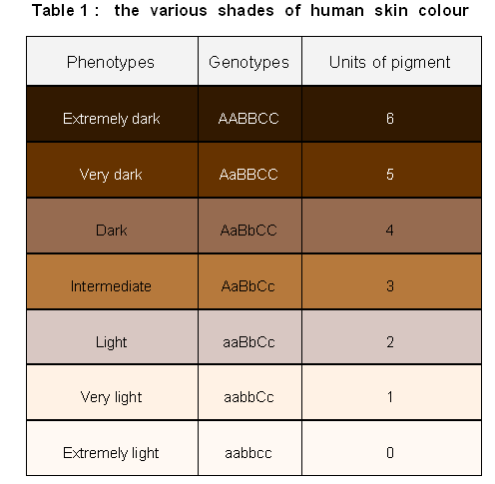
REVIEW!
…

Slide 107
Most traits are polygenic, controlled by two or more genes with six alleles.
  Height, eye color, skin color are all controlled by multiple alleles.
  .
…

Slide 108
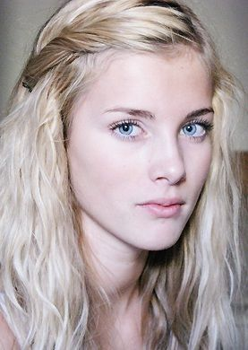
Most traits are polygenic, controlled by two or more genes with six alleles.
  Height, eye color, skin color are all controlled by multiple alleles.
  .
If you were recessive for all three alleles for skin color then you might have light colored skin.

Slide 109
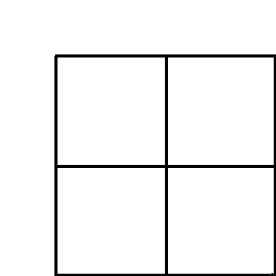
Punnett Square: A diagram that is used to predict the outcome of a particular cross
  (Probability / likelihood that that an event / cross will occur)
Copyright © 2024 SlideSpark .LLC

Slide 110
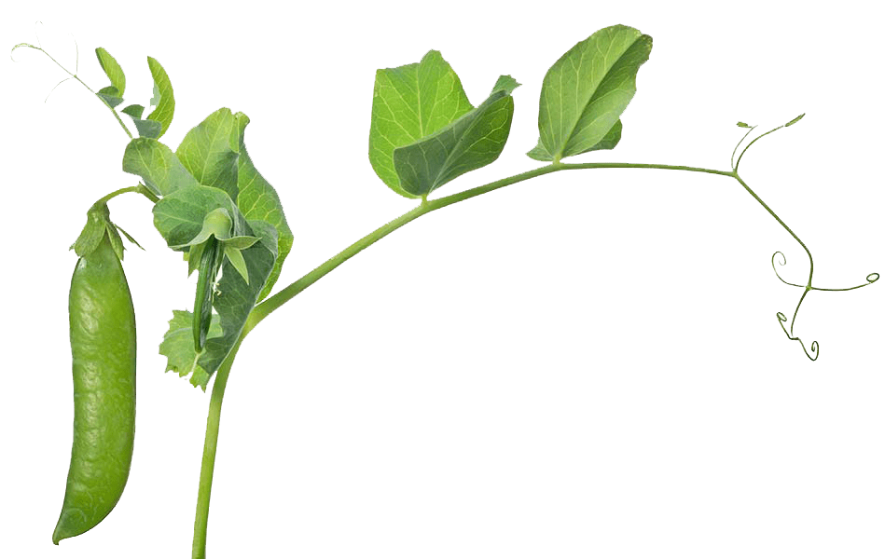
Punnett Square: A diagram that is used to predict the outcome of a particular cross
  (Probability / likelihood that that an event / cross will occur)
100% Chance offspring will be tall
Copyright © 2024 SlideSpark .LLC

Slide 111
Punnett Square: A diagram that is used to predict the outcome of a particular cross
  (Probability / likelihood that that an event / cross will occur)
100% Chance offspring will be tall
Recessive, not gone
Don’t forget the F2 Gen
Copyright © 2024 SlideSpark .LLC

Slide 112
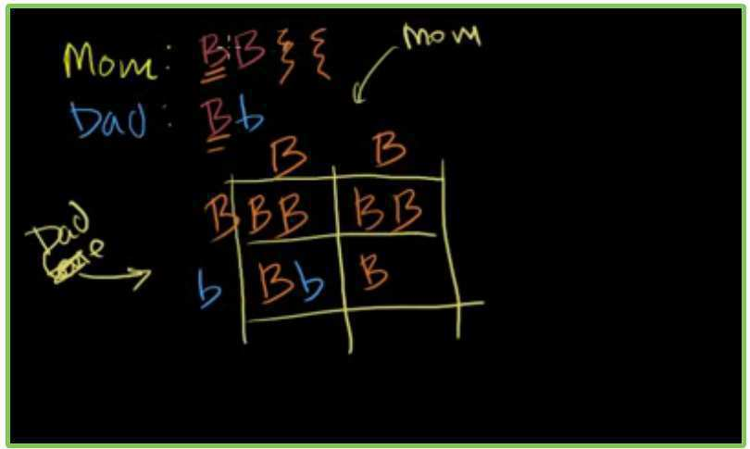
Video Link! Khan Academy “Punnett Squares.” (Advanced)
  http://www.khanacademy.org/video/punnett-square-fun?playlist=Biology
Copyright © 2024 SlideSpark .LLC

Slide 113

When a man and women decide to have a child, who determines the gender?
Copyright © 2024 SlideSpark .LLC

Slide 114
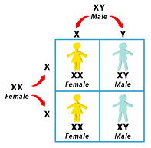
Remember!
For all Punnett
Squares
Copyright © 2024 SlideSpark .LLC

Slide 115

Meiosis
Egg
Meiosis
It’s sex cells
and probability
Egg
Copyright © 2024 SlideSpark .LLC

Slide 116
Use the Punnett Square below to help you.
  XX=Female XY=Male
Copyright © 2024 SlideSpark .LLC

Slide 117
Use the Punnett Square below to help you.
  XX=Female XY=Male
Copyright © 2024 SlideSpark .LLC

Slide 118
Use the Punnett Square below to help you.
  XX=Female XY=Male
Copyright © 2024 SlideSpark .LLC

Slide 119
Use the Punnett Square below to help you.
  XX=Female XY=Male
Copyright © 2024 SlideSpark .LLC

Slide 120
Use the Punnett Square below to help you.
  XX=Female XY=Male
Copyright © 2024 SlideSpark .LLC

Slide 121
Use the Punnett Square below to help you.
  XX=Female XY=Male
Copyright © 2024 SlideSpark .LLC

Slide 122
Use the Punnett Square below to help you.
  XX=Female XY=Male
Copyright © 2024 SlideSpark .LLC

Slide 123
Use the Punnett Square below to help you.
  XX=Female XY=Male
Copyright © 2024 SlideSpark .LLC

Slide 124
Use the Punnett Square below to help you.
  XX=Female XY=Male
Copyright © 2024 SlideSpark .LLC

Slide 125
Use the Punnett Square below to help you.
  XX=Female XY=Male
Copyright © 2024 SlideSpark .LLC

Slide 126
Use the Punnett Square below to help you.
  XX=Female XY=Male
Copyright © 2024 SlideSpark .LLC

Slide 127
Use the Punnett Square below to help you.
  XX=Female XY=Male
Copyright © 2024 SlideSpark .LLC

Slide 128
Use the Punnett Square below to help you.
  XX=Female XY=Male
Copyright © 2024 SlideSpark .LLC

Slide 129
Use the Punnett Square below to help you.
  XX=Female XY=Male
Copyright © 2024 SlideSpark .LLC

Slide 130
Use the Punnett Square below to help you.
  XX=Female XY=Male
Copyright © 2024 SlideSpark .LLC

Slide 131
Use the Punnett Square below to help you.
  XX=Female XY=Male
Copyright © 2024 SlideSpark .LLC

Slide 132
Use the Punnett Square below to help you.
  XX=Female XY=Male
Copyright © 2024 SlideSpark .LLC

Slide 133
Use the Punnett Square below to help you.
  XX=Female XY=Male
Copyright © 2024 SlideSpark .LLC

Slide 134
Use the Punnett Square below to help you.
  XX=Female XY=Male
Copyright © 2024 SlideSpark .LLC

Slide 135
Use the Punnett Square below to help you.
  XX=Female XY=Male
Copyright © 2024 SlideSpark .LLC

Slide 136
Use the Punnett Square below to help you.
  XX=Female XY=Male
Copyright © 2024 SlideSpark .LLC

Slide 137
Use the Punnett Square below to help you.
  XX=Female XY=Male
Who determines gender?
Copyright © 2024 SlideSpark .LLC

Slide 138

Answer! The male, he is the only one who carries the Y chromosome.
Copyright © 2024 SlideSpark .LLC

Slide 139
Answer! The male, he is the only one who carries the Y chromosome. If he gives the X it is female, if he gives the Y it is male.
Copyright © 2024 SlideSpark .LLC

Slide 140
Answer! The male, he is the only one who carries the Y chromosome. If he gives the X it is female, if he gives the Y it is male. The woman is XX and can only give the X.
Copyright © 2024 SlideSpark .LLC

Slide 142

Copyright © 2024 SlideSpark .LLC

Slide 143
Copyright © 2024 SlideSpark .LLC

Slide 144
Copyright © 2024 SlideSpark .LLC

Slide 145
Copyright © 2024 SlideSpark .LLC

Slide 146
In some cultures, women are harassed and looked down upon when they give birth to a daughter.
Copyright © 2024 SlideSpark .LLC

Slide 147
In some cultures, women are harassed and looked down upon when they give birth to a daughter.
“I’m too ignorant to understand the science but very quick to be abusive.”
Copyright © 2024 SlideSpark .LLC

Slide 148
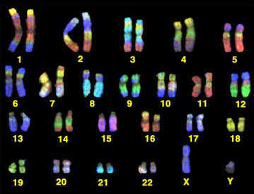
Humans have 23 pairs of chromosomes (46 total)
Copyright © 2024 SlideSpark .LLC

Slide 149
Humans have 23 pairs of chromosomes (46 total)
These are somatic cells
Copyright © 2024 SlideSpark .LLC

Slide 150
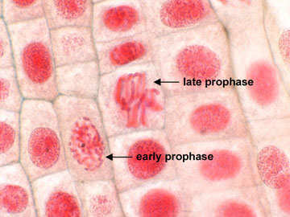
Humans have 23 pairs of chromosomes (46 total)
These are somatic cells
Copyright © 2024 SlideSpark .LLC

Slide 151
Humans have 23 pairs of chromosomes (46 total)
These are somatic cells
Haploid or Diploid?
Copyright © 2024 SlideSpark .LLC

Slide 152
Humans have 23 pairs of chromosomes (46 total)
These are somatic cells
Diploid
Copyright © 2024 SlideSpark .LLC

Slide 153
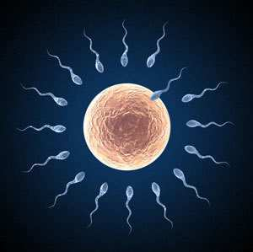
Humans have 23 pairs of chromosomes (46 total)
These are somatic cells
Diploid
Sex Cells (Gametes)
Haploid or Diploid?
Copyright © 2024 SlideSpark .LLC

Slide 154
Humans have 23 pairs of chromosomes (46 total)
These are somatic cells
Diploid
Sex Cells (Gametes)
Haploid
Copyright © 2024 SlideSpark .LLC

Slide 155
Humans have 23 pairs of chromosomes (46 total)
Are these chromosomes
from a man or woman?
Copyright © 2024 SlideSpark .LLC

Slide 156
Humans have 23 pairs of chromosomes (46 total)
Answer: Man, only men have the Y
Chromosome (#23), Woman are XX
Copyright © 2024 SlideSpark .LLC

Slide 157
Humans have 23 pairs of chromosomes (46 total)
Answer: Man, only men have the Y
chromosome (#23), Woman are XX
Copyright © 2024 SlideSpark .LLC

Slide 158
Somatic Chromosome: Any chromosomes that aren’t a sex linked chromosome.
  aka autosomes
Somatic Chromosomes
Copyright © 2024 SlideSpark .LLC

Slide 159
Sex Chromosome: A chromosome involved with determining the sex of an organism, typically one of two kinds. (X,Y)
  aka allosome
Somatic Chromosomes
Sex Chromosomes
Copyright © 2024 SlideSpark .LLC

Slide 160
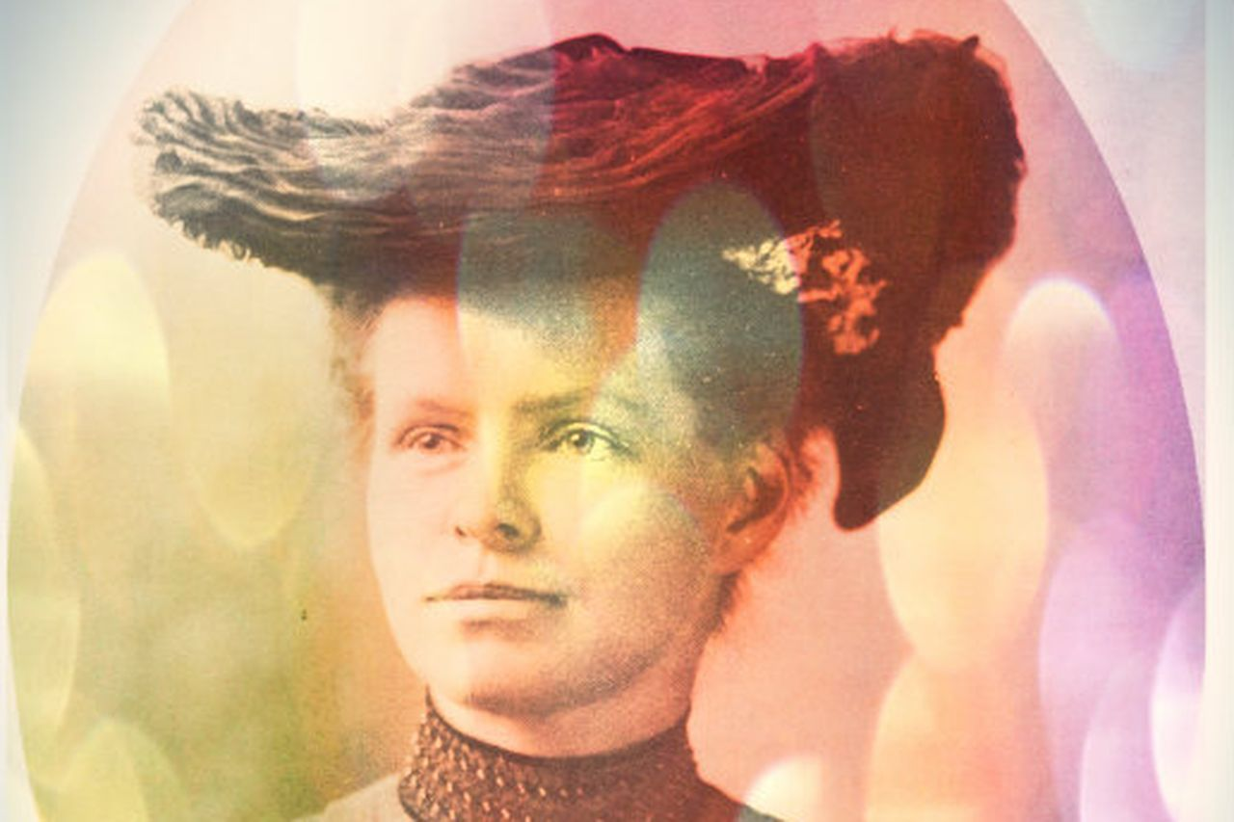
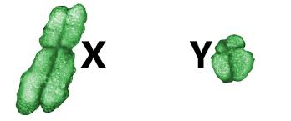
Biologist Nettie Stevens in 1905 Discovered the X and Y chromosome and answered the thousand year old question of why boys become boys and girls become girls.
Learn more about Nettie Stevens at… http://www.vox.com/2016/7/7/12105830/nettie-stevens-genetics-gender-sex-chromosomes
Copyright © 2024 SlideSpark .LLC

Slide 161
X and Y Song.
  https://www.youtube.com/watch?v=NU3hoJDgX70
Copyright © 2024 SlideSpark .LLC

Slide 162

Really interesting NPR (Radio Lab) Science Friday. (Optional) Adult Content
  Genghis Khan, the Y chromosome and his 16 million descendants.
    https://radiolab.org/episodes/91519-genghis-khan
XY
Copyright © 2024 SlideSpark .LLC

Slide 163
Genetics
Part 5
Lesson 3

Slide 164


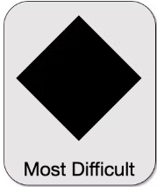
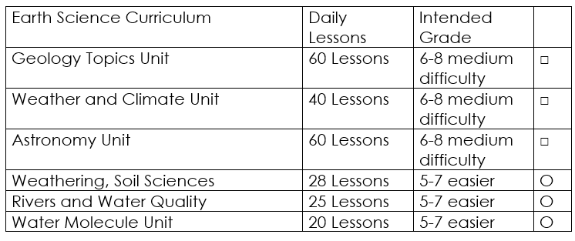

Curriculum Guide
Number of Lessons in each unit (50 min, daily lessons) and difficult rating scale / intended grade level.
=Easier, = More difficult, =Most difficult
Earth Science Units

Slide 165


Life Science Units

Slide 166

Physical Science

Slide 167
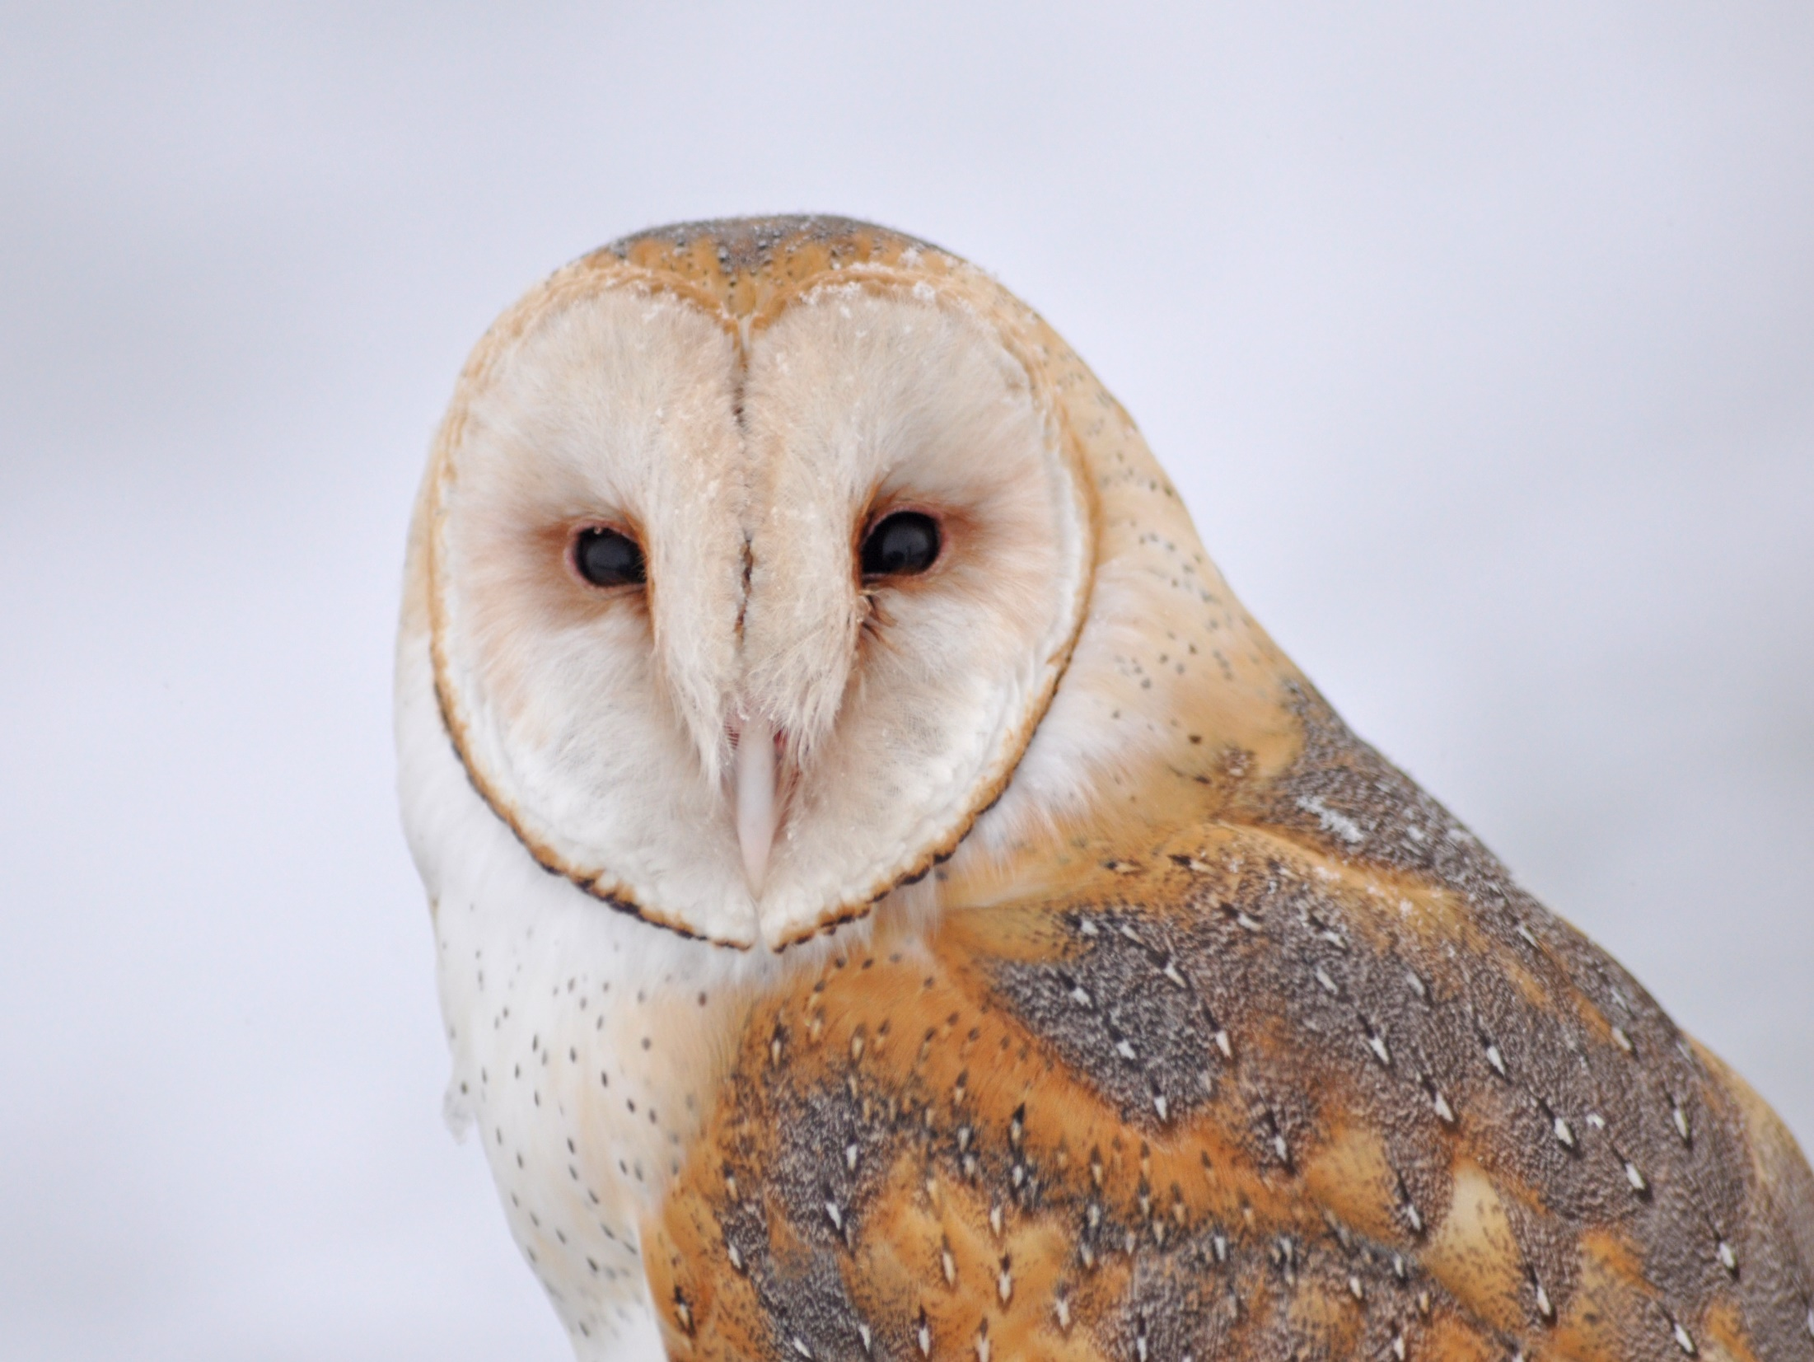
Dear Valued Educator,
Our fully editable .pptx and .doc resources are perfect for educators looking to bring enthusiasm and creativity to their lessons. We encourage you to make changes to fit your needs and style. As science educators, we’re committed to providing students with the tools they need to succeed in the classroom and beyond. Each unit in the curriculum includes a range of resources that have been developed through extensive research and use in a busy classroom. Our teaching approach is designed to make science education engaging and exciting for learners of all ages. We offer a one-of-a-kind science curriculum that will challenge, inspire, and educate students to become tomorrow's scientists and leaders. Join us today and learn more about how our program can help you achieve your classroom goals.
With appreciation,
Support@SlideSpark.net

Slide 168





Thank you for your time and interest in our Science curriculum. We strive to provide students with engaging and informative lessons that will spark their curiosity and encourage scientific exploration. Should you have any questions or concerns, please do not hesitate to contact us. Thank you again for considering our curriculum, and we wish you all the best in your educational journey.
Sincerely,
Support@slidespark.net
SlideSpark Science on TpT

