Slide 1
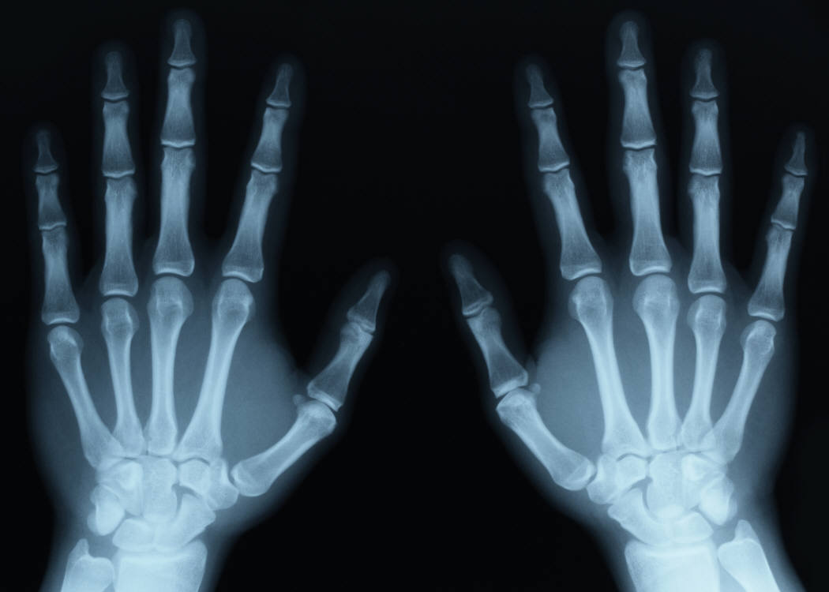

Skeletal System
Review Game
Part 2
Lesson 7
Review Game

Slide 2
Skeletal and Muscular System
GIVE THE DOG THE BONE | BARE BONES | JOINT EFFORT | MUSCLE-UP | -BONUS- SKELETONS
1 | 6 | 11 | 16 | *21
2 | 7 | 12 | 17 | *22
3 | 8 | 13 | 18 | *23
4 | 9 | 14 | 19 | *24
5 | 10 | 15 | 20 | *25
Final Question:________________
Copyright © 2024 SlideSpark .LLC

Slide 3
How to play…
  Don’t play like Jeo_ _ _ _ y.
  Class should be divided into several small groups.
  Groups should use science journal (red slide notes), homework, and other available materials to assist you.
  Groups can communicate quietly with each other but no sharing answers between groups.
    Practice quietly communicating right now?
    Practice Communication Question:
    Your group gets to order one pizza, and you can have two toppings. What does your group want?

Slide 4

Questions 1-20 = 5pts Each
Final Category (Bonus) = 1pt Each
Final Questions = 5 pt wager
If you wager 5 on the last question and get it wrong you lose 5 pts. Wager 5 and get it right you get 5 pts.
Find the Owl =
Secretly write “Owl” in the correct box worth 1pt.
“I’ll be about this big.”

Slide 5
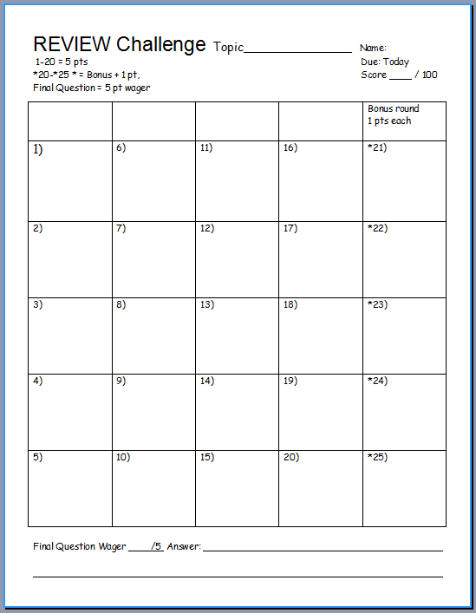
Is your name on the review sheet?
Name

Slide 6
Is your name on the review sheet?
Add the categories
along the top
on the next slide.

Slide 7

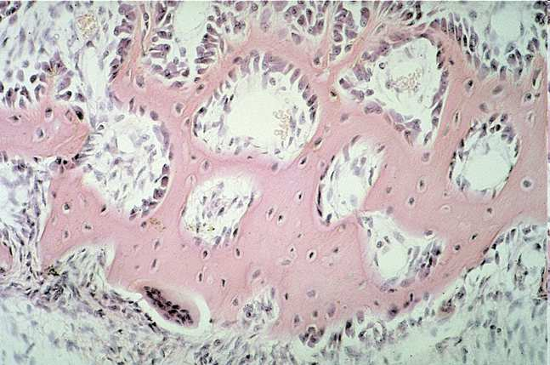
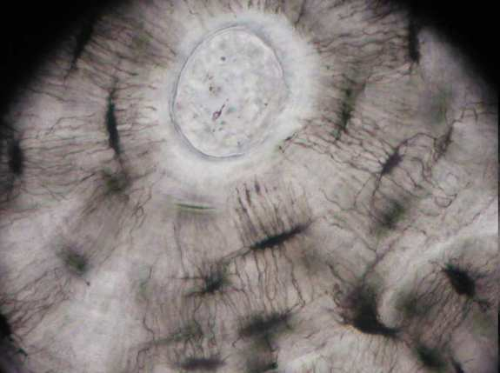
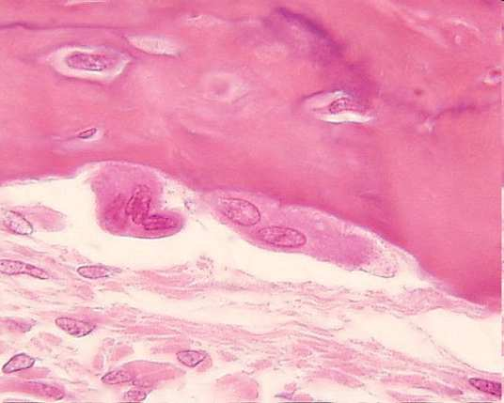
Bone Cells perform all of the following jobs except…
  A.) Make new bone and help repair damage.
  B.) Carry nutrients and waste products to and from blood vessels in the bone.
  C.) Allows muscle fibers to contract and relax.
  D.) Break down bone and help to sculpt and shape it.
Copyright © 2024 SlideSpark .LLC

Slide 8
Bone Cells perform all of the following jobs except…
  A.) Make new bone and help repair damage.
  B.) Carry nutrients and waste products to and from blood vessels in the bone.
  C.) Allows muscle fibers to contract and relax.
  D.) Break down bone and help to sculpt and shape it.
Copyright © 2024 SlideSpark .LLC

Slide 9
Bone Cells perform all of the following jobs except…
  A.) Make new bone and help repair damage.
  B.) Carry nutrients and waste products to and from blood vessels in the bone.
  C.) Allows muscle fibers to contract and relax.
  D.) Break down bone and help to sculpt and shape it.
Copyright © 2024 SlideSpark .LLC

Slide 10
Bone Cells perform all of the following jobs except…
  A.) Make new bone and help repair damage.
  B.) Carry nutrients and waste products to and from blood vessels in the bone.
  C.) Make muscle fibers contract and relax.
  D.) Break down bone and help to sculpt and shape it.
Copyright © 2024 SlideSpark .LLC

Slide 11
Bone Cells perform all of the following jobs except…
  A.) Make new bone and help repair damage.
  B.) Carry nutrients and waste products to and from blood vessels in the bone.
  C.) Make muscle fibers contract and relax.
  D.) Break down bone and help to sculpt and shape it.
Copyright © 2024 SlideSpark .LLC

Slide 12
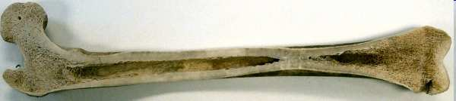

What’s the soft fatty substance in the cavities of bones in which blood cells are produced?

Slide 13

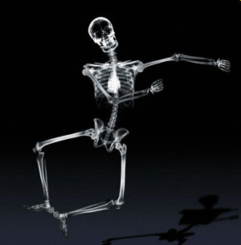
The Skeletal System performs all of the following jobs except for…
A.) Provides the shape and form.
B.) Supports.
C.) Protects.
D.) Produces blood.
E.) Provides Oxygen
F.) Allows movement.
G.) Stores minerals
Copyright © 2024 SlideSpark .LLC

Slide 14
The Skeletal System performs all of the following jobs except for…
A.) Provides the shape and form.
B.) Supports.
C.) Protects.
D.) Produces blood.
E.) Provides Oxygen
F.) Allows movement.
G.) Stores minerals
Copyright © 2024 SlideSpark .LLC

Slide 15
The Skeletal System performs all of the following jobs except for…
A.) Provides the shape and form.
B.) Supports.
C.) Protects.
D.) Produces blood.
E.) Provides Oxygen
F.) Allows movement.
G.) Stores minerals
Copyright © 2024 SlideSpark .LLC

Slide 16
The Skeletal System performs all of the following jobs except for…
A.) Provides the shape and form.
B.) Supports.
C.) Protects.
D.) Produces blood.
E.) Provides Oxygen
F.) Allows movement.
G.) Stores minerals
Copyright © 2024 SlideSpark .LLC

Slide 17
The Skeletal System performs all of the following jobs except for…
A.) Provides the shape and form.
B.) Supports.
C.) Protects.
D.) Produces blood.
E.) Provides Oxygen
F.) Allows movement.
G.) Stores minerals
Copyright © 2024 SlideSpark .LLC

Slide 18
The Skeletal System performs all of the following jobs except for…
A.) Provides the shape and form.
B.) Supports.
C.) Protects.
D.) Produces blood.
E.) Provides Oxygen
F.) Allows movement.
G.) Stores minerals
Copyright © 2024 SlideSpark .LLC

Slide 19
The Skeletal System performs all of the following jobs except for…
A.) Provides the shape and form.
B.) Supports.
C.) Protects.
D.) Produces blood.
E.) Provides Oxygen
F.) Allows movement.
G.) Stores minerals
Copyright © 2024 SlideSpark .LLC

Slide 20
The Skeletal System performs all of the following jobs except for…
A.) Provides the shape and form.
B.) Supports.
C.) Protects.
D.) Produces blood.
E.) Provides Oxygen
F.) Allows movement.
G.) Stores minerals
Copyright © 2024 SlideSpark .LLC

Slide 21
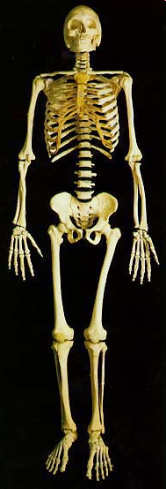
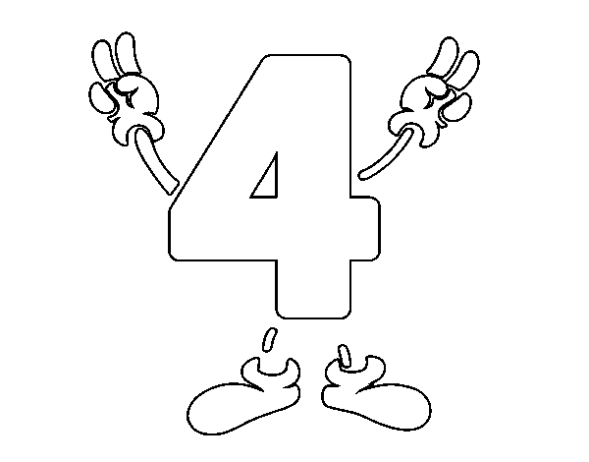
Which skeleton is the axial, and which is the appendicular?
A
B

Slide 22

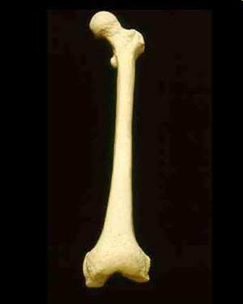
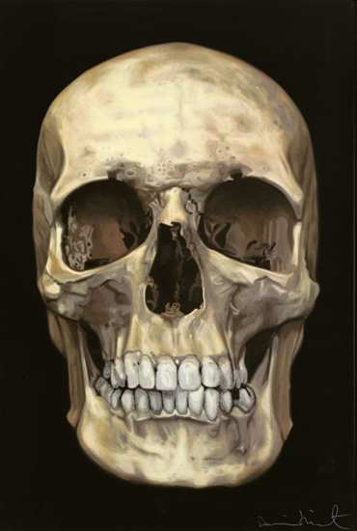
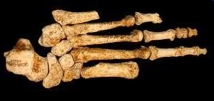
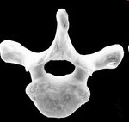
  Which is a long bone, flat bone, irregular bone, and short bone?
Long Bone
B
Short Bone
D
Flat Bone
Long
Bone
A
C
Irregular Bone
Copyright © 2024 SlideSpark .LLC

Slide 23
Skeletal and Muscular System
GIVE THE DOG THE BONE | BARE BONES | JOINT EFFORT | MUSCLE-UP | -BONUS- SKELETONS and MUSCLES
1 | 6 | 11 | 16 | *21
2 | 7 | 12 | 17 | *22
3 | 8 | 13 | 18 | *23
4 | 9 | 14 | 19 | *24
5 | 10 | 15 | 20 | *25
Final Question:________________
Copyright © 2024 SlideSpark .LLC

Slide 24
Skeletal and Muscular System
GIVE THE DOG THE BONE | BARE BONES | JOINT EFFORT | MUSCLE-UP | -BONUS- SKELETONS and MUSCLES
1 | 6 | 11 | 16 | *21
2 | 7 | 12 | 17 | *22
3 | 8 | 13 | 18 | *23
4 | 9 | 14 | 19 | *24
5 | 10 | 15 | 20 | *25
Final Question:________________
Copyright © 2024 SlideSpark .LLC

Slide 25

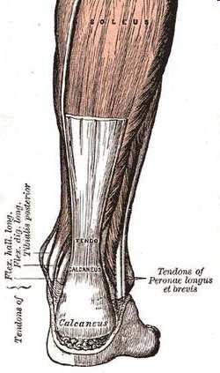
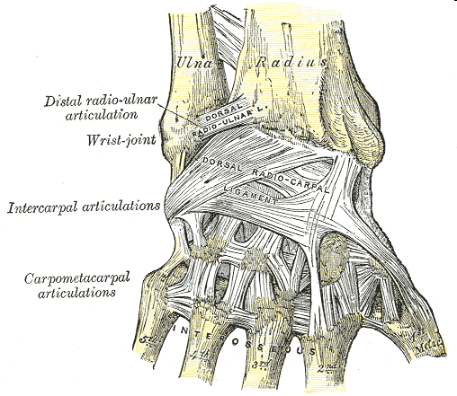
Name the two important connective tissues shown in the pictures below.
A
B
Copyright © 2024 SlideSpark .LLC

Slide 26
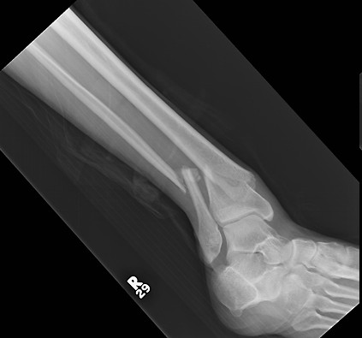
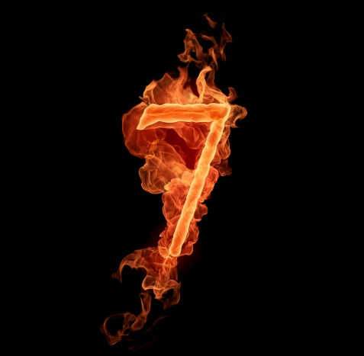
4
A
B
C
D

Slide 27
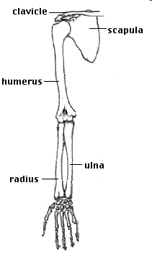
Please name the following bones in the picture below?
A
E
8
B
D
C
Copyright © 2024 SlideSpark .LLC

Slide 28

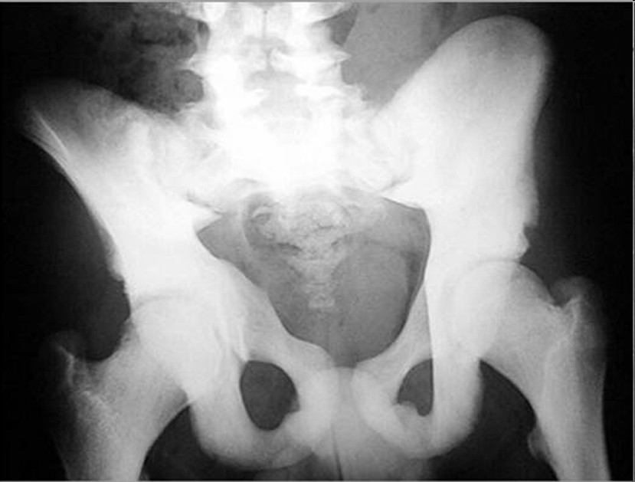
Please identify which letter below are long bones, flat bones, and irregular bones.
A
B
C
Copyright © 2024 SlideSpark .LLC

Slide 29
Please identify which letter below are long bones, flat bones, and irregular bones.
A
10
B
1 bonus point each if you can identify each bone (A, B, C)
C
Copyright © 2024 SlideSpark .LLC

Slide 30
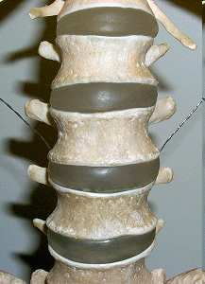
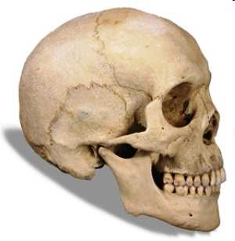
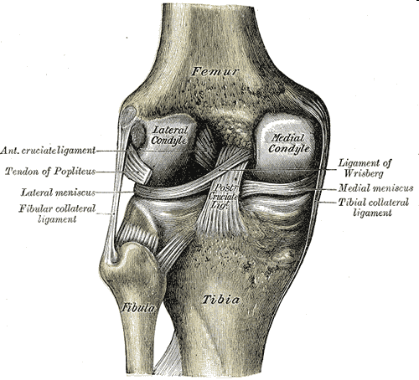
10
Which Joint is the following?
  Fibrous (immovable)
  Cartilagenous (partially movable)
  Synovial (freely movable)
A
B
C
Copyright © 2024 SlideSpark .LLC

Slide 31
Skeletal and Muscular System
GIVE THE DOG THE BONE | BARE BONES | JOINT EFFORT | MUSCLE-UP | -BONUS- SKELETONS and MUSCLES
1 | 6 | 11 | 16 | *21
2 | 7 | 12 | 17 | *22
3 | 8 | 13 | 18 | *23
4 | 9 | 14 | 19 | *24
5 | 10 | 15 | 20 | *25
Final Question:________________
Copyright © 2024 SlideSpark .LLC

Slide 32
Skeletal and Muscular System
GIVE THE DOG THE BONE | BARE BONES | JOINT EFFORT | MUSCLE-UP | -BONUS- SKELETONS and MUSCLES
1 | 6 | 11 | 16 | *21
2 | 7 | 12 | 17 | *22
3 | 8 | 13 | 18 | *23
4 | 9 | 14 | 19 | *24
5 | 10 | 15 | 20 | *25
Final Question:________________
Copyright © 2024 SlideSpark .LLC

Slide 33
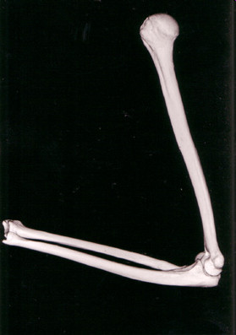
Please name the type of joint shown below?
11
Copyright © 2024 SlideSpark .LLC

Slide 34
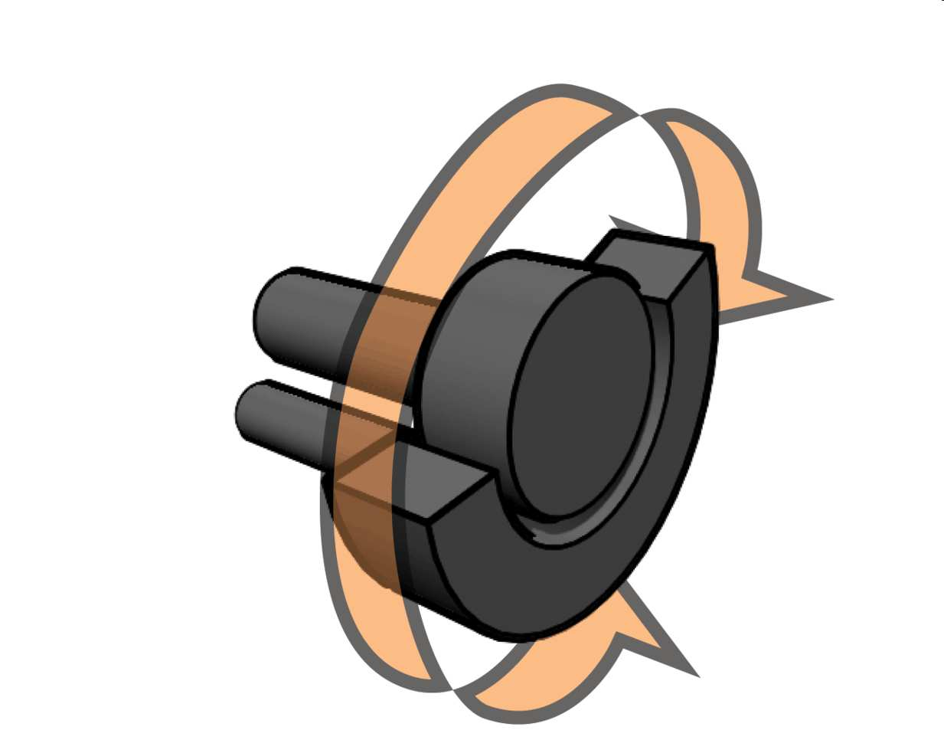
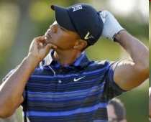

Please name the type of joint shown below?
12
Copyright © 2024 SlideSpark .LLC

Slide 35
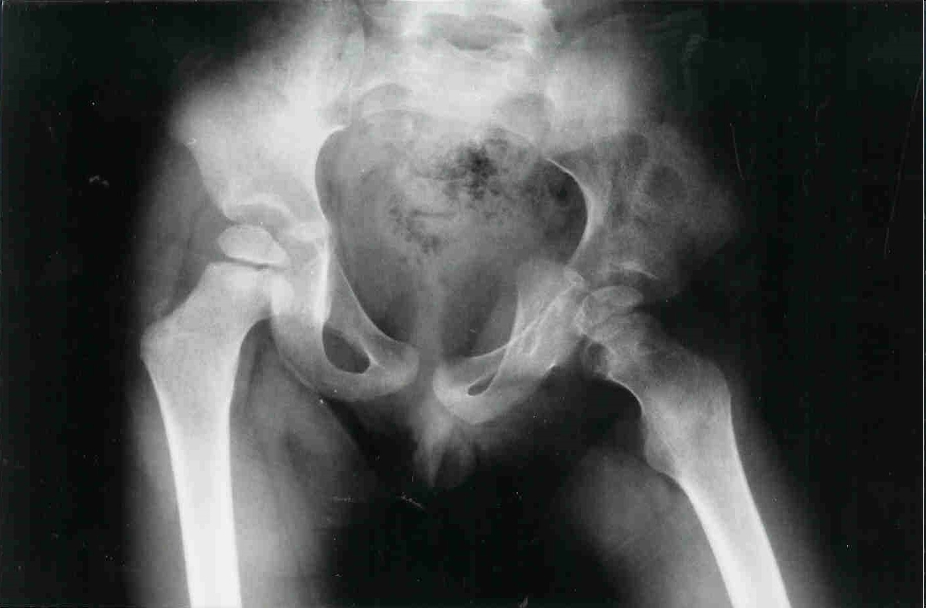
Please name the type of joint shown below?
13
Copyright © 2024 SlideSpark .LLC

Slide 36

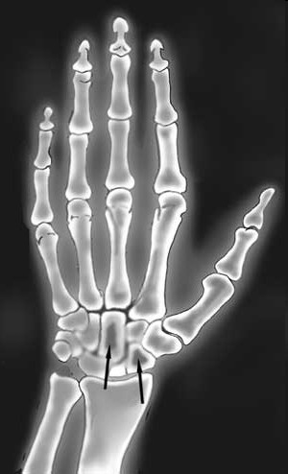
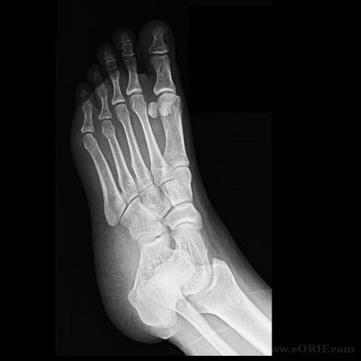
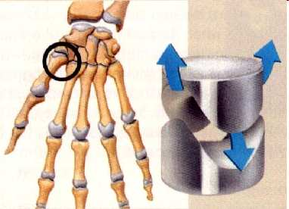
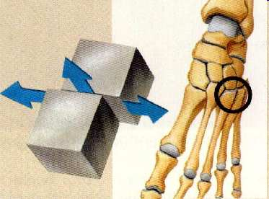
Please name the two types of joints shown below?
A
B
Copyright © 2024 SlideSpark .LLC

Slide 37
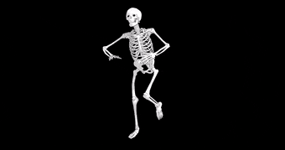
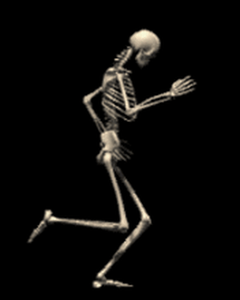
The skeletal system does all of the following except…
A.) Provides the shape and form.
B.) Supports.
C.) Sends Impulses to the Muscles.
D.) Protects.
E.) Produces blood.
15

Slide 38

Within a range of 10, How many bones are in an adult human?
16
16

Slide 39
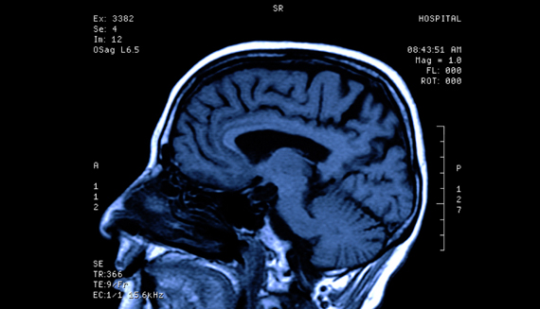

Which is bogus of a brain injury?
Seizures
Loss of Consciousness
Convulsions
Spinal fluid to leak out of the nose and ears
Persistent Headaches
Awareness
Dilation of Pupils
Coma
Loss of Coordination
Slurred Speech
Numbness and weakness in fingers and toes.
Strangeness in behavior, combativeness, irritability, anxiety.
Inability to awake from sleep

Slide 40
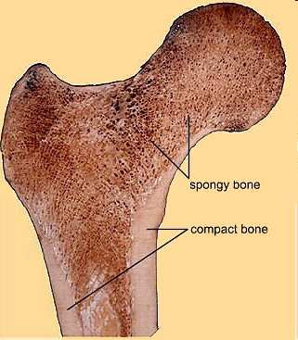
What are two main categories of bones.
  A=
  B=
18
A
B
Copyright © 2024 SlideSpark .LLC

Slide 41
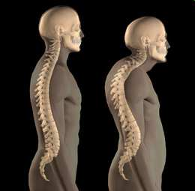
This is the name of a disease that causes the thinning of bone tissue and loss of bone density over time.
A.) Osteoporosis
B.) Bone Decay Syndrome
C.) Synovial Joint Failure
D.) Cardiovascular Disease
E.) Brody Myopathy
19
Copyright © 2024 SlideSpark .LLC

Slide 42
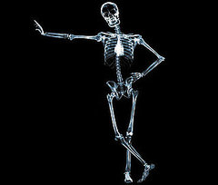
True or False? The human skeleton can grow and repair itself.
20
F
orm
F
ollows
F
unction

Slide 43
Bio Organization, Skeletal, Muscular System
LEVEL-OUT | BARE BONES | JOINT EFFORT | MUSCLE-UP | -BONUS- SKELETONS and MUSCLES
1 | 6 | 11 | 16 | *21
2 | 7 | 12 | 17 | *22
3 | 8 | 13 | 18 | *23
4 | 9 | 14 | 19 | *24
5 | 10 | 15 | 20 | *25
Final Question:________________
Copyright © 2024 SlideSpark .LLC

Slide 44
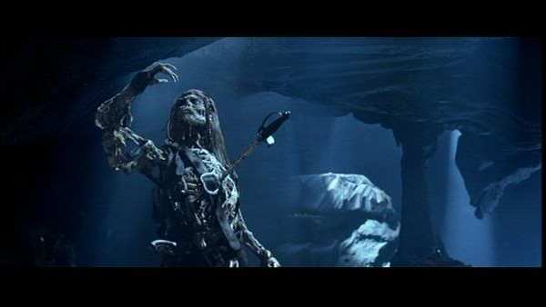
Name the character from this movie?
Jack Sparrow
*21
Copyright © 2024 SlideSpark .LLC

Slide 45
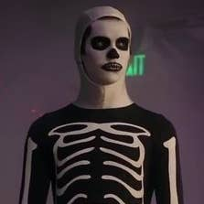
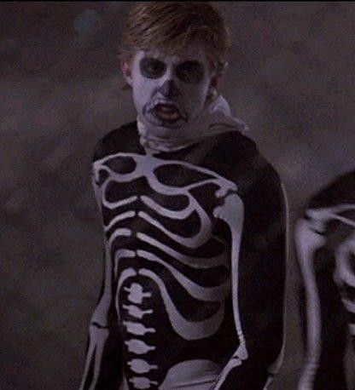
What dojo do these two fight for?
*22

Slide 46
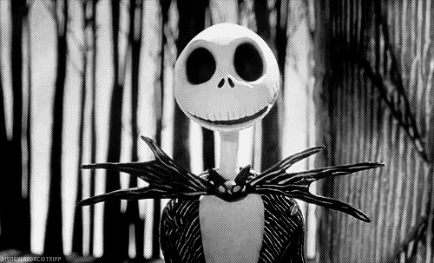
Who is this? Or what movie?
*23

Slide 47
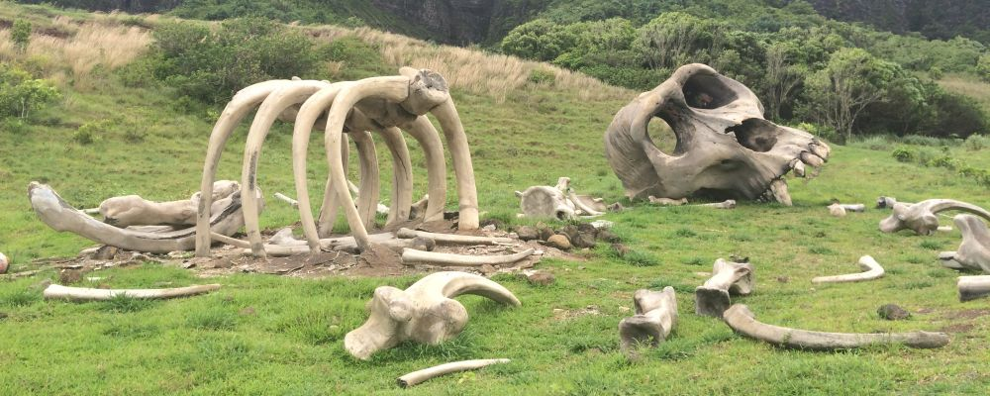
Name this Island?
*24

Slide 48
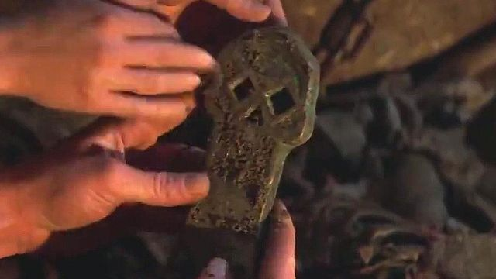
Name the movie with this key?
*25

Slide 49
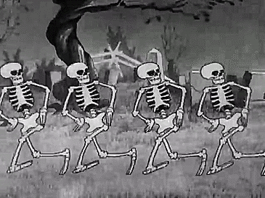
5 Point Wager Question

Slide 50
Bio Organization, Skeletal, Muscular System
LEVEL-OUT | BARE BONES | JOINT EFFORT | MUSCLE-UP | -BONUS- SKELETONS and MUSCLES
1 | 6 | 11 | 16 | *21
2 | 7 | 12 | 17 | *22
3 | 8 | 13 | 18 | *23
4 | 9 | 14 | 19 | *24
5 | 10 | 15 | 20 | *25
Final Question:________________
Copyright © 2024 SlideSpark .LLC

Slide 51
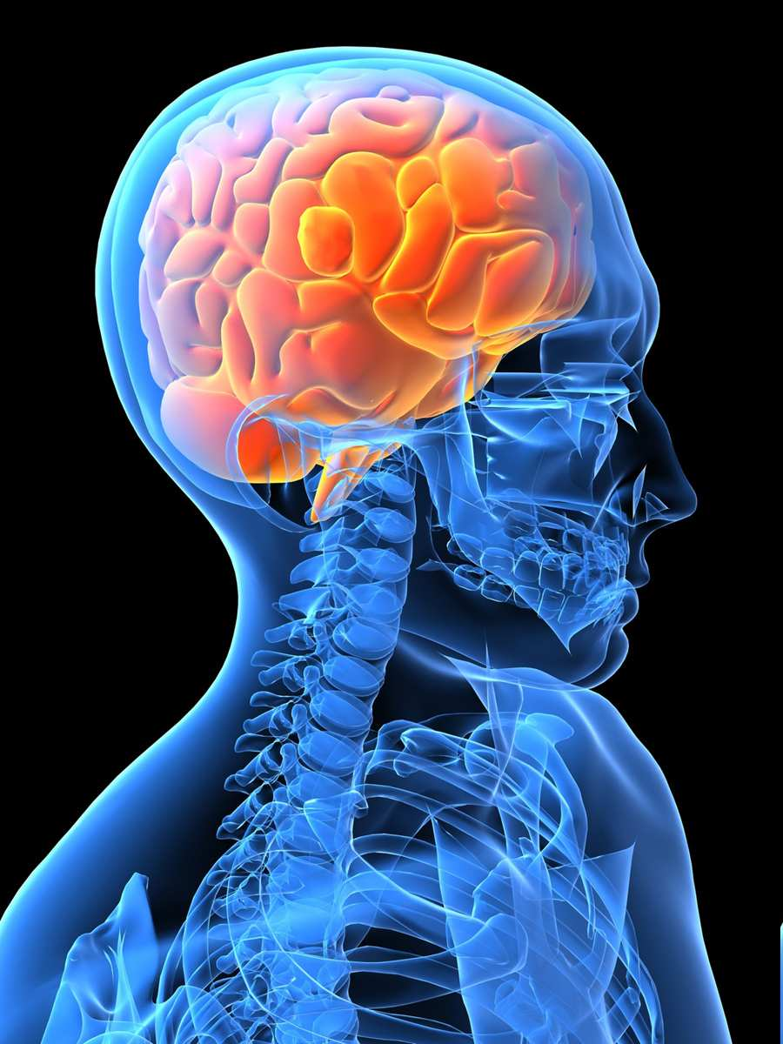
Always wear a seatbelt when driving in a car, and always wear a helmet when appropriate to avoid TBI. What does TBI stand for?
Copyright © 2024 SlideSpark .LLC

Slide 52
Skeletal System
Review Game
Part 2
Lesson 7
Review Game

Slide 53

Skeletal System
Review Game
Part 2
Lesson 8
Review Game

Slide 54
Skeletal and Muscular System
GIVE THE DOG THE BONE | BARE BONES | JOINT EFFORT | MUSCLE-UP | -BONUS- SKELETONS and MUSCLES
1 | 6 | 11 | 16 | *21
2 | 7 | 12 | 17 | *22
3 | 8 | 13 | 18 | *23
4 | 9 | 14 | 19 | *24
5 | 10 | 15 | 20 | *25
Final Question:________________
Copyright © 2024 SlideSpark .LLC

Slide 55
Bone Cells perform all of the following jobs except…
  A.) Make new bone and help repair damage.
  B.) Carry nutrients and waste products to and from blood vessels in the bone.
  C.) Allows muscle fibers to contract and relax.
  D.) Break down bone and help to sculpt and shape it.
Copyright © 2024 SlideSpark .LLC

Slide 56
Bone Cells perform all of the following jobs except…
  A.) Make new bone and help repair damage.
  B.) Carry nutrients and waste products to and from blood vessels in the bone.
  C.) Allows muscle fibers to contract and relax.
  D.) Break down bone and help to sculpt and shape it.
Copyright © 2024 SlideSpark .LLC

Slide 57
Bone Cells perform all of the following jobs except…
  A.) Make new bone and help repair damage.
  B.) Carry nutrients and waste products to and from blood vessels in the bone.
  C.) Allows muscle fibers to contract and relax.
  D.) Break down bone and help to sculpt and shape it.
Copyright © 2024 SlideSpark .LLC

Slide 58
Bone Cells perform all of the following jobs except…
  A.) Make new bone and help repair damage.
  B.) Carry nutrients and waste products to and from blood vessels in the bone.
  C.) Make muscle fibers contract and relax.
  D.) Break down bone and help to sculpt and shape it.
Copyright © 2024 SlideSpark .LLC

Slide 59
Bone Cells perform all of the following jobs except…
  A.) Make new bone and help repair damage.
  B.) Carry nutrients and waste products to and from blood vessels in the bone.
  C.) Make muscle fibers contract and relax.
  D.) Break down bone and help to sculpt and shape it.
Copyright © 2024 SlideSpark .LLC

Slide 60
Bone Cells perform all of the following jobs except…
  A.) Make new bone and help repair damage.
  B.) Carry nutrients and waste products to and from blood vessels in the bone.
  C.) Make muscle fibers contract and relax.
  D.) Break down bone and help to sculpt and shape it.
and the answer is…
Copyright © 2024 SlideSpark .LLC

Slide 61
Bone Cells perform all of the following jobs except…
  A.) Make new bone and help repair damage.
  B.) Carry nutrients and waste products to and from blood vessels in the bone.
  C.) Make muscle fibers contract and relax.
  D.) Break down bone and help to sculpt and shape it.
and the answer is…
Copyright © 2024 SlideSpark .LLC

Slide 62
What’s the soft fatty substance in the cavities of bones in which blood cells are produced?

Slide 63
What’s the soft fatty substance in the cavities of bones in which blood cells are produced?
Bone Marrow

Slide 64
What’s the soft fatty substance in the cavities of bones in which blood cells are produced?
Bone Marrow
Red =

Slide 65
What’s the soft fatty substance in the cavities of bones in which blood cells are produced?
Bone Marrow
Red = Creates Blood Cell

Slide 66
What’s the soft fatty substance in the cavities of bones in which blood cells are produced?
Bone Marrow
Red = Creates Blood Cell
Yellow =

Slide 67
What’s the soft fatty substance in the cavities of bones in which blood cells are produced?
Bone Marrow
Red = Creates Blood Cell
Yellow = Fatty

Slide 68
The Skeletal System performs all of the following jobs except for…
A.) Provides the shape and form.
B.) Supports.
C.) Protects.
D.) Produces blood.
E.) Provides Oxygen
F.) Allows movement.
G.) Stores minerals
Copyright © 2024 SlideSpark .LLC

Slide 69
The Skeletal System performs all of the following jobs except for…
A.) Provides the shape and form.
B.) Supports.
C.) Protects.
D.) Produces blood.
E.) Provides Oxygen
F.) Allows movement.
G.) Stores minerals
Copyright © 2024 SlideSpark .LLC

Slide 70
The Skeletal System performs all of the following jobs except for…
A.) Provides the shape and form.
B.) Supports.
C.) Protects.
D.) Produces blood.
E.) Provides Oxygen
F.) Allows movement.
G.) Stores minerals
Copyright © 2024 SlideSpark .LLC

Slide 71
The Skeletal System performs all of the following jobs except for…
A.) Provides the shape and form.
B.) Supports.
C.) Protects.
D.) Produces blood.
E.) Provides Oxygen
F.) Allows movement.
G.) Stores minerals
Copyright © 2024 SlideSpark .LLC

Slide 72
The Skeletal System performs all of the following jobs except for…
A.) Provides the shape and form.
B.) Supports.
C.) Protects.
D.) Produces blood.
E.) Provides Oxygen
F.) Allows movement.
G.) Stores minerals
Copyright © 2024 SlideSpark .LLC

Slide 73
The Skeletal System performs all of the following jobs except for…
A.) Provides the shape and form.
B.) Supports.
C.) Protects.
D.) Produces blood.
E.) Provides Oxygen
F.) Allows movement.
G.) Stores minerals
Copyright © 2024 SlideSpark .LLC

Slide 74
The Skeletal System performs all of the following jobs except for…
A.) Provides the shape and form.
B.) Supports.
C.) Protects.
D.) Produces blood.
E.) Provides Oxygen
F.) Allows movement.
G.) Stores minerals
Copyright © 2024 SlideSpark .LLC

Slide 75
The Skeletal System performs all of the following jobs except for…
A.) Provides the shape and form.
B.) Supports.
C.) Protects.
D.) Produces blood.
E.) Provides Oxygen
F.) Allows movement.
G.) Stores minerals
Copyright © 2024 SlideSpark .LLC

Slide 76
The Skeletal System performs all of the following jobs except for…
A.) Provides the shape and form.
B.) Supports.
C.) Protects.
D.) Produces blood.
E.) Provides Oxygen
F.) Allows movement.
G.) Stores minerals
answer is…
Copyright © 2024 SlideSpark .LLC

Slide 77
The Skeletal System performs all of the following jobs except for…
A.) Provides the shape and form.
B.) Supports.
C.) Protects.
D.) Produces blood.
E.) Provides Oxygen
F.) Allows movement.
G.) Stores minerals
answer is…
Copyright © 2024 SlideSpark .LLC

Slide 78
Which skeleton is the axial, and which is the appendicular?
A
B

Slide 79
Which skeleton is the axial, and which is the appendicular?
A
B

Slide 80
Which skeleton is the axial, and which is the appendicular?
A
B
Axial

Slide 81
Which skeleton is the axial, and which is the appendicular?
A
B
Axial

Slide 82
Which skeleton is the axial, and which is the appendicular?
A
B
Appendicular
Axial

Slide 83
Which skeleton is the axial, and which is the appendicular?
A
B
Appendicular
Axial

Slide 84
Which skeleton is the axial, and which is the appendicular?
A
B
Appendicular
Axial

Slide 85
Which skeleton is the axial, and which is the appendicular?
A
B
Appendicular
Axial

Slide 86
  Which is a long bone, flat bone, irregular bone, and short bone?
Long Bone
B
Short Bone
D
Flat Bone
Long
Bone
A
C
Irregular Bone
Copyright © 2024 SlideSpark .LLC

Slide 87
  Which is a long bone, flat bone, irregular bone, and short bone?
Long Bone
B
Short Bone
D
Flat Bone
Long
Bone
A
C
Irregular Bone
Copyright © 2024 SlideSpark .LLC

Slide 88
  Which is a long bone, flat bone, irregular bone, and short bone?
Long Bone
B
Short Bone
D
Flat Bone
Long
Bone
A
C
Irregular Bone
Copyright © 2024 SlideSpark .LLC

Slide 89
  Which is a long bone, flat bone, irregular bone, and short bone?
Long Bone
B
Short Bone
D
Flat Bone
Long
Bone
A
C
Irregular Bone
Copyright © 2024 SlideSpark .LLC

Slide 90
  Which is a long bone, flat bone, irregular bone, and short bone?
Long Bone
B
Short Bone
D
Flat Bone
Long
Bone
A
C
Irregular Bone
Copyright © 2024 SlideSpark .LLC

Slide 91
  Which is a long bone, flat bone, irregular bone, and short bone?
Long Bone
B
Short Bone
D
Flat Bone
Long
Bone
A
C
Irregular Bone
Copyright © 2024 SlideSpark .LLC

Slide 92
  Which is a long bone, flat bone, irregular bone, and short bone?
Long Bone
B
Short Bone
D
Flat Bone
Long
Bone
A
C
Irregular Bone
Copyright © 2024 SlideSpark .LLC

Slide 93
  Which is a long bone, flat bone, irregular bone, and short bone?
Long Bone
B
Short Bone
D
Flat Bone
Long
Bone
A
C
Irregular Bone
Copyright © 2024 SlideSpark .LLC

Slide 94
  Which is a long bone, flat bone, irregular bone, and short bone?
Long Bone
B
Short Bone
D
Flat Bone
Long
Bone
A
C
Irregular Bone
Copyright © 2024 SlideSpark .LLC

Slide 95
Skeletal and Muscular System
GIVE THE DOG THE BONE | BARE BONES | JOINT EFFORT | MUSCLE-UP | -BONUS- SKELETONS and MUSCLES
1 | 6 | 11 | 16 | *21
2 | 7 | 12 | 17 | *22
3 | 8 | 13 | 18 | *23
4 | 9 | 14 | 19 | *24
5 | 10 | 15 | 20 | *25
Final Question:________________
Copyright © 2024 SlideSpark .LLC

Slide 96
Skeletal and Muscular System
GIVE THE DOG THE BONE | BARE BONES | JOINT EFFORT | MUSCLE-UP | -BONUS- SKELETONS and MUSCLES
1 | 6 | 11 | 16 | *21
2 | 7 | 12 | 17 | *22
3 | 8 | 13 | 18 | *23
4 | 9 | 14 | 19 | *24
5 | 10 | 15 | 20 | *25
Final Question:________________
Copyright © 2024 SlideSpark .LLC

Slide 97
Name the two important connective tissues shown in the pictures below.
A
B
Copyright © 2024 SlideSpark .LLC

Slide 98
Name the two important connective tissues shown in the pictures below.
A
B
Copyright © 2024 SlideSpark .LLC

Slide 99
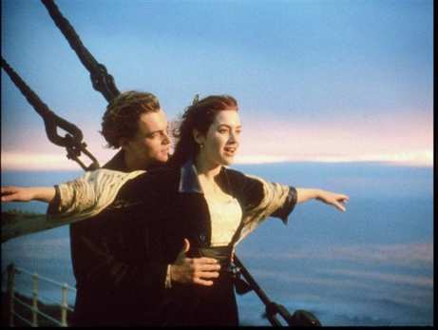
Name the two important connective tissues shown in the pictures below.
A
B
T
TENDON
Copyright © 2024 SlideSpark .LLC

Slide 100
Name the two important connective tissues shown in the pictures below.
A
B
T
TENDON
Copyright © 2024 SlideSpark .LLC

Slide 101

Name the two important connective tissues shown in the pictures below.
A
B
T
L
TENDON
LIGAMENT
Copyright © 2024 SlideSpark .LLC

Slide 102
Name the two important connective tissues shown in the pictures below.
A
B
T
L
TENDON
LIGAMENT
Copyright © 2024 SlideSpark .LLC

Slide 103
4
A
B
C
D

Slide 104
4
A
B
C
D

Slide 105
4
A
Fibula
B
C
D

Slide 106
4
A
Fibula
B
C
D

Slide 107
4
A
Fibula
B
Tibia
C
D

Slide 108
4
A
Fibula
B
Tibia
C
D

Slide 109
4
A
Fibula
B
Tibia
Tarsals
C
D

Slide 110
4
A
Fibula
B
Tibia
Tarsals
C
D

Slide 111
4
A
Fibula
B
Tibia
Tarsals
C
Metatarsals
D

Slide 112
Please name the following bones in the picture below?
A
8
B
D
C
Copyright © 2024 SlideSpark .LLC

Slide 113
Please name the following bones in the picture below?
A
8
B
D
C
Copyright © 2024 SlideSpark .LLC

Slide 114
Please name the following bones in the picture below?
A
A
8
B
D
C
Copyright © 2024 SlideSpark .LLC

Slide 115
Please name the following bones in the picture below?
A
A
8
B
D
C
Copyright © 2024 SlideSpark .LLC

Slide 116
Please name the following bones in the picture below?
A
A
8
B
D
C
Copyright © 2024 SlideSpark .LLC

Slide 117
Please name the following bones in the picture below?
A
A
8
B
D
C
Copyright © 2024 SlideSpark .LLC

Slide 118
Please name the following bones in the picture below?
A
A
8
B
D
C
Copyright © 2024 SlideSpark .LLC

Slide 119
Please name the following bones in the picture below?
A
A
8
B
D
C
Copyright © 2024 SlideSpark .LLC

Slide 120
Please name the following bones in the picture below?
A
A
8
B
D
C
Copyright © 2024 SlideSpark .LLC

Slide 121
Please name the following bones in the picture below?
A
A
E
8
B
D
C
Copyright © 2024 SlideSpark .LLC

Slide 122
Please name the following bones in the picture below?
A
A
E
8
B
D
C
Copyright © 2024 SlideSpark .LLC

Slide 123
Please name the following bones in the picture below?
A
A
E
8
B
D
C
Copyright © 2024 SlideSpark .LLC

Slide 124
Please identify which letter below are long bones, flat bones, and irregular bones.
A
B
C
Copyright © 2024 SlideSpark .LLC

Slide 125
Please identify which letter below are long bones, flat bones, and irregular bones.
A
10
B
1 bonus point each if you can identify each bone (A, B, C)
C
Copyright © 2024 SlideSpark .LLC

Slide 126
Please identify which letter below are long bones, flat bones, and irregular bones.
A
10
B
C
Copyright © 2024 SlideSpark .LLC

Slide 127
Please identify which letter below are long bones, flat bones, and irregular bones.
A Irregular
10
B
C
Copyright © 2024 SlideSpark .LLC

Slide 128
Please identify which letter below are long bones, flat bones, and irregular bones.
A Irregular
10
B
C
Copyright © 2024 SlideSpark .LLC

Slide 129
Please identify which letter below are long bones, flat bones, and irregular bones.
A Irregular
10
B Flat Bones
C
Copyright © 2024 SlideSpark .LLC

Slide 130
Please identify which letter below are long bones, flat bones, and irregular bones.
A Irregular
10
B Flat Bones
C
Copyright © 2024 SlideSpark .LLC

Slide 131
Please identify which letter below are long bones, flat bones, and irregular bones.
A Irregular
10
B Flat Bones
C Long Bones
Copyright © 2024 SlideSpark .LLC

Slide 132
Please identify which letter below are long bones, flat bones, and irregular bones.
A Irregular
10
B Flat Bones
C Long Bones
Copyright © 2024 SlideSpark .LLC

Slide 133
Please identify which letter below are long bones, flat bones, and irregular bones.
A Irregular
10
*Vertebrae
B Flat Bones
C Long Bones
Copyright © 2024 SlideSpark .LLC

Slide 134
Please identify which letter below are long bones, flat bones, and irregular bones.
A Irregular
10
*Vertebrae
B Flat Bones
C Long Bones
Copyright © 2024 SlideSpark .LLC

Slide 135
Please identify which letter below are long bones, flat bones, and irregular bones.
A Irregular
10
*Vertebrae
B Flat Bones
*Pelvis
C Long Bones
Copyright © 2024 SlideSpark .LLC

Slide 136
Please identify which letter below are long bones, flat bones, and irregular bones.
A Irregular
10
*Vertebrae
B Flat Bones
*Pelvis
C Long Bones
Copyright © 2024 SlideSpark .LLC

Slide 137
Please identify which letter below are long bones, flat bones, and irregular bones.
A Irregular
10
*Vertebrae
B Flat Bones
*Pelvis
C Long Bones
*Femur
Copyright © 2024 SlideSpark .LLC

Slide 138
10
Which Joint is the following?
  Fibrous (immovable)
  Cartilagenous (partially movable)
  Synovial (freely movable)
A
B
C
Copyright © 2024 SlideSpark .LLC

Slide 139
10
Which Joint is the following?
  Fibrous (immovable)
  Cartilagenous (partially movable)
  Synovial (freely movable)
A
B
C
Copyright © 2024 SlideSpark .LLC

Slide 140
10
Which Joint is the following?
  Fibrous (immovable)
  Cartilagenous (partially movable)
  Synovial (freely movable)
A
B
C
Cartilagenous
Copyright © 2024 SlideSpark .LLC

Slide 141
10
Which Joint is the following?
  Fibrous (immovable)
  Cartilagenous (partially movable)
  Synovial (freely movable)
A
B
C
Cartilagenous
Copyright © 2024 SlideSpark .LLC

Slide 142
10
Which Joint is the following?
  Fibrous (immovable)
  Cartilagenous (partially movable)
  Synovial (freely movable)
A
B
C
Fibrous
Cartilagenous
Copyright © 2024 SlideSpark .LLC

Slide 143
10
Which Joint is the following?
  Fibrous (immovable)
  Cartilagenous (partially movable)
  Synovial (freely movable)
A
B
C
Fibrous
Cartilagenous
Copyright © 2024 SlideSpark .LLC

Slide 144
10
Which Joint is the following?
  Fibrous (immovable)
  Cartilagenous (partially movable)
  Synovial (freely movable)
A
B
C
Fibrous
Cartilagenous
Synovial
Copyright © 2024 SlideSpark .LLC

Slide 145
Skeletal and Muscular System
GIVE THE DOG THE BONE | BARE BONES | JOINT EFFORT | MUSCLE-UP | -BONUS- SKELETONS and MUSCLES
1 | 6 | 11 | 16 | *21
2 | 7 | 12 | 17 | *22
3 | 8 | 13 | 18 | *23
4 | 9 | 14 | 19 | *24
5 | 10 | 15 | 20 | *25
Final Question:________________
Copyright © 2024 SlideSpark .LLC

Slide 146
Skeletal and Muscular System
GIVE THE DOG THE BONE | BARE BONES | JOINT EFFORT | MUSCLE-UP | -BONUS- SKELETONS and MUSCLES
1 | 6 | 11 | 16 | *21
2 | 7 | 12 | 17 | *22
3 | 8 | 13 | 18 | *23
4 | 9 | 14 | 19 | *24
5 | 10 | 15 | 20 | *25
Final Question:________________
Copyright © 2024 SlideSpark .LLC

Slide 147
Please name the type of joint shown below?
11
Copyright © 2024 SlideSpark .LLC

Slide 148
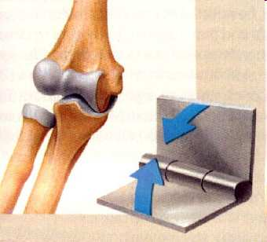
Please name the type of joint shown below?
11
Copyright © 2024 SlideSpark .LLC

Slide 149
Please name the type of joint shown below?
11
Hinge
Joint
Copyright © 2024 SlideSpark .LLC

Slide 150
Please name the type of joint shown below?
11
Joint
Hinge
Copyright © 2024 SlideSpark .LLC

Slide 151
Please name the type of joint shown below?
11
Joint
Hinge
Copyright © 2024 SlideSpark .LLC

Slide 152
Please name the type of joint shown below?
11
Joint
Hinge
Copyright © 2024 SlideSpark .LLC

Slide 153
Please name the type of joint shown below?
11
Hinge
Joint
Copyright © 2024 SlideSpark .LLC

Slide 154
Please name the type of joint shown below?
11
Joint
Hinge
Copyright © 2024 SlideSpark .LLC

Slide 155
Please name the type of joint shown below?
11
Joint
Hinge
Copyright © 2024 SlideSpark .LLC

Slide 156
Please name the type of joint shown below?
11
Joint
Hinge
Copyright © 2024 SlideSpark .LLC

Slide 157
Please name the type of joint shown below?
11
Hinge
Joint
Copyright © 2024 SlideSpark .LLC

Slide 158
Please name the type of joint shown below?
11
Joint
Hinge
Copyright © 2024 SlideSpark .LLC

Slide 159
Please name the type of joint shown below?
11
Joint
Hinge
Copyright © 2024 SlideSpark .LLC

Slide 160
Please name the type of joint shown below?
12
Copyright © 2024 SlideSpark .LLC

Slide 161
Please name the type of joint shown below?
12
Copyright © 2024 SlideSpark .LLC

Slide 162
Please name the type of joint shown below?
12 Pivot Joint
Copyright © 2024 SlideSpark .LLC

Slide 163

Please name the type of joint shown below?
12 Pivot Joint
Copyright © 2024 SlideSpark .LLC

Slide 164
Please name the type of joint shown below?
12 Pivot Joint
Copyright © 2024 SlideSpark .LLC

Slide 165
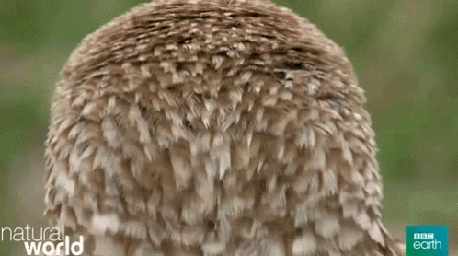

Slide 166
Please name the type of joint shown below?
13
Copyright © 2024 SlideSpark .LLC

Slide 167
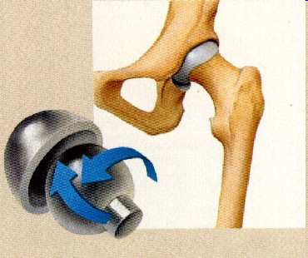
Please name the type of joint shown below?
13
Ball and Socket
Copyright © 2024 SlideSpark .LLC

Slide 168
Please name the two types of joints shown below?
A
B
Copyright © 2024 SlideSpark .LLC

Slide 169
Please name the two types of joints shown below? 1 Bonus Point each to name the bones.
A
B
Copyright © 2024 SlideSpark .LLC

Slide 170
Please name the two types of joints shown below?
A
B
Copyright © 2024 SlideSpark .LLC

Slide 171
Please name the two types of joints shown below? A = Saddle
A Saddle
B
Copyright © 2024 SlideSpark .LLC

Slide 172
Please name the two types of joints shown below? A = Saddle
A Saddle
B
Copyright © 2024 SlideSpark .LLC

Slide 173
Please name the two types of joints shown below? A = Saddle B = Gliding Joint
A Saddle
B
Copyright © 2024 SlideSpark .LLC

Slide 174
Please name the two types of joints shown below? A = Saddle B = Gliding Joint
A Saddle
B
Copyright © 2024 SlideSpark .LLC

Slide 175
Please name the two types of joints shown below? A = Saddle B = Gliding Joint
A Saddle
B
Copyright © 2024 SlideSpark .LLC

Slide 176
Please name the two types of joints shown below? A = Saddle B = Gliding Joint
A Saddle
B
*Metacarpals
Copyright © 2024 SlideSpark .LLC

Slide 177
Please name the two types of joints shown below? A = Saddle B = Gliding Joint
A Saddle
B
*Metacarpals
Copyright © 2024 SlideSpark .LLC

Slide 178
Please name the two types of joints shown below? A = Saddle B = Gliding Joint
A Saddle
B
*Metacarpals
*Metatarsals
Copyright © 2024 SlideSpark .LLC

Slide 179
Please name the two types of joints shown below? A = Saddle B = Gliding Joint
A Saddle
B
*Metacarpals
*Metatarsals
Copyright © 2024 SlideSpark .LLC

Slide 180
The skeletal system does all of the following except…
A.) Provides the shape and form.
B.) Supports.
C.) Sends Impulses to the Muscles.
D.) Protects.
E.) Produces blood.
15

Slide 181
Within a range of 10, How many bones are in an adult human?
16
16

Slide 182
Within a range of 10, How many bones are in an adult human?
An adult human has 206 bones.
When you are born, you have over 300 bones. They fuse together as you get older.
16
16

Slide 183
Which is bogus of a brain injury?
Seizures
Loss of Consciousness
Convulsions
Spinal fluid to leak out of the nose and ears
Persistent Headaches
Awareness
Dilation of Pupils
Coma
Loss of Coordination
Slurred Speech
Numbness and weakness in fingers and toes.
Strangeness in behavior, combativeness, irritability, anxiety.
Inability to awake from sleep

Slide 184
Which is bogus of a brain injury?
Seizures
Loss of Consciousness
Convulsions
Spinal fluid to leak out of the nose and ears
Persistent Headaches
Awareness
Dilation of Pupils
Loss of Coordination
Coma
Slurred Speech
Numbness and weakness in fingers and toes.
Strangeness in behavior, combativeness, irritability, anxiety.
Inability to awake from sleep

Slide 185
Which is bogus of a brain injury?
Seizures
Loss of Consciousness
Convulsions
Spinal fluid to leak out of the nose and ears
Persistent Headaches
Confusion
Dilation of Pupils
Loss of Coordination
Coma
Slurred Speech
Numbness and weakness in fingers and toes.
Strangeness in behavior, combativeness, irritability, anxiety.
Inability to awake from sleep

Slide 186
What are two main categories of bones.
  A=
  B=
18
A
B
Copyright © 2024 SlideSpark .LLC

Slide 187
What are two main categories of bones.
  A= Spongy Bone (Cancellous bone)
  B=
18
A
B
Copyright © 2024 SlideSpark .LLC

Slide 188
What are two main categories of bones.
  A= Spongy Bone (Cancellous bone)
  B= Compact Bone
18
A
B
Copyright © 2024 SlideSpark .LLC

Slide 189
This is the name of a disease that causes the thinning of bone tissue and loss of bone density over time.
A.) Osteoporosis
B.) Bone Decay Syndrome
C.) Synovial Joint Failure
D.) Cardiovascular Disease
E.) Brody Myopathy
19
Copyright © 2024 SlideSpark .LLC

Slide 190
True or False? The human skeleton can grow and repair itself.
20
F
orm
F
ollows
F
unction

Slide 191
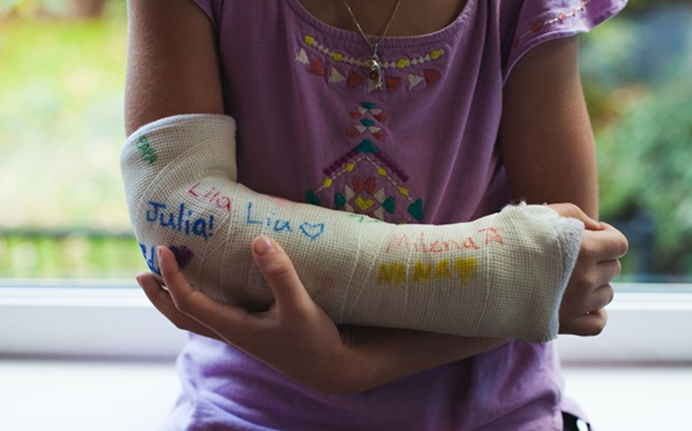
True or False? The human skeleton can grow and repair itself.
20
F
orm
F
ollows
F
unction
TRUE!

Slide 192
Bio Organization, Skeletal, Muscular System
LEVEL-OUT | BARE BONES | JOINT EFFORT | MUSCLE-UP | -BONUS- SKELETONS and MUSCLES
1 | 6 | 11 | 16 | *21
2 | 7 | 12 | 17 | *22
3 | 8 | 13 | 18 | *23
4 | 9 | 14 | 19 | *24
5 | 10 | 15 | 20 | *25
Final Question:________________
Copyright © 2024 SlideSpark .LLC

Slide 193
Name the character from this movie?
Jack Sparrow
*21
Copyright © 2024 SlideSpark .LLC

Slide 194

Name the character from this movie?
Jack Sparrow
*21
Captain Jack Sparrow
Copyright © 2024 SlideSpark .LLC

Slide 195
Name the character from this movie?
Jack Sparrow
*21
Captain Jack Sparrow
“That’s Captain Jack
Sparrow please.”
Copyright © 2024 SlideSpark .LLC

Slide 196

What dojo do these two fight for?
*22

Slide 197
Who is this? Or what movie?
*23

Slide 198

Who is this? Or what movie?
*23
Jack the Pumpkin King

Slide 199
Name this Island?
*24

Slide 200

Name this Island?
*24

Slide 201
Name the movie with this key?
*25

Slide 202

Name the movie with this key?
*25

Slide 203
5 Point Wager Question

Slide 204
Bio Organization, Skeletal, Muscular System
LEVEL-OUT | BARE BONES | JOINT EFFORT | MUSCLE-UP | -BONUS- SKELETONS and MUSCLES
1 | 6 | 11 | 16 | *21
2 | 7 | 12 | 17 | *22
3 | 8 | 13 | 18 | *23
4 | 9 | 14 | 19 | *24
5 | 10 | 15 | 20 | *25
Final Question:________________
Copyright © 2024 SlideSpark .LLC

Slide 205
Always wear a seatbelt when driving in a car, and always wear a helmet when appropriate to avoid TBI. What does TBI stand for?
Copyright © 2024 SlideSpark .LLC

Slide 206
Always wear a seatbelt when driving in a car, and always wear a helmet when appropriate to avoid TBI. What does TBI stand for?
TBI Traumatic Brain Injury
Copyright © 2024 SlideSpark .LLC

Slide 207

Skeletal System and Muscular System Review Game
1-20 = 5 points each
20-25 = Bonus (1 point each)
Final Question = 5 point wager
Find the Owl = 1 point
Copyright © 2024 SlideSpark .LLC

Slide 208
Skeletal System
Review Game
Part 2
Lesson 8
Review Game

Slide 209



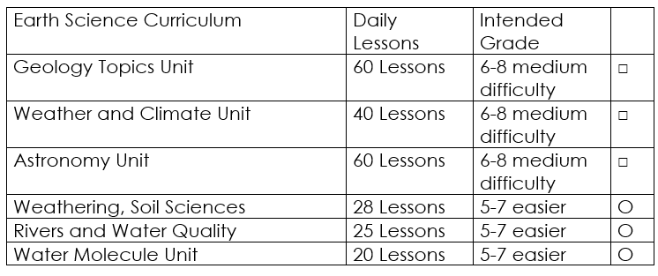

Curriculum Guide
Number of Lessons in each unit (50 min, daily lessons) and difficult rating scale / intended grade level.
=Easier, = More difficult, =Most difficult
Earth Science Units

Slide 210


Life Science Units

Slide 211

Physical Science

Slide 212

Dear Valued Educator,
Our fully editable .pptx and .doc resources are perfect for educators looking to bring enthusiasm and creativity to their lessons. We encourage you to make changes to fit your needs and style. As science educators, we’re committed to providing students with the tools they need to succeed in the classroom and beyond. Each unit in the curriculum includes a range of resources that have been developed through extensive research and use in a busy classroom. Our teaching approach is designed to make science education engaging and exciting for learners of all ages. We offer a one-of-a-kind science curriculum that will challenge, inspire, and educate students to become tomorrow's scientists and leaders. Join us today and learn more about how our program can help you achieve your classroom goals.
With appreciation,
Support@SlideSpark.net

Slide 213





Thank you for your time and interest in our Science curriculum. We strive to provide students with engaging and informative lessons that will spark their curiosity and encourage scientific exploration. Should you have any questions or concerns, please do not hesitate to contact us. Thank you again for considering our curriculum, and we wish you all the best in your educational journey.
Sincerely,
Support@slidespark.net
SlideSpark Science on TpT

