Slide 1
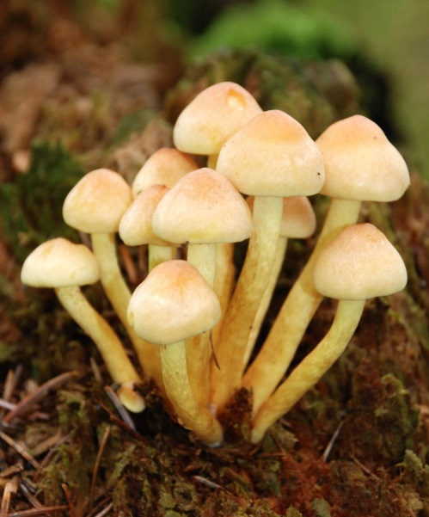
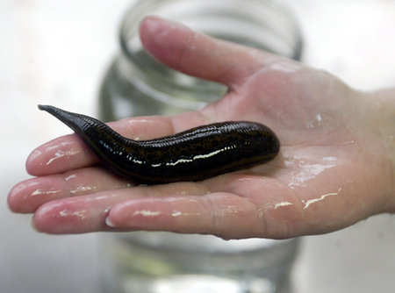

Kingdom Fungi
Review Game
Part 5
Lesson 7

Slide 2
Kingdom Fungi Review Game
IDENTITY CRISIS | DA VISION | MOLDY CHEESE | ROOM MUSH | -Bonus- WHIMISCAL
1 | 6 | 11 | 16 | *21
2 | 7 | 12 | 17 | *22
3 | 8 | 13 | 18 | *23
4 | 9 | 14 | 19 | *24
5 | 10 | 15 | 20 | *25

Slide 3
How to play…
  Don’t play like Jeo_ _ _ _ y.
  Class should be divided into several small groups.
  Groups should use science journal (red slide notes), homework, and other available materials to assist you.
  Groups can communicate quietly with each other but no sharing answers between groups.
    Practice quietly communicating right now?
    Practice Communication Question:
    Your group gets to order one pizza and you can have two toppings. What does your group want?

Slide 4

Questions 1-20 = 5pts Each
Final Category (Bonus) = 1pt Each
Final Questions = 5 pt wager
If you wager 5 on the last question and get it wrong you lose 5 pts. Wager 5 and get it right you get 5 pts.
Find the Owl =
Secretly write “Owl” in the correct box worth 1pt.
“I’ll be about this big.”

Slide 5
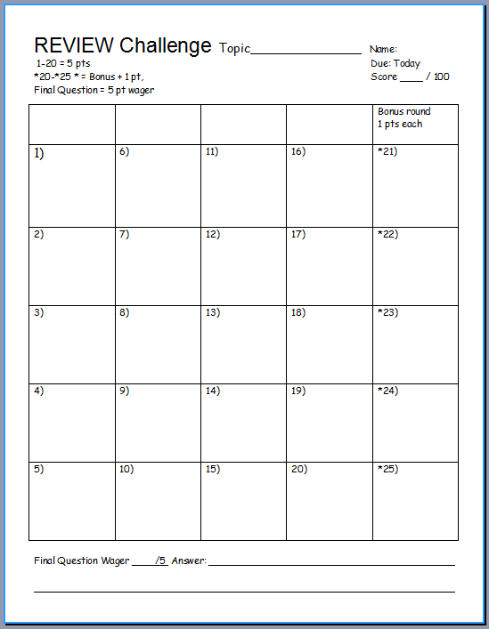
Is your name on the review sheet?
Name

Slide 6
Is your name on the review sheet?
Add the categories
along the top
on the next slide.

Slide 7
Kingdom Fungi Review Game
IDENTITY CRISIS | DA VISION | MOLDY CHEESE | ROOM MUSH | -Bonus- WHIMISCAL
1 | 6 | 11 | 16 | *21
2 | 7 | 12 | 17 | *22
3 | 8 | 13 | 18 | *23
4 | 9 | 14 | 19 | *24
5 | 10 | 15 | 20 | *25

Slide 8
Kingdom Fungi Review Game
IDENTITY CRISIS | DA VISION | MOLDY CHEESE | ROOM MUSH | -Bonus- WHIMISCAL
1 | 6 | 11 | 16 | *21
2 | 7 | 12 | 17 | *22
3 | 8 | 13 | 18 | *23
4 | 9 | 14 | 19 | *24
5 | 10 | 15 | 20 | *25

Slide 9
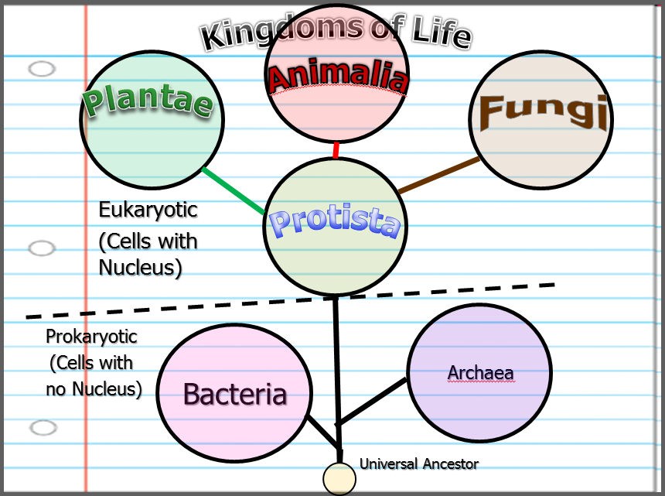
1
Which one below best describes the Kingdom Fungi?
  A.) An autotrophic single celled organism that’s eukaryotic.
  B.) A heterotrophic multi-cellular organism with cell walls made of chitin.
  C.) A prokaryotic heterotroph.
  D.) A eukaryotic multi-cellular heterotrophic organisms that consumes food.
  E.) A eukaryotic multi-cellular autroph.
Copyright © 2024 SlideSpark .LLC

Slide 10
1
Which one below best describes the Kingdom Fungi?
  A.) An autotrophic single celled organism that’s eukaryotic.
  B.) A heterotrophic multi-cellular organism with cell walls that absorbs its food
  C.) A prokaryotic heterotroph.
  D.) A eukaryotic multi-cellular heterotrophic organisms that consumes food.
  E.) A eukaryotic multi-cellular autotroph.
Copyright © 2024 SlideSpark .LLC

Slide 11
1
Which one below best describes the Kingdom Fungi?
  A.) An autotrophic single celled organism that’s eukaryotic.
  B.) A heterotrophic multi-cellular organism with cell walls that absorbs its food
  C.) A prokaryotic heterotroph.
  D.) A eukaryotic multi-cellular heterotrophic organisms that consumes food.
  E.) A eukaryotic multi-cellular autotroph.
Copyright © 2024 SlideSpark .LLC

Slide 12
1
Which one below best describes the Kingdom Fungi?
  A.) An autotrophic single celled organism that’s eukaryotic.
  B.) A heterotrophic multi-cellular organism with cell walls that absorbs its food
  C.) A prokaryotic heterotroph.
  D.) A eukaryotic multi-cellular heterotrophic organisms that consumes food.
  E.) A eukaryotic multi-cellular autotroph.
Copyright © 2024 SlideSpark .LLC

Slide 13
1
Which one below best describes the Kingdom Fungi?
  A.) An autotrophic single celled organism that’s eukaryotic.
  B.) A heterotrophic multi-cellular organism with cell walls that absorbs its food
  C.) A prokaryotic heterotroph.
  D.) A eukaryotic multi-cellular heterotrophic organisms that consumes food.
  E.) A eukaryotic multi-cellular autotroph.
Copyright © 2024 SlideSpark .LLC

Slide 14
1
Which one below best describes the Kingdom Fungi?
  A.) An autotrophic single celled organism that’s eukaryotic.
  B.) A heterotrophic multi-cellular organism with cell walls that absorbs its food
  C.) A prokaryotic heterotroph.
  D.) A eukaryotic multi-cellular heterotrophic organisms that consumes food.
  E.) A eukaryotic multi-cellular autotroph.
Copyright © 2024 SlideSpark .LLC

Slide 15
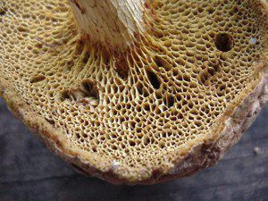
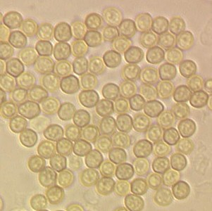
Fungi reproduce using spores.
2

Slide 16
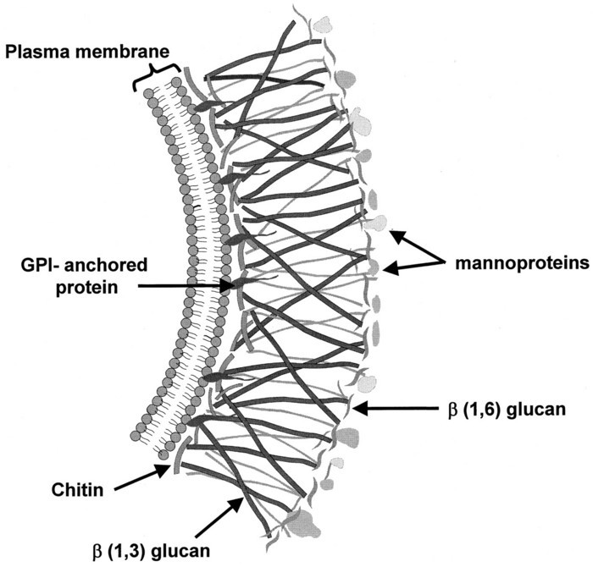
Fungi also have cell walls consisting largely of chitin instead of cellulose.
3

Slide 17

Do Fungi absorb their food on the inside or outside?
4
Excretion of digestive enzymes
Food
Source
Organic molecules absorbed by hyphae.

Slide 18
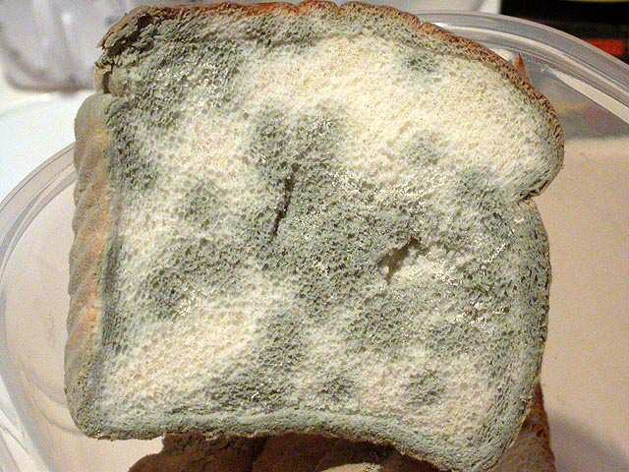
Mold belongs to this Division of Fungi?
5
Copyright © 2024 SlideSpark .LLC

Slide 19
Kingdom Fungi Review Game
IDENTITY CRISIS | DA VISION | MOLDY CHEESE | ROOM MUSH | -Bonus- WHIMISCAL
1 | 6 | 11 | 16 | *21
2 | 7 | 12 | 17 | *22
3 | 8 | 13 | 18 | *23
4 | 9 | 14 | 19 | *24
5 | 10 | 15 | 20 | *25

Slide 20
Kingdom Fungi Review Game
IDENTITY CRISIS | DA VISION | MOLDY CHEESE | ROOM MUSH | -Bonus- WHIMISCAL
1 | 6 | 11 | 16 | *21
2 | 7 | 12 | 17 | *22
3 | 8 | 13 | 18 | *23
4 | 9 | 14 | 19 | *24
5 | 10 | 15 | 20 | *25

Slide 21
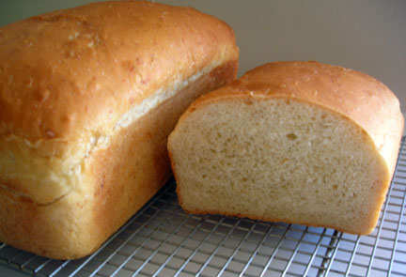
This common Fungi is a necessary ingredient to make bread. Some belong to Basidiomycota
6
Copyright © 2024 SlideSpark .LLC

Slide 22
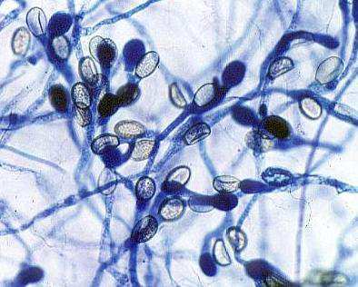
7
Chytridiomycota are known as the Primitive Fungi
  Live on land and water.
  Great decomposers.
Copyright © 2024 SlideSpark .LLC

Slide 23
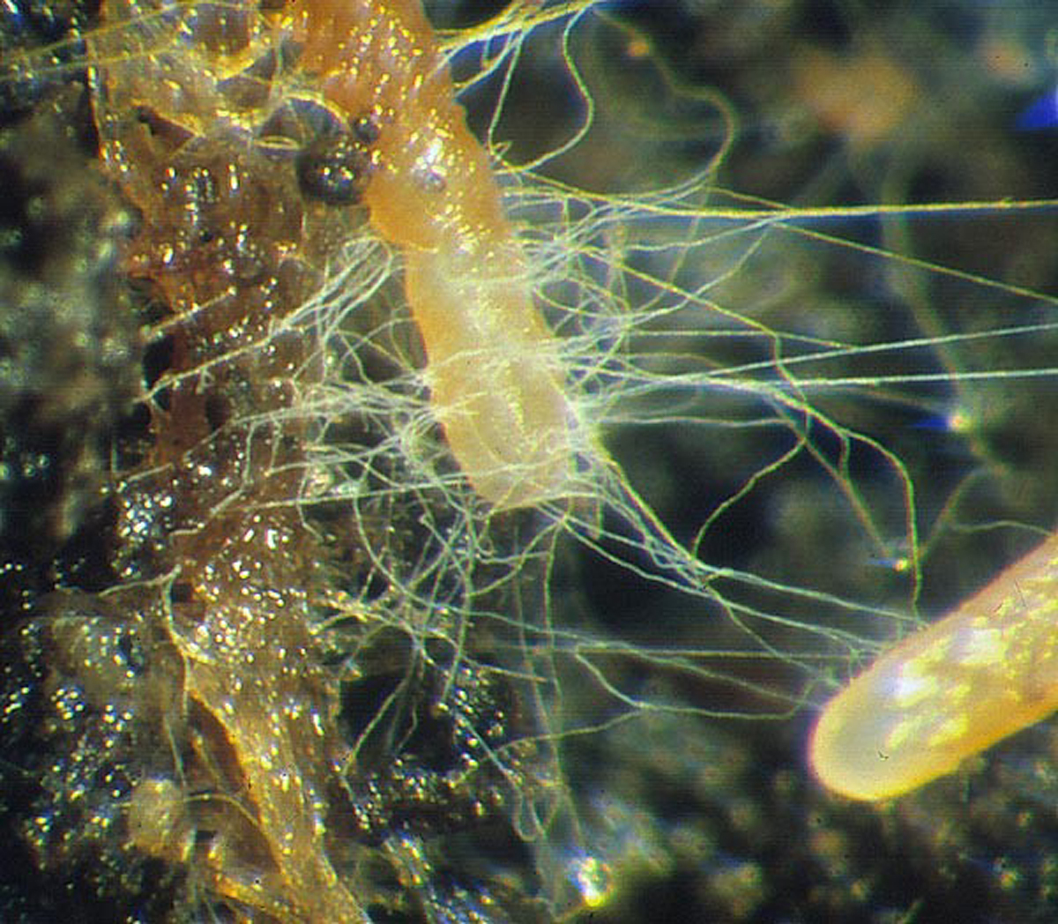
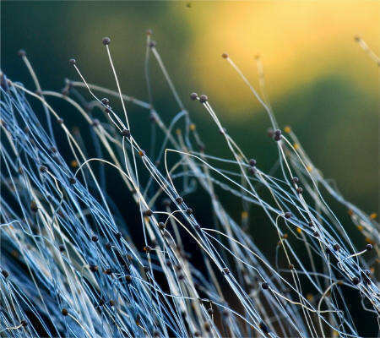

Zygomycota
  They Live only on land. Mycorrhizal fungi can live in the soil and often form relationships with plants.
Copyright © 2024 SlideSpark .LLC

Slide 24
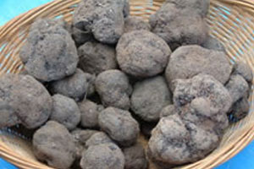
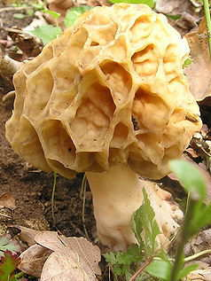
9
Name this Division of the Kingdom Fungi?
  75% of all Fungi.
  Yeast.
  Truffles
  Called Sac Fungi
Copyright © 2024 SlideSpark .LLC

Slide 25

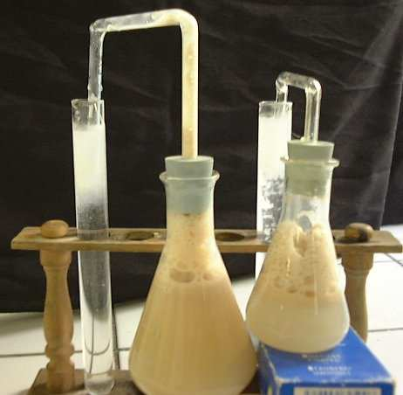
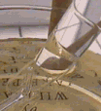

Name this Process: Fermentation
Sugar Ethyl Alcohol Carbon Dioxide
C6H12O6 2C2H5OH + 2CO2
Carbonation
10

Slide 26
Kingdom Fungi Review Game
IDENTITY CRISIS | DA VISION | MOLDY CHEESE | ROOM MUSH | -Bonus- WHIMISCAL
1 | 6 | 11 | 16 | *21
2 | 7 | 12 | 17 | *22
3 | 8 | 13 | 18 | *23
4 | 9 | 14 | 19 | *24
5 | 10 | 15 | 20 | *25

Slide 27
Kingdom Fungi Review Game
IDENTITY CRISIS | DA VISION | MOLDY CHEESE | ROOM MUSH | -Bonus- WHIMISCAL
1 | 6 | 11 | 16 | *21
2 | 7 | 12 | 17 | *22
3 | 8 | 13 | 18 | *23
4 | 9 | 14 | 19 | *24
5 | 10 | 15 | 20 | *25

Slide 28
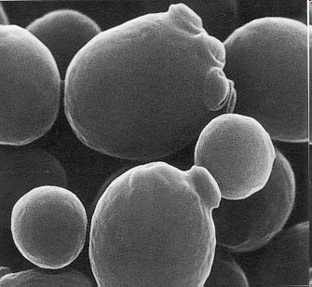
Yeast is reproducing asexually in the process of budding shown below.
11

Slide 29
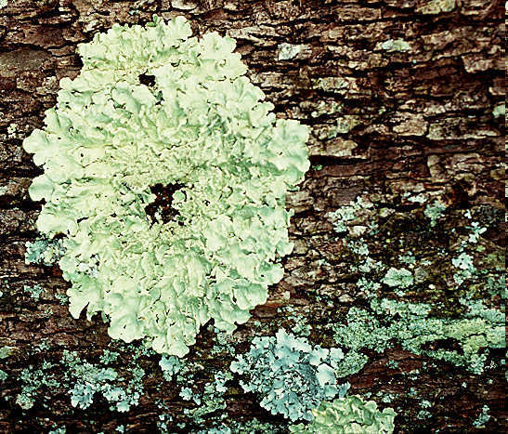

Lichen (Mycophycophyta): Are a algae and fungus growing together in a symbiotic relationship.
12
Copyright © 2024 SlideSpark .LLC

Slide 30
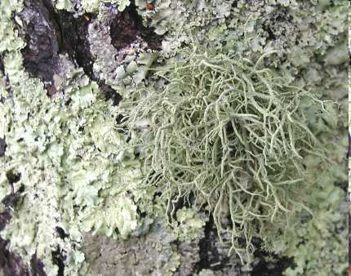

Which is fruticose, and which is foliose lichen in the photograph below?
B
A
Copyright © 2024 SlideSpark .LLC

Slide 31
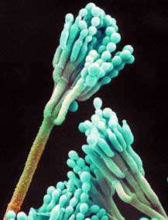
These are the Imperfect Fungi: Deuteromycota
  The leftovers ☹. Much classification unknown, asexual spore formation.
  Includes Athletes foot, Penicillin.
14
Copyright © 2024 SlideSpark .LLC

Slide 32
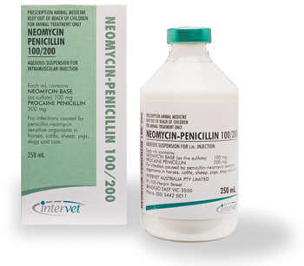
Penicillin (Fungi) is humanities great weapon against these organisms.
15
+
Copyright © 2024 SlideSpark .LLC

Slide 33
Kingdom Fungi Review Game
IDENTITY CRISIS | DA VISION | MOLDY CHEESE | ROOM MUSH | -Bonus- WHIMISCAL
1 | 6 | 11 | 16 | *21
2 | 7 | 12 | 17 | *22
3 | 8 | 13 | 18 | *23
4 | 9 | 14 | 19 | *24
5 | 10 | 15 | 20 | *25

Slide 34
Kingdom Fungi Review Game
IDENTITY CRISIS | DA VISION | MOLDY CHEESE | ROOM MUSH | -Bonus- WHIMISCAL
1 | 6 | 11 | 16 | *21
2 | 7 | 12 | 17 | *22
3 | 8 | 13 | 18 | *23
4 | 9 | 14 | 19 | *24
5 | 10 | 15 | 20 | *25

Slide 35
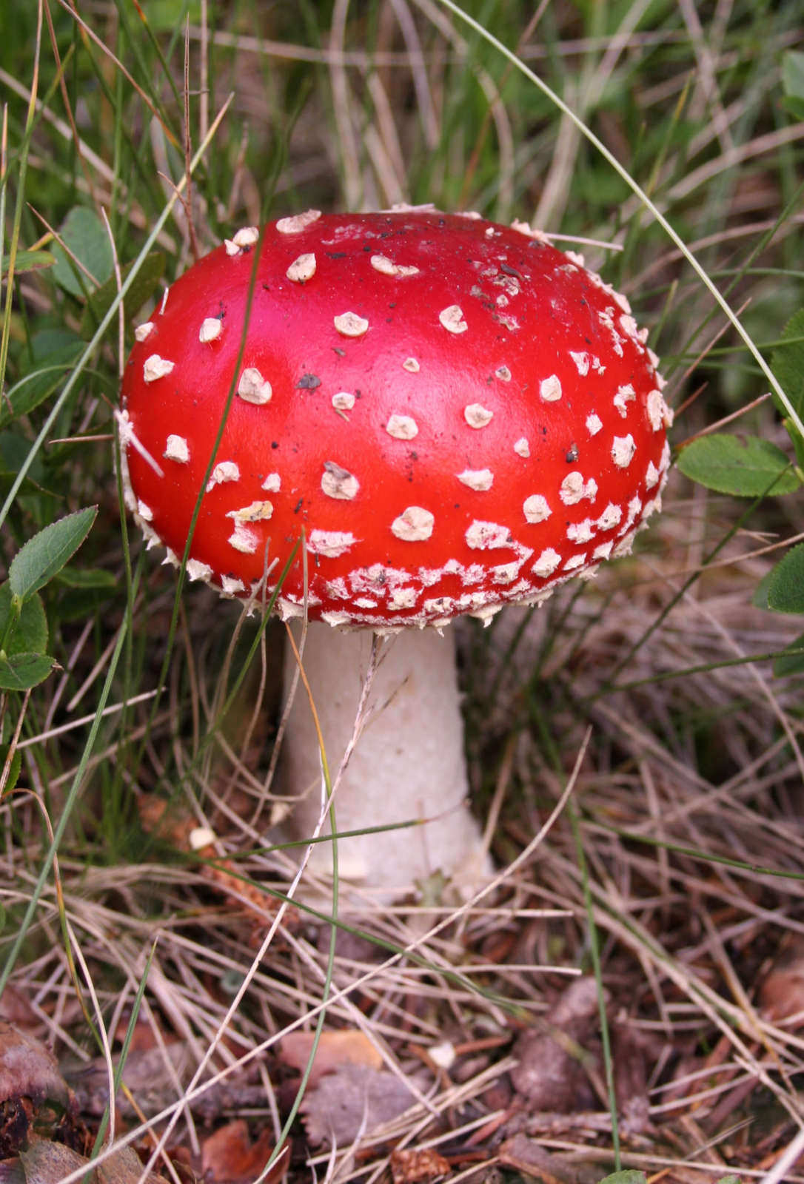
16
Name this Division:
Basidiomycota / Club Fungi
  Mushrooms.
  Decomposition of wood.
Copyright © 2024 SlideSpark .LLC

Slide 36
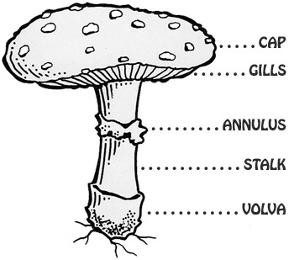

What are the name for the terms hidden below?
A
B
C
Copyright © 2024 SlideSpark .LLC

Slide 37
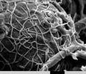

This is the name for the part of the Mycelium- The part of the fungus that feeds, grows, and ultimately may produce a mushroom.
Copyright © 2024 SlideSpark .LLC

Slide 38
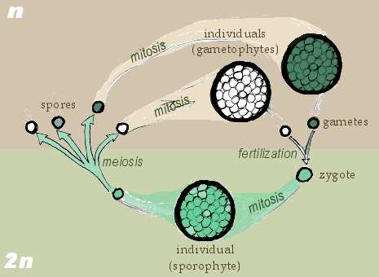
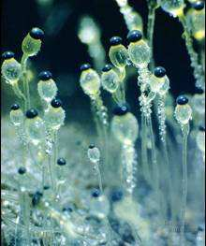
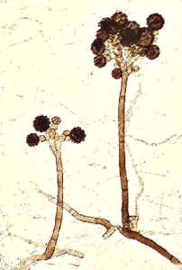




Reproductive cycles of the Fungi.
  Diploid cells contain two complete sets (2n) of chromosomes.
  Haploid cells have half the number of chromosomes (n) as diploid - i.e. a haploid cell contains only one complete set of chromosomes.
A
B

Slide 39
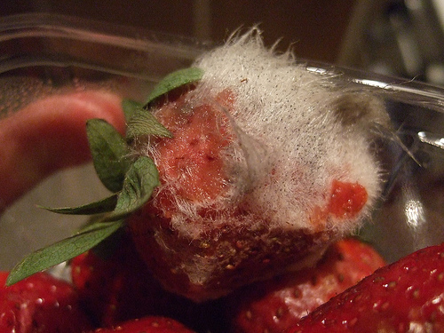
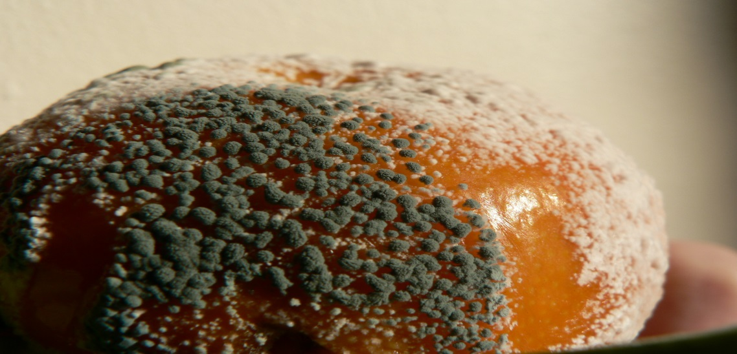
To prevent mold growth, all of the following is recommended except …
  A.) Limit moisture.
  B.) Limit cold temperatures (Place food in a warm environment)
  C.) Limit spores (use bags and containers)
  D.) Limit available food sources (remove moldy food from the group.)
20

Slide 40
To prevent mold growth, all of the following is recommended except …
  A.) Limit moisture.
  B.) Limit cold temperatures (Place food in a warm environment)
  C.) Limit spores (use bags and containers)
  D.) Limit available food sources (remove moldy food from the group.)
20

Slide 41
To prevent mold growth, all of the following is recommended except …
  A.) Limit moisture.
  B.) Limit cold temperatures (Place food in a warm environment)
  C.) Limit spores (use bags and containers)
  D.) Limit available food sources (remove moldy food from the group.)
20

Slide 42
To prevent mold growth, all of the following is recommended except …
  A.) Limit moisture.
  B.) Limit cold temperatures (Place food in a warm environment)
  C.) Limit spores (use bags and containers)
  D.) Limit available food sources (remove moldy food from the group.)
20

Slide 43
To prevent mold growth, all of the following is recommended except …
  A.) Limit moisture.
  B.) Limit cold temperatures (Place food in a warm environment)
  C.) Limit spores (use bags and containers)
  D.) Limit available food sources (remove moldy food from the group.)
20

Slide 44
Kingdom Fungi Review Game
IDENTITY CRISIS | DA VISION | MOLDY CHEESE | ROOM MUSH | -Bonus- WHIMISCAL
1 | 6 | 11 | 16 | *21
2 | 7 | 12 | 17 | *22
3 | 8 | 13 | 18 | *23
4 | 9 | 14 | 19 | *24
5 | 10 | 15 | 20 | *25

Slide 45
Kingdom Fungi Review Game
IDENTITY CRISIS | DA VISION | MOLDY CHEESE | ROOM MUSH | -Bonus- WHIMISCAL
1 | 6 | 11 | 16 | *21
2 | 7 | 12 | 17 | *22
3 | 8 | 13 | 18 | *23
4 | 9 | 14 | 19 | *24
5 | 10 | 15 | 20 | *25

Slide 46

Name this SMURF?
*21

Slide 47
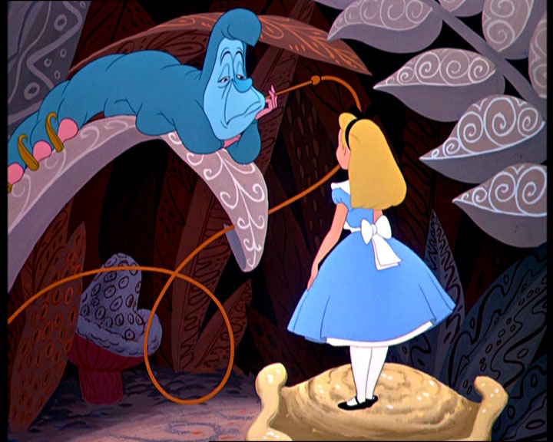
Name this Movie?
*22

Slide 48
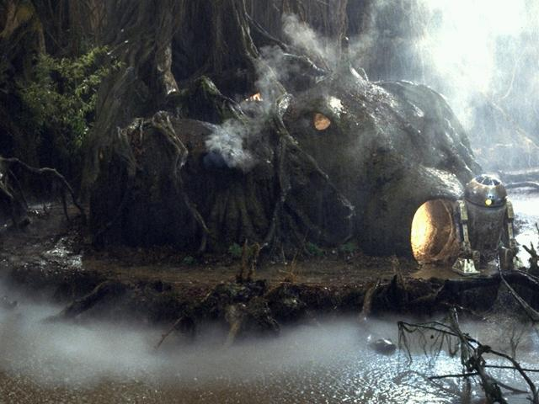
Who lives here?
*23

Slide 49
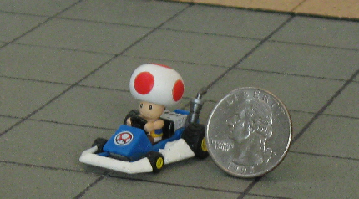
Who is this?
*24

Slide 50

Who is this?
*25

Slide 51
Kingdom Fungi Review Game
IDENTITY CRISIS | DA VISION | MOLDY CHEESE | ROOM MUSH | -Bonus- WHIMISCAL
1 | 6 | 11 | 16 | *21
2 | 7 | 12 | 17 | *22
3 | 8 | 13 | 18 | *23
4 | 9 | 14 | 19 | *24
5 | 10 | 15 | 20 | *25
Final Question

Slide 52
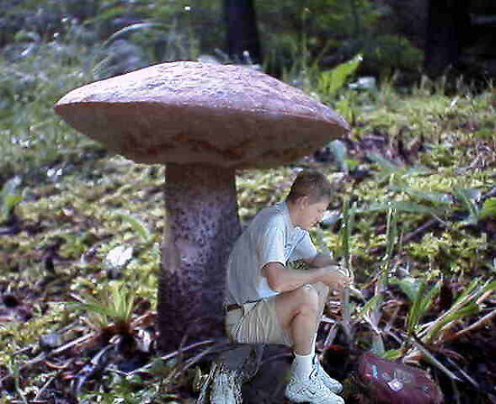
5 Point Wager Question
Photoshop

Slide 53
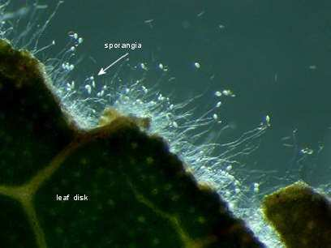
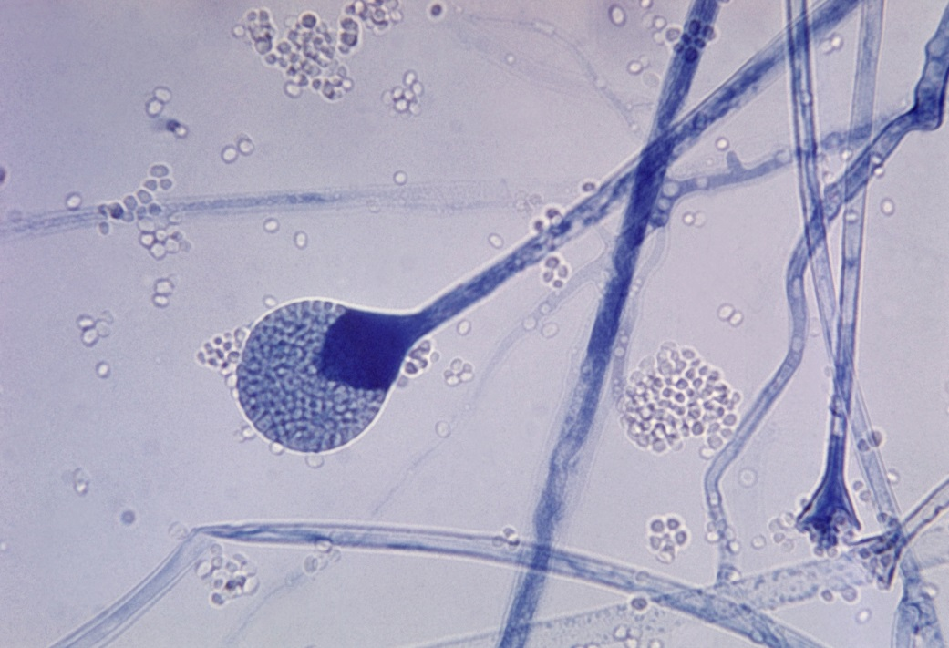
This is the structure producing and containing spores.

Slide 54
Kingdom Fungi
Review Game
Part 5
Lesson 7

Slide 55

Kingdom Fungi
Review Game
Part 5
Lesson 8

Slide 56
Kingdom Fungi Review Game
IDENTITY CRISIS | DA VISION | MOLDY CHEESE | ROOM MUSH | -Bonus- WHIMISCAL
1 | 6 | 11 | 16 | *21
2 | 7 | 12 | 17 | *22
3 | 8 | 13 | 18 | *23
4 | 9 | 14 | 19 | *24
5 | 10 | 15 | 20 | *25

Slide 57
Kingdom Fungi Review Game
IDENTITY CRISIS | DA VISION | MOLDY CHEESE | ROOM MUSH | -Bonus- WHIMISCAL
1 | 6 | 11 | 16 | *21
2 | 7 | 12 | 17 | *22
3 | 8 | 13 | 18 | *23
4 | 9 | 14 | 19 | *24
5 | 10 | 15 | 20 | *25

Slide 58
1
Which one below best describes the Kingdom Fungi?
  A.) An autotrophic single celled organism that’s eukaryotic.
  B.) A heterotrophic multi-cellular organism with cell walls made of chitin.
  C.) A prokaryotic heterotroph.
  D.) A eukaryotic multi-cellular heterotrophic organisms that consumes food.
  E.) A eukaryotic multi-cellular autroph.
Copyright © 2024 SlideSpark .LLC

Slide 59
1
Which one below best describes the Kingdom Fungi?
  A.) An autotrophic single celled organism that’s eukaryotic.
  B.) A heterotrophic multi-cellular organism with cell walls that absorbs its food
  C.) A prokaryotic heterotroph.
  D.) A eukaryotic multi-cellular heterotrophic organisms that consumes food.
  E.) A eukaryotic multi-cellular autotroph.
Copyright © 2024 SlideSpark .LLC

Slide 60
1
Which one below best describes the Kingdom Fungi?
  A.) An autotrophic single celled organism that’s eukaryotic.
  B.) A heterotrophic multi-cellular organism with cell walls that absorbs its food
  C.) A prokaryotic heterotroph.
  D.) A eukaryotic multi-cellular heterotrophic organisms that consumes food.
  E.) A eukaryotic multi-cellular autotroph.
Copyright © 2024 SlideSpark .LLC

Slide 61
1
Which one below best describes the Kingdom Fungi?
  A.) An autotrophic single celled organism that’s eukaryotic.
  B.) A heterotrophic multi-cellular organism with cell walls that absorbs its food
  C.) A prokaryotic heterotroph.
  D.) A eukaryotic multi-cellular heterotrophic organisms that consumes food.
  E.) A eukaryotic multi-cellular autotroph.
Copyright © 2024 SlideSpark .LLC

Slide 62
1
Which one below best describes the Kingdom Fungi?
  A.) An autotrophic single celled organism that’s eukaryotic.
  B.) A heterotrophic multi-cellular organism with cell walls that absorbs its food
  C.) A prokaryotic heterotroph.
  D.) A eukaryotic multi-cellular heterotrophic organisms that consumes food.
  E.) A eukaryotic multi-cellular autotroph.
Copyright © 2024 SlideSpark .LLC

Slide 63
1
Which one below best describes the Kingdom Fungi?
  A.) An autotrophic single celled organism that’s eukaryotic.
  B.) A heterotrophic multi-cellular organism with cell walls that absorbs its food
  C.) A prokaryotic heterotroph.
  D.) A eukaryotic multi-cellular heterotrophic organisms that consumes food.
  E.) A eukaryotic multi-cellular autotroph.
Copyright © 2024 SlideSpark .LLC

Slide 64
1
Which one below best describes the Kingdom Fungi?
  A.) An autotrophic single celled organism that’s eukaryotic.
  B.) A heterotrophic multi-cellular organism with cell walls that absorbs its food
  C.) A prokaryotic heterotroph.
  D.) A eukaryotic multi-cellular heterotrophic organisms that consumes food.
  E.) A eukaryotic multi-cellular autotroph.
answer…
Copyright © 2024 SlideSpark .LLC

Slide 65
1
Which one below best describes the Kingdom Fungi?
  A.) An autotrophic single celled organism that’s eukaryotic.
  B.) A heterotrophic multi-cellular organism with cell walls that absorbs its food
  C.) A prokaryotic heterotroph.
  D.) A eukaryotic multi-cellular heterotrophic organisms that consumes food.
  E.) A eukaryotic multi-cellular autotroph.
answer…
Copyright © 2024 SlideSpark .LLC

Slide 66
Fungi reproduce using spores.
2

Slide 67
Fungi reproduce using spores.
2

Slide 68
Fungi reproduce using spores.
2
SPORES

Slide 69
Fungi also have cell walls consisting largely of chitin instead of cellulose.
3

Slide 70
Fungi also have cell walls consisting largely of chitin instead of cellulose.
3

Slide 71
Fungi also have cell walls consisting largely of chitin instead of cellulose.
3
Chitin

Slide 72
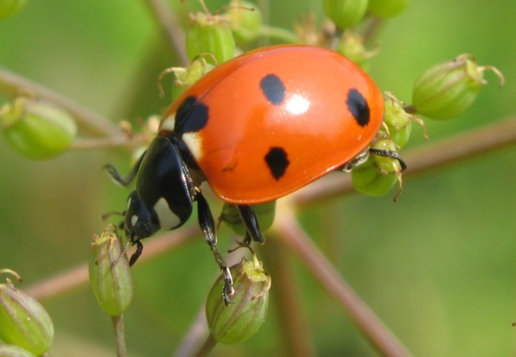
Fungi also have cell walls consisting largely of chitin instead of cellulose.
Exoskeletons are also made of Chitin
3
Chitin

Slide 73
Do Fungi absorb their food on the inside or outside?
4
Excretion of digestive enzymes
Food
Source
Organic molecules absorbed by hyphae.

Slide 74
Do Fungi absorb their food on the inside or outside?
4
Excretion of digestive enzymes
answer…
Food
Source
Organic molecules absorbed by hyphae.

Slide 75
Do Fungi absorb their food on the inside or outside?
Outside
4
Excretion of digestive enzymes
answer…
Food
Source
Organic molecules absorbed by hyphae.

Slide 76
Mold belongs to this Division of Fungi?
5
Copyright © 2024 SlideSpark .LLC

Slide 77
Mold belongs to this Division of Fungi?
5
Zygomycota
Copyright © 2024 SlideSpark .LLC

Slide 78
Kingdom Fungi Review Game
IDENTITY CRISIS | DA VISION | MOLDY CHEESE | ROOM MUSH | -Bonus- WHIMISCAL
1 | 6 | 11 | 16 | *21
2 | 7 | 12 | 17 | *22
3 | 8 | 13 | 18 | *23
4 | 9 | 14 | 19 | *24
5 | 10 | 15 | 20 | *25

Slide 79
Kingdom Fungi Review Game
IDENTITY CRISIS | DA VISION | MOLDY CHEESE | ROOM MUSH | -Bonus- WHIMISCAL
1 | 6 | 11 | 16 | *21
2 | 7 | 12 | 17 | *22
3 | 8 | 13 | 18 | *23
4 | 9 | 14 | 19 | *24
5 | 10 | 15 | 20 | *25

Slide 80
This common Fungi is a necessary ingredient to make bread. Some belong to Basidiomycota
6
Copyright © 2024 SlideSpark .LLC

Slide 81
This common Fungi is a necessary ingredient to make bread. Some belong to Basidiomycota
Division Ascomycota
Yeast
6
Copyright © 2024 SlideSpark .LLC

Slide 82
7
Chytridiomycota are known as the Primitive Fungi
  Live on land and water.
  Great decomposers.
Copyright © 2024 SlideSpark .LLC

Slide 83
7
Chytridiomycota are known as the Primitive Fungi
  Live on land and water.
  Great decomposers.
Copyright © 2024 SlideSpark .LLC

Slide 84
7
Chytridiomycota are known as the Primitive Fungi
  Live on land and water.
  Great decomposers.
Copyright © 2024 SlideSpark .LLC

Slide 85
Zygomycota
  They Live only on land. Mycorrhizal fungi can live in the soil and often form relationships with plants.
Copyright © 2024 SlideSpark .LLC

Slide 86
Zygomycota
  They Live only on land. Mycorrhizal fungi can live in the soil and often form relationships with plants.
Copyright © 2024 SlideSpark .LLC

Slide 87
Zygomycota
  They Live only on land. Mycorrhizal fungi can live in the soil and often form relationships with plants.
Soil
Copyright © 2024 SlideSpark .LLC

Slide 88
9
Name this Division of the Kingdom Fungi?
  75% of all Fungi.
  Yeast.
  Truffles
  Called Sac Fungi
Copyright © 2024 SlideSpark .LLC

Slide 89
9
Name this Division of the Kingdom Fungi?
  75% of all Fungi.
  Yeast.
  Truffles
  Called Sac Fungi
answer is…
Copyright © 2024 SlideSpark .LLC

Slide 90
9
Name this Division of the Kingdom Fungi?
  75% of all Fungi.
  Yeast.
  Truffles
  Called Sac Fungi
Ascomycota
answer is…
Copyright © 2024 SlideSpark .LLC

Slide 91
Name this Process: Fermentation
Sugar Ethyl Alcohol Carbon Dioxide
C6H12O6 2C2H5OH + 2CO2
Carbonation
10

Slide 92
Name this Process: Fermentation
Sugar Ethyl Alcohol Carbon Dioxide
C6H12O6 2C2H5OH + 2CO2
Carbonation
10

Slide 93
Name this Process: Fermentation
Sugar Ethyl Alcohol Carbon Dioxide
C6H12O6 2C2H5OH + 2CO2
Carbonation
Fermentation
10

Slide 94
Kingdom Fungi Review Game
IDENTITY CRISIS | DA VISION | MOLDY CHEESE | ROOM MUSH | -Bonus- WHIMISCAL
1 | 6 | 11 | 16 | *21
2 | 7 | 12 | 17 | *22
3 | 8 | 13 | 18 | *23
4 | 9 | 14 | 19 | *24
5 | 10 | 15 | 20 | *25

Slide 95
Kingdom Fungi Review Game
IDENTITY CRISIS | DA VISION | MOLDY CHEESE | ROOM MUSH | -Bonus- WHIMISCAL
1 | 6 | 11 | 16 | *21
2 | 7 | 12 | 17 | *22
3 | 8 | 13 | 18 | *23
4 | 9 | 14 | 19 | *24
5 | 10 | 15 | 20 | *25

Slide 96
Yeast is reproducing asexually in the process of budding shown below.
11

Slide 97
Yeast is reproducing asexually in the process of budding shown below.
11

Slide 98
Yeast is reproducing asexually in the process of budding shown below.
11
Budding

Slide 99

Lichen (Mycophycophyta): Are a algae and fungus growing together in a symbiotic relationship.
12
Copyright © 2024 SlideSpark .LLC

Slide 100
Lichen (Mycophycophyta): Are a algae and fungus growing together in a symbiotic relationship.
12
Copyright © 2024 SlideSpark .LLC

Slide 101

Lichen (Mycophycophyta): Are a algae and fungus growing together in a symbiotic relationship.
12
Algae
(Protista)
Copyright © 2024 SlideSpark .LLC

Slide 102
Which is fruticose, and which is foliose lichen in the photograph below?
B
A
Copyright © 2024 SlideSpark .LLC

Slide 103
Which is fruticose, and which is foliose lichen in the photograph below?
B
A
Copyright © 2024 SlideSpark .LLC

Slide 104
Which is fruticose, and which is foliose lichen in the photograph below?
B
A
Foliose
Copyright © 2024 SlideSpark .LLC

Slide 105
Which is fruticose, and which is foliose lichen in the photograph below?
B
A
Foliose
Leafy
Copyright © 2024 SlideSpark .LLC

Slide 106
Which is fruticose, and which is foliose lichen in the photograph below?
B
A
Foliose
Leafy
Copyright © 2024 SlideSpark .LLC

Slide 107
Which is fruticose, and which is foliose lichen in the photograph below?
B
A
Fruticose
Branchy
Foliose
Leafy
Copyright © 2024 SlideSpark .LLC

Slide 108
These are the Imperfect Fungi: Deuteromycota
  The leftovers ☹. Much classification unknown, asexual spore formation.
  Includes Athletes foot, Penicillin.
14
Copyright © 2024 SlideSpark .LLC

Slide 109
These are the Imperfect Fungi: Deuteromycota
  The leftovers ☹. Much classification unknown, asexual spore formation.
  Includes Athletes foot, Penicillin.
14
Copyright © 2024 SlideSpark .LLC

Slide 110
These are the Imperfect Fungi: Deuteromycota
  The leftovers ☹. Much classification unknown, asexual spore formation.
  Includes Athletes foot, Penicillin.
14
Deuteromycota
Copyright © 2024 SlideSpark .LLC

Slide 111
Penicillin (Fungi) is humanities great weapon against these organisms.
15
+
Copyright © 2024 SlideSpark .LLC

Slide 112
Penicillin (Fungi) is humanities great weapon against these organisms.
15
+
answer…
Copyright © 2024 SlideSpark .LLC

Slide 113
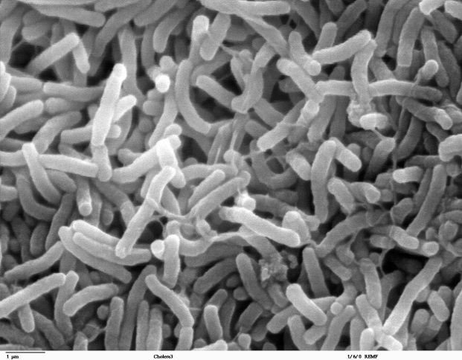
Penicillin (Fungi) is humanities great weapon against these organisms.
15
+
Bacteria
answer…
Copyright © 2024 SlideSpark .LLC

Slide 114
Kingdom Fungi Review Game
IDENTITY CRISIS | DA VISION | MOLDY CHEESE | ROOM MUSH | -Bonus- WHIMISCAL
1 | 6 | 11 | 16 | *21
2 | 7 | 12 | 17 | *22
3 | 8 | 13 | 18 | *23
4 | 9 | 14 | 19 | *24
5 | 10 | 15 | 20 | *25

Slide 115
Kingdom Fungi Review Game
IDENTITY CRISIS | DA VISION | MOLDY CHEESE | ROOM MUSH | -Bonus- WHIMISCAL
1 | 6 | 11 | 16 | *21
2 | 7 | 12 | 17 | *22
3 | 8 | 13 | 18 | *23
4 | 9 | 14 | 19 | *24
5 | 10 | 15 | 20 | *25

Slide 116
16
Name this Division:
Basidiomycota / Club Fungi
  Mushrooms.
  Decomposition of wood.
Copyright © 2024 SlideSpark .LLC

Slide 117
16
Name this Division:
Basidiomycota / Club Fungi
  Mushrooms.
  Decomposition of wood.
Copyright © 2024 SlideSpark .LLC

Slide 118
16
Name this Division:
Basidiomycota / Club Fungi
  Mushrooms.
  Decomposition of wood.
Basidiomycota
Copyright © 2024 SlideSpark .LLC

Slide 119
What are the name for the terms hidden below?
Copyright © 2024 SlideSpark .LLC

Slide 120
What are the name for the terms hidden below?
Copyright © 2024 SlideSpark .LLC

Slide 121
What are the name for the terms hidden below?
Cap
Copyright © 2024 SlideSpark .LLC

Slide 122
What are the name for the terms hidden below?
Cap
Copyright © 2024 SlideSpark .LLC

Slide 123
What are the name for the terms hidden below?
Cap
Gills
Copyright © 2024 SlideSpark .LLC

Slide 124
What are the name for the terms hidden below?
Cap
Gills
Copyright © 2024 SlideSpark .LLC

Slide 125
What are the name for the terms hidden below?
Cap
Gills
Stalk
Copyright © 2024 SlideSpark .LLC

Slide 126
This is the name for the part of the Mycelium- The part of the fungus that feeds, grows, and ultimately may produce a mushroom.
Copyright © 2024 SlideSpark .LLC

Slide 127
This is the name for the part of the Mycelium- The part of the fungus that feeds, grows, and ultimately may produce a mushroom.
Hyphae
Copyright © 2024 SlideSpark .LLC

Slide 128
Reproductive cycles of the Fungi.
  Diploid cells contain two complete sets (2n) of chromosomes.
  Haploid cells have half the number of chromosomes (n) as diploid - i.e. a haploid cell contains only one complete set of chromosomes.

Slide 129
Reproductive cycles of the Fungi.
  Diploid cells contain two complete sets (2n) of chromosomes.
  Haploid cells have half the number of chromosomes (n) as diploid - i.e. a haploid cell contains only one complete set of chromosomes.

Slide 130
Reproductive cycles of the Fungi.
  Diploid cells contain two complete sets (2n) of chromosomes.
  Haploid cells have half the number of chromosomes (n) as diploid - i.e. a haploid cell contains only one complete set of chromosomes.
Diploid 2n

Slide 131
Reproductive cycles of the Fungi.
  Diploid cells contain two complete sets (2n) of chromosomes.
  Haploid cells have half the number of chromosomes (n) as diploid - i.e. a haploid cell contains only one complete set of chromosomes.
Diploid 2n

Slide 132

Reproductive cycles of the Fungi.
  Diploid cells contain two complete sets (2n) of chromosomes.
  Haploid cells have half the number of chromosomes (n) as diploid - i.e. a haploid cell contains only one complete set of chromosomes.
Diploid 2n

Slide 133
To prevent mold growth, all of the following is recommended except …
  A.) Limit moisture.
  B.) Limit cold temperatures (Place food in a warm environment)
  C.) Limit spores (use bags and containers)
  D.) Limit available food sources (remove moldy food from the group.)
20

Slide 134
To prevent mold growth, all of the following is recommended except …
  A.) Limit moisture.
  B.) Limit cold temperatures (Place food in a warm environment)
  C.) Limit spores (use bags and containers)
  D.) Limit available food sources (remove moldy food from the group.)
20

Slide 135
To prevent mold growth, all of the following is recommended except …
  A.) Limit moisture.
  B.) Limit cold temperatures (Place food in a warm environment)
  C.) Limit spores (use bags and containers)
  D.) Limit available food sources (remove moldy food from the group.)
20

Slide 136
To prevent mold growth, all of the following is recommended except …
  A.) Limit moisture.
  B.) Limit cold temperatures (Place food in a warm environment)
  C.) Limit spores (use bags and containers)
  D.) Limit available food sources (remove moldy food from the group.)
20

Slide 137
To prevent mold growth, all of the following is recommended except …
  A.) Limit moisture.
  B.) Limit cold temperatures (Place food in a warm environment)
  C.) Limit spores (use bags and containers)
  D.) Limit available food sources (remove moldy food from the group.)
20

Slide 138
To prevent mold growth, all of the following is recommended except …
  A.) Limit moisture.
  B.) Limit cold temperatures (Place food in a warm environment)
  C.) Limit spores (use bags and containers)
  D.) Limit available food sources (remove moldy food from the group.)
20
answer is…

Slide 139
To prevent mold growth, all of the following is recommended except …
  A.) Limit moisture.
  B.) Limit cold temperatures (Place food in a warm environment)
  C.) Limit spores (use bags and containers)
  D.) Limit available food sources (remove moldy food from the group.)
20
answer is…

Slide 140
To prevent mold growth, all of the following is recommended except …
  A.) Limit moisture.
  B.) Limit warm temperatures (Place food in a cold environment)
  C.) Limit spores (use bags and containers)
  D.) Limit available food sources (remove moldy food from the group.)
20
answer is…

Slide 141
Kingdom Fungi Review Game
IDENTITY CRISIS | DA VISION | MOLDY CHEESE | ROOM MUSH | -Bonus- WHIMISCAL
1 | 6 | 11 | 16 | *21
2 | 7 | 12 | 17 | *22
3 | 8 | 13 | 18 | *23
4 | 9 | 14 | 19 | *24
5 | 10 | 15 | 20 | *25

Slide 142
Kingdom Fungi Review Game
IDENTITY CRISIS | DA VISION | MOLDY CHEESE | ROOM MUSH | -Bonus- WHIMISCAL
1 | 6 | 11 | 16 | *21
2 | 7 | 12 | 17 | *22
3 | 8 | 13 | 18 | *23
4 | 9 | 14 | 19 | *24
5 | 10 | 15 | 20 | *25

Slide 143
Name this SMURF?
*21

Slide 144
Name this SMURF?
*21
Brainy Smurf

Slide 145
Name this Movie?
*22

Slide 146
Name this Movie?
*22

Slide 147
Name this Movie?
*22

Slide 148
Name this Movie?
*22

Slide 149
Name this Movie?
*22
Alice in Wonderland

Slide 150
Who lives here?
*23

Slide 151

Who lives here?
*23
Yoda

Slide 152
Who is this?
*24

Slide 153
Who is this?
*24
Toad

Slide 154
Who is this?
*25

Slide 155
Who is this?
*25
Radagast
the Brown

Slide 156
Kingdom Fungi Review Game
IDENTITY CRISIS | DA VISION | MOLDY CHEESE | ROOM MUSH | -Bonus- WHIMISCAL
1 | 6 | 11 | 16 | *21
2 | 7 | 12 | 17 | *22
3 | 8 | 13 | 18 | *23
4 | 9 | 14 | 19 | *24
5 | 10 | 15 | 20 | *25
Final Question

Slide 157
5 Point Wager Question
Photoshop

Slide 158
This is the structure producing and containing spores.

Slide 159
This is the structure producing and containing spores.
answer is…

Slide 160
This is the structure producing and containing spores.
Sporangia
answer is…

Slide 161
Fungi Review Game
Questions 1-20 = 5pts Each
Final Category (Bonus) = 1pt Each
Final Questions = 5 pt wager
Find the Owl =
Secretly write “Owl” in the correct box worth 1pt.

Slide 162
Kingdom Fungi
Review Game
Part 5
Lesson 8

Slide 163



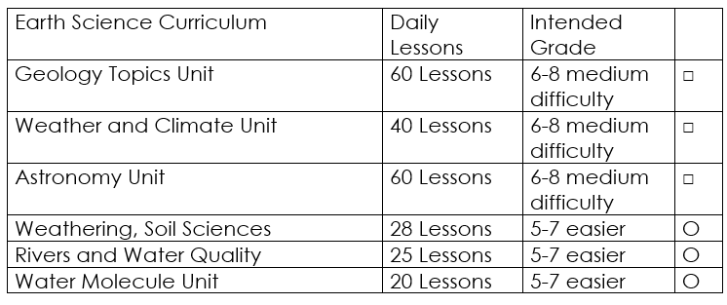

Curriculum Guide
Number of Lessons in each unit (50 min, daily lessons) and difficult rating scale / intended grade level.
=Easier, = More difficult, =Most difficult
Earth Science Units

Slide 164


Life Science Units

Slide 165

Physical Science

Slide 166
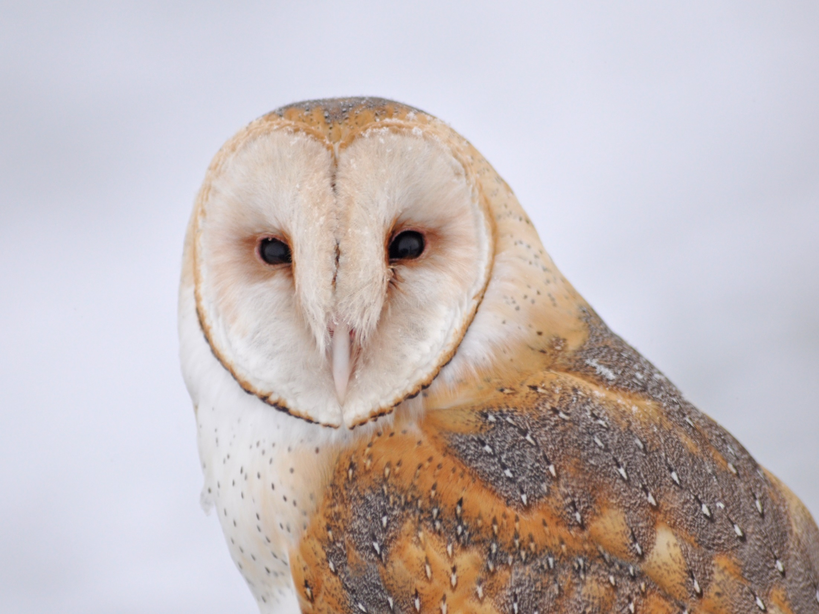
Dear Valued Educator,
Our fully editable .pptx and .doc resources are perfect for educators looking to bring enthusiasm and creativity to their lessons. We encourage you to make changes to fit your needs and style. As science educators, we’re committed to providing students with the tools they need to succeed in the classroom and beyond. Each unit in the curriculum includes a range of resources that have been developed through extensive research and use in a busy classroom. Our teaching approach is designed to make science education engaging and exciting for learners of all ages. We offer a one-of-a-kind science curriculum that will challenge, inspire, and educate students to become tomorrow's scientists and leaders. Join us today and learn more about how our program can help you achieve your classroom goals.
With appreciation,
Support@SlideSpark.net

Slide 167





Thank you for your time and interest in our Science curriculum. We strive to provide students with engaging and informative lessons that will spark their curiosity and encourage scientific exploration. Should you have any questions or concerns, please do not hesitate to contact us. Thank you again for considering our curriculum, and we wish you all the best in your educational journey.
Sincerely,
Support@slidespark.net
SlideSpark Science on TpT

