Slide 1
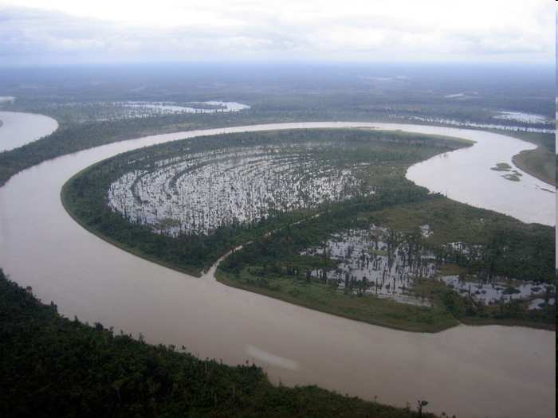


Review Game
Part 1
Lesson 6

Slide 2
Rivers and Watersheds Game
A RIVER RUNS THROUGH IT | A DAY ON THE RIVER | MUDDY WATERS | HIGH WATER | BONUS FAMOUS FISH
1 | 6 | 11 | 16 | *21
2 | 7 | 12 | 17 | *22
3 | 8 | 13 | 18 | *23
4 | 9 | 14 | 19 | *24
5 | 10 | 15 | 20 | *25
Copyright © 2024 SlideSpark .LLC

Slide 3
How to play…
  Don’t play like Jeo_ _ _ _ y.
  Class should be divided into several small groups.
  Groups should use science journal (red slide notes), homework, and other available materials to assist you.
  Groups can communicate quietly with each other but no sharing answers between groups.
    Practice quietly communicating right now?
    Practice Communication Question:
    Your group gets to order one pizza, and you can have two toppings, what does your group want?

Slide 4

Questions 1-20 = 5pts Each
Final Category (Bonus) = 1pt Each
Final Questions = 5 pt wager
If you wager 5 on the last question and get it wrong you lose 5 pts. Wager 5 and get right you get 5 pts.
Find the Owl =
Secretly write “Owl” in the correct box worth 1pt.
“I’ll be about this big.”

Slide 5
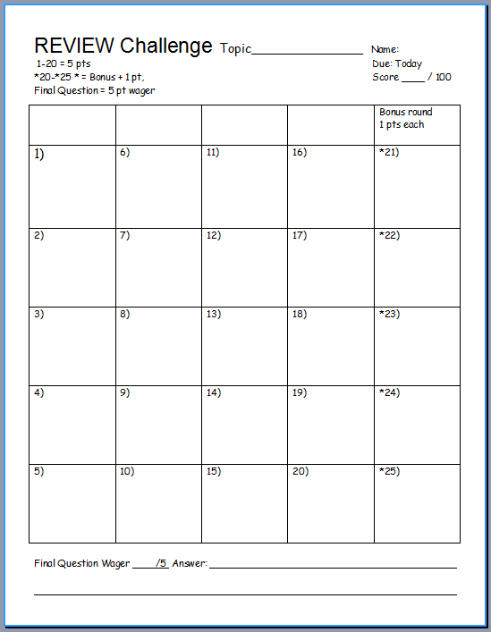
Is your name on the review sheet?
Name

Slide 6
Is your name on the review sheet?
Add the categories
along the top
on the next slide.

Slide 7
Rivers, Watersheds, and Water Quality Game
A RIVER RUNS THROUGH IT | A DAY ON THE RIVER | MUDDY WATERS | HIGH WATER | BONUS FAMOUS FISH
1 | 6 | 11 | 16 | *21
2 | 7 | 12 | 17 | *22
3 | 8 | 13 | 18 | *23
4 | 9 | 14 | 19 | *24
5 | 10 | 15 | 20 | *25
Copyright © 2024 SlideSpark .LLC

Slide 8
Rivers, Watersheds, and Water Quality Game
A RIVER RUNS THROUGH IT | A DAY ON THE RIVER | MUDDY WATERS | HIGH WATER | BONUS FAMOUS FISH
1 | 6 | 11 | 16 | *21
2 | 7 | 12 | 17 | *22
3 | 8 | 13 | 18 | *23
4 | 9 | 14 | 19 | *24
5 | 10 | 15 | 20 | *25
Copyright © 2024 SlideSpark .LLC

Slide 9
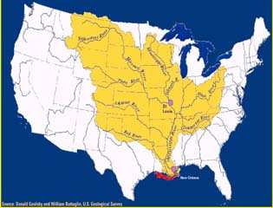
What is highlighted in the picture below?
1
Copyright © 2024 SlideSpark .LLC

Slide 10
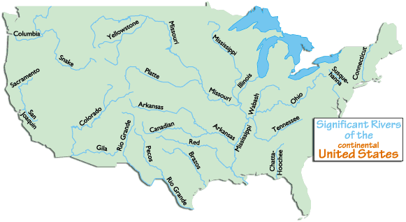
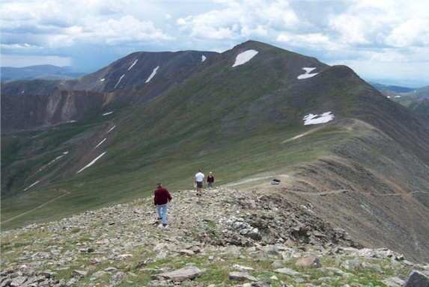
2
Name A?
A

Slide 11
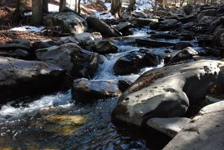
What is the general name for the small streams that become the start for most rivers?
3
Copyright © 2024 SlideSpark .LLC

Slide 12
What part of a river can be seen in the photo below?
Headwaters
Downriver
Floodplain
Mouth/Delta
Confluence
4
Copyright © 2024 SlideSpark .LLC

Slide 13
What part of a river can be seen in the photo below?
Headwaters
Downriver
Floodplain
Mouth/Delta
Confluence
4
Copyright © 2024 SlideSpark .LLC

Slide 14
What part of a river can be seen in the photo below?
Headwaters
Downriver
Floodplain
Mouth/Delta
Confluence
4
Copyright © 2024 SlideSpark .LLC

Slide 15
What part of a river can be seen in the photo below?
Headwaters
Downriver
Floodplain
Mouth/Delta
Confluence
4
Copyright © 2024 SlideSpark .LLC

Slide 16
What part of a river can be seen in the photo below?
Headwaters
Downriver
Floodplain
Mouth/Delta
Confluence
4
Copyright © 2024 SlideSpark .LLC

Slide 17
What part of a river can be seen in the photo below?
Headwaters
Downriver
Floodplain
Mouth/Delta
Confluence
4
Copyright © 2024 SlideSpark .LLC

Slide 18
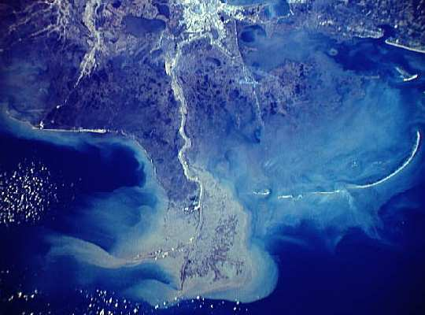
What part of a river can be seen in the photo below?
Headwaters
Downriver
Floodplain
Mouth/Delta
Confluence
5
Copyright © 2024 SlideSpark .LLC

Slide 19
What part of a river can be seen in the photo below?
Headwaters
Downriver
Floodplain
Mouth/Delta
Confluence
5
Copyright © 2024 SlideSpark .LLC

Slide 20
What part of a river can be seen in the photo below?
Headwaters
Downriver
Floodplain
Mouth/Delta
Confluence
5
Copyright © 2024 SlideSpark .LLC

Slide 21
What part of a river can be seen in the photo below?
Headwaters
Downriver
Floodplain
Mouth/Delta
Confluence
5
Copyright © 2024 SlideSpark .LLC

Slide 22
What part of a river can be seen in the photo below?
Headwaters
Downriver
Floodplain
Mouth/Delta
Confluence
5
Copyright © 2024 SlideSpark .LLC

Slide 23
What part of a river can be seen in the photo below?
Headwaters
Downriver
Floodplain
Mouth/Delta
Confluence
Confluence
5
Copyright © 2024 SlideSpark .LLC

Slide 24
Rivers and Watersheds Game
A RIVER RUNS THROUGH IT | A DAY ON THE RIVER | MUDDY WATERS | HIGH WATER | BONUS FAMOUS FISH
1 | 6 | 11 | 16 | *21
2 | 7 | 12 | 17 | *22
3 | 8 | 13 | 18 | *23
4 | 9 | 14 | 19 | *24
5 | 10 | 15 | 20 | *25
Copyright © 2024 SlideSpark .LLC

Slide 25
Rivers and Watersheds Game
A RIVER RUNS THROUGH IT | A DAY ON THE RIVER | MUDDY WATERS | HIGH WATER | BONUS FAMOUS FISH
1 | 6 | 11 | 16 | *21
2 | 7 | 12 | 17 | *22
3 | 8 | 13 | 18 | *23
4 | 9 | 14 | 19 | *24
5 | 10 | 15 | 20 | *25
Copyright © 2024 SlideSpark .LLC

Slide 26
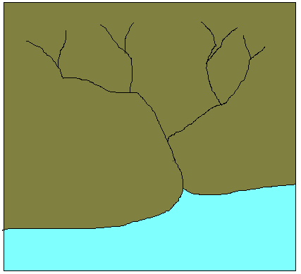
What is the stream order of the river below?
1
2
3
4
216
6
Copyright © 2024 SlideSpark .LLC

Slide 27
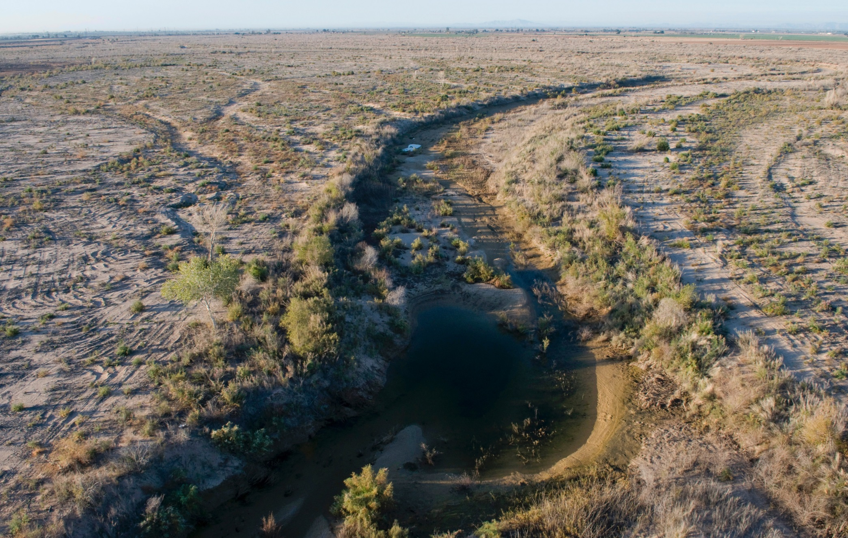
7
Name this…
7
Copyright © 2024 SlideSpark .LLC

Slide 28
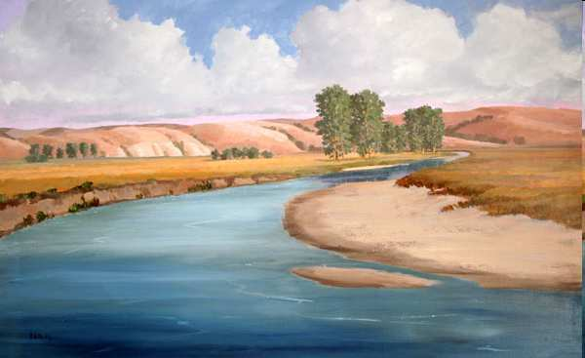
What three physical features of a river are the arrows pointing toward?
A
B
C
8
Copyright © 2024 SlideSpark .LLC

Slide 29
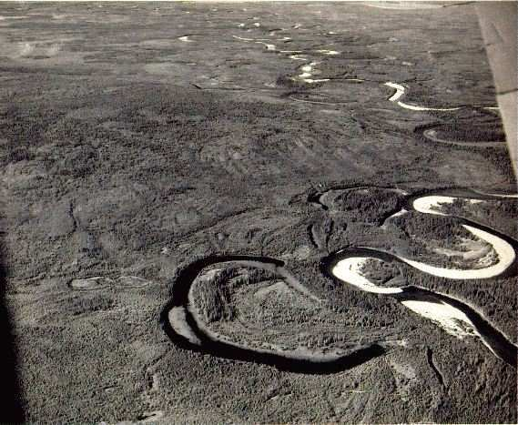

What physical feature of a river is the arrow pointing to?
9
Copyright © 2024 SlideSpark .LLC

Slide 30
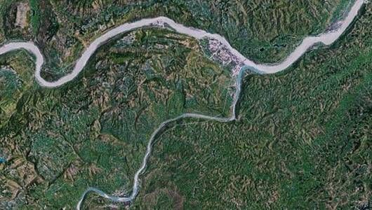
This is the name for a stream or river which flows into a mainstream.
10
Copyright © 2024 SlideSpark .LLC

Slide 31
Rivers and Watersheds Game
A RIVER RUNS THROUGH IT | A DAY ON THE RIVER | MUDDY WATERS | HIGH WATER | BONUS FAMOUS FISH
1 | 6 | 11 | 16 | *21
2 | 7 | 12 | 17 | *22
3 | 8 | 13 | 18 | *23
4 | 9 | 14 | 19 | *24
5 | 10 | 15 | 20 | *25
Copyright © 2024 SlideSpark .LLC

Slide 32
Rivers and Watersheds Game
A RIVER RUNS THROUGH IT | A DAY ON THE RIVER | MUDDY WATERS | HIGH WATER | BONUS FAMOUS FISH
1 | 6 | 11 | 16 | *21
2 | 7 | 12 | 17 | *22
3 | 8 | 13 | 18 | *23
4 | 9 | 14 | 19 | *24
5 | 10 | 15 | 20 | *25
Copyright © 2024 SlideSpark .LLC

Slide 33
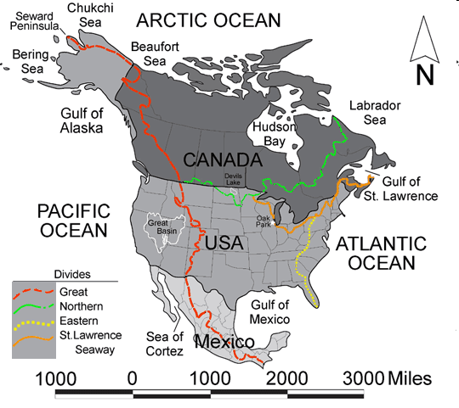
Name this large watershed that does not drain into the ocean.
16
11
Copyright © 2024 SlideSpark .LLC

Slide 34

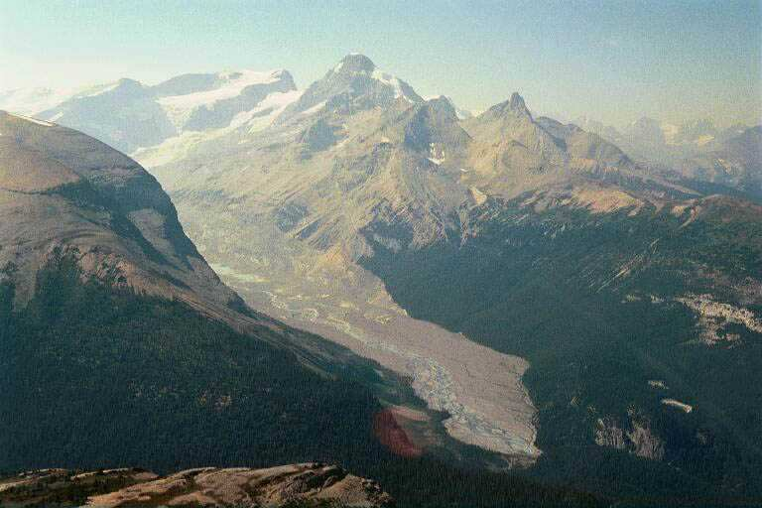
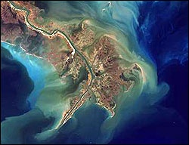
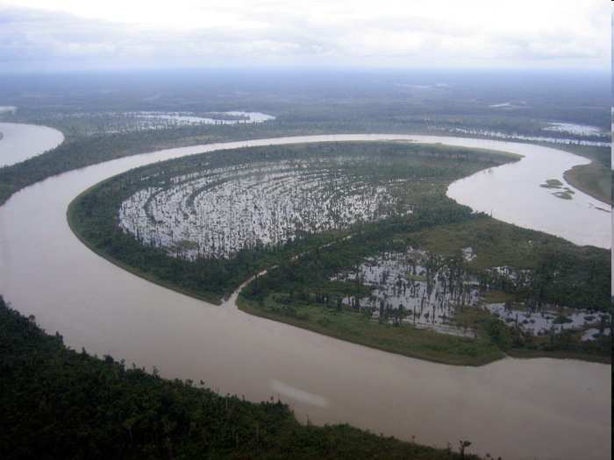
12
Rivers generally start in the…
A.) Ocean
B.) Mouth and Delta
C.) Mountains
D.) Floodplain
E.) Nobody Knows
Copyright © 2024 SlideSpark .LLC

Slide 35
12
Rivers generally start in the…
A.) Ocean
B.) Mouth and Delta
C.) Mountains
D.) Floodplain
E.) Nobody Knows
Copyright © 2024 SlideSpark .LLC

Slide 36
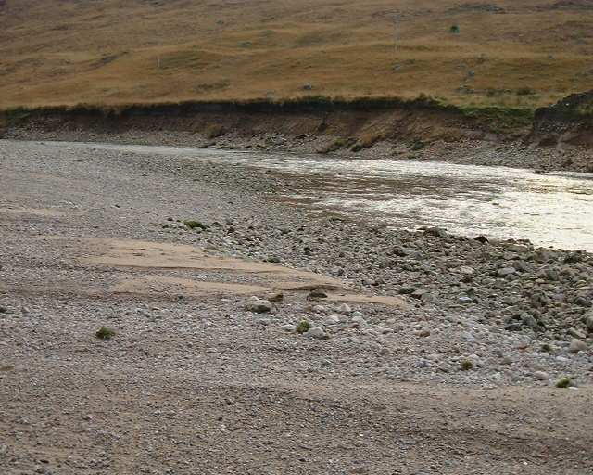
13
Name the big three below?
Erosion
Process where fragments of soil and rock are broken off from the surface and carried away.
Transport
Material (sediment) is moved from one area to another – usually downstream
Deposition
Process by which fragments of rock are dropped in a new location.
Copyright © 2024 SlideSpark .LLC

Slide 37
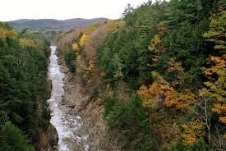
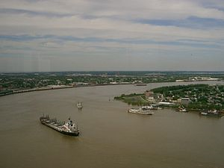

Which river is young and which is old?
B
A

Slide 38
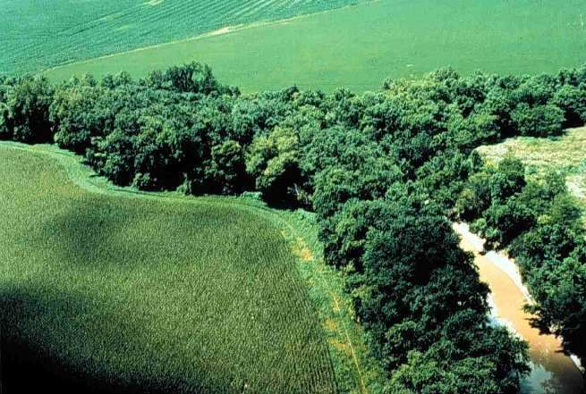
Name this forested area along the river way below?
15

Slide 39
Rivers and Watersheds Game
A RIVER RUNS THROUGH IT | A DAY ON THE RIVER | MUDDY WATERS | HIGH WATER | BONUS FAMOUS FISH
1 | 6 | 11 | 16 | *21
2 | 7 | 12 | 17 | *22
3 | 8 | 13 | 18 | *23
4 | 9 | 14 | 19 | *24
5 | 10 | 15 | 20 | *25
Copyright © 2024 SlideSpark .LLC

Slide 40
Rivers and Watersheds Game
A RIVER RUNS THROUGH IT | A DAY ON THE RIVER | MUDDY WATERS | HIGH WATER | BONUS FAMOUS FISH
1 | 6 | 11 | 16 | *21
2 | 7 | 12 | 17 | *22
3 | 8 | 13 | 18 | *23
4 | 9 | 14 | 19 | *24
5 | 10 | 15 | 20 | *25
Copyright © 2024 SlideSpark .LLC

Slide 41
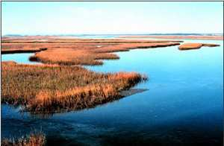
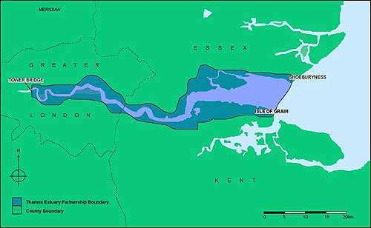
This is the name for the area where a river meets the sea or ocean, where fresh water from the river meets salt water from the sea (tidal)
16
Copyright © 2024 SlideSpark .LLC

Slide 42
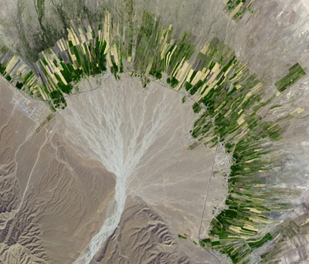
17
This is an example of a...

Slide 43
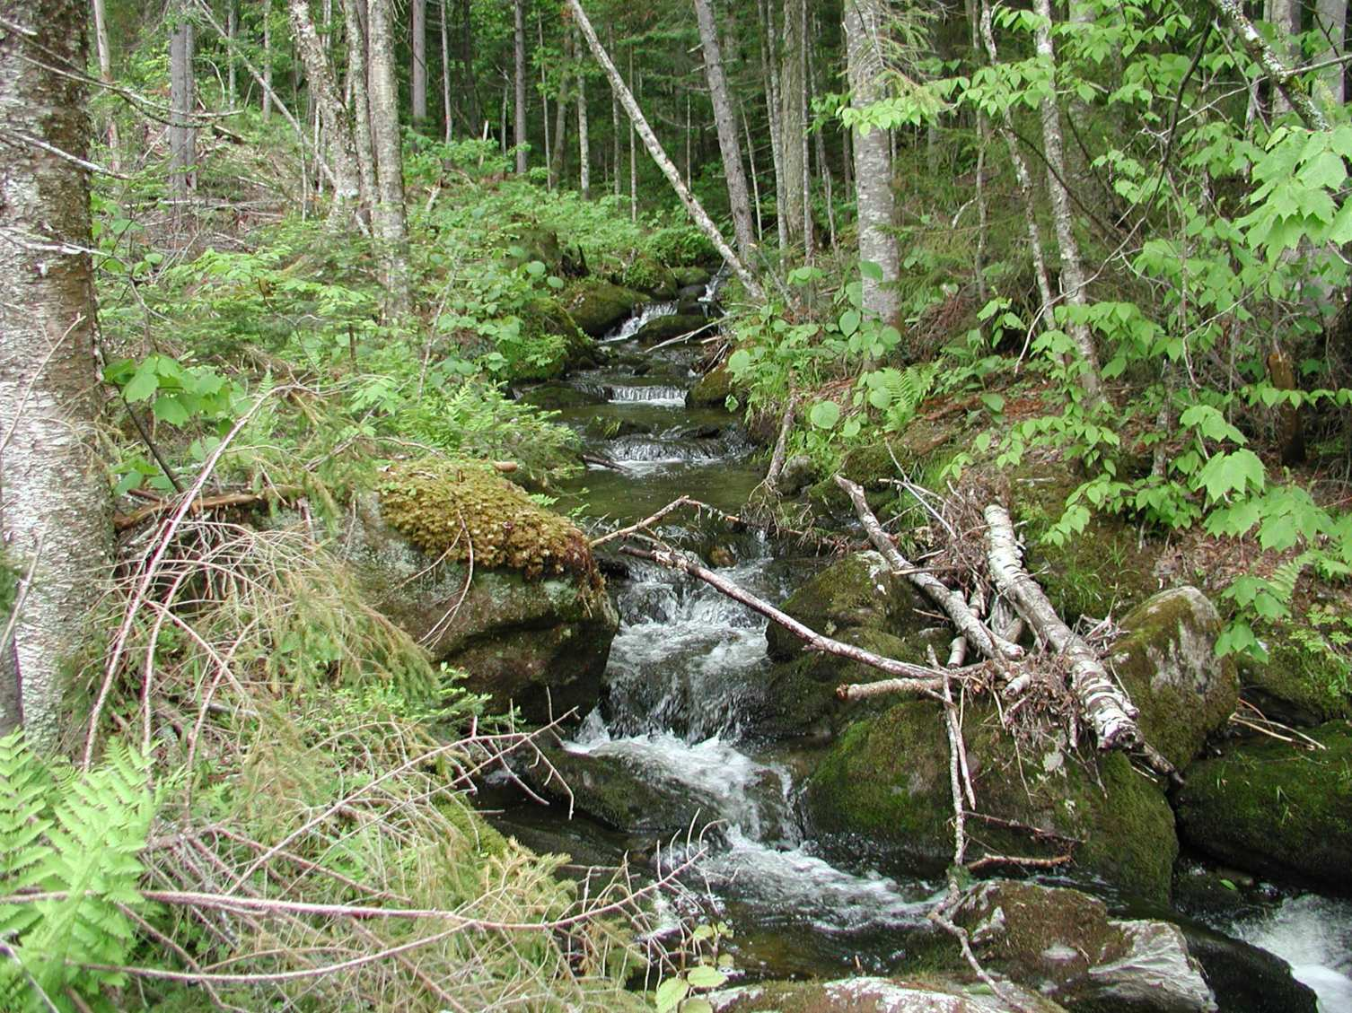

Which is true of the headwaters?
  A.) Low velocity, low oxygen, and high nutrients
  B.) High velocity, high oxygen and low nutrients
  C.) High sediment, low velocity
  D.) Where salt water mixes with freshwater
18

Slide 44
Which is true of the headwaters?
  A.) Low velocity, low oxygen, and high nutrients
  B.) High velocity, high oxygen and low nutrients
  C.) High sediment, low velocity
  D.) Where salt water mixes with freshwater
18

Slide 45
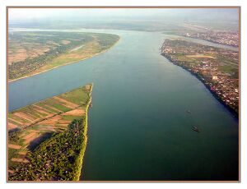
Which direction is
the river flowing?
A
?
Name
B
19

Slide 46
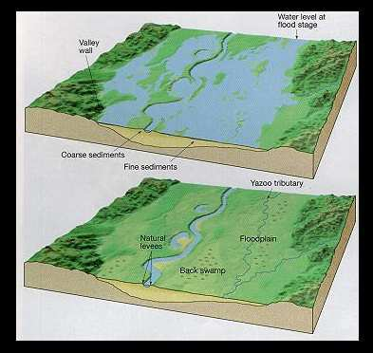
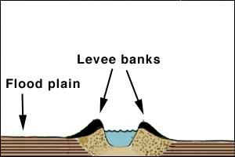
20
?
?
?
?
?
Yazoo tributaries run
parallel to a river
in the floodplain
because of the
natural levees
Natural Levee

Slide 47
Rivers and Watersheds Game
A RIVER RUNS THROUGH IT | A DAY ON THE RIVER | MUDDY WATERS | HIGH WATER | BONUS FAMOUS FISH
1 | 6 | 11 | 16 | *21
2 | 7 | 12 | 17 | *22
3 | 8 | 13 | 18 | *23
4 | 9 | 14 | 19 | *24
5 | 10 | 15 | 20 | *25
Copyright © 2024 SlideSpark .LLC

Slide 48
Rivers and Watersheds Game
A RIVER RUNS THROUGH IT | A DAY ON THE RIVER | MUDDY WATERS | HIGH WATER | BONUS FAMOUS FISH
1 | 6 | 11 | 16 | *21
2 | 7 | 12 | 17 | *22
3 | 8 | 13 | 18 | *23
4 | 9 | 14 | 19 | *24
5 | 10 | 15 | 20 | *25
Copyright © 2024 SlideSpark .LLC

Slide 49
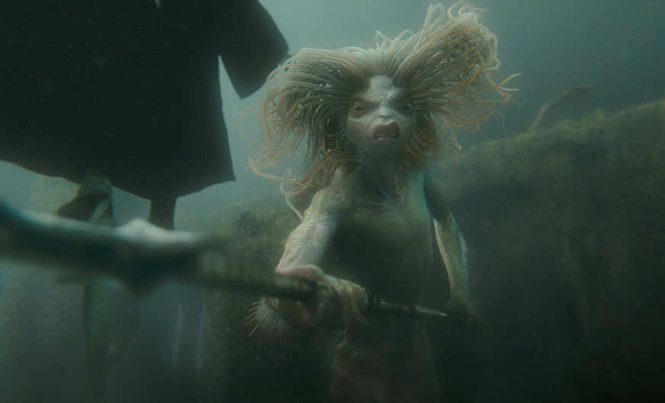
The underwater scene below occurred in what movie?
*21
Copyright © 2024 SlideSpark .LLC

Slide 50

The scene below is from what movie starring Will Smith?
*22
Copyright © 2024 SlideSpark .LLC

Slide 51

*23
Name the brand of fish stick
23
Copyright © 2024 SlideSpark .LLC

Slide 52

Name the company that makes these Goldfish?
24
Copyright © 2024 SlideSpark .LLC

Slide 53

What words are blocked out below in this Dr. Seuss Classic?
*25
Copyright © 2024 SlideSpark .LLC

Slide 54
A RIVER RUNS THROUGH IT | A DAY ON THE RIVER | MUDDY WATERS | HIGH WATER | BONUS FAMOUS FISH
1 | 6 | 11 | 16 | *21
2 | 7 | 12 | 17 | *22
3 | 8 | 13 | 18 | *23
4 | 9 | 14 | 19 | *24
5 | 10 | 15 | 20 | *25
Final Question________________
Copyright © 2024 SlideSpark .LLC

Slide 55


Slide 56
“This is a 5 pt wager question.”

Slide 57
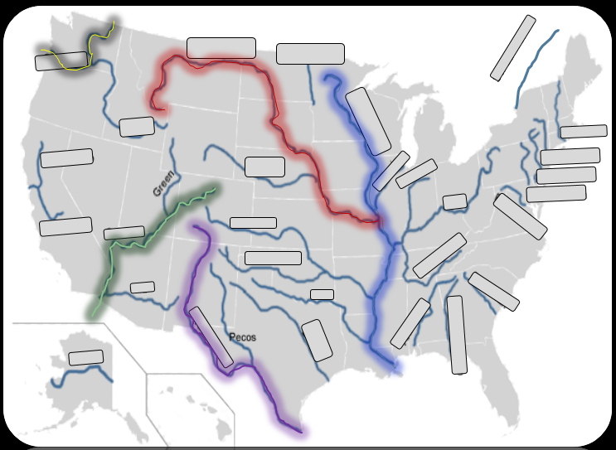
Name the five rivers in the United States that are highlighted on the next slide?

Slide 58
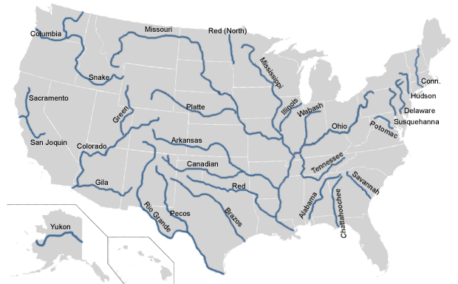
\
St. Lawrence

Slide 59
Review Game
Part 1
Lesson 6

Slide 60

Review Game
Part 1
Lesson 7

Slide 61
Rivers and Watersheds Review Game
A RIVER RUNS THROUGH IT | A DAY ON THE RIVER | MUDDY WATERS | HIGH WATER | BONUS FAMOUS FISH
1 | 6 | 11 | 16 | *21
2 | 7 | 12 | 17 | *22
3 | 8 | 13 | 18 | *23
4 | 9 | 14 | 19 | *24
5 | 10 | 15 | 20 | *25
Copyright © 2024 SlideSpark .LLC

Slide 62
What is highlighted in the picture below?
1
Copyright © 2024 SlideSpark .LLC

Slide 63
What is highlighted in the picture below?
Mississippi River Watershed
1
Watershed
Copyright © 2024 SlideSpark .LLC

Slide 64
2
Name A?
A

Slide 65
2
Name A?
A

Slide 66
2
A
Continental Divide

Slide 67
What is the general name for the place that rivers start in the mountains?
3
Copyright © 2024 SlideSpark .LLC

Slide 68
What is the general name for the place that rivers start in the mountains?
Headwaters
3
Copyright © 2024 SlideSpark .LLC

Slide 69
What part of a river can be seen in the photo below?
Headwaters
Downriver
Floodplain
Mouth/Delta
Confluence
4
Copyright © 2024 SlideSpark .LLC

Slide 70
What part of a river can be seen in the photo below?
Headwaters
Downriver
Floodplain
Mouth/Delta
Confluence
4
Copyright © 2024 SlideSpark .LLC

Slide 71
What part of a river can be seen in the photo below?
Headwaters
Downriver
Floodplain
Mouth/Delta
Confluence
4
Copyright © 2024 SlideSpark .LLC

Slide 72
What part of a river can be seen in the photo below?
Headwaters
Downriver
Floodplain
Mouth/Delta
Confluence
4
Copyright © 2024 SlideSpark .LLC

Slide 73
What part of a river can be seen in the photo below?
Headwaters
Downriver
Floodplain
Mouth/Delta
Confluence
4
Copyright © 2024 SlideSpark .LLC

Slide 74
What part of a river can be seen in the photo below?
Headwaters
Downriver
Floodplain
Mouth/Delta
Confluence
4
Copyright © 2024 SlideSpark .LLC

Slide 75
What part of a river can be seen in the photo below?
Headwaters
Downriver
Floodplain
Mouth/Delta
Confluence
Answer is...
4
Copyright © 2024 SlideSpark .LLC

Slide 76
What part of a river can be seen in the photo below?
Headwaters
Downriver
Floodplain
Mouth/Delta
Confluence
Answer is...
4
Copyright © 2024 SlideSpark .LLC

Slide 77
What part of a river can be seen in the photo below?
Headwaters
Downriver
Floodplain
Mouth/Delta
Confluence
5
Copyright © 2024 SlideSpark .LLC

Slide 78
What part of a river can be seen in the photo below?
Headwaters
Downriver
Floodplain
Mouth/Delta
Confluence
5
Copyright © 2024 SlideSpark .LLC

Slide 79
What part of a river can be seen in the photo below?
Headwaters
Downriver
Floodplain
Mouth/Delta
Confluence
5
Copyright © 2024 SlideSpark .LLC

Slide 80
What part of a river can be seen in the photo below?
Headwaters
Downriver
Floodplain
Mouth/Delta
Confluence
5
Copyright © 2024 SlideSpark .LLC

Slide 81
What part of a river can be seen in the photo below?
Headwaters
Downriver
Floodplain
Mouth/Delta
Confluence
5
Copyright © 2024 SlideSpark .LLC

Slide 82
What part of a river can be seen in the photo below?
Headwaters
Downriver
Floodplain
Mouth/Delta
Confluence
Answer is...
5
Copyright © 2024 SlideSpark .LLC

Slide 83
What part of a river can be seen in the photo below?
Headwaters
Downriver
Floodplain
Mouth/Delta
Confluence
Answer is...
5
Copyright © 2024 SlideSpark .LLC

Slide 84
Rivers and Watersheds Review Game
A RIVER RUNS THROUGH IT | A DAY ON THE RIVER | MUDDY WATERS | HIGH WATER | BONUS FAMOUS FISH
1 | 6 | 11 | 16 | *21
2 | 7 | 12 | 17 | *22
3 | 8 | 13 | 18 | *23
4 | 9 | 14 | 19 | *24
5 | 10 | 15 | 20 | *25
Copyright © 2024 SlideSpark .LLC

Slide 85
Rivers and Watersheds Review Game
A RIVER RUNS THROUGH IT | A DAY ON THE RIVER | MUDDY WATERS | HIGH WATER | BONUS FAMOUS FISH
1 | 6 | 11 | 16 | *21
2 | 7 | 12 | 17 | *22
3 | 8 | 13 | 18 | *23
4 | 9 | 14 | 19 | *24
5 | 10 | 15 | 20 | *25
Copyright © 2024 SlideSpark .LLC

Slide 86
What is the stream order of the river below?
1
2
3
4
216
6
Copyright © 2024 SlideSpark .LLC

Slide 87
What is the stream order of the river below?
1
2
3
4
216
1
1
1
1
1
1
1
1
6
Copyright © 2024 SlideSpark .LLC

Slide 88
What is the stream order of the river below?
1
2
3
4
216
1
1
1
1
1
1
1
1
2
2
2
2
6
Copyright © 2024 SlideSpark .LLC

Slide 89
What is the stream order of the river below?
1
2
3
4
216
1
1
1
1
1
1
1
1
2
2
2
2
3
3
6
Copyright © 2024 SlideSpark .LLC

Slide 90
What is the stream order of the river below?
1
2
3
4
216
1
1
1
1
1
1
1
1
2
2
2
2
3
3
4
6
Copyright © 2024 SlideSpark .LLC

Slide 91
What is the stream order of the river below?
1
2
3
4
216
1
1
1
1
1
1
1
1
2
2
2
2
3
3
4
6
Copyright © 2024 SlideSpark .LLC

Slide 92
What is the stream order of the river below?
1
2
3
4
216
1
1
1
1
1
1
1
1
2
2
2
2
3
3
4
6
Copyright © 2024 SlideSpark .LLC

Slide 93
7
Name this…
7
Copyright © 2024 SlideSpark .LLC

Slide 94
7
Name this…
Old Channel
7
Copyright © 2024 SlideSpark .LLC

Slide 95
What three physical features of a river are the arrows pointing to?
8
Copyright © 2024 SlideSpark .LLC

Slide 96
What three physical features of a river are the arrows pointing to?
8
Copyright © 2024 SlideSpark .LLC

Slide 97
What three physical features of a river are the arrows pointing to?
Cut-bank
8
Copyright © 2024 SlideSpark .LLC

Slide 98
What three physical features of a river are the arrows pointing to?
Cut-bank
8
Copyright © 2024 SlideSpark .LLC

Slide 99
What three physical features of a river are the arrows pointing to?
Cut-bank Pool
8
Copyright © 2024 SlideSpark .LLC

Slide 100
What three physical features of a river are the arrows pointing to?
Cut-bank Pool
8
Copyright © 2024 SlideSpark .LLC

Slide 101
What three physical features of a river are the arrows pointing to?
Cut-bank Pool Point Bar
8
Copyright © 2024 SlideSpark .LLC

Slide 102
What physical feature of a river is the arrow pointing to?
9
Copyright © 2024 SlideSpark .LLC

Slide 103
What physical feature of a river is the arrow pointing to?
9
Oxbow Lake
Copyright © 2024 SlideSpark .LLC

Slide 104
What physical feature of a river is the arrow pointing to?
9
Oxbow Lake
Copyright © 2024 SlideSpark .LLC

Slide 105
This is the name for a stream or river which flows into a mainstream.
10
Copyright © 2024 SlideSpark .LLC

Slide 106
This is the name for a stream or river which flows into a mainstream.
10
Tributary
Copyright © 2024 SlideSpark .LLC

Slide 107
Rivers and Watersheds Review Game
A RIVER RUNS THROUGH IT | A DAY ON THE RIVER | MUDDY WATERS | HIGH WATER | BONUS FAMOUS FISH
1 | 6 | 11 | 16 | *21
2 | 7 | 12 | 17 | *22
3 | 8 | 13 | 18 | *23
4 | 9 | 14 | 19 | *24
5 | 10 | 15 | 20 | *25
Copyright © 2024 SlideSpark .LLC

Slide 108
Rivers and Watersheds Review Game
A RIVER RUNS THROUGH IT | A DAY ON THE RIVER | MUDDY WATERS | HIGH WATER | BONUS FAMOUS FISH
1 | 6 | 11 | 16 | *21
2 | 7 | 12 | 17 | *22
3 | 8 | 13 | 18 | *23
4 | 9 | 14 | 19 | *24
5 | 10 | 15 | 20 | *25
Copyright © 2024 SlideSpark .LLC

Slide 109
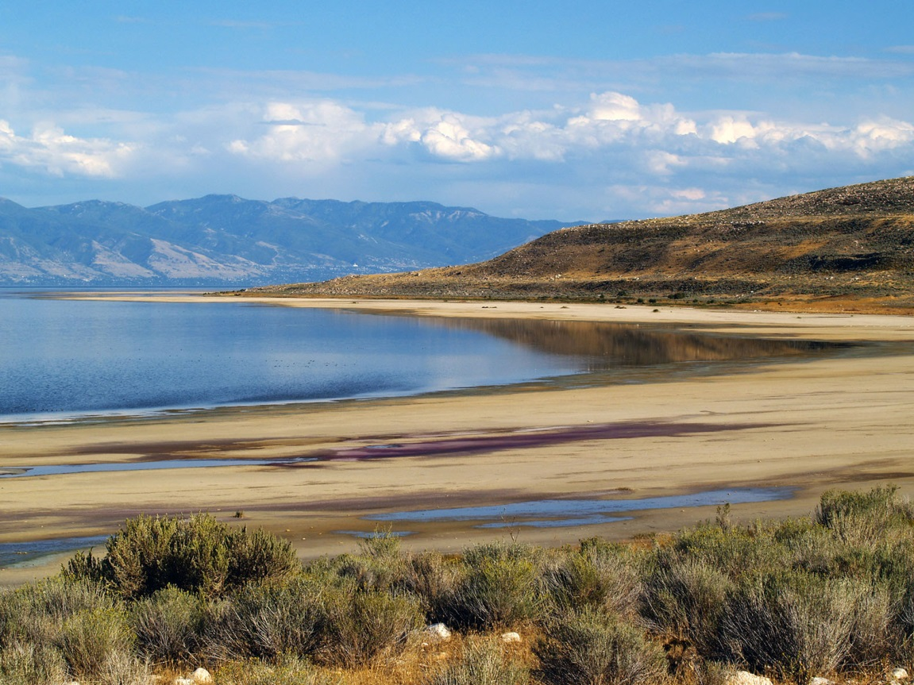
Name this large watershed that does not drain into the ocean.
16
11
Copyright © 2024 SlideSpark .LLC

Slide 110
Name this large watershed that does not drain into the ocean.
Great Basin
16
11
Copyright © 2024 SlideSpark .LLC

Slide 111
12
Rivers generally start in the…
A.) Ocean
B.) Mouth and Delta
C.) Mountains
D.) Floodplain
E.) Nobody Knows
Copyright © 2024 SlideSpark .LLC

Slide 112
12
Rivers generally start in the…
A.) Ocean
B.) Mouth and Delta
C.) Mountains
D.) Floodplain
E.) Nobody Knows
Copyright © 2024 SlideSpark .LLC

Slide 113
12
Rivers generally start in the…
A.) Ocean
B.) Mouth and Delta
C.) Mountains
D.) Floodplain
E.) Nobody Knows
Copyright © 2024 SlideSpark .LLC

Slide 114
13
Name the big three below?
Erosion
Process where fragments of soil and rock are broken off from the surface and carried away.
Transport
Material (sediment) is moved from one area to another – usually downstream
Deposition
Process by which fragments of rock are deposited in a new location.
Copyright © 2024 SlideSpark .LLC

Slide 115
13
Name the big three below?
Erosion
Process where fragments of soil and rock are broken off from the surface and carried away.
Transport
Material (sediment) is moved from one area to another – usually downstream
Deposition
Process by which fragments of rock are deposited in a new location.
Copyright © 2024 SlideSpark .LLC

Slide 116
13
Name the big three below?
Erosion
Transport
Material (sediment) is moved from one area to another – usually downstream
Deposition
Process by which fragments of rock are deposited in a new location.
Copyright © 2024 SlideSpark .LLC

Slide 117
13
Name the big three below?
Erosion
Transport
Material (sediment) is moved from one area to another – usually downstream
Deposition
Process by which fragments of rock are deposited in a new location.
Copyright © 2024 SlideSpark .LLC

Slide 118
13
Name the big three below?
Erosion
Transport
Deposition
Process by which fragments of rock are deposited in a new location.
Copyright © 2024 SlideSpark .LLC

Slide 119
13
Name the big three below?
Erosion
Transport
Deposition
Process by which fragments of rock are deposited in a new location.
Copyright © 2024 SlideSpark .LLC

Slide 120
13
Name the big three below?
Erosion
Transport
Deposition
Copyright © 2024 SlideSpark .LLC

Slide 121
Which river is young and which is old?
B
A

Slide 122
Which river is young and which is old?
B
A

Slide 123
Which river is young and which is old?
B
A
Young
V

Slide 124
Which river is young and which is old?
B
A
Young
V

Slide 125
Which river is young and which is old?
B
A
Young
Old
V
U

Slide 126
Name this area along the river way below?
15

Slide 127
Name this area along the river way below?
15
Riparian Area /
Buffer

Slide 128
Name this area along the river way below?
15
Riparian Area /
Buffer
Prevents Erosion
Prevents Erosion

Slide 129
Name this area along the river way below?
15
Riparian Area /
Buffer
Prevents Erosion
Prevents Erosion
Creates a buffer to pollution

Slide 130
Name this area along the river way below?
15
Riparian Area /
Buffer
Prevents Erosion
Prevents Erosion
Creates a buffer to pollution
Corridor for animals
to move / migrate

Slide 131
Rivers and Watersheds Review Game
A RIVER RUNS THROUGH IT | A DAY ON THE RIVER | MUDDY WATERS | HIGH WATER | BONUS FAMOUS FISH
1 | 6 | 11 | 16 | *21
2 | 7 | 12 | 17 | *22
3 | 8 | 13 | 18 | *23
4 | 9 | 14 | 19 | *24
5 | 10 | 15 | 20 | *25
Copyright © 2024 SlideSpark .LLC

Slide 132
Rivers and Watersheds Review Game
A RIVER RUNS THROUGH IT | A DAY ON THE RIVER | MUDDY WATERS | HIGH WATER | BONUS FAMOUS FISH
1 | 6 | 11 | 16 | *21
2 | 7 | 12 | 17 | *22
3 | 8 | 13 | 18 | *23
4 | 9 | 14 | 19 | *24
5 | 10 | 15 | 20 | *25
Copyright © 2024 SlideSpark .LLC

Slide 133
This is the name for the area where a river meets the sea or ocean, where fresh water from the river meets salt water from the sea (tidal)
16
Copyright © 2024 SlideSpark .LLC

Slide 134
This is the name for the area where a river meets the sea or ocean, where fresh water from the river meets salt water from the sea (tidal)
16
Estuary
Copyright © 2024 SlideSpark .LLC

Slide 135
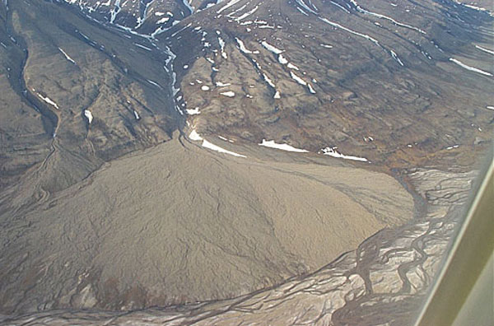
17
This is an example of a...

Slide 136
17
This is an example of a...
Allulival Fan

Slide 137
Which is true of the headwaters?
  A.) Low velocity, low oxygen, and high nutrients
  B.) High velocity, high oxygen and low nutrients
  C.) High sediment, low velocity
  D.) Where salt water mixes with freshwater
18

Slide 138
Which is true of the headwaters?
  A.) Low velocity, low oxygen, and high nutrients
  B.) High velocity, high oxygen and low nutrients
  C.) High sediment, low velocity
  D.) Where salt water mixes with freshwater
18

Slide 139
Which is true of the headwaters?
  A.) Low velocity, low oxygen, and high nutrients
  B.) High velocity, high oxygen and low nutrients
  C.) High sediment, low velocity
  D.) Where salt water mixes with freshwater
18

Slide 140

Which is true of the headwaters?
  A.) Low velocity, low oxygen, and high nutrients
  B.) High velocity, high oxygen and low nutrients
  C.) High sediment, low velocity
  D.) Where salt water mixes with freshwater
18

Slide 141
Which direction is
the river flowing?
A
?
Name
B
19

Slide 142
Which direction is
the river flowing?
A
?
Name
B
19

Slide 143
A
?
Name
19

Slide 144
A
?
Name
19

Slide 145
A
Confluence
19

Slide 146
20
?
?
?
?
?
Yazoo tributaries run
parallel to a river
in the floodplain
because of the
natural levees
Natural Levee

Slide 147
20
?
?
?
?
?
Yazoo tributaries run
parallel to a river
in the floodplain
because of the
natural levees
Natural Levee

Slide 148
20
Yazoo tributaries run
parallel to a river
in the floodplain
because of the
natural levees
Yazoo
Natural Levee

Slide 149
Rivers and Watersheds Review Game
A RIVER RUNS THROUGH IT | A DAY ON THE RIVER | MUDDY WATERS | HIGH WATER | BONUS FAMOUS FISH
1 | 6 | 11 | 16 | *21
2 | 7 | 12 | 17 | *22
3 | 8 | 13 | 18 | *23
4 | 9 | 14 | 19 | *24
5 | 10 | 15 | 20 | *25
Copyright © 2024 SlideSpark .LLC

Slide 150
Rivers and Watersheds Review Game
A RIVER RUNS THROUGH IT | A DAY ON THE RIVER | MUDDY WATERS | HIGH WATER | BONUS FAMOUS FISH
1 | 6 | 11 | 16 | *21
2 | 7 | 12 | 17 | *22
3 | 8 | 13 | 18 | *23
4 | 9 | 14 | 19 | *24
5 | 10 | 15 | 20 | *25
Copyright © 2024 SlideSpark .LLC

Slide 151
The underwater scene below occurred in what movie?
*21
Copyright © 2024 SlideSpark .LLC

Slide 152
The underwater scene below occurred in what movie?
Harry Potter and the Goblet of Fire
*21
Copyright © 2024 SlideSpark .LLC

Slide 153
The scene below is from what movie starring Will Smith?
*22
Copyright © 2024 SlideSpark .LLC

Slide 154
The scene below is from what movie starring Will Smith? Shark Tales (2004)
*22
Copyright © 2024 SlideSpark .LLC

Slide 155
*23
Name the brand of fish stick
23
Copyright © 2024 SlideSpark .LLC

Slide 156
*23
Name the brand of fish stick
23
Copyright © 2024 SlideSpark .LLC

Slide 157
Name the company that makes these Goldfish?
24
Copyright © 2024 SlideSpark .LLC

Slide 158
Name the company that makes these Goldfish?
24
Copyright © 2024 SlideSpark .LLC

Slide 159
Name the company that makes these Goldfish?
24
Pepperidge Farm
Copyright © 2024 SlideSpark .LLC

Slide 160
What words are blocked out below in this Dr. Seuss Classic?
*25
Copyright © 2024 SlideSpark .LLC

Slide 161
What words are blocked out below in this Dr. Seuss Classic?
*25
Copyright © 2024 SlideSpark .LLC

Slide 162
What words are blocked out below in this Dr. Seuss Classic?
*25
Copyright © 2024 SlideSpark .LLC

Slide 163
What words are blocked out below in this Dr. Seuss Classic?
one fish,
*25
Copyright © 2024 SlideSpark .LLC

Slide 164
What words are blocked out below in this Dr. Seuss Classic?
one fish, two fish,
*25
Copyright © 2024 SlideSpark .LLC

Slide 165
What words are blocked out below in this Dr. Seuss Classic?
one fish, two fish, red fish,
*25
Copyright © 2024 SlideSpark .LLC

Slide 166
What words are blocked out below in this Dr. Seuss Classic?
one fish, two fish, red fish, blue fish
*25
Copyright © 2024 SlideSpark .LLC

Slide 167
Rivers and Watersheds Review Game
A RIVER RUNS THROUGH IT | A DAY ON THE RIVER | WATER QUALITY | HIGH WATER | BONUS FAMOUS FISH
1 | 6 | 11 | 16 | *21
2 | 7 | 12 | 17 | *22
3 | 8 | 13 | 18 | *23
4 | 9 | 14 | 19 | *24
5 | 10 | 15 | 20 | *25
Copyright © 2024 SlideSpark .LLC

Slide 168
Rivers and Watersheds Review Game
A RIVER RUNS THROUGH IT | A DAY ON THE RIVER | WATER QUALITY | HIGH WATER | BONUS FAMOUS FISH
1 | 6 | 11 | 16 | *21
2 | 7 | 12 | 17 | *22
3 | 8 | 13 | 18 | *23
4 | 9 | 14 | 19 | *24
5 | 10 | 15 | 20 | *25
Final Question:________
Copyright © 2024 SlideSpark .LLC

Slide 170
“This is a 5 pt wager question.”

Slide 171
Name the five rivers in the United States that are highlighted on the next slide?

Slide 172
\
St. Lawrence

Slide 173
\
St. Lawrence

Slide 174
\
St. Lawrence

Slide 175
\
St. Lawrence

Slide 176
\
St. Lawrence

Slide 177
\
St. Lawrence

Slide 178
\
St. Lawrence

Slide 179
\
St. Lawrence

Slide 180
\
St. Lawrence

Slide 181
\
St. Lawrence

Slide 182
\
St. Lawrence

Slide 183
\
St. Lawrence

Slide 184
Is your name on the review sheet?
Name

Slide 185

Questions 1-20 = 5pts Each
Final Category (Bonus) = 1pt Each
Final Questions = 5 pt wager
Find the Owl = + 1pt
Secretly write “Owl” in the correct box worth 1pt.

Slide 186
Review Game
Part 1
Lesson 7

Slide 187



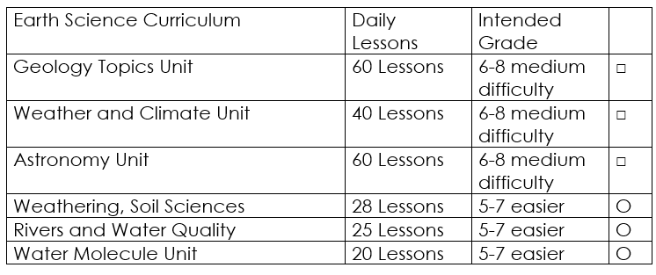

Curriculum Guide
Number of Lessons in each unit (50 min, daily lessons) and difficult rating scale / intended grade level.
=Easier, = More difficult, =Most difficult
Earth Science Units

Slide 188


Life Science Units

Slide 189

Physical Science

Slide 190
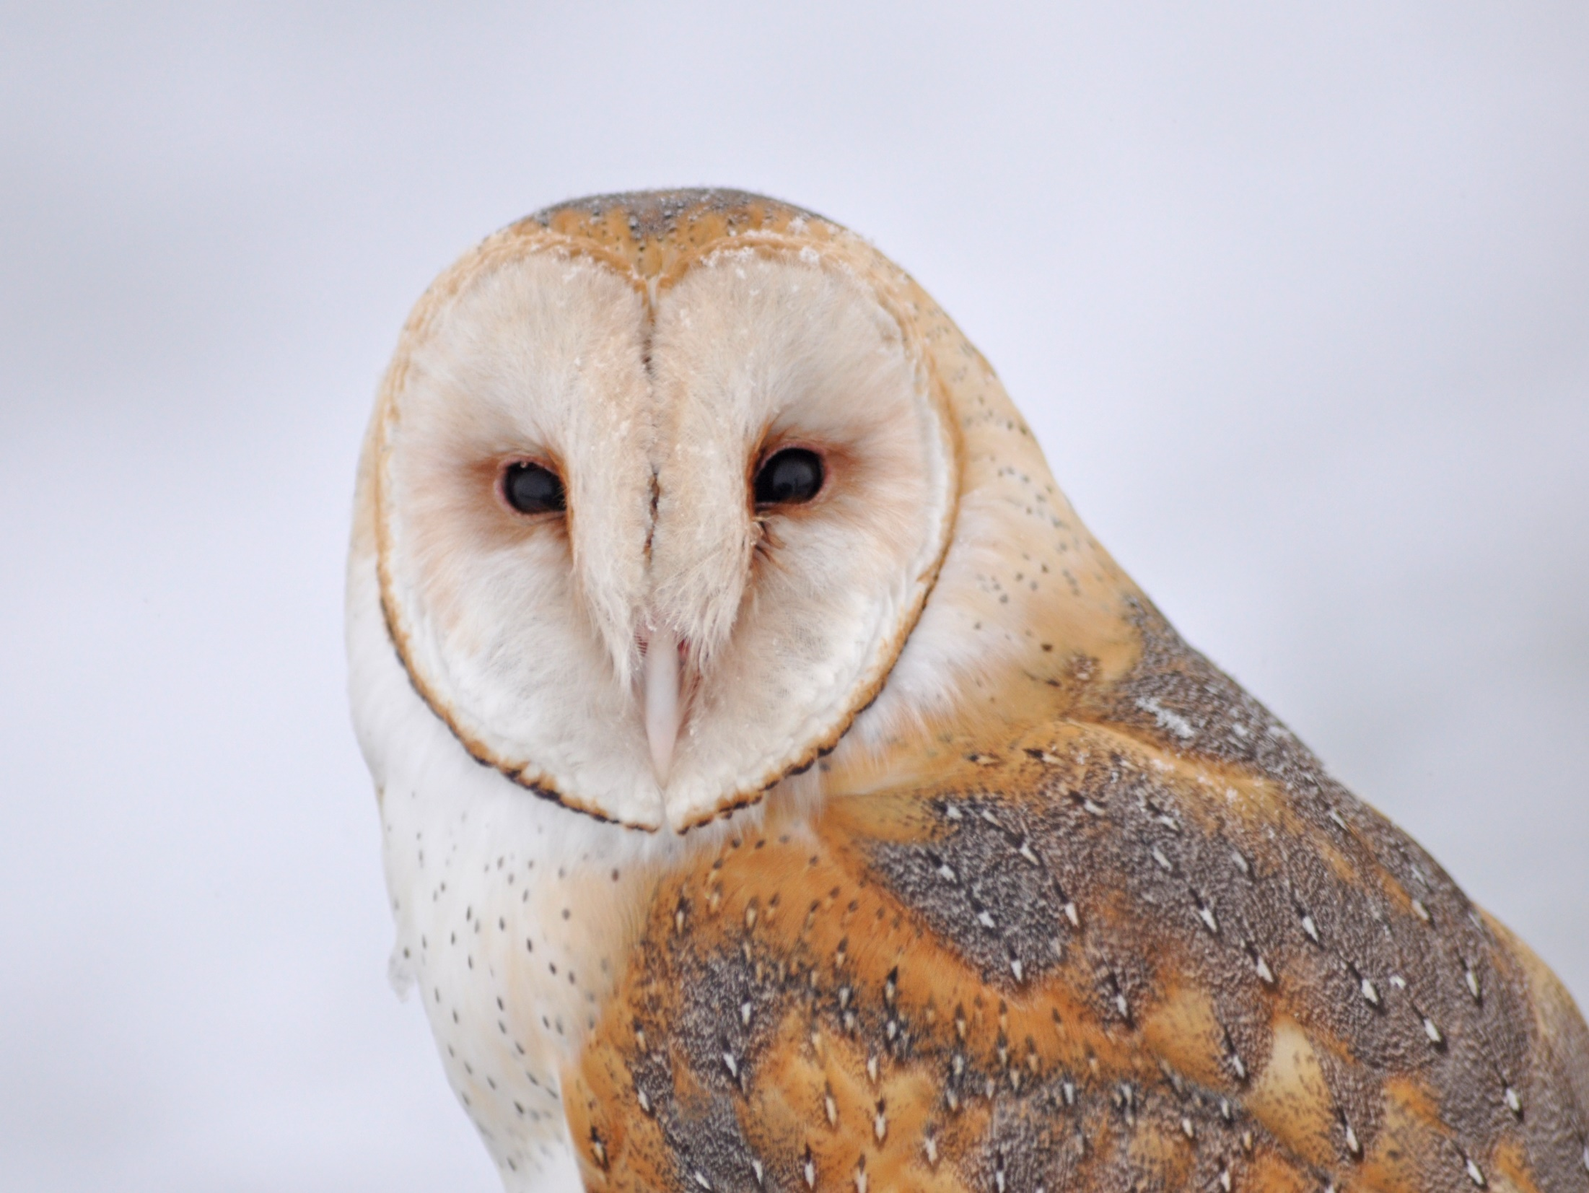
Dear Valued Educator,
Our fully editable .pptx and .doc resources are perfect for educators looking to bring enthusiasm and creativity to their lessons. We encourage you to make changes to fit your needs and style. As science educators, we’re committed to providing students with the tools they need to succeed in the classroom and beyond. Each unit in the curriculum includes a range of resources that have been developed through extensive research and use in a busy classroom. Our teaching approach is designed to make science education engaging and exciting for learners of all ages. We offer a one-of-a-kind science curriculum that will challenge, inspire, and educate students to become tomorrow's scientists and leaders. Join us today and learn more about how our program can help you achieve your classroom goals.
With appreciation,
Support@SlideSpark.net

Slide 191





Thank you for your time and interest in our Science curriculum. We strive to provide students with engaging and informative lessons that will spark their curiosity and encourage scientific exploration. Should you have any questions or concerns, please do not hesitate to contact us. Thank you again for considering our curriculum, and we wish you all the best in your educational journey.
Sincerely,
Support@slidespark.net
SlideSpark Science on TpT

