Slide 1
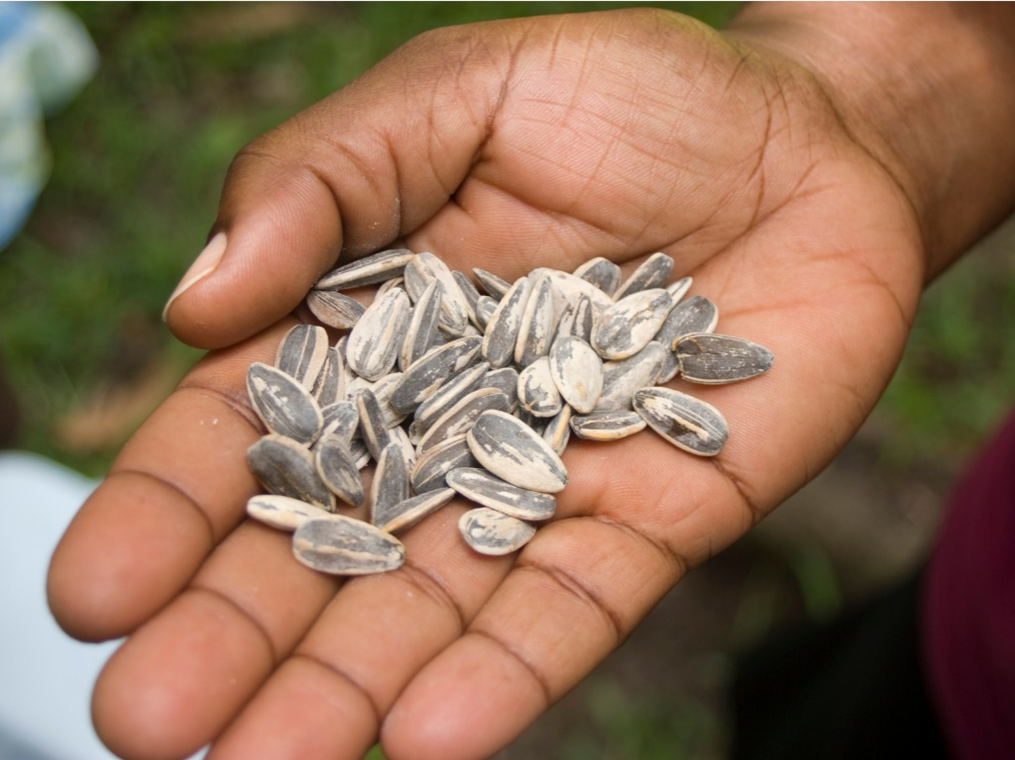

Seeds
Part 3
Lesson 1

Slide 2
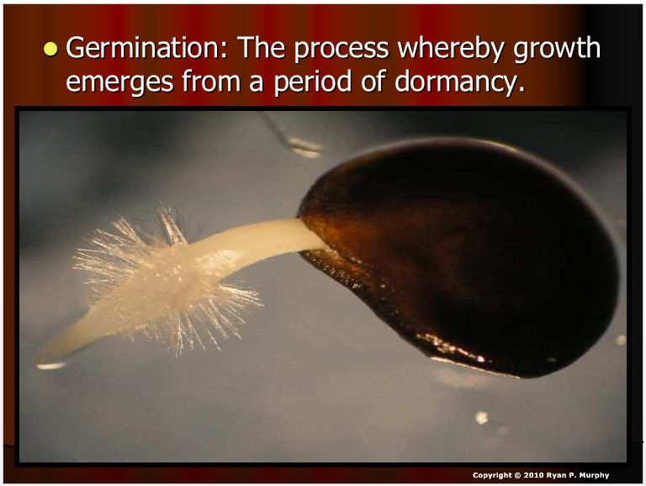

RED SLIDE: These slides contain critical notes and important fill-in the blanks. Please record the important terms in your work bundle.
First and last Name
Science, Grade, Class
Copyright © 2024 SlideSpark .LLC

Slide 3
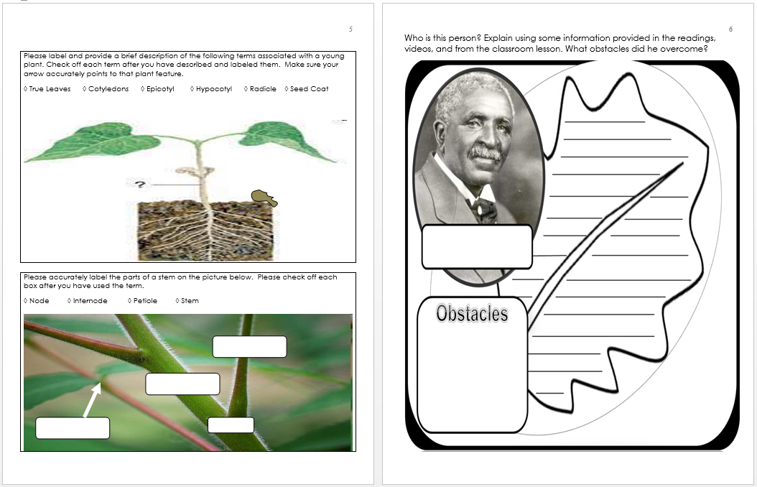
RED SLIDE: These slides contain critical notes and important fill-in the blanks. Please record the important terms in your work bundle.
  You’ll need these notes to complete the work bundle
First and last Name
Science, Grade, Class
Copyright © 2024 SlideSpark .LLC

Slide 4
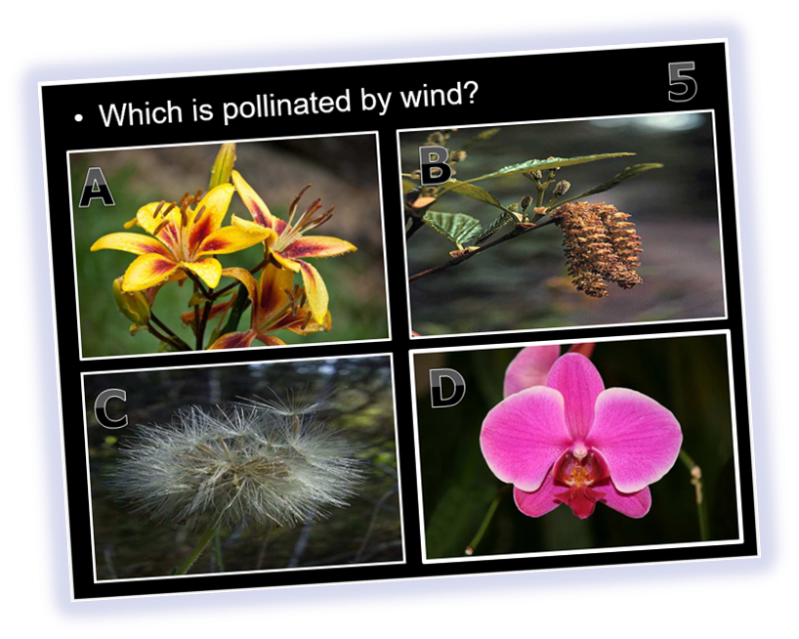
RED SLIDE: These slides contain critical notes and important fill-in the blanks. Please record the important terms in your work bundle.
  You’ll need these notes to complete the work bundle and to be successful on the review game.
First and last Name
Science, Grade, Class
Copyright © 2024 SlideSpark .LLC

Slide 5
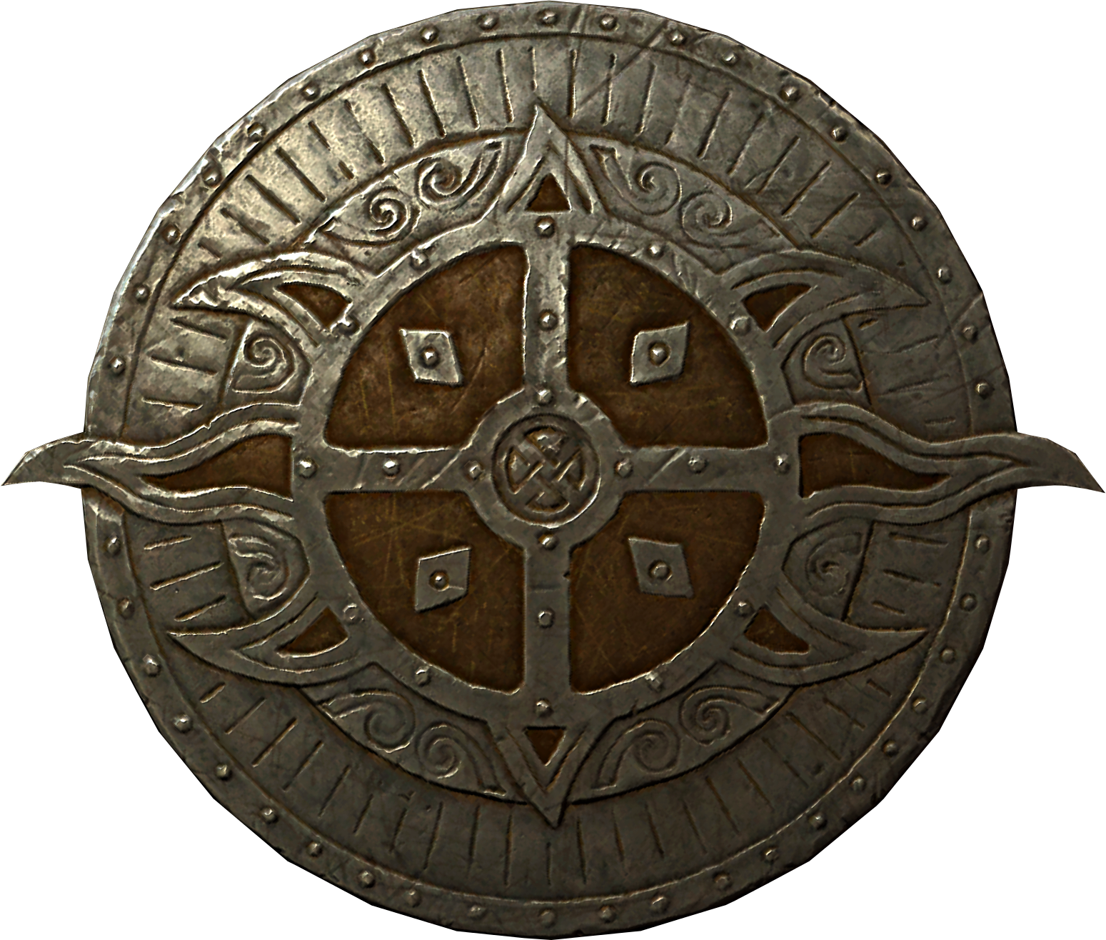
Listen to the teacher and others.
Please no
shout outs.
One speaker at a
time. Please
raise your
hand.
Respect
First,
Last,
and Always.
Safety
Make
Good
Choices
Be Present
Never
Give
Up!
Responsibility
Stay
Organized
Help
Others
Focus on
Task completion
Avoid
Distractions
Science from Murf LLC
Copyright © 2024 SlideSpark .LLC

Slide 6
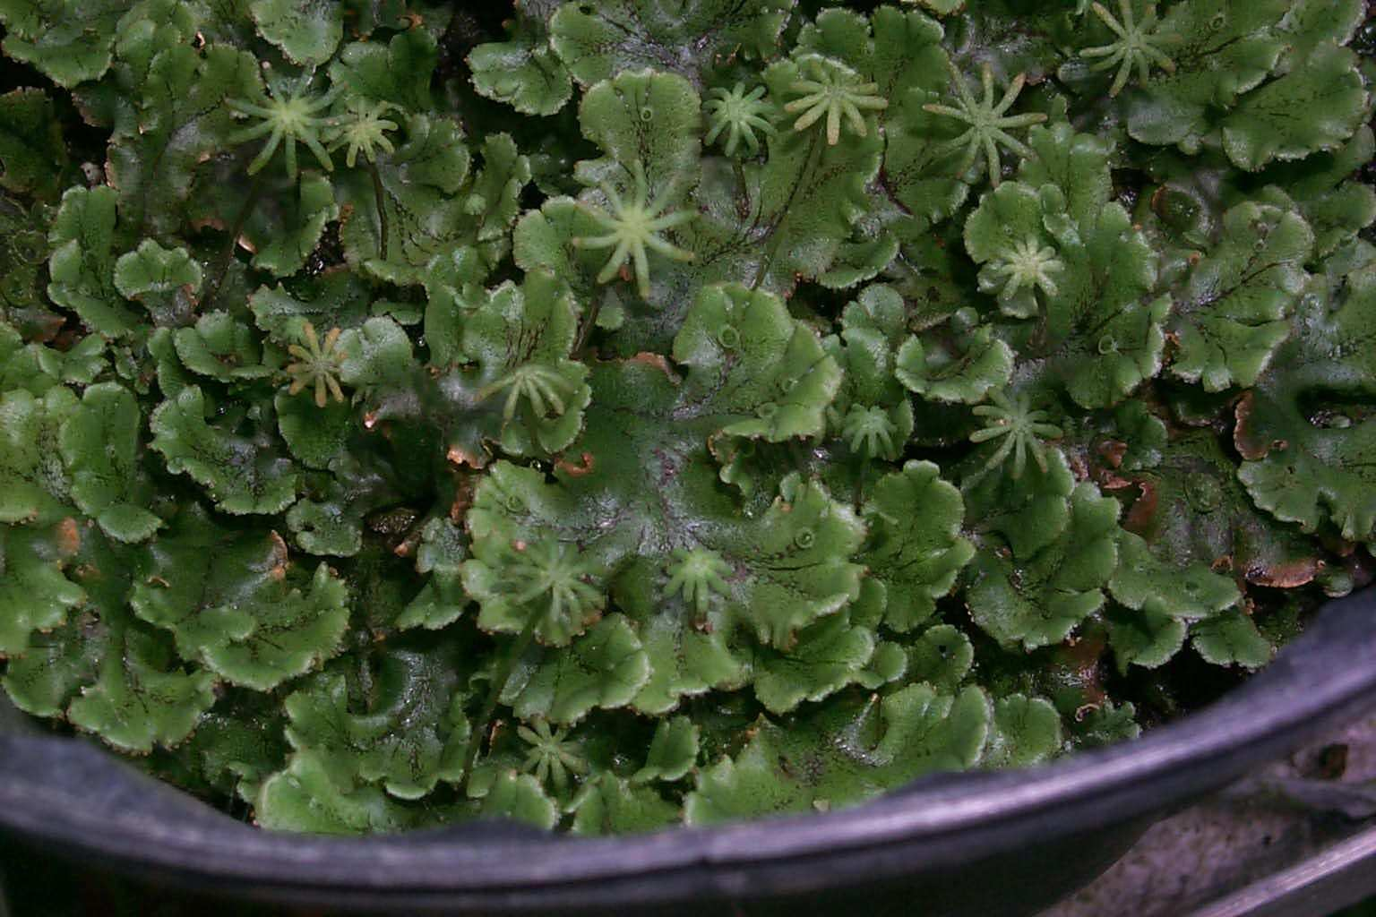
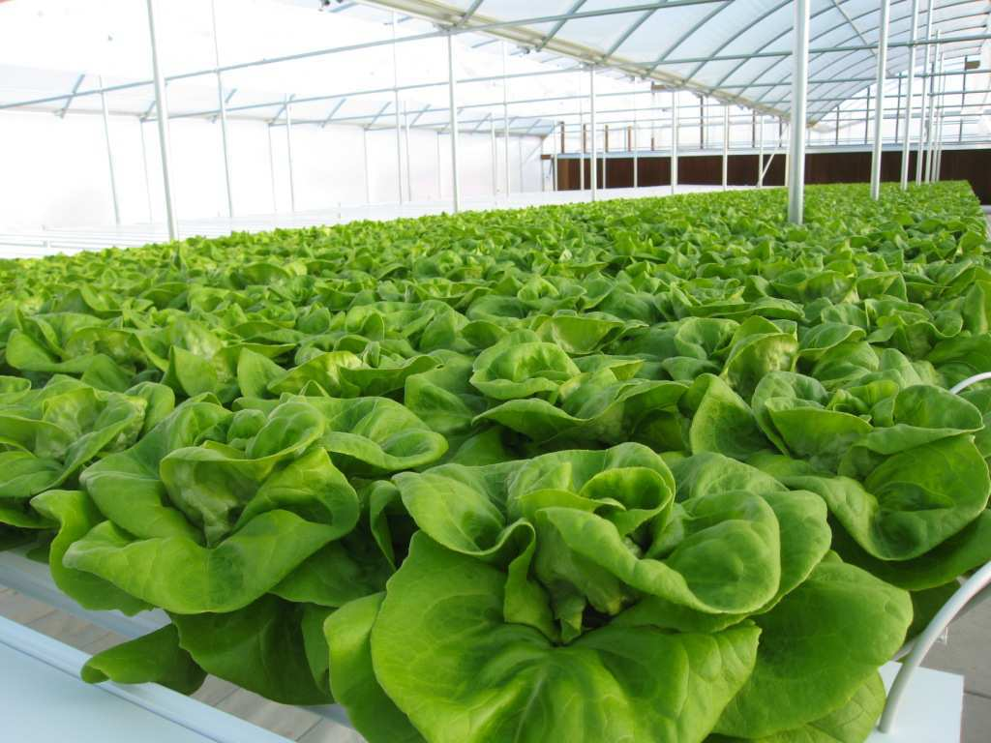
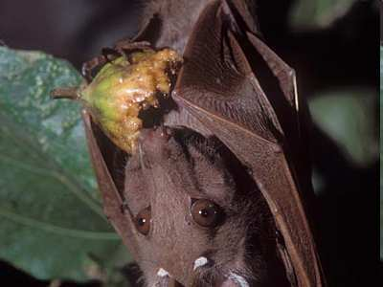
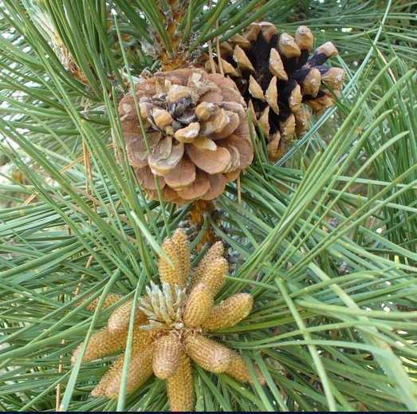
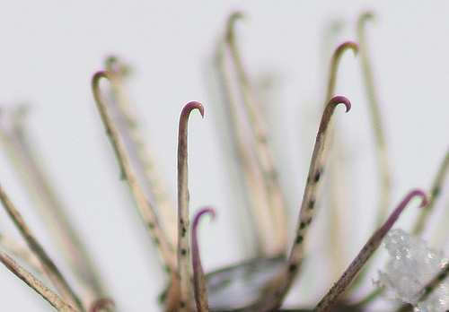
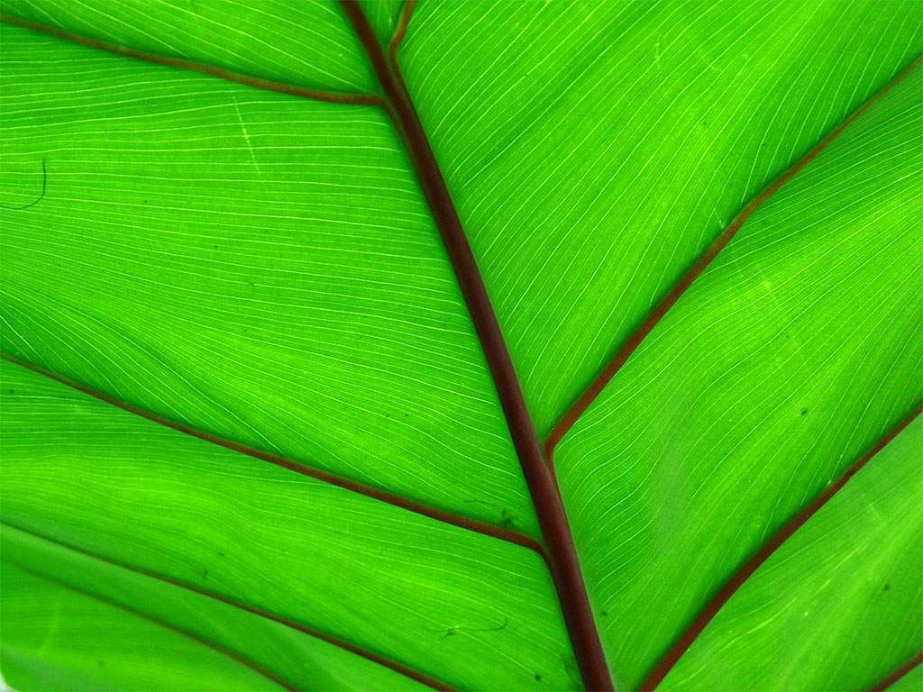
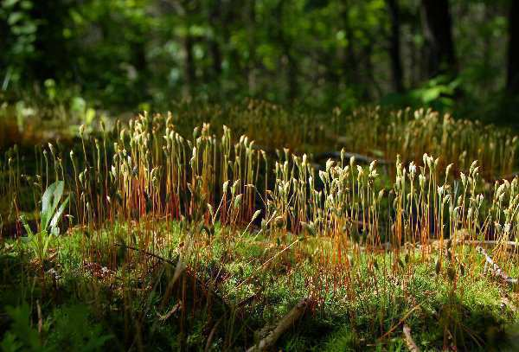
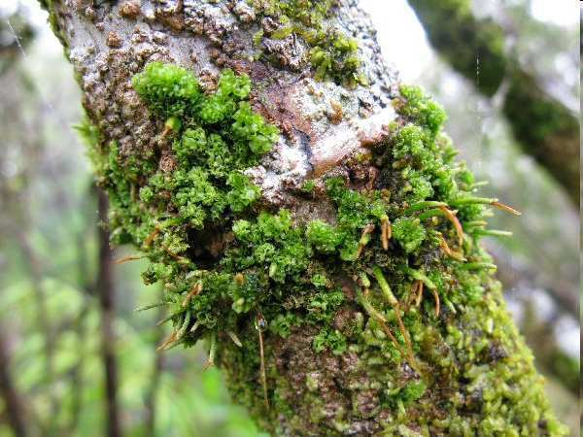
Plants, Eukaryotic, multi-cellular,
and photosynthetic.
Capturing energy from the sun
Using CO2 and water to…
create sugar and oxygen.
connected to animals, and
necessary for our survival

Slide 7
Plants, Eukaryotic, multi-cellular,
and photosynthetic.
Capturing energy from the sun
Using CO2 and water to…
create sugar and oxygen.
connected to animals, and
necessary for our survival

Slide 8
Plants, Eukaryotic, multi-cellular,
and photosynthetic.
Capturing energy from the sun
Using CO2 and water to…
create sugar and oxygen.
connected to animals, and
necessary for our survival

Slide 9
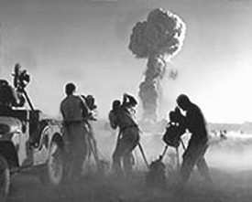
Next Area of Focus: ________ ?
Copyright © 2024 SlideSpark .LLC

Slide 10
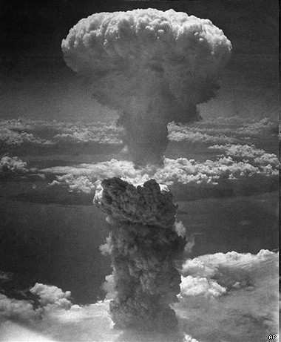
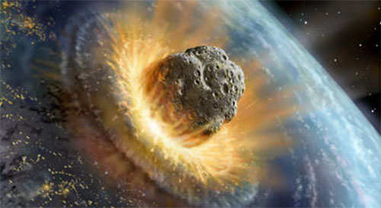
Activity! Imagine nuclear war broke out, or a meteor impacted on the planet, super volcanic event, or a virus killed every plant and seed, on the planet.
  What next? Create a 5 step plan for you to survive.
  Title your entry as your Doomsday survival plan.
Copyright © 2024 SlideSpark .LLC

Slide 11
Activity! Imagine nuclear war broke out, or a meteor impacted on the planet, super volcanic event, or a virus killed every plant and seed, on the planet.
  What next? Create a 5 step plan for you to survive.
  Title your entry as your Doomsday survival plan.
Copyright © 2024 SlideSpark .LLC

Slide 12
Activity! Imagine nuclear war broke out, or a meteor impacted on the planet, super volcanic event, or a virus killed every plant and seed, on the planet.
  What next? Create a 5 step plan for you to survive.
  Title your entry as your Doomsday survival plan.
Copyright © 2024 SlideSpark .LLC

Slide 13
Activity! Imagine nuclear war broke out, or a meteor impacted on the planet, super volcanic event, or a virus killed every plant and seed, on the planet.
  What next? Create a 5 step plan for you to survive.
  Title your entry as your Doomsday survival plan.
Copyright © 2024 SlideSpark .LLC

Slide 14
Activity! Imagine nuclear war broke out, or a meteor impacted on the planet, super volcanic event, or a virus killed every plant and seed, on the planet.
  What next? Create a 5 step plan for you to survive.
  Title your entry as your Doomsday survival plan.
Copyright © 2024 SlideSpark .LLC

Slide 15
Activity! Imagine nuclear war broke out, or a meteor impacted on the planet, super volcanic event, or a virus killed every plant and seed, on the planet.
  What next? Create a 5 step plan for you to survive.
  Title your entry as your Doomsday survival plan.
Copyright © 2024 SlideSpark .LLC

Slide 16
Activity! Imagine nuclear war broke out, or a meteor impacted on the planet, super volcanic event, or a virus killed every plant and seed, on the planet.
  What next? Create a 5 step plan for you to survive.
  Title your entry as your Doomsday survival plan.
Copyright © 2024 SlideSpark .LLC

Slide 17
Activity! Imagine nuclear war broke out, or a meteor impacted on the planet, super volcanic event, or a virus killed every plant and seed, on the planet.
  What next? Create a 5 step plan for you to survive.
  Title your entry as your Doomsday survival plan.
Copyright © 2024 SlideSpark .LLC

Slide 18
Activity! Imagine nuclear war broke out, or a meteor impacted on the planet, super volcanic event, or a virus killed every plant and seed, on the planet.
  What next? Create a 5 step plan for you to survive.
  Title your entry as your Doomsday survival plan.
Copyright © 2024 SlideSpark .LLC

Slide 19

Activity! Imagine nuclear war broke out, or a meteor impacted on the planet, super volcanic event, or a virus killed every plant and seed, on the planet.
  What next? Create a 5 step plan for you to survive.
  Title your entry as your Doomsday survival plan.
Copyright © 2024 SlideSpark .LLC

Slide 20

Activity! Imagine nuclear war broke out, or a meteor impacted on the planet, super volcanic event, or a virus killed every plant and seed, on the planet.
  What next? Create a 5 step plan for you to survive.
  Title your entry as your Doomsday survival plan.
Copyright © 2024 SlideSpark .LLC

Slide 21
Activity! Imagine nuclear war broke out, or a meteor impacted on the planet, super volcanic event, or a virus killed every plant and seed on the planet. No more plants!
Copyright © 2024 SlideSpark .LLC

Slide 22
Activity! Imagine nuclear war broke out, or a meteor impacted on the planet, super volcanic event, or a virus killed every plant and seed on the planet. No more plants!
  What’s next? Create a 5 step plan for your survival.
  Title your entry as your Doomsday survival plan.
Copyright © 2024 SlideSpark .LLC

Slide 23
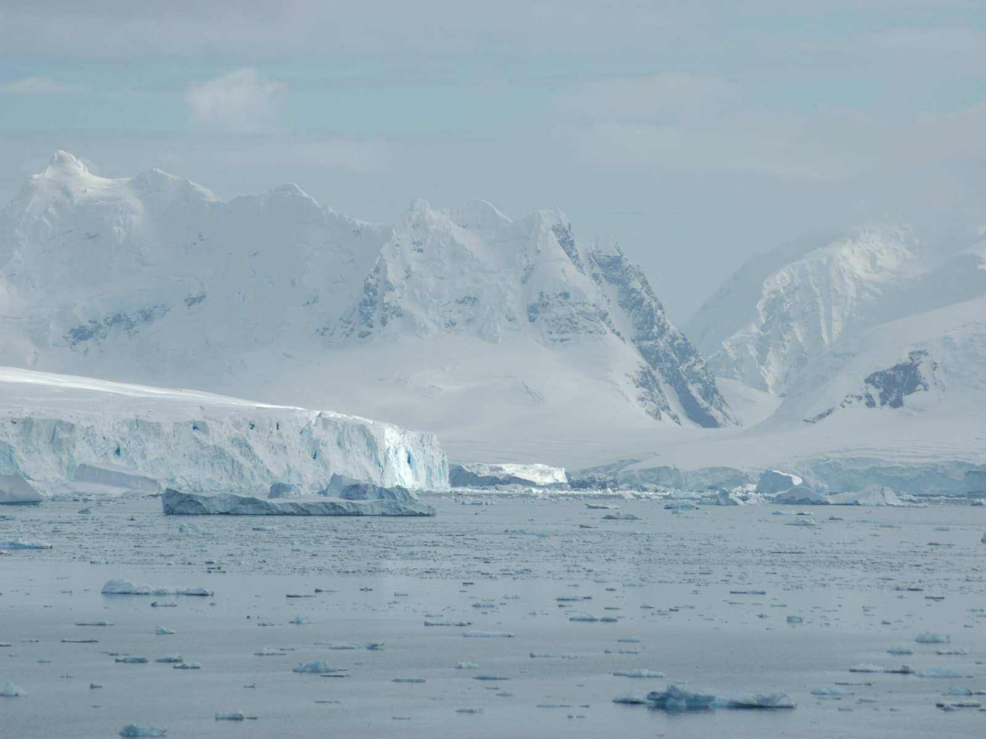
Artic Winds sound effects for trip at … http://www.youtube.com/watch?v=3yzwpn0VfQg

Slide 24
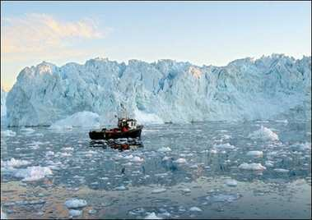
Find a boat and head North

Slide 25
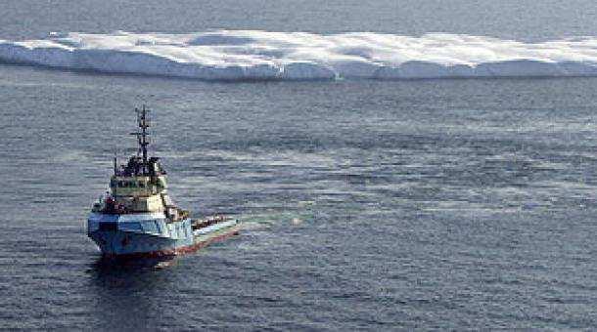
Keep Going

Slide 26
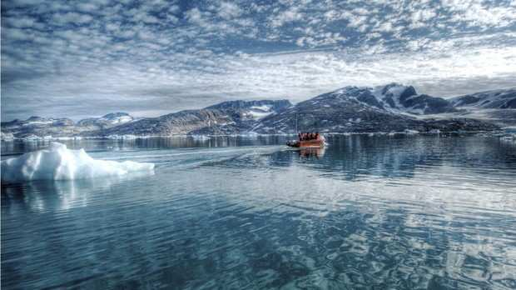
and going…

Slide 27
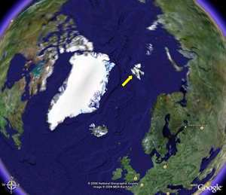
Travel Here

Slide 28
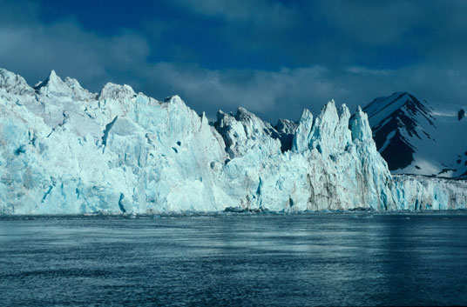
Make your way onto to Svalbard, Norway

Slide 29
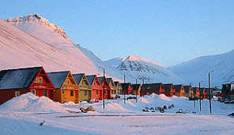
Northern most town in
the world…. Keep Going

Slide 30
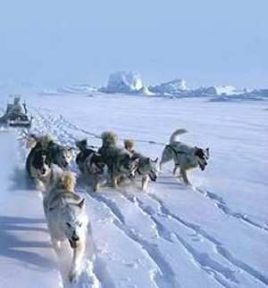
Find some sled dogs

Slide 31
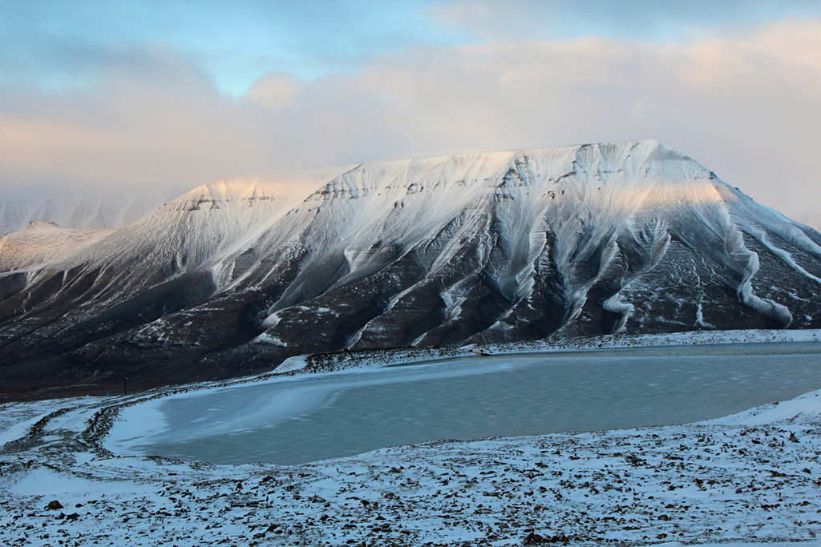
Keep Going

Slide 32
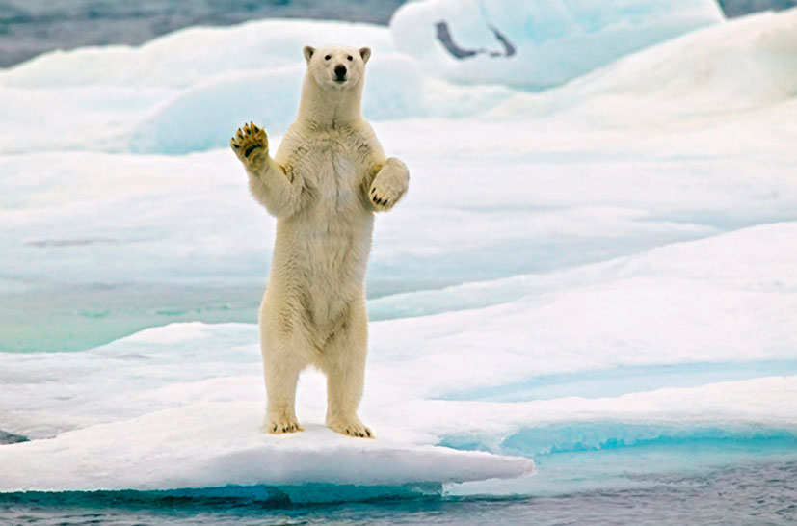
Look out for Polar Bears

Slide 33
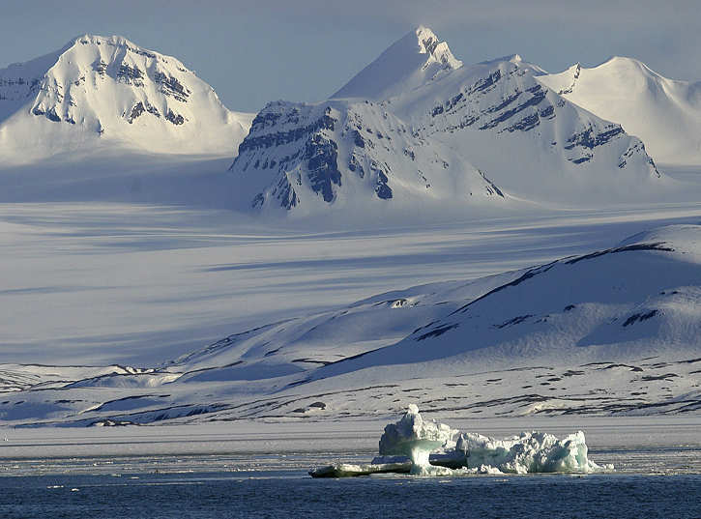
Keep Going

Slide 34
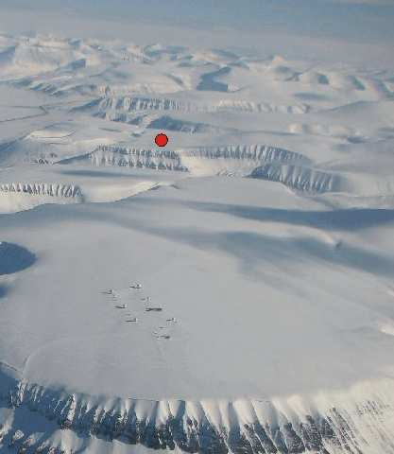
Go to this spot

Slide 35
Go to this spot
GPS 78°14′17″N 15°26′50″E﻿ / ﻿78.238166°N 15.447236°E

Slide 36
Go to this spot
GPS 78°14′17″N 15°26′50″E﻿ / ﻿78.238166°N 15.447236°E
Go into the valley

Slide 37
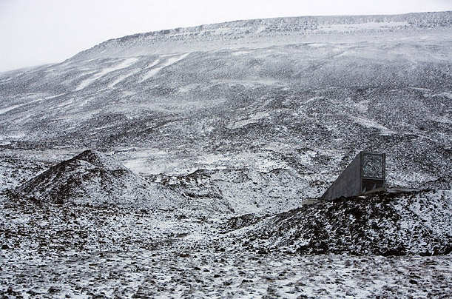

Slide 38
You can save the world here

Slide 39
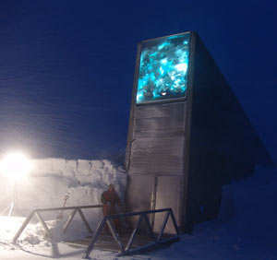

Slide 40
Go Inside the
Doomsday
Vault

Slide 41
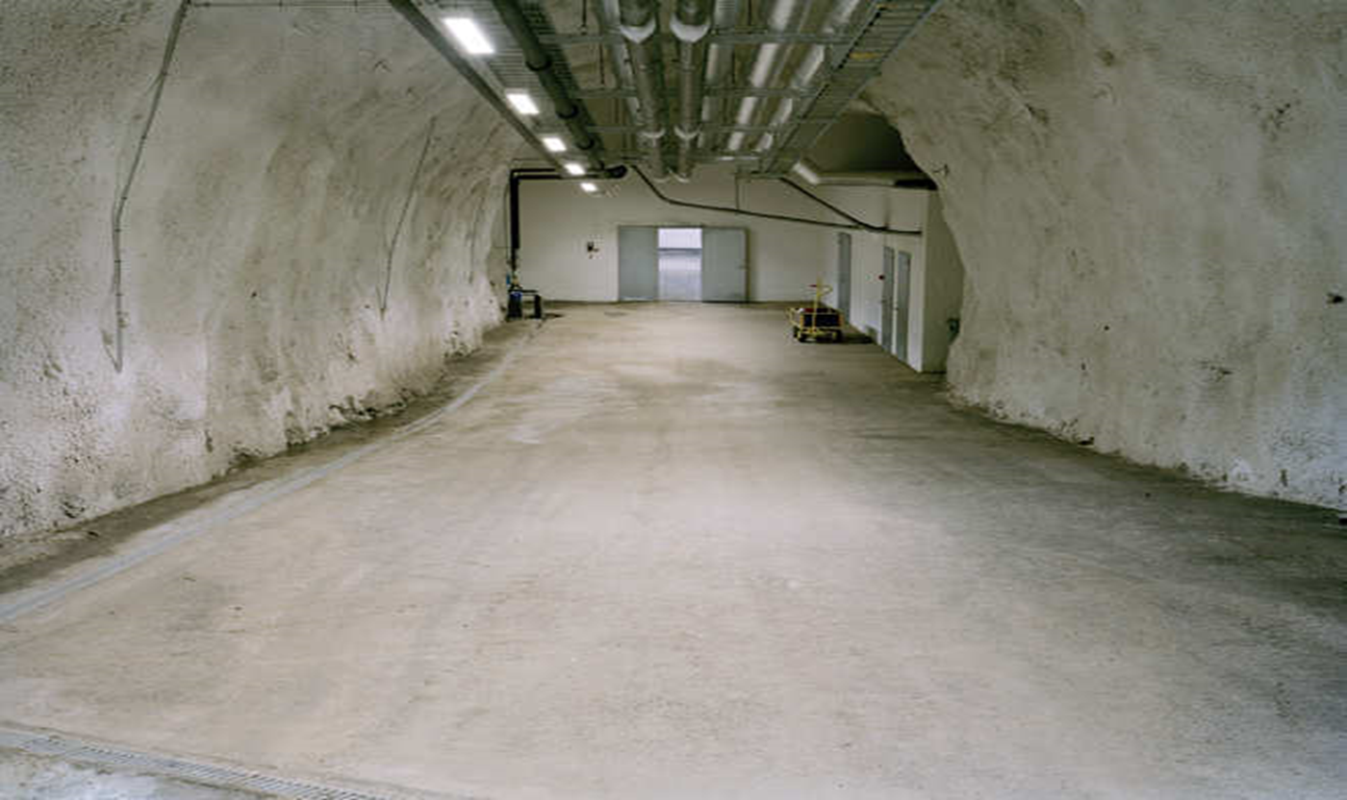

Slide 42
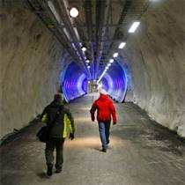
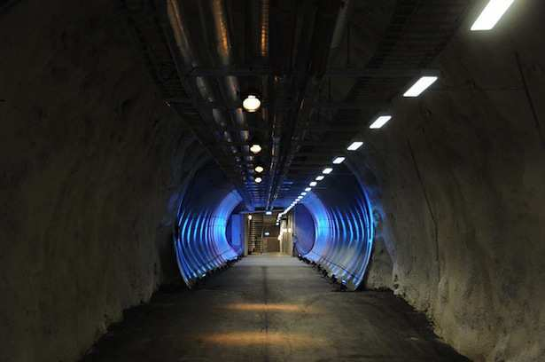
Head deep down the tunnel into the cold earth of the Arctic Circle….and look for?
Copyright © 2024 SlideSpark .LLC

Slide 43
Head deep down the tunnel into the cold earth of the Arctic Circle….and look for?
Keep Going
Copyright © 2024 SlideSpark .LLC

Slide 44

Head deep down the tunnel into the cold earth of the Arctic Circle….and look for?
Copyright © 2024 SlideSpark .LLC

Slide 45
Head deep down the tunnel into the cold earth of the Arctic Circle….and look for?
Keep Going
Copyright © 2024 SlideSpark .LLC

Slide 46
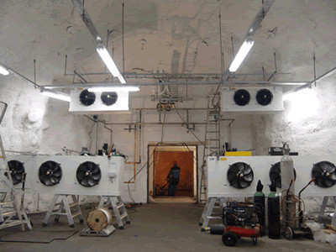
Video! The Doomsday Vault.
  Is it worth the money? You decide.
  http://www.youtube.com/watch?v=QbOl72aUthM
Learn more about the Svalbard Global Vault at… http://www.regjeringen.no/en/dep/lmd/campain/svalbard-global-seed-vault.html?id=462220
Copyright © 2024 SlideSpark .LLC

Slide 47
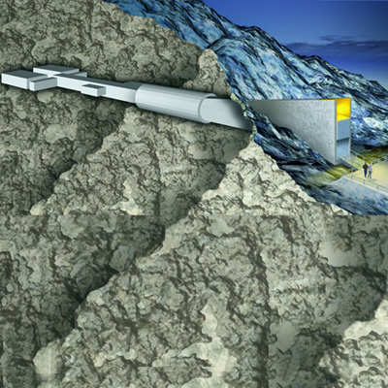
This vault...
  Insurance for crop diversity and to a way to avoid plant extinction.
  Mostly for plant breeders and researchers.
Copyright © 2024 SlideSpark .LLC

Slide 48
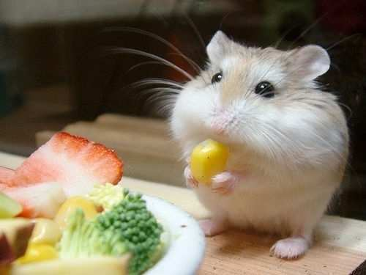

Slide 49


Activity! Germination Observation
  Planning ahead. Fill clear cup with water soaked cotton balls or paper towels. Place a large bean seed in cup so it’s pressed on to the side of the cup (visible). Record date and now wait.
Date____
Clear cd Case will work as well.

Slide 50
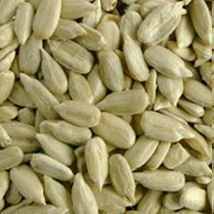
New Area of Focus: Seeds.

Slide 51
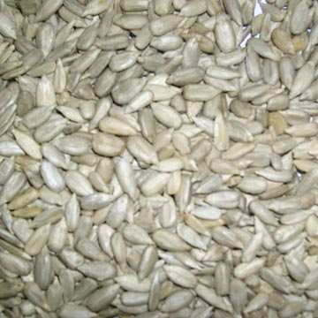
Seed: (Easy) A baby Plant.
Copyright © 2024 SlideSpark .LLC

Slide 52
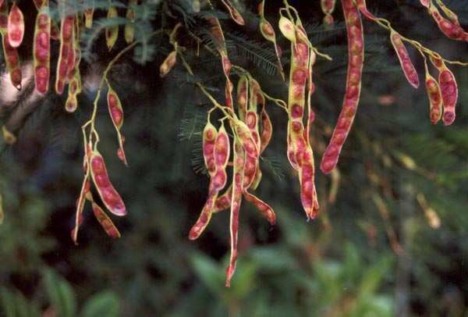
Seed: (Hard)
Copyright © 2024 SlideSpark .LLC

Slide 53
Seed: (Hard) A mature fertilized plant ovule consisting of an embryo,
Copyright © 2024 SlideSpark .LLC

Slide 54
Seed: (Hard) A mature fertilized plant ovule consisting of an embryo, its food source,
Copyright © 2024 SlideSpark .LLC

Slide 55
Seed: (Hard) A mature fertilized plant ovule consisting of an embryo, its food source, and having a protective coat.
Copyright © 2024 SlideSpark .LLC

Slide 56
Seed: (Hard) A mature fertilized plant ovule consisting of an embryo, its food source, and having a protective coat.
Copyright © 2024 SlideSpark .LLC

Slide 57
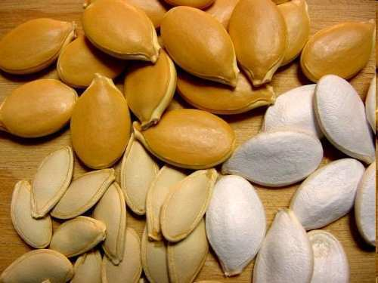
Activity! External Seed Observation before dissection.
  Please make detailed observations of the seeds on your table. Please include…
  Seed coat
  Where the seed attaches to the plant
  Color
  How is the seed spread? (Air, Animal, etc.)
Copyright © 2024 SlideSpark .LLC

Slide 58

Activity! External Seed Observation before dissection.
  Please make detailed observations of the seeds on your table. Please include…
  Seed coat
  Where the seed attaches to the plant
  Color
  How is the seed spread? (Air, Animal, etc.)
Copyright © 2024 SlideSpark .LLC

Slide 59
Activity! Seed Dissection. Please include…
Visual on next slide.
  Cotyledon: Leaf of the developing plant with stored food
  Seed Coat
  Radicle
  Hypocotyl
  Embryo (Hypocotyl / Radicle)
Copyright © 2024 SlideSpark .LLC

Slide 60
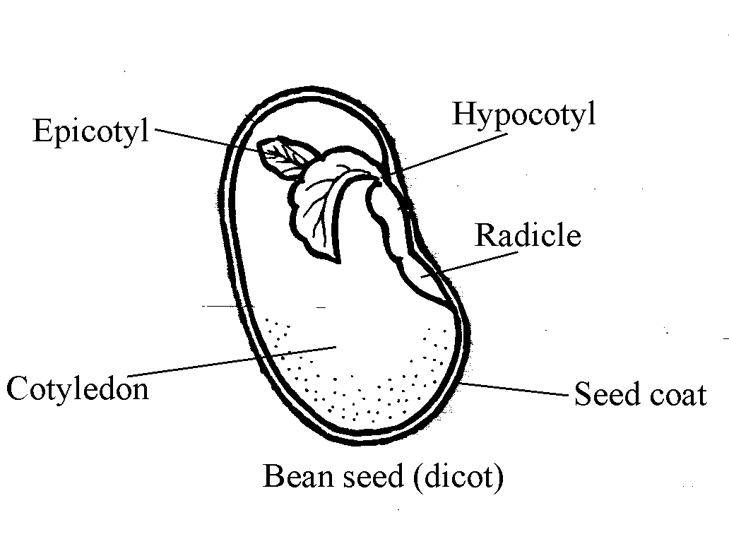

Slide 66
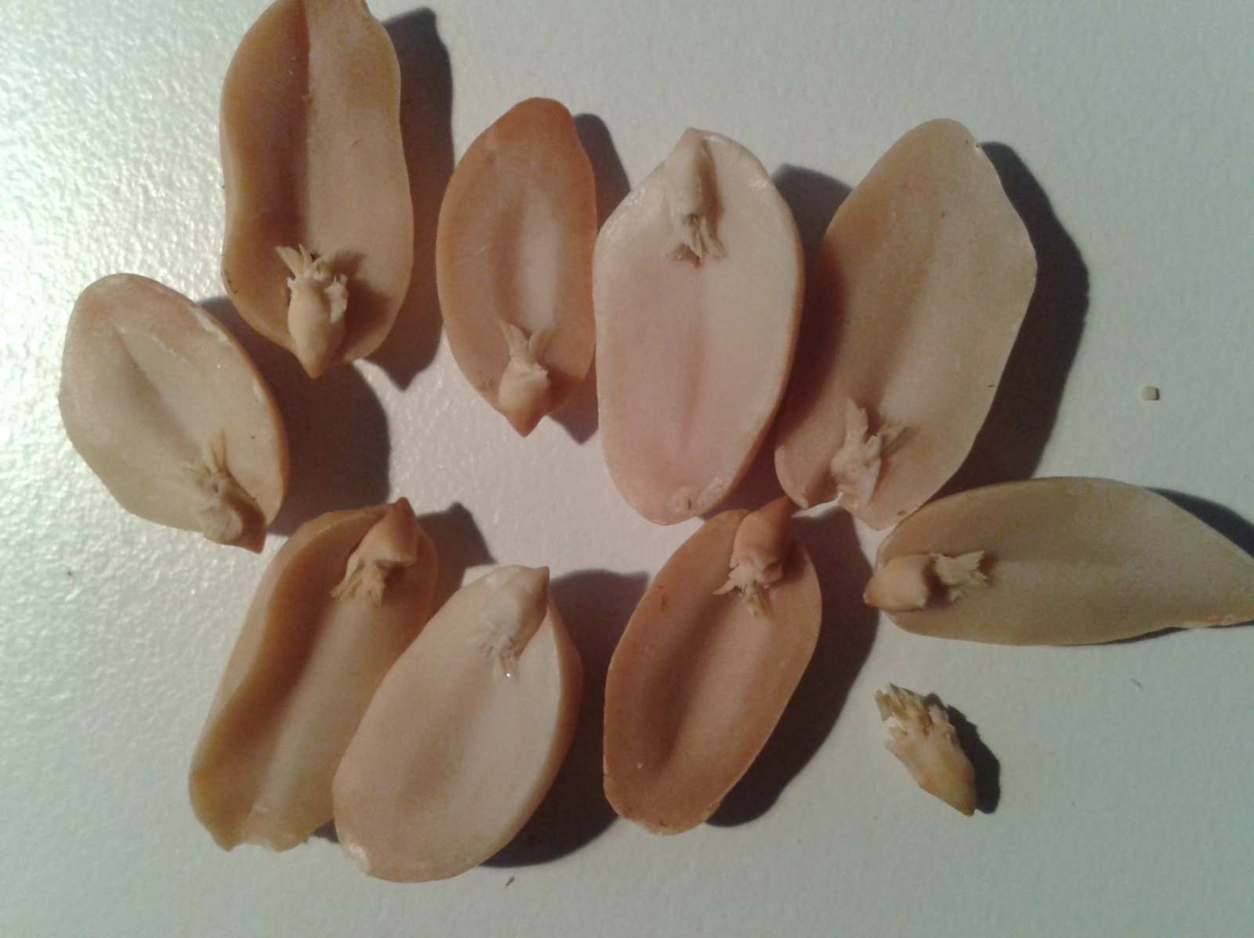
Hypocotyl
Epicotyl
Cotyledon
Radicle

Slide 67
Hypocotyl
Epicotyl
Cotyledon
Radicle

Slide 68
Hypocotyl
Epicotyl
Cotyledon
Radicle

Slide 69
Hypocotyl
Epicotyl
Cotyledon
Radicle

Slide 70
Hypocotyl
Epicotyl
Cotyledon
Radicle

Slide 71
Hypocotyl
Epicotyl
Cotyledon
Radicle

Slide 72
Hypocotyl
Epicotyl
Cotyledon
Radicle

Slide 73
Hypocotyl
Epicotyl
Cotyledon
Radicle

Slide 74
Hypocotyl
Epicotyl
Cotyledon
Radicle

Slide 75
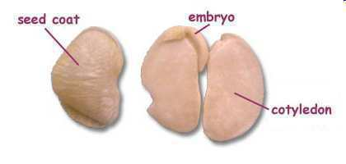
Seed Coat: Protects seed from drying out, aids in seed dispersal, opens when conditions are right.
Copyright © 2024 SlideSpark .LLC

Slide 76
Seeds
Part 3
Lesson 1

Slide 77



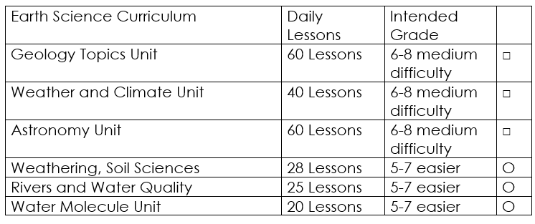

Curriculum Guide
Number of Lessons in each unit (50 min, daily lessons) and difficult rating scale / intended grade level.
=Easier, = More difficult, =Most difficult
Earth Science Units

Slide 78


Life Science Units

Slide 79

Physical Science

Slide 80
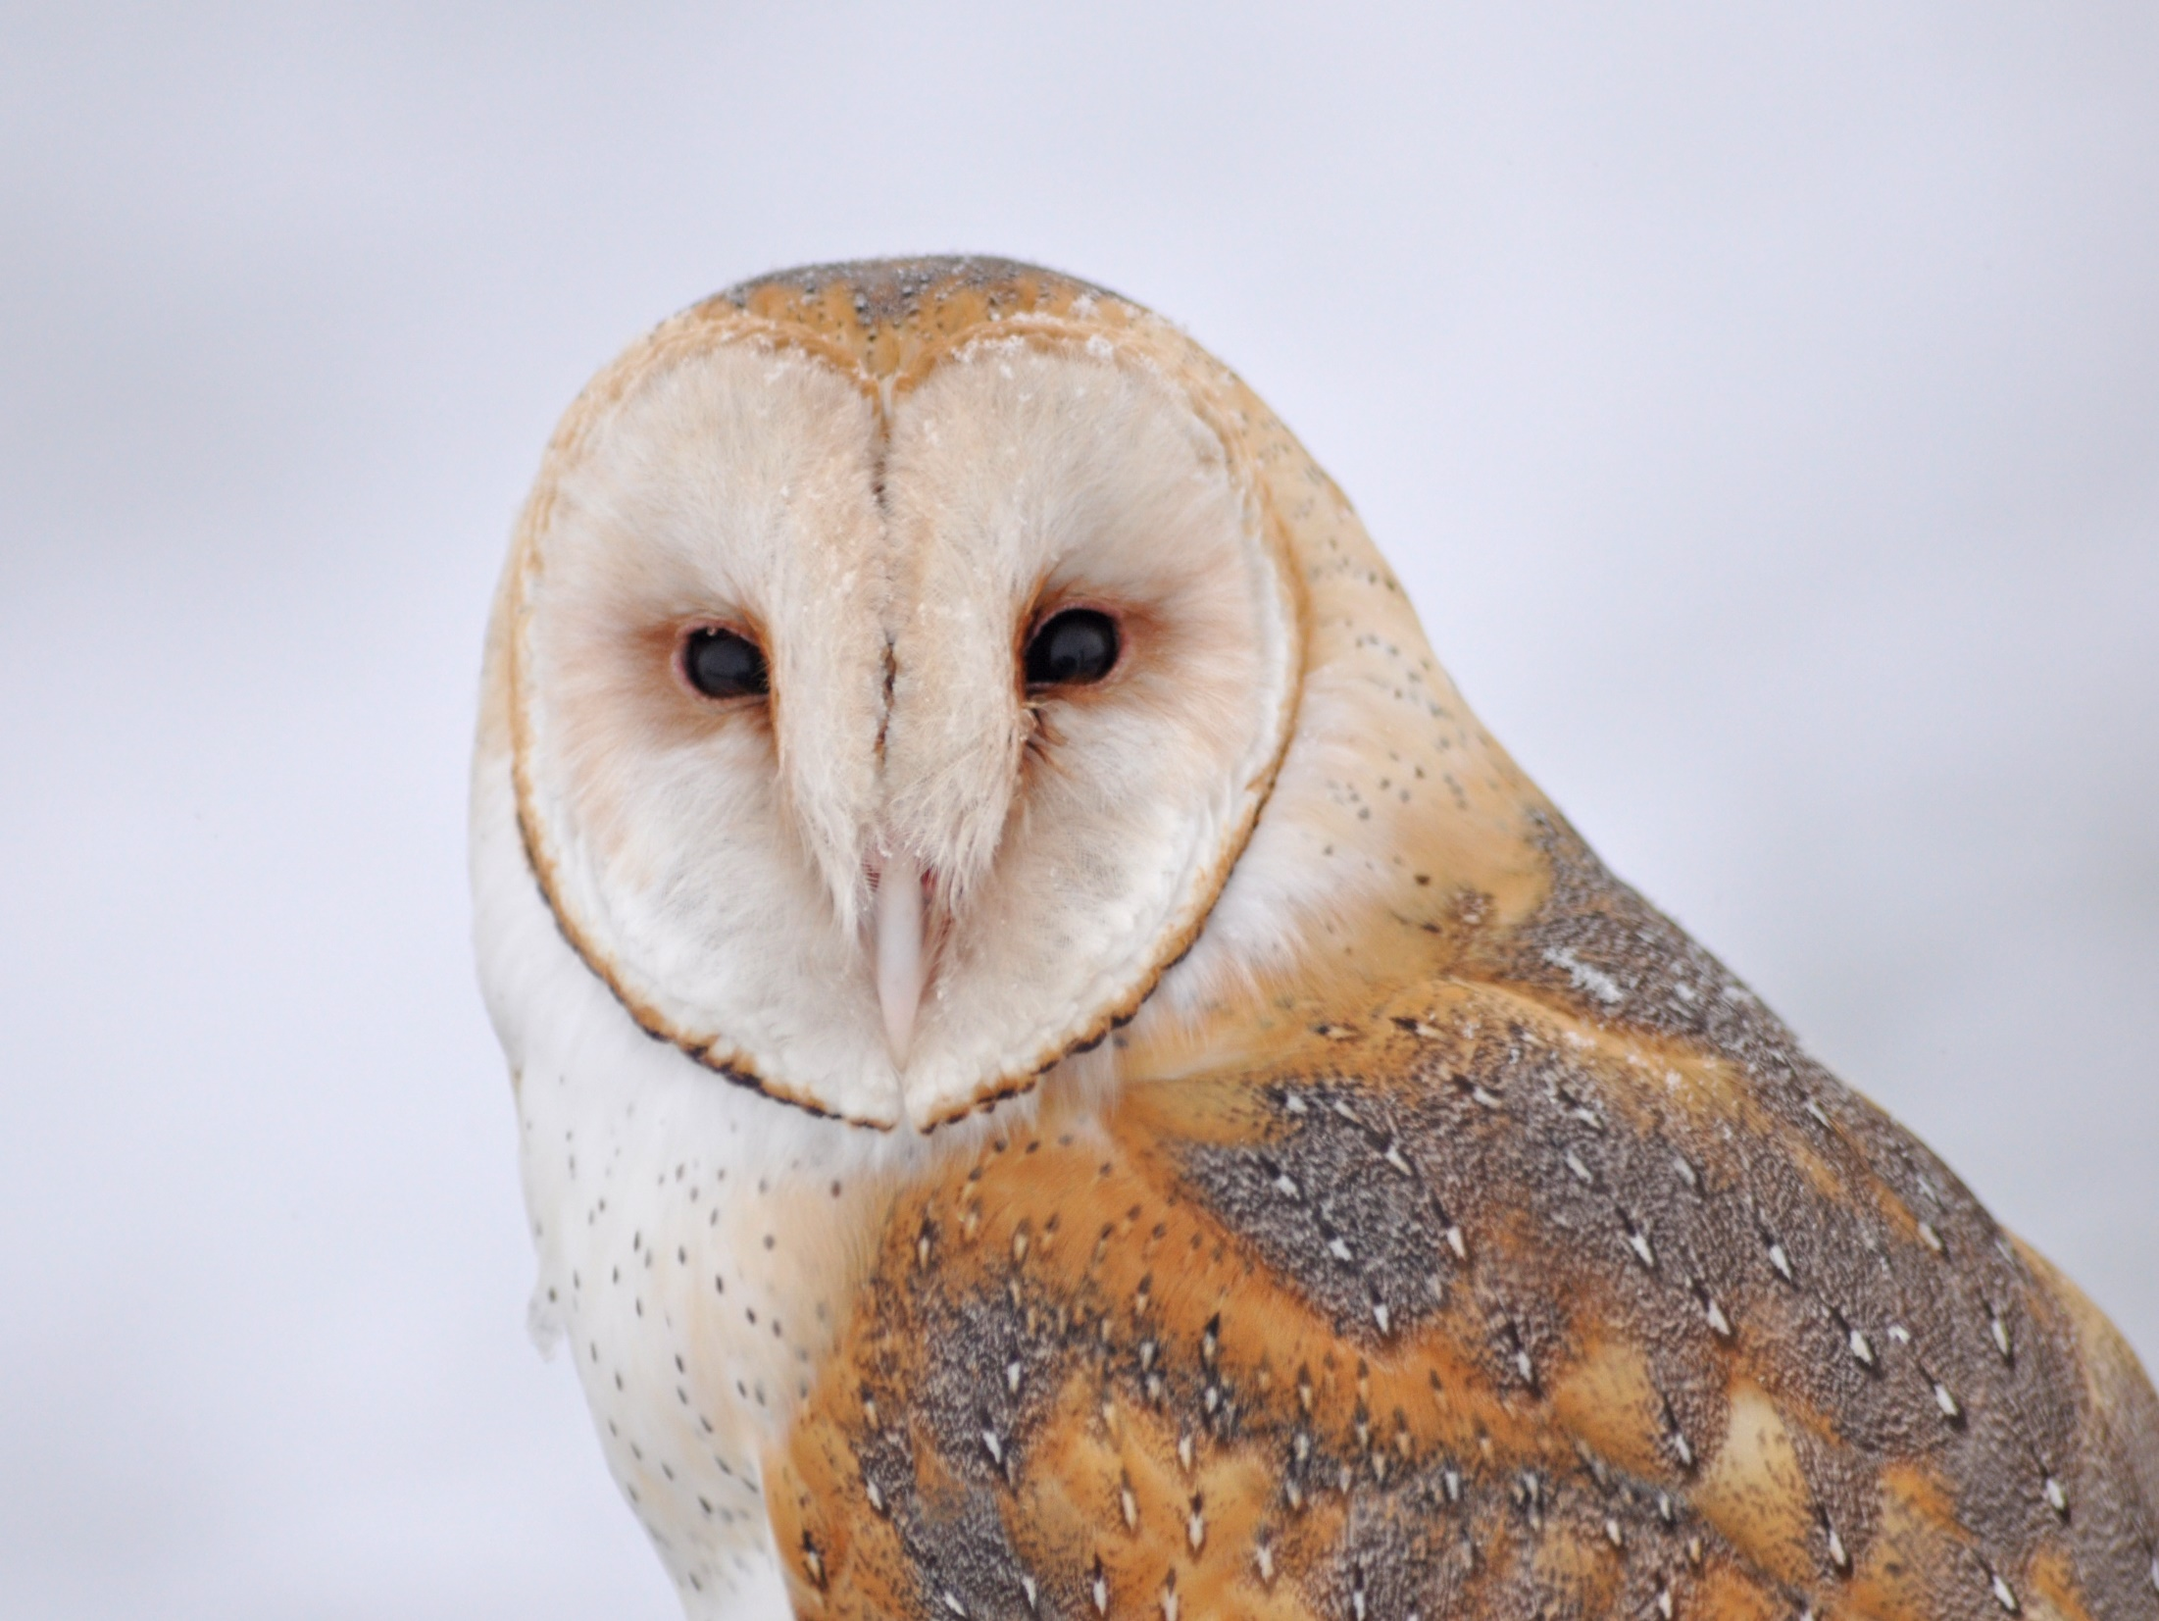
Dear Valued Educator,
Our fully editable .pptx and .doc resources are perfect for educators looking to bring enthusiasm and creativity to their lessons. We encourage you to make changes to fit your needs and style. As science educators, we’re committed to providing students with the tools they need to succeed in the classroom and beyond. Each unit in the curriculum includes a range of resources that have been developed through extensive research and use in a busy classroom. Our teaching approach is designed to make science education engaging and exciting for learners of all ages. We offer a one-of-a-kind science curriculum that will challenge, inspire, and educate students to become tomorrow's scientists and leaders. Join us today and learn more about how our program can help you achieve your classroom goals.
With appreciation,
Support@SlideSpark.net

Slide 81





Thank you for your time and interest in our Science curriculum. We strive to provide students with engaging and informative lessons that will spark their curiosity and encourage scientific exploration. Should you have any questions or concerns, please do not hesitate to contact us. Thank you again for considering our curriculum, and we wish you all the best in your educational journey.
Sincerely,
Support@slidespark.net
SlideSpark Science on TpT

