Slide 1
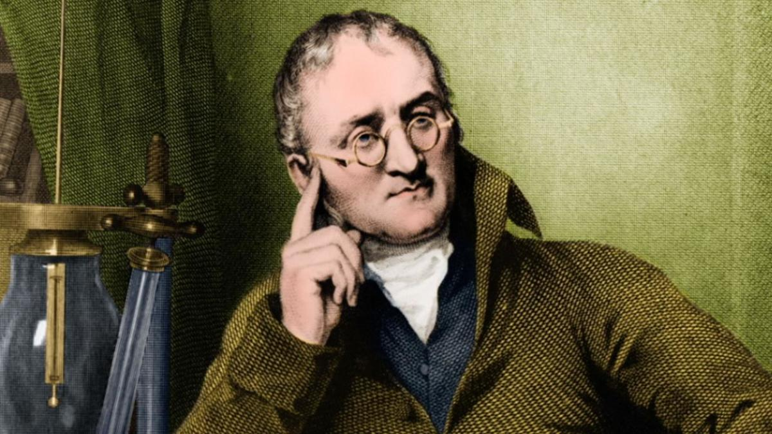

Atomic Theory
Part 3
Lesson 1

Slide 2
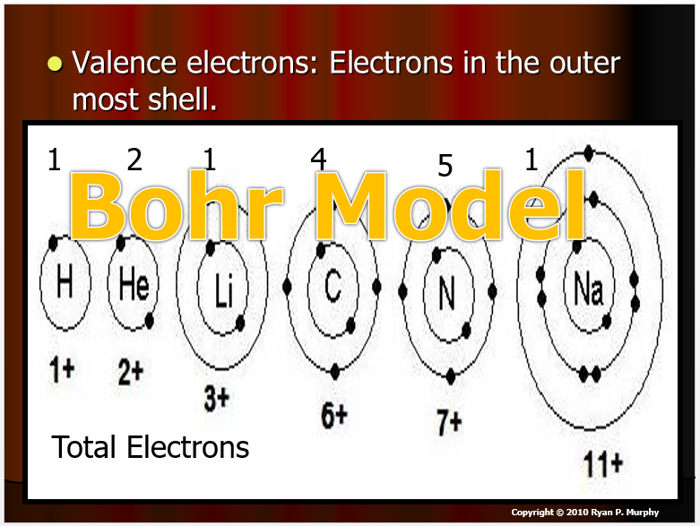
Red Slides: Please record the important terms in your work bundle.
First and last Name
Science, Grade, Class
Copyright © 2024 SlideSpark .LLC

Slide 3
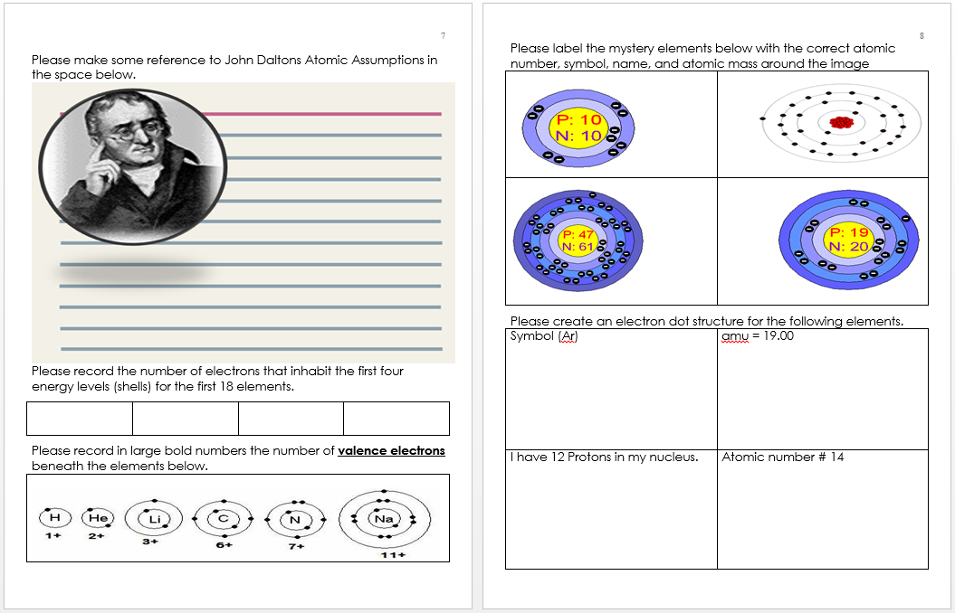
Red Slides: Please record the important terms in your work bundle.
  You’ll need these notes to complete the work bundle
First and last Name
Science, Grade, Class
Copyright © 2024 SlideSpark .LLC

Slide 4
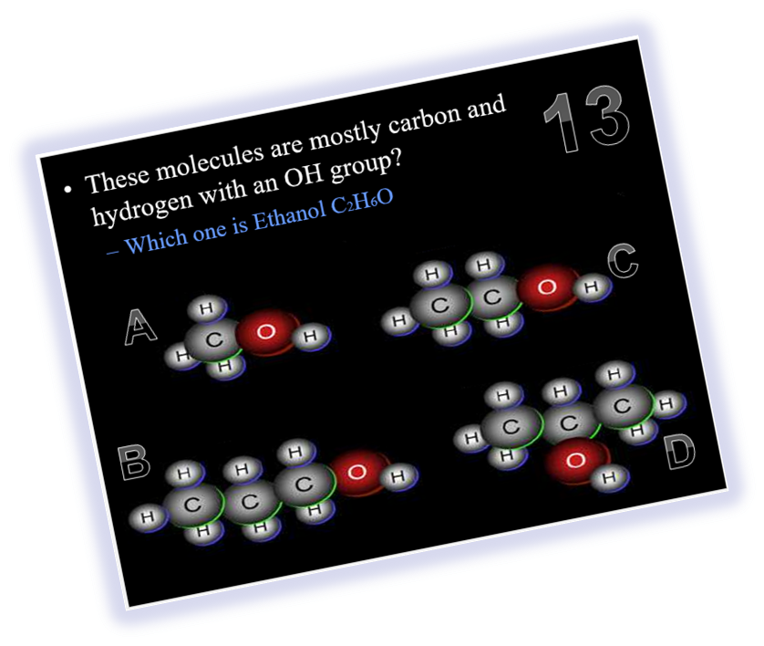
Red Slides: Please record the important terms in your work bundle.
  You’ll need these notes to complete the work bundle and to be successful on the review game.
First and last Name
Science, Grade, Class
Copyright © 2024 SlideSpark .LLC

Slide 5

Listen to the teacher and others.
Please no
shout outs.
One speaker at a
time. Please
raise your
hand.
Respect
First,
Last,
and Always.
Safety
Make
Good
Choices
Be Present
Never
Give
Up!
Responsibility
Stay
Organized
Help
Others
Focus on
Task completion
Avoid
Distractions
Science from Murf LLC
Copyright © 2024 SlideSpark .LLC

Slide 6
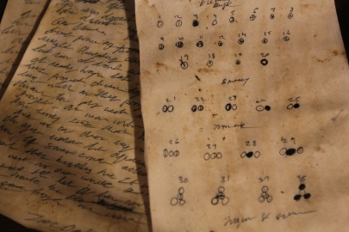
John Dalton’s Atomic Theories

Slide 7
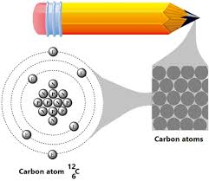
John Dalton’s Atomic Theories
  -All matter is composed of _________?

Slide 8
John Dalton’s Atomic Theories
  -All matter is composed of atoms.

Slide 9
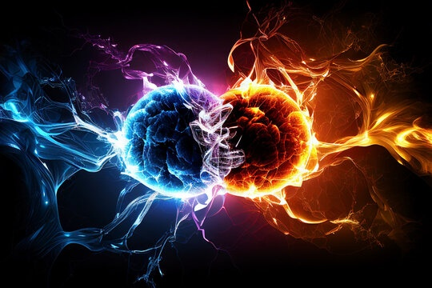
Atoms cannot be created or ___________.

Slide 10
Atoms cannot be created or destroyed.

Slide 11
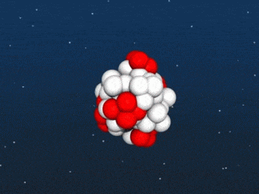
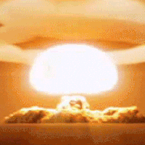
Atoms cannot be created or destroyed.
We’ll discuss changes to
The laws at the end

Slide 12
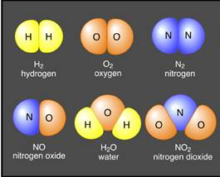
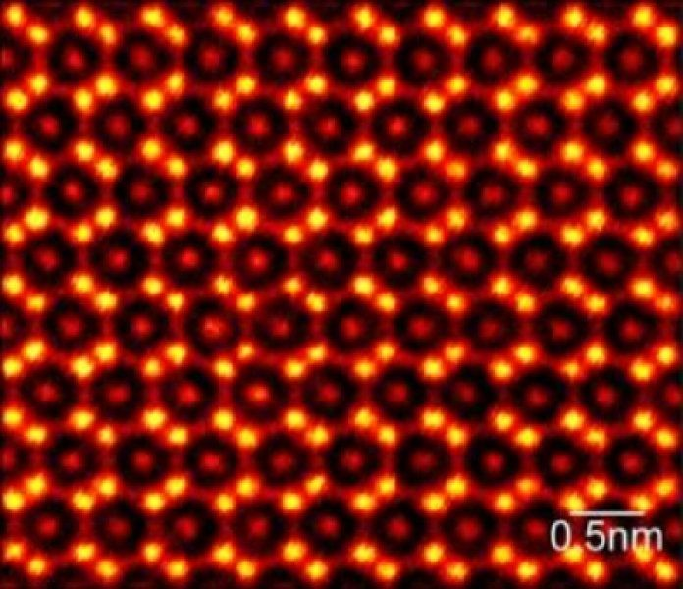
All atoms of the same element are _______.

Slide 13
All atoms of the same element are identical.

Slide 14
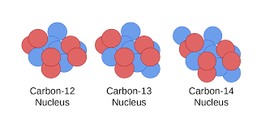
All atoms of the same element are identical.
????????????

Slide 15
All atoms of the same element are identical.
Isotopes

Slide 16
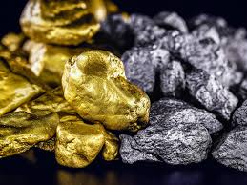
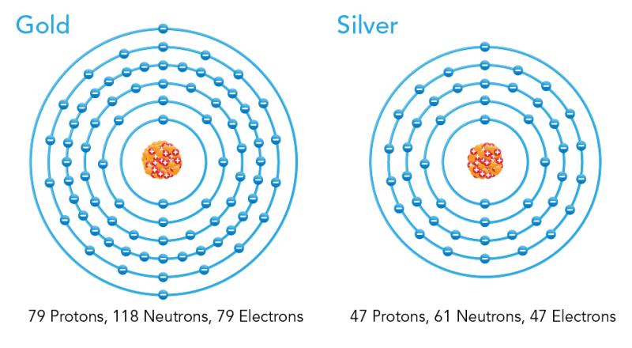
Different elements have different types of ________.

Slide 17
Different elements have different types of atoms.

Slide 18
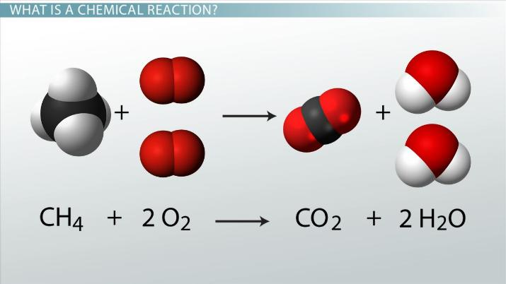
Chemical reactions occur when atoms are __________.

Slide 19
Chemical reactions occur when atoms are rearranged.

Slide 20
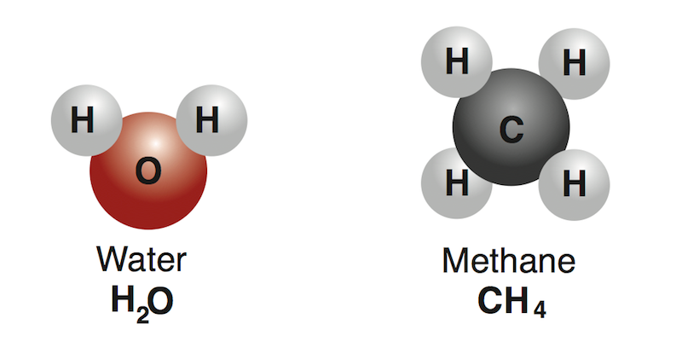
Compounds are formed from atoms of the _________.

Slide 21
Compounds are formed from atoms of the elements.

Slide 22
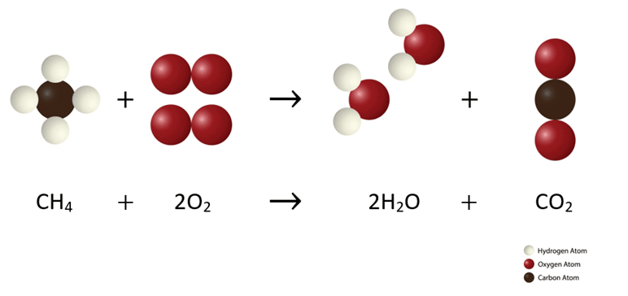
Law Conservation of Mass.
Matter isn’t created
or destroyed, but just
rearranged in a chemical
reaction.

Slide 24
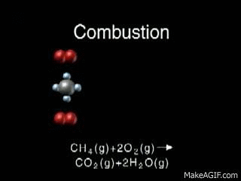
Compounds are formed from atoms of the elements.

Slide 25
Which is not one of John Daltons Atomic Theories?
  A.) All matter is composed of atoms.
  B.) Atoms cannot be made or destroyed.
  C.) All atoms of the same element are identical.
  D.) Different elements have the same type of atoms.
  E.) Chemical reactions occur when atoms are rearranged.
  F.) Compounds are formed from atoms of the constituent elements.
Copyright © 2024 SlideSpark .LLC

Slide 26
Which is not one of John Daltons Atomic Theories?
  A.) All matter is composed of atoms.
  B.) Atoms cannot be made or destroyed.
  C.) All atoms of the same element are identical.
  D.) Different elements have the same type of atoms.
  E.) Chemical reactions occur when atoms are rearranged.
  F.) Compounds are formed from atoms of the constituent elements.
Copyright © 2024 SlideSpark .LLC

Slide 27
Which is not one of John Daltons Atomic Theories?
  A.) All matter is composed of atoms.
  B.) Atoms cannot be made or destroyed.
  C.) All atoms of the same element are identical.
  D.) Different elements have different types of atoms.
  E.) Chemical reactions occur when atoms are rearranged.
  F.) Compounds are formed from atoms of the constituent elements.
Copyright © 2024 SlideSpark .LLC

Slide 28
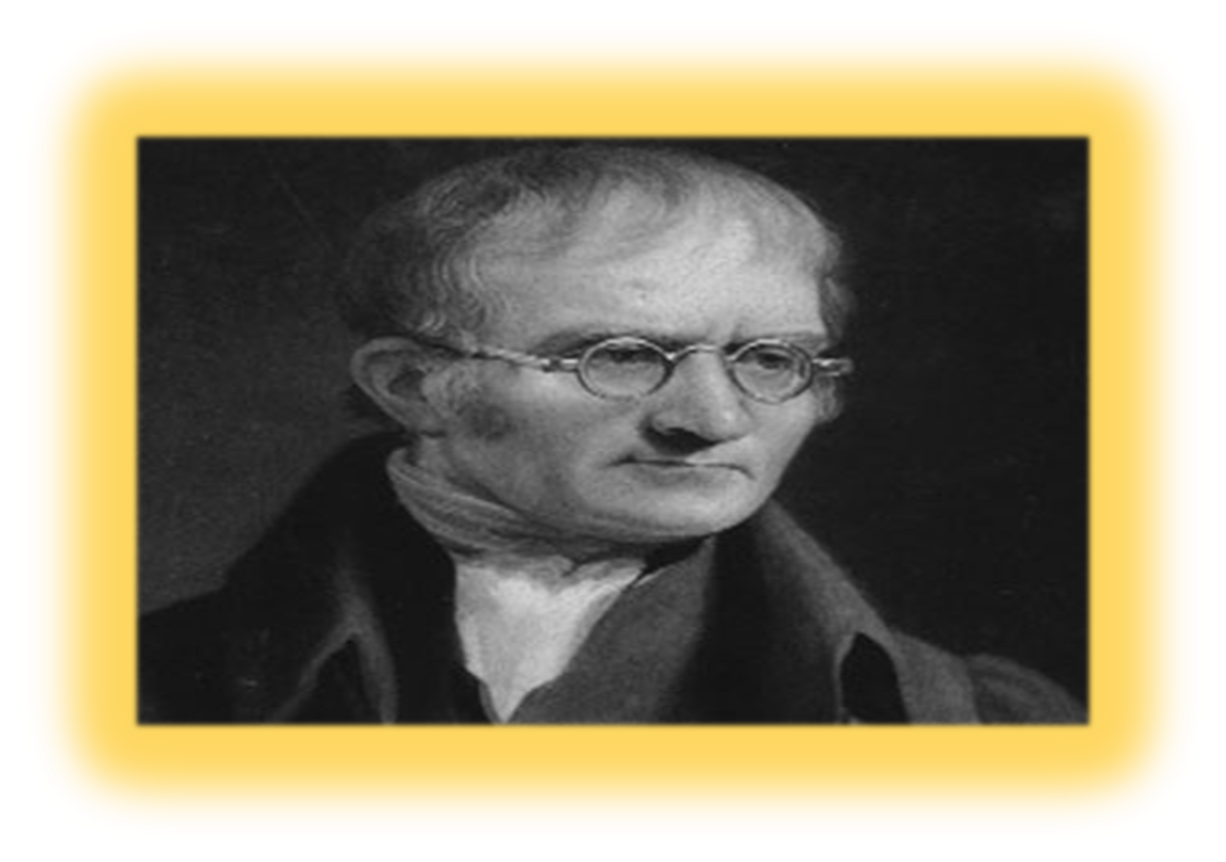

“One more time.”

Slide 29
Which is not one of John Daltons Atomic Theories?
  A.) All matter is composed of atoms.
  B.) Atoms cannot be made or destroyed.
  C.) All atoms of the same element are different.
  D.) Different elements have different types of atoms.
  E.) Chemical reactions occur when atoms are rearranged.
  F.) Compounds are formed from atoms of the constituent elements.
Copyright © 2024 SlideSpark .LLC

Slide 30
Which is not one of John Daltons Atomic Theories?
  A.) All matter is composed of atoms.
  B.) Atoms cannot be made or destroyed.
  C.) All atoms of the same element are different.
  D.) Different elements have different types of atoms.
  E.) Chemical reactions occur when atoms are rearranged.
  F.) Compounds are formed from atoms of the constituent elements.
Copyright © 2024 SlideSpark .LLC

Slide 31
Which is not one of John Daltons Atomic Theories?
  A.) All matter is composed of atoms.
  B.) Atoms cannot be made or destroyed.
  C.) All atoms of the same element are identical.
  D.) Different elements have different types of atoms.
  E.) Chemical reactions occur when atoms are rearranged.
  F.) Compounds are formed from atoms of the constituent elements.
Copyright © 2024 SlideSpark .LLC

Slide 32

“I was one of the first people to document color blindness.”
Learn more: http://www.biography.com/people/john-dalton-9265201

Slide 33
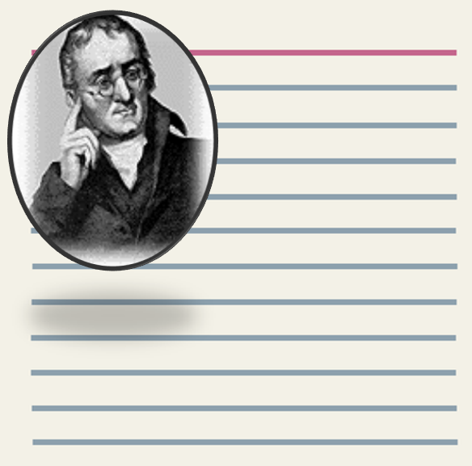

Slide 34
Dalton’s Atomic theory. The general tenets of this theory were as follows:

Slide 35
Dalton’s Atomic theory. The general tenets of this theory were as follows:
All matter is composed of extremely small particles called atoms.

Slide 36
Dalton’s Atomic theory. The general tenets of this theory were as follows:
All matter is composed of extremely small particles called atoms.
Atoms of a given element are identical in size, mass, and other properties. Atoms of different elements differ in size, mass, and other properties.

Slide 37
Dalton’s Atomic theory. The general tenets of this theory were as follows:
All matter is composed of extremely small particles called atoms.
Atoms of a given element are identical in size, mass, and other properties. Atoms of different elements differ in size, mass, and other properties.
Atoms cannot be subdivided, created, or destroyed.

Slide 38
Dalton’s Atomic theory. The general tenets of this theory were as follows:
All matter is composed of extremely small particles called atoms.
Atoms of a given element are identical in size, mass, and other properties. Atoms of different elements differ in size, mass, and other properties.
Atoms cannot be subdivided, created, or destroyed.
Atoms of different elements can combine in simple whole number ratios to form chemical compounds.

Slide 39
Dalton’s Atomic theory. The general tenets of this theory were as follows:
All matter is composed of extremely small particles called atoms.
Atoms of a given element are identical in size, mass, and other properties. Atoms of different elements differ in size, mass, and other properties.
Atoms cannot be subdivided, created, or destroyed.
Atoms of different elements can combine in simple whole number ratios to form chemical compounds.
In chemical reactions, atoms are combined, separated, or rearranged.

Slide 40
Dalton’s Atomic theory. The general tenets of this theory were as follows:
All matter is composed of extremely small particles called atoms.
Atoms of a given element are identical in size, mass, and other properties. Atoms of different elements differ in size, mass, and other properties.
Atoms cannot be subdivided, created, or destroyed.
Atoms of different elements can combine in simple whole number ratios to form chemical compounds.
In chemical reactions, atoms are combined, separated, or rearranged.
Three changes. We know now that (1) an atom can be further sub-divided, (2) all atoms of an element are not identical in mass (Isotopes), and (3) using nuclear fission and fusion techniques, we can create or destroy atoms by changing them into other atoms.

Slide 41
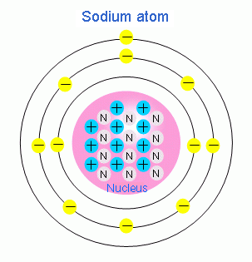
Atomic Mass = AMU Atomic Mass Units, The number of protons, neutrons, and electrons.
Important Review
Copyright © 2024 SlideSpark .LLC

Slide 42
Review! To find # of protons and electrons
Copyright © 2024 SlideSpark .LLC

Slide 43
Review! To find # of protons and electrons
  It is the atomic number, or count the P+ or E-.
Copyright © 2024 SlideSpark .LLC

Slide 44
Review! To find # of protons and electrons
  It is the atomic number, or count the P+ or E-.
Copyright © 2024 SlideSpark .LLC

Slide 45
Review! To find # of protons and electrons
  It is the atomic number, or count the P+ or E-.
An atom can gain or lose electrons, becoming what is known as an ion. An ion is nothing more than an electrically charged atom. Adding or removing electrons from an atom does not change which element it is, just its net charge.
Copyright © 2024 SlideSpark .LLC

Slide 46
Review! To find # of protons and electrons
  It is the atomic number.
  What is this atoms Atomic number?
Copyright © 2024 SlideSpark .LLC

Slide 47
Answer!
Copyright © 2024 SlideSpark .LLC

Slide 48
Answer! Count the 11 Protons or 11 Electrons
Copyright © 2024 SlideSpark .LLC

Slide 49
Answer! Atomic Number 11.
  What element is #11
Copyright © 2024 SlideSpark .LLC

Slide 50
Answer! Atomic Number 11.
  What element is #11 Sodium
Copyright © 2024 SlideSpark .LLC

Slide 51
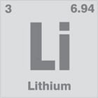
Review! To find # of neutrons
Copyright © 2024 SlideSpark .LLC

Slide 52
Review! To find # of neutrons
  Subtract the atomic number from the atomic mass to determine the difference.
Copyright © 2024 SlideSpark .LLC

Slide 53
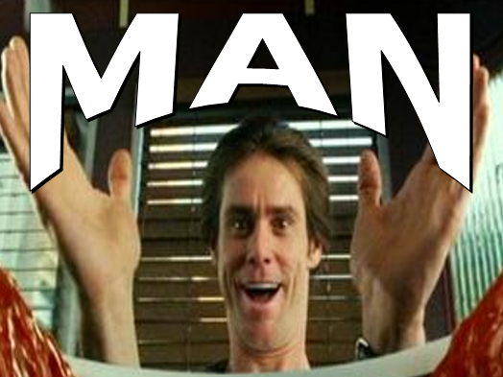
Review! To find # of neutrons
  Subtract the atomic number from the atomic mass to determine the difference.
  How many neutrons does Lithium have?
Mass – Atomic # = Neutrons
Copyright © 2024 SlideSpark .LLC

Slide 54
Review! To find # of neutrons
  Subtract the atomic number from the atomic mass to determine the difference.
  How many neutrons does Lithium have?
Atomic Mass
Copyright © 2024 SlideSpark .LLC

Slide 55
Review! To find # of neutrons
  Subtract the atomic number from the atomic mass to determine the difference.
  How many neutrons does Lithium have?
Atomic Mass
Atomic Number
Copyright © 2024 SlideSpark .LLC

Slide 56
Review! To find # of neutrons
  Subtract the atomic number from the atomic mass to determine the difference.
  How many neutrons does Lithium have?
Atomic Mass
Atomic Number
6.94 amu – 3 =
Copyright © 2024 SlideSpark .LLC

Slide 57
Answer! 6.94 – 3 = 3.94
Atomic Mass
Atomic Number
6.94 amu – 3 =
Copyright © 2024 SlideSpark .LLC

Slide 58
Answer! 6.94 – 3 = 3.94 or 4 neutrons
Atomic Mass
Atomic Number
6.94 amu – 3 =
Copyright © 2024 SlideSpark .LLC

Slide 59
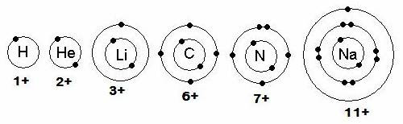
New Area of Focus: Electron Orbitals
Copyright © 2024 SlideSpark .LLC

Slide 60
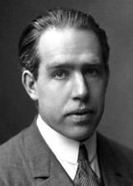
Niels Bohr (1915): Student to Ernest Rutherford.
  The Bohr model is a simplified picture of an atom. We will spend a lot of time learning this, and then….
  The correct theory of the atom…
    (Quantum Mechanics)
    More Difficult

Slide 61
Niels Bohr (1915): Student to Ernest Rutherford.
  The Bohr model is a simplified picture of an atom. We will spend a lot of time learning this, and then….
  The correct theory of the atom…
    (Quantum Mechanics)
    More Difficult
  Learn more http://chemed.chem.purdue.edu/genchem/history/bohr.html
“Hey, I suggested the idea that electrons move from one energy level to another in large steps.”.-Quantum….
Learn more: http://en.wikipedia.org/wiki/Niels_Bohr

Slide 62
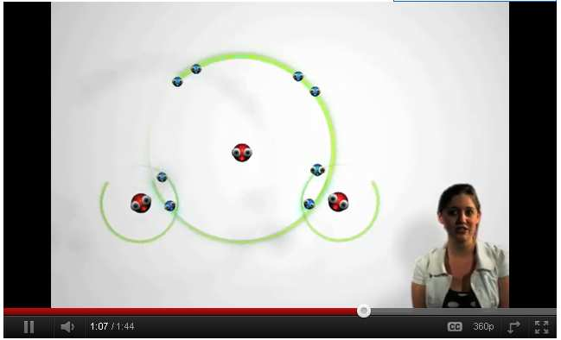
Video Link! Electron Orbitals
  http://www.youtube.com/watch?v=rNM21emkMJo

Slide 63
Valence electrons: Electrons in the outer most shell.
Copyright © 2024 SlideSpark .LLC

Slide 64
Valence electrons: Electrons in the outer most shell.
How many valence electrons?
Copyright © 2024 SlideSpark .LLC

Slide 65
Valence electrons: Electrons in the outer most shell.
Copyright © 2024 SlideSpark .LLC

Slide 66
Valence electrons: Electrons in the outer most shell.
1
Copyright © 2024 SlideSpark .LLC

Slide 67
Valence electrons: Electrons in the outer most shell.
1
Copyright © 2024 SlideSpark .LLC

Slide 68
Valence electrons: Electrons in the outer most shell.
1
2
Copyright © 2024 SlideSpark .LLC

Slide 69
Valence electrons: Electrons in the outer most shell.
1
2
Copyright © 2024 SlideSpark .LLC

Slide 70
Valence electrons: Electrons in the outer most shell.
1
2
1
Copyright © 2024 SlideSpark .LLC

Slide 71
Valence electrons: Electrons in the outer most shell.
1
2
1
Copyright © 2024 SlideSpark .LLC

Slide 72
Valence electrons: Electrons in the outer most shell.
1
2
1
4
Copyright © 2024 SlideSpark .LLC

Slide 73
Valence electrons: Electrons in the outer most shell.
1
2
1
4
Copyright © 2024 SlideSpark .LLC

Slide 74
Valence electrons: Electrons in the outer most shell.
1
2
1
4
5
Copyright © 2024 SlideSpark .LLC

Slide 75
Valence electrons: Electrons in the outer most shell.
1
2
1
4
5
Copyright © 2024 SlideSpark .LLC

Slide 76
Valence electrons: Electrons in the outer most shell.
1
2
1
4
5
1
Copyright © 2024 SlideSpark .LLC

Slide 77
Valence electrons: Electrons in the outer most shell.
1
2
1
4
5
1
Total Electrons
Copyright © 2024 SlideSpark .LLC

Slide 78

Valence electrons: Electrons in the outer most shell.
1
2
1
4
5
1
Total Electrons
Copyright © 2024 SlideSpark .LLC

Slide 79

Activity! Quiz Wiz: Name the atom based on the electron orbitals / atomic number.
  Also tell me how many valence the atom has?
Copyright © 2024 SlideSpark .LLC

Slide 80
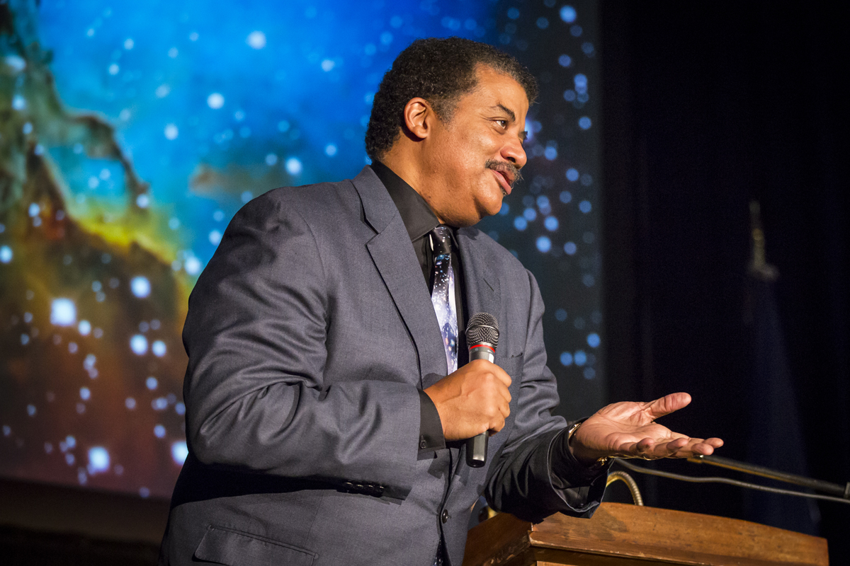
Answers! Quiz Wiz: The answer will be given after each questions instead of at the end.
We’ll just do out loud
Please raise your hand
Copyright © 2024 SlideSpark .LLC

Slide 81
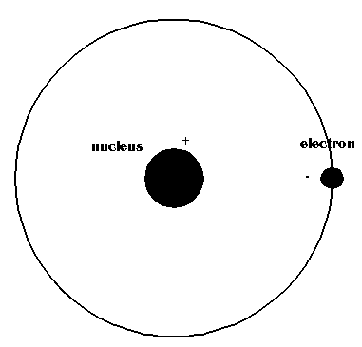
1

Slide 82
1
Hydrogen (#1)
1 Valence Electron

Slide 83
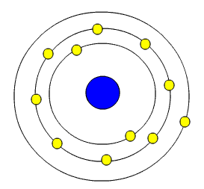
2

Slide 84
2
Sodium (#11)
1 Valence Electron

Slide 85
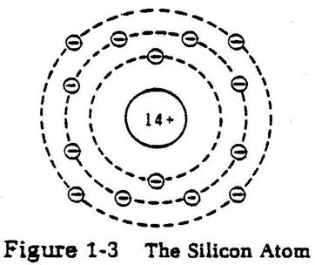
3

Slide 86
3
Silicon (#14)
4 Valence
Electrons

Slide 87
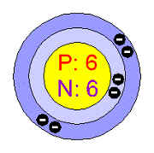
4

Slide 88
4
Carbon (#6)
4 Valence
Electrons

Slide 89
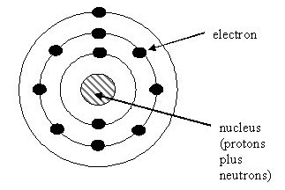
5

Slide 90
5
Sodium Again (#11)
1 Valence Electron

Slide 91
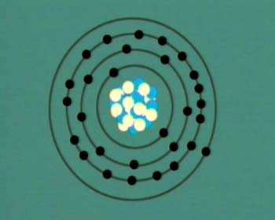
6

Slide 92
6
Copper (#29)
1 Valence Electron

Slide 93
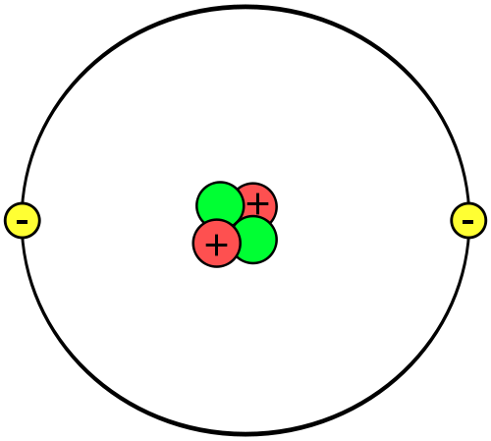
7

Slide 94
7
Helium (#2)
2 Valence Electrons

Slide 95
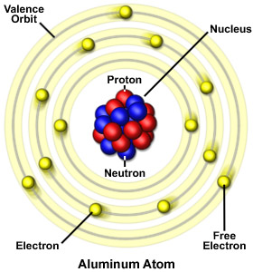
8

Slide 96
8
Aluminum (13)
3 Valence Electrons

Slide 97
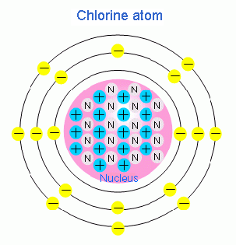
9

Slide 98
9
Chlorine ( #17)
7 Valence Electrons

Slide 99
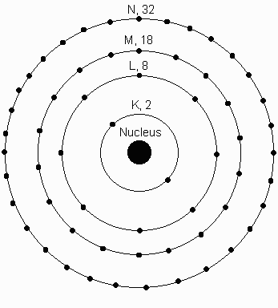
10

Slide 100
10
Neodymium (#60)
32 Valence Electrons

Slide 101
10
2+8+18+32=60
Neodymium (#60)
32 Valence Electrons

Slide 102
10
2+8+18+32=60
Neodymium (#60)
32 Valence Electrons

Slide 103
10
2+8+18+32=60
Neodymium (#60)
32 Valence Electrons

Slide 104
10
2+8+18+32=60
Neodymium (#60)
32 Valence Electrons

Slide 105
10
2+8+18+32=60
Neodymium (#60)
32 Valence Electrons

Slide 106
10
2+8+18+32=60
Neodymium (#60)
32 Valence Electrons

Slide 107

*11 Bonus
Name this gum

Slide 108
*11 Bonus
Name this gum

Slide 109
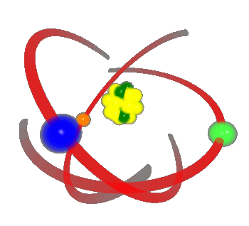
*11 Bonus
Electron
als
Name this gum

Slide 110

Try and be the first to name the picture hidden beneath the boxes?
  Raise your hand when you think you know. You only get one guess.
  These two box games are work bonus points on the balancing chemical equations sheet.
Copyright © 2024 SlideSpark .LLC

Slide 111
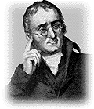
Copyright © 2024 SlideSpark .LLC

Slide 112
Copyright © 2024 SlideSpark .LLC

Slide 113
Copyright © 2024 SlideSpark .LLC

Slide 114
Copyright © 2024 SlideSpark .LLC

Slide 115
Copyright © 2024 SlideSpark .LLC

Slide 116
Copyright © 2024 SlideSpark .LLC

Slide 117
Copyright © 2024 SlideSpark .LLC

Slide 118
Copyright © 2024 SlideSpark .LLC

Slide 119
Copyright © 2024 SlideSpark .LLC

Slide 120
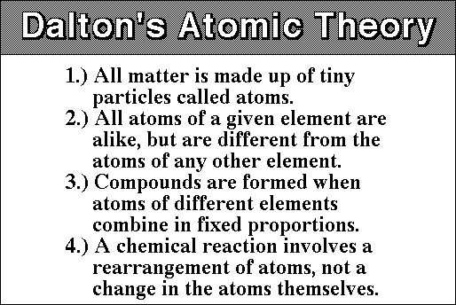
Copyright © 2024 SlideSpark .LLC

Slide 121
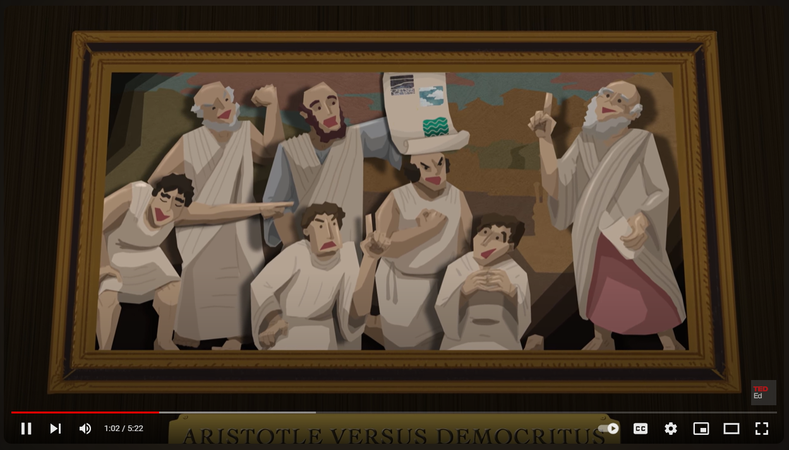
Video Atomic Theory
  https://www.youtube.com/watch?v=xazQRcSCRaY

Slide 122
Atomic Theory
Part 3
Lesson 1

Slide 123



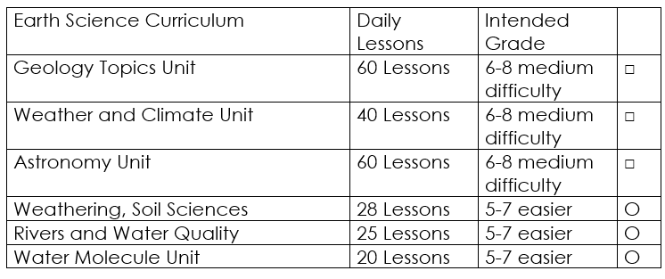

Curriculum Guide
Number of Lessons in each unit (50 min, daily lessons) and difficult rating scale / intended grade level.
=Easier, = More difficult, =Most difficult
Earth Science Units

Slide 124


Life Science Units

Slide 125

Physical Science

Slide 126

Dear Valued Educator,
Our fully editable .pptx and .doc resources are perfect for educators looking to bring enthusiasm and creativity to their lessons. We encourage you to make changes to fit your needs and style. As science educators, we’re committed to providing students with the tools they need to succeed in the classroom and beyond. Each unit in the curriculum includes a range of resources that have been developed through extensive research and use in a busy classroom. Our teaching approach is designed to make science education engaging and exciting for learners of all ages. We offer a one-of-a-kind science curriculum that will challenge, inspire, and educate students to become tomorrow's scientists and leaders. Join us today and learn more about how our program can help you achieve your classroom goals.
With appreciation,
Support@SlideSpark.net

Slide 127





Thank you for your time and interest in our Science curriculum. We strive to provide students with engaging and informative lessons that will spark their curiosity and encourage scientific exploration. Should you have any questions or concerns, please do not hesitate to contact us. Thank you again for considering our curriculum, and we wish you all the best in your educational journey.
Sincerely,
Support@slidespark.net
SlideSpark Science on TpT

