Slide 1
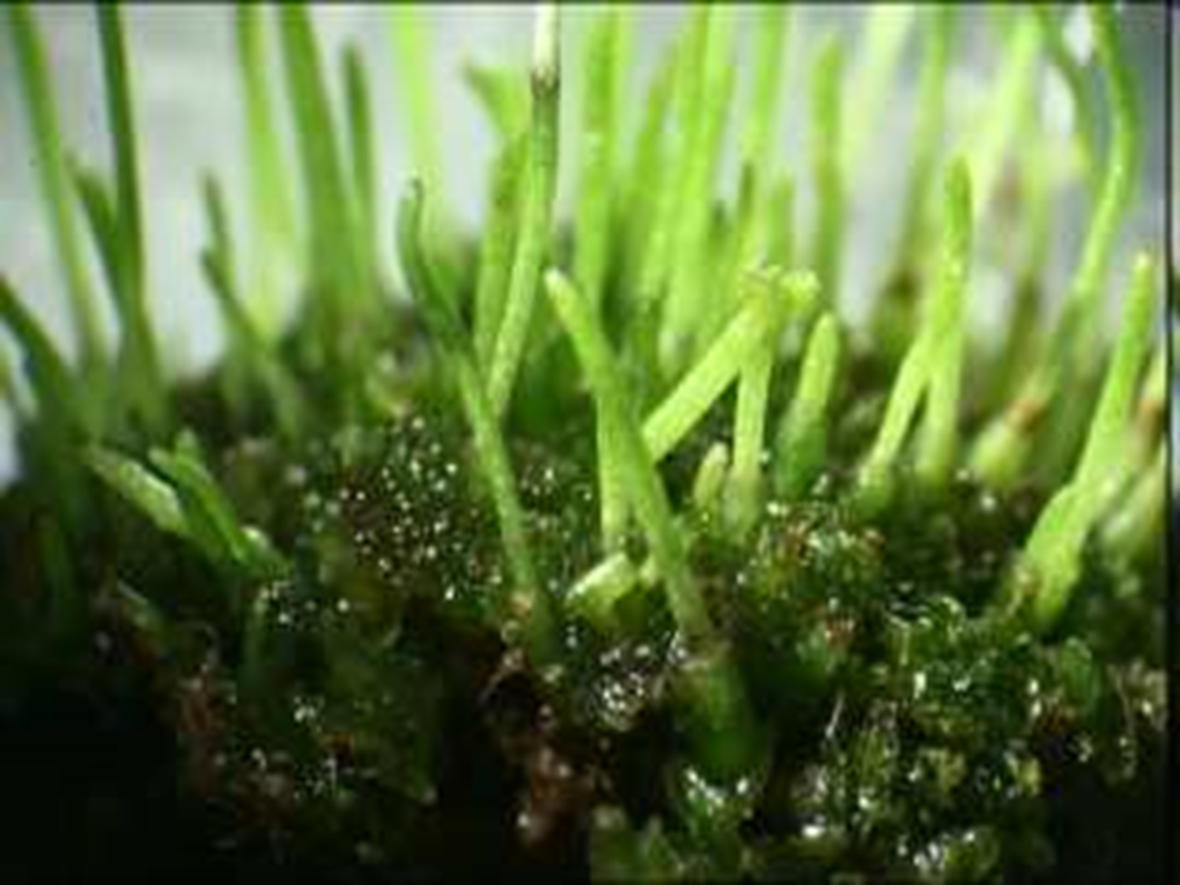

Non-Vascular Plants
Part 2
Lesson 4

Slide 2
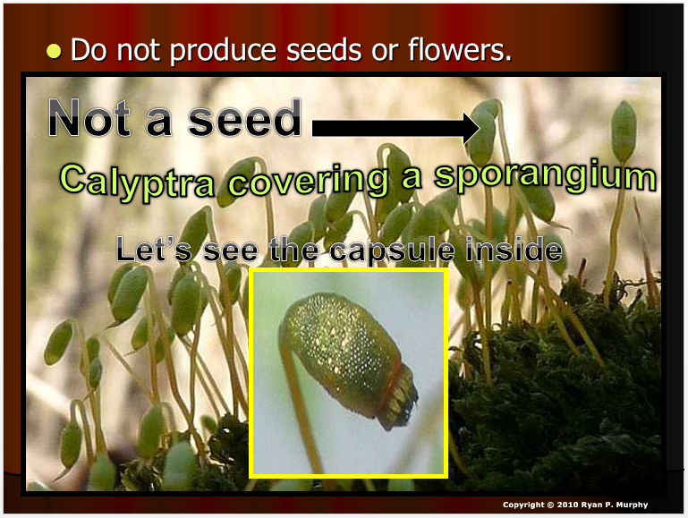
RED SLIDE: These slides contain critical notes and important fill-in the blanks. Please record the important terms in your work bundle.
First and last Name
Science, Grade, Class
Copyright © 2024 SlideSpark .LLC

Slide 3
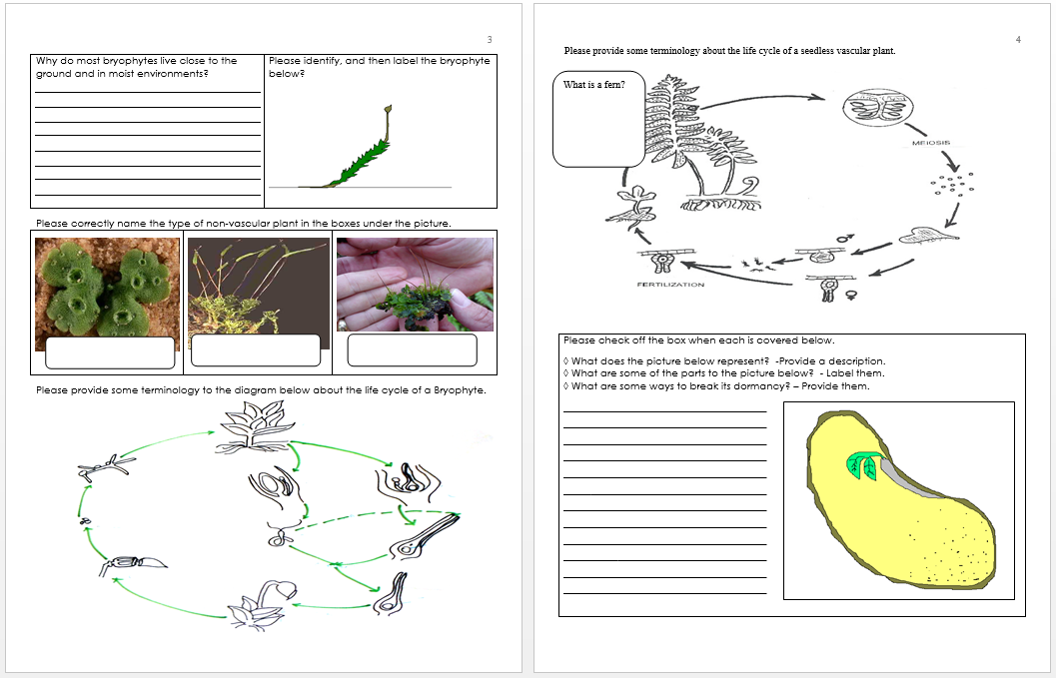
RED SLIDE: These slides contain critical notes and important fill-in the blanks. Please record the important terms in your work bundle.
  You’ll need these notes to complete the work bundle
First and last Name
Science, Grade, Class
Copyright © 2024 SlideSpark .LLC

Slide 4
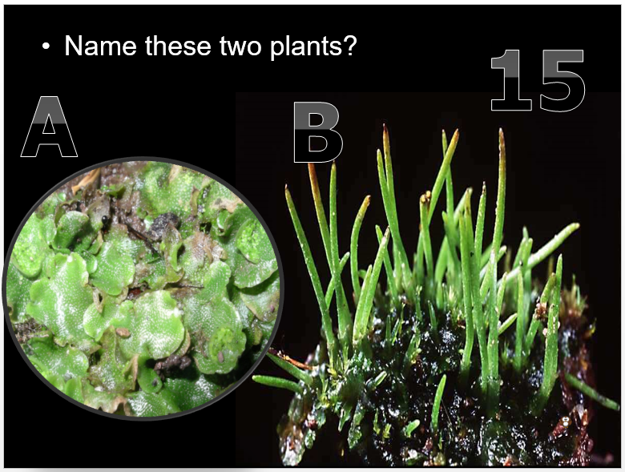
RED SLIDE: These slides contain critical notes and important fill-in the blanks. Please record the important terms in your work bundle.
  You’ll need these notes to complete the work bundle and to be successful on the review game.
First and last Name
Science, Grade, Class
Copyright © 2024 SlideSpark .LLC

Slide 5
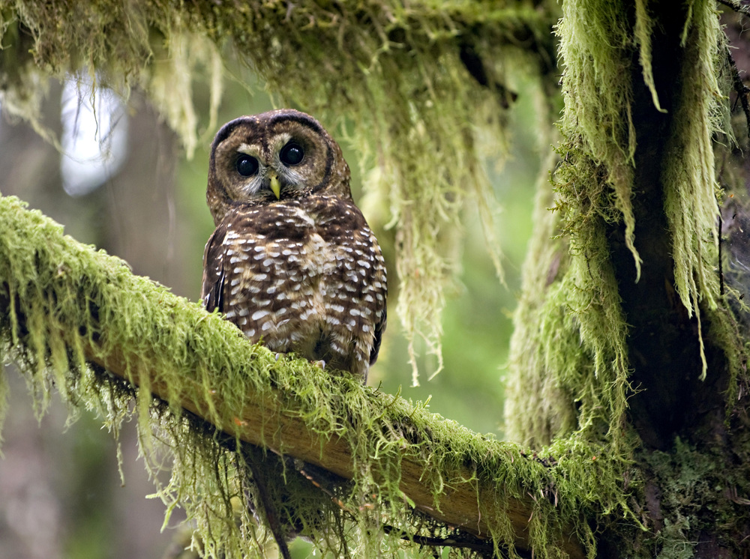



Keep an eye out for “The-Owl” and raise your hand as soon as you see her.
  She’ll be hiding somewhere in the slideshow
Copyright © 2024 SlideSpark .LLC

Slide 6

Listen to the teacher and others.
Please no
shout outs.
One speaker at a
time. Please
raise your
hand.
Respect
First,
Last,
and Always.
Safety
Make
Good
Choices
Be Present
Never
Give
Up!
Responsibility
Stay
Organized
Help
Others
Focus on
Task completion
Avoid
Distractions
Science from Murf LLC
Copyright © 2024 SlideSpark .LLC

Slide 7
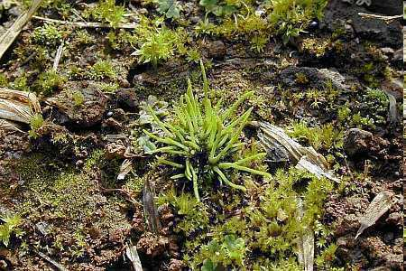
Non-vascular plants include…
  -
  -
  -
REVIEW!
Copyright © 2024 SlideSpark .LLC

Slide 8
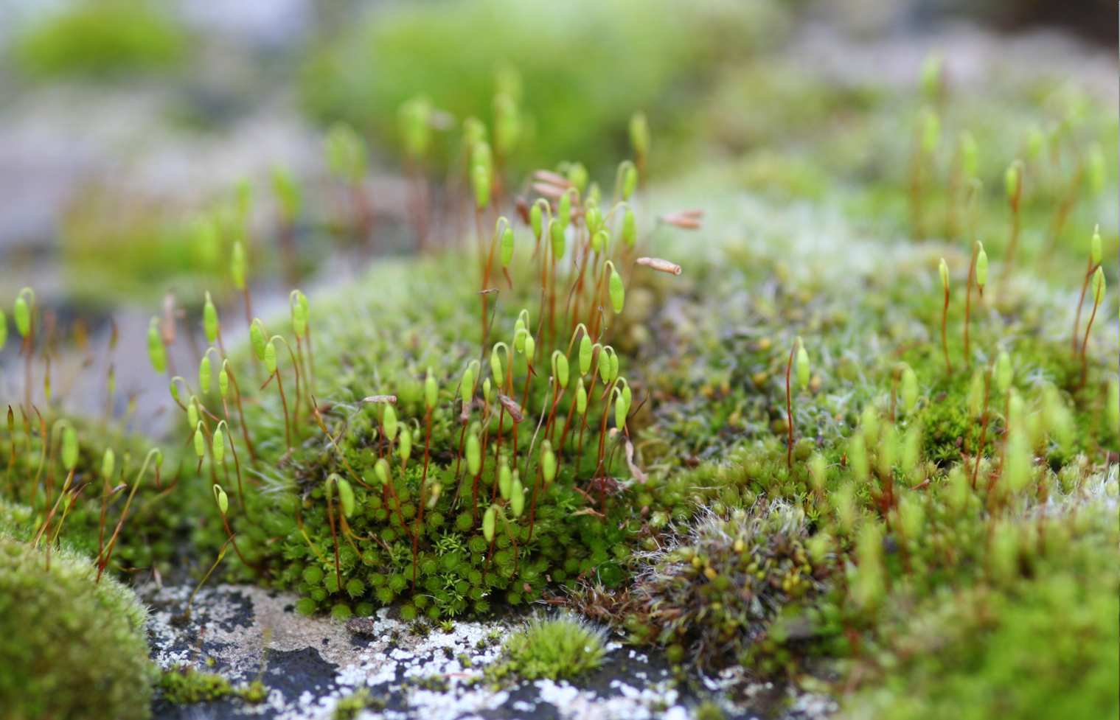
Mosses (Bryophytes)
Copyright © 2024 SlideSpark .LLC

Slide 9
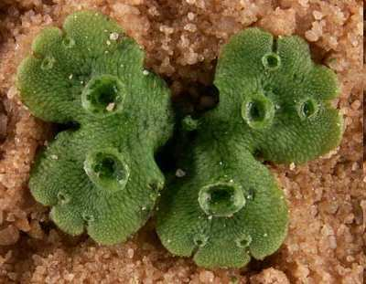
Liverworts
Division Marchantiophyta
NEW SLIDE!
Learn more about liverworts at… http://www.bio.umass.edu/biology/conn.river/liverwts.html
Copyright © 2024 SlideSpark .LLC

Slide 10
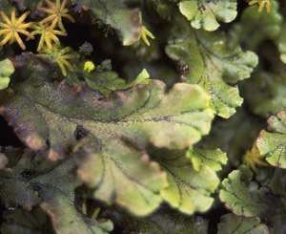
Liverworts: A small flowerless green plant with leaflike stems or lobed leaves, occurring in moist habitats. Liverworts lack true roots and reproduce by means of spores released from capsules.
Copyright © 2024 SlideSpark .LLC

Slide 11
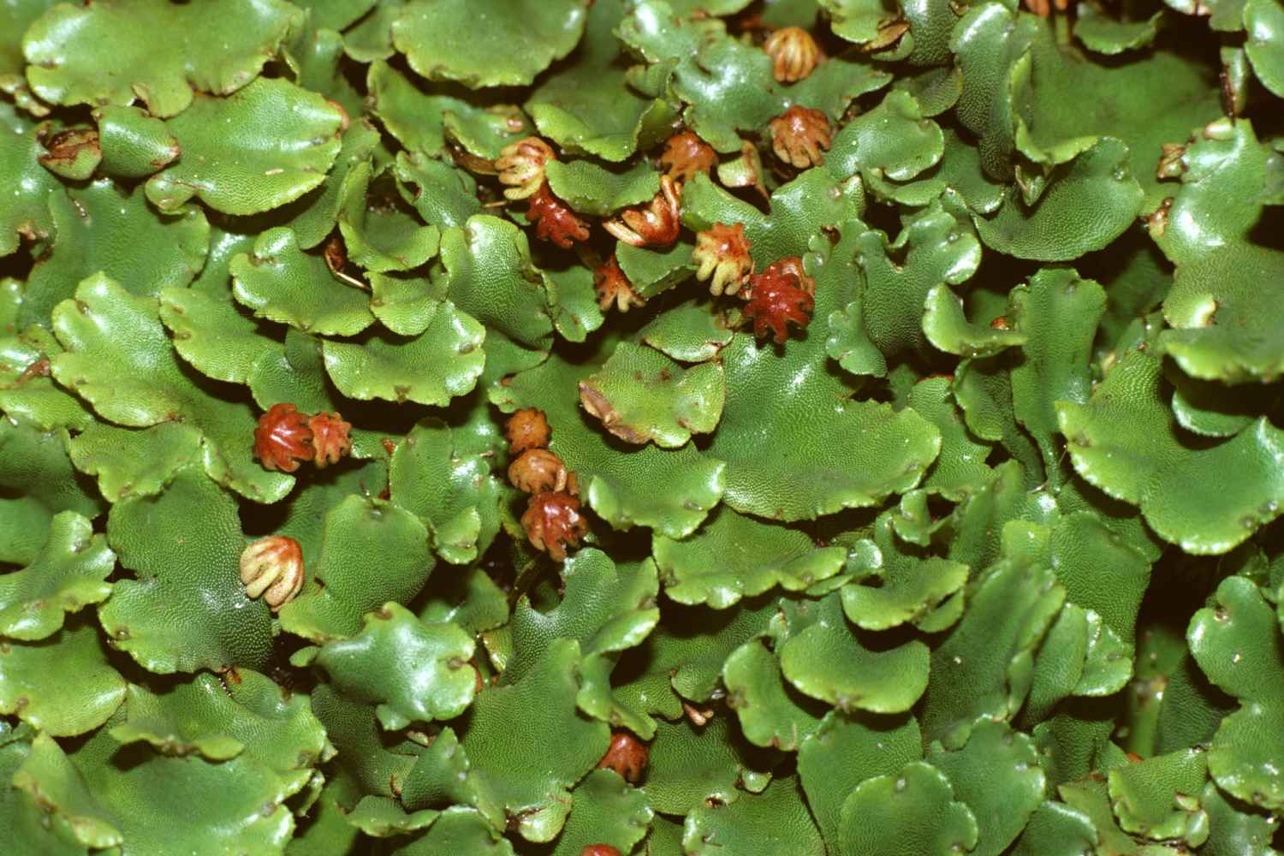
Another bryophyte species are the liverworts.
Copyright © 2024 SlideSpark .LLC

Slide 12
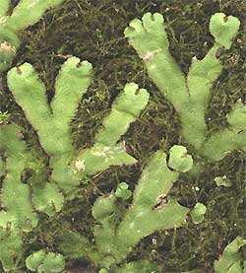
The 8,000 or so species of the earth's liverworts are usually divided into two groups
Copyright © 2024 SlideSpark .LLC

Slide 13
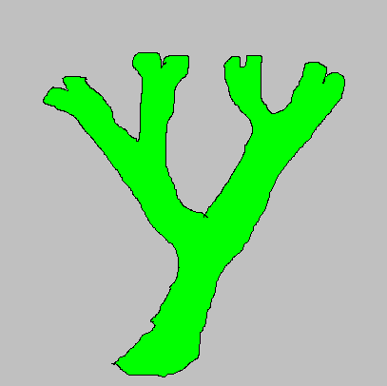
Draw a sketch of the two types of Liverworts.
Branched
Copyright © 2024 SlideSpark .LLC

Slide 14
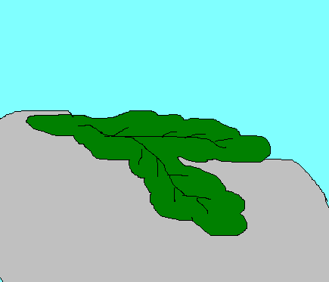
Draw a sketch of the two types of Liverworts.
Branched Leafy
Copyright © 2024 SlideSpark .LLC

Slide 15
Which is liverwort is branched, and which is leafy?
A
B
Copyright © 2024 SlideSpark .LLC

Slide 16
Which is liverwort is branched, and which is leafy?
A
B
Copyright © 2024 SlideSpark .LLC

Slide 17
Which is liverwort is branched, and which is leafy?
A
B
Branched
Copyright © 2024 SlideSpark .LLC

Slide 18
Which is liverwort is branched, and which is leafy?
A
B
Branched
Copyright © 2024 SlideSpark .LLC

Slide 19
Which is liverwort is branched, and which is leafy?
A
B
Branched
Leafy
Copyright © 2024 SlideSpark .LLC

Slide 20
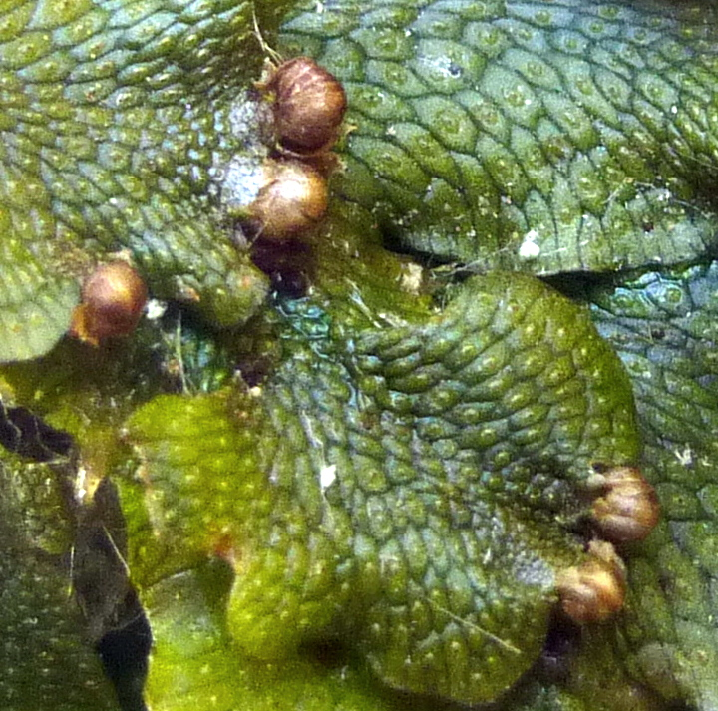

Slide 21
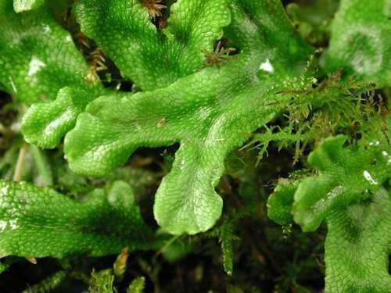
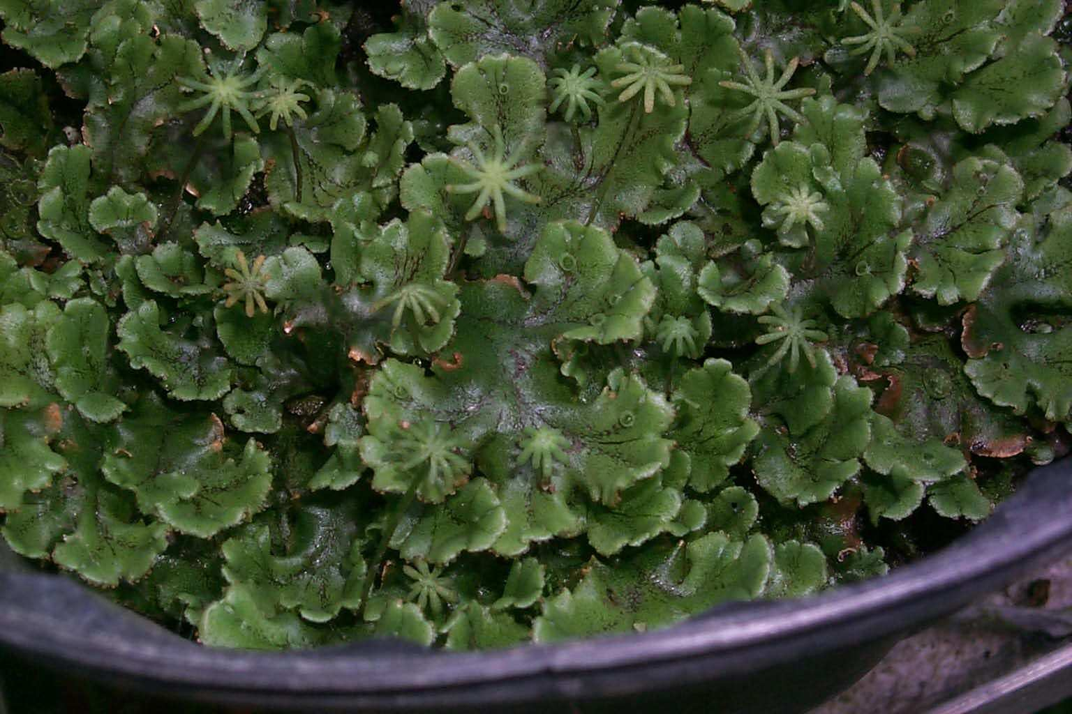
Which picture is a leafy liverwort, and which is branched liverwort?
A
B
Copyright © 2024 SlideSpark .LLC

Slide 22
Which picture is a leafy liverwort, and which is branched liverwort?
A
B
Copyright © 2024 SlideSpark .LLC

Slide 23
Which picture is a leafy liverwort, and which is branched liverwort?
A
B
Branched
Copyright © 2024 SlideSpark .LLC

Slide 24
Which picture is a leafy liverwort, and which is branched liverwort?
A
B
Branched
Copyright © 2024 SlideSpark .LLC

Slide 25
Which picture is a leafy liverwort, and which is branched liverwort?
A
B
Leafy
Branched
Copyright © 2024 SlideSpark .LLC

Slide 26
Which picture is a leafy liverwort, and which is branched liverwort?
A
B
Leafy
Branched
Learn more about liverworts and hornworts at… http://www.teara.govt.nz/en/liverworts-and-hornworts/page-2
Copyright © 2024 SlideSpark .LLC

Slide 27
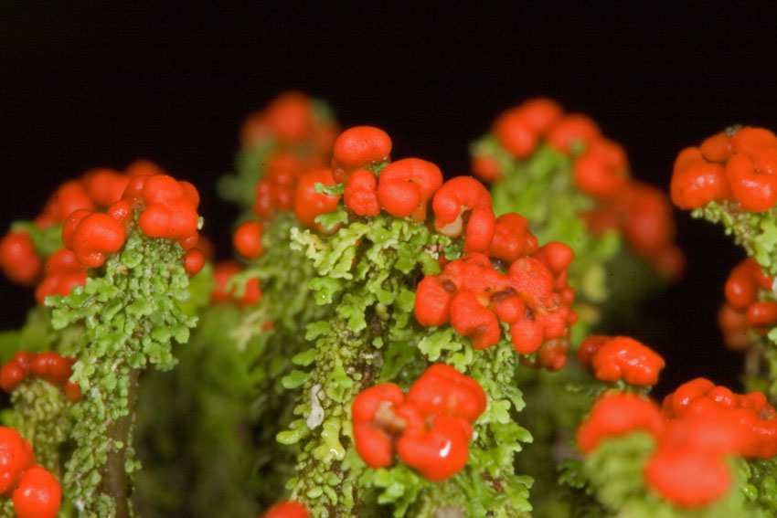
Liverwort Sporangia

Slide 28
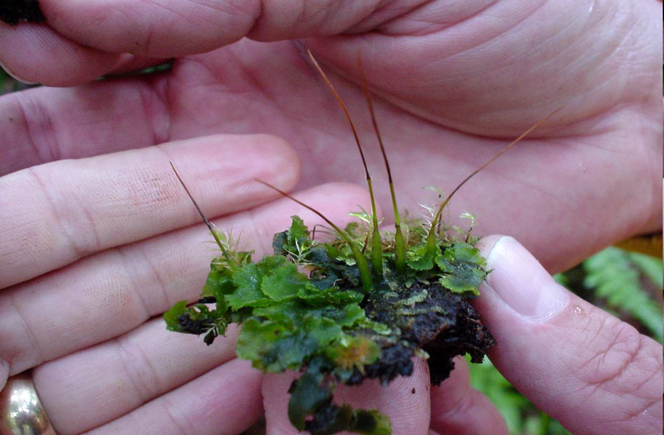
Hornworts
Anthocerotophyta
Learn more about hornworts at… http://www.ucmp.berkeley.edu/plants/anthocerotophyta.html
Copyright © 2024 SlideSpark .LLC

Slide 29
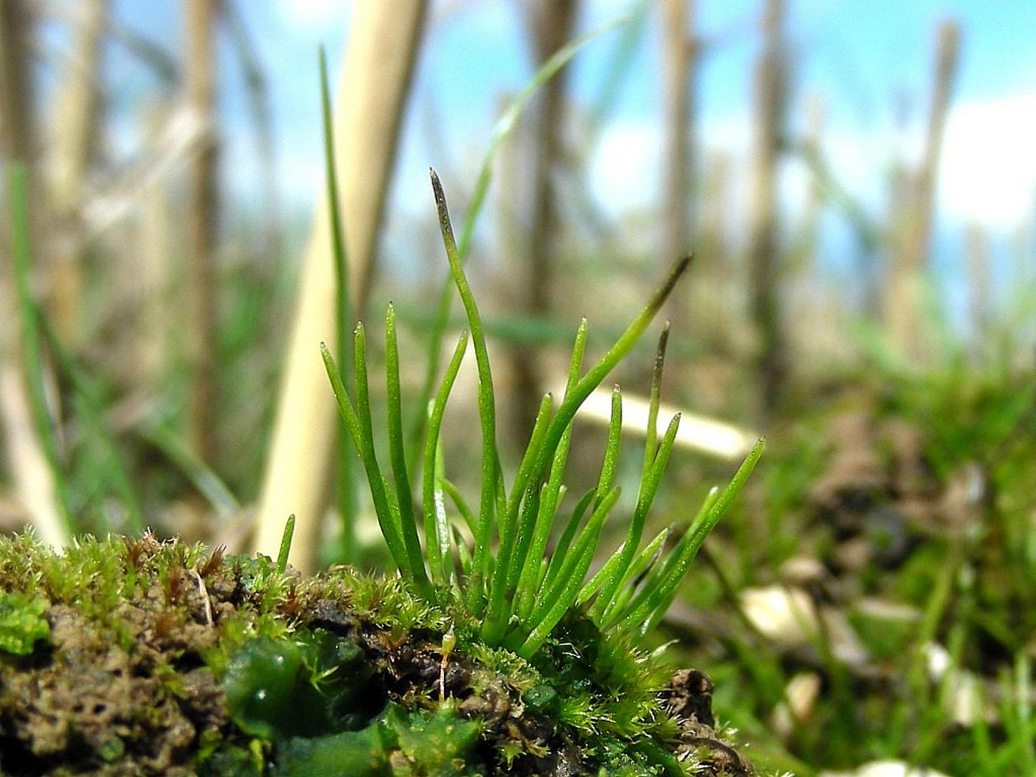
Hornworts: Are a group of bryophytes constituting the division Anthocerotophyta. The common name refers to the elongated horn-like structure, which is the sporophyte. As in mosses and liverworts, the flattened, green plant body of a hornwort is the gametophyte plant.
Copyright © 2024 SlideSpark .LLC

Slide 30
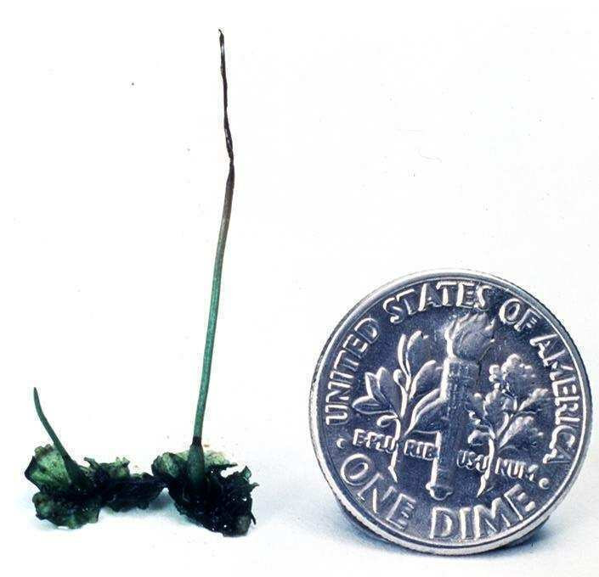

Slide 31

They’re HUGE!

Slide 32
Size Scale Needed
They’re HUGE!

Slide 33
Size Scale Needed

Slide 34
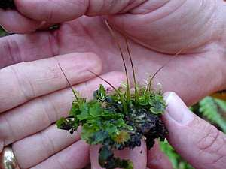

Slide 35
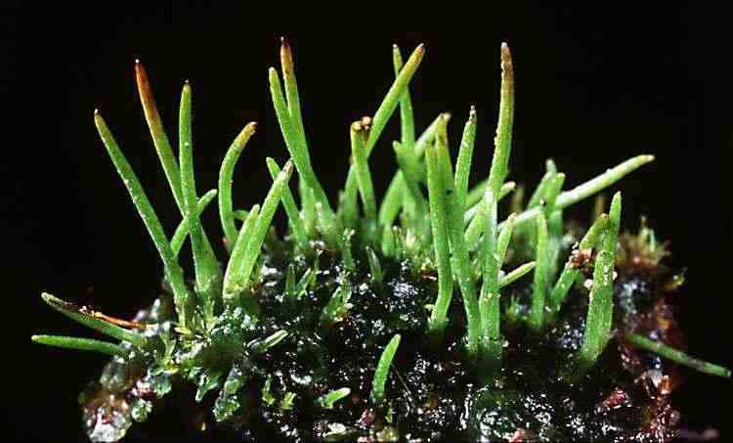

Slide 38
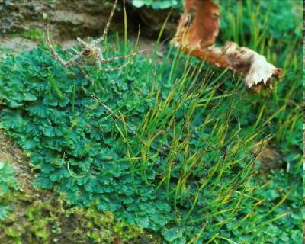
Some species grow in large numbers as tiny weeds in the soil of gardens and cultivated fields.
Copyright © 2024 SlideSpark .LLC

Slide 39
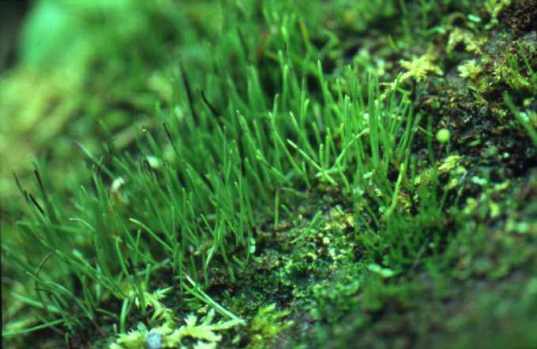

Slide 40
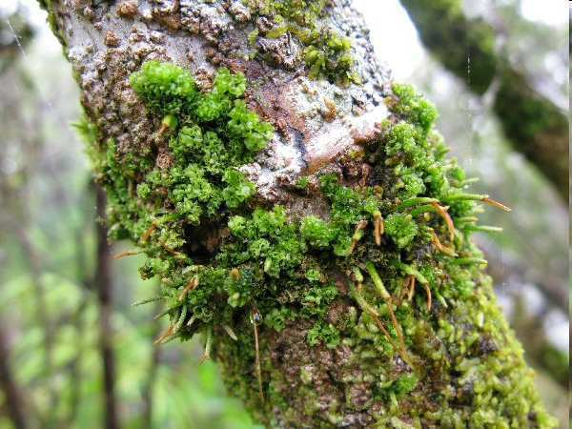
Large tropical and sub-tropical species of Dendroceros may be found growing on the bark of trees.
Epiphytes
Copyright © 2024 SlideSpark .LLC

Slide 41
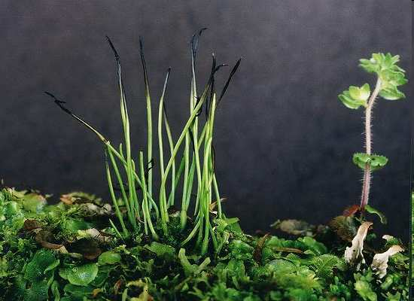
Please draw a hornwort and label it in your journal.
Copyright © 2024 SlideSpark .LLC

Slide 42
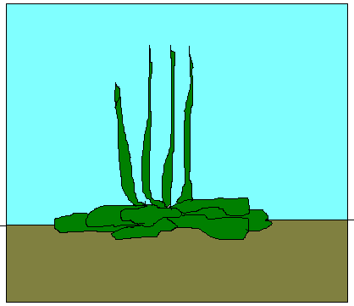
Please draw a hornwort and label it in your journal.
Copyright © 2024 SlideSpark .LLC

Slide 43
Quiz Wiz 1-10 Stand and Identify the Non-vascular Bryophyte with a symbol
  Moss, Liverwort, Hornwort.

Slide 44
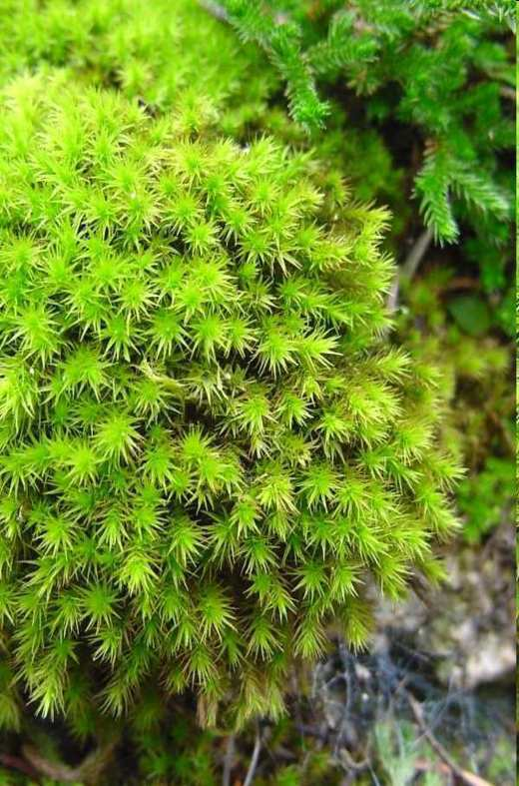
Quiz Wiz 1-10 Stand and Identify the Non-vascular Bryophyte with a symbol
  Moss, Liverwort, Hornwort.
Moss

Slide 45


Quiz Wiz 1-10 Stand and Identify the Non-vascular Bryophyte with a symbol
  Moss, Liverwort, Hornwort.
Moss

Slide 46
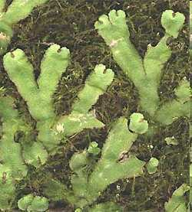
Quiz Wiz 1-10 Stand and Identify the Non-vascular Bryophyte with a symbol
  Moss, Liverwort, Hornwort.
Moss
Liverwort

Slide 47

Quiz Wiz 1-10 Stand and Identify the Non-vascular Bryophyte with a symbol
  Moss, Liverwort, Hornwort.
Moss
Liverwort

Slide 48
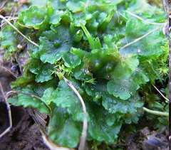
Quiz Wiz 1-10 Stand and Identify the Non-vascular Bryophyte with a symbol
  Moss, Liverwort, Hornwort.
Moss
Liverwort
Hornwort

Slide 49
Quiz Wiz 1-10 Stand and Identify the Non-vascular Bryophyte with a symbol
  Moss, Liverwort, Hornwort.
Moss
Liverwort
Hornwort

Slide 50
Practice!

Slide 51
Practice!

Slide 52
Practice!
Hornwort

Slide 53
Practice!
Hornwort

Slide 54
Practice!
Hornwort
Liverwort

Slide 55
Practice!
Hornwort
Liverwort

Slide 56
Practice!
Hornwort
Liverwort
Moss

Slide 57
Practice!
Hornwort
Liverwort
Moss
Some music for the standing and silent quiz. https://www.youtube.com/watch?v=V-F-bAKB_EM

Slide 58
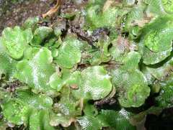
1

Slide 59
1

Slide 60
1
Liverwort

Slide 61
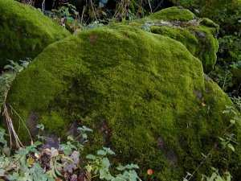
2
2

Slide 62
2
2

Slide 63
2
Moss
2

Slide 64
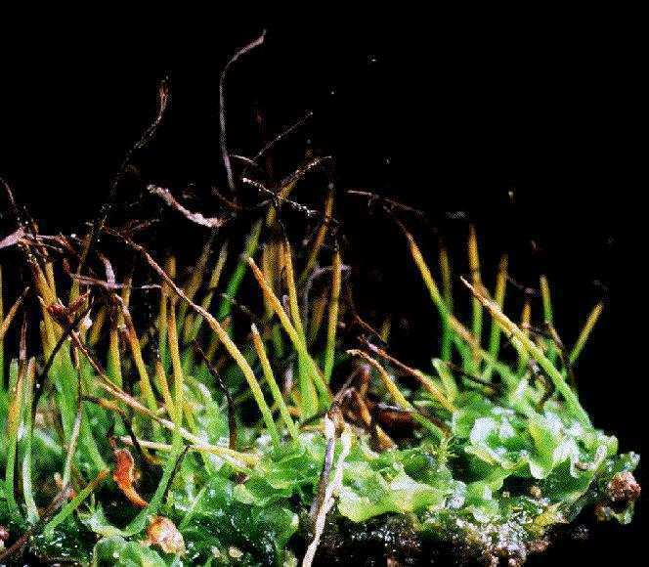
3

Slide 65
3

Slide 66
3
Hornwort

Slide 67
4

Slide 68
4

Slide 69
4
Liverwort

Slide 70
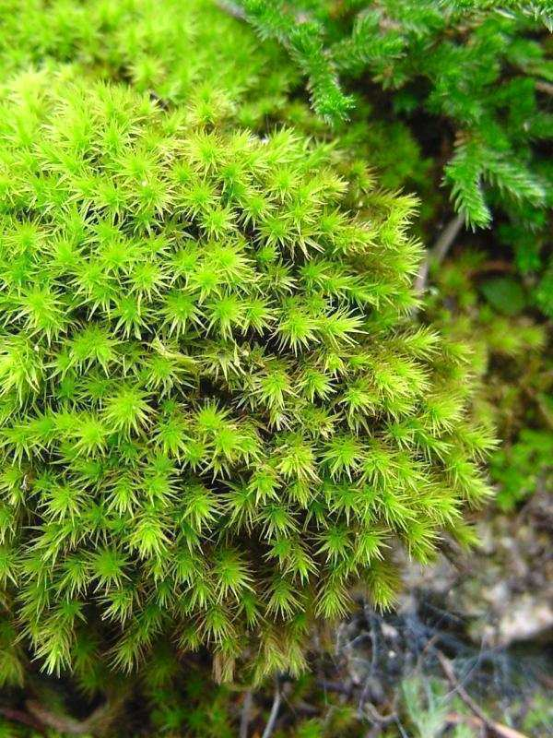
5

Slide 71
5

Slide 72
5
Moss

Slide 73

6

Slide 74
6

Slide 75
6
Hornwort

Slide 76
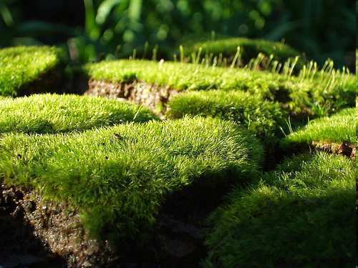
7

Slide 77
7

Slide 78
7
Moss

Slide 79

8

Slide 80
8

Slide 81
8
Hornwort

Slide 82
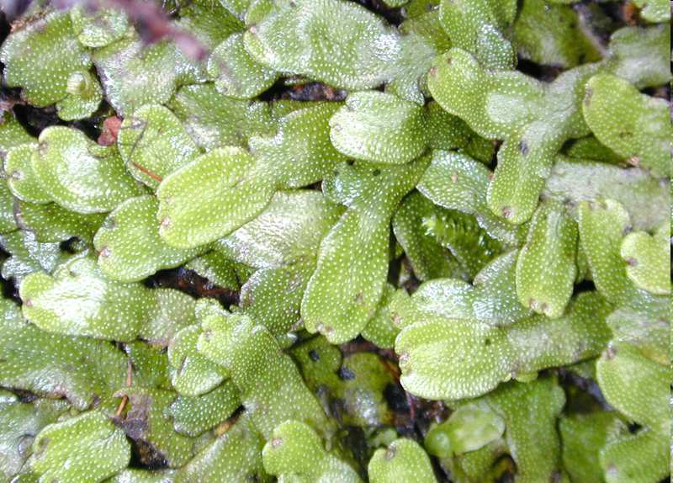
9

Slide 83
9

Slide 84
9
Liverwort

Slide 85
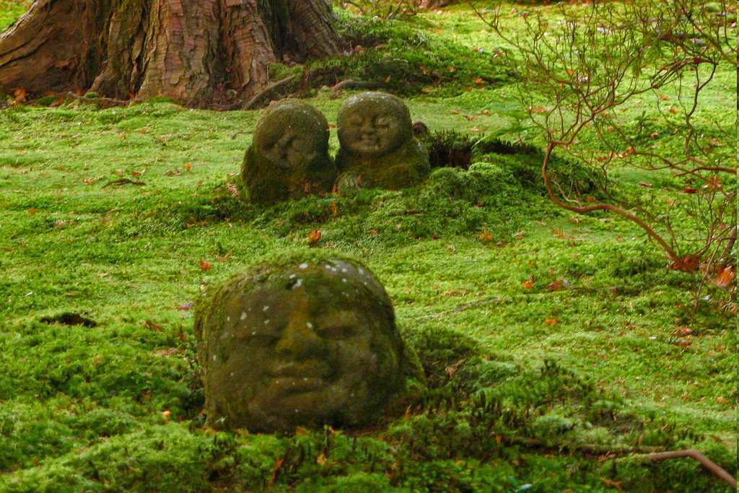
10

Slide 86
10

Slide 87
10
Moss

Slide 88


Bonus: What former NFL star is this?

Slide 89
Bonus: What former NFL star is this?

Slide 90
Bonus: What former NFL star is this?
Randy Moss

Slide 91
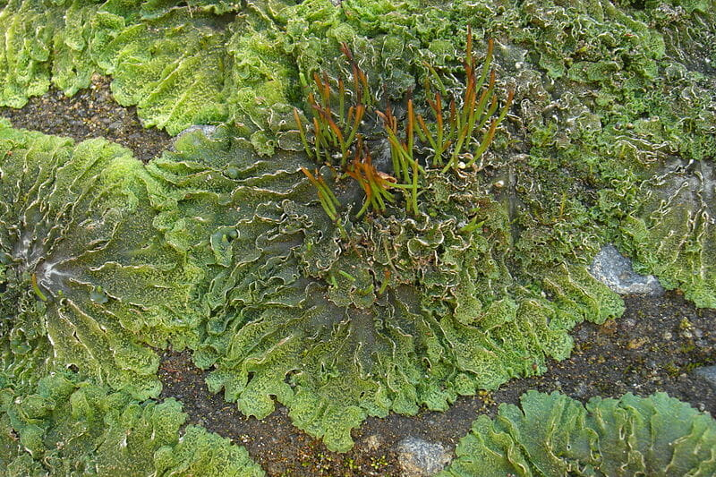
The bryophyte lifecycle consists of alternating generations between the haploid gametophyte and the diploid sporophyte.

Slide 92
The bryophyte lifecycle consists of alternating generations between the haploid gametophyte and the diploid sporophyte.
  The two haploid gametes (sperm and egg) fuse, a diploid zygote is formed.

Slide 93
The bryophyte lifecycle consists of alternating generations between the haploid gametophyte and the diploid sporophyte.
  The two haploid gametes (sperm and egg) fuse, a diploid zygote is formed.
    The zygote of bryophytes grows inside the archegonia and will eventually become a diploid sporophyte.

Slide 94
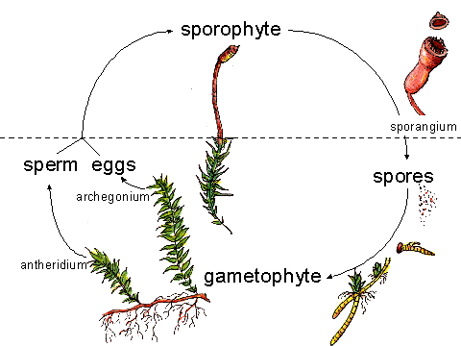
Life Cycle

Slide 95
Life Cycle

Slide 96
Life Cycle

Slide 97
Life Cycle

Slide 98
Life Cycle

Slide 99
Life Cycle

Slide 100
Life Cycle

Slide 101
Life Cycle
n

Slide 102
Life Cycle
n
n

Slide 103
Life Cycle
n
n

Slide 104
Life Cycle
n
n

Slide 105
Life Cycle
n
+
n

Slide 106
Life Cycle
2n

Slide 107
Life Cycle

Slide 108

Life Cycle

Slide 109

Life Cycle

Slide 110
Life Cycle

Slide 111
Life Cycle (Alternation of Generations)

Slide 112
Life Cycle (Alternation of Generations)
Requires Water

Slide 113
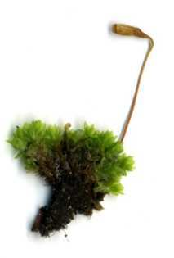
Life Cycle (Alternation of Generations)
Requires Water

Slide 114
Life Cycle (Alternation of Generations)
Requires Water
Learn more about bryophyte life cycles at… http://ohioplants.org/bryophytes-lifecycle/

Slide 115
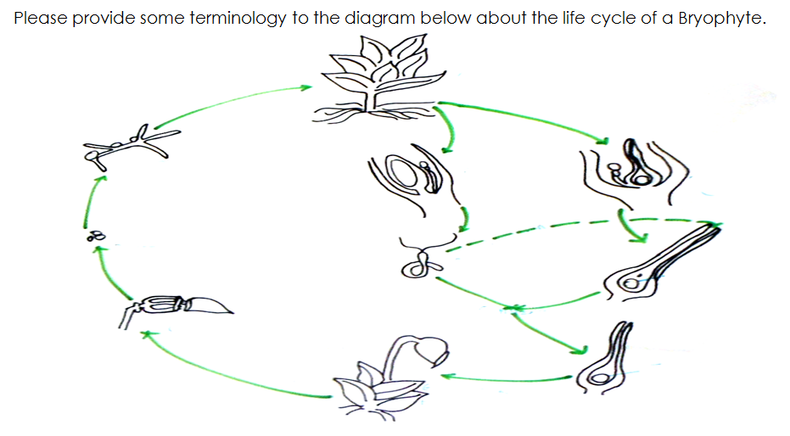

Slide 116
Capsule
Sporophyte
Stalk

Slide 117
Spores
Sporangium
Capsule
Sporophyte
Stalk

Slide 118
Lands somewhere wet ☺
Spores
Sporangium
Capsule
Sporophyte
Stalk

Slide 119
Gametophyte
Gametophyte
Lands somewhere wet ☺
Spores
Sporangium
Capsule
Sporophyte
Stalk

Slide 120
Gametophyte
Gametophyte
Antheridium (Male)
Lands somewhere wet ☺
Spores
(Male)
Sperm 1n
Sporangium
Capsule
Sporophyte
Stalk

Slide 121
Gametophyte
Gametophyte
Archegonium (female)
Antheridium (Male)
Lands somewhere wet ☺
Spores
(Male)
Sperm 1n
Sporangium
(Female)
Egg 1n
Capsule
Sporophyte
Stalk

Slide 122
Gametophyte
Gametophyte
Archegonium (female)
Antheridium (Male)
Lands somewhere wet ☺
Spores
(Male)
Sperm 1n
Sporangium
(Female)
Egg 1n
Capsule
Sporophyte
Stalk

Slide 123
Gametophyte
Gametophyte
Archegonium (female)
Antheridium (Male)
Lands somewhere wet ☺
Spores
(Male)
Sperm 1n
Sporangium
(Female)
Egg 1n
Capsule
Sporophyte
Stalk
2n Zygote
Creates Sporophyte

Slide 124
Gametophyte
Gametophyte
Archegonium (female)
Antheridium (Male)
Lands somewhere wet ☺
Spores
(Male)
Sperm 1n
Sporangium
(Female)
Egg 1n
Capsule
Sporophyte
Stalk
2n Zygote
Creates Sporophyte

Slide 125
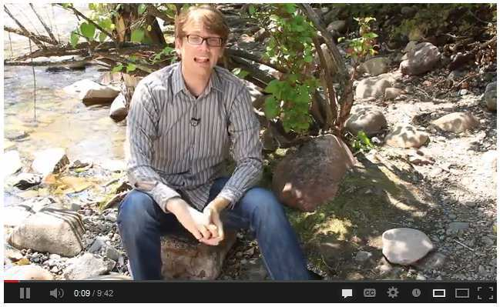

Video Link! Hank explains nonvascular plants and the alterations of generations.
  http://www.youtube.com/watch_popup?v=iWaX97p6y9U
  Preview for language and content.

Slide 126
Non-Vascular Plants
Part 2
Lesson 4

Slide 127





Curriculum Guide
Number of Lessons in each unit (50 min, daily lessons) and difficult rating scale / intended grade level.
=Easier, = More difficult, =Most difficult
Earth Science Units

Slide 128


Life Science Units

Slide 129

Physical Science

Slide 130
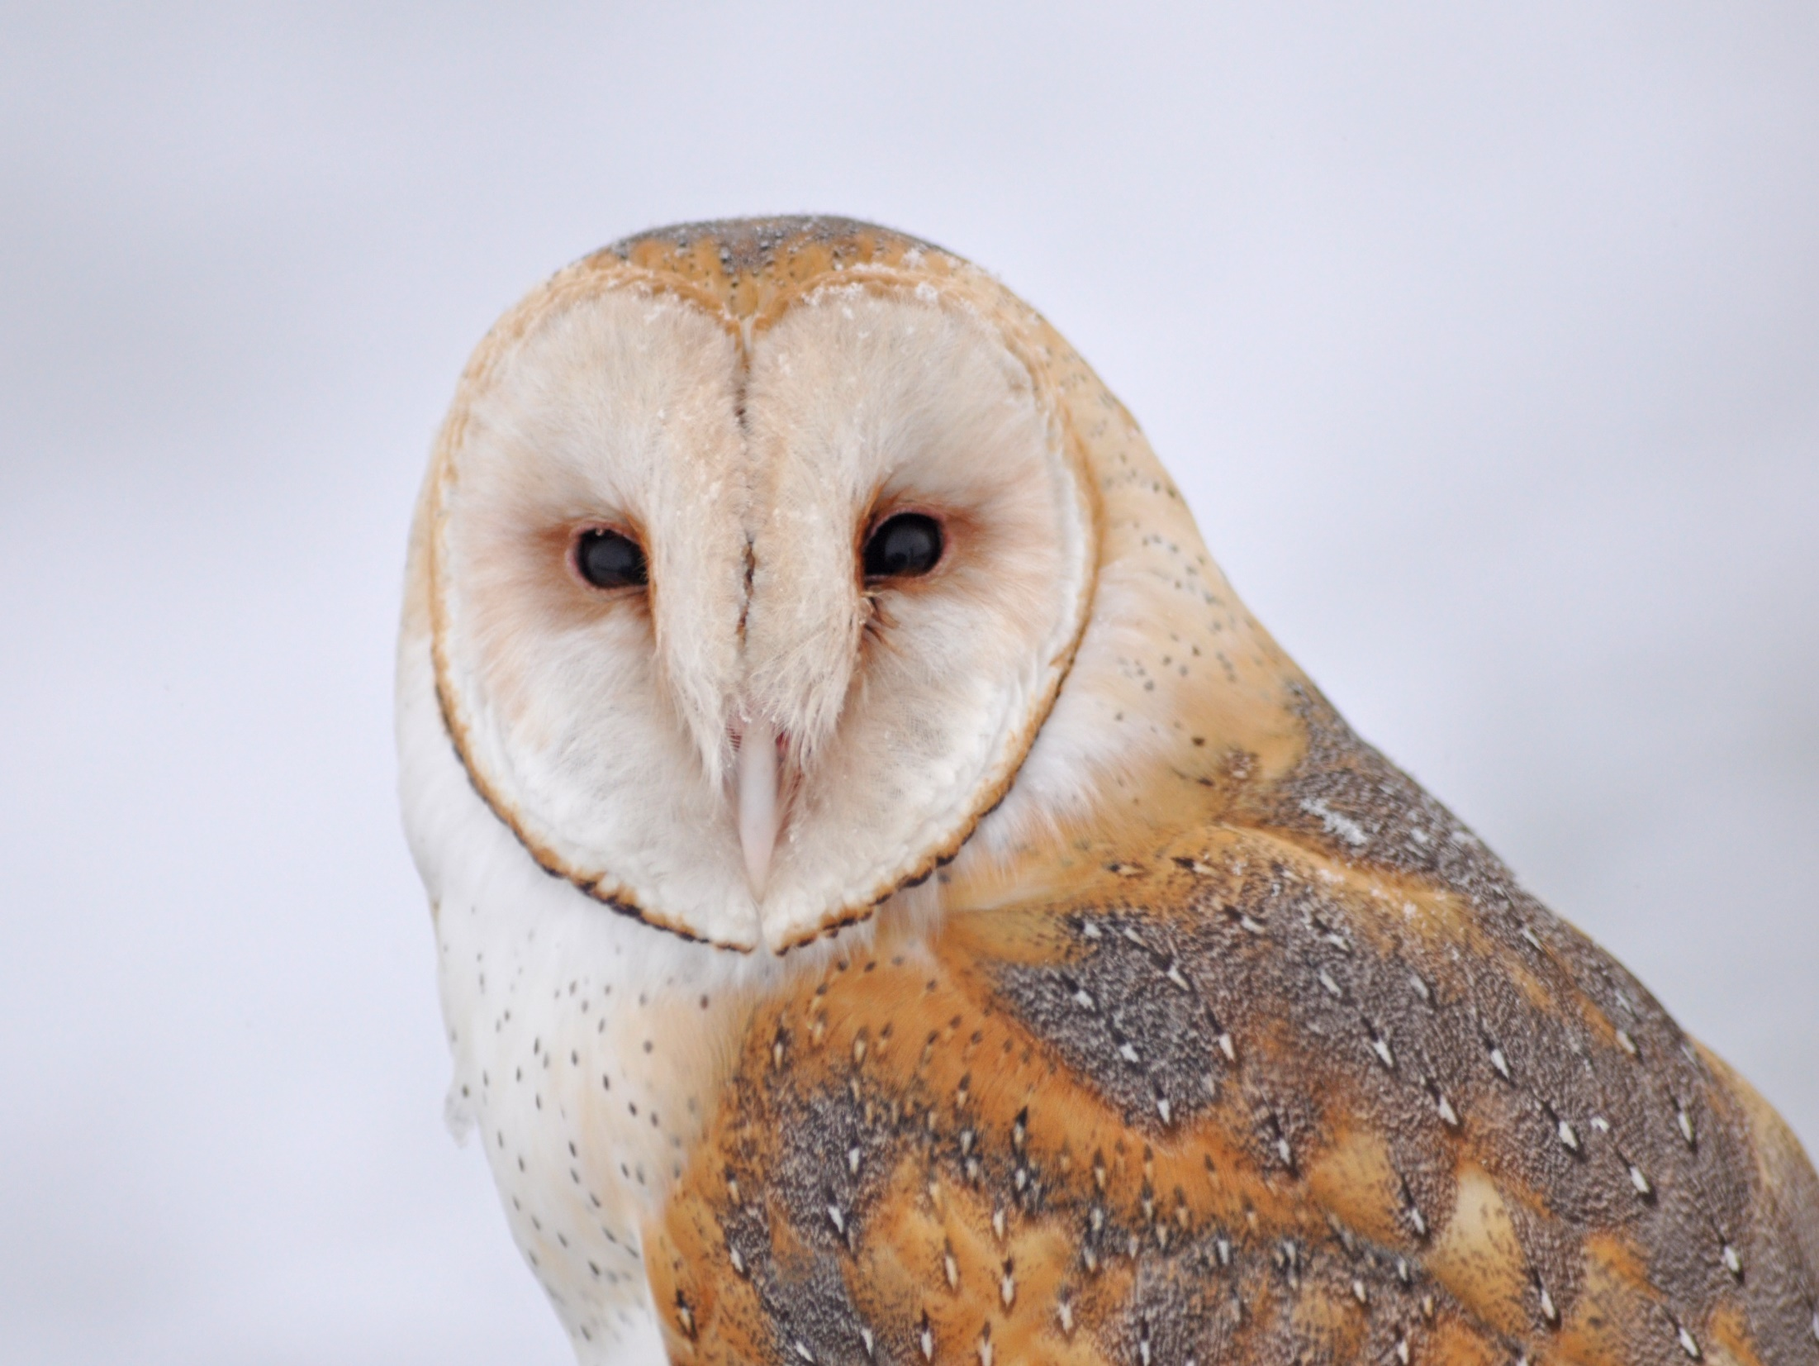
Dear Valued Educator,
Our fully editable .pptx and .doc resources are perfect for educators looking to bring enthusiasm and creativity to their lessons. We encourage you to make changes to fit your needs and style. As science educators, we’re committed to providing students with the tools they need to succeed in the classroom and beyond. Each unit in the curriculum includes a range of resources that have been developed through extensive research and use in a busy classroom. Our teaching approach is designed to make science education engaging and exciting for learners of all ages. We offer a one-of-a-kind science curriculum that will challenge, inspire, and educate students to become tomorrow's scientists and leaders. Join us today and learn more about how our program can help you achieve your classroom goals.
With appreciation,
Support@SlideSpark.net

Slide 131





Thank you for your time and interest in our Science curriculum. We strive to provide students with engaging and informative lessons that will spark their curiosity and encourage scientific exploration. Should you have any questions or concerns, please do not hesitate to contact us. Thank you again for considering our curriculum, and we wish you all the best in your educational journey.
Sincerely,
Support@slidespark.net
SlideSpark Science on TpT

