Slide 1
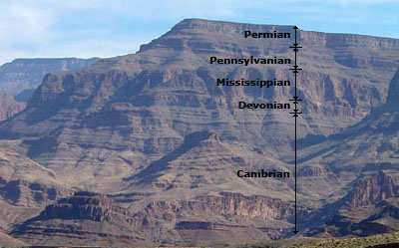

Earth System History
Review Game
Part 3
Lesson 7

Slide 2
Earth System History Review Game
IN THE NICK OF TIME | UNITS OF TIME | PICTURES IN TIME | ANYTHING EARTH HISTORY | -BONUS- DINOSAURS
1 | 6 | 11 | 16 | *21
2 | 7 | 12 | 17 | *22
3 | 8 | 13 | 18 | *23
4 | 9 | 14 | 19 | *24
5 | 10 | 15 | 20 | *25
Copyright © 2024 SlideSpark .LLC

Slide 3
How to play…
  Don’t play like Jeo_ _ _ _ y.
  Class should be divided into several small groups.
  Groups should use science journal (red slide notes), homework, and other available materials to assist you.
  Groups can communicate quietly with each other but no sharing answers between groups.
    Practice quietly communicating right now?
    Practice Communication Question:
    Your group gets to order one pizza, and you can have two toppings. What does your group want?

Slide 4

Questions 1-20 = 5pts Each
Final Category (Bonus) = 1pt Each
Final Questions = 5 pt wager
If you wager 5 on the last question and get it wrong you lose 5 pts. Wager 5 and get it right you get 5 pts.
Find the Owl =
Secretly write “Owl” in the correct box worth 1pt.
“I’ll be about this big.”

Slide 5
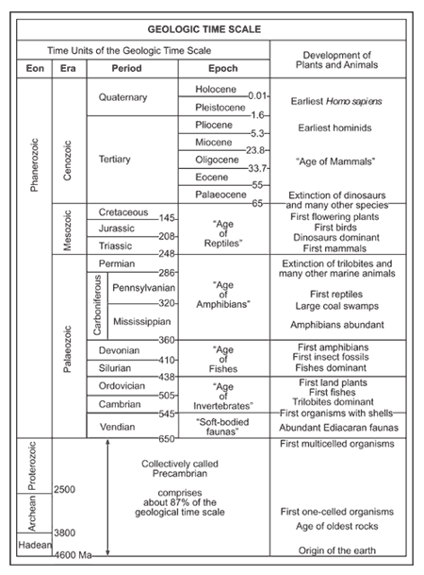
Have this sheet handy as you will be using it frequently during this review game.
Copyright © 2024 SlideSpark .LLC

Slide 6
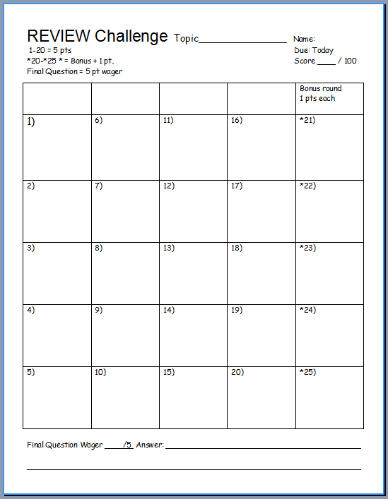
Is your name on the review sheet?
Name

Slide 7
Is your name on the review sheet?
Add the categories
along the top
on the next slide.

Slide 8
Earth System History Review Game
IN THE NICK OF TIME | UNITS OF TIME | PICTURES IN TIME | ANYTHING EARTH HISTORY | -BONUS- DINOSAURS
1 | 6 | 11 | 16 | *21
2 | 7 | 12 | 17 | *22
3 | 8 | 13 | 18 | *23
4 | 9 | 14 | 19 | *24
5 | 10 | 15 | 20 | *25
Copyright © 2024 SlideSpark .LLC

Slide 9
Earth System History Review Game
IN THE NICK OF TIME | UNITS OF TIME | PICTURES IN TIME | ANYTHING EARTH HISTORY | -BONUS- DINOSAURS
1 | 6 | 11 | 16 | *21
2 | 7 | 12 | 17 | *22
3 | 8 | 13 | 18 | *23
4 | 9 | 14 | 19 | *24
5 | 10 | 15 | 20 | *25
Copyright © 2024 SlideSpark .LLC

Slide 10

The appearance of early humans is best represented by which picture on the 12 hour Earth calendar.
1
A
B
C
D
Copyright © 2024 SlideSpark .LLC

Slide 11
The appearance of the earliest forms of basic life is best represented by which picture on the 12 hour Earth calendar.
2
A
B
C
D
Copyright © 2024 SlideSpark .LLC

Slide 12
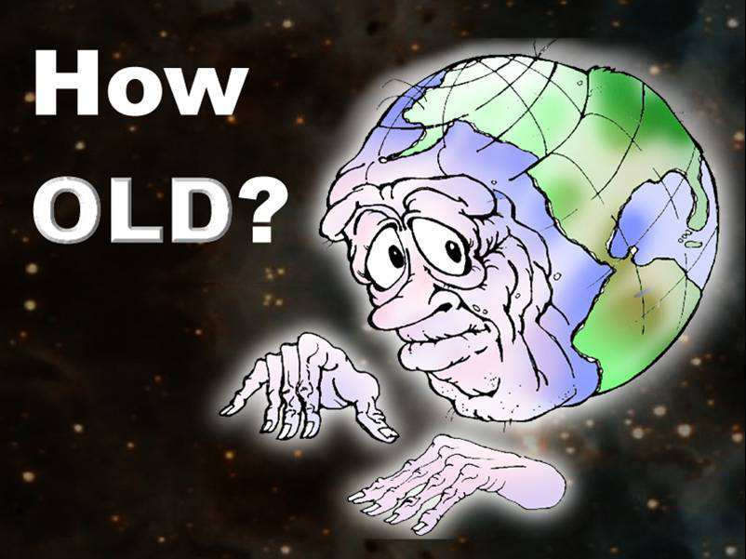
3
Roughly, How old is the earth?

Slide 13
This describes how layers of Earth that are on the bottom are usually older and contain older fossils.
4

Slide 14
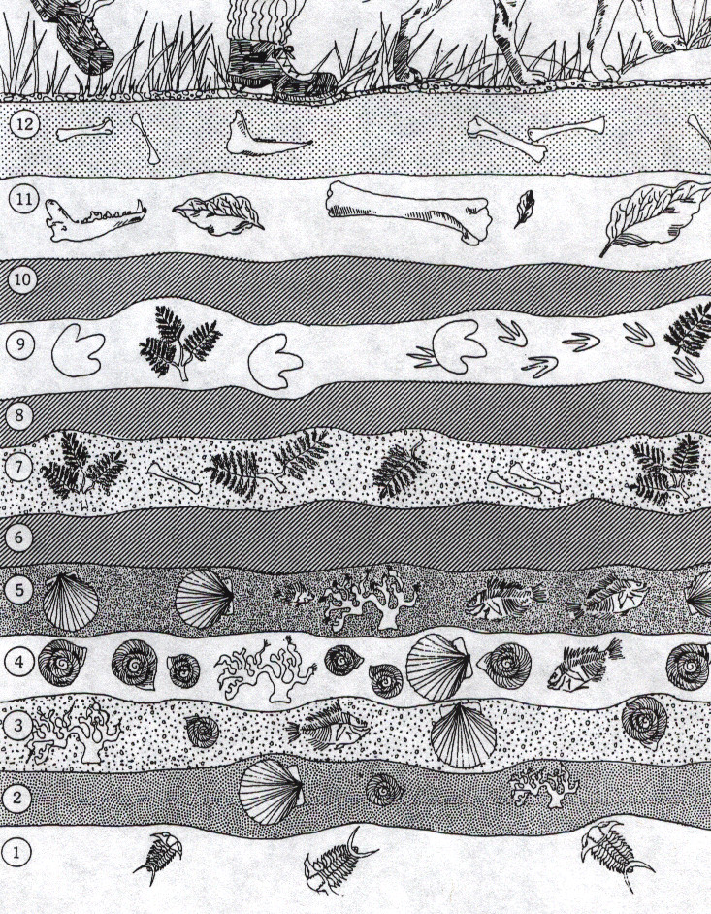
What may have occurred at numbers 6, 8, and 10?
5
Copyright © 2024 SlideSpark .LLC

Slide 15
Earth System History Review Game
IN THE NICK OF TIME | UNITS OF TIME | PICTURES IN TIME | ANYTHING EARTH HISTORY | -BONUS- DINOSAURS
1 | 6 | 11 | 16 | *21
2 | 7 | 12 | 17 | *22
3 | 8 | 13 | 18 | *23
4 | 9 | 14 | 19 | *24
5 | 10 | 15 | 20 | *25
Copyright © 2024 SlideSpark .LLC

Slide 16
This is the correct order for the units of time from the formation of the earth to present?
6
Copyright © 2024 SlideSpark .LLC

Slide 17
This is the correct order for the units of time from the formation of the earth to present?
  A.) Mesozoic Era, Archean Eon, Cenozoic Era, Cambrian Period
  B.) Precambrian Supereon, Paleozoic Era, Mesozoic Era, Cenozoic Era
  C.) Quaternary Period, Tertiary Period, Devonian Period, Cretaceous Period.
  D.) Jurassic Period, Triassic Period, Cretaceous Period, Carboniferous Period
  E.) Paleocene Epoch, Holocene Epoch, Hadean Eon, Proterozoic Eon
6
Copyright © 2024 SlideSpark .LLC

Slide 18
This is the correct order for the units of time from the formation of the earth to present?
  A.) Mesozoic Era, Archean Eon, Cenozoic Era, Cambrian Period
  B.) Precambrian Super-Eon, Paleozoic Era, Mesozoic Era, Cenozoic Era
  C.) Quaternary Period, Tertiary Period, Devonian Period, Cretaceous Period.
  D.) Jurassic Period, Triassic Period, Cretaceous Period, Carboniferous Period
  E.) Paleocene Epoch, Holocene Epoch, Hadean Eon, Proterozoic Eon
6
Copyright © 2024 SlideSpark .LLC

Slide 19
This is the correct order for the units of time from the formation of the earth to present?
  A.) Mesozoic Era, Archean Eon, Cenozoic Era, Cambrian Period
  B.) Precambrian Super-Eon, Paleozoic Era, Mesozoic Era, Cenozoic Era
  C.) Quaternary Period, Tertiary Period, Devonian Period, Cretaceous Period.
  D.) Jurassic Period, Triassic Period, Cretaceous Period, Carboniferous Period
  E.) Paleocene Epoch, Holocene Epoch, Hadean Eon, Proterozoic Eon
6
Copyright © 2024 SlideSpark .LLC

Slide 20
This is the correct order for the units of time from the formation of the earth to present?
  A.) Mesozoic Era, Archean Eon, Cenozoic Era, Cambrian Period
  B.) Precambrian Super-Eon, Paleozoic Era, Mesozoic Era, Cenozoic Era
  C.) Quaternary Period, Tertiary Period, Devonian Period, Cretaceous Period.
  D.) Jurassic Period, Triassic Period, Cretaceous Period, Carboniferous Period
  E.) Paleocene Epoch, Holocene Epoch, Hadean Eon, Proterozoic Eon
6
Copyright © 2024 SlideSpark .LLC

Slide 21
This is the correct order for the units of time from the formation of the earth to present?
  A.) Mesozoic Era, Archean Eon, Cenozoic Era, Cambrian Period
  B.) Precambrian Super-Eon, Paleozoic Era, Mesozoic Era, Cenozoic Era
  C.) Quaternary Period, Tertiary Period, Devonian Period, Cretaceous Period.
  D.) Jurassic Period, Triassic Period, Cretaceous Period, Carboniferous Period
  E.) Paleocene Epoch, Holocene Epoch, Hadean Eon, Proterozoic Eon
6
Copyright © 2024 SlideSpark .LLC

Slide 22
Which of the following units of time is the longest?
7
Copyright © 2024 SlideSpark .LLC

Slide 23
Which of the following units of time is the longest?
  A.) Phanerzoic Eon
7
Copyright © 2024 SlideSpark .LLC

Slide 24
Which of the following units of time is the longest?
  A.) Phanerzoic Eon
  B.) Mesozoic Era
7
Copyright © 2024 SlideSpark .LLC

Slide 25
Which of the following units of time is the longest?
  A.) Phanerzoic Eon
  B.) Mesozoic Era
  C.) Jurassic Period
7
Copyright © 2024 SlideSpark .LLC

Slide 26
Which of the following units of time is the longest?
  A.) Phanerzoic Eon
  B.) Mesozoic Era
  C.) Jurassic Period
  D.) Pliocene Epoch
7
Copyright © 2024 SlideSpark .LLC

Slide 27
Which of the following units of time is the longest?
  A.) Phanerzoic Eon
  B.) Mesozoic Era
  C.) Jurassic Period
  D.) Pliocene Epoch
  E.) Science Class
7
Copyright © 2024 SlideSpark .LLC

Slide 28

Mass extinction events occurred at the end of these two periods.
8
Copyright © 2024 SlideSpark .LLC

Slide 29
Mass extinction events occurred at the end of these two periods.
  A.) Cambrian and Tertiary Periods
8
Copyright © 2024 SlideSpark .LLC

Slide 30
Mass extinction events occurred at the end of these two periods.
  A.) Cambrian and Tertiary Periods
  B.) Mississippian and Pennsylvanian Periods
8
Copyright © 2024 SlideSpark .LLC

Slide 31
Mass extinction events occurred at the end of these two periods.
  A.) Cambrian and Tertiary Periods
  B.) Mississippian and Pennsylvanian Periods
  C.) Permian and Cretaceous Periods
8
Copyright © 2024 SlideSpark .LLC

Slide 32
Mass extinction events occurred at the end of these two periods.
  A.) Cambrian and Tertiary Periods
  B.) Mississippian and Pennsylvanian Periods
  C.) Permian and Cretaceous Periods
  D.) Vendian and Silurian Periods
8
Copyright © 2024 SlideSpark .LLC

Slide 33
Mass extinction events occurred at the end of these two periods.
  A.) Cambrian and Tertiary Periods
  B.) Mississippian and Pennsylvanian Periods
  C.) Permian and Cretaceous Periods
  D.) Vendian and Silurian Periods
  E.) No mass extinction events have ever occurred.
8
Copyright © 2024 SlideSpark .LLC

Slide 34
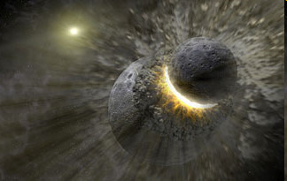
Which unit of Geologic Time best represents the formation of the moon?
9
Copyright © 2024 SlideSpark .LLC

Slide 35
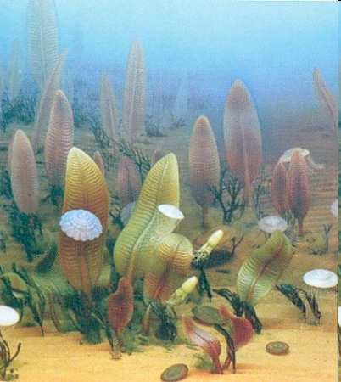
This picture best represents which Era on the Geologic Time Scale?
10
Copyright © 2024 SlideSpark .LLC

Slide 36
Earth System History Review Game
IN THE NICK OF TIME | UNITS OF TIME | PICTURES IN TIME | ANYTHING EARTH HISTORY | -BONUS- DINOSAURS
1 | 6 | 11 | 16 | *21
2 | 7 | 12 | 17 | *22
3 | 8 | 13 | 18 | *23
4 | 9 | 14 | 19 | *24
5 | 10 | 15 | 20 | *25
Copyright © 2024 SlideSpark .LLC

Slide 37
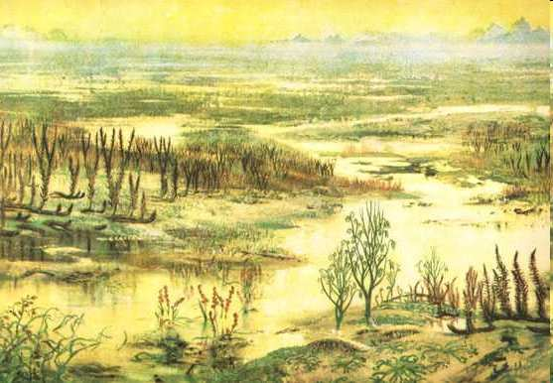
This picture best represents which Period on the Geologic Time Scale?
11
Copyright © 2024 SlideSpark .LLC

Slide 38
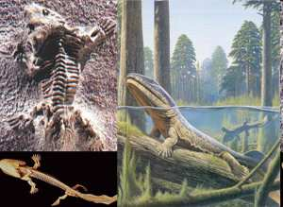
This picture best represents which Period on the Geologic Time Scale?
11
12
Copyright © 2024 SlideSpark .LLC

Slide 39
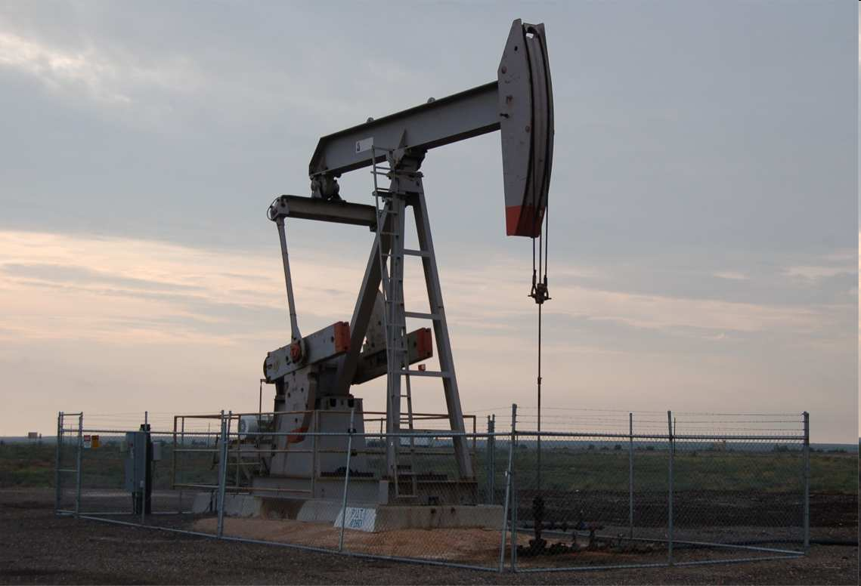
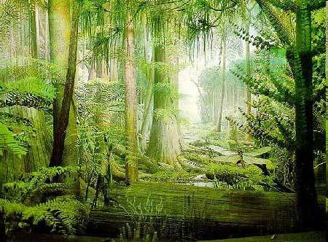
Most of the coal and other forms of fossil fuel are the carbon rich remains of plants and animals that lived during this period?
11
12
13
Copyright © 2024 SlideSpark .LLC

Slide 40
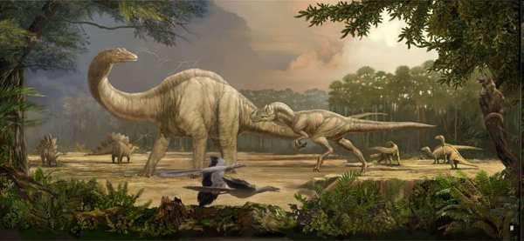

This picture best represents which Period on the Geologic Time Scale?
  Note: Emergence of Birds
11
12
14
Copyright © 2024 SlideSpark .LLC

Slide 41
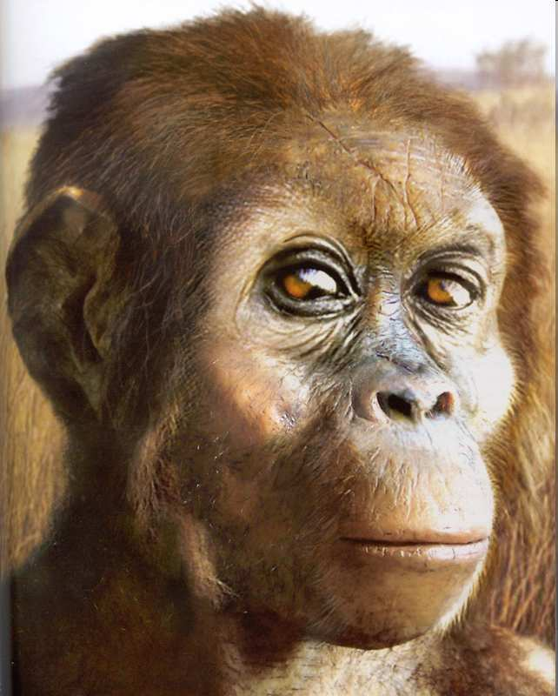
This picture best represents which Period on the Geologic Time Scale?
11
12
15
Copyright © 2024 SlideSpark .LLC

Slide 42
Earth System History Review Game
IN THE NICK OF TIME | UNITS OF TIME | PICTURES IN TIME | ANYTHING EARTH HISTORY | -BONUS- DINOSAURS
1 | 6 | 11 | 16 | *21
2 | 7 | 12 | 17 | *22
3 | 8 | 13 | 18 | *23
4 | 9 | 14 | 19 | *24
5 | 10 | 15 | 20 | *25
Copyright © 2024 SlideSpark .LLC

Slide 43
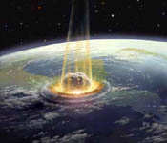
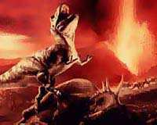
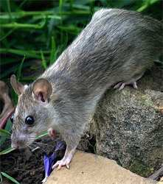
What is the K and the Pg in the K-Pg Mass Extinction Event that wiped out the dinosaurs and allowed the age of the mammals to begin.
16
Copyright © 2024 SlideSpark .LLC

Slide 44
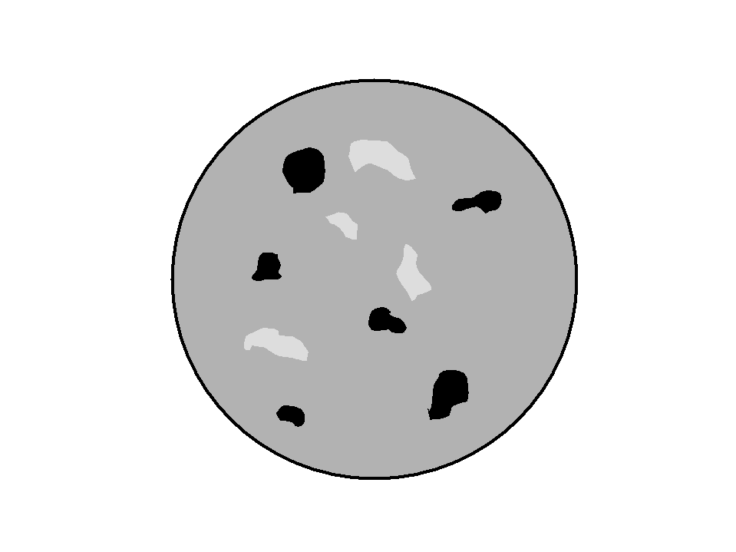
What is this an animation of? When did it happen?
17
Copyright © 2024 SlideSpark .LLC

Slide 45
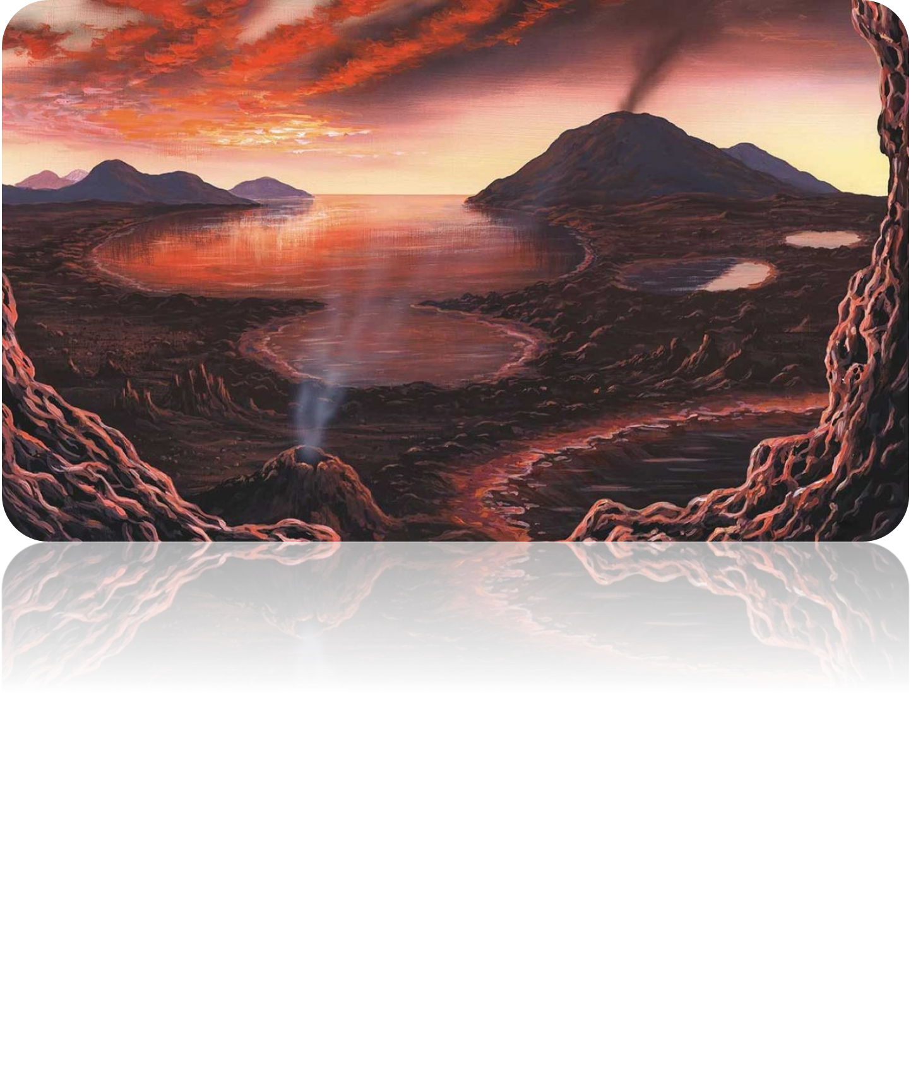
These were created from outgassing from
the interior of the planet?
17
With some help from meteorites
18

Slide 46
All of the following are similarities between birds and bird-like dinosaurs (Theropods) except…
19
Copyright © 2024 SlideSpark .LLC

Slide 47
All of the following are similarities between birds and bird-like dinosaurs (Theropods) except…
  A.) Three toed foot.
19
Copyright © 2024 SlideSpark .LLC

Slide 48
All of the following are similarities between birds and bird-like dinosaurs (Theropods) except…
  A.) Three toed foot.
  B.) Walk on two legs.
19
Copyright © 2024 SlideSpark .LLC

Slide 49
All of the following are similarities between birds and bird-like dinosaurs (Theropods) except…
  A.) Three toed foot.
  B.) Walk on two legs.
  C.) Dense heavy bones.
19
Copyright © 2024 SlideSpark .LLC

Slide 50
All of the following are similarities between birds and bird-like dinosaurs (Theropods) except…
  A.) Three toed foot.
  B.) Walk on two legs.
  C.) Dense heavy bones.
  D.) Wishbone.
19
Copyright © 2024 SlideSpark .LLC

Slide 51
All of the following are similarities between birds and bird-like dinosaurs (Theropods) except…
  A.) Three toed foot.
  B.) Walk on two legs.
  C.) Dense heavy bones.
  D.) Wishbone.
  E.) Backward pointing pelvis.
19
Copyright © 2024 SlideSpark .LLC

Slide 52
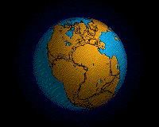
What supercontinent that is shown below began to break apart during the early Jurassic Period?
20

Slide 53
Earth System History Review Game
IN THE NICK OF TIME | UNITS OF TIME | PICTURES IN TIME | ANYTHING EARTH HISTORY | -BONUS- DINOSAURS
1 | 6 | 11 | 16 | *21
2 | 7 | 12 | 17 | *22
3 | 8 | 13 | 18 | *23
4 | 9 | 14 | 19 | *24
5 | 10 | 15 | 20 | *25
Copyright © 2024 SlideSpark .LLC

Slide 54

Who is the actor seen below in the movie Land of the Lost?
*21
Copyright © 2024 SlideSpark .LLC

Slide 55
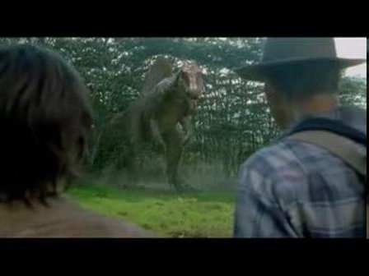
A Spinosaurus is depicted in this Movie?
*22
Copyright © 2024 SlideSpark .LLC

Slide 56
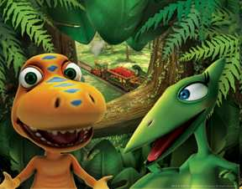
Name this PBS T.V. Show that helps educate kids about dinosaurs of the Mesozoic Era?
*23
Copyright © 2024 SlideSpark .LLC

Slide 57
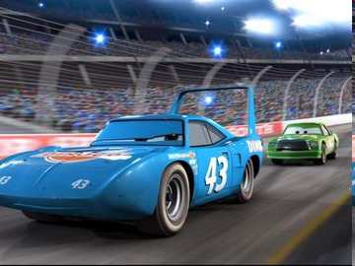
Strip Weathers races for this corporation in the Pixar movie Cars?
*24
Copyright © 2024 SlideSpark .LLC

Slide 58
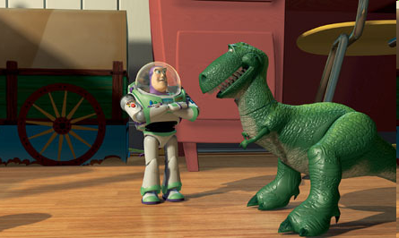
Correctly Spell the full name of Rex’s species seen here in Toy Story III?
*25
Copyright © 2024 SlideSpark .LLC

Slide 59
Earth System History Review Game
IN THE NICK OF TIME | UNITS OF TIME | PICTURES IN TIME | ANYTHING EARTH HISTORY | -BONUS- DINOSAURS
1 | 6 | 11 | 16 | *21
2 | 7 | 12 | 17 | *22
3 | 8 | 13 | 18 | *23
4 | 9 | 14 | 19 | *24
5 | 10 | 15 | 20 | *25
Final Question_______________
Copyright © 2024 SlideSpark .LLC

Slide 60
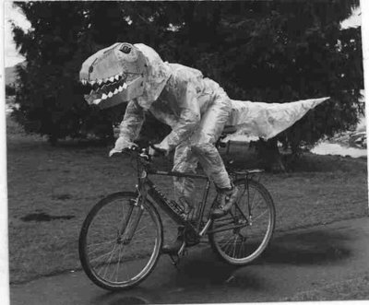
“This is a 5pt wager question.” “Please make your wager now.”

Slide 61
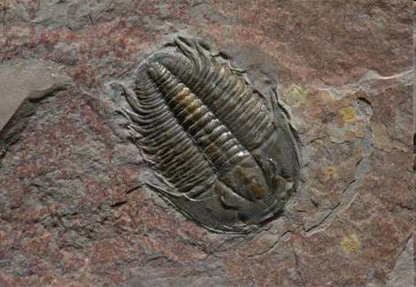
Final Question?
  What is the name of the organism seen below that dominated in the early Paleozoic long before life moved to land?
Copyright © 2024 SlideSpark .LLC

Slide 62
Earth System History
Review Game
Part 3
Lesson 7

Slide 63

Earth System History
Review Game
Part 3
Lesson 8

Slide 64
Earth System History Review Game
IN THE NICK OF TIME | UNITS OF TIME | PICTURES IN TIME | ANYTHING EARTH HISTORY | -BONUS- DINOSAURS
1 | 6 | 11 | 16 | *21
2 | 7 | 12 | 17 | *22
3 | 8 | 13 | 18 | *23
4 | 9 | 14 | 19 | *24
5 | 10 | 15 | 20 | *25
Copyright © 2024 SlideSpark .LLC

Slide 65
The appearance of early humans is best represented by which picture on the 12 hour Earth calendar.
1
A
B
C
D
Copyright © 2024 SlideSpark .LLC

Slide 66
The appearance of early humans is best represented by which picture on the 12 hour Earth calendar. Answer: C 11:59
1
A
B
C
D
Copyright © 2024 SlideSpark .LLC

Slide 67
The appearance of the earliest forms of basic life is best represented by which picture on the 12 hour Earth calendar.
2
A
B
C
D
Copyright © 2024 SlideSpark .LLC

Slide 68
The appearance of the earliest forms of basic life is best represented by which picture on the 12 hour Earth calendar. Answer D: Archean
2
A
B
C
D
Copyright © 2024 SlideSpark .LLC

Slide 69
3
Roughly, How old is the earth?

Slide 70
3
Roughly, How old is the earth?
4.54 Billion Years Old

Slide 71
This describes how layers of Earth that are on the bottom are usually older and contain older fossils.
4

Slide 72
This describes how layers of Earth that are on the bottom are usually older and contain older fossils. Principle of Superposition
4

Slide 73
What may have occurred at numbers 6, 8, and 10?
5
Copyright © 2024 SlideSpark .LLC

Slide 74
What may have occurred at numbers 6, 8, and 10?
An Extinction Event
5
Copyright © 2024 SlideSpark .LLC

Slide 75
What may have occurred at numbers 6, 8, and 10?
An Extinction Event
“99.5%”
5
Copyright © 2024 SlideSpark .LLC

Slide 76
Earth System History Review Game
IN THE NICK OF TIME | UNITS OF TIME | PICTURES IN TIME | ANYTHING EARTH HISTORY | -BONUS- DINOSAURS
1 | 6 | 11 | 16 | *21
2 | 7 | 12 | 17 | *22
3 | 8 | 13 | 18 | *23
4 | 9 | 14 | 19 | *24
5 | 10 | 15 | 20 | *25
Copyright © 2024 SlideSpark .LLC

Slide 77
This is the correct order for the units of time from the formation of the earth to present?
6
Copyright © 2024 SlideSpark .LLC

Slide 78
This is the correct order for the units of time from the formation of the earth to present?
  A.) Mesozoic Era, Archean Eon, Cenozoic Era, Cambrian Period
  B.) Precambrian Supereon, Paleozoic Era, Mesozoic Era, Cenozoic Era
  C.) Quaternary Period, Tertiary Period, Devonian Period, Cretaceous Period.
  D.) Jurassic Period, Triassic Period, Cretaceous Period, Carboniferous Period
  E.) Paleocene Epoch, Holocene Epoch, Hadean Eon, Proterozoic Eon
6
Copyright © 2024 SlideSpark .LLC

Slide 79
This is the correct order for the units of time from the formation of the earth to present?
  A.) Mesozoic Era, Archean Eon, Cenozoic Era, Cambrian Period
  B.) Precambrian Super-Eon, Paleozoic Era, Mesozoic Era, Cenozoic Era
  C.) Quaternary Period, Tertiary Period, Devonian Period, Cretaceous Period.
  D.) Jurassic Period, Triassic Period, Cretaceous Period, Carboniferous Period
  E.) Paleocene Epoch, Holocene Epoch, Hadean Eon, Proterozoic Eon
6
Copyright © 2024 SlideSpark .LLC

Slide 80
This is the correct order for the units of time from the formation of the earth to present?
  A.) Mesozoic Era, Archean Eon, Cenozoic Era, Cambrian Period
  B.) Precambrian Super-Eon, Paleozoic Era, Mesozoic Era, Cenozoic Era
  C.) Quaternary Period, Tertiary Period, Devonian Period, Cretaceous Period.
  D.) Jurassic Period, Triassic Period, Cretaceous Period, Carboniferous Period
  E.) Paleocene Epoch, Holocene Epoch, Hadean Eon, Proterozoic Eon
6
Copyright © 2024 SlideSpark .LLC

Slide 81
This is the correct order for the units of time from the formation of the earth to present?
  A.) Mesozoic Era, Archean Eon, Cenozoic Era, Cambrian Period
  B.) Precambrian Super-Eon, Paleozoic Era, Mesozoic Era, Cenozoic Era
  C.) Quaternary Period, Tertiary Period, Devonian Period, Cretaceous Period.
  D.) Jurassic Period, Triassic Period, Cretaceous Period, Carboniferous Period
  E.) Paleocene Epoch, Holocene Epoch, Hadean Eon, Proterozoic Eon
6
Copyright © 2024 SlideSpark .LLC

Slide 82
This is the correct order for the units of time from the formation of the earth to present?
  A.) Mesozoic Era, Archean Eon, Cenozoic Era, Cambrian Period
  B.) Precambrian Super-Eon, Paleozoic Era, Mesozoic Era, Cenozoic Era
  C.) Quaternary Period, Tertiary Period, Devonian Period, Cretaceous Period.
  D.) Jurassic Period, Triassic Period, Cretaceous Period, Carboniferous Period
  E.) Paleocene Epoch, Holocene Epoch, Hadean Eon, Proterozoic Eon
6
Copyright © 2024 SlideSpark .LLC

Slide 83
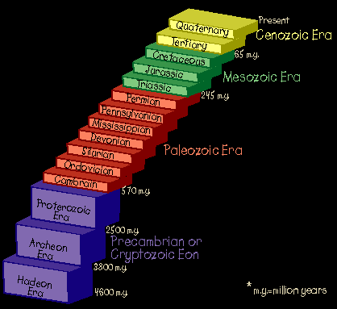
This is the correct order for the units of time from the formation of the earth to present?
  A.) Mesozoic Era, Archean Eon, Cenozoic Era, Cambrian Period
  B.) Precambrian Super-Eon, Paleozoic Era, Mesozoic Era, Cenozoic Era
  C.) Quaternary Period, Tertiary Period, Devonian Period, Cretaceous Period.
  D.) Jurassic Period, Triassic Period, Cretaceous Period, Carboniferous Period
  E.) Paleocene Epoch, Holocene Epoch, Hadean Eon, Proterozoic Eon
6
Copyright © 2024 SlideSpark .LLC

Slide 84
This is the correct order for the units of time from the formation of the earth to present?
  A.) Mesozoic Era, Archean Eon, Cenozoic Era, Cambrian Period
  B.) Precambrian Super-Eon, Paleozoic Era, Mesozoic Era, Cenozoic Era
  C.) Quaternary Period, Tertiary Period, Devonian Period, Cretaceous Period.
  D.) Jurassic Period, Triassic Period, Cretaceous Period, Carboniferous Period
  E.) Paleocene Epoch, Holocene Epoch, Hadean Eon, Proterozoic Eon
6
Copyright © 2024 SlideSpark .LLC

Slide 85
This is the correct order for the units of time from the formation of the earth to present?
  A.) Mesozoic Era, Archean Eon, Cenozoic Era, Cambrian Period
  B.) Precambrian Super-Eon, Paleozoic Era, Mesozoic Era, Cenozoic Era
  C.) Quaternary Period, Tertiary Period, Devonian Period, Cretaceous Period.
  D.) Jurassic Period, Triassic Period, Cretaceous Period, Carboniferous Period
  E.) Paleocene Epoch, Holocene Epoch, Hadean Eon, Proterozoic Eon
6
Copyright © 2024 SlideSpark .LLC

Slide 86
This is the correct order for the units of time from the formation of the earth to present?
  A.) Mesozoic Era, Archean Eon, Cenozoic Era, Cambrian Period
  B.) Precambrian Super-Eon, Paleozoic Era, Mesozoic Era, Cenozoic Era
  C.) Quaternary Period, Tertiary Period, Devonian Period, Cretaceous Period.
  D.) Jurassic Period, Triassic Period, Cretaceous Period, Carboniferous Period
  E.) Paleocene Epoch, Holocene Epoch, Hadean Eon, Proterozoic Eon
6
Copyright © 2024 SlideSpark .LLC

Slide 87
This is the correct order for the units of time from the formation of the earth to present?
  A.) Mesozoic Era, Archean Eon, Cenozoic Era, Cambrian Period
  B.) Precambrian Super-Eon, Paleozoic Era, Mesozoic Era, Cenozoic Era
  C.) Quaternary Period, Tertiary Period, Devonian Period, Cretaceous Period.
  D.) Jurassic Period, Triassic Period, Cretaceous Period, Carboniferous Period
  E.) Paleocene Epoch, Holocene Epoch, Hadean Eon, Proterozoic Eon
6
Copyright © 2024 SlideSpark .LLC

Slide 88
Which of the following units of time is the longest?
7
Copyright © 2024 SlideSpark .LLC

Slide 89
Which of the following units of time is the longest?
  A.) Phanerzoic Eon
7
Copyright © 2024 SlideSpark .LLC

Slide 90
Which of the following units of time is the longest?
  A.) Phanerzoic Eon
  B.) Mesozoic Era
7
Copyright © 2024 SlideSpark .LLC

Slide 91
Which of the following units of time is the longest?
  A.) Phanerzoic Eon
  B.) Mesozoic Era
  C.) Jurassic Period
7
Copyright © 2024 SlideSpark .LLC

Slide 92
Which of the following units of time is the longest?
  A.) Phanerzoic Eon
  B.) Mesozoic Era
  C.) Jurassic Period
  D.) Pliocene Epoch
7
Copyright © 2024 SlideSpark .LLC

Slide 93
Which of the following units of time is the longest?
  A.) Phanerzoic Eon
  B.) Mesozoic Era
  C.) Jurassic Period
  D.) Pliocene Epoch
  E.) Science Class
7
Copyright © 2024 SlideSpark .LLC

Slide 94
Which of the following units of time is the longest?
  A.) Phanerzoic Eon
  B.) Mesozoic Era
  C.) Jurassic Period
  D.) Pliocene Epoch
  E.) Science Class
7
Copyright © 2024 SlideSpark .LLC

Slide 95
Which of the following units of time is the longest?
  A.) Phanerzoic Eon
  B.) Mesozoic Era
  C.) Jurassic Period
  D.) Pliocene Epoch
  E.) Science Class
7
Copyright © 2024 SlideSpark .LLC

Slide 96
Which of the following units of time is the longest?
  A.) Phanerzoic Eon
  B.) Mesozoic Era
  C.) Jurassic Period
  D.) Pliocene Epoch
  E.) Science Class
7
Copyright © 2024 SlideSpark .LLC

Slide 97
Which of the following units of time is the longest?
  A.) Phanerzoic Eon
  B.) Mesozoic Era
  C.) Jurassic Period
  D.) Pliocene Epoch
  E.) Science Class
7
Copyright © 2024 SlideSpark .LLC

Slide 98
Which of the following units of time is the longest?
  A.) Phanerzoic Eon
  B.) Mesozoic Era
  C.) Jurassic Period
  D.) Pliocene Epoch
  E.) Science Class
7
Copyright © 2024 SlideSpark .LLC

Slide 99

Which of the following units of time is the longest?
  A.) Phanerzoic Eon
  B.) Mesozoic Era
  C.) Jurassic Period
  D.) Pliocene Epoch
  E.) Science Class
7
Copyright © 2024 SlideSpark .LLC

Slide 100
Mass extinction events occurred at the end of these two periods.
8
Copyright © 2024 SlideSpark .LLC

Slide 101
Mass extinction events occurred at the end of these two periods.
  A.) Cambrian and Tertiary Periods
8
Copyright © 2024 SlideSpark .LLC

Slide 102
Mass extinction events occurred at the end of these two periods.
  A.) Cambrian and Tertiary Periods
  B.) Mississippian and Pennsylvanian Periods
8
Copyright © 2024 SlideSpark .LLC

Slide 103
Mass extinction events occurred at the end of these two periods.
  A.) Cambrian and Tertiary Periods
  B.) Mississippian and Pennsylvanian Periods
  C.) Permian and Cretaceous Periods
8
Copyright © 2024 SlideSpark .LLC

Slide 104
Mass extinction events occurred at the end of these two periods.
  A.) Cambrian and Tertiary Periods
  B.) Mississippian and Pennsylvanian Periods
  C.) Permian and Cretaceous Periods
  D.) Vendian and Silurian Periods
8
Copyright © 2024 SlideSpark .LLC

Slide 105
Mass extinction events occurred at the end of these two periods.
  A.) Cambrian and Tertiary Periods
  B.) Mississippian and Pennsylvanian Periods
  C.) Permian and Cretaceous Periods
  D.) Vendian and Silurian Periods
  E.) No mass extinction events have ever occurred.
8
Copyright © 2024 SlideSpark .LLC

Slide 106
Mass extinction events occurred at the end of these two periods.
  A.) Cambrian and Tertiary Periods
  B.) Mississippian and Pennsylvanian Periods
  C.) Permian and Cretaceous Periods
  D.) Vendian and Silurian Periods
  E.) No mass extinction events have ever occurred.
8
Copyright © 2024 SlideSpark .LLC

Slide 107
Which unit of Geologic Time best represents the formation of the moon?
9
Copyright © 2024 SlideSpark .LLC

Slide 108
Which unit of Geologic Time best represents the formation of the moon?
  The Precambrian Super -Eon (Hadean Eon Accepted)
9
Copyright © 2024 SlideSpark .LLC

Slide 109
Which unit of Geologic Time best represents the formation of the moon?
  The Precambrian Super -Eon (Hadean Eon Accepted)
9
Causes Axial Tilt in Earth 23.5°
Copyright © 2024 SlideSpark .LLC

Slide 110
This picture best represents which Era on the Geologic Time Scale?
10
Copyright © 2024 SlideSpark .LLC

Slide 111
This picture best represents which Era on the Geologic Time Scale?
Paleozoic Era
10
Copyright © 2024 SlideSpark .LLC

Slide 112
This picture best represents which Era on the Geologic Time Scale?
Paleozoic Era (Early Vendian / Cambrian Period)
10
Copyright © 2024 SlideSpark .LLC

Slide 113
Earth System History Review Game
IN THE NICK OF TIME | UNITS OF TIME | PICTURES IN TIME | ANYTHING EARTH HISTORY | -BONUS- DINOSAURS
1 | 6 | 11 | 16 | *21
2 | 7 | 12 | 17 | *22
3 | 8 | 13 | 18 | *23
4 | 9 | 14 | 19 | *24
5 | 10 | 15 | 20 | *25
Copyright © 2024 SlideSpark .LLC

Slide 114
This picture best represents which Period on the Geologic Time Scale?
11
Copyright © 2024 SlideSpark .LLC

Slide 115
This picture best represents which Period on the Geologic Time Scale?
Ordovician Period (First Land Plants)
During Paleozoic Era
11
Copyright © 2024 SlideSpark .LLC

Slide 116
This picture best represents which Period on the Geologic Time Scale?
11
12
Copyright © 2024 SlideSpark .LLC

Slide 117
This picture best represents which Period on the Geologic Time Scale?
Devonian
11
12
Copyright © 2024 SlideSpark .LLC

Slide 118
This picture best represents which Period on the Geologic Time Scale?
Devonian or Early Carboniferous Period
During Paleozoic Era
11
12
Copyright © 2024 SlideSpark .LLC

Slide 119
Most of the coal and other forms of fossil fuel are the carbon rich remains of plants and animals that lived during this period?
11
12
13
Copyright © 2024 SlideSpark .LLC

Slide 120
Most of the coal and other forms of fossil fuel are the carbon rich remains of plants and animals that lived during this period?
Carboniferous Period
11
12
13
Copyright © 2024 SlideSpark .LLC

Slide 121
Most of the coal and other forms of fossil fuel are the carbon rich remains of plants and animals that lived during this period?
Carboniferous Period
11
12
13
Copyright © 2024 SlideSpark .LLC

Slide 122
Most of the coal and other forms of fossil fuel are the carbon rich remains of plants and animals that lived during this period?
Carboniferous Period
11
12
13
During Paleozoic Era
Copyright © 2024 SlideSpark .LLC

Slide 123
This picture best represents which Period on the Geologic Time Scale?
  Note: Emergence of Birds
11
12
14
Copyright © 2024 SlideSpark .LLC

Slide 124
This picture best represents which Period on the Geologic Time Scale?
  Note: Emergence of Birds Answer: Jurassic Period
11
12
14
Copyright © 2024 SlideSpark .LLC

Slide 125
This picture best represents which Period on the Geologic Time Scale?
  Note: Emergence of Birds Answer: Jurassic Period
“Hoot” “Hoot”
Owl + 1pt
11
12
14
Copyright © 2024 SlideSpark .LLC

Slide 126
This picture best represents which Period on the Geologic Time Scale?
  Note: Emergence of Birds Answer: Jurassic Period
“Hoot” “Hoot”
Owl + 1pt
11
12
14
Copyright © 2024 SlideSpark .LLC

Slide 127
This picture best represents which Period on the Geologic Time Scale?
11
12
15
Copyright © 2024 SlideSpark .LLC

Slide 128
This picture best represents which Period on the Geologic Time Scale?
Tertiary Period
11
12
15
Copyright © 2024 SlideSpark .LLC

Slide 129
This picture best represents which Period on the Geologic Time Scale?
Tertiary Period (Quaternary Accepted as well)
11
During Cenozoic Era
12
15
Copyright © 2024 SlideSpark .LLC

Slide 130
Earth System History Review Game
IN THE NICK OF TIME | UNITS OF TIME | PICTURES IN TIME | ANYTHING EARTH HISTORY | -BONUS- DINOSAURS
1 | 6 | 11 | 16 | *21
2 | 7 | 12 | 17 | *22
3 | 8 | 13 | 18 | *23
4 | 9 | 14 | 19 | *24
5 | 10 | 15 | 20 | *25
Copyright © 2024 SlideSpark .LLC

Slide 131
What is the K and the Pg in the K-Pg Mass Extinction Event that wiped out the dinosaurs and allowed the age of the mammals to begin.
16
Copyright © 2024 SlideSpark .LLC

Slide 132
What is the K and the Pg in the K-pg (Also known as the K-T) Mass Extinction Event that wiped out the dinosaurs and allowed the age of the mammals to begin.
16
Copyright © 2024 SlideSpark .LLC

Slide 133
What is the K and the Pg in the K-pg (Also known as the K-T) Mass Extinction Event that wiped out the dinosaurs and allowed the age of the mammals to begin.
K=Cretaceous Pg- Paleogene or
Tertiary
16
Copyright © 2024 SlideSpark .LLC

Slide 134
What is this an animation of? When did it happen?
17
Copyright © 2024 SlideSpark .LLC

Slide 135
What is this an animation of? When did it happen?
Layers of the Earth Forming
17
Copyright © 2024 SlideSpark .LLC

Slide 136
What is this an animation of? When did it happen?
Layers of the Earth Forming (Hadean Eon)
17
Copyright © 2024 SlideSpark .LLC

Slide 137
These were created from outgassing from
the interior of the planet?
17
18

Slide 138
These were created from outgassing from
the interior of the planet?
17
Early Ocean and
Atmosphere
18

Slide 139
All of the following are similarities between birds and bird-like dinosaurs (Theropods) except…
19
Copyright © 2024 SlideSpark .LLC

Slide 140
All of the following are similarities between birds and bird-like dinosaurs (Theropods) except…
  A.) Three toed foot.
19
Copyright © 2024 SlideSpark .LLC

Slide 141
All of the following are similarities between birds and bird-like dinosaurs (Theropods) except…
  A.) Three toed foot.
  B.) Walk on two legs.
19
Copyright © 2024 SlideSpark .LLC

Slide 142
All of the following are similarities between birds and bird-like dinosaurs (Theropods) except…
  A.) Three toed foot.
  B.) Walk on two legs.
  C.) Dense heavy bones.
19
Copyright © 2024 SlideSpark .LLC

Slide 143
All of the following are similarities between birds and bird-like dinosaurs (Theropods) except…
  A.) Three toed foot.
  B.) Walk on two legs.
  C.) Dense heavy bones.
  D.) Wishbone.
19
Copyright © 2024 SlideSpark .LLC

Slide 144
All of the following are similarities between birds and bird-like dinosaurs (Theropods) except…
  A.) Three toed foot.
  B.) Walk on two legs.
  C.) Dense heavy bones.
  D.) Wishbone.
  E.) Backward pointing pelvis.
19
Copyright © 2024 SlideSpark .LLC

Slide 145
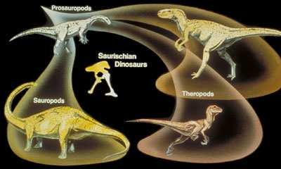
All of the following are similarities between birds and bird-like dinosaurs (Theropods) except…
  A.) Three toed foot.
  B.) Walk on two legs.
  C.) Dense heavy bones.
  D.) Wishbone.
  E.) Backward pointing pelvis.
19
Copyright © 2024 SlideSpark .LLC

Slide 146
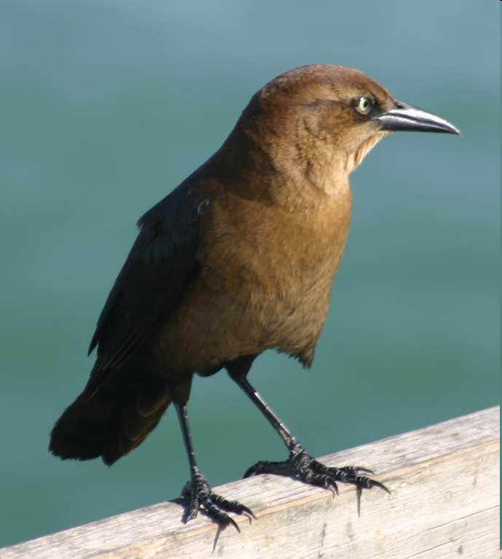
All of the following are similarities between birds and bird-like dinosaurs (Theropods) except…
  A.) Three toed foot.
  B.) Walk on two legs.
  C.) Dense heavy bones.
  D.) Wishbone.
  E.) Backward pointing pelvis.
19
Copyright © 2024 SlideSpark .LLC

Slide 147
All of the following are similarities between birds and bird-like dinosaurs (Theropods) except…
  A.) Three toed foot.
  B.) Walk on two legs.
  C.) Dense heavy bones.
  D.) Wishbone.
  E.) Backward pointing pelvis.
19
Copyright © 2024 SlideSpark .LLC

Slide 148
What supercontinent that is shown below began to break apart during the early Jurassic Period?
20

Slide 149
What supercontinent that is shown below began to break apart during the early Jurassic Period?
PANGEA
20

Slide 150
Earth System History Review Game
IN THE NICK OF TIME | UNITS OF TIME | PICTURES IN TIME | ANYTHING EARTH HISTORY | -BONUS- DINOSAURS
1 | 6 | 11 | 16 | *21
2 | 7 | 12 | 17 | *22
3 | 8 | 13 | 18 | *23
4 | 9 | 14 | 19 | *24
5 | 10 | 15 | 20 | *25
Copyright © 2024 SlideSpark .LLC

Slide 151
Who is the actor seen below in the movie Land of the Lost?
*21
Copyright © 2024 SlideSpark .LLC

Slide 152
Who is the actor seen below in the movie Land of the Lost? Will Ferrell
*21
Copyright © 2024 SlideSpark .LLC

Slide 153
A Spinosaurus is depicted in this Movie?
*22
Copyright © 2024 SlideSpark .LLC

Slide 154
A Spinosaurus is depicted in this Movie?
Jurassic Park III (2001)
*22
Copyright © 2024 SlideSpark .LLC

Slide 155
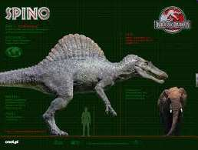
A Spinosaurus is depicted in this Movie?
Jurassic Park III (2001)
*22

Slide 156
Name this PBS T.V. Show that helps educate kids about dinosaurs of the Mesozoic Era?
*23
Copyright © 2024 SlideSpark .LLC

Slide 157
Name this PBS T.V. Show that helps educate kids about dinosaurs of the Mesozoic Era?
Dinosaur Train
*23
Copyright © 2024 SlideSpark .LLC

Slide 158
Strip Weathers races for this corporation in the Pixar movie Cars?
*24
Copyright © 2024 SlideSpark .LLC

Slide 159
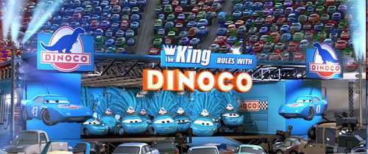
Strip Weathers races for this corporation in the Pixar movie Cars? Dinoco
*24

Slide 160
Strip Weathers races for this corporation in the Pixar movie Cars?
*24
Copyright © 2024 SlideSpark .LLC
Copyright © 2024 SlideSpark .LLC

Slide 161
Strip Weathers races for this corporation in the Pixar movie Cars? Carboniferous Period was before the large dinosaurs of the Mesozoic
*24

Slide 162
Correctly Spell the full name of Rex’s species seen here in Toy Story III?
*25
Copyright © 2024 SlideSpark .LLC

Slide 163
Correctly Spell the full name of Rex’s species seen here in Toy Story III? Tyrannosaurus
*25
Copyright © 2024 SlideSpark .LLC

Slide 164
Earth System History Review Game
IN THE NICK OF TIME | UNITS OF TIME | PICTURES IN TIME | ANYTHING EARTH HISTORY | -BONUS- DINOSAURS
1 | 6 | 11 | 16 | *21
2 | 7 | 12 | 17 | *22
3 | 8 | 13 | 18 | *23
4 | 9 | 14 | 19 | *24
5 | 10 | 15 | 20 | *25
Final Question_______________
Copyright © 2024 SlideSpark .LLC

Slide 165
“This is a 5pt wager question.” “Please make your wager now.”

Slide 166
Final Question?
  What is the name of the organism seen below that dominated in the early Paleozoic long before life moved to land?
Copyright © 2024 SlideSpark .LLC

Slide 167
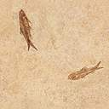
Final Question?
  What is the name of the organism seen below that dominated in the early Paleozoic long before life moved to land?
Trilobite
Copyright © 2024 SlideSpark .LLC

Slide 168
SCORING

Slide 169
Questions 1-20 = 5pts Each
Final Category (Bonus) = 1pt Each
Final Questions = 5 pt wager
Find the Owl =
Secretly write “Owl” in the correct box worth 1pt.

Slide 170
Earth System History
Review Game
Part 3
Lesson 8

Slide 171



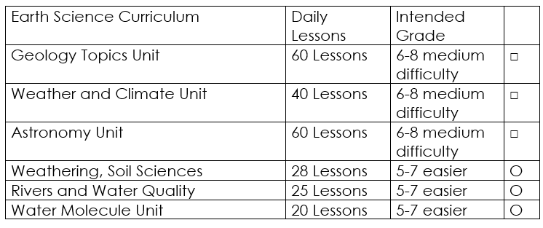

Curriculum Guide
Number of Lessons in each unit (50 min, daily lessons) and difficult rating scale / intended grade level.
=Easier, = More difficult, =Most difficult
Earth Science Units

Slide 172


Life Science Units

Slide 173

Physical Science

Slide 174
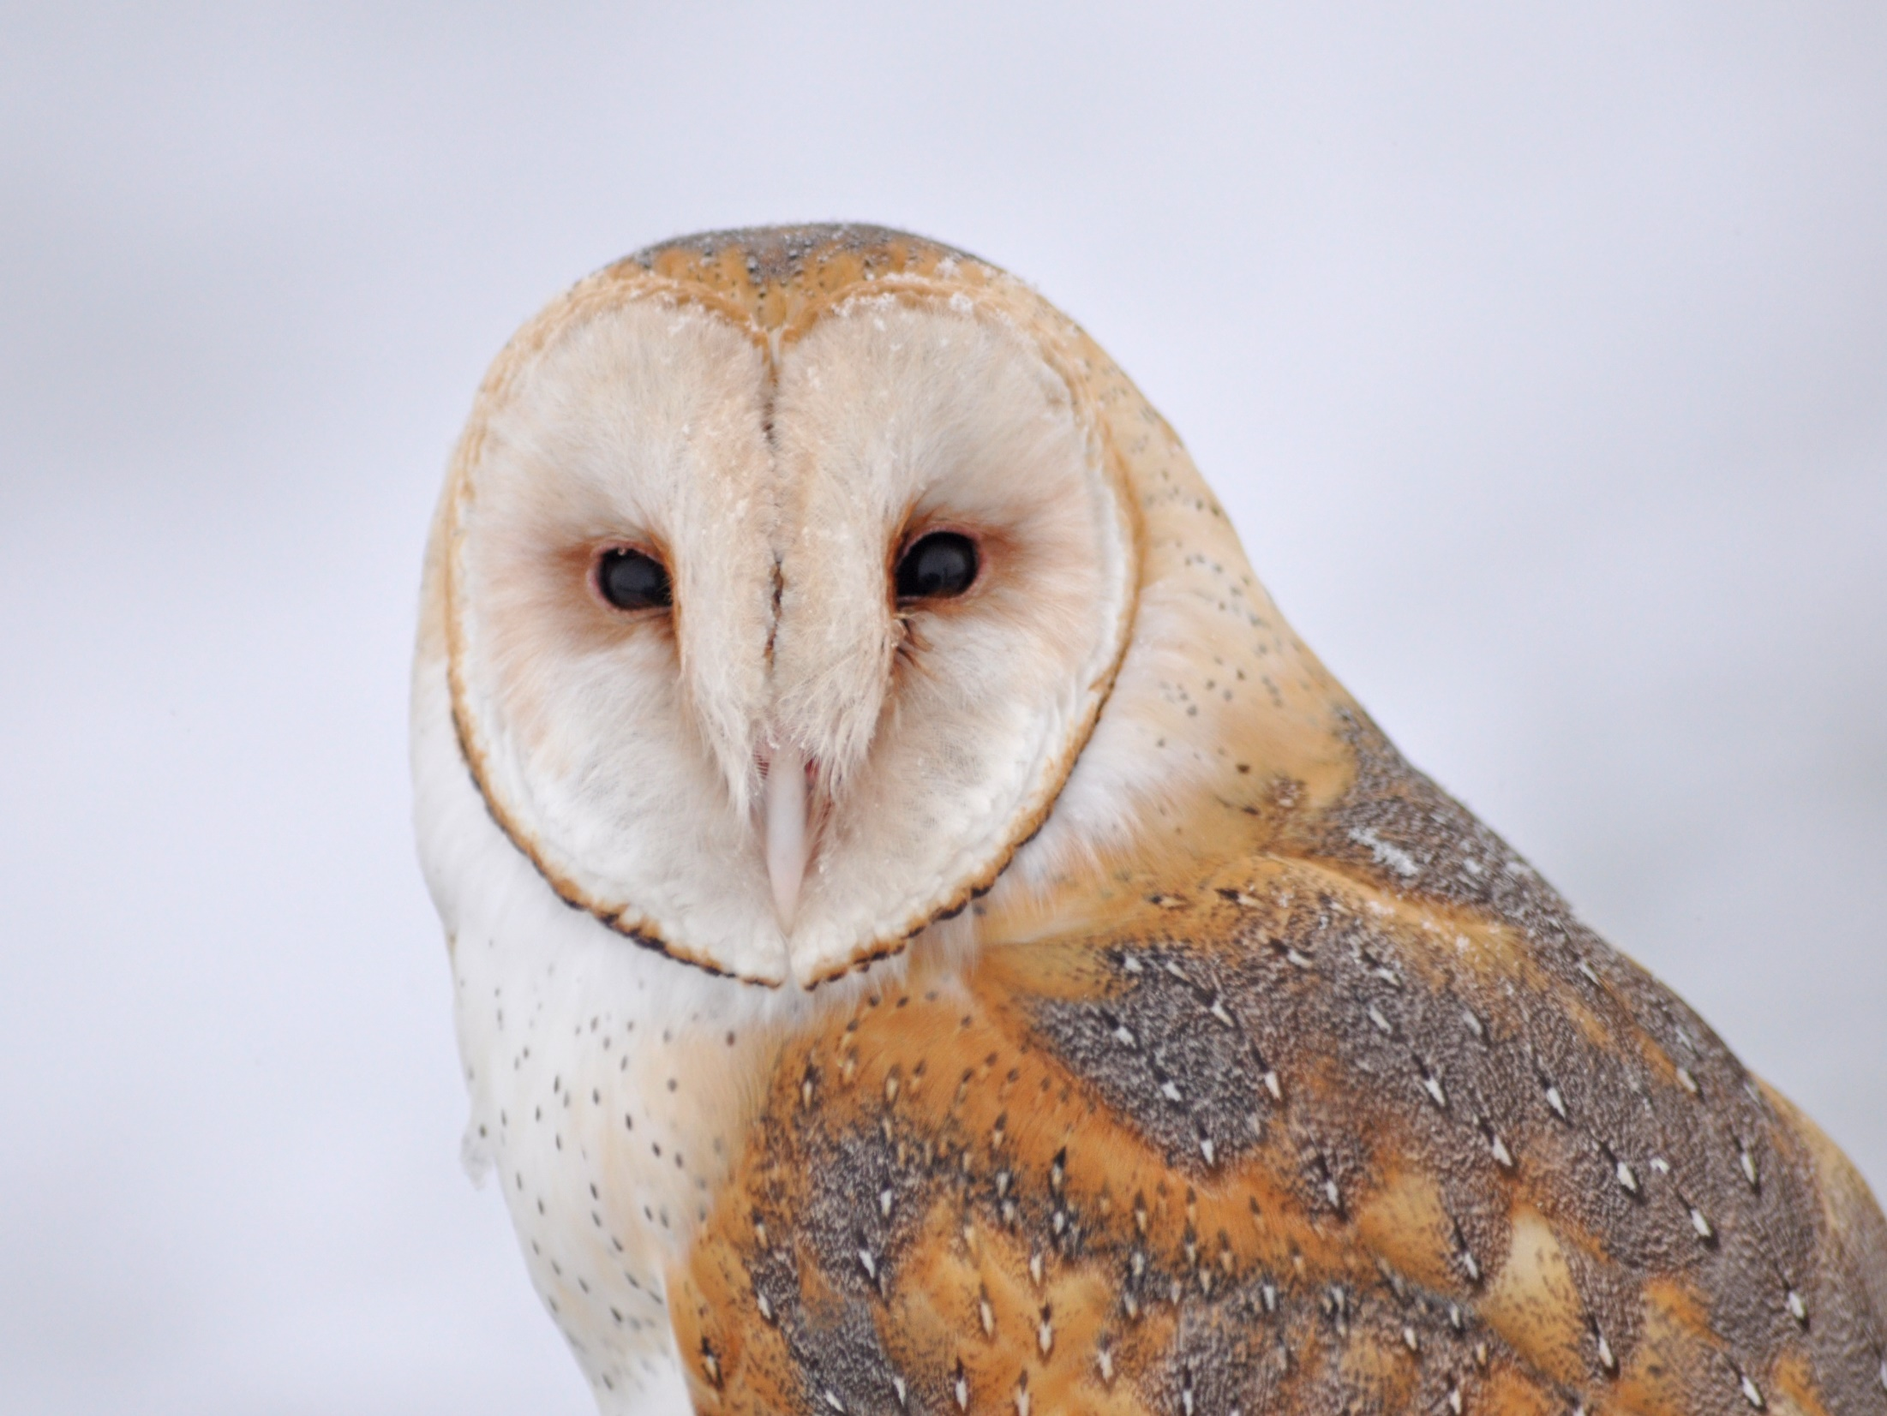
Dear Valued Educator,
Our fully editable .pptx and .doc resources are perfect for educators looking to bring enthusiasm and creativity to their lessons. We encourage you to make changes to fit your needs and style. As science educators, we’re committed to providing students with the tools they need to succeed in the classroom and beyond. Each unit in the curriculum includes a range of resources that have been developed through extensive research and use in a busy classroom. Our teaching approach is designed to make science education engaging and exciting for learners of all ages. We offer a one-of-a-kind science curriculum that will challenge, inspire, and educate students to become tomorrow's scientists and leaders. Join us today and learn more about how our program can help you achieve your classroom goals.
With appreciation,
Support@SlideSpark.net

Slide 175





Thank you for your time and interest in our Science curriculum. We strive to provide students with engaging and informative lessons that will spark their curiosity and encourage scientific exploration. Should you have any questions or concerns, please do not hesitate to contact us. Thank you again for considering our curriculum, and we wish you all the best in your educational journey.
Sincerely,
Support@slidespark.net
SlideSpark Science on TpT

