Slide 1
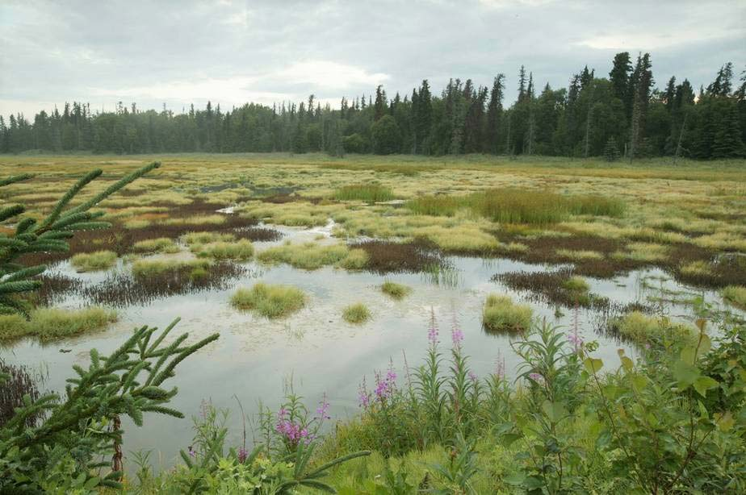

Wetlands
Part 3
Lesson 3

Slide 2
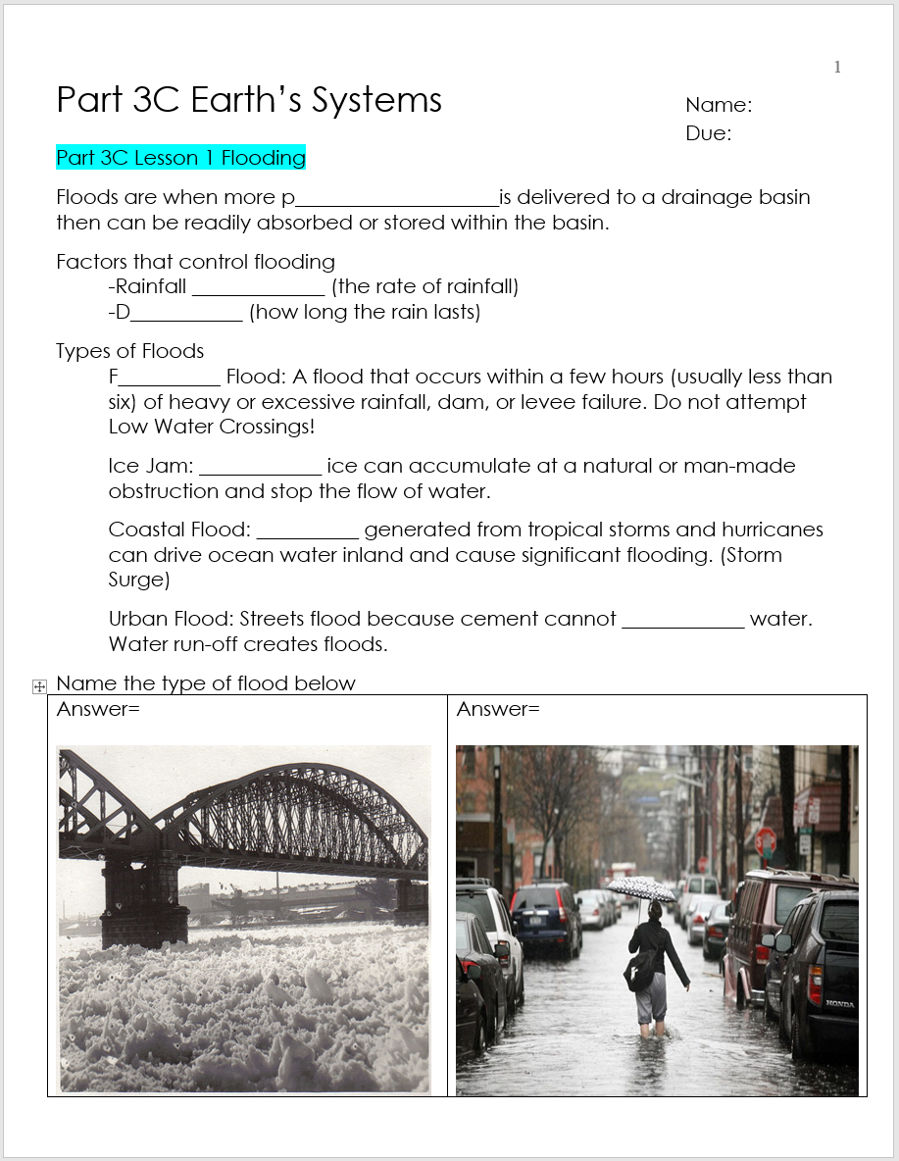
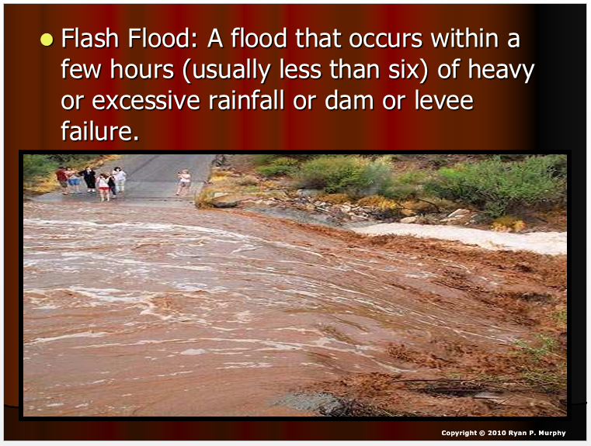

RED SLIDE: These slides contain critical notes and important fill-in the blanks. Please record the important terms in your work bundle.
Flash
First and last Name
Science, Grade, Class
Copyright © 2024 SlideSpark .LLC

Slide 3
RED SLIDE: These slides contain critical notes and important fill-in the blanks. Please record the important terms in your work bundle.
  You’ll need these notes to complete the work bundle and to be successful on the review game.
Flash
First and last Name
Science, Grade, Class
Copyright © 2024 SlideSpark .LLC

Slide 4

Listen to the teacher and others.
Please no
shout outs.
One speaker at a
time. Please
raise your
hand.
Respect
First,
Last,
and Always.
Safety
Make
Good
Choices
Be Present
Never
Give
Up!
Responsibility
Stay
Organized
Help
Others
Focus on
Task completion
Avoid
Distractions
Science from Murf LLC
Copyright © 2024 SlideSpark .LLC

Slide 5
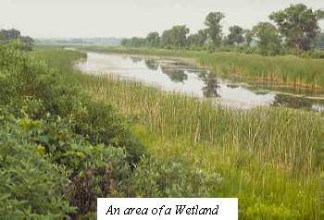
Wetlands: An area that is regularly wet and has vegetation that is adapted for life in saturated-soil conditions.
Flood Prevention
Copyright © 2024 SlideSpark .LLC

Slide 6
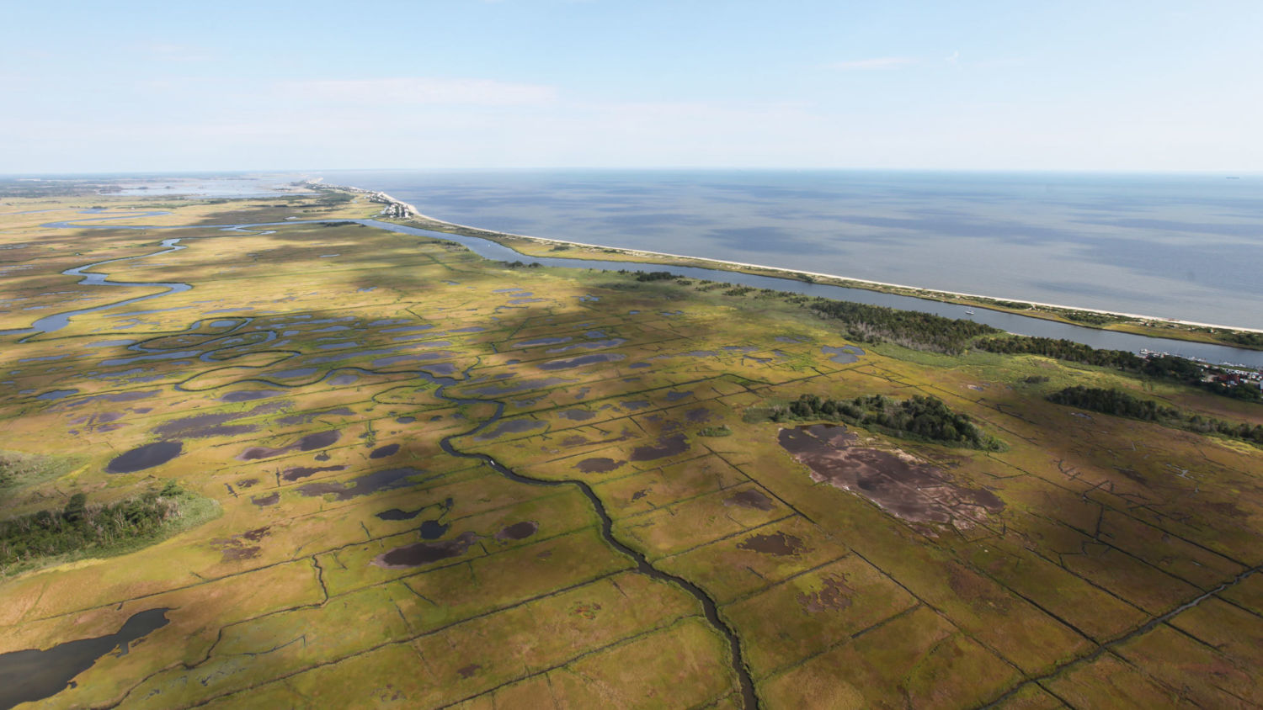

Slide 7
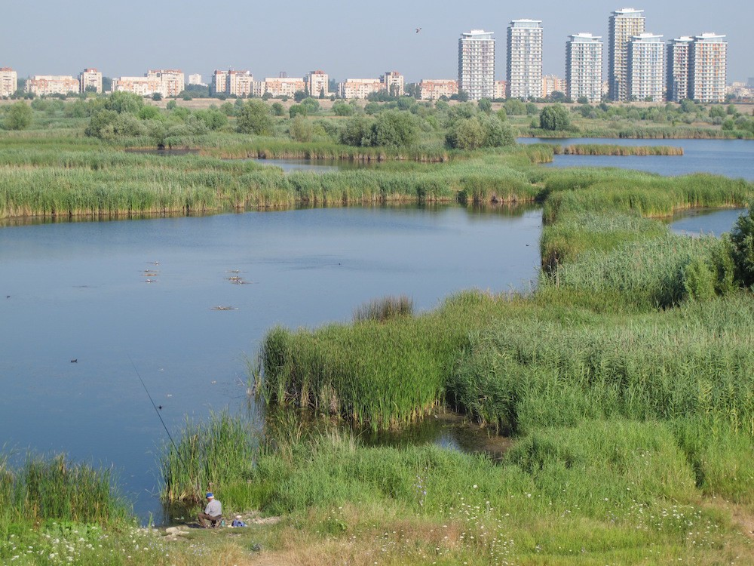

Slide 8
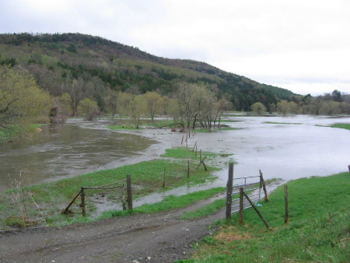

Slide 9
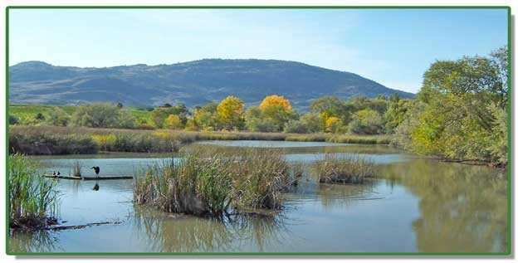

Slide 10
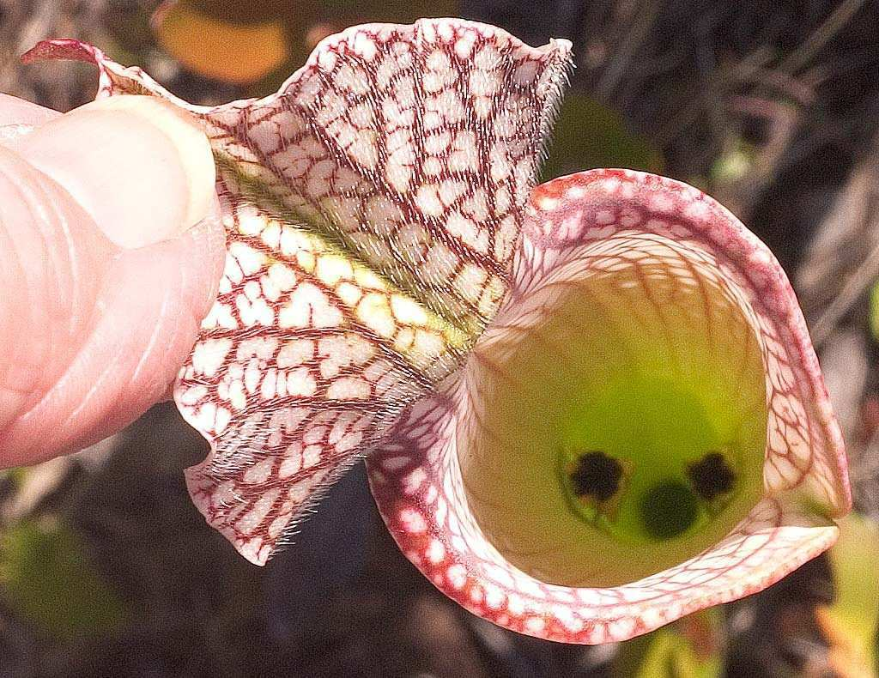

Slide 11
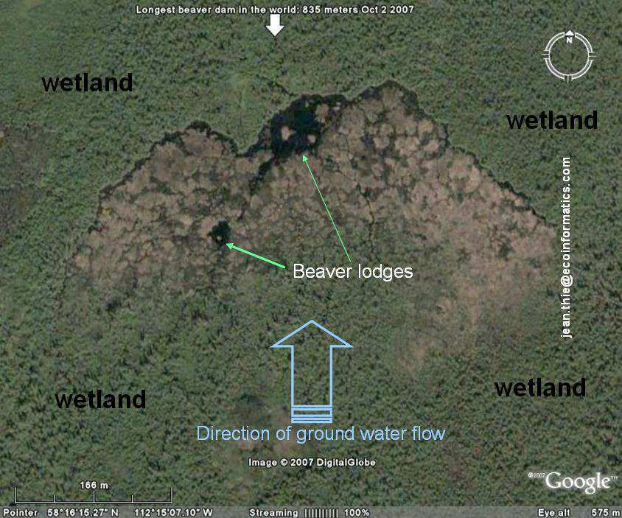

Slide 12
Which is which?
Swamp
Marsh
A treeless wetland of grasses, sedges and cattails.
Characterized by the presence of trees growing on mineral soils with poor drainage.

Slide 13
Which is which?
Swamp
Marsh
A treeless wetland of grasses, sedges and cattails.
Characterized by the presence of trees growing on mineral soils with poor drainage.

Slide 14
Which is which?
Swamp
Marsh
A treeless wetland of grasses, sedges and cattails.
Characterized by the presence of trees growing on mineral soils with poor drainage.

Slide 15
Which is which?
Swamp
Marsh
A treeless wetland of grasses, sedges and cattails.
Characterized by the presence of trees growing on mineral soils with poor drainage.

Slide 16
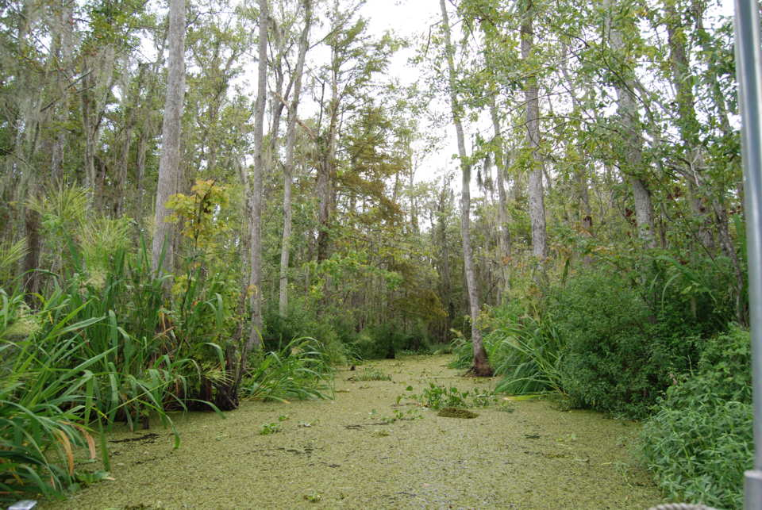
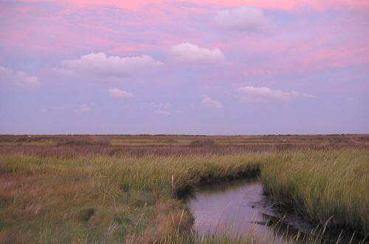
Which is a marsh and which is a swamp?
A
B

Slide 17
Which is a marsh and which is a swamp?
A
B

Slide 18
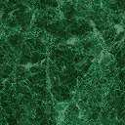
Which is a marsh and which is a swamp?
A
B
Swamp

Slide 19
Which is a marsh and which is a swamp?
A
B
Swamp

Slide 20
Which is a marsh and which is a swamp?
A
B
Marsh
Swamp

Slide 21
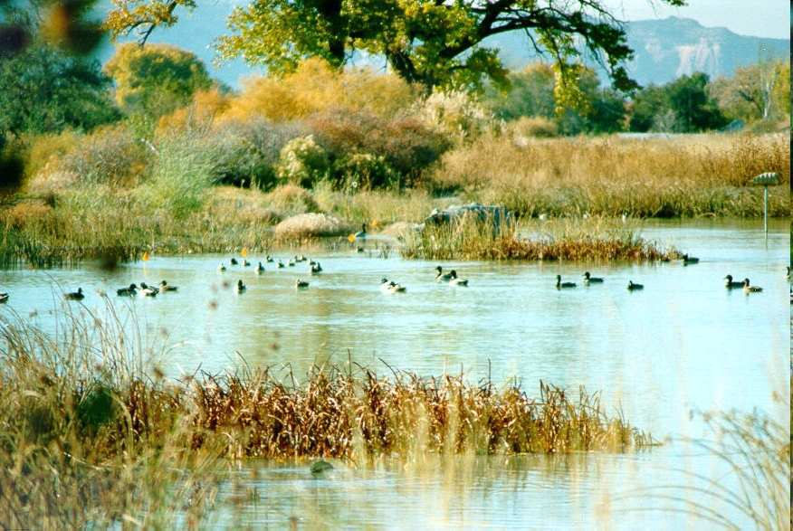
Wetlands are extremely important because they…
  -
  -
  -
Copyright © 2024 SlideSpark .LLC

Slide 22
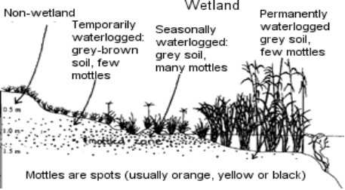
Control flooding by absorbing water like a sponge.
Copyright © 2024 SlideSpark .LLC

Slide 23
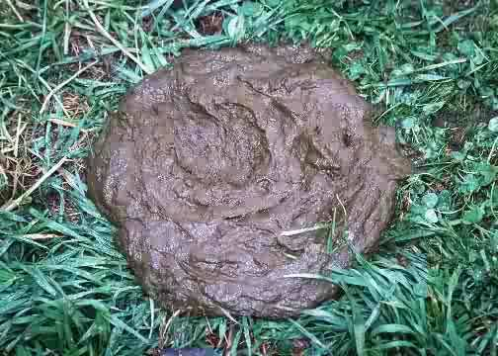
They filter out / break down pollution. (Biogeochemical cycling).
Copyright © 2024 SlideSpark .LLC

Slide 24
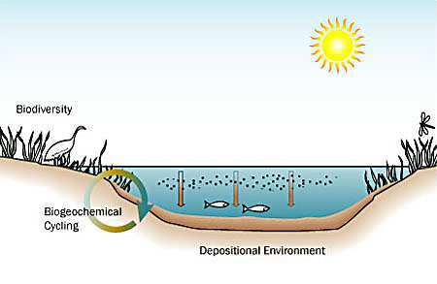

Slide 25
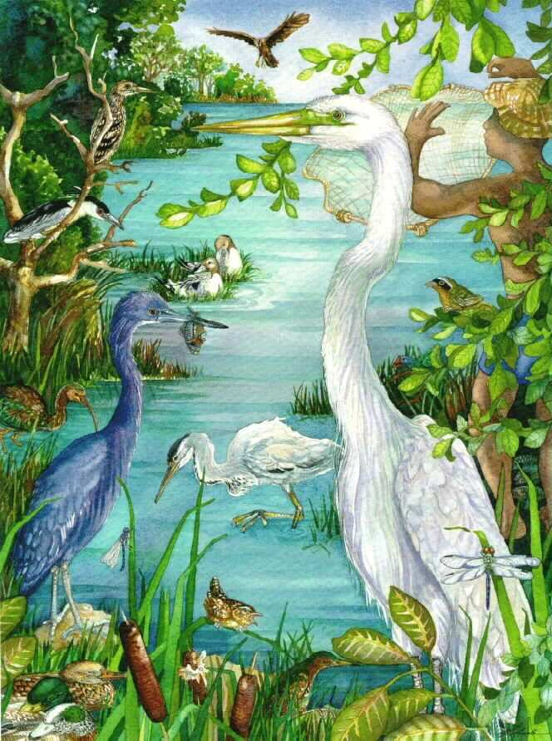
Provides habitat for many animals and plants.

Slide 26
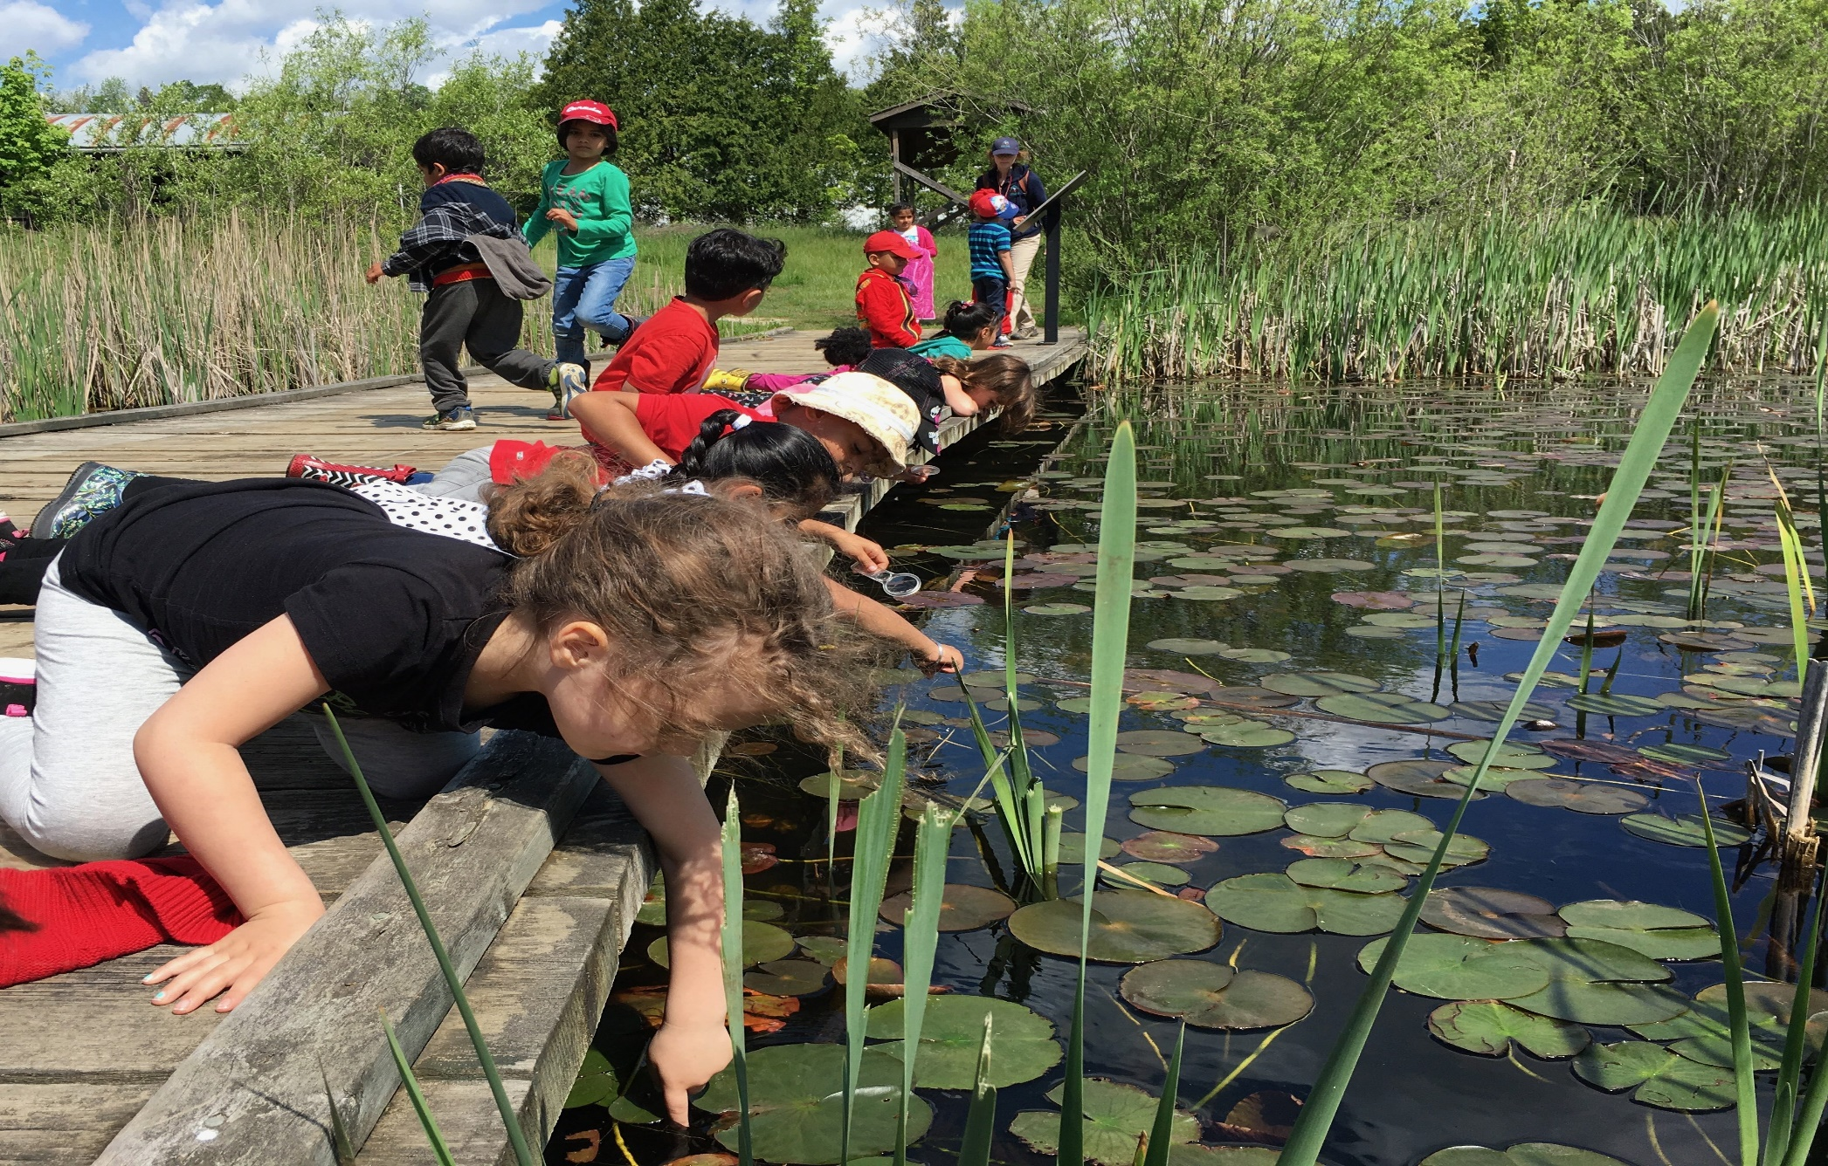
Provides recreation opportunities.

Slide 27
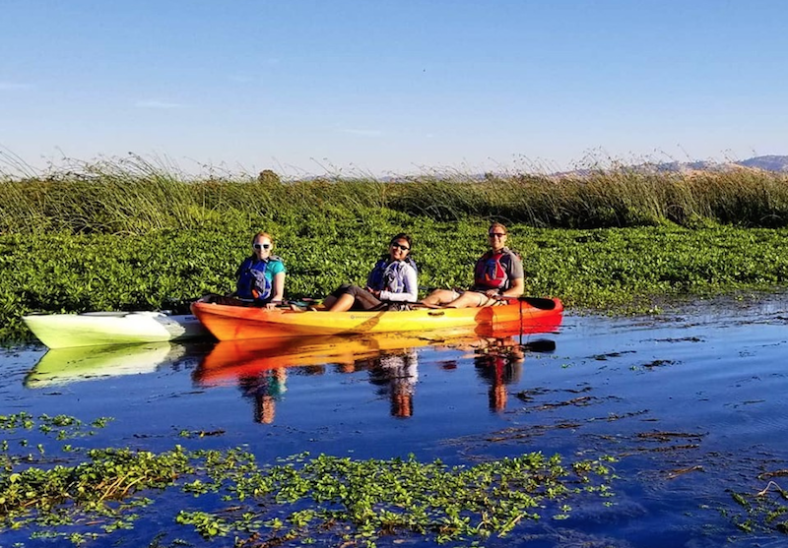

Slide 28
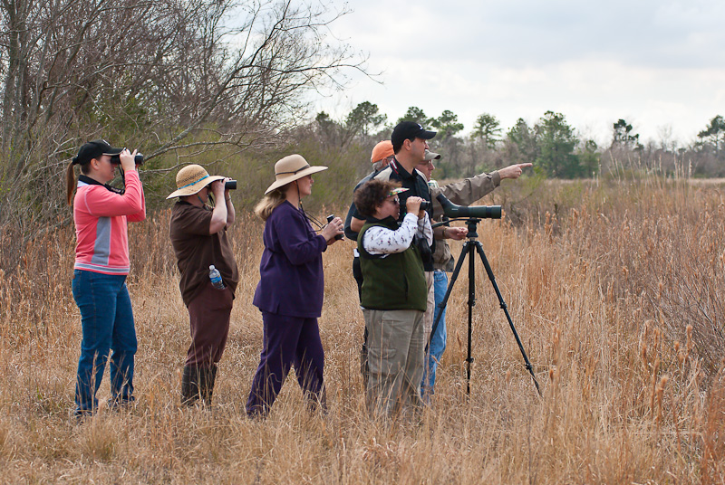

Slide 29
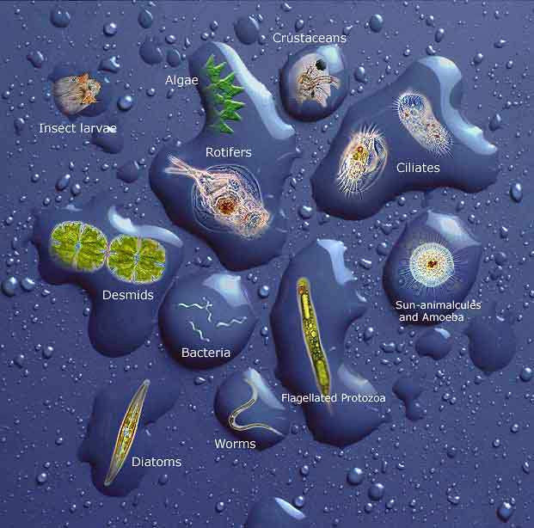

Slide 30
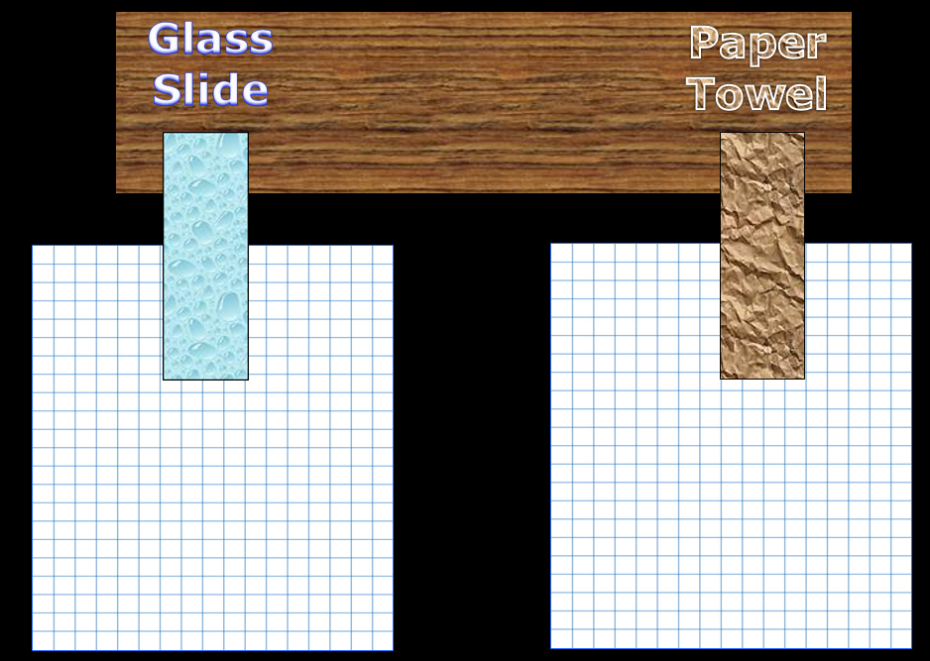

Activity! Wetland vs.Urbanization.
  Create this spreadsheet.
Zone above town | Acres Flooded
Urban (glass slide)
Wetland (paper towel)
Copyright © 2024 SlideSpark .LLC

Slide 31
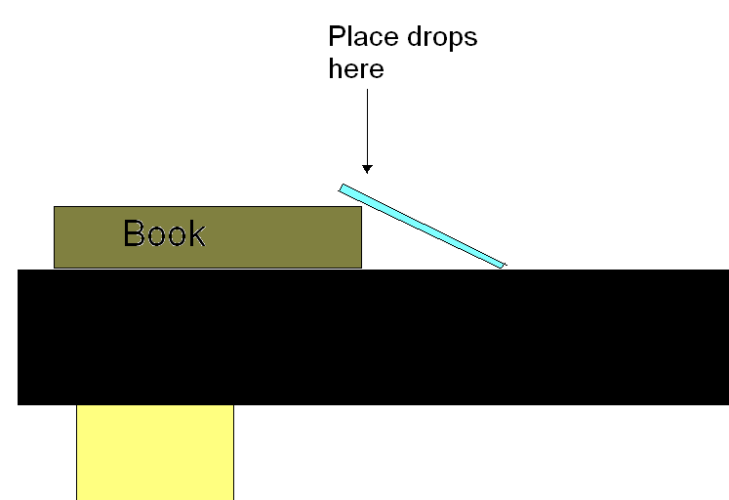
Activity! Wetland vs.Urbanization.
  Use a book or piece of wood and place two glass slides so they create a ramp.
    Overhead visual next slide.
  Wrap one in a small piece
  of paper towel.
  Place 60 drops on each.
  Record your observations of each in journal.
  Each box on graph paper could be an acre to compare the two (Wetland vs. Urbanization).
Copyright © 2024 SlideSpark .LLC

Slide 32




Glass
Slide
Paper
Towel
X
X

Slide 33
Glass
Slide
Paper
Towel
X
X
Could mark locations of your pretend house with group members for fun. To see if it gets flooded.

Slide 34

Glass
Slide
Paper
Towel
Pencil edge shortly after last drop
X
Pencil edge shortly after last drop
X
Count the number of “acres” /squares flooded. Count full squares first then do edges / partial squares.
Count the number of “acres” /squares flooded. Count full squares first then do edges / partial squares. Estimate. ½ + ½ = 1
You can use multiplication over counting?

Slide 35

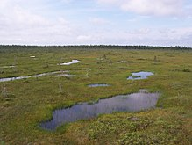
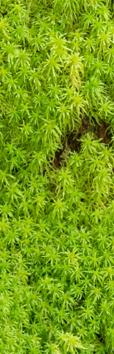
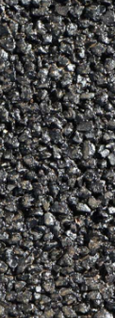
How many acres flooded in the urban area compared to the area with wetlands on slope?
X
X
Count the number of “acres” /squares flooded. Count full squares first then do edges / partial squares.
Count the number of “acres” /squares flooded. Count full squares first then do edges / partial squares. Estimate. ½ + ½ = 1
You can use multiplication over counting?

Slide 36
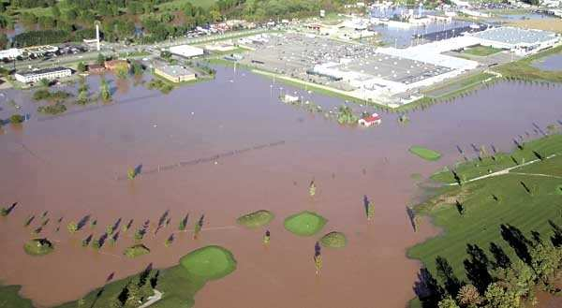
Questions
  What were your results?
    (Use acreage data)
  What is demonstrated in this experiment?
  Should we protect wetlands, Why or why not?
Copyright © 2024 SlideSpark .LLC

Slide 37
Questions
  What were your results?
Copyright © 2024 SlideSpark .LLC

Slide 38
Questions
  What were your results?
  Answer: The glass slide with the paper towel (wetland) absorbed much more water than the just the glass slide (urban) area.
Copyright © 2024 SlideSpark .LLC

Slide 39
Questions
  What is demonstrated in this experiment?
Copyright © 2024 SlideSpark .LLC

Slide 40
Questions
  What is demonstrated in this experiment?
  Answer: That wetlands serve a purpose in the prevention of floods.
Copyright © 2024 SlideSpark .LLC

Slide 41
Questions
  Should we protect wetlands, Why or why not?
Copyright © 2024 SlideSpark .LLC

Slide 42
Questions
  Should we protect wetlands, Why or why not?
  Answer: Wetlands should be protected for all of the valuable things they do. Many wetlands are protected for this reason.
Copyright © 2024 SlideSpark .LLC

Slide 43
Questions
  Should we protect wetlands, Why or why not?
  Answer: Wetlands should be protected for all of the valuable things they do. Many wetlands are protected for this reason.
Wetlands and flood control. Learn more at…
http://water.epa.gov/type/wetlands/flood.cfm
Copyright © 2024 SlideSpark .LLC

Slide 44

Try and figure out the picture beneath the boxes.
  When you think you know, raise your hand. You only get one guess.
Copyright © 2024 SlideSpark .LLC

Slide 53

Swamp
or

Slide 54
Swamp
or
Marsh

Slide 55
Trees
Swamp

Slide 56
Wetlands
Part 3
Lesson 3

Slide 57



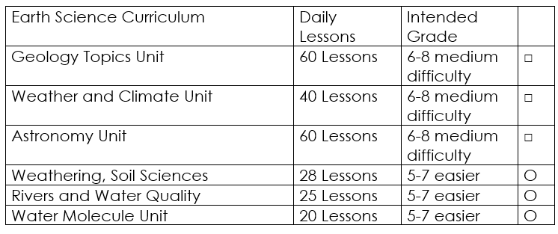

Curriculum Guide
Number of Lessons in each unit (50 min, daily lessons) and difficult rating scale / intended grade level.
=Easier, = More difficult, =Most difficult
Earth Science Units

Slide 58


Life Science Units

Slide 59

Physical Science

Slide 60
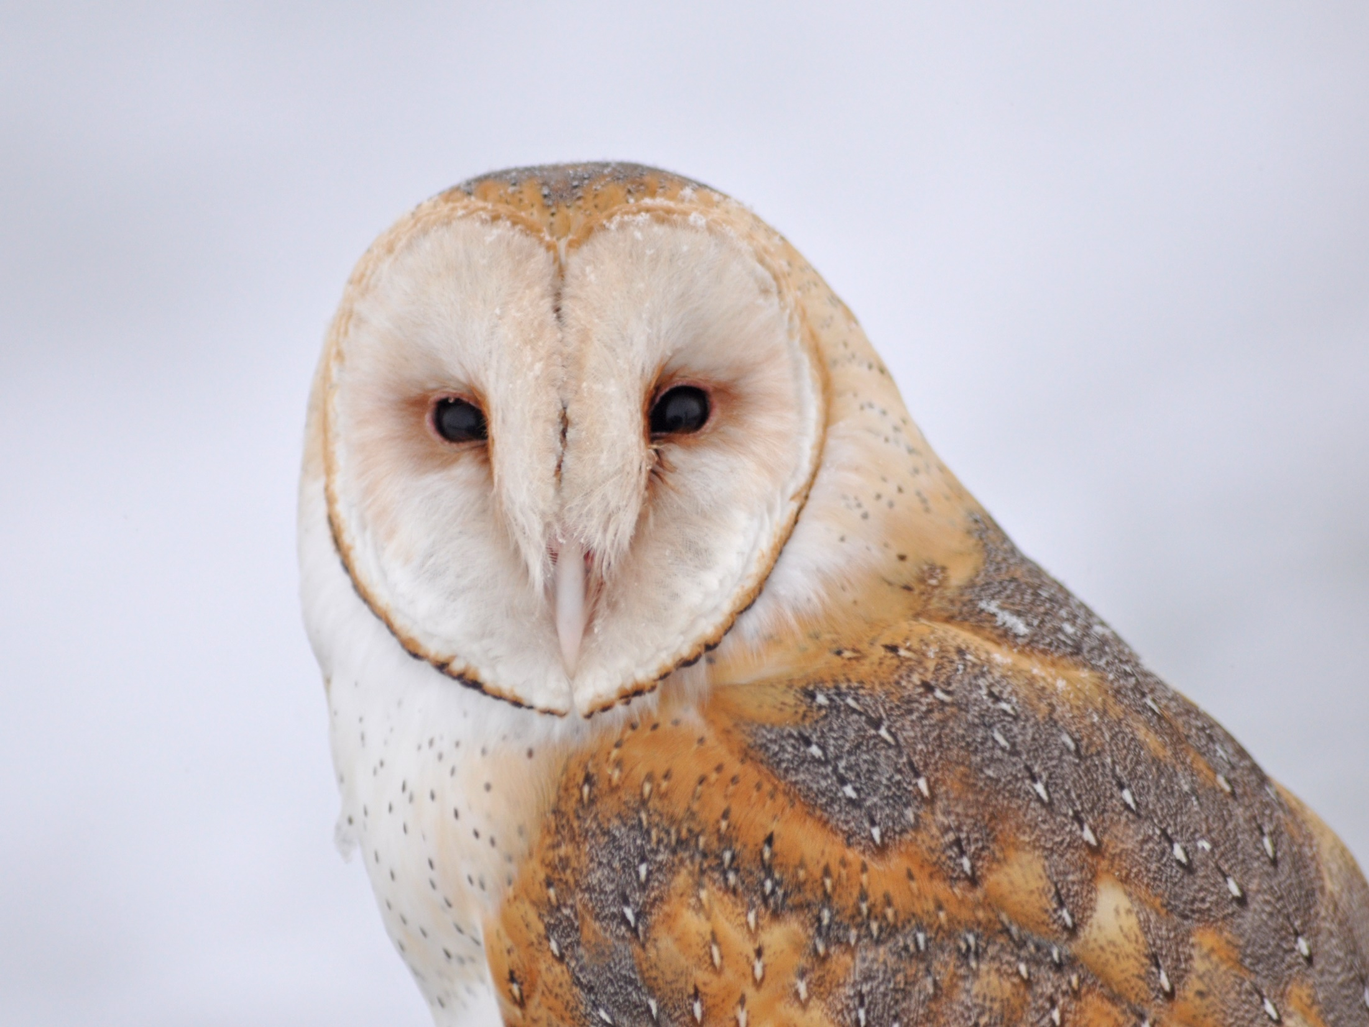
Dear Valued Educator,
Our fully editable .pptx and .doc resources are perfect for educators looking to bring enthusiasm and creativity to their lessons. We encourage you to make changes to fit your needs and style. As science educators, we’re committed to providing students with the tools they need to succeed in the classroom and beyond. Each unit in the curriculum includes a range of resources that have been developed through extensive research and use in a busy classroom. Our teaching approach is designed to make science education engaging and exciting for learners of all ages. We offer a one-of-a-kind science curriculum that will challenge, inspire, and educate students to become tomorrow's scientists and leaders. Join us today and learn more about how our program can help you achieve your classroom goals.
With appreciation,
Support@SlideSpark.net

Slide 61





Thank you for your time and interest in our Science curriculum. We strive to provide students with engaging and informative lessons that will spark their curiosity and encourage scientific exploration. Should you have any questions or concerns, please do not hesitate to contact us. Thank you again for considering our curriculum, and we wish you all the best in your educational journey.
Sincerely,
Support@slidespark.net
SlideSpark Science on TpT

