Slide 1
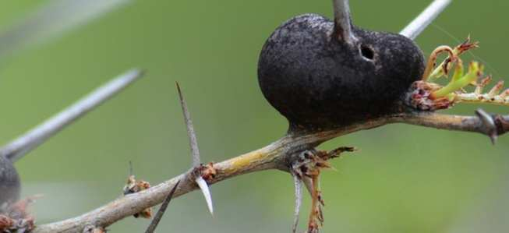
Ecology Interactions Unit
Part 3
Review Game

Slide 2
Symbiosis and Exotic Species
GET OFF ME | BY MY SIDE | STRANGE PETS | NOT FROM HERE | -Bonus- FOREIGN FILMS
1 | 6 | 11 | 16 | *21
2 | 7 | 12 | 17 | *22
3 | 8 | 13 | 18 | *23
4 | 9 | 14 | 19 | *24
5 | 10 | 15 | 20 | *25

Slide 3
How to play…
Don’t play like Jeo_ _ _ _ y.
Class should be divided into several small groups.
Groups should use science journal (red slide notes), homework, and other available materials to assist you.
Groups can communicate quietly with each other but no sharing answers between groups.
Practice quietly communicating right now?
Practice Communication Question:
Your group gets to order one pizza and you can have two toppings. What does your group want?

Slide 4
Questions 1-20 = 5pts Each
Final Category (Bonus) = 1pt Each
Final Questions = 5 pt wager
If you wager 5 on the last question and get it wrong you lose 5 pts. Wager 5 and get it right you get 5 pts.
Find the Owl =
Secretly write “Owl” in the correct box worth 1pt.
“I’ll be about this big.”

Slide 5
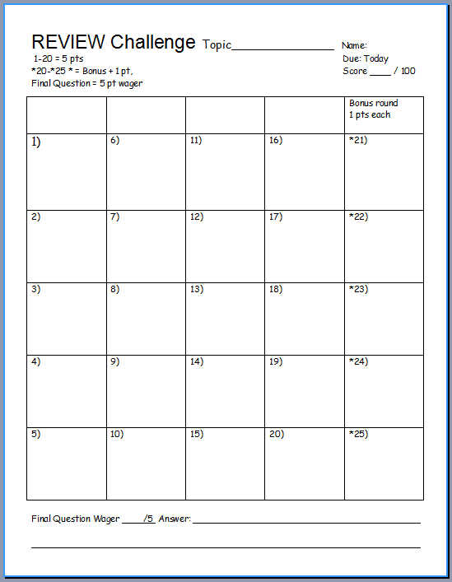
Is your name on the review sheet?
Name

Slide 6
Is your name on the review sheet?
Add the categories
along the top
on the next slide.

Slide 7
Ecology Interactions
GET AWAY | BY MY SIDE | STRANGE PETS | NOT FROM HERE | -Bonus- FOREIGN FILMS
1 | 6 | 11 | 16 | *21
2 | 7 | 12 | 17 | *22
3 | 8 | 13 | 18 | *23
4 | 9 | 14 | 19 | *24
5 | 10 | 15 | 20 | *25

Slide 8
Ecology Interactions
GET AWAY | BY MY SIDE | STRANGE PETS | NOT FROM HERE | -Bonus- FOREIGN FILMS
1 | 6 | 11 | 16 | *21
2 | 7 | 12 | 17 | *22
3 | 8 | 13 | 18 | *23
4 | 9 | 14 | 19 | *24
5 | 10 | 15 | 20 | *25

Slide 9
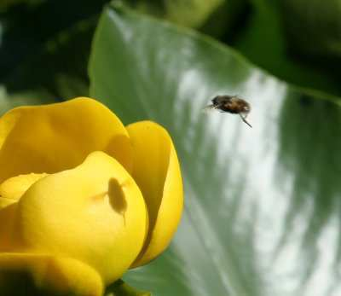
This is the name for a long term relationship between two or more different species.
1
Copyright © 2024 SlideSpark LLC

Slide 10
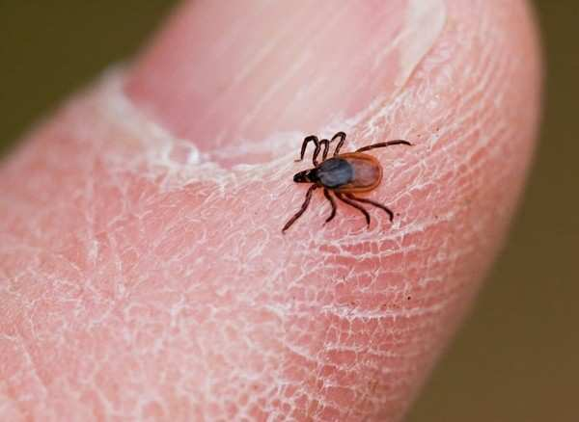
This is the type of symbiosis seen below?
2
Copyright © 2024 SlideSpark LLC

Slide 11
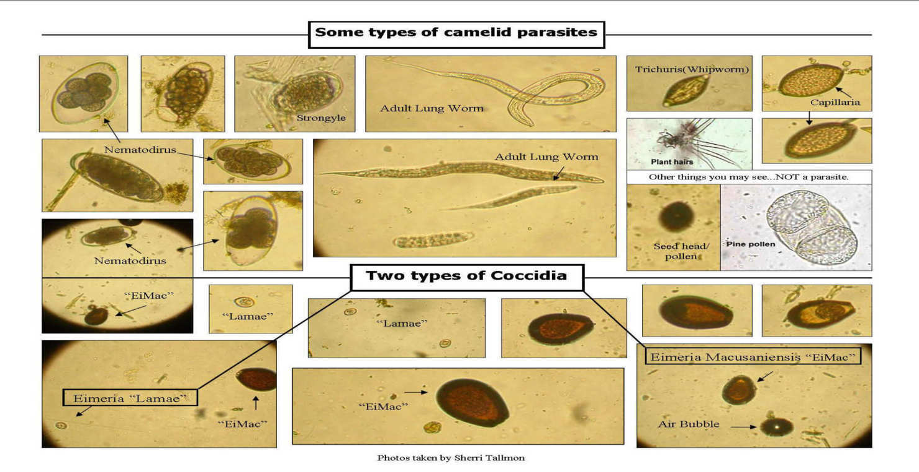
True or False.
Parasitism is one of the most successful modes of life displayed by any living organism?
For every species on earth, they may host a handful of unique parasites.
3
Copyright © 2024 SlideSpark LLC

Slide 12
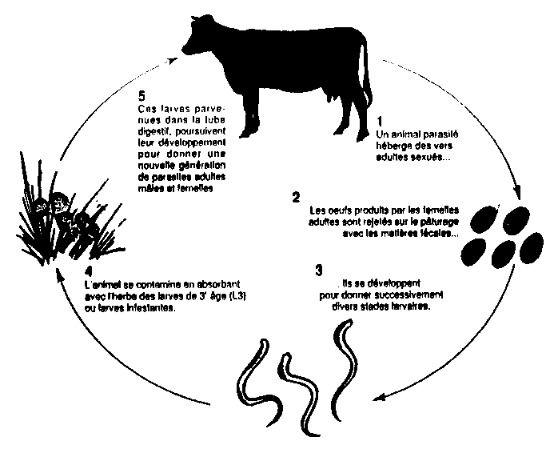
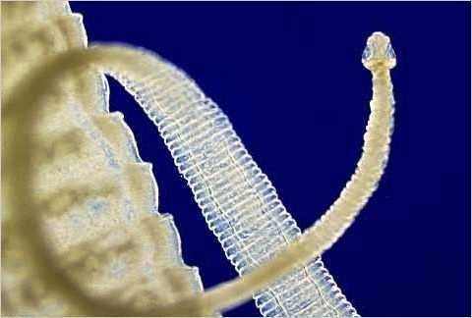
True or False. Parasite life cycles can often be complicated and go through a number and variety of organisms?
Most parasites have very complicated life cycles, often going through a number of different species before finding a host.
4
Host
Eggs
Rest
Larvae
Copyright © 2024 SlideSpark LLC

Slide 13
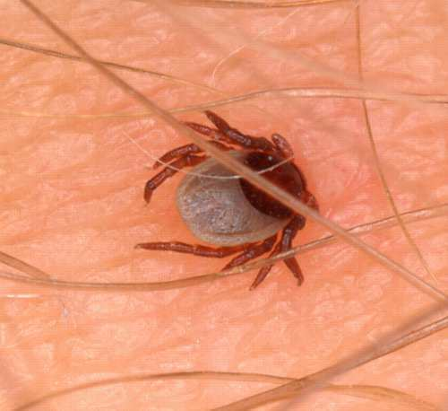
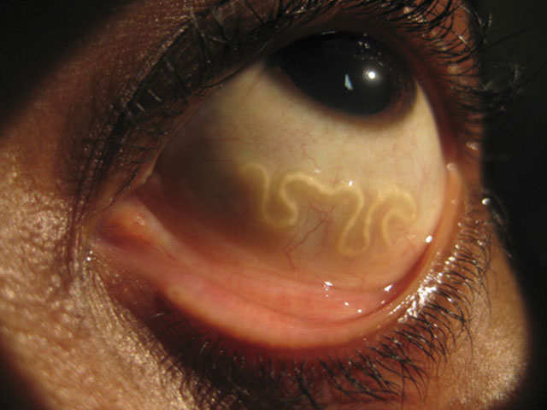
Which is an endoparasite, and which is an ectoparasite?
A
B
5
Copyright © 2024 SlideSpark LLC

Slide 14
Ecology Interactions
GET AWAY | BY MY SIDE | STRANGE PETS | NOT FROM HERE | -Bonus- FOREIGN FILMS
1 | 6 | 11 | 16 | *21
2 | 7 | 12 | 17 | *22
3 | 8 | 13 | 18 | *23
4 | 9 | 14 | 19 | *24
5 | 10 | 15 | 20 | *25

Slide 15
Ecology Interactions
GET AWAY | BY MY SIDE | STRANGE PETS | NOT FROM HERE | -Bonus- FOREIGN FILMS
1 | 6 | 11 | 16 | *21
2 | 7 | 12 | 17 | *22
3 | 8 | 13 | 18 | *23
4 | 9 | 14 | 19 | *24
5 | 10 | 15 | 20 | *25

Slide 16
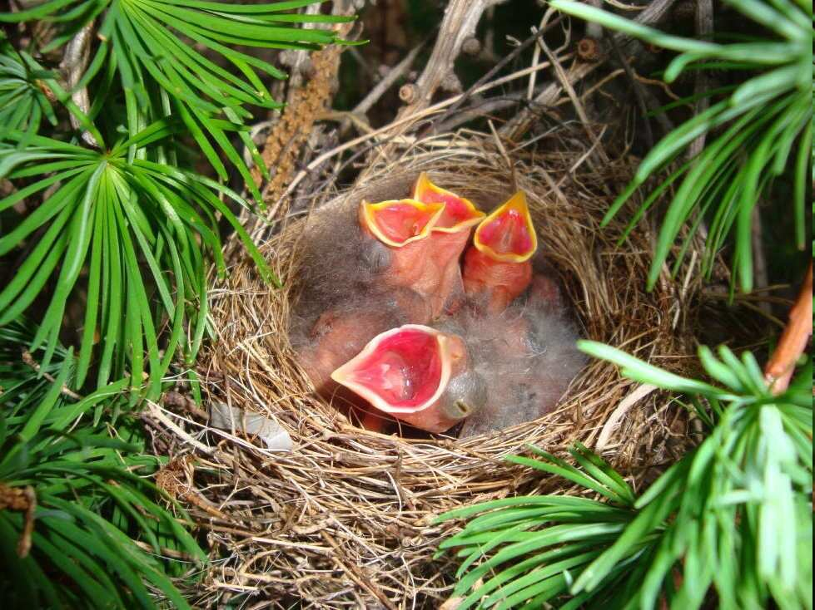
This is the name for a unique type of parasitism seen in birds that involves the laying of eggs in the nests of other birds.
The eggs are left under the parental care of the host parents.
6

Slide 17
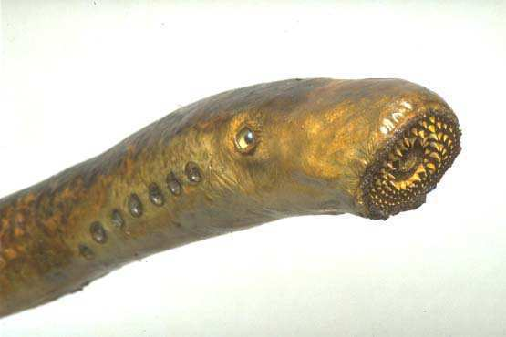
Name this jawless fish (Parasite)
They attach to fish with a sucker and bore a hole into flesh with their tongue.
7
Copyright © 2024 SlideSpark LLC

Slide 18
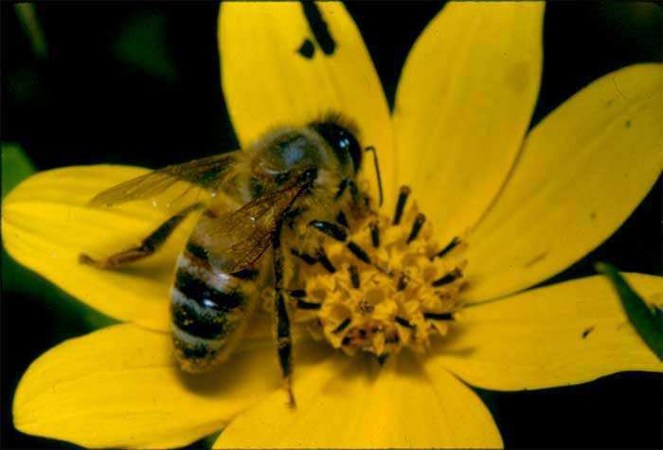
This is the type of evolution of two or more species, each adapting to changes in the other.
8

Slide 19
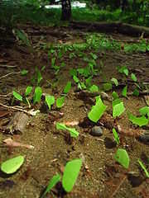
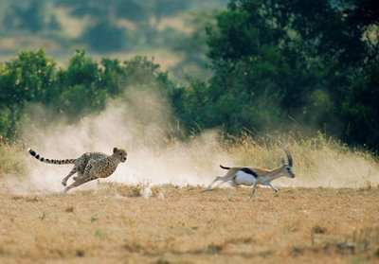
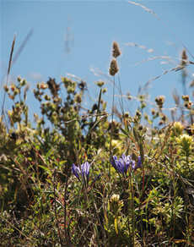
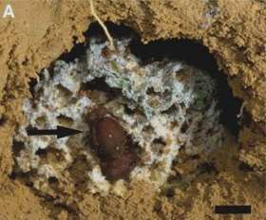
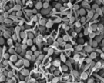
9
Which is which ecological relationship?
A.) Predator/prey and parasite/host
B.) Competitive species
C.) Mutualistic species
A
B
C

Slide 20
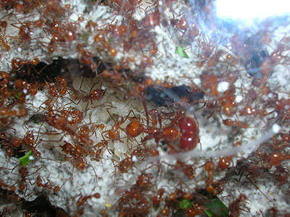
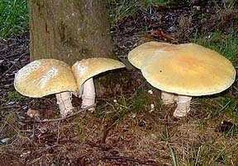
This is the type of mutualism where both species help feed each other.
Usually nutrient related.
10

Slide 21
Ecology Interactions
GET AWAY | BY MY SIDE | STRANGE PETS | NOT FROM HERE | -Bonus- FOREIGN FILMS
1 | 6 | 11 | 16 | *21
2 | 7 | 12 | 17 | *22
3 | 8 | 13 | 18 | *23
4 | 9 | 14 | 19 | *24
5 | 10 | 15 | 20 | *25

Slide 22
Ecology Interactions
GET AWAY | BY MY SIDE | STRANGE PETS | NOT FROM HERE | -Bonus- FOREIGN FILMS
1 | 6 | 11 | 16 | *21
2 | 7 | 12 | 17 | *22
3 | 8 | 13 | 18 | *23
4 | 9 | 14 | 19 | *24
5 | 10 | 15 | 20 | *25

Slide 23
This is the type of mutualism where one species protects the other and gets some benefits for its help.
11
Copyright © 2024 SlideSpark LLC

Slide 24
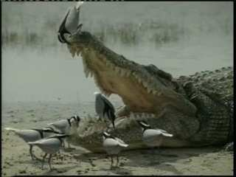
This is the type of mutualism where one species gets food and shelter, the other has parasites removed.
12
Copyright © 2024 SlideSpark LLC

Slide 25
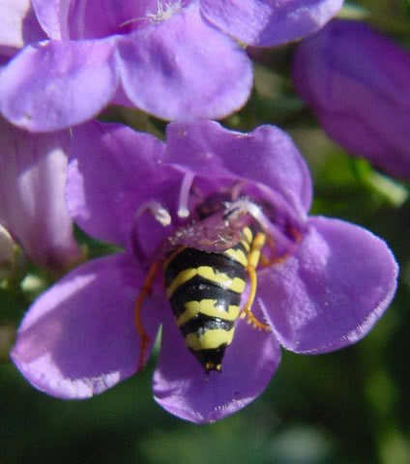
This is the type of mutualism where one species receives food in exchange for moving the pollen or seeds of its partner.
13
Copyright © 2024 SlideSpark LLC

Slide 26
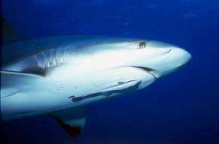
Name the type of Symbiosis?
+
Parasitism
Commensalism
Mutualism
Shark
Neutral
Neutral
Commensalism
-
Interspecific Competition?
Neutral
Parasitism
Remora
-
+

Slide 27
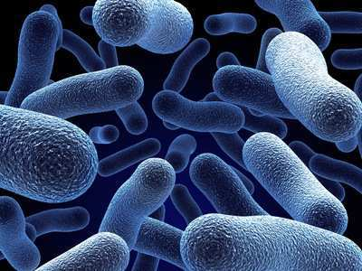
Bacteria live in our body. They are…
A.) Parasitic only
B.) Commensalisitic and Parasitic
C.) Mutualistic only
D.) Mutualistic, Commensalistic, and Parasitic
15

Slide 28
Bacteria live in our body. They are…
A.) Parasitic only
B.) Commensalisitic and Parasitic
C.) Mutualistic only
D.) Mutualistic, Commensalistic, and Parasitic
15

Slide 29
Bacteria live in our body. They are…
A.) Parasitic only
B.) Commensalisitic and Parasitic
C.) Mutualistic only
D.) Mutualistic, Commensalistic, and Parasitic
15

Slide 30
Bacteria live in our body. They are…
A.) Parasitic only
B.) Commensalisitic and Parasitic
C.) Mutualistic only
D.) Mutualistic, Commensalistic, and Parasitic
15

Slide 31
Bacteria live in our body. They are…
A.) Parasitic only
B.) Commensalisitic and Parasitic
C.) Mutualistic only
D.) Mutualistic, Commensalistic, and Parasitic
15

Slide 32
Ecology Interactions
GET AWAY | BY MY SIDE | STRANGE PETS | NOT FROM HERE | -Bonus- FOREIGN FILMS
1 | 6 | 11 | 16 | *21
2 | 7 | 12 | 17 | *22
3 | 8 | 13 | 18 | *23
4 | 9 | 14 | 19 | *24
5 | 10 | 15 | 20 | *25

Slide 33
Ecology Interactions
GET AWAY | BY MY SIDE | STRANGE PETS | NOT FROM HERE | -Bonus- FOREIGN FILMS
1 | 6 | 11 | 16 | *21
2 | 7 | 12 | 17 | *22
3 | 8 | 13 | 18 | *23
4 | 9 | 14 | 19 | *24
5 | 10 | 15 | 20 | *25

Slide 34
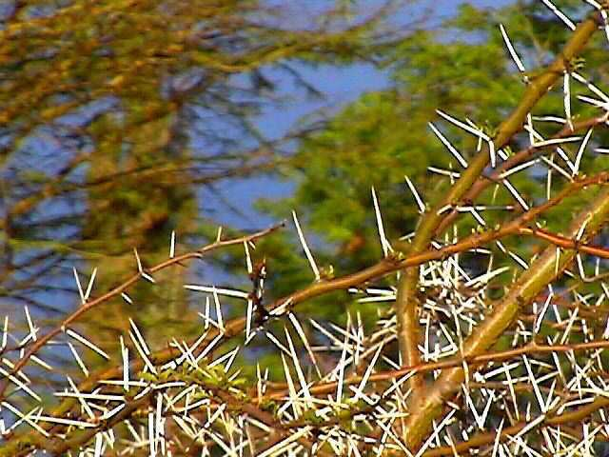
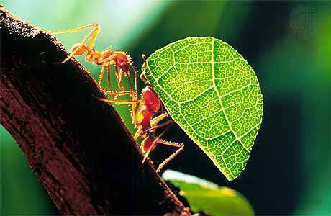
Which one uses microbe farms, and which one uses mechanical defenses?
A
B
Copyright © 2024 SlideSpark LLC

Slide 35
17
Which one is poison ivy?
A
B
C
D

Slide 36
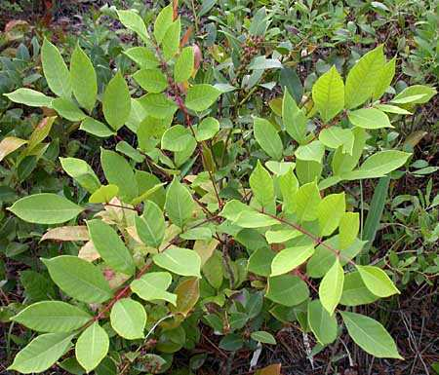
17
Which one is poison ivy?
A
B
C
D

Slide 37
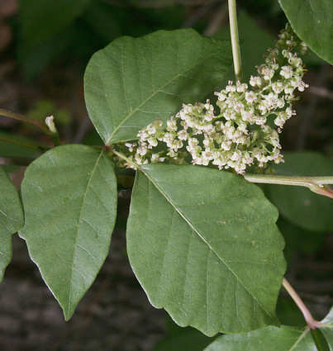
17
Which one is poison ivy?
A
B
C
D

Slide 38
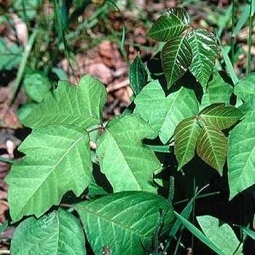
17
Which one is poison ivy?
A
B
C
D

Slide 39
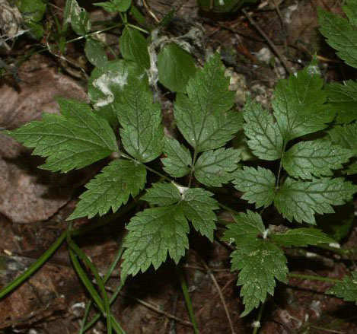
17
Which one is poison ivy?
A
B
C
D

Slide 40
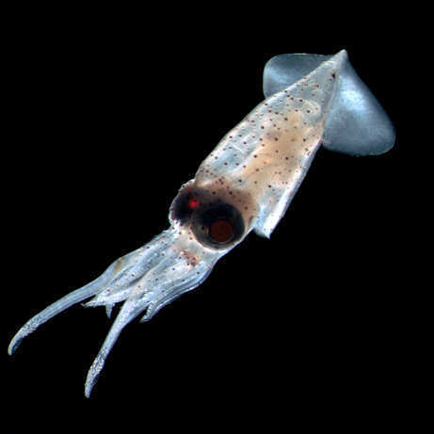
This is the term for an exotic species that causes harm to people, the environment, and native species.
18
Copyright © 2024 SlideSpark LLC

Slide 41
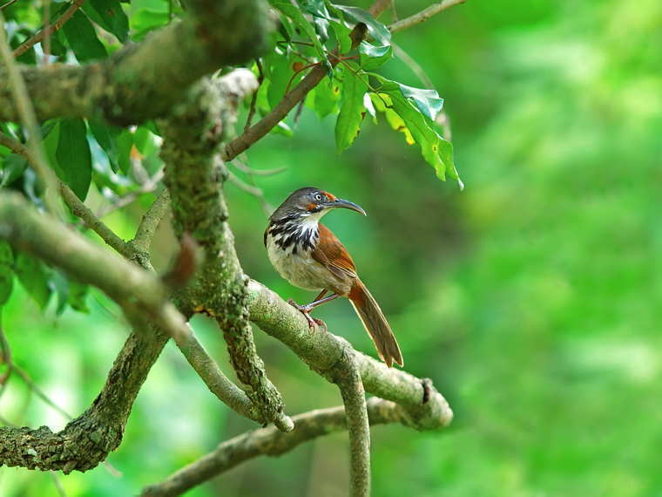
This is the name for an organism that has lived in the area for a considerable amount of time.
19
Copyright © 2024 SlideSpark LLC

Slide 42
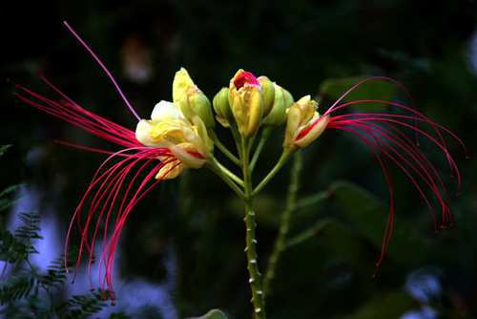
Name 5 invasive exotic species.
(1 point each)
20

Slide 43
Ecology Interactions
GET AWAY | BY MY SIDE | STRANGE PETS | NOT FROM HERE | -Bonus- FOREIGN FILMS
1 | 6 | 11 | 16 | *21
2 | 7 | 12 | 17 | *22
3 | 8 | 13 | 18 | *23
4 | 9 | 14 | 19 | *24
5 | 10 | 15 | 20 | *25

Slide 44
Ecology Interactions
GET AWAY | BY MY SIDE | STRANGE PETS | NOT FROM HERE | -Bonus- FOREIGN FILMS
1 | 6 | 11 | 16 | *21
2 | 7 | 12 | 17 | *22
3 | 8 | 13 | 18 | *23
4 | 9 | 14 | 19 | *24
5 | 10 | 15 | 20 | *25

Slide 45
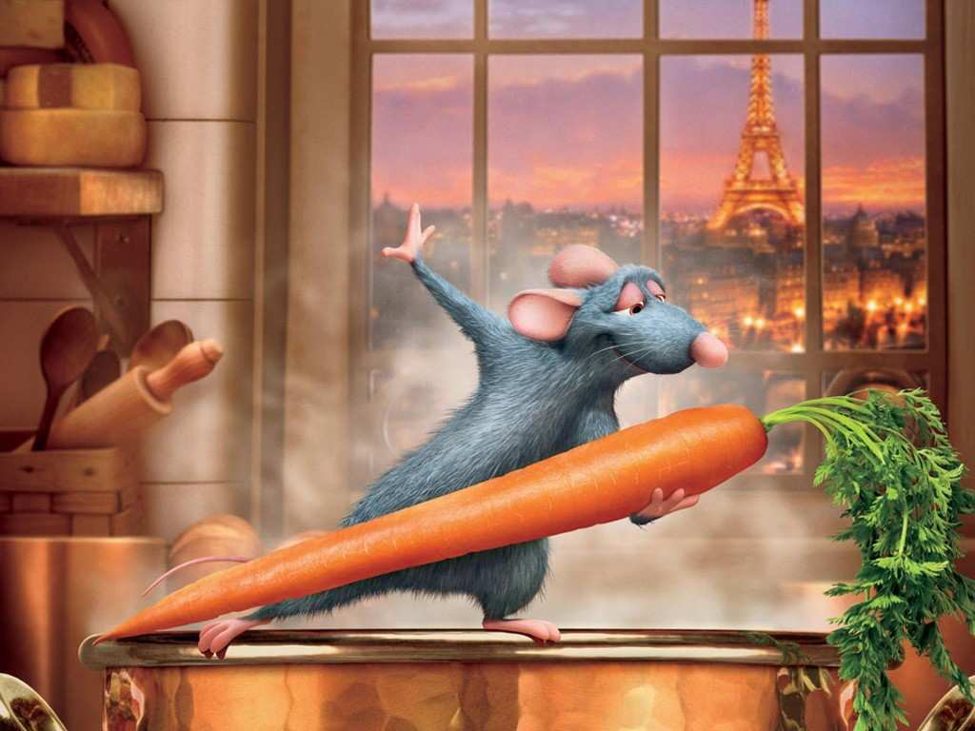
Name this movie with the correct spelling.
*21

Slide 46
Name this secret agent and his code name?
*22

Slide 47
The Mummy
*23

Slide 48
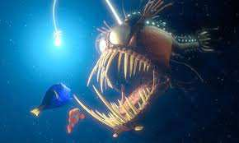
Example of aggressive mimicry in this movie?
*24

Slide 49
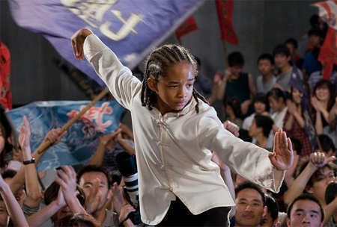
Competition occurs in this movie?
*25

Slide 50
Part III Ecology Interactions
GET AWAY | BY MY SIDE | STRANGE PETS | NOT FROM HERE | -Bonus- FOREIGN FILMS
1 | 6 | 11 | 16 | *21
2 | 7 | 12 | 17 | *22
3 | 8 | 13 | 18 | *23
4 | 9 | 14 | 19 | *24
5 | 10 | 15 | 20 | *25

Slide 51
Ecology Interactions
GET AWAY | BY MY SIDE | STRANGE PETS | NOT FROM HERE | -Bonus- FOREIGN FILMS
1 | 6 | 11 | 16 | *21
2 | 7 | 12 | 17 | *22
3 | 8 | 13 | 18 | *23
4 | 9 | 14 | 19 | *24
5 | 10 | 15 | 20 | *25
Final Question_______

Slide 52
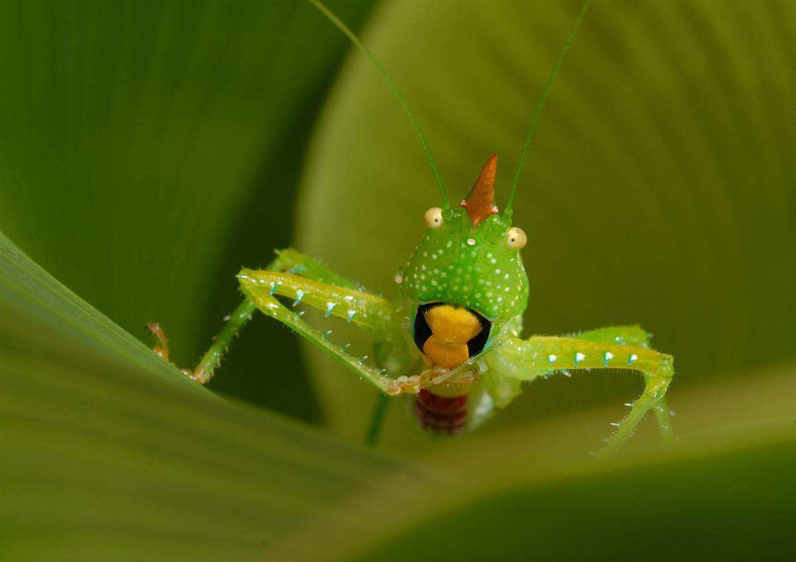
5 Point Wager Question

Slide 53
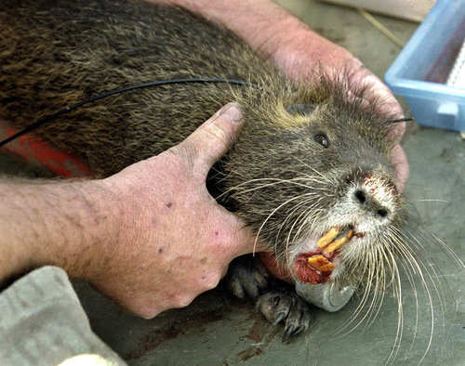
Name at least 5 ways exotics species are spread?

Slide 54
Ecology Interactions Unit
Part 3
Review Game

Slide 55
Ecology Interactions Unit
Answer Key
Part 3
Review Game

Slide 56
Part III, IV Ecology Interactions
GET OFF ME | BY MY SIDE | STRANGE PETS | NOT FROM HERE | -Bonus- FOREIGN FILMS
1 | 6 | 11 | 16 | *21
2 | 7 | 12 | 17 | *22
3 | 8 | 13 | 18 | *23
4 | 9 | 14 | 19 | *24
5 | 10 | 15 | 20 | *25

Slide 57
Part III, IV Ecology Interactions
GET AWAY | BY MY SIDE | STRANGE PETS | NOT FROM HERE | -Bonus- FOREIGN FILMS
1 | 6 | 11 | 16 | *21
2 | 7 | 12 | 17 | *22
3 | 8 | 13 | 18 | *23
4 | 9 | 14 | 19 | *24
5 | 10 | 15 | 20 | *25

Slide 58
This is the name for a long term relationship between two or more different species.
1
Copyright © 2010 Ryan P. Murphy

Slide 59
This is the name for a long term relationship between two or more different species.
1
SYMBIOSIS
Copyright © 2010 Ryan P. Murphy

Slide 60
This is the type of symbiosis seen below?
2
Copyright © 2010 Ryan P. Murphy

Slide 61
This is the type of symbiosis seen below?
2
Parasitism
Copyright © 2010 Ryan P. Murphy

Slide 62
True or False.
Parasitism is one of the most successful modes of life displayed by any living organism?
For every species on earth, they may host a handful of unique parasites.
3
Copyright © 2010 Ryan P. Murphy

Slide 63
True or False.
Parasitism is one of the most successful modes of life displayed by any living organism?
For every species on earth, they may host a handful of unique parasites.
3
Copyright © 2010 Ryan P. Murphy

Slide 64
True or False.
Parasitism is one of the most successful modes of life displayed by any living organism?
For every species on earth, they may host a handful of unique parasites.
3
TRUE
Copyright © 2010 Ryan P. Murphy

Slide 65
True or False. Parasite life cycles can often be complicated and go through a number and variety of organisms?
Most parasites have very complicated life cycles, often going through a number of different species before finding a host.
4
Host
Eggs
Rest
Larvae
Copyright © 2010 Ryan P. Murphy

Slide 66
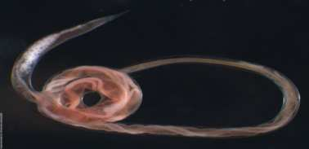
True or False. Parasite life cycles can often be complicated and go through a number and variety of organisms?
Most parasites have very complicated life cycles, often going through a number of different species before finding a host.
4
Host
Eggs
Rest
Larvae
Copyright © 2010 Ryan P. Murphy

Slide 67
True or False. Parasite life cycles can often be complicated and go through a number and variety of organisms?
Most parasites have very complicated life cycles, often going through a number of different species before finding a host.
4
Host
TRUE
Eggs
Rest
Larvae
Copyright © 2010 Ryan P. Murphy

Slide 68
Which is an endoparasite, and which is an ectoparasite?
A
B
5
Copyright © 2010 Ryan P. Murphy

Slide 69
Which is an endoparasite, and which is an ectoparasite?
A
B
5
Copyright © 2010 Ryan P. Murphy

Slide 70
Which is an endoparasite, and which is an ectoparasite?
A
B
5
Copyright © 2010 Ryan P. Murphy

Slide 71
Which is an endoparasite, and which is an ectoparasite?
A
B
5
Copyright © 2010 Ryan P. Murphy

Slide 72
Which is an endoparasite, and which is an ectoparasite?
A
B
5
Ectoparasite
(Outside Body)
Copyright © 2010 Ryan P. Murphy

Slide 73
Which is an endoparasite, and which is an ectoparasite?
A
B
5
Ectoparasite
(Outside Body)
Copyright © 2010 Ryan P. Murphy

Slide 74
Which is an endoparasite, and which is an ectoparasite?
A
B
5
Endoparasite
(Inside Body)
Ectoparasite
(Outside Body)
Copyright © 2010 Ryan P. Murphy

Slide 75
Ecology Interactions
GET AWAY | BY MY SIDE | STRANGE PETS | NOT FROM HERE | -Bonus- FOREIGN FILMS
1 | 6 | 11 | 16 | *21
2 | 7 | 12 | 17 | *22
3 | 8 | 13 | 18 | *23
4 | 9 | 14 | 19 | *24
5 | 10 | 15 | 20 | *25

Slide 76
Ecology Interactions
GET AWAY | BY MY SIDE | STRANGE PETS | NOT FROM HERE | -Bonus- FOREIGN FILMS
1 | 6 | 11 | 16 | *21
2 | 7 | 12 | 17 | *22
3 | 8 | 13 | 18 | *23
4 | 9 | 14 | 19 | *24
5 | 10 | 15 | 20 | *25

Slide 77
This is the name for a unique type of parasitism seen in birds that involves the laying of eggs in the nests of other birds.
The eggs are left under the parental care of the host parents.
6

Slide 78
This is the name for a unique type of parasitism seen in birds that involves the laying of eggs in the nests of other birds.
The eggs are left under the parental care of the host parents.
6
Brood Parasitism

Slide 79
Name this jawless fish (Parasite)
They attach to fish with a sucker and bore a hole into flesh with their tongue.
7
Copyright © 2010 Ryan P. Murphy

Slide 80
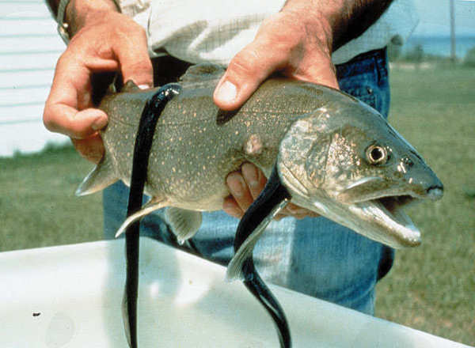
Name this jawless fish (Parasite)
They attach to fish with a sucker and bore a hole into flesh with their tongue.
7
Sea Lamprey
Copyright © 2010 Ryan P. Murphy

Slide 81
This is the type of evolution of two or more species, each adapting to changes in the other.
8

Slide 82
This is the type of evolution of two or more species, each adapting to changes in the other.
Coevolution
8

Slide 83
9
Which is which ecological relationship?
A.) Predator/prey and parasite/host
B.) Competitive species
C.) Mutualistic species
A
B
C

Slide 84
9
Which is which ecological relationship?
A.) Predator/prey and parasite/host
B.) Competitive species
C.) Mutualistic species
A
B
C

Slide 85
9
Which is which ecological relationship?
A.) Predator/prey and parasite/host
B.) Competitive species
C.) Mutualistic species
A
B
C
Mutualistic

Slide 86
9
Which is which ecological relationship?
A.) Predator/prey and parasite/host
B.) Competitive species
C.) Mutualistic species
A
B
C
Mutualistic

Slide 87
9
Which is which ecological relationship?
A.) Predator/prey and parasite/host
B.) Competitive species
C.) Mutualistic species
A
B
C
Predator
Prey
Mutualistic

Slide 88
9
Which is which ecological relationship?
A.) Predator/prey and parasite/host
B.) Competitive species
C.) Mutualistic species
A
B
C
Predator
Prey
Mutualistic

Slide 89
9
Which is which ecological relationship?
A.) Predator/prey and parasite/host
B.) Competitive species
C.) Mutualistic species
A
B
C
Predator
Prey
Mutualistic
Competitive
(For Light and
Nutrients)

Slide 90
This is the type of mutualism where both species help feed each other.
Usually nutrient related.
10

Slide 91
This is the type of mutualism where both species help feed each other.
Usually nutrient related.
10
Trophic Mutualism

Slide 92
Ecology Interactions
GET AWAY | BY MY SIDE | STRANGE PETS | NOT FROM HERE | -Bonus- FOREIGN FILMS
1 | 6 | 11 | 16 | *21
2 | 7 | 12 | 17 | *22
3 | 8 | 13 | 18 | *23
4 | 9 | 14 | 19 | *24
5 | 10 | 15 | 20 | *25

Slide 93
Ecology Interactions
GET AWAY | BY MY SIDE | STRANGE PETS | NOT FROM HERE | -Bonus- FOREIGN FILMS
1 | 6 | 11 | 16 | *21
2 | 7 | 12 | 17 | *22
3 | 8 | 13 | 18 | *23
4 | 9 | 14 | 19 | *24
5 | 10 | 15 | 20 | *25

Slide 94
This is the type of mutualism where one species protects the other and gets some benefits for its help.
11
Copyright © 2010 Ryan P. Murphy

Slide 95
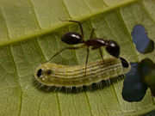
This is the type of mutualism where one species protects the other and gets some benefits for its help.
11
Defensive
Mutualism
Copyright © 2010 Ryan P. Murphy

Slide 96
This is the type of mutualism where one species gets food and shelter, the other has parasites removed.
12
Copyright © 2010 Ryan P. Murphy

Slide 97
This is the type of mutualism where one species gets food and shelter, the other has parasites removed.
Cleaning
Symbiosis
12
Copyright © 2010 Ryan P. Murphy

Slide 98
This is the type of mutualism where one species receives food in exchange for moving the pollen or seeds of its partner.
13
Copyright © 2010 Ryan P. Murphy

Slide 99
This is the type of mutualism where one species receives food in exchange for moving the pollen or seeds of its partner.
13
Dispersive
Mutualism
Copyright © 2010 Ryan P. Murphy

Slide 100
This is the type of mutualism where one species receives food in exchange for moving the pollen or seeds of its partner.
13
Dispersive
Mutualism
Copyright © 2010 Ryan P. Murphy

Slide 101
Name the type of Symbiosis?
+
Parasitism
Commensalism
Mutualism
Shark
Neutral
Neutral
Commensalism
-
Interspecific Competition?
Neutral
Parasitism
Remora
-
+

Slide 102
Name the type of Symbiosis?
+
Parasitism
Commensalism
Mutualism
Shark
Neutral
Neutral
Commensalism
-
Interspecific Competition?
Neutral
Parasitism
Remora
-
+

Slide 103
Name the type of Symbiosis?
+
Parasitism
Commensalism
Mutualism
Shark
Neutral
Neutral
Commensalism
-
Interspecific Competition?
Neutral
Parasitism
Remora
-
+

Slide 104
Name the type of Symbiosis?
+
Parasitism
Commensalism
Mutualism
Shark
Neutral
Neutral
Commensalism
-
Interspecific Competition?
Neutral
Parasitism
Remora
-
+
Commensalism

Slide 105
Bacteria live in our body. They are…
A.) Parasitic only
B.) Commensalisitic and Parasitic
C.) Mutualistic only
D.) Mutualistic, Commensalistic, and Parasitic
15

Slide 106
Bacteria live in our body. They are…
A.) Parasitic only
B.) Commensalisitic and Parasitic
C.) Mutualistic only
D.) Mutualistic, Commensalistic, and Parasitic
15

Slide 107
Bacteria live in our body. They are…
A.) Parasitic only
B.) Commensalisitic and Parasitic
C.) Mutualistic only
D.) Mutualistic, Commensalistic, and Parasitic
15

Slide 108
Bacteria live in our body. They are…
A.) Parasitic only
B.) Commensalisitic and Parasitic
C.) Mutualistic only
D.) Mutualistic, Commensalistic, and Parasitic
15

Slide 109
Bacteria live in our body. They are…
A.) Parasitic only
B.) Commensalisitic and Parasitic
C.) Mutualistic only
D.) Mutualistic, Commensalistic, and Parasitic
15

Slide 110
Bacteria live in our body. They are…
A.) Parasitic only
B.) Commensalisitic and Parasitic
C.) Mutualistic only
D.) Mutualistic, Commensalistic, and Parasitic
15
Answer is…

Slide 111
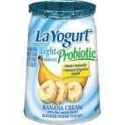
Bacteria live in our body. They are…
A.) Parasitic only
B.) Commensalisitic and Parasitic
C.) Mutualistic only
D.) Mutualistic, Commensalistic, and Parasitic
15
Mutualistic

Slide 112
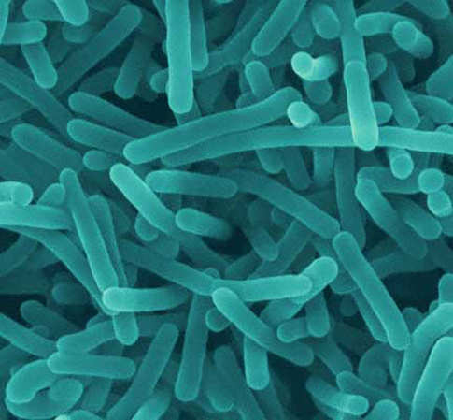
Bacteria live in our body. They are…
A.) Parasitic only
B.) Commensalisitic and Parasitic
C.) Mutualistic only
D.) Mutualistic, Commensalistic, and Parasitic
15
Mutualistic
Commensalistic

Slide 113
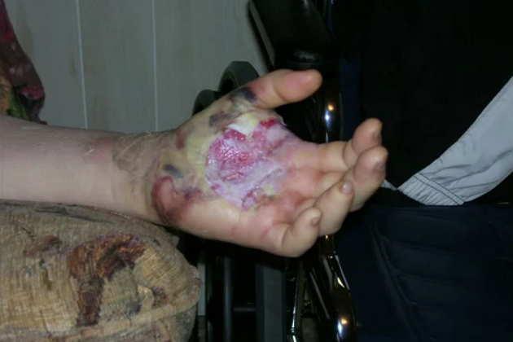
Bacteria live in our body. They are…
A.) Parasitic only
B.) Commensalisitic and Parasitic
C.) Mutualistic only
D.) Mutualistic, Commensalistic, and Parasitic
15
Mutualistic
Commensalistic
Parasitic

Slide 114
Bacteria live in our body. They are…
A.) Parasitic only
B.) Commensalisitic and Parasitic
C.) Mutualistic only
D.) Mutualistic, Commensalistic, and Parasitic
15
Mutualistic
Commensalistic
Parasitic

Slide 115
Ecology Interactions
GET AWAY | BY MY SIDE | STRANGE PETS | NOT FROM HERE | -Bonus- FOREIGN FILMS
1 | 6 | 11 | 16 | *21
2 | 7 | 12 | 17 | *22
3 | 8 | 13 | 18 | *23
4 | 9 | 14 | 19 | *24
5 | 10 | 15 | 20 | *25

Slide 116
Ecology Interactions
GET AWAY | BY MY SIDE | STRANGE PETS | NOT FROM HERE | -Bonus- FOREIGN FILMS
1 | 6 | 11 | 16 | *21
2 | 7 | 12 | 17 | *22
3 | 8 | 13 | 18 | *23
4 | 9 | 14 | 19 | *24
5 | 10 | 15 | 20 | *25

Slide 117
Which one uses microbe farms, and which one uses mechanical defenses?
A
B
Copyright © 2010 Ryan P. Murphy

Slide 118
Which one uses microbe farms, and which one uses mechanical defenses?
A
B
Copyright © 2010 Ryan P. Murphy

Slide 119
Which one uses microbe farms, and which one uses mechanical defenses?
A
B
Thorns
(Mechanical
Defense)
Copyright © 2010 Ryan P. Murphy

Slide 120
Which one uses microbe farms, and which one uses mechanical defenses?
A
B
Thorns
(Mechanical
Defense)
Copyright © 2010 Ryan P. Murphy

Slide 121
Which one uses microbe farms, and which one uses mechanical defenses?
A
B
Thorns
(Mechanical
Defense)
Microbe Farms
(Fungus and
Bacteria)
Copyright © 2010 Ryan P. Murphy

Slide 122
17
Which one is poison ivy?
A
B
C
D

Slide 123
17
Which one is poison ivy?
A
B
C
D

Slide 124
17
Which one is poison ivy?
A
B
C
D

Slide 125
17
Which one is poison ivy?
A
B
C
D

Slide 126
17
Which one is poison ivy?
A
B
C
D

Slide 127
17
Which one is poison ivy?
A
B
C
D

Slide 128
17
Which one is poison ivy?
A
B
Poison Sumac
C
D

Slide 129
17
Which one is poison ivy?
A
B
Poison Sumac
C
D

Slide 130
17
Which one is poison ivy?
A
B
Poison Sumac
C
D
Poison Oak

Slide 131
17
Which one is poison ivy?
A
B
Poison Sumac
C
D
Poison Oak

Slide 132
17
Which one is poison ivy?
A
B
Poison Sumac
C
D
Poison Oak
Not Poisonous

Slide 133
17
Which one is poison ivy?
A
B
Poison Sumac
C
D
Poison Oak
Not Poisonous

Slide 134
17
Which one is poison ivy?
A
B
Poison Ivy
Poison Sumac
C
D
Poison Oak
Not Poisonous

Slide 135
17
Which one is poison ivy?
A
B
Poison Ivy
Poison Sumac
Leaves of three let it be…
C
D
Poison Oak
Leaves of three let it be…
Not Poisonous

Slide 136
This is the term for an exotic species that causes harm to people, the environment, and native species.
18
Copyright © 2010 Ryan P. Murphy

Slide 137
This is the term for an exotic species that causes harm to people, the environment, and native species.
18
Invasive Exotic
Species
Copyright © 2010 Ryan P. Murphy

Slide 138
This is the name for an organism that has lived in the area for a considerable amount of time.
19
Copyright © 2010 Ryan P. Murphy

Slide 139
This is the name for an organism that has lived in the area for a considerable amount of time.
19
Native / Endemic
Copyright © 2010 Ryan P. Murphy

Slide 140
Name 5 invasive exotic species.
(1 point each)
20

Slide 141
Name 5 invasive exotic species.
(1 point each)
100 worst global invasive exotic species list
http://www.issg.org/database/species/search.asp?st=100ss
20

Slide 142
Ecology Interactions
GET AWAY | BY MY SIDE | STRANGE PETS | NOT FROM HERE | -Bonus- FOREIGN FILMS
1 | 6 | 11 | 16 | *21
2 | 7 | 12 | 17 | *22
3 | 8 | 13 | 18 | *23
4 | 9 | 14 | 19 | *24
5 | 10 | 15 | 20 | *25

Slide 143
Ecology Interactions
GET AWAY | BY MY SIDE | STRANGE PETS | NOT FROM HERE | -Bonus- FOREIGN FILMS
1 | 6 | 11 | 16 | *21
2 | 7 | 12 | 17 | *22
3 | 8 | 13 | 18 | *23
4 | 9 | 14 | 19 | *24
5 | 10 | 15 | 20 | *25

Slide 144
Name this movie with the correct spelling.
*21

Slide 145
Name this movie with the correct spelling.
*21

Slide 146
Name this movie with the correct spelling.
*21
Ratatouille

Slide 147
Name this secret agent and his code name?
*22

Slide 148
Name this secret agent and his code name?
*22
James Bond
007

Slide 149
The Mummy
*23

Slide 150
The Mummy
*23

Slide 151
The Mummy
*23

Slide 152
Example of aggressive mimicry in this movie?
*24

Slide 153
Example of aggressive mimicry in this movie?
*24

Slide 154
Example of aggressive mimicry in this movie?
*24
Finding Nemo

Slide 155
Competition occurs in this movie?
*25

Slide 156
Competition occurs in this movie?
*25
The Karate Kid

Slide 157
Ecology Interactions
GET AWAY | BY MY SIDE | STRANGE PETS | NOT FROM HERE | -Bonus- FOREIGN FILMS
1 | 6 | 11 | 16 | *21
2 | 7 | 12 | 17 | *22
3 | 8 | 13 | 18 | *23
4 | 9 | 14 | 19 | *24
5 | 10 | 15 | 20 | *25

Slide 158
Ecology Interactions
GET AWAY | BY MY SIDE | STRANGE PETS | NOT FROM HERE | -Bonus- FOREIGN FILMS
1 | 6 | 11 | 16 | *21
2 | 7 | 12 | 17 | *22
3 | 8 | 13 | 18 | *23
4 | 9 | 14 | 19 | *24
5 | 10 | 15 | 20 | *25
Final Question_______

Slide 159
5 Point Wager Question

Slide 160
Name at least 5 ways exotics species are spread?

Slide 161
Exotic species travel by…
Ballast water
Boat hulls
Aquaculture escape
Intentional introductions
Aquarium releases
Live food industry (escapes)
Driving vehicles
Escaped ornamental plants
Fishing bait release
Illegal stockings
More →
Copyright © 2010 Ryan P. Murphy

Slide 162
Other ways exotic species are spread.
Domestic animals become feral
Disposal of waste water (has seeds in it)
Science laboratory escape
Sea food packaging disposal
Past government programs.
Moving fill (has seeds)
Land and water alterations
Biological control introductions
Introduce and exotic to control an exotic.
Copyright © 2010 Ryan P. Murphy

Slide 163
Ecology Interactions Unit
Review Game
1-20 = 5 points each
20-25 = Bonus (1 point each)
Final Question = 5 point wager
Find the Owl = 1 point

Slide 164
Ecology Interactions Unit
Answer Key
Part 3
Review Game

